Slide 1
Processing-in-Memory in the Wild
Sasha Fedorova
University of British Columbia
MongoDB

Slide 2
Acknowledgments
Students
Andrada Zoltan
Craig Mustard
Jacob Grossbard
Joel Nider
John Ramsden
Larry Liu
Mohammad Dashti
Niloo Zarif
Collaborators (UPMEM)
Alexandre Ghiti
Jordi Chauzi
Rémy Cimadomo
Fabrice Devaux
Romaric Jodin
Julien Legriel
Vincent Palatin
UBC
Systopia

Slide 3
PIM: Now commercially available
UPMEM PIM-capable DRAM commercially available today
DDR4-compatible DRAM with small general-purpose processors
Integrated into standard off-the-shelf servers
Samsung Function in Memory Architecture (FIMA) – coming up
Processors near HBM memory
Execute 32-instruction snippets, total of nine instructions available

Slide 4
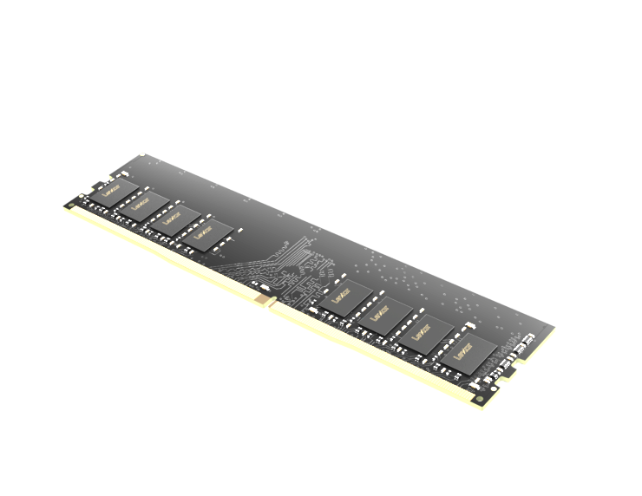
UPMEM Overview
Looks and can be used like regular DRAM
Drop-in replacement for DDR4 DRAM
Each chip is equipped with small processors
Can be used in off-the-shelf servers
regular DRAM
UPMEM DRAM

Slide 5
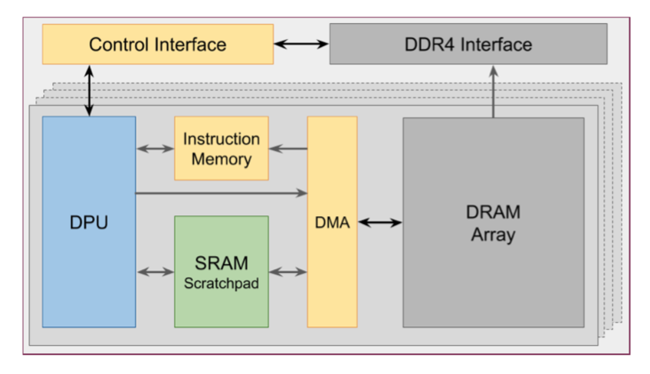
UPMEM architecture
One DPU per 64MB slice of DRAM
8GB DIMM: 128 DPUs
Each DPU has its own DMA engine
DRAM Slice
64MB
Many DPUs can achieve very high DRAM bandwidth together
UPMEM DRAM
DRAM Processing UNIT
General-purpose processor
Simple, in-order, 267-500MHz
No cache, only scratchpad memory

Slide 6
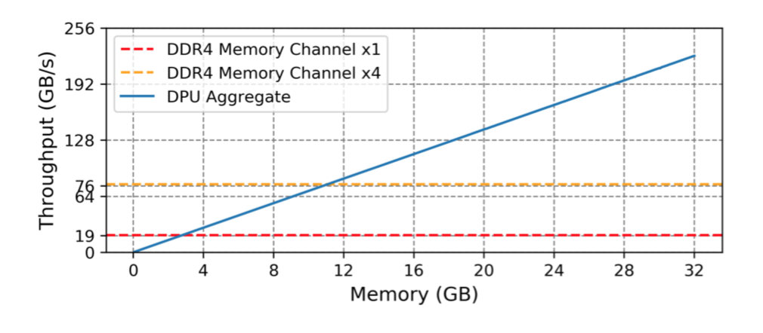
PIM superpower: High DRAM bandwidth
DPUs running at 267 MHz
Only 32GB PIM DRAM
Sequentially read every byte of memory
128GB DRAM, 500MHz DPUs: 2TB/sec bandwidth
J. Nider, C. Mustard, A. Zoltan, J. Ramsden, L. Liu, J. Grossbard, M. Dashti, R. Jodin, A. Ghiti, J. Chauzi, A. Fedorova
A Case Study of Processing-in-Memory in off-the-Shelf Systems, USENIX ATC 2021

Slide 7
Total cost of ownership
You can also get high memory bandwidth
On high-end CPUs
HBM (high-bandwidth memory)
GPUs
PIM can deliver high bandwidth at a lower cost ($$ and Watts)
…if you are able to use it efficiently

Slide 8
PIM superpower: Low TCO
Processor (Intel Xeon) | DRAM | PIM | Max. memory bandwidth (PIM or DRAM) | Cost
Low-bandwidth system
4110 | 48GB |  | 115GB/s | $860
4110 | 48GB | 24GB | 134GB/s | $1,760
Medium-bandwidth system
4110 | 48GB | 144GB | 806GB/s | $6,260
5318H | 192GB |  | 511GB/s | $6,532
High-bandwidth system
4110 | 64GB | 256GB | 1434GB/s | $10,580
8380 | 448GB |  | 1434GB/s | $83,580+
Price:
8GB UPMEM DIMM: ~$300
More CPUs adds memory channels, but requires expensive high-end CPUs
Power:
Typical server with DRAM: about 400W
A server with 128GB PIM DRAM: 700W
*Prices include just CPU and memory

Slide 9
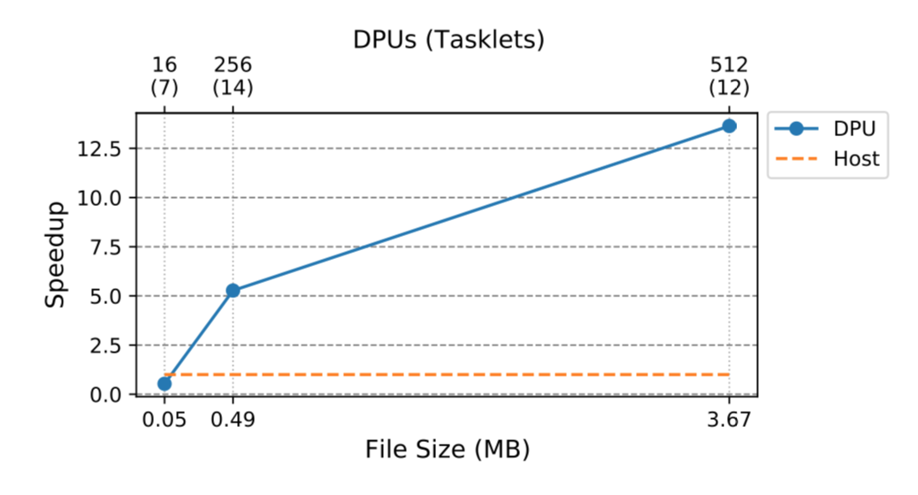
PIM performance: hyper-dimensional computing
Number of DPUs
More data → more DPUs → more throughput
Speedup over a single host CPU
End-to-end measurements
J. Nider, C. Mustard, A. Zoltan, J. Ramsden, L. Liu, J. Grossbard, M. Dashti, R. Jodin, A. Ghiti, J. Chauzi, A. Fedorova
A Case Study of Processing-in-Memory in off-the-Shelf Systems, to appear in USENIX ATC 2021

Slide 10
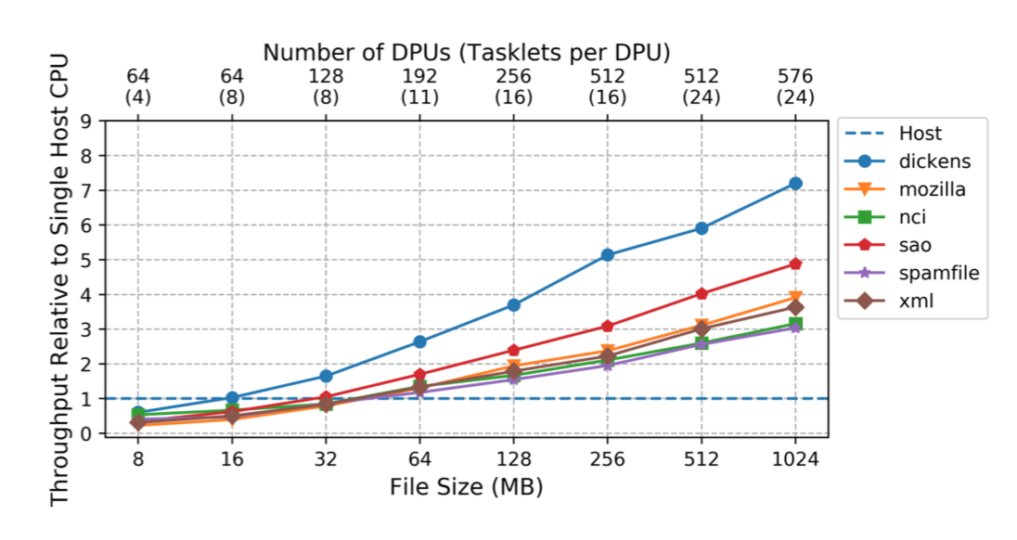
PIM performance: compression
Number of DPUs
Snappy compression
Speedup over a single CPU
End-to-end measurements
Different input files
More data → more DPUs → more throughput
J. Nider, C. Mustard, A. Zoltan, J. Ramsden, L. Liu, J. Grossbard, M. Dashti, R. Jodin, A. Ghiti, J. Chauzi, A. Fedorova
A Case Study of Processing-in-Memory in off-the-Shelf Systems, to appear in USENIX ATC 2021

Slide 11
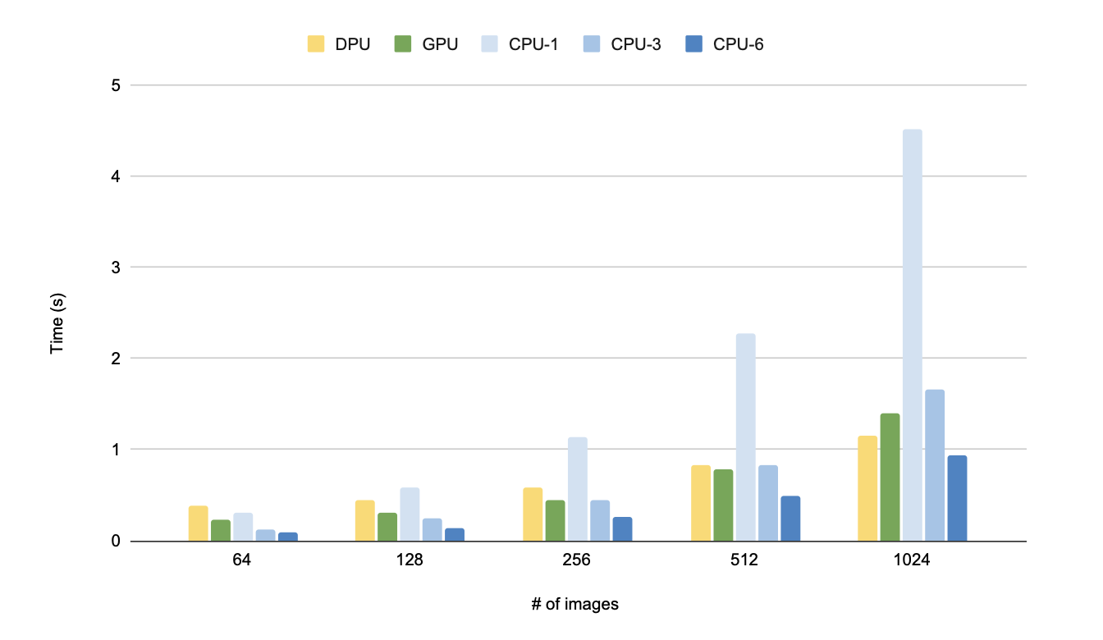
Image Processing on PIM
Motivation: pre-process images for ML training
PIM
lower is better

Slide 12
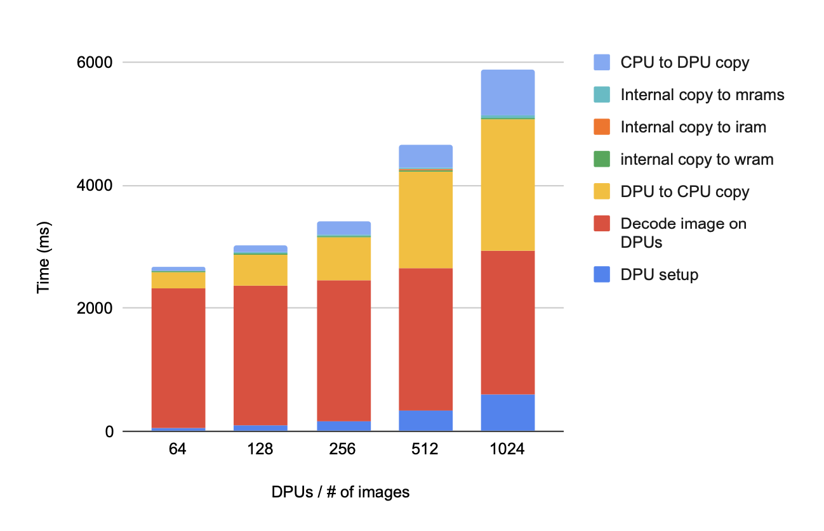
Moving data back-and-forth
copy overhead

Slide 13
PIM limitations
DPUs store data in different format than the CPU expects:
Has to do with interleaving
CPU has to de-interleave the data used by DPU
DRAM Slice
64MB
CPU splits a cache line across slices for better performance
0 | 1 | 2 | 3 | 4 | 5 | 6 | 7
First 8-bytes of cache line
UPMEM DRAM
DPUs can’t talk to each other
Each DPU sees data only in its slice

Slide 14
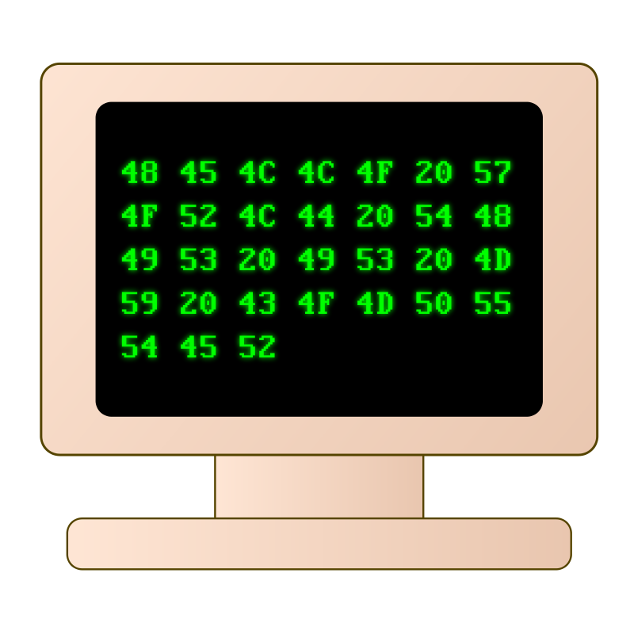
Deep Learning Recommendation Models in PIM
Problem
DNN-trained models
Inference done on CPUs
Models can be very large (even terabytes¹)
Inference is bandwidth intensive
Can this be done?
Parts of DLRM inference were done in-memory² and in-storage¹
CPU Nodes
In-memory DLRM inference
Challenges
Some DLRM inference phases are compute-intensive
Skewed workload: balanced parallelism may be difficult to achieve
[1] Wilkening et al. RecSSD…, ASPLOS 2021
[2] Ke et al. RecNMP…, ISCA 2020

Slide 15
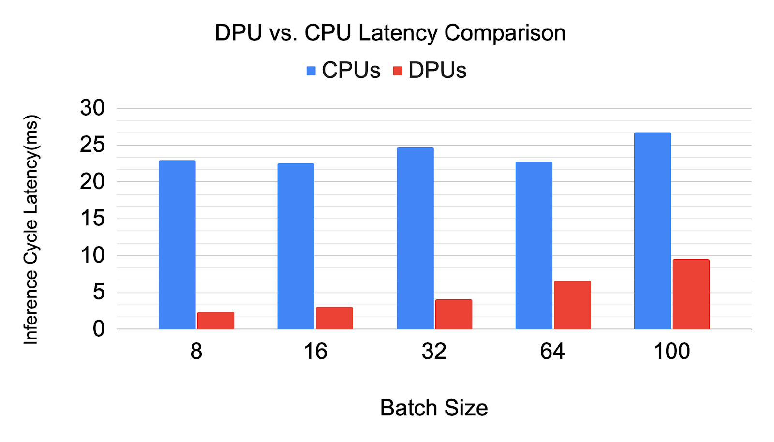
DLRM Inference in PIM
lower is better
RMC2 model
Latency of a single reference cycle. Larger batch size – more work.
Notes:
Total Embedding size 4 GB Per DPU Embedding data: 2 MB Per rank embedding data: 128 MB number of DPUs used: 2048 which is 32 ranks with 64 DPUs per rank. (edited)

Slide 16
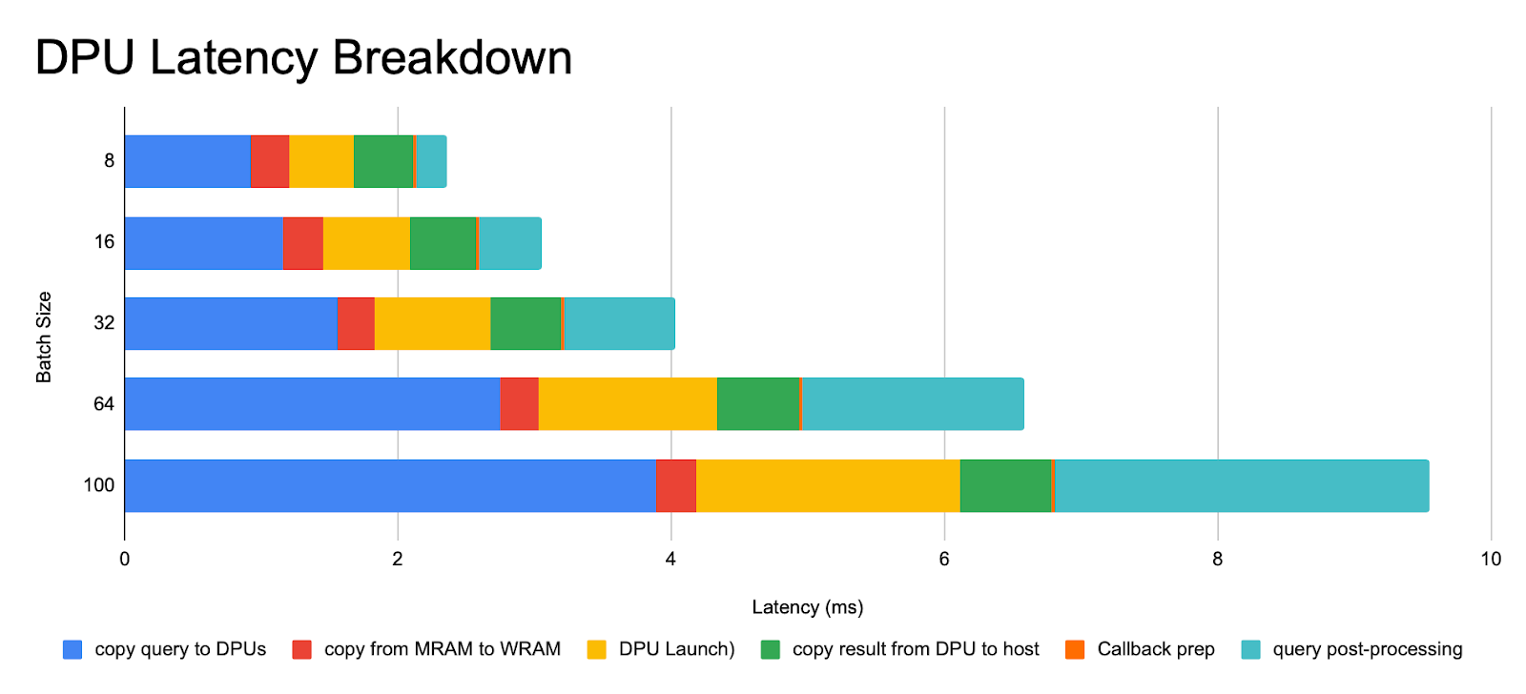
Where does the time go?
Useful work on PIM

Slide 17
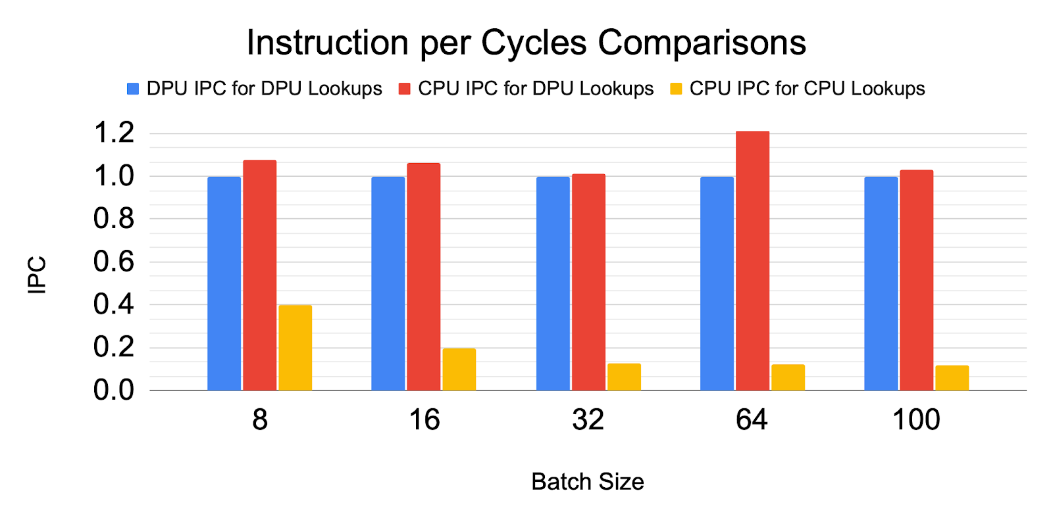
Low IPC when inference done on CPU
Inference done on CPU

Slide 18
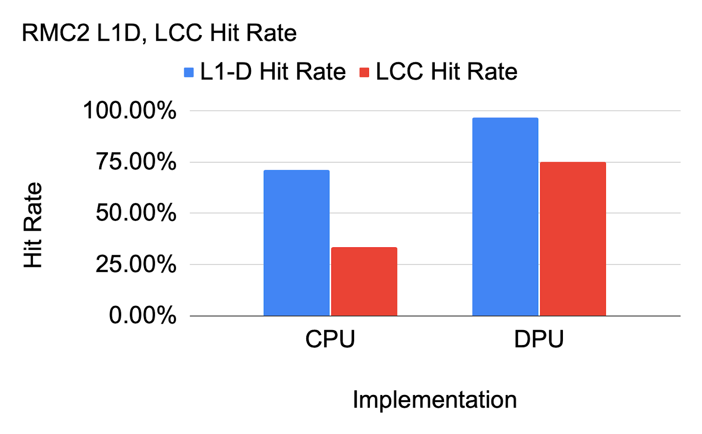
CPU implementation hits the memory wall
CPU cache hit – inference on CPU
CPU cache hit – inference on PIM

Slide 19
Key-value store (in-memory cache) in PIM
Application Servers
Benefits:
Cache servers use general-purpose CPUs
Get rid of expensive CPUs
Save money and power
Can this be done?
Get/put interface to memory
Hashtable and a memory allocator inside PIM
Data already sharded across cache servers – no communication needed!
Challenges
Difficult to buffer get requests; executing one at a time may be inefficient
get/put API
Cache servers
memcached
memcached
memcached
memcached
Database servers
DB
DB
DB
DB
[1] LightStore (ASPLOS’19) – a key value store in SSD

Slide 20
Filtering-in-memory
Key-value store with a column-store architecture
30MB of data per DPU
20 tasklets
Notes:
Question: How do DPUs compare to CPU for a typical column-store workload: filtration?
PIM Setup: Each DPU is assigned 30MB of data. This data is divided among tasklets. Tasklets use a global lock to copy once a chunk (2048 bytes) of output data is ready. An optimum number of tasklets (20) is used for this experiment. The experiment assumes that data is already resident in the PIM-enabled DRAM. In other words, the runtime consists of DPU execution time and the time it takes to copy out the result.
CPU Setup: The experiment uses Intel Xeon Silver 4110 which has 2 CPUs, each containing 8 physical cores. There is 128 GB of memory on this server. Cache sizes are:
L1d cache: 32KB
L2 cache: 1MB
L3 cache: 11MB
There is a thread for each physical core that performs the filtering for a portion of the input data.
Each thread processes 240 MB of data.

Slide 21
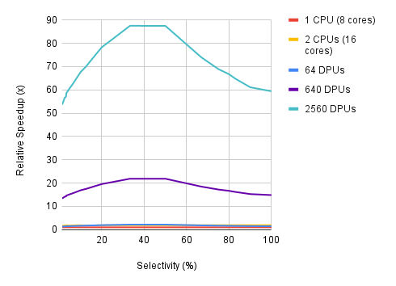
Filtering on PIM vs on CPU
As selectivity increases, we need to copy more data to back to the CPU

Slide 22
Disaggregation Meets Near-Data Processing
Disaggregation
Blending

Slide 23
Disaggregated memory meets PIM
PIM-enabled memory blades

Slide 24
Memory management
Each DPU can run its own memory allocator
Keep a local page table
Can even compress pages on the fly

Slide 25
Disaggregated memory meets PIM
100s ns
CPUs use load/store interface to access memory
~10s of µs
Let memory run applications!

Slide 26
Disaggregated Memory Runs Applications
Disaggregated memory consists of CPU-less PIM blades
PIM array runs an entire application
CPU blades access memory via a higher-level API
Similar ideas:
AIFM (OSDI 2020): Application-integrated far memory
KV-Direct (SOSP 2017): key-value API to memory via a smart NIC and RDMA
StRoM (EuroSys 2020): Smart Remote Memory
load/store
Higher-level interface

