Slide 1
1st Workshop on Memory-Centric Computing: Logistics
Geraldo F. Oliveira
https://geraldofojunior.github.io
ASPLOS 2025
30 March 2025

Slide 2
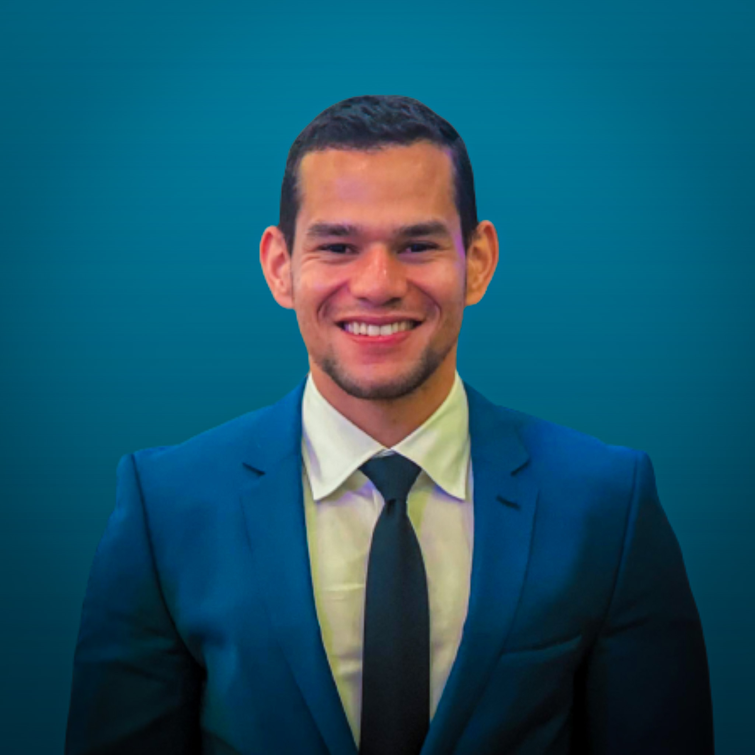
Brief Self Introduction
Geraldo F. Oliveira
Researcher @ SAFARI Research Group since November 2017
Very soon, I will defend my PhD thesis, advised by Onur Mutlu
I am in the job market for industry positions
https://geraldofojunior.github.io/
geraldofojunior@gmail.com (Best way to reach me)
https://safari.ethz.ch
Research in:
Computer architecture, computer systems, hardware security
Memory and storage systems
Hardware security, safety, predictability
Fault tolerance
Hardware/software cooperation
…

Slide 3
Get the Materials Online
https://events.safari.ethz.ch/asplos25-MCCSys/doku.php

Slide 4
Organizers
Geraldo F. Oliveira
Researcher @ SAFARI Research Group since November 2017
I am in the job market for industry positions
https://geraldofojunior.github.io/
Dr. Mohammad Sadrosadati
Senior Researcher and Lecturer, SAFARI @ ETH Zürich
https://scholar.google.com/citations?user=-mHpDvAAAAAJ
Ataberk Olgun
PhD Candidate, SAFARI Research @ ETH Zürich
https://ataberkolgun.com/
Prof. Onur Mutlu
Professor of Computer Science at ETH Zurich
https://people.inf.ethz.ch/omutlu/index.html

Slide 5
Agenda Tutorial (Morning)
Prof. Onur Mutlu: Recent Advances in Processing-in-DRAM
Processing-Near-Memory Systems: Developments from Academia & Industry
Programming Processing-Near-Memory Systems
Coffee Break
Processing-Using-Memory Systems for Bulk Bitwise Operations
Dr. Mohammad Sadr: Processing-Near-Storage & Processing-Using-Storage
Infrastructure for PIM Research & Research Challenges
Lunch

Slide 6
Agenda Workshop (Afternoon)
Hamid Farzaneh (TU Dresden): CINM (Cinnamon): A Compilation Infrastructure for Heterogeneous Compute In-Memory and Compute Near-Memory Paradigms
Theocharis Diamantidis (National Technical University of Athens): Harnessing PIM Techniques for Accelerating Sum Operations in FPGA-DRAM Architectures
Krystian Chmielewski (Huawei Warsaw Research Center): Pitfalls of UPMEM Kernel Development
Coffee Break
Yintao He (UCAS): PAPI: Exploiting Dynamic Parallelism in Large Language Model Decoding with a Processing-In-Memory-Enabled Computing System
Yufeng Gu (University of Michigan): PIM Is All You Need: A CXL-Enabled GPU-Free System for Large Language Model Inference
Dr. Christina Giannoula (University of Toronto): PyGim: An Efficient Graph Neural Network Library for Real Processing-In-Memory Architectures

Slide 7
Next PIM Workshops (I)
https://events.safari.ethz.ch/ics25-MCCSys/doku.php

Slide 8
Next PIM Workshops (II)
https://events.safari.ethz.ch/isca25-MCCSys/doku.php

Slide 9
1st Workshop on Memory-Centric Computing: Logistics
Geraldo F. Oliveira
https://geraldofojunior.github.io
ASPLOS 2025
30 March 2025

