Slide 1
Harnessing CIM techniques for accelerating sum operations in FPGA-DRAM architectures
NATIONAL TECHNICAL UNIVERSITY OF ATHENS
School of Electrical and Computer Engineering
Microprocessors and Digital Systems Lab
Supervisor: D. Soudris
Co-Supervisor: G. Lentaris
Theocharis Diamantidis

Slide 2
Context
Introduction
Background & Related Work
Proposed Solution & Methodology
Experiments & Results
Conclusions & Future Work

Slide 3
Introduction
Modern Systems are Processor-Centric
Repeated Data Movement between CPU & Memory
High Energy Consumption
Reduced Speed
"Memory Wall”
Multicore Architectures
Memory Latency Bottleneck
Near Memory Computing
Computation is moved near memory
Compute In Memory
Computation is executed directly in memory

Slide 4
Introduction
Computations in Commercial DRAM chips
Previous work already show simple logical operations (AND/OR/NOT/ROW COPY)
e.g Group Safari / O. Mutlu [1] [2] [3]
Current Thesis / Motivation: It is possible to develop extensions towards more complex logic/arithmetic functions
in already available chips, in the field
Compute In Memory
Computation is executed directly in memory
[1] Safari, Yuksel, I E PULSAR: Simultaneous Many-Row Activation for Reliable and High-Performance Computing in Off-the-Shelf DRAM Chips
[2] Safari, Yuksel, I E Functionally-Complete Boolean Logic in Real DRAM Chips: Experimental Characterization and Analysis
[3] Safari Nastanar Hajinazar SIMDRAM: An End-to-End Framework for Bit-Serial SIMD Computing in DRAM

Slide 5
Contributions
Simulation Level approximation of the timing Constraints
Developing a Full-Adder with 1, 2, 4, 8, 16 bits on actual commercial DRAM HW
Proof of Concept Function (Sum) with proposed FPGA-DRAM co-processing approach
Evaluation of Success Rate and Acceleration factors for multiple scenarios of logical operations

Slide 6
Background
DRAM Organization
DRAM Module
Bitline
Subarray
Wordline
…
…
Bank
DRAM Row
DRAM
Chip
…
. . .
Chip I/O
…
…
…
…
Row Buffer
…
DRAM Bank
DRAM Subarray
Safari, Yuksel, I E Pulsar: Simultaneous Many-Row Activation in Off-the-Shelf DRAM Chips Experimental Characterization and Analysis

Slide 7
Background
Bitline
Wordline
DRAM Cell
Wordline
Access transistor
…
DRAM Cell
charge
leakage
paths
DRAM Subarray
…
Capacitor
Bitline
…
…
…
…
Row Buffer
I/O Circuitry
Safari, Yuksel, I E Pulsar: Simultaneous Many-Row Activation in Off-the-Shelf DRAM Chips Experimental Characterization and Analysis

Slide 8
Related Work
ACT src
ROW-COPY
Fetch src’s content into the sense amplifiers
d
s
t
s
r
c
Enabe the src’s wordline
d
s
t
s
r
c
Safari, Yuksel, I E Pulsar: Simultaneous Many-Row Activation in Off-the-Shelf DRAM Chips Experimental Characterization and Analysis

Slide 9
Related Work
No time violation
Time Violation
PRE
ACT dst
ROW-COPY
ACT src
Bitlines are still at src voltage
src’s content is copied to dst
s
r
c
d
s
t
s
r
c
d
s
t
s
r
c
Safari, Yuksel, I E Pulsar: Simultaneous Many-Row Activation in Off-the-Shelf DRAM Chips Experimental Characterization and Analysis

Slide 10
Related Work
FRAC Operation
Safari, Yuksel, I E Pulsar: Simultaneous Many-Row Activation in Off-the-Shelf DRAM Chips Experimental Characterization and Analysis

Slide 11
Related Work
Time violation
Time violation
Frac Op.
ACT R1
PRE
ACT R2
LOGICAL AND/OR
R1
a
a
a
R2
b
b
b
c
c
c
d
s
t

Slide 12
Related Work
Time violation
Time violation
Frac Op.
ACT R1
PRE
ACT R2
LOGICAL AND/OR
R1
a
a
a
R2
b
b
b
MAJ3 (a,b,c)
c
c
c
d
s
t

Slide 13
Related Work
Time violation
Time violation
Frac Op.
ACT R1
PRE
ACT R2
LOGICAL AND/OR
R1
a
a
a
R2
b
b
b
MAJ (A, B, C)
c
c
c
MAJ (A, B, 0) = AND (A, B)
d
s
t
MAJ (A, B, 1) = OR (A, B)

Slide 14
Proposed Solutions
Limitation
Corresponding Solution
Bit transfer (i.e. shifting, propagation of carry out) between columns is prohibited.
Column-major architectures, where all numbers and their bits are stored in the same bit-line.
NOT operation cannot be executed in the same sub-array.
Store the operand and the complementary one and (if necessary) calculate the complementary result in each step
Logical operations for the same full-adder cannot be conducted in parallel.
Use bit-serial arithmetic and exploit the group of rows as much as possible.
The number of operands is restricted by the number of rows in the sub-array.
Utilize co-processing in memory and in the FPGA.
The results of each operation overwrites all the rows in the group.
Execute each operation in different groups of rows.

Slide 15
Methodology & Design Space Exploration for improving Accuracy and Speed
Estimate the timing parameters to violate on a simulation level.
Identifying the boundaries of the sub-array on actual hardware level
Exploring Simultaneously Opening-Rows
Activate different groups of rows to achieve more accurate results.
Testing timing parameters between commands.
Evaluate the in-Memory Full-Adder
DSE parameters: Banks, sub-arrays, group of rows, bit-lines, bit width, numbers per column, total numbers per sum, DRAM command timing, operands for logical operations.

Slide 16
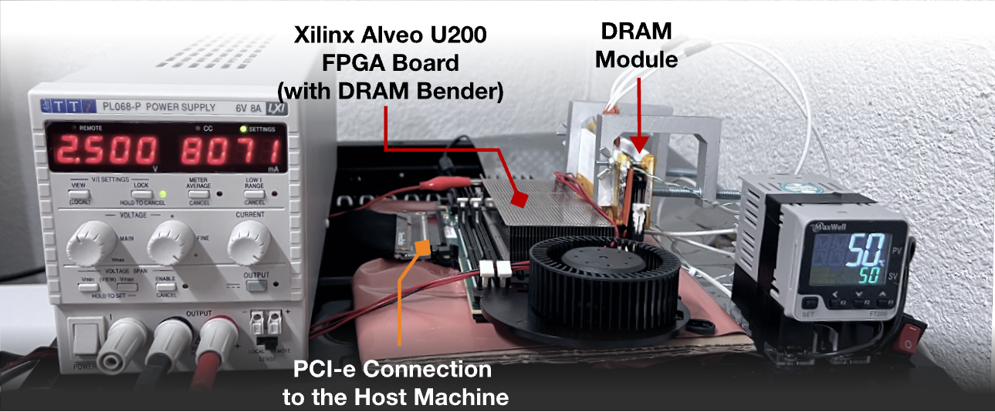
Setup
Experiment Setup
Xilinx Alveo U200 FPGA Board (200MHz).
Evaluation was conducted on DDR4 memories.
DRAM Bender HW → infrastructure with fine-grained control over DRAM.
DRAM Bender SW →Framework facilitating memory access flexibility.
Add commands into a list (Control flow, Arithmetic, Memory) with high-level programming languages (C++) and then schedule the DDR commands into the DRAM.
A. Olgun"DRAM Bender: An Extensible and Versatile FPGA-based Infrastructure to Easily Test State-of-the-art DRAM Chips

Slide 17
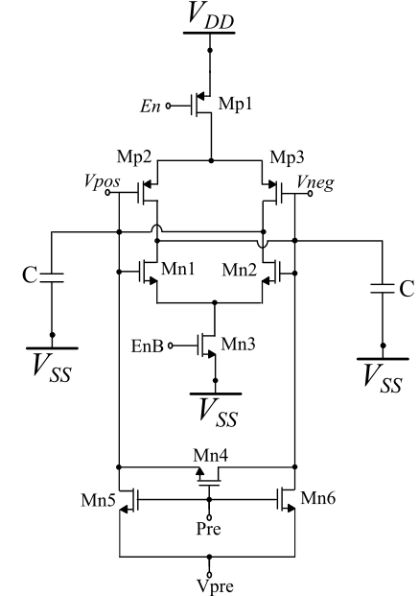
Experiments & Results
Estimate the timing parameters to violate on a simulation level.
Capacitors equal to the parasitic capacitance of bit-line.
The inverters have a positive feedback. With small deviations the output is driven to Vdd or ground.
Precharge Circuit. The Voltage that is precharged must be without noise.

Slide 18
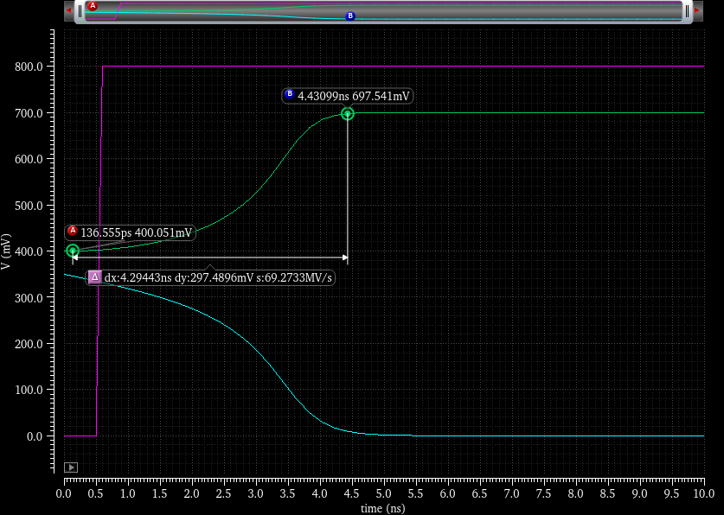
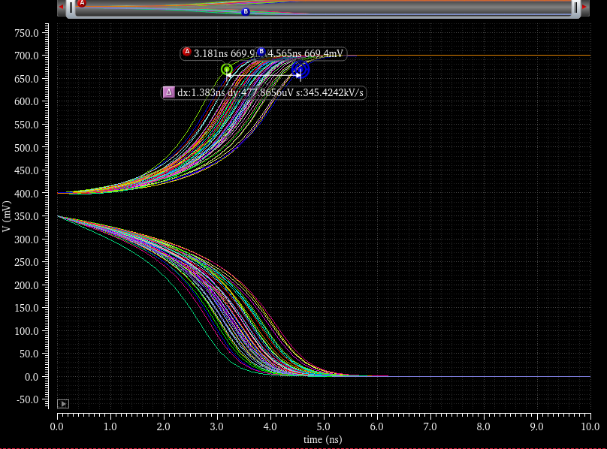
Experiments & Results
Estimation of the Timing Parameters
Monte Carlo Analysis

Slide 19
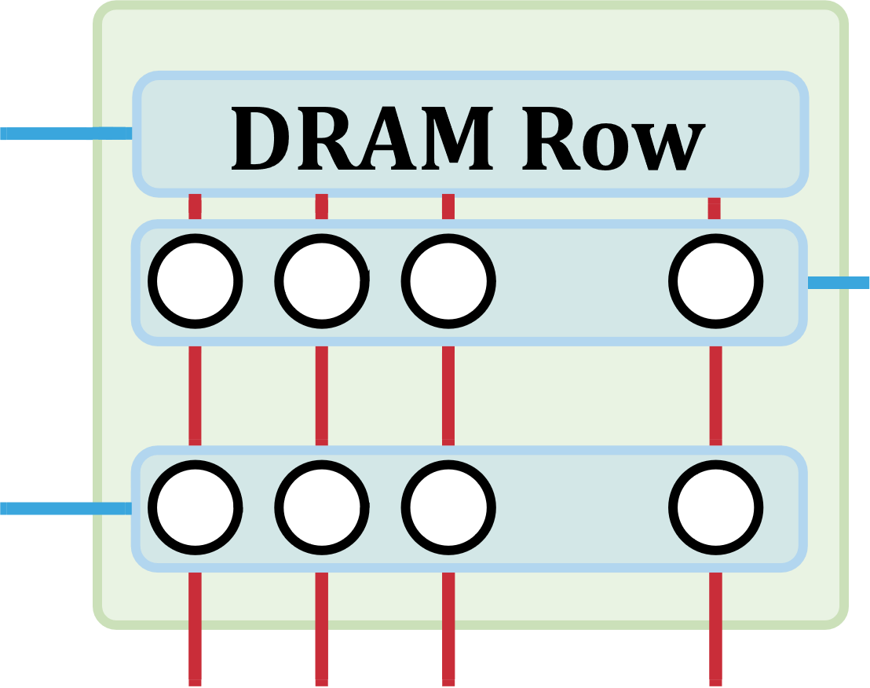
Experiments & Results
Identifying the boundaries of the sub-array
…
…
…
We implement the Row-Copy
Zeroing the whole memory
Write all ones in a random row R1
Issue a row-copy command Act(R1)-Pre-Act(R2)
Read the data in row R2
Loop for rows R2
Sense Amplifiers
…
…
…

Slide 20
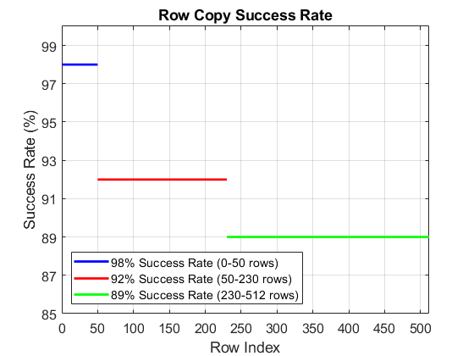
Experiments & Results
Results
512 rows in each sub-array
32 sub-arrays in each bank
Success Rate in Row Copy depends:
Data Stored in Cells
The Row Index
…
…

Slide 21
Experiments & Results
Exploring Simultaneously Opening-Rows
Activating two rows in quick succession
can simultaneously activate
many rows in a subarray
ACT Row A
PRE
ACT Row B
WR
If rows are activated, WR command overwrites all of the activated rows’ content
ACT
Row A
…
ACT
Row B
Results: 2, 4, 8, 16 rows can be activated simultaneously

Slide 22
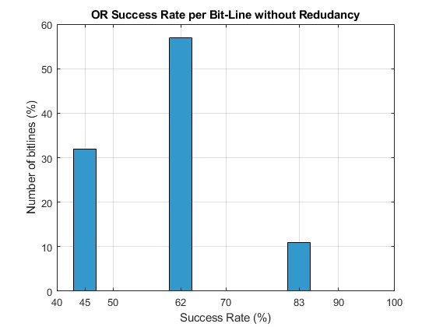
Experiments & Results
Next: study single AND/OR operations for the given DRAM chip
DSE for optimal timing
Evaluation of Success Rate
A subset of columns (~6000) have higher success rate without redundancy.
Idle cycles between ACT-PRE-ACT equal 0
Randomness of bit values lead to worse results
The results are almost the same for AND/OR

Slide 23
Experiments & Results
Next: 1-bit Full Adder
Step 1: Store operands in the same Bit-Line
Step 2: Store the complementary values
Step 3: Choose how many groups of rows will be used
Step 4: Execute the logical operations in these groups
Step 5: Store the result in another row

Slide 24
Experiments & Results
A
R251
1-bit Full Adder
A’
B
B’
. . .
Cin
Cin’
1
1
1
1
1
1
1
1
1
1
1
1
1
1
0
0
0
0
0
0
0
0
0
0
0
0
0
0
Sum
Cout
R261

Slide 25
Experiments & Results
1-bit Full Adder
Cout will be used as input in the next bits
We need 15 groups of 4 rows in total

Slide 26
Experiments & Results
R12
A
A’
B
R15
B’
Cin
Cin’
1
1
1
1
1
1
1
1
1
1
0
0
0
0
0
0
0
0
0
0

Slide 27
Experiments & Results
R12
A
A’
B
1
1
1
1
1
1
1
1
1
1
R15
B’
Cin
Cin’
We issue the commands ACT(R12)-PRE-ACT(R13) and produce the logical OR
1
1
1
1
1
1
1
1
1
1
0
0
0
0
0
0
0
0
0
0

Slide 28
Experiments & Results
To the next group
R12
R15
If we have more than 1 bit in each operand, we add the Cout of the previous stage in the same way we add Cin

Slide 29
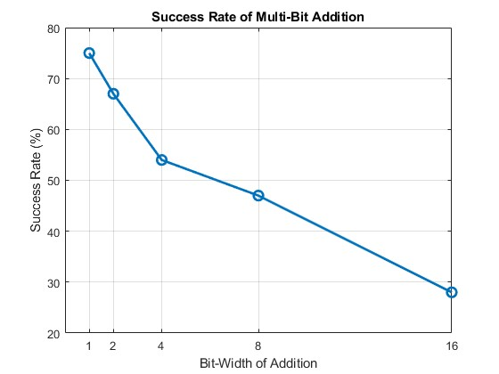
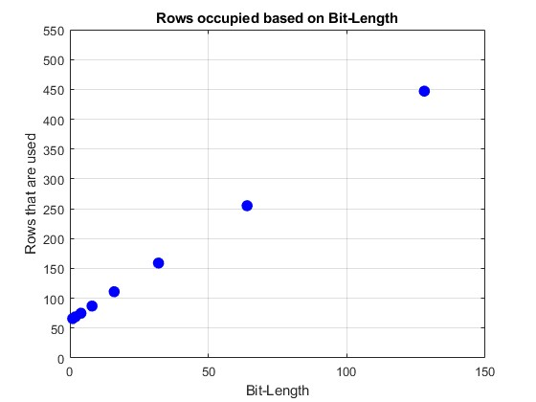
Experiments & Results
Next: Addition of more than 1 bit-length operands

Slide 30
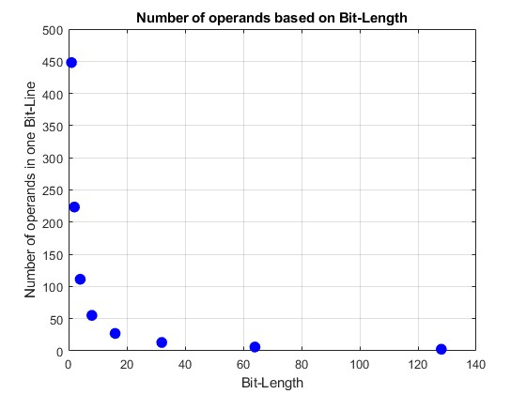
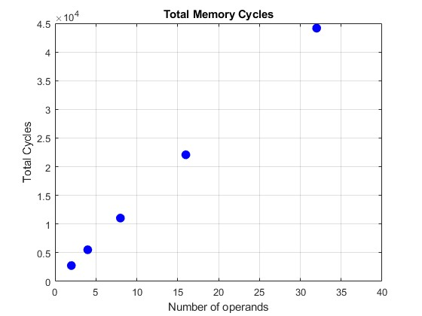
Experiments & Results
Next: Sum of more than two operands
We need 45000 cycles to add 32 8-bit operands!
Do we exploit all the 65000 bit-lines?

Slide 31
Comments
The presented full-adder was designed in a general way using AND/OR logical gates based on Boolean algebra.
We can achieve better results by using Majority logic which must be specific for every function which is ~ 4x times faster
C_{in}
MAJ
C_{out}
B
A
MAJ
Sum
MAJ

Slide 32
DRAM-FPGA Co-Processing
Ping Pong Pipelined Buffers / Interleaver
8 bits
Interleaver with Ping-Pong buffers
8 bits
DRAM
MUX
SUM
Accumulator
8 bits
8 bits
8 bits
Interleaver: Write per row Read per column

Slide 33
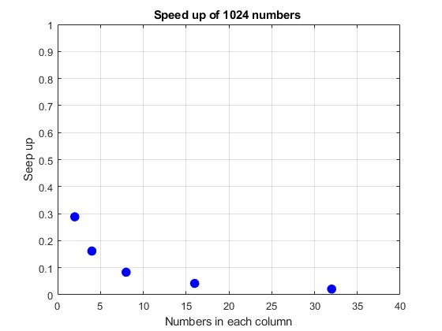
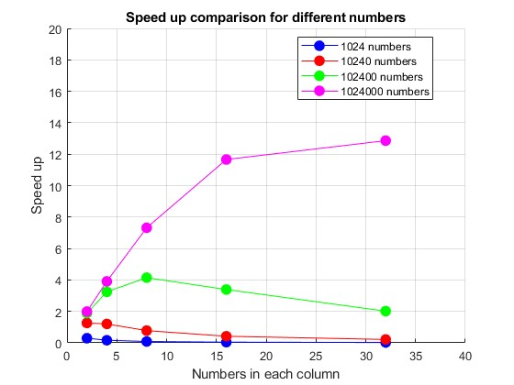
DRAM-FPGA Co-Design
Accelaration of the sum-operation
8 bits

Slide 34
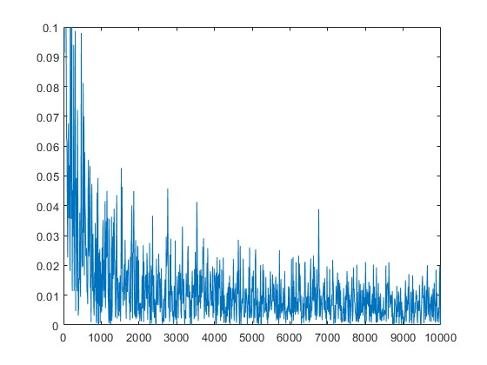
Conclusions & Future Work
For small number of operands, we have no acceleration
For larger number of operands, we have speed-up but with errors
8 bits

Slide 35
Conclusions & Future Work
Explore the multiplication operator
Estimation of the Power Efficiency
DSP applications (thousands of Convolution Kernel multiplications via thousands of columns operating in parallel, such as Sobel, approximate Gauss)
ML applications where there is bit error tolerance
8 bits

