Slide 1
Compilation for heterogeneous compute-in/near-memory systems
Hamid Farzaneh
TU Dresden, Germany
MCCSys Workshop
ASPLOS 2025

Slide 2
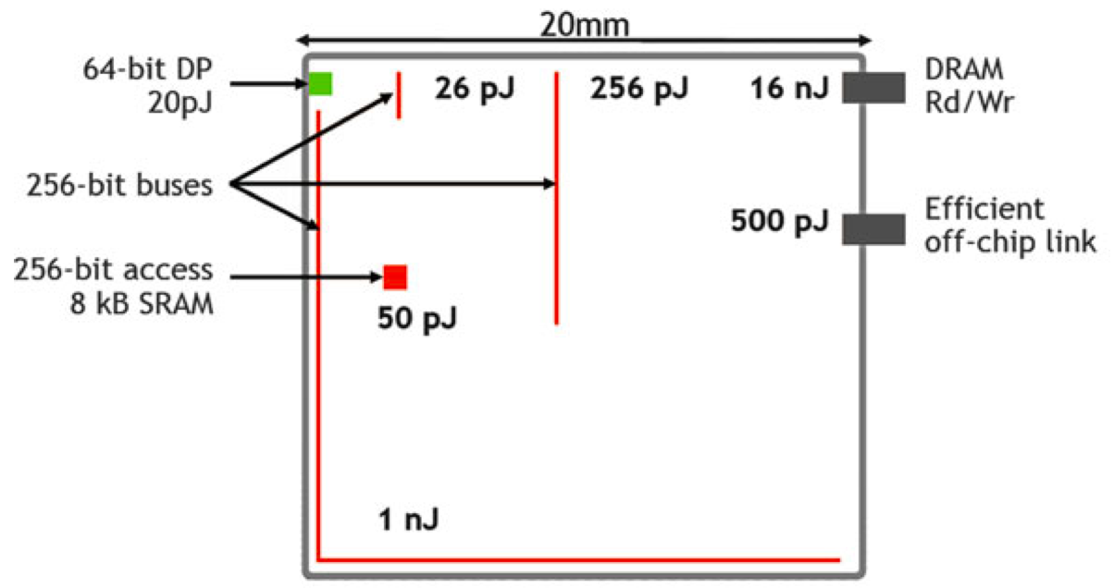
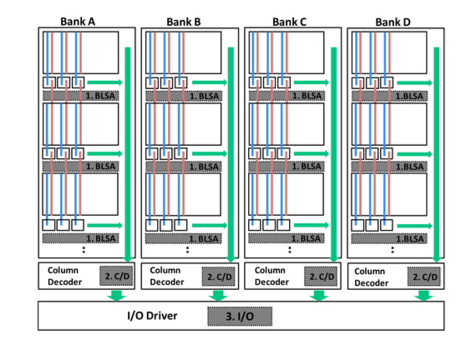
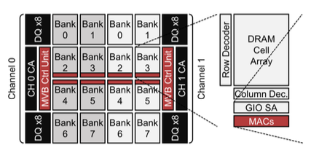
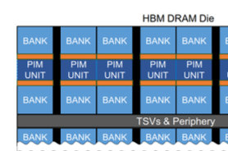
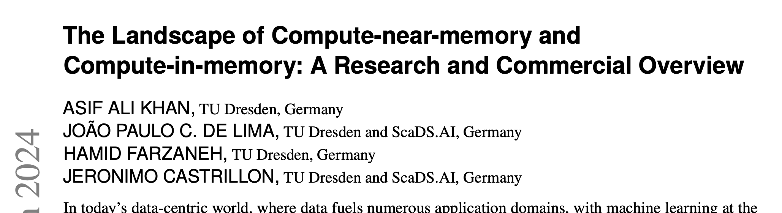
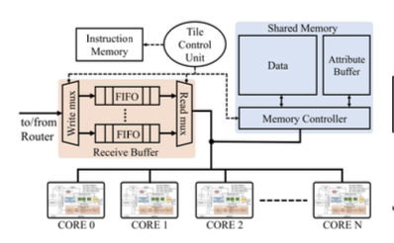
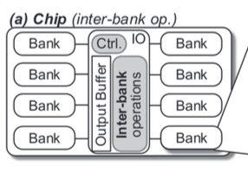
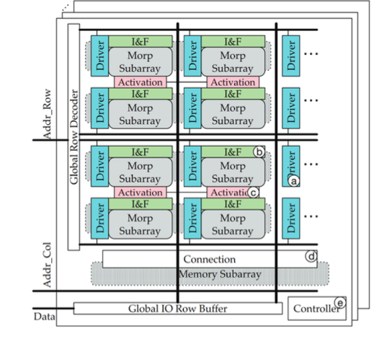
Emerging data-centric architectures
Compute (almost) in-place, avoid data movement, transformations to match primitives
Novel architectures for near-memory (CNM) and in-memory computing (CIM)
Communication dominates arithmetic
Bartolini, S., "Parallel Programming in Cyber-Physical Systems." Cyber-Physical Systems Security. Springer 2018
A. Khan, et al "The Landscape of Compute-near-memory and Compute-in-memory: A Research and Commercial Overview." arXiv:2401.1442 (2024)

Slide 3
Categorization: CNM and CIM Systems
Gómez-Luna, Juan, et al. arXiv:2105.03814 (2021)
S. Lee et al. ISCA (2021)

Slide 4
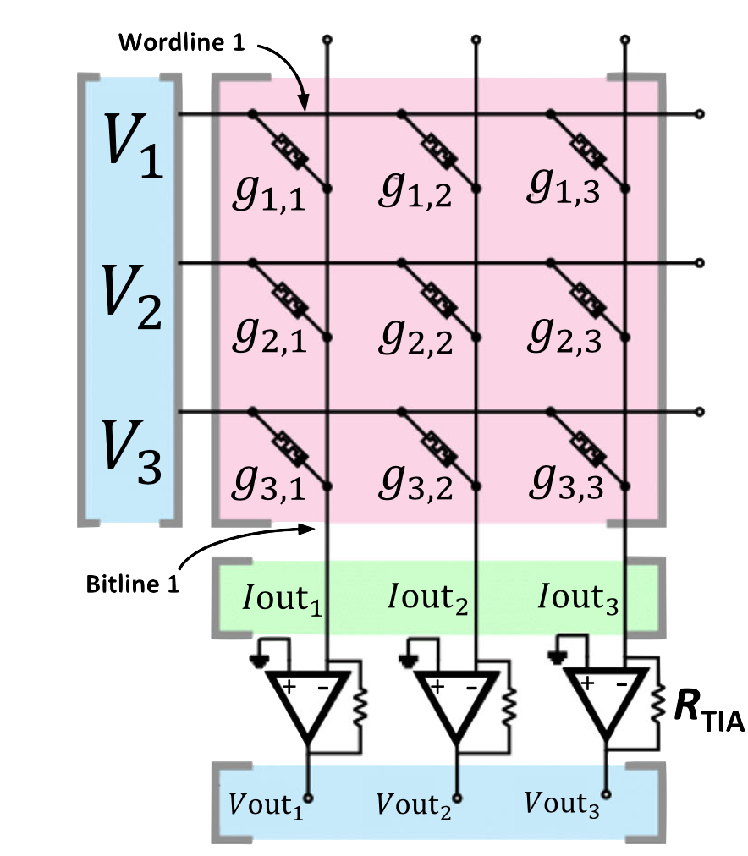
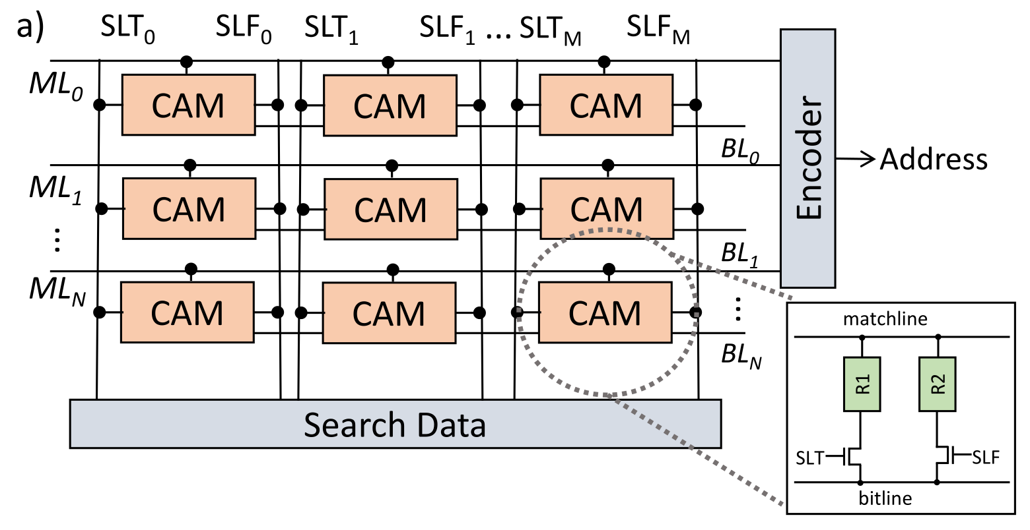
Categorization: CNM and CIM Systems
Gómez-Luna, Juan, et al. arXiv:2105.03814 (2021)
Aguirre, F. et al. Nature (2023)
S. Lee et al. ISCA (2021)
J. P. Cardoso de Lima, et al. FPL (2020)

Slide 5
Categorization: CNM and CIM Systems
Different systems share a lot of commonalities.
There is no established programming methodology.
Gómez-Luna, Juan, et al. arXiv:2105.03814 (2021)
Aguirre, F. et al. Nature (2023)
S. Lee et al. ISCA (2021)
J. P. Cardoso de Lima, et al. FPL (2020)

Slide 6
Cinnamon: A Compilation infrastructure for CINM
Abstract set of operations for CINM systems
Reusable blocks for different purposes
Hierarchical flow: domain specific and target specific transformation
Input: Common abstractions, such as linear algebra and beyond

Slide 7
Cinnamon: A Compilation infrastructure for CINM
Abstract set of operations for CINM systems
Reusable blocks for different purposes
Hierarchical flow: domain specific and target specific transformation
Input: Common abstractions, such as linear algebra and beyond

Slide 8
Cinnamon: A Compilation infrastructure for CINM
Abstract set of operations for CINM systems
Reusable blocks for different purposes
Hierarchical flow: domain specific and target specific transformation
Input: Common abstractions, such as linear algebra and beyond

Slide 9
Cinnamon: A Compilation infrastructure for CINM
Abstract set of operations for CINM systems
Reusable blocks for different purposes
Hierarchical flow: domain specific and target specific transformation
Input: Common abstractions, such as linear algebra and beyond

Slide 10
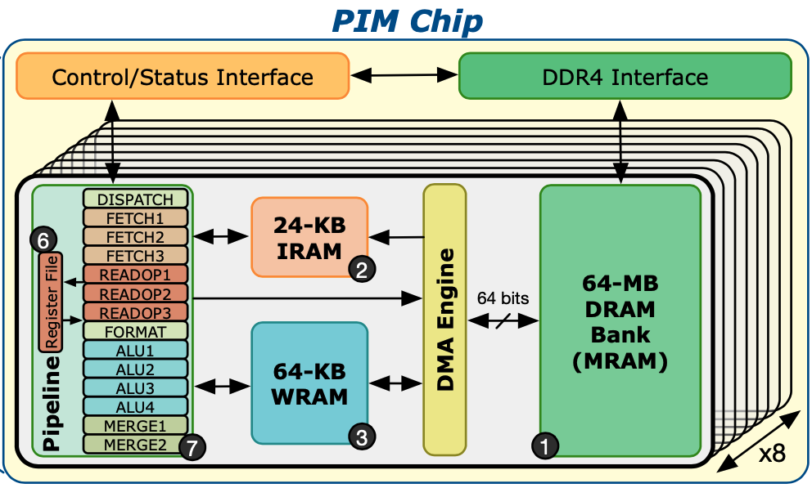
UPMEM example: Matmult
def mm(int32(64, 64) A, int32(64, 64) B) -> (int32(64, 64) C) {
C(i,j) += A(i,k) * B(k,j)
where i in 0:64, k in 0:64, j in 0:64
}

Slide 11
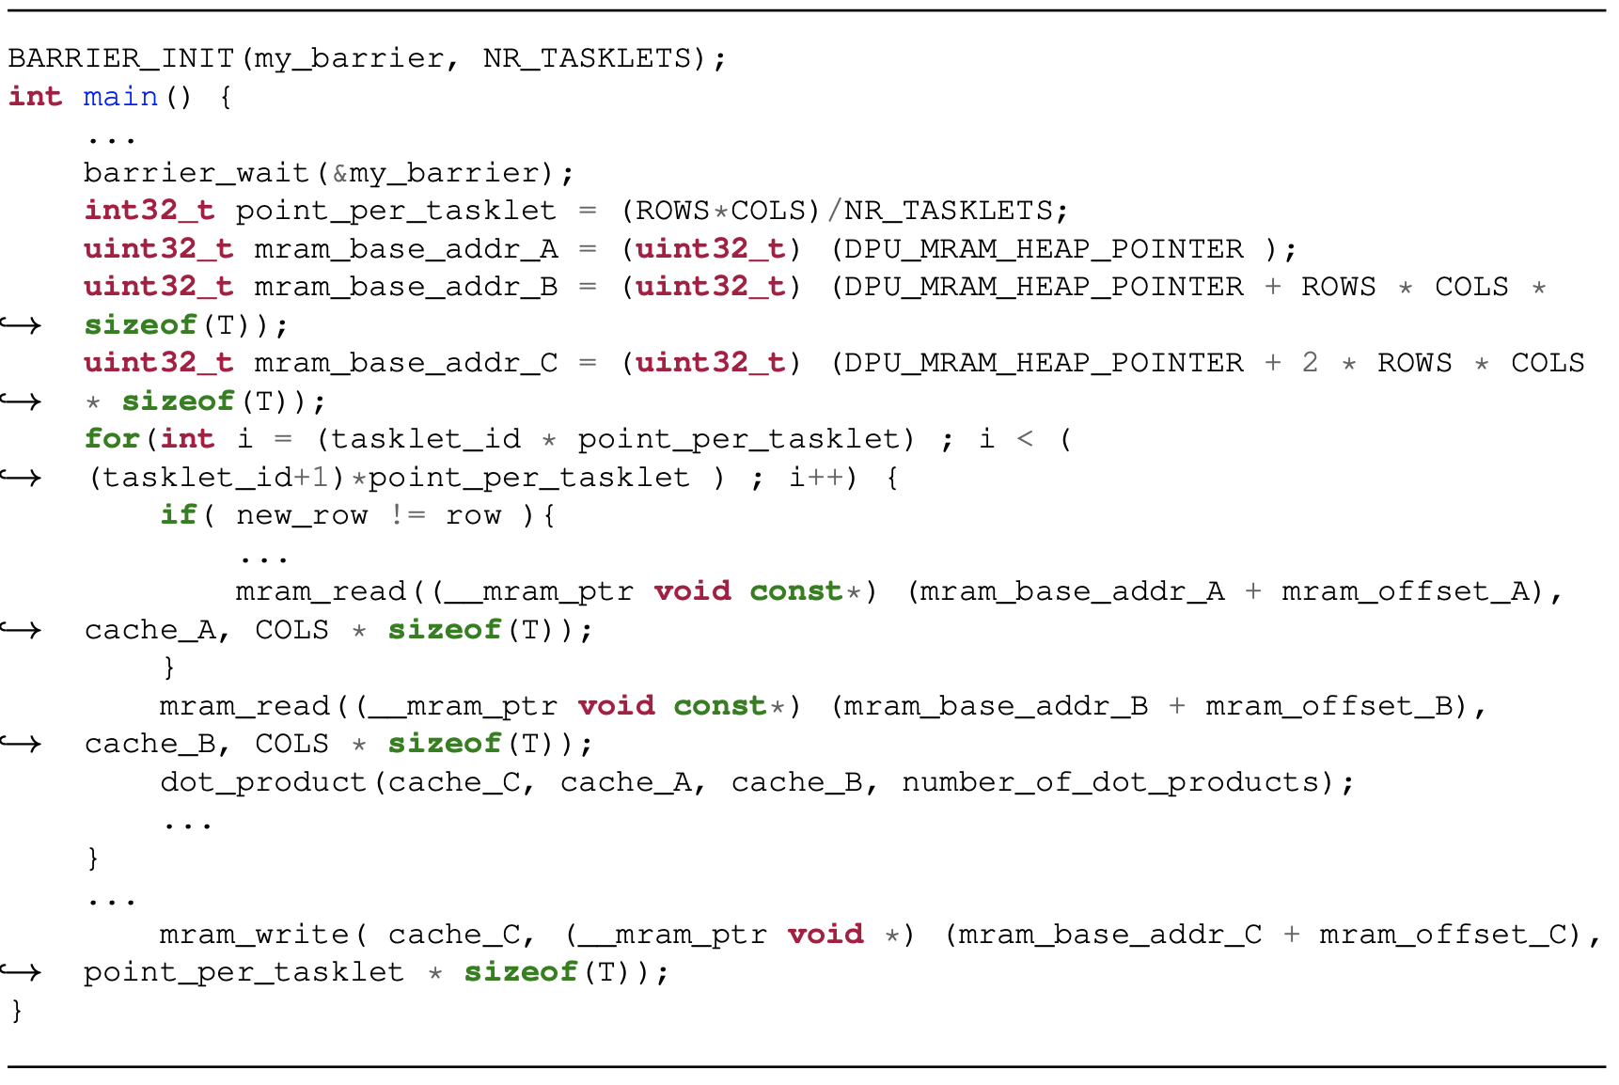
UPMEM example: Matmult
def mm(int32(64, 64) A, int32(64, 64) B) -> (int32(64, 64) C) {
C(i,j) += A(i,k) * B(k,j)
where i in 0:64, k in 0:64, j in 0:64
}

Slide 12
UPMEM example: Matmult
def mm(int32(64, 64) A, int32(64, 64) B) -> (int32(64, 64) C) {
C(i,j) += A(i,k) * B(k,j)
where i in 0:64, k in 0:64, j in 0:64
}

Slide 13
UPMEM example: Matmult
def mm(int32(64, 64) A, int32(64, 64) B) -> (int32(64, 64) C) {
C(i,j) += A(i,k) * B(k,j)
where i in 0:64, k in 0:64, j in 0:64
}
%3 = cinm.op.gemm %0, %1 : (tensor<64x64xi32>, tensor<64x64xi32>) -> tensor<64x64xi32>

Slide 14
UPMEM example: Matmult
%3 = cinm.op.gemm %0, %1 : (tensor<64x64xi32>, tensor<64x64xi32>) -> tensor<64x64xi32>
Host code
Device code
upmem.module @dpu_kernels {
upmem.func @main()
attributes {num_tasklets = N : i64} {
...
upmem.memcpy mram_to_wram ...
upmem.memcpy mram_to_wram ...
scf.for %arg0 = 0 to 64 {
%6 = memref.load %1[%arg0] : memref<64xi32>
%7 = memref.load %3[%arg0] : memref<64xi32>
%8 = memref.load %5[] : memref<i32>
%9 = arith.muli %6, %7 : i32
%10 = arith.addi %9, %8 : i32
memref.store %10, %5[] : memref<i32>
}
upmem.memcpy wram_to_mram ...
upmem.return
}
}
func.func @main() {
...
%1 = upmem.alloc_dpus : !upmem.hierarchy<1x16x1>
scf.for %arg0 = %c0 to %c64 step %c16 {
scf.for %arg1 = %c0 to %c64 step %c1 {
upmem.scatter %subview[264, 64, #map] onto %1 : ...
upmem.scatter %alloc_0[8, 64, #map1] onto %1 : ...
upmem.scatter %0[0, 1, #map2] onto %1 : ...
upmem.launch_func @dpu_kernels::@main %1 : ...
upmem.gather %alloc_1[0, 1, #map2] from %1 : ...
...
}
}
upmem.free_dpus %1 : !upmem.hierarchy<1x16x1>
return
}

Slide 15
CIM-Crossbar example: Matmult
%3 = cinm.op.gemm %0, %1 : (tensor<64x64xi32>, tensor<64x64xi32>) -> tensor<64x64xi32>
%dev = cim.acquire_device -> !cim.deviceId
%xbar = cim.acquire_crossbar %dev : ... -> !cim.crossbarId
%fut0 = cim.op.gemm %xbar, %barg0, %btw0 : ... -> !cim.future<…>
%bm0 = cim.barrier %fut0 : !cim.future<…> -> tensor<…>
cim.release_crossbar %xbar : !cim.crossbarId
cim.release_device %dev : !cim.deviceId
…
memristor.write_to_crossbar %c0_i32, %rhsb : i32, memref<…>
memristor.gemm %xbar, %lhsb, %resb : i32, memref<…>, memref<…>
memristor.barrier %xbar : i32
…

Slide 16
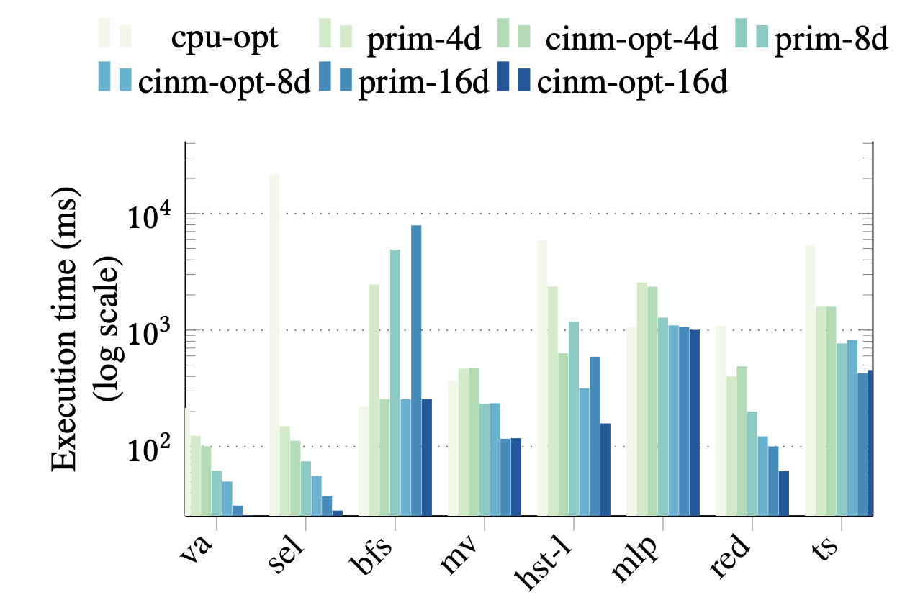
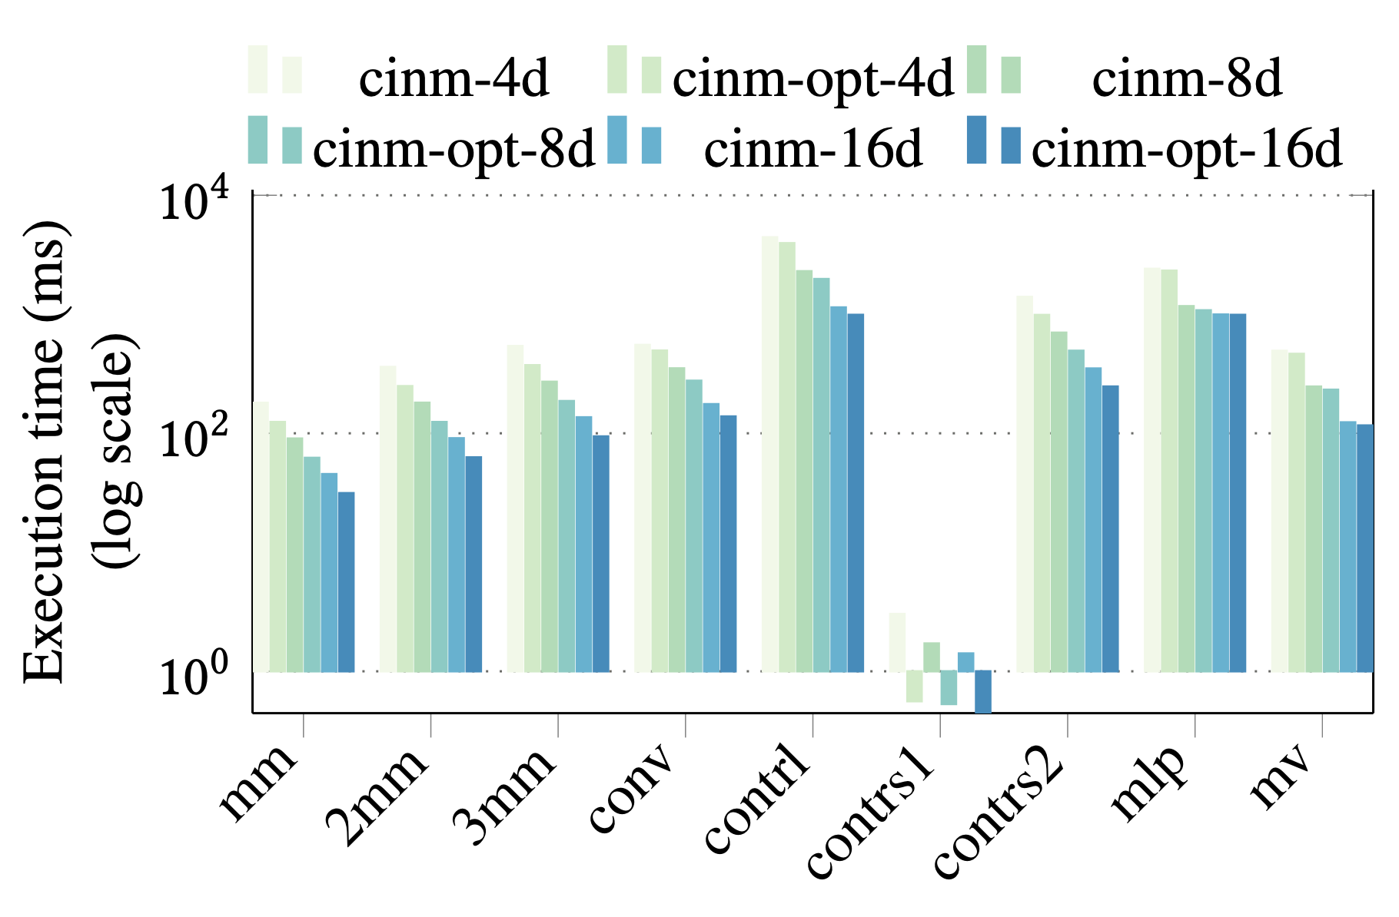
UPMEM CNM system: results
Manual designs 2-5x faster than CPU. CINM 1.5-2x faster than hand-optimized code
1-DIMM 128 DPUs
4-DIMMs 512 DPUs
8-DIMMs 1024 DPUs
16-DIMMs 2048 DPUs
Optimizations achieve 40%-50% speedup (geomean)

Slide 17
CIM-Crossbar: results
Crossbar target: validate results of SOA
Reuse the domain-specific transformations
Enable device-specific optimizations

Slide 18
CIM-Crossbar: results
Crossbar target: validate results of SOA
Reuse the domain-specific transformations
Enable device-specific optimizations
Will be presented on Thursday

Slide 19
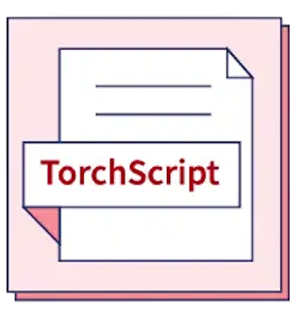
Domain-target implementation challenges
What the user writes
What the device expects
Only manual translation and mapping
…
cam_config = load_config()
cam = CAMASim(cam_config)
cam.write(CAM_Data)
CAM_pred_ids, _, _ = cam.query(CAM_Query)
return CAM_pred_ids
…

Slide 20
Challenges with manual designs
Key variations in current CAM-based designs
CAM types (TCAM, MCAM, ACAM) with perf/accuracy trade-offs
Distance metrics (e.g., Hamming, Euclidean, cosine similarity)
Language variations
Varied merging strategies for handling partial results
Presently, all of this is handled manually with low-level APIs, restricting CAMs to device experts

Slide 21
C4CAM: Lowering for different CAM-based acc.

Slide 22
C4CAM: Lowering for different CAM-based acc.

Slide 23
C4CAM: Lowering for different CAM-based acc.

Slide 24
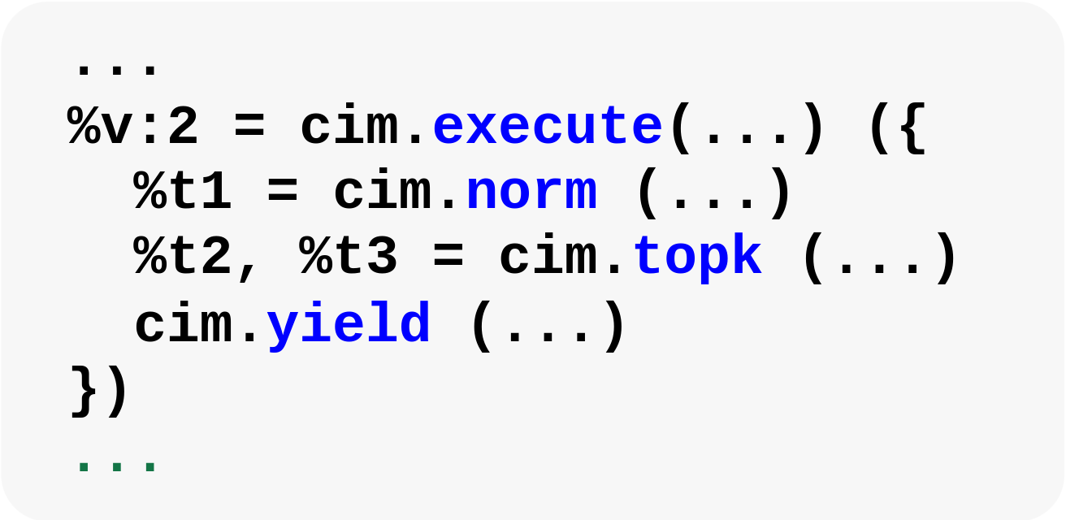
C4CAM: Lowering for different CAM-based acc.

Slide 25
C4CAM: Lowering for different CAM-based acc.

Slide 26
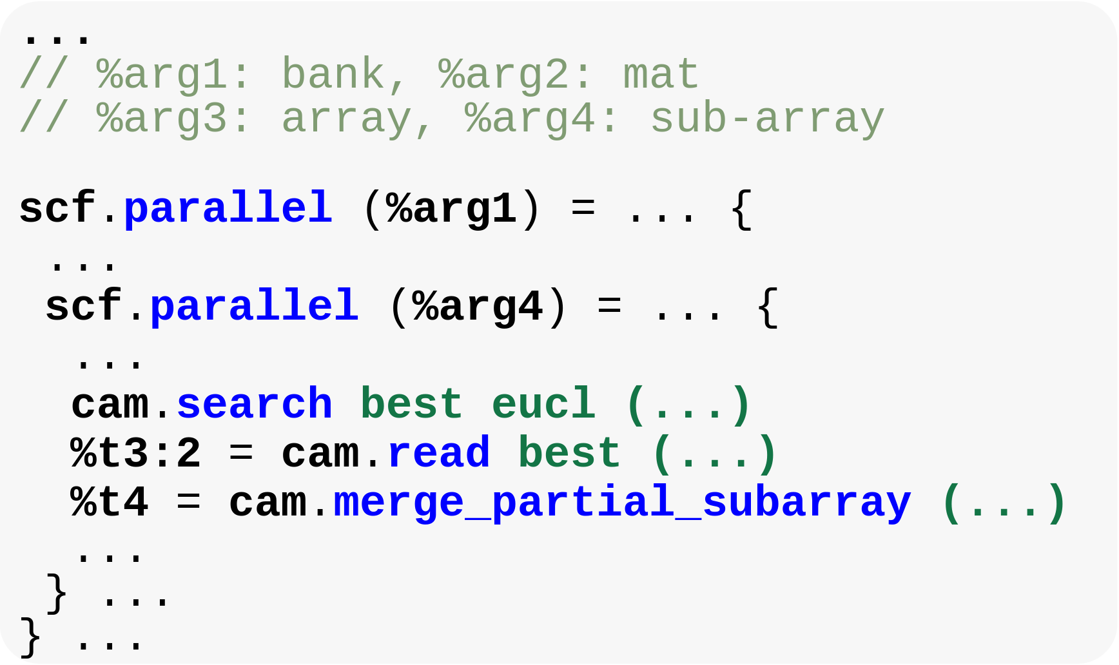
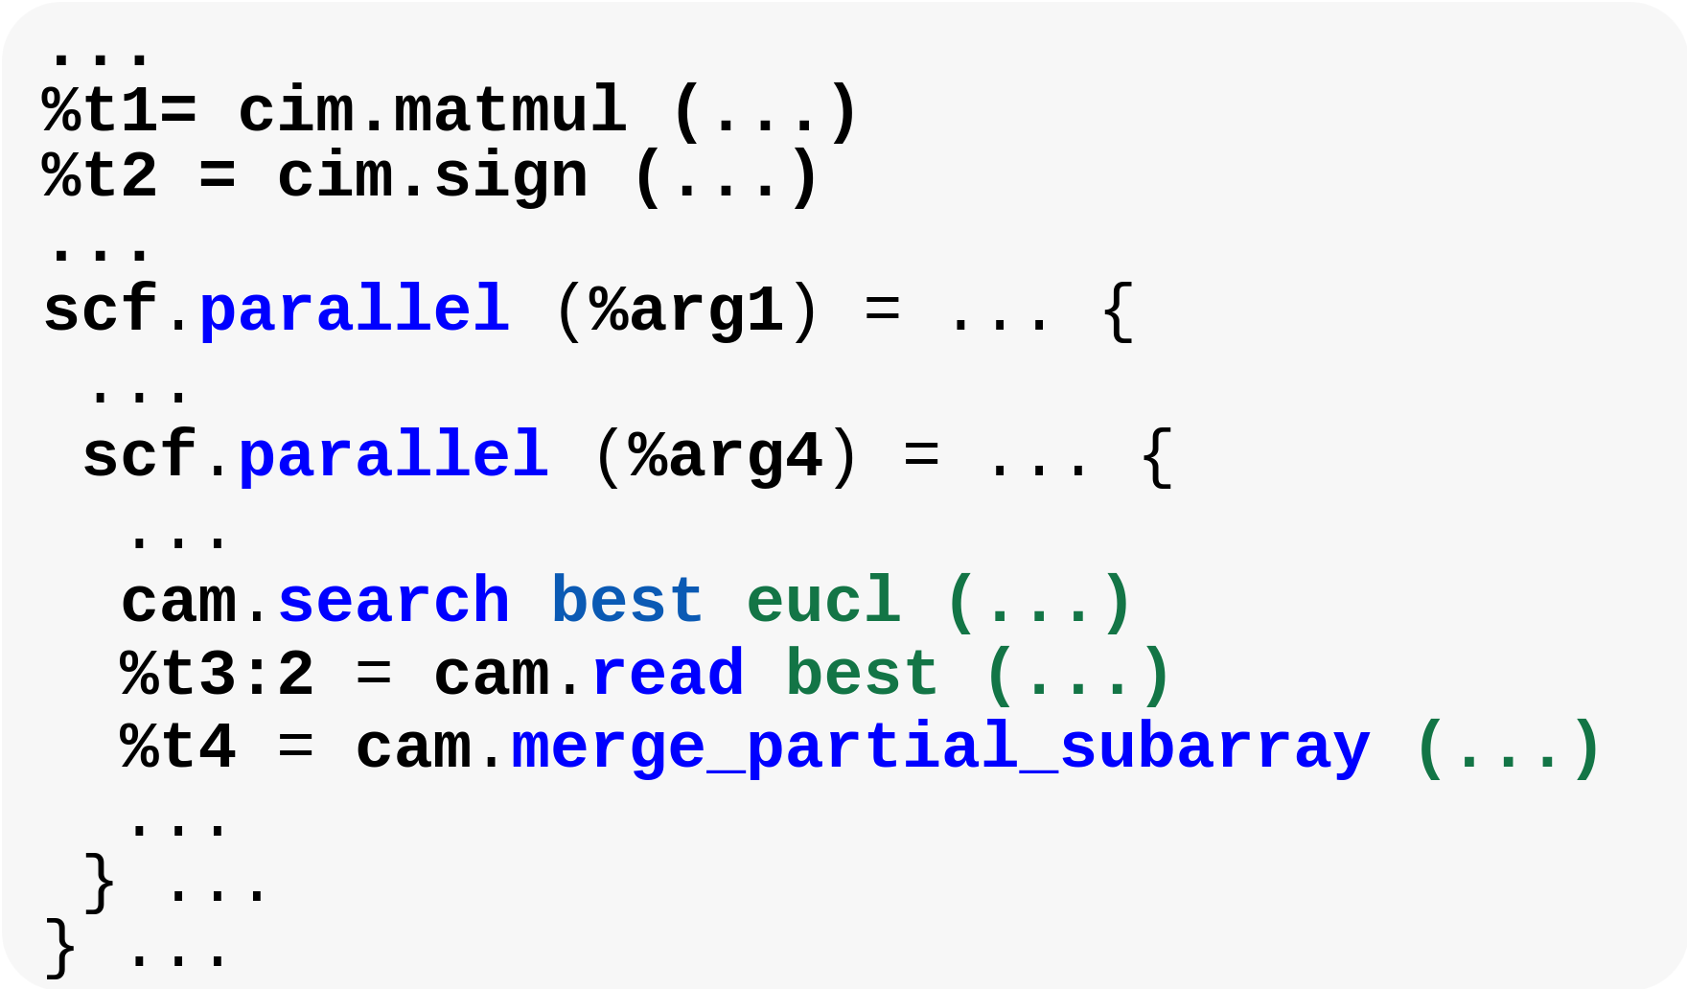
C4CAM: Lowering for different CAM-based acc.
MCAM
TCAM

Slide 27
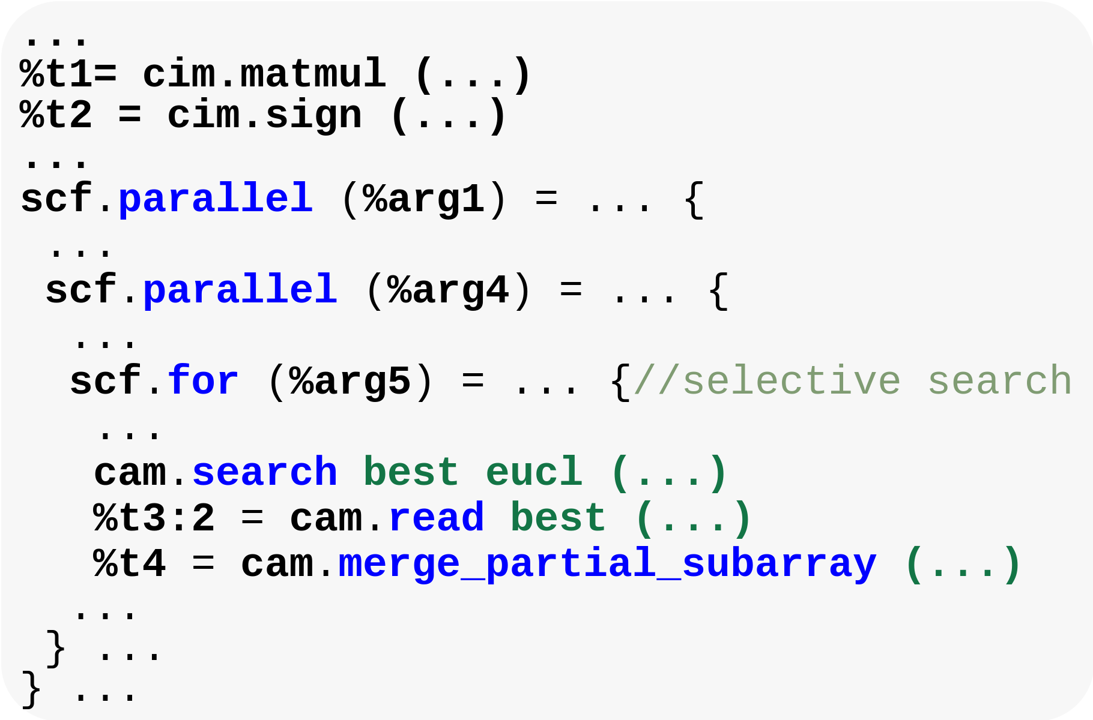
C4CAM: Lowering for different CAM-based acc.
Selective search
MCAM
TCAM

Slide 28
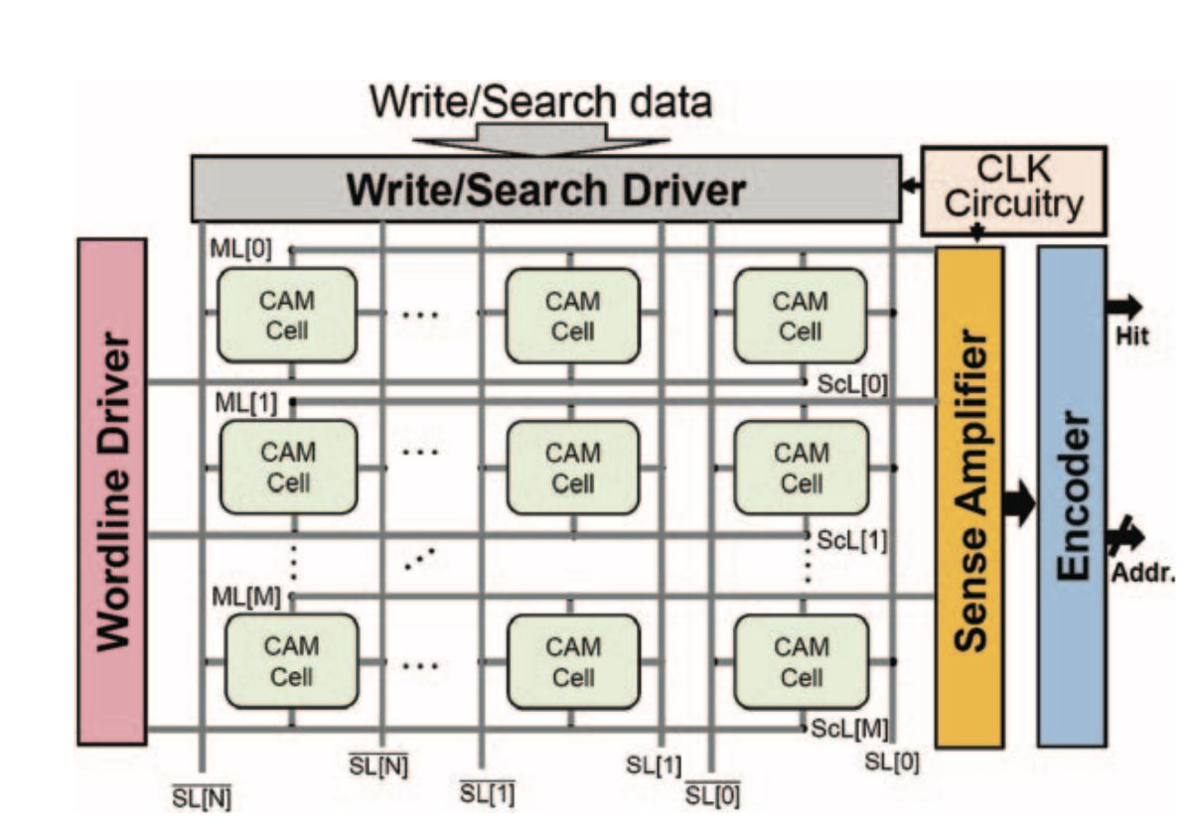
Content addressable memories (CAMs)
NVM-based CAMs: Great for KNNs, One-shot learning, …
CINM support for similarity and CAM arch exploration
Automatic flow from TorchScript matches manual designs
H. Farzaneh, et al. “C4CAM: A Compiler for CAM-based In-memory Accelerators”, ASPLOS, 2024
KNN results (128x128 CAM): 14x faster and ~10⁴ less energy compared to GPU

Slide 29
CAMs: Design space exploration
Retargetable compiler for CAM exploration: Sizes and features
Compiler flags for optimization target
Asplos 2024
H. Farzaneh, et al. “C4CAM: A Compiler for CAM-based In-memory Accelerators”, ASPLOS, 2024
Different flags expose trade-offs w/o manual re-coding. Next: include device-level parameters

Slide 30
Cinnamon – C4CAM
Gómez-Luna, Juan, et al. arXiv:2105.03814 (2021)
Aguirre, F. et al. Nature (2023)
S. Lee et al. ISCA (2021)
J. P. Cardoso de Lima, et al. FPL (2020)

Slide 31
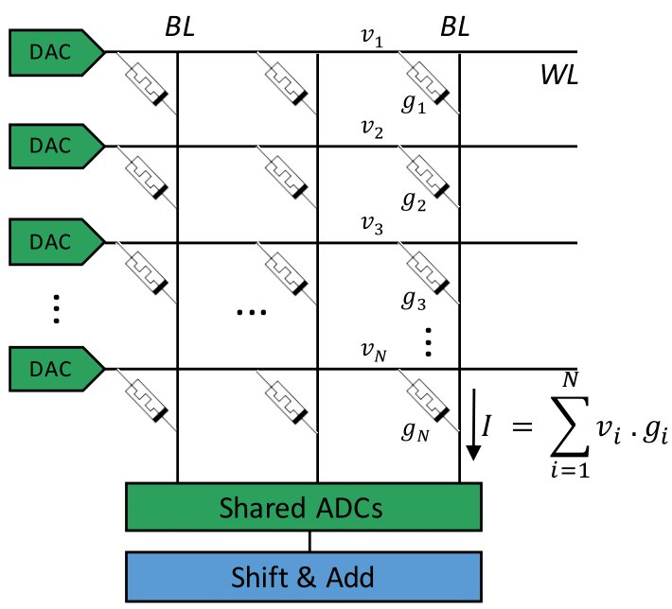
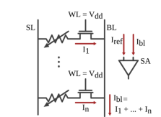
Memristor-based CIM
Memristor-crossbars enable:
Analog dot-product using DA/AD converters
Bitwise operations (OR, AND, and NOT) using custom SA
L. Xie et al., Scouting Logic, ISVLSI'2017
Li and Patel, Bitweaving, SIGMOD'2013.

Slide 32
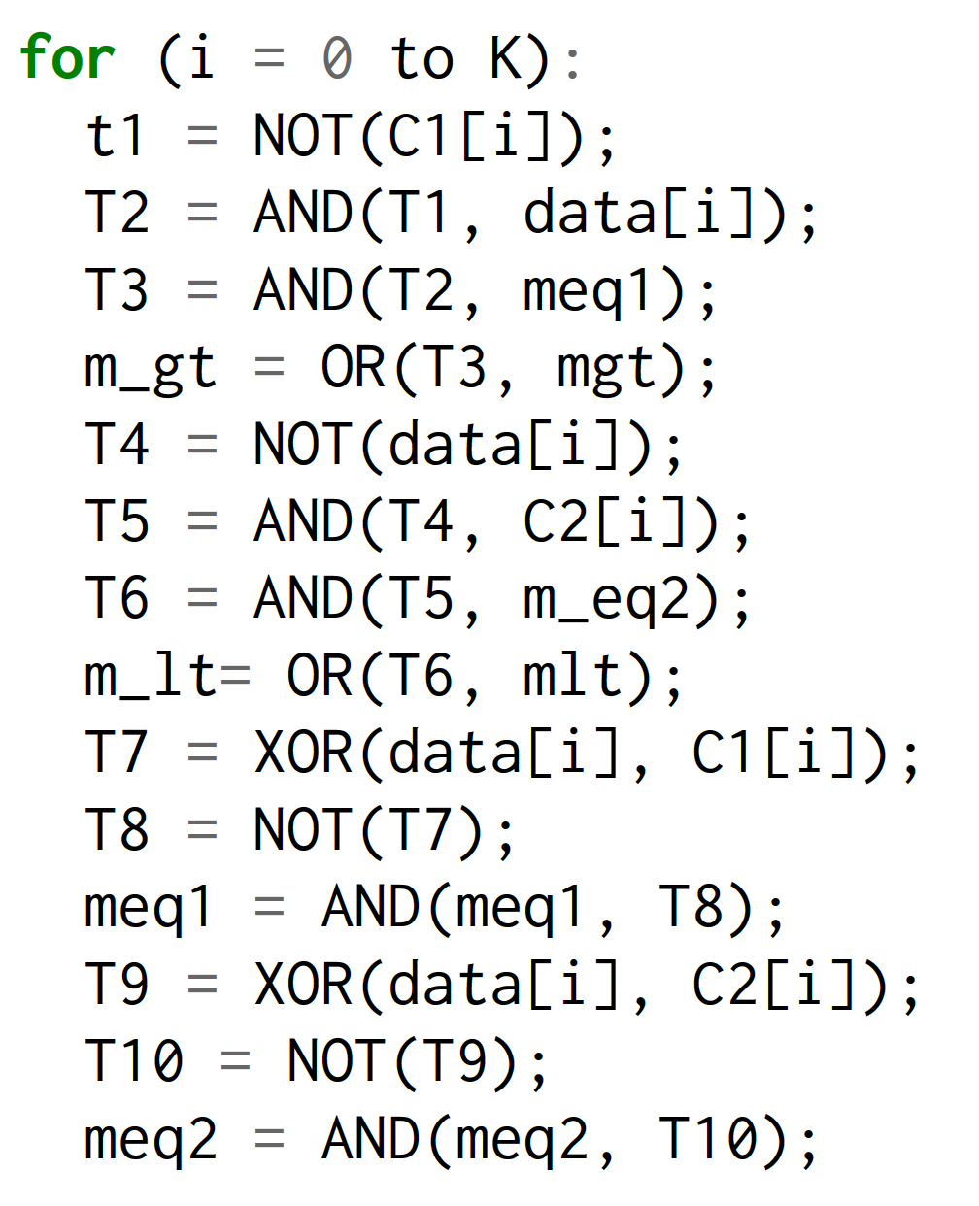
Sherlock: Logic-in-memory in NVMs
Li and Patel, Bitweaving, SIGMOD'2013.

Slide 33
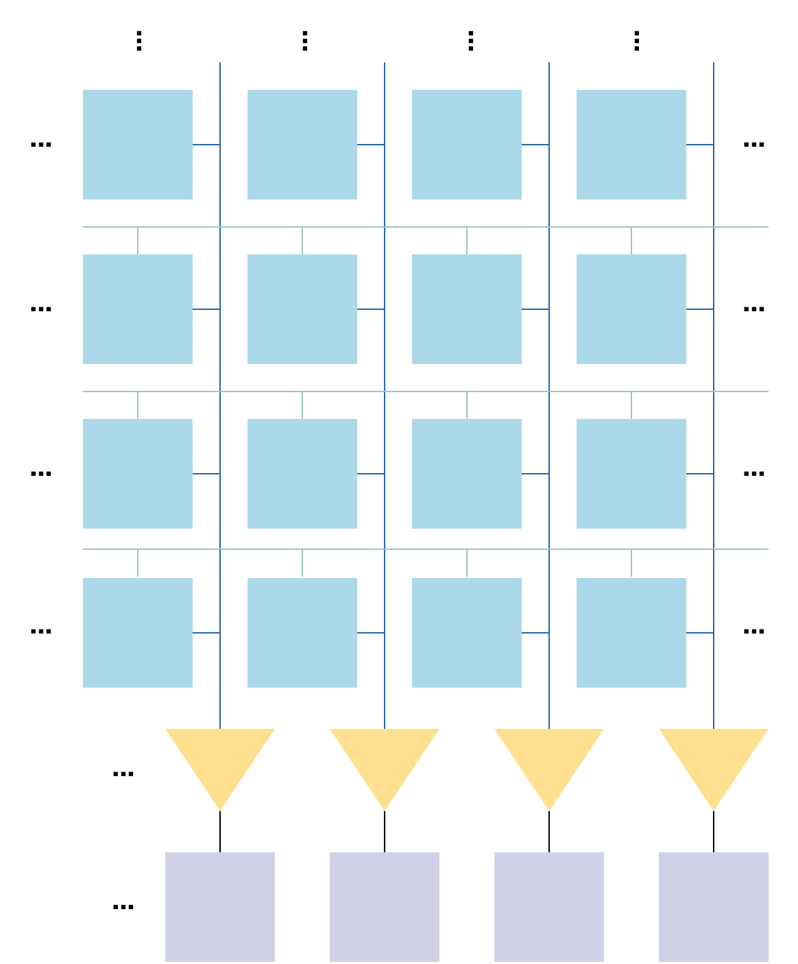
Sherlock: Logic-in-memory in NVMs
Li and Patel, Bitweaving, SIGMOD'2013.

Slide 34
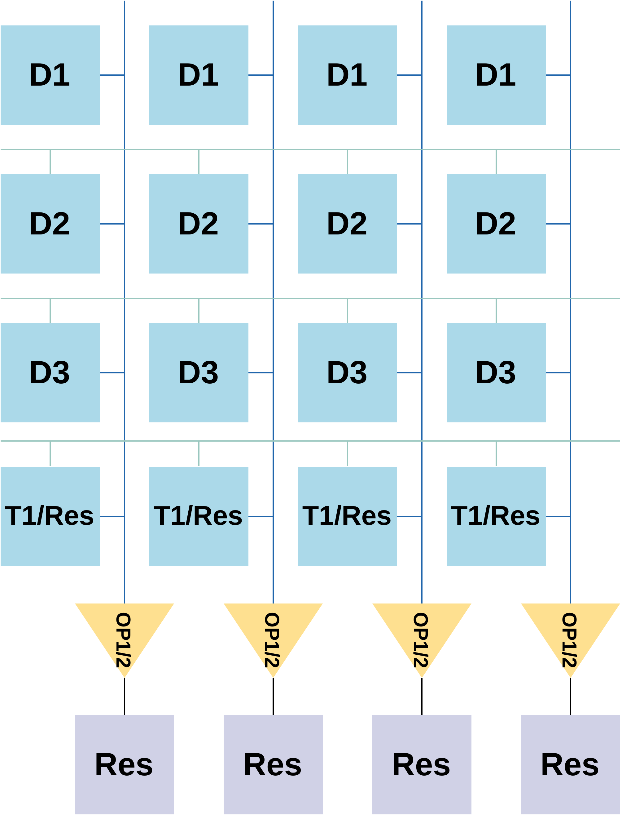
Sherlock: Logic-in-memory in NVMs
Li and Patel, Bitweaving, SIGMOD'2013.

Slide 35
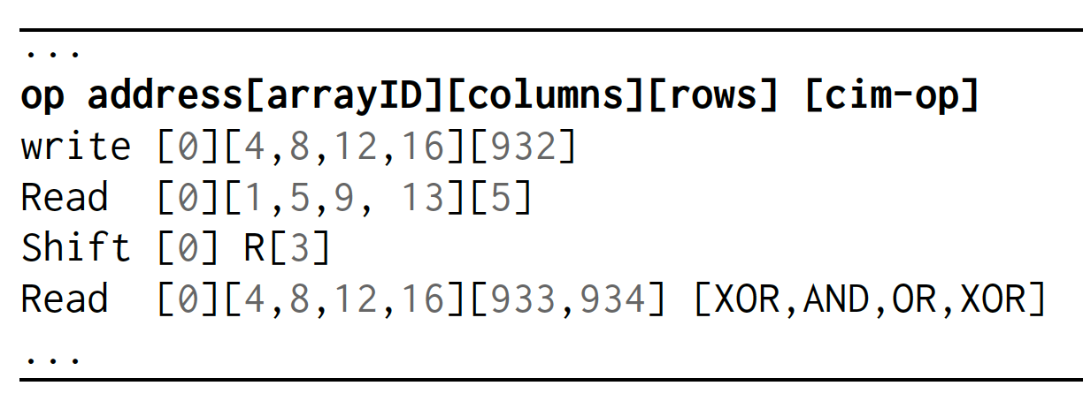
Sherlock: Logic-in-memory in NVMs
Li and Patel, Bitweaving, SIGMOD'2013.

Slide 36
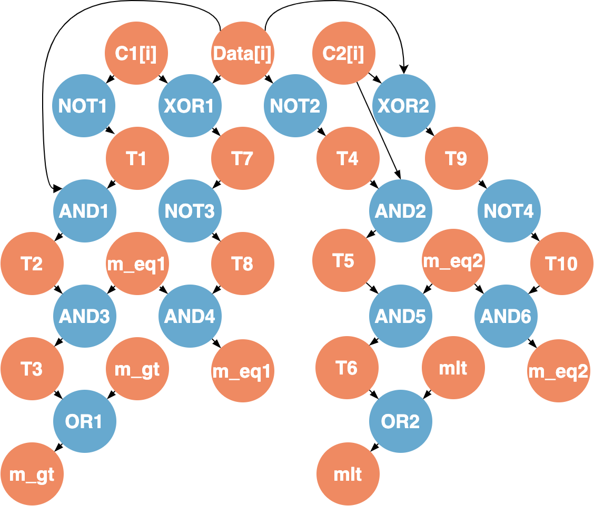
Sherlock mapping
Goal: find clusters of operations that match the device model

Slide 37
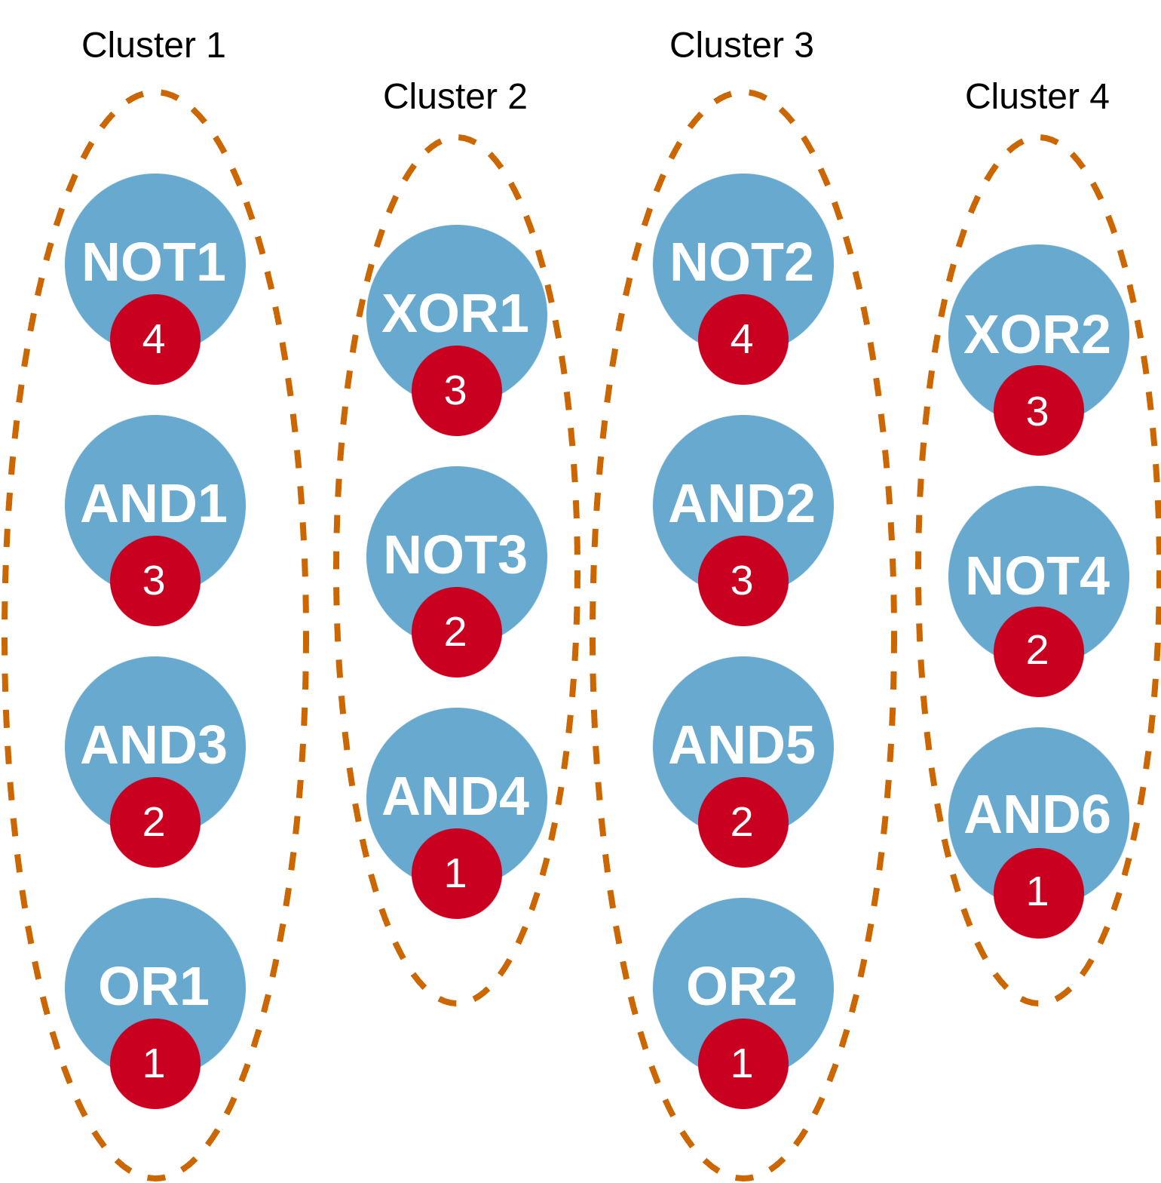
Sherlock mapping
Goal: find clusters of operations that match the device model

Slide 38
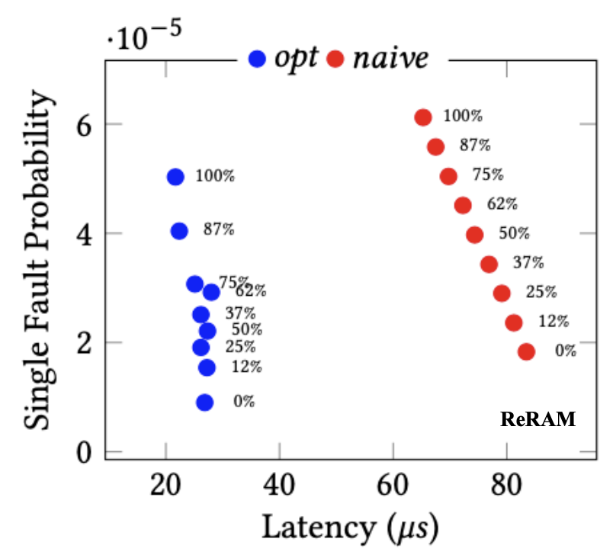
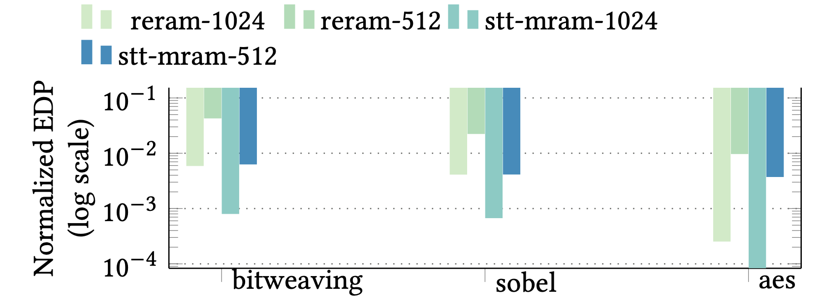
Sherlock: Logic-in-memory in NVMs
Massively parallel multi-operand bit-wise operations in-memory
Complex mapping of operands, operations and temporaries to columns
Optimized mapping: Less latency (10x), better reliability (~4.6x)
Orders of magnitude better EDP vs CPU baseline
H. Farzaneh, et al. “"SHERLOCK: Scheduling Efficient and Reliable Bulk Bitwise Operations in NVMs", DAC 2024
Notes:
First plot: % is the amount of multi-operand operations (decrease reliability, improves performance)

Slide 39
Conclusions
Most recent innovations in computing systems center around memory
Data movement dominates the execution time and energy consumption
Near- and in-memory computing achieve orders of magnitude energy savings
For these novel architectures to go mainstream, programmability/accessibility is the key, and requires more attention
Cinnamon is a step in that direction, targeting heterogeneous CINM systems
Notes:
Mention here that in short-term UPMEM and optane DC can alleviate the problem

Slide 40
Thanks!

Slide 41
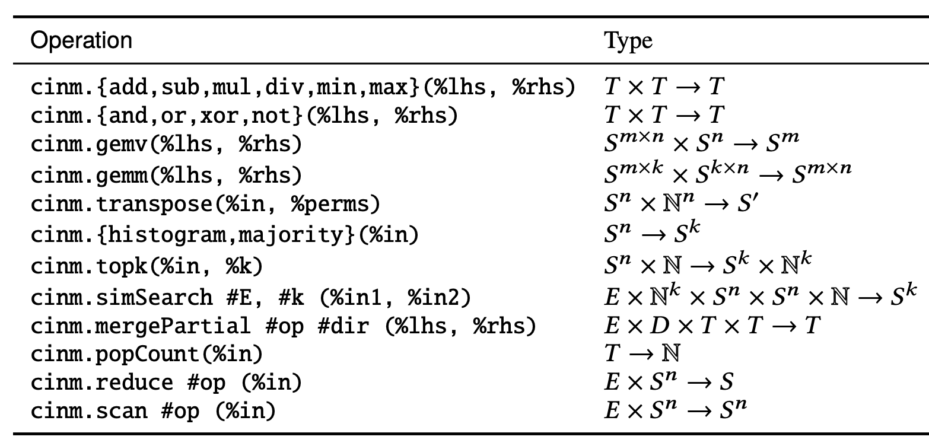
CINM: Common operations and transformations

Slide 42
CINM: Common operations and transformations
+ Common transformations: Tiling, loop reorder, operation fusion, operation rewriting , …

Slide 43
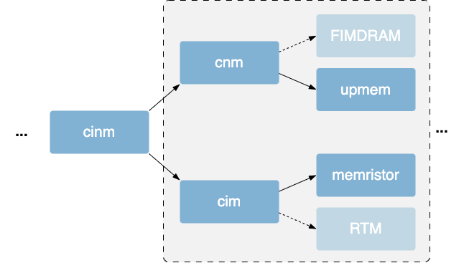
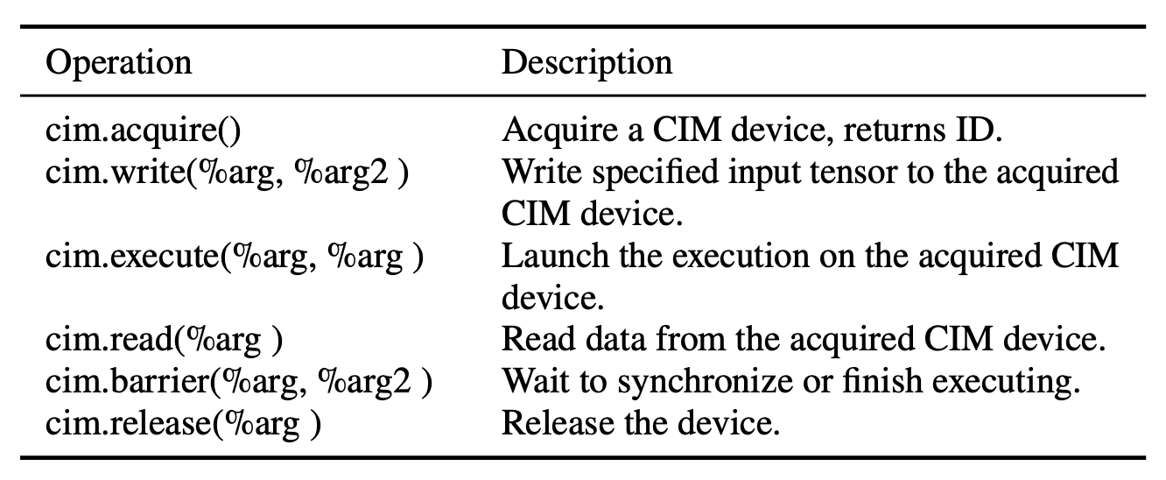
CNM/CIM: Abstraction programming models

Slide 44
CNM/CIM: Abstraction programming models
Device specific

