Slide 1
Pitfalls of UPMEM kernel development
Heterogeneous Memory Software Lab, Poland
Krystian Chmielewski, Tadeusz Kobus, Paweł Piotrowicz, Jarosław Ławnicki, Uladzislau Lukyanau, Maciej Maciejewski, Zhang Hongjun
krystian.chmielewski@huawei.com

Slide 2
What is UPMEM?
HOST
NUMA 0
NUMA 1
CPU
CPU
CPU
CPU
CPU
CPU
MC
MC
BANK
DDR4 channels
DDR4 channels
DRAM Array
(MRAM) 64MB
ule
ule
DRAM
dule
dule
UPMEM PIM Module
UPMEM PIM Module
DRAM
High Bandwidth (1GB/s) Internal Data Bus
DRAM Processing Unit (DPU)
Instruction Memory (IRAM) <= 3968 instr
Working Memory (WRAM)
<= 63488 B
UPMEM PIM Rank
RISC Multi-threaded Pipeline
400MHz
x8

Slide 3
ADD and MUL performance analysis

Slide 4
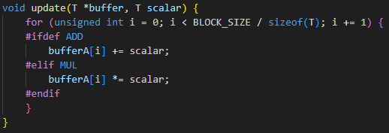
Basic operations on UPMEM
-64%
But why?
-82%
No native support for INT32 MUL

Slide 5
Basic operations on UPMEM
-64%
But why?
-82%
No native support for INT32 MUL

Slide 6
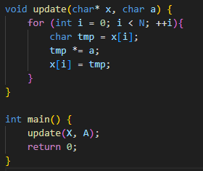
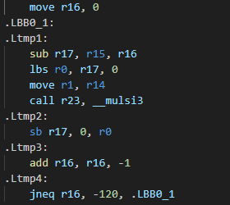
Issues with INT8 MUL
Compiler sometimes uses INT32 MUL __mulsi3 function (SHIFT&ADD, ~9 cycles) instead of INT8 MUL mul_sl_sl (1 cycle) instruction
Often loops are not being unrolled at all
Unrolling through #pragma unroll is often not possible – not enough IRAM

Slide 7
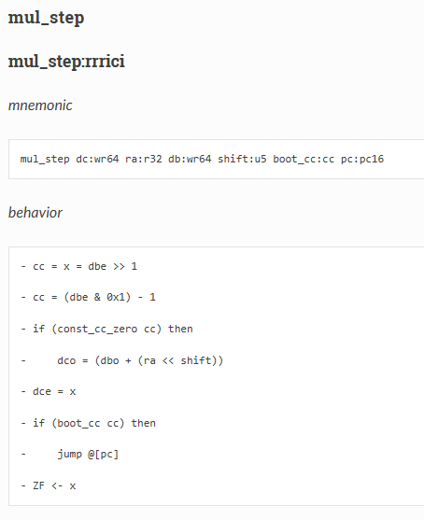
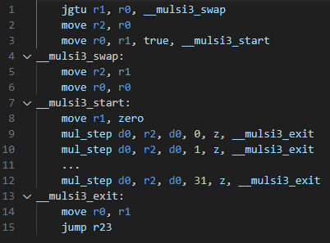
__mulsi3 – SHIFT & ADD

Slide 8
Changing instructions on function inline
Compilation with –O2 or –O3 will result in inlining based on N (if it’s compile time constant)
Loop unrolling also depends on N
Inside the main function, INT32 MUL (SHIFT&ADD) is used
N:
0
28
39
Function is inlined
Loop is fully unrolled
INT8 MUL is used (1 cycle)
Function is not inlined
Loop is fully unrolled,
INT8 MUL is used (1 cycle)
Function is inlined
Loop is not unrolled
INT32 MUL (SHIFT&ADD) is used (~9 cycles)

Slide 9
INT8/INT32 MUL Optimization

Slide 10
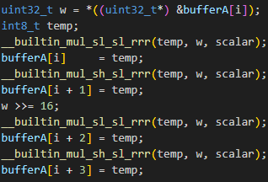
Optimized INT8 MUL
Ensuring the use of the correct instruction for INT8
Unrolling:
Full (compiler decides) #pragma unroll
Manual, e.g., x4 #pragma unroll 4
Loading data by 4 or 8 bytes (INT8x4, INT8x8)
> 5x speedup
vs baseline
baseline

Slide 11
Optimized INT32 MUL
2x speedup vs baseline
Replacing _mulsi3 (SHIFT&ADD, ~30 cycles) with a custom implementation that uses INT8 MUL
Unrolling also helps
baseline
X = (x3, x2, x1, x0)
Y = (y3, y2, y1, y0)
X * Y = 2^0 (x0 * y0)
+ 2^8 (x0 * y1 + x1 * y0)
+ 2^16 (x0 * y2 + x1 * y1 + x2 * y0)
+ 2^24 (x0 * y3 + x1 * y2 + x2 * y1 + x3 * y0)

Slide 12
Unrolling helps a lot
Loops are pretty costly, when we are not spending a lot of cycles on single iteration
Use #pragma unroll to force compiler to unroll loops

Slide 13
Basic operations on UPMEM revisited
+26%
MUL is now faster than optmized ADD for INT8
-82%
MUL is still slower than ADD for INT32
Still, 2x speedup for MUL in raw numbers
baseline
baseline
baseline
baseline

Slide 14
UPMEM vs CPU
Speedup vs Kunpeng
1.1x → 6.5x
1.5x → 2.6x
5.2x → 10.4x
1.9x → 3.5x

Slide 15
Memory transfer optimizations

Slide 16
Memory transfers
Host → PIM (dpu_prepare_xfer, dpu_push_xfer):
Transfer size and symbol offset need to be a multiple of 8B → error otherwise
Extra care is needed to handle the remainder, if any
Host buffers need to be aligned up to 8B
MRAM → WRAM (mram_read, mram_write):
Transfer size needs to be a multiple of 8B (max 2048B)
Read/write operations silently align down the address to 8B → no error is raised
mram_read_unaligned and mram_write_unaligned functions require ~300 more instructions → GEMV where the matrix is stored contiguously and row size is odd

Slide 17
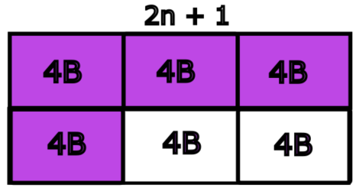
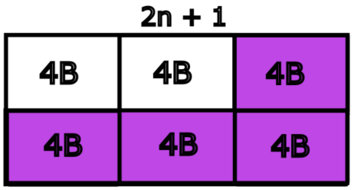
Reading unaligned memory MRAM
Address we read from/write to must be aligned to 8B
Number of bytes read/written must be a multiple of 8B

Slide 18
Optimized data transfers
CPU
CPU
UPMEM server:
DRAM can be the bottleneck (only 2 DDR4-3200 channels)
Transposing data heavily engages the CPU
DPU allocation is not NUMA-aware:
No way to allocate DPUs assigned to specific CPU
A significant variance (~12%) in memory transfer speeds with default DPU allocation
Simple API extension to allow DPU allocation on specific NUMA node:
Changes only in the user-space library
Simple filtering of available ranks during DPU allocations
DRAM
DRAM
UPMEM DIMMS
UPMEM DIMMS
UPMEM DIMMS
UPMEM DIMMS
UPMEM DIMMS
UPMEM DIMMS
UPMEM DIMMS
UPMEM DIMMS
UPMEM DIMMS
UPMEM DIMMS

Slide 19
Optimized data transfers (parallel copy)

Slide 20
Summary
UPMEM Compiler:
Generates inefficient INT8 MUL (__mulsi3 SHIFT&ADD)
Rarely performs unrolling
DPU Optimizations:
A little extra care with INT8 MUL provides huge gains
INT32 MUL performance is also improved
The achieved performance of INT8/INT32 ADD/MUL makes UPMEM viable for testing AI workloads (albeit with quantization, FP remains unpractical on UPMEM)
Optimized data transfers:
NUMA-awareness can go a long way
Contact me at: krystian.chmielewski@huawei.com

Slide 21
Thank you!

