Slide 1
Tutorial on Memory-Centric Computing: PIM Adoption & Programmability
Geraldo F. Oliveira
Prof. Onur Mutlu
HEART 2024
21 June 2024

Slide 2
Agenda
Introduction to Memory-Centric Computing Systems
Real-World Processing-Near-Memory Systems
Processing-Using-Memory Architectures for Bulk Bitwise Operations
Lunch Break
PIM Programming & Infrastructure for PIM Research
Tentatively: Hands-on Lab on Programming and Understanding a Real Processing-in-Memory Architecture

Slide 3
Processing in Memory: Adoption Challenges
1. Processing near Memory
2. Processing using Memory

Slide 4
Eliminating the Adoption Barriers
How to Enable Adoption of Processing in Memory

Slide 5
Potential Barriers to Adoption of PIM
1. Applications & software for PIM
2. Ease of programming (interfaces and compiler/HW support)
3. System and security support: coherence, synchronization, virtual memory, isolation, communication interfaces, …
4. Runtime and compilation systems for adaptive scheduling, data mapping, access/sharing control, …
5. Infrastructures to assess benefits and feasibility
All can be solved with change of mindset

Slide 6
We Need to Revisit the Entire Stack
Problem
Algorithm
Program/Language
System Software
SW/HW Interface
Micro-architecture
Logic
Devices
Electrons
We can get there step by step

Slide 7
Adoption: How to Keep It Simple?
Junwhan Ahn, Sungjoo Yoo, Onur Mutlu, and Kiyoung Choi, "PIM-Enabled Instructions: A Low-Overhead, Locality-Aware Processing-in-Memory Architecture" Proceedings of the 42nd International Symposium on Computer Architecture (ISCA), Portland, OR, June 2015. [Slides (pdf)] [Lightning Session Slides (pdf)]

Slide 8
Adoption: How to Ease Programmability? (I)
Geraldo F. Oliveira, Alain Kohli, David Novo, Juan Gómez-Luna, Onur Mutlu, “DaPPA: A Data-Parallel Framework for Processing-in-Memory Architectures,” in PACT SRC Student Competition, Vienna, Austria, October 2023.

Slide 9
Adoption: How to Ease Programmability? (II)
Jinfan Chen, Juan Gómez-Luna, Izzat El Hajj, YuXin Guo, and Onur Mutlu, "SimplePIM: A Software Framework for Productive and Efficient Processing in Memory" Proceedings of the 32nd International Conference on Parallel Architectures and Compilation Techniques (PACT), Vienna, Austria, October 2023.

Slide 10
Adoption: How to Maintain Coherence? (I)
Amirali Boroumand, Saugata Ghose, Minesh Patel, Hasan Hassan, Brandon Lucia, Kevin Hsieh, Krishna T. Malladi, Hongzhong Zheng, and Onur Mutlu, "LazyPIM: An Efficient Cache Coherence Mechanism for Processing-in-Memory" IEEE Computer Architecture Letters (CAL), June 2016.

Slide 11
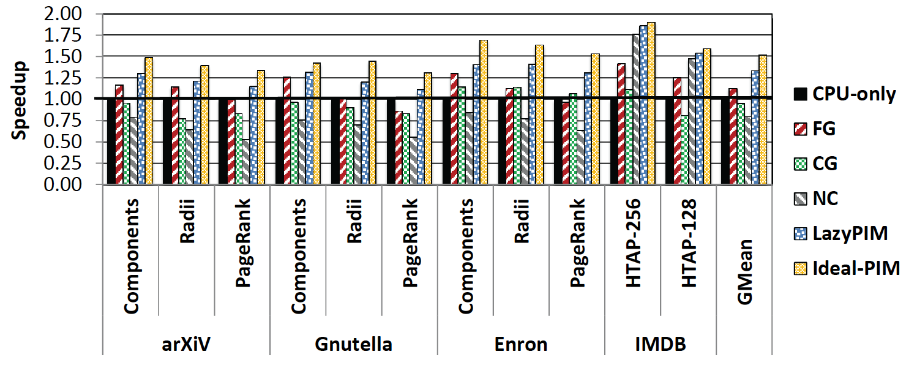
Challenge: Coherence for Hybrid CPU-PIM Apps
Traditional
coherence
No coherence
overhead

Slide 12
Adoption: How to Maintain Coherence? (II)
Amirali Boroumand, Saugata Ghose, Minesh Patel, Hasan Hassan, Brandon Lucia, Kevin Hsieh, Krishna T. Malladi, Hongzhong Zheng, and Onur Mutlu, "CoNDA: Efficient Cache Coherence Support for Near-Data Accelerators" Proceedings of the 46th International Symposium on Computer Architecture (ISCA), Phoenix, AZ, USA, June 2019.

Slide 13
Adoption: How to Support Synchronization?
Christina Giannoula, Nandita Vijaykumar, Nikela Papadopoulou, Vasileios Karakostas, Ivan Fernandez, Juan Gómez-Luna, Lois Orosa, Nectarios Koziris, Georgios Goumas, Onur Mutlu, "SynCron: Efficient Synchronization Support for Near-Data-Processing Architectures" Proceedings of the 27th International Symposium on High-Performance Computer Architecture (HPCA), Virtual, February-March 2021. [Slides (pptx) (pdf)] [Short Talk Slides (pptx) (pdf)] [Talk Video (21 minutes)] [Short Talk Video (7 minutes)]

Slide 14
Adoption: How to Support Virtual Memory?
Kevin Hsieh, Samira Khan, Nandita Vijaykumar, Kevin K. Chang, Amirali Boroumand, Saugata Ghose, and Onur Mutlu, "Accelerating Pointer Chasing in 3D-Stacked Memory: Challenges, Mechanisms, Evaluation" Proceedings of the 34th IEEE International Conference on Computer Design (ICCD), Phoenix, AZ, USA, October 2016.

Slide 15
Adoption: Code and Data Mapping
Kevin Hsieh, Eiman Ebrahimi, Gwangsun Kim, Niladrish Chatterjee, Mike O'Connor, Nandita Vijaykumar, Onur Mutlu, and Stephen W. Keckler, "Transparent Offloading and Mapping (TOM): Enabling Programmer-Transparent Near-Data Processing in GPU Systems" Proceedings of the 43rd International Symposium on Computer Architecture (ISCA), Seoul, South Korea, June 2016. [Slides (pptx) (pdf)] [Lightning Session Slides (pptx) (pdf)]

Slide 16
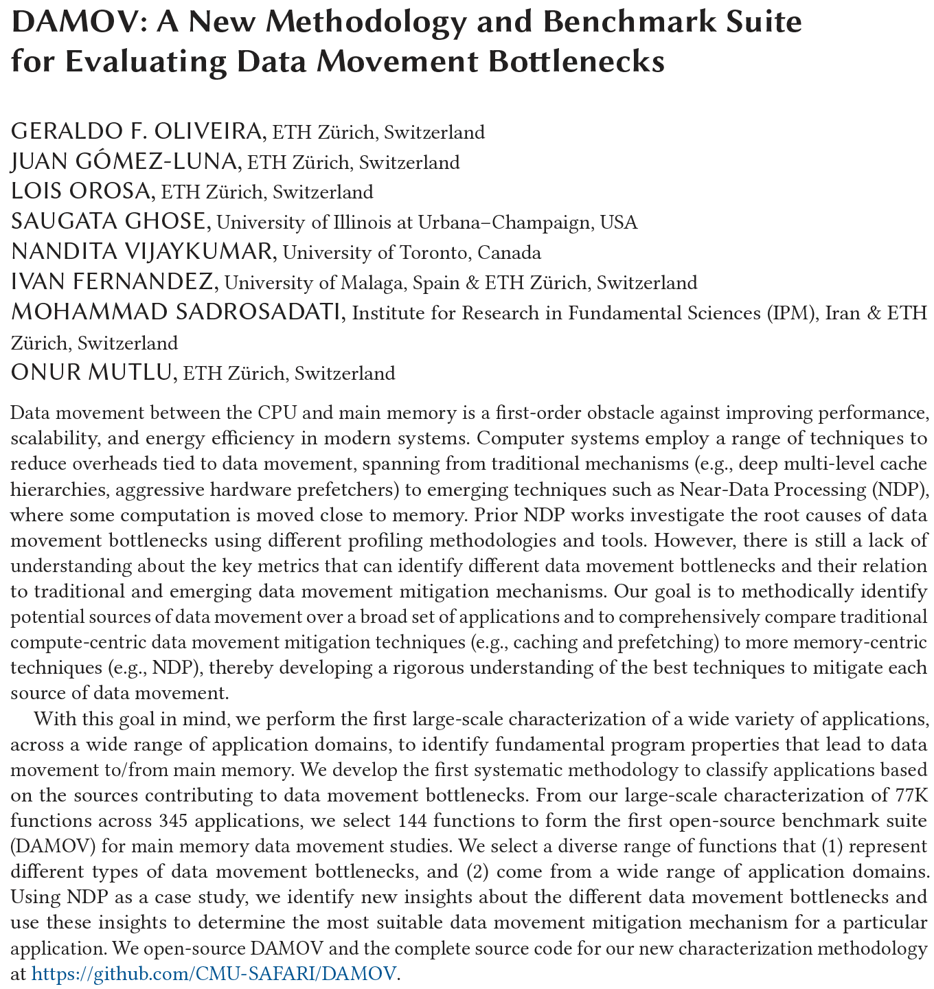
DAMOV Analysis Methodology & Workloads
https://arxiv.org/pdf/2105.03725.pdf

Slide 17
Methodology Overview
User Input
Step 1
Application Profiling
DAMOV-SIM Simulator
Target Application
roi_begin
ld 0xFF
st 0xAF
ld 0xFF
st 0xAF
ld 0xFF
Source Code
Memory Traces
# Cores
roi_end
Profiler
Scalability Analysis
DRAM Bandwidth
Methodology Output
Step 2
Locality-based Clustering
DRAM Latency
L1/L2 Cache Capacity
High
Temporal Locality
LFMR
L3 Cache Contention
High
Spatial Locality
Temp. Locality
L1 Cache Capacity
…
Step 3
Memory Bottleneck Class.
Memory Bottleneck Classes
LFMR
Compute-Bound
Low
Arithmetic Intensity
Low
LLC MPKI
Last-to-First
Miss Ratio (LFMR)
264
Notes:
Our methodology has three steps.
[CLICK] It takes as input an application’s source code and its input datasets.
[CLICK] In Step 1, we use a hardware profiling tool to identify memory-bound functions across many applications. This step allows for a quick first-level identification of many applications that suffer from memory bottlenecks and functions that cause these bottlenecks.
[CLICK] We utilize a new simulator, called DAMOV-SIM to collect key metrics and execute performance analysis of the functions identified in Step 1.
[CLICK] In Step 2, we use the architecture-independent profiling tool to collect metrics that provide insights about the memory access behavior of the memory-bottlenecked functions.
[CLICK] In Step 3, we collect architecture-dependent metrics and analyze the performance and energy of each function in an application when each of our three candidate data movement mitigation mechanisms is applied to the system.
[CLICK] By combining the data obtained from all three steps, we can systematically classify the leading causes of data movement bottlenecks in an application or function into different bottleneck classes
[NEXT]

Slide 18
Methodology Overview
User Input
Step 1
Application Profiling
DAMOV-SIM Simulator
Target Application
roi_begin
ld 0xFF
st 0xAF
ld 0xFF
st 0xAF
ld 0xFF
Source Code
Memory Traces
# Cores
roi_end
Profiler
Scalability Analysis
DRAM Bandwidth
Methodology Output
Step 2
Locality-based Clustering
DRAM Latency
L1/L2 Cache Capacity
High
Temporal Locality
LFMR
L3 Cache Contention
High
Spatial Locality
Temp. Locality
L1 Cache Capacity
…
Step 3
Memory Bottleneck Class.
Memory Bottleneck Classes
LFMR
Compute-Bound
Low
Arithmetic Intensity
Low
LLC MPKI
Last-to-First
Miss Ratio (LFMR)
265
Notes:
So let’s check the first step
[NEXT]

Slide 19
Step 1: Application Profiling
Goal: Identify application functions that suffer from data movement bottlenecks
Signal processing
Machine learning
Data mining
Hardware Profiling Tool:
Intel VTune
Data analytics
Genomics
Deep Neural Networks
Security
Linear algebra
Image processing
Data reorganization
Graph processing
Physics
Database
MemoryBound:
CPU is stalled due to load/store
266
Notes:
[CLICK] The goal of the first step is to identify functions in an application that suffers from memory bottlenecks
[CLICK] To profile the applications and identify functions that suffer from data movement bottlenecks
[CLICK] we use a hardware profiling tool. In this work, we decided to use Intel Vtune
[CLICK] Intel Vtune provides a metric called Memory bound, which is defined as the percentage of CPU pipeline slots that are not utilized because of memory stalls.
[NEXT]

Slide 20
Methodology Overview
User Input
Step 1
Application Profiling
DAMOV-SIM Simulator
Target Application
roi_begin
ld 0xFF
st 0xAF
ld 0xFF
st 0xAF
ld 0xFF
Source Code
Memory Traces
# Cores
roi_end
Profiler
Scalability Analysis
DRAM Bandwidth
Methodology Output
Step 2
Locality-based Clustering
DRAM Latency
L1/L2 Cache Capacity
High
Temporal Locality
LFMR
L3 Cache Contention
High
Spatial Locality
Temp. Locality
L1 Cache Capacity
…
Step 3
Memory Bottleneck Class.
Memory Bottleneck Classes
LFMR
Compute-Bound
Low
Arithmetic Intensity
Low
LLC MPKI
Last-to-First
Miss Ratio (LFMR)
267
Notes:
Let's give a look to the second step.
[NEXT]

Slide 21
Step 2: Locality-Based Clustering
Goal: analyze application’s memory characteristics
Spatial Locality⁷
Stride Profile Histogram
Stride Profile Histogram
Memory Trace
Frequency (count)
Frequency (count)
0
1
2
3
4
5
stride profile(1)+= 1
1
2
4
8
16
32
…
2^{N}
1
2
4
8
16
32
…
2^{N}
Stride Profile (bin)
Stride Profile (bin)
Low spatial locality
High spatial locality
[7] Weinberg+, “Quantifying Locality in the Memory Access Patterns of HPC Applications,” SC, 2005
268
Notes:
In Step 2, we aim to analyze application’s memory characteristics, as locality, thus we could understand how it affects the components of the memory system, as cache behavior or prefetching. To this end, we evaluate two key metrics.
[CLICK] We first evaluate spatial locality from an application.
[CLICK] For this, we collect the memory trace of an application
[CLICK] To build a histogram called the stride profile, where each bin stores how many times each stride appear in the memory trace.
[CLICK] In this example, the stride between the first accessed address and the next accessed address is equal to 1. We increment a stride profile histogram in bin 1 to indicate such stride has been observed.
[CLICK] We use the stride profile histogram to calculate the cumulative distribution of stride profiles, which represents the final spatial locality value.
[CLICK] A spatial locality value close to 0 is caused by large stride values or random accesses, as shown in this example. In such case, we say the application has low spatial locality
[CLICK] A spatial locality value close to 1 is caused by a completely sequential access pattern. . In such case, we say the application has high spatial locality
[NEXT]

Slide 22
Step 2: Locality-Based Clustering
Goal: analyze application’s memory characteristics
Spatial Locality⁷
Stride Profile Histogram
Stride Profile Histogram
Memory Trace
Frequency (count)
Frequency (count)
0
1
2
3
4
5
stride profile(1)+= 1
1
2
4
8
16
32
…
2^{N}
1
2
4
8
16
32
…
2^{N}
Stride Profile (bin)
Stride Profile (bin)
Low spatial locality
High spatial locality
Temporal Locality⁷
Reuse Profile Histogram
Reuse Profile Histogram
Memory Trace
Frequency (count)
Frequency (count)
A
A
A
A
reuse profile(4)+= 1
1
2
4
8
16
32
…
2^{N}
1
2
4
8
16
32
…
2^{N}
Reuse Profile (bin)
Reuse Profile (bin)
Low temporal locality
High temporal locality
[7] Weinberg+, “Quantifying Locality in the Memory Access Patterns of HPC Applications,” SC, 2005
269
Notes:
[CLICK] Similarly, we evaluate how much temporal locality an application has.
[CLICK] For this, we collect the memory trace of an application
[CLICK] to create a histogram called reuse profile, where each bin represents the number of times a memory address is reused. For each memory address, we increment the bin that represents the corresponding number of repetitions.
[CLICK] In this example, memory address A is reused 4 times. Thus, we increment the reuse profile histogram in bin 4 to indicate such reuse has been observed.
[CLICK] We use the reuse profile histogram to calculate the cumulative distribution of rese profiles, which represents the final temporal locality value.
[CLICK] A temporal locality value close to 0 is caused by low data reuse. In such case, we say the application has low temporal locality
[CLICK] A temporal locality value close to 1 is caused by high data reuse/ In such case, we say the application has high temporal locality
[NEXT]

Slide 23
Methodology Overview
User Input
Step 1
Application Profiling
DAMOV-SIM Simulator
Target Application
roi_begin
ld 0xFF
st 0xAF
ld 0xFF
st 0xAF
ld 0xFF
Source Code
Memory Traces
# Cores
roi_end
Profiler
Scalability Analysis
DRAM Bandwidth
Methodology Output
Step 2
Locality-based Clustering
DRAM Latency
L1/L2 Cache Capacity
High
Temporal Locality
LFMR
L3 Cache Contention
High
Spatial Locality
Temp. Locality
L1 Cache Capacity
…
Step 3
Memory Bottleneck Class.
Memory Bottleneck Classes
LFMR
Compute-Bound
Low
Arithmetic Intensity
Low
LLC MPKI
Last-to-First
Miss Ratio (LFMR)
270
Notes:
Finally, let's look deeper into Step 3 of our methodology
[NEXT]

Slide 24
Step 3: Memory Bottleneck Classification (1/2)
Arithmetic Intensity (AI)
- floating-point/arithmetic operations per L1 cache lines accessed
→ shows computational intensity per memory request
LLC Misses-per-Kilo-Instructions (MPKI)
- LLC misses per one thousand instructions
→ shows memory intensity
Last-to-First Miss Ratio (LFMR)
- LLC misses per L1 misses
→ shows if an application benefits from L2/L3 caches
271
Notes:
While Step 2 allows us to understand inherent application sources for memory boundedness, it is important to understand how hardware architectural features can also result in memory bottlenecks. As a result, in our third step we perform a scalability analysis of the functions selected in Step 1, where we evaluate performance and energy scaling for three different system configurations. The scalability analysis makes use of three architecture-dependent metrics:
[CLICK] First, Arithmetic Intensity (AI), defined as the number of arithmetic and logic operations performed per L1 cache line accessed.
[CLICK] This metric indicates how much computation there is per memory request. Intuitively, applications with high AI are likely to be computationally intensive, while applications with low AI tend to be memory intensive
[CLICK] Second, Misses per Kilo-Instruction (MPKI), defined as the number of LLC misses per one thousand instructions.
[CLICK] This metric is considered to be a good indicator of NDP suitability by several prior works since it indicates memory intensity of an application.
[CLICK] and third, a new metric called Last-to-First Miss-Ratio (LFMR) define as the ratio between the number of LLC misses and the total number of L1 cache misses.
[CLICK] We find that this metric accurately identifies how much an application benefits from the deep cache hierarchy. An LFMR value close to 0 means that the number of LLC misses is very small compared to the number of L1 misses. However, an LFMR value close to 1 means that very few L1 misses hit in L2 or L3 caches, and the application does not benefit much from the deep cache hierarchy, and most L1 misses need to be serviced by main memory
[NEXT]
[NEXT]

Slide 25
Step 3: Memory Bottleneck Classification (2/2)
Goal: identify the specific sources of data movement bottlenecks
Configuration 1: Host CPU System
DRAM
DRAM
DRAM
L3
DRAM
DAMOV-SIM Simulator
L1
L2
CPU
L1
L2
CPU
L1
L2
Off-chip link
CPU
L1
L2
CPU
Configuration 2: NDP System
DRAM
DRAM
DRAM
# Cores
DRAM
CPU
L1
…
Off-chip link
CPU
L1
Scalability Analysis
CPU
L1
CPU
L1
Integrated ZSim and Ramulator
Logic Layer
Scalability Analysis:
1, 4, 16, 64, and 256 out-of-order/in-order host and NDP CPU cores
3D-stacked memory as main memory
DAMOV-SIM: https://github.com/CMU-SAFARI/DAMOV
272
Notes:
[CLICK] The goal of the scalability analysis we perform is to nail down the specific sources of data movement bottlenecks in the application.
In this analysis, we evaluate the performance and energy scaling of an application in three different system configurations; and collect the key metrics for our bottleneck classification
[CLICK] During scalability analysis, we simulate three system configurations of a general-purpose multicore processor. To this end, we build a framework that integrates the ZSim CPU simulator with the Ramulator memory simulator to produce a fast, scalable, and cycle-accurate open-source simulator called DAMOV-SIM. We use ZSim to simulate the core microarchitecture, cache hierarchy, coherence protocol, and prefetchers. We use Ramulator to simulate the DRAM architecture, memory controllers, and memory accesses.
[CLICK] The first configuration we evaluate is of a host CPU with a deep cache hierarchy, with a 32 KB, private L1 cache, a 256 KB private L2 cache, and a shared 8MB L3 cache.
[CLICK] The second configuration is of an NDP CPU with only a private read-only L1 cache of 32 KB.
In our paper we evaluate an third configuration that includes hardware prefetcher on top of configuration 1. However, we omit such configuration in this talk.
The remaining components of the processor configuration are kept the same to isolate the impact of only the caches, prefetchers, and NDP.
This way, we expect that the performance and energy differences between the three configurations to come exclusively from the different data movement requirements.
[CLICK] For all configurations, we sweep the number of CPU cores in our analysis from 1 to 256, as previous works show that large core counts are necessary to saturate the bandwidth provided by modern high-bandwidth memories, and because modern CPUs and NDP proposals can have varying core counts.
[CLICK] We simulate a memory architecture similar to the Hybrid Memory Cube device where the host CPU accesses memory through a high-speed off-chip link,
[CLICK] and the NDP logic resides in the logic layer of the memory chip and has direct access to the DRAM banks, thus taking advantage of higher memory bandwidth and lower memory latency.
[NEXT]

Slide 26
Step 3: Memory Bottleneck Analysis
Memory Bottleneck Class
High
Low
1a: DRAM Bandwidth
High
AI
MPKI
Low
1b: DRAM Latency
AI
Low
Low
Six classes of
data movement bottlenecks:
each class ↔ data movement
mitigation mechanism
LFMR
Low
Low
1c: L1/L2
Cache Capacity
Decreasing
MPKI
AI
Temporal Locality
Increasing
Low
Low
2a: L3 Cache Contention
MPKI
AI
LFMR
Low
2b: L1 Cache Capacity
High
MPKI
AI
Low
Low
2c: Compute-Bound
High
Notes:
[CLICK] With such classification, we analyze how the functions in each class correlates with different data movement mitigation mechanisms in terms of performance and energy using our scalability analysis.
[NEXT]

Slide 27
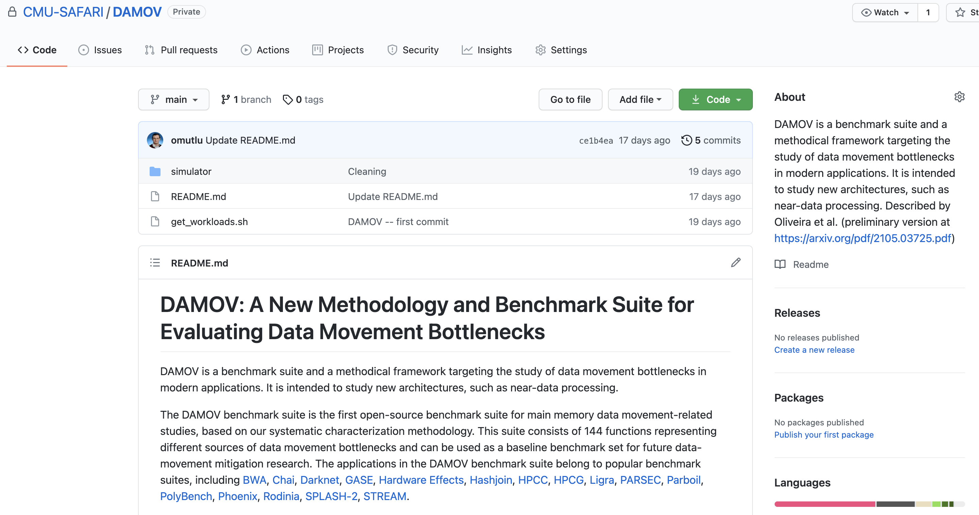
DAMOV is Open Source
We open-source our benchmark suite and our toolchain
DAMOV-SIM
DAMOV
Benchmarks
Notes:
We open source DAMOV to facilitate further research in mitigating data movement bottlenecks, including in near data processing.
[CLICK] In our DAMOV repository, we provide
[CLICK] The complete set of 144 application functions that compose our benchmark suite
[CLICK] And our DAMOV-SIM simulator
[NEXT]

Slide 28
DAMOV is Open Source
We open-source our benchmark suite and our toolchain
Get DAMOV at:
https://github.com/CMU-SAFARI/DAMOV
DAMOV-SIM
DAMOV
Benchmarks
Notes:
We open source DAMOV to facilitate further research in mitigating data movement bottlenecks, including in near data processing.
[CLICK] In our DAMOV repository, we provide
[CLICK] The complete set of 144 application functions that compose our benchmark suite
[CLICK] And our DAMOV-SIM simulator
[NEXT]

Slide 29
More on DAMOV Analysis Methodology & Workloads
https://www.youtube.com/watch?v=GWideVyo0nM&list=PL5Q2soXY2Zi_tOTAYm--dYByNPL7JhwR9&index=3

Slide 30
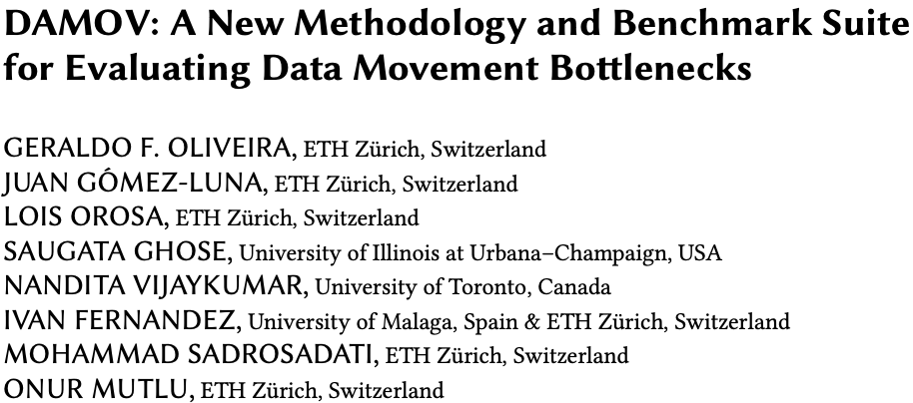
More on DAMOV Methods & Benchmarks
Geraldo F. Oliveira, Juan Gomez-Luna, Lois Orosa, Saugata Ghose, Nandita Vijaykumar, Ivan fernandez, Mohammad Sadrosadati, and Onur Mutlu, "DAMOV: A New Methodology and Benchmark Suite for Evaluating Data Movement Bottlenecks" IEEE Access, 8 September 2021. Preprint in arXiv, 8 May 2021. [arXiv preprint] [IEEE Access version] [DAMOV Suite and Simulator Source Code] [SAFARI Live Seminar Video (2 hrs 40 mins)] [Short Talk Video (21 minutes)]

Slide 31
Challenge and Opportunity for Future
Fundamentally
Energy-Efficient
(Data-Centric)
Computing Architectures

Slide 32
Challenge and Opportunity for Future
Fundamentally
High-Performance
(Data-Centric)
Computing Architectures

Slide 33
Challenge and Opportunity for Future
Computing Architectures
with
Minimal Data Movement

Slide 34
Concluding Remarks
We must design systems to be balanced, high-performance, energy-efficient (all at the same time) → intelligent systems
Data-centric, data-driven, data-aware
Enable computation capability inside and close to memory
This can
Lead to orders-of-magnitude improvements
Enable new applications & computing platforms
Enable better understanding of nature
…
Future of truly memory-centric computing is bright
We need to do research & design across the computing stack
Notes:
Perhaps we have taken processor-centric system design a bit too far

Slide 35
Fundamentally Better Architectures
Data-centric
Data-driven
Data-aware

Slide 36
We Need to Revisit the Entire Stack
Problem
Algorithm
Program/Language
System Software
SW/HW Interface
Micro-architecture
Logic
Devices
Electrons
We can get there step by step

Slide 37
We Need to Exploit Good Principles
Data-centric system design
All components intelligent
Better (cross-layer) communication, better interfaces
Better-than-worst-case design
Heterogeneity
Flexibility, adaptability
Open minds

Slide 38
PIM Review and Open Problems
Onur Mutlu, Saugata Ghose, Juan Gomez-Luna, and Rachata Ausavarungnirun, "A Modern Primer on Processing in Memory" Invited Book Chapter in Emerging Computing: From Devices to Systems - Looking Beyond Moore and Von Neumann, Springer, to be published in 2021.
https://arxiv.org/pdf/1903.03988.pdf

Slide 39
Special Research Sessions & Courses (I)
Special Session at ISVLSI 2022: 9 cutting-edge talks
https://www.youtube.com/watch?v=qeukNs5XI3g

Slide 40
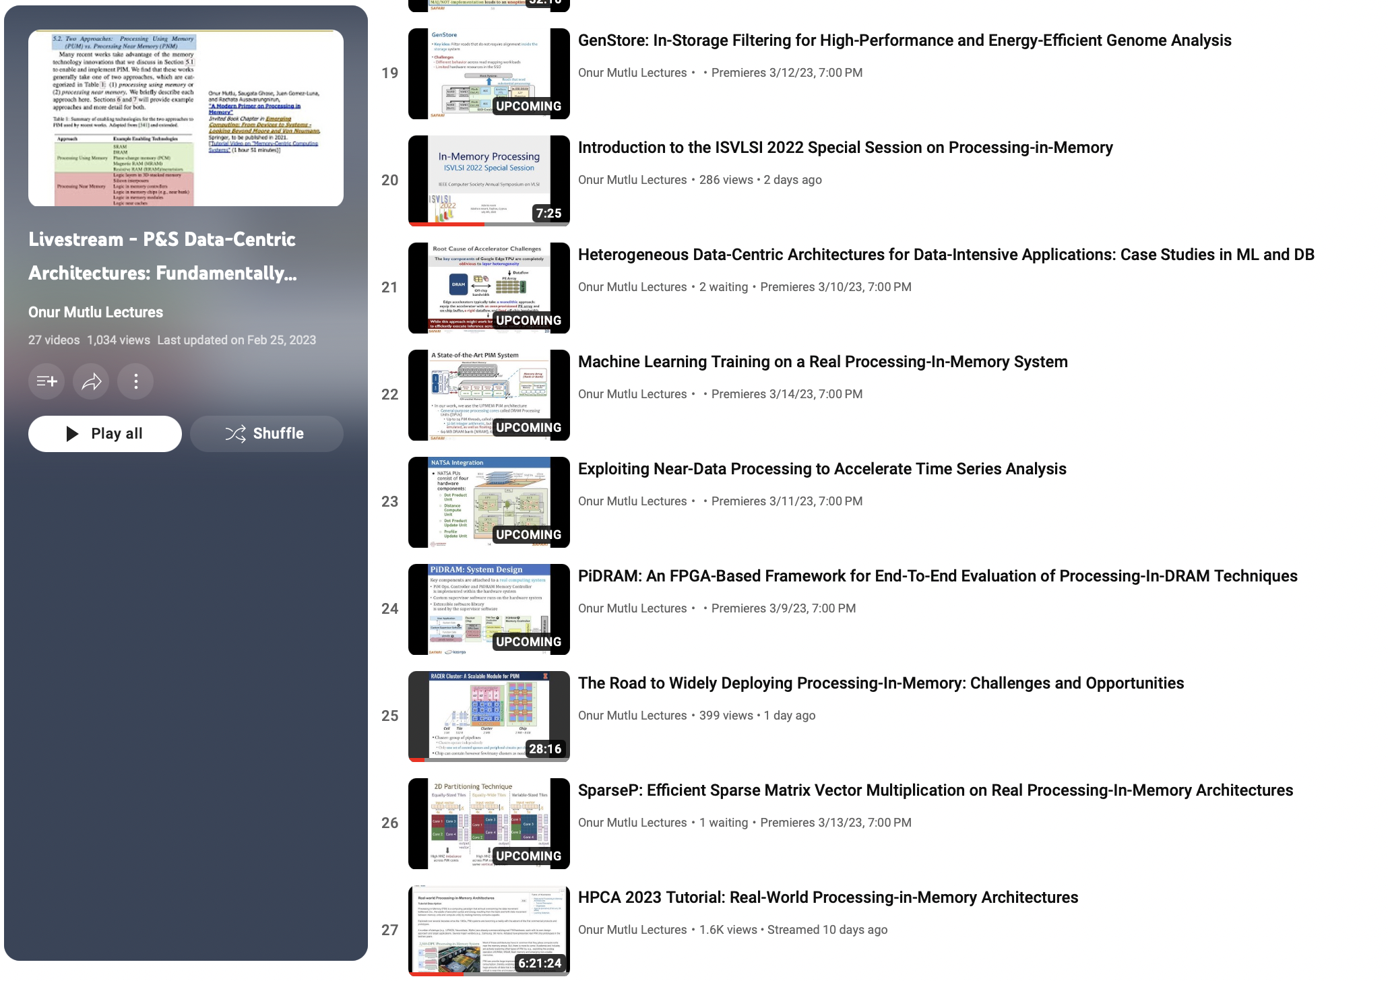
Special Research Sessions & Courses (II)
Special Session at ISVLSI 2022: 9 cutting-edge talks
https://www.youtube.com/playlist?list=PL5Q2soXY2Zi8KzG2CQYRNQOVD0GOBrnKy

Slide 41
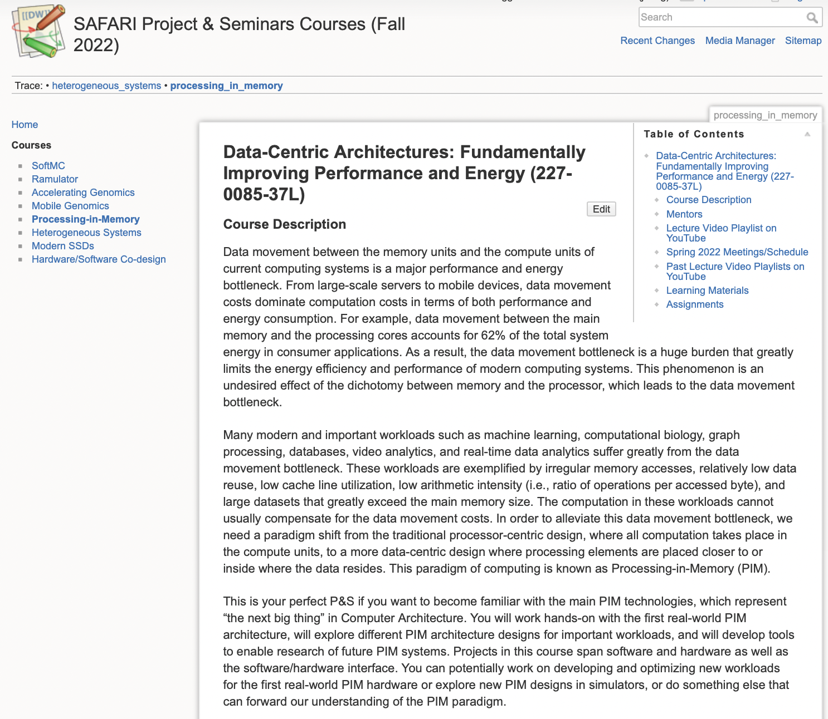
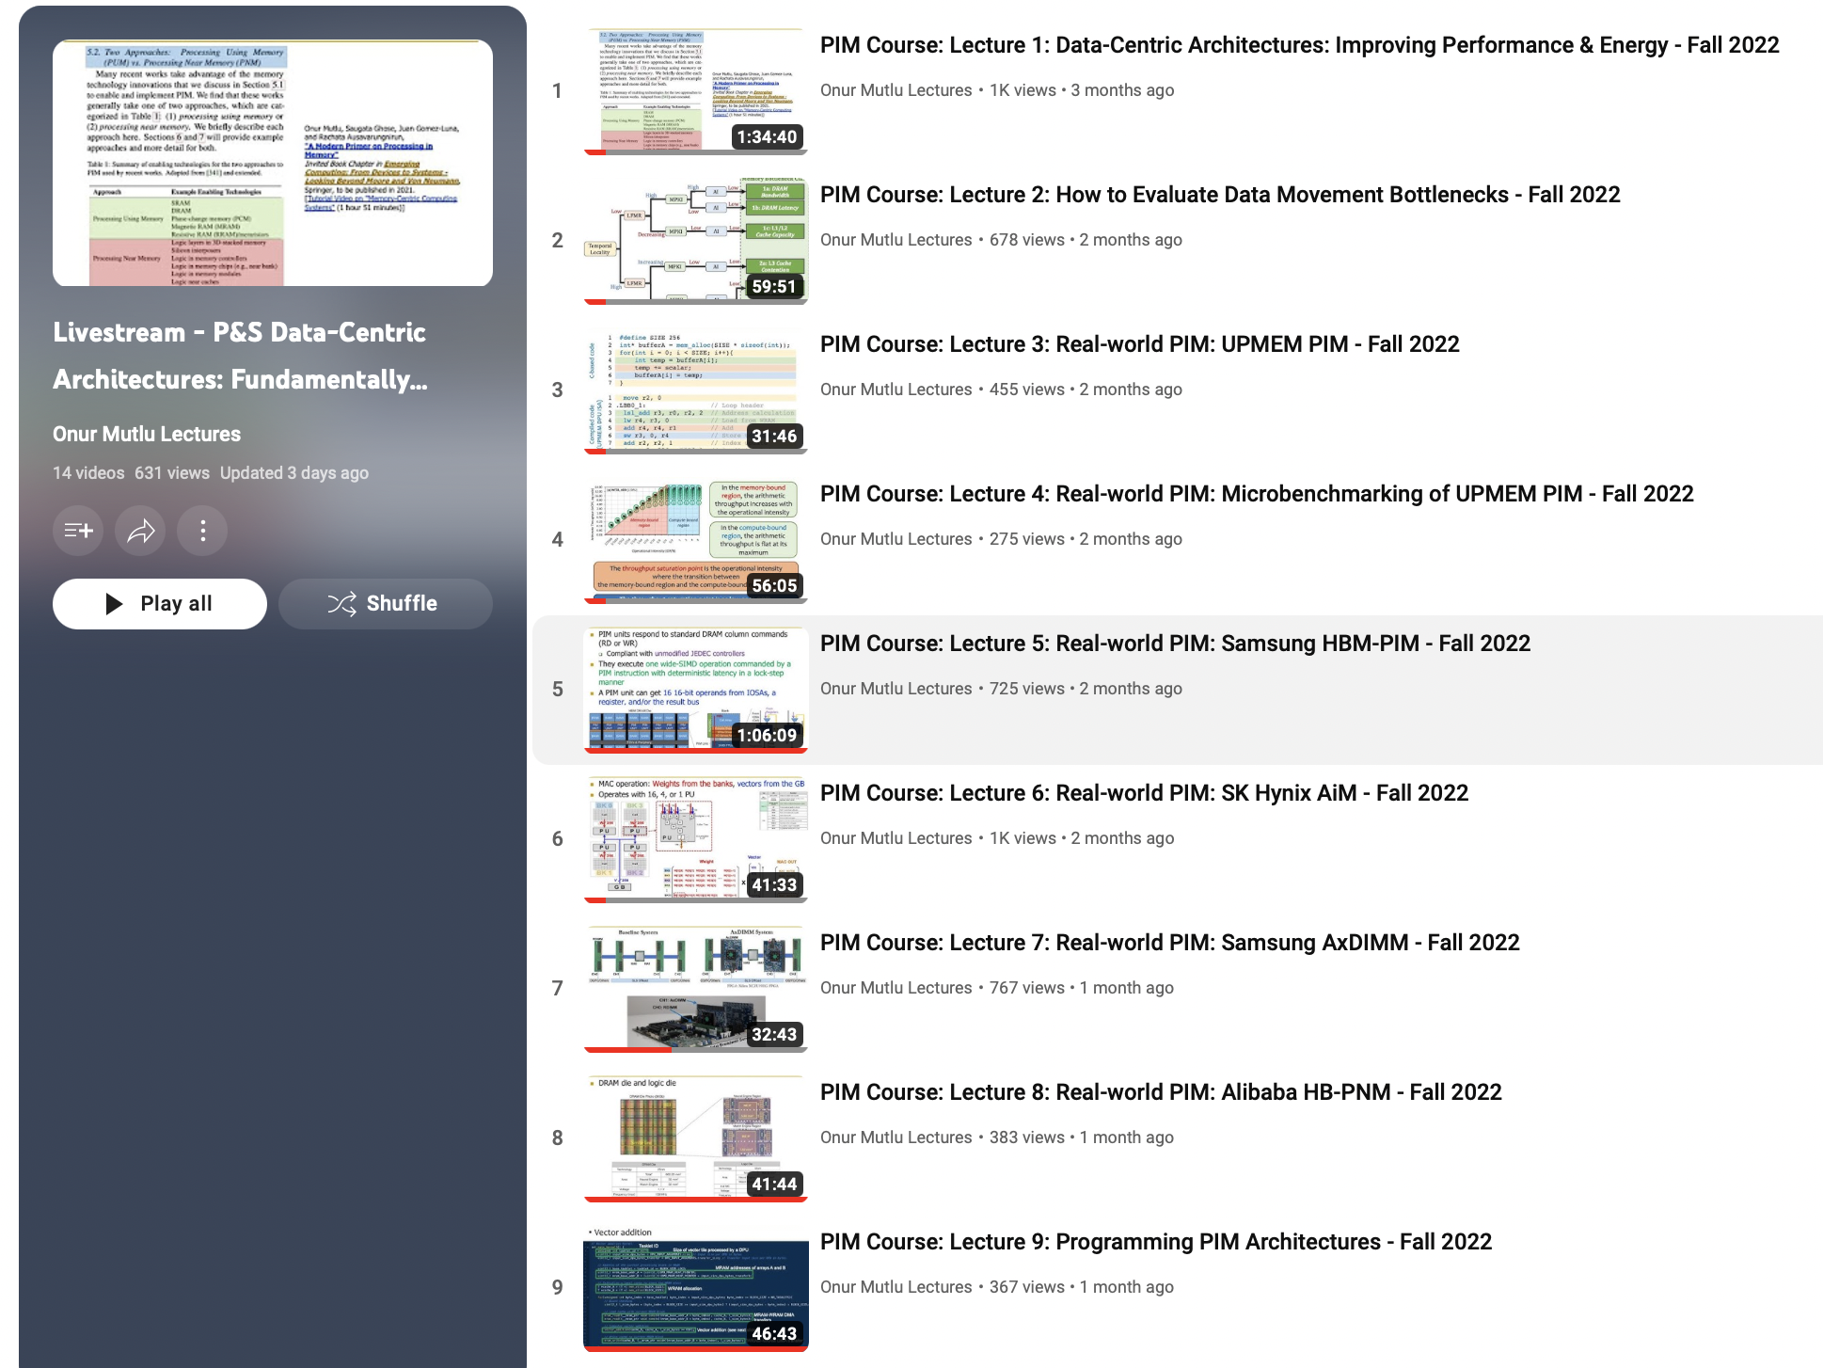
Processing-in-Memory Course (Fall 2022)
Short weekly lectures
Hands-on projects
https://safari.ethz.ch/projects_and_seminars/fall2022/doku.php?id=processing_in_memory
https://youtube.com/playlist?list=PL5Q2soXY2Zi8KzG2CQYRNQOVD0GOBrnKy

Slide 42
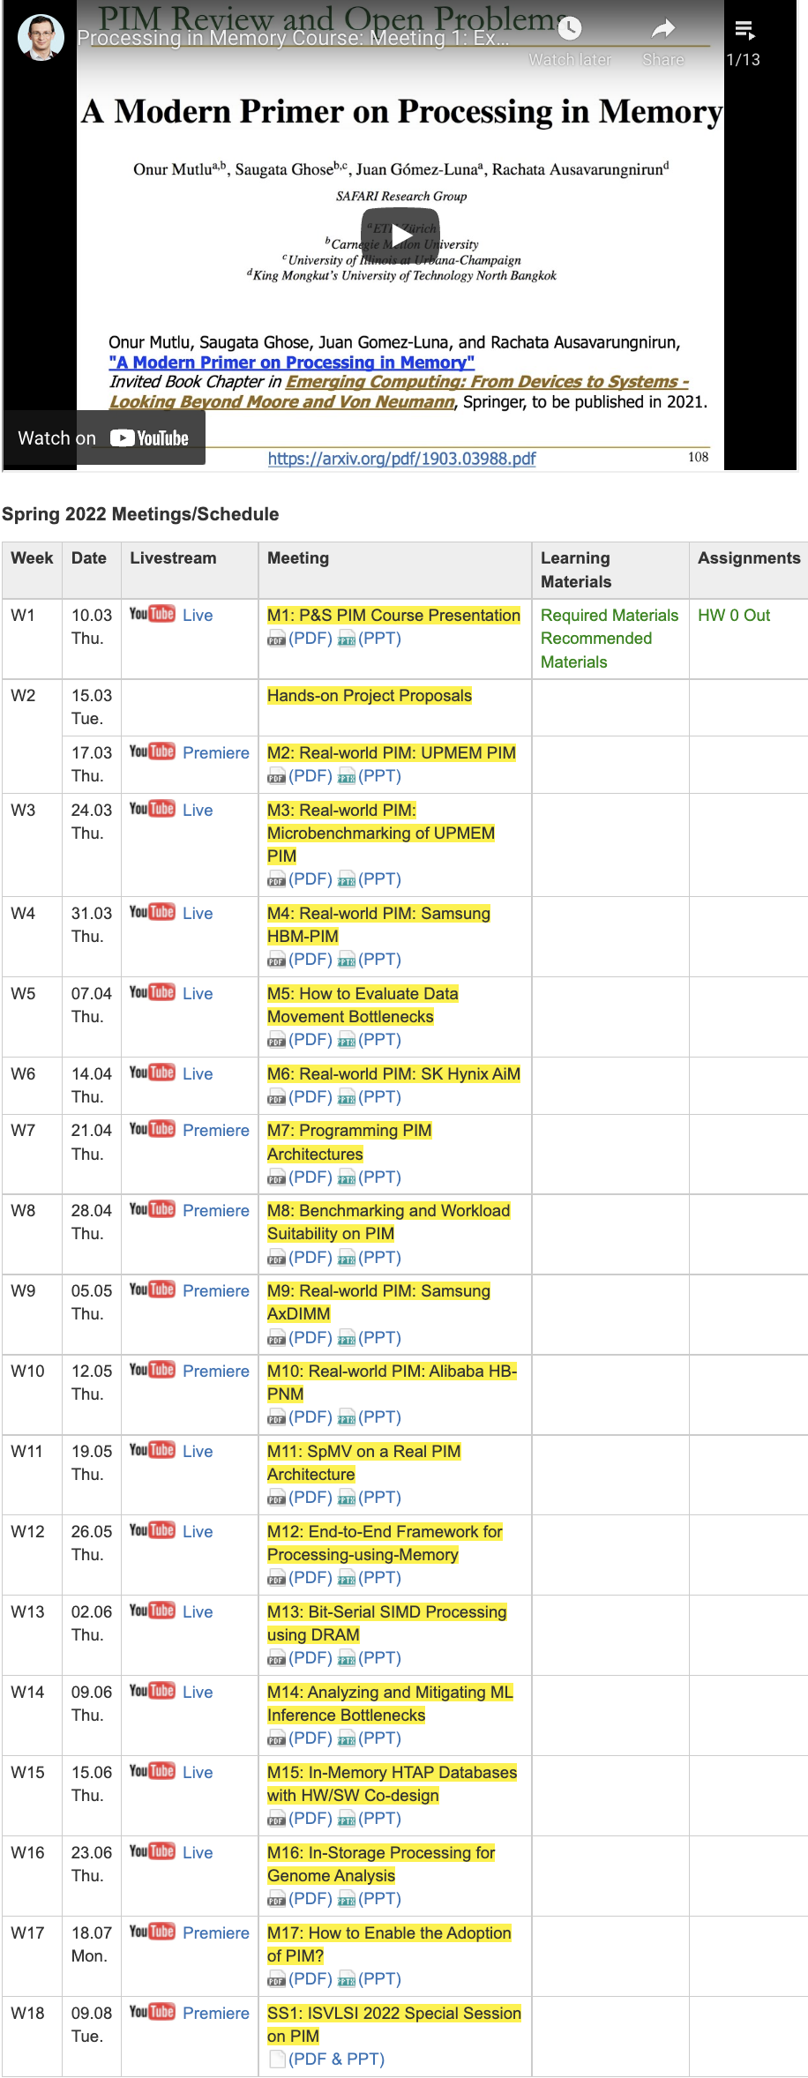
PIM Course (Fall 2022)
Fall 2022 Edition:
https://safari.ethz.ch/projects_and_seminars/fall2022/doku.php?id=processing_in_memory
Spring 2022 Edition:
https://safari.ethz.ch/projects_and_seminars/spring2022/doku.php?id=processing_in_memory
Youtube Livestream (Fall 2022):
https://www.youtube.com/watch?v=QLL0wQ9I4Dw&list=PL5Q2soXY2Zi8KzG2CQYRNQOVD0GOBrnKy
Youtube Livestream (Spring 2022):
https://www.youtube.com/watch?v=9e4Chnwdovo&list=PL5Q2soXY2Zi-841fUYYUK9EsXKhQKRPyX
Project course
Taken by Bachelor’s/Master’s students
Processing-in-Memory lectures
Hands-on research exploration
Many research readings
https://www.youtube.com/onurmutlulectures

Slide 43
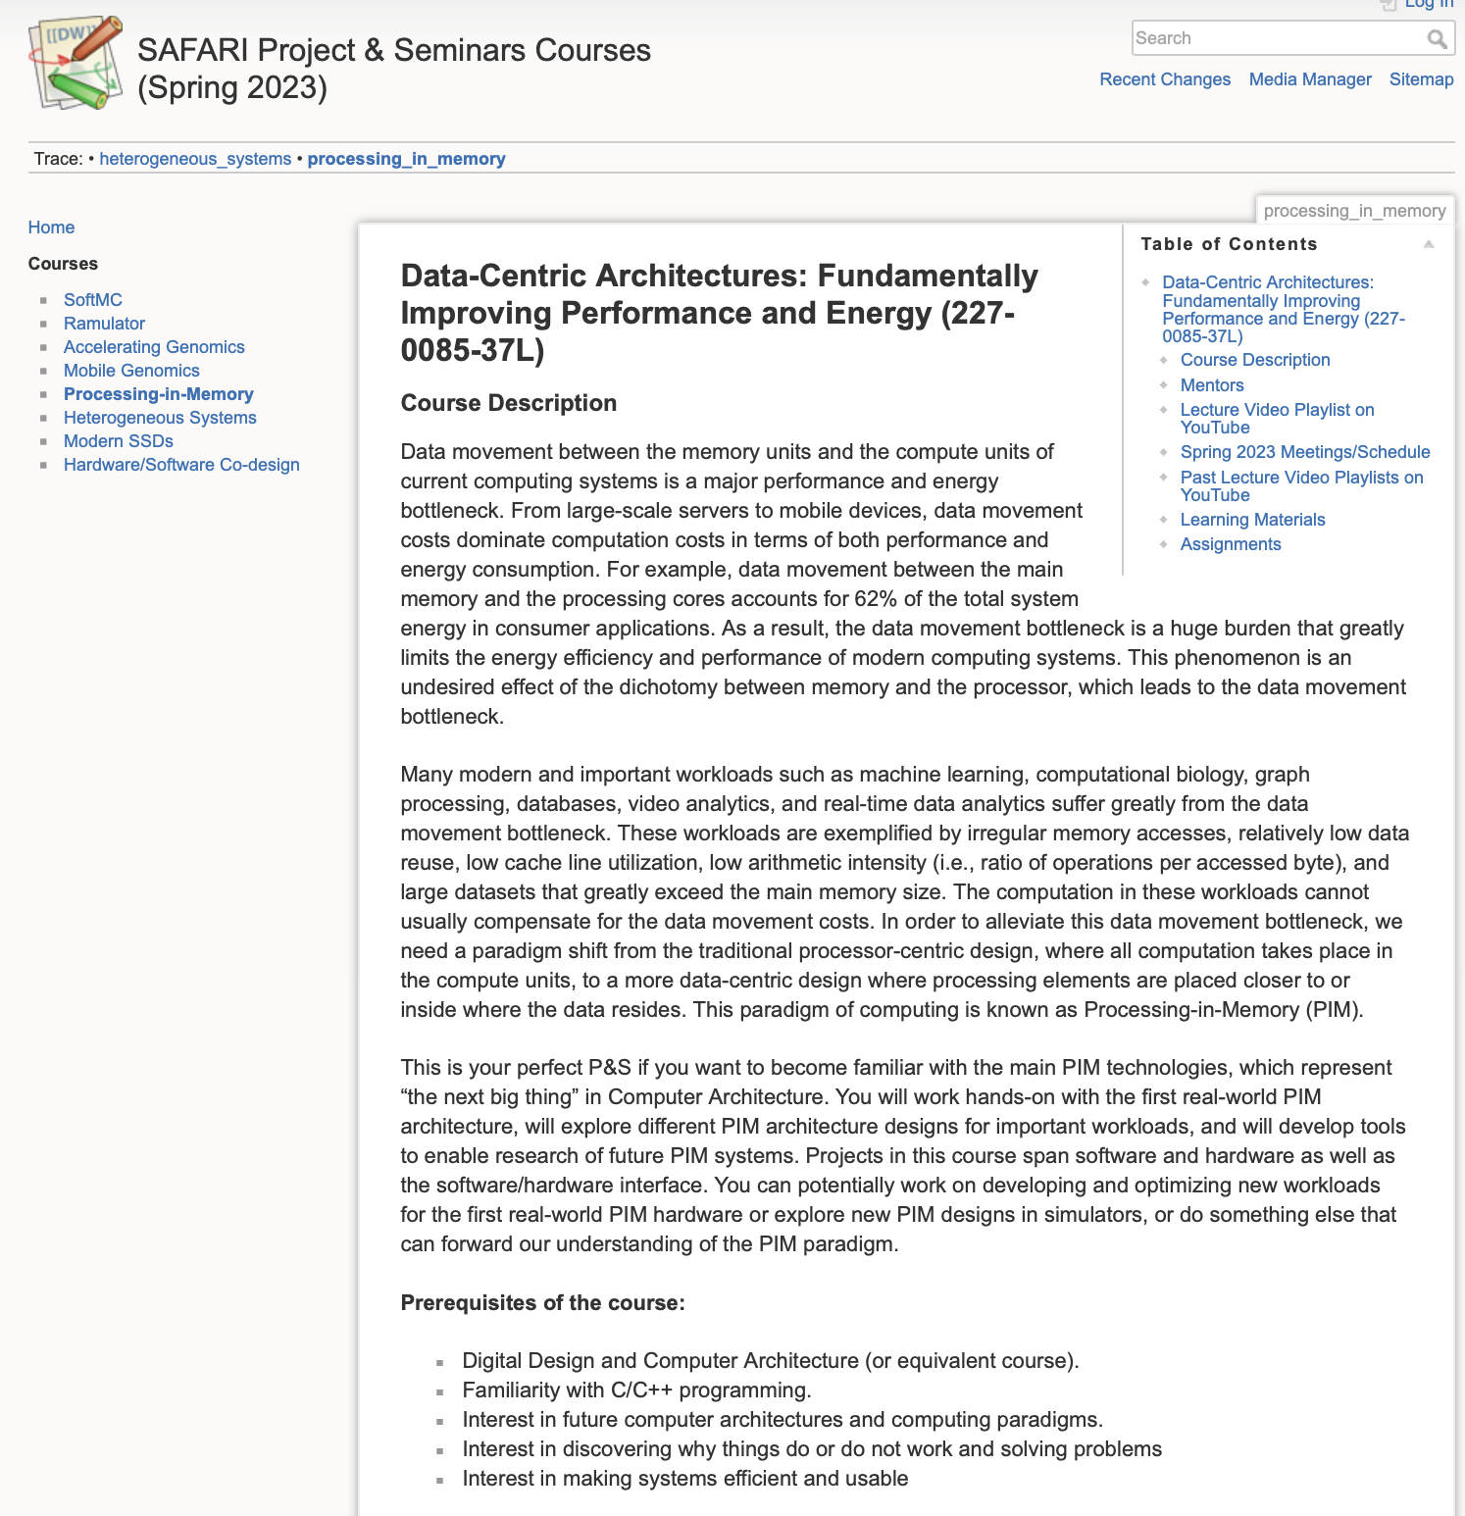
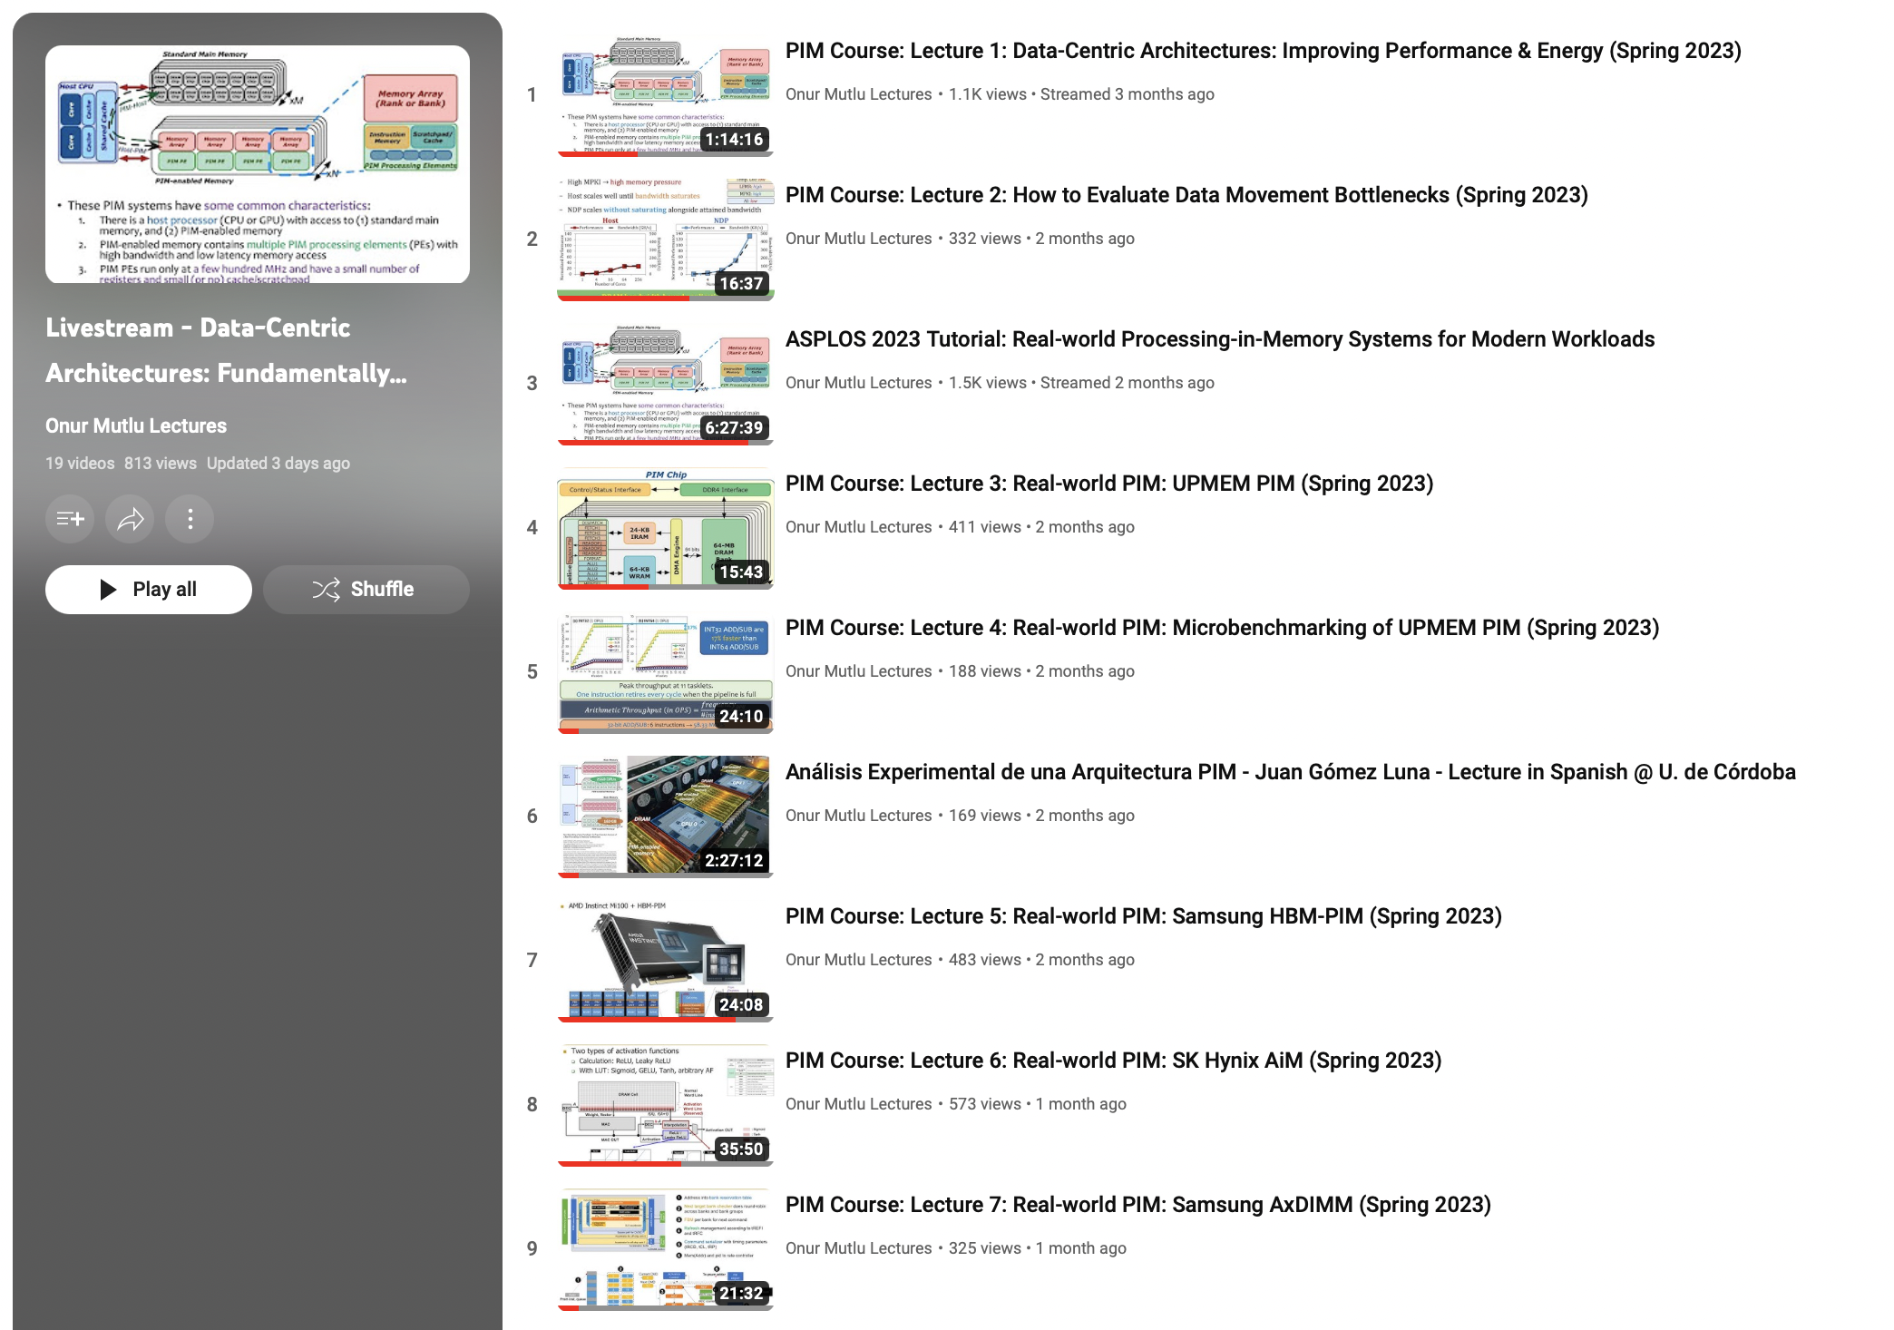
Processing-in-Memory Course (Spring 2023)
Short weekly lectures
Hands-on projects
https://www.youtube.com/playlist?list=PL5Q2soXY2Zi_EObuoAZVSq_o6UySWQHvZ
https://safari.ethz.ch/projects_and_seminars/spring2023/doku.php?id=processing_in_memory

Slide 44
Real PIM Tutorials [ISCA’23, ASPLOS’23, HPCA’23]
June, March, Feb : Lectures + Hands-on labs + Invited talks
https://events.safari.ethz.ch/isca-pim-tutorial/

Slide 45
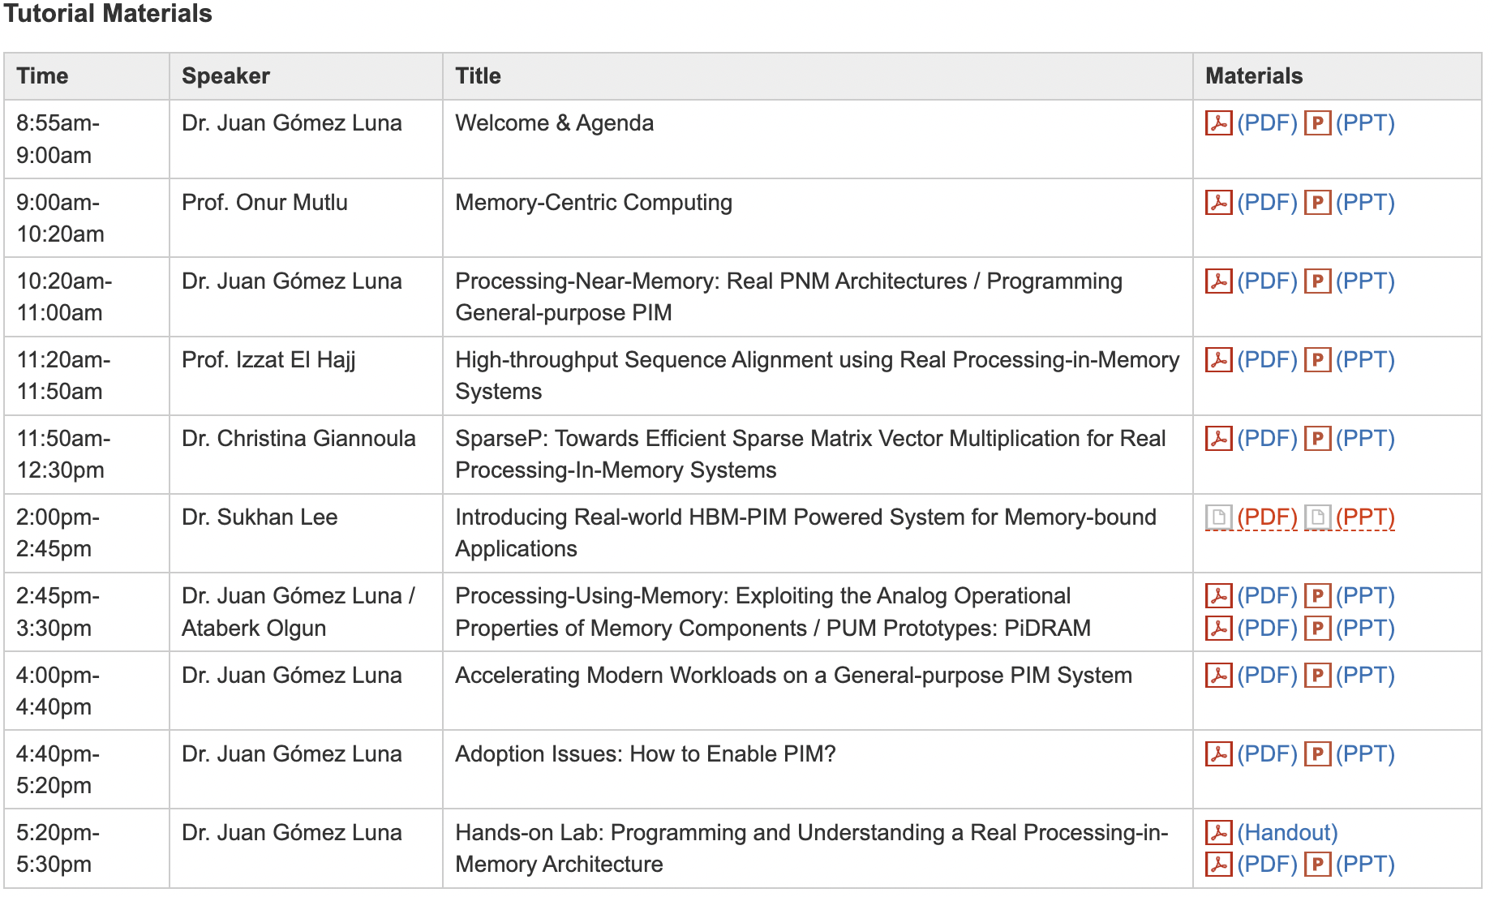
Real PIM Tutorial [ISCA 2023]
June 18: Lectures + Hands-on labs + Invited talks
https://www.youtube.com/live/GIb5EgSrWk0
https://events.safari.ethz.ch/isca-pim-tutorial/

Slide 46
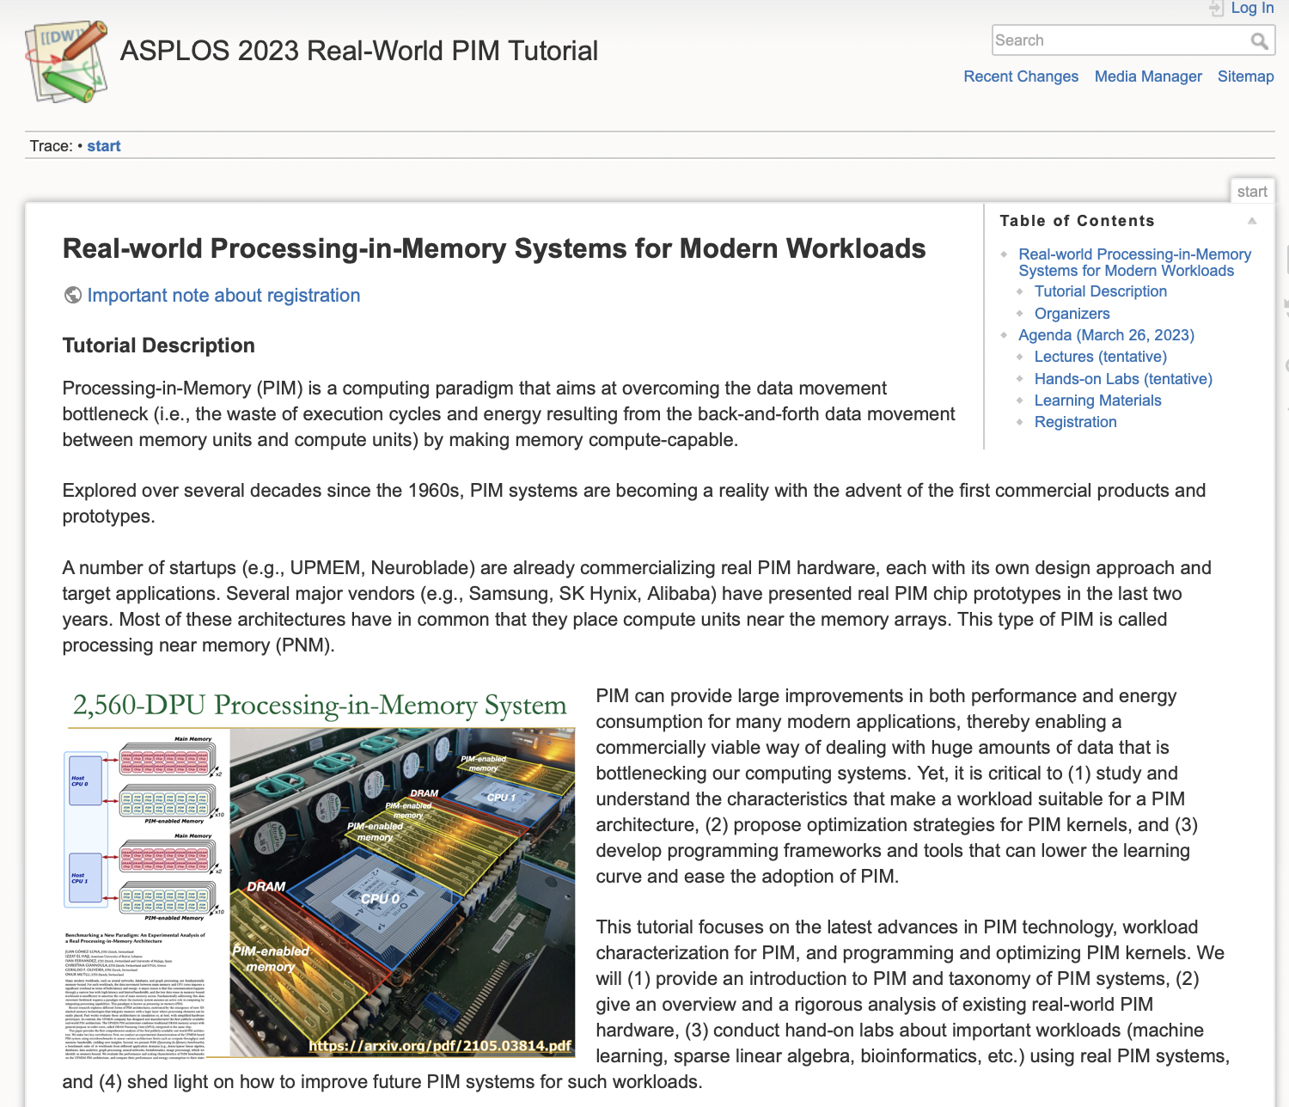
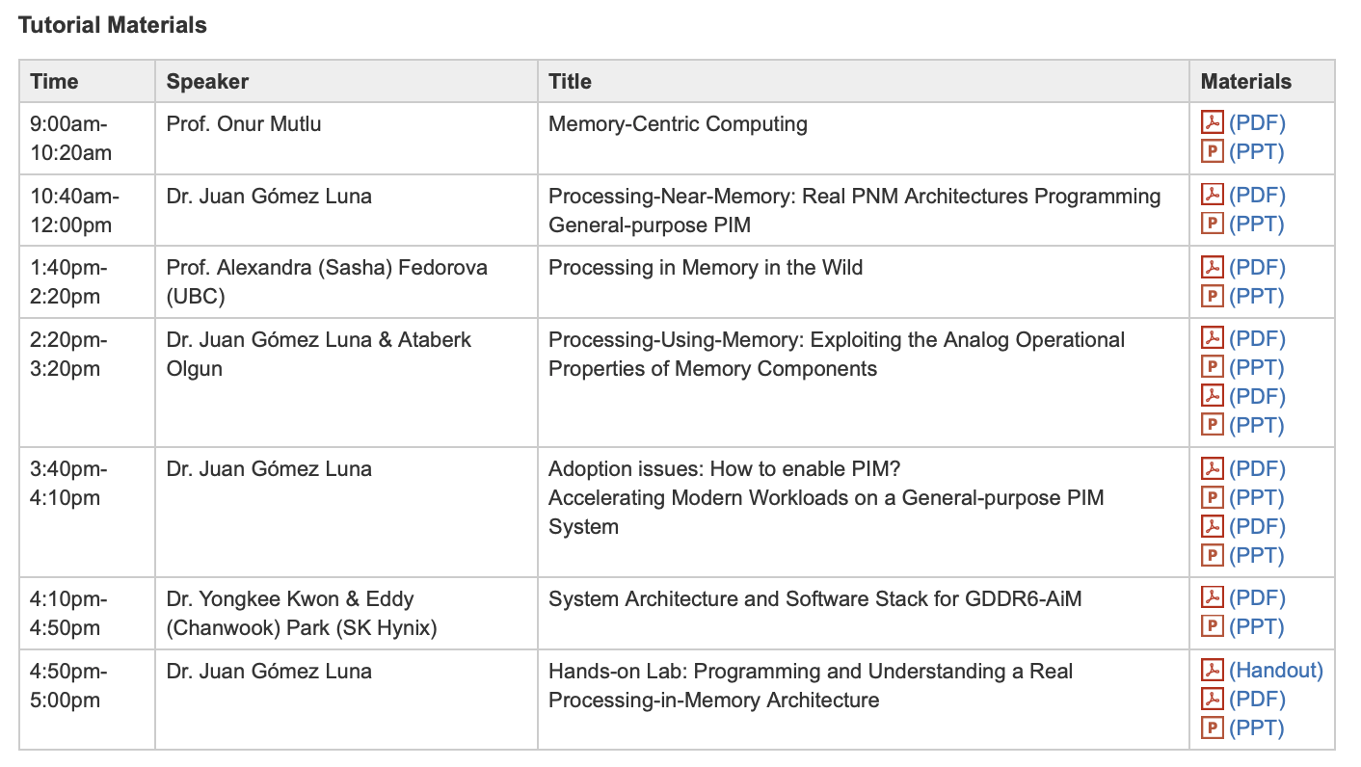
Real PIM Tutorial [ASPLOS 2023]
March 26: Lectures + Hands-on labs + Invited talks
https://www.youtube.com/watch?v=oYCaLcT0Kmo
https://events.safari.ethz.ch/asplos-pim-tutorial/

Slide 47
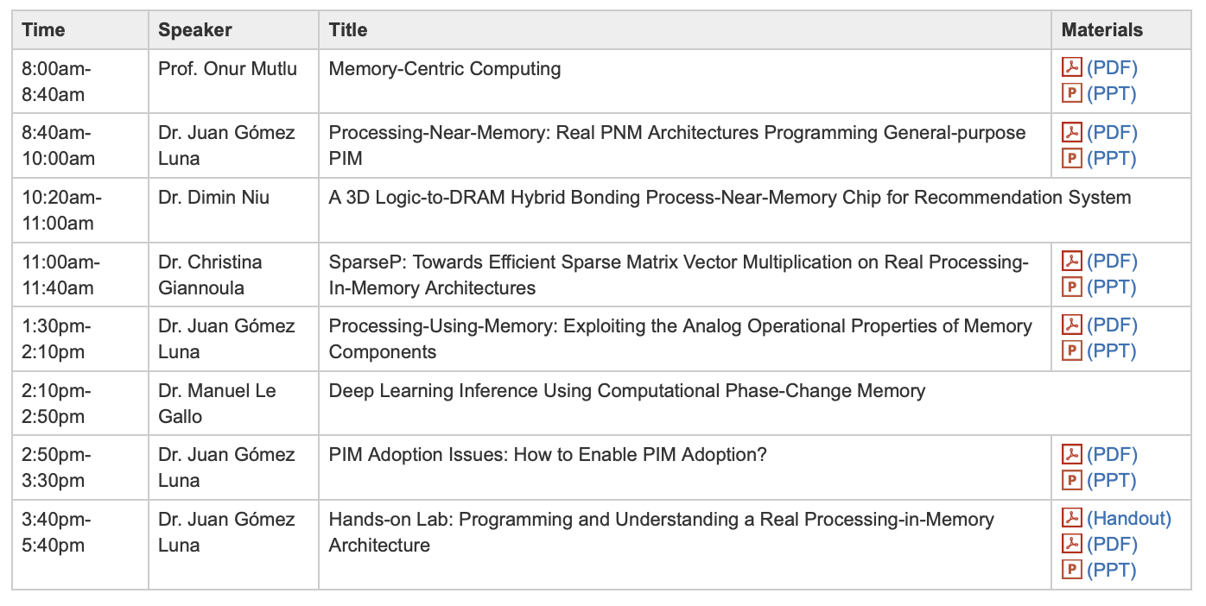
Real PIM Tutorial [HPCA 2023]
February 26: Lectures + Hands-on labs + Invited Talks
https://www.youtube.com/watch?v=f5-nT1tbz5w
https://events.safari.ethz.ch/real-pim-tutorial/

Slide 48
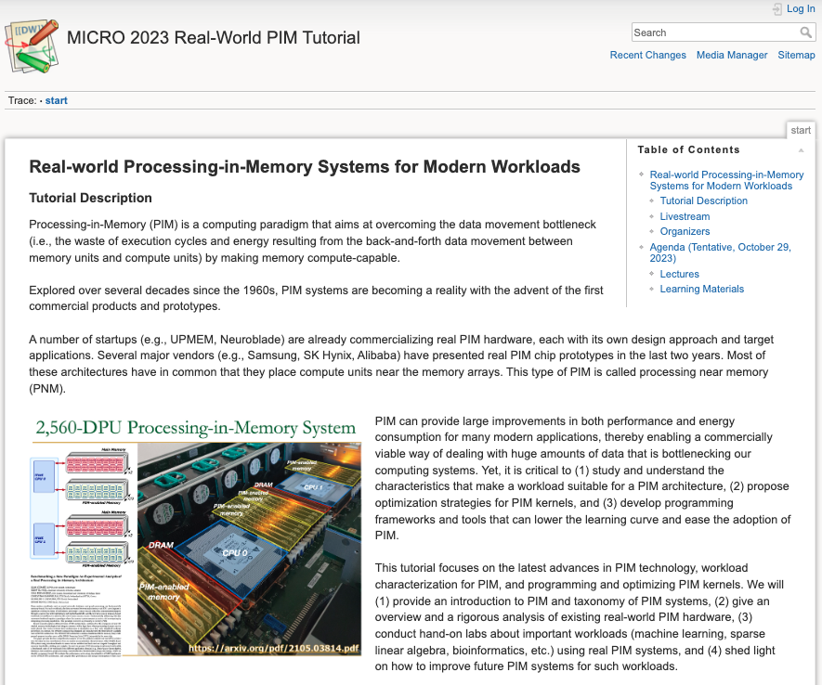
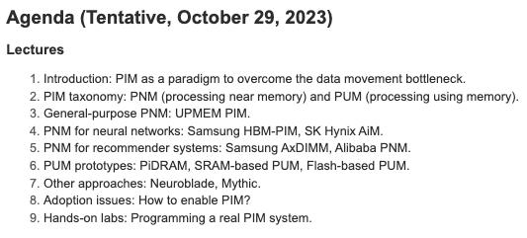
Real PIM Tutorial [MICRO 2023]
October 29: Lectures + Hands-on labs + Invited talks
https://www.youtube.com/ live/ohU00NSIxOI
https://events.safari.ethz.ch/micro-pim-tutorial

Slide 49
This PIM Tutorial at HEART 2024
https://events.safari.ethz.ch/heart24-memorycentric-tutorial

Slide 50
Upcoming PIM Tutorial at ISCA 2024
https://events.safari.ethz.ch/isca24-memorycentric-tutorial

Slide 51
Referenced Papers, Talks, Artifacts
All are available at
https://people.inf.ethz.ch/omutlu/projects.htm
https://www.youtube.com/onurmutlulectures
https://github.com/CMU-SAFARI/

Slide 52
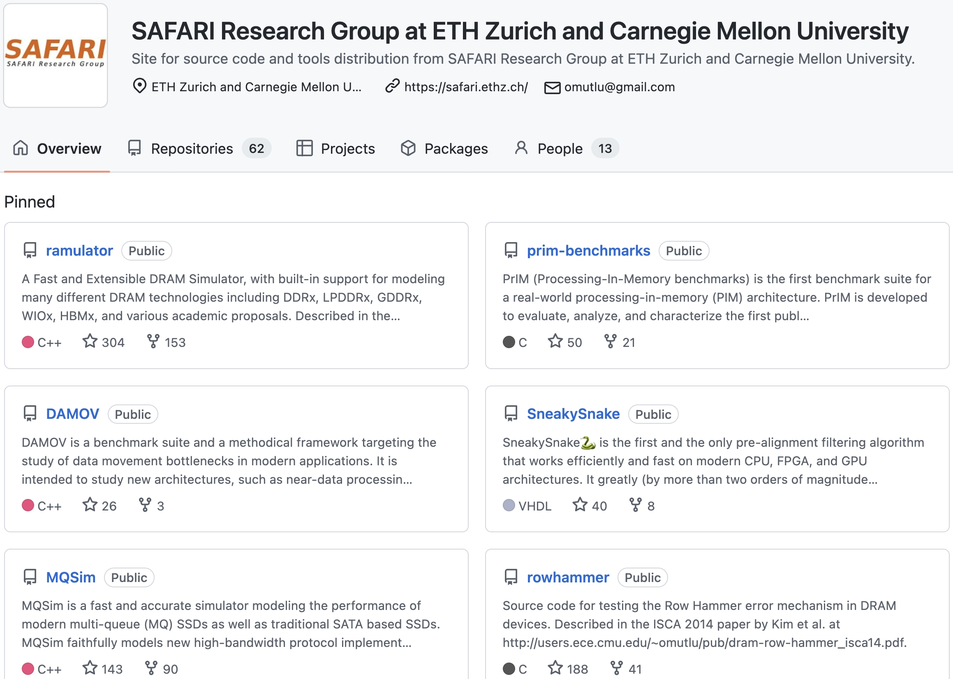
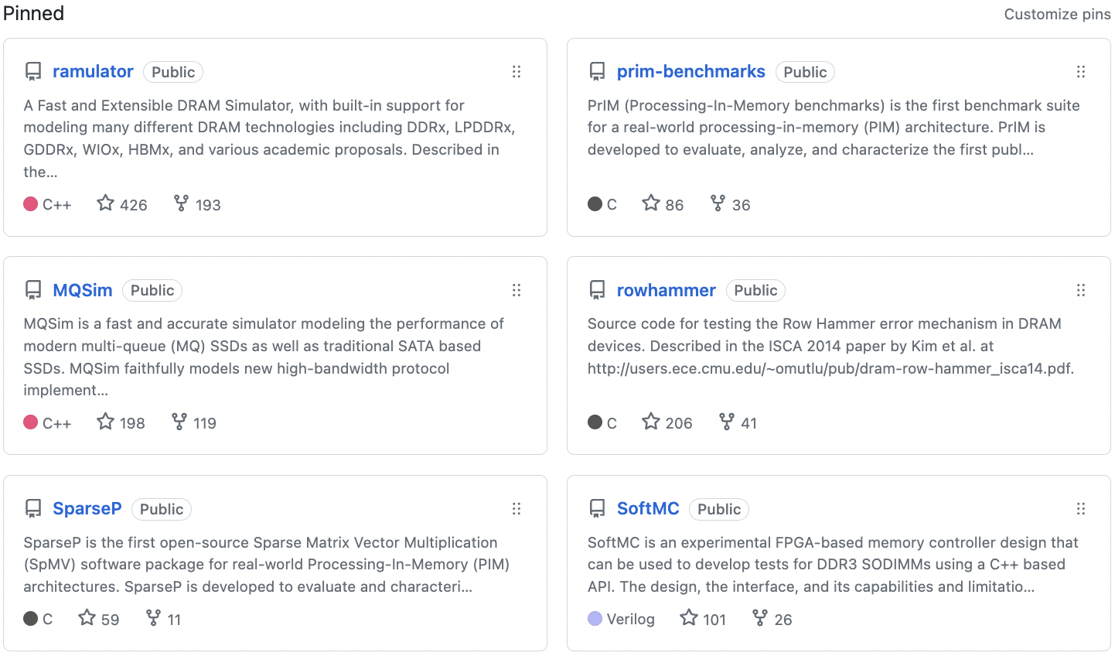
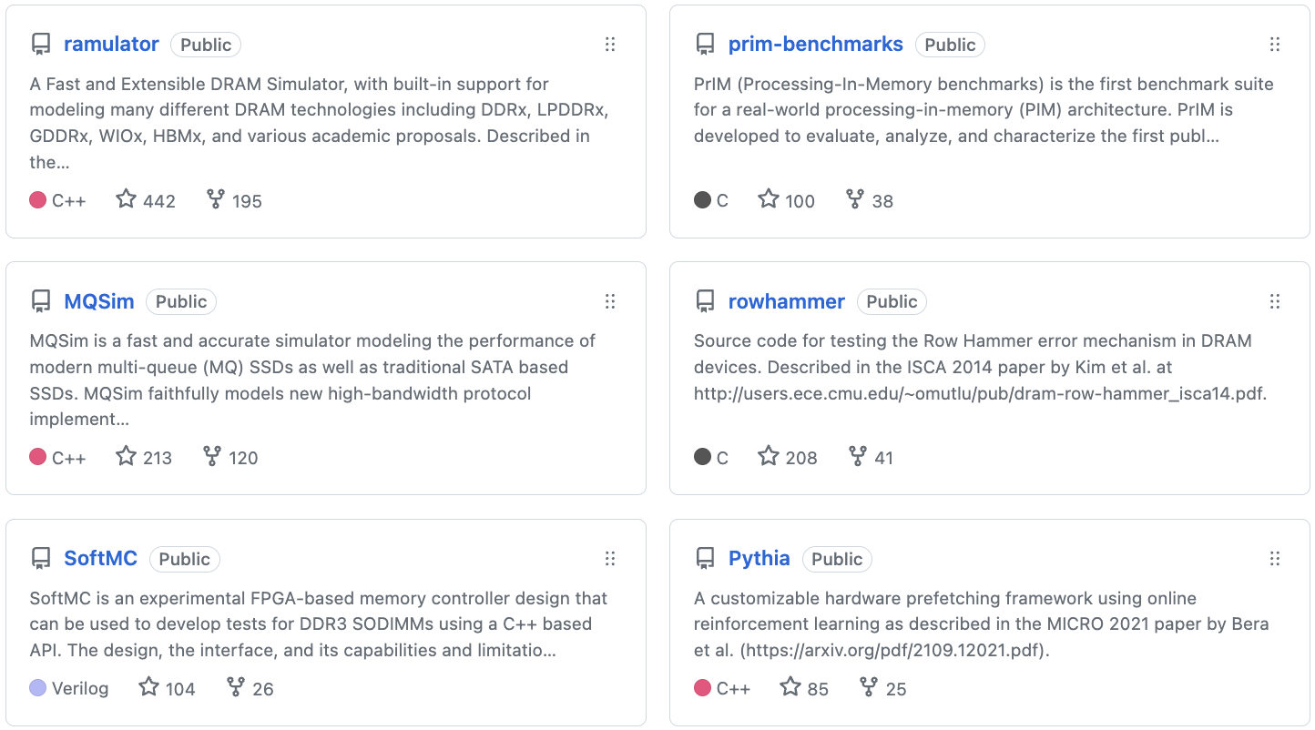
Open Source Tools: SAFARI GitHub
https://github.com/CMU-SAFARI/

Slide 53
Tutorial on Memory-Centric Computing: PIM Adoption & Programmability
Geraldo F. Oliveira
Prof. Onur Mutlu
HEART 2024
21 June 2024

