Slide 1


2nd Workshop on
Memory-Centric Computing:
Logistics
Geraldo F. Oliveira
https://geraldofojunior.github.io
ICS 2025
08 June 2025

Slide 2
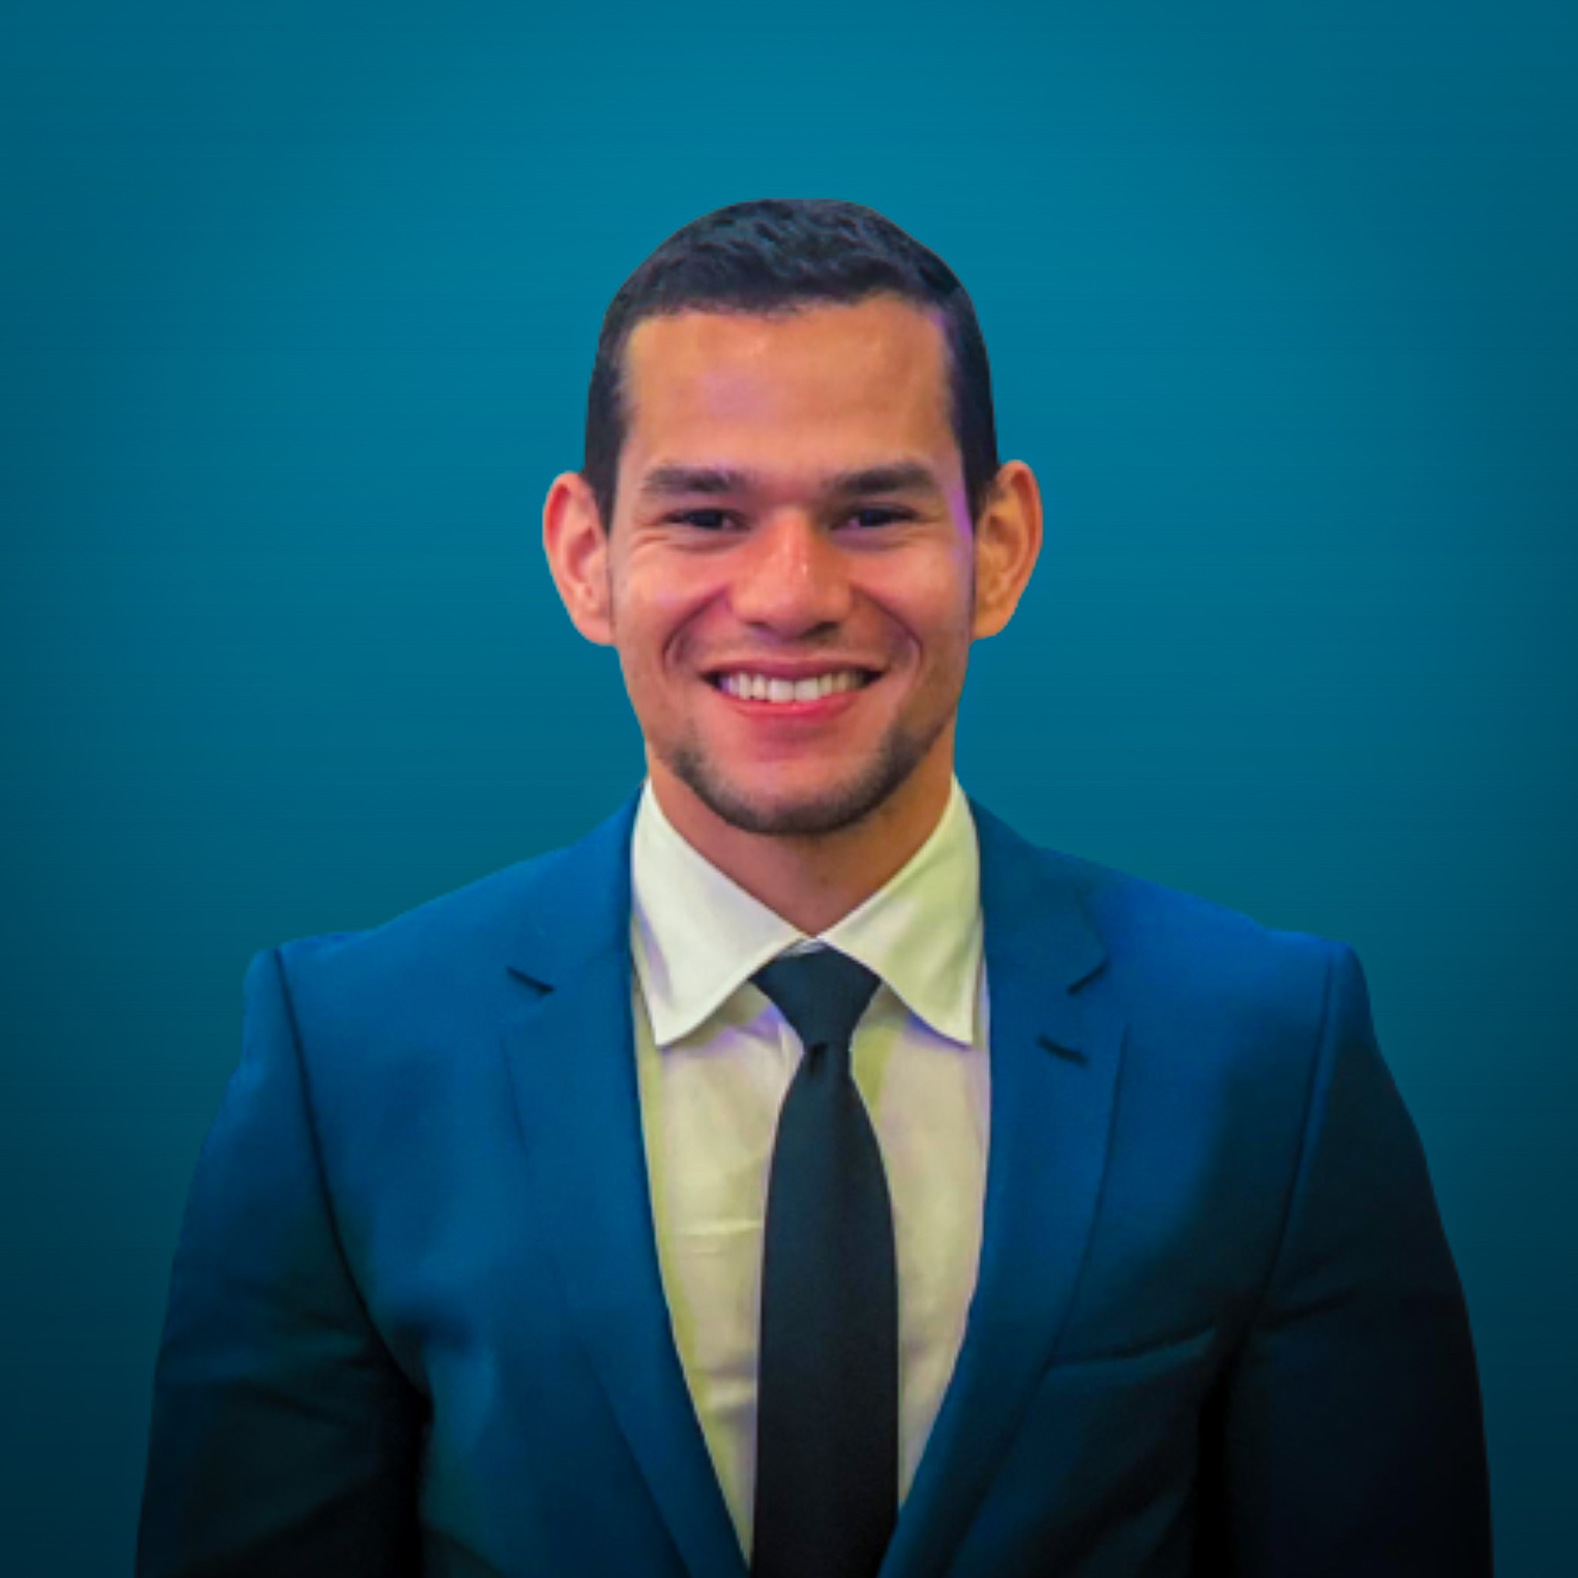
Brief Self Introduction
Dr. Geraldo F. Oliveira
  Researcher @ SAFARI Research Group since November 2017
  I am in the job market for industry positions
  https://geraldofojunior.github.io/
  geraldofojunior@gmail.com (Best way to reach me)
  https://safari.ethz.ch
Research in:
  Computer architecture, computer systems, hardware security
  Memory and storage systems
  Hardware security, safety, predictability
  Fault tolerance
  Hardware/software cooperation
  …

Slide 3

Get the Materials Online
https://events.safari.ethz.ch/ics25-MCCSys/doku.php

Slide 4
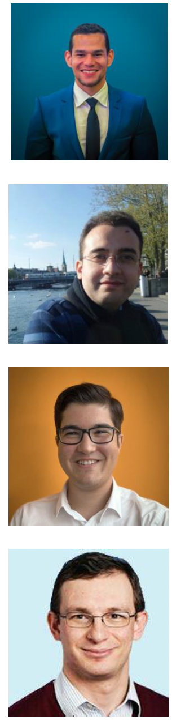
Organizers
Dr. Geraldo F. Oliveira
  Researcher @ SAFARI Research Group since November 2017
  I am in the job market for industry positions
  https://geraldofojunior.github.io/
Dr. Mohammad Sadrosadati
  Senior Researcher and Lecturer, SAFARI @ ETH Zürich
  https://scholar.google.com/citations?user=-mHpDvAAAAAJ
Ataberk Olgun
  PhD Candidate, SAFARI Research @ ETH Zürich
  https://ataberkolgun.com/
Prof. Onur Mutlu
  Professor of Computer Science at ETH Zurich
  https://people.inf.ethz.ch/omutlu/index.html

Slide 5
Agenda Tutorial (Morning)
Prof. Onur Mutlu / Dr. Geraldo F. Oliveira:
Recent Advances in Processing-in-DRAM
Processing-Using-Memory (PUM) Systems – Part I
Coffee Break
Ismail E. Yuksel
Functionally-Complete Boolean Logic in Real DRAM Chips
Processing-Using-Memory (PUM) Systems – Part II
Processing-Near-Memory (PNM) Systems: Academia & Industry Developments – Part I
Lunch

Slide 6
Agenda Workshop (Afternoon) – Part I
Processing-Near-Memory (PNM) Systems: Academia & Industry Developments – Part II
Dr. Konstantina Koliogeorgi
PIM Architectures for Bioinformatics
Infrastructure for PIM Research &
Research Challenges
Proteus: Achieving High-Performance Processing-Using-DRAM with Dynamic Bit-Precision, Adaptive Data Representation, and Flexible Arithmetic
Coffee Break

Slide 7
Agenda Workshop (Afternoon) – Part II
Taewoon Kang
SparsePIM: An Efficient HBM-Based PIM Architecture for Sparse Matrix-Vector Multiplications
Prof. Elaheh Sadredini
Keep it Close, Keep it Secure! Towards Efficient, Secure, and Programmable Memory-Centric Computing
Melina Soysal
MARS: Processing-In-Memory Acceleration of Raw Signal Genome Analysis Inside the Storage Subsystem
Closing Remarks

Slide 8
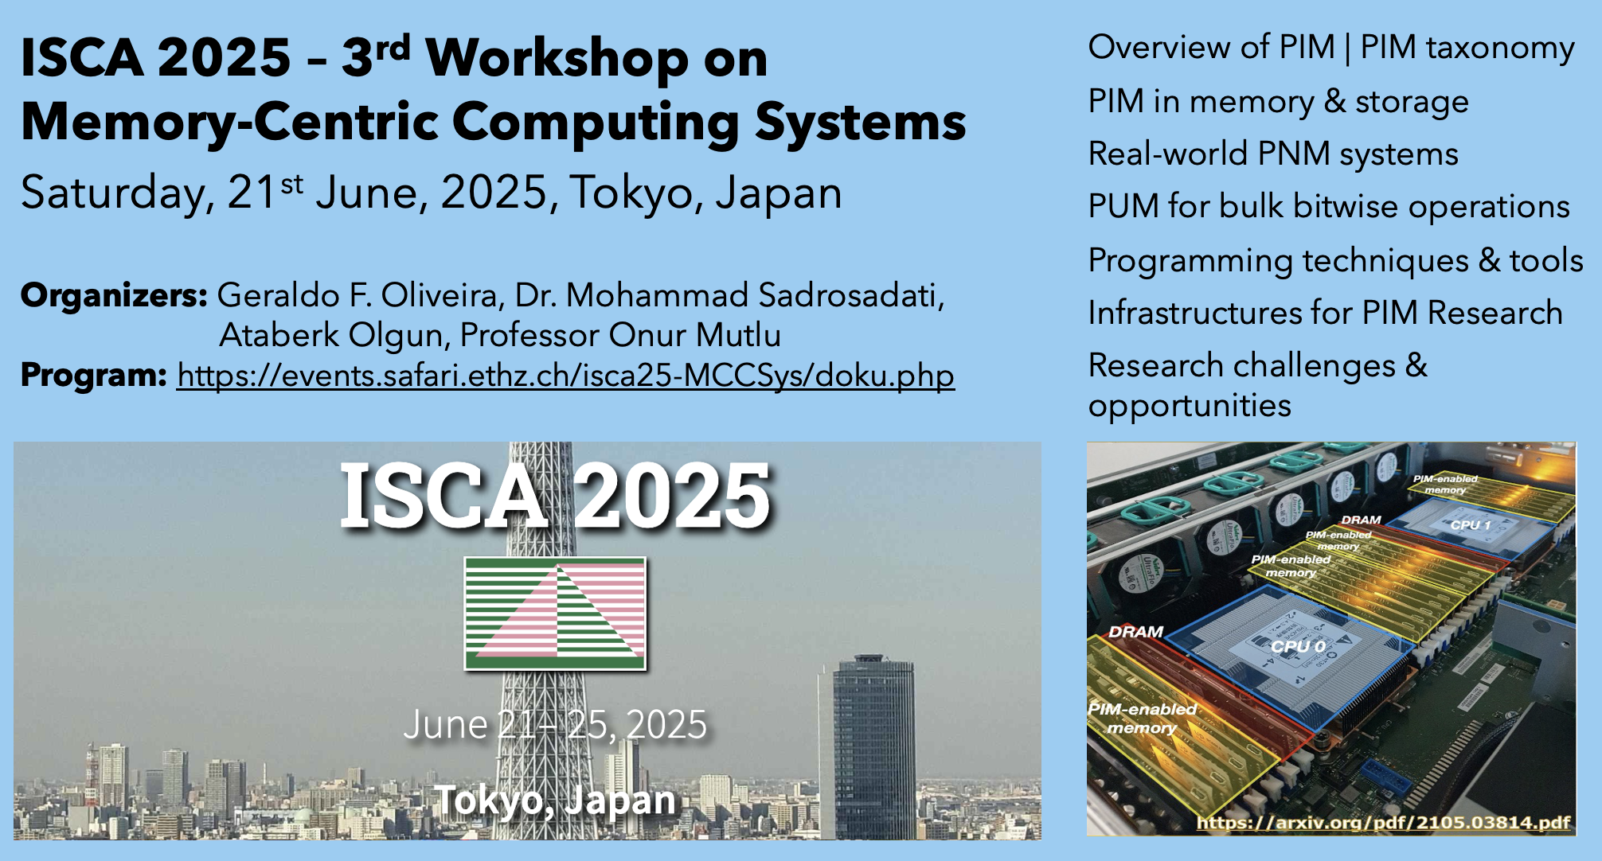
Next PIM Workshops (II)
https://events.safari.ethz.ch/isca25-MCCSys/doku.php

Slide 9
2nd Workshop on
Memory-Centric Computing:
Logistics
Geraldo F. Oliveira
https://geraldofojunior.github.io
ICS 2025
08 June 2025

