Slide 1


2nd Workshop on
Memory-Centric Computing:
Memory-Centric Computing
Dr. Geraldo F. Oliveira
https://geraldofojunior.github.io
ICS 2025
08 June 2025

Slide 2
The Problem
Computing
is Bottlenecked by Data

Slide 3
Data is Key for AI, ML, Genomics, …
Important workloads are all data intensive
They require rapid and efficient processing of large amounts of data
Data is increasing
  We can generate more than we can process
  We need to perform more sophisticated analyses on more data

Slide 4
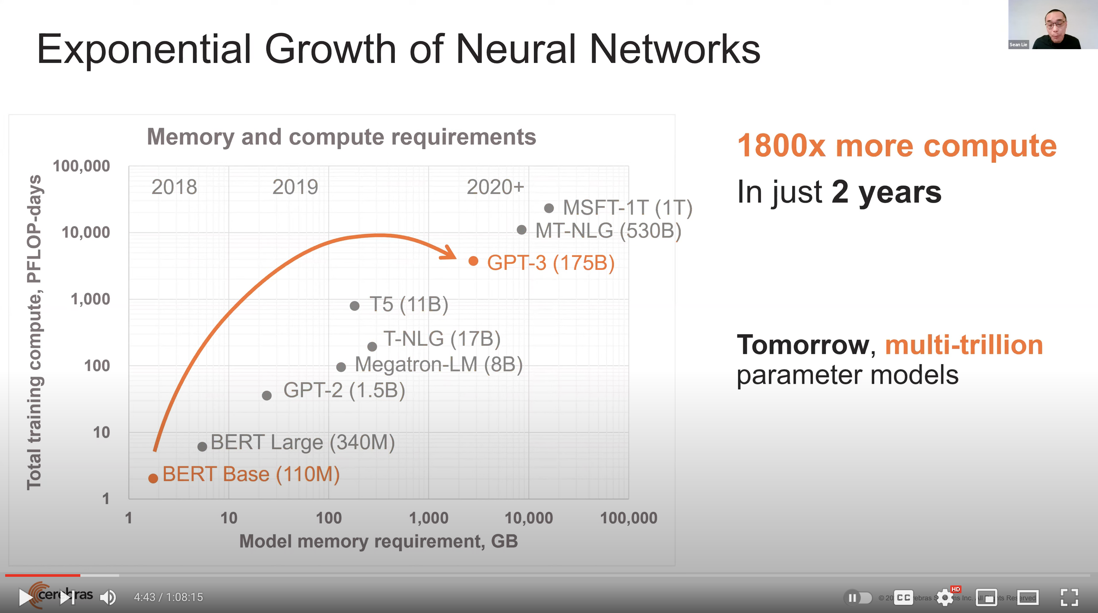
Huge Demand for Performance & Efficiency
Source: https://youtu.be/Bh13Idwcb0Q?t=283

Slide 5
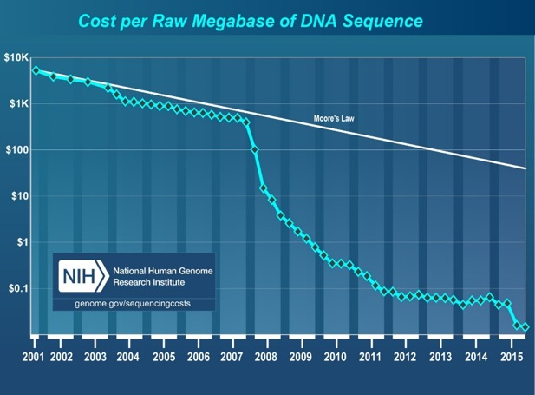
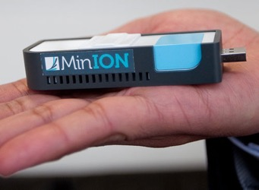
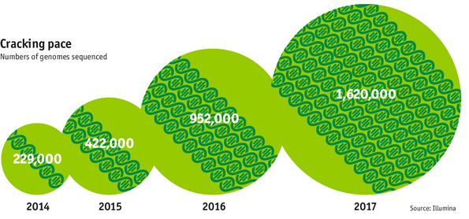

Huge Demand for Performance & Efficiency
development of new
sequencing technologies
Oxford Nanopore MinION
Number of Genomes Sequenced
http://www.economist.com/news/21631808-so-much-genetic-data-so-many-uses-genes-unzipped
Notes:
However, since the development of high throughput sequencing (HTS) technologies, the cost of genome sequencing has fallen off a cliff (<< 1,000$) making it viable for almost everyone's use.

Slide 6
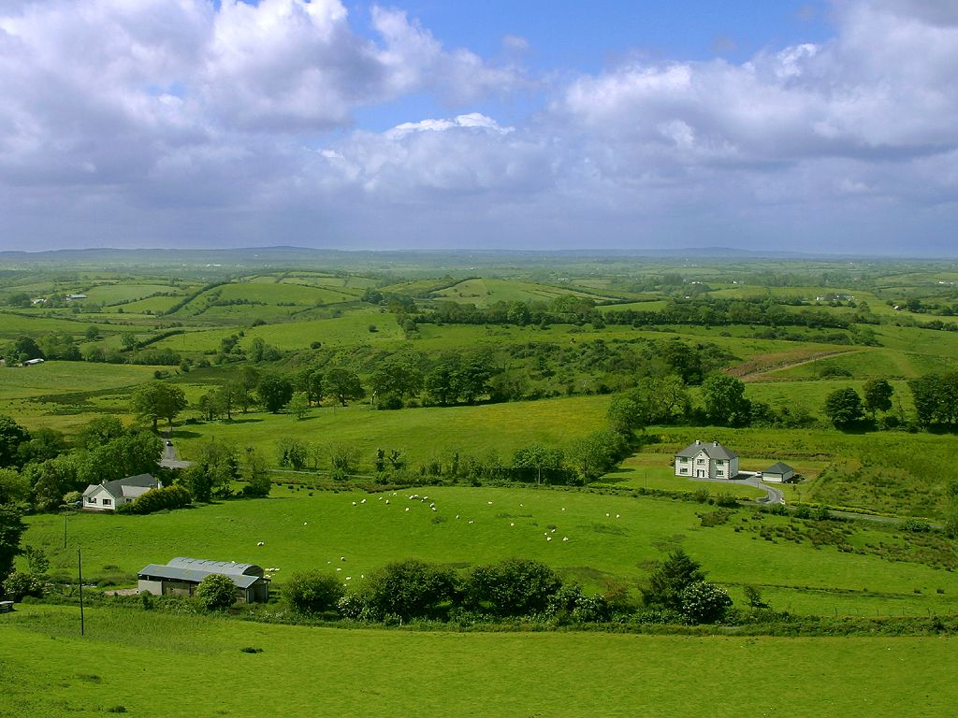
Do We Want This?
Source: V. Milutinovic

Slide 7
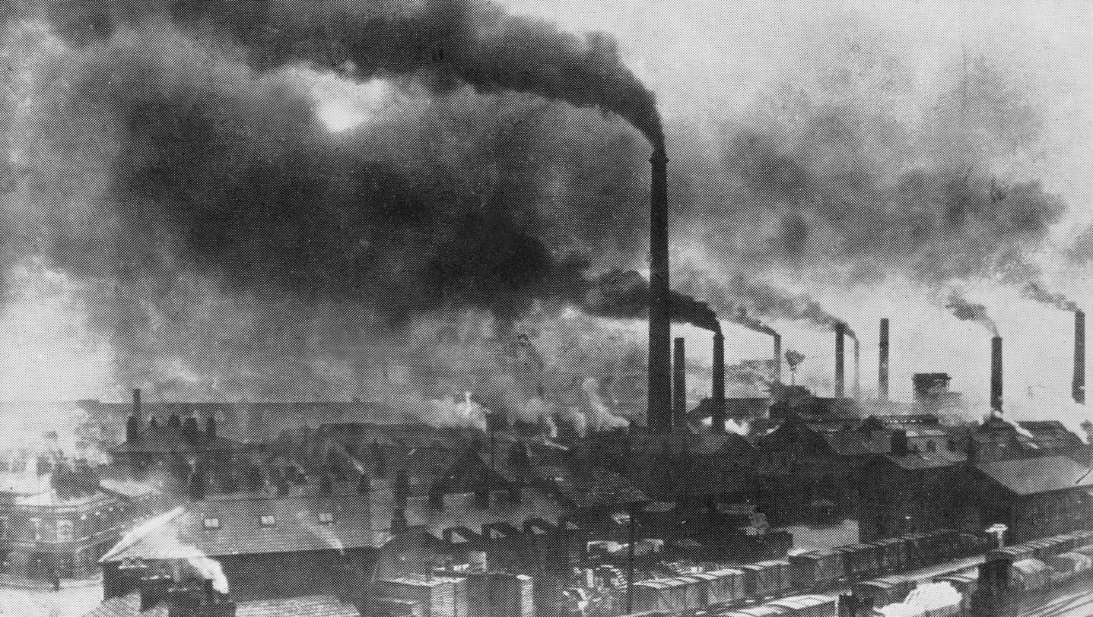
Or This?
Source: V. Milutinovic

Slide 8
Challenge and Opportunity for Future
High Performance,
Energy Efficient,
Sustainable
(All at the Same Time)

Slide 9
The Problem
Data access is the major performance and energy bottleneck
Our current
design principles
cause great energy waste
(and great performance loss)

Slide 10
The Problem
Processing of data
is performed
far away from the data

Slide 11
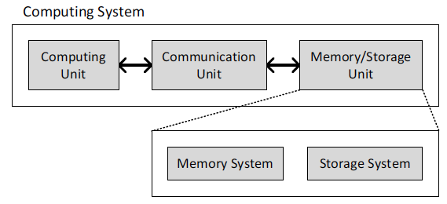
Today’s Computing Systems
Processor centric
All data processed in the processor → at great system cost

Slide 12
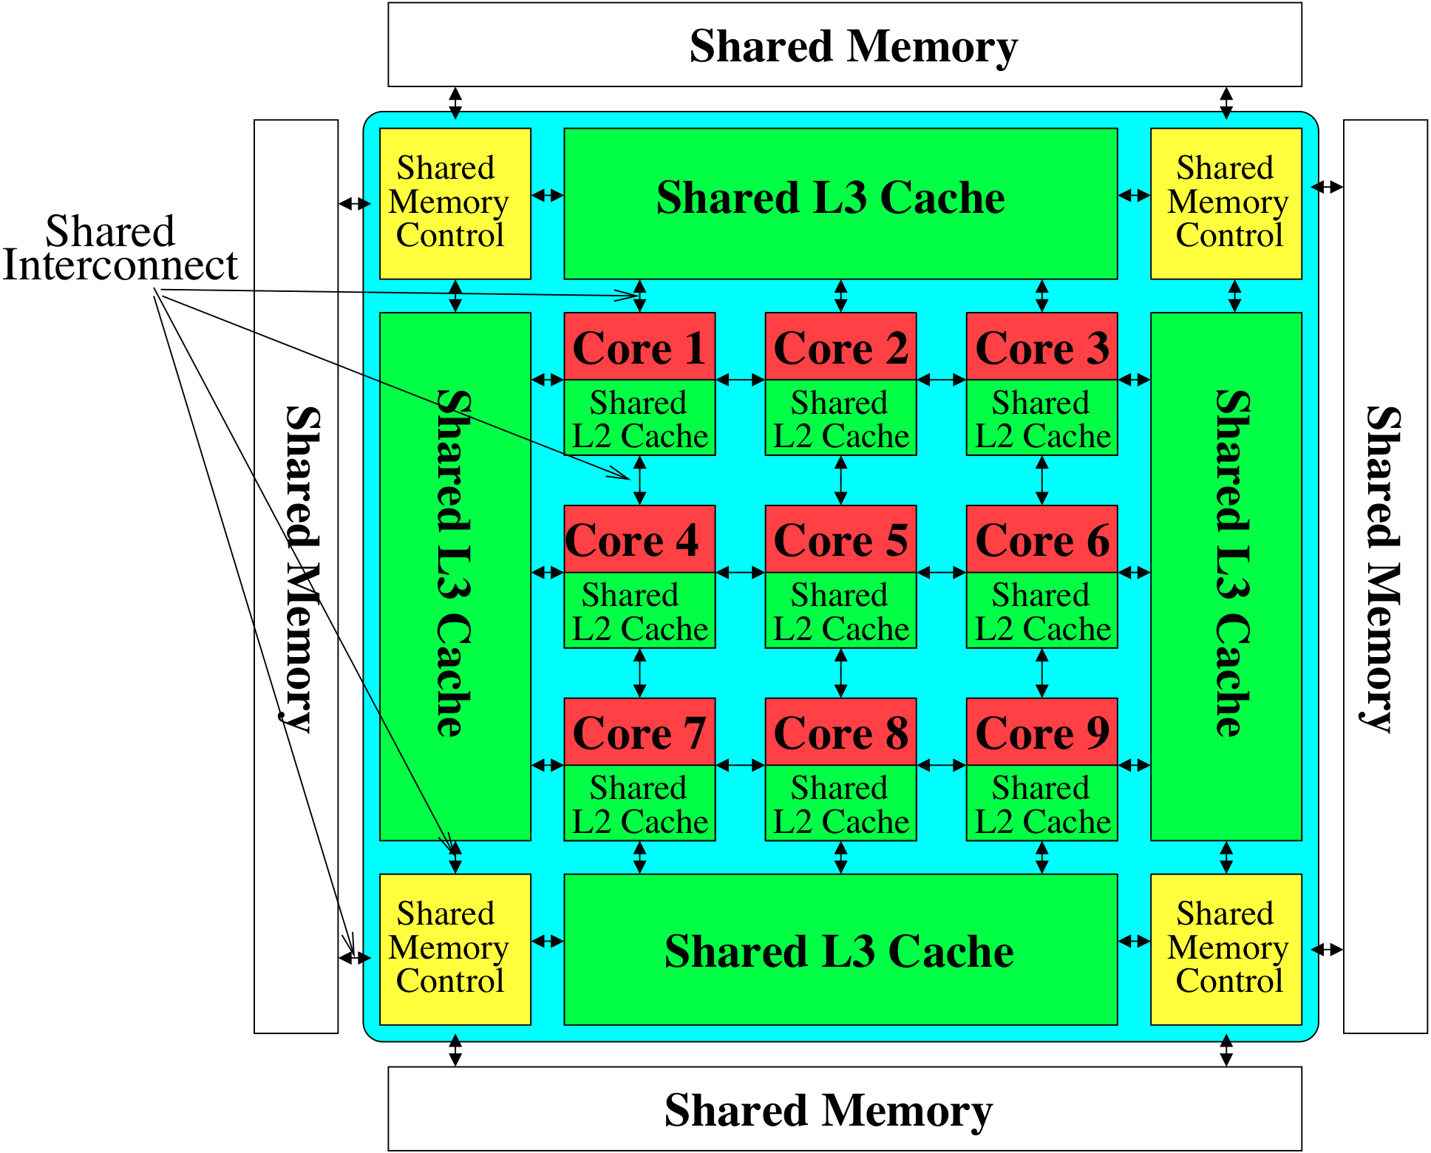

Perils of Processor-Centric Design
Most of the system is dedicated to storing and moving data
Yet, system is still bottlenecked by memory

Slide 13
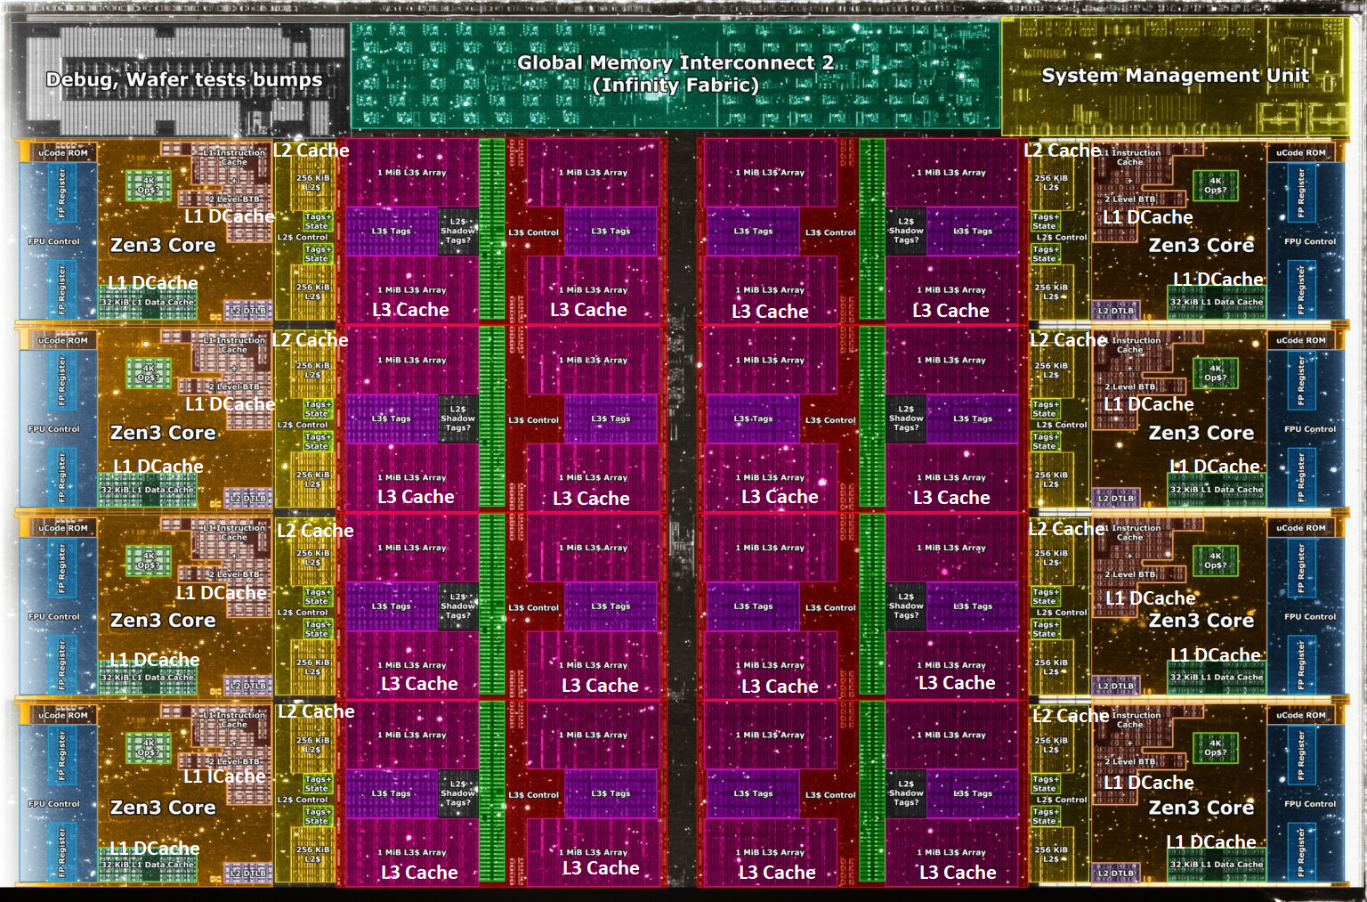
Deeper and Larger Memory Hierarchies
Core Count:
8 cores/16 threads
L1 Caches:
32 KB per core
L2 Caches:
512 KB per core
L3 Cache:
32 MB shared
AMD Ryzen 5000, 2020
https://wccftech.com/amd-ryzen-5000-zen-3-vermeer-undressed-high-res-die-shots-close-ups-pictured-detailed/

Slide 14
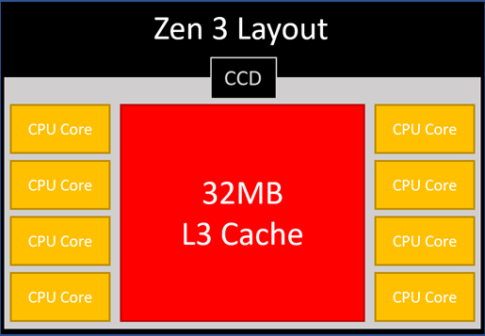
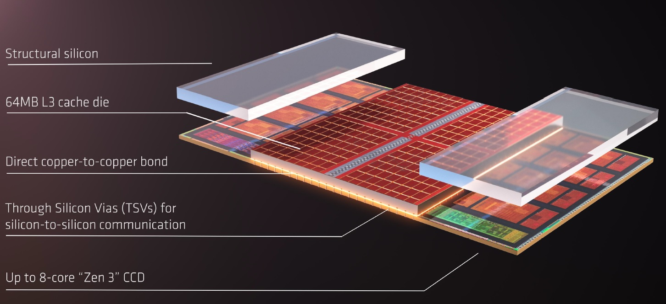
AMD’s 3D Last Level Cache (2021)
AMD increases the L3 size of their 8-core Zen 3 processors from 32 MB to 96 MB
Additional 64 MB L3 cache die stacked on top of the processor die
- Connected using Through Silicon Vias (TSVs)
- Total of 96 MB L3 cache
https://community.microcenter.com/discussion/5134/comparing-zen-3-to-zen-2
https://youtu.be/gqAYMx34euU
https://www.tech-critter.com/amd-keynote-computex-2021/
Notes:
CCD = Core Chiplet Die
Structural silicon is used to equalize the height and facilitate heat dissipation from the cores.

Slide 15
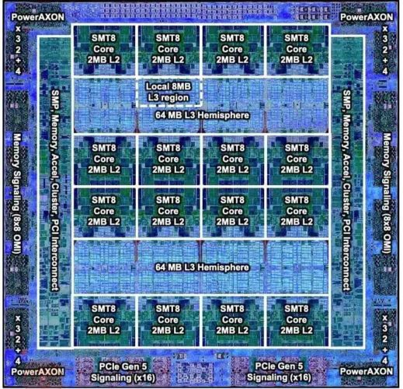
Deeper and Larger Memory Hierarchies
IBM POWER10,
2020
Cores:
15-16 cores,
8 threads/core
L2 Caches:
2 MB per core
L3 Cache:
120 MB shared
https://www.it-techblog.de/ibm-power10-prozessor-mehr-speicher-mehr-tempo-mehr-sicherheit/09/2020/

Slide 16
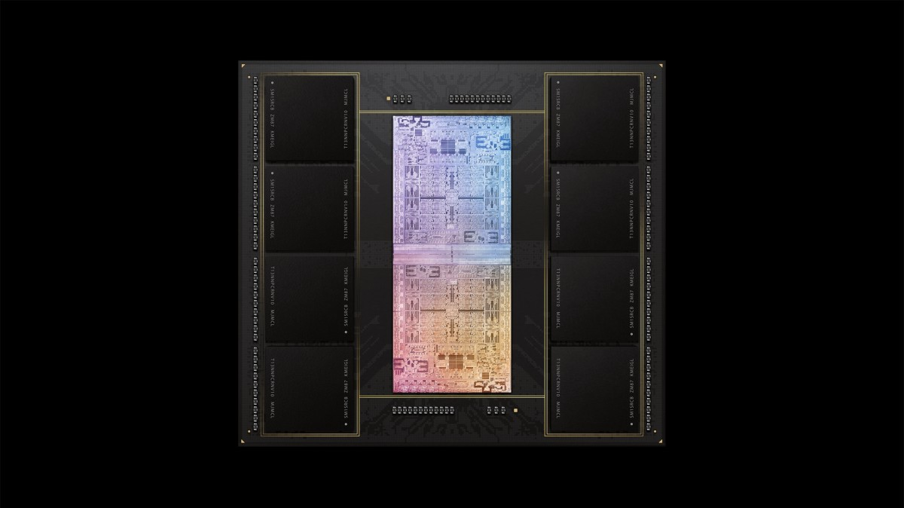
Deeper and Larger Memory Hierarchies
A lot of
SRAM
Storage
DRAM
DRAM
Storage
Apple M1 Ultra System (2022)
https://www.gsmarena.com/apple_announces_m1_ultra_with_20core_cpu_and_64core_gpu-news-53481.php

Slide 17
Data Overwhelms Modern Machines …
Storage/memory capability
Communication capability
Computation capability
Greatly impacts robustness, energy, performance, cost

Slide 18
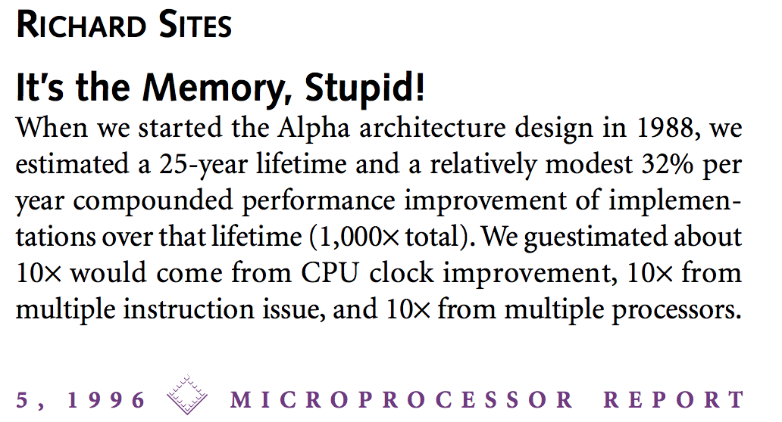
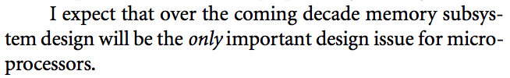
It’s the Memory, Stupid!
“It’s the Memory, Stupid!” (Richard Sites, MPR, 1996)
http://cva.stanford.edu/classes/cs99s/papers/architects_look_to_future.pdf

Slide 19
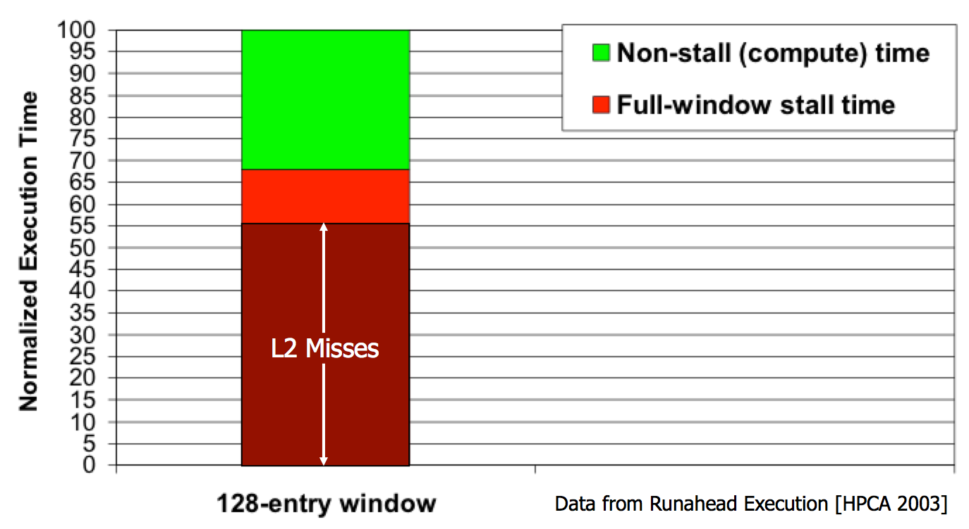
The Performance Perspective
Mutlu+, “Runahead Execution: An Alternative to Very Large Instruction Windows for Out-of-Order Processors,” HPCA 2003.

Slide 20
The Performance Perspective
Onur Mutlu, Jared Stark, Chris Wilkerson, and Yale N. Patt,
"Runahead Execution: An Alternative to Very Large Instruction Windows for Out-of-order Processors"
Proceedings of the 9th International Symposium on High-Performance Computer Architecture (HPCA), pages 129-140, Anaheim, CA, February 2003. Slides (pdf)
  One of the 15 computer arch. papers of 2003 selected as Top Picks by IEEE Micro.
  HPCA Test of Time Award (awarded in 2021).

Slide 21
The Performance Perspective (Today)
All of Google’s Data Center Workloads (2015):
Kanev+, “Profiling a Warehouse-Scale Computer,” ISCA 2015.

Slide 22
Three Key Systems Trends
1. Data access is a major bottleneck
  Applications are increasingly data hungry
2. Energy consumption is a key limiter
3. Data movement energy dominates compute
  Especially true for off-chip to on-chip movement

Slide 23
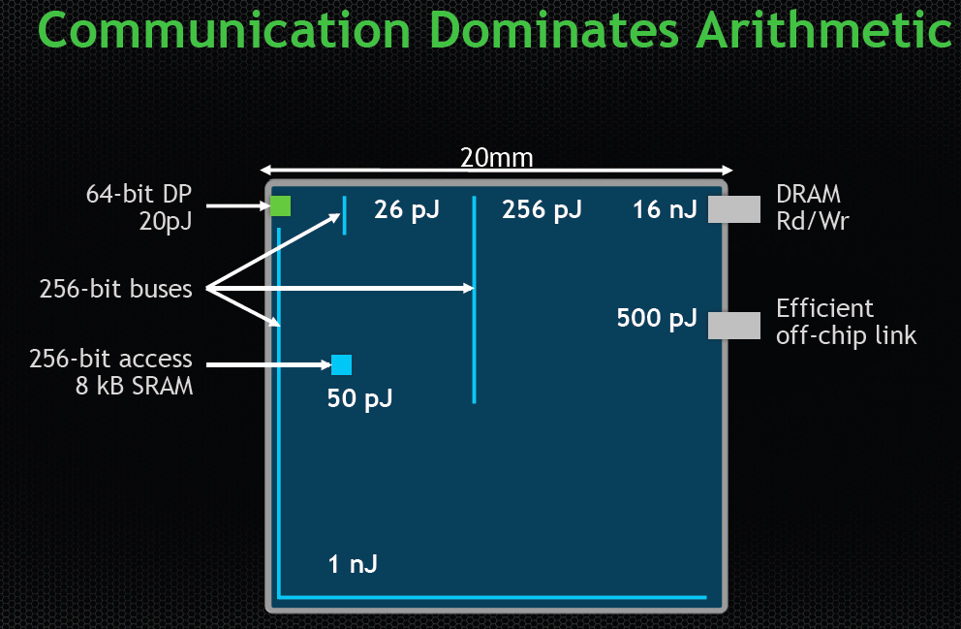
Data Movement vs. Computation Energy
Dally, HiPEAC 2015
A memory access consumes ~100-1000X
the energy of a complex addition

Slide 24
Data Movement vs. Computation Energy
Han+, “EIE: Efficient Inference Engine on Compressed Deep Neural Network,” ISCA 2016.

Slide 25
Data Movement vs. Computation Energy
6400X
A memory access consumes 6400X
the energy of a simple integer addition
Han+, “EIE: Efficient Inference Engine on Compressed Deep Neural Network,” ISCA 2016.

Slide 26
Energy Waste in Mobile Devices
Amirali Boroumand, Saugata Ghose, Youngsok Kim, Rachata Ausavarungnirun, Eric Shiu, Rahul Thakur, Daehyun Kim, Aki Kuusela, Allan Knies, Parthasarathy Ranganathan, and Onur Mutlu,
"Google Workloads for Consumer Devices: Mitigating Data Movement Bottlenecks"
Proceedings of the 23rd International Conference on Architectural Support for Programming Languages and Operating Systems (ASPLOS), Williamsburg, VA, USA, March 2018.
62.7% of the total system energy
is spent on data movement

Slide 27
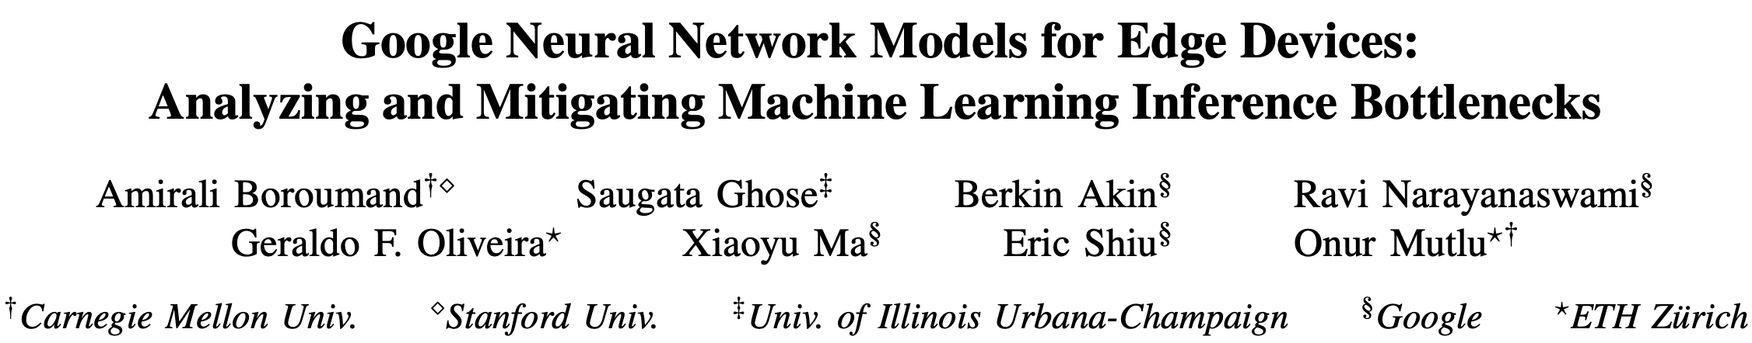
Energy Waste in Accelerators
Amirali Boroumand, Saugata Ghose, Berkin Akin, Ravi Narayanaswami, Geraldo F. Oliveira, Xiaoyu Ma, Eric Shiu, and Onur Mutlu,
"Google Neural Network Models for Edge Devices: Analyzing and Mitigating Machine Learning Inference Bottlenecks"
Proceedings of the 30th International Conference on Parallel Architectures and Compilation Techniques (PACT), Virtual, September 2021.
[Slides (pptx) (pdf)]
[Talk Video (14 minutes)]
> 90% of the total system energy
is spent on memory in large ML models

Slide 28
We Do Not Want to Move Data!
Dally, HiPEAC 2015
A memory access consumes ~100-1000X
the energy of a complex addition

Slide 29
We Need A Paradigm Shift To …
Enable computation with minimal data movement
Compute where it makes sense (where data resides)
Make computing architectures more data-centric

Slide 30
Process Data Where It Makes Sense
Sensors
A lot of
SRAM
Storage
DRAM
DRAM
Storage
Apple M1 Ultra System (2022)
https://www.gsmarena.com/apple_announces_m1_ultra_with_20core_cpu_and_64core_gpu-news-53481.php

Slide 31
Goal: Processing Inside Memory/Storage
Many questions … How do we design the:
  compute-capable memory & controllers?
  processors & communication units?
  software & hardware interfaces?
  system software, compilers, languages?
  algorithms & theoretical foundations?
Memory/Storage
Database
Graphs
Media
Processor
Core
Cache
Query
Interconnect
Problem
Results
Algorithm
Program/Language
System Software
SW/HW Interface
Micro-architecture
Logic
Devices
Electrons

Slide 32
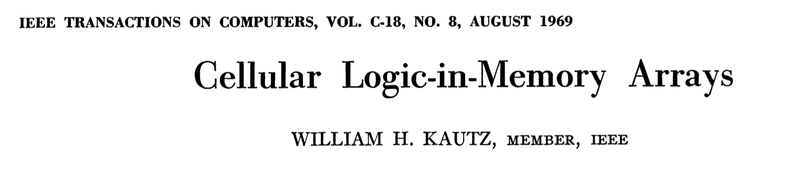
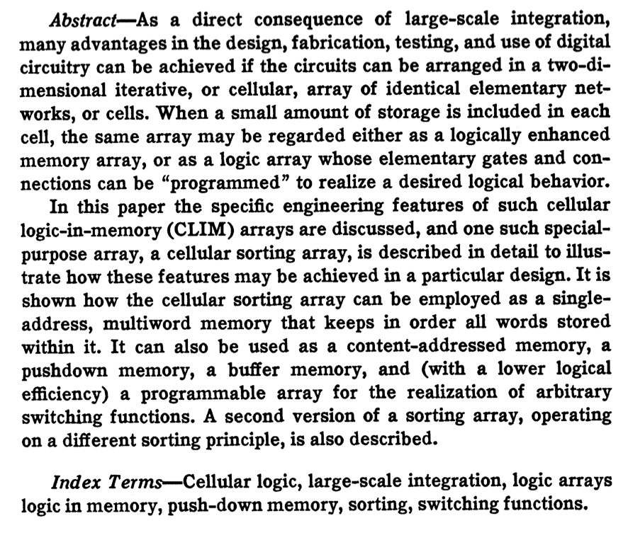
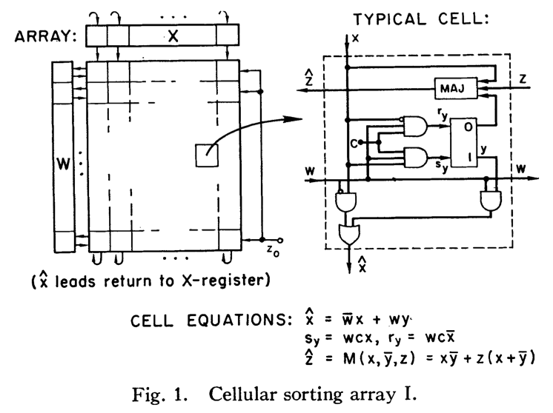
Processing in/near Memory: An Old Idea
Kautz, “Cellular Logic-in-Memory Arrays”, IEEE TC 1969.
https://doi.org/10.1109/T-C.1969.222754

Slide 33
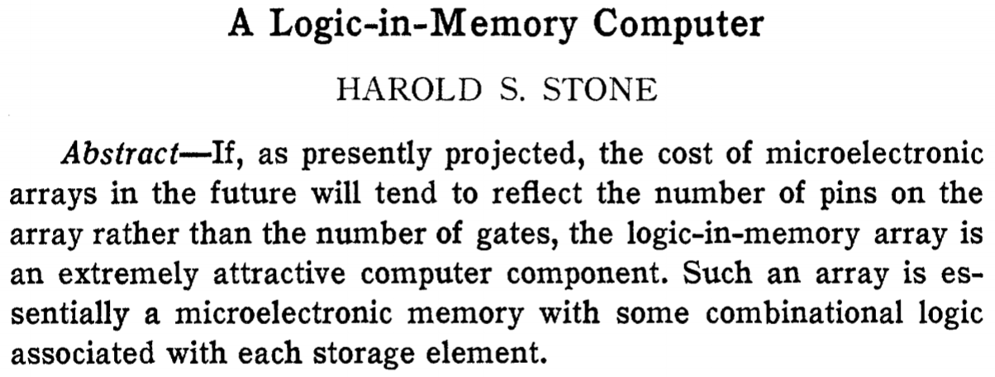
Processing in/near Memory: An Old Idea
Stone, “A Logic-in-Memory Computer,” IEEE TC 1970.
https://safari.ethz.ch/architecture/fall2020/lib/exe/fetch.php?media=stone_logic_in_memory_1970.pdf

Slide 34
Why In-Memory Computation Today?
Huge problems with Memory Technology
  Memory technology scaling is not going well (e.g., RowHammer)
  Many scaling issues demand intelligence in memory
Huge demand from Applications & Systems
  Data access bottleneck
  Energy & power bottlenecks
  Data movement energy dominates computation energy
  Need all at the same time: performance, energy, sustainability
  We can improve all metrics by minimizing data movement
Designs are squeezed in the middle

Slide 35
RowHammer [Kim et al., ISCA 2014]
One can
predictably induce errors
in most DRAM memory chips
Kim+, “Flipping Bits in Memory Without Accessing Them: An Experimental Study of DRAM Disturbance Errors,” ISCA 2014.

Slide 36
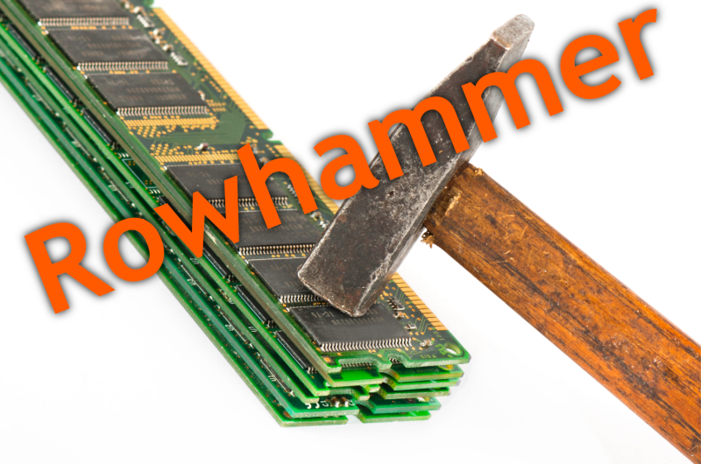
Notes:
Picture from the article:
http://thehackernews.com/2015/03/dram-rowhammer-vulnerability.html

Slide 37
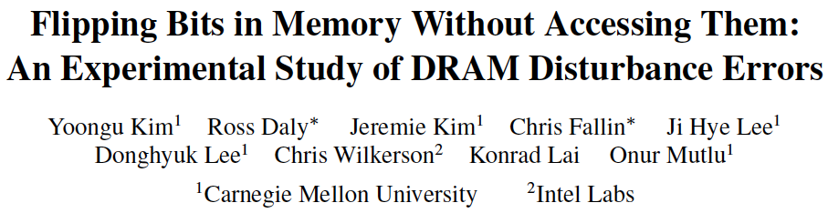
RowHammer [ISCA 2014]
Yoongu Kim, Ross Daly, Jeremie Kim, Chris Fallin, Ji Hye Lee, Donghyuk Lee, Chris Wilkerson, Konrad Lai, and Onur Mutlu,
"Flipping Bits in Memory Without Accessing Them: An Experimental Study of DRAM Disturbance Errors"
Proceedings of the 41st International Symposium on Computer Architecture (ISCA), Minneapolis, MN, June 2014.
[Slides (pptx) (pdf)] [Lightning Session Slides (pptx) (pdf)] [Source Code and Data] [Lecture Video (1 hr 49 mins), 25 September 2020]
One of the 7 papers of 2012-2017 selected as Top Picks in Hardware and Embedded Security for IEEE TCAD (link).
Selected to the ISCA-50 25-Year Retrospective Issue covering 1996-2020 in 2023 (Retrospective (pdf) Full Issue).

Slide 38
The Push from Circuits and Devices
Main Memory Needs
Intelligent Controllers

Slide 39
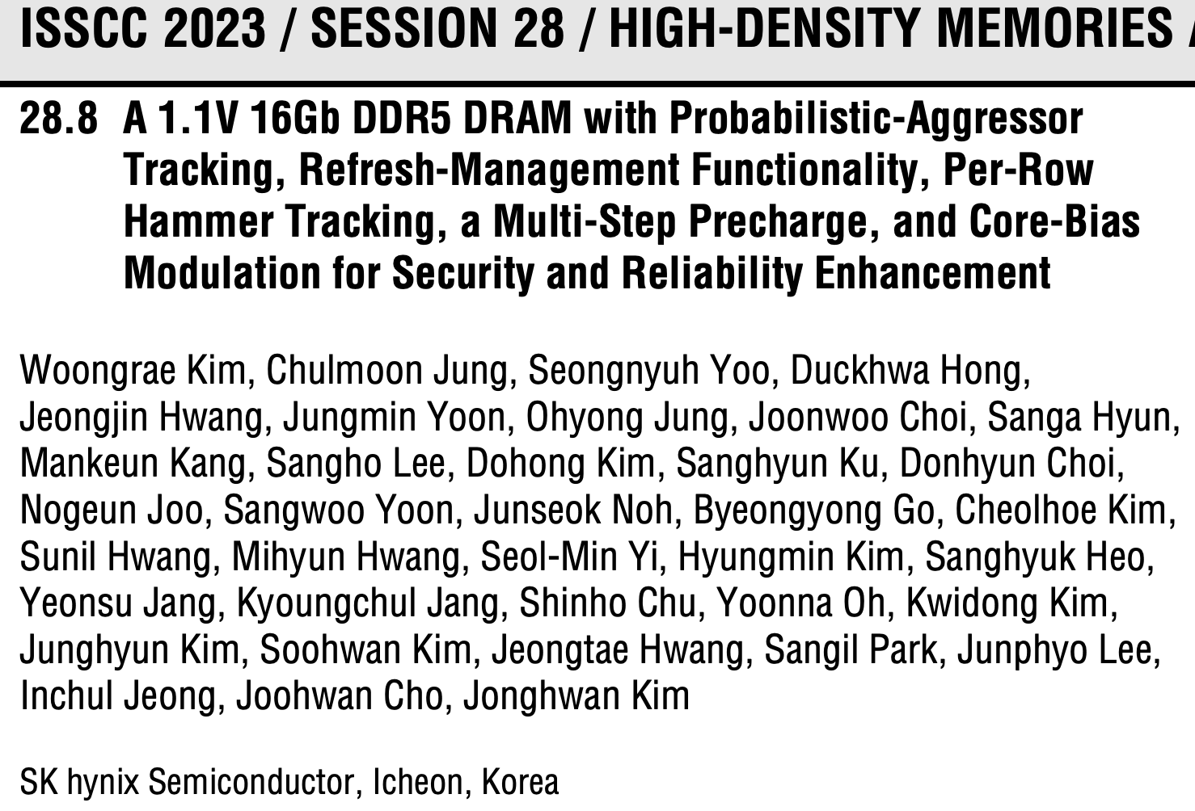

Industry’s Intelligent DRAM Controllers (I)

Slide 40
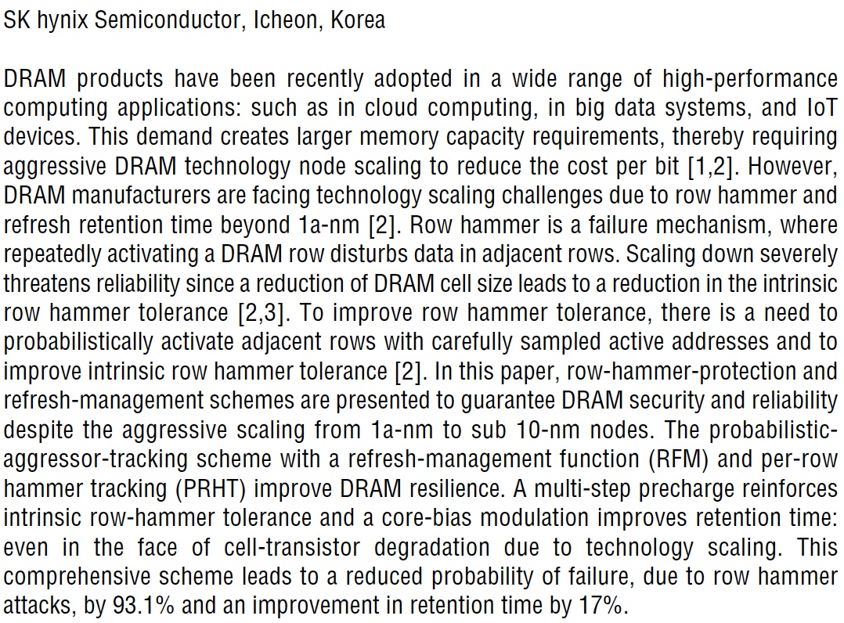
Industry’s Intelligent DRAM Controllers (II)

Slide 41
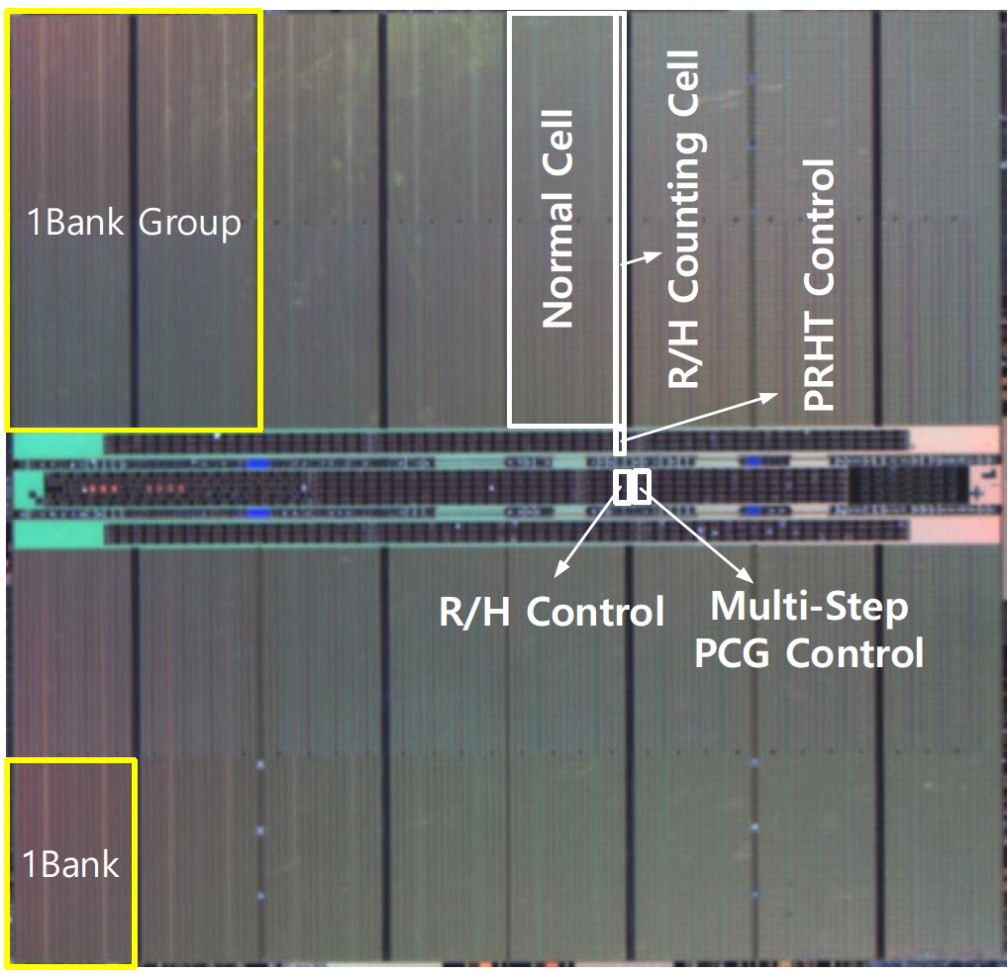
Industry’s Intelligent DRAM Controllers (III)

Slide 42
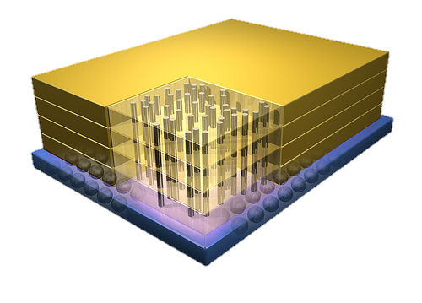


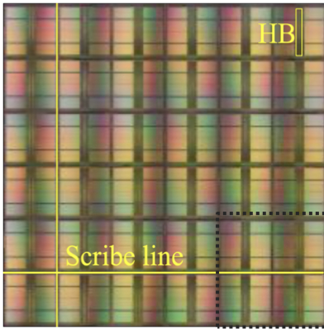
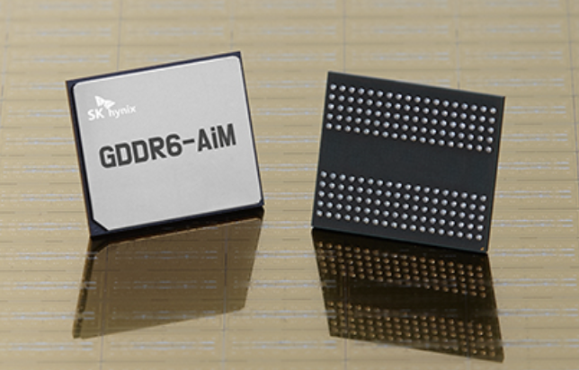
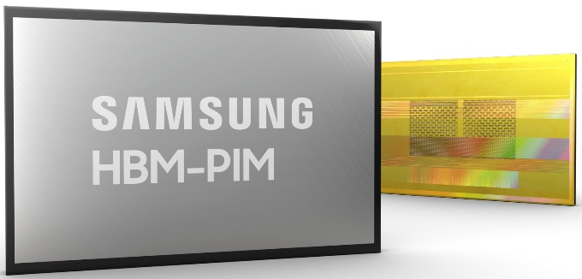
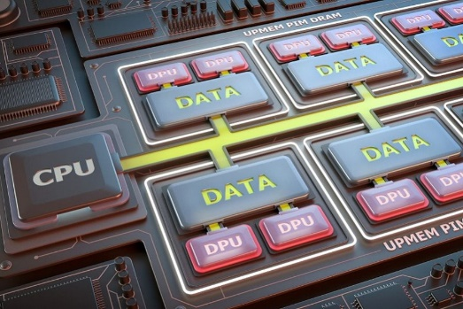
Processing-in-Memory Landscape Today
[Samsung 2021]
[Alibaba 2022]
[SK Hynix 2022]
[Samsung 2021]
[UPMEM 2019]
And, many other experimental chips and startups

Slide 43
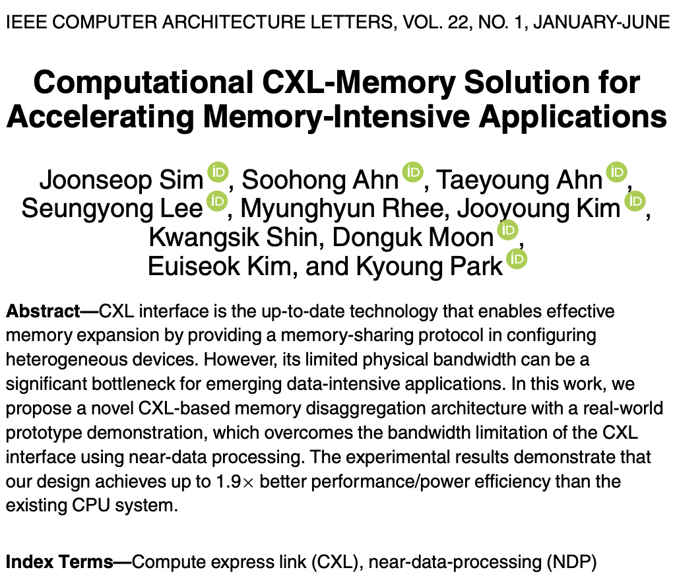
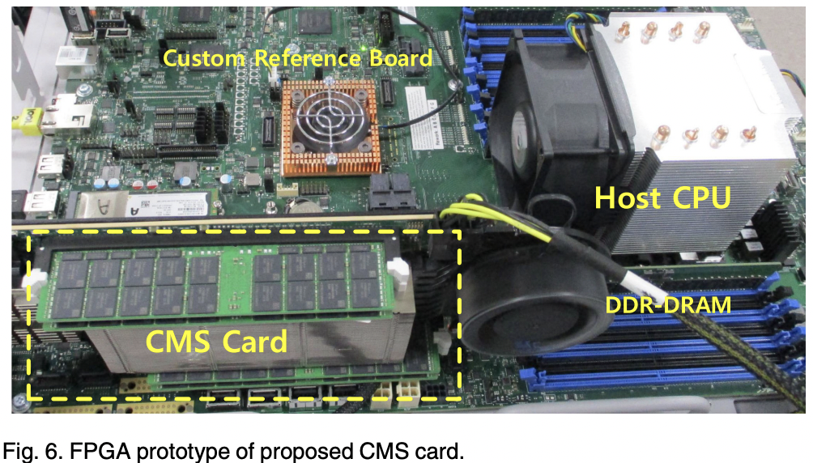
Processing-in-Memory Landscape Today

Slide 44
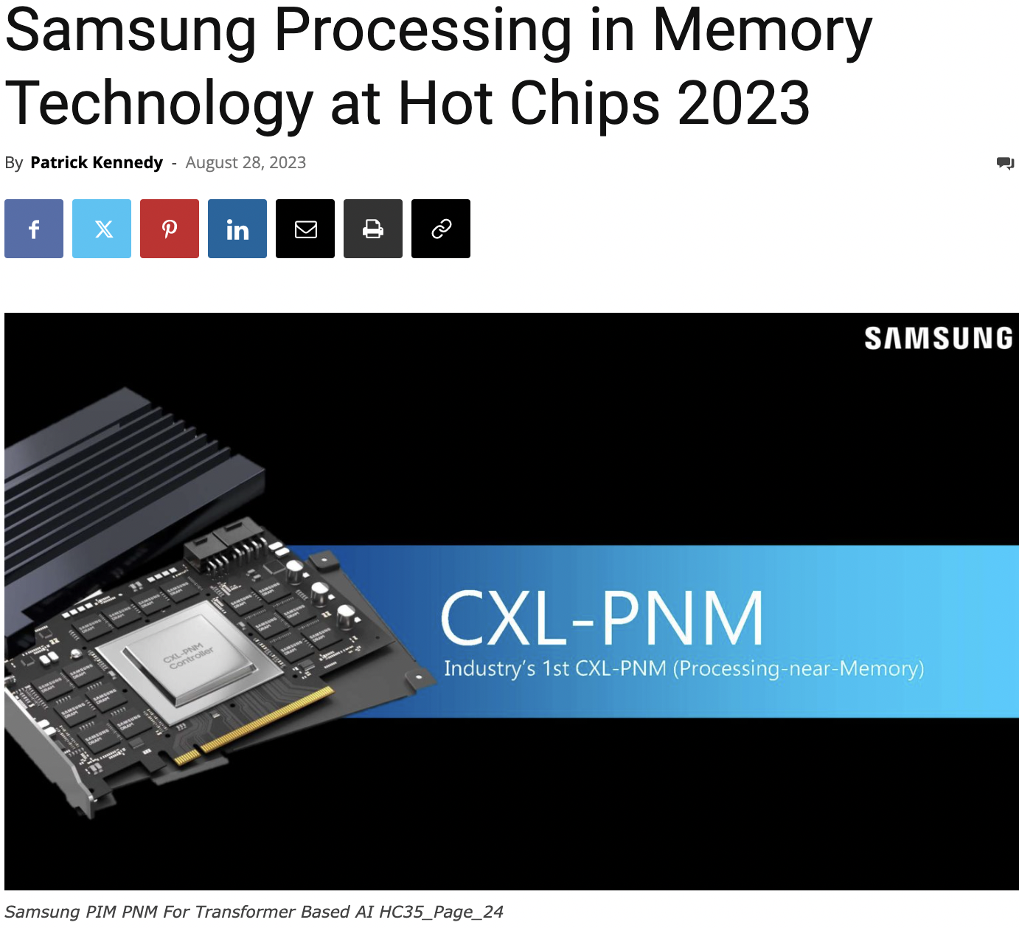
Processing-in-Memory Landscape Today
https://www.servethehome.com/samsung-processing-in-memory-technology-at-hot-chips-2023/

Slide 45
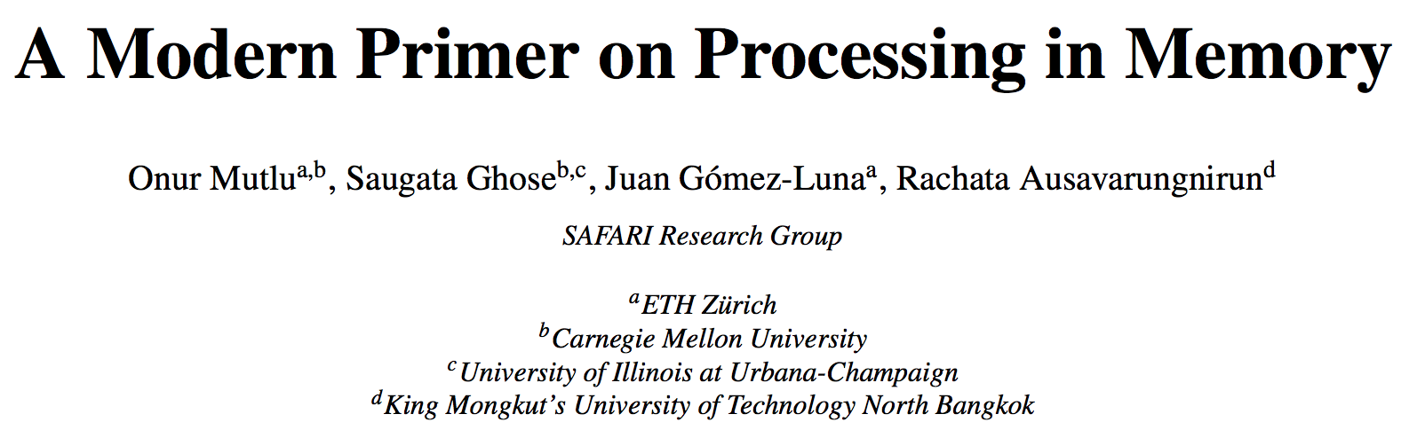
PIM Review and Open Problems
Onur Mutlu, Saugata Ghose, Juan Gomez-Luna, and Rachata Ausavarungnirun,
"A Modern Primer on Processing in Memory"
Invited Book Chapter in Emerging Computing: From Devices to Systems - Looking Beyond Moore and Von Neumann, Springer, to be published in 2021.
https://arxiv.org/pdf/2012.03112.pdf

Slide 46
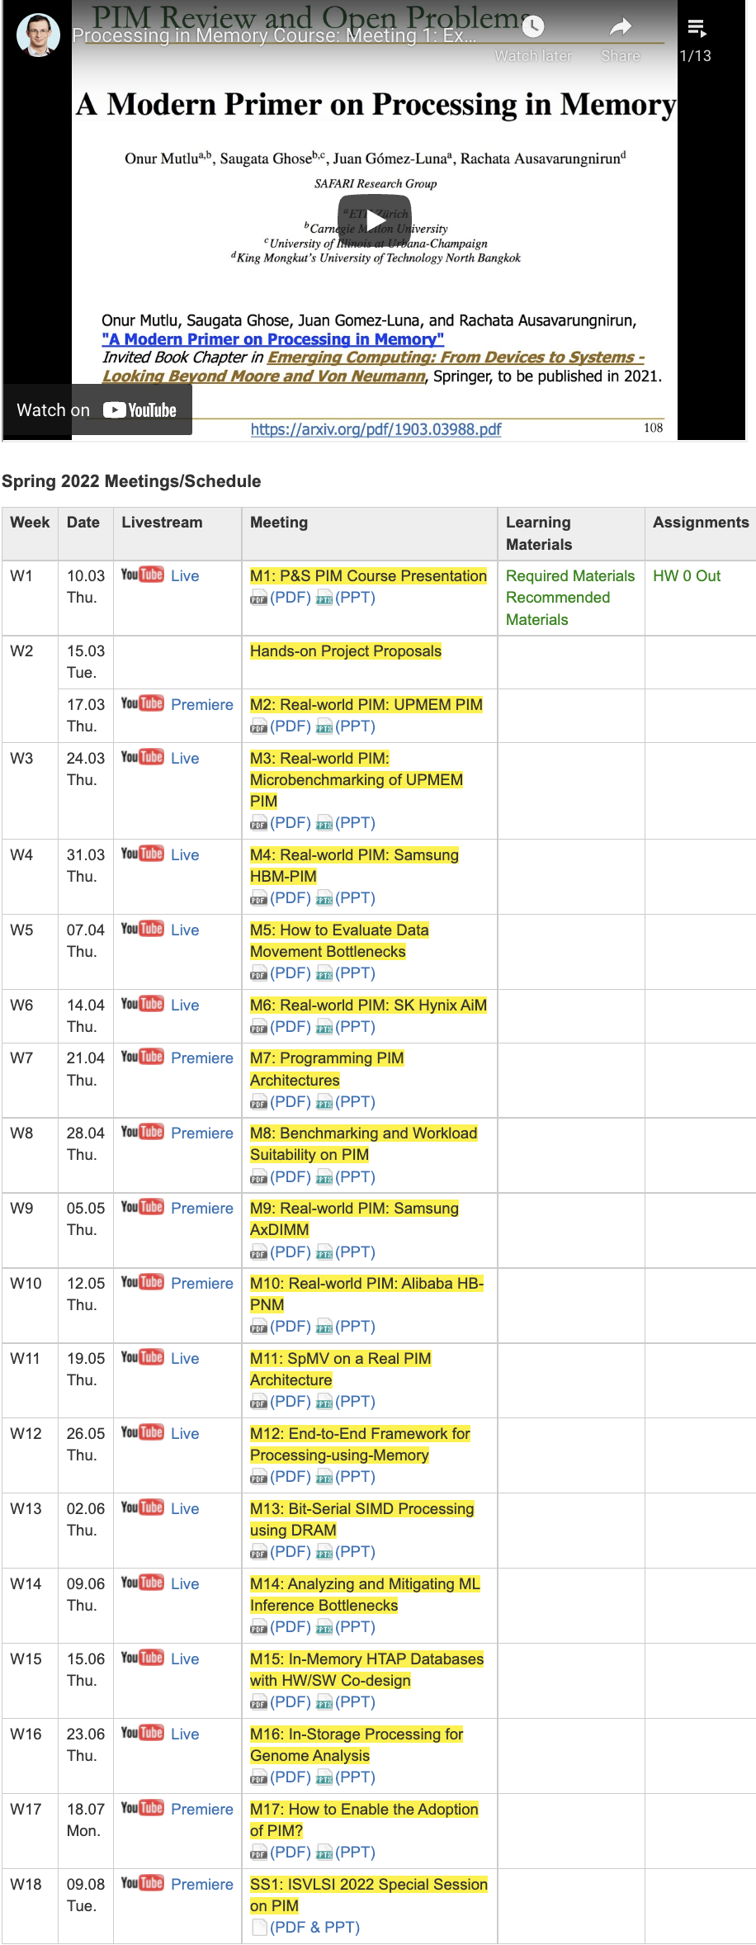
PIM Course (Fall 2022)
Fall 2022 Edition:
  https://safari.ethz.ch/projects_and_seminars/fall2022/doku.php?id=processing_in_memory
Spring 2022 Edition:
  https://safari.ethz.ch/projects_and_seminars/spring2022/doku.php?id=processing_in_memory
Youtube Livestream (Fall 2022):
  https://www.youtube.com/watch?v=QLL0wQ9I4Dw&list=PL5Q2soXY2Zi8KzG2CQYRNQOVD0GOBrnKy
Youtube Livestream (Spring 2022):
  https://www.youtube.com/watch?v=9e4Chnwdovo&list=PL5Q2soXY2Zi-841fUYYUK9EsXKhQKRPyX
Project course
  Taken by Bachelor’s/Master’s students
  Processing-in-Memory lectures
  Hands-on research exploration
  Many research readings
https://www.youtube.com/onurmutlulectures

Slide 47
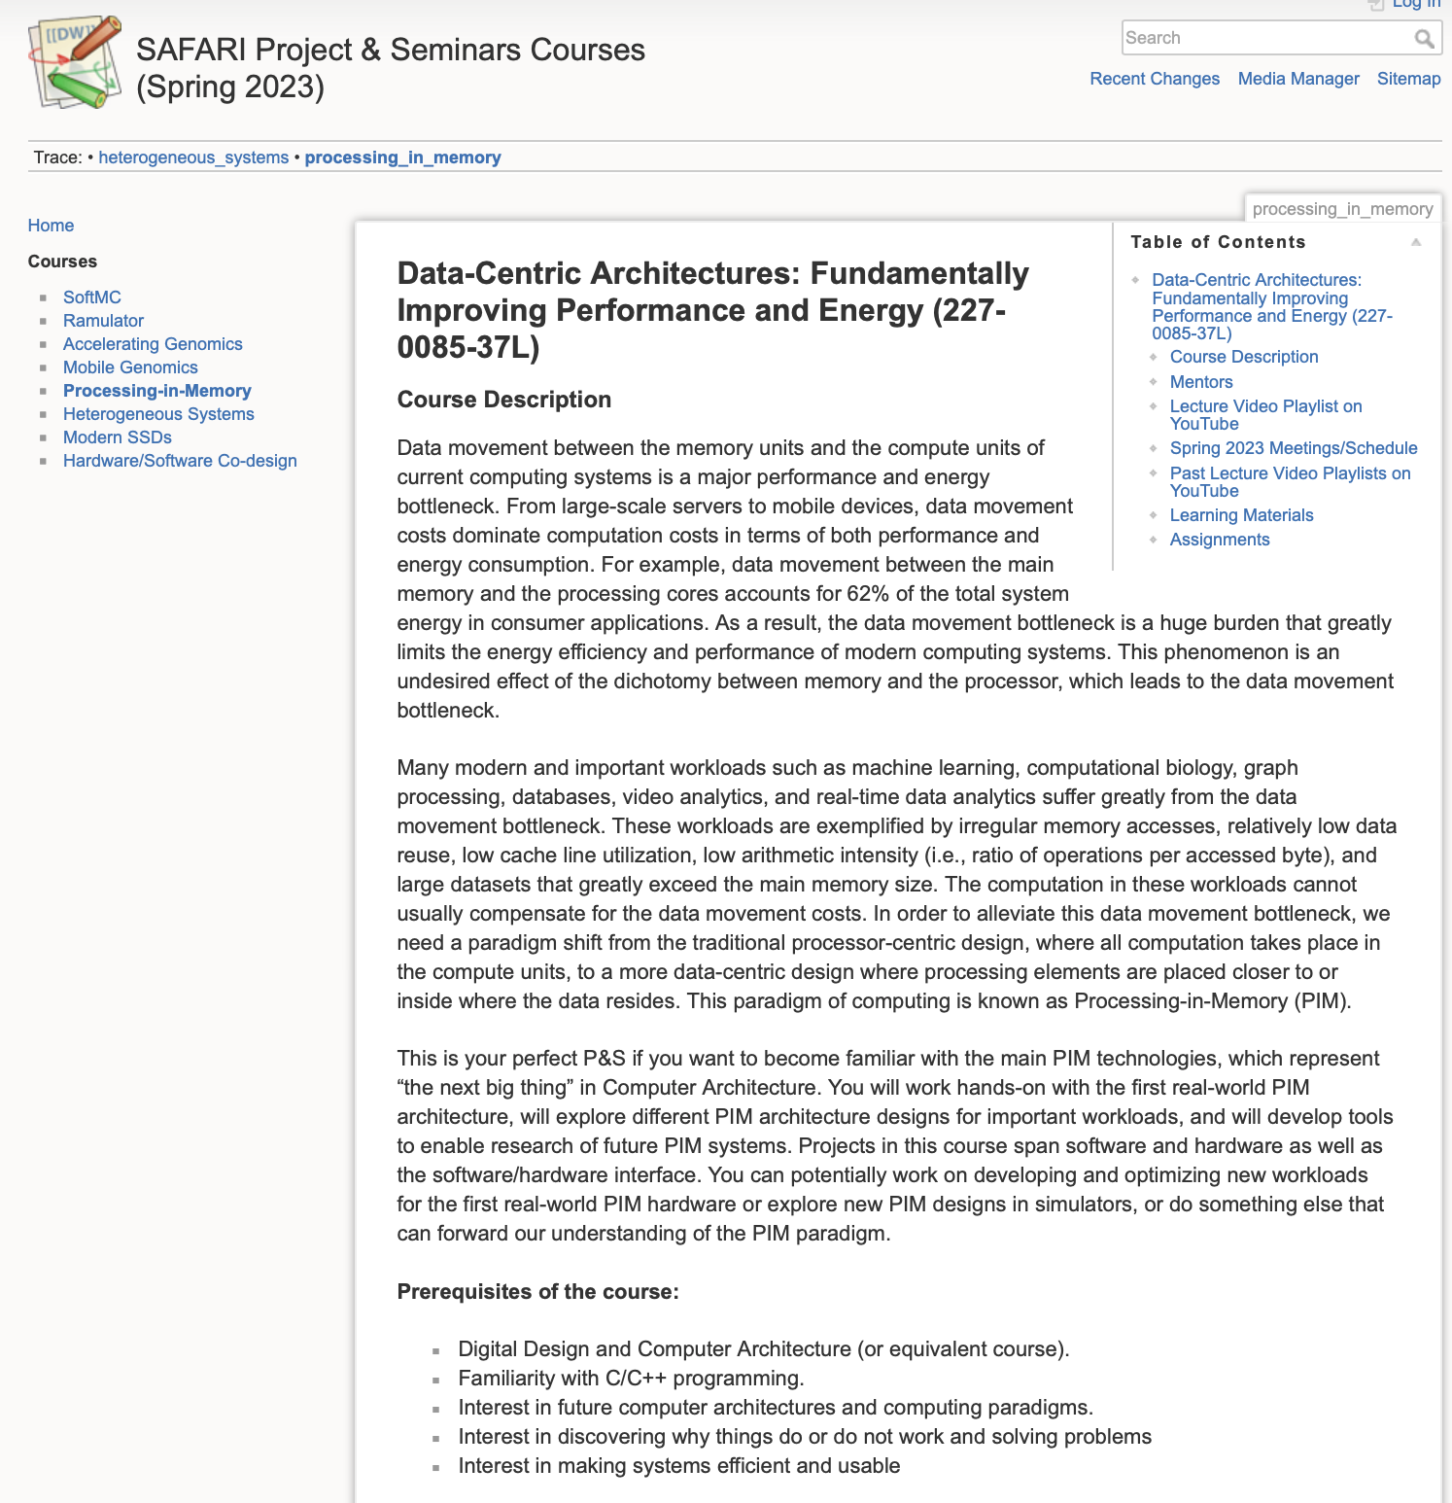
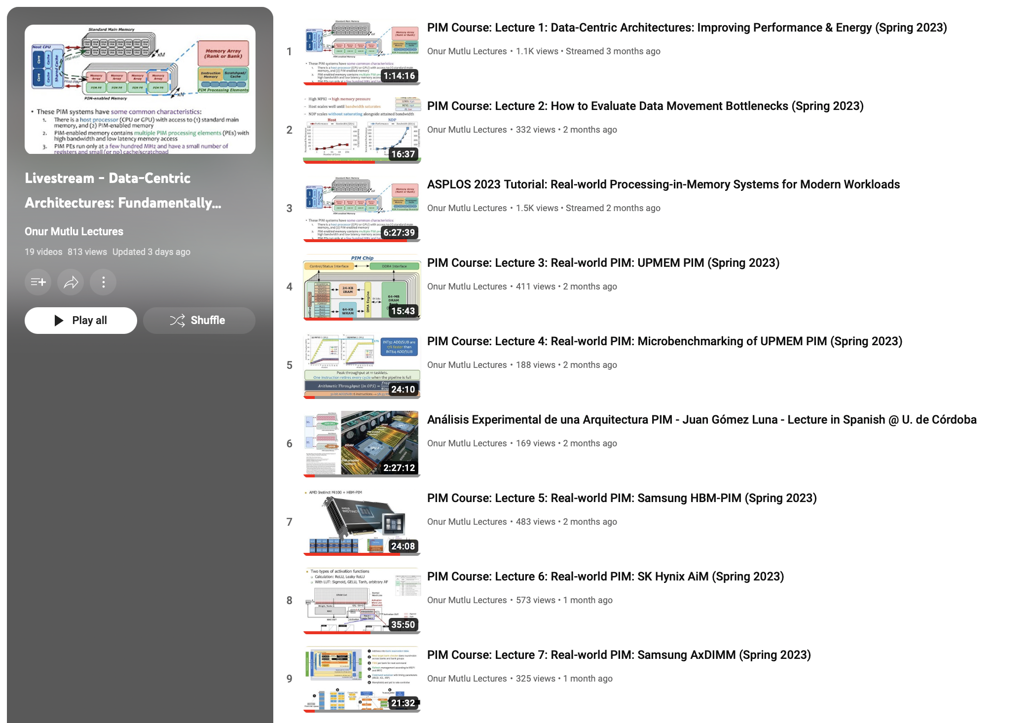
Processing-in-Memory Course (Spring 2023)
Short weekly lectures
Hands-on projects
https://www.youtube.com/playlist?list=PL5Q2soXY2Zi_EObuoAZVSq_o6UySWQHvZ
https://safari.ethz.ch/projects_and_seminars/spring2023/doku.php?id=processing_in_memory

Slide 48
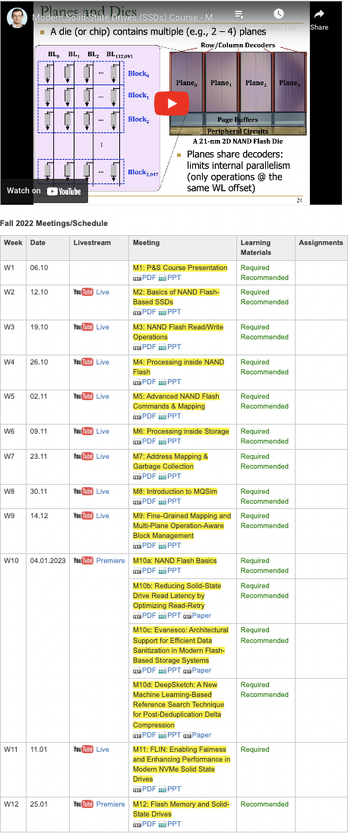
SSD Course (Spring 2023)
Spring 2023 Edition:
  https://safari.ethz.ch/projects_and_seminars/spring2023/doku.php?id=modern_ssds
Fall 2022 Edition:
  https://safari.ethz.ch/projects_and_seminars/fall2022/doku.php?id=modern_ssds
Youtube Livestream (Spring 2023):
  https://www.youtube.com/watch?v=4VTwOMmsnJY&list=PL5Q2soXY2Zi_8qOM5Icpp8hB2SHtm4z57&pp=iAQB
Youtube Livestream (Fall 2022):
  https://www.youtube.com/watch?v=hqLrd-Uj0aU&list=PL5Q2soXY2Zi9BJhenUq4JI5bwhAMpAp13&pp=iAQB
Project course
  Taken by Bachelor’s/Master’s students
  SSD Basics and Advanced Topics
  Hands-on research exploration
  Many research readings
https://www.youtube.com/onurmutlulectures

Slide 49
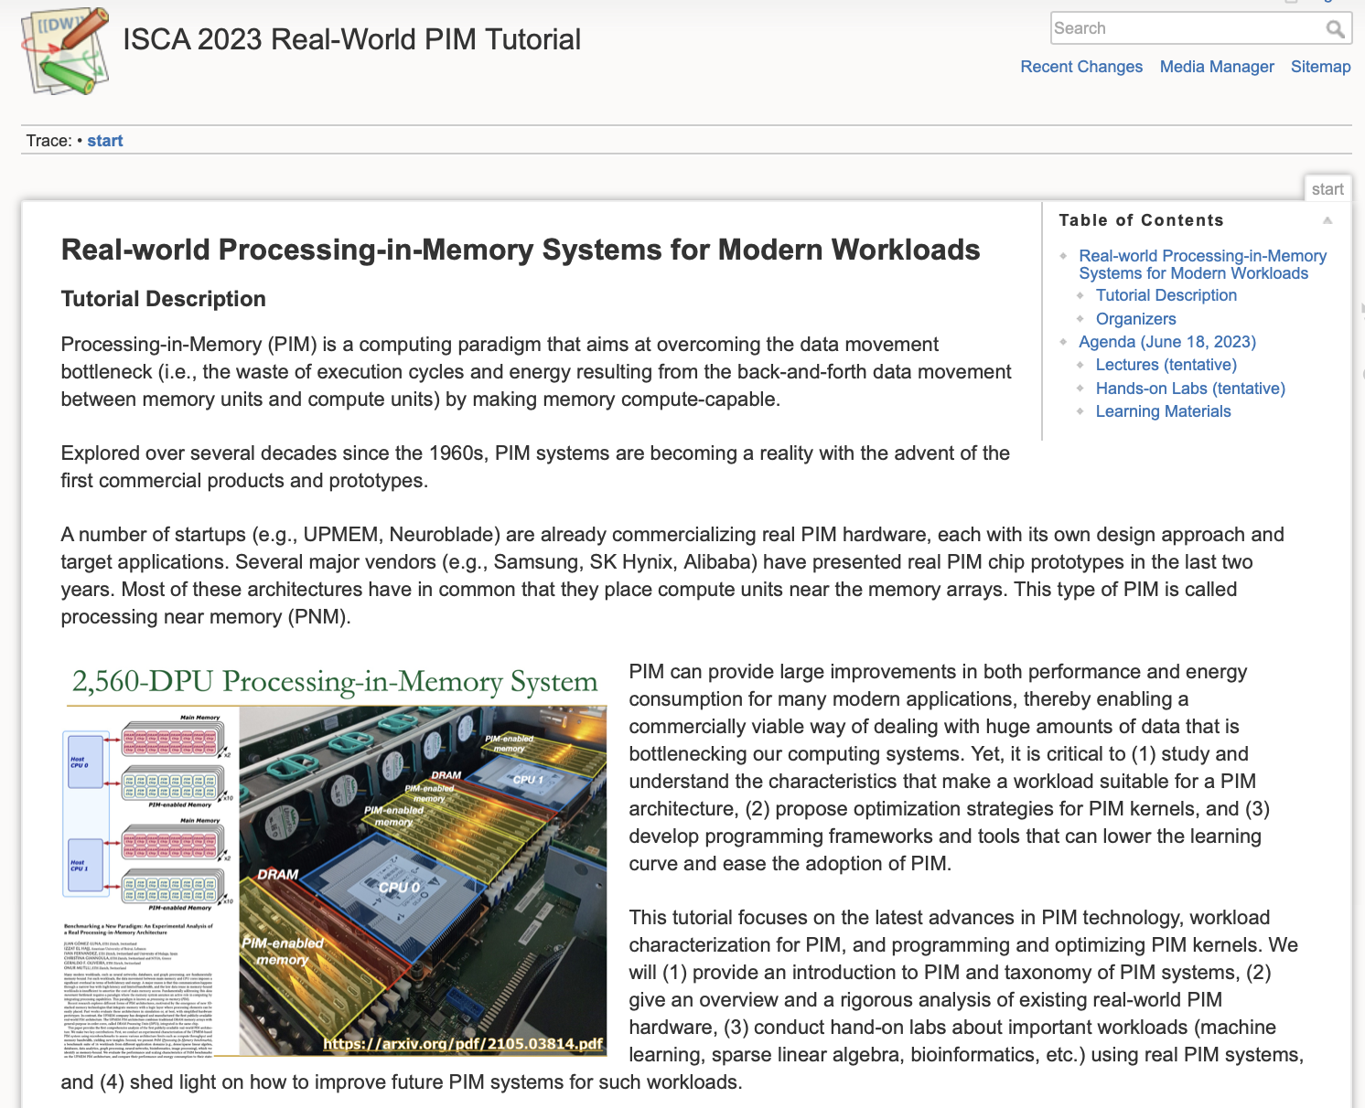
Real PIM Tutorials [MICRO’23, ISCA’23, ASPLOS’23, HPCA’23]
Jun, Mar, Feb, Oct : Lectures + Hands-on labs + Invited talks
https://events.safari.ethz.ch/isca-pim-tutorial/

Slide 50
We Need to Think Differently from the Past Approaches

Slide 51
Processing in Memory:
Two Approaches
1. Processing using Memory
2. Processing near Memory

Slide 52
A PIM Taxonomy
Nature (of computation)
  Using: Use operational properties of memory structures
  Near: Add logic close to memory structures
Technology
  Flash, DRAM, SRAM, RRAM, MRAM, FeRAM, PCM, 3D, …
Location
  Sensor, Cold Storage, Hard Disk, SSD, Main Memory, Cache, Register File, Memory Controller, Interconnect, …
A tuple of the three determines “PIM type”
One can combine multiple “PIM types” in a system

Slide 53
Mindset: Memory as an Accelerator
CPU
core
CPU
core
mini-CPU
core
GPU
(throughput)
core
GPU
(throughput)
core
video
core
GPU
(throughput)
core
GPU
(throughput)
core
CPU
core
CPU
core
Memory
imaging
core
LLC
Specialized
compute-capability
in memory
Memory Controller
Memory Bus
Memory similar to a “conventional” accelerator

Slide 54
Example PIM Type: Processing using DRAM
Nature: Using
Technology: DRAM
Location: Main Memory
Processing using DRAM in Main Memory
Seshadri+, “Fast Bulk Bitwise AND and OR in DRAM”, IEEE CAL 2015.
Seshadri+, “Ambit: In-Memory Accelerator for Bulk Bitwise Operations Using Commodity DRAM Technology,” MICRO 2017.
Hajinazar+, “SIMDRAM: A Framework for Bit-Serial SIMD Processing using DRAM,” ASPLOS 2021.
Oliveira+, “MIMDRAM: An End-to-End Processing-Using-DRAM System for High-Throughput, Energy-Efficient and Programmer-Transparent Multiple-Instruction Multiple-Data Processing,” HPCA 2024.

Slide 55
Processing using DRAM
We can support
  Bulk bitwise AND, OR, NOT, MAJ
  Bulk bitwise COPY and INIT/ZERO
  True Random Number Generation; Physical Unclonable Functions
  Lookup Table based more complex computation
At low cost
Using analog computation capability of DRAM
  Idea: activating (multiple) rows performs computation
    Even in commodity off-the-shelf DRAM chips!
30-77X performance and energy improvement
  Seshadri+, “Ambit: In-Memory Accelerator for Bulk Bitwise Operations Using Commodity DRAM Technology,” MICRO 2017.
  Seshadri+“RowClone: Fast and Efficient In-DRAM Copy and Initialization of Bulk Data,” MICRO 2013.

Slide 56

Starting Simple: Data Copy and Initialization
  memmove & memcpy: 5% cycles in Google’s datacenter [Kanev+ ISCA’15]
000000000000000
Zero initialization
(e.g., security)
Forking
Checkpointing
Many more
VM Cloning
Deduplication
Page Migration

Slide 57
Today’s Systems: Bulk Data Copy
1) High latency
Memory
3) Cache pollution
L3
CPU
L2
L1
MC
2) High bandwidth utilization
4) Unwanted data movement
1046ns, 3.6uJ (for 4KB page copy via DMA)

Slide 58
Future Systems: In-Memory Copy
3) No cache pollution
1) Low latency
Memory
L3
CPU
L2
L1
MC
2) Low bandwidth utilization
4) No unwanted data movement
1046ns, 3.6uJ
→ 90ns, 0.04uJ

Slide 59
RowClone: In-DRAM Row Copy
Idea: Two consecutive ACTivates
4 Kbytes
Negligible HW cost
Step 1: Activate row A
Step 2: Activate row B
Transfer row
DRAM subarray
Transfer
row
Row Buffer (4 Kbytes)
8 bits
Data Bus
Notes:
copy

Slide 60
RowClone: Latency and Energy Savings
11.6x
74x
Seshadri et al., “RowClone: Fast and Efficient In-DRAM Copy and Initialization of Bulk Data,” MICRO 2013.

Slide 61
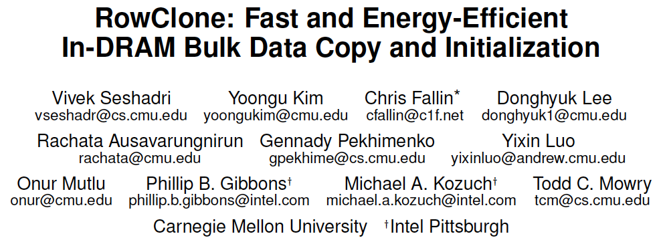
More on RowClone
Vivek Seshadri, Yoongu Kim, Chris Fallin, Donghyuk Lee, Rachata Ausavarungnirun, Gennady Pekhimenko, Yixin Luo, Onur Mutlu, Michael A. Kozuch, Phillip B. Gibbons, and Todd C. Mowry,
"RowClone: Fast and Energy-Efficient In-DRAM Bulk Data Copy and Initialization"
Proceedings of the 46th International Symposium on Microarchitecture (MICRO), Davis, CA, December 2013. [Slides (pptx) (pdf)] [Lightning Session Slides (pptx) (pdf)] [Poster (pptx) (pdf)]

Slide 62
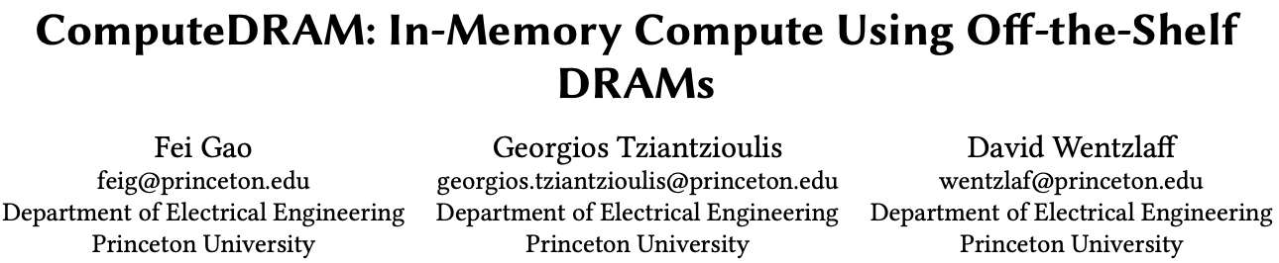
RowClone in Off-the-Shelf DRAM Chips
Idea: Violate DRAM timing parameters to mimic RowClone
https://parallel.princeton.edu/papers/micro19-gao.pdf

Slide 63
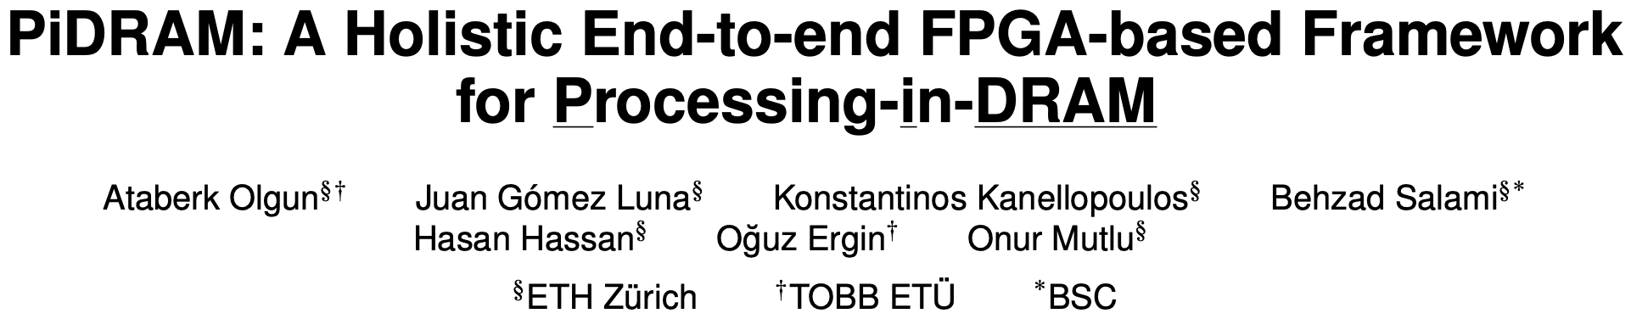
Real Processing Using Memory Prototype
End-to-end RowClone & TRNG using off-the-shelf DRAM chips
Idea: Violate DRAM timing parameters to mimic RowClone
https://arxiv.org/pdf/2111.00082.pdf
https://github.com/cmu-safari/pidram
https://www.youtube.com/watch?v=qeukNs5XI3g&t=4192s

Slide 64
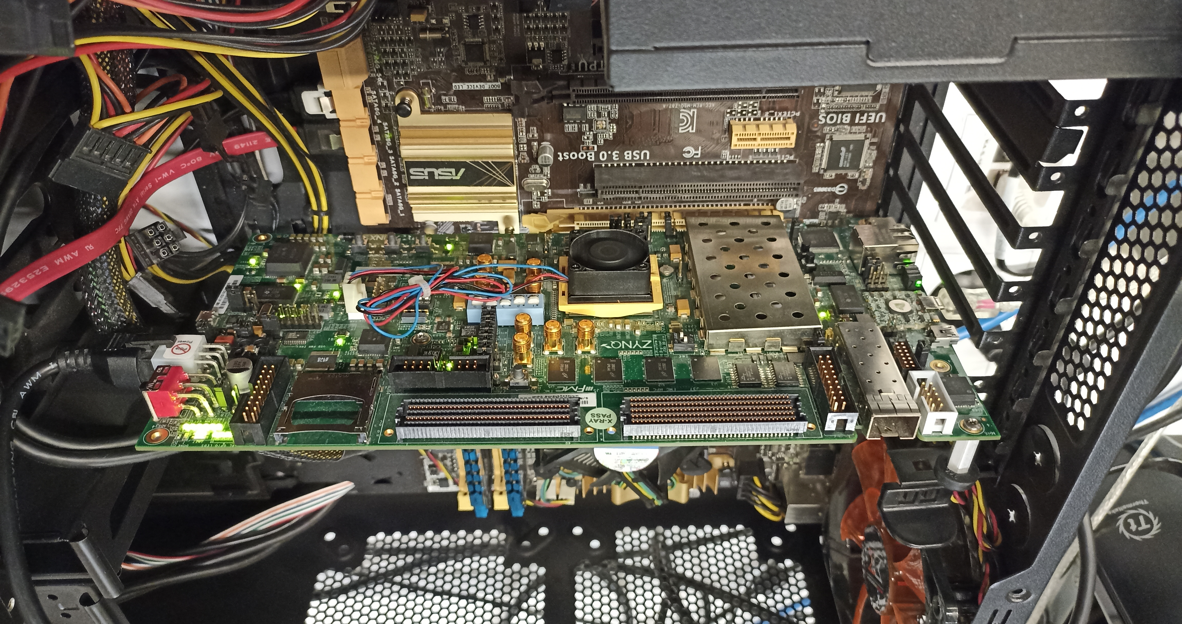
Real Processing-using-Memory Prototype
https://arxiv.org/pdf/2111.00082.pdf
https://github.com/cmu-safari/pidram
https://www.youtube.com/watch?v=qeukNs5XI3g&t=4192s
Host Machine
FPGA Board
RISC-V System
PiM-Enabled DIMM

Slide 65
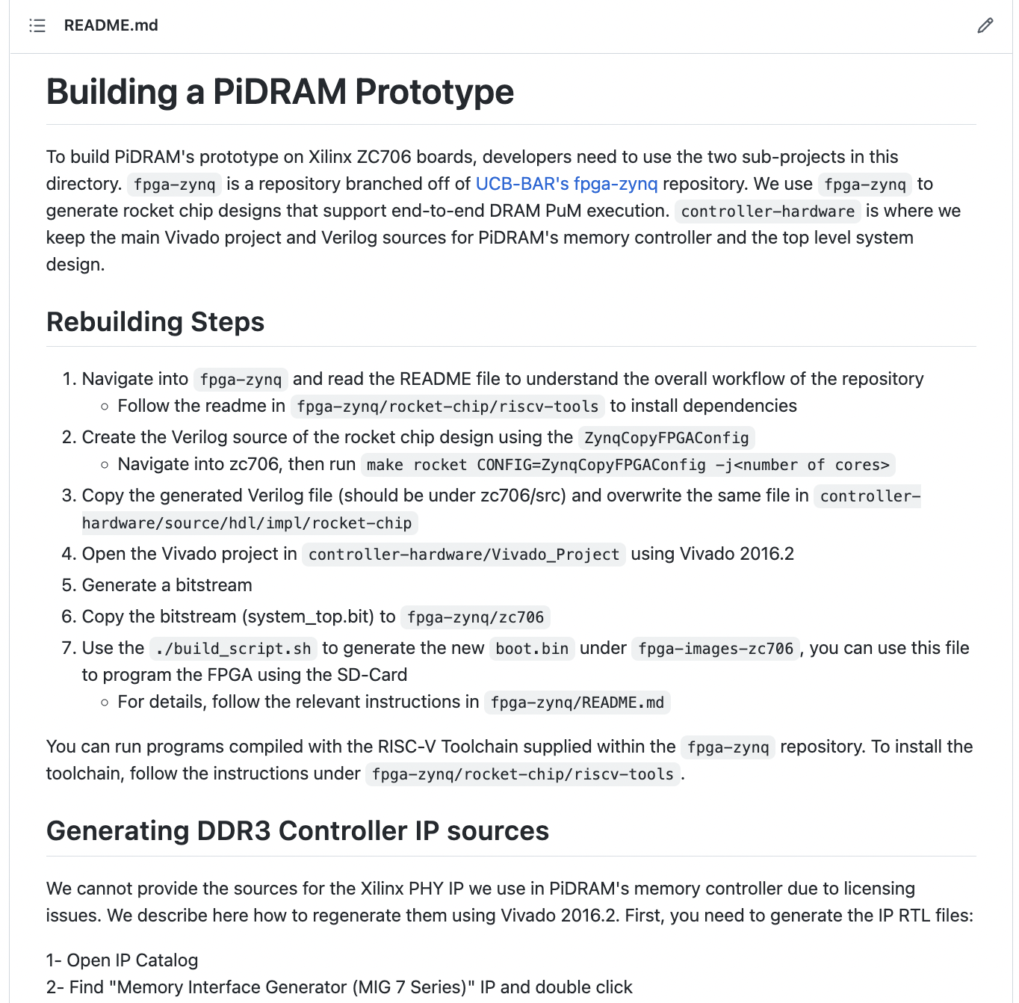
Real Processing-using-Memory Prototype
https://arxiv.org/pdf/2111.00082.pdf
https://github.com/cmu-safari/pidram
https://www.youtube.com/watch?v=qeukNs5XI3g&t=4192s

Slide 66
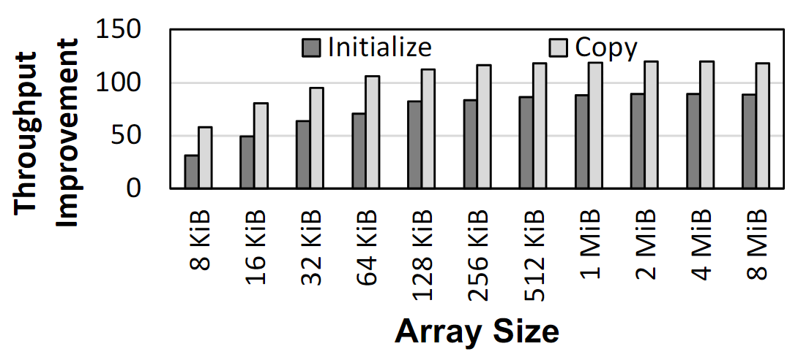
Microbenchmark Copy/Initialization Throughput
In-DRAM Copy and Initialization
improve throughput by 119x and 89x
Notes:
This plot shows the throughput improvement provided by in-DRAM copy operations for bulk data initialization and copy over CPU-based copy and initialization using LOAD and STORE instructions. We do not execute any CLFLUSH instructions and assume that the data is up to date in DRAM and there are no cached copies.
The x-axis shows the size of the arrays that we copy or initialize. The dark gray bar shows the improvement for initialization operations, and the bright gray bar shows the improvement for copy operations.
[CLICK] We observe that in-DRAM copy and initialization operations improve copy and initialization throughput by 119x and 89x including the overheads of system support required for RowClone operations

Slide 67
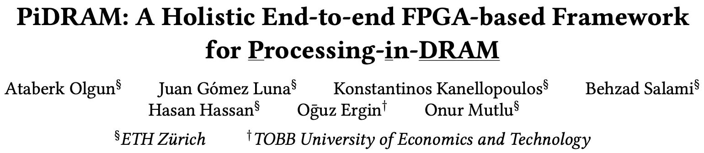
More on PiDRAM
Ataberk Olgun, Juan Gomez Luna, Konstantinos Kanellopoulos, Behzad Salami, Hasan Hassan, Oguz Ergin, and Onur Mutlu,
"PiDRAM: A Holistic End-to-end FPGA-based Framework for Processing-in-DRAM"
ACM Transactions on Architecture and Code Optimization (TACO), March 2023.
[arXiv version]
Presented at the 18th HiPEAC Conference, Toulouse, France, January 2023.
[Slides (pptx) (pdf)]
[Longer Lecture Slides (pptx) (pdf)]
[Lecture Video (40 minutes)]
[PiDRAM Source Code]

Slide 68
RowClone Extensions and Follow-Up Work
Can this be improved to do faster inter-subarray copy?
  Yes, see LISA [Chang et al., HPCA 2016]
Can we enable data movement at smaller granularities within a bank?
  Yes, see FIGARO [Wang et al., MICRO 2020]
Can this be improved to do better inter-bank copy?
  Yes, see Network-on-Memory [CAL 2020]
Can similar ideas and DRAM properties be used to perform computation on data?
  Yes, see Ambit [Seshadri et al., CAL 2015, MICRO 2017]

Slide 69
LISA: Increasing Connectivity in DRAM
Kevin K. Chang, Prashant J. Nair, Saugata Ghose, Donghyuk Lee, Moinuddin K. Qureshi, and Onur Mutlu,
"Low-Cost Inter-Linked Subarrays (LISA): Enabling Fast Inter-Subarray Data Movement in DRAM"
Proceedings of the 22nd International Symposium on High-Performance Computer Architecture (HPCA), Barcelona, Spain, March 2016.
[Slides (pptx) (pdf)]
[Source Code]

Slide 70
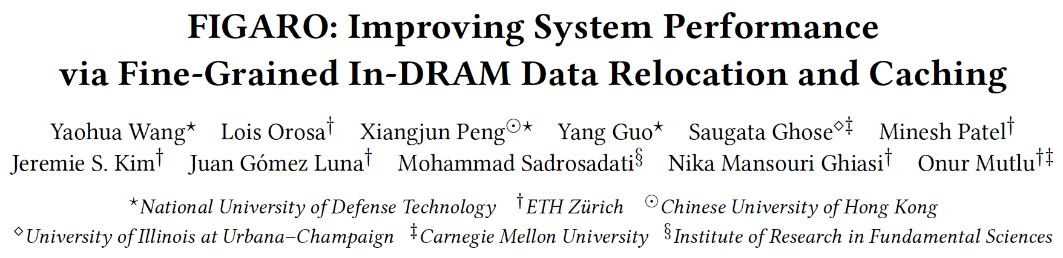
FIGARO: Fine-Grained In-DRAM Copy
Yaohua Wang, Lois Orosa, Xiangjun Peng, Yang Guo, Saugata Ghose, Minesh Patel, Jeremie S. Kim, Juan Gómez Luna, Mohammad Sadrosadati, Nika Mansouri Ghiasi, and Onur Mutlu,
"FIGARO: Improving System Performance via Fine-Grained In-DRAM Data Relocation and Caching"
Proceedings of the 53rd International Symposium on Microarchitecture (MICRO), Virtual, October 2020.

Slide 71
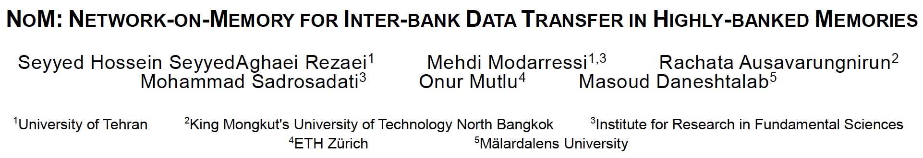
Network-On-Memory: Fast Inter-Bank Copy
Seyyed Hossein SeyyedAghaei Rezaei, Mehdi Modarressi, Rachata Ausavarungnirun, Mohammad Sadrosadati, Onur Mutlu, and Masoud Daneshtalab,
"NoM: Network-on-Memory for Inter-Bank Data Transfer in Highly-Banked Memories"
IEEE Computer Architecture Letters (CAL), to appear in 2020.

Slide 72
Mindset: Memory as an Accelerator
CPU
core
CPU
core
mini-CPU
core
GPU
(throughput)
core
GPU
(throughput)
core
video
core
GPU
(throughput)
core
GPU
(throughput)
core
CPU
core
CPU
core
Memory
imaging
core
LLC
Specialized
compute-capability
in memory
Memory Controller
Memory Bus
Memory similar to a “conventional” accelerator

Slide 73

Lecture on RowClone & Processing using DRAM
https://www.youtube.com/watch?v=n6Pwg1qax_E&list=PL5Q2soXY2Zi_7UBNmC9B8Yr5JSwTG9yH4&index=4

Slide 74
(Truly) In-Memory Computation
We can support in-DRAM AND, OR, NOT, MAJ
At low cost
Using analog computation capability of DRAM
  Idea: activating multiple rows performs computation
30-60X performance and energy improvement
  Seshadri+, “Ambit: In-Memory Accelerator for Bulk Bitwise Operations Using Commodity DRAM Technology,” MICRO 2017.
New memory technologies enable even more opportunities
  Memristors, resistive RAM, phase change mem, STT-MRAM, …
  Can operate on data with minimal movement

Slide 75
In-DRAM AND/OR: Triple Row Activation
½V_{DD}
½V_{DD}+δ
V_{DD}
A
Final State
AB + BC + AC
B
C
C(A + B) + ~C(AB)
dis
en
0
½V_{DD}
Seshadri+, “Fast Bulk Bitwise AND and OR in DRAM”, IEEE CAL 2015.

Slide 76
Bulk Bitwise Operations in Workloads
[1] Li and Patel, BitWeaving, SIGMOD 2013
[2] Goodwin+, BitFunnel, SIGIR 2017

Slide 77
In-DRAM Acceleration of Database Queries
>4-12X Performance Improvement
Seshadri+, “Ambit: In-Memory Accelerator for Bulk Bitwise Operations using Commodity DRAM Technology,” MICRO 2017.

Slide 78

More on In-DRAM Bulk AND/OR
Vivek Seshadri, Kevin Hsieh, Amirali Boroumand, Donghyuk Lee, Michael A. Kozuch, Onur Mutlu, Phillip B. Gibbons, and Todd C. Mowry,
"Fast Bulk Bitwise AND and OR in DRAM"
IEEE Computer Architecture Letters (CAL), April 2015.

Slide 79
More on Ambit
Vivek Seshadri, Donghyuk Lee, Thomas Mullins, Hasan Hassan, Amirali Boroumand, Jeremie Kim, Michael A. Kozuch, Onur Mutlu, Phillip B. Gibbons, and Todd C. Mowry,
"Ambit: In-Memory Accelerator for Bulk Bitwise Operations Using Commodity DRAM Technology"
Proceedings of the 50th International Symposium on Microarchitecture (MICRO), Boston, MA, USA, October 2017.
[Slides (pptx) (pdf)] [Lightning Session Slides (pptx) (pdf)] [Poster (pptx) (pdf)]

Slide 80

In-DRAM Bulk Bitwise Execution
Vivek Seshadri and Onur Mutlu,
"In-DRAM Bulk Bitwise Execution Engine"
Invited Book Chapter in Advances in Computers, to appear in 2020.
[Preliminary arXiv version]

Slide 81

SIMDRAM Framework
Nastaran Hajinazar, Geraldo F. Oliveira, Sven Gregorio, Joao Dinis Ferreira, Nika Mansouri Ghiasi, Minesh Patel, Mohammed Alser, Saugata Ghose, Juan Gomez-Luna, and Onur Mutlu,
"SIMDRAM: An End-to-End Framework for Bit-Serial SIMD Computing in DRAM"
Proceedings of the 26th International Conference on Architectural Support for Programming Languages and Operating Systems (ASPLOS), Virtual, March-April 2021.
[2-page Extended Abstract]
[Short Talk Slides (pptx) (pdf)]
[Talk Slides (pptx) (pdf)]
[Short Talk Video (5 mins)]
[Full Talk Video (27 mins)]

Slide 82





SIMDRAM Framework: Overview
User Input
Step 1: Generate
MAJ logic
Step 2: Generate
sequence of
DRAM commands
SIMDRAM Output
Desired operation
New SIMDRAM $μ$Program
ACT/PRE
ACT/PRE
ACT/PRE
ACT/ACT/PRE
done
$$μProgram$$
$$μProgram$$
MAJ
Main memory
AND/OR/NOT logic
MAJ/NOT logic
bbop_new
New SIMDRAM
instruction
ISA
$μ$Program
User Input
Step 3: Execution according to $μ$Program
SIMDRAM Output
SIMDRAM-enabled application
Instruction result
in memory
foo () {
bbop_new
}
ACT/PRE
ACT/PRE
ACT/PRE
ACT/PRE/PRE
done
ACT/PRE
Control Unit
$μ$Program
Memory Controller

Slide 83
SIMDRAM Key Results
Evaluated on:
  16 complex in-DRAM operations
  7 commonly-used real-world applications
SIMDRAM provides:
88× and 5.8× the throughput of a CPU and a high-end GPU, respectively, over 16 operations
257× and 31× the energy efficiency of a CPU and a high-end GPU, respectively, over 16 operations
21× and 2.1× the performance of a CPU an a high-end GPU, over seven real-world applications

Slide 84
More on SIMDRAM
Nastaran Hajinazar, Geraldo F. Oliveira, Sven Gregorio, Joao Dinis Ferreira, Nika Mansouri Ghiasi, Minesh Patel, Mohammed Alser, Saugata Ghose, Juan Gomez-Luna, and Onur Mutlu,
"SIMDRAM: An End-to-End Framework for Bit-Serial SIMD Computing in DRAM"
Proceedings of the 26th International Conference on Architectural Support for Programming Languages and Operating Systems (ASPLOS), Virtual, March-April 2021.
[2-page Extended Abstract]
[Short Talk Slides (pptx) (pdf)]
[Talk Slides (pptx) (pdf)]
[Short Talk Video (5 mins)]
[Full Talk Video (27 mins)]

Slide 85


MIMDRAM: More Flexible Processing using DRAM
Appears at HPCA 2024
https://arxiv.org/pdf/2402.19080.pdf

Slide 86
MIMDRAM: Executive Summary
Problem: Processing-Using-DRAM (PUD) suffers from three issues caused by DRAM’s large and rigid access granularity
Underutilization due to data parallelism variation in (and across) applications
Limited computation support due to a lack of interconnects
Challenging programming model due to a lack of compilers
Goal: Design a flexible PUD system that overcomes the three limitations caused by DRAM’s large and rigid access granularity
Key Mechanism: MIMDRAM, a hardware/software co-design PUD system
Key idea: leverage fine-grained DRAM for PUD operation
HW: - simple changes to the DRAM array, enabling concurrent PUD operations
- low-cost interconnects at the DRAM peripherals for data reduction
SW: - compiler and OS support to generate and map PUD instructions
Key Results: MIMDRAM achieves
14.3x, 30.6x, and 6.8x the energy efficiency of state-of-the-art PUD systems, a high-end CPU and GPU, respectively
Small area cost to a DRAM chip (1.11%) and CPU die (0.6%)
https://github.com/CMU-SAFARI/MIMDRAM
Notes:
Before we start, I will give a summary of OUR work.
Processing-in-memory architectures are emerging solutions to mitigate data movement bottlenecks by moving computation where the data resides. In particular, processing using DRAM is a PIM architecture that utilizes DRAM’s analog operating principles to implement bulk operations.
[CLICK] Even though processing-using-DRAM can often accelerate many application domains, they suffer from three issues caused by DRAM’s large and rigid access granularity
[CLICK] First, they suffer from under-utilization due to a mismatch in the data parallelism in applications and DRAM’s data parallelism
[CLICK] Second, they suffer from limited computation support, in particular for reduction operations, due to a lack of native interconnects for data movement within a DRAM array
[CLICK] Third, programming processing using-DRAM architectures is a challenging task due to a lack of automation tools
[CLICK] Therefore, our goal in this work is to design a flexible PUD system that overcomes the three limitations caused by DRAM’s large and rigid access granularity
[CLICK] To this end, we propose MIMDRAM, a hardware/software co-designed PUD system
[CLICK] The key idea of MIMDRAM is to leverage fine-grained DRAM for PUD operation, which is, the ability to access only segments of a DRAM row. We leverage such key idea in both hardware and software
[CLICK] On the hardware-side, we implement simple modifications to the DRAM array to enable the allocation of only the resources required for a PUD operation. This also allows MIMDRAM to concurrently execute independent PUD operations in a single DRAM array.
We also implement low-cost interconnects at the DRAM peripheral logic, enabling native in-DRAM vector reduction.
[CLICK] On the software side, we implement compiler and operating system support to generate and map PUD operations to the underlying hardware substrate.
[CLICK[ We extensively evaluation MIMDRAM, and we observe that it achieves
[CLICK] significant performance and energy efficiency gains compared to state-of-the-art PUD systems, a high-end CPU and GPU
[CLICK] while incuring low area cost to a DRAM chip and CPU die.
[NEXT]

Slide 87

In-DRAM Lookup-Table Based Execution
João Dinis Ferreira, Gabriel Falcao, Juan Gómez-Luna, Mohammed Alser, Lois Orosa, Mohammad Sadrosadati, Jeremie S. Kim, Geraldo F. Oliveira, Taha Shahroodi, Anant Nori, and Onur Mutlu,
"pLUTo: Enabling Massively Parallel Computation in DRAM via Lookup Tables"
Proceedings of the 55th International Symposium on Microarchitecture (MICRO), Chicago, IL, USA, October 2022.
[Slides (pptx) (pdf)]
[Longer Lecture Slides (pptx) (pdf)]
[Lecture Video (26 minutes)]
[arXiv version]
[Source Code (Officially Artifact Evaluated with All Badges)]
Officially artifact evaluated as available, reusable and reproducible.
https://arxiv.org/pdf/2104.07699.pdf

Slide 88

In-DRAM Physical Unclonable Functions
Jeremie S. Kim, Minesh Patel, Hasan Hassan, and Onur Mutlu,
"The DRAM Latency PUF: Quickly Evaluating Physical Unclonable Functions by Exploiting the Latency-Reliability Tradeoff in Modern DRAM Devices"
Proceedings of the 24th International Symposium on High-Performance Computer Architecture (HPCA), Vienna, Austria, February 2018.
[Lightning Talk Video]
[Slides (pptx) (pdf)] [Lightning Session Slides (pptx) (pdf)]
[Full Talk Lecture Video (28 minutes)]

Slide 89

In-DRAM True Random Number Generation
Jeremie S. Kim, Minesh Patel, Hasan Hassan, Lois Orosa, and Onur Mutlu,
"D-RaNGe: Using Commodity DRAM Devices to Generate True Random Numbers with Low Latency and High Throughput"
Proceedings of the 25th International Symposium on High-Performance Computer Architecture (HPCA), Washington, DC, USA, February 2019.
[Slides (pptx) (pdf)]
[Full Talk Video (21 minutes)]
[Full Talk Lecture Video (27 minutes)]
Top Picks Honorable Mention by IEEE Micro.

Slide 90

In-DRAM True Random Number Generation
Ataberk Olgun, Minesh Patel, A. Giray Yaglikci, Haocong Luo, Jeremie S. Kim, F. Nisa Bostanci, Nandita Vijaykumar, Oguz Ergin, and Onur Mutlu,
"QUAC-TRNG: High-Throughput True Random Number Generation Using Quadruple Row Activation in Commodity DRAM Chips"
Proceedings of the 48th International Symposium on Computer Architecture (ISCA), Virtual, June 2021.
[Slides (pptx) (pdf)]
[Short Talk Slides (pptx) (pdf)]
[Talk Video (25 minutes)]
[SAFARI Live Seminar Video (1 hr 26 mins)]

Slide 91

In-DRAM True Random Number Generation
F. Nisa Bostanci, Ataberk Olgun, Lois Orosa, A. Giray Yaglikci, Jeremie S. Kim, Hasan Hassan, Oguz Ergin, and Onur Mutlu,
"DR-STRaNGe: End-to-End System Design for DRAM-based True Random Number Generators"
Proceedings of the 28th International Symposium on High-Performance Computer Architecture (HPCA), Virtual, April 2022.
[Slides (pptx) (pdf)]
[Short Talk Slides (pptx) (pdf)]
https://arxiv.org/pdf/2201.01385.pdf

Slide 92


DRAM Chips Are Already (Quite) Capable!
Appears at HPCA 2024
https://arxiv.org/pdf/2402.18736.pdf

Slide 93



DRAM Chips Are Already (Quite) Capable!
https://arxiv.org/pdf/2312.02880.pdf

Slide 94

DRAM Chips Are Already (Quite) Capable!
Appears at DSN 2024
https://arxiv.org/pdf/2405.06081

Slide 95
The Capability of COTS DRAM Chips
We demonstrate that COTS DRAM chips:
1
Can simultaneously activate up to
48 rows in two neighboring subarrays
2
Can perform NOT operation
with up to 32 output operands
3
Can perform up to 16-input
AND, NAND, OR, and NOR operations
95
Notes:
[CLICK]In this study, we experimentally demonstrate that off-the-shelf DRAM chips
[CLICK] Can simultaneously activating up to 48 DRAM rows in two neighboring subarrays
[CLICK] Can performing NOT operation with up to 32 output operands
[CLICK] Can performing up to 16-input AND, NAND, OR, and NOR operations

Slide 96
Key Idea: NOT Operation
Connect rows in neighboring subarrays
through a NOT gate by simultaneously activating rows
src
src
src
NOT gate
A
A
A
SA
SA
SA
ACT src
ACT dst
~A
dst
dst
dst
96
Notes:
Our key idea is to leverage the connection between neighboring subarrays,
[CLICK] the NOT gate in the sense amplifier.
[CLICK] By simultaneously activating rows in neighboring subarrays, we can connect these rows through a NOT gate
[CLICK] As an example, source and destination in neighboring subarrays and if we first activate src
[CLICK] and then activate destination, this result in sense amplifier to drive the negated src value to the dst

Slide 97
Key Idea: NAND, NOR, AND, OR
Manipulate the bitline voltage to express
a wide variety of functions using
multiple-row activation in neighboring subarrays
V_{REF}
V_{(A,B)}
A
A
B
B
SA
Multiple Row ACT
SA
sense amp.
compares
V_{(A,B)} and V_{(X,Y)}
X
X
Y
Y
V_{REF}
V_{(X,Y)}
97
Notes:
[CLICK] Let me give the key idea by showing four cells: X,Y,A, and B, two from each neighboring subarrays.
[CLICK] Now if we activate these four cells simultaneously,
[CLICK] the bitline at the bottom subarray becomes the function of voltages in X and Y and the bitline at the top subarray becomes the function of voltages in A and B
[CLICK] Sense amplifier will compare voltage at the bottom bitline to the voltage at the top bitline and figure out which one is higher

Slide 98
FC-DRAM: Executive Summary
Motivation: Processing-using-DRAM can alleviate
the performance and energy bottlenecks caused by data movement
  Prior works show that existing DRAM chips can perform
  three-input majority and two-input AND and OR operations
Problem: Proof-of-concept demonstrations on
commercial off-the-shelf (COTS) DRAM chips do not provide
  functionally-complete operations (e.g., NAND or NOR)
  NOT operation
  AND and OR operations with more than two inputs
Experimental Study: 256 DDR4 chips from two major manufacturers
Key Results:
  COTS DRAM chips can perform NOT and
  {2, 4, 8, 16}-input AND, NAND, OR, and NOR operations
  with very high reliability (>94% success rate)
  Data pattern and temperature only slightly affect
  the reliability of these operations (<1.98% decrease in success rate)
98
Notes:
Let’s start with an executive summary.
[CLICK] Processing-Using-DRAM is a promising paradigm that can alleviate the performance and energy bottlenecks caused by frequent data movement between main memory and processing units.
[CLICK] Proof-of-concept demonstrations on commercial-off-the-shelf DRAM chips do not provide
[CLICK]Functionally-complete operations, such as NAND or NOR
[CLICK] NOT operation
[CLICK] More than two-input AND and OR operations
[CLICK]In this study, we test 256 off-the-shelf DDR4 DRAM chips from two major manufacturers
[CLICK] Based on our analyses, we highlight that
[CLICK] We can perform NOT and up to 16-input AND, NAND, OR, and NOR operations with very high reliability
[CLICK] The impact of data patterns and the temperature on the reliability of these operations are small.
our work demonstrates the capability of performing functionally-complete Boolean logic in COTS DRAM chips. We believe these empirical results demonstrate
the promising potential of using DRAM as a computation substrate. Now let’s delve in ..

Slide 99

In-Flash Bulk Bitwise Execution
Jisung Park, Roknoddin Azizi, Geraldo F. Oliveira, Mohammad Sadrosadati, Rakesh Nadig, David Novo, Juan Gómez-Luna, Myungsuk Kim, and Onur Mutlu,
"Flash-Cosmos: In-Flash Bulk Bitwise Operations Using Inherent Computation Capability of NAND Flash Memory"
Proceedings of the 55th International Symposium on Microarchitecture (MICRO), Chicago, IL, USA, October 2022.
[Slides (pptx) (pdf)]
[Longer Lecture Slides (pptx) (pdf)]
[Lecture Video (44 minutes)]
[arXiv version]
https://arxiv.org/pdf/2209.05566.pdf

Slide 100
Flash-Cosmos: Basic Ideas
Flash-Cosmos enables
  Computation on multiple operands with a single sensing operation
  Accurate computation results by eliminating raw bit errors in stored data
NAND Flash Chip
Operand O₁
Operand O₁
Operand O₂
Operand O₂
Operand O₃
Operand O₃
…
…
Simultaneous sensing
Operand O₃₂
Operand O₃₂
Bitlines (BLs)
Page Buffer
O₁ & O₂ & O₃ & … & O₃₂
Notes:
At a very high level, Flash-Cosmos enables [Click] computation while sensing multiple operands at once and accurate computation results by zeroing raw bit errors in stored data. [Click]

Slide 101
Multi-Wordline Sensing (MWS): Bitwise AND
Intra-Block MWS:
Simultaneously activates multiple WLs in the same block
→ Bitwise AND of the stored data in the WLs
BL₁
BL₂
BL₃
BL₄
A bitline reads as ‘1’ only when all the target cells store ‘1’
→ Equivalent to the bitwise AND of all the target cells
WL₁
0
0
1
1
…
Target Cell:
Operate
as a resistance (1)
or an open switch (0)
WL₂
0
1
0
1
…
WL₃
1
0
1
1
…
WL₄
0
0
1
0
…
…
…
…
…
Result:
0
0
0
0
Notes:
The bitline current cannot flow through Bitline 4 any longer, as it has a cell that stores ‘0’ and blocks the bitline current. [Click]

Slide 102
Multi-Wordline Sensing (MWS): Bitwise AND
Intra-Block MWS:
Simultaneously activates multiple WLs in the same block
→ Bitwise AND of the stored data in the WLs
BL₁
BL₂
BL₃
BL₄
Flash-Cosmos (Intra-Block MWS) enables
bitwise AND of multiple pages in the same block
via a single sensing operation
WL₁
0
0
1
1
…
A bitline reads as ‘1’ only when all the target cells store ‘1’
→ Equivalent to the bitwise AND of all the target cells
Target Cell:
Operate
as a resistance (1)
or an open switch (0)
WL₂
0
1
0
1
…
WL₃
1
0
1
1
…
WL₄
0
0
1
1
…
…
…
…
…
Result:
0
0
0
1
Notes:
This way, intra-block MWS enables bitwise AND operation on any pages in the same block via a single sensing operation. [Click]

Slide 103


Other Types of Bitwise Operations
Flash-Cosmos also enables
other types of bitwise operations (NOT/NAND/NOR/XOR/XNOR)
leveraging existing features of NAND flash memory
https://arxiv.org/abs/2209.05566.pdf

Slide 104
Results: Real-Device Characterization
No changes to the cell array
of commodity NAND flash chips
Can have many operands
(AND: up to 48, OR: up to 4)
with small increase in sensing latency (< 10%)
ESP significantly improves
the reliability of computation results
(no observed bit error in the tested flash cells)
Notes:
Through our real-device characterization, we demnostrated that both MWS operations are possible without requiring any change ot the cell array of commodity NAND flash chips, [Click] and they can reliably activate multiple wordlines at the same time without significant increase in sensing latency. [Click]
We also observed no errors in the tested cells when we program data using ESP, which shows that Flash-Cosmos enables reliable in-flash bulk bitwise operations. [Click]

Slide 105
Results: Performance & Energy
ISP
ParaBit
Flash-Cosmos
150×
70×
Speedup over OSP
Energy benefit over OSP
14×
2×
25×
3.5×
12×
2×
13.4×
3.3×
1.6×
10×
2.5×
20×
Flash-Cosmos provides significant performance & energy benefits over all the baselines
The larger the number of operands,
the higher the performance & energy benefits
Notes:
As system-level evaluation, [Click] we evaluate the speedup and [Click] energy benefit over the conventional system. [Click]
We observe that Flash-Cosmos provides significant performance and energy benefits over all the baselines, including the state-of-the-art in-flash bulk bitwise operation technique, [Click] and the larger the number of operands for bulk bitwise operations, the higher the performance and energy benefits that Flash-Cosmos can achieve over other computing platforms. [Click]

Slide 106

Pinatubo: RowClone and Bitwise Ops in PCM
https://cseweb.ucsd.edu/~jzhao/files/Pinatubo-dac2016.pdf

Slide 107
Other Readings on Processing using NVM
Shafiee+, “ISAAC: A Convolutional Neural Network Accelerator with In-Situ Analog Arithmetic in Crossbars”, ISCA 2016.
Chi+, “PRIME: A Novel Processing-in-memory Architecture for Neural Network Computation in ReRAM-based Main Memory”, ISCA 2016.
Prezioso+, “Training and Operation of an Integrated Neuromorphic Network based on Metal-Oxide Memristors”, Nature 2015
Ambrogio+, “Equivalent-accuracy accelerated neural-network training using analogue memory”, Nature 2018.

Slide 108
Processing in Memory:
Two Approaches
1. Processing using Memory
2. Processing near Memory

Slide 109
PIM Review and Open Problems
Onur Mutlu, Saugata Ghose, Juan Gomez-Luna, and Rachata Ausavarungnirun,
"A Modern Primer on Processing in Memory"
Invited Book Chapter in Emerging Computing: From Devices to Systems - Looking Beyond Moore and Von Neumann, Springer, to be published in 2021.
https://arxiv.org/pdf/2012.03112.pdf

Slide 110
Mindset: Memory as an Accelerator
CPU
core
CPU
core
mini-CPU
core
GPU
(throughput)
core
GPU
(throughput)
core
video
core
GPU
(throughput)
core
GPU
(throughput)
core
CPU
core
CPU
core
Memory
imaging
core
LLC
Specialized
compute-capability
in memory
Memory Controller
Memory Bus
Memory similar to a “conventional” accelerator

Slide 111




Accelerating In-Memory Graph Analytics
Large graphs are everywhere (circa 2015)
Scalable large-scale graph processing is challenging
36 Million
Wikipedia Pages
1.4 Billion
Facebook Users
300 Million
Twitter Users
30 Billion
Instagram Photos

Slide 112
Key Bottlenecks in Graph Processing
for (v: graph.vertices) {
for (w: v.successors) {
w.next_rank += weight * v.rank;
}
}
1. Frequent random memory accesses
v
&w
w.rank
w.next_rank
w.edges
weight * v.rank
w
…
2. Little amount of computation

Slide 113
Opportunity: 3D-Stacked Logic+Memory
Memory
Logic
Other “True 3D” technologies
under development

Slide 114
Tesseract System for Graph Processing
Interconnected set of 3D-stacked memory+logic chips with simple cores
Host Processor
Memory
Memory-Mapped
Accelerator Interface
(Noncacheable, Physically Addressed)
Logic
In-Order Core
DRAM Controller
…
…
LP
PF Buffer
Crossbar Network
…
MTP
…
Message Queue
NI
Ahn+, “A Scalable Processing-in-Memory Accelerator for Parallel Graph Processing” ISCA 2015.

Slide 115
Tesseract System for Graph Processing
Host Processor
Memory
Memory-Mapped
Accelerator Interface
(Noncacheable, Physically Addressed)
Logic
In-Order Core
DRAM Controller
…
…
Communications via
Remote Function Calls
LP
PF Buffer
Crossbar Network
…
MTP
…
Message Queue
NI

Slide 116
Tesseract System for Graph Processing
Host Processor
Memory
Memory-Mapped
Accelerator Interface
(Noncacheable, Physically Addressed)
Logic
Prefetching
In-Order Core
DRAM Controller
…
…
LP
PF Buffer
Crossbar Network
…
MTP
…
Message Queue
NI

Slide 117
Evaluated Systems
DDR3-OoO
HMC-OoO
HMC-MC
Tesseract
32 Tesseract Cores
8 OoO
4GHz
8 OoO
4GHz
8 OoO
4GHz
8 OoO
4GHz
128
In-Order
2GHz
128
In-Order
2GHz
8 OoO
4GHz
8 OoO
4GHz
8 OoO
4GHz
8 OoO
4GHz
128
In-Order
2GHz
128
In-Order
2GHz
102.4GB/s
640GB/s
640GB/s
8TB/s
Ahn+, “A Scalable Processing-in-Memory Accelerator for Parallel Graph Processing” ISCA 2015.

Slide 118
Tesseract Graph Processing Performance
>13X Performance Improvement
On five graph processing algorithms
Ahn+, “A Scalable Processing-in-Memory Accelerator for Parallel Graph Processing” ISCA 2015.

Slide 119
Tesseract Graph Processing System Energy
> 8X Energy Reduction
Ahn+, “A Scalable Processing-in-Memory Accelerator for Parallel Graph Processing” ISCA 2015.

Slide 120

More on Tesseract
Junwhan Ahn, Sungpack Hong, Sungjoo Yoo, Onur Mutlu, and Kiyoung Choi,
"A Scalable Processing-in-Memory Accelerator for Parallel Graph Processing"
Proceedings of the 42nd International Symposium on Computer Architecture (ISCA), Portland, OR, June 2015.
[Slides (pptx) (pdf)] [Lightning Session Slides (pptx) (pdf)]
Top Picks Honorable Mention by IEEE Micro.
Selected to the ISCA-50 25-Year Retrospective Issue covering 1996-2020 in 2023 (Retrospective (pdf) Full Issue).

Slide 121

Accelerating Graph Pattern Mining
Maciej Besta, Raghavendra Kanakagiri, Grzegorz Kwasniewski, Rachata Ausavarungnirun, Jakub Beránek, Konstantinos Kanellopoulos, Kacper Janda, Zur Vonarburg-Shmaria, Lukas Gianinazzi, Ioana Stefan, Juan Gómez-Luna, Marcin Copik, Lukas Kapp-Schwoerer, Salvatore Di Girolamo, Nils Blach, Marek Konieczny, Onur Mutlu, and Torsten Hoefler,
"SISA: Set-Centric Instruction Set Architecture for Graph Mining on Processing-in-Memory Systems"
Proceedings of the 54th International Symposium on Microarchitecture (MICRO), Virtual, October 2021.
[Slides (pdf)]
[Talk Video (22 minutes)]
[Lightning Talk Video (1.5 minutes)]
[Full arXiv version]

Slide 122
Accelerating Neural Network Inference
Amirali Boroumand, Saugata Ghose, Berkin Akin, Ravi Narayanaswami, Geraldo F. Oliveira, Xiaoyu Ma, Eric Shiu, and Onur Mutlu,
"Google Neural Network Models for Edge Devices: Analyzing and Mitigating Machine Learning Inference Bottlenecks"
Proceedings of the 30th International Conference on Parallel Architectures and Compilation Techniques (PACT), Virtual, September 2021.
[Slides (pptx) (pdf)]
[Talk Video (14 minutes)]

Slide 123





Google Neural Network Models for Edge Devices:
Analyzing and Mitigating
Machine Learning Inference Bottlenecks
Amirali Boroumand Saugata Ghose Berkin Akin
Ravi Narayanaswami Geraldo F. Oliveira Xiaoyu Ma
Eric Shiu Onur Mutlu
PACT 2021
Notes:
Hi, I’m Geraldo, a PhD Student at ETH Zurich.
Today I will present our work “Google Neural Network Models for Edge Devices: Analyzing and Mitigating Machine Learning Inference Bottlenecks”
This work was lead by Amirali Boroumand during his internship at Google.

Slide 124
Executive Summary
Context: We extensively analyze a state-of-the-art edge ML accelerator (Google Edge TPU) using 24 Google edge models
  Wide range of models (CNNs, LSTMs, Transducers, RCNNs)
Problem: The Edge TPU accelerator suffers from three challenges:
  It operates significantly below its peak throughput
  It operates significantly below its theoretical energy efficiency
  It inefficiently handles memory accesses
  Key Insight: These shortcomings arise from the monolithic design of the Edge TPU accelerator
  The Edge TPU accelerator design does not account for layer heterogeneity
  Key Mechanism: A new framework called Mensa
  Mensa consists of heterogeneous accelerators whose dataflow and hardware are specialized for specific families of layers
  Key Results: We design a version of Mensa for Google edge ML models
  Mensa improves performance and energy by 3.0X and 3.1X
  Mensa reduces cost and improves area efficiency
Notes:
First, I will give an overview of this work.
[CLICK] In this work, we extensively analyze 24 edge NN models from Google while running inference on the Google Edge TPU accelerator for various types of NN models
[CLICK] We identify that while running NN inference, the accelerator suffers from three main challenges
[CLICK] it operates significantly below its peak throughput
[CLICK] it operates significantly below its theorical peak energy efficiency
[CLICK] and its memory system is not efficient
[CLICK] Our analysis leads to the key insight that these challenges arrive due to the monolithic one-size-fit-all design of the accelerators, which does not account for heterogeneity across different NN layers
[CLICK] To solve this issue, we propose Mensa, a framework that maps the execution of a particular NN layer to its most appropriate hardware accelerator
[CLICK] We extensively evaluate Mensa for Google NN models and we observe that it improves performance and energy efficiency by 3.0x and 3.1x compared to the baseline Edge TPU accelerator while reducing area and cost across 24 edge ML models
[NEXT]

Slide 125





Google Edge Neural Network Models
  We analyze inference execution using 24 edge NN models
6 RNN
Transducers
2 LSTMs
Speech Recognition
Language Translation
13 CNN
3 RCNN
Google Edge TPU
Face Detection
Image Captioning
Notes:
[CLICK] We analyze inference execution on the accelerator using 24 edge NN models that serve as internal benchmarks for the Google Edge TPU, including
[CLICK] 6 RNN Transducers, used for applications such as automatic speech recognition.
[CLICK] 13 convolutional neural networks (CNNs), typically used for applications such as image classification and object detection
[CLICK] 2 long short-term memories (LSTMs), used for applications such as language translation and and handwriting recognition, and
[CLICK] 3 recurrent convolutional neural networks (RCNNs), used for applications such as image captioning
[NEXT]

Slide 126
Diversity Across the Models
Insight 1: there is significant variation in terms of
layer characteristics across the models
Layers from
CNNs and RCNNs
Layers from
LSTMs and Transducers
Notes:
We draw key two insights from our model analysis
[CLICK] First, we observe a large variation in terms of layer characteristics across different models.
[CLICK] To illustrate, the figure shows the total parameter footprint vs. the FLOP/B ratio (or reuse) across the layers of representative CNNs, LSTMs, and Transducers
[CLICK] We observe from the figure that that layers from LSTMs and Transducers have larger parameter footprints and lower reuse than layers from CNNs.
[NEXT]

Slide 127
Diversity Within the Models
Insight 2: even within each model, layers exhibit
significant variation in terms of layer characteristics
For example, our analysis of edge CNN models shows:
1
2
Variation in MAC intensity: up to 200x across layers
Variation in FLOP/Byte: up to 244x across layers
Notes:
[CLICK] Second, even within a single model, layers show variation in terms of layer characteristics
[CLICK] For example, we observe that layers in a single CNN models show
[CLICK] a varying MAC intensity of up to 200x across different layers
and
[CLICK] a varying flop/byte ratio of up to 244x across different layers
[NEXT]

Slide 128


Mensa High-Level Overview
Edge TPU Accelerator
Mensa
Model A
Model B
Model C
Model A
Model B
Model C
Runtime
Family 1
Family 2
Family 3
CPU
3D-Stacked DRAM
PE
PE
PE
PE
PE
PE
PE
PE
PE
PE
PE
PE
PE
PE
PE
PE
Buffer
PE
PE
PE
PE
PE
PE
PE
PE
NoC
PE
PE
PE
PE
PE
PE
PE
PE
PE
PE
PE
PE
PE
PE
PE
PE
NoC
PE
PE
PE
PE
PE
PE
PE
PE
NoC
NoC
PE
PE
PE
PE
PE
PE
PE
PE
PE
PE
PE
PE
PE
PE
PE
PE
Monolithic Accelerator
Buffer
Buffer
Buffer
Acc. 1
Acc. 2
Acc. 3
Heterogeneous Accelerators
Notes:
[CLICK ] In a baseline system, different machine learning models are execute in a single, monolithic edge accelerator, which leads to performance and energy issues.
[CLICK] On the other hand, Mensa distributes the layers from an NN model using a runtime scheduler across a collection of smaller hardware accelerators that are catered the properties of different layer types. By specializing each accelerator to a subset of layers, Mensa avoids the shortcomings of current monolithic edge ML accelerators, resulting in a highly-efficient and high-performance accelerator with a much smaller area.
Next I will give an brief overview of Mensa’s ruy
[NEXT]

Slide 129
Identifying Layer Families
  Key observation: the majority of layers group into
  a small number of layer families
Family 1
Family 1
Family 2
Family 5
Family 2
Family 4
Family 5
Family 3
Family 3
Family 4
  Families 1 & 2: low parameter footprint, high data reuse and MAC intensity
  → compute-centric layers
  Families 3, 4 & 5: high parameter footprint, low data reuse and MAC intensity
  → data-centric layers
Notes:
First, we need to decide how many accelerators we need based on the key characteristics of our NN models.
[CLICK] We make a key observation that the majority of the layers we target fall into five major families in terms key characteristics that impact hardware design
[CLICK] First, we find two Families of layers (families 1 and 2) that have low parameter footprint and high data reuse and MAC intensity. We call such layers compute-centric layers.
[CLICK] Second, we find three families of layers (families, 3, 4 and 5) that have high parameter footprint , low data reuse and MAC intensity. We call such layers data-centric layers.
[NEXT]

Slide 130
Mensa: Energy Reduction
Mensa-G reduces energy consumption by 3.0X
compared to the baseline Edge TPU
Notes:
[CLICK] Fist, Mensa-G placement of accelerators and careful dataflow design enables to reduce the energy consumed by on-chip and off-chip parameter traffic by 15.3x on average compared to the baseline.
[CLICK] Second, Mensa-G reduces the dynamic energy of on-chip buffers and Noc by almost 50x compared to the Baseline system with high bw memory.
[CLICK] We conclude that Mensa-G reduces energy by 66% and improves inference energy efficiency by 3.0x compared to the baseline edge TPU.
[NEXT]

Slide 131
Mensa: Throughput Improvement
Mensa-G improves inference throughput by 3.1X
compared to the baseline Edge TPU
Notes:
[CLICK] We also analyze Mensa-G’s throughput compared to the Baseline edge TPU and Baseline edge TPU with the high bandwidth off-chip memory
[CLICK] We observe that Mensa-G’s improve throughput compared to the baseline edge TPU by 3.1X on average
[NEXT]

Slide 132
Mensa: Highly-Efficient ML Inference
Amirali Boroumand, Saugata Ghose, Berkin Akin, Ravi Narayanaswami, Geraldo F. Oliveira, Xiaoyu Ma, Eric Shiu, and Onur Mutlu,
"Google Neural Network Models for Edge Devices: Analyzing and Mitigating Machine Learning Inference Bottlenecks"
Proceedings of the 30th International Conference on Parallel Architectures and Compilation Techniques (PACT), Virtual, September 2021.
[Slides (pptx) (pdf)]
[Talk Video (14 minutes)]

Slide 133

In-Storage Genomic Data Filtering [ASPLOS 2022]
Nika Mansouri Ghiasi, Jisung Park, Harun Mustafa, Jeremie Kim, Ataberk Olgun, Arvid Gollwitzer, Damla Senol Cali, Can Firtina, Haiyu Mao, Nour Almadhoun Alserr, Rachata Ausavarungnirun, Nandita Vijaykumar, Mohammed Alser, and Onur Mutlu,
"GenStore: A High-Performance and Energy-Efficient In-Storage Computing System for Genome Sequence Analysis"
Proceedings of the 27th International Conference on Architectural Support for Programming Languages and Operating Systems (ASPLOS), Virtual, February-March 2022.
[Lightning Talk Slides (pptx) (pdf)]
[Lightning Talk Video (90 seconds)]

Slide 134

Genome Sequence Analysis
Data Movement from Storage
Alignment
Storage
System
Main
Memory
Cache
Computation
Unit
(CPU or Accelerator)
AAGCTTCCATGG
CGTTCCTTGGCA
GGGCCAGAATG
CCTTTGGGTCCA
AAAATTCCATGG
GAATGGGGCCA
TTTTTTCCAAAA
TCCCCGGGGCCA
GCTTCCAGAATG
Computation overhead
Data movement overhead
Notes:
Read mapping performs alignment on large genomic datasets, containing millions of reads. [CLICK]
Therefore, read mapping is both computationally expensive [CLICK]
And incurs high data movement overhead [CLICK]

Slide 135



Compute-Centric Accelerators
Heuristics
Accelerators
Filters
Storage
System
Main
Memory
Cache
Computation
Unit
(CPU or Accelerator)
AAGCTTCCATGG
CGTTCCTTGGCA
GGGCCAGAATG
CCTTTGGGTCCA
AAAATTCCATGG
GAATGGGGCCA
TTTTTTCCAAAA
TCCCCGGGGCCA
GCTTCCAGAATG
✓
Computation overhead
Data movement overhead
Notes:
There has been significant effort into improving read mapping performance [CLICK]
Through efficient heuristics [CLICK]
hardware accelerators [CLICK]
and various filters that prune reads that do not require expensive computation [CLICK].
While these approaches address the computation overhead in read mapping [CLICK]
[While Reads Move] None of them alleviate the data movement overhead from storage, whose impact becomes even larger when the computation overhead gets alleviated [CLICK]

Slide 136

Key Idea: In-Storage Filtering
Filter reads that do not require alignment
inside the storage system
Storage
System
Main
Memory
Cache
Computation
Unit
(CPU or Accelerator)
AAGCTTCCATGG
CGTTCCTTGGCA
GGGCCAGAATG
CCTTTGGGTCCA
AAAATTCCATGG
GAATGGGGCCA
TTTTTTCCAAAA
TCCCCGGGGCCA
GCTTCCAGAATG
Filtered Reads
Exactly-matching reads
Do not need expensive approximate string matching during alignment
Non-matching reads
Do not have potential matching locations and can skip alignment
Notes:
Our key idea is to filter reads that do not require the expensive alignment computation in the storage system [CLICK] …
[While Reads Move] To fundamentally reduce the data movement overhead of read mapping
Examples of the reads that not require the costlt alignment step
Exactly-matching reads to the reference genome that do not need approximate string matching performed during alignment
Non-matching reads that have no potential matching locations in the reference genome hence skip the alignemt step

Slide 137
GenStore
Filter reads that do not require alignment
inside the storage system
GenStore-Enabled
Storage
System
Main
Memory
Cache
Computation
Unit
(CPU or Accelerator)
✓
Computation overhead
✓
Data movement overhead
  GenStore provides significant speedup (1.4x - 33.6x) and
  energy reduction (3.9x – 29.2x) at low cost
Notes:
We propose GenStore, the first in-storage processing system designed for genome sequence analysis. [CLICK]
To reduce both the computation [CLICK]
And the data movement overhead [CLICK]
GenStore provides high-performance and energy benefits compared to state-of-the-art HW and SW baselines [CLICK]

Slide 138
In-Storage Genomic Data Filtering [ASPLOS 2022]
Nika Mansouri Ghiasi, Jisung Park, Harun Mustafa, Jeremie Kim, Ataberk Olgun, Arvid Gollwitzer, Damla Senol Cali, Can Firtina, Haiyu Mao, Nour Almadhoun Alserr, Rachata Ausavarungnirun, Nandita Vijaykumar, Mohammed Alser, and Onur Mutlu,
"GenStore: A High-Performance and Energy-Efficient In-Storage Computing System for Genome Sequence Analysis"
Proceedings of the 27th International Conference on Architectural Support for Programming Languages and Operating Systems (ASPLOS), Virtual, February-March 2022.
[Lightning Talk Slides (pptx) (pdf)]
[Lightning Talk Video (90 seconds)]

Slide 139
We Need to Revisit the Entire Stack
With a memory-centric mindset
Problem
Algorithm
Program/Language
System Software
SW/HW Interface
Micro-architecture
Logic
Devices
Electrons
We can get there step by step

Slide 140
PIM Review and Open Problems
Onur Mutlu, Saugata Ghose, Juan Gomez-Luna, and Rachata Ausavarungnirun,
"A Modern Primer on Processing in Memory"
Invited Book Chapter in Emerging Computing: From Devices to Systems - Looking Beyond Moore and Von Neumann, Springer, to be published in 2021.
https://arxiv.org/pdf/2012.03112.pdf

Slide 141

PIM Review and Open Problems (II)
Saugata Ghose, Amirali Boroumand, Jeremie S. Kim, Juan Gomez-Luna, and Onur Mutlu,
"Processing-in-Memory: A Workload-Driven Perspective"
Invited Article in IBM Journal of Research & Development, Special Issue on Hardware for Artificial Intelligence, to appear in November 2019.
[Preliminary arXiv version]
https://arxiv.org/pdf/1907.12947.pdf

Slide 142
Processing in Memory:
Adoption Challenges
1. Processing using Memory
2. Processing near Memory

Slide 143
Eliminating the Adoption Barriers
How to Enable Adoption of Processing in Memory

Slide 144
Potential Barriers to Adoption of PIM
1. Applications & software for PIM
2. Ease of programming (interfaces and compiler/HW support)
3. System and security support: coherence, synchronization, virtual memory, isolation, communication interfaces, …
4. Runtime and compilation systems for adaptive scheduling, data mapping, access/sharing control, …
5. Infrastructures to assess benefits and feasibility
All can be solved with change of mindset

Slide 145
We Need to Revisit the Entire Stack
With a memory-centric mindset
Problem
Algorithm
Program/Language
System Software
SW/HW Interface
Micro-architecture
Logic
Devices
Electrons
We can get there step by step

Slide 146
Processing-in-Memory Landscape Today
[Samsung 2021]
[Alibaba 2022]
[SK Hynix 2022]
[Samsung 2021]
[UPMEM 2019]
And, many other experimental chips and startups

Slide 147

Adoption: How to Keep It Simple?
Junwhan Ahn, Sungjoo Yoo, Onur Mutlu, and Kiyoung Choi,
"PIM-Enabled Instructions: A Low-Overhead, Locality-Aware Processing-in-Memory Architecture"
Proceedings of the 42nd International Symposium on Computer Architecture (ISCA), Portland, OR, June 2015.
[Slides (pdf)] [Lightning Session Slides (pdf)]

Slide 148

Adoption: How to Ease Programmability? (I)
Geraldo F. Oliveira, Alain Kohli, David Novo,
Juan Gómez-Luna, Onur Mutlu,
“DaPPA: A Data-Parallel Framework for Processing-in-Memory Architectures,”
in PACT SRC Student Competition, Vienna, Austria, October 2023.

Slide 149

Adoption: How to Ease Programmability? (II)
Jinfan Chen, Juan Gómez-Luna, Izzat El Hajj, YuXin Guo, and Onur Mutlu,
"SimplePIM: A Software Framework for Productive and Efficient Processing in Memory"
Proceedings of the 32nd International Conference on Parallel Architectures and Compilation Techniques (PACT), Vienna, Austria, October 2023.

Slide 150

Adoption: How to Ease Programmability? (III)
Geraldo F. Oliveira, Juan Gomez-Luna, Lois Orosa, Saugata Ghose, Nandita Vijaykumar, Ivan fernandez, Mohammad Sadrosadati, and Onur Mutlu,
"DAMOV: A New Methodology and Benchmark Suite for Evaluating Data Movement Bottlenecks"
IEEE Access, 8 September 2021.
Preprint in arXiv, 8 May 2021.
[arXiv preprint]
[IEEE Access version]
[DAMOV Suite and Simulator Source Code]
[SAFARI Live Seminar Video (2 hrs 40 mins)]
[Short Talk Video (21 minutes)]

Slide 151

Adoption: How to Maintain Coherence? (I)
Amirali Boroumand, Saugata Ghose, Minesh Patel, Hasan Hassan, Brandon Lucia, Kevin Hsieh, Krishna T. Malladi, Hongzhong Zheng, and Onur Mutlu,
"LazyPIM: An Efficient Cache Coherence Mechanism for Processing-in-Memory"
IEEE Computer Architecture Letters (CAL), June 2016.

Slide 152

Challenge: Coherence for Hybrid CPU-PIM Apps
Traditional
coherence
No coherence
overhead

Slide 153

Adoption: How to Maintain Coherence? (II)
Amirali Boroumand, Saugata Ghose, Minesh Patel, Hasan Hassan, Brandon Lucia, Kevin Hsieh, Krishna T. Malladi, Hongzhong Zheng, and Onur Mutlu,
"CoNDA: Efficient Cache Coherence Support for Near-Data Accelerators"
Proceedings of the 46th International Symposium on Computer Architecture (ISCA), Phoenix, AZ, USA, June 2019.

Slide 154
Adoption: How to Support Synchronization?
Christina Giannoula, Nandita Vijaykumar, Nikela Papadopoulou, Vasileios Karakostas, Ivan Fernandez, Juan Gómez-Luna, Lois Orosa, Nectarios Koziris, Georgios Goumas, Onur Mutlu,
"SynCron: Efficient Synchronization Support for Near-Data-Processing Architectures"
Proceedings of the 27th International Symposium on High-Performance Computer Architecture (HPCA), Virtual, February-March 2021.
[Slides (pptx) (pdf)]
[Short Talk Slides (pptx) (pdf)]
[Talk Video (21 minutes)]
[Short Talk Video (7 minutes)]

Slide 155

Adoption: How to Support Virtual Memory?
Kevin Hsieh, Samira Khan, Nandita Vijaykumar, Kevin K. Chang, Amirali Boroumand, Saugata Ghose, and Onur Mutlu,
"Accelerating Pointer Chasing in 3D-Stacked Memory: Challenges, Mechanisms, Evaluation"
Proceedings of the 34th IEEE International Conference on Computer Design (ICCD), Phoenix, AZ, USA, October 2016.

Slide 156

Adoption: Evaluation Infrastructures
Haocong Luo, Yahya Can Tugrul, F. Nisa Bostanci, Ataberk Olgun, A. Giray Yaglikci, and Onur Mutlu,
"Ramulator 2.0: A Modern, Modular, and Extensible DRAM Simulator"
Preprint on arxiv, August 2023.
[arXiv version]
[Ramulator 2.0 Source Code]
https://arxiv.org/pdf/2308.11030.pdf
https://github.com/CMU-SAFARI/ramulator2

Slide 157
Concluding Remarks

Slide 158
Challenge and Opportunity for Future
Fundamentally
Energy-Efficient
(Data-Centric)
Computing Architectures

Slide 159
Challenge and Opportunity for Future
Fundamentally
High-Performance
(Data-Centric)
Computing Architectures

Slide 160
Challenge and Opportunity for Future
Computing Architectures
with
Minimal Data Movement

Slide 161
Concluding Remarks
It is time to design principled system architectures to solve the memory problem
We must design systems to be balanced, high-performance, and energy-efficient → memory-centric
  Enable computation capabilities in memory
This can
  Lead to orders-of-magnitude improvements
  Enable new applications & computing platforms
  Enable better understanding of nature
  …
Future of truly memory-centric computing is bright
  We need to do research & design across the computing stack
Notes:
Perhaps we have taken processor-centric system design a bit too far

Slide 162
Fundamentally Better Architectures
Data-centric
Data-driven
Data-aware

Slide 163
We Need to Revisit the Entire Stack
With a memory-centric mindset
Problem
Algorithm
Program/Language
System Software
SW/HW Interface
Micro-architecture
Logic
Devices
Electrons
We can get there step by step

Slide 164
PIM Review and Open Problems
Onur Mutlu, Saugata Ghose, Juan Gomez-Luna, and Rachata Ausavarungnirun,
"A Modern Primer on Processing in Memory"
Invited Book Chapter in Emerging Computing: From Devices to Systems - Looking Beyond Moore and Von Neumann, Springer, to be published in 2021.
https://arxiv.org/pdf/2012.03112.pdf

Slide 165
Referenced Papers, Talks, Artifacts
All are available at
  https://people.inf.ethz.ch/omutlu/projects.htm
  https://www.youtube.com/onurmutlulectures
  https://github.com/CMU-SAFARI/

Slide 166
Funding Acknowledgments
Alibaba, AMD, ASML, Google, Facebook, Hi-Silicon, HP Labs, Huawei, IBM, Intel, Microsoft, Nvidia, Oracle, Qualcomm, Rambus, Samsung, Seagate, VMware, Xilinx
NSF
NIH
GSRC
SRC
CyLab
EFCL
SNSF
Thank you!

Slide 167

Acknowledgments
Think BIG, Aim HIGH!
https://safari.ethz.ch

Slide 168

SAFARI Newsletter June 2023 Edition
https://safari.ethz.ch/safari-newsletter-june-2023/

Slide 169













Open Source Tools: SAFARI GitHub
https://github.com/CMU-SAFARI/

Slide 170
2nd Workshop on
Memory-Centric Computing:
Memory-Centric Computing
Dr. Geraldo F. Oliveira
https://geraldofojunior.github.io
ICS 2025
08 June 2025

