Slide 1


2nd Workshop on
Memory-Centric Computing:
Processing-Using-Memory - Part I
Dr. Geraldo F. Oliveira
https://geraldofojunior.github.io
ICS 2025
08 June 2025

Slide 2
Processing-in-Memory:
Overview
  Two main approaches for Processing-in-Memory:
1
Processing-Near-Memory: PIM logic is added to the same die as memory or to the logic layer of 3D-stacked memory
2
Processing-Using-Memory: uses the operational principles of
memory cells to perform computation
DRAM
(e.g., 3D-Stacked Memory)
DRAM Bank
Vault
Controller
Processing-
Using-DRAM
DRAM Vault
…
PHY
Processing-Near-Vault
…
Processing-Near-Bank
Notes:
Processing-in-Memory architectures alleviate data movement bottlenecks by moving computation to where the data resides. Such architectures can be implemented
[CLICK] by adding logic near the memory arrays, in what is called processing-near-memory or
[CLICK] by using the analog operating principles of the memory cells to perform computation, in what is called processing-using-memory
[NEXT]

Slide 3
Processing-in-Memory:
Overview
  Two main approaches for Processing-in-Memory:
1
Processing-Near-Memory: PIM logic is added to the same die as memory or to the logic layer of 3D-stacked memory
2
Processing-Using-Memory: uses the operational principles of
memory cells to perform computation
DRAM
(e.g., 3D-Stacked Memory)
DRAM Bank
Vault
Controller
Processing-
Using-DRAM
DRAM Vault
…
PHY
Processing-Near-Vault
…
Processing-Near-Bank
Notes:
Processing-in-Memory architectures alleviate data movement bottlenecks by moving computation to where the data resides. Such architectures can be implemented
[CLICK] by adding logic near the memory arrays, in what is called processing-near-memory or
[CLICK] by using the analog operating principles of the memory cells to perform computation, in what is called processing-using-memory
[NEXT]

Slide 4

Inside a DRAM Chip
Bitline
Wordline
Subarray
(2D Array
of DRAM Cells)
DRAM Cells
Wordline
Access
Transistor
Bitline
Sense Amplifiers
Row Buffer
Storage
Capacitor
DRAM Bank
DRAM Chips
DRAM Module
Notes:
A DRAM module
[CLICK] is composed of many DRAM chips
[CLICK] Each DRAM chip is composed of several banks.
[CLICK] Each bank has many subarrays, which are a 2D array of DRAM cells
[CLICK] The 2D array of DRAM cells are horizontally connected via a wordline
[CLICK] And vertically connected via a bitline
[CLICK] The bitlines are connected to an array of sense amplifiers
[CLICK] called row buffer .
[CLICK] A DRAM cell is composed of
[CLICK] A storage capacitor, which holds the data stored in DRAM as charge and
[CLICK] An access transistor, which enables and disables the charge flow from the storage capacitor to the bitline
[NEXT]

Slide 5
DRAM Cell Operation
wordline
½ V_{DD}
access
transistor
bitline
storage
capacitor
1. ACTIVATE (ACT)
2. READ/WRITE
3. PRECHARGE (PRE)
enable
sense
amplifier
Notes:
The DRAM cells operates using three main commands: ACTIVATE, READ/WRITE, and PRECHARGE.
[NEXT]

Slide 6
DRAM Cell Operation (1/3)
wordline
1. raise wordline
V_{DD}
½ V_{DD}
+ δ
access
transistor
bitline
storage
capacitor
1. ACTIVATE (ACT)
5. capacitor charge is restored
2. capacitor loses charge to bitline
2. READ/WRITE
4. amplify deviation
in the bitline
3. PRECHARGE (PRE)
3. enable
sense amplifier
enable
sense
amplifier
Notes:
To read the charge level stored in the storage capacitor, the memory controller issues an ACTIVATE command. Prior to receiving the ACTIVATE command, the bitline is held under a reference voltage, usually 1/2 VDD.
[CLICK] First, once the DRAM array receives the ACTIVE command, the wordline of the target row is asserted, which connects all cells along the row to their respective bitlines.
[CLICK] Second, the storage capacitor shares charge with its corresponding bitline
[CLICK] Third, the sense amplifier is enabled and
[CLICK] Fourth, the resulting bitline voltage shift is sensed and amplified by the bitline’s sense amplifier. Once the sense amplifiers finish amplification
[CLICK] the row buffer will contain the values originally stored within the cells along the asserted wordline. Also, the charge in the storage capacitor is fully restored. At the end of the ACTIVATE operation, the DRAM array is ready to receive read and write requests from the memory controller.
[NEXT]]

Slide 7
DRAM Cell Operation (2/3)
wordline
V_{DD}
access
transistor
bitline
storage
capacitor
1. ACTIVATE (ACT)
2. READ/WRITE
3. PRECHARGE (PRE)
enable
read/write charge
latched in sense amplifier
sense
amplifier
Notes:
The memory controller then issues read or write commands to columns within the activated row.
[NEXT]

Slide 8
DRAM Cell Operation (3/3)
1. lower
wordline
wordline
V_{DD}
2. precharge bitline for next access
½ V_{DD}
access
transistor
bitline
storage
capacitor
1. ACTIVATE (ACT)
2. READ/WRITE
3. PRECHARGE (PRE)
3. disable
sense amplifier
enable
sense
amplifier
Notes:
To prepare the DRAM array for future access to other DRAM rows, the memory controller issues a precharge command. It works as follows
[CLICK] First, the capacitor is disconnected from the bitline by disabling the wordline
[CLICK] Second, the bitline voltage is restored to its quiescent state. Now, the DRAM array is ready for next accesses.
[CLICK] Third, the sense amplifier is disabled.
[NEXT]

Slide 9
RowClone: In-DRAM Row Copy
Idea: Two consecutive ACTivates
4 Kbytes
Negligible HW cost
Step 1: Activate row A
Step 2: Activate row B
Transfer row
DRAM subarray
Transfer
row
Row Buffer (4 Kbytes)
8 bits
11.6X latency reduction, 74X energy reduction
Data Bus
Notes:
copy

Slide 10
RowClone: Intra-Subarray
V_{DD}
V_{DD}/2 + δ
V_{DD}
V_{DD}/2
V_{DD}/2 + δ
src
0
dst
0
Amplify the difference
Data gets copied
Sense Amplifier
(Row Buffer)
V_{DD}/2
0

Slide 11
RowClone: Inter-Bank
Chip I/O
Bank
Shared internal bus
Memory Channel
Overlap the latency of the read and the write
1.9X latency reduction, 3.2X energy reduction

Slide 12
Generalized RowClone
0.01% area cost
Inter Subarray Copy
(Use Inter-Bank Copy Twice)
Subarray
Chip I/O
Bank
Bank I/O
Memory Channel
Inter Bank Copy
(Pipelined
Internal RD/WR)
Intra Subarray
Copy (2 ACTs)

Slide 13
RowClone: Latency and Energy Savings
11.6x
74x
Seshadri et al., “RowClone: Fast and Efficient In-DRAM Copy and Initialization of Bulk Data,” MICRO 2013.

Slide 14
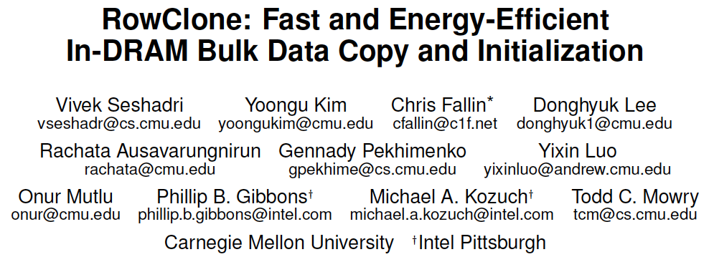
More on RowClone
Vivek Seshadri, Yoongu Kim, Chris Fallin, Donghyuk Lee, Rachata Ausavarungnirun, Gennady Pekhimenko, Yixin Luo, Onur Mutlu, Michael A. Kozuch, Phillip B. Gibbons, and Todd C. Mowry,
"RowClone: Fast and Energy-Efficient In-DRAM Bulk Data Copy and Initialization"
Proceedings of the 46th International Symposium on Microarchitecture (MICRO), Davis, CA, December 2013. [Slides (pptx) (pdf)] [Lightning Session Slides (pptx) (pdf)] [Poster (pptx) (pdf)]

Slide 15
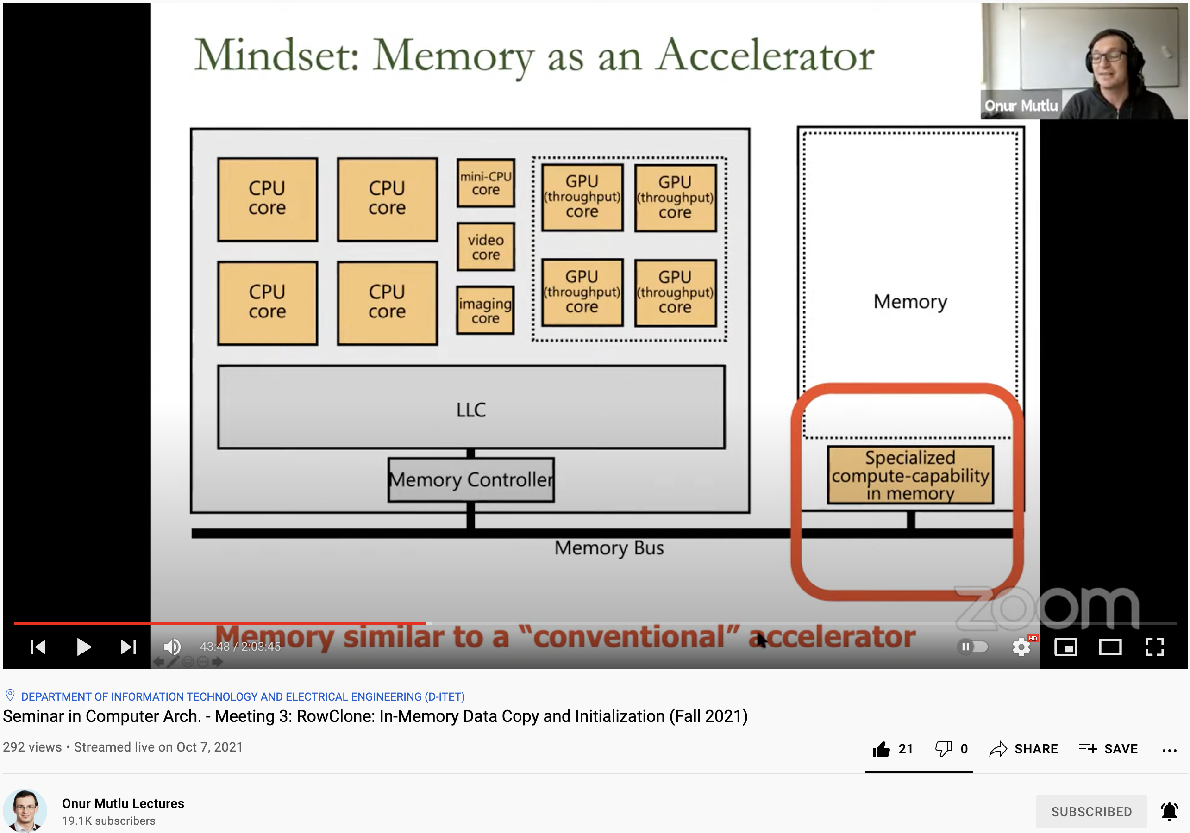
Lecture on RowClone & Processing using DRAM
https://www.youtube.com/watch?v=n6Pwg1qax_E&list=PL5Q2soXY2Zi_7UBNmC9B8Yr5JSwTG9yH4&index=4

Slide 16
RowClone Extensions and Follow-Up Work
Can we do faster inter-subarray copy?
  Yes, see LISA [Chang et al., HPCA 2016]
Can we enable data movement at smaller granularities within a bank?
  Yes, see FIGARO [Wang et al., MICRO 2020]
Can we do better inter-bank copy?
  Yes, see Network-on-Memory [CAL 2020]
Can similar ideas and DRAM properties be used to perform computation on data?
  Yes, see Ambit [Seshadri et al., CAL 2015, MICRO 2017]
  Yes, see SIMDRAM [Hajinazar & Oliveira, ASPLOS 2021]

Slide 17
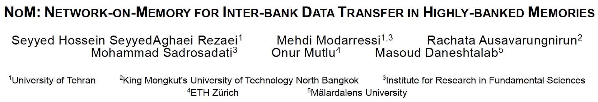
Network-On-Memory: Fast Inter-Bank Copy
Seyyed Hossein SeyyedAghaei Rezaei, Mehdi Modarressi, Rachata Ausavarungnirun, Mohammad Sadrosadati, Onur Mutlu, and Masoud Daneshtalab,
"NoM: Network-on-Memory for Inter-Bank Data Transfer in Highly-Banked Memories"
IEEE Computer Architecture Letters (CAL), 2020.

Slide 18
LISA: Increasing Connectivity in DRAM
Kevin K. Chang, Prashant J. Nair, Saugata Ghose, Donghyuk Lee, Moinuddin K. Qureshi, and Onur Mutlu,
"Low-Cost Inter-Linked Subarrays (LISA): Enabling Fast Inter-Subarray Data Movement in DRAM"
Proceedings of the 22nd International Symposium on High-Performance Computer Architecture (HPCA), Barcelona, Spain, March 2016.
[Slides (pptx) (pdf)]
[Source Code]

Slide 19
Moving Data Inside DRAM?
8Kb
Bank
512
rows
Subarray 1
Bank
DRAM
cell
Subarray 2
Bank
Subarray 3
…
…
Bank
Subarray N
DRAM
Internal
Data Bus (64b)
Low connectivity in DRAM is the fundamental bottleneck for bulk data movement
Goal: Provide a new substrate to enable
wide connectivity between subarrays

Slide 20

Key Idea and Applications
Low-cost Inter-linked subarrays (LISA)
  Fast bulk data movement between subarrays
  Wide datapath via isolation transistors: 0.8% DRAM chip area
LISA is a versatile substrate → new applications
Subarray 1
…
Subarray 2
  Fast bulk data copy: Copy latency 1.363ms→0.148ms (9.2x)
  → 66% speedup, -55% DRAM energy
  In-DRAM caching: Hot data access latency 48.7ns→21.5ns (2.2x)
  → 5% speedup
  Fast precharge: Precharge latency 13.1ns→5.0ns (2.6x)
  → 8% speedup

Slide 21
More on LISA
Kevin K. Chang, Prashant J. Nair, Saugata Ghose, Donghyuk Lee, Moinuddin K. Qureshi, and Onur Mutlu,
"Low-Cost Inter-Linked Subarrays (LISA): Enabling Fast Inter-Subarray Data Movement in DRAM"
Proceedings of the 22nd International Symposium on High-Performance Computer Architecture (HPCA), Barcelona, Spain, March 2016.
[Slides (pptx) (pdf)]
[Source Code]

Slide 22
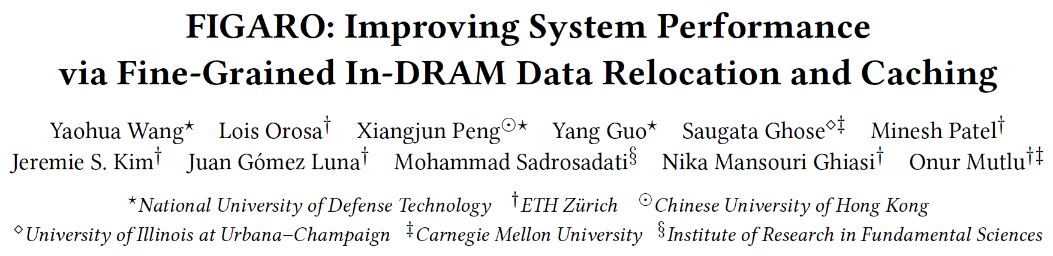
FIGARO: Fine-Grained In-DRAM Copy
Yaohua Wang, Lois Orosa, Xiangjun Peng, Yang Guo, Saugata Ghose, Minesh Patel, Jeremie S. Kim, Juan Gómez Luna, Mohammad Sadrosadati, Nika Mansouri Ghiasi, and Onur Mutlu,
"FIGARO: Improving System Performance via Fine-Grained In-DRAM Data Relocation and Caching"
Proceedings of the 53rd International Symposium on Microarchitecture (MICRO), Virtual, October 2020.

Slide 23
In-Memory Bulk Bitwise Operations
We can support in-DRAM COPY, ZERO, AND, OR, NOT, MAJ
At low cost
Using inherent analog computation capability of DRAM
  Idea: activating multiple rows performs computation
30-60X performance and energy improvement
  Seshadri+, “Ambit: In-Memory Accelerator for Bulk Bitwise Operations Using Commodity DRAM Technology,” MICRO 2017.
New memory technologies enable even more opportunities
  Memristors, resistive RAM, phase change mem, STT-MRAM, …
  Can operate on data with minimal movement

Slide 24
In-DRAM AND/OR: Triple Row Activation
½V_{DD}
½V_{DD}+δ
V_{DD}
A
Final State
AB + BC + AC
B
C
C(A + B) + ~C(AB)
dis
en
0
½V_{DD}
Seshadri+, “Fast Bulk Bitwise AND and OR in DRAM”, IEEE CAL 2015.

Slide 25
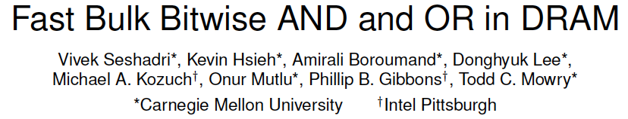
More on In-DRAM Bulk AND/OR
Vivek Seshadri, Kevin Hsieh, Amirali Boroumand, Donghyuk Lee, Michael A. Kozuch, Onur Mutlu, Phillip B. Gibbons, and Todd C. Mowry,
"Fast Bulk Bitwise AND and OR in DRAM"
IEEE Computer Architecture Letters (CAL), April 2015.

Slide 26
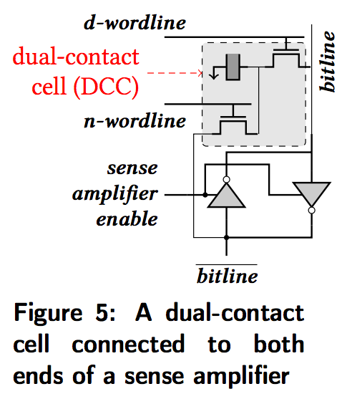
In-DRAM NOT: Dual Contact Cell
Idea:
Feed the
negated value
in the sense amplifier
into a special row
Seshadri+, “Ambit: In-Memory Accelerator for Bulk Bitwise Operations using Commodity DRAM Technology,” MICRO 2017.

Slide 27
In-DRAM NOT Operation
Seshadri+, “Ambit: In-Memory Accelerator for Bulk Bitwise Operations using Commodity DRAM Technology,” MICRO 2017.

Slide 28
Ambit vs. DDR3: Performance and Energy
32X
35X
Seshadri+, “Ambit: In-Memory Accelerator for Bulk Bitwise Operations using Commodity DRAM Technology,” MICRO 2017.

Slide 29
Bulk Bitwise Operations in Workloads
[1] Li and Patel, BitWeaving, SIGMOD 2013
[2] Goodwin+, BitFunnel, SIGIR 2017

Slide 30
Example Data Structure: Bitmap Index
Alternative to B-tree and its variants
Efficient for performing range queries and joins
Many bitwise operations to perform a query
age < 18
18 < age < 25
25 < age < 60
age > 60
Bitmap 1
Bitmap 2
Bitmap 3
Bitmap 4

Slide 31
Performance: Bitmap Index on Ambit
>5.4-6.6X Performance Improvement
Seshadri+, “Ambit: In-Memory Accelerator for Bulk Bitwise Operations using Commodity DRAM Technology,” MICRO 2017.

Slide 32
Performance: BitWeaving on Ambit
>4-12X Performance Improvement
Seshadri+, “Ambit: In-Memory Accelerator for Bulk Bitwise Operations using Commodity DRAM Technology,” MICRO 2017.

Slide 33
More on In-DRAM Bulk AND/OR
Vivek Seshadri, Kevin Hsieh, Amirali Boroumand, Donghyuk Lee, Michael A. Kozuch, Onur Mutlu, Phillip B. Gibbons, and Todd C. Mowry,
"Fast Bulk Bitwise AND and OR in DRAM"
IEEE Computer Architecture Letters (CAL), April 2015.

Slide 34
More on In-DRAM Bitwise Operations
Vivek Seshadri et al., “Ambit: In-Memory Accelerator for Bulk Bitwise Operations Using Commodity DRAM Technology,” MICRO 2017.

Slide 35
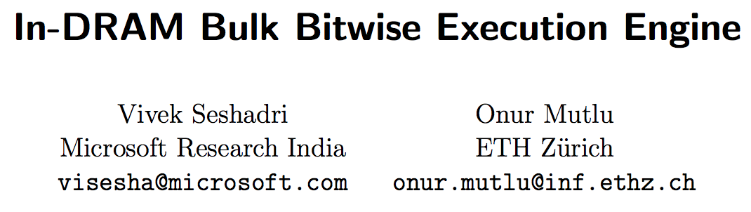
More on In-DRAM Bulk Bitwise Execution
Vivek Seshadri and Onur Mutlu,
"In-DRAM Bulk Bitwise Execution Engine"
Invited Book Chapter in Advances in Computers, to appear in 2020.
[Preliminary arXiv version]

Slide 36
Outline
Processing-Using-Memory (PUM) Solutions
  Review of DRAM Background, RowClone, and Ambit
  SIMDRAM & MIMDRAM: Generalizing PUM Computing
  pLUTo: Extending Operation Support with LUTs
  PUM in Off-the-Shelf DRAM Chips
  PUM Beyond Boolean/Arithmetic and DRAM
Processing-Near-Memory (PNM) Solutions
  Overview
  Accelerating Neural Networks & Databases
  Real PNM Systems
Barriers for Adoption (and Current Solutions)
Conclusion

Slide 37

SIMDRAM Framework
Nastaran Hajinazar, Geraldo F. Oliveira, Sven Gregorio, Joao Dinis Ferreira, Nika Mansouri Ghiasi, Minesh Patel, Mohammed Alser, Saugata Ghose, Juan Gomez-Luna, and Onur Mutlu,
"SIMDRAM: An End-to-End Framework for Bit-Serial SIMD Computing in DRAM"
Proceedings of the 26th International Conference on Architectural Support for Programming Languages and Operating Systems (ASPLOS), Virtual, March-April 2021.
[2-page Extended Abstract]
[Short Talk Slides (pptx) (pdf)]
[Talk Slides (pptx) (pdf)]
[Short Talk Video (5 mins)]
[Full Talk Video (27 mins)]
https://arxiv.org/abs/2105.12839

Slide 38
SIMDRAM Key Idea
SIMDRAM: An end-to-end processing-using-DRAM framework that provides the programming interface, the ISA, and the hardware support for:
  Efficiently computing complex operations in DRAM
  Providing the ability to implement arbitrary operations as required
  Using an in-DRAM massively-parallel SIMD substrate that requires minimal changes to DRAM architecture
38

Slide 39
SIMDRAM: PuM Substrate
SIMDRAM framework is built around a DRAM substrate that enables two techniques:
(1) Vertical data layout
(2) Majority-based computation
most significant bit (MSB)
C_{out}= AB + AC_{in} + BC_{in}
A
MAJ
Row Decoder
4-bit element size
B
C_{out}
C_{in}
least significant bit (LSB)
Pros compared to the conventional horizontal layout:
Implicit shift operation
Massive parallelism
Pros compared to AND/OR/NOT-based computation:
Higher performance
Higher throughput
Lower energy consumption
39

Slide 40





SIMDRAM Framework: Overview
User Input
Step 1: Generate
MAJ logic
Step 2: Generate
sequence of
DRAM commands
SIMDRAM Output
Desired operation
New SIMDRAM $μ$Program
ACT/PRE
ACT/PRE
ACT/PRE
ACT/ACT/PRE
done
$$μProgram$$
$$μProgram$$
MAJ
Main memory
AND/OR/NOT logic
MAJ/NOT logic
bbop_new
New SIMDRAM
instruction
ISA
$μ$Program
User Input
Step 3: Execution according to $μ$Program
SIMDRAM Output
SIMDRAM-enabled application
Instruction result
in memory
foo () {
bbop_new
}
ACT/PRE
ACT/PRE
ACT/PRE
ACT/PRE/PRE
done
ACT/PRE
Control Unit
$μ$Program
Memory Controller
40

Slide 41
SIMDRAM Framework: Step 1
User Input
Step 1: Generate
MAJ logic
Step 2: Generate
sequence of
DRAM commands
SIMDRAM Output
Desired operation
New SIMDRAM $μ$Program
ACT/PRE
ACT/PRE
ACT/PRE
ACT/ACT/PRE
done
$$μProgram$$
$$μProgram$$
MAJ
Main memory
AND/OR/NOT logic
MAJ/NOT logic
bbop_new
New SIMDRAM
instruction
ISA
$μ$Program
User Input
Step 3: Execution according to $μ$Program
SIMDRAM Output
SIMDRAM-enabled application
Instruction result
in memory
foo () {
bbop_new
}
ACT/PRE
ACT/PRE
ACT/PRE
ACT/PRE/PRE
done
ACT/PRE
Control Unit
$μ$Program
Memory Controller
41

Slide 42

Step 1: Naïve MAJ/NOT Implementation
A
A
MAJ
C
B
C
output is “1” only when A = B = “1”
B
0
A
A
MAJ
C
B
C
  output is “0” only when A = B = “0”
B
1
A
0
MAJ
B
A
Part 1
B
C_{out}
MAJ
C_{out}
MAJ
MAJ
1
C_{in}
1
0
C_{in}
Naïvely converting AND/OR/NOT-implementation to MAJ/NOT-implementation leads to an unoptimized circuit
42

Slide 43
Step 1: Efficient MAJ/NOT Implementation
Greedy
optimization
algorithm⁴
0
MAJ
A
MAJ
A
B
Part 2
B
C_{out}
MAJ
1
MAJ
C_{out}
1
MAJ
C_{in}
0
C_{in}
Step 1 generates an optimized
MAJ/NOT-implementation of the desired operation
⁴ L. Amarù et al, “Majority-Inverter Graph: A Novel Data-Structure and Algorithms for Efficient Logic Optimization”, DAC, 2014.
43

Slide 44
SIMDRAM Framework: Step 2
User Input
Step 1: Generate
MAJ logic
Step 2: Generate
sequence of
DRAM commands
SIMDRAM Output
Desired operation
New SIMDRAM $μ$Program
ACT/PRE
ACT/PRE
ACT/PRE
ACT/ACT/PRE
done
$$μProgram$$
$$μProgram$$
MAJ
Main memory
AND/OR/NOT logic
MAJ/NOT logic
bbop_new
New SIMDRAM
instruction
ISA
$μ$Program
User Input
Step 3: Execution according to $μ$Program
SIMDRAM Output
SIMDRAM-enabled application
Instruction result
in memory
foo () {
bbop_new
}
ACT/PRE
ACT/PRE
ACT/PRE
ACT/PRE/PRE
done
ACT/PRE
Control Unit
$μ$Program
Memory Controller
44

Slide 45
Step 2: µProgram Generation
µProgram: A series of microarchitectural operations (e.g., ACT/PRE) that SIMDRAM uses to execute SIMDRAM operation in DRAM
Goal of Step 2: To generate the µProgram that executes the desired SIMDRAM operation in DRAM
Task 1: Allocate DRAM rows to the operands
Task 2: Generate µProgram
45

Slide 46
Step 2: µProgram Generation
µProgram: A series of microarchitectural operations (e.g., ACT/PRE) that SIMDRAM uses to execute SIMDRAM operation in DRAM
Goal of Step 2: To generate the µProgram that executes the desired SIMDRAM operation in DRAM
Task 1: Allocate DRAM rows to the operands
Task 2: Generate µProgram
46

Slide 47
Task 1: Allocating DRAM Rows to Operands
Allocation algorithm considers two constraints specific to processing-using-DRAM
regular
row decoder
Constraint 1:
Limited number of rows reserved for computation
1
1
1
1
1
1
1
1
1
1
1
1
1
1
0
0
0
0
0
0
0
0
0
0
0
0
0
0
Compute
Row decoder
Compute
rows
subarray organization
47

Slide 48
Task 1: Allocating DRAM Rows to Operands
Allocation algorithm considers two constraints specific to processing-using-DRAM
regular
row decoder
Constraint 2:
Destructive behavior
of triple-row activation
1
1
1
1
1
1
1
1
1
1
1
1
1
1
0
0
0
0
0
0
0
0
0
0
0
0
0
0
Compute
Row decoder
Overwritten with MAJ output
subarray organization
48

Slide 49
Task 1: Allocating DRAM Rows to Operands
Allocation algorithm:
Assigns as many inputs as the number of free compute rows
All three input rows contain the MAJ output and can be reused
Allocation
algorithm
A
MAJ
B
C_{out}
C_{in}
1
1
1
1
1
1
1
1
1
1
1
1
1
0
0
0
0
0
0
0
0
0
0
0
0
0
C_{out}
Triple-row activation
C_{out}
C_{out}
49

Slide 50
Step 2: µProgram Generation
µProgram: A series of microarchitectural operations (e.g., ACT/PRE) that SIMDRAM uses to execute SIMDRAM operation in DRAM
Goal of Step 2: To generate the µProgram that executes the desired SIMDRAM operation in DRAM
Task 1: Allocate DRAM rows to the operands
Task 2: Generate µProgram
50

Slide 51
Task 2: Generate an Initial µProgram
Initial µProgram
1. Copy A to reserved row (ACT/ACT/PRE)
2. Copy B to reserved row (ACT/ACT/PRE)
3. Copy C_{in} to reserved row
(ACT/ACT/PRE)
4. Execute MAJ
(ACT/PRE)
5. Copy C_{out} to destination row
(ACT/PRE)
MAJ
A
MAJ
A
C_{out}
B
C_{out}
B
C_{in}
C_{in}
1. Generate
µProgram
51

Slide 52
Task 2: Optimize the µProgram
Initial µProgram
1. Copy A to reserved row (ACT/ACT/PRE)
2. Copy B to reserved row (ACT/ACT/PRE)
3. Copy C_{in} to reserved row
(ACT/ACT/PRE)
4. Execute MAJ
(ACT/PRE)
5. Copy C_{out} to destination row
(ACT/PRE)
MAJ
A
MAJ
A
C_{out}
B
C_{out}
B
C_{in}
C_{in}
1. Generate
µProgram
2. Optimize
52

Slide 53
Task 2: Optimize the µProgram
Initial µProgram
1. Copy A to reserved row (ACT/ACT/PRE)
2. Copy B to reserved row (ACT/ACT/PRE)
3. Copy C_{in} to reserved row
(ACT/ACT/PRE)
4. Execute MAJ
(ACT/PRE)
5. Copy C_{out} to destination row
(ACT/PRE)
MAJ
^{Coalesce}
^{row copies}
A
MAJ
A
C_{out}
B
C_{out}
B
C_{in}
C_{in}
1. Generate
µProgram
2. Optimize
53

Slide 54
Task 2: Optimize the µProgram
Initial µProgram
1. Copy A to reserved row (ACT/ACT/PRE)
2. Copy B to reserved row (ACT/ACT/PRE)
3. Copy C_{in} to reserved row
(ACT/ACT/PRE)
4. Execute MAJ
(ACT/PRE)
5. Copy C_{out} to destination row
(ACT/PRE)
MAJ
A
MAJ
A
C_{out}
B
C_{out}
B
C_{in}
C_{in}
1. Generate
µProgram
^{Merge}
^{MAJ + row copy}
2. Optimize
54

Slide 55
Task 2: Optimize the µProgram
Optimized µProgram
Initial µProgram
1. Copy A to reserved row (ACT/ACT/PRE)
2. Copy B to reserved row (ACT/ACT/PRE)
3. Copy C_{in} to reserved row
(ACT/ACT/PRE)
4. Execute MAJ
(ACT/PRE)
5. Copy C_{out} to destination row
(ACT/PRE)
Copy A, B, C_{in}
to reserved rows
(ACT/ACT/PRE)
2. Execute MAJ and
copy C_{out} to destination row
(ACT/ACT/PRE)
MAJ
^{Coalesce}
^{row copies}
A
MAJ
A
C_{out}
B
C_{out}
B
C_{in}
C_{in}
1. Generate
µProgram
^{Merge}
^{MAJ + row copy}
2. Optimize
55

Slide 56
Task 2: Generate N-bit Computation
Final µProgram is optimized and computes the desired operation for operands of N-bit size in a bit-serial fashion
Final µProgram
Optimized µProgram
Repeat N times:
Copy A, B, C_{in}
to reserved rows
(ACT/ACT/PRE)
2. Execute MAJ and
copy C_{out} to destination row
(ACT/ACT/PRE)
Repeat N times:
Copy A, B, C_{in}
to reserved rows
(ACT/ACT/PRE)
2. Execute MAJ and
copy C_{out} to destination row
(ACT/ACT/PRE)
MAJ
A
MAJ
A
C_{out}
B
C_{out}
B
C_{in}
C_{in}
1. Generate
µProgram
2. Optimize
3. Generate N-bit
computation
56

Slide 57
Task 2: Generate µProgram
Final µProgram is optimized and computes the desired operation for operands of N-bit size in a bit-serial fashion
Final µProgram
Repeat N times:
Copy A, B, C_{in}
to reserved rows
(ACT/ACT/PRE)
2. Execute MAJ and
copy C_{out} to destination row
(ACT/ACT/PRE)
Stored in a reserved DRAM region
for future use
A new SIMDRAM instruction (called bbop_new)
added to CPU ISA
57

Slide 58
SIMDRAM Framework: Step 3
User Input
Step 1: Generate
MAJ logic
Step 2: Generate
sequence of
DRAM commands
SIMDRAM Output
Desired operation
New SIMDRAM $μ$Program
ACT/PRE
ACT/PRE
ACT/PRE
ACT/ACT/PRE
done
$$μProgram$$
$$μProgram$$
MAJ
Main memory
AND/OR/NOT logic
MAJ/NOT logic
bbop_new
New SIMDRAM
instruction
ISA
$μ$Program
User Input
Step 3: Execution according to $μ$Program
SIMDRAM Output
SIMDRAM-enabled application
Instruction result
in memory
foo () {
bbop_new
}
ACT/PRE
ACT/PRE
ACT/PRE
ACT/PRE/PRE
done
ACT/PRE
Control Unit
$μ$Program
Memory Controller
58

Slide 59
Step 3: µProgram Execution
SIMDRAM control unit: handles the execution of the µProgram at runtime
Upon receiving a bbop instruction, the control unit:
  Loads the µProgram corresponding to SIMDRAM operation
  Issues the sequence of DRAM commands (ACT/PRE) stored in the µProgram to SIMDRAM subarrays to perform the in-DRAM operation
User Input
Step 3: Execution according to $μ$Program
SIMDRAM Output
SIMDRAM-enabled application
Instruction result
in memory
foo () {
bbop_new
}
ACT/PRE
ACT/PRE
ACT/PRE
ACT/ACT/PRE
done
ACT/PRE
Control Unit
$μ$Program
Memory Controller
18
59

Slide 60
System Integration
Efficiently transposing data
Programming interface
Handling page faults, address translation, coherence, and interrupts
Handling limited subarray size
Security implications
Limitations of our framework
60

Slide 61
Transposing Data
SIMDRAM operates on vertically-laid-out data
Other system components expect data to be laid out horizontally
Challenging to share data between SIMDRAM and CPU
61

Slide 62
Transposition Unit
Transforms the data layout from horizontal to vertical, and vice versa
Last–Level Cache
Object Tracker (OT)
Horizontal → Vertical
Transpose
Vertical → Horizontal
Transpose
Transpose Buffer
Transposition Unit
Transpose Buffer
Store Unit
Fetch Unit
Memory Controller
62

Slide 63
Efficiently Transposing Data
Last–Level Cache
Object Tracker (OT)
Horizontal → Vertical
Transpose
Vertical → Horizontal
Transpose
Transposition Unit
Transpose Buffer
Low impact on the throughput of
SIMDRAM operations
Transpose Buffer
Store Unit
Fetch Unit
Low area cost (0.06 mm² in 22nm tech. node)
Memory Controller
63

Slide 64
Throughput Analysis
Average normalized throughput across all 16 SIMDRAM operations
SIMDRAM significantly outperforms
all state-of-the-art baselines for a wide range of operations
64

Slide 65
Energy Analysis
Average normalized energy efficiency across all 16 SIMDRAM operations
SIMDRAM is more energy-efficient than
all state-of-the-art baselines for a wide range of operations
65

Slide 66
Real-World Applications
Average speedup across 7 real-world applications
SIMDRAM effectively and efficiently accelerates
many commonly-used real-world applications
66

Slide 67
SIMDRAM Conclusion
SIMDRAM:
  Enables efficient computation of a flexible set and wide range of operations in a PuM massively parallel SIMD substrate
  Provides the hardware, programming, and ISA support, to:
    Address key system integration challenges
    Allow programmers to define and employ new operations without hardware changes
More in the paper:
  Efficiently transposing data
  Programming interface
  Handling page faults, address translation, coherence, and interrupts
  Security implications
  Reliability evaluation
  Comparison to in-cache computing
  And more …
  SIMDRAM is a promising PuM framework
  Can ease the adoption of processing-using-DRAM architectures
  Improves the performance and efficiency of processing-using-memory architectures
67

Slide 68
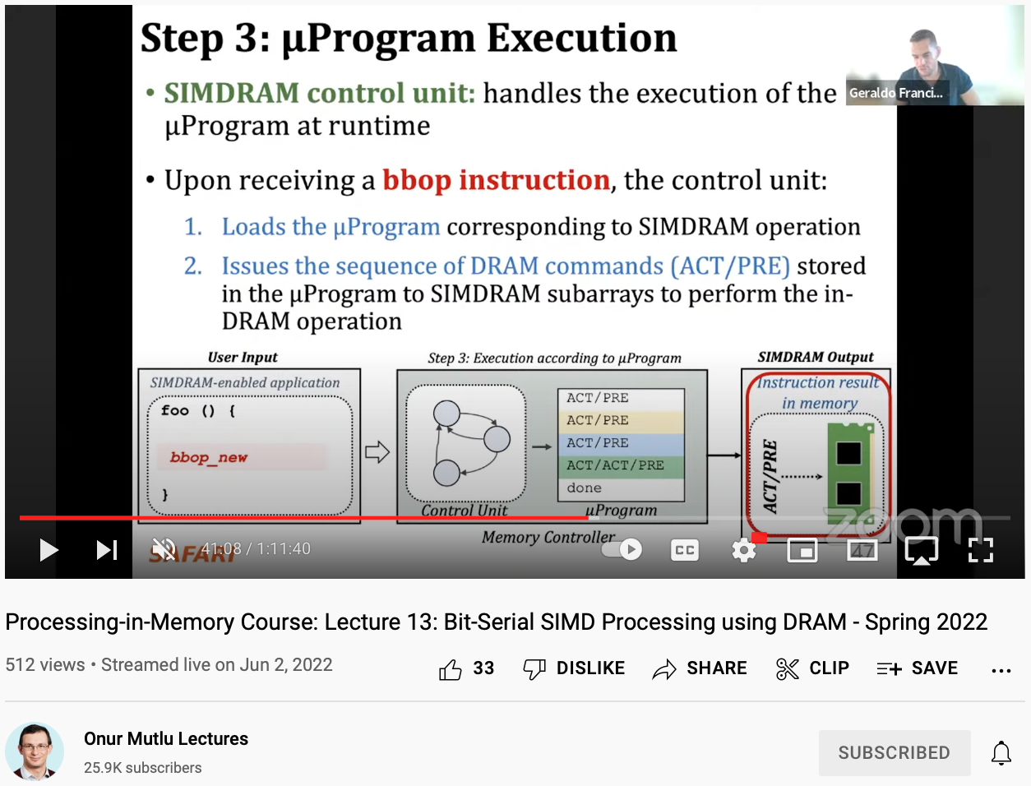
Lecture on SIMDRAM
https://youtu.be/pmZoAAhvkRQ

Slide 69
SIMDRAM: Follow-Ups
Limitations of current substrate?
  Computing granularity
  Data layout conversion
  High-latency bit-serial operations
  Assembly-like programming model
  Application scope
  …
We are working on even better processing-using-memory substrates
  One step at a time!

Slide 70
2nd Workshop on
Memory-Centric Computing:
Processing-Using-Memory - Part I
Dr. Geraldo F. Oliveira
https://geraldofojunior.github.io
ICS 2025
08 June 2025

