Slide 1


2nd Workshop on
Memory-Centric Computing:
Processing-Near-Memory - Part I
Dr. Geraldo F. Oliveira
https://geraldofojunior.github.io
ICS 2025
08 June 2025

Slide 2
Processing-in-Memory:
Overview
  Two main approaches for Processing-in-Memory:
1
Processing-Near-Memory: PIM logic is added to the same die as memory or to the logic layer of 3D-stacked memory
2
Processing-Using-Memory: uses the operational principles of
memory cells to perform computation
DRAM
(e.g., 3D-Stacked Memory)
DRAM Bank
Vault
Controller
Processing-
Using-DRAM
DRAM Vault
…
PHY
Processing-Near-Vault
…
Processing-Near-Bank
Notes:
Processing-in-Memory architectures alleviate data movement bottlenecks by moving computation to where the data resides. Such architectures can be implemented
[CLICK] by adding logic near the memory arrays, in what is called processing-near-memory or
[CLICK] by using the analog operating principles of the memory cells to perform computation, in what is called processing-using-memory
[NEXT]

Slide 3
When to Employ PNM
Mobile consumer workloads
(GoogleWL²)
Graph processing
(Tesseract¹)
Neural networks
(GoogleWL²)
Processing-near-Memory
Databases
(Polynesia⁵)
DNA
sequence mapping
(GenASM³; GRIM-Filter⁴)
Time series analysis
(NATSA⁶)
...
[1] Ahn+, “A Scalable Processing-in-Memory Accelerator for Parallel Graph Processing," ISCA, 2015
[2] Boroumand+, "Google Workloads for Consumer Devices: Mitigating Data Movement Bottlenecks,” ASPLOS, 2018
[3] Cali+, "GenASM: A High-Performance, Low-Power Approximate String Matching Acceleration Framework for Genome Sequence Analysis,” MICRO, 2020
[4] Kim+, "GRIM-Filter: Fast Seed Location Filtering in DNA Read Mapping Using Processing-in-Memory Technologies,” BMC Genomics, 2018
[5] Boroumand+, "Polynesia: Enabling High-Performance and Energy-Efficient Hybrid Transactional/Analytical Databases with Hardware/Software Co-Design,” ICDE, 2022
[6] Fernandez+, “NATSA: A Near-Data Processing Accelerator for Time Series Analysis,” ICCD, 2020

Slide 4
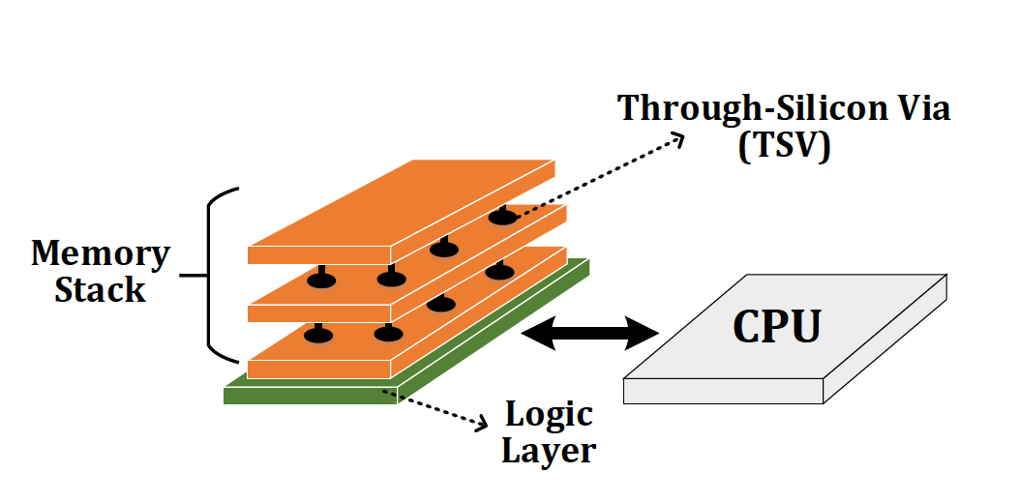
Processing Near-Memory (PNM)
Processing Near-Memory (PNM)
  Move computation closer to where the data resides
Logic layer
3D stacked DRAM
Memory controller
Memory module (DIMM)

Slide 5
PNM: Design Challenges
Limited power & area budget with 3D-stacked memories
  e.g., area and power budget of the vault’s underlying logic layer is just 4.4mm² and 312mW (circa HMC 2.0)
Strict thermal constraints
  It requires cooling solutions to remove heat throughout a 3D stack (i.e., volume-wise) instead of a 2D surface
Challenging manufacturing of logic+DRAM
  Logic process has been developed for speed performance, DRAM process for density and memory reliability
  e.g., Logic gates implemented with memory process slowdowns by ~21.5% [Kim+, Integration'99]

Slide 6
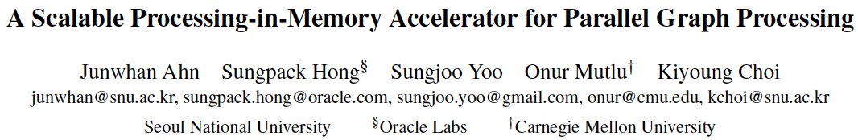
Tesseract System for Graph Processing
Junwhan Ahn, Sungpack Hong, Sungjoo Yoo, Onur Mutlu, and Kiyoung Choi,
"A Scalable Processing-in-Memory Accelerator for Parallel Graph Processing"
Proceedings of the 42nd International Symposium on Computer Architecture (ISCA), Portland, OR, June 2015.
[Slides (pptx) (pdf)] [Lightning Session Slides (pptx) (pdf)]
Top Picks Honorable Mention by IEEE Micro.
Selected to the ISCA-50 25-Year Retrospective Issue covering 1996-2020 in 2023 (Retrospective (pdf) Full Issue).

Slide 7
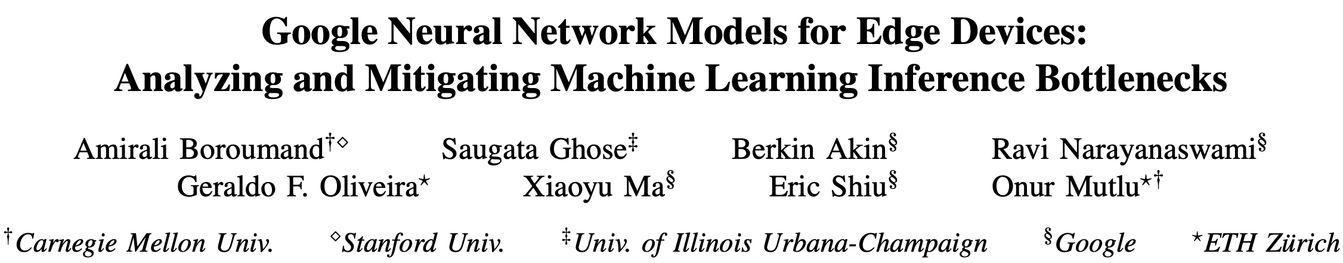
Accelerating Neural Network Inference
Amirali Boroumand, Saugata Ghose, Berkin Akin, Ravi Narayanaswami, Geraldo F. Oliveira, Xiaoyu Ma, Eric Shiu, and Onur Mutlu,
"Google Neural Network Models for Edge Devices: Analyzing and Mitigating Machine Learning Inference Bottlenecks"
Proceedings of the 30th International Conference on Parallel Architectures and Compilation Techniques (PACT), Virtual, September 2021.
[Slides (pptx) (pdf)]
[Talk Video (14 minutes)]

Slide 8
PIM for Mobile Devices
Amirali Boroumand, Saugata Ghose, Youngsok Kim, Rachata Ausavarungnirun, Eric Shiu, Rahul Thakur, Daehyun Kim, Aki Kuusela, Allan Knies, Parthasarathy Ranganathan, and Onur Mutlu,
"Google Workloads for Consumer Devices: Mitigating Data Movement Bottlenecks"
Proceedings of the 23rd International Conference on Architectural Support for Programming Languages and Operating Systems (ASPLOS), Williamsburg, VA, USA, March 2018.
[Slides (pptx) (pdf)] [Lightning Session Slides (pptx) (pdf)] [Poster (pptx) (pdf)]
[Lightning Talk Video (2 minutes)]
[Full Talk Video (21 minutes)]

Slide 9
Possible PNM Designs
General-purpose programmable cores
  Wimpy cores (possibility of running any workload)
  E.g. from academia: Tesseract PIM for Graph Processing
  E.g. from industry: UPMEM PIM
PIM Core
Cache
Fixed-function units
  Hardware/software co-designed PIM for efficiency
  E.g. from academia: Mensa for NN Edge Inference
  E.g. from industry: Samsung HBM-PIM, SK hynix AiM
PIM-Accelerator 1
…
PIM-Accelerator N
Reconfigurable architectures
  PNM cores coupled with FPGAs, CGRA
  E.g. from academia: NERO for Weather Prediction
  E.g. from industry: Samsung AxDIMM
Reconfigurable Accelerator

Slide 10
Possible PNM Designs
General-purpose programmable cores
  Wimpy cores (possibility of running any workload)
  E.g. from academia: Tesseract PIM for Graph Processing
  E.g. from industry: UPMEM PIM
PIM Core
Cache
Fixed-function units
  Hardware/software co-designed PIM for efficiency
  E.g. from academia: Mensa for NN Edge Inference
  E.g. from industry: Samsung HBM-PIM, SK hynix AiM
PIM-Accelerator 1
…
PIM-Accelerator N
Reconfigurable architectures
  PNM cores coupled with FPGAs, CGRA
  E.g. from academia: NERO for Weather Prediction
  E.g. from industry: Samsung AxDIMM
Reconfigurable Accelerator

Slide 11




Accelerating In-Memory Graph Processing
Large graphs are everywhere (circa 2015)
Scalable large-scale graph processing is challenging
36 Million
Wikipedia Pages
1.4 Billion
Facebook Users
300 Million
Twitter Users
30 Billion
Instagram Photos

Slide 12
Key Bottlenecks in Graph Processing
for (v: graph.vertices) {
for (w: v.successors) {
w.next_rank += weight * v.rank;
}
}
1. Frequent random memory accesses
v
&w
w.rank
w.next_rank
w.edges
weight * v.rank
w
…
2. Little amount of computation

Slide 13

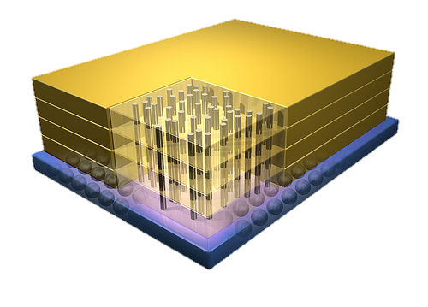
Opportunity: 3D-Stacked Logic+Memory
Memory
Logic
Other “True 3D” technologies
under development

Slide 14
Tesseract System for Graph Processing
Interconnected set of 3D-stacked memory+logic chips with simple cores
Host Processor
Memory
Memory-Mapped
Accelerator Interface
(Noncacheable, Physically Addressed)
Logic
In-Order Core
DRAM Controller
…
…
LP
PF Buffer
Crossbar Network
…
MTP
…
Message Queue
NI
14
Ahn+, “A Scalable Processing-in-Memory Accelerator for Parallel Graph Processing” ISCA 2015.

Slide 15
More on Tesseract
Junwhan Ahn, Sungpack Hong, Sungjoo Yoo, Onur Mutlu, and Kiyoung Choi,
"A Scalable Processing-in-Memory Accelerator for Parallel Graph Processing"
Proceedings of the 42nd International Symposium on Computer Architecture (ISCA), Portland, OR, June 2015.
[Slides (pptx) (pdf)] [Lightning Session Slides (pptx) (pdf)]
Top Picks Honorable Mention by IEEE Micro.
Selected to the ISCA-50 25-Year Retrospective Issue covering 1996-2020 in 2023
(Retrospective (pdf) Full Issue).

Slide 16
Possible PNM Designs
General-purpose programmable cores
  Wimpy cores (possibility of running any workload)
  E.g. from academia: Tesseract PIM for Graph Processing
  E.g. from industry: UPMEM PIM
PIM Core
Cache
Fixed-function units
  Hardware/software co-designed PIM for efficiency
  E.g. from academia: Mensa for NN Edge Inference
  E.g. from industry: Samsung HBM-PIM, SK hynix AiM
PIM-Accelerator 1
…
PIM-Accelerator N
Reconfigurable architectures
  PNM cores coupled with FPGAs, CGRA
  E.g. from academia: NERO for Weather Prediction
  E.g. from industry: Samsung AxDIMM
Reconfigurable Accelerator

Slide 17
UPMEM Processing-in-DRAM Engine (2019)
Processing in DRAM Engine
Includes standard DIMM modules, with a large number of DPU processors combined with DRAM chips.
Replaces standard DIMMs
  DDR4 R-DIMM modules
    8GB+128 DPUs (16 PIM chips)
    Standard 2x-nm DRAM process
  Large amounts of compute & memory bandwidth
CPU
(x86, ARM, RV…)
DDR
Data bus
https://www.anandtech.com/show/14750/hot-chips-31-analysis-inmemory-processing-by-upmem
https://www.upmem.com/video-upmem-presenting-its-true-processing-in-memory-solution-hot-chips-2019/

Slide 18
Accelerator Model (I)
UPMEM DIMMs coexist with conventional DIMMs
Integration of UPMEM DIMMs in a system follows an accelerator model
UPMEM DIMMs can be seen as a loosely coupled accelerator
  Explicit data movement between the main processor (host CPU) and the accelerator (UPMEM)
  Explicit kernel launch onto the UPMEM processors
This resembles GPU computing

Slide 19
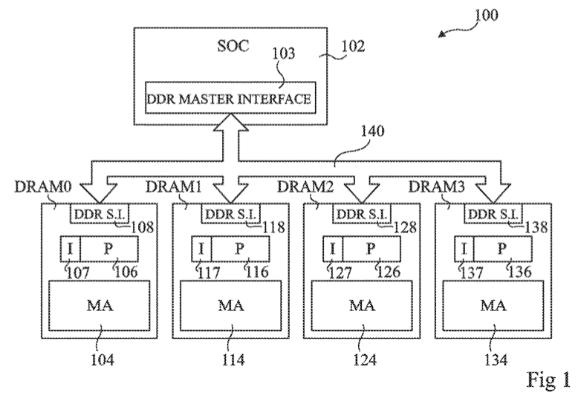
System Organization (I)
FIG. 1 schematically illustrates a computing system comprising DRAM circuits having integrated processors according to an example embodiment
Fabrice Devaux, Jean-François Roy. “Memory circuit with integrated processor.” US 10,324,870 B2.

Slide 20
System Organization (II)
In a UPMEM-based PIM system UPMEM DIMMs coexist with regular DDR4 DIMMs
Notes:
P21 DIMMs.
DPUs cannot be shared. There is a large number of DPUs.
No need for OS.
This simplifies security implications. No side channels.

Slide 21
System Organization (III)
A UPMEM DIMM contains 8 or 16 chips
  Thus, 1 or 2 ranks of 8 chips each
Inside each PIM chip there are:
  8 64MB banks per chip: Main RAM (MRAM) banks
  8 DRAM Processing Units (DPUs) in each chip, 64 DPUs per rank

Slide 22
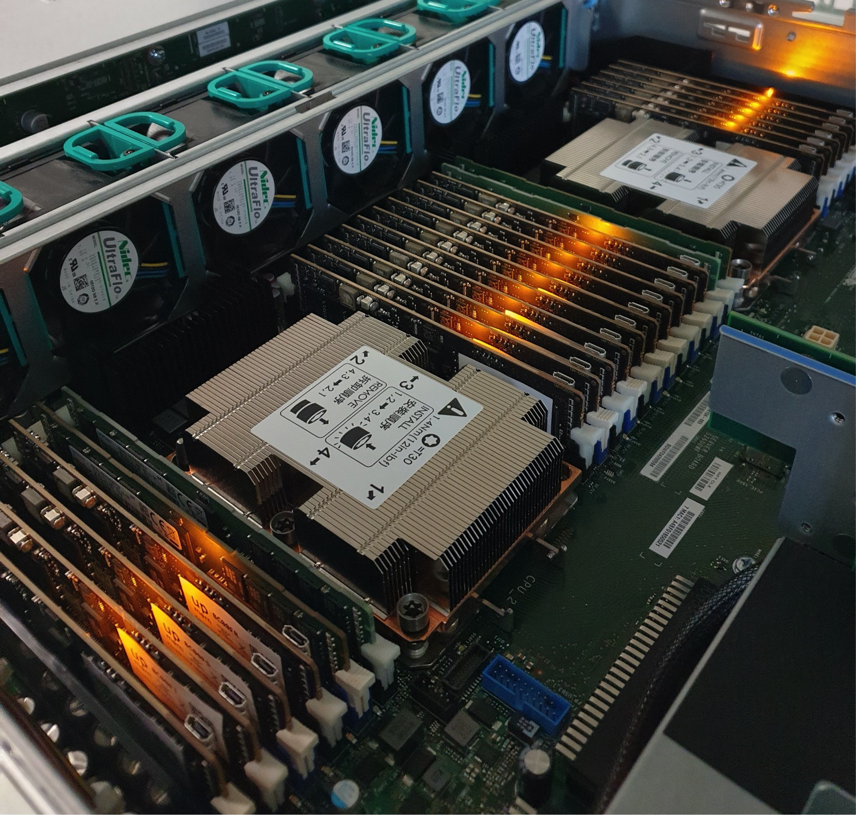
2,560-DPU System (II)

Slide 23
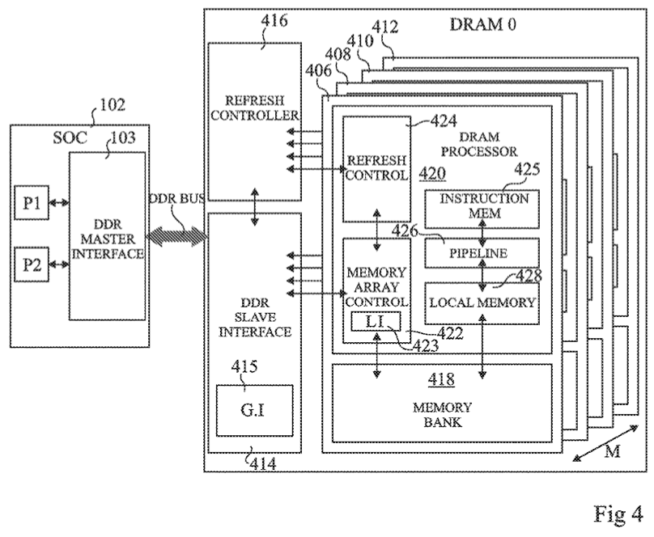
DRAM Processing Unit (I)
FIG. 4 schematically illustrates part of the computing system of FIG. 1 in more detail according to an example embodiment
Fabrice Devaux, Jean-François Roy. “Memory circuit with integrated processor.” US 10,324,870 B2.

Slide 24
DRAM Processing Unit (II)

Slide 25
DPU: Arithmetic Throughput vs. Operational Intensity

Slide 26
DPU Pipeline
In-order pipeline
  Up to 425 MHz
Fine-grain multithreaded
  24 hardware threads
14 pipeline stages
  DISPATCH: Thread selection
  FETCH: Instruction fetch
  READOP: Register file
  FORMAT: Operand formatting
  ALU: Operation and WRAM
  MERGE: Result formatting
To the DMA engine

Slide 27
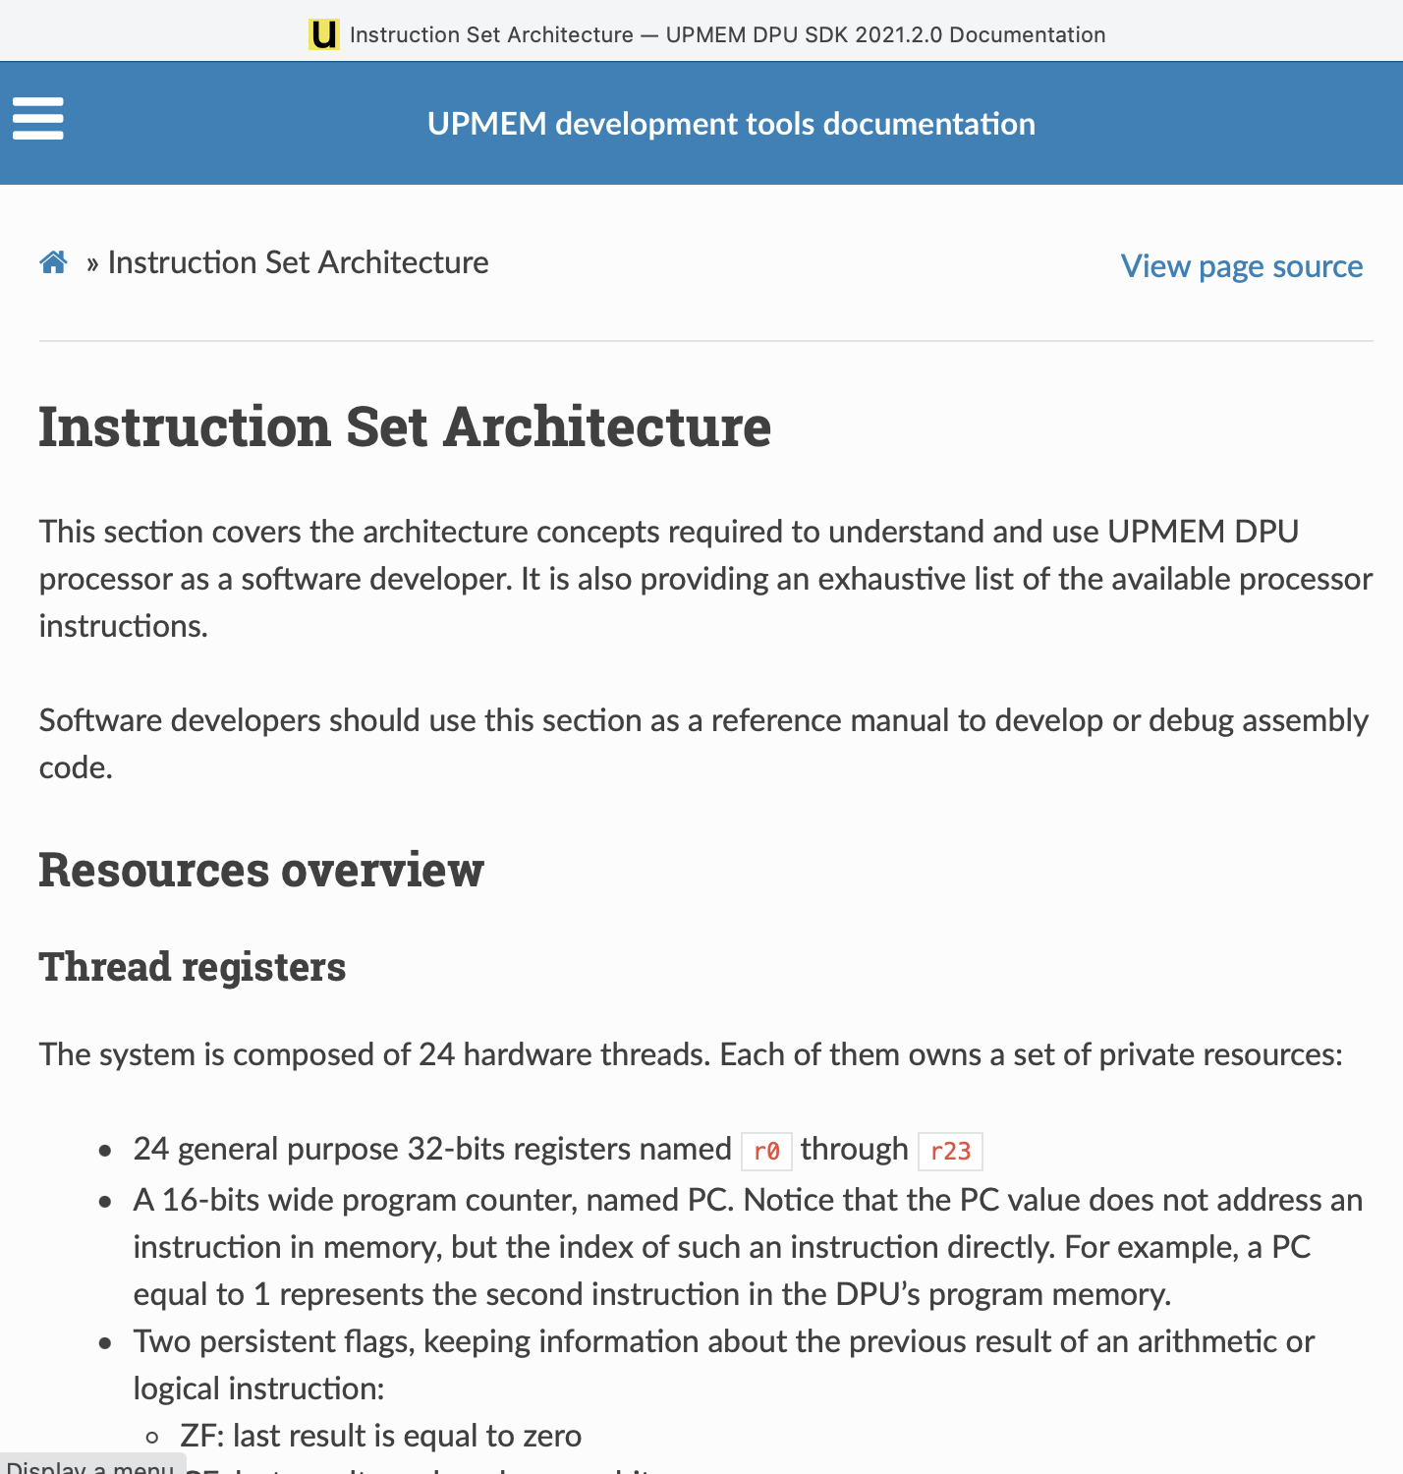
DPU Instruction Set Architecture
Specific 32-bit ISA
  Aiming at scalar, in-order, and multithreaded implementation
  Allowing compilation of 64-bit C code
  LLVM/Clang compiler
https://sdk.upmem.com/2021.2.0/201_IS.html#

Slide 28
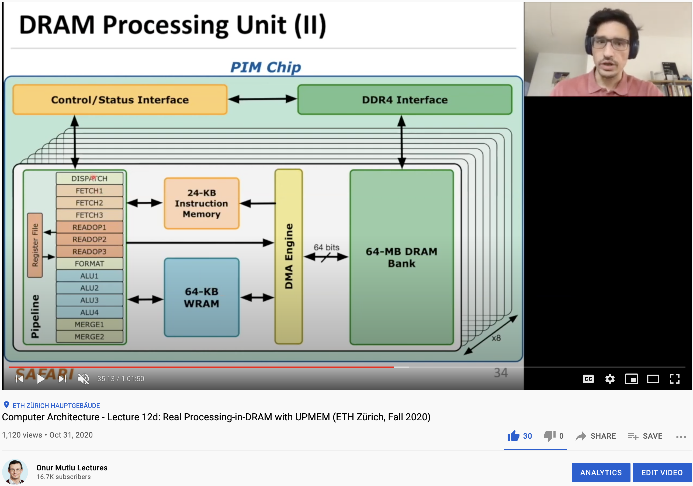
More on the UPMEM PIM System
https://www.youtube.com/watch?v=Sscy1Wrr22A&list=PL5Q2soXY2Zi9xidyIgBxUz7xRPS-wisBN&index=26

Slide 29
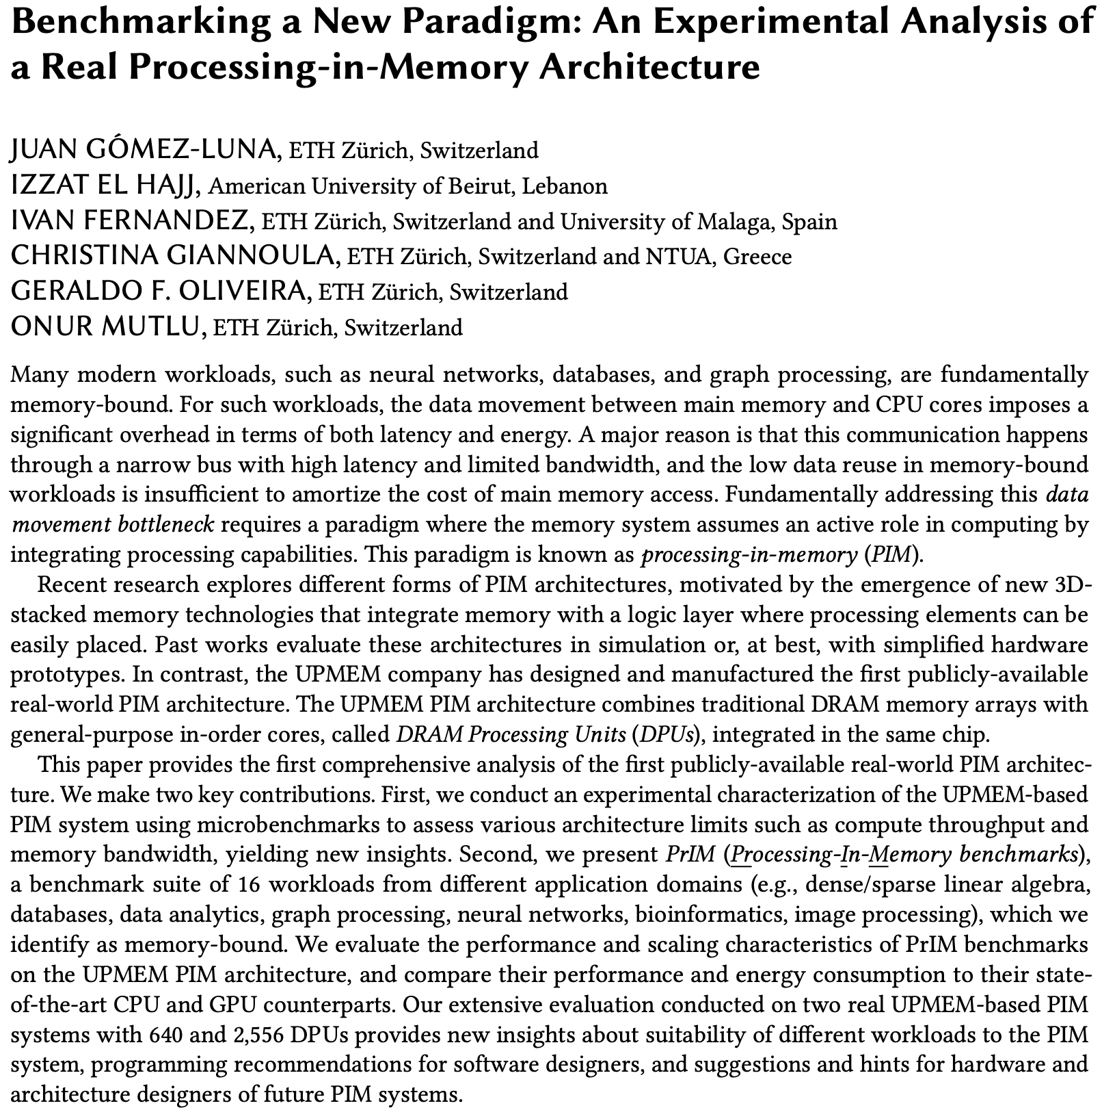
Experimental Analysis of the UPMEM PIM Engine
https://arxiv.org/pdf/2105.03814.pdf

Slide 30
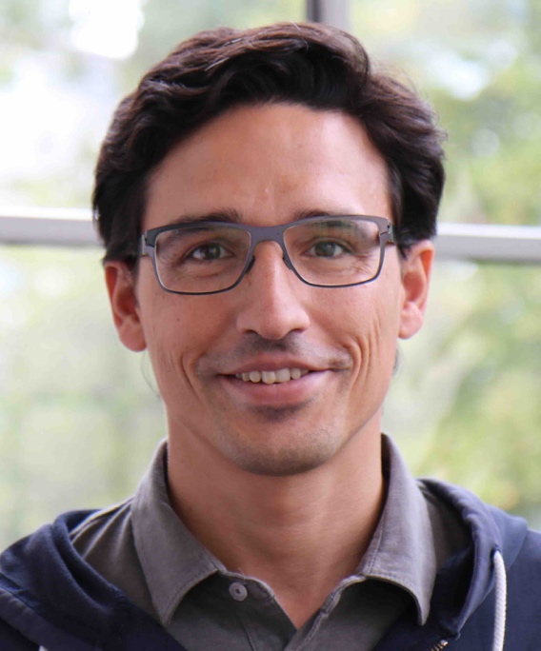
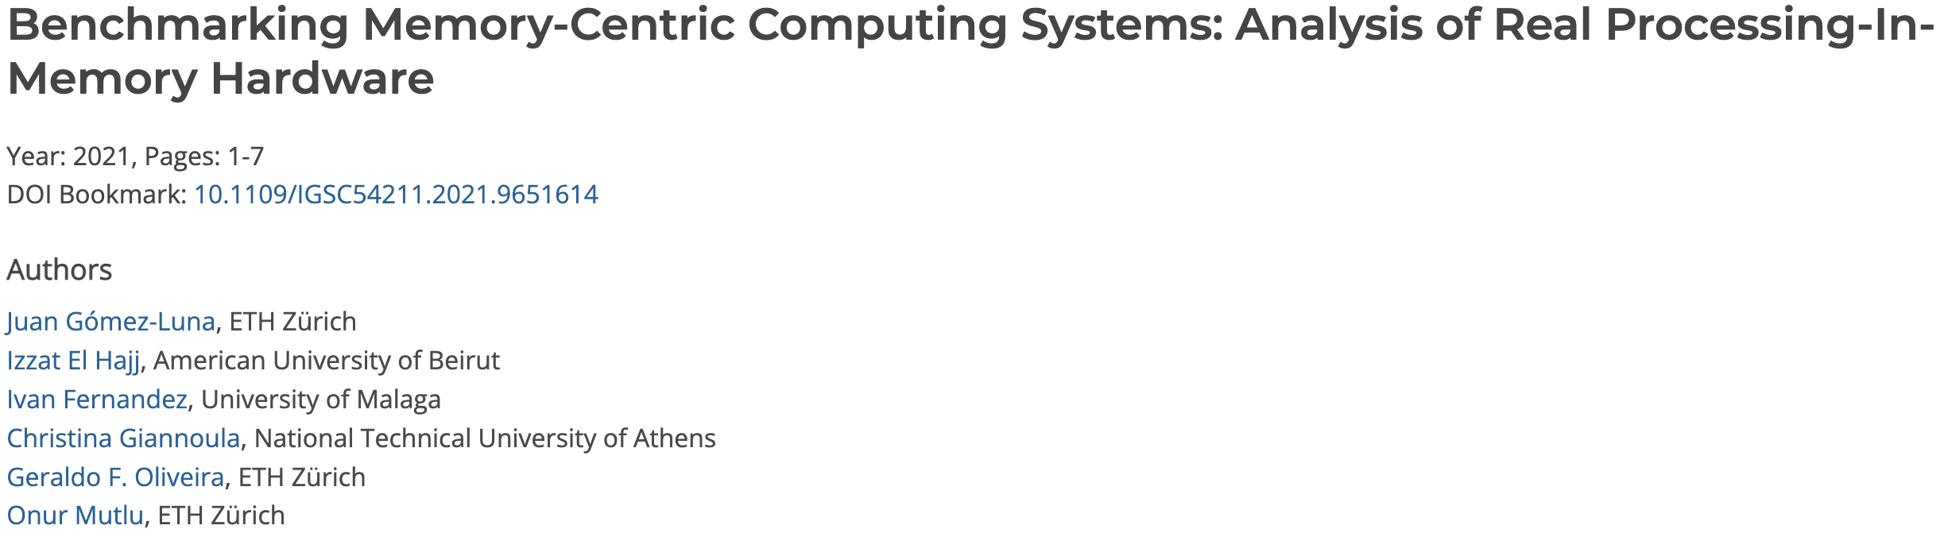
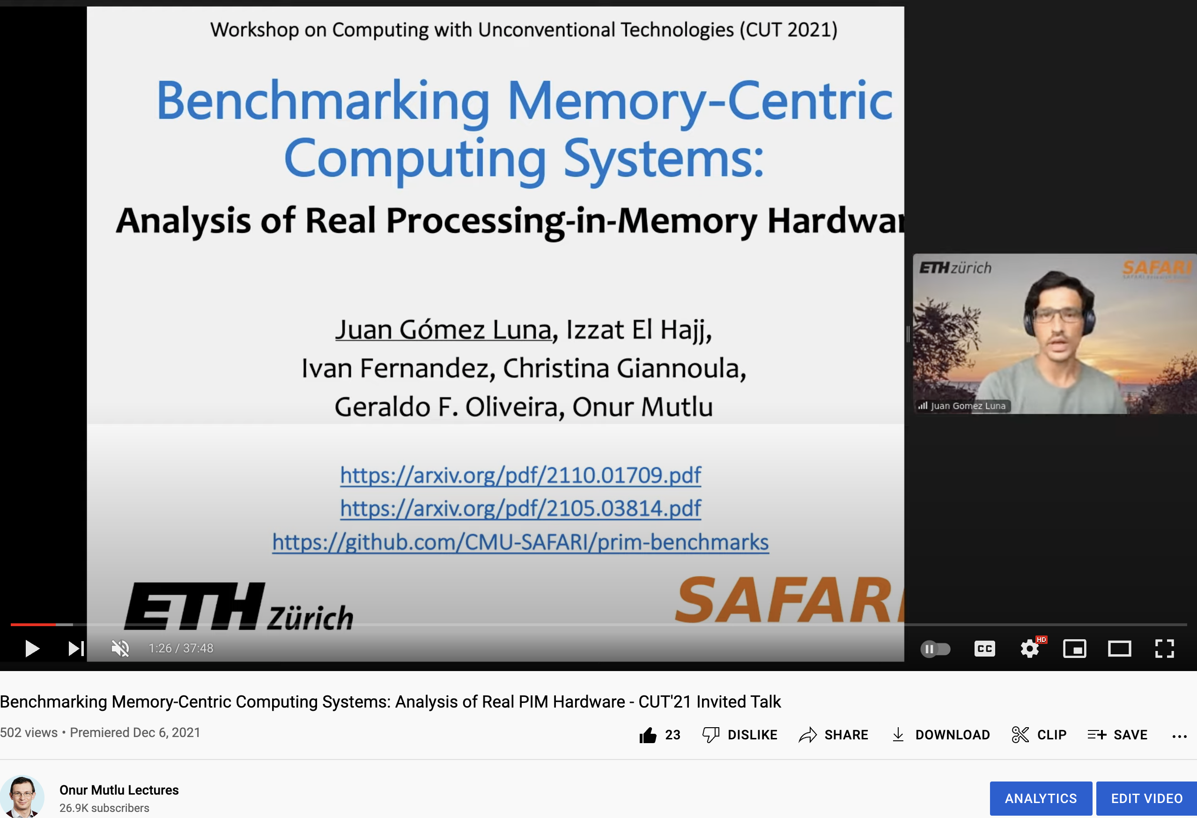
Recent SRC TECHCON Presentation
Dr. Juan Gomez-Luna
  Benchmarking Memory-Centric Computing Systems: Analysis of Real Processing-in-Memory Hardware
  Based on two major works
    https://arxiv.org/pdf/2105.03814.pdf
    https://arxiv.org/pdf/2207.07886.pdf
https://www.youtube.com/watch?v=nphV36SrysA

Slide 31
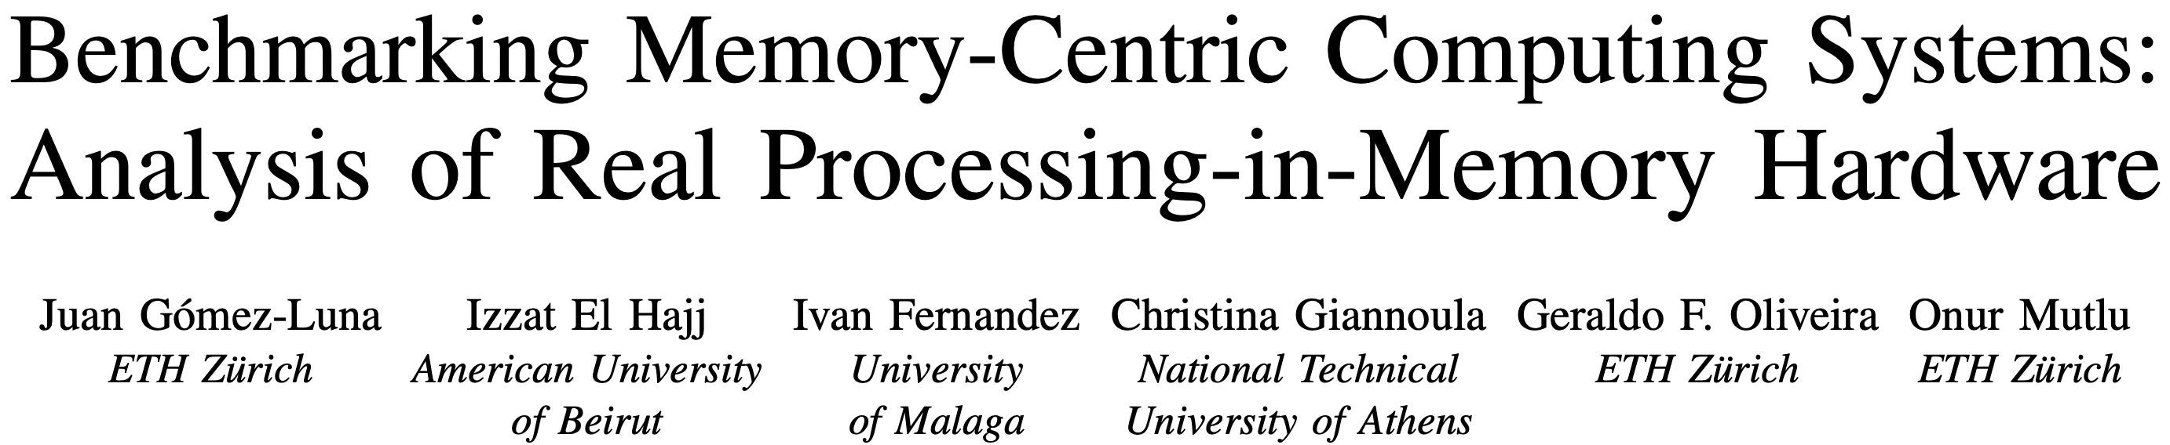
UPMEM PIM System Summary & Analysis
Juan Gomez-Luna, Izzat El Hajj, Ivan Fernandez, Christina Giannoula, Geraldo F. Oliveira, and Onur Mutlu,
"Benchmarking Memory-Centric Computing Systems: Analysis of Real Processing-in-Memory Hardware"
Invited Paper at Workshop on Computing with Unconventional Technologies (CUT), Virtual, October 2021.
[arXiv version]
[PrIM Benchmarks Source Code]
[Slides (pptx) (pdf)]
[Talk Video (37 minutes)]
[Lightning Talk Video (3 minutes)]

Slide 32
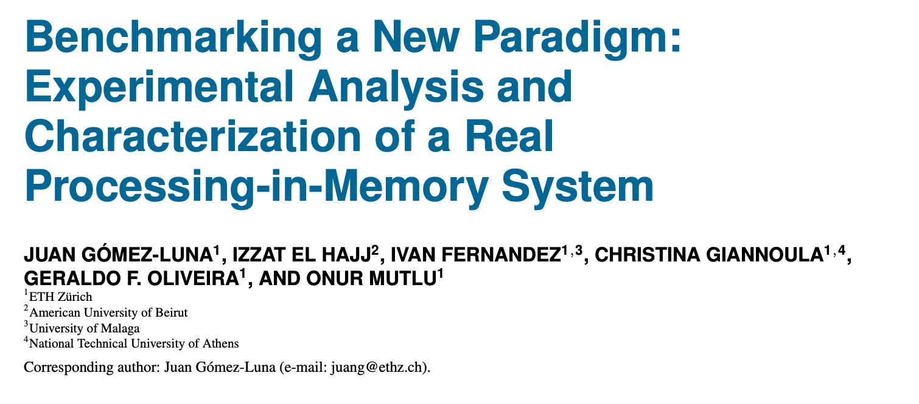
Understanding a Modern PIM Architecture
https://arxiv.org/pdf/2105.03814.pdf
https://github.com/CMU-SAFARI/prim-benchmarks

Slide 33
PrIM Benchmarks: Application Domains
Domain | Benchmark | Short name
Dense linear algebra | Vector Addition | VA
 | Matrix-Vector Multiply | GEMV
Sparse linear algebra | Sparse Matrix-Vector Multiply | SpMV
Databases | Select | SEL
 | Unique | UNI
Data analytics | Binary Search | BS
 | Time Series Analysis | TS
Graph processing | Breadth-First Search | BFS
Neural networks | Multilayer Perceptron | MLP
Bioinformatics | Needleman-Wunsch | NW
Image processing | Image histogram (short) | HST-S
 | Image histogram (large) | HST-L
Parallel primitives | Reduction | RED
 | Prefix sum (scan-scan-add) | SCAN-SSA
 | Prefix sum (reduce-scan-scan) | SCAN-RSS
 | Matrix transposition | TRNS

Slide 34
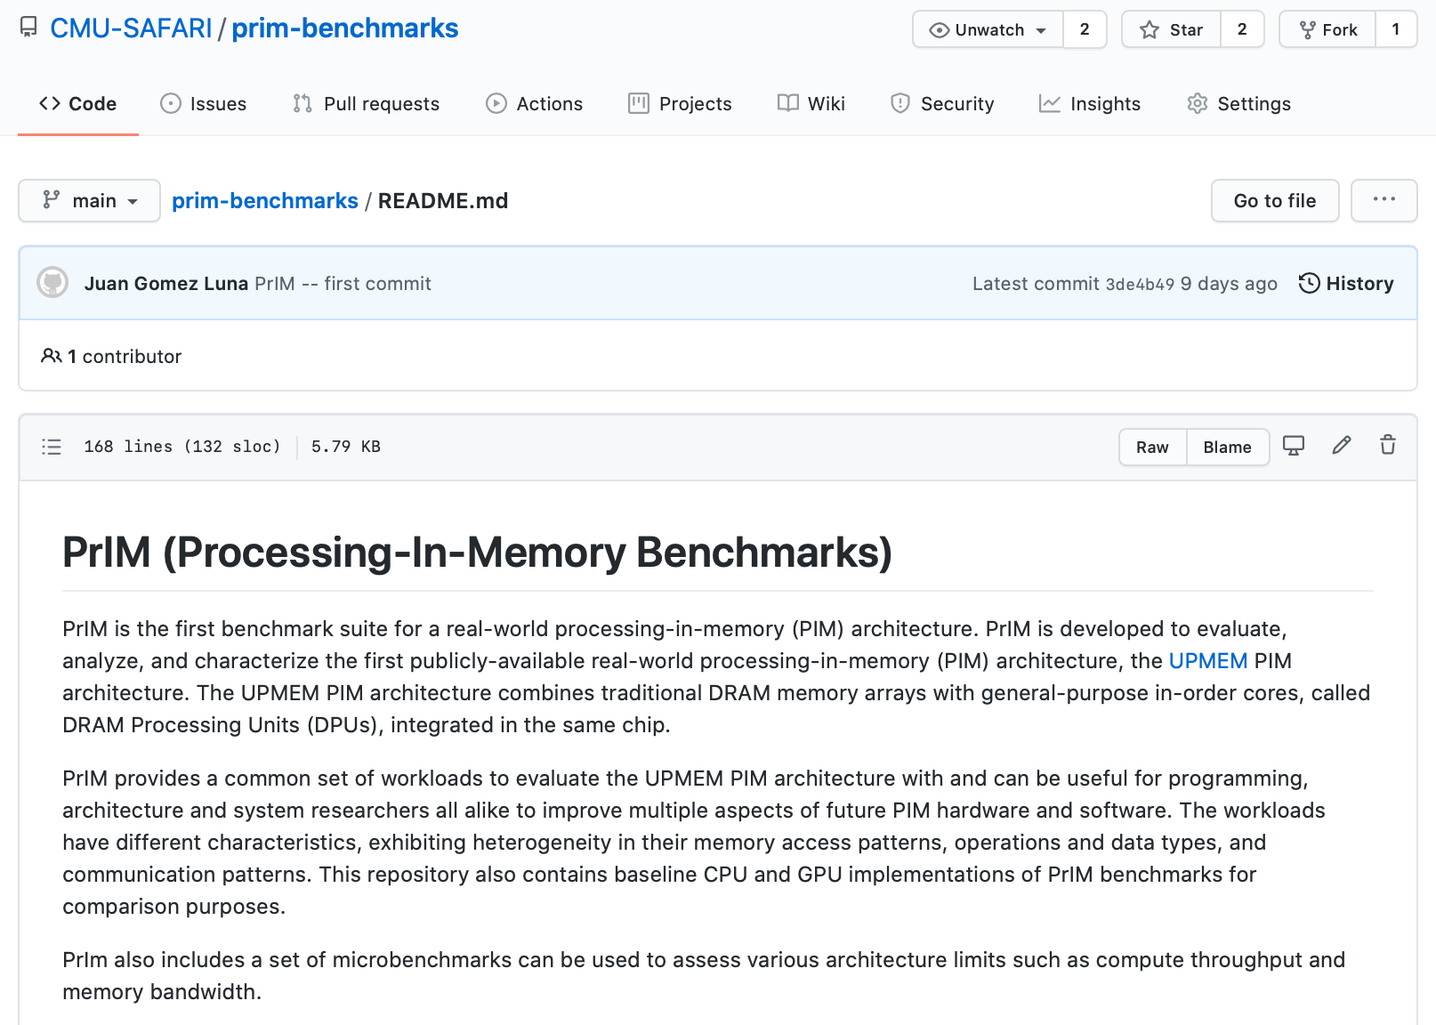
PrIM Benchmarks are Open Source
All microbenchmarks, benchmarks, and scripts
https://github.com/CMU-SAFARI/prim-benchmarks

Slide 35
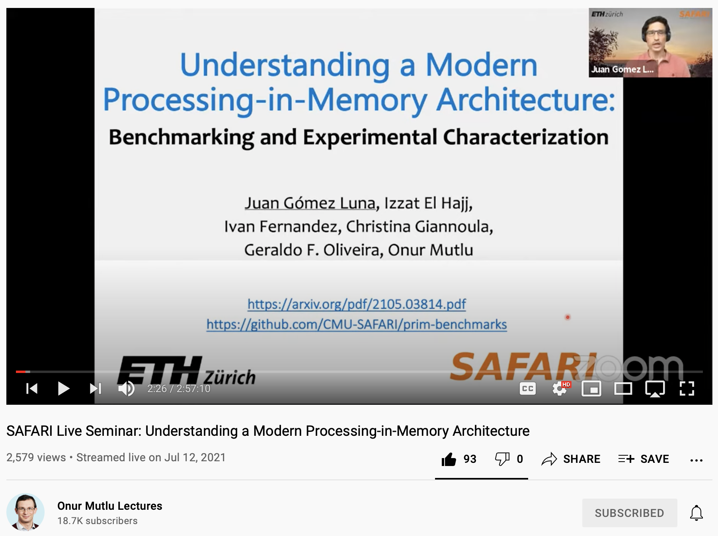
Understanding a Modern PIM Architecture
https://www.youtube.com/watch?v=D8Hjy2iU9l4&list=PL5Q2soXY2Zi_tOTAYm--dYByNPL7JhwR9

Slide 36
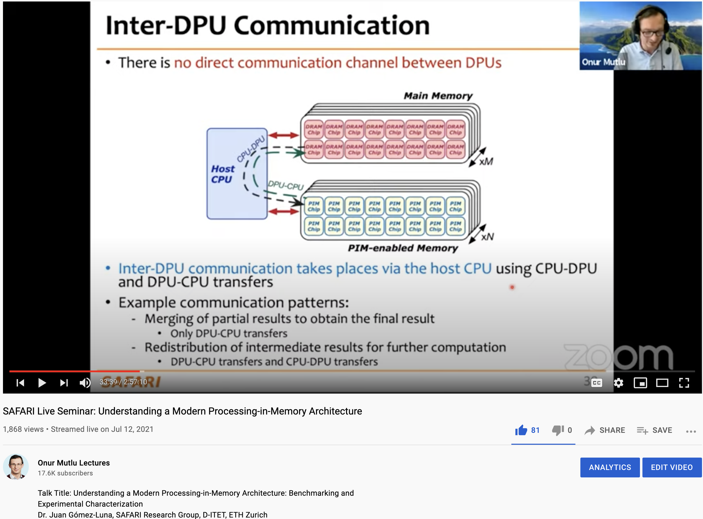
More on Analysis of the UPMEM PIM Engine
https://www.youtube.com/watch?v=D8Hjy2iU9l4&list=PL5Q2soXY2Zi_tOTAYm--dYByNPL7JhwR9

Slide 37
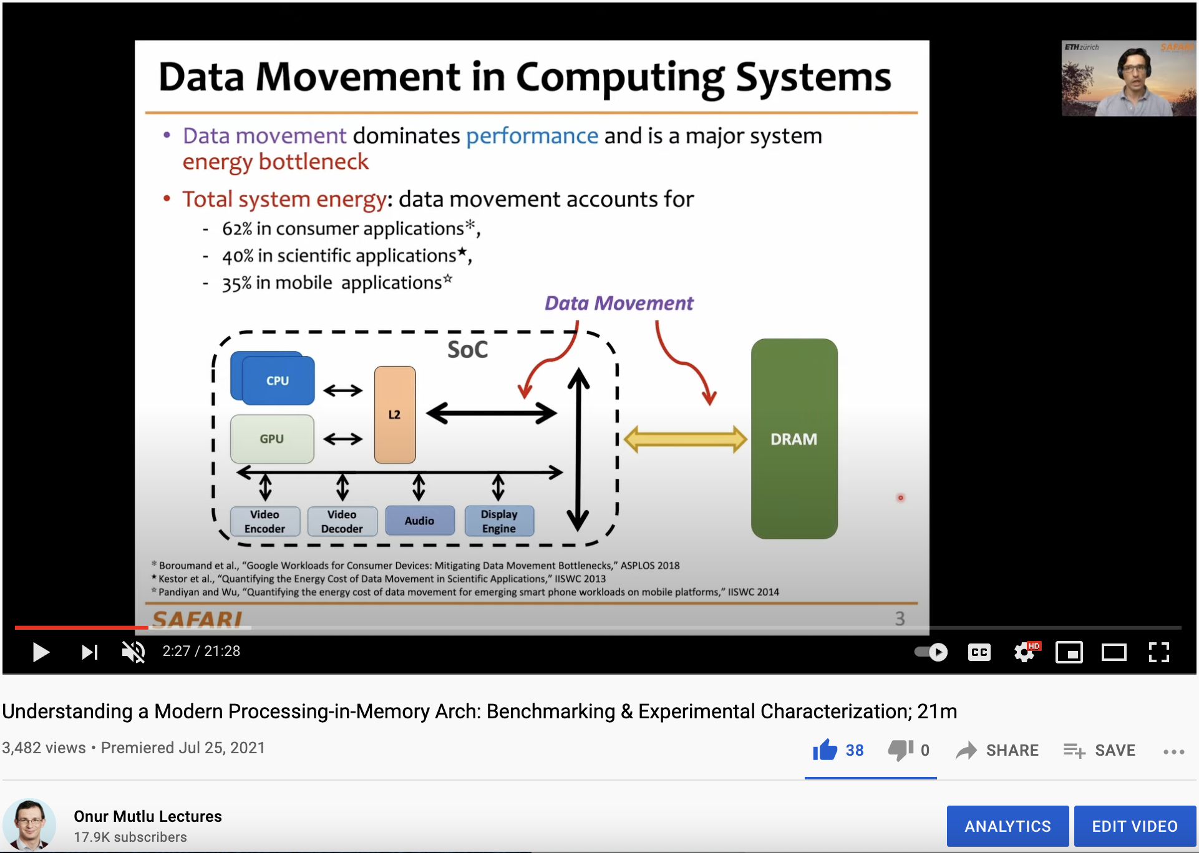
More on Analysis of the UPMEM PIM Engine
https://www.youtube.com/watch?v=Pp9jSU2b9oM&list=PL5Q2soXY2Zi8_VVChACnON4sfh2bJ5IrD&index=159

Slide 38
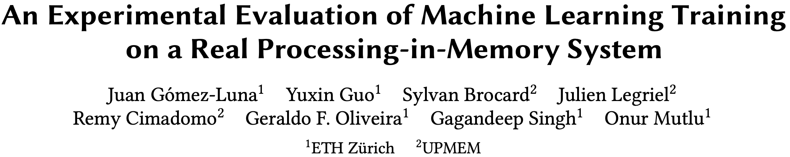
ML Training on Real PIM Systems
Juan Gómez Luna, Yuxin Guo, Sylvan Brocard, Julien Legriel, Remy Cimadomo, Geraldo F. Oliveira, Gagandeep Singh, and Onur Mutlu,
"Evaluating Machine Learning Workloads on Memory-Centric Computing Systems"
Proceedings of the 2023 IEEE International Symposium on Performance Analysis of Systems and Software (ISPASS), Raleigh, North Carolina, USA, April 2023.
[arXiv version, 16 July 2022.]
[PIM-ML Source Code]
Best paper session.
https://github.com/CMU-SAFARI/pim-ml
https://arxiv.org/pdf/2207.07886.pdf

Slide 39
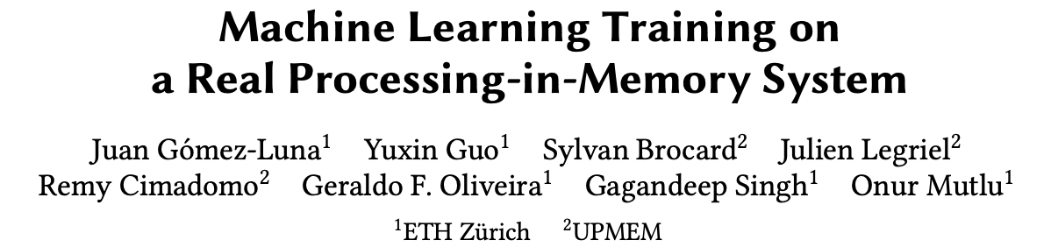
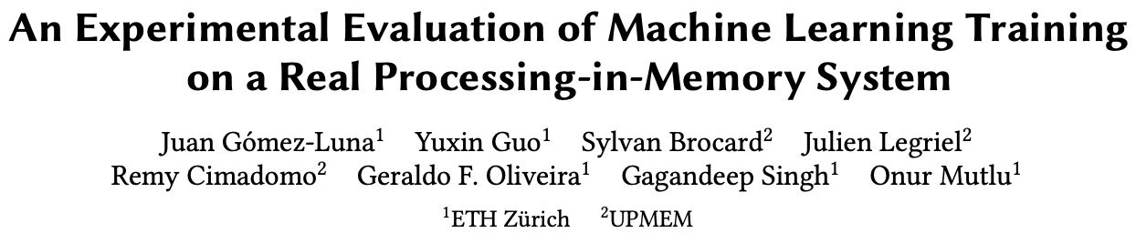
ML Training on a Real PIM System
Short version: https://arxiv.org/pdf/2206.06022.pdf
Long version: https://arxiv.org/pdf/2207.07886.pdf
https://www.youtube.com/watch?v=qeukNs5XI3g&t=11226s

Slide 40
ML Training on a Real PIM System
Need to optimize data representation
  (1) fixed-point
  (2) quantization
  (3) hybrid precision
Use lookup tables (LUTs) to implement complex functions (e.g., sigmoid)
Optimize data placement & layout for streaming
Large speedups: 2.8X/27X vs. CPU, 1.3x/3.2x vs. GPU

Slide 41
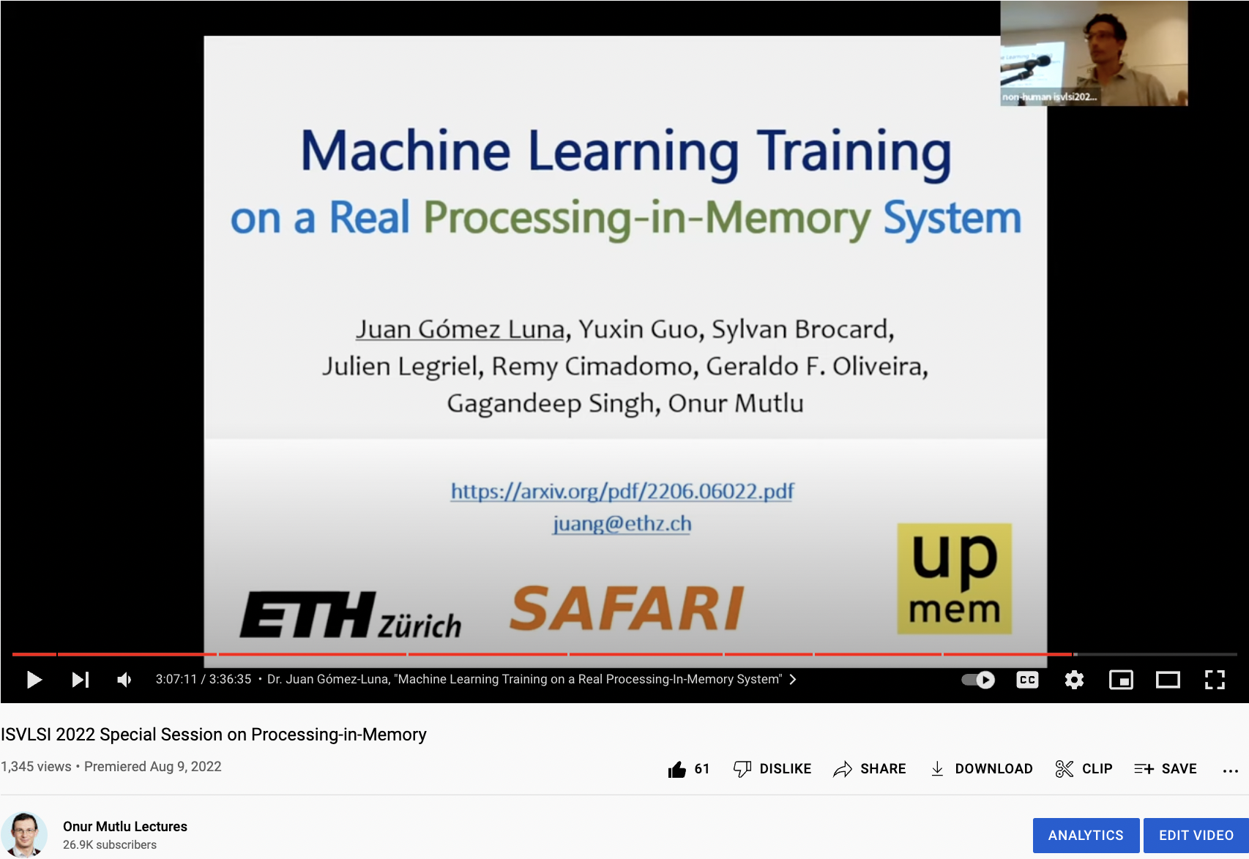
ML Training on Real PIM Talk Video
https://www.youtube.com/watch?v=qeukNs5XI3g&t=11226s

Slide 42
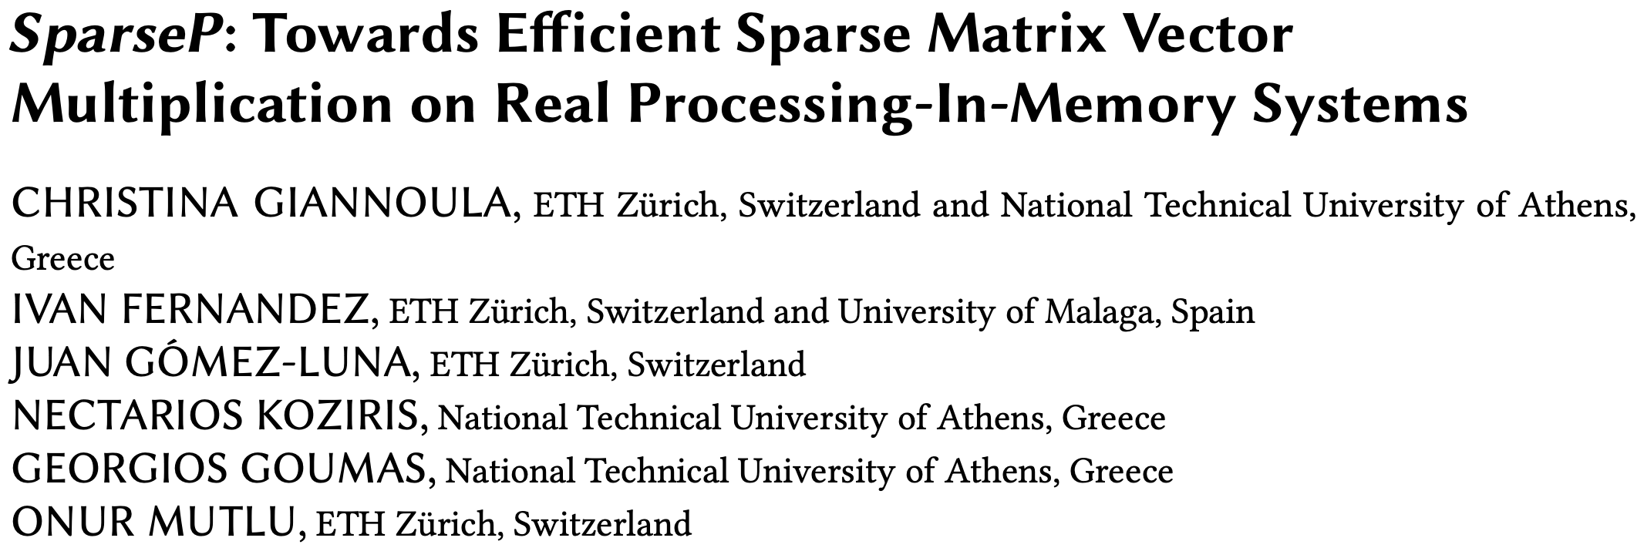
SpMV Multiplication on Real PIM Systems
Appears at SIGMETRICS 2022
https://arxiv.org/pdf/2201.05072.pdf
https://github.com/CMU-SAFARI/SparseP
https://www.youtube.com/watch?v=5kaOsJKlGrE

Slide 43
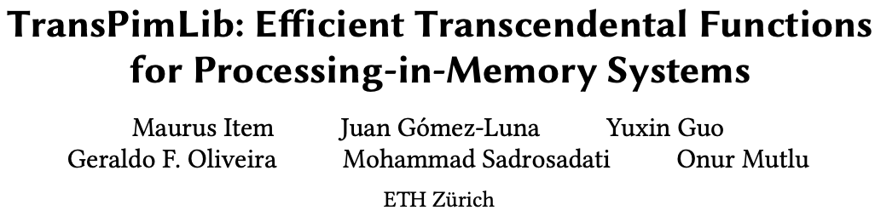
Transcendental Functions on Real PIM Systems
Maurus Item, Juan Gómez Luna, Yuxin Guo, Geraldo F. Oliveira, Mohammad Sadrosadati, and Onur Mutlu,
"TransPimLib: Efficient Transcendental Functions for Processing-in-Memory Systems"
Proceedings of the 2023 IEEE International Symposium on Performance Analysis of Systems and Software (ISPASS), Raleigh, North Carolina, USA, April 2023.
[arXiv version]
[Slides (pptx) (pdf)]
[TransPimLib Source Code]
[Talk Video (17 minutes)]
https://github.com/CMU-SAFARI/transpimlib
https://arxiv.org/pdf/2304.01951.pdf

Slide 44
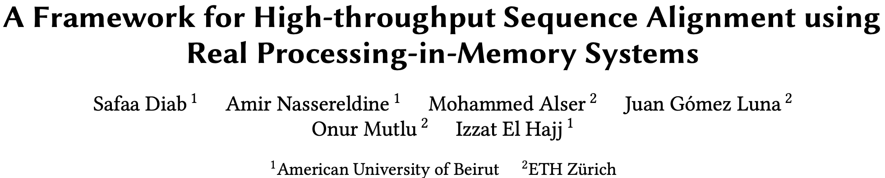
Sequence Alignment on Real PIM Systems
Safaa Diab, Amir Nassereldine, Mohammed Alser, Juan Gómez Luna, Onur Mutlu, and Izzat El Hajj,
"A Framework for High-throughput Sequence Alignment using Real Processing-in-Memory Systems"
Bioinformatics, [published online on] 27 March 2023.
[Online link at Bioinformatics Journal]
[arXiv preprint]
[AiM Source Code]
https://github.com/CMU-SAFARI/alignment-in-memory
https://arxiv.org/pdf/2208.01243.pdf

Slide 45
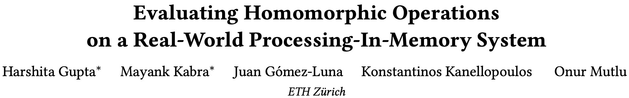
Homomorphic Operations on Real PIM Systems
Harshita Gupta, Mayank Kabra, Juan Gómez-Luna, Konstantinos Kanellopoulos, and Onur Mutlu,
"Evaluating Homomorphic Operations on a Real-World Processing-In-Memory System"
Proceedings of the 2023 IEEE International Symposium on Workload Characterization Poster Session (IISWC), Ghent, Belgium, October 2023.
[arXiv version]
[Lightning Talk Slides (pptx) (pdf)]
[Poster (pptx) (pdf)]
https://arxiv.org/pdf/2309.06545.pdf

Slide 46
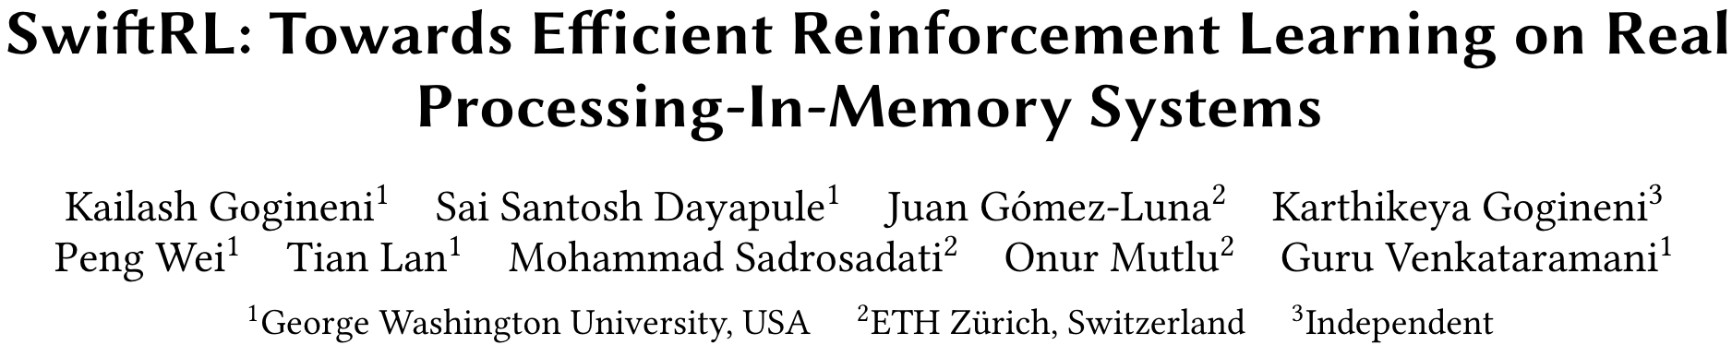
Accelerating Reinforcement Learning
Kailash Gogineni, Sai Santosh Dayapule, Juan Gomez-Luna, Karthikeya Gogineni, Peng Wei, Tian Lan, Mohammad Sadrosadati, Onur Mutlu, Guru Venkataramani,
"SwiftRL: Towards Efficient Reinforcement Learning on Real Processing-In-Memory Systems"
Proceedings of the 2024 IEEE International Symposium on Performance Analysis of Systems and Software (ISPASS), Indianapolis, Indiana, May 2024.
[Slides (pptx) (pdf)]
[arXiv version]
https://arxiv.org/pdf/2405.03967

Slide 47
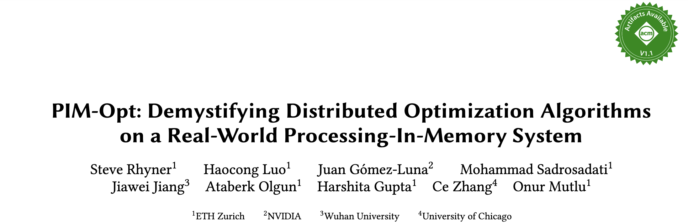
Accelerating ML Training on Real PIM Systems
Steve Rhyner, Haocong Luo, Juan Gómez-Luna, Mohammad Sadrosadati, Jiawei Jiang, Ataberk Olgun, Harshita Gupta, Ce Zhang, and Onur Mutlu,
"PIM-Opt: Demystifying Distributed Optimization Algorithms on a Real-World Processing-In-Memory System"
Proceedings of the 33rd International Conference on Parallel Architectures and Compilation Techniques (PACT), Long Beach, CA, USA, October 2024.
[Preliminary arXiv version]
https://arxiv.org/pdf/2404.07164

Slide 48
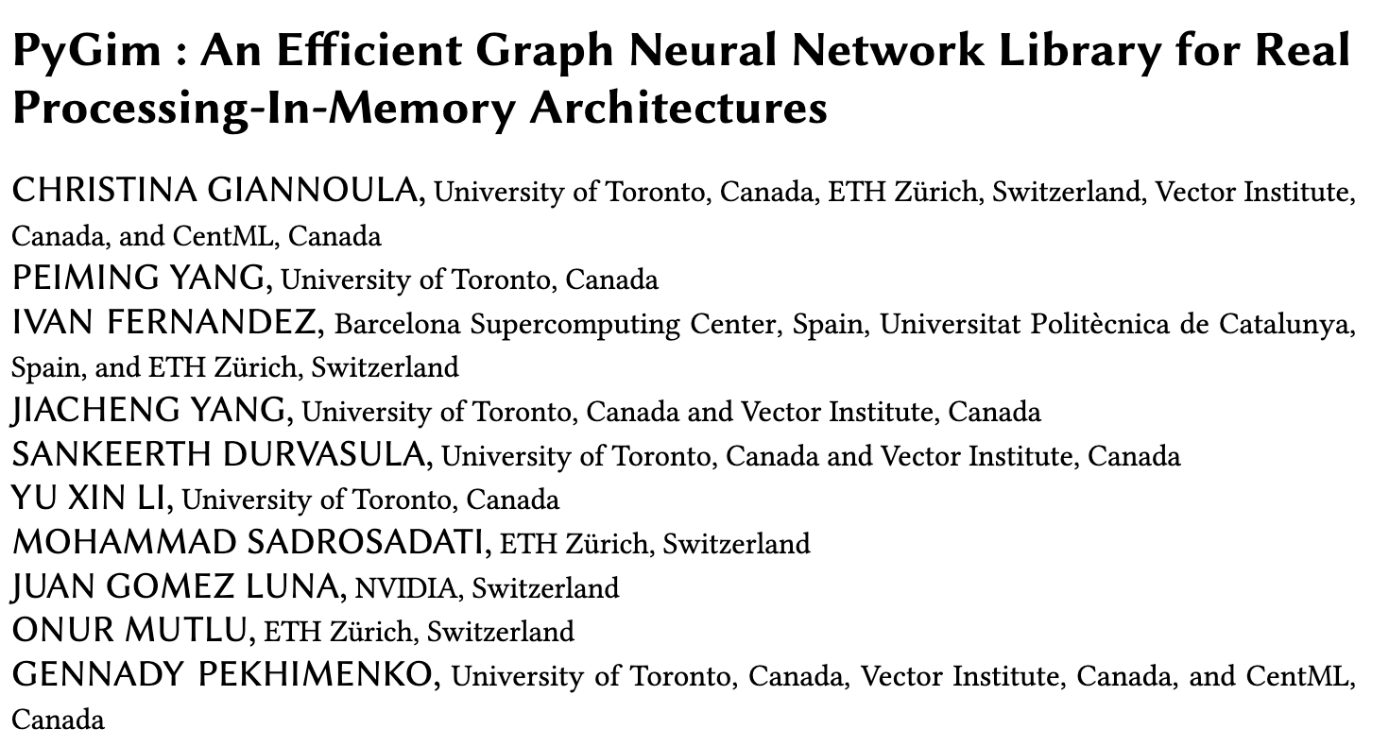
Accelerating GNNs on Real PIM Systems
https://arxiv.org/pdf/2402.16731

Slide 49
SpMV Multiplication on Real PIM Systems
Appears in SIGMETRICS 2022
https://arxiv.org/pdf/2201.05072.pdf
https://github.com/CMU-SAFARI/SparseP
https://www.youtube.com/watch?v=5kaOsJKlGrE

Slide 50
Sequence Alignment on Real PIM Systems
Safaa Diab, Amir Nassereldine, Mohammed Alser, Juan Gómez Luna, Onur Mutlu, and Izzat El Hajj,
"A Framework for High-throughput Sequence Alignment using Real Processing-in-Memory Systems"
Bioinformatics, [published online on] 27 March 2023.
[Online link at Bioinformatics Journal]
[arXiv preprint]
[AiM Source Code]
https://github.com/CMU-SAFARI/alignment-in-memory
https://arxiv.org/pdf/2208.01243.pdf

Slide 51
Summary
Sequence alignment on traditional systems is limited by the memory bandwidth bottleneck
Processing-in-memory (PIM) overcomes this bottleneck by placing cores near the memory
Our framework, Alignment-in-Memory (AIM), is a PIM framework that supports multiple alignment algorithms (NW, SWG, GenASM, WFA)
  Implemented on UPMEM, the first real PIM system
Results show substantial speedups over both CPUs (1.8X-28X) and GPUs (1.2X-2.7X)
AIM is available at:
  https://github.com/CMU-SAFARI/alignment-in-memory
51

Slide 52
2nd Workshop on
Memory-Centric Computing:
Processing-Near-Memory - Part I
Dr. Geraldo F. Oliveira
https://geraldofojunior.github.io
ICS 2025
08 June 2025

