Slide 1


2nd Workshop on
Memory-Centric Computing:
Processing-Near-Memory - Part II
Dr. Geraldo F. Oliveira
https://geraldofojunior.github.io
ICS 2025
08 June 2025

Slide 2
Possible PNM Designs
General-purpose programmable cores
  Wimpy cores (possibility of running any workload)
  E.g. from academia: Tesseract PIM for Graph Processing
  E.g. from industry: UPMEM PIM
PIM Core
Cache
Fixed-function units
  Hardware/software co-designed PIM for efficiency
  E.g. from academia: Mensa for NN Edge Inference
  E.g. from industry: Samsung HBM-PIM, SK hynix AiM
PIM-Accelerator 1
…
PIM-Accelerator N
Reconfigurable architectures
  PNM cores coupled with FPGAs, CGRA
  E.g. from academia: NERO for Weather Prediction
  E.g. from industry: Samsung AxDIMM
Reconfigurable Accelerator

Slide 3
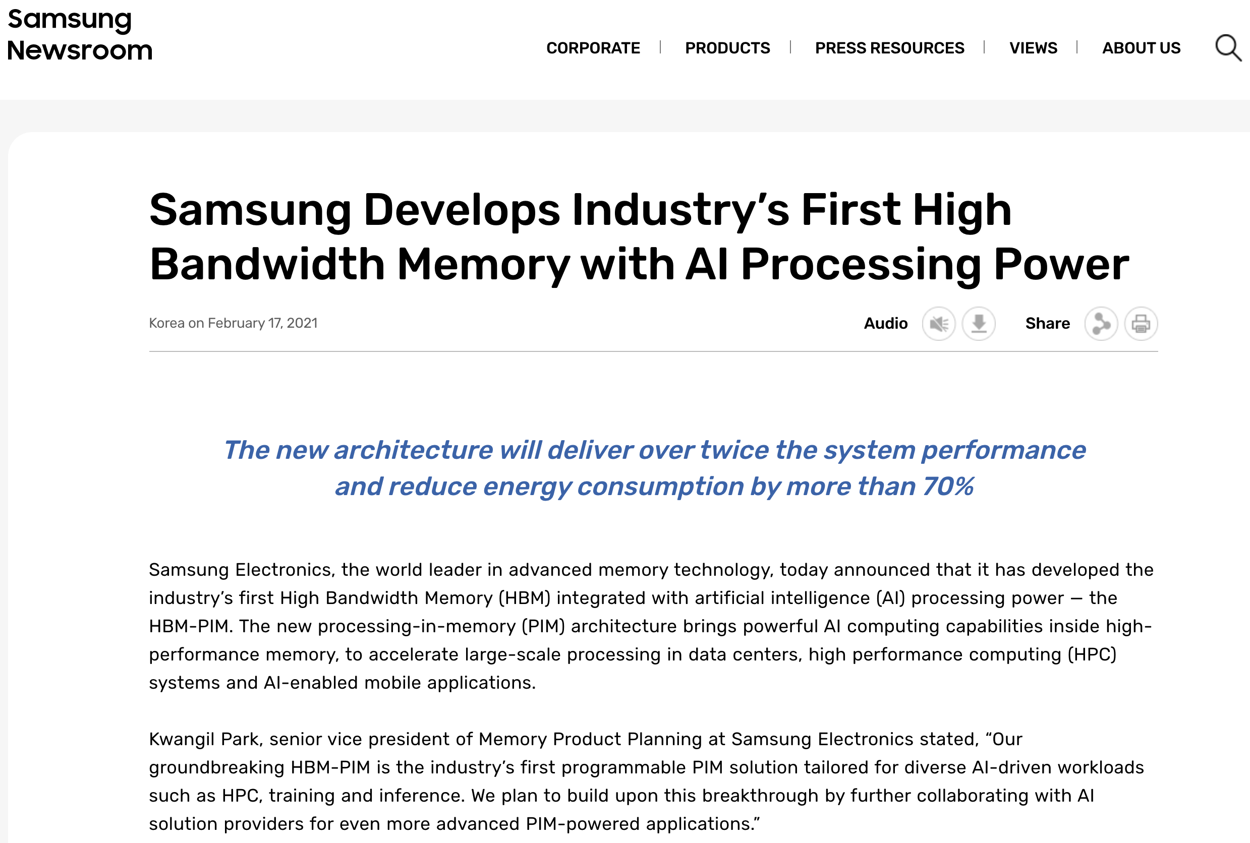
Samsung Function-in-Memory DRAM (2021)
https://news.samsung.com/global/samsung-develops-industrys-first-high-bandwidth-memory-with-ai-processing-power

Slide 4
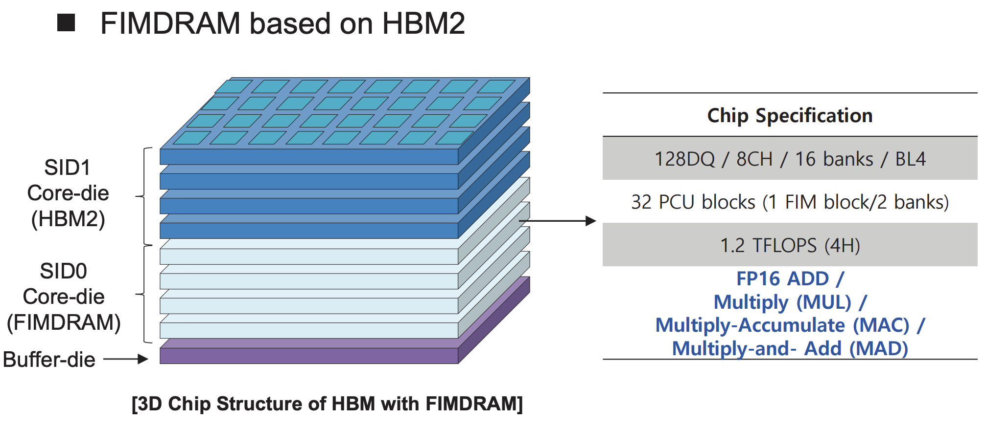
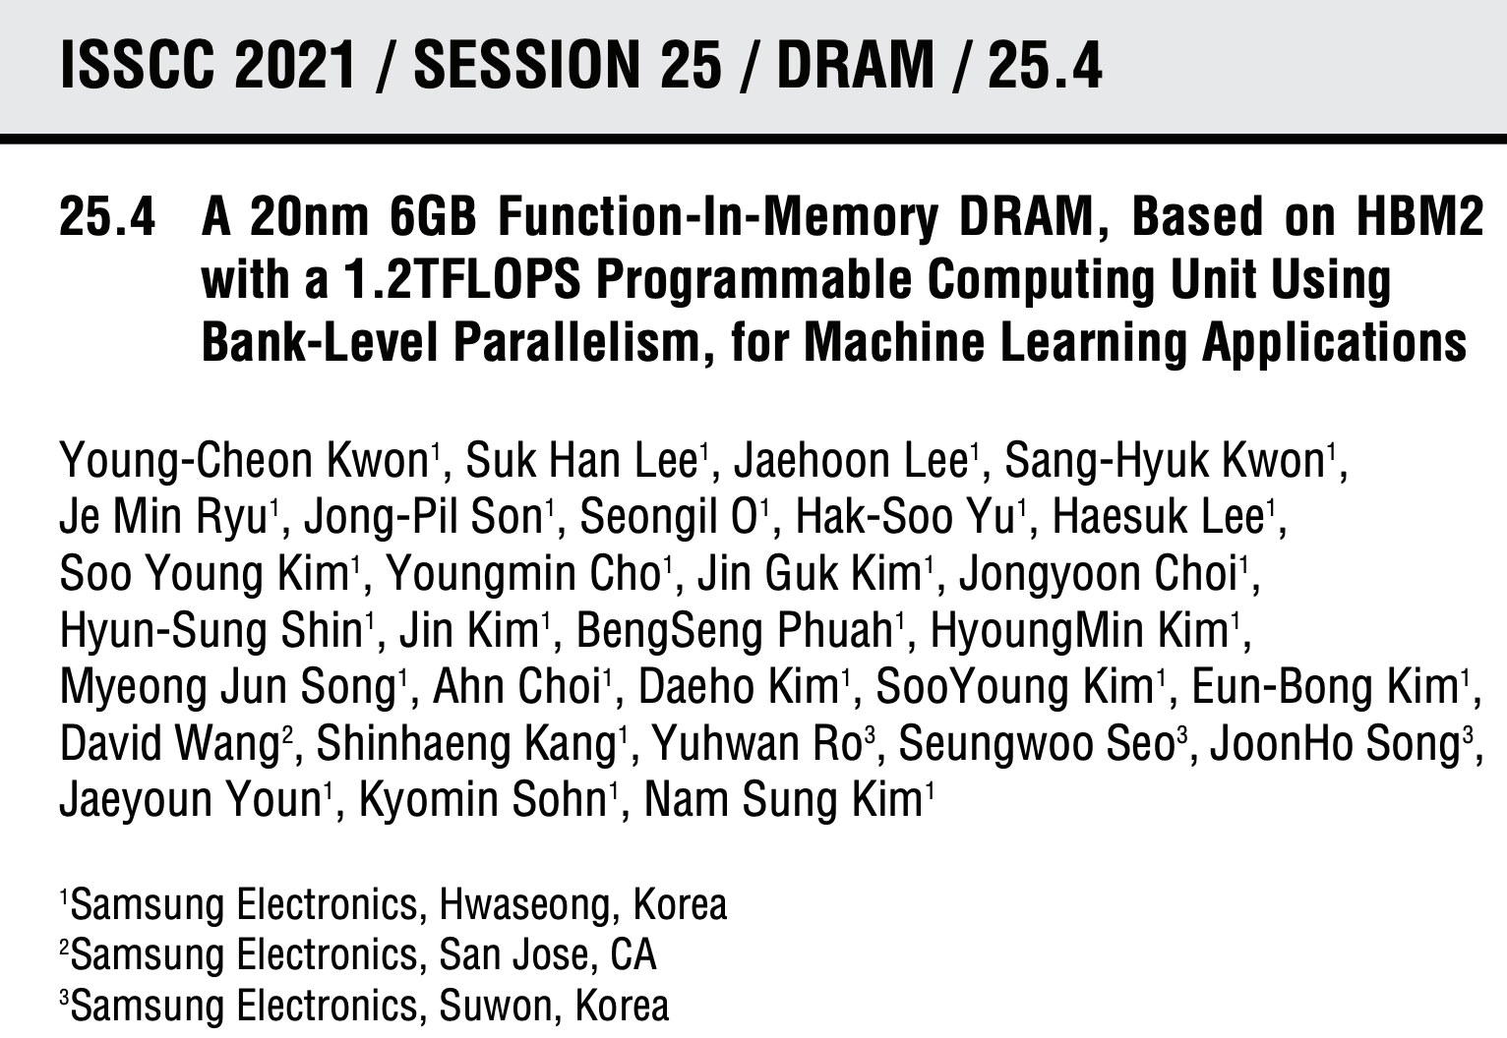
Samsung Function-in-Memory DRAM (2021)

Slide 5
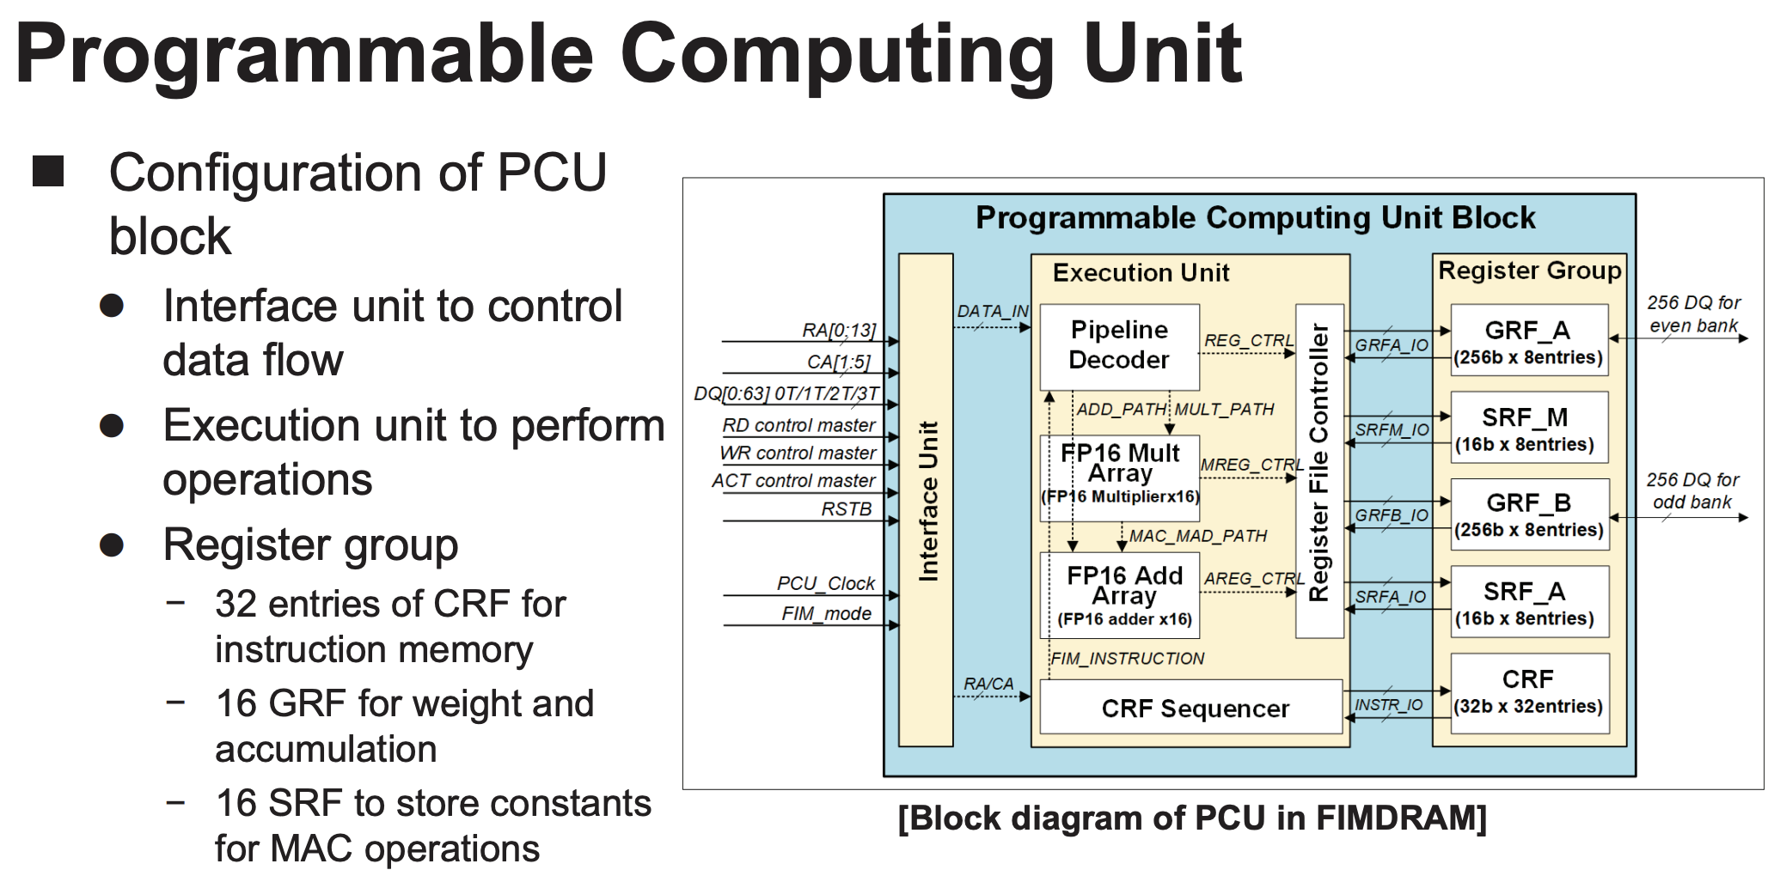
Samsung Function-in-Memory DRAM (2021)

Slide 6
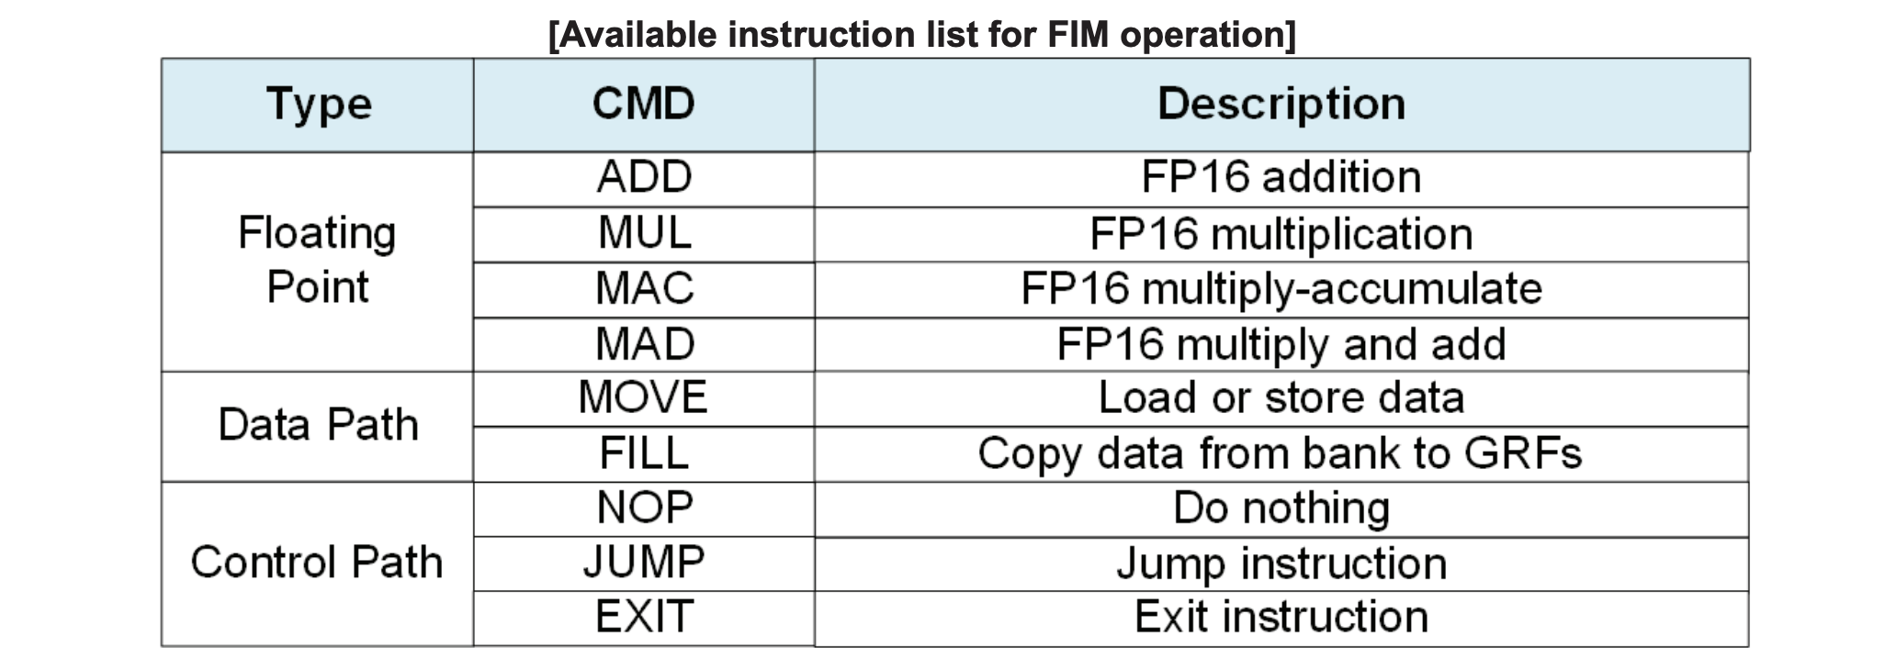
Samsung Function-in-Memory DRAM (2021)

Slide 7
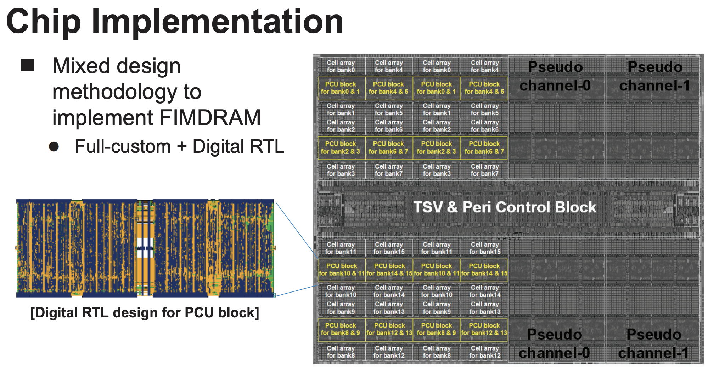
Samsung Function-in-Memory DRAM (2021)

Slide 8
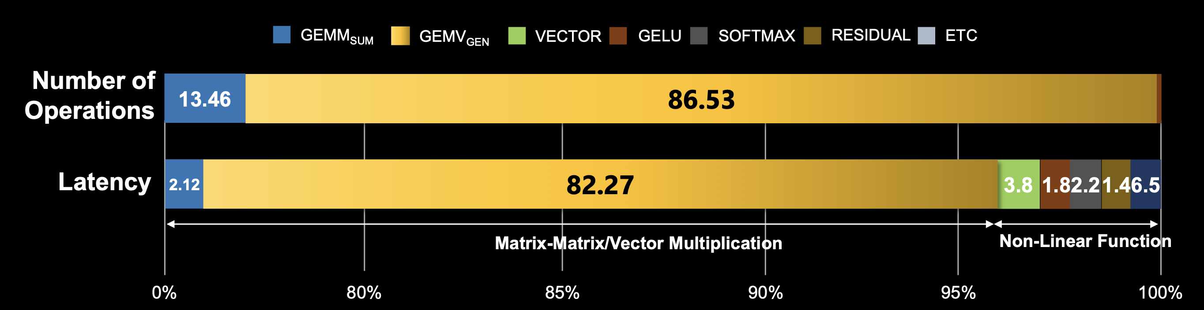
Samsung PNM Solutions for Generative AI (2023)
Main target: transformer decoders used in ChatGPT, GPT-3
  Compute-bound step: Summarization
  Memory-bound step: Generation
    Most of the execution time is spent on the memory copy from the host CPU memory to the CPU memory
GEMV portion can be 60%-80% of total generation latency, which is the target of PIM/PNM
[J. H. Kim+ HC, 2023]

Slide 9
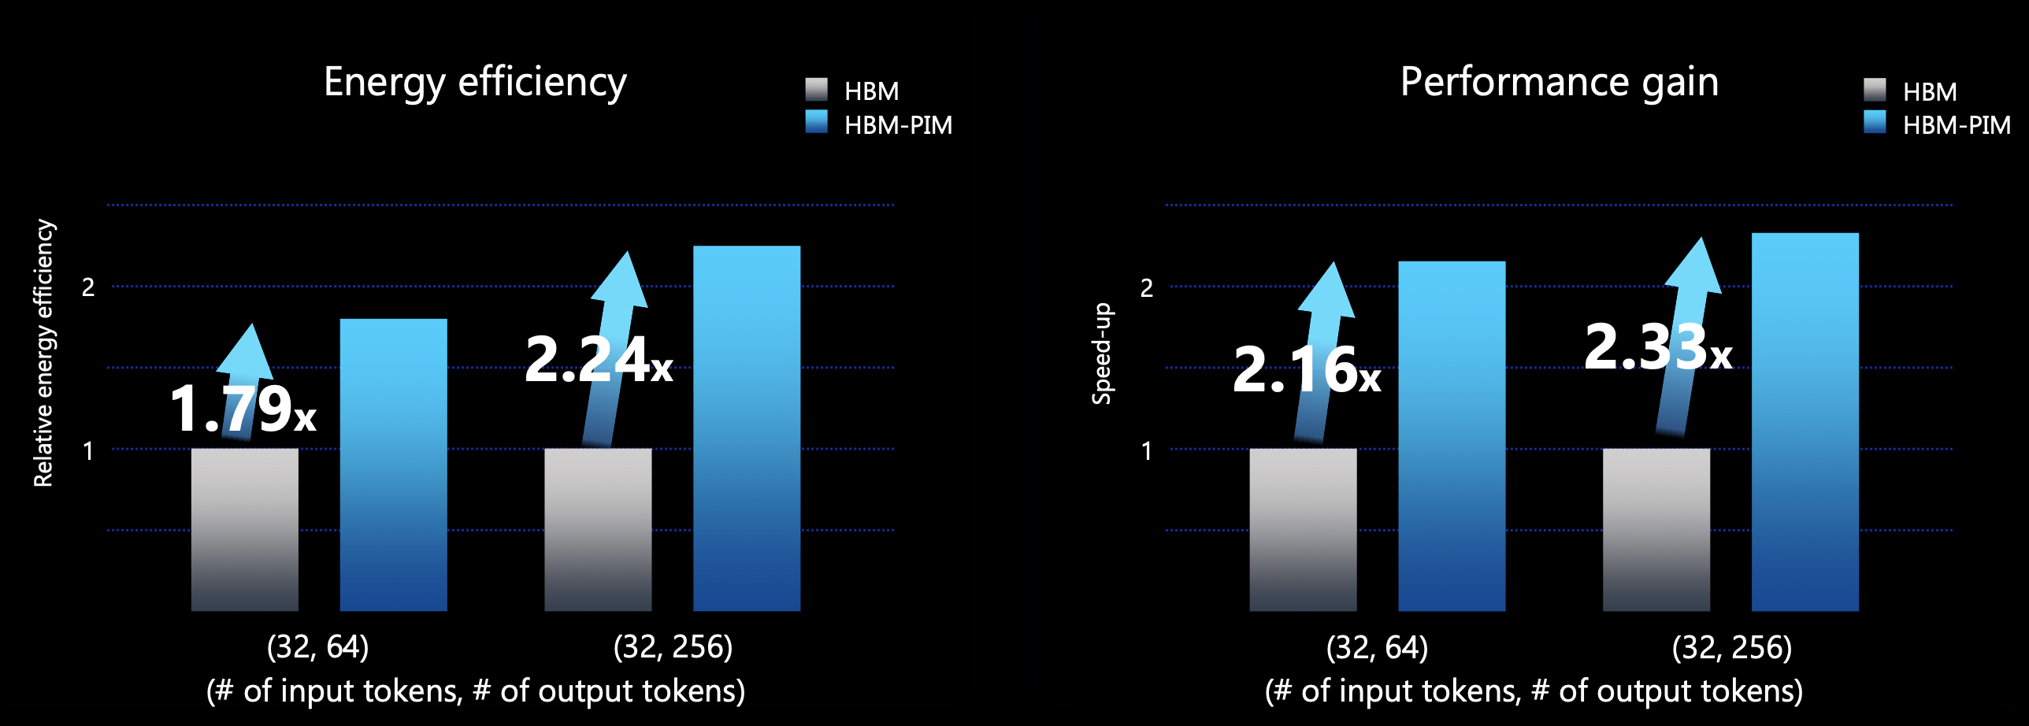
Solution I: Samsung’s HBM-PIM (2023)
AMD MI100 GPUs fabricated with HBM-PIM
Experimental setup: GPT-J (6B, 32 input tokes), single AMD MI100-PIM GPU
GPT can be accelerated by more than 2x over baseline
[J. H. Kim+ HC, 2023]

Slide 10
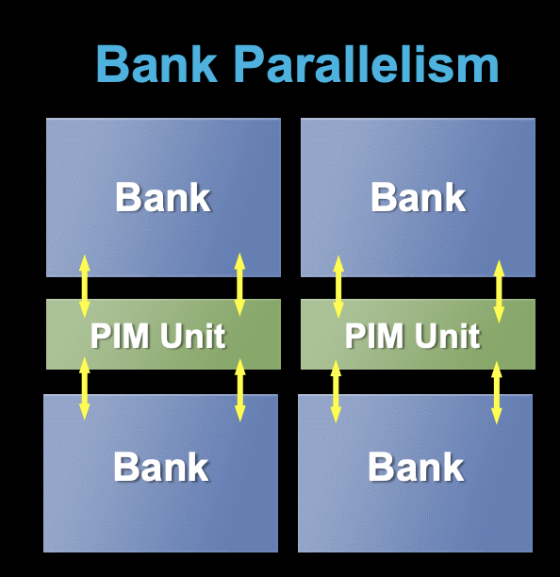
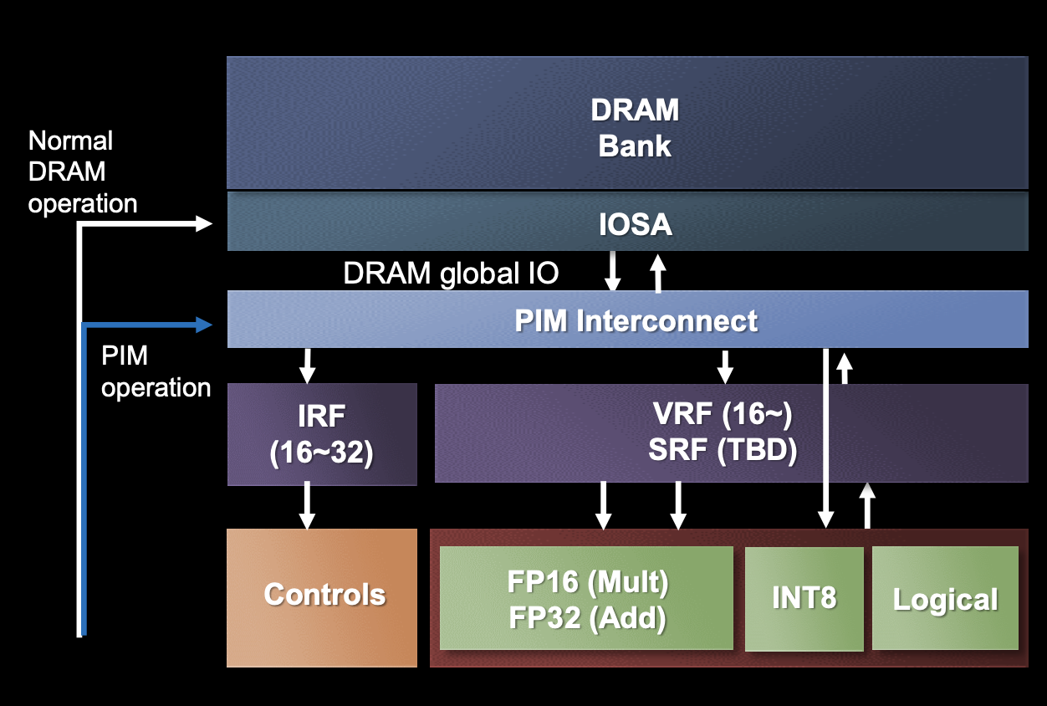
Solution II: Samsung’s LPDDR-PIM (2023)
PIM for on-device generative AI
  Datacenter costs and power consumption are increasing due to the growing demand for cloud AI
LPDDR-PIM improves battery life by preventing memory over-provisioning just for bandwidth
4.47x performance gains and 70.6% energy reduction in GPT-2
[J. H. Kim+ HC, 2023]

Slide 11
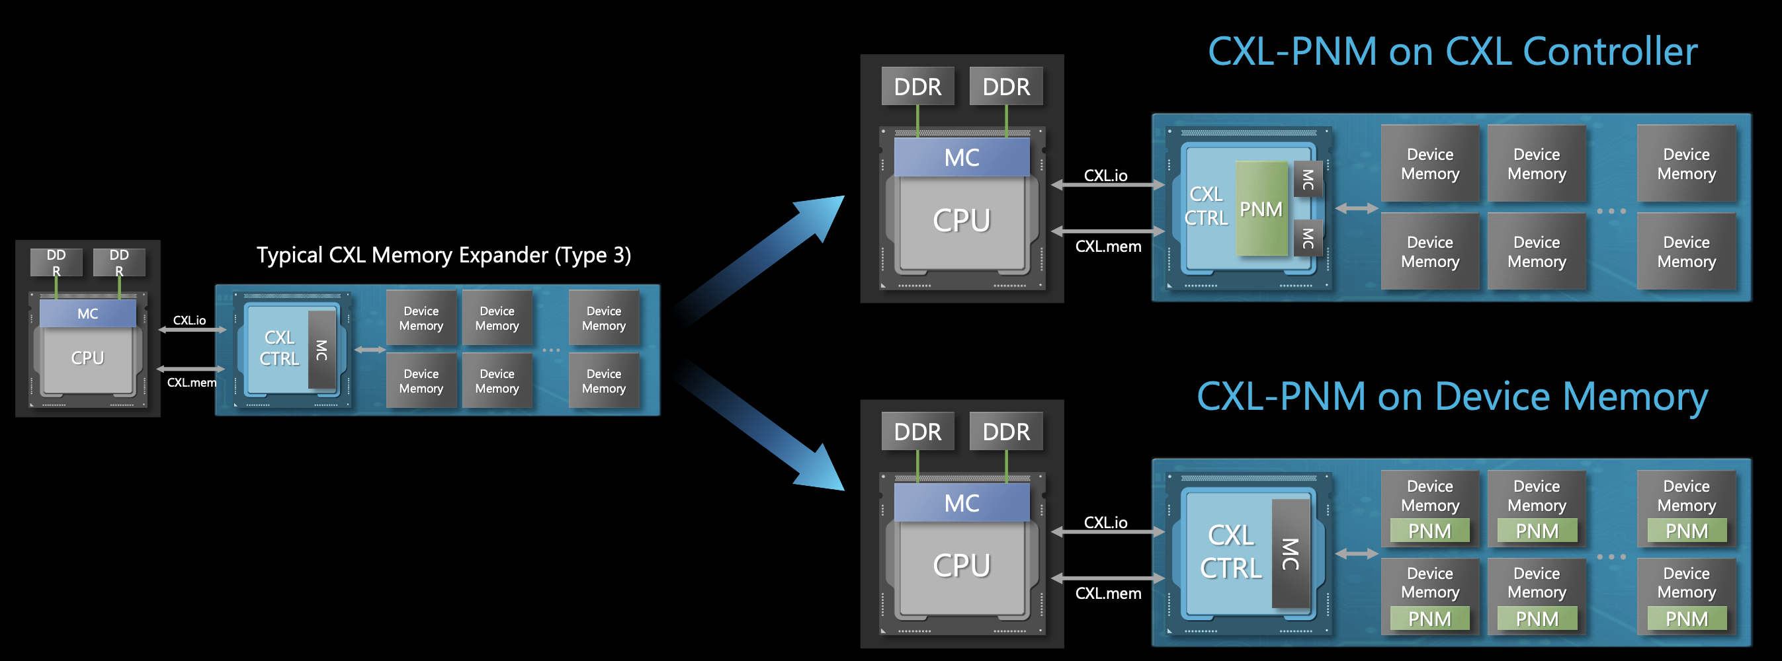
Solution III: Samsung’s CXL-PNM (2023)
A CXL-based processing-near-memory solution
  Improves capacity, bandwidth, and power
  Large-scale large-language models are often capacity-bound
Multiple CXL-PNM can offer 4.4x higher energy efficiency and
53% higher throughput than multiple GPUs
[J. H. Kim+ HC, 2023]

Slide 12
SK hynix AiM: Chip Implementation (2022)
4 Gb AiM die with 16 processing units (PUs)
Lee et al., A 1ynm 1.25V 8Gb, 16Gb/s/pin GDDR6-based Accelerator-in-Memory supporting 1TFLOPS MAC Operation and Various Activation Functions for Deep-Learning Applications, ISSCC 2022
Notes:
* The operating voltage is 1.25V:
- Lowered from 1.35V of the normal GDDR6, for bank parallel operation.
* 16Gb/s is reached at 1.25V in DL operation.
Flat-lid package for lower thermal resistance.
Tested in a prototype system with an FPGA (connected to host CPU via PCIe).

Slide 13
SK hynix AiM: System Organization (2022)
GDDR6-based AiM architecture
Lee et al., A 1ynm 1.25V 8Gb, 16Gb/s/pin GDDR6-based Accelerator-in-Memory supporting 1TFLOPS MAC Operation and Various Activation Functions for Deep-Learning Applications, ISSCC 2022

Slide 14
Possible PNM Designs
General-purpose programmable cores
  Wimpy cores (possibility of running any workload)
  E.g. from academia: Tesseract PIM for Graph Processing
  E.g. from industry: UPMEM PIM
PIM Core
Cache
Fixed-function units
  Hardware/software co-designed PIM for efficiency
  E.g. from academia: Mensa for NN Edge Inference
  E.g. from industry: Samsung HBM-PIM, SK hynix AiM
PIM-Accelerator 1
…
PIM-Accelerator N
Reconfigurable architectures
  PNM cores coupled with FPGAs, CGRA
  E.g. from academia: NERO for Weather Prediction
  E.g. from industry: Samsung AxDIMM
Reconfigurable Accelerator

Slide 15
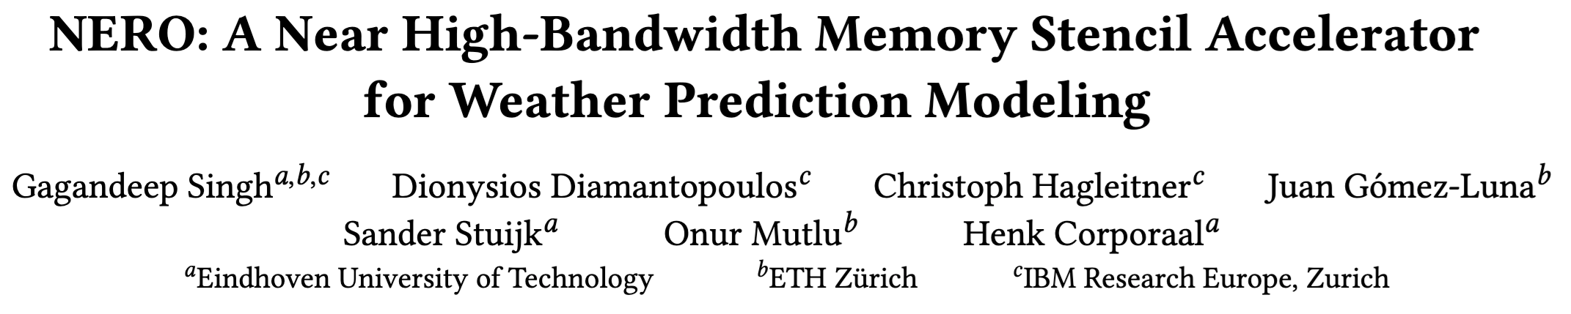
FPGA-based Processing Near Memory
Gagandeep Singh, Dionysios Diamantopoulos, Christoph Hagleitner, Juan Gómez-Luna, Sander Stuijk, Onur Mutlu, and Henk Corporaal,
"NERO: A Near High-Bandwidth Memory Stencil Accelerator for Weather Prediction Modeling"
Proceedings of the 30th International Conference on Field-Programmable Logic and Applications (FPL), Gothenburg, Sweden, September 2020.

Slide 16
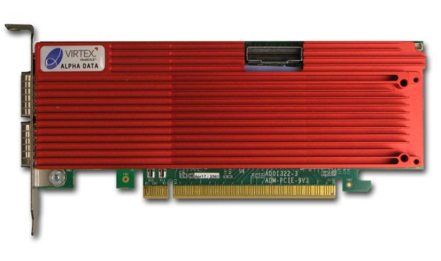
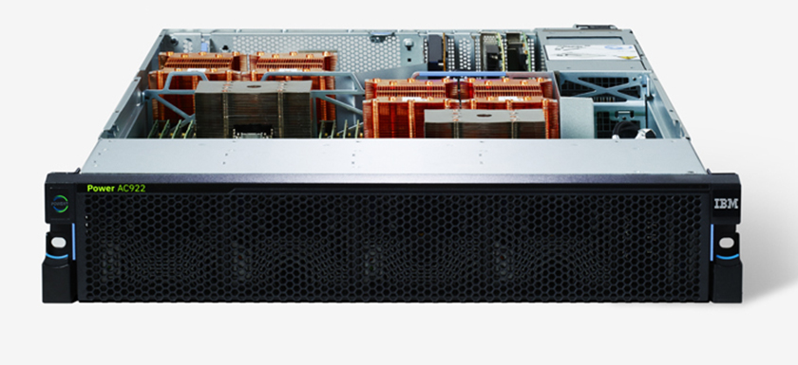
Heterogeneous System: CPU+FPGA
CAPI2
Source: IBM
Source: AlphaData
POWER9 AC922
DDR4-based AD9V3 board
We evaluate two POWER9+FPGA systems:
  1. HBM-based board AD9H7
  Xilinx Virtex Ultrascale+™ XCVU37P-2
  2. DDR4-based board AD9V3
  Xilinx Virtex Ultrascale+™ XCVU3P-2
Notes:
and the second is alphadata 9v3 with DDR4
Our CPU-FPGA heterogeneous platform offloads the rep-ri-zen-tuh-tiv weather kernels onto the FPGA
% with 98% of stencil execution time
%In the execution flow of our application:
Application data is stored in the HOST DRAM
Since our platform offers memory-coherent access of FPGA to the system memory, we build a pipelined execution, where communication time for transferring data from host to FPGA memory is masked with the actual FPGA processing
%Despite the low computational complexity, we were able to hide the memory access latency with the CAPI2 interface

Slide 17
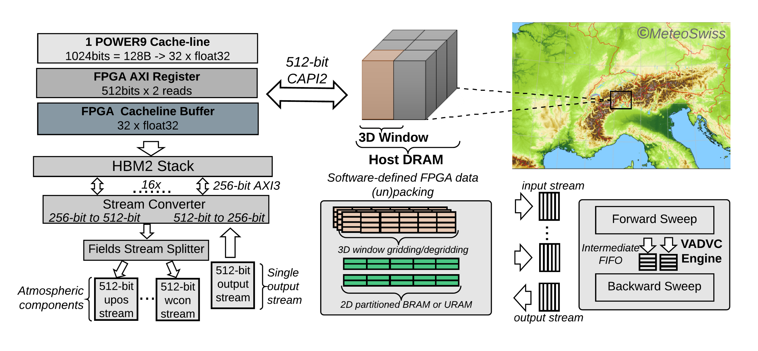
NERO Design Flow
Notes:
This is the complete design flow. All the tasks execute in a dataflow manner that enables task-level parallelism.
%Note that we show only a single port-based PE operation. However, for multiple PEs, we enable multiple HBM ports.

Slide 18
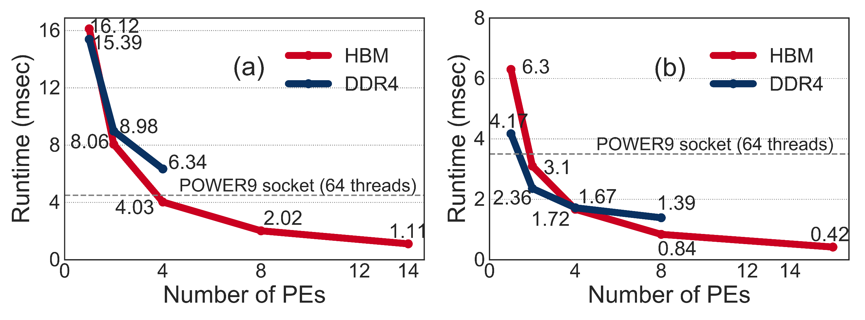
NERO Performance Analysis
Vertical Advection
Horizontal Diffusion
NERO is 4.2x and 8.3x faster than
a complete POWER9 socket
Notes:
By carefully designing the micro-archictecture architecture with application specific heterogeneous memory hierarchy, NERO is 4.2 times and 8.3 times faster for vertical advection and horizontal diffusion respectively than a complete~POWER9~socket.

Slide 19
Possible PNM Designs
General-purpose programmable cores
  Wimpy cores (possibility of running any workload)
  E.g. from academia: Tesseract PIM for Graph Processing
  E.g. from industry: UPMEM PIM
PIM Core
Cache
Fixed-function units
  Hardware/software co-designed PIM for efficiency
  E.g. from academia: Mensa for NN Edge Inference
  E.g. from industry: Samsung HBM-PIM, SK hynix AiM
PIM-Accelerator 1
…
PIM-Accelerator N
Reconfigurable architectures
  PNM cores coupled with FPGAs, CGRA
  E.g. from academia: NERO for Weather Prediction
  E.g. from industry: Samsung AxDIMM
Reconfigurable Accelerator

Slide 20
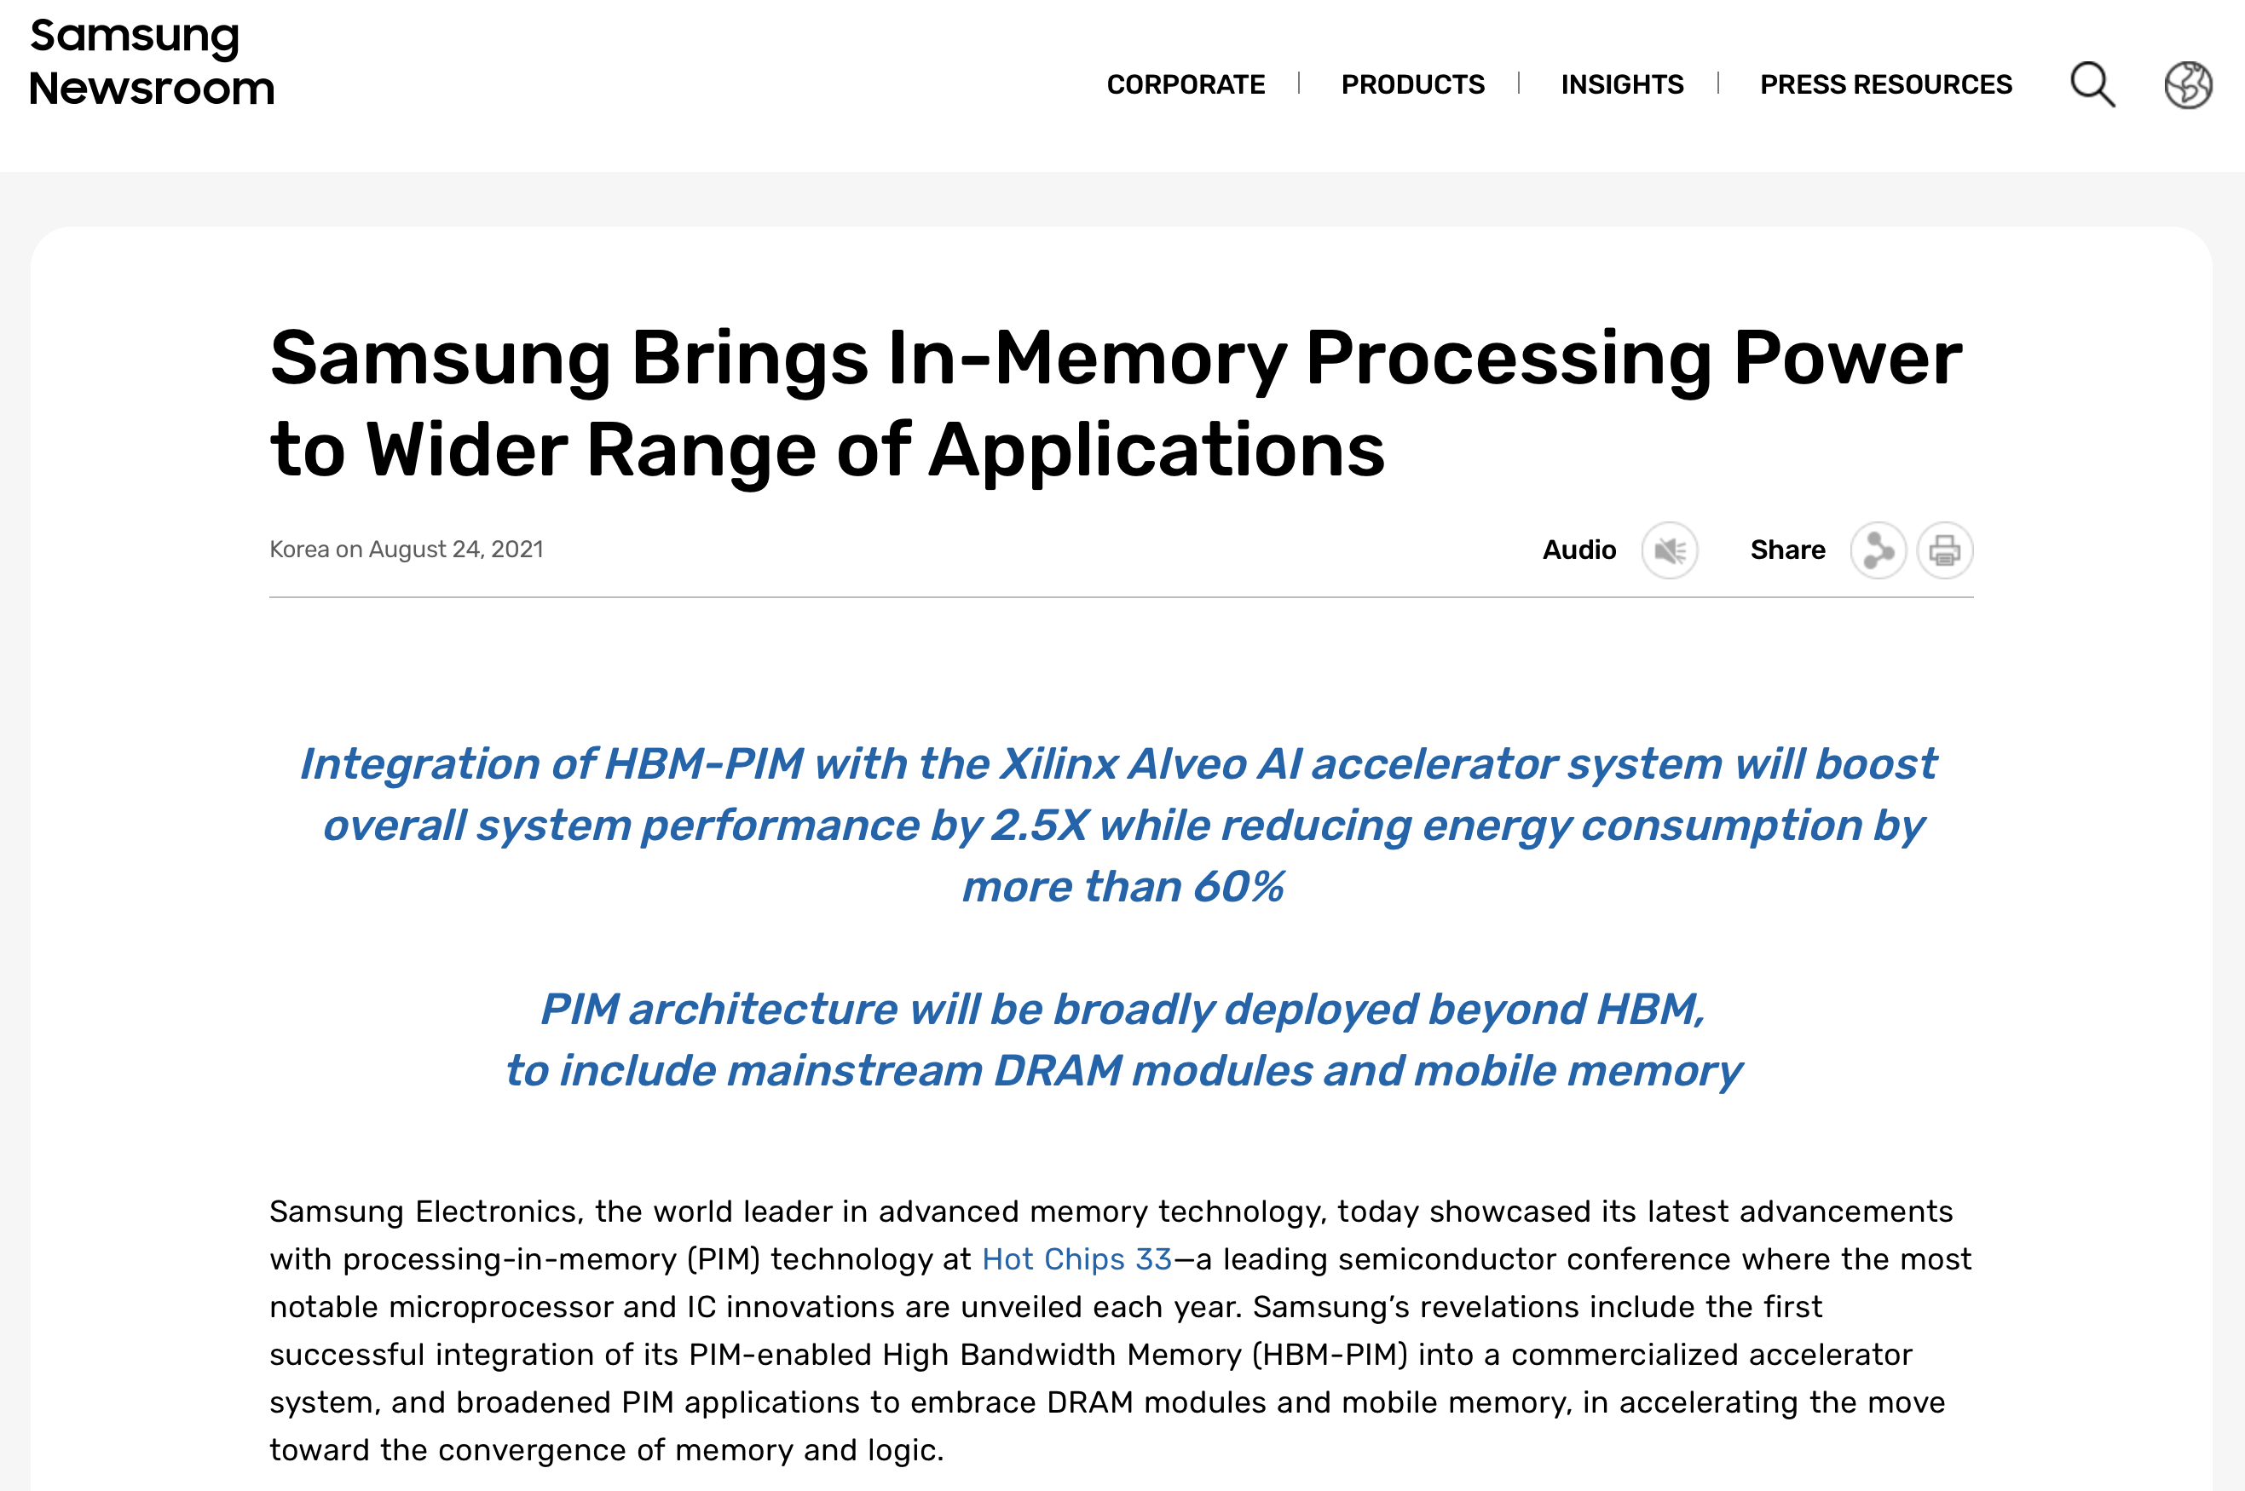
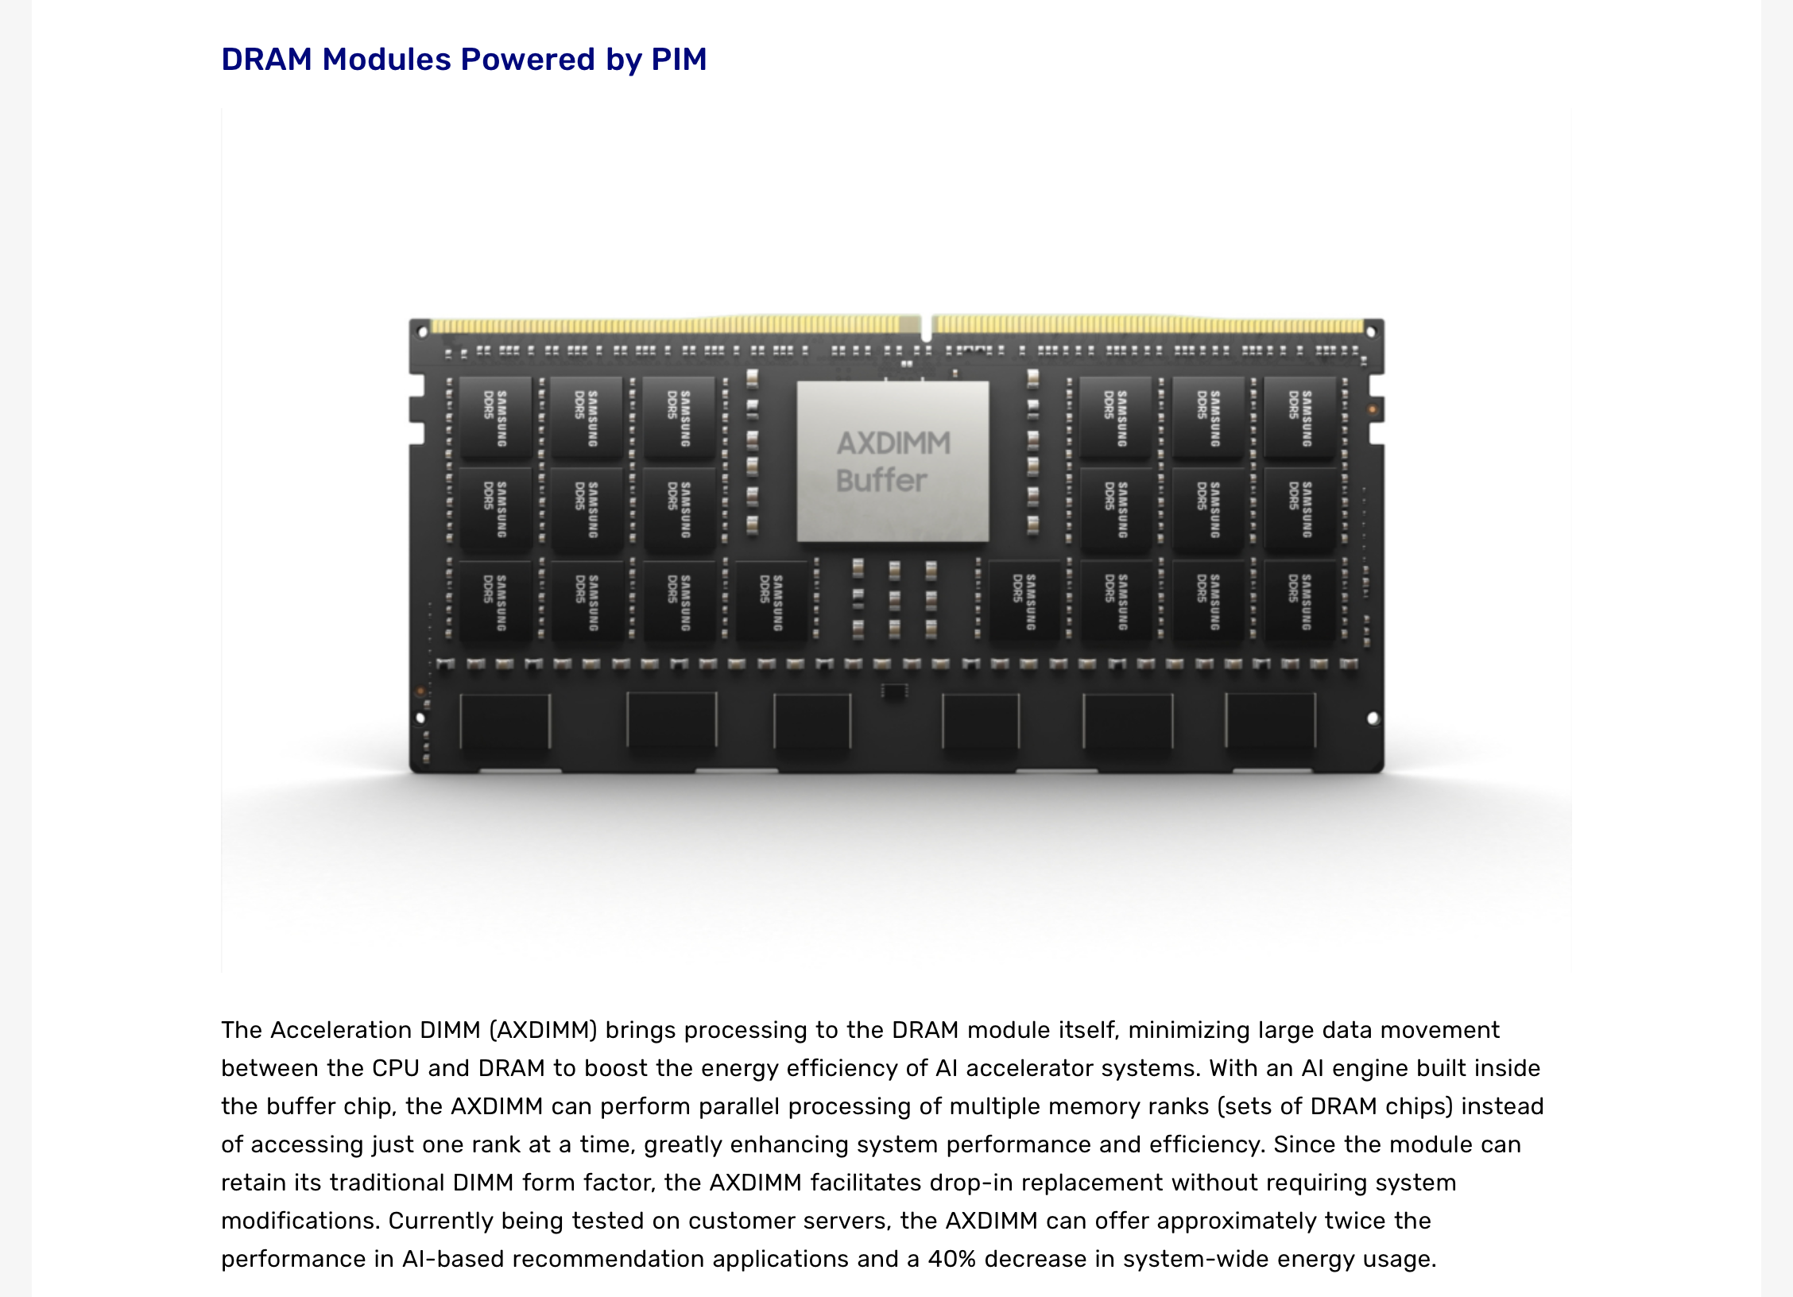
Samsung AxDIMM (2021)
https://news.samsung.com/global/samsung-brings-in-memory-processing-power-to-wider-range-of-applications

Slide 21
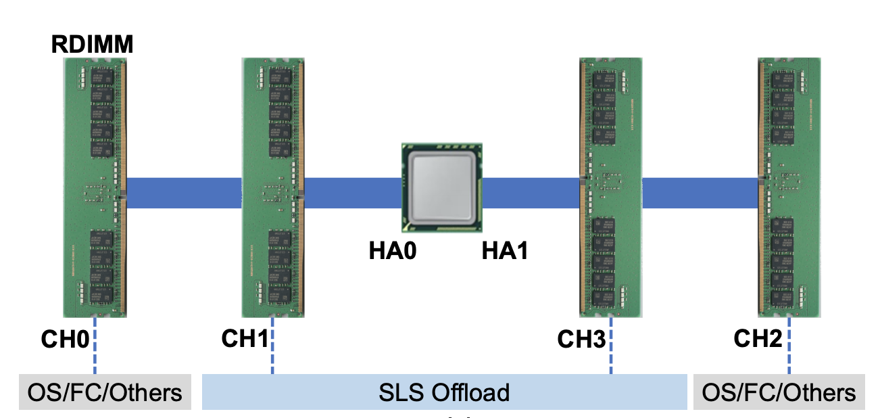
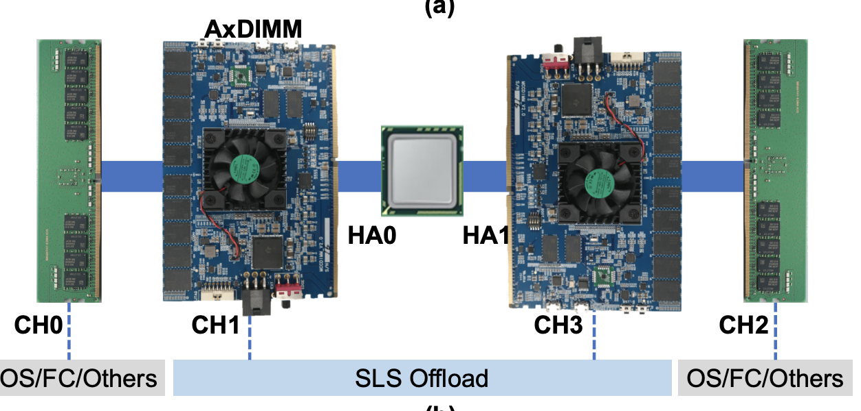
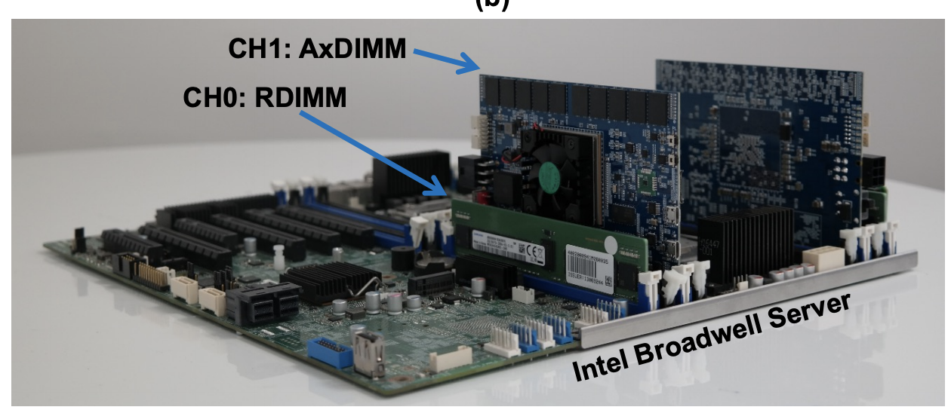
Samsung AxDIMM (2021)
DIMM-based PIM
  DLRM recommendation system
Baseline System
AxDIMM System
[Ke+, IEEE Micro’2021]

Slide 22
AxDIMM Design: Hardware Architecture
FPGA board with standard DIMM interface:
It serves as a real-system
near-memory processing implementation
[Ke+, IEEE Micro’2021]

Slide 23
AxDIMM Design: Hardware Architecture
Two execution modes:
non-acceleration mode
acceleration mode (blocking)
[Ke+, IEEE Micro’2021]
Notes:
Blocking = No concurrent access from host.

Slide 24
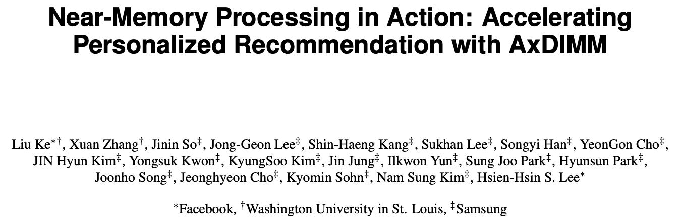
Sparse Length Sum with AxDIMM (IEEE Micro 2021)
https://doi.org/10.1109/MM.2021.3097700

Slide 25
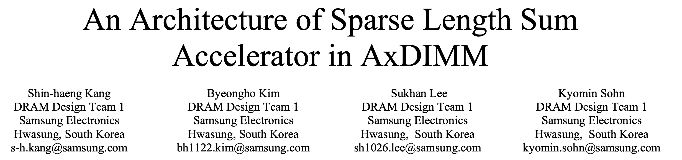
Sparse Length Sum with AxDIMM (AICAS 2022)
https://doi.org/10.1109/AICAS54282.2022.9869896

Slide 26
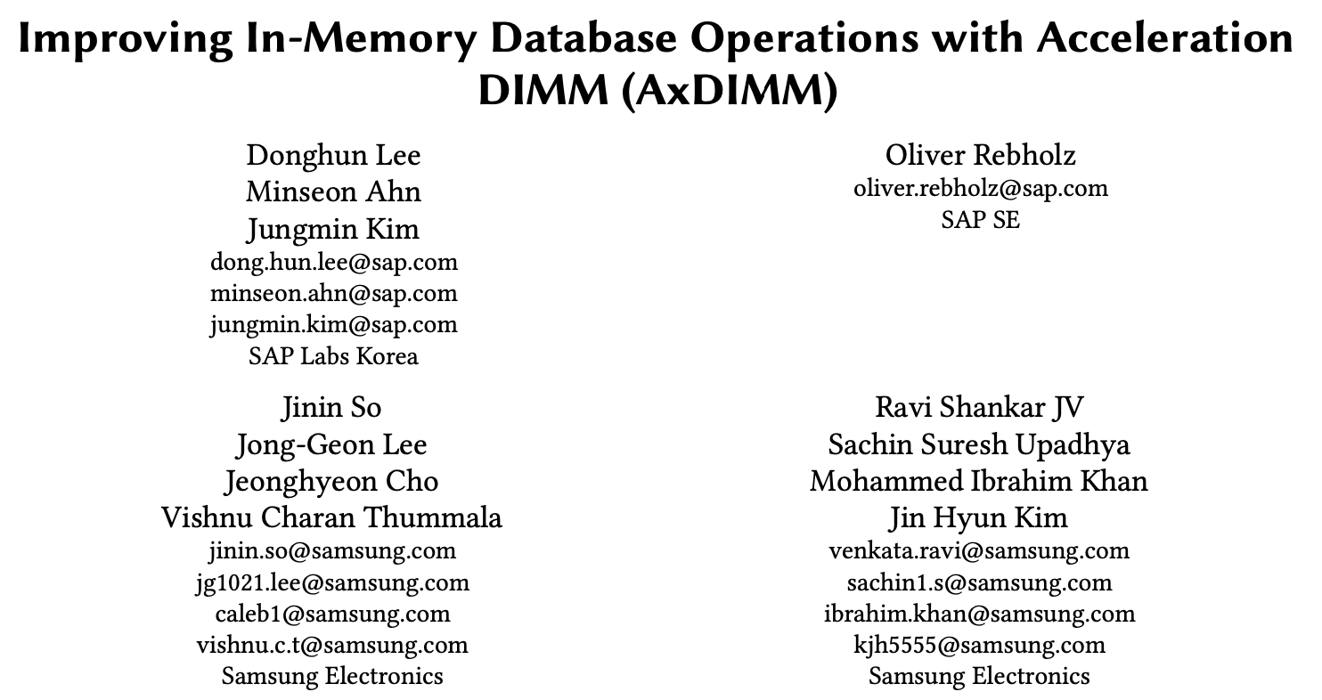
Database Operations with AxDIMM (DaMoN 2022)
https://doi.org/10.1145/3533737.3535093

Slide 27
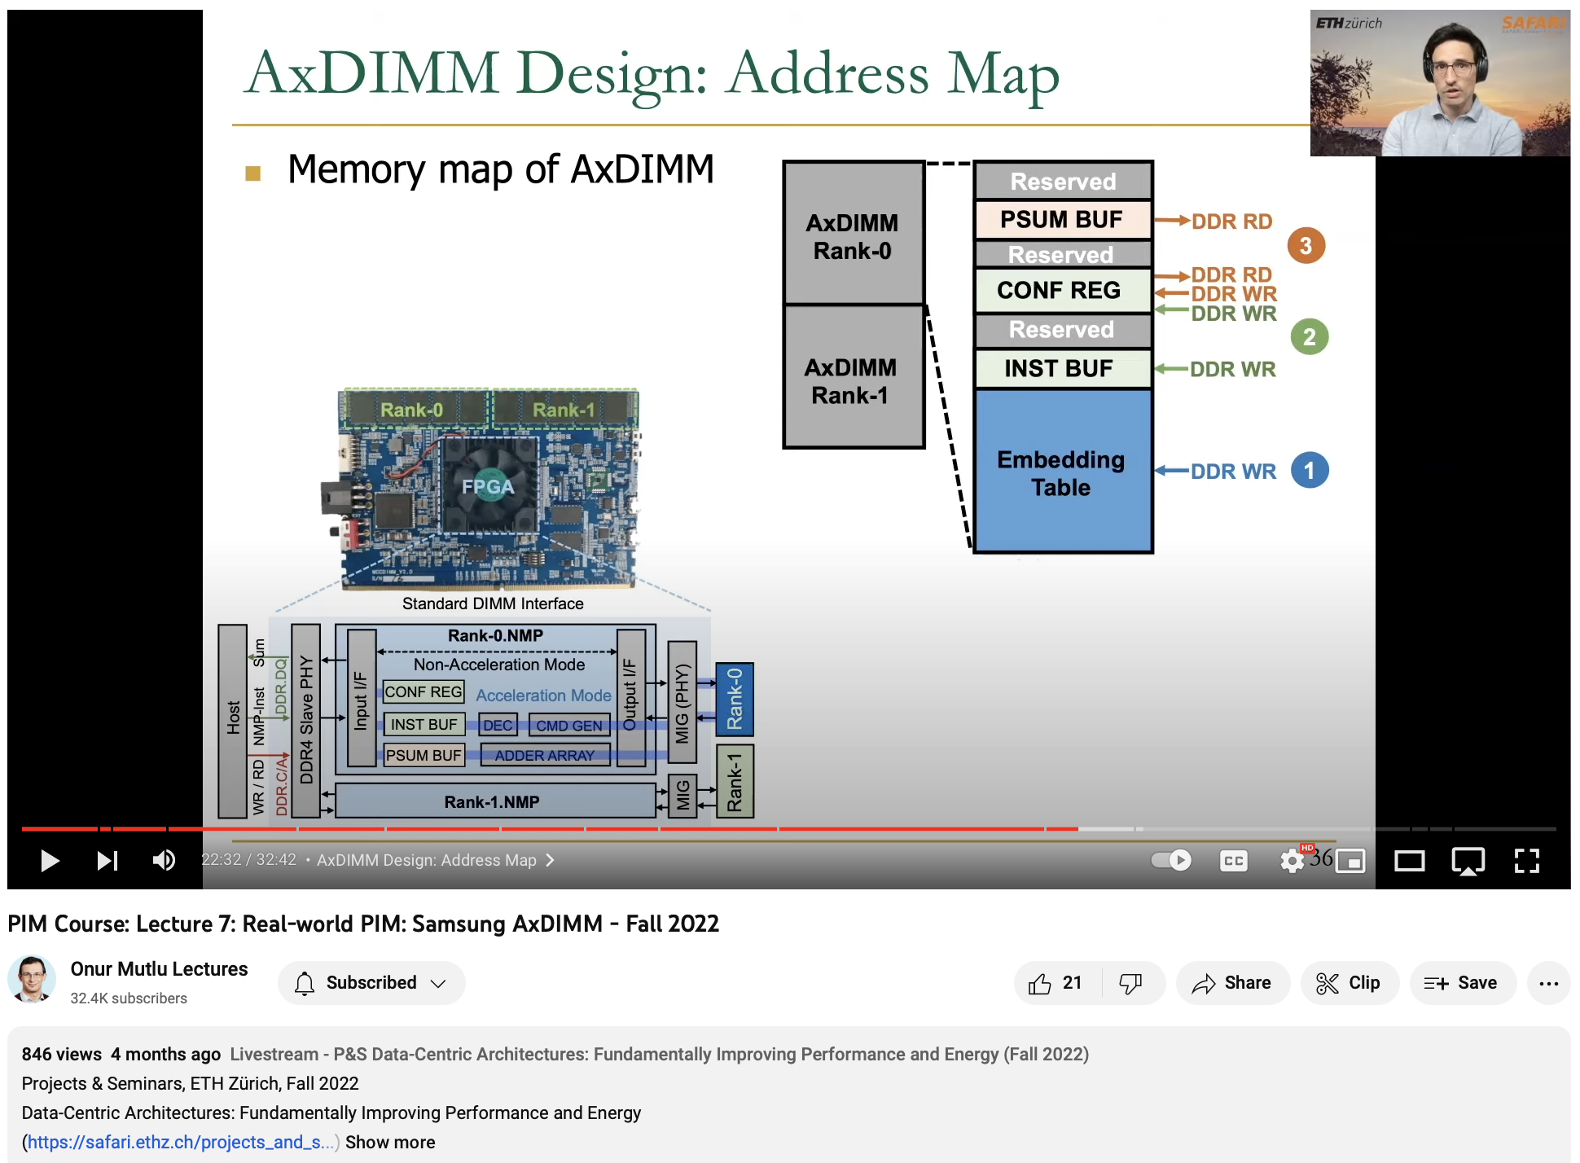
Longer Lecture on AxDIMM
https://youtu.be/SXdzQZAKG-Y

Slide 28
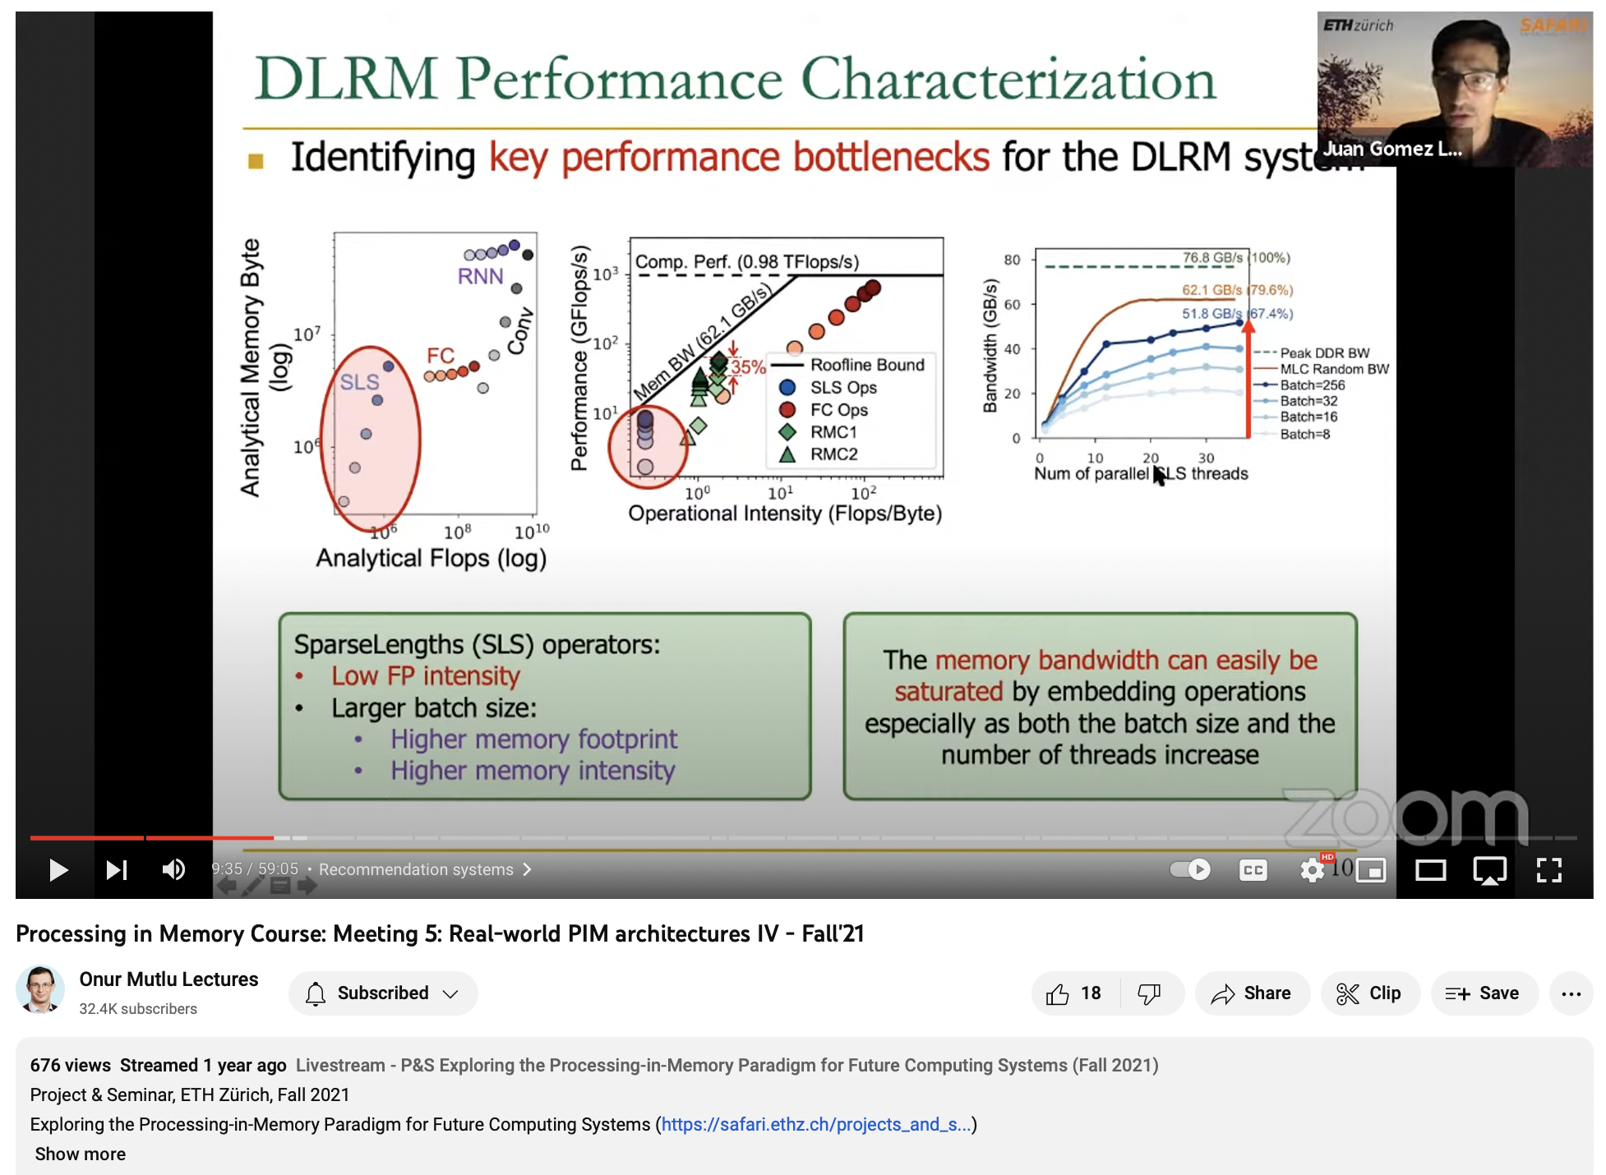
Another Longer Lecture on AxDIMM
https://youtu.be/2FMQg786GKs

Slide 29
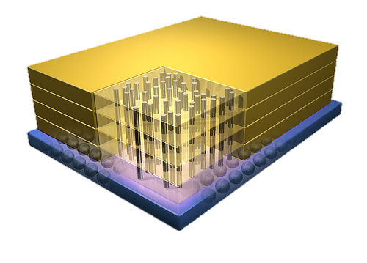


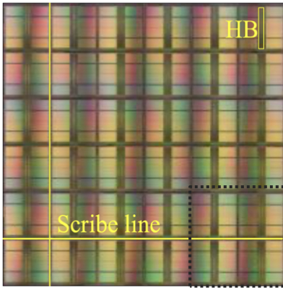
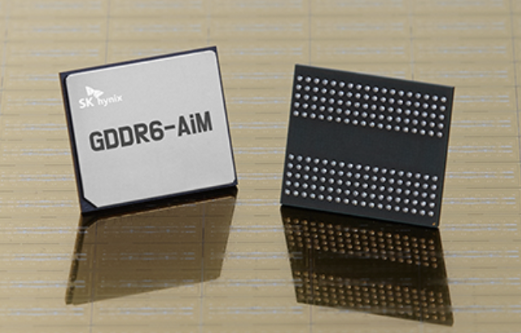
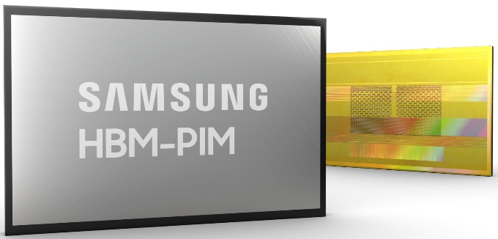

Processing-in-Memory Landscape Today
[Samsung 2021]
[Alibaba 2022]
[SK Hynix 2022]
[Samsung 2021]
[UPMEM 2019]
This does not include many experimental chips and startups

Slide 30
Possible PNM Designs
General-purpose programmable cores
  Wimpy cores (possibility of running any workload)
  E.g. from academia: Tesseract PIM for Graph Processing
  E.g. from industry: UPMEM PIM
PIM Core
Cache
Fixed-function units
  Hardware/software co-designed PIM for efficiency
  E.g. from academia: Mensa for NN Edge Inference
  E.g. from industry: Samsung HBM-PIM, SK hynix AiM
PIM-Accelerator 1
…
PIM-Accelerator N
Reconfigurable architectures
  PNM cores coupled with FPGAs, CGRA
  E.g. from academia: NERO for Weather Prediction
  E.g. from industry: Samsung AxDIMM
Reconfigurable Accelerator

Slide 31

Research Tools PNM: DAMOV-SIM
Geraldo F. Oliveira, Juan Gomez-Luna, Lois Orosa, Saugata Ghose, Nandita Vijaykumar, Ivan fernandez, Mohammad Sadrosadati, and Onur Mutlu,
"DAMOV: A New Methodology and Benchmark Suite for Evaluating Data Movement Bottlenecks"
IEEE Access, 8 September 2021.
Preprint in arXiv, 8 May 2021.
[arXiv preprint]
[IEEE Access version]
[DAMOV Suite and Simulator Source Code]
[SAFARI Live Seminar Video (2 hrs 40 mins)]
[Short Talk Video (21 minutes)]

Slide 32
Step 3: Memory Bottleneck Classification (2/2)
Goal: identify the specific sources of data movement bottlenecks
Configuration 1: Host CPU System
DRAM
DRAM
DRAM
L3
DRAM
DAMOV-SIM Simulator
L1
L2
CPU
L1
L2
CPU
L1
L2
Off-chip link
CPU
L1
L2
CPU
Configuration 2: NDP System
DRAM
DRAM
DRAM
# Cores
DRAM
CPU
L1
…
Off-chip link
CPU
L1
Scalability Analysis
CPU
L1
CPU
L1
Integrated ZSim and Ramulator
Logic Layer
Scalability Analysis:
  1, 4, 16, 64, and 256 out-of-order/in-order host and NDP CPU cores
  3D-stacked memory as main memory
DAMOV-SIM: https://github.com/CMU-SAFARI/DAMOV
272
Notes:
[CLICK] The goal of the scalability analysis we perform is to nail down the specific sources of data movement bottlenecks in the application.
In this analysis, we evaluate the performance and energy scaling of an application in three different system configurations; and collect the key metrics for our bottleneck classification
[CLICK] During scalability analysis, we simulate three system configurations of a general-purpose multicore processor. To this end, we build a framework that integrates the ZSim CPU simulator with the Ramulator memory simulator to produce a fast, scalable, and cycle-accurate open-source simulator called DAMOV-SIM. We use ZSim to simulate the core microarchitecture, cache hierarchy, coherence protocol, and prefetchers. We use Ramulator to simulate the DRAM architecture, memory controllers, and memory accesses.
[CLICK] The first configuration we evaluate is of a host CPU with a deep cache hierarchy, with a 32 KB, private L1 cache, a 256 KB private L2 cache, and a shared 8MB L3 cache.
[CLICK] The second configuration is of an NDP CPU with only a private read-only L1 cache of 32 KB.
In our paper we evaluate an third configuration that includes hardware prefetcher on top of configuration 1. However, we omit such configuration in this talk.
The remaining components of the processor configuration are kept the same to isolate the impact of only the caches, prefetchers, and NDP.
This way, we expect that the performance and energy differences between the three configurations to come exclusively from the different data movement requirements.
[CLICK] For all configurations, we sweep the number of CPU cores in our analysis from 1 to 256, as previous works show that large core counts are necessary to saturate the bandwidth provided by modern high-bandwidth memories, and because modern CPUs and NDP proposals can have varying core counts.
[CLICK] We simulate a memory architecture similar to the Hybrid Memory Cube device where the host CPU accesses memory through a high-speed off-chip link,
[CLICK] and the NDP logic resides in the logic layer of the memory chip and has direct access to the DRAM banks, thus taking advantage of higher memory bandwidth and lower memory latency.
[NEXT]

Slide 33
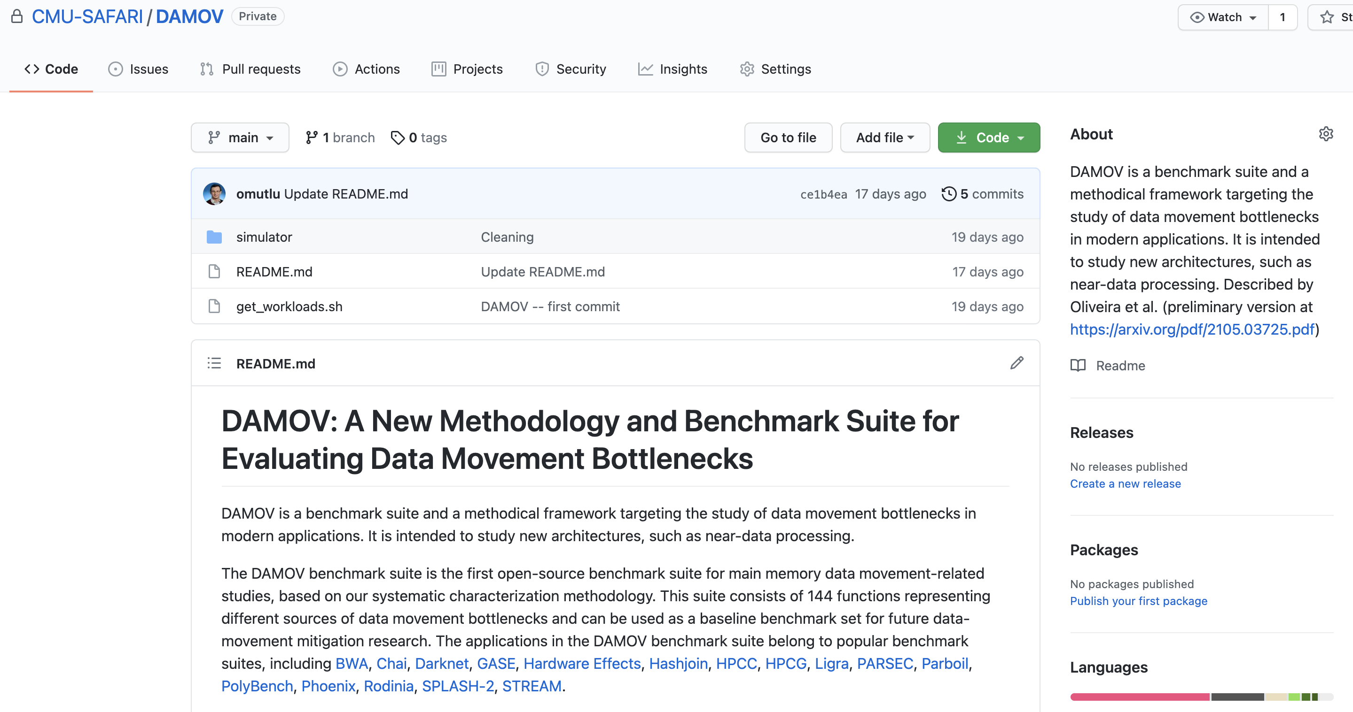
DAMOV is Open Source
We open-source our benchmark suite and our toolchain
DAMOV-SIM
DAMOV
Benchmarks
Notes:
We open source DAMOV to facilitate further research in mitigating data movement bottlenecks, including in near data processing.
[CLICK] In our DAMOV repository, we provide
[CLICK] The complete set of 144 application functions that compose our benchmark suite
[CLICK] And our DAMOV-SIM simulator
[NEXT]

Slide 34
DAMOV is Open Source
We open-source our benchmark suite and our toolchain
Get DAMOV at:
https://github.com/CMU-SAFARI/DAMOV
DAMOV-SIM
DAMOV
Benchmarks
Notes:
We open source DAMOV to facilitate further research in mitigating data movement bottlenecks, including in near data processing.
[CLICK] In our DAMOV repository, we provide
[CLICK] The complete set of 144 application functions that compose our benchmark suite
[CLICK] And our DAMOV-SIM simulator
[NEXT]

Slide 35
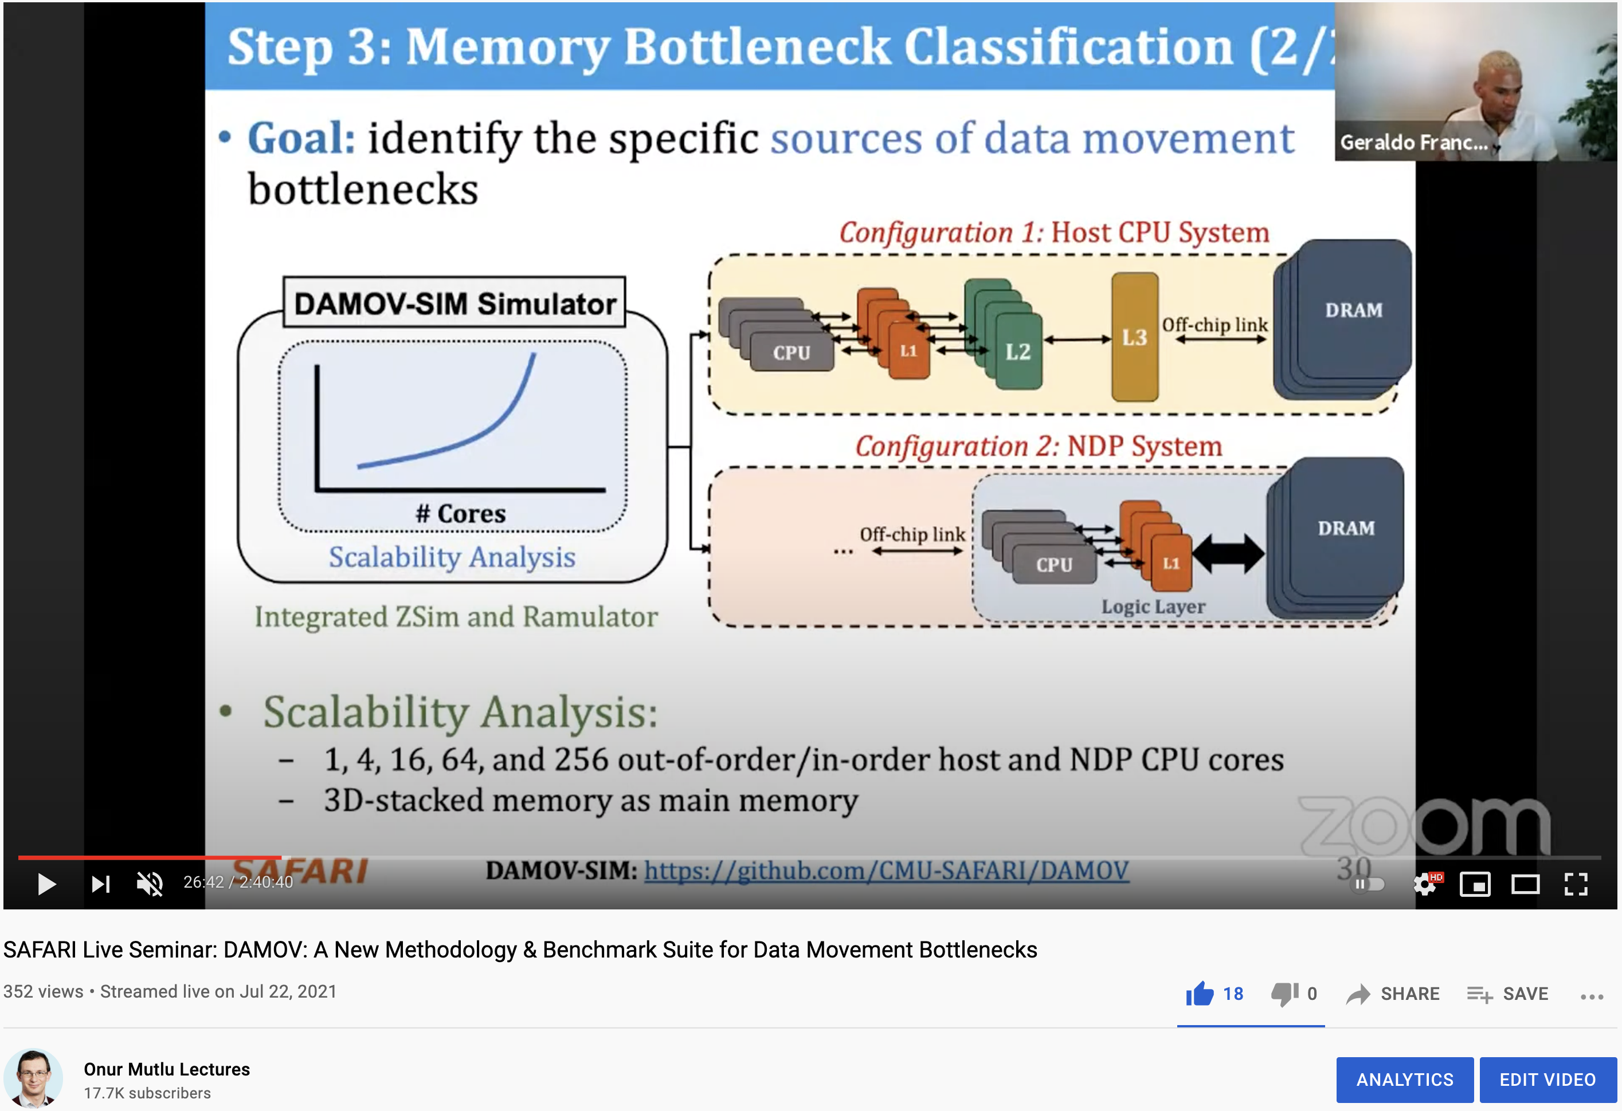
More on DAMOV Analysis Methodology & Workloads
https://www.youtube.com/watch?v=GWideVyo0nM&list=PL5Q2soXY2Zi_tOTAYm--dYByNPL7JhwR9&index=3

Slide 36
More on DAMOV Methods & Benchmarks
Geraldo F. Oliveira, Juan Gomez-Luna, Lois Orosa, Saugata Ghose, Nandita Vijaykumar, Ivan fernandez, Mohammad Sadrosadati, and Onur Mutlu,
"DAMOV: A New Methodology and Benchmark Suite for Evaluating Data Movement Bottlenecks"
IEEE Access, 8 September 2021.
Preprint in arXiv, 8 May 2021.
[arXiv preprint]
[IEEE Access version]
[DAMOV Suite and Simulator Source Code]
[SAFARI Live Seminar Video (2 hrs 40 mins)]
[Short Talk Video (21 minutes)]

Slide 37
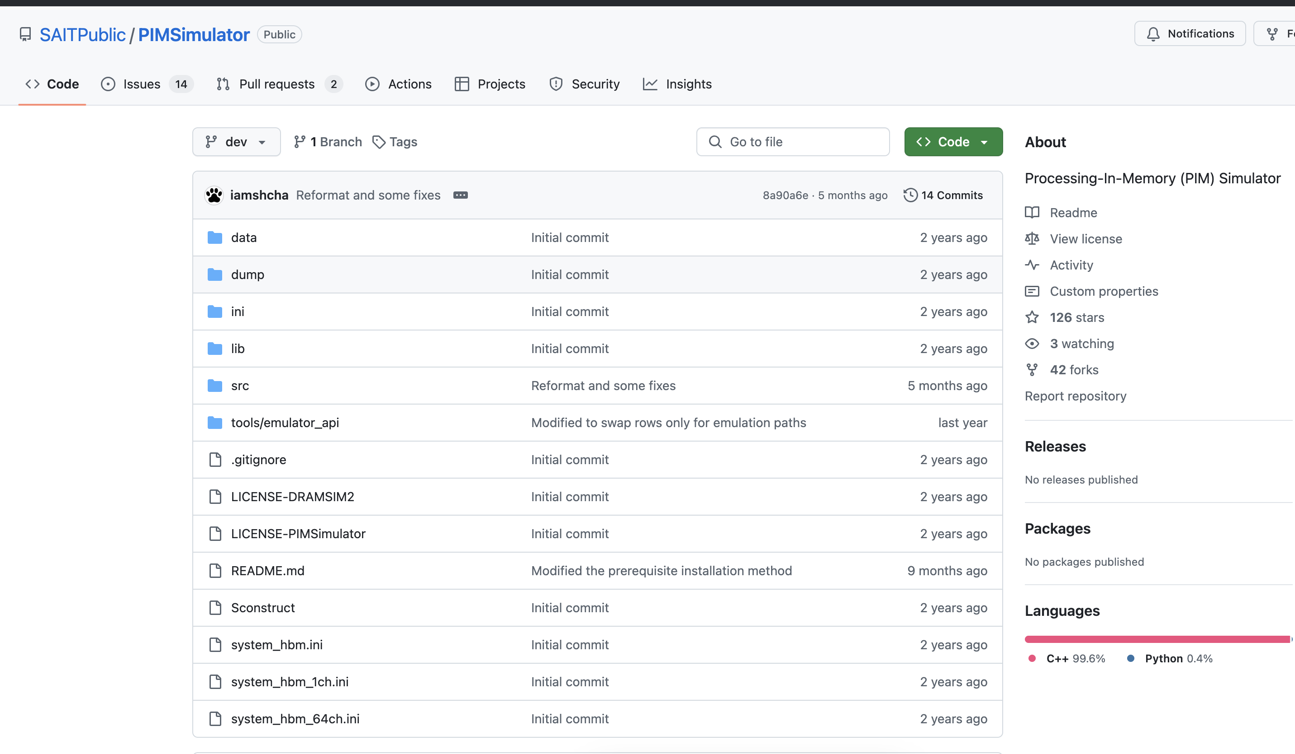
Research Tools PNM: Samsung HBM-PIM
https://github.com/SAITPublic/PIMSimulator

Slide 38
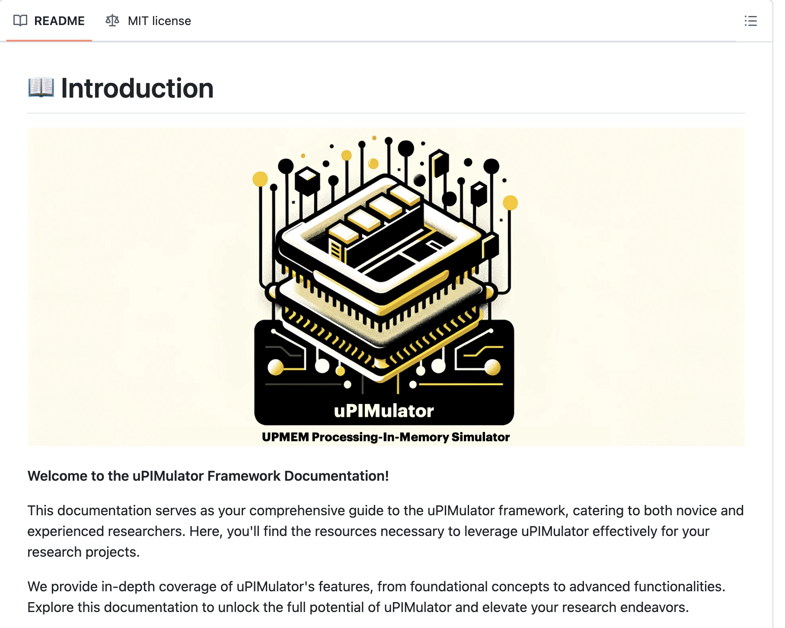
Research Tools PNM: UPMEM PIM (I)
https://github.com/VIA-Research/uPIMulator

Slide 39
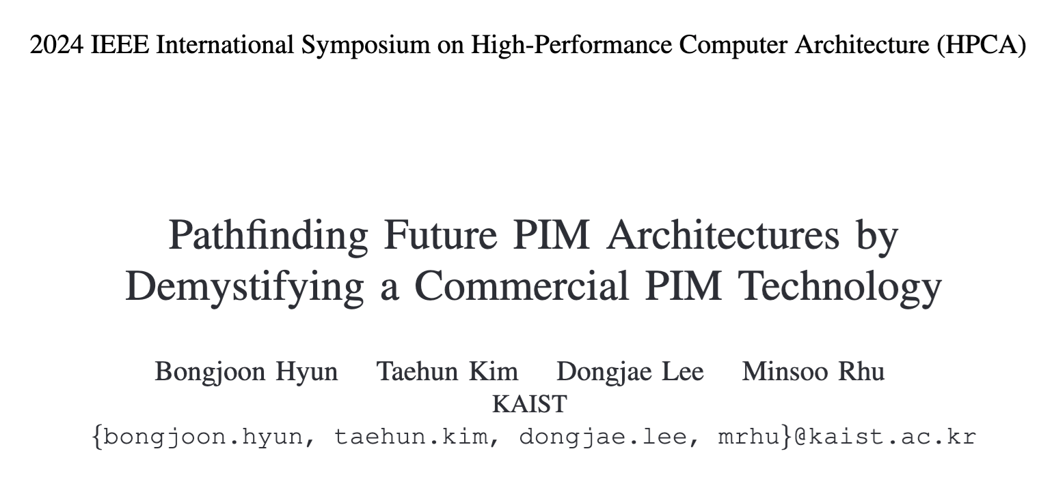
Research Tools PNM: UPMEM PIM (II)
https://ieeexplore.ieee.org/document/10476411/

Slide 40
2nd Workshop on
Memory-Centric Computing:
Processing-Near-Memory - Part I
Dr. Geraldo F. Oliveira
https://geraldofojunior.github.io
ICS 2025
08 June 2025

