Slide 1


2nd Workshop on
Memory-Centric Computing:
PIM Adoption & Programmability
Dr. Geraldo F. Oliveira
https://geraldofojunior.github.io
ICS 2025
08 June 2025

Slide 2
Eliminating the Adoption Barriers
How to Enable Adoption of Processing in Memory

Slide 3
Potential Barriers to Adoption of PIM
1. Applications & software for PIM
2. Ease of programming (interfaces and compiler/HW support)
3. System and security support: coherence, synchronization, virtual memory, isolation, communication interfaces, …
4. Runtime and compilation systems for adaptive scheduling, data mapping, access/sharing control, …
5. Infrastructures to assess benefits and feasibility
All can be solved with change of mindset

Slide 4
We Need to Revisit the Entire Stack
Problem
Algorithm
Program/Language
System Software
SW/HW Interface
Micro-architecture
Logic
Devices
Electrons
We can get there step by step

Slide 5
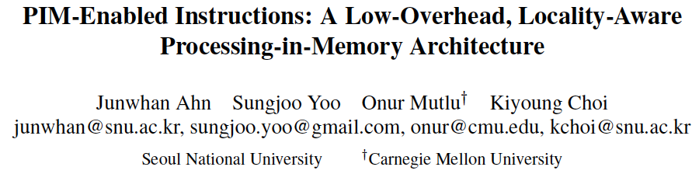
Adoption: How to Keep It Simple?
Junwhan Ahn, Sungjoo Yoo, Onur Mutlu, and Kiyoung Choi,
"PIM-Enabled Instructions: A Low-Overhead, Locality-Aware Processing-in-Memory Architecture"
Proceedings of the 42nd International Symposium on Computer Architecture (ISCA), Portland, OR, June 2015.
[Slides (pdf)] [Lightning Session Slides (pdf)]

Slide 6
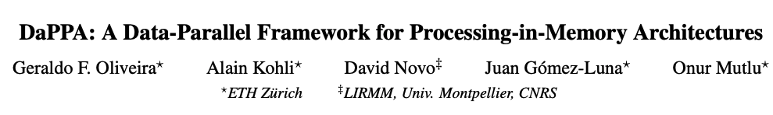
Adoption: How to Ease Programmability? (I)
Geraldo F. Oliveira, Alain Kohli, David Novo,
Juan Gómez-Luna, Onur Mutlu,
“DaPPA: A Data-Parallel Framework for Processing-in-Memory Architectures,”
in PACT SRC Student Competition, Vienna, Austria, October 2023.

Slide 7
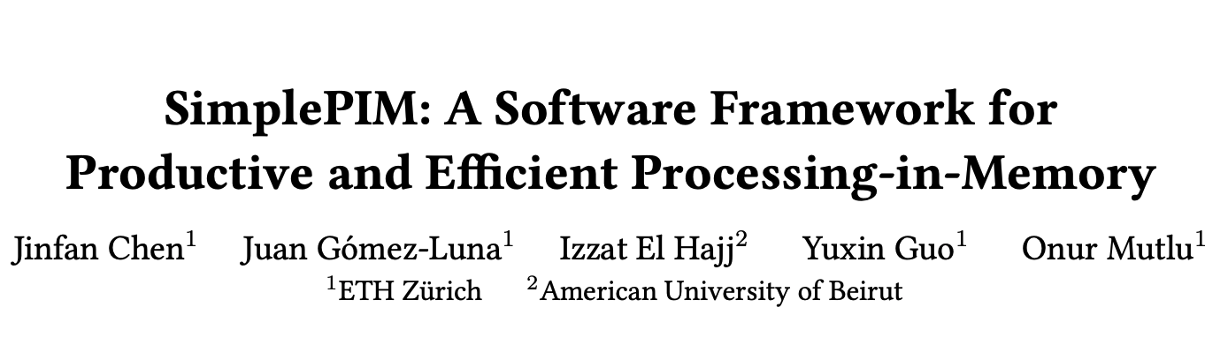
Adoption: How to Ease Programmability? (II)
Jinfan Chen, Juan Gómez-Luna, Izzat El Hajj, YuXin Guo, and Onur Mutlu,
"SimplePIM: A Software Framework for Productive and Efficient Processing in Memory"
Proceedings of the 32nd International Conference on Parallel Architectures and Compilation Techniques (PACT), Vienna, Austria, October 2023.

Slide 8
The Programmability Barrier:
Overview
  Programming the UPMEM-based system requires:
1
Splitting input data and computation across PIM chips
2
Transferring input data from main memory to PIM chips
3
Manually handling caching in PIM’s scratchpad memory
4
Transferring output data from PIM chips to main memory
4
1
2
3
1
2
3
4
Programming a general-purpose PIM architecture leads to non-trivial effort → requires
knowledge of the underlying hardware and
manual fine-grained data movement handling
Notes:
In order to program the UPMEM system, the programmer needs to perform four main operations.
[CLICK] First, it needs to split input data across PIM chips
[CLICK] Second, it needs to transfer input data from main memory to PIM chips
[CLICK] Third, it needs to manually handle caching inside the PIM’s scratchpad memory
[CLICK] and fourth, it needs to transfer output data from PIM chips to main memory
[NEXT]

Slide 9
The Programmability Barrier:
Vector Addition Example
Programmer’s Tasks:
Align data | Collect parameters | Distribute parameters | Launch computation | Collect results | Manage scratchpad | Orchestrate computation | Just write my kernel
Notes:
Let’s see how such four tasks translate into code.
Next, I will show code snippets of a vector addition implemented using the UPMEM programming model.
[NEXT]

Slide 10
The Programmability Barrier:
Vector Addition Example
Programmer’s Tasks:
Align data | Collect parameters | Distribute parameters | Launch computation | Collect results | Manage scratchpad | Orchestrate computation | Just write my kernel
const unsigned int input_size = 1073741824; // Example value
const unsigned int input_size_8bytes =
((input_size * sizeof(T)) % 8) != 0
? roundup(input_size, 8) : input_size;
const unsigned int input_size_dpu = divceil(input_size, nr_of_dpus);
const unsigned int input_size_dpu_8bytes =
((input_size_dpu * sizeof(T)) % 8) != 0
? roundup(input_size_dpu, 8) : input_size_dpu;
Notes:
The programmer has several tasks that need to be translated into code, including aligning data within PIM chips
[NEXT]

Slide 11
The Programmability Barrier:
Vector Addition Example
Programmer’s Tasks:
Align data | Collect parameters | Distribute parameters | Launch computation | Collect results | Manage scratchpad | Orchestrate computation | Just write my kernel
unsigned int kernel = 0;
dpu_arguments_t input_arguments[NR_DPUS];
for(i=0; i<nr_of_dpus-1; i++) {
input_arguments[i].size = input_size_dpu_8bytes * sizeof(T);
input_arguments[i].transfer_size = input_size_dpu_8bytes * sizeof(T);
input_arguments[i].kernel = kernel;
}
input_arguments[nr_of_dpus-1].size =
(input_size_8bytes - input_size_dpu_8bytes * (NR_DPUS-1)) * sizeof(T);
input_arguments[nr_of_dpus-1].transfer_size =
input_size_dpu_8bytes * sizeof(T);
input_arguments[nr_of_dpus-1].kernel = kernel;
Notes:
Collect input parameters
[NEXT]

Slide 12
The Programmability Barrier:
Vector Addition Example
Programmer’s Tasks:
Align data | Collect parameters | Distribute parameters | Launch computation | Collect results | Manage scratchpad | Orchestrate computation | Just write my kernel
DPU_ASSERT(dpu_push_xfer(dpu_set, DPU_XFER_TO_DPU, "DPU_INPUT_ARGUMENTS",
0, sizeof(input_arguments[0]), DPU_XFER_DEFAULT));
DPU_FOREACH(dpu_set, dpu, i) {
DPU_ASSERT(dpu_prepare_xfer(dpu, bufferA + input_size_dpu_8bytes * i));
}
DPU_ASSERT(dpu_push_xfer(dpu_set, DPU_XFER_TO_DPU, DPU_MRAM_HEAP_POINTER_NAME,
0, input_size_dpu_8bytes * sizeof(T), DPU_XFER_DEFAULT));
DPU_FOREACH(dpu_set, dpu, i) {
DPU_ASSERT(dpu_prepare_xfer(dpu, bufferB + input_size_dpu_8bytes * i));
}
DPU_ASSERT(dpu_push_xfer(dpu_set, DPU_XFER_TO_DPU, DPU_MRAM_HEAP_POINTER_NAME,
input_size_dpu_8bytes * sizeof(T),
input_size_dpu_8bytes * sizeof(T), DPU_XFER_DEFAULT));
Notes:
Distribute input parameters across PIM cores
[NEXT]

Slide 13
The Programmability Barrier:
Vector Addition Example
Programmer’s Tasks:
Align data | Collect parameters | Distribute parameters | Launch computation | Collect results | Manage scratchpad | Orchestrate computation | Just write my kernel
DPU_ASSERT(dpu_launch(dpu_set, DPU_SYNCHRONOUS));
Notes:
Launch PIM computation
[NEXT]

Slide 14
The Programmability Barrier:
Vector Addition Example
Programmer’s Tasks:
Align data | Collect parameters | Distribute parameters | Launch computation | Collect results | Manage scratchpad | Orchestrate computation | Just write my kernel
i = 0;
DPU_FOREACH(dpu_set, dpu, i) {
DPU_ASSERT(dpu_prepare_xfer(dpu,
bufferC + input_size_dpu_8bytes * i));
}
DPU_ASSERT(dpu_push_xfer(dpu_set, DPU_XFER_FROM_DPU,
DPU_MRAM_HEAP_POINTER_NAME,
input_size_dpu_8bytes * sizeof(T),
input_size_dpu_8bytes * sizeof(T),
DPU_XFER_DEFAULT));
Notes:
Collect PIM results
[NEXT]

Slide 15
The Programmability Barrier:
Vector Addition Example
Programmer’s Tasks:
Align data | Collect parameters | Distribute parameters | Launch computation | Collect results | Manage scratchpad | Orchestrate computation | Just write my kernel
barrier_wait(&my_barrier);
uint32_t input_size_dpu_bytes = DPU_INPUT_ARGUMENTS.size;
uint32_t input_size_dpu_bytes_transfer =
DPU_INPUT_ARGUMENTS.transfer_size;
uint32_t base_tasklet = tasklet_id << BLOCK_SIZE_LOG2;
uint32_t mram_base_addr_A = (uint32_t)DPU_MRAM_HEAP_POINTER;
uint32_t mram_base_addr_B = (uint32_t)(DPU_MRAM_HEAP_POINTER
+ input_size_dpu_bytes_transfer);
T *cache_A = (T *) mem_alloc(BLOCK_SIZE);
T *cache_B = (T *) mem_alloc(BLOCK_SIZE);
Notes:
Manage the PIM scratchpad memory
[NEXT]

Slide 16
The Programmability Barrier:
Vector Addition Example
Programmer’s Tasks:
Align data | Collect parameters | Distribute parameters | Launch computation | Collect results | Manage scratchpad | Orchestrate computation | Just write my kernel
for (int byte_index = base_tasklet; byte_index < input_size_dpu_bytes;
byte_index += BLOCK_SIZE * NR_TASKLETS){
uint32_t l_size_bytes = (byte_index + BLOCK_SIZE >=
input_size_dpu_bytes)
? (input_size_dpu_bytes - byte_index) : BLOCK_SIZE;
mram_read((__mram_ptr void const*)(mram_base_addr_A + byte_index),
cache_A, l_size_bytes);
mram_read((__mram_ptr void const*)(mram_base_addr_B + byte_index),
cache_B, l_size_bytes);
vector_addition(cache_B, cache_A, l_size_bytes >> DIV);
mram_write(cache_B, (__mram_ptr void*)(mram_base_addr_B + byte_index)
l_size_bytes);
}
Notes:
Orchestrate data movement and computation across PIM cores
[NEXT]

Slide 17
The Programmability Barrier:
Vector Addition Example
Programmer’s Tasks:
Goal:
Align data | Collect parameters | Distribute parameters | Launch computation | Collect results | Manage scratchpad | Orchestrate computation | Just write my kernel
static void vector_addition(T *bufferB, T *bufferA, int l_size){
for (unsigned int i = 0; i < l_size; i++){
bufferB[i] += bufferA[i];
}
}
Notes:
However, the programmer’s main goal is to just perform a simple vector addition
[NEXT]

Slide 18
The Programmability Barrier:
Summary
Programmer’s Tasks:
Goal:
Align data | Collect parameters | Distribute parameters | Launch computation | Collect results | Manage scratchpad | Orchestrate computation | Just write my kernel
Programming the UPMEM system
leads to non-trivial effort → requires
knowledge of the underlying hardware and
manual fine-grained data movement handling
Problem
static void vector_addition(T *bufferB, T *bufferA, int l_size){
for (unsigned int i = 0; i < l_size; i++){
bufferB[i] += bufferA[i];
}
}
Notes:
We conclude that programming the UPMEM system leads to non-trivial effort by the programmer since it requires knowledge of the underlying hardware and manual data movement handling
[NEXT[

Slide 19
Our Goal
To ease programmability for the UPMEM system,
allowing a programmer to write
efficient PIM-friendly code
without the need to
explicitly manage hardware resources
Goal
Notes:
Therefore, our goal in this work is to ease programmability for the UPMEM system, allowing the programmer to write PIM-friendly code efficiently.
[NEXT]

Slide 20
Outline
Introduction
1
The Programmability Barrier
2
SimplePIM Overview
3
Management, Communication & Processing Interfaces
Evaluation Results
DaPPA Overview
4
DaPPA Main Components
Evaluation Results
Conclusion
5
Notes:
This is the outline for my talk. First, I will give a brief introduction to PIM architectures. Second, I will talk about the problem our paper aims to solve and then on our solution. Fourth, I will briefly showcase our key results and then conclude.
[NEXT]

Slide 21
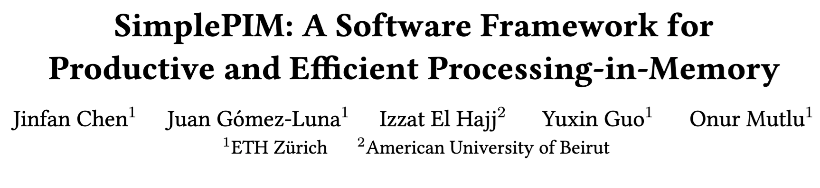
SimplePIM:
A Software Framework for Productive and Efficient Processing in Memory
Jinfan Chen, Juan Gómez-Luna, Izzat El Hajj, Yuxin Guo, and Onur Mutlu,
"SimplePIM: A Software Framework for Productive and Efficient Processing in Memory"
Proceedings of the 32nd International Conference on Parallel Architectures and Compilation Techniques (PACT),
Vienna, Austria, October 2023.
[Slides (pptx) (pdf)]
[SimplePIM Source Code]

Slide 22
SimplePIM Programming Framework:
Overview
SimplePIM provides standard abstractions to
build and deploy applications on PIM systems
1
  Management interface
  → Metadata for PIM-resident arrays
2
  Communication interface
  → Abstractions for host-PIM and PIM-PIM communication
3
  Processing interface
  → Iterators (map, reduce, zip) to implement workloads
Notes:
[CLICK] Our software framework, SimplePIM, leverages the massive memory bandwidth and parallelism offered by PIM hardware to operate on arrays of arbitrary size and dimensions. SimplePIM offers three key interfaces to support PIM systems like UPMEM.
[CLICK] The management interface stores metadata for the PIM-resident arrays, which can be accessed by the programmer and other parts of SimplePIM as needed.
[CLICK] The communication interface provides abstractions for both Host-PIM and PIM-PIM communication patterns.
These patterns are similar to communication patterns in other distributed frameworks such as MPI [71], which makes it easier for SimplePIM to be adopted.
[CLICK] The processing interface leverages PIM’s high memory bandwidth and parallelism to execute map, reduce, and zip iterators on PIM arrays.
Programmers can combine these iterators to implement many widely-used workloads ranging from simple vector addition to complex machine learning model training.
[CLICK] Let’s check each one of these interfaces next
[NEXT]

Slide 23
SimplePIM Programming Framework:
Management Interface
Metadata for PIM-resident arrays
  array_meta_data_t describes a PIM-resident array
  simple_pim_management_t for managing PIM-resident arrays
lookup: Retrieves all relevant information of an array
register: Registers the metadata of an array
free: Removes the metadata of an array
array_meta_data_t* simple_pim_array_lookup(const char* id,
simple_pim_management_t* management);
void simple_pim_array_register(array_meta_data_t* meta_data,
simple_pim_management_t* management);
void simple_pim_array_free(const char* id, simple_pim_management_t* management);

Slide 24
SimplePIM Programming Framework:
Communication Interface (I)
SimplePIM Host-to-CPU Broadcast
  Transfers a host array to all PIM cores in the system
void simple_pim_array_broadcast(char* const id, void* arr, uint64_t len,
uint32_t type_size, simple_pim_management_t* management);

Slide 25
SimplePIM Programming Framework:
Communication Interface (II)
Host-to-PIM SimplePIM Scatter
  Distributes an array to PIM DRAM banks
Host-to-PIM SimplePIM Gather
  Collects portions of an array from PIM DRAM banks
void simple_pim_array_scatter(char* const id, void* arr, uint64_t len,
uint32_t type_size, simple_pim_management_t* management);
void* simple_pim_array_gather(char* const id, simple_pim_management_t* management);

Slide 26
SimplePIM Programming Framework:
Communication Interface (III)
PIM-to-PIM Communication: AllReduce
  Used for algorithm synchronization
  The programmer specifies an accumulative function
void simple_pim_array_allreduce(char* const id, handle_t* handle,
simple_pim_management_t* management);

Slide 27
SimplePIM Programming Framework:
Communication Interface (IV)
PIM-to-PIM Communication: AllGather
  Combines array pieces and distributes the complete array to all PIM cores
void simple_pim_array_allgather(char* const id, char* new_id,
simple_pim_management_t* management);

Slide 28
SimplePIM Programming Framework:
Processing Interface (I)
Array Map
  Applies map_func to every element of the data array
void simple_pim_array_map(const char* src_id, const char* dest_id,
uint32_t output_type, handle_t* handle, simple_pim_management_t* management);

Slide 29
SimplePIM Programming Framework:
Processing Interface (II)
Array Reduction
  The map_to_val_func function transforms an input element to an output value and an output index
  The acc_func function accumulates the output values onto the output array
void simple_pim_array_red(const char* src_id, const char* dest_id,
uint32_t output_type, uint32_t output_len, handle_t* handle,
simple_pim_management_t* management);

Slide 30
SimplePIM Programming Framework:
Processing Interface (III)
Array Zip
  Takes two input arrays and combines their elements into an output array
void simple_pim_array_zip(const char* src1_id, const char* src2_id,
const char* dest_id, simple_pim_management_t* management);

Slide 31
SimplePIM Programming Framework:
General Code Optimizations
Strength reduction
Loop unrolling
Avoiding boundary checks
Function inlining
Adjustment of data transfer sizes

Slide 32
Evaluation Results:
Evaluation Methodology
Evaluated system
  UPMEM PIM system with 2,432 PIM cores with
  159 GB of PIM DRAM
Real-world Benchmarks
  Vector addition
  Reduction
  Histogram
  K-Means
  Linear regression
  Logistic regression
Comparison to hand-optimized codes in terms of programming productivity and performance

Slide 33
Evaluation Results:
Productive Improvement (I)
Example: Hand-optimized histogram with UPMEM SDK
... // Initialize global variables and functions for histogram
int main_kernel() {
if (tasklet_id == 0)
mem_reset(); // Reset the heap
... // Initialize variables and the histogram
T *input_buff_A = (T*)mem_alloc(2048); // Allocate buffer in scratchpad memory
for (unsigned int byte_index = base_tasklet; byte_index < input_size; byte_index += stride) {
// Boundary checking
uint32_t l_size_bytes = (byte_index + 2048 >= input_size) ? (input_size - byte_index) : 2048;
// Load scratchpad with a DRAM block
mram_read((const __mram_ptr void*)(mram_base_addr_A + byte_index), input_buff_A, l_size_bytes);
// Histogram calculation
histogram(hist, bins, input_buff_A, l_size_bytes/sizeof(uint32_t));
}
...
barrier_wait(&my_barrier); // Barrier to synchronize PIM threads
... // Merging histograms from different tasklets into one histo_dpu
// Write result from scratchpad to DRAM
if (tasklet_id == 0)
if (bins * sizeof(uint32_t) <= 2048)
mram_write(histo_dpu, (__mram_ptr void*)mram_base_addr_histo, bins * sizeof(uint32_t));
else
for (unsigned int offset = 0; offset < ((bins * sizeof(uint32_t)) >> 11); offset++) {
mram_write(histo_dpu + (offset << 9), (__mram_ptr void*)(mram_base_addr_histo +
(offset << 11)), 2048);
}
return 0;
}

Slide 34
Evaluation Results:
Productive Improvement (II)
Example: SimplePIM histogram
// Programmer-defined functions in the file "histo_filepath"
void init_func (uint32_t size, void* ptr) {
char* casted_value_ptr = (char*) ptr;
for (int i = 0; i < size; i++)
casted_value_ptr[i] = 0;
}
void acc_func (void* dest, void* src) {
*(uint32_t*)dest += *(uint32_t*)src;
}
void map_to_val_func (void* input, void* output, uint32_t* key) {
uint32_t d = *((uint32_t*)input);
*(uint32_t*)output = 1;
*key = d * bins >> 12;
}
// Host side handle creation and iterator call
handle_t* handle = simple_pim_create_handle("histo_filepath", REDUCE, NULL, 0);
// Transfer (scatter) data to PIM, register as "t1"
simple_pim_array_scatter("t1", src, bins, sizeof(T), management);
// Run histogram on "t1" and produce "t2"
simple_pim_array_red("t1", "t2", sizeof(T), bins, handle, management);
// Host side handle creation and iterator call
handle_t* handle = simple_pim_create_handle("histo_filepath", REDUCE, NULL, 0);
// Transfer (scatter) data to PIM, register as "t1"
simple_pim_array_scatter("t1", src, bins, sizeof(T), management);
// Run histogram on "t1" and produce "t2"
simple_pim_array_red("t1", "t2", sizeof(T), bins, handle, management);

Slide 35
Evaluation Results:
Productive Improvement (III)
Lines of code (LoC) reduction
 | SimplePIM | Hand-optimized | LoC Reduction
Reduction | 14 | 83 | 5.93×
Vector Addition | 14 | 82 | 5.86×
Histogram | 21 | 114 | 5.43×
Linear Regression | 48 | 157 | 3.27×
Logistic Regression | 59 | 176 | 2.98×
K-Means | 68 | 206 | 3.03×
SimplePIM reduces the number of lines of
effective code by a factor of 2.98× to 5.93×

Slide 36
Evaluation Results:
Weak Scaling Analysis
SimplePIM achieves comparable performance for reduction, histogram, and linear regression
SimplePIM outperforms hand-optimized implementations
for vector addition, logistic regression,
and k-means by 10%-37%

Slide 37
Evaluation Results:
Strong Scaling Analysis
SimplePIM scales better than hand-optimized implementations for reduction, histogram, and linear regression
SimplePIM outperforms hand-optimized implementations
for vector addition, logistic regression, and k-means
by 15%-43%

Slide 38
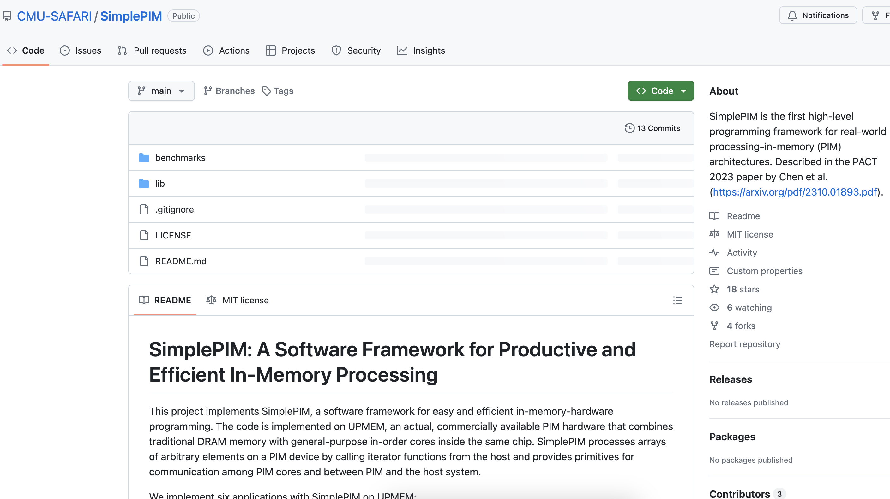
Source Code
https://github.com/CMU-SAFARI/SimplePIM

Slide 39
SimplePIM:
A Software Framework for Productive and Efficient Processing in Memory
Jinfan Chen, Juan Gómez-Luna, Izzat El Hajj, Yuxin Guo, and Onur Mutlu,
"SimplePIM: A Software Framework for Productive and Efficient Processing in Memory"
Proceedings of the 32nd International Conference on Parallel Architectures and Compilation Techniques (PACT),
Vienna, Austria, October 2023.
[Slides (pptx) (pdf)]
[SimplePIM Source Code]

Slide 40
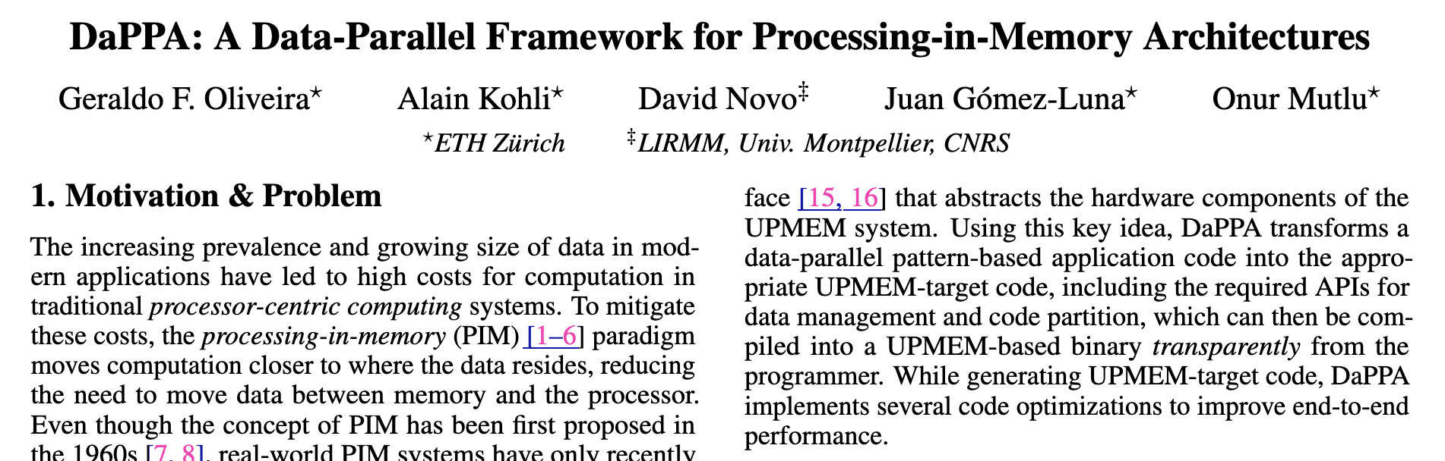
DaPPA:
A Data-Parallel Framework for Processing-in-Memory Architectures
Geraldo F. Oliveira, Alain Kohli, David Novo, Juan Gómez-Luna,
Onur Mutlu
”DaPPA: A Data-Parallel Framework for Processing-in-Memory Architectures,”
arXiv:2310.10168 [cs.AR]
2nd Place ACM Student Research Competition at the 32nd International Conference on Parallel Architectures and Compilation Techniques (PACT),
Vienna, Austria, October 2023.

Slide 41
DaPPA:
Key Idea & Overview
Leverage an intuitive
data-parallel pattern-based interface for
PIM programming
Key Idea
DaPPA , a Data-Parallel PIM Architecture that
automatically distributes input and gathers output data, handles memory management, and
parallelizes work across PIM cores
  DaPPA is composed of three main components:
1
Data-Parallel Pattern APIs
2
Dataflow Programming Interface
3
Dynamic Template-Based Compilation
Notes:
The key idea behind DaPPA is to use an intuitive data-parallel pattern Based programming interface for PIM
[CLICK] DaPPA uses such an interface to automatically distribute and gather data across PIM chips, handle memory management and to parallelism computation across PIM cores
[CLICK] DaPPA is composed of three main components.
[CLICK] A collection of data-parallel pattern APIs
[CLICK] A dataflow programming interface
[CLICK] and a dynamic template-based compilation
[NEXT]

Slide 42
DaPPA:
Data-Parallel Pattern APIs
Pre-defined functions that implement high-level
data-parallel pattern primitives
Skeleton and pattern-based parallel programming are a common abstraction for parallel architectures
  M. Cole, “Bringing Skeletons Out of the Closet: A Pragmatic Manifesto for Skeletal Parallel Programming,” Parallel Computing, 2004
DaPPA supports five primary data-parallel patterns
map
reduce
filter
window
group
f
f
f
f
f
f
f
f
f
f
f
f
f
f
f
The user can combine all five data-parallel primitives
to describe complex data transformations
Notes:
The data parallel pattern APIs are a collection of pre-defined functions that implement high-level data-parallel pattern priorities.
[CLICK] DaPPA uses such APIs to implement a skeleton programming model, which is a common approach to abstract hardware components of parallel architectures, including multi-processor systems, GPUs, and custom accelerators.
[CLICK] DaPPA supports five primary data-parallel patterns, including map, reduce, filter, window, and group
[CLICK] The user can combine all five primitives for more complex patterns
[NEXT]

Slide 43
DaPPA:
Dataflow Programming Interface
DaPPA exposes to the user a
dataflow-based programming interface
defines a collection of
transformations over the input data
Pipeline
input
stage 1
stage 2
stage N
output
x
f
x
f
x
f
f
f
each stage represents
a parallel pattern
data flows sequentially
across each stage
Notes:
DaPPA exposes a dataflow-based programming interface to the users. The interface has three main components.
[CLICK] First, a Pipeline defines a collection of transformations over the input data
[CLICK] Second, a stage defines a parallel pattern-based data transformation
[CLICK] Third, stage communication happens sequentially, with data following from one stage to another within the pipeline
[NEXT]

Slide 44
DaPPA:
Dynamic Template-Based Compilation
DaPPA uses a dynamic template-based compilation to
generate PIM code in two main steps
1
Templating: DaPPA creates a base UPMEM code based on a basic skeleton of a UPMEM application
  We use the Inja C++ templating engine
Optimizations: DaPPA uses a series of transformations to
  extract data required by the UPMEM code template
  calculate the memory offsets for MRAMs and WRAMs
  divide computation between CPU and PIM cores
2
DaPPA compiles and executes each stage in a Pipeline per time → allows for runtime optimizations
Notes:
DaPPA uses a dynamic template-based compilation to generate PIM code in two main steps
[CLICK] First, DaPPA creates UPMEM code using a template engine called Inja
[CLICK] Second, DaPPA applies a series of transformations to the code to extract the information required to feed the UPMEM code template from the Pipeline model, calculates memory offsets for automatically data handling, and divides computation between CPU and PIM cores, even allowing for collaborative execution between host cores and PIM cores
[CLICK] During the dynamic template-based compilation, DaPPA compiles and executes each Pipeline stage once per time, allowing for runtime optimizations based on output data
[NEXT]

Slide 45
DaPPA:
Putting All Together
Example of DaPPA’s implementation of a
vector dot product operation
Notes:
Let’s see how DaPPA can be used to implement a simple dot product operation in the UPMEM system
[NEXT]

Slide 46
DaPPA:
Putting All Together
Example of DaPPA’s implementation of a
vector dot product operation
Notes:
First, the programmer chooses suitable data parallel patterns to represent the computation. In this case, a map and reduce patterns
[NEXT]

Slide 47
DaPPA:
Putting All Together
Example of DaPPA’s implementation of a
vector dot product operation
Notes:
Second, the user creates two pipeline stages in C++ to implement the computation. Note that there is no hardware specific code required here.
[NEXT]

Slide 48
DaPPA:
Putting All Together
Example of DaPPA’s implementation of a
vector dot product operation
Notes:
Finally, DaPPA takes the C++-based pipeline, and dynamically compiles and executes each stage in the UPMEM system.
[NEXT]

Slide 49
Evaluation:
Methodology Overview
Evaluation Setup
  Host CPU: 2-socket Intel® Xeon Silver 4110 CPU
  PIM Cores: 20 UPMEM PIM DIMMs (160 GB PIM memory)
  2560 DPUs in total
Workloads: 6 workloads from the PrIM benchmark suite
  Vector addition (VA); Select (SEL); Unique (UNI); Reduce (RED); General matrix-vector multiply (GEMV); Histogram small (HST-S)
Metrics
  End-to-end execution time (average of 10 runs)
  Programming complexity (in lines of code)
Notes:
We evaluate DaPPA using a real UPMEM system with more than 2000 PIM cores
[CLICK] We use six workloads from the PrIM benchmark suite
[CLICK] We compare DaPPA’s performance and programming complexity against the hand-tuned PrIM workloads
[NEXT]

Slide 50
Evaluation:
Performance Analysis
Large performance improvement due to
parallel data transfers & host+PIM collaborative exec.
Notes:
In this plot, we show DaPPA’s performance normalized to the hand-tuned PrIM implementations.
[CLICK] We observe a large performance improvement for some workloads, due to DAPPA usage of parallel data transfers and collaborative host and PIM execution
[NEXT[

Slide 51
Evaluation:
Performance Analysis
2.1x
DaPPA significantly improves end-to-end performance
compared to hand-tuned implementations
Notes:
Overall, DAPPA provides 2.1x the performance of hand-tuned code.
[NEXT]

Slide 52
Evaluation:
Programming Complexity Analysis
94.4%
DaPPA significantly reduces programming complexity
by abstracting hardware components
Notes:
Next, we evaluate programming complexity measured in lines of code.
[CLICK] On average, DaPPA reduces the required lines of code by 94% compared to PrIM.
[NEXT]

Slide 53
Evaluation:
Comparison to State-of-the-Art
SimplePIM [Chen+, PACT’23]: a framework that uses
(1) iterator functions and (2) primitives for communication
to aid PIM programmability
Compared to SimplePIM, DaPPA provides three key benefits
  Higher abstraction level → The programmer does not need
  to manually specify communication patterns used
  during computation
  Support for more parallel patterns → DaPPA supports
  two more parallel primitives (window and group), and
  allows the mixing of parallel patterns
  Further execution optimizations → DaPPA allows
  using idle host resources for collaborative execution
DaPPA improves state-of-the-art frameworks for
PIM programmability
Notes:
We briefly compared DaPPA to a previously proposed framework for PIM programmability called SimplePIM.
Compared to SimplePIM, DaPPA provides
[CLICK] A higher abstraction level, where the user does not need to manually specific communication across PIM cores as in SIMPLE PIM; two more parallel patterns, and further optimizations as colloborative PIM+host execution.
[CLICK] We conclude that DaPPA improves the state-of-the-art in PIM programmability
[NEXT]

Slide 54
DaPPA:
A Data-Parallel Framework for Processing-in-Memory Architectures
Geraldo F. Oliveira, Alain Kohli, David Novo, Juan Gómez-Luna,
Onur Mutlu
”DaPPA: A Data-Parallel Framework for Processing-in-Memory Architectures,”
arXiv:2310.10168 [cs.AR]
2nd Place ACM Student Research Competition at the 32nd International Conference on Parallel Architectures and Compilation Techniques (PACT),
Vienna, Austria, October 2023.

Slide 55
2nd Workshop on
Memory-Centric Computing:
PIM Adoption & Programmability
Dr. Geraldo F. Oliveira
https://geraldofojunior.github.io
ICS 2025
08 June 2025

