Slide 1

Functionally-Complete Boolean Logic in Real DRAM Chips
Experimental Characterization and Analysis
Ismail Emir Yüksel
Yahya C. Tugrul Ataberk Olgun F. Nisa Bostancı
A. Giray Yaglıkçı Geraldo F. Oliveira Haocong Luo
Juan Gómez–Luna Mohammad Sadr Onur Mutlu
Notes:
Hello, I am Ismail Emir Yuksel.
I will be presenting our work, Functionally-Complete Boolean Logic in Real DRAM Chips

Slide 2
Executive Summary
Motivation: Processing-using-DRAM can alleviate
the performance and energy bottlenecks caused by data movement
  Prior works show that existing DRAM chips can perform
  three-input majority and two-input AND and OR operations
Problem: Proof-of-concept demonstrations on
commercial off-the-shelf (COTS) DRAM chips do not provide
  functionally-complete operations (e.g., NAND or NOR)
  NOT operation
  AND and OR operations with more than two inputs
Experimental Study: 256 DDR4 chips from two major manufacturers
Key Results:
  COTS DRAM chips can perform NOT and
  {2, 4, 8, 16}-input AND, NAND, OR, and NOR operations
  with very high reliability (>94% success rate)
  Data pattern and temperature only slightly affect
  the reliability of these operations (<1.98% decrease in success rate)
2
Notes:
Let’s start with an executive summary.
[CLICK] Processing-Using-DRAM is a promising paradigm that can alleviate the performance and energy bottlenecks caused by frequent data movement between main memory and processing units.
[CLICK] Proof-of-concept demonstrations on commercial-off-the-shelf DRAM chips do not provide
[CLICK]Functionally-complete operations, such as NAND or NOR
[CLICK] NOT operation
[CLICK] More than two-input AND and OR operations
[CLICK]In this study, we test 256 off-the-shelf DDR4 DRAM chips from two major manufacturers
[CLICK] Based on our analyses, we highlight that
[CLICK] We can perform NOT and up to 16-input AND, NAND, OR, and NOR operations with very high reliability
[CLICK] The impact of data patterns and the temperature on the reliability of these operations are small.
our work demonstrates the capability of performing functionally-complete Boolean logic in COTS DRAM chips. We believe these empirical results demonstrate
the promising potential of using DRAM as a computation substrate. Now let’s delve in ..

Slide 3
Outline
Background
Goal & Overview
Experimental Methodology
Multiple-Row Activation in Neighboring Subarrays
NOT Operation
AND, NAND, OR, and NOR Operations
Conclusion
3
Notes:
Here is the outline of my talk [CLICK]

Slide 4
Outline
Background
Goal & Overview
Experimental Methodology
Multiple-Row Activation in Neighboring Subarrays
NOT Operation
AND, NAND, OR, and NOR Operations
Conclusion
4
Notes:
Let’s start with a background and the overview of our study

Slide 5

Data Movement Bottleneck
Today’s computing systems are processor centric
All data is processed in the processor → at great system cost
Computing Unit
(CPU, GPU, FPGA, Accelerators)
Main Memory
(DRAM)
Memory
Channel
More than 60% of the total system energy is spent on data movement¹
¹ A. Boroumand et al., “Google Workloads for Consumer Devices: Mitigating Data Movement Bottlenecks,” ASPLOS, 2018

Slide 6
Processing-In-Memory (PIM)
  Two main approaches for Processing-In-Memory:
1
Processing-Near-Memory: PIM logic is added
near the memory arrays or to the logic layer of 3D-stacked memory
2
Processing-Using-Memory: uses the analog
operational principles of memory cells to perform computation
DRAM
(e.g., 3D-Stacked Memory)
DRAM Bank
Vault
Controller
Processing-
Using-DRAM
DRAM Vault
…
PHY
Processing-Near-Vault
…
Processing-Near-Bank
Notes:
Processing-in-Memory architectures alleviate data movement bottlenecks by moving computation to where the data resides. Such architectures can be implemented
[CLICK] by adding logic near the memory arrays, in what is called processing-near-memory or
[CLICK] by using the analog operating principles of the memory cells to perform computation, in what is called processing-using-memory

Slide 7

DRAM Organization
DRAM Module
DRAM
Chip
Sense Amplifiers
DRAM Cell
…
Subarray
Bank
DRAM Row
Chip I/O
Sense Amps.
…
Wordline
Bitline
DRAM Chip
DRAM Bank
7
Notes:
DRAM is used as the main memory in many computing systems. [CLICK]
a DRAM module consists of multiple DRAM chips [CLICK]
Each chip contains multiple banks [CLICK]
Each bank is composed of multiple subarrays and sense amplifiers [CLICK]
And within each subarray, there is a two dimensional array of DRAM cells. [CLICK]
These cells are organized into rows that are selected using wordlines [CLICK]
And the cells are connected to a row of sense amplifiers via bitlines [CLICK]

Slide 8
DRAM Open Bitline Architecture
SA
SA
bitline
SA
Sense
Amplifier
SA
SA
Subarray
bitline
SA
SA
DRAM Bank
8
Notes:
To achieve high-density DRAM chips, open-bitline architecture is widely adopted in modern DRAM modules.
[CLICK]
In this architecture each subarray’s bitlines are connected to two rows of sense amplifiers one above and one below the subarray,
This results in neighboring subarrays share common sense amplifiers.

Slide 9
DRAM Open Bitline Architecture
Activated
SA
SA
bitline
Sense
Amplifier
NOT
Gate
SA
SA
Subarray
bitline
SA
SA
DRAM Bank
Not
Activated
Serves as the reference for the SA
9
Notes:
[Click] During an activation, another bitline in a neighboring subarray is also involved to serve as the reference of the sense amplifier, which is bitline-bar in this example.
After a successful activation, the bitline and bitline-bar have a complementary voltage
[CLICK] as the sense amplifier consists of two back-to-back inverters.

Slide 10
DRAM Operation
DRAM Subarray
ACTIVATE (ACT):
Fetch the row’s content
into the sense amplifiers
1
1
1
1
1
Column Access (RD/WR):
Read/Write the target
column and drive to I/O
2
Sense
Amps.
PRECHARGE (PRE):
Prepare the subarray
for a new ACTIVATE
3
I/O Circuitry
Notes:
Data is internally accessed in a row granularity. To access data, [CLICK]
the memory controller first needs to activate the row that contains the data and fetch the row’s content into the sense amplifiers [CLICK]
Then, column accesses are serviced from the sense amplifiers [CLICK]
Finally, the subarray needs to be precharged to get ready for the next row activation [CLICK]

Slide 11
Outline
Background
Goal & Overview
Experimental Methodology
Multiple-Row Activation in Neighboring Subarrays
NOT Operation
AND, NAND, OR, and NOR Operations
Conclusion
11
Notes:
Let’s start with a background and the overview of our study

Slide 12
Our Goal
Understand the capability of COTS DRAM chips beyond just storing data
Rigorously characterize
the reliability of this capability
COTS: Commercial Off-The-Shelf
Notes:
Our goal is to
[CLICK] understand the capability of off-the-shelf DRAM chips other than just storing data and
[CLICK] Rigorously characterize the reliability of this capability

Slide 13
The Capability of COTS DRAM Chips
We demonstrate that COTS DRAM chips:
1
Can simultaneously activate up to
48 rows in two neighboring subarrays
2
Can perform NOT operation
with up to 32 output operands
3
Can perform up to 16-input
AND, NAND, OR, and NOR operations
13
Notes:
[CLICK]In this study, we experimentally demonstrate that off-the-shelf DRAM chips
[CLICK] Can simultaneously activating up to 48 DRAM rows in two neighboring subarrays
[CLICK] Can performing NOT operation with up to 32 output operands
[CLICK] Can performing up to 16-input AND, NAND, OR, and NOR operations

Slide 14
Outline
Background
Goal & Overview
Experimental Methodology
Multiple-Row Activation in Neighboring Subarrays
NOT Operation
AND, NAND, OR, and NOR Operations
Conclusion
14
Notes:
<Script>

Slide 15
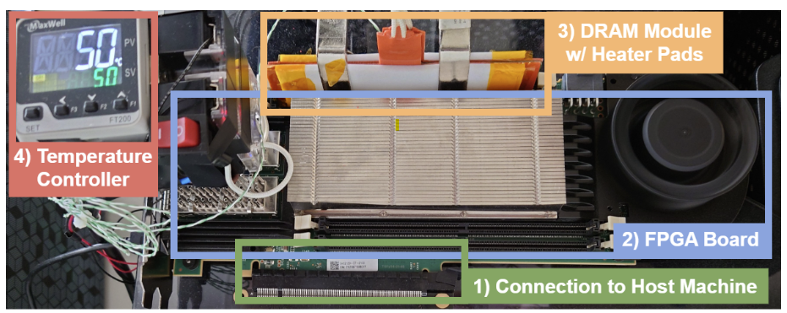
DRAM Testing Infrastructure
Developed from DRAM Bender [Olgun+, TCAD’23]*
Fine-grained control over DRAM commands, timings, and temperature
*Olgun et al., "DRAM Bender: An Extensible and Versatile FPGA-based Infrastructure
to Easily Test State-of-the-art DRAM Chips," TCAD, 2023.
15
Notes:
[CLICK] We use a FPGA based DDR4 testing infrastructure developed from DRAM bender that
[CLICK] enables fine-grained control over DRAM commands, timings, and temperature

Slide 16
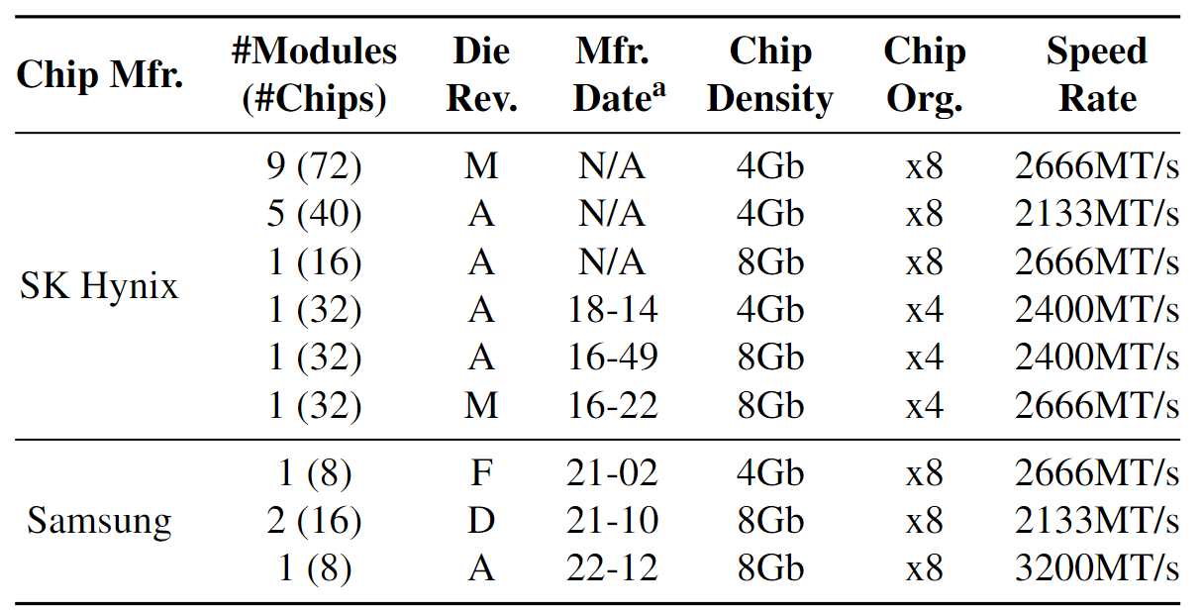
DRAM Chips Tested
256 DDR4 chips from two major DRAM manufacturers
Covers different die revisions and chip densities
16
Notes:
[CLICK]We test 256 DDR4 chips from two major DRAM manufacturers,
[CLICK] covering different die densities and revisions

Slide 17

Testing Methodology
Carefully sweep:
  Row addresses: Row A and Row B
  Timing parameters: Between ACT → PRE and PRE → ACT
ACT Row A
PRE
ACT Row B
Subarray X
ACT
Row A
Neighboring Subarrays
Shared Sense Amplifiers
Subarray Y
ACT
Row B
DRAM Bank
17
Notes:
In this study, we focus on two neighboring subarrays, here denoted as Subarray X and Subarray Y, which share a common component, sense amplifiers
[CLICK] We perform our experiment using the following command sequence: Activate Row A, which is in the subarray X, Precharge, and Activate Row B
[CLICK] We carefully sweep four parameters: Row addresses: Row A and Row B
[CLICK] Timing parameters between ACT Row A and Precharge and between Precharge and ACT Row B

Slide 18
Outline
Background
Goal & Overview
Experimental Methodology
Multiple-Row Activation in Neighboring Subarrays
NOT Operation
AND, NAND, OR, and NOR Operations
Conclusion
18
Notes:
Let’s move to our first analysis

Slide 19
The Capability of COTS DRAM Chips
We demonstrate that COTS DRAM chips:
1
Can simultaneously activate up to
48 rows in two neighboring subarrays
2
Can perform NOT operation
with up to 32 output operands
3
Can perform up to 16-input
AND, NAND, OR, and NOR operations
19
Notes:
In this analysis,
[CLICK] we will demonstrate that how off-the-shelf DRAM chips are capable of simultaneously activating up to 48 rows in two neighboring subarrays

Slide 20

Key Observation
Activating two rows in quick succession
can simultaneously activate
multiple rows in neighboring subarrays
36ns
14ns
ACT Row A
PRE
ACT Row B
<3ns
<3ns
Subarray X
ACT
Row A
Neighboring Subarrays
Shared Sense Amplifiers
Subarray Y
ACT
Row B
DRAM Bank
20
Notes:
Our key observation is activating two rows in quick succession can simultaneously activate multiple rows in neighboring subarrays
[CLICK] You may remember this pictorial example where Subarray X and Subarray Y are neighbor subarrays and Row A is in Subarray X and Row B is in Subarray Y.
[CLICK] When we respect to the timing parameters between ACT and PRE and PRE and ACT, we activate a single row at a time.
[CLICK] However, when we greatly violate these timing parameters, we observe that we can activate multiple rows at once in neighboring subarrays

Slide 21
Characterization Methodology
To understand which and how many rows are simultaneously activated
  Sweep Row A and Row B addresses
All rows in Subarray X
All rows in Subarray Y
ACT Row A
PRE
ACT Row B
<3ns
<3ns
Subarray X
ACT
Row A
Shared Sense Amplifiers
Subarray Y
ACT
Row B
DRAM Bank
21
Notes:
[CLICK] To rigorously characterize and to understand which and how many rows are activated
[CLICK] We sweep two key parameters: Row A address: we sweep it to test all rows in Subarray X and Row B address: we test all rows in Subarray Y, again to remind you Subarray X and Subarray Y are neighbors

Slide 22
Key Results
COTS DRAM chips have two distinct sets of
activation patterns in neighboring subarrays
when two rows are activated with violated timings
Exactly the same number of rows
in each subarray
are activated
Twice as many rows in one subarray
compared to its neighbor subarray are activated
Subarray X
Subarray X
Up to 16 rows
Up to 16 rows
Shared Sense Amplifiers
Shared Sense Amplifiers
Subarray Y
Subarray Y
Up to 16 rows
Up to 32 rows
A total of 32 rows
A total of 48 rows
22
Notes:
We observe when Row A and B in neighboring subarrays are activated with violated timing parameters
[CLICK] Off-the-shelf DRAM chips have two distinct sets of simultaneous activation patterns in two neighboring subarrays
[CLICK] First pattern is exactly the same number rows in each subarray are activated.
[CLICK] We observe that we can activate up to 16 rows in neighboring subarrays, in other words a total of 32 rows
[CLICK] Second pattern is twice as many rows in one subarray compared to its neighbor subarray are activated
[CLICK] We observe that we can activate up to 16 rows in one subarray while activating up to 32 rows in its neighbor subarray, a total of 48 rows

Slide 23
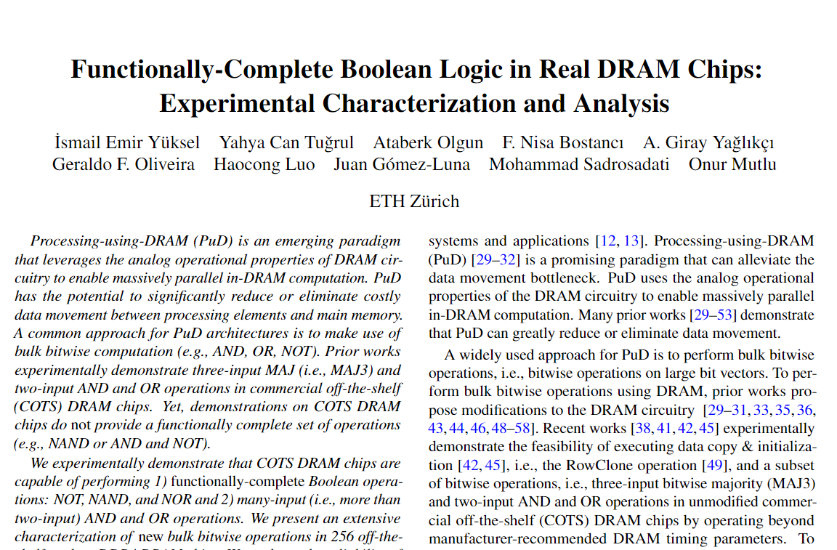
Key Takeaway
COTS DRAM chips have two distinct sets of
activation patterns in neighboring subarrays
COTS DRAM chips can simultaneously activate
up to 48 rows in two neighboring subarrays
Exactly the same number of rows
in each subarray
Twice as many rows in one subarray
compared to its neighbor subarray
Subarray X
Subarray X
Up to 16 rows
Up to 16 rows
Shared Sense Amplifiers
Shared Sense Amplifiers
(More results in the paper)
Subarray Y
Subarray Y
Up to 16 rows
Up to 32 rows
https://arxiv.org/pdf/2402.18736.pdf
23
Notes:
Our takeaway is
[CLICK] off-the-shelf DRAM chips can indeed simultaneously activate multiple rows in two neighboring subarrays and they can activate up to 48 rows.
[CLICK] As our time limited, I would like to refer you to our paper for more results and detailed analysis

Slide 24
Outline
Background
Goal & Overview
Experimental Methodology
Multiple-Row Activation in Neighboring Subarrays
NOT Operation
AND, NAND, OR, and NOR Operations
Conclusion
24
Notes:
Now our second analysis: NOT operation

Slide 25

The Capability of COTS DRAM Chips
We demonstrate that COTS DRAM chips:
1
Can simultaneously activate up to
48 rows in two neighboring subarrays
2
Can perform NOT operation
with up to 32 output operands
3
Can perform up to 16-input
AND, NAND, OR, and NOR operations
25
Notes:
[CLICK] We demonstrated that off-the-shelf DRAM chips are capable of activating multiple rows in neighboring subarrays
[CLICK] By leveraging our first observation, now let’s see how we can perform NOT operation in off-the-shelf DRAM chips

Slide 26
Key Idea
Connect rows in neighboring subarrays
through a NOT gate by simultaneously activating rows
src
src
src
NOT gate
A
A
A
SA
SA
SA
ACT src
ACT dst
~A
dst
dst
dst
26
Notes:
Our key idea is to leverage the connection between neighboring subarrays,
[CLICK] the NOT gate in the sense amplifier.
[CLICK] By simultaneously activating rows in neighboring subarrays, we can connect these rows through a NOT gate
[CLICK] As an example, source and destination in neighboring subarrays and if we first activate src
[CLICK] and then activate destination, this result in sense amplifier to drive the negated src value to the dst

Slide 27
NOT Operation: A Walkthrough
ACT src
GND
½ V_{DD}
src
connects src to bitline
dst
½ V_{DD}
GND
27
Notes:
Let’s see how we can perform NOT operation in real DRAM chips at a lower abstraction-level
[CLICK] As an example, we have source and destination cells, both store GROUND (low voltage) and bitlines are precharged to vdd over two
[CLICK] We first issue an activation to the source, which asserts the source wordline and starts charge sharing process between source and its bitline

Slide 28
NOT Operation: A Walkthrough
ACT src
Nominal
GND
GND
drives bitline to GND
src
drives bitline to VDD
dst
VDD
GND
28
Notes:
We wait for nominal timing parameters, which assures sense amplifier amplifies the difference and
[CLICK] drives ground to the source’s bitline and VDD to the destination’s bitline

Slide 29
NOT Operation: A Walkthrough
ACT src
PRE
ACT dst
Nominal
<3ns
GND
src
sense amplifier is still enabled
connects dst to bitline
dst
VDD
dst’s bitline is still VDD
29
Notes:
We then issue back-to-back precharge and activation commands with violated timing parameters. This operation leads to
[CLICK] connecting destination cell to its bitline
[CLICK] keeping the sense amplifier enabled
[CLICK] keeping the destination’s bitline to VDD

Slide 30
NOT Operation: A Walkthrough
ACT src
PRE
ACT dst
Nominal
<3ns
GND
negated value of src (VDD) is written to dst
src
dst
VDD
30
Notes:
Eventually, as sense amplifier is enabled and bitline is still VDD, the negated value of the source, which is VDD, is written to dst

Slide 31

Characterization Methodology
Sweep Row A and Row B addresses
All rows in Subarray X
All rows in Subarray Y
ACT Row A
PRE
ACT Row B
Nominal
<3ns
Sweep DRAM chip temperature
95◦C
50◦C
31
Notes:
To answer these questions,
[CLICK] similar to our previous analysis, we sweep Row addresses where Row A and Row B in neighboring subarrays
[CLICK] We sweep DRAM chip temperature from 50 degree Celsius to 95 degree celcius

Slide 32

Reliability Metric
Success Rate (for a DRAM cell)
Percentage of trials where the correct output of
a tested operation is stored in the cell
GND
Total of 10000 trials
src
…
dst
GND
Success rate for this cell: 50%
32
Notes:
To evaluate the reliability of NOT Operation,
[CLICK]we define a metric called success rate
[CLICK] Success rate for a DRAM cell refers to percentage of correct trials
[CLICK] We test total of 10000 trials and record the success rate for each tested cell

Slide 33
Key Takeaways from In-DRAM NOT Operation
Key Takeaway 1
COTS DRAM chips can perform NOT operations
with up to 32 destination rows
Key Takeaway 2
Temperature has a small effect on
the reliability of NOT operations
33
Notes:
This analysis provides two key takeaway lessons: [CLICK]
[CLICK] First, off-the-shelf DRAM chips can perform NOT operations with up to 32 destination rows
[CLICK] Second, temperature has a small effect on the reliability of NOT operations

Slide 34
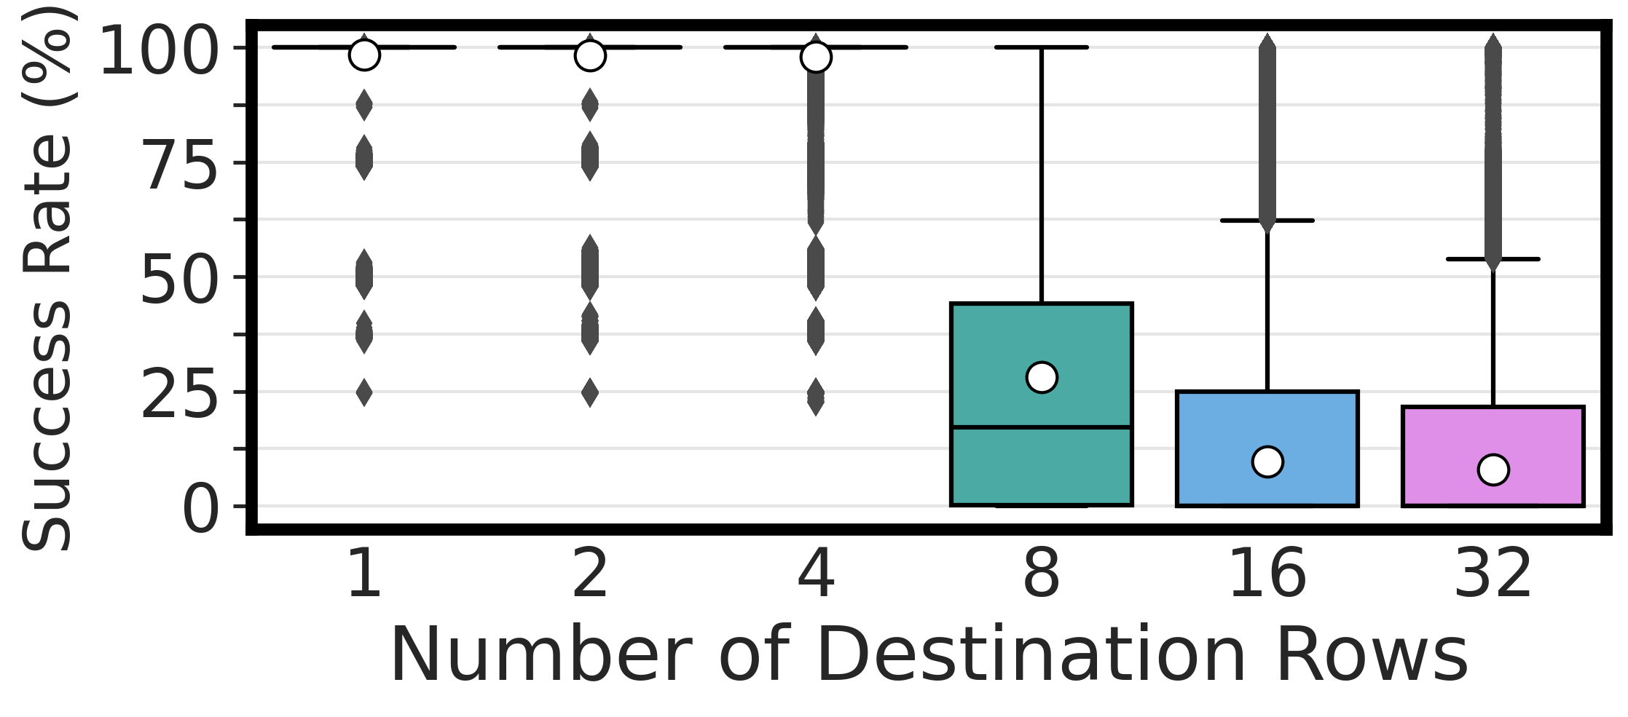
Performing NOT in COTS DRAM Chips
There is at least one DRAM cell that can
perform the NOT operation
with a 100% success rate
COTS DRAM chips can perform NOT operations
with up to 32 destination rows
34
Notes:
Let’s take a look at our first results
[CLICK] In the x-axis you see the number of destination rows and y-axis shows the success rate distributions across tested DRAM cells
[CLICK] We observe that there is at least one DRAM cell that can perform the NOT operation with a 100% success rate in every tested number of destination rows
[CLICK] Our takeaway from this experiment is off-the-shelf DRAM chips are capable of performing NOT operations with up to 32 destination rows

Slide 35
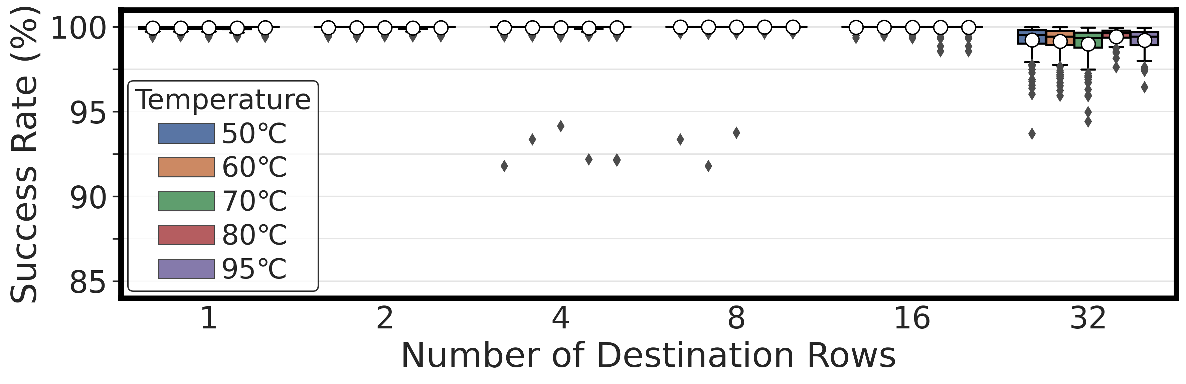
Impact of Temperature
Used destination cells that can perform NOT operation with >90% success rate at 50◦C
from 50◦C to 95◦C
only 0.2% variation in average success rate
Temperature has a small effect on
the reliability of NOT operations
35
Notes:
Our next experiment is the impact of temperature on the reliability of the NOT operation
[CLICK] To maintain a reasonable experiment time we use destination cells that can perform NOT operation with more than 90% success rate at 50 degree Celsius
[CLICK] In this plot again x-axis is the number of destination rows and the y-axis shows the success rate distribution across DRAM cells and hue shows the tested temperature levels in each cluster of boxes temperature increases from left to right
[CLICK] We observe that when we increase the temperature from 50 degree Celsius to 95 degree Celsius, there is only 0.2% variation in average success rate in 32 destination rows
[CLICK] Our takeaway from this experiment is temperature has a small effect on the reliability of NOT operations

Slide 36
Outline
Background
Goal & Overview
Experimental Methodology
Multiple-Row Activation in Neighboring Subarrays
NOT Operation
AND, NAND, OR, and NOR Operations
Conclusion
36
Notes:
Now, let’s move to our last analysis

Slide 37
The Capability of COTS DRAM Chips
We demonstrate that COTS DRAM chips:
1
Can simultaneously activate up to
48 rows in two neighboring subarrays
2
Can perform NOT operation
with up to 32 output operands
3
Can perform up to 16-input
AND, NAND, OR, and NOR operations
37
Notes:
[CLICK] Until now, We demonstrated that off-the-shelf DRAM chips are capable of activating multiple rows in neighboring subarrays and performing NOT operation
[CLICK] Now we will see how these two demonstrations enables us to perform up to 16-input AND, NAND, OR, and NOR operations

Slide 38
Key Idea
Manipulate the bitline voltage to express
a wide variety of functions using
multiple-row activation in neighboring subarrays
V_{REF}
V_{(A,B)}
A
A
B
B
SA
Multiple Row ACT
SA
sense amp.
compares
V_{(A,B)} and V_{(X,Y)}
X
X
Y
Y
V_{REF}
V_{(X,Y)}
38
Notes:
[CLICK] Let me give the key idea by showing four cells: X,Y,A, and B, two from each neighboring subarrays.
[CLICK] Now if we activate these four cells simultaneously,
[CLICK] the bitline at the bottom subarray becomes the function of voltages in X and Y and the bitline at the top subarray becomes the function of voltages in A and B
[CLICK] Sense amplifier will compare voltage at the bottom bitline to the voltage at the top bitline and figure out which one is higher

Slide 39
Two-Input AND and NAND Operations
ACT
PRE
ACT
<3ns
<3ns
AVG(V_{DD},V_{DD}/2)
V_{DD}
Reference Subarray (REF)
V_{DD}/2*
Compute Subarray (COM)
X
Y
AVG(X,Y)
39
*Gao et al., "FracDRAM: Fractional Values in Off-the-Shelf DRAM," in MICRO, 2022.
Notes:
Now let me show you the basic intuition to perform two-input AND and NAND operations.
[CLICK] For this example, we have two subarrays: reference and compute subarrays, each of which consists of two cells.
[CLICK] Reference subarray’s cells store VDD and VDD/2 as a side note we store VDD/2,using FracDRAM’s technique.
[CLICK] and in the compute subarray we have X and Y.
With this setup, if we activate all these four cells
[CLICK] using ACT-PRE-ACT sequence, we will get AND of X and Y in the compute subarray and NAND of X and Y in the reference subarray.
[CLICK] To simplify things assume bitlines will have the average value of their corresponding cell’s voltage values. Such as, Reference bitline will be the average of VDD and VDD half.
Now let me prove that that is the case. I am going to cover all combinations of X and Y values.

Slide 40
Two-Input AND and NAND Operations
ACT
PRE
ACT
<3ns
<3ns
3V_{DD}/4
V_{DD}=1 & GND = 0
X
Y
COM
REF
VDD
0
1
sense amp.
compares
the voltages on the bitlines
0
0
0
1
0
1
0
1
1
0
0
1
GND
1
1
1
0
GND
40
Notes:
In the first row of truth table, X and Y are GND.
[CLICK] This results in bitline in the compute subarray to be GND and the reference bitline is 3 vdd over 4.
[CLICK] Sense amplifier will amplify the voltage difference and since 3 vdd over 4 is greater than GND, reference cells store VDD and compute cells store GND

Slide 41
Two-Input AND and NAND Operations
ACT
PRE
ACT
<3ns
<3ns
3V_{DD}/4
V_{DD}=1 & GND = 0
X
Y
COM
REF
VDD
0
1
sense amp.
compares
the voltages on the bitlines
0
0
0
1
0
1
0
1
0
1
0
1
1
0
0
1
GND
1
1
1
0
V_{DD}/2
41
Notes:
In the second row of truth table, X is GND and Y is VDD
[CLICK] As the bitline voltage in compute subarray is lower than reference subarray’s bitline voltage
[CLICK] reference cells store VDD and compute cells store GND

Slide 42
Two-Input AND and NAND Operations
ACT
PRE
ACT
<3ns
<3ns
3V_{DD}/4
V_{DD}=1 & GND = 0
X
Y
COM
REF
VDD
0
1
sense amp.
compares
the voltages on the bitlines
0
0
0
1
0
1
0
1
0
1
0
1
1
0
0
1
GND
1
0
0
1
1
1
1
0
V_{DD}/2
42
Notes:
In the third row of truth table, X is VDD and Y is GND
[CLICK] This results in bitline in the compute subarray to be VDD half and the reference bitline is 3 vdd over 4.
[CLICK] Again, the sense amplifier will amplify the voltage difference and since 3 vdd over 4 is greater than vdd half, reference cells store VDD and compute cells store GND

Slide 43
Two-Input AND and NAND Operations
ACT
PRE
ACT
<3ns
<3ns
3V_{DD}/4
V_{DD}=1 & GND = 0
X
Y
COM
REF
GND
0
1
sense amp.
compares
the voltages on the bitlines
0
0
0
1
0
1
0
1
0
1
0
1
1
0
0
1
VDD
1
0
0
1
1
1
1
0
1
1
1
0
VDD
43
Notes:
In the last row of truth table, X and Y are both VDD
[CLICK] This results in bitline in the compute subarray to be VDD and the reference bitline is 3 vdd over 4.
[CLICK] Again, the sense amplifier will amplify the voltage difference. However, this time compute subarray’s bitline is greater than. As a results reference cells store GND and compute cells store VDD
Consequently, this example shows compute subarray stores the result of the and operation of X and Y. and reference subarray cells store the result of the nand of operation of X and Y.

Slide 44
Two-Input AND and NAND Operations
ACT
PRE
ACT
<3ns
<3ns
AVG(V_{DD},V_{DD}/2)
V_{DD}=1 & GND = 0
V_{DD}
Reference Subarray (REF)
AND
NAND
X
Y
COM
REF
V_{DD}/2*
0
0
0
1
0
1
0
1
Compute Subarray (COM)
X
1
0
0
1
Y
1
1
1
0
AVG(X,Y)
44
*Gao et al., "FracDRAM: Fractional Values in Off-the-Shelf DRAM," in MICRO, 2022.

Slide 45
Many-Input AND, NAND, OR, and NOR Operations
ACT REF
PRE
ACT COM
<3ns
<3ns
We can express AND, NAND, OR, and NOR operations
by carefully manipulating the reference voltage
AVG(V_{DD},V_{DD}/2)
V_{DD}=1 & GND = 0
V_{DD}
Reference Subarray (REF)
X
Y
AND
NAND
V_{DD}/2
0
0
0
1
0
1
0
1
Compute Subarray (COM)
1
0
0
1
X
(More details in the paper)
Y
1
1
1
0
AVG(X,Y)
https://arxiv.org/pdf/2402.18736.pdf
45
Notes:
By carefully choosing the voltage levels of the cells in the reference subarray, we can express many-input AND, NAND, OR, and NOR operations
[CLICK] As our time is limited, please check our paper for more details.

Slide 46
Characterization Methodology
Sweep Row A and Row B addresses
All rows in Subarray X
All rows in Subarray Y
ACT Row A
PRE
ACT Row B
<3ns
<3ns
Subarray X
ACT
Row A
Shared Sense Amplifiers
Subarray Y
ACT
Row B
DRAM Bank
46

Slide 47
Key Takeaways from In-DRAM Operations
Key Takeaway 1
COTS DRAM chips can perform
{2, 4, 8, 16}-input AND, NAND, OR, and NOR operations
Key Takeaway 2
COTS DRAM chips can perform
AND, NAND, OR, and NOR operations
with very high reliability
Key Takeaway 3
Data pattern slightly affects
the reliability of AND, NAND, OR, and NOR operations
47

Slide 48
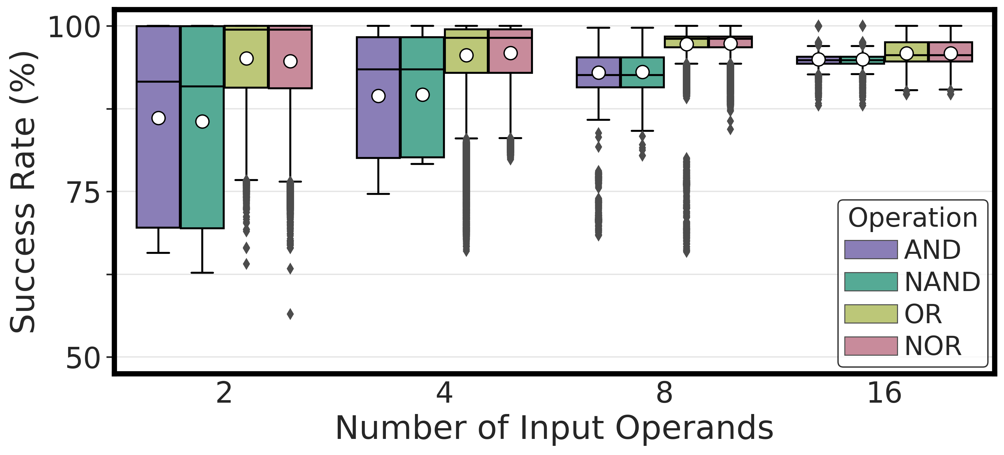
Performing AND, NAND, OR, and NOR
COTS DRAM chips can perform
{2, 4, 8, 16}-input AND, NAND, OR, and NOR operations
48
Notes:
Let’s see our first results
[CLICK] Here is the plot, in the x-axis we have the number of input operands and y-axis shows the success rate distribution across dram cells and the hue shows the type of operation
[CLICK] Our key takeaway from this experiment is off-the-shelf DRAM chips can perform 2, 4, 8, 16 input AND, NAND, OR, and NOR operations

Slide 49
Performing AND, NAND, OR, and NOR
COTS DRAM chips can perform
16-input AND, NAND, OR, and NOR operations
with very high success rate (>94%)
49
Notes:
Let’s see our first results
[CLICK] Here is the plot, in the x-axis we have the number of input operands and y-axis shows the success rate distribution across dram cells and the hue shows the type of operation
[CLICK] Our key takeaway from this experiment is off-the-shelf DRAM chips can perform 2, 4, 8, 16 input AND, NAND, OR, and NOR operations

Slide 50
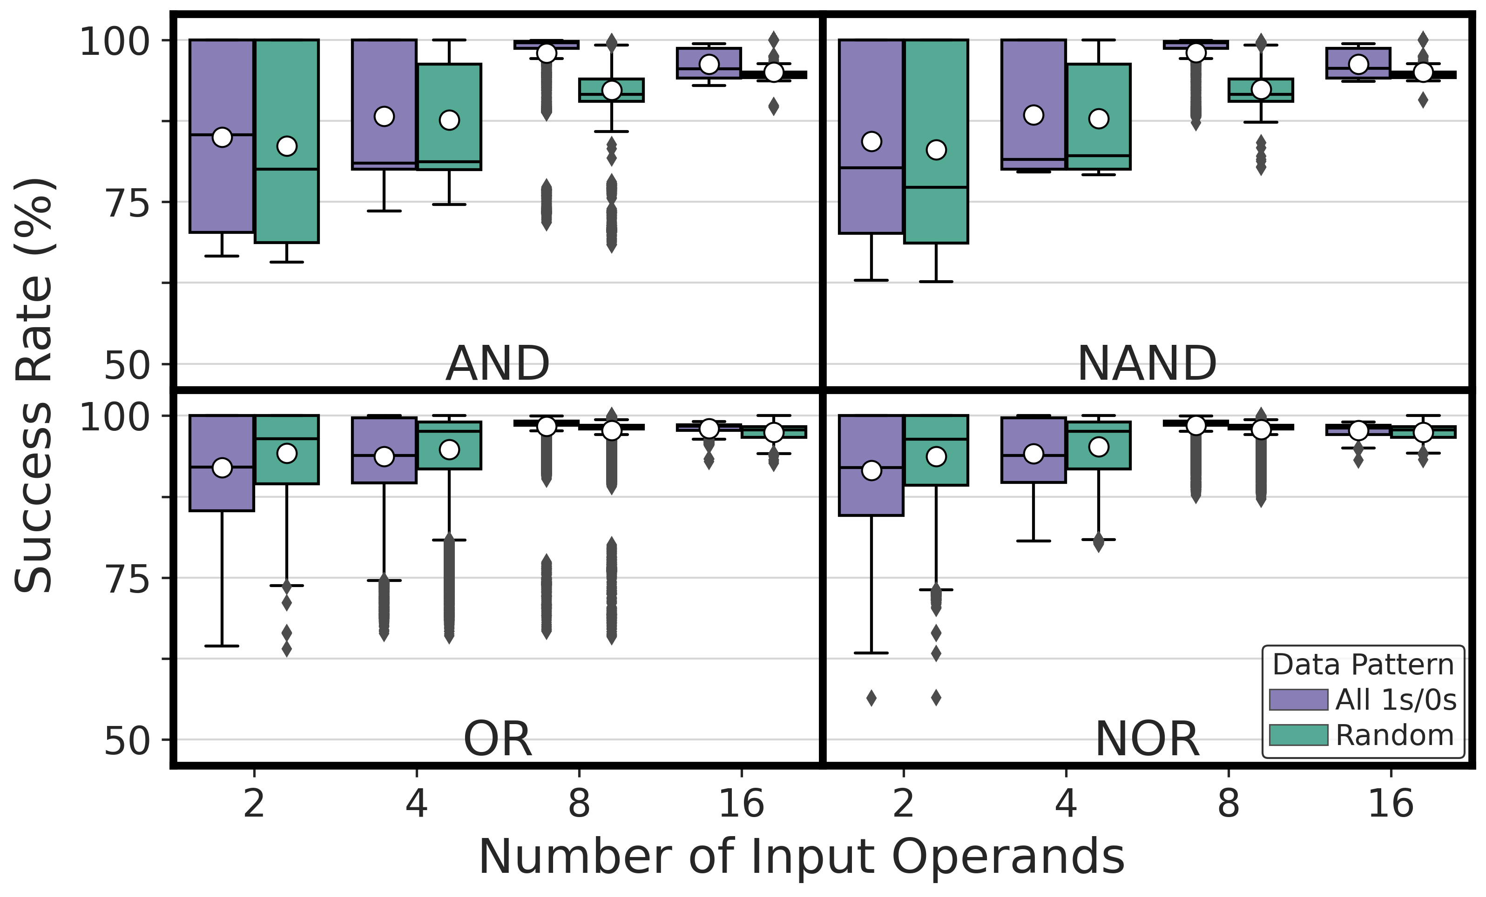
Impact of Data Pattern
1.98% variation in average success rate
across all number of input operands
50
Notes:
Our second analysis the impact of data pattern
[CLICK] This plot depicts the effect of data pattern on the NOR operation’s success rate: x-axis shows the number of input operands and y-axis shows the success rate distribution and hue shows the tested data patterns: either all 1s/0s in a row and random data pattern.
[CLICK] We observe a 1.97% variation in average success rate across all tested number of input operands

Slide 51
Impact of Data Pattern
Impact of data pattern is consistent
across all tested operations
51
Notes:
Here we show AND, NAND, OR, and NOR operations and
[CLICK] We observe that the impact of data pattern is consistent across all tested operations

Slide 52
Impact of Data Pattern
Data pattern slightly affects
the reliability of AND, NAND, OR, and NOR operations
52
Notes:
Our takeaway from this experiment is data pattern slightly affects the reliability of AND, NAND, OR, and NOR operations.

Slide 53
More in the Paper
Detailed hypotheses & key ideas to perform
  NOT operation
  Many-input AND, NAND, OR, and NOR operations
How the reliability of bitwise operations are affected by
  The location of activated rows
  Temperature (for AND, NAND, OR, and NOR)
  DRAM speed rate
  Chip density and die revision
Discussion on the limitations of COTS DRAM chips
53
Notes:
You can find the following in the paper
[CLICK] The key ideas and hypotheses on how a COTS DRAM chip is capable of performing these operations
[CLICK] How the reliability of tested operations are affected by: Spatial Variation, more temperature results, DRAM Speed Rate and Chip density and Die revision
[CLICK] And what are the limitations that we face in off-the-shelf DRAM chips and a broad discussion on this topic

Slide 54
Available on arXiv
https://arxiv.org/pdf/2402.18736.pdf
54
Notes:
The extended version of our study is available on arxiv

Slide 55
Outline
Background
Goal & Overview
Experimental Methodology
Multiple-Row Activation in Neighboring Subarrays
NOT Operation
AND, NAND, OR, and NOR Operations
Conclusion
55
Notes:
Let me conclude my talk

Slide 56
Conclusion
We experimentally demonstrate that commercial off-the-shelf (COTS) DRAM chips can perform:
  Functionally-complete Boolean operations: NOT, NAND, and NOR
  Up to 16-input AND, NAND, OR, and NOR operations
We characterize the success rate of these operations on
256 COTS DDR4 chips from two major manufacturers
We highlight two key results:
  We can perform NOT and
  {2, 4, 8, 16}-input AND, NAND, OR, and NOR operations
  on COTS DRAM chips with very high success rates (>94%)
  Data pattern and temperature only slightly affect
  the reliability of these operations
We believe these empirical results demonstrate
the promising potential of using DRAM as a computation substrate
56

Slide 57
Functionally-Complete Boolean Logic in Real DRAM Chips
Experimental Characterization and Analysis
Ismail Emir Yüksel
Yahya C. Tugrul Ataberk Olgun F. Nisa Bostancı
A. Giray Yaglıkçı Geraldo F. Oliveira Haocong Luo
Juan Gómez–Luna Mohammad Sadr Onur Mutlu
Notes:
Hello, I am Ismail Emir Yuksel.
I will be presenting our work, Functionally-Complete Boolean Logic in Real DRAM Chips

Slide 58


Simultaneous Many-Row Activation in Off-the-Shelf DRAM Chips
Experimental Characterization and Analysis
İsmail Emir Yüksel
Yahya C. Tuğrul F. Nisa Bostancı Geraldo F. Oliveira
A. Giray Yağlıkçı Ataberk Olgun Melina Soysal Haocong Luo
Juan Gómez–Luna Mohammad Sadr Onur Mutlu
Notes:
Hello, I am Ismail Emir Yuksel.
I will be presenting our work, Simultaneous Many-Row Activation in Off-the-Shelf DRAM Chips

Slide 59
Executive Summary
Motivation:
Processing-Using-DRAM (PUD) alleviates data movement bottlenecks
Commercial off-the-shelf (COTS) DRAM chips can perform
three-input majority (MAJ3) and in-DRAM copy operations
Goal: To experimentally analyze and understand
The computational capability of COTS DRAM chips beyond that of prior works
The robustness of such capability under various operating conditions
Experimental Study: 120 DDR4 chips from two major manufacturers
COTS DRAM chips can perform MAJ5, MAJ7, and MAJ9 operations
and copy one DRAM row to up to 31 different rows at once
Storing multiple redundant copies of MAJ’s input operands (i.e., input replication)
drastically increases robustness (>30% higher success rate)
Operating conditions (temperature, voltage, and data pattern)
affect the robustness of in-DRAM operations (by up to 11.52% success rate)
https://github.com/CMU-SAFARI/SiMRA-DRAM
Notes:
Let’s start with an executive summary
[CLICK] Processing-Using-DRAM is a promising paradigm to alleviate performance and energy overheads caused by frequent data movement between main memory and processing unit
[CLICK] Prior works show that off-the-shelf DRAM chips are capable of performing three-input majority and in-DRAM copy operations
[CLICK] In this study, our goal is to experimentally analyze and understand the computational capability of off-the-shelf DRAM chips beyond what prior works have demonstrated
[CLICK] and the robustness of such capability under various operating conditions
[CLICK] To this end, we conduct our experimental study on 120 DDR4 DRAM chips from two major manufacturers and
[CLICK] We show that off-the-shelf DRAM chips can perform MAJ5, MAJ7, and MAJ7 operations and copy one row’s content to up to 31 different rows simultaneously
[CLICK] We show that storing multiple redundant copies of majority operations’ input operands drastically increases robustness, more than 30% increase in success rate, which is our robustness metric
[CLICK] Finally, we observe that operating conditions (such as temperature, voltage, and data pattern) can affect the robustness of in-DRAM operations by up to 11.52% on average
[CLICK] Our work is artifact evaluated and fully open sourced, you can access our repository from this link here
-----
Whitespace is broken

Slide 60
Leveraging Simultaneous Many-Row Activation
1
Perform MAJX (where X>3) operations
2
Increase the robustness of MAJX operations
3
Copy one row’s content to multiple rows
Notes:
By leveraging simultaneous many-row activation, we can
[CLICK] Perform majority operations with more than three inputs
[CLICK] We can increase the robustness of majority operations
[CLICK] And we can copy one row’s content to multiple rows

Slide 61
Leveraging Simultaneous Many-Row Activation
1
Perform MAJX (where X>3) operations
2
Increase the robustness of MAJX operations
3
Copy one row’s content to multiple rows
Notes:
Next, I will show how we can copy one row’s content to multiple rows

Slide 62
In-DRAM Multiple Row Copy (Multi-RowCopy)
Simultaneously activate many rows to
copy one row’s content to multiple destination rows
RowClone
Multi-RowCopy
s
r
c
d
s
t
s
r
c
d
s
t
s
r
c
s
r
c
s
r
c
d
s
t
d
s
t
d
s
t
s
r
c
s
r
c
s
r
c
[Seshadri+ MICRO’13]
Notes:
[CLICK] Our key idea is since we can activate many rows simultaneously, we can copy one row’s content to other simultaneously activated rows
[CLICK] Let’s recall the RowClone example where we copy source to destination
[CLICK] In RowClone, we first activate the source row which will copy its content to sense amplifiers
[CLICK] And then, we activate destination row to drive the sense amplifier’s content to destination row
[CLICK] In our mechanism, which we call Multi-RowCopy, we have several destination rows
[CLICK] Here we activate many destination rows simultaneously
[CLICK] and thus sense amplifier drives its content to these destination rows.

Slide 63
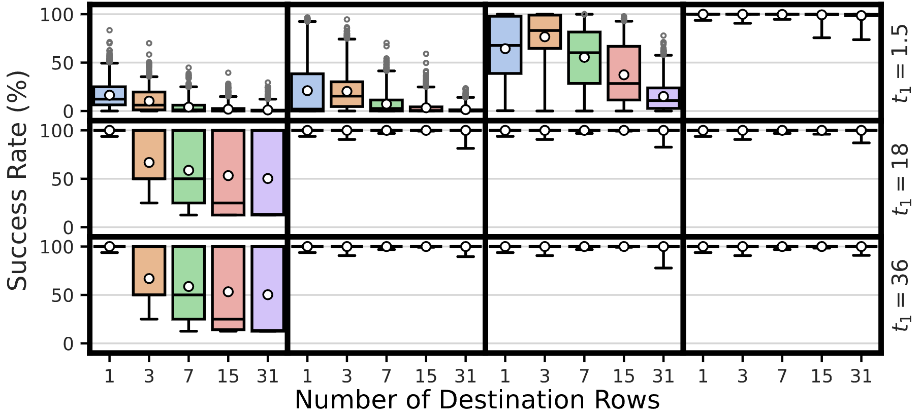
Robustness of Multi-RowCopy
Average: >99.98%
COTS DRAM chips can copy one row’s content
to up to 31 rows with a very high success rate
Notes:
Now let me show you the first result
[CLICK] In this plot, y-axis shows the success rate
[CLICK] x-axis shows the number of destination rows from 1 to 31
[CLICK] And we plot the success rate distribution as a box-and-whiskers plot
[CLICK] We observe that the average success rate is higher than 99.98% across all tested number of destination rows
[CLICK] Hence, we conclude that off-the-shelf DRAM chips can copy one row’s content to up to 31 rows with a very high success rate

Slide 64
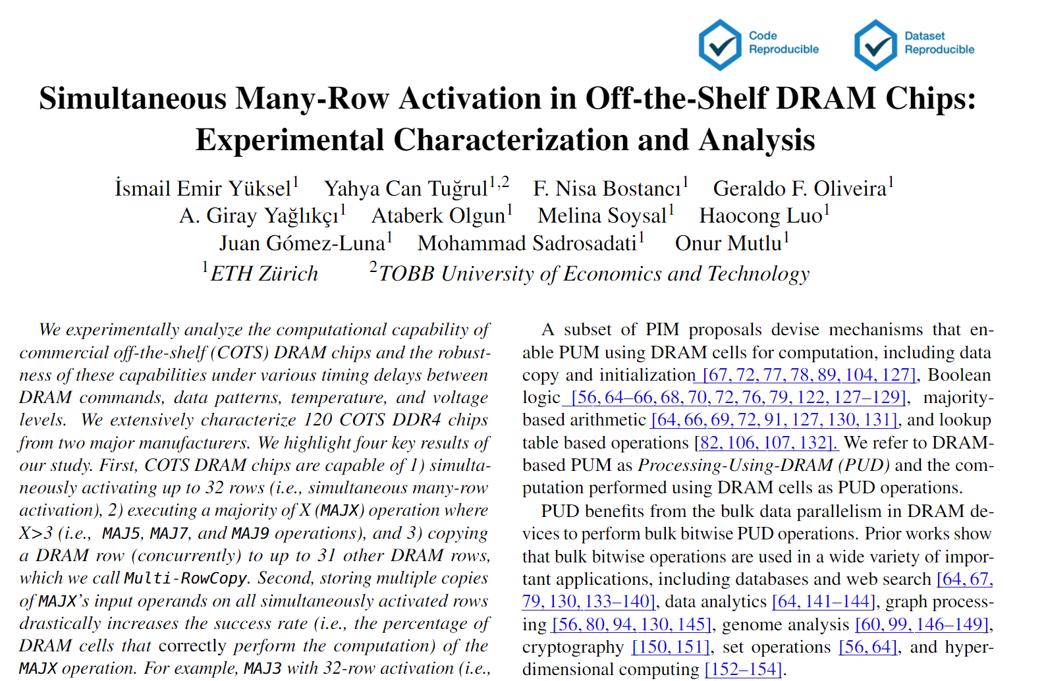
Available on arXiv
https://arxiv.org/pdf/2405.06081
Notes:
The extended version of our study is available on arxiv

Slide 65
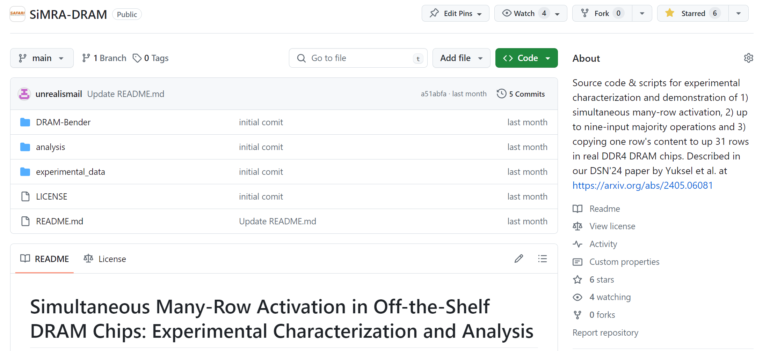
Our Work is Open Source and Artifact Evaluated
https://github.com/CMU-SAFARI/SiMRA-DRAM
Notes:
And our work is artifact evaluated and got every badges
[CLICK] You can download our code from github and start testing right away!

Slide 66


Simultaneous Many-Row Activation in Off-the-Shelf DRAM Chips
Experimental Characterization and Analysis
Paper
GitHub
İsmail Emir Yüksel
Yahya C. Tuğrul F. Nisa Bostancı Geraldo F. Oliveira
A. Giray Yağlıkçı Ataberk Olgun Melina Soysal Haocong Luo
Juan Gómez–Luna Mohammad Sadr Onur Mutlu
Notes:
Hello, I am Ismail Emir Yuksel.
I will be presenting our work, Simultaneous Many-Row Activation in Off-the-Shelf DRAM Chips

Slide 67
Functionally-Complete Boolean Logic in Real DRAM Chips
Experimental Characterization and Analysis
Backup Slides
Ismail Emir Yüksel
Yahya C. Tugrul Ataberk Olgun F. Nisa Bostancı
A. Giray Yaglıkçı Geraldo F. Oliveira Haocong Luo
Juan Gómez–Luna Mohammad Sadr Onur Mutlu
Notes:
Hello, I am Ismail Emir Yuksel.
I will be presenting our work, Functionally-Complete Boolean Logic in Real DRAM Chips

Slide 68
Experimental Methodology
We test all banks in each DRAM chip
We test three neighboring subarray pairs in each bank
We test all possible combinations of activated rows
…
Bank
Chip I/O
…
DRAM Chip
DRAM Bank
68
Notes:
We use a FPGA based DDR4 testing infrastructure developed from DRAM bender that enables fine-grained control over DRAM commands, timings, and temperature to characterize RowPress

Slide 69
Experimental Methodology
We test all possible combinations of Row A and Row B
Subarray X
R_{A}
…
R_{A}
…
…
R_{A}
…
Sense Amps.
R_{B}
…
…
R_{B}
…
DRAM Bank
R_{B}
…
Subarray Y
69
Notes:
We use a FPGA based DDR4 testing infrastructure developed from DRAM bender that enables fine-grained control over DRAM commands, timings, and temperature to characterize RowPress

Slide 70

Performing NOT in COTS DRAM Chips
The average success of the NOT operation with
four destination row: 98.37%
thirty-two destination rows: 7.95%
As the number of destination rows increases,
more DRAM cells produce incorrect results.
70

Slide 71
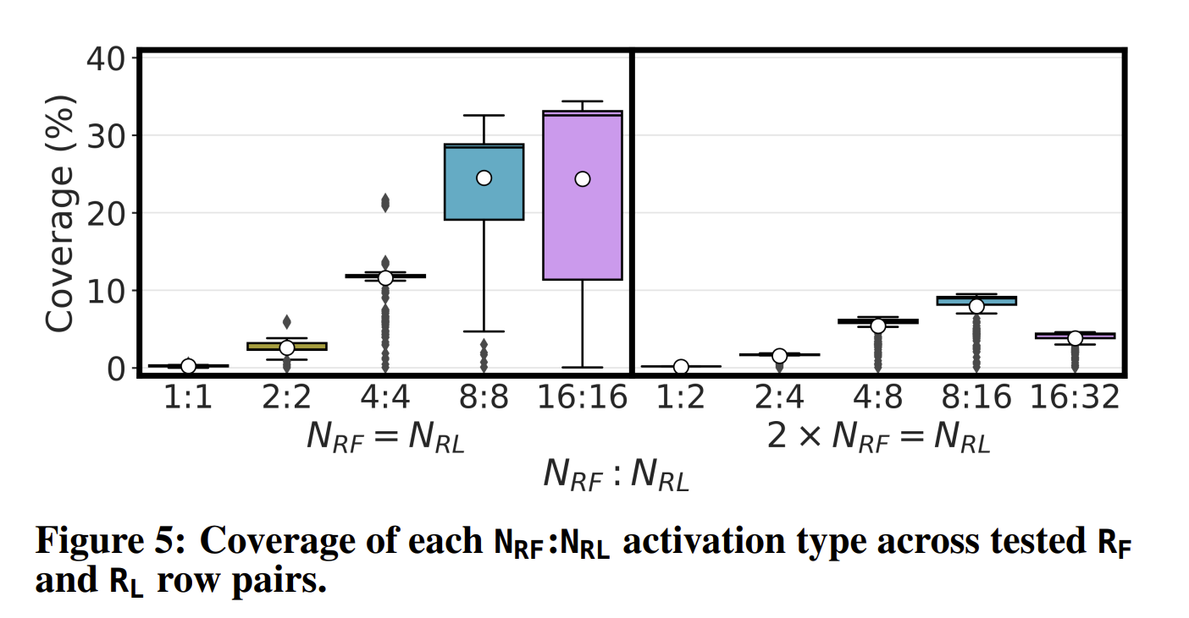
The Coverage of Multiple-Row Activation
71
Notes:
COTS DRAM chips can perform 1:1, 1:2, 2:2, 2:4, 4:4, 4:8, 8:8, 8:16, 16:16, and 16:32 activation with an average coverage across all tested DRAM chips of 0.23%, 0.15%, 2.60%, 1.53%, 11.58%, 5.42%, 24.52%, 7.95%, 24.35%, and 3.82%, respectively.

Slide 72
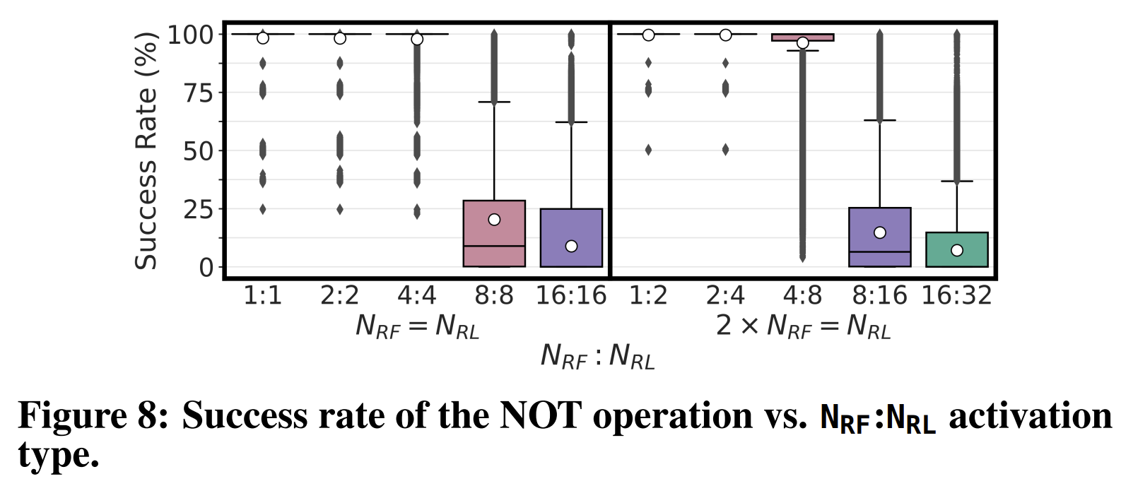
NOT vs. Activation Trend
72
Notes:
COTS DRAM chips can perform 1:1, 1:2, 2:2, 2:4, 4:4, 4:8, 8:8, 8:16, 16:16, and 16:32 activation with an average coverage across all tested DRAM chips of 0.23%, 0.15%, 2.60%, 1.53%, 11.58%, 5.42%, 24.52%, 7.95%, 24.35%, and 3.82%, respectively.

Slide 73
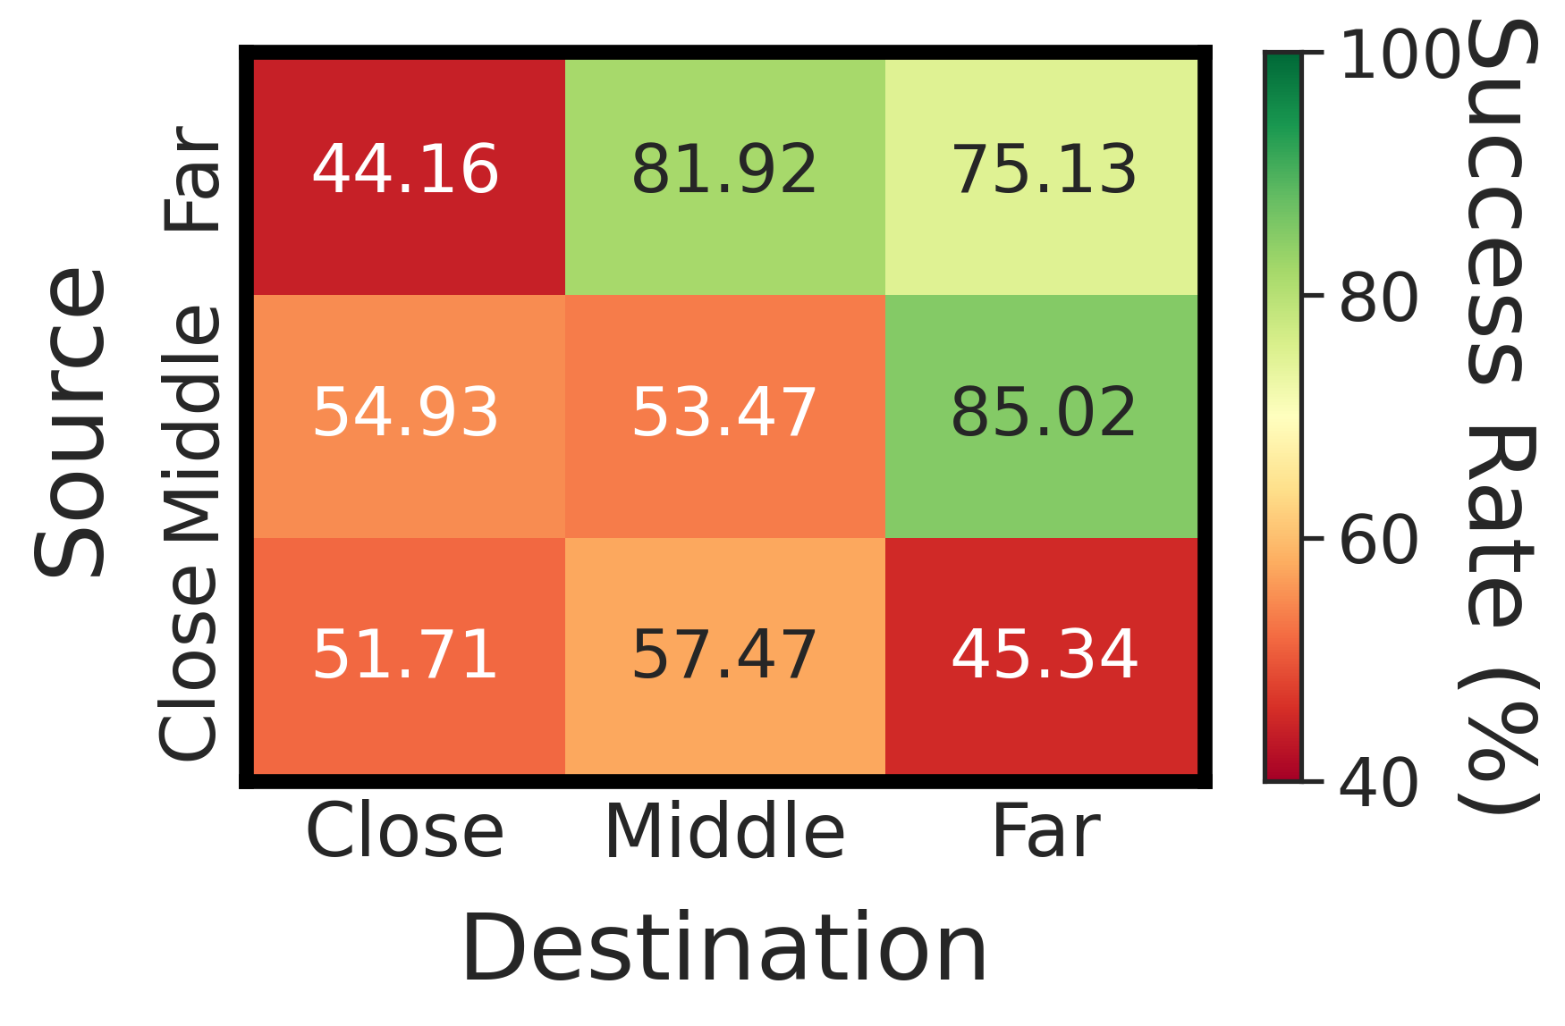

Impact of Location in NOT Op.
Categorize the distance between activated rows (source and destination rows) and the sense amplifiers into three regions: Far, Middle, and Close
Source Subarray
Far
Middle
Close
Sense Amp.
Close
Middle
Far
Destination Subarray
The distance between activated rows and the sense amplifiers significantly affects the reliability
73

Slide 74
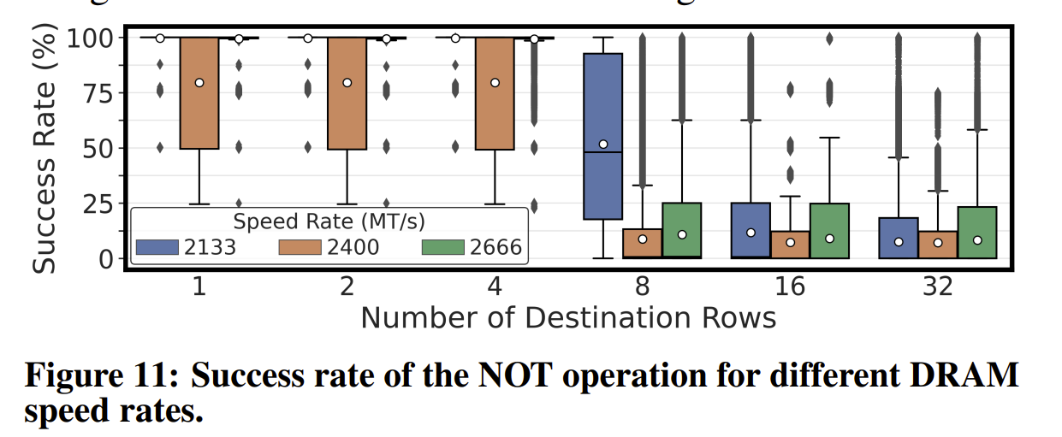
The effect of DRAM Speed Rate on NOT
74
Notes:
COTS DRAM chips can perform 1:1, 1:2, 2:2, 2:4, 4:4, 4:8, 8:8, 8:16, 16:16, and 16:32 activation with an average coverage across all tested DRAM chips of 0.23%, 0.15%, 2.60%, 1.53%, 11.58%, 5.42%, 24.52%, 7.95%, 24.35%, and 3.82%, respectively.

Slide 75
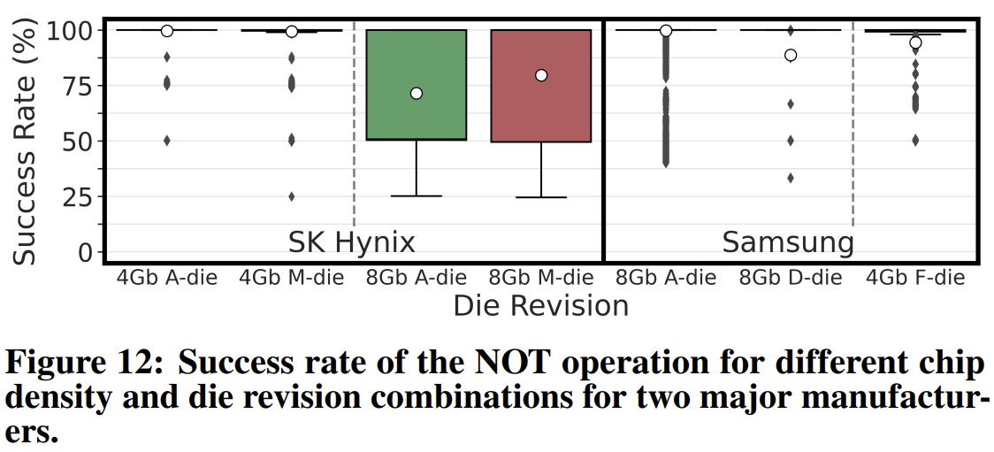
Chip Density & Die Revision (NOT)
75
Notes:
COTS DRAM chips can perform 1:1, 1:2, 2:2, 2:4, 4:4, 4:8, 8:8, 8:16, 16:16, and 16:32 activation with an average coverage across all tested DRAM chips of 0.23%, 0.15%, 2.60%, 1.53%, 11.58%, 5.42%, 24.52%, 7.95%, 24.35%, and 3.82%, respectively.

Slide 76
Performing AND, NAND, OR, and NOR
The reliability distributions are very similar between 1) AND-NAND and 2) OR – NOR operations.
76

Slide 77
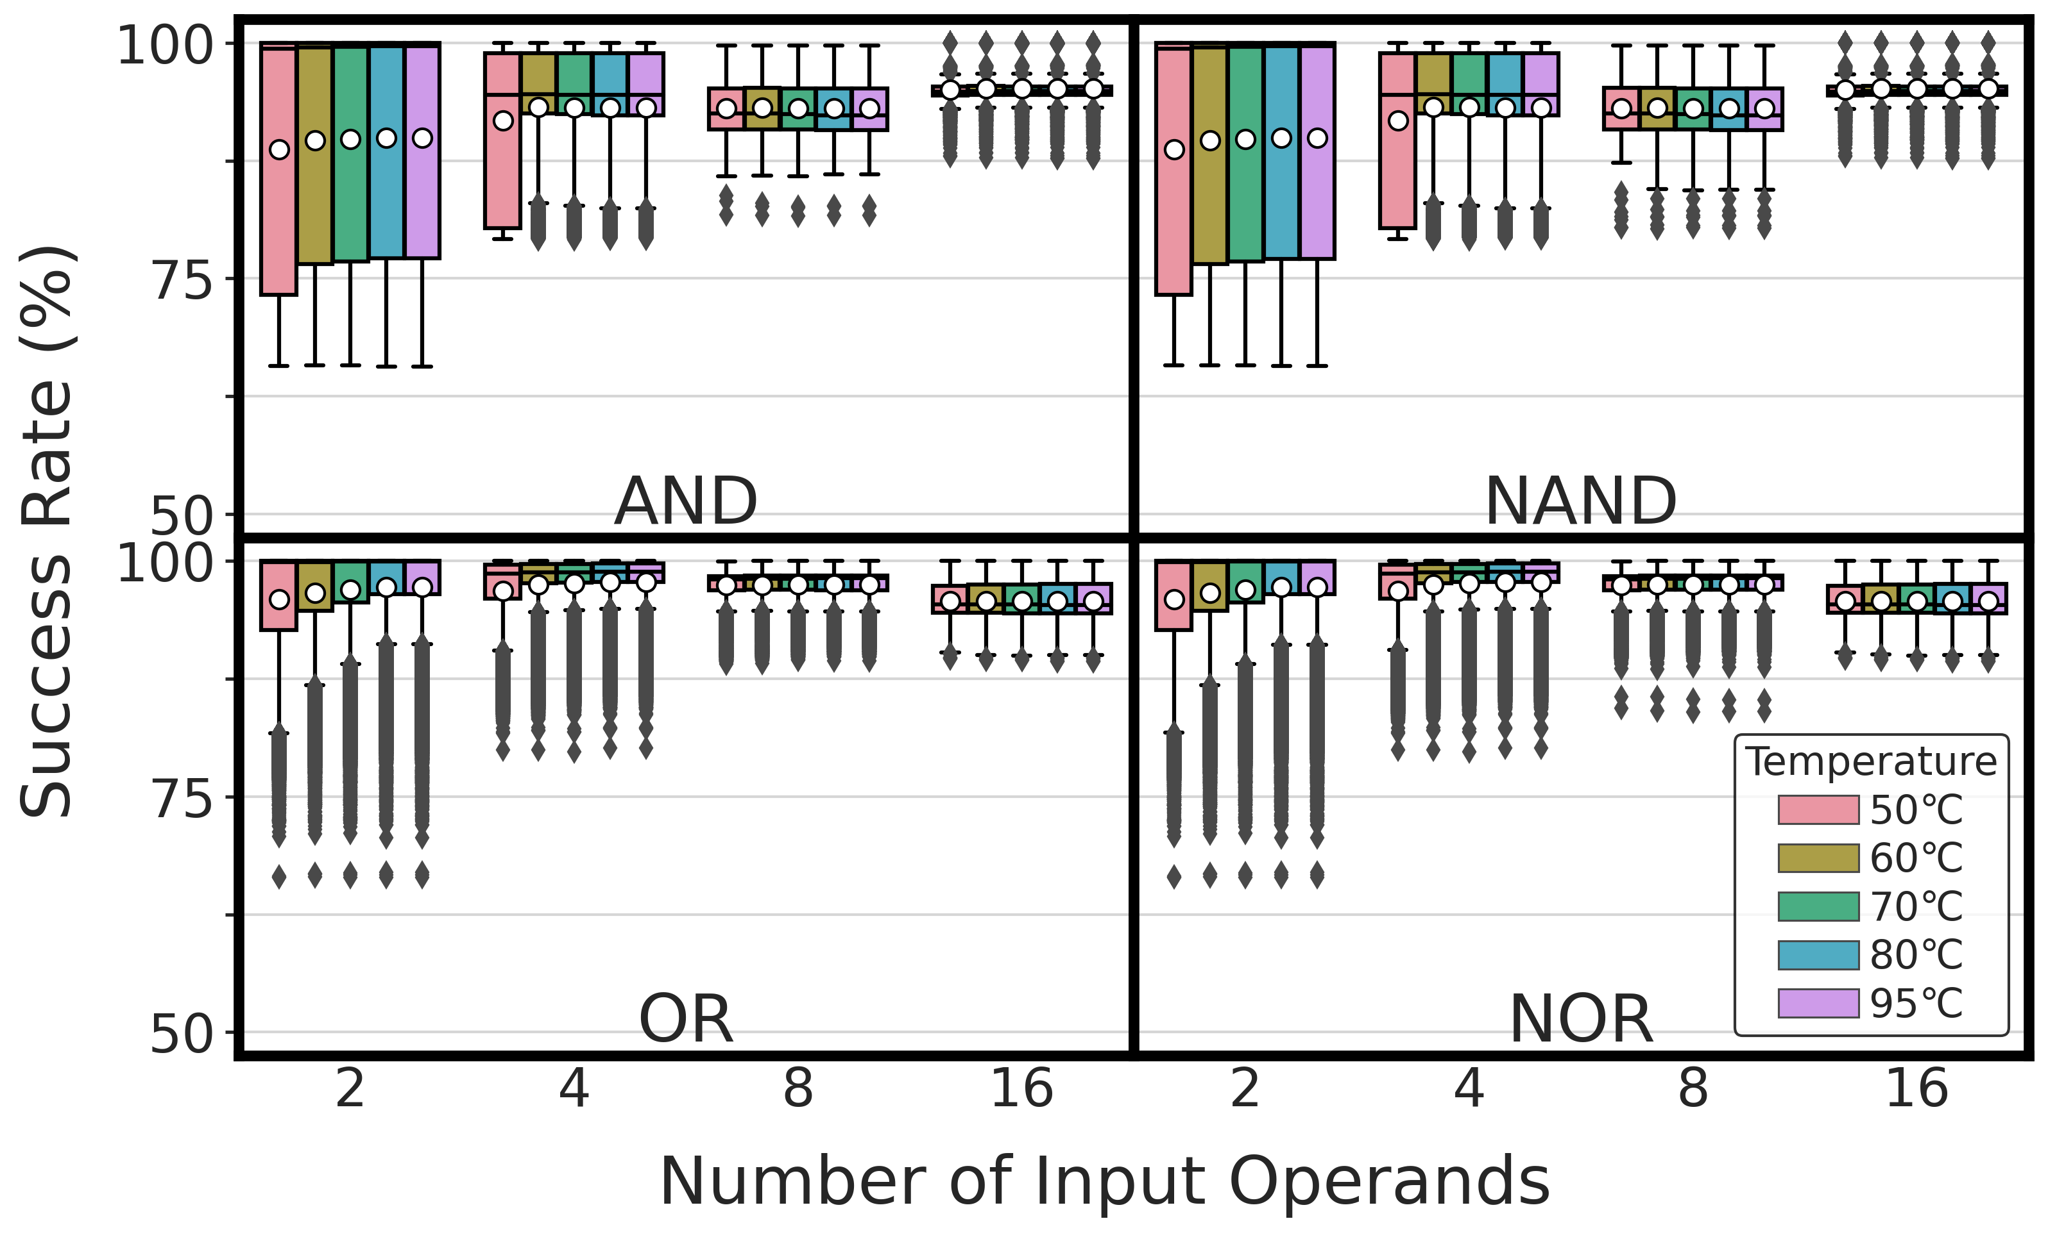
Impact of Temperature
Temperature has a small effect on
the reliability of AND, NAND, OR, and NOR operations
77

Slide 78
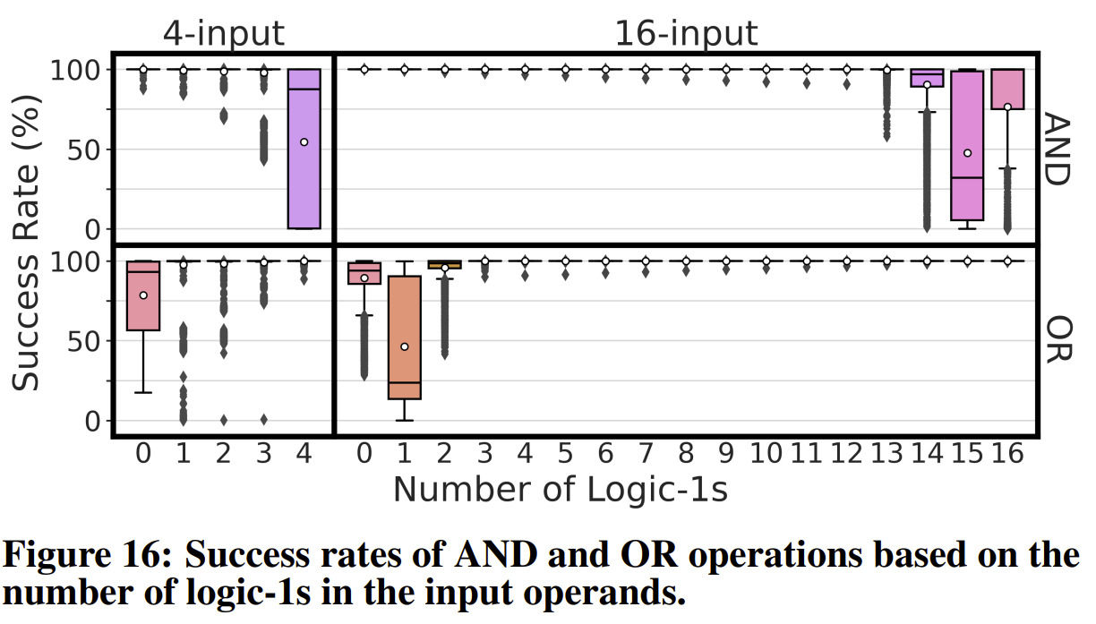
Boolean Operations vs. Number of 1s
78
Notes:
COTS DRAM chips can perform 1:1, 1:2, 2:2, 2:4, 4:4, 4:8, 8:8, 8:16, 16:16, and 16:32 activation with an average coverage across all tested DRAM chips of 0.23%, 0.15%, 2.60%, 1.53%, 11.58%, 5.42%, 24.52%, 7.95%, 24.35%, and 3.82%, respectively.

Slide 79
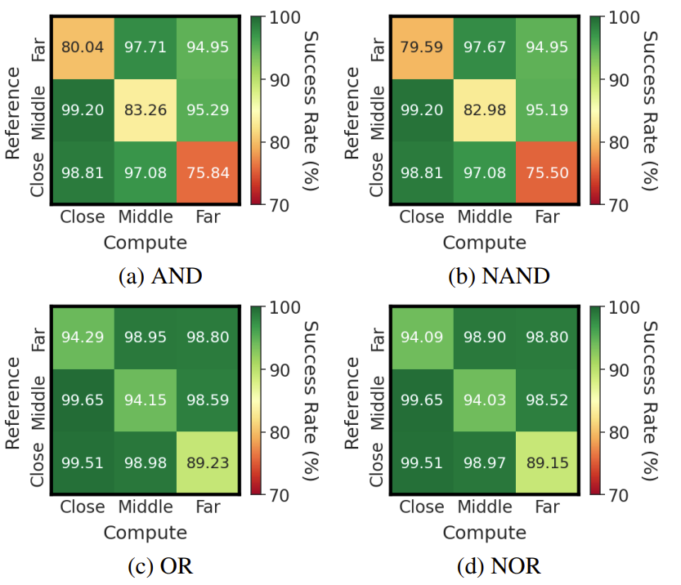
The Effect of the Location
79
Notes:
COTS DRAM chips can perform 1:1, 1:2, 2:2, 2:4, 4:4, 4:8, 8:8, 8:16, 16:16, and 16:32 activation with an average coverage across all tested DRAM chips of 0.23%, 0.15%, 2.60%, 1.53%, 11.58%, 5.42%, 24.52%, 7.95%, 24.35%, and 3.82%, respectively.

Slide 80
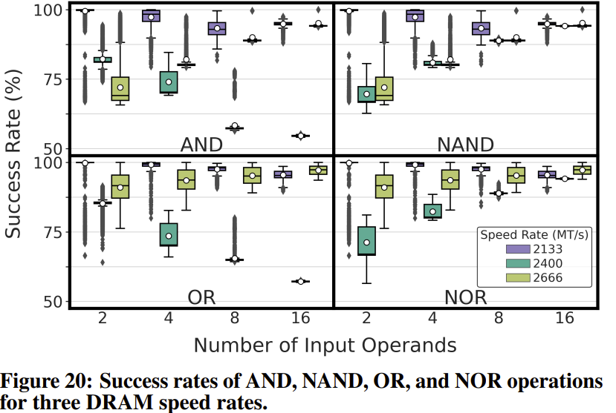
DRAM Speed Rate vs. Bitwise Ops.
80
Notes:
COTS DRAM chips can perform 1:1, 1:2, 2:2, 2:4, 4:4, 4:8, 8:8, 8:16, 16:16, and 16:32 activation with an average coverage across all tested DRAM chips of 0.23%, 0.15%, 2.60%, 1.53%, 11.58%, 5.42%, 24.52%, 7.95%, 24.35%, and 3.82%, respectively.

Slide 81
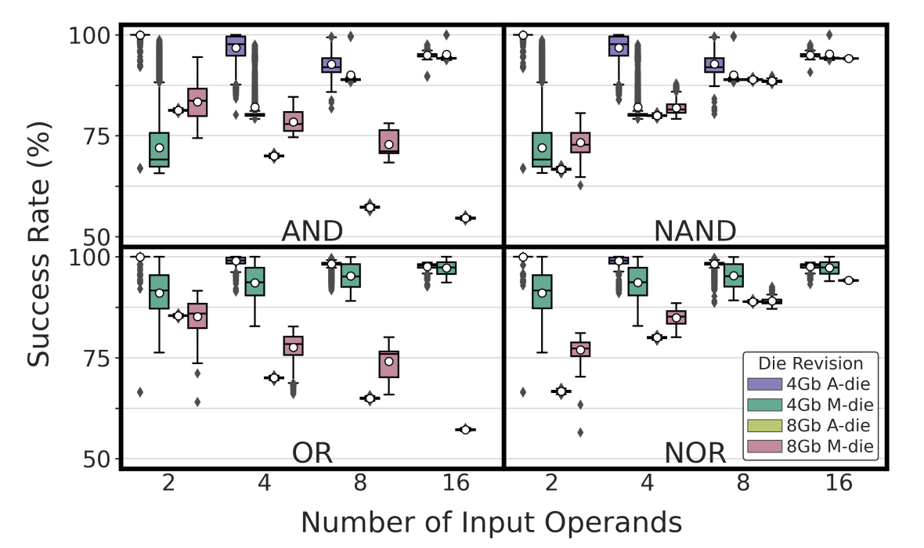
Chip Density&Die Revision vs. Bitwise Ops.
81
Notes:
COTS DRAM chips can perform 1:1, 1:2, 2:2, 2:4, 4:4, 4:8, 8:8, 8:16, 16:16, and 16:32 activation with an average coverage across all tested DRAM chips of 0.23%, 0.15%, 2.60%, 1.53%, 11.58%, 5.42%, 24.52%, 7.95%, 24.35%, and 3.82%, respectively.

Slide 82
DRAM Cell Operation
wordline
bitline
capacitor
1. ACTIVATE (ACT)
access transistor
2. PRECHARGE (PRE)
Sense Amp
enable
NOT Gate
bitline
82
Notes:
Here we take a closer look into DRAM cell.
A DRAM cell consists of two main components: capacitor and access transistor.
Capacitor holds the data as a form of electrical charge.
Access transistor connects cell to the subarray through wordline and bitline.
As we discussed, bitline is connected to the sense amplifier which consists of two back-to-back NOT gates.
In this study, we focus on two major DRAM commands: ACT and PRE, let’s see how they work.

Slide 83
DRAM Cell Operation - ACTIVATE
deviation in bitline voltage
wordline
1
raise wordline
0
V_{DD}
½ V_{DD}
+ δ
bitline
capacitor
access transistor
connects cell to bitline
cell loses
charge to bitline
cell regains charge
enable
1
0
enable sense amp
bitline
½ V_{DD}
0
83
Notes:
First, ACT

Slide 84
DRAM Cell Operation - PRECHARGE
wordline
1
Precharge bitline
for next access
0
lower wordline
V_{DD}
½ V_{DD}
bitline
capacitor
access transistor
enable
1
0
Disable
Sense Amp
bitline
½ V_{DD}
0
84
Notes:
PRE

Slide 85
Simultaneous Many-Row Activation in Off-the-Shelf DRAM Chips
Experimental Characterization and Analysis
İsmail Emir Yüksel
Yahya C. Tuğrul F. Nisa Bostancı Geraldo F. Oliveira
A. Giray Yağlıkçı Ataberk Olgun Melina Soysal Haocong Luo
Juan Gómez–Luna Mohammad Sadr Onur Mutlu
Notes:
Hello, I am Ismail Emir Yuksel.
I will be presenting our work, Simultaneous Many-Row Activation in Off-the-Shelf DRAM Chips

Slide 86
Executive Summary
Motivation:
Processing-Using-DRAM (PUD) alleviates data movement bottlenecks
Commercial off-the-shelf (COTS) DRAM chips can perform
three-input majority (MAJ3) and in-DRAM copy operations
Goal: To experimentally analyze and understand
The computational capability of COTS DRAM chips beyond that of prior works
The robustness of such capability under various operating conditions
Experimental Study: 120 DDR4 chips from two major manufacturers
COTS DRAM chips can perform MAJ5, MAJ7, and MAJ9 operations
and copy one DRAM row to up to 31 different rows at once
Storing multiple redundant copies of MAJ’s input operands (i.e., input replication)
drastically increases robustness (>30% higher success rate)
Operating conditions (temperature, voltage, and data pattern)
affect the robustness of in-DRAM operations (by up to 11.52% success rate)
https://github.com/CMU-SAFARI/SiMRA-DRAM
Notes:
Let’s start with an executive summary
[CLICK] Processing-Using-DRAM is a promising paradigm to alleviate performance and energy overheads caused by frequent data movement between main memory and processing unit
[CLICK] Prior works show that off-the-shelf DRAM chips are capable of performing three-input majority and in-DRAM copy operations
[CLICK] In this study, our goal is to experimentally analyze and understand the computational capability of off-the-shelf DRAM chips beyond what prior works have demonstrated
[CLICK] and the robustness of such capability under various operating conditions
[CLICK] To this end, we conduct our experimental study on 120 DDR4 DRAM chips from two major manufacturers and
[CLICK] We show that off-the-shelf DRAM chips can perform MAJ5, MAJ7, and MAJ7 operations and copy one row’s content to up to 31 different rows simultaneously
[CLICK] We show that storing multiple redundant copies of majority operations’ input operands drastically increases robustness, more than 30% increase in success rate, which is our robustness metric
[CLICK] Finally, we observe that operating conditions (such as temperature, voltage, and data pattern) can affect the robustness of in-DRAM operations by up to 11.52% on average
[CLICK] Our work is artifact evaluated and fully open sourced, you can access our repository from this link here
-----
Whitespace is broken

Slide 87
Outline
Motivation & Background
Goal
Experimental Methodology
Simultaneous Many-Row Activation
MAJX Operation
Multi-RowCopy Operation
Conclusion
Notes:
Here is the outline of my talk

Slide 88
Outline
Motivation & Background
Goal
Experimental Methodology
Simultaneous Many-Row Activation
MAJX Operation
Multi-RowCopy Operation
Conclusion
Notes:
Let’s start with a background

Slide 89
Data Movement Bottleneck
Today’s computing systems are processor centric
All data is processed in the processor → at great system cost
Computing Unit
(CPU, GPU, FPGA, Accelerators)
Main Memory
(DRAM)
Memory
Channel
More than 60% of the total system energy is spent on data movement¹
¹ A. Boroumand et al., “Google Workloads for Consumer Devices: Mitigating Data Movement Bottlenecks,” ASPLOS, 2018

Slide 90
Processing-In-Memory (PIM)
  Two main approaches for Processing-In-Memory:
1
Processing-Near-Memory: PIM logic is added near the memory arrays
or to the logic layer of 3D-stacked memory
2
Processing-Using-Memory: uses the analog operational principles of
memory cells to perform computation
DRAM
(e.g., 3D-Stacked Memory)
DRAM Bank
Vault
Controller
Processing-
Using-DRAM
DRAM Vault
…
PHY
Processing-Near-Vault
…
Processing-Near-Bank
Notes:
Processing-in-Memory architectures alleviate data movement bottlenecks by moving computation to where the data resides. Such architectures can be implemented
[CLICK] by adding logic near the memory arrays, in what is called processing-near-memory or
[CLICK] by using the analog operating principles of the memory cells to perform computation, in what is called processing-using-memory

Slide 91
Processing-In-Memory (PIM)
  Two main approaches for Processing-In-Memory:
1
Processing-Near-Memory: PIM logic is added near the memory arrays
or to the logic layer of 3D-stacked memory
2
Processing-Using-Memory: uses the analog operational principles of
memory cells to perform computation
DRAM
(e.g., 3D-Stacked Memory)
DRAM Bank
Vault
Controller
Processing-
Using-DRAM
DRAM Vault
…
PHY
Processing-Near-Vault
…
Processing-Near-Bank
Notes:
In this work, we focus on processing-using-memory architectures. In particular, its implementation using DRAM.
Before I introduce processing-using-DRAM architectures, I will provide a short background on DRAM organization and operation.

Slide 92
DRAM Organization
DRAM Module
DRAM
Chip
Subarray
DRAM Cell
Bank
…
Wordline
Chip I/O
Row Decoder
DRAM Row
Bitline
…
Sense Amps.
DRAM Chip
DRAM Bank
DRAM Subarray
Notes:
DRAM is used as the main memory in many computing systems.
[CLICK] a DRAM module consists of multiple DRAM chips
[CLICK]Each chip contains multiple banks
[CLICK] Each bank is composed of multiple subarrays and sense amplifiers
[CLICK] And within each subarray, there is a two dimensional array of DRAM cells.
[CLICK] These cells are organized into rows that are selected using wordlines
[CLICK] And the cells are connected to a row of sense amplifiers via bitlines

Slide 93
DRAM Operation
DRAM Subarray
1
ACTIVATE (ACT):
Fetch the row’s content
into the sense amplifiers
2
Column Access (RD/WR):
Read/Write the target
column and drive to I/O
Sense
Amplifiers
3
PRECHARGE (PRE):
Prepare the bank
for a new ACTIVATE
I/O Circuitry
Notes:
Data is internally accessed in a row granularity. To access data,
[CLICK] the memory controller first needs to activate the row that contains the data and fetch the row’s content into the sense amplifiers
[CLICK] Then, column accesses are serviced from the sense amplifiers
[CLICK] Finally, the subarray needs to be precharged to get ready for the next row activation

Slide 94
In-DRAM Row-Copy (RowClone)
Copying the source (src) row’s content to
the destination (dst) row
s
r
c
d
s
t
s
r
c
d
s
t
s
r
c
[Seshadri+ MICRO’13]
Notes:
In this study, we focus on two prior in-DRAM operations. First one is in-DRAM Row-Copy, which is also called RowClone
[CLICK] The RowClone operation copies the source row’s content to the destination row. Now let’s see how we perform RowClone

Slide 95
In-DRAM Row-Copy (RowClone)
ACT src
Fetch src’s content
into the sense amplifiers
d
s
t
s
r
c
Assert the src’s wordline
d
s
t
s
r
c
[Seshadri+ MICRO’13]
Notes:
[CLICK] To perform RowClone, we first activate the source row by issuing ACT src command. This will assert the src’s wordline
[CLICK] and then fetch src’s content into the sense amplifiers

Slide 96
In-DRAM Row-Copy (RowClone)
ACT src
ACT dst
Bitlines are still at src voltage
s
r
c
d
s
t
src’s content
is copied to dst
s
r
c
sense amplifier is still enabled
d
s
t
s
r
c
[Seshadri+ MICRO’13]
Notes:
After that, we activate
[CLICK] the destination row without performing precharge operation in between two activate commands
[CLICK] By doing that DRAM will keep the bitlines at src voltage
[CLICK] and keep the sense amplifier enabled
[CLICK] As a result, after some time, the source row’s content is copied to the destination row

Slide 97
In-DRAM Majority-of-Three (MAJ3)
Performing a MAJ3 operation
using three rows as input operands
a
a
a
b
b
b
b
b
b
d
s
t
b
b
b
MAJ3(a, b, b) = b
[Seshadri+ MICRO’17]
Notes:
Similarly,
[CLICK] prior works show that DRAM can perform MAJ3 operation using three rows as input operands

Slide 98
In-DRAM Majority-of-Three (MAJ3)
Activate three rows simultaneously
a
a
a
Three rows perturb bitlines simultaneously
Assert three rows’ wordlines
b
b
b
b
b
b
d
s
t
b
b
b
Sense amplifiers sample the output of majority
[Seshadri+ MICRO’17, Gao+ MICRO’19]
Notes:
These works first
[CLICK] activate three rows simultaneously by either modifying the row decoder circuitry or violating standard DRAM timing parameters in off-the-shelf DRAM chips, we will see how this works in real DRAM chips later in this talk
[CLICK] By activating three rows simultaneously, DRAM will assert these rows’ wordlines
[CLICK] After that these activated rows perturb bitlines simultaneously
[CLICK] After some time, sense amplifier amplifies the perturbation on the bitline and sample the output of majority of the values stored in activated rows

Slide 99
Outline
Motivation & Background
Goal
Experimental Methodology
Simultaneous Many-Row Activation
MAJX Operation
Multi-RowCopy Operation
Conclusion
Notes:
Now let’s move to our goal in this study

Slide 100
Our Goal
Experimentally understand
the computational capability of COTS DRAM chips
Experimentally analyze
the robustness of such capability
under various operating conditions
Notes:
Our goal is to
[CLICK] Experimentally understand the computational capability of off-the-shelf DRAM chips beyond what prior works have demonstrated
[CLICK] And experimentally analyze the robustness of such capability under various operating conditions

Slide 101
Outline
Motivation & Background
Goal
Experimental Methodology
Simultaneous Many-Row Activation
MAJX Operation
Multi-RowCopy Operation
Conclusion
Notes:
Now, let’s move to our methodology

Slide 102
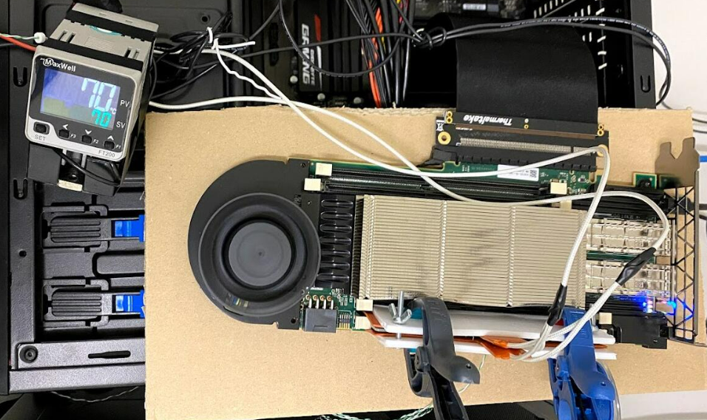
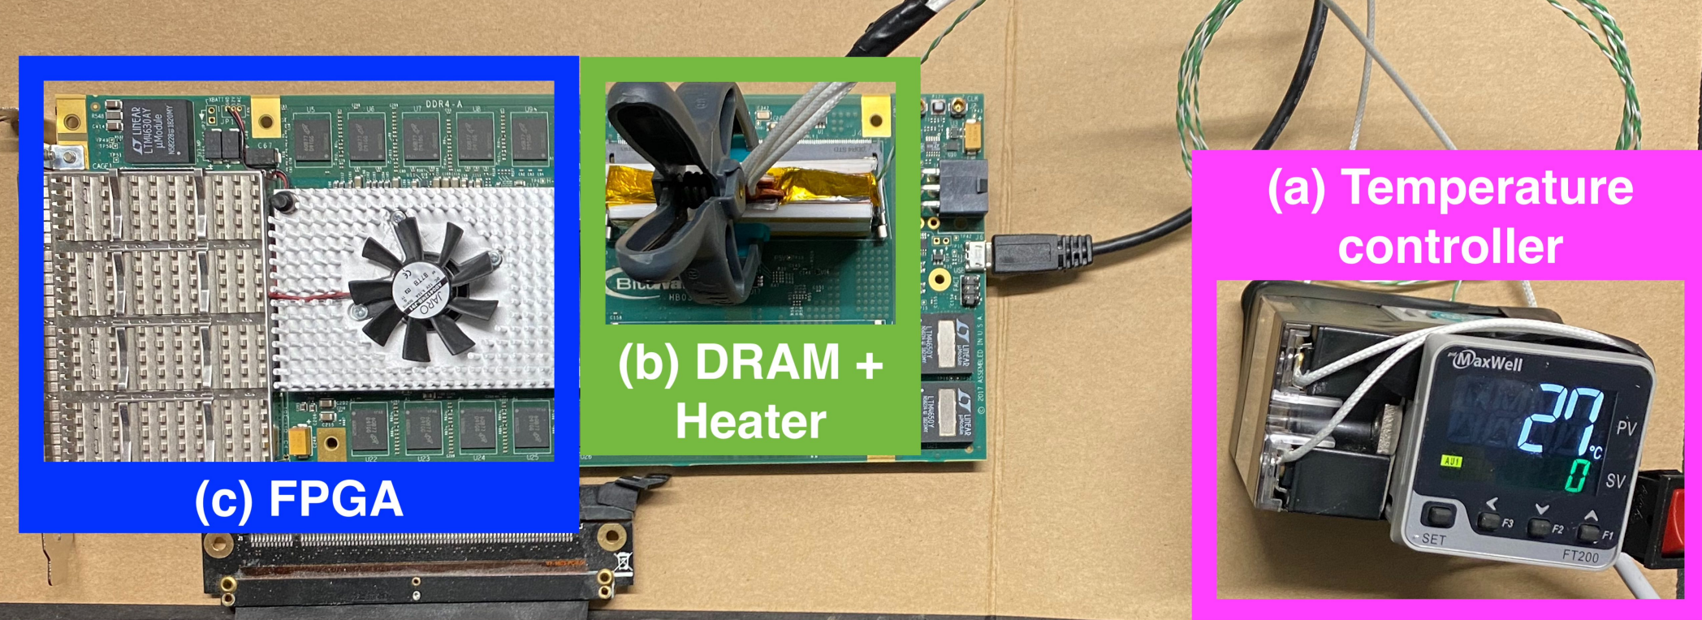
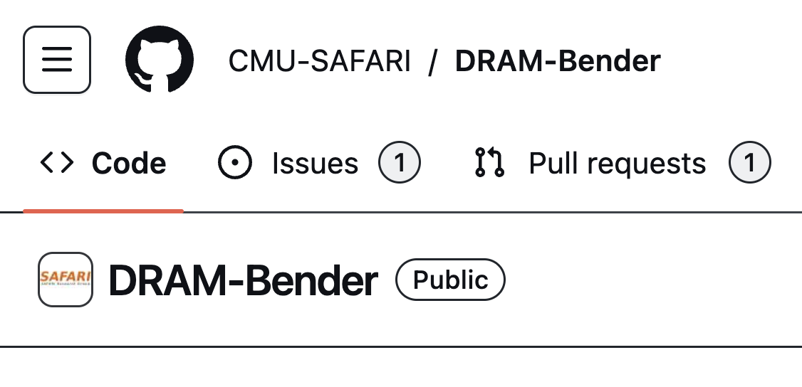
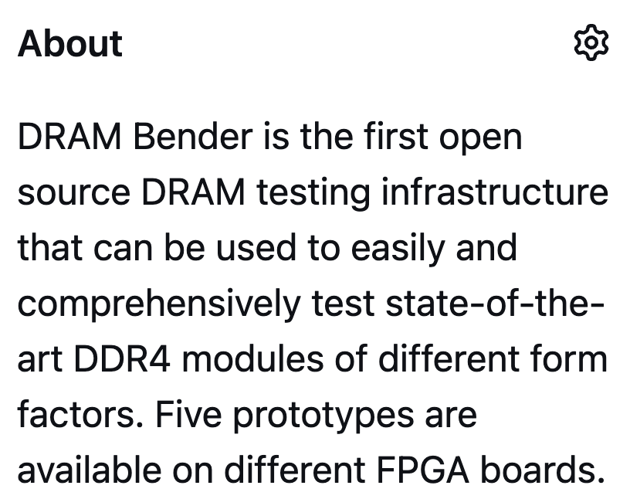
DRAM Testing Infrastructure (I)
DRAM Bender DDR3/4 Testing Infrastructure
https://github.com/CMU-SAFARI/DRAM-Bender
Olgun et al., "DRAM Bender: An Extensible and Versatile FPGA-based Infrastructure to Easily Test State-of-the-art DRAM Chips," TCAD, 2023.
Notes:
[CLICK] We use a FPGA based DDR4 testing infrastructure called DRAM bender which is fully open-sourced

Slide 103
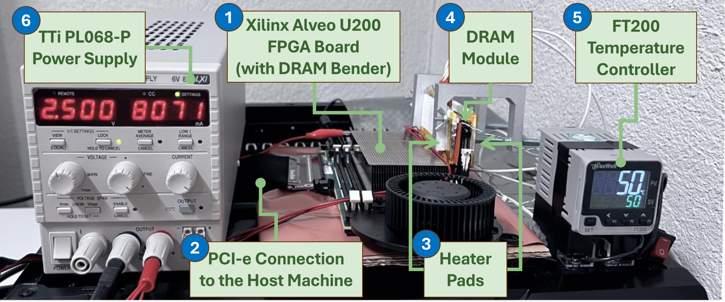
DRAM Testing Infrastructure (II)
Fine-grained control over DRAM commands, timings,
temperature, and voltage
Olgun et al., "DRAM Bender: An Extensible and Versatile FPGA-based Infrastructure to Easily Test State-of-the-art DRAM Chips," TCAD, 2023.
Notes:
This infrastucture
[CLICK] enables fine-grained control over DRAM commands, timings, temperature and voltage

Slide 104
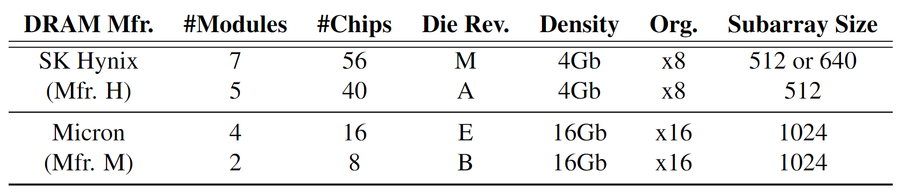
DRAM Chips Tested
120 DDR4 chips from two major DRAM manufacturers
Covers different die revisions and chip densities
Notes:
[CLICK] We test 120 DDR4 chips from two major DRAM manufacturers,
[CLICK] covering different die densities and revisions

Slide 105

Testing Methodology (I)
Carefully sweep
    Row addresses: Row A and Row B (>3M row pairs)
    Timing parameters: Between ACT → PRE and PRE → ACT
All rows in Subarray X
ACT Row A
PRE
ACT Row B
Subarray X
ACT
Row A
…
ACT
Row B
DRAM Bank
Notes:
[CLICK] In this study, we focus on individual subarrays, here denoted as Subarray X
[CLICK] We perform our experiment using the following command sequence: Activate Row A, Precharge, and Activate Row B, where Row A and Row B in the same subarray
[CLICK] We carefully sweep four parameters: Row addresses: Row A and Row B
[CLICK] Timing parameters between ACT Row A and Precharge and between Precharge and ACT Row B

Slide 106


Testing Methodology (II)
Temperature
Wordline Voltage
50◦C
90◦C
2.5V
2.1V
Notes:
We also test two major operating parameters
[CLICK] First, temperature. We sweep temperature from 50C to 90C Celsius
[CLICK] Second, wordline voltage. We reduce the wordline voltage from its nominal value, 2.5V to 2.1V

Slide 107
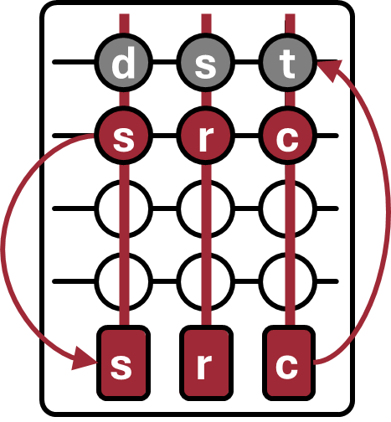
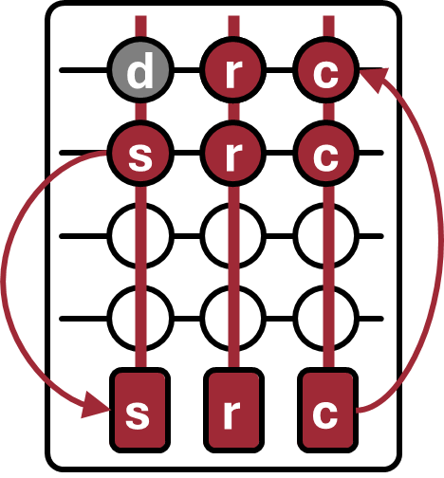
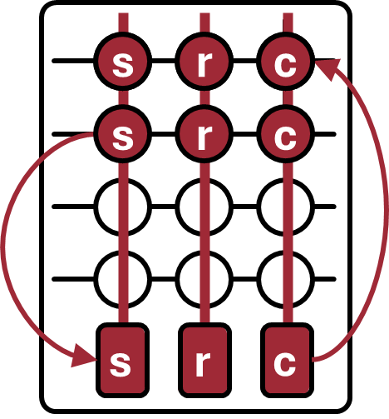
Robustness Metric: Success Rate
Percentage of DRAM cells that produce
correct output of a tested operation in all test trials
Total of 10,000 trials
Success rate for this example: 66.67% (2/3)
Notes:
To evaluate the robustness of in-DRAM operations, we define a metric called success rate
[CLICK] as the percentage of DRAM cells that produce correct output of a tested operation in all test trials. We test total of 10000 trials and record the success rate for each tested cell
[CLICK] Let’s see the success rate in a in-DRAM copy example where we try to copy src to dst.
[CLICK] Assume we have three trials and in the first trial, first cell produce incorrect result. Meaning we couldn’t copy s value to that cell.
[CLICK] As a result, two out of three cells for this source and destination row pair produce correct output in all test trials.
[CLICK]Hence the success rate for this experiment is 66.67%

Slide 108
Outline
Motivation & Background
Goal
Experimental Methodology
Simultaneous Many-Row Activation
MAJX Operation
Multi-RowCopy Operation
Conclusion
Notes:
Now, let’s see how we perform simultaneous many-row activation in off-the-shelf DRAM chips

Slide 109
Key Observation
Activating two rows in quick succession
can simultaneously activate
many rows in a subarray
36ns
14ns
ACT Row A
PRE
ACT Row B
<3ns
<3ns
Subarray X
ACT
Row A
…
ACT
Row B
DRAM Bank
Notes:
Our key observation is activating two rows in quick succession can simultaneously activate many rows in a subarray
[CLICK] You may remember this pictorial example where Row A and Row B is in Subarray X.
[CLICK] When we respect to the timing parameters between ACT and PRE and PRE and ACT
[CLICK] we activate a single row at a time.
[CLICK] However, when we greatly violate these timing parameters, we observe that we can activate many rows at once in the same subarray

Slide 110
Hypothesis: Row Decoder Circuitry
Simultaneous many-row activation is possible
due to the hierarchical DRAM row decoder design
DRAM Subarray
Row Address
Wordline
Row Decoder
Row Address (RA)
2x4
Stage 1
Decoder
Stage 2
Decoder
Stage 3
Decoder
Stage 4
Decoder
Stage 5
Decoder
Notes:
We hypothesize that simultaneous many-row activation is possible due to the hierarchical DRAM row decoder design
[CLICK] Let’s recall a DRAM subarray where we have rows, sense amplifiers and row decoder circuitry
[CLICK] Row decoder circuitry decodes the row address that is sent with activate command and assert the corresponding wordline
[CLICK] As we mentioned, row decoder circuitry is hierarchical and has multiple stages of decoders
[CLICK] Each decoder stage takes some parts of the row address and asserts intermediate signals that are essentially drives the wordline using such intermediate signals

Slide 111
Row Decoder: A Tree Example
We can visualize the hierarchical row decoder circuitry as a tree
Decoder Output
...
...
...
...
...
Wordline A
...
...
...
...
...
...
...
...
Wordline B
...
...
...
2x4
Stage 1
Decoder
Stage 5
Decoder
Notes:
To explain it in a higher abstraction level,
[CLICK] We can visualize the row decoder as a tree which
[CLICK] Each level of the tree represents a decoder stage
[CLICK] each node represents a decoder output

Slide 112
Activating a Single Row
36ns
ACT Row A
PRE
1. Decode
Row A address
...
...
...
...
Wordline A
...
Wordline A
2. Assert
corresponding signals
...
...
...
...
3. Follow
asserted nodes path from root to leaf
...
...
...
...
4. Assert wordline
...
Wordline B
...
...
Notes:
Let’s see an example when we activate a single row
[CLICK] Assume that we issue ACT Row A command, which will essentially assert the Wordline A signal
[CLICK] After issuing the activation command, the row decoder circuitry decodes Row A address
[CLICK] And assert corresponding signals in the tree
[CLICK] After the decoding completed, row decoder follows the asserted nodes path from root to leaf
[CLICK] As a result, it asserts wordline, in this it is Wordline A
[CLICK] After a successful activation we can issue PRE command which deasserts every asserted signals in the row decoder circuitry including the wordline

Slide 113
Activating Many Rows: A Walkthrough
Back-to-back ACT commands with violated timings
asserts many more signals in the row decoder
36ns
14ns
ACT Row A
PRE
ACT Row B
<3ns
<3ns
...
...
...
1. Keep the previously asserted signals active
...
Wordline A
...
Wordline A
...
2. Decode Row B &
assert corresponding signals
...
...
...
...
3. Follow
newly asserted nodes’ path
...
...
...
4. Simultaneously
activate many rows
Wordline B
...
Wordline B
...
...
Notes:
So that was an activation of a single row, now let’s see a simultaneous activation of many rows.
[CLICK] Our hypothesis is back-to-back ACT commands with violated timings asserts many more signals in the circuitry

Slide 114
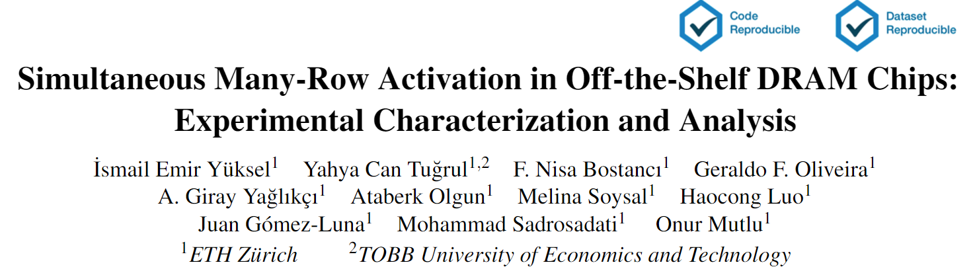
Hypothesis: Row Decoder Circuitry
(More discussions & hypotheses in the paper)
https://arxiv.org/pdf/2405.06081
Notes:
As our time limited, I would like to refer you to our paper for more detailed circuitry and discussions about row decoder circuitry

Slide 115

Characterization Methodology (I)
If rows are activated, WR command overwrites
all of the activated rows’ content
ACT Row A
PRE
ACT Row B
WR
Subarray X
ACT
Row A
…
ACT
Row B
DRAM Bank

Slide 116
Characterization Methodology (II)
Carefully sweep
    Row addresses: Row A and Row B
    Timing parameters: Between ACT → PRE and PRE → ACT
    Temperature (◦C): 50, 60, 70, 80, and 90
    Wordline Voltage (V): 2.5, 2.4, 2.3, 2.2, and 2.1
All rows in Subarray X
Temperature
Wordline Voltage
ACT Row A
PRE
ACT Row B
Subarray X
ACT
Row A
…
ACT
Row B
50 ◦C
90 ◦C
2.5V
2.1V
DRAM Bank
Notes:
As we mentioned previously; we carefully sweep
[CLICK] Row Addresses and timing parameters
[CLICK] Temperature and wordline voltage

Slide 117
Key Takeaways from Simultaneous Many-Row ACT
Key Takeaway 1
COTS DRAM chips are capable of simultaneously activating 2, 4, 8, 16, and 32 rows
Key Takeaway 2
Simultaneous many-row activation is highly resilient to temperature and wordline voltage changes
Notes:
Our analysis provides two key takeaway lessons:
[CLICK] First, off-the-shelf DRAM chips can are capable of simultaneously activating 2, 4, 8, 16, and 32 rows
[CLICK] Second, temperature and wordline voltage has a small effect on the robustness of simultaneous many-row activation

Slide 118
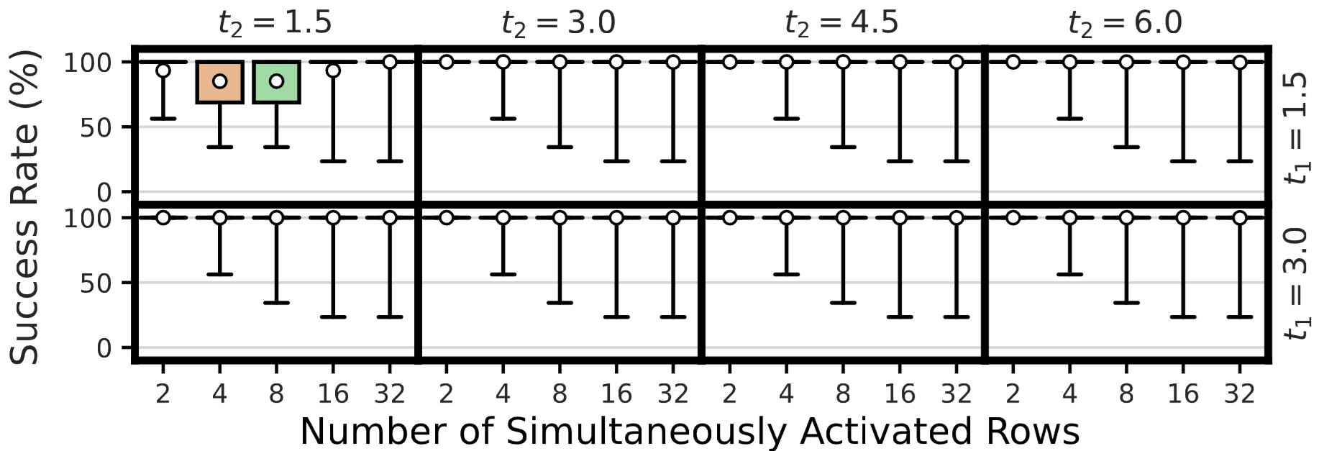
Robustness of Simultaneous Many-Row Activation
Percentage of cells overwritten with WR command
Average: 99.99%
Average: 99.85%
COTS DRAM chips can simultaneously activate
2, 4, 8, 16, and 32 rows in the same subarray
Notes:
Let’s take a look at our first results
[CLICK] Y-axis shows the success rate [CLICK] In the x-axis you see the number of simultaneously activated rows from 2 to 32
[CLICK] This plots shows a distributions across tested DRAM cells as a box-and-whiskers plot.
[CLICK] We observe that up to 16 row activation we can achieve 99.99 percent success rate while in 32 row activation we have 99.85 percent
[CLICK] Our takeaway from this experiment is off-the-shelf DRAM chips can activate 2, 4, 8, 16, and 32 rows in the same subarray

Slide 119
Also in the Paper: Impact of Temperature & Voltage
Temperature
Increasing temperature up to 90◦C
has a small effect on the success rate of simultaneous many-row activation
50 ◦C
90 ◦C
Wordline Voltage
Reducing the wordline voltage
only slightly affects the success rate of simultaneous many-row activation
2.5V
2.1V

Slide 120
Leveraging Simultaneous Many-Row Activation
1
Perform MAJX (where X>3) operations
2
Increase the robustness of MAJX operations
3
Copy one row’s content to multiple rows
Notes:
By leveraging simultaneous many-row activation, we can
[CLICK] Perform majority operations with more than three inputs
[CLICK] We can increase the robustness of majority operations
[CLICK] And we can copy one row’s content to multiple rows

Slide 121
Outline
Motivation & Background
Goal
Experimental Methodology
Simultaneous Many-Row Activation
MAJX Operation
Multi-RowCopy Operation
Conclusion
Notes:
Next, let’s see how we leverage many-row activation to perform majority operations

Slide 122
Leveraging Simultaneous Many-Row Activation
1
Perform MAJX (where X>3) operations
2
Increase the robustness of MAJX operations
3
Copy one row’s content to multiple rows
Notes:
Let’s start with the first one

Slide 123
In-DRAM Majority-of-X (MAJX)
Simultaneously activate many rows to perform MAJX (where X>3) operations
MAJ5(a, b, b, b, a) = b
MAJ7(a, b, b, a, a, b, b) = b
a
a
a
a
a
a
b
b
b
b
b
b
b
b
b
b
b
b
b
b
b
a
a
a
a
a
a
a
a
a
d
s
t
b
b
b
d
s
t
b
b
b
b
b
b
b
b
b
Notes:
Our key idea is to simultaneously activate many rows to perform MAJX operations where X is greater than 3
[CLICK] For example, if we can activate 5 rows at once
[CLICK] we can perform MAJ5 operations
[CLICK] Or if we simultaneously activate seven rows,
[CLICK] we can perform MAJ7

Slide 124
MAJX in Real DRAM Chips
For MAJX, we need to activate X rows simultaneously
We can only simultaneously activate 2, 4, 8, 16, and 32 rows
Question
  How do we perform MAJX while
  simultaneously activating more than X rows?
Answer
  Making some rows neutral during the MAJX operation
  using the Frac operation*
a
a
=
b
b
b
MAJ5
w/ 8-row activation
MAJ5
w/ 5-row activation
b
b
a
b
3x Neutral
Rows
N
a
N
b
N
b
*[Gao+MICRO’22]
Notes:
So, let’s see how we can perform majority operations in real chips
[CLICK] For MAJX, we need to activate X rows simultaneously
[CLICK] However, we can simultaneously activate 2, 4, 8, 16, and 32 rows
[CLICK] The question is straightforward: How do we perform MAJX by simultaneously activating more than X rows? For example MAJ5 with 8-row activation
[CLICK] The answer is we prevent some rows from contributing to charge using the Frac operation, which is demonstrated in the prior work. Basically, these rows will be neutral rows, as if they are not activated
[CLICK] For example, MAJ5 with 5-row activation will be the same as MAJ5 with 8-row activation where three of these rows are neutral rows

Slide 125
Leveraging Simultaneous Many-Row Activation
1
Perform MAJX (where X>3) operations
2
Increase the robustness of MAJX operations
3
Copy one row’s content to multiple rows
Notes:
Now we are done with performing MAJX operations, let’s see how we can increase the robustness of these operations

Slide 126
Improving the Robustness (Input Replication)
Storing multiple copies of MAJX input operands can increase the robustness of MAJX operations
MAJ3(a, b, b) = b
MAJ6(a, b, b, a, b, b) = b
a
a
a
a
a
a
a
a
a
a
a
a
b
b
b
b
b
b
b
b
b
b
b
b
b
b
b
b
b
b
b
b
b
b
b
b
d
s
t
a
a
a
d
s
t
b
b
b
d
s
t
Incorrect
result
b
b
b
Correct
result
d
s
t
d
s
t
b
b
a
b
b
b
Notes:
Our key idea is to store multiple copies of majority operations’ input operands, which we call Input Replication
[CLICK] For example, we can increase the success rate of MAJ3 operation by activating 6 rows and replicating input operands two times

Slide 127
Characterization Methodology
Carefully sweep
    Row addresses: Row A and Row B
    Timing parameters: Between ACT → PRE and PRE → ACT
    Temperature (◦C): 50, 60, 70, 80, and 90
    Wordline Voltage (V): 2.5, 2.4, 2.3, 2.2, and 2.1
All rows in Subarray X
Temperature
Wordline Voltage
ACT Row A
PRE
ACT Row B
Subarray X
ACT
Row A
…
ACT
Row B
50 ◦C
90 ◦C
2.5V
2.1V
DRAM Bank
Notes:
As we mentioned previously; we carefully sweep
[CLICK] Row Addresses and timing parameters
[CLICK] Temperature and wordline voltage

Slide 128
Key Takeaways from MAJX Operation
Key Takeaway 1
COTS DRAM chips are capable of performing
MAJ5, MAJ7, and MAJ9 operations
Key Takeaway 2
Storing multiple copies of MAJX’s input operands
significantly increases the MAJX’s success rate
Key Takeaway 3
Voltage and temperature slightly affect the success rate,
whereas data pattern affects significantly
Notes:
Our analysis provides three key takeaway lessons:
[CLICK] First, off-the-shelf DRAM chips are capable of performing MAJ5, MAJ7, MAJ9 operations
[CLICK] Second, storing multiple copies of MAJX’s input operands significantly increases the MAJX’s success rate
[CLICK] Voltage and temperature slightly affects the success rate whereas data pattern affects significantly

Slide 129
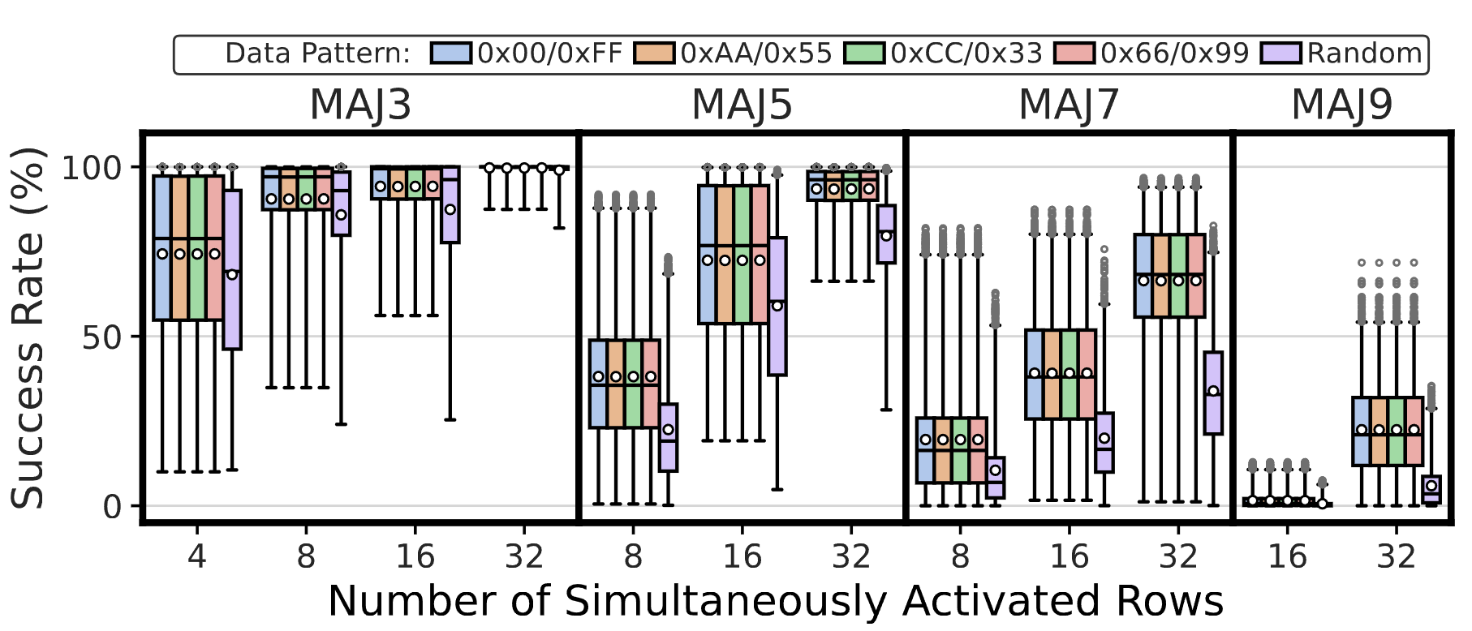
Robustness of MAJX Operations
COTS DRAM chips are capable of performing
MAJ5, MAJ7, and MAJ9 operations
Notes:
Now let me show you the first result the robustness of tested majority operations. In this figure, each subplot shows a different majority operation, from left to right the number of input operand in majority operation increases.
[CLICK] x-axis shows the number simultaneously activated rows
[CLICK] For this analysis, we will first focus on one data pattern: all ones or zeros
[CLICK] Let’s take look at the MAJ3 results where we use boxplot to show the success rate distributions
[CLICK] To simplify things, we focus on one distribution point that achieves highest success rate
[CLICK] From this figure we conclude that off-the-shelf DRAM chips are capable of performing up to nine-input majority operations

Slide 130
Impact of Input Replication
13.11% increase
30.81% increase
56.27% increase
35.15% increase
Similar trend in success rate increase in all tested MAJX operations
Final average success rate MAJ3 (MAJ5): 99.68% (93.49%)
Storing multiple copies of MAJ’s input operands increases
the success rate of MAJ3, MAJ5, MAJ7, and MAJ9 operations
Notes:
Now let’s see how input replication affects the success rate
[CLICK] Again, here, let’s first focus on MAJ3 operation
[CLICK] We observe that when we increase the number of input operand copies in majority-of-three operation, we observe a drastic 30.81% increase in average success rate
[CLICK] And this increasing trend in success rate is consistent across all tested majority operations
[CLICK] Hence, we conclude that storing multiple copies of input operands increases the success rate of MAJ3, 5, 7, and 9 operations

Slide 131
Impact of Data Pattern
11.52% decrease in success rate on average (up to 32.56%) across all tested MAJX operations
Data pattern significantly affects
the success rate of the MAJX operation
Notes:
Here, we see the full results for MAJ3 operations where each colored boxplot represent a different data pattern in every tested data points in x-axis
[CLICK] We observe that when we use random data pattern to perform MAJ3 operation success rate decreases in every number of simultaneously activated rows
[CLICK] And this observation is consistent across all tested majority operations. We observe that on average across all tested majority operations there is a 11.52% decrease in success rate and the maximum decrease is 32.56%
[CLICK] We conclude that data pattern significantly affects the success rate of majority operations

Slide 132
Also in the Paper: Impact of Temperature & Voltage
Temperature
Temperature slightly affects
the success rate of the MAJX operation
50 ◦C
90 ◦C
Wordline Voltage
Wordline voltage has a small effect on
the success rate of the MAJX operation
2.5V
2.1V

Slide 133
Outline
Motivation & Background
Goal
Experimental Methodology
Simultaneous Many-Row Activation
MAJX Operation
Multi-RowCopy Operation
Conclusion
Notes:
Now let’s move to our last but not least in-DRAM operation

Slide 134
Leveraging Simultaneous Many-Row Activation
1
Perform MAJX (where X>3) operations
2
Increase the robustness of MAJX operations
3
Copy one row’s content to multiple rows
Notes:
Next, I will show how we can copy one row’s content to multiple rows

Slide 135
In-DRAM Multiple Row Copy (Multi-RowCopy)
Simultaneously activate many rows to
copy one row’s content to multiple destination rows
RowClone
Multi-RowCopy
s
r
c
d
s
t
s
r
c
d
s
t
s
r
c
s
r
c
s
r
c
d
s
t
d
s
t
d
s
t
s
r
c
s
r
c
s
r
c
[Seshadri+ MICRO’13]
Notes:
[CLICK] Our key idea is since we can activate many rows simultaneously, we can copy one row’s content to other simultaneously activated rows
[CLICK] Let’s recall the RowClone example where we copy source to destination
[CLICK] In RowClone, we first activate the source row which will copy its content to sense amplifiers
[CLICK] And then, we activate destination row to drive the sense amplifier’s content to destination row
[CLICK] In our mechanism, which we call Multi-RowCopy, we have several destination rows
[CLICK] Here we activate many destination rows simultaneously
[CLICK] and thus sense amplifier drives its content to these destination rows.

Slide 136
Characterization Methodology (II)
Carefully sweep
    Row addresses: Row A and Row B
    Timing parameters: Between ACT → PRE and PRE → ACT
    Temperature (◦C): 50, 60, 70, 80, and 90
    Wordline Voltage (V): 2.5, 2.4, 2.3, 2.2, and 2.1
All rows in Subarray X
Temperature
Wordline Voltage
ACT Row A
PRE
ACT Row B
Subarray X
ACT
Row A
…
ACT
Row B
50 ◦C
90 ◦C
2.5V
2.1V
DRAM Bank
Notes:
As we mentioned previously; we carefully sweep
[CLICK] Row Addresses and timing parameters
[CLICK] Temperature and wordline voltage

Slide 137
Key Takeaways from Multi-RowCopy
Key Takeaway 1
COTS DRAM chips are capable of copying one row’s data
to 1, 3, 7, 15, and 31 other rows at very high success rates
Key Takeaway 2
Multi-RowCopy in COTS DRAM chips is highly resilient to changes in data pattern, temperature, and wordline voltage
Notes:
Our analysis provides two key takeaway lessons:
[CLICK] First, off-the-shelf DRAM chips are capable of copying one row’s data to 1, 3, 7, 15, and 31 other rows at very high success rates
[CLICK] Multi-RowCopy in COTS DRAM chips is highly resilient to changes in data pattern, temperature, and wordline voltage

Slide 138
Robustness of Multi-RowCopy
Average: >99.98%
COTS DRAM chips can copy one row’s content
to up to 31 rows with a very high success rate
Notes:
Now let me show you the first result
[CLICK] In this plot, y-axis shows the success rate
[CLICK] x-axis shows the number of destination rows from 1 to 31
[CLICK] And we plot the success rate distribution as a box-and-whiskers plot
[CLICK] We observe that the average success rate is higher than 99.98% across all tested number of destination rows
[CLICK] Hence, we conclude that off-the-shelf DRAM chips can copy one row’s content to up to 31 rows with a very high success rate

Slide 139
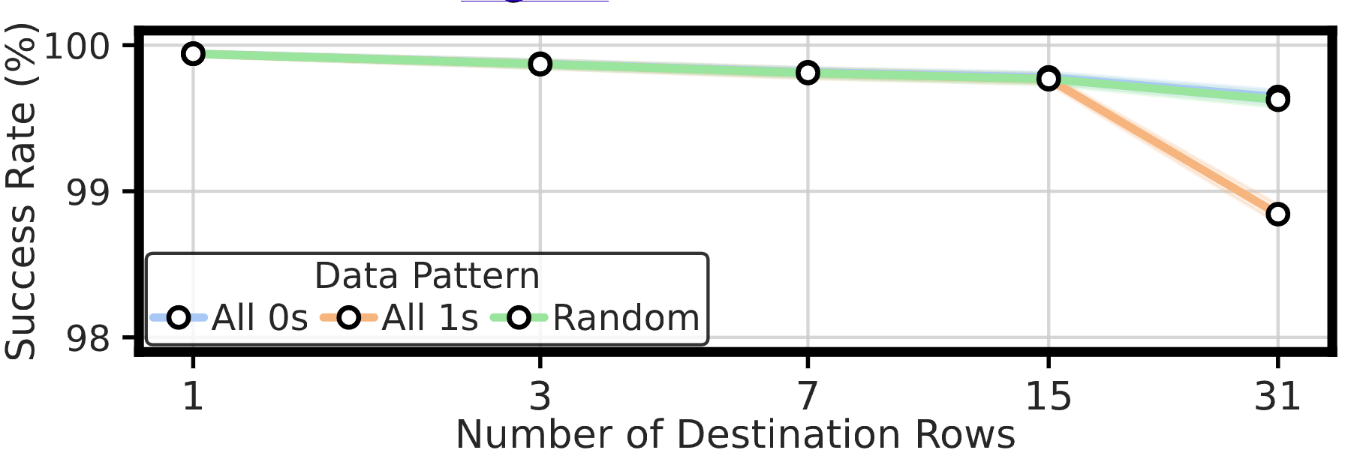
Impact of Data Pattern
At most 0.79% decrease in average success rate
Data pattern has a small effect
on the success rate of the Multi-RowCopy operation
Notes:
Now let’s analyze the impact of data pattern
[CLICK] We plot the average success rate for each number of destination rows and show the trend using a lineplot. Each colered line represent a different data pattern
[CLICK] We observe that data pattern decreases the average success rate at most by 0.79%
[CLICK] We conclude that data pattern has a small effect on the success rate

Slide 140
Also in the Paper: Impact of Temperature & Voltage
Temperature
Increasing temperature up to 90◦C
has a very small effect on
the success rate of the Multi-RowCopy operation
50 ◦C
90 ◦C
Wordline Voltage
Reducing the wordline voltage
only slightly affects
the success rate of the Multi-RowCopy operation
2.5V
2.1V

Slide 141
More in the Paper
Detailed hypotheses and key ideas on
    Hypothetical row decoder circuitry
    Input Replication
More characterization results
    Power consumption of simultaneous many-row activation
    Effect of timing delays between ACT-PRE and PRE-ACT commands
    Effect of temperature and wordline voltage
Circuit-level (SPICE) experiments for input replication
Potential performance benefits of enabling new in-DRAM operations
    Majority-based computation
    Content destruction-based cold-boot attack prevention
Discussions on the limitations of tested COTS DRAM chips
Notes:
We have more content in the paper, including
…

Slide 142
Available on arXiv
https://arxiv.org/pdf/2405.06081
Notes:
The extended version of our study is available on arxiv

Slide 143
Our Work is Open Source and Artifact Evaluated
https://github.com/CMU-SAFARI/SiMRA-DRAM
Notes:
And our work is artifact evaluated and got every badges
[CLICK] You can download our code from github and start testing right away!

Slide 144
Outline
Motivation & Background
Goal
Experimental Methodology
Simultaneous Many-Row Activation
MAJX Operation
Multi-RowCopy Operation
Conclusion
Notes:
Let me conclude my talk

Slide 145
Conclusion
We experimentally demonstrate that COTS DRAM chips can
simultaneously activate up to 32 DRAM rows
perform MAJ3, MAJ5, MAJ7, and MAJ9 operations
copy one row’s content to up to 31 rows
We characterize 120 DDR4 chips and highlight three key results
Storing multiple copies of MAJX’s input operands (i.e., input replication)
drastically increases the success rate of MAJX operations
Voltage and temperature slightly affect the success rate of MAJX operation,
whereas data pattern affects significantly
Multi-RowCopy is highly resilient to changes in data pattern, temperature, and wordline voltage
We believe these empirical results demonstrate
the promising potential of using DRAM as a computation substrate
https://github.com/CMU-SAFARI/SiMRA-DRAM
Notes:
In this study,
[CLICK] We experimentally demonstrate that off-the-shelf DRAM chips can simultaneously activate up to 32 DRAM rows
[CLICK] perform MAJ3, MAJ5, MAJ7, and MAJ9 operations
[CLICK] and copy one row’s content into up to 31 different rows simultaneously
[CLICK] We characterize the success rate of in-DRAM operations on 120 DDR4 chips from two major manufacturers And we highlight three key results
[CLICK] By storing multiple copies of majority’s input operands, we can increase the success rate of majority operations
[CLICK] and operating conditions can significantly affect the robustness of in-DRAM operations
[CLICK] We conclude that these empirical results demonstrate the promising potential of using DRAM as a computation substrate

Slide 146
Simultaneous Many-Row Activation in Off-the-Shelf DRAM Chips
Experimental Characterization and Analysis
Paper
GitHub
İsmail Emir Yüksel
Yahya C. Tuğrul F. Nisa Bostancı Geraldo F. Oliveira
A. Giray Yağlıkçı Ataberk Olgun Melina Soysal Haocong Luo
Juan Gómez–Luna Mohammad Sadr Onur Mutlu
Notes:
Hello, I am Ismail Emir Yuksel.
I will be presenting our work, Simultaneous Many-Row Activation in Off-the-Shelf DRAM Chips

Slide 147
Simultaneous Many-Row Activation in Off-the-Shelf DRAM Chips
Experimental Characterization and Analysis
Backup Slides
İsmail Emir Yüksel
Yahya C. Tuğrul F. Nisa Bostancı Geraldo F. Oliveira
A. Giray Yağlıkçı Ataberk Olgun Melina Soysal Haocong Luo
Juan Gómez–Luna Mohammad Sadr Onur Mutlu
Notes:
Hello, I am Ismail Emir Yuksel.
I will be presenting our work, Simultaneous Many-Row Activation in Off-the-Shelf DRAM Chips

Slide 148
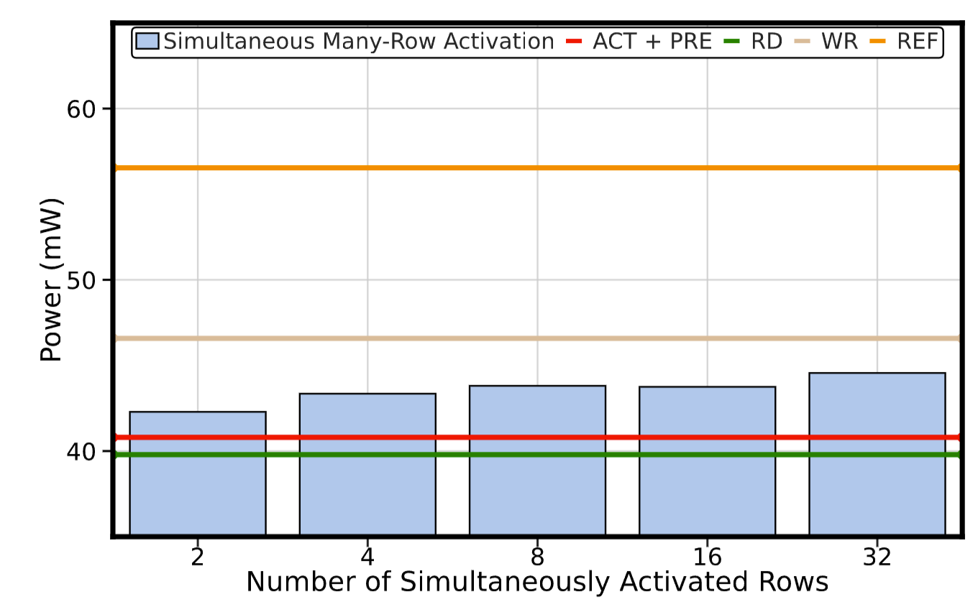
Power Consumption of Many-Row ACT
32-row activation consumes 21.19% less power than
the most power-consuming single DRAM operation (i.e., REF)
Simultaneous many-row activation power draw
likely meets the power budget of DDR4 chips

Slide 149
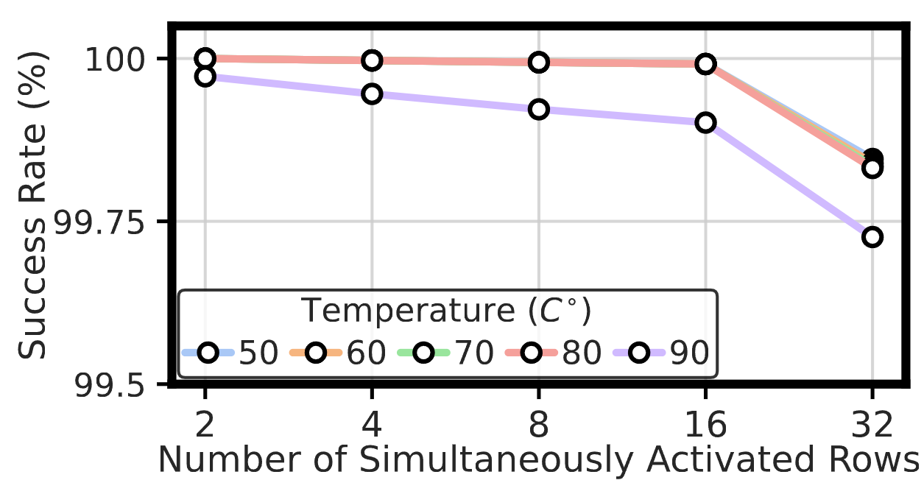
Impact of Temperature in Many-Row ACT
Max. decrease: 0.16%
Increasing temperature up to 90◦C
has a small effect on the success rate
Notes:
Next, we analyze the impact of temperature, again y-axis shows the success rate and x-axis shows the number of simultaneously activated rows
[CLICK] We plot the average success rate for each temperature as lineplot
[CLICK] Colors indicate different temperature levels
[CLICK] We observe that the maximum decrease in average success rate is 0.16% in 32-row activation
[CLICK] We conclude that increasing temperature up to 90C has a small effect on the success rate

Slide 150
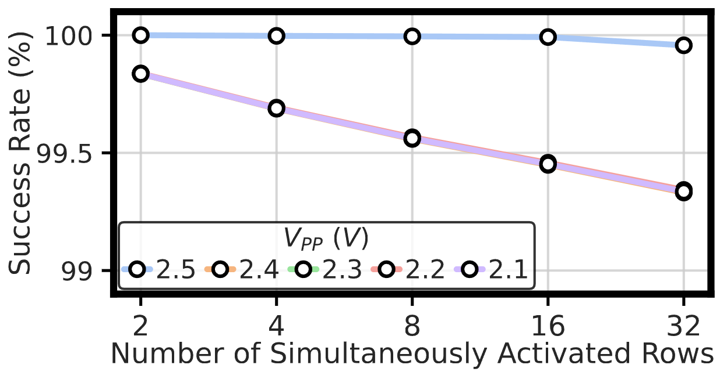
Impact of Voltage in Many-Row ACT
Max. decrease: 0.64%
Reducing the wordline voltage
only slightly affects the success rate
Notes:
Lastly, let’s see how voltage scaling affects the success rate.
[CLICK] Again we plot the average success rate as a lineplot
[CLICK] And each color indicate different voltage level
[CLICK] We observe that when we reduce the voltage from 2.5V to 2.1V average success rate decreases by 0.64% at most, which is in 32-row activation
[CLICK] We conclude that reducing the wordline voltage only slightly affects the success rate

Slide 151
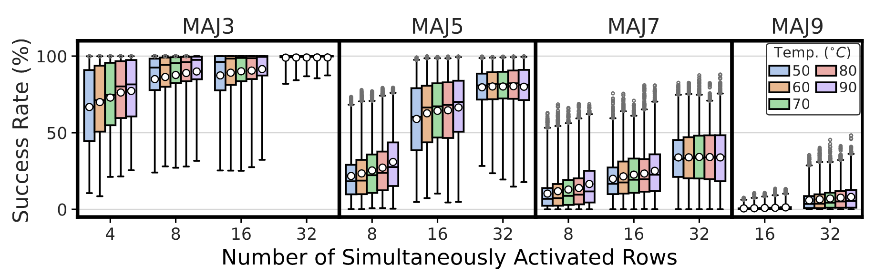
Impact of Temperature in MAJX
15.20% increase
from 50 ◦C to 90 ◦C , the success rate varies by 4.25% on average across all the tested operations
Temperature slightly affects
the success rate of the MAJX operation
Notes:
Next, let’s see the effect of temperature
[CLICK] In this plot each coloered box represents a different temperature level and temperature increases from left to right
[CLICK] In some cases, we observe a significant increase in success rate when we increase the temperature from 50C to 90C
[CLICK] On average, the success varies by 4.25% across all tested majority operations when we increase the temperature from 50 to 90
[CLICK] We conclude that temperature slightly affects the success rate of majority operations

Slide 152
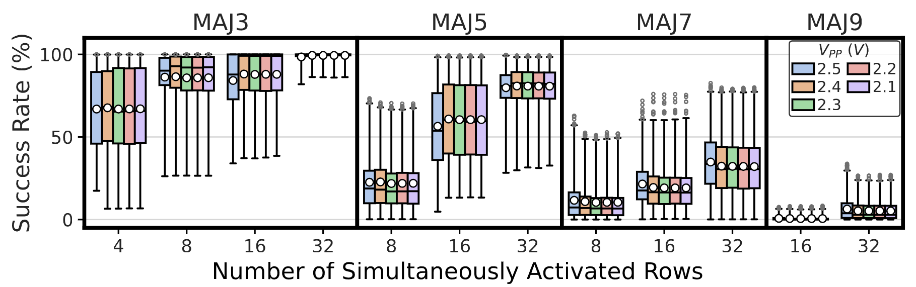
Impact of Voltage in MAJX Operations
Wordline voltage slightly affects
the success rate of the MAJX operation

Slide 153
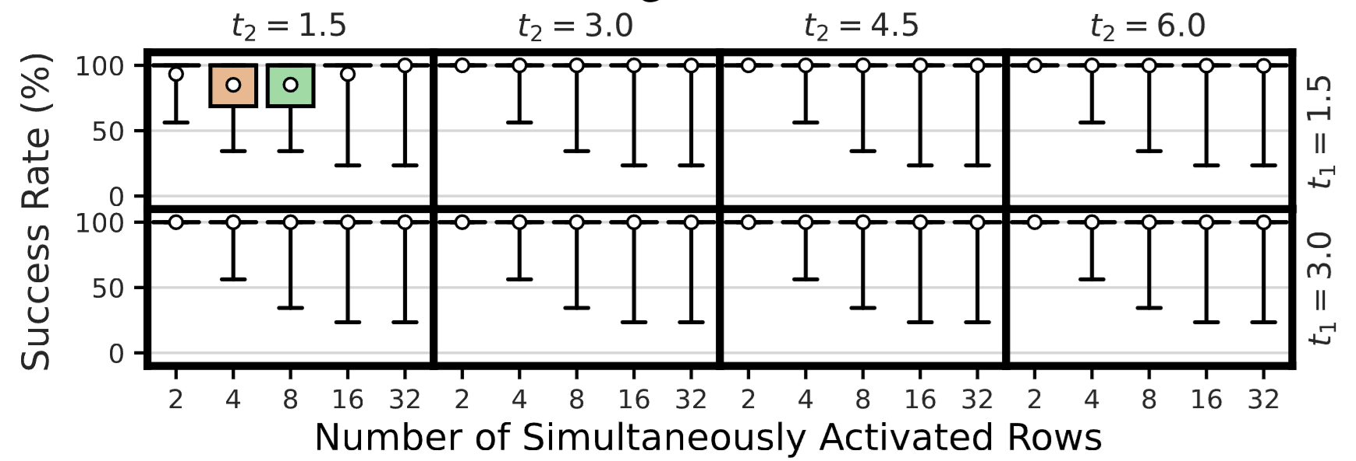
Impact of Timing Delays in Many-Row ACT

Slide 154
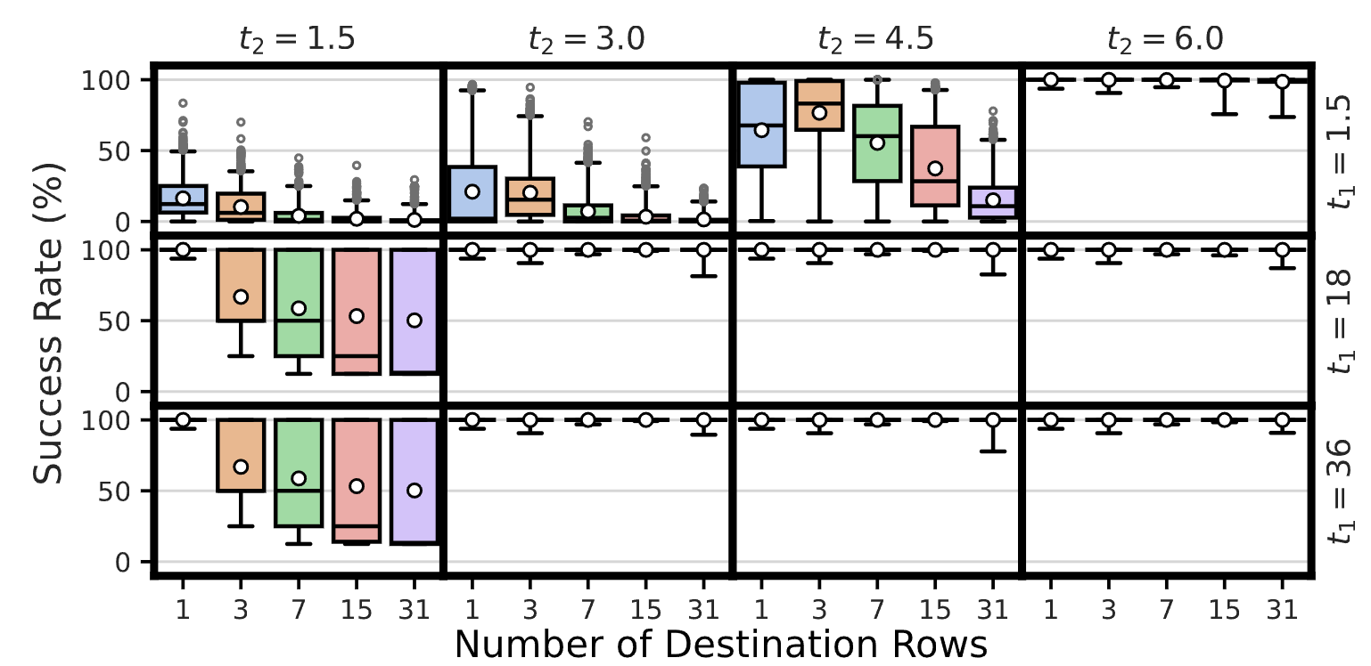
Impact of Timing Delays in MAJX

Slide 155
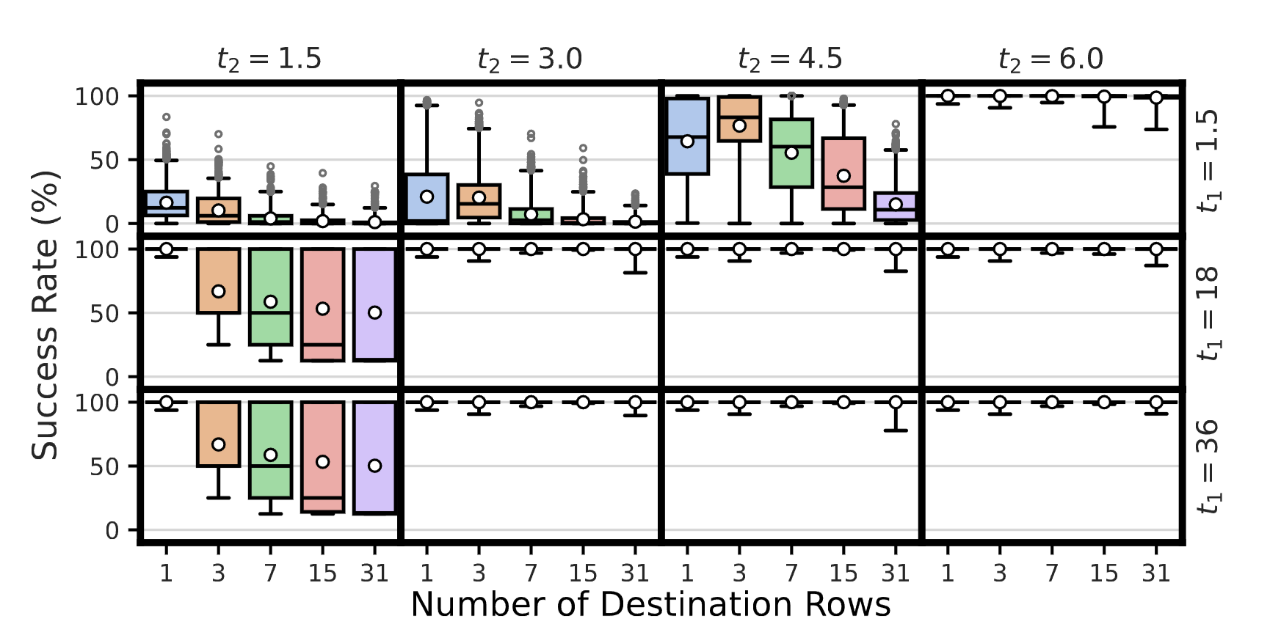
Impact of Timing Delays in Multi-RowCopy

Slide 156
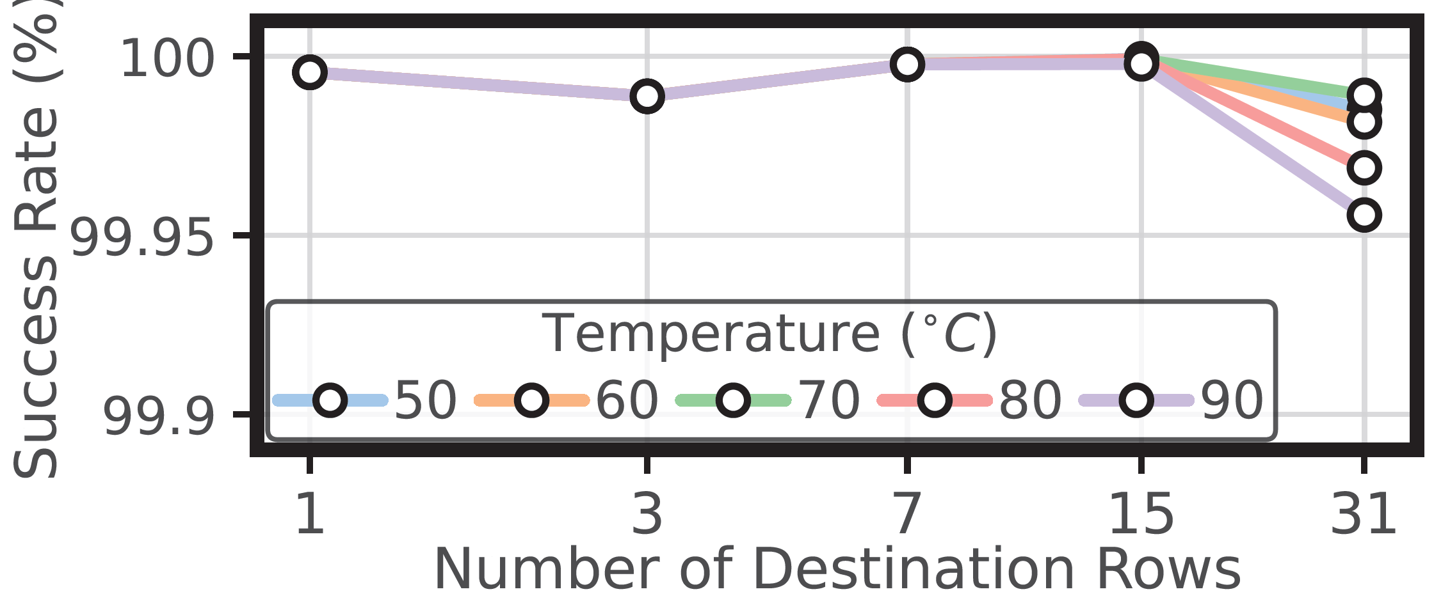
Impact of Temperature in Multi-RowCopy
Only 0.04% decrease in average success rate
Increasing temperature up to 90◦C
has a very small effect on the success rate
Notes:
Lastly, let’s see how temperature affects the success rate of the Multi-RowCopy operation
[CLICK] Here again we plot the average success rate as a lineplot and each colored line represent a different temperature level
[CLICK] We observe that there is only 0.04% percent decrease in average success rate when we increase the temperature to 90C
[CLICK] We conclude that increasing temperature up to 90C has a very small effect on the success rate

Slide 157
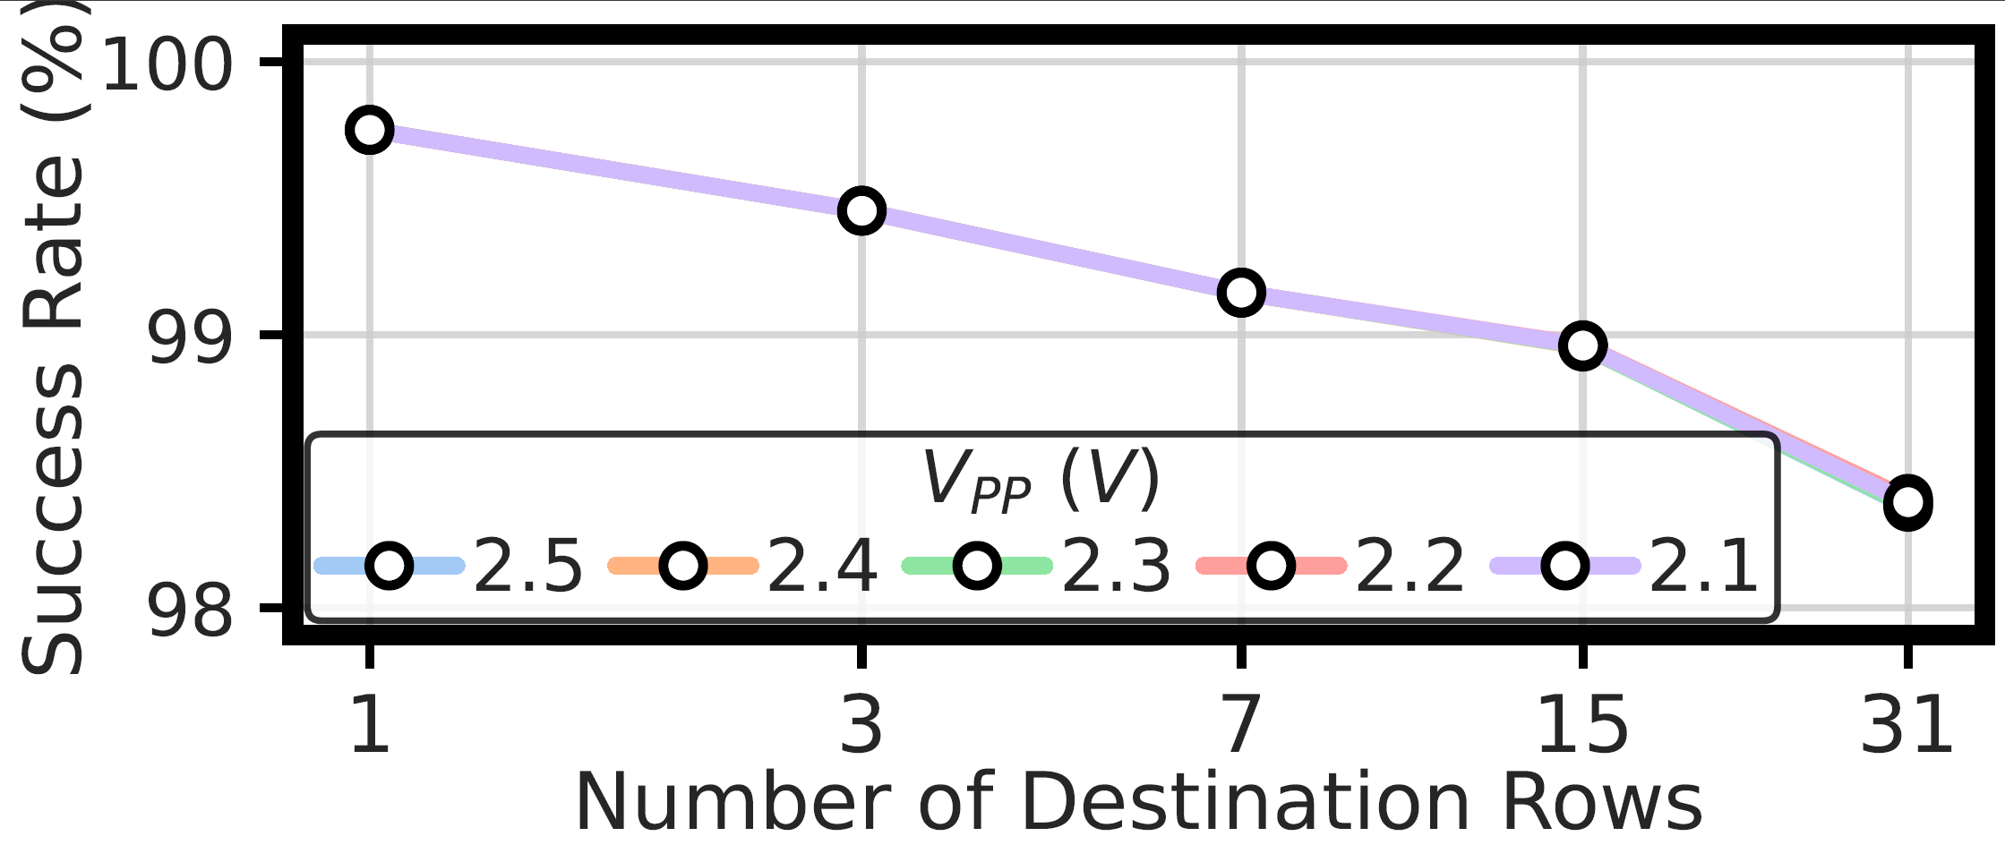
Impact of Voltage in Multi-RowCopy
Reducing the wordline voltage
only slightly affects the success rate

Slide 158
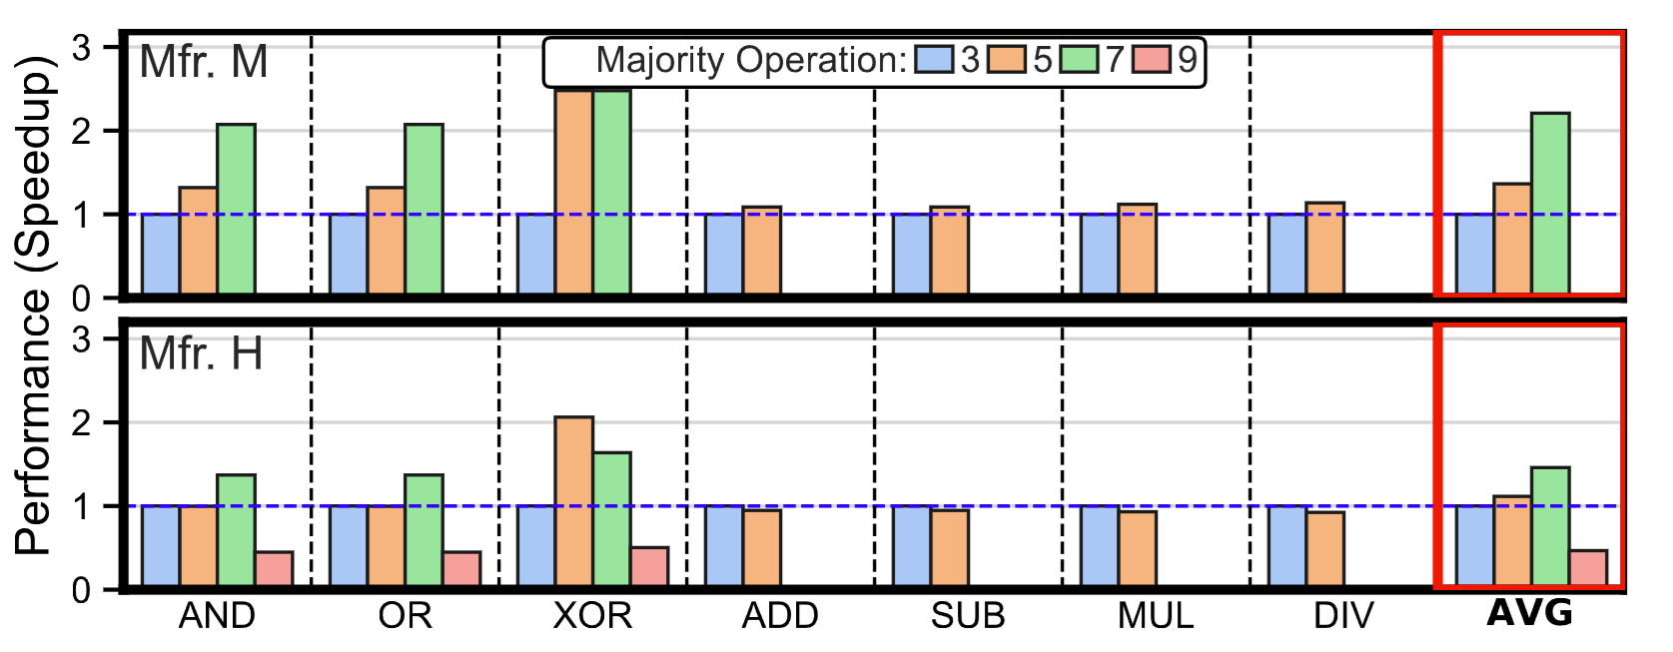
Majority-based Computation
New MAJX operations provide
121.61% (46.54%) higher performance
over using only MAJ3 in Mfr. M (Mfr. H) on average.

Slide 159
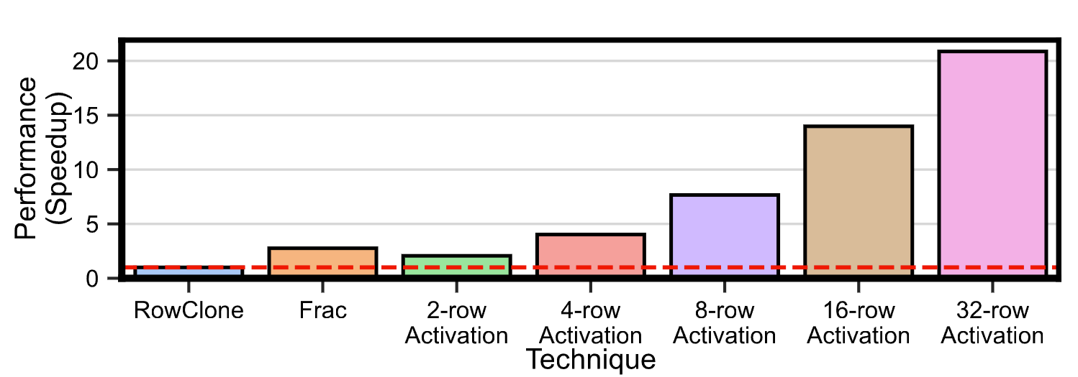
Cold Boot Attack Prevention
Multi-RowCopy-based content destruction outperforms both RowClone-based and Frac-based content destruction by up to 20.87× and 7.55×, respectively.

Slide 160
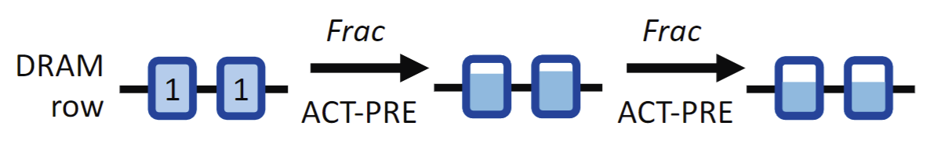
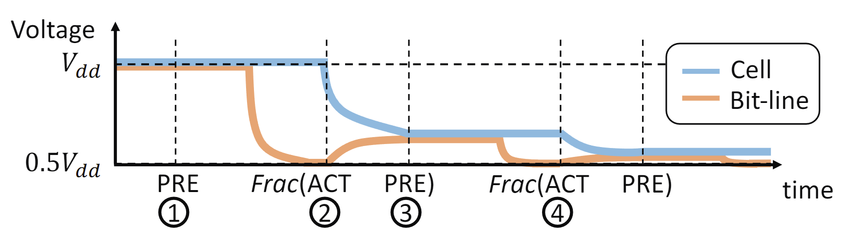
Frac Operation

Slide 161
Input Replication in Real Chips
MAJ3(a, b, c) = F
MAJ6(a, b, c, a, b, c) = F
V_{PRE}
V_{PRE}+ Δ_{a} + Δ_{b} + Δ_{c}
V_{PRE} + 2x(Δ_{a} + Δ_{b} + Δ_{c})
V_{PRE}
a
a
b
Low perturbation
b
2x higher perturbation
c
c
a
N
b
X
c
Neutral
Rows
N
Correct
Result
Incorrect
Result
N
F
Notes:
Let’s see how we can perform input replication in real DRAM chips at a lower abstraction-level
[CLICK] Assume we want to perform MAJ3(a,b,c) operation and the correct output for this operation is F
[CLICK] Without any replication, we would use 4-row activation map the inputs into three cells and make the remaining row neutral. Initially the bitlines that these four rows are connected to has precharge voltage value
[CLICK] To perform MAJ3 we activate these four rows simultaneously
[CLICK] Then they perturb the bitline
[CLICK] However, these perturbation is sometimes lower than the safe margin that sense amplifier operates due to connecting multiple cells to the bitline concurrently. As a result, sense amplifier cannot correctly amplify the perturbation and produce incorrect result
[CLICK] Now let’s see what happens when we use input replication
[CLICK] For this example, we will perform MAJ3 operation with 8-row activation where we replicate each input two times and make the remaining two rows neutral
[CLICK] To perform this operation we activate these eight rows simultaneously
[CLICK] Then they perturb the bitline, note that since we have two copies from each we have 2x higher perturbation
[CLICK] As a result of the higher perturbation, sense amplifier amplifies the perturbation safely and produce correct result

Slide 162
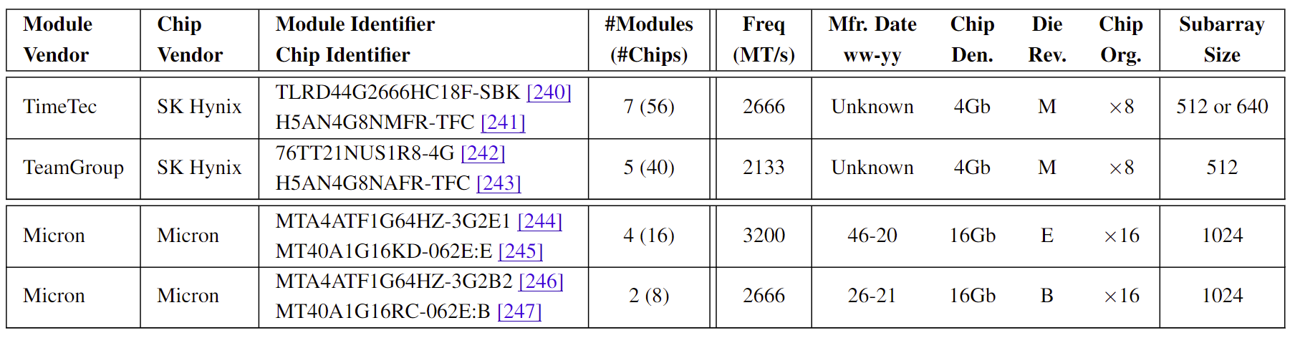
DRAM Chips Tested: Extended Table

Slide 163
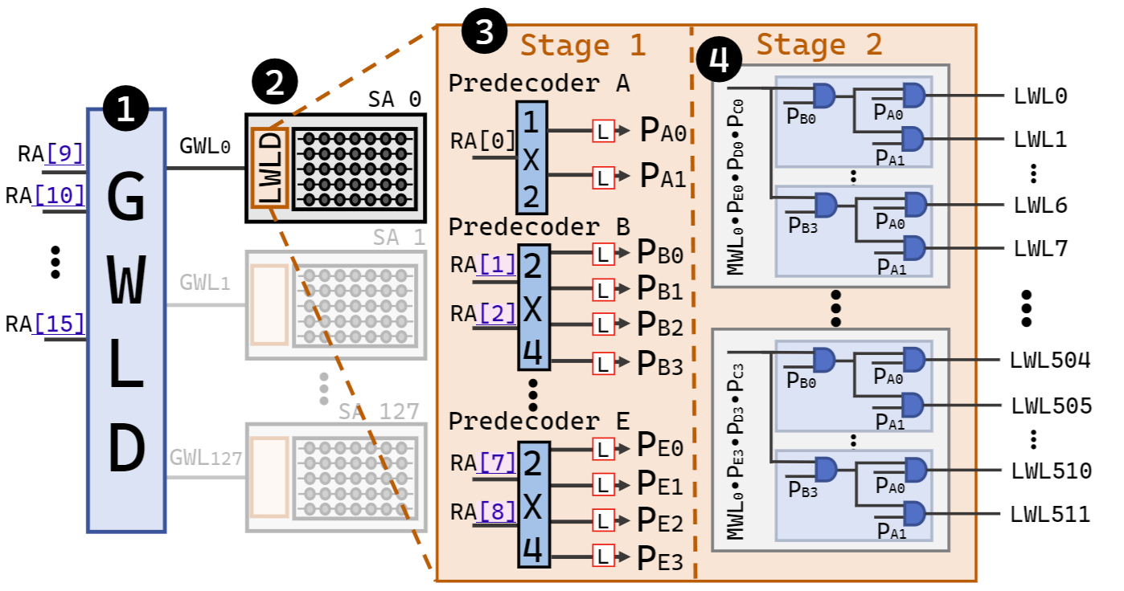
Row Decoder Circuitry

Slide 164
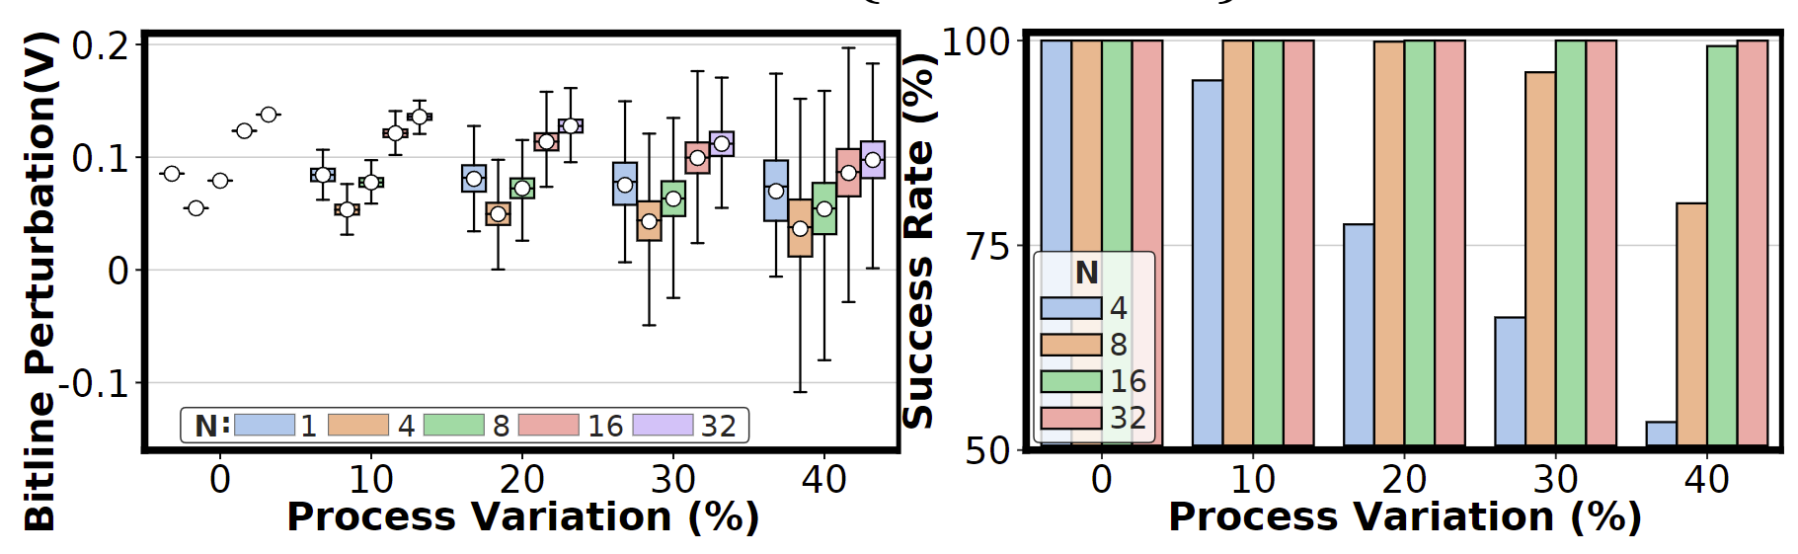
Effect of Input Replication on the Bitline Deviation

Slide 165
Limitations of Tested COTS DRAM Chips (I)
Some COTS DRAM chips do not support all in-DRAM operations
    We do not observe simultaneous many-row activation
    in tested 64 Samsung chips
    Hypothesis
      Internal DRAM circuitry ignores the PRE command or
      the second ACT command when the timing parameters are greatly violated
    If such a limitation were not imposed, we believe these DRAM chips are also fundamentally capable of performing the operations
    we examine in this work

Slide 166
Limitations of Tested COTS DRAM Chips (II)
Tested COTS DRAM chips support only
consecutive two row activation and
simultaneous activation of 2, 4, 8, 16, and 32 rows
    Hypothesis
      This is due to our current infrastructure limitations,
      where we can issue DRAM commands at intervals of only 1.5ns.
      Having fine-grained control on timing would allow us to deassert/assert desired intermediate signals
      in the row decoder circuitry

Slide 167
Limitations of Tested COTS DRAM Chips (III)
Performing in-DRAM operations potentially have an effect
on transient errors in DRAM chips
    We perform each test (a single data point in the distribution)
    10K times
    We do not observe any errors in rows
    outside of the simultaneously activated row group
    We believe that investigating all potential effects
    (e.g., on transient errors) requires a much more extensive exploration of various aspects

Slide 168
Open Research Questions
1
Is it possible to robustly activate
more than four DRAM rows simultaneously?
2
What other PUD operations can be realized
in COTS DRAM chips?
3
How robustly can PUD operations be performed
in COTS DRAM chips?
4
Can the robustness of PUD operations be improved?
5
What are the effects of operating conditions
on the robustness of PUD operations?

Slide 169
DRAM Cell Operation
wordline
bitline
capacitor
1. ACTIVATE (ACT)
access transistor
2. PRECHARGE (PRE)
Sense Amp
enable
NOT Gate
bitline
169
Notes:
Here we take a closer look into DRAM cell.
A DRAM cell consists of two main components: capacitor and access transistor.
Capacitor holds the data as a form of electrical charge.
Access transistor connects cell to the subarray through wordline and bitline.
As we discussed, bitline is connected to the sense amplifier which consists of two back-to-back NOT gates.
In this study, we focus on two major DRAM commands: ACT and PRE, let’s see how they work.

Slide 170
DRAM Cell Operation - ACTIVATE
deviation in bitline voltage
wordline
1
raise wordline
0
V_{DD}
½ V_{DD}
+ δ
bitline
capacitor
access transistor
connects cell to bitline
cell loses
charge to bitline
cell regains charge
enable
1
0
enable sense amp
bitline
½ V_{DD}
0
170
Notes:
First, ACT

Slide 171
DRAM Cell Operation - PRECHARGE
wordline
1
Precharge bitline
for next access
0
lower wordline
V_{DD}
½ V_{DD}
bitline
capacitor
access transistor
enable
1
0
Disable
Sense Amp
bitline
½ V_{DD}
0
171
Notes:
PRE

