Slide 1


PIM Architectures for Bioinformatics
Dr. Konstantina Koliogeorgi
kkoliogeorgi@ethz.ch
https://people.inf.ethz.ch/
ICS 2025
08 June 2025
Notes:
Hello
My name is Konstantina and I ll cover the next part of the workshop covering pim arch for bioin

Slide 2

Brief Self Introduction
Konstantina Koliogeorgi
  Senior Researcher and Lecturer @ SAFARI
  PhD, National Technical University of Athens, 2023
  kkoliogeorgi@safari.ethz.ch
Research & Teaching Areas
  Hardware/Software Co-Design
  Heterogeneous System Architecture
  Reconfigurable Computing and Architectures
  Hardware Acceleration
  Optimized Architectures for Genome analysis
  High Level Synthesis Tools
  Design Space Exploration
Notes:
Some brief introd for myself

Slide 3
Agenda
Brief Introduction to Genomics
Data Movement Bottlenecks during analysis
Designing algorithms and architectures that tackle data movement overhead
  Target Multiple Steps of Pipeline
  Leverage Processing-In-Memory
  Leverage In-Storage Processing
Notes:
First a brief intro to genomics and the bottleneck causes by data mov bottl
That motivates the need for design….
We will cover accelerated solution that target …

Slide 4


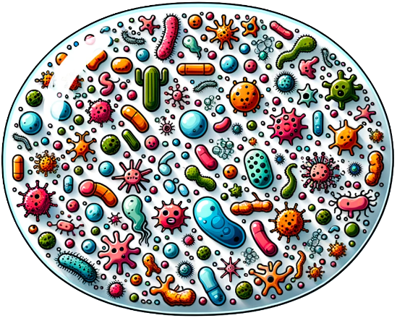

Faster, Scalable & Accurate Genome Analysis
Uncovering and treating diseases
linked to genomic variations
Altering genomes to solve
fundamental challenges of life
Detecting pathogens
in the environment
Rapid surveillance of
disease outbreaks
And, many, many other applications …
Notes:
There is a variety of applications in genome analysis whose importance highlight the need for making faster scalable and accurate….

Slide 5
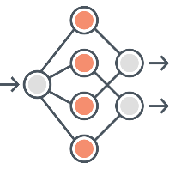




Typical Genome Sequence Analysis
Sequencing
Basecalling
Filtering
Read Mapping
reference
ACGT
mapping pos.
DNA
Raw signals
reads
Sequencing extract small fragments of the original DNA sequence
Basecalling
  convert raw signals to DNA bases
  Deep Neural Networks
Read mapping
  aligns reads to potential matching locations in the reference genome
Notes:
Vertical?

Slide 6
Significant barrier
to genome analyses

Slide 7







Data Movement Dominates Performance
Data movement dominates performance and
is a major system energy bottleneck (accounting for 40%-62%)
Data Movement
Sequencing
Machine
Storage (SSD/HDD)
Main Memory
Microprocessor
Single memory request consumes >160$×$ - 800$×$ more energy compared to performing an addition operation
⁻ Boroumand et al., “Google Workloads for Consumer Devices: Mitigating Data Movement Bottlenecks,” ASPLOS 2018
⁻ Kestor et al., “Quantifying the Energy Cost of Data Movement in Scientific Applications,” IISWC 2013
⁻ Pandiyan and Wu, “Quantifying the energy cost of data movement for emerging smart phone workloads on mobile platforms,” IISWC 2014
Notes:
Today, data movement dominates the performance because large chunks of data need to be stored in storage systems and
[CLICK]
moved between the CPU and main memory for genome analysis.
The CPU accesses off-chip main memory through a pin-limited bus known as the memory channel,
[CLICK]
and a high amount of data movement across the memory channel is extremely costly in terms of both execution time and energy.

Slide 8
Data analysis
is performed
far away from the data

Slide 9
We need to orchestrate
algorithms and architectures
to handle data well
Notes:
However,

Slide 10
Genomic Analysis Steps in Memory
We need to design algorithms
that fit processing-in-memory

Slide 11
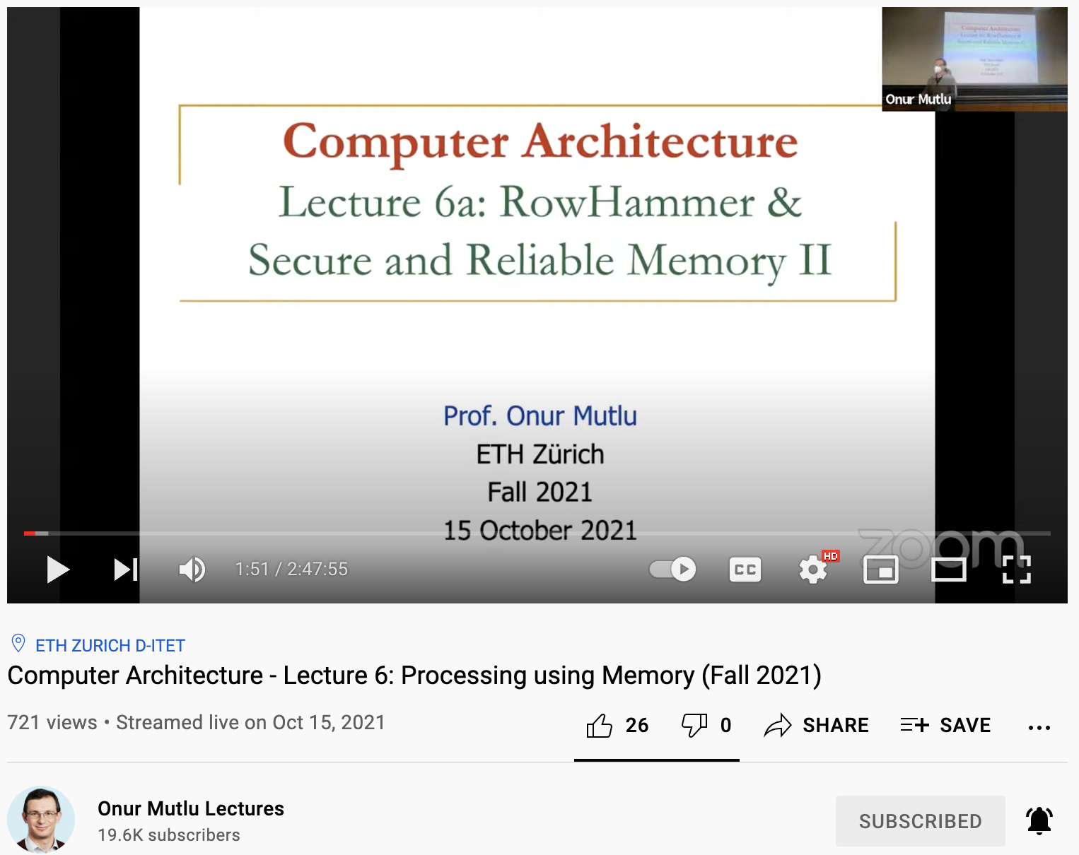
Processing Using Memory
https://www.youtube.com/watch?v=HNd4skQrt6I
Notes:
Powerful approach is use..

Slide 12
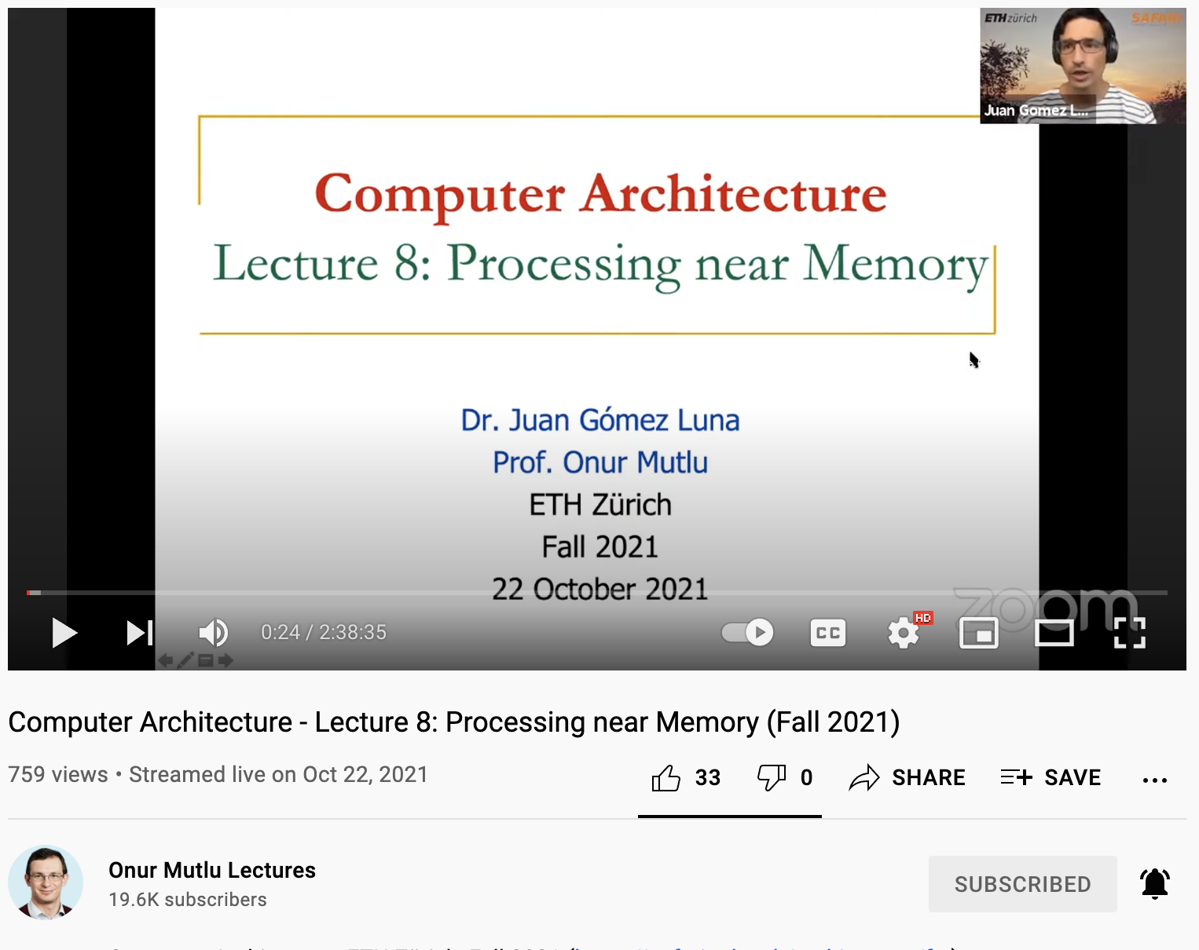
Processing Near Memory
https://www.youtube.com/watch?v=kpgLmX9sdcI

Slide 13
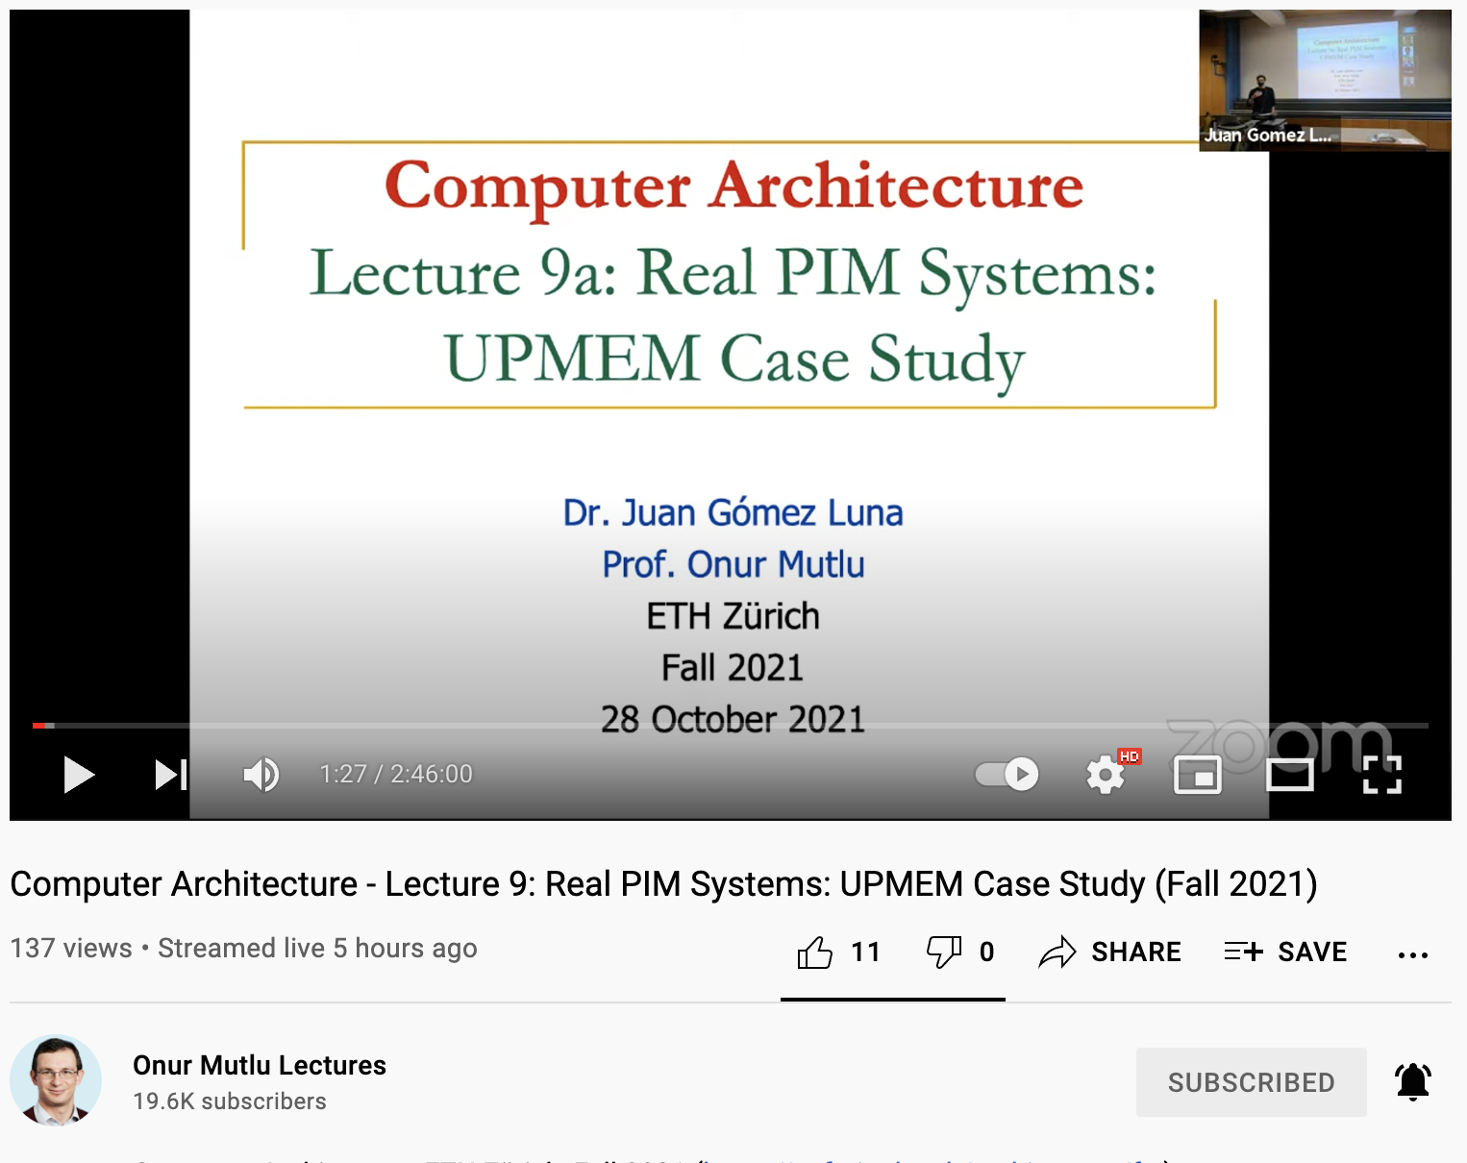
Using Real PIM System
https://www.youtube.com/watch?v=TuVw_SKaTCo

Slide 14
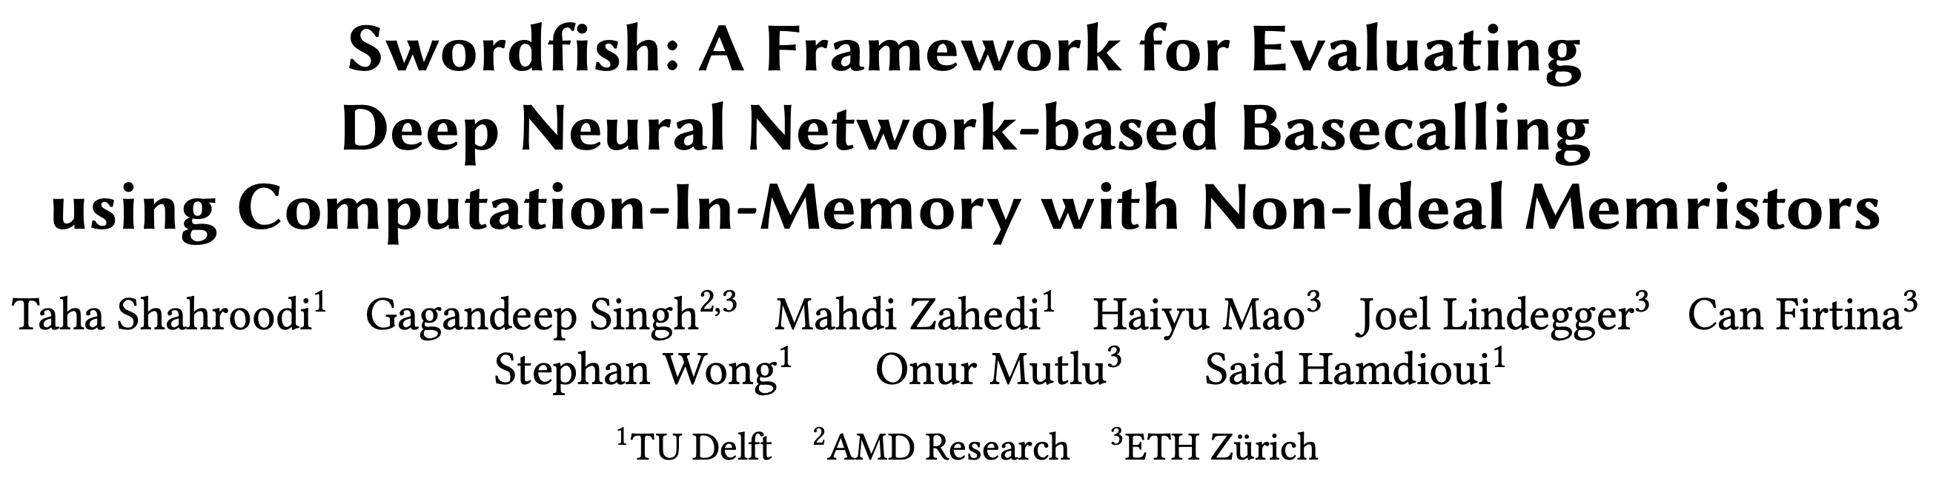
Raw Signal Translation using PIM [MICRO '23]
Taha Shahroodi, Gagandeep Singh, Mahdi Zahedi, Haiyu Mao, Joel Lindegger,
Can Firtina, Stephan Wong, Onur Mutlu, and Said Hamdioui,
"Swordfish: A Framework for Evaluating Deep Neural Network-based Basecalling using Computation-In-Memory with Non-Ideal Memristors"
Proceedings of the 56th International Symposium on Microarchitecture (MICRO), Toronto, ON, Canada, November 2023.
[Slides (pptx) (pdf)]
[arXiv version]
Notes:
promising results, for using pim to accelerate basecalling.
Specifically,Swordfish paper presents
Memristor-based CIM for DNN Acceleration of basecalling

Slide 15
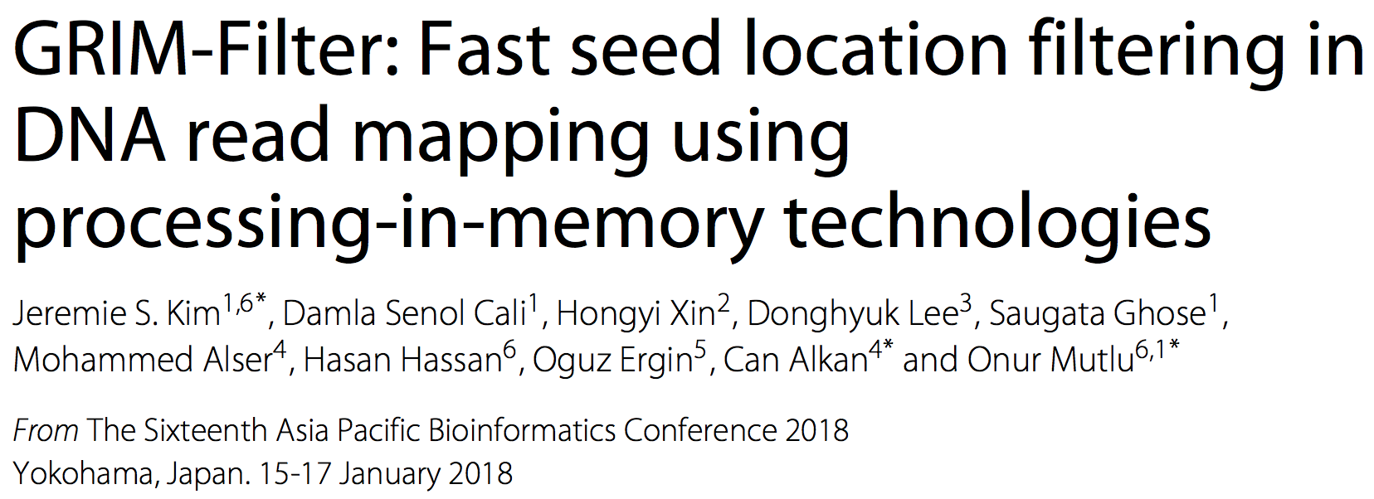
Using PIM for filtering
Jeremie S. Kim, Damla Senol Cali, Hongyi Xin, Donghyuk Lee, Saugata Ghose, Mohammed Alser, Hasan Hassan, Oguz Ergin, Can Alkan, and Onur Mutlu,
"GRIM-Filter: Fast Seed Location Filtering in DNA Read Mapping Using Processing-in-Memory Technologies"
BMC Genomics, 2018.
Proceedings of the 16th Asia Pacific Bioinformatics Conference (APBC), Yokohama, Japan, January 2018.
arxiv.org Version (pdf)

Slide 16
GRIM-Filter in 3D-Stacked DRAM
Highly Parallel mechanism
Memory Bound: Given the frequent accesses to memory, we find that GRIM-Filter is memory bound
These properties together make GRIM-Filter a good algorithm to be run in 3D-Stacked DRAM
Details are in [Kim+, BMC Genomics 2018]
Notes:
This works has both algorithmic and architectural contribution
Presents a (1) ..that is however memory bound due to
o Introduce parallelism to q-gram string matching
o Utilize a 3D-stacked DRAM to alleviates the memory bandwidth issue of our algorithm and parallelizes most of the filter.
Recent technology that tightly couples memory and logic vertically with very high bandwidth connectors

Slide 17
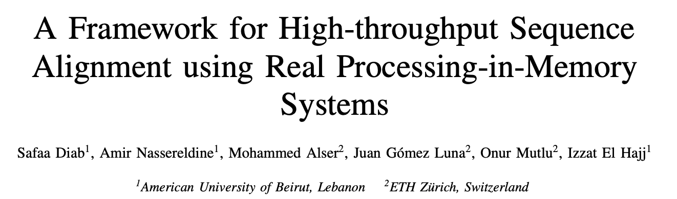
AIM (PIM Sequence Alignment Framework)
Safaa Diab, Amir Nassereldine, Mohammed Alser, Juan Gómez-Luna,
Onur Mutlu, Izzat El Hajj
“A Framework for High-throughput Sequence Alignment using Real Processing-in-Memory Systems“
arXiv, 2022
[Source code]
Notes:
Alignment part in mapping
AIM presents PIM sequence alignment framework
UPMEM is the first publicly-available programmable PIM system in the market
evaluate the suitability of real PIM systems for accelerating sequence alignment algorithms
NW, SWG, GenASM, WFA, and WFA-adaptive
a real processing-in-memory system can substantially outperform server-grade multi-threaded CPU systems running at full-scale when performing sequence alignment for a variety of algorithms, read lengths, and edit distance thresholds. W

Slide 18
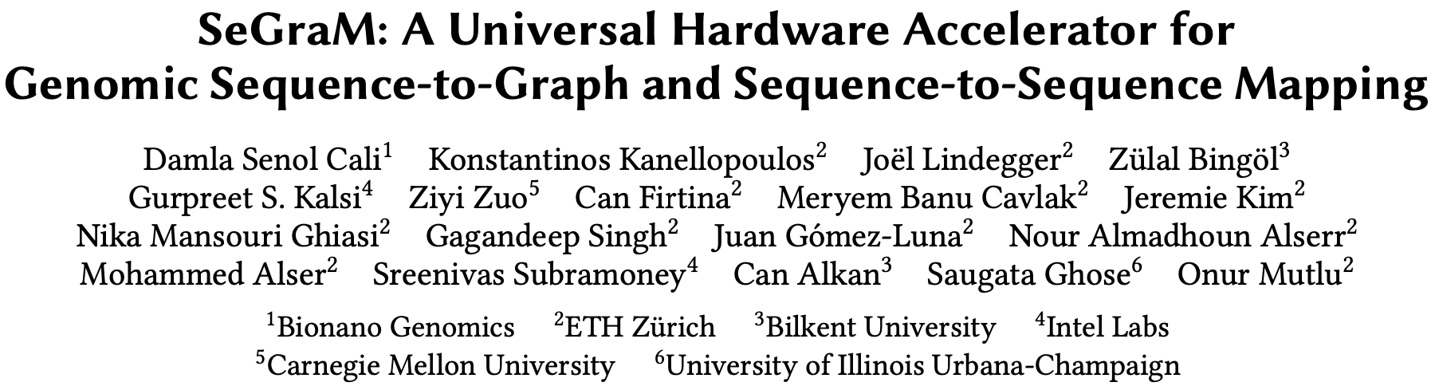
Accelerating Sequence-to-Graph Mapping
Damla Senol Cali, Konstantinos Kanellopoulos, Joel Lindegger, Zulal Bingol, Gurpreet S. Kalsi, Ziyi Zuo, Can Firtina, Meryem Banu Cavlak, Jeremie Kim, Nika MansouriGhiasi, Gagandeep Singh, Juan Gomez-Luna, Nour Almadhoun Alserr, Mohammed Alser, Sreenivas Subramoney, Can Alkan, Saugata Ghose, and Onur Mutlu,
"SeGraM: A Universal Hardware Accelerator for Genomic Sequence-to-Graph and Sequence-to-Sequence Mapping"
Proceedings of the 49th International Symposium on Computer Architecture (ISCA), New York, June 2022.
[arXiv version]
https://arxiv.org/pdf/2205.05883.pdf

Slide 19
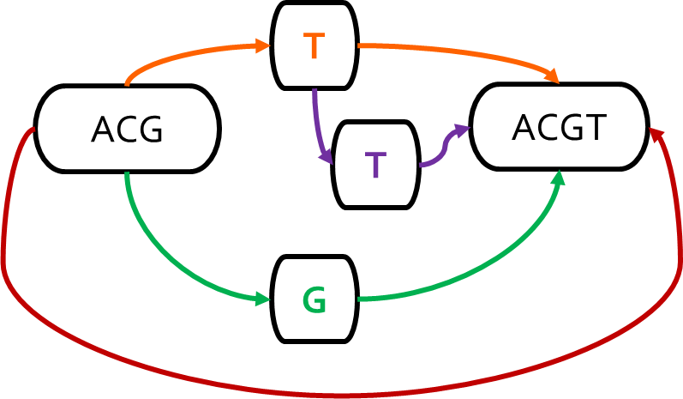
Genome Sequence Analysis
Mapping the reads to a reference genome (i.e., read mapping) is a
critical step in genome sequence analysis
Sequence-to-Sequence (S2S) Mapping
Sequence-to-Graph (S2G) Mapping
Linear Reference: ACGTACGT
Read: ACGG
Alternative Sequence: ACGGACGT
Alternative Sequence: ACGTTACGT
Alternative Sequence: ACG‒ACGT
Graph-based Reference:
Read: ACGG
Sequence-to-graph mapping results in notable quality improvements.
However, it is a more difficult computational problem,
with no prior hardware design.
Notes:
Read mapping, which is the process of mapping the reads to a reference genome is a critical step in genome sequence analysis
Traditionally, we perform seq2seq mapping, where we
Map reads collected from an individual to a known linear reference genome sequence
Emphasizes the genetic variations that are present in the single reference genome
Ignores other variations that are not represented in the single linear reference sequence
Introduces reference bias
However, s2s mapping is a well studied problem with many available tools and accelerators
Recent works replace the linear reference sequence with a graph-based representation of the reference genome (genome graph). Thus, we can perform seq2graph mapping.
Captures the genetic variations and diversity across many individuals in a population
[CLICK] Results in notable quality improvements in GSA

Slide 20
Analysis of State-of-the-Art Tools
Based on our analysis with GraphAligner and vg:
Observation 1: Alignment step is the bottleneck
Observation 2: Alignment suffers from high cache miss rates
Observation 3: Seeding suffers from the DRAM latency bottleneck
Observation 4: Baseline tools scale sublinearly
SW
HW
Observation 5: Existing S2S mapping accelerators are unsuitable
for the S2G mapping problem
Observation 6: Existing graph accelerators are unable to handle
S2G alignment
Notes:
In order to further understand the performance bottlenecks of the state-of-the-art sequence-to-graph mapping tools, we rigorously analyze two such tools, GraphAligner [61] and vg [36], and we make four key observations.
[CLICK] (1) Among the three online steps of the read mapping pipeline alignment i) constitutes majority of the end-to-end execution of sequence-to-graph mapping, and ii) is even more expensive than its counterpart in the traditional read mapping pipeline.
[CLICK] (2) Alignment suffers from high cache miss rates, due to the high amount of internal data that is generated and reused during this step.
[CLICK} (3) Seeding suffers from the main memory (DRAM) latency bottleneck, due to the high number of irregular memory accesses.
[CLICK] (4) Both state-of-the-art tools scale sublinearly as thread count increases, wasting available thread-level parallelism in hardware.
[CLICK] We also investigate the existing HW accelerators. It is important to note that there is no existing hardware accelerator for sequence-to-graph mapping or alignment problems.
[CLICK] Even though there are several hardware accelerators designed to alleviate bottlenecks in several steps of traditional sequence-to-sequence (S2S) mapping, none of these
designs can be directly employed for the sequence-to-graph (S2G) mapping problem. This is because S2S mapping is a special case of S2G mapping, where all nodes have only one incoming edge. Existing accelerators are limited to only this special case, and are unsuitable for the more general S2G mapping problem, where we also need to consider multiple edges (i.e., hops) that a node can have.
[CLICK] We also look at the possibility of exploiting existing several graph accelerators. While existing graph accelerators could potentially be customized to help the seeding step of the sequence-to-graph mapping pipeline, they are unable to handle the major bottleneck of sequence-to-graph mapping, which is alignment. Alignment is not a graph traversal workload, and instead is an expensive bitvector-based or DP-based computational problem.
Thus, we need to have a specialized, balanced, and scalable design for compute units, on-chip memory, and main memory accesses for both the seeding and alignment steps of sequence-to-graph mapping.

Slide 21
SeGraM: First Graph Mapping Accelerator
Our Goal:
Specialized, high-performance, scalable, and low-cost algorithm/hardware co-design that alleviates bottlenecks in multiple steps of sequence-to-graph mapping
SeGraM: First universal algorithm/hardware co-designed genomic mapping accelerator that can effectively and efficiently support:
Sequence-to-graph mapping
Sequence-to-sequence mapping
Both short and long reads
Notes:
[CLICK] Thus, our goal is to come up with a specialized, high-performance, scalable, and low-cost algorithm/hardware co-design that alleviates bottlenecks in both the seeding and alignment steps of sequence-to-graph mapping.
[CLICK] To this end, we propose SeGraM, a universal algorithm/hardware co-designed genomic mapping accelerator that can effectively and efficiently support both sequence-to-graph mapping and sequence-to-sequence mapping, for both short and long reads. To our knowledge, SeGraM is the first algorithm/hardware co-design for accelerating
sequence-to-graph mapping.

Slide 22

Overall System Design of SeGraM
  High-Bandwidth Memory (HBM): Enables low-latency and highly-parallel memory access
High Bandwidth Memory (HBM2E) Stack
High Bandwidth Memory (HBM2E) Stack
. . .
CH1
. . .
CH0
CH2
CH6
CH7
SeGraM Module (1 x per HBM2E stack)
Host
SeGraM Module (1 x per HBM2E stack)
Host
MS
MS
MS
MS
MS
X
4
. . .
BA
BA
BA
BA
BA
SeGraM
Acc.
SeGraM
Acc.
SeGraM
Acc.
SeGraM
Acc.
SeGraM
Acc.
Notes:
[CLICK] SeGraM is connected to a host system that is responsible for the pre-processing steps and for transferring the query read to the accelerator.
[CLICK] Next to each HBM2E channel, we place one SeGraM accelerator, such that it will have exclusive access without any interference from other SeGraM accelerators.
[CLICK] Each SeGraM accelerator is a combination of one MinSeed accelerator and one BitAlign accelerator.
[CLICK] Each HBM2E stack has eight memory channels, thus connected to 8 SeGraM accelerators, which define one SeGraM module.
[CLICK] Our hardware platform includes four off-chip HBM2E stacks, thus 4 SeGraM modules, thus 32 SeGraM accelerators in total. ====================================================================================================================
Each SeGraM accelerator has exclusive access to one HBM2E channel to ensure low-latency memory access, without any interference from other SeGraM accelerators in each module.
There is no communication required between different SeGraM accelerators in a single SeGraM module, and each SeGraM accelerator communicates with the host independently of other SeGraM accelerators.
[CLICK] We replicate the graph-based reference and hash-table-based index across all 4 independent HBM2E stacks, which enables us to have 32 independent SeGraM accelerators running in parallel.
[CLICK] Within each stack, to balance the memory footprint across all channels, we distribute the graph and index structures of all chromosomes (1–22, X, Y) based on their sizes across the eight independent channels
[CLICK] We design each SeGraM accelerator (MinSeed + BitAlign) to operate in a pipelined fashion and we employ double buffering technique for all MS scratchpads, such that we can hide the latency of the MinSeed accelerator.

Slide 23
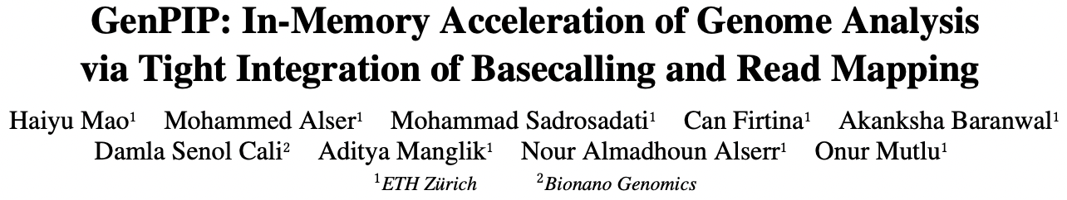
Accelerating Basecalling + Read Mapping via PIM
Haiyu Mao, Mohammed Alser, Mohammad Sadrosadati, Can Firtina, Akanksha Baranwal, Damla Senol Cali, Aditya Manglik, Nour Almadhoun Alserr, and Onur Mutlu,
"GenPIP: In-Memory Acceleration of Genome Analysis via Tight Integration of Basecalling and Read Mapping"
Proceedings of the 55th International Symposium on Microarchitecture (MICRO), Chicago, IL, USA, October 2022.
[Slides (pptx) (pdf)]
[Longer Lecture Slides (pptx) (pdf)]
[Lecture Video (25 minutes)]
[arXiv version]
https://arxiv.org/pdf/2209.08600.pdf

Slide 24

Overview: Two Limitations
Multiple steps in genome analysis
Large data movement between multiple steps
A lot of
wasted computation done on data that is later discovered to be useless
Notes:
[CLICK] There are multiple steps in the genome analysis
[CLICK] We observe there is large data movement between these steps
[CLICK] and a lot of wasted computation done on the data that later discovered to be useless

Slide 25
Limitation 1: Large Data Movement
Using a human dataset in [NC’19] as an example:
Raw Signals
Basecalling
Reads
Read quality
control
High-quality
reads
Read
mapping
Mapped
reads
3913 GB
546 GB
437 GB
382 GB
Large data movement between genome analysis steps
[NC'19] Rory Bowden, Robert W Davies, Andreas Heger, Alistair T Pagnamenta, Mariateresa de Cesare, Laura E Oikkonen, Duncan Parkes, Colin Freeman, Fatima Dhalla, Smita Y Patel, et al. Sequencing of human genomes with nanopore technology. Nature Communications, 2019.
Notes:
The genome analysis pipeline has two main limitations
The first one is large data movement
We use a human dataset as an example
We move the raw signals to the basecalling
Then store the reads
And move the reads to the machine that executes read quality control
Then move the high quality reads to machines executes read mapping
In the end, only mapped reads are reviewed by bio analysts.
We conclude that there is large data movement between these steps

Slide 26
Limitation 2: Wasted Computation
Using a human dataset in [NC’19] as an example:
100%
79.5%
69.5%
Raw Signals
Basecalling
Reads
Read quality
control
High-quality
reads
Read
mapping
Mapped
reads
Low-quality
reads
Unmapped
reads
20.5%
10%
A considerable amount of computation on useless data due to
Low-quality reads
Unmapped reads
[NC'19] Rory Bowden, Robert W Davies, Andreas Heger, Alistair T Pagnamenta, Mariateresa de Cesare, Laura E Oikkonen, Duncan Parkes, Colin Freeman, Fatima Dhalla, Smita Y Patel, et al. Sequencing of human genomes with nanopore technology. Nature Communications, 2019.
Notes:
Second, 100% of reads are basecalled but 20.5% low-quality reads are filtered
And 10% of unmapped reads are discarded.
We conclude that there is a considerable amount of computation on useless data due to low quality reads and unmapped reads

Slide 27
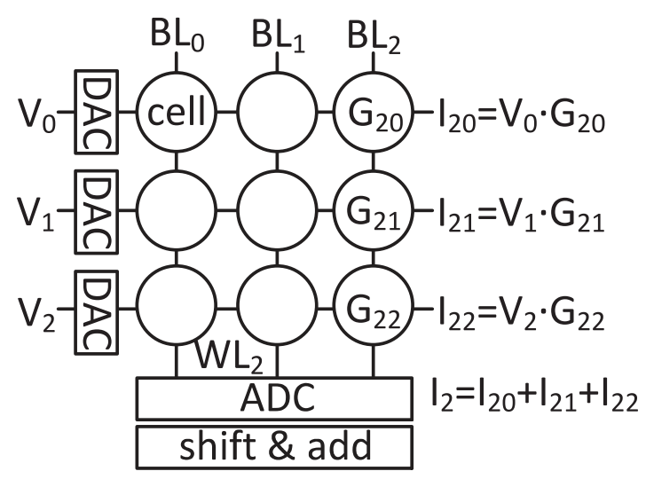
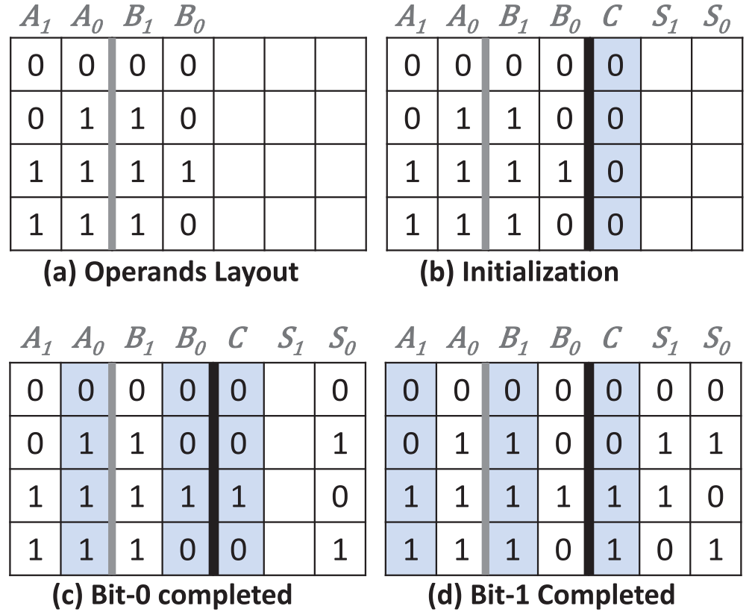
State-of-the-art Works
NVM-based PIM is an efficient technique to reduce data movement by processing data using or near memory
  Reduce the data movement in a single genome analysis step
  Exacerbate the data movement overhead between analysis steps
Raw Signals
Basecalling
Reads
Read quality
control
High-quality
reads
Read
mapping
Mapped
reads
NVM-based PIM for dot-product operation [Helix, PACT’20]
NVM-based PIM for search and addition
[PARC, ASPDAC’20]
No prior work tackles data movement between analysis steps and reduces useless computation
Notes:
Previous works accelerate either basecalling or read mapping using processing in memory
A prior work uses NVM-based PIM for dot-product calculation to accelerate basecalling since dot-product is the main operation in basecalling
A prior work uses NVM-based CAM for search and addition operation to accelerate read mapping since these two operations are the dominant operations in read mapping
These PIM accelerators reduce the data movement in a single step
But exacerbate the data movement overhead between analysis steps
And there is no prior work tackles data movement problem between the steps and reduce useless computation

Slide 28
Goal and Opportunities
Goal: Efficiently accelerate the entire genome analysis pipeline while minimizing data movement and useless computation
We perform a study to quantify potential performance benefits
  Results are normalized to the performance of GPU
NVM-based PIM accelerators for separate basecalling and read mapping
no data movement
between the accelerators of analysis steps
no data movement
and
no useless reads
(ideal case)
Notes:
Our goal in this work is to efficiently accelerate the entire genome analysis pipeline while minimizing data movement and useless computation
To quantify potential benefits of overcoming the two limitations, we compare performance of the three systems and results are normalized to the performance of GPU
First, Basecalling and read mapping are executed in two in-memory accelerators separately, which achieves 2.7 times speedup
Assume there is no data movement, which achieves 6.1 times speedup
Assume there is no data movement and no useless reads in the pipeline. Which achieves 9 times speedup

Slide 29
Overview: GenPIP
GenPIP: A fast and energy-efficient in-memory acceleration system for the Genome analysis PIPeline via tight integration of genome analysis steps
GenPIP has two key techniques
  Chunk-based pipeline (CP)
    Provides fine-grained collaboration of genome analysis steps
  Early rejection (ER)
    Timely stops the execution on useless data by predicting which reads will not be useful
GenPIP outperforms state-of-the-art software & hardware solutions using CPU, GPU, and optimistic PIM by 41.6×, 8.4x, and 1.4x, respectively.
Notes:
To overcome these two limitations, we propose GenPIP
[CLICK] GenPIP is A fast and energy-efficient in-memory acceleration system for the Genome analysis PIPeline via tight integration of genome analysis steps
[CLICK] GenPIP has two key techniques
A chunk-based pipeline that provides fine-grained collaboration of genome analysis steps
An early-rejection technique predicts which reads will not be useful and then stops the execution of basecalling and read mapping for such reads
[CLICK] GenPIP outperforms state-of-the-art software & hardware solutions.

Slide 30
Key Results – Performance
1.4x
8.4x
41.6x
GenPIP provides 41.6x, 8.4x, and 1.4x speedup over CPU, GPU, and optimistic PIM
Both CP and ER are critical to the speedup
Notes:
Here are the results of performance.
On average, GenPIP provides 41.6x over CPU, 8.4x over GPU, and 1.4x speedup over optimistic PIM, , which is an ideal integration
More evaluation details in the paper show both CP and ER are critical to the speedup

Slide 31
Key Results – Energy Efficiency
1.37x
20.8x
32.8x
GenPIP provides 32.8x, 20.8x, and 1.37x energy savings
over CPU, GPU, and optimistic PIM
ER is especially critical to the energy efficiency
Notes:
Here are the energy reduction results
On average, GenPIP provides 32.8, 20.8, and 1.37x energy savings compared to CPU, GPU, and optimistic PIM, which is an ideal integration
We also find that reducing data movement and useless data contribute a lot to the energy reduction

Slide 32
Accelerating Basecalling + Read Mapping via PIM
Haiyu Mao, Mohammed Alser, Mohammad Sadrosadati, Can Firtina, Akanksha Baranwal, Damla Senol Cali, Aditya Manglik, Nour Almadhoun Alserr, and Onur Mutlu,
"GenPIP: In-Memory Acceleration of Genome Analysis via Tight Integration of Basecalling and Read Mapping"
Proceedings of the 55th International Symposium on Microarchitecture (MICRO), Chicago, IL, USA, October 2022.
[Slides (pptx) (pdf)]
[Longer Lecture Slides (pptx) (pdf)]
[Lecture Video (25 minutes)]
[arXiv version]
https://arxiv.org/pdf/2209.08600.pdf

Slide 33
Can we process data closer to where it is stored?

Slide 34
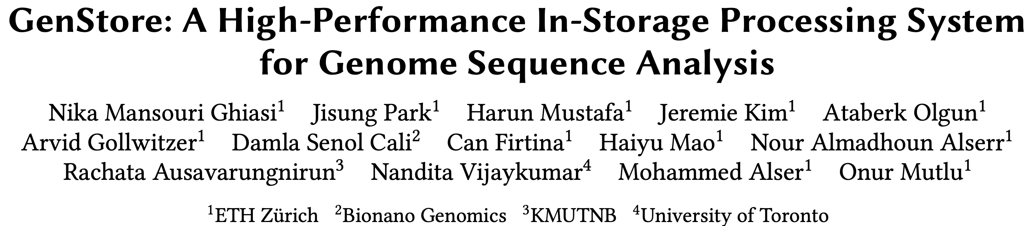
In-Storage Genome Filtering [ASPLOS 2022]
Nika Mansouri Ghiasi, Jisung Park, Harun Mustafa, Jeremie Kim, Ataberk Olgun, Arvid Gollwitzer, Damla Senol Cali, Can Firtina, Haiyu Mao, Nour Almadhoun Alserr, Rachata Ausavarungnirun, Nandita Vijaykumar, Mohammed Alser, and Onur Mutlu,
"GenStore: A High-Performance and Energy-Efficient In-Storage Computing System for Genome Sequence Analysis"
Proceedings of the 27th International Conference on Architectural Support for Programming Languages and Operating Systems (ASPLOS), Virtual, February-March 2022.
[Lightning Talk Slides (pptx) (pdf)]
[Lightning Talk Video (90 seconds)]

Slide 35

Genome Sequence Analysis
Data Movement from Storage
Alignment
Storage
System
Main
Memory
Cache
Computation
Unit
(CPU or Accelerator)
AAGCTTCCATGG
CGTTCCTTGGCA
GGGCCAGAATG
CCTTTGGGTCCA
AAAATTCCATGG
GAATGGGGCCA
TTTTTTCCAAAA
TCCCCGGGGCCA
GCTTCCAGAATG
Computation overhead
Data movement overhead
Notes:
Read mapping performs alignment on large genomic datasets, containing millions of reads. [CLICK]
Therefore, read mapping is both computationally expensive [CLICK]
And incurs high data movement overhead [CLICK]

Slide 36


Accelerating Genome Sequence Analysis
Heuristics
Accelerators
Filters
Storage
System
Main
Memory
Cache
Computation
Unit
(CPU or Accelerator)
AAGCTTCCATGG
CGTTCCTTGGCA
GGGCCAGAATG
CCTTTGGGTCCA
AAAATTCCATGG
GAATGGGGCCA
TTTTTTCCAAAA
TCCCCGGGGCCA
GCTTCCAGAATG
✓
Computation overhead
Data movement overhead
Notes:
There has been significant effort into improving read mapping performance [CLICK]
Through efficient heuristics [CLICK]
hardware accelerators [CLICK]
and various filters that prune reads that do not require expensive computation [CLICK].
While these approaches address the computation overhead in read mapping [CLICK]
[While Reads Move] None of them alleviate the data movement overhead from storage, whose impact becomes even larger when the computation overhead gets alleviated [CLICK]

Slide 37

Key Idea
Filter reads that do not require alignment
inside the storage system
Storage
System
Main
Memory
Cache
Computation
Unit
(CPU or Accelerator)
AAGCTTCCATGG
CGTTCCTTGGCA
GGGCCAGAATG
CCTTTGGGTCCA
AAAATTCCATGG
GAATGGGGCCA
TTTTTTCCAAAA
TCCCCGGGGCCA
GCTTCCAGAATG
Filtered Reads
Exactly-matching reads
Do not need expensive approximate string matching during alignment
Non-matching reads
Do not have potential matching locations and can skip alignment
Notes:
Our key idea is to filter reads that do not require the expensive alignment computation in the storage system [CLICK] …
[While Reads Move] To fundamentally reduce the data movement overhead of read mapping
Examples of the reads that not require the costlt alignment step
Exactly-matching reads to the reference genome that do not need approximate string matching performed during alignment
Non-matching reads that have no potential matching locations in the reference genome hence skip the alignemt step

Slide 38
GenStore
Filter reads that do not require alignment
inside the storage system
GenStore-Enabled
Storage
System
Main
Memory
Cache
Computation
Unit
(CPU or Accelerator)
✓
Computation overhead
✓
Data movement overhead
  GenStore provides significant speedup (1.4x - 33.6x) and
  energy reduction (3.9x – 29.2x) at low cost
Notes:
We propose GenStore, the first in-storage processing system designed for genome sequence analysis. [CLICK]
To reduce both the computation [CLICK]
And the data movement overhead [CLICK]
GenStore provides high-performance and energy benefits compared to state-of-the-art HW and SW baselines [CLICK]

Slide 39
In-Storage Genome Filtering [ASPLOS 2022]
Nika Mansouri Ghiasi, Jisung Park, Harun Mustafa, Jeremie Kim, Ataberk Olgun, Arvid Gollwitzer, Damla Senol Cali, Can Firtina, Haiyu Mao, Nour Almadhoun Alserr, Rachata Ausavarungnirun, Nandita Vijaykumar, Mohammed Alser, and Onur Mutlu,
"GenStore: A High-Performance and Energy-Efficient In-Storage Computing System for Genome Sequence Analysis"
Proceedings of the 27th International Conference on Architectural Support for Programming Languages and Operating Systems (ASPLOS), Virtual, February-March 2022.
[Lightning Talk Slides (pptx) (pdf)]
[Lightning Talk Video (90 seconds)]

Slide 40
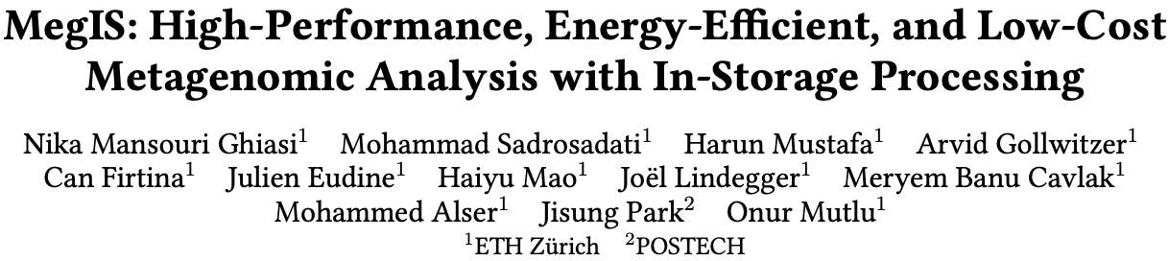
In-Storage Metagenomics [ISCA 2024]
Nika Mansouri Ghiasi, Mohammad Sadrosadati, Harun Mustafa, Arvid Gollwitzer, Can Firtina, Julien Eudine, Haiyu Mao, Joel Lindegger, Meryem Banu Cavlak, Mohammed Alser, Jisung Park, and Onur Mutlu,
"MegIS: High-Performance and Low-Cost Metagenomic Analysis with In-Storage Processing"
Proceedings of the 51st Annual International Symposium on Computer Architecture (ISCA), Buenos Aires, Argentina, July 2024.
[Slides (pptx) (pdf)]
[arXiv version]
https://arxiv.org/pdf/2406.19113

Slide 41


MegIS: Metagenomics In-Storage
First in-storage system for end-to-end metagenomic analysis
Idea: Cooperative in-storage processing for metagenomic analysis
  Hardware/software co-design between the storage system and host system
FTL
SSD
Controller
SSD DRAM
Cores
Standard
Metadata
Host System
MegIS-Enabled SSD
Cntrl
Cntrl
⋯
Channel#1
⋯
Channel#N
Notes:
Which is the first in-storage processing system for end-to-end metagenomic analysis
The key idea of megis is Cooperative ISP for metagenomics
Which is enabled by a synergistic hardware/software co-design between the storage system and the host system

Slide 42
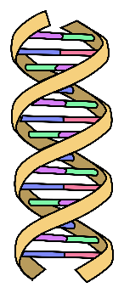





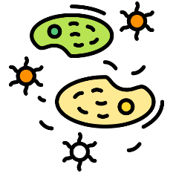




MegIS’s Steps
Step 1
GCTCA
Preparation
of Input Queries
Query
K-mers
CTCAT
TCATG
…
Step 2
Metagenomic sample
with species that
are not known in advance
V. cholerae
Presence/Absence Identification
SARS-CoV-2
E. coli
Step 3
Abundance
Estimation
A large database
containing information
on many species

Slide 43
MegIS Hardware-Software Co-Design
FTL
SSD
Controller
SSD DRAM
Cores
Standard
Metadata
Host System
MegIS-Enabled SSD
Cntrl
Cntrl
⋯
Channel#1
⋯
Channel#N
Notes:
To (i) leverage and (ii) orchestrate the capabilities of both systems, megis includes hw/sw co-design in 5 directions

Slide 44

MegIS Hardware-Software Co-Design
Task partitioning and mapping
Each step executes
in its most suitable system
Data/computation flow coordination
Reduce communication overhead
Reduce #writes to flash chips
Step 1
Step 2
Step 3
MegIS
FTL
SSD
Controller
SSD DRAM
FTL
Cores
Standard
Metadata
ACC
ACC
Host System
MegIS-Enabled SSD
Cntrl
Cntrl
MegIS
Metadata
⋯
Channel#1
⋯
Channel#N
Storage-aware algorithms
Enable efficient
access patterns to the SSD
Lightweight in-storage accelerators
Minimize SRAM/DRAM buffer spaces needed inside the SSD
Data mapping scheme and Flash Translation Layer (FTL)
Specialize to the characteristics of metagenomic analysis
Leverage the SSD’s full internal bandwidth
Notes:
6 mins until here

Slide 45
Evaluation: Speedup over the Software Baselines
Performance-Optimized
Accuracy-Optimized
MegIS
SSD-C
SSD-C
Speedup
5.8x
5.8x
14.9x
14.9x
Sample Genetic Diversity
Sample Genetic Diversity
MegIS provides significant speedup over both
Performance-Optimized and Accuracy-Optimized baselines
Notes:
We analyze the benefits of MegIS for samples with low, medium, and high genetic diversity,
And here I am showing for a cost optimized-SSD
We observe that compared to both P-Opt and A-Opt
MegIS provides significant speedups

Slide 46
Evaluation: Reduction in Energy Consumption
On average across different input sets and SSDs
5.4x
15.2x
1.9x
GeoMean Energy Reduction
(Higher is Better)
MegIS provides significant energy reduction over
the Performance-Optimized, Accuracy-Optimized, and PIM baselines
Notes:
Next, we show megis's energy reduction on average accross different input sets and SSDs and observe that megis provides...

Slide 47
In-Storage Metagenomics [ISCA 2024]
Nika Mansouri Ghiasi, Mohammad Sadrosadati, Harun Mustafa, Arvid Gollwitzer, Can Firtina, Julien Eudine, Haiyu Mao, Joel Lindegger, Meryem Banu Cavlak, Mohammed Alser, Jisung Park, and Onur Mutlu,
"MegIS: High-Performance and Low-Cost Metagenomic Analysis with In-Storage Processing"
Proceedings of the 51st Annual International Symposium on Computer Architecture (ISCA), Buenos Aires, Argentina, July 2024.
[Slides (pptx) (pdf)]
[arXiv version]
https://arxiv.org/pdf/2406.19113

Slide 48
Conclusion
System design for bioinformatics is a critical problem
  It has large scientific, medical, societal, personal implications
This talk is about accelerating genomics by alleviating data movement bottleneck
We covered various recent works on individual algorithms and pipelines
  PnM, PuM, ISP
Many future opportunities exist
  Especially with new sequencing technologies
  Especially with new applications and use cases

Slide 49
PIM Architectures for Bioinformatics
Dr. Konstantina Koliogeorgi
kkoliogeorgi@ethz.ch
https://people.inf.ethz.ch/
ICS 2025
08 June 2025

