Slide 1
High-throughput Sequence Alignment using Real Processing-in-Memory Systems
Safaa Diab, Amir Nassereldine, Mohammed Alser, Juan Gómez Luna, Onur Mutlu, Izzat El Hajj
June 18, 2023
Real-world Processing-in-Memory Systems for Modern Workloads (at ISCA’23)

Slide 2
High-throughput Sequence Alignment using Real Processing-in-Memory Systems
Published in Bioinformatics (2023)
https://arxiv.org/pdf/2208.01243.pdf
Source code: https://github.com/safaad/aim

Slide 3
Summary
Sequence alignment is memory-bound on traditional processor-centric systems
Processing-in-memory (PIM) overcomes the memory bandwidth bottleneck by placing cores near the memory
We present Alignment-in-Memory (AIM), a framework for sequence alignment on real PIM systems
Supports multiple alignment algorithms: NW, SWG, GenASM, and WFA
Implemented on UPMEM, the first real PIM system
Results show substantial speedups over CPUs and GPUs

Slide 4
Outline
Background on sequence alignment
Processing-in-memory
Our framework
Evaluation

Slide 5
Outline
Background on sequence alignment
Processing-in-memory
Our framework
Evaluation

Slide 6
Genome Analysis and Sequence Alignment
A genome is the complete set of an organism’s genetic instructions
DNA is a string of base pairs (characters): A, C, G, T
The human genome contains 3.2 billion base pairs
Genome analysis helps to understand genetic variations, predict the presence and abundance of microbes, monitor disease outbreaks, develop personalized medicine, etc.
Sequencing machines provide only randomized fragments (reads) of the genome
Depending on the sequencing technology, there are short (50-300 bp) and long reads (10K-100K bp)
Need to be mapped to the reference genome
A key step in the read mapping process is sequence alignment
Quadratic-time dynamic programming algorithms, e.g., Smith-Waterman, Needleman-Wunsch
State-of-the-art algorithms: GenASM, WFA, WFA-adaptive

Slide 7
Sequence Alignment Example with the Smith-Waterman Algorithm
A
A
T
C
0
0
0
0
0
A
0
1
0
A
0
3
1
0
C
0
3
1
6
4
C
0
3
1
4
9
Align two sequences by filling a matrix that scores the similarity between the two sequences and their subsequences

Slide 8
Sequence Alignment Example with the Smith-Waterman Algorithm
A
A
T
C
0
0
0
0
0
A
0
3
3
1
0
1
0
A
0
3
6
4
2
$$H_{i−1, j−1}$$
$$H_{i−1, j}$$
3
1
0
C
0
1
4
3
7
$$H_{i, j−1}$$
$$H_{i, j}$$
3
1
6
4
C
0
0
2
1
6
3
1
4
9
Assign different scores for matches (+3), mismatches (-3), new gaps (-2), and continuing gaps (-1)
Take the maximum score for reaching a cell from previous cells

Slide 9
Sequence Alignment Example with the Smith-Waterman Algorithm
A
A
T
C
0
0
0
0
0
A
0
3
3
1
0
1
0
A
A
T
C
A
0
3
6
4
2
3
1
0
A
A
-
C
C
0
1
4
3
7
3
1
6
4
C
0
0
2
1
6
3
1
4
9
Perform a traceback through the matrix to find the best alignment

Slide 10
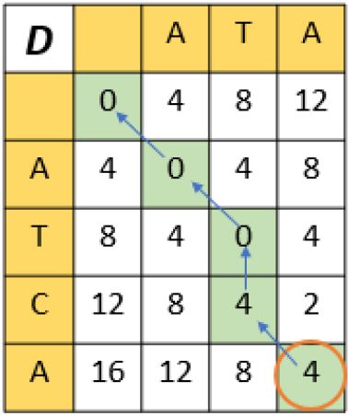
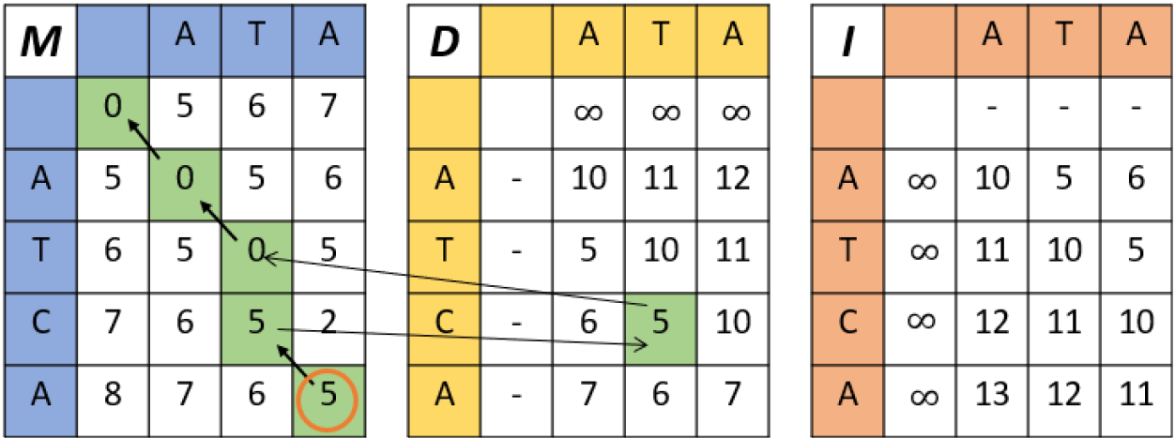
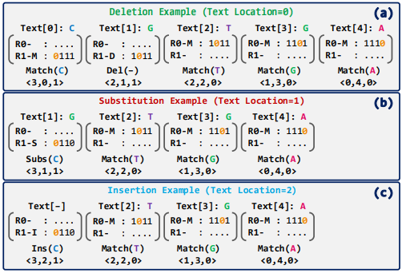
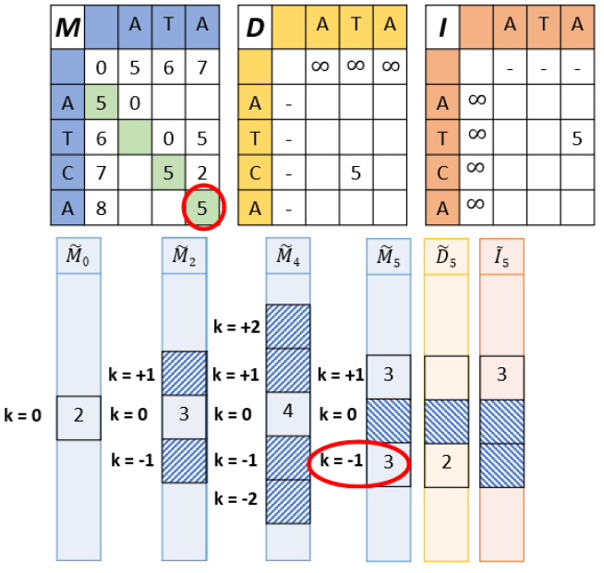
Sequence Alignment Algorithms
Needleman-Wunsch (NW)
Smith-Waterman-Gotoh (SWG)
GenASM
Wavefront Algorithm (WFA)
Cali, Damla Senol, et al. "GenASM: A high-performance, low-power approximate string matching acceleration framework for genome sequence analysis." MICRO, 2020.
Marco-Sola, Santiago, et al. "Fast gap-affine pairwise alignment using the wavefront algorithm." Bioinformatics 37.4 (2021): 456-463.

Slide 11
Sequence Alignment Scaling on CPUs
Observation: limited performance improvement as the number of CPU threads grows
Read length
# threads

Slide 12
Sequence Alignment Scaling on CPUs
Observation: limited performance improvement as the number of CPU threads grows
Read length
As the number of CPU threads grows, IPC decreases meaning threads spend more time idle
# threads
# threads

Slide 13
Sequence Alignment Scaling on CPUs
Observation: limited performance improvement as the number of CPU threads grows
Read length
As the number of CPU threads grows, IPC decreases meaning threads spend more time idle
As the number of CPU threads grows, threads spend more time stalling waiting for memory
# threads
10¹⁴
10¹³
10¹²
10¹¹
10¹⁰
10⁹
# threads
# threads

Slide 14
Outline
Background on sequence alignment
Processing-in-memory
Our framework
Evaluation

Slide 15
Memory Bandwidth Bottleneck
CPU Chip
CPU
Core
CPU
Core
Memory Chip
DRAM Bank
DRAM Bank
DRAM Bank
DRAM Bank
Data movement
Conventional CPU processing

Slide 16
Processing-in-Memory
CPU Chip
CPU Chip
CPU
Core
CPU
Core
CPU
Core
CPU
Core
Memory Chip
Memory Chip
DRAM Bank
DRAM Bank
DRAM Bank
DRAM Bank
DRAM Bank
DRAM Bank
DRAM Bank
DRAM Bank
PIM Core
PIM Core
PIM Core
PIM Core
Data movement
Conventional CPU processing
Processing-in-memory (PIM)

Slide 17
Real Processing-in-Memory Systems
Real-world PIM architectures are becoming a reality
UPMEM PIM, Samsung HBM-PIM, Samsung AxDIMM, SK Hynix AiM, Alibaba HB-PNM
These PIM systems have some common characteristics:
There is a host processor (CPU or GPU) with access to (1) standard main memory, and (2) PIM-enabled memory
PIM-enabled memory contains multiple PIM processing elements (PEs) with high bandwidth and low latency memory access
PIM PEs run only at a few hundred MHz and have a small number of registers and small (or no) cache/scratchpad
PIM PEs may need to communicate via the host processor

Slide 18
UPMEM: The First Real PIM Hardware

Slide 19
UPMEM: The First Real PIM Hardware

Slide 20
Outline
Background on sequence alignment
Processing-in-memory
Our framework
Evaluation

Slide 21
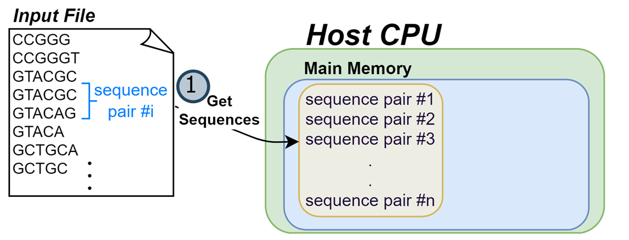
AIM: Alignment-in-Memory

Slide 22
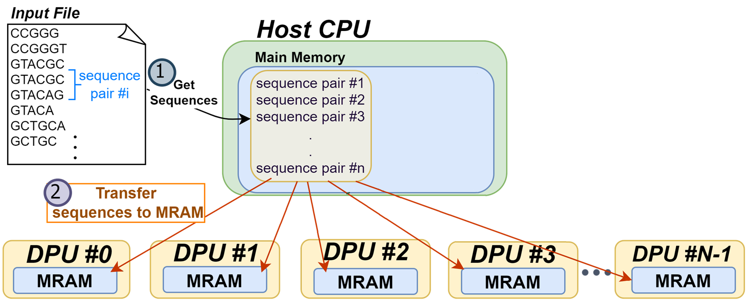
AIM: Alignment-in-Memory

Slide 23
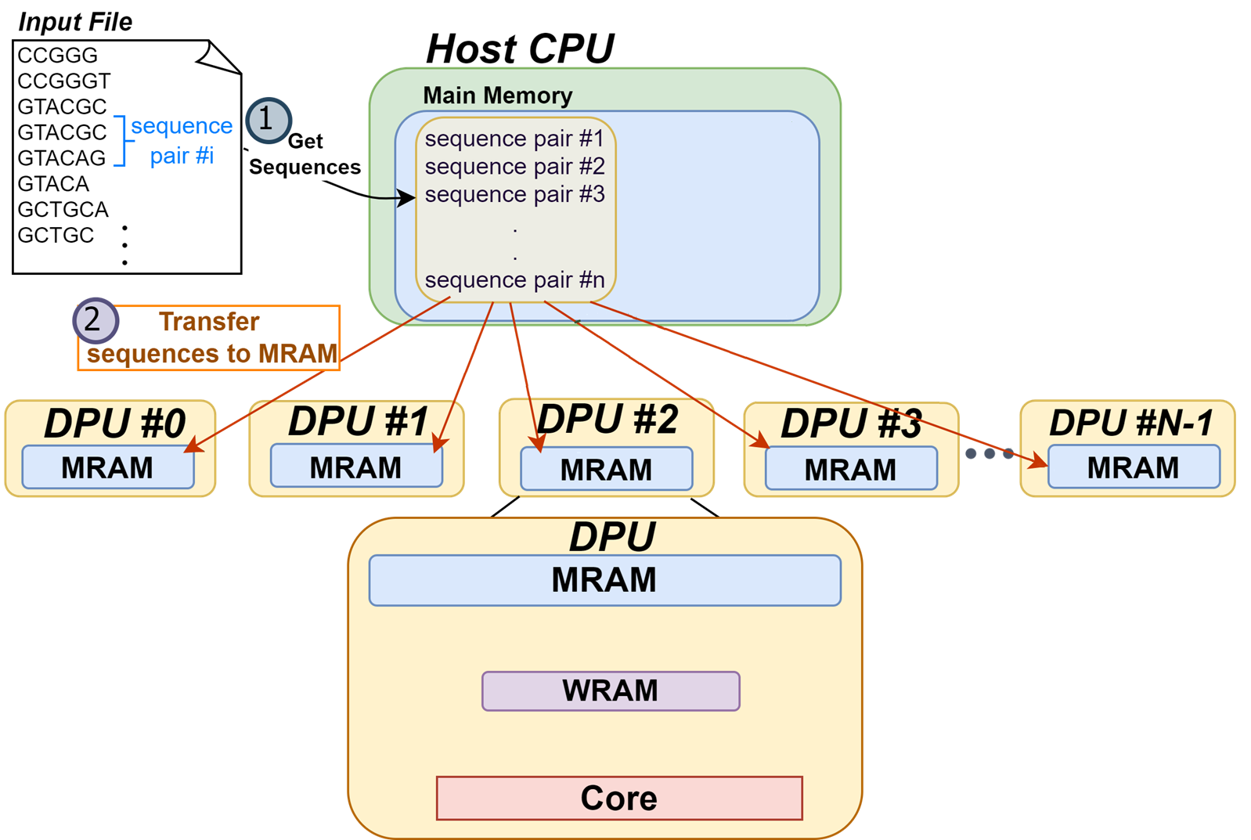
AIM: Alignment-in-Memory

Slide 24
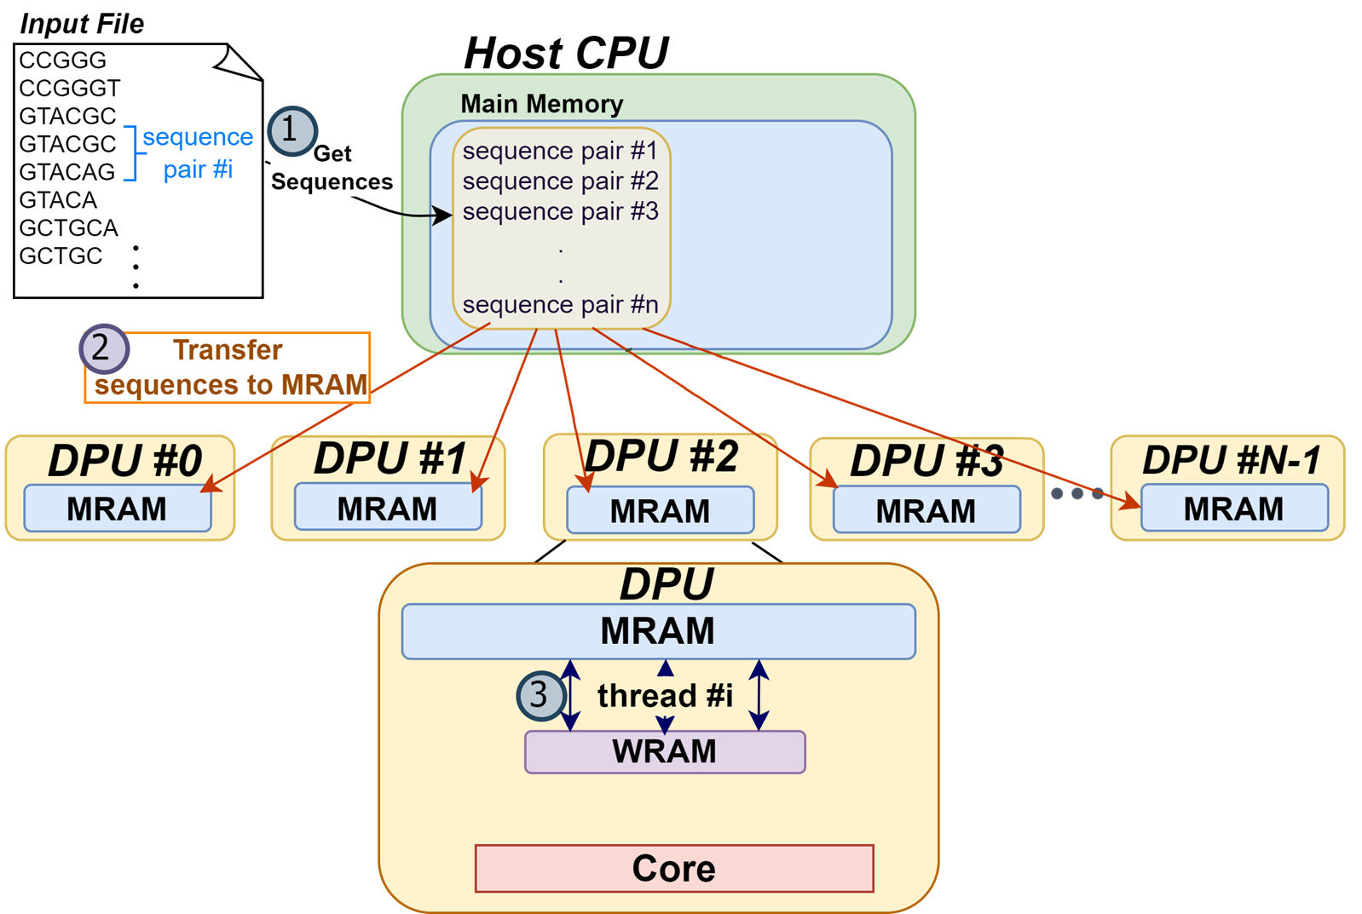
AIM: Alignment-in-Memory

Slide 25
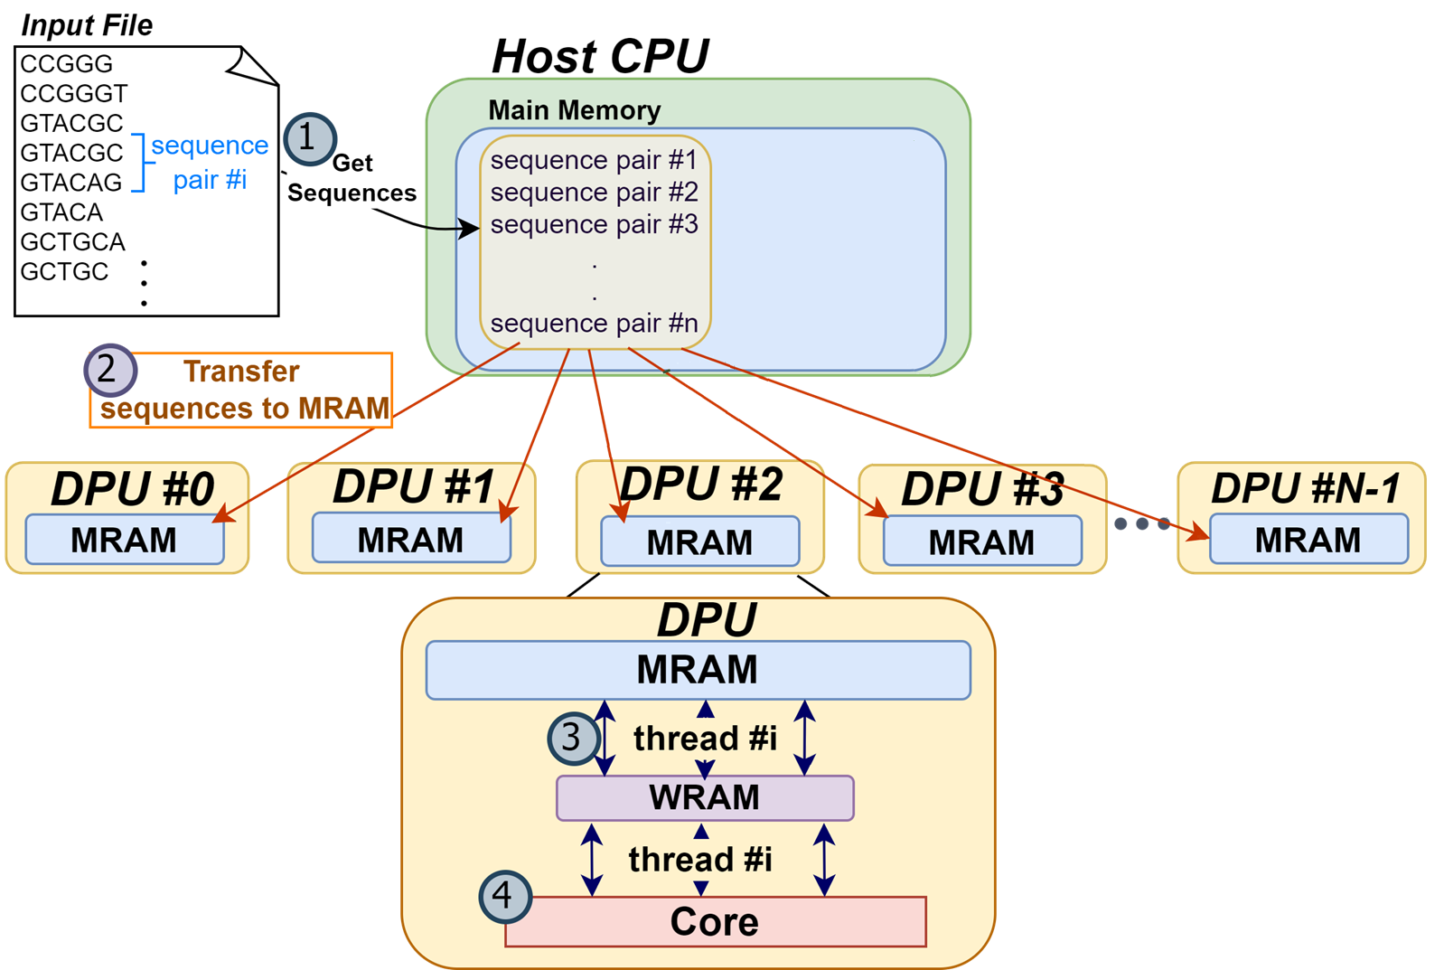
AIM: Alignment-in-Memory

Slide 26
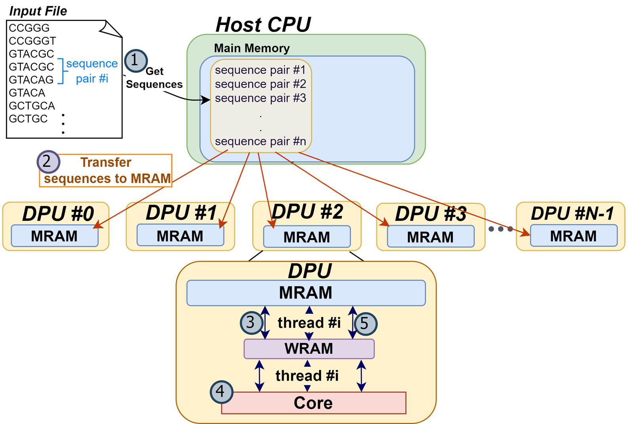
AIM: Alignment-in-Memory

Slide 27
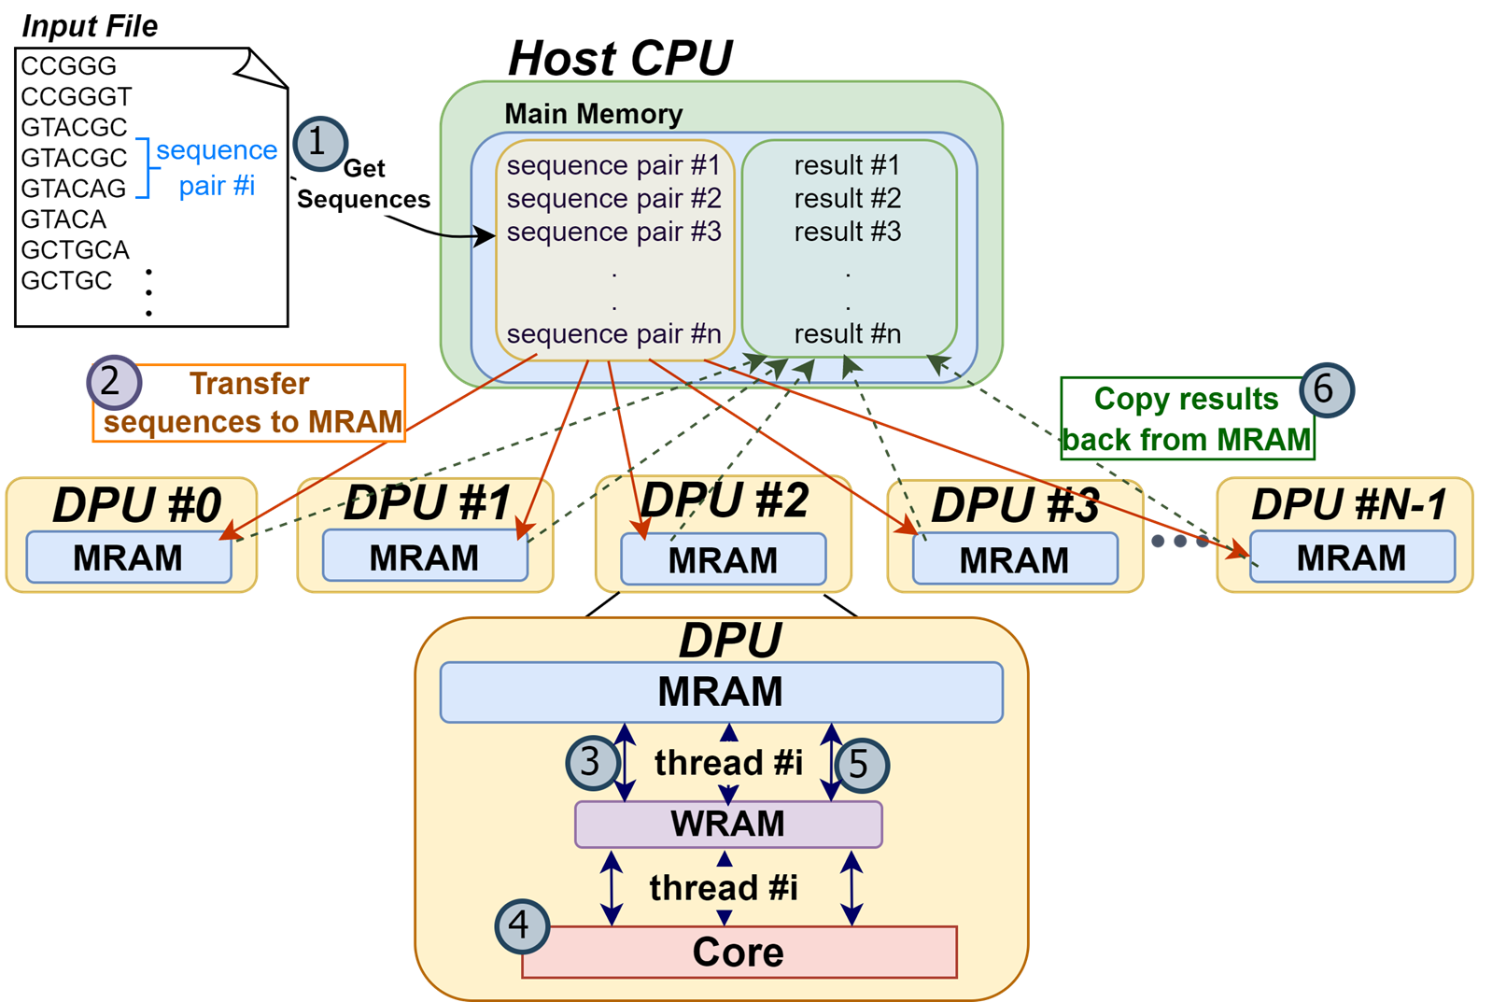
AIM: Alignment-in-Memory

Slide 28
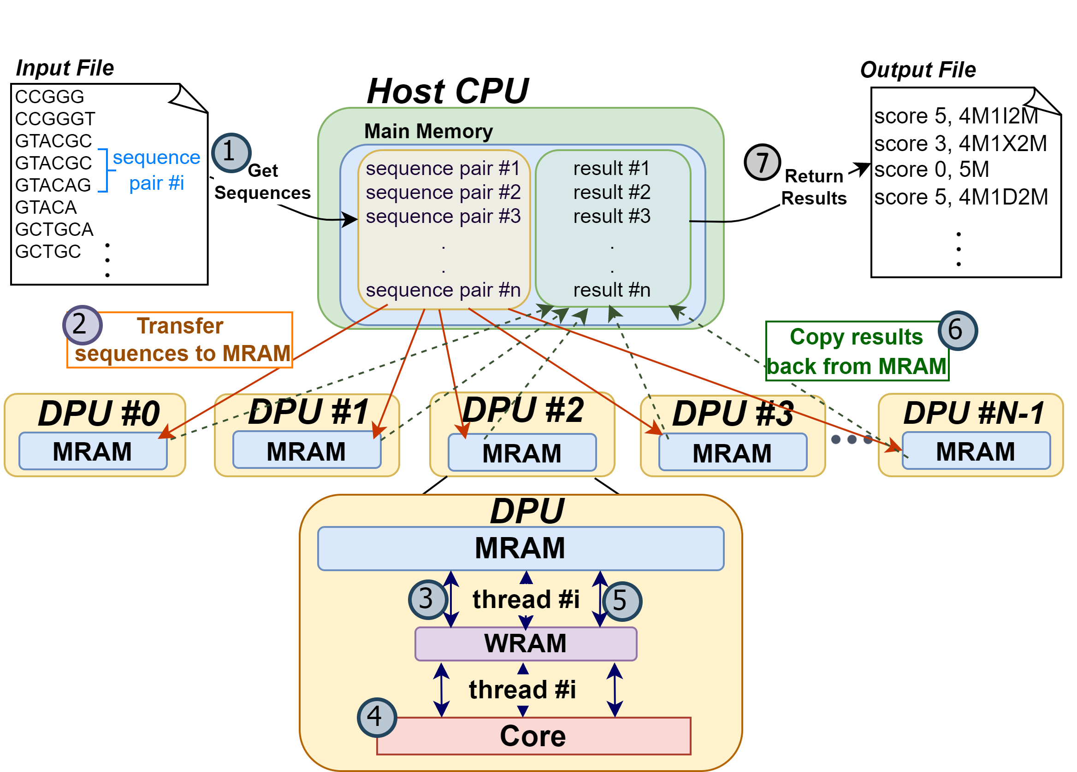
AIM: Alignment-in-Memory

Slide 29
Supported Algorithms
Needleman-Wunsch (NW)
Smith-Waterman-Gotoh (SWG)
GenASM
Wavefront Algorithm (WFA)
Cali, Damla Senol, et al. "GenASM: A high-performance, low-power approximate string matching acceleration framework for genome sequence analysis." MICRO, 2020.
Marco-Sola, Santiago, et al. "Fast gap-affine pairwise alignment using the wavefront algorithm." Bioinformatics 37.4 (2021): 456-463.

Slide 30
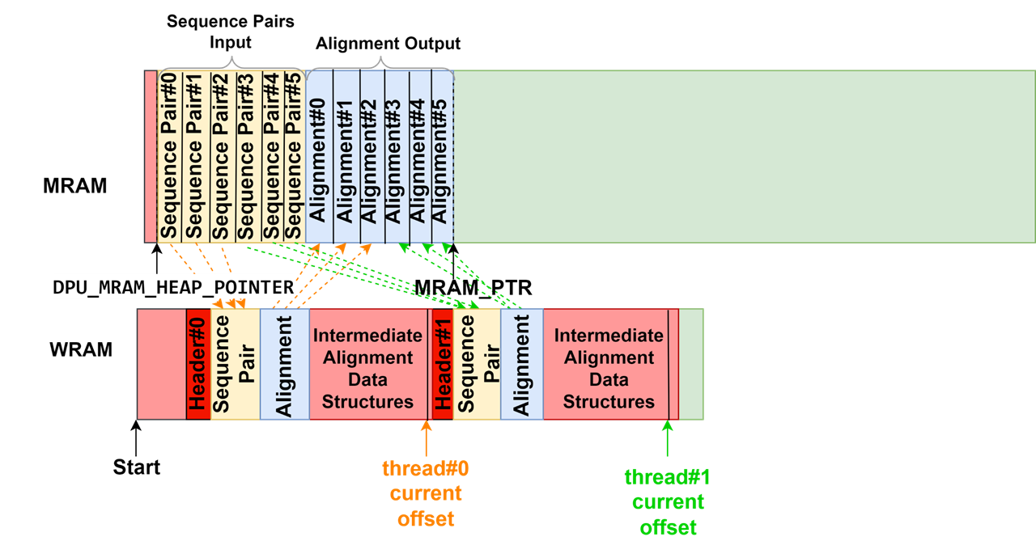
Managing the UPMEM Memory Hierarchy
Using WRAM only for intermediate data structures

Slide 31
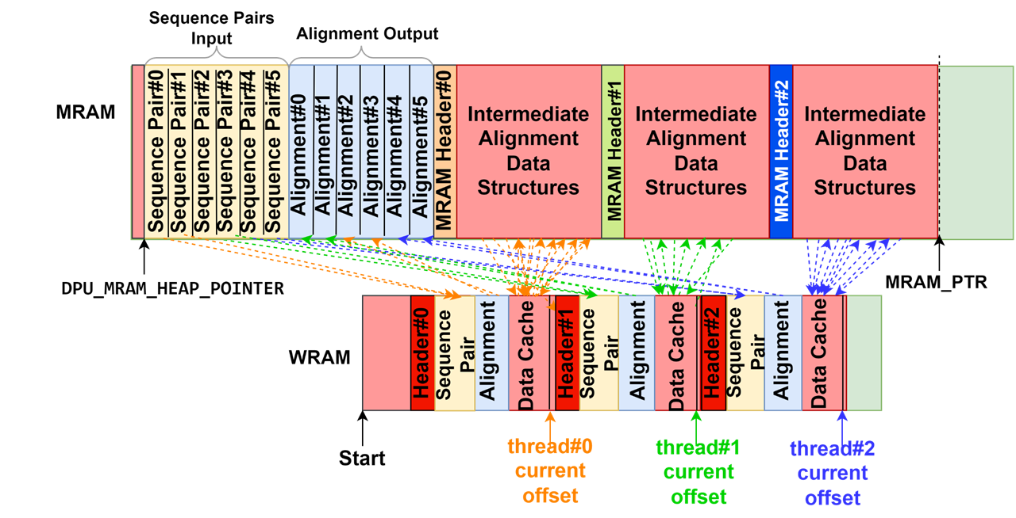
Managing the UPMEM Memory Hierarchy
Using WRAM only for intermediate data structures
Using WRAM and MRAM for intermediate data structures

Slide 32
Outline
Background on sequence alignment
Processing-in-memory
Our framework
Evaluation

Slide 33
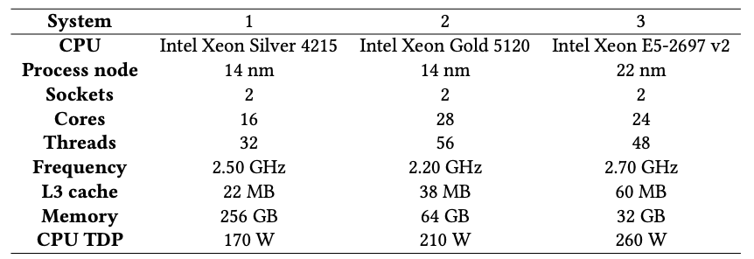
Methodology
Real and synthetic datasets
Evaluated systems
UPMEM PIM system with 2,560 PIM cores @ 425 MHz and 160 GB of DRAM
Three CPU systems
*
*
*
^
*https://www.ebi.ac.uk/ena/browser/view
^https://github.com/smarco/WFA2-lib

Slide 34
PIM vs CPU
Edit distance threshold = 1%
Read length
Edit distance threshold = 5%
Read length
Observation #1: The best performing CPU system is the one with the largest L3 cache (demonstrates memory-boundedness of sequence alignment)

Slide 35
PIM vs CPU
Edit distance threshold = 1%
Read length
Edit distance threshold = 5%
Read length
Observation #2: PIM outperforms CPU in the majority of cases
(up to 4.06× for SWG, up to 1.83× for WFA, and up to 2.56× for WFA-adaptive)

Slide 36
PIM vs CPU
Edit distance threshold = 1%
Read length
Edit distance threshold = 5%
Read length
Observation #3: When data transfer time is not included, PIM outperforms CPU even more (up to 25.93× for WFA, up to 28.14× for WFA-adaptive)

Slide 37
PIM vs CPU
Edit distance threshold = 1%
Read length
Edit distance threshold = 5%
Read length
Observation #3: When data transfer time is not included, PIM outperforms CPU even more (up to 25.93× for WFA, up to 28.14× for WFA-adaptive)

Slide 38
PIM vs CPU
Edit distance threshold = 1%
Read length
Edit distance threshold = 5%
Read length
Observation #4: PIM does not outperform CPU for algorithms with regular access patterns at small read lengths

Slide 39
PIM vs. CPU for WFA-adaptive with Large Read Lengths
Edit distance
Read length
Observation #1: PIM continues to outperform CPU for very large read lengths

Slide 40
PIM vs. CPU for WFA-adaptive with Large Read Lengths
Edit distance
Read length
Observation #1: PIM continues to outperform CPU for very large read lengths
Observation #2: Scalability currently limited by WRAM capacity

Slide 41
PIM vs. CPU for WFA-adaptive with Large Read Lengths
Edit distance
Read length
Observation #1: PIM continues to outperform CPU for very large read lengths
Observation #2: Scalability currently limited by WRAM capacity

Slide 42
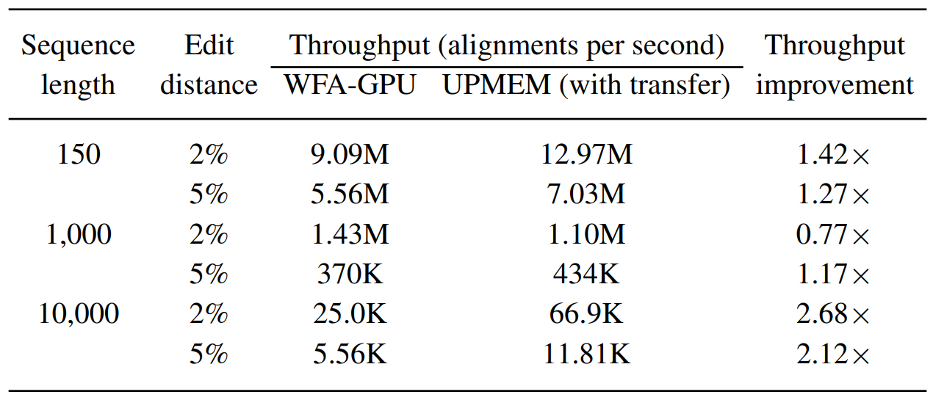
PIM vs. GPU
Observation: PIM outperforms GPU in the majority of cases
Aguado-Puig, Quim, et al. "WFA-GPU: Gap-affine pairwise alignment using GPUs." bioRxiv (2022)

Slide 43
Using WRAM only vs. WRAM and MRAM for Intermediate Data Structures
Read length

Slide 44
Using WRAM only vs. WRAM and MRAM for Intermediate Data Structures
Read length
Observation #1: For algorithms that use large data structures (NW and SWG), WRAM only does not scale

Slide 45
Using WRAM only vs. WRAM and MRAM for Intermediate Data Structures
Read length
Observation #2: For algorithms that use small data structures (GenASM), WRAM only is better

Slide 46
Using WRAM only vs. WRAM and MRAM for Intermediate Data Structures
Read length
Observation #3: For algorithms that use medium-sized data structures (WFA, WFA-adaptive), WRAM only is better for short reads while WRAM+MRAM is better for long reads

Slide 47
Summary
Sequence alignment is memory-bound on traditional processor-centric systems
Processing-in-memory (PIM) overcomes the memory bandwidth bottleneck by placing cores near the memory
We present Alignment-in-Memory (AIM), a framework for sequence alignment on real PIM systems
Supports multiple alignment algorithms: NW, SWG, GenASM, and WFA
Implemented on UPMEM, the first real PIM system
Results show substantial speedups over CPUs and GPUs
AIM is available at: https://github.com/safaad/aim

