Slide 1
International Symposium on Computer Architecture (ISCA)
Real-world
Processing-in-Memory
Systems
for Modern Workloads
https://www.youtube.com/live/GIb5EgSrWk0?feature=share
Room: Magnolia 16
Marriott World Center Orlando
Orlando, FL, USA
July 18th, 2023

Slide 2
Data Movement in Computing Systems
Data movement dominates performance and is a major system energy bottleneck
Total system energy: data movement accounts for
62% in consumer applications✻,
40% in scientific applications★,
35% in mobile applications☆
Data Movement
SoC
DRAM
CPU
CPU
L2
GPU
Video Encoder
Video Decoder
Audio
Display Engine
✻ Boroumand et al., “Google Workloads for Consumer Devices: Mitigating Data Movement Bottlenecks,” ASPLOS 2018
★ Kestor et al., “Quantifying the Energy Cost of Data Movement in Scientific Applications,” IISWC 2013
☆ Pandiyan and Wu, “Quantifying the energy cost of data movement for emerging smart phone workloads on mobile platforms,” IISWC 2014

Slide 3
Data Movement in Computing Systems
Data movement dominates performance and is a major system energy bottleneck
Total system energy: data movement accounts for
62% in consumer applications✻,
40% in scientific applications★,
35% in mobile applications☆
Compute systems should be more data-centric
Data Movement
SoC
CPU
Processing-In-Memory proposes
computing where it makes sense
(where data resides)
CPU
L2
DRAM
GPU
Video Encoder
Video Decoder
Audio
Display Engine
✻ Boroumand et al., “Google Workloads for Consumer Devices: Mitigating Data Movement Bottlenecks,” ASPLOS 2018
★ Kestor et al., “Quantifying the Energy Cost of Data Movement in Scientific Applications,” IISWC 2013
☆ Pandiyan and Wu, “Quantifying the energy cost of data movement for emerging smart phone workloads on mobile platforms,” IISWC 2014

Slide 4
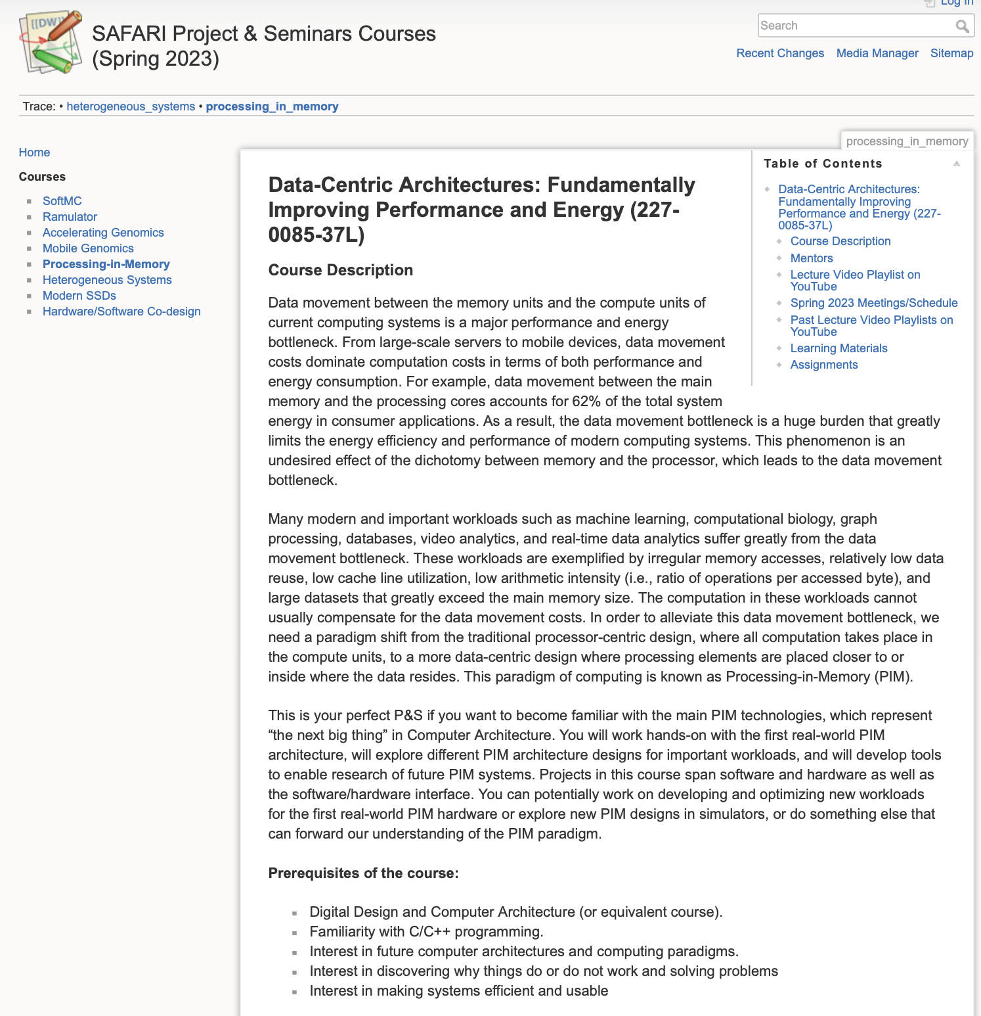
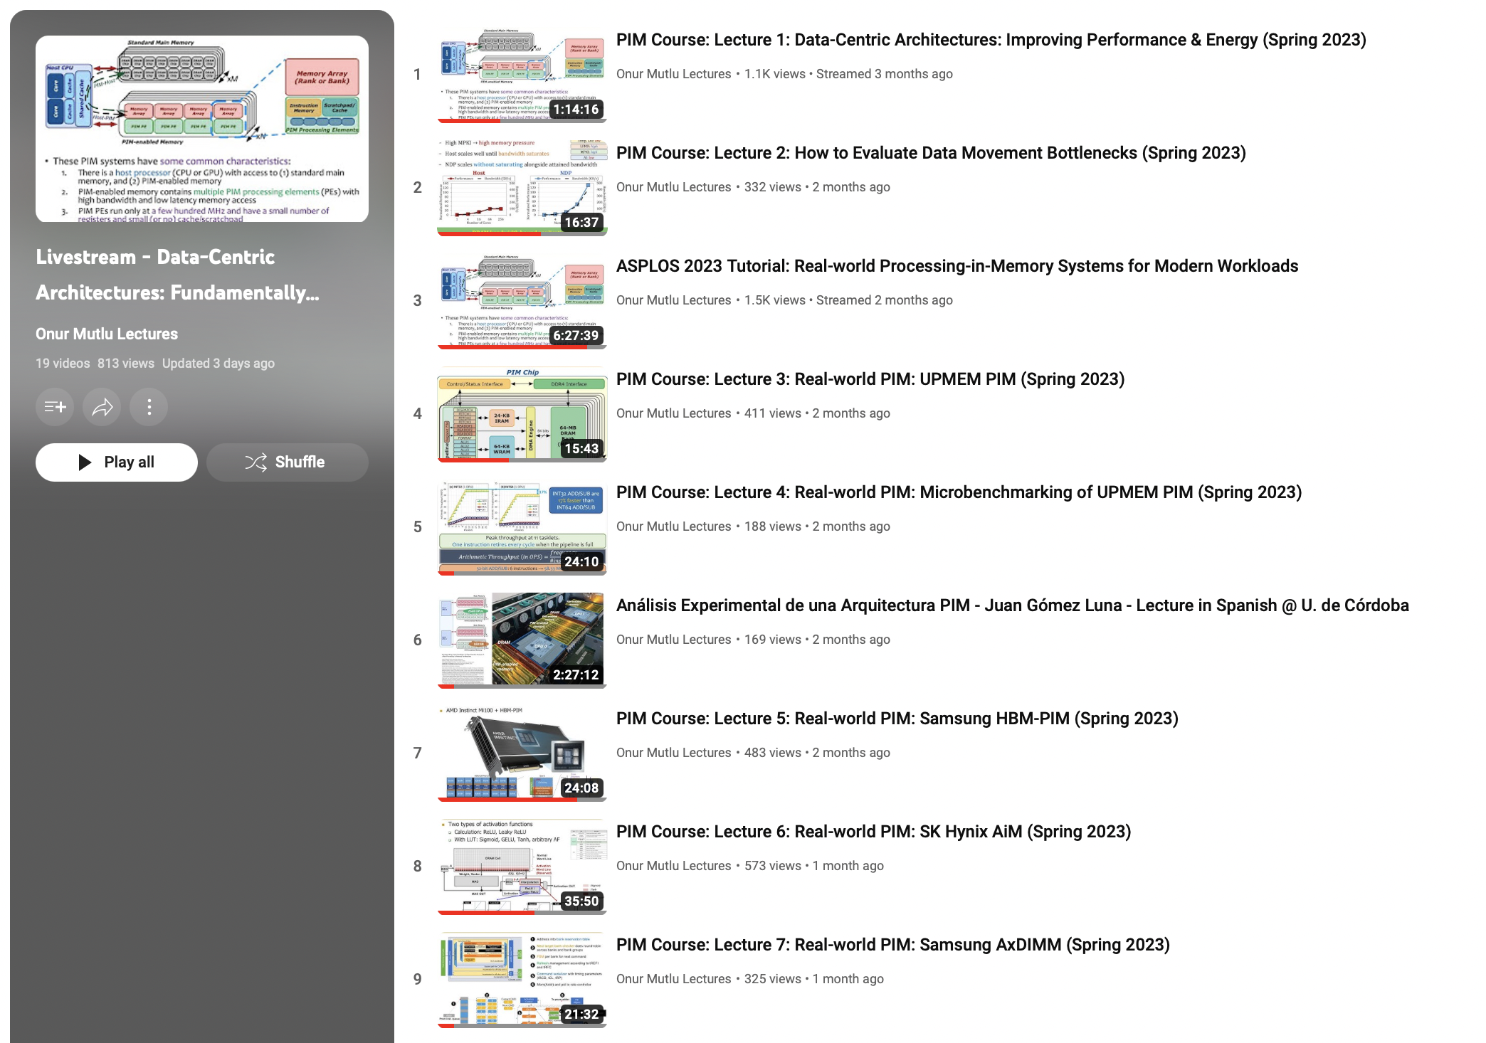
Processing-in-Memory Course (Spring 2023)
Short weekly lectures
Hands-on projects
https://www.youtube.com/playlist?list=PL5Q2soXY2Zi_EObuoAZVSq_o6UySWQHvZ
https://safari.ethz.ch/projects_and_seminars/spring2023/doku.php?id=processing_in_memory

Slide 5
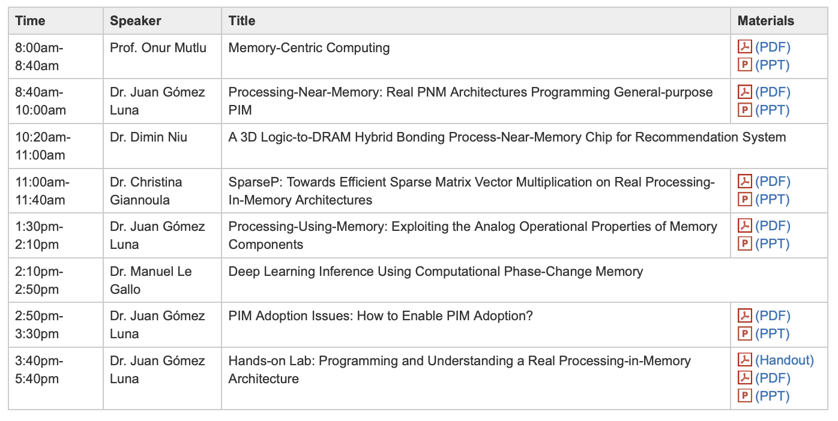
Real PIM Tutorial (HPCA 2023)
February 26th: Lectures + Hands-on labs + Invited lectures
https://www.youtube.com/live/f5-nT1tbz5w?feature=share
https://events.safari.ethz.ch/real-pim-tutorial/doku.php?id=start

Slide 6
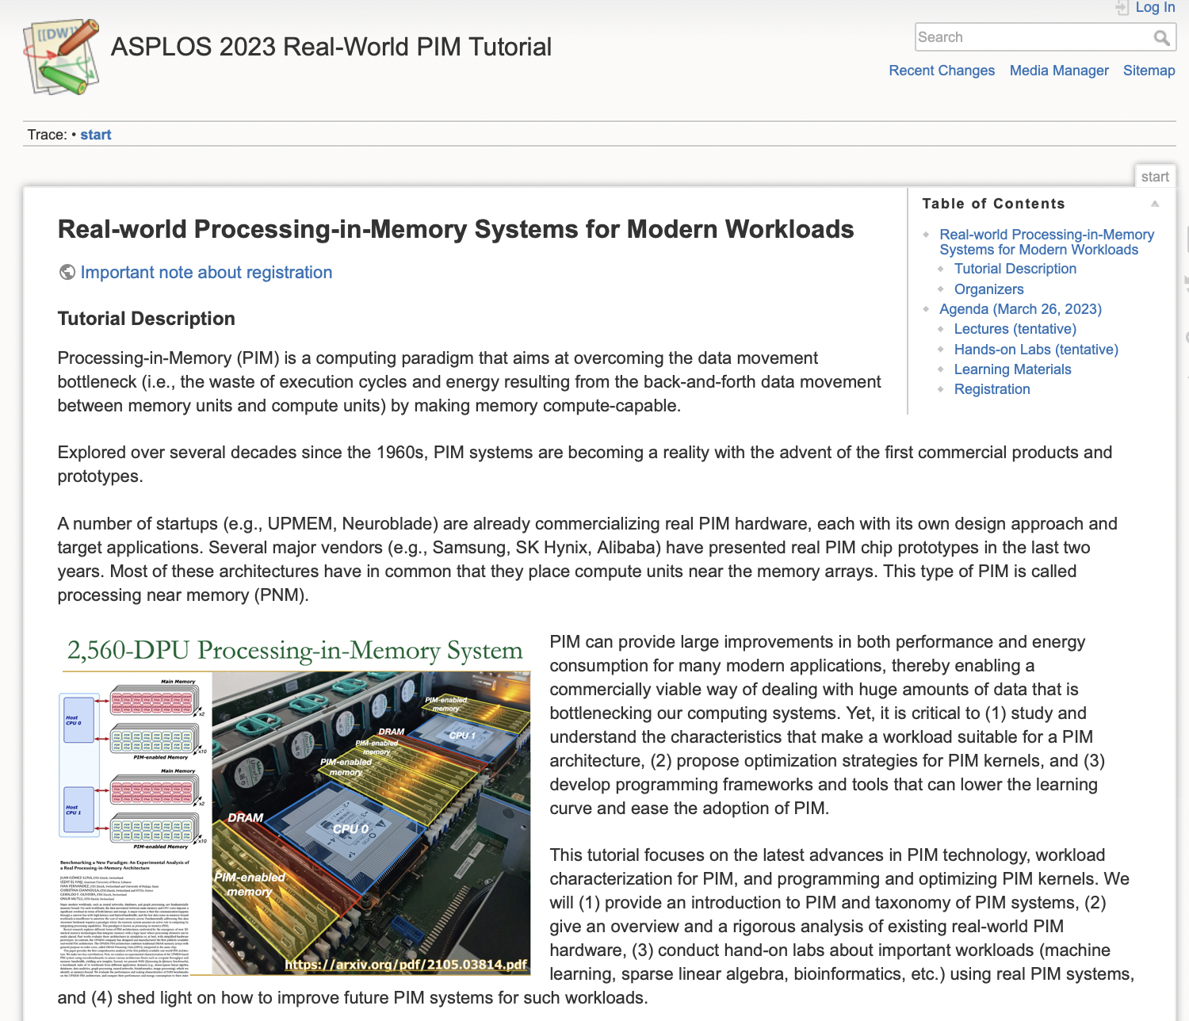
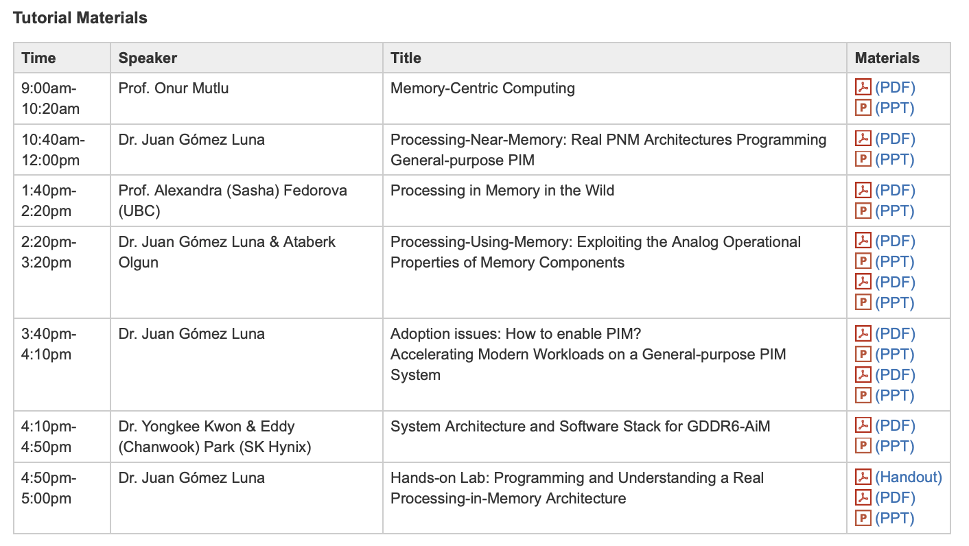
Real PIM Tutorial (ASPLOS 2023)
March 26th: Lectures + Hands-on labs + Invited lectures
https://www.youtube.com/live/oYCaLcT0Kmo?feature=share
https://events.safari.ethz.ch/asplos-pim-tutorial/doku.php?id=start

Slide 7
Real PIM Tutorial (ISCA 2023)
June 18th: Lectures + Hands-on labs + Invited lectures
https://events.safari.ethz.ch/isca-pim-tutorial/doku.php?id=start

Slide 8
Real PIM Tutorial (ISCA 2023)
https://www.youtube.com/live/GIb5EgSrWk0?feature=share

Slide 9
Agenda
9:00am-10:20am, Prof. Onur Mutlu/Dr. Juan Gómez Luna, “Memory-centric Computing: Introduction to PIM as a Paradigm to Overcome the Data Movement Bottleneck”.
PIM taxonomy: PNM (processing near memory) and PUM (processing using memory).
10:20am-11:00pm, Dr. Juan Gómez Luna, “Processing-Near-Memory: Real PNM”.
PNM prototypes: Samsung HBM-PIM, SK Hynix AiM, Samsung AxDIMM, Alibaba HB-PNM.
UPMEM PIM: Architecture and Programming.
Coffee break (11:00am-11:20am)
11:20am-11:50am, Prof. Izzat El Hajj (AUB), “High-throughput Sequence Alignment using Real Processing-in-Memory Systems”.
11:50am-12:30pm, Dr. Christina Giannoula (UofT), “SparseP: Towards Efficient Sparse Matrix Vector Multiplication on Real Processing-In-Memory Systems”.
Lunch break (12:30pm-2:00pm)
2:00pm-2:45pm, Dr. Sukhan Lee (Samsung), “Introducing Real-world HBM-PIM Powered System for Memory-bound Applications”.
2:45pm-3:30pm, Dr. Juan Gómez Luna/Ataberk Olgun, “Processing-Using-Memory and PUM Prototypes: Ambit/SIMDRAM, PiDRAM”.
Coffee break (3:30pm-4pm)
4:00pm-4:40pm, Dr. Juan Gómez Luna, “Accelerating Modern Workloads on a General-purpose PIM System”.
4:40pm-5:20pm, Dr. Juan Gómez Luna, “Adoption Issues: How to Enable PIM?”
5:20pm-5:30pm, Dr. Juan Gómez Luna, “Introduction/Preparation for Hands-on labs”.
Optional - Hands-on Lab: Programming and Understanding a Real PIM Architecture.

Slide 10
Sequence Alignment on Real PIM
High-throughput Sequence Alignment using Real Processing-in-Memory Systems
Prof. Izzat El Hajj
Abstract: Sequence alignment is a memory bound computation whose performance in modern systems is limited by the memory bandwidth bottleneck. Processing-in-memory architectures alleviate this bottleneck by providing the memory with computing competencies. We present Alignment-in-Memory (AIM), a framework for high-throughput sequence alignment using processing-in-memory which we have implemented and evaluated it on UPMEM, the first publicly-available general-purpose programmable processing-in-memory system. Our evaluation shows that a real processing-in-memory system can substantially outperform server-grade multi-threaded CPU systems running at full-scale when performing sequence alignment for a variety of algorithms, read lengths, and edit distance thresholds. We hope that our findings inspire more work on creating and accelerating bioinformatics algorithms for such real processing-in-memory systems. Our code is available at: https://github.com/safaad/aim.
Bio: Izzat El Hajj is an Assistant Professor in the Department of Computer Science at the American University of Beirut. His research interests are in application acceleration and programming support for emerging parallel processors and memory technologies, with a particular interest in GPUs and processing-in-memory. Izzat received his M.S. and Ph.D. in Electrical and Computer Engineering at the University of Illinois at Urbana-Champaign and his B.E. in Electrical and Computer Engineering at the American University of Beirut.

Slide 11
SpMV on a Real PIM System
SparseP: Towards Efficient Sparse Matrix Vector Multiplication for Real Processing-In-Memory Systems
Dr. Christina Giannoula
Abstract: Several manufacturers have already started to commercialize near-bank Processing-In-Memory (PIM) architectures. Near-bank PIM architectures place simple cores close to DRAM banks and can yield significant performance and energy improvements in parallel applications by alleviating data access costs. Real PIM systems can provide high levels of parallelism, large aggregate memory bandwidth and low memory access latency, thereby being a good fit to accelerate the widely-used, memory-bound Sparse Matrix Vector Multiplication (SpMV) kernel.
This talk provides the first comprehensive analysis of SpMV on a real-world PIM architecture, and presents SparseP, the first SpMV library for real PIM architectures. We will discuss three key contributions that we make in our Sigmetrics 2022 paper. First, we implement a wide variety of software strategies on SpMV for a multithreaded PIM core and characterize the computational limits of a single multithreaded PIM core. Second, we design various load balancing schemes across multiple PIM cores, and two types of data partitioning techniques to execute SpMV on thousands of PIM cores: (1) 1D-partitioned kernels to perform the complete SpMV computation only using PIM cores, and (2) 2D-partitioned kernels to strive a balance between computation and data transfer costs to PIM-enabled memory. Third, we compare SpMV execution on a real-world PIM system with 2528 PIM cores to state-of-the-art CPU and GPU systems to study the performance and energy efficiency of various devices. SparseP software package provides 25 SpMV kernels for real PIM systems supporting the four most widely used compressed matrix formats, and a wide range of data types. Our extensive evaluation provides new insights and recommendations for software designers and hardware architects to efficiently accelerate SpMV on real PIM systems.
Bio: Christina Giannoula is a Postdoctoral Researcher at the University of Toronto working with Prof. Gennady Pekhimenko and the EcoSystem research group. She is also working with the SAFARI research group, which is led by Prof. Onur Mutlu. She received her Ph.D. in October 2022 from School of Electrical and Computer Engineering (ECE) at the National Technical University of Athens (NTUA) advised by Prof. Georgios Goumas, Prof. Nectarios Koziris and Prof. Onur Mutlu. Her research interests lie in the intersection of computer architecture, computer systems and high-performance computing. Specifically, her research focuses on the hardware/software co-design of emerging applications, including graph processing, pointer-chasing data structures, machine learning workloads, and sparse linear algebra, with modern computing paradigms, such as large-scale multicore systems, disaggregated memory systems and near-data processing architectures. She has several publications and awards for her research on these topics.

Slide 12
Samsung HBM-PIM
Introducing Real-world HBM-PIM Powered System for Memory-bound Applications
Dr. Sukhan Lee
Abstract: Since the introduction of Samsung's groundbreaking high bandwidth memory with in-memory processing (HBM-PIM) in 2021, a number of HBM-PIM enabled systems, including a GPU cluster and FPGA, have been developed. These advancements have been presented and showcased at various conferences and journals, spanning from ISSCC 2021 to Memcon 2023. In this tutorial, we provide a comprehensive overview of HBM-PIM, covering its architectural aspects, the associated software ecosystem, and the structure of PIM-powered systems. We also present energy-efficient performance results for memory-bound applications achieved by these systems.
Bio: Sukhan Lee received a Ph.D. degree in intelligent convergence systems from Seoul National University. In 2018, he joined the Memory Division, Samsung Electronics, Hwaseong, Korea, where he has been involved in DRAM circuit design. His research interests include memory microarchitecture and neural network system hardware architecture and design.

Slide 13
International Symposium on Computer Architecture (ISCA)
Real-world
Processing-in-Memory
Systems
for Modern Workloads
https://www.youtube.com/live/GIb5EgSrWk0?feature=share
Room: Magnolia 16
Marriott World Center Orlando
Orlando, FL, USA
July 18th, 2023

