Slide 1
Tutorial on Memory-Centric Computing: Introduction
Geraldo F. Oliveira
Prof. Onur Mutlu
ISCA 2024
29 June 2024

Slide 2
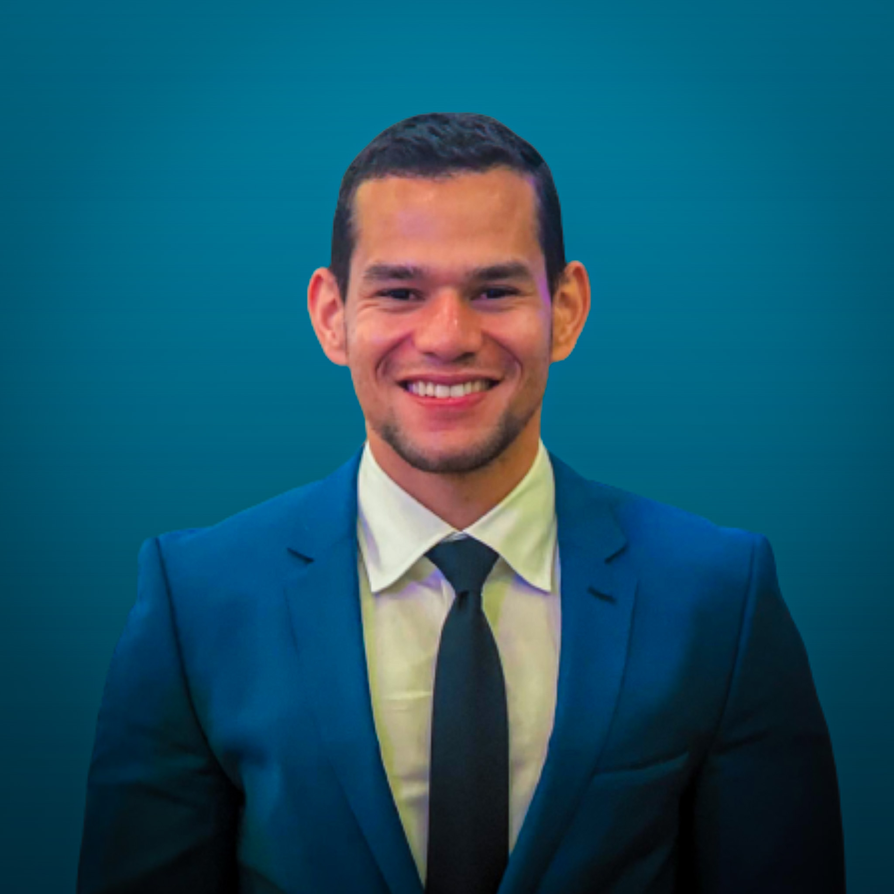
Brief Self Introduction
Geraldo F. Oliveira
Researcher @ SAFARI Research Group since November 2017
Soon, I will defend my PhD thesis, advised by Onur Mutlu
https://geraldofojunior.github.io/
geraldofojunior@gmail.com (Best way to reach me)
https://safari.ethz.ch
Research in:
Computer architecture, computer systems, hardware security
Memory and storage systems
Hardware security, safety, predictability
Fault tolerance
Hardware/software cooperation
…

Slide 3
Agenda
Introduction to Memory-Centric Computing Systems
Invited Talk by Prof. Minsoo Rhu: “Memory-Centric Computing Systems – For AI and Beyond”
Coffee Break
Real-World Processing-Near-Memory Systems
Processing-Using-Memory Architectures for Bulk Bitwise Op.
Invited Talk by Prof. Saugata Ghose: “RACER and ReRAM PUM”
PIM Programming & Infrastructure for PIM Research
Closing Remarks

Slide 4
Agenda
Introduction to Memory-Centric Computing Systems
Invited Talk by Prof. Minsoo Rhu: “Memory-Centric Computing Systems – For AI and Beyond”
Coffee Break
Real-World Processing-Near-Memory Systems
Processing-Using-Memory Architectures for Bulk Bitwise Op.
Invited Talk by Prof. Saugata Ghose: “RACER and ReRAM PUM”
PIM Programming & Infrastructure for PIM Research
Closing Remarks

Slide 5
The Problem
Computing
is Bottlenecked by Data

Slide 6
Data is Key for AI, ML, Genomics, …
Important workloads are all data intensive
They require rapid and efficient processing of large amounts of data
Data is increasing
We can generate more than we can process
We need to perform more sophisticated analyses on more data

Slide 7
Huge Demand for Performance & Efficiency
~4 orders of magnitude increase in memory requirement in just two years!
https://www.youtube.com/watch?v=x2-qB0J7KHw

Slide 8
Data is Key for Future Workloads
In-memory Databases
[Mao+, EuroSys’12; Clapp+ (Intel), IISWC’15]
Graph/Tree Processing
[Xu+, IISWC’12; Umuroglu+, FPL’15]
In-Memory Data Analytics
[Clapp+ (Intel), IISWC’15;
Awan+, BDCloud’15]
Datacenter Workloads [Kanev+ (Google), ISCA’15]
8

Slide 9
Data Overwhelms Modern Machines
In-memory Databases
[Mao+, EuroSys’12; Clapp+ (Intel), IISWC’15]
Graph/Tree Processing
[Xu+, IISWC’12; Umuroglu+, FPL’15]
Data → performance & energy bottleneck
In-Memory Data Analytics
[Clapp+ (Intel), IISWC’15;
Awan+, BDCloud’15]
Datacenter Workloads [Kanev+ (Google), ISCA’15]
9

Slide 10
Data is Key for Future Workloads
Chrome
TensorFlow Mobile
Google’s web browser
Google’s machine learning framework
Video Playback
Video Capture
Google’s video codec
Google’s video codec
10
Notes:
In this work, we take a look at widely-used google consumer workloads, to figure out the major sources of energy consumption.
We look at Google Chrome web brower. We take a look at Tensorflow, Google’s machine learning framework, and we also take a look at two important video related workloads, video playback and video capture, both rely on Google’s vp9 codec technology.

Slide 11
Data Overwhelms Modern Machines
Chrome
TensorFlow Mobile
Google’s web browser
Google’s machine learning framework
Data → performance & energy bottleneck
Video Playback
Video Capture
Google’s video codec
Google’s video codec
11
Notes:
In this work, we take a look at widely-used google consumer workloads, to figure out the major sources of energy consumption.
We look at Google Chrome web brower. We take a look at Tensorflow, Google’s machine learning framework, and we also take a look at two important video related workloads, video playback and video capture, both rely on Google’s vp9 codec technology.

Slide 12
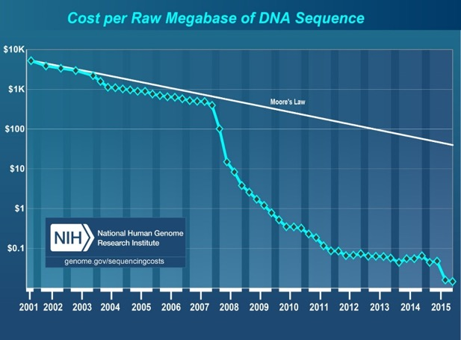
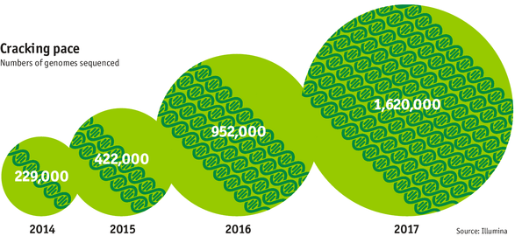
Data is Key for Future Workloads
development of high-throughput sequencing (HTS) technologies
Number of Genomes Sequenced
http://www.economist.com/news/21631808-so-much-genetic-data-so-many-uses-genes-unzipped
Notes:
However, since the development of high throughput sequencing (HTS) technologies, the cost of genome sequencing has fallen off a cliff (<< 1,000$) making it viable for almost everyone's use.

Slide 13
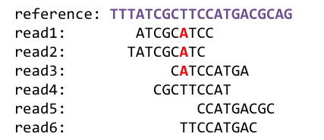
1
Sequencing
Genome Analysis
Read Mapping
2
Data → performance & energy bottleneck
Variant Calling
Scientific Discovery
3
4
Notes:
Genome analysis starts with sequencing random short DNA fragments of copies of the original molecule.
Unfortunately, these reads lack information about their order and which part of genome they are originated from.
Hence the second step is to map these reads to a long reference genome.

Slide 14
Data Overwhelms Modern Machines …
Storage/memory capability
Communication capability
Computation capability
Greatly impacts robustness, energy, performance, cost

Slide 15
A Computing System
Three key components
Computation
Communication
Storage/memory
Burks, Goldstein, von Neumann, “Preliminary discussion of the
logical design of an electronic computing instrument,” 1946.
Image source: https://lbsitbytes2010.wordpress.com/2013/03/29/john-von-neumann-roll-no-15/

Slide 16
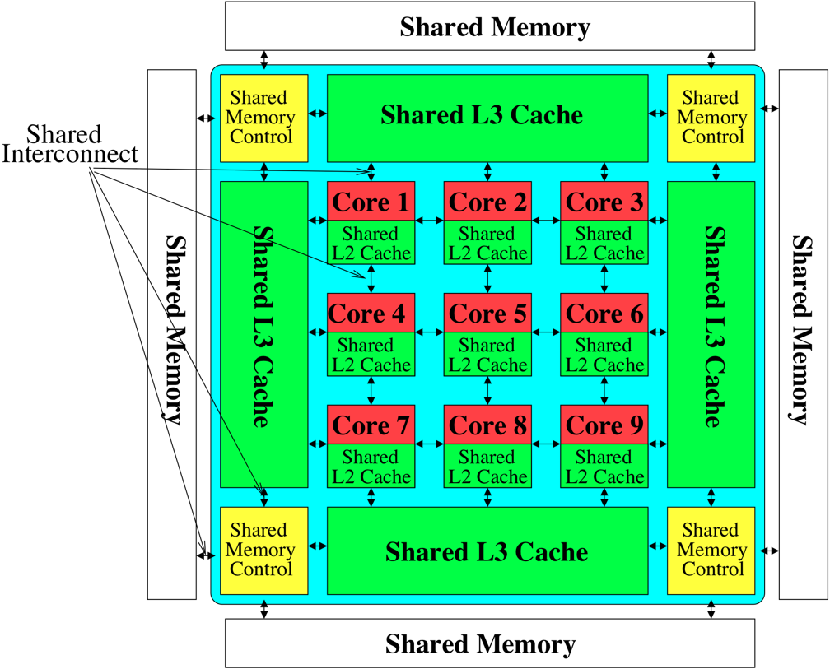
Perils of Processor-Centric Design
Most of the system is dedicated to storing and moving data
Yet, system is still bottlenecked by memory

Slide 17
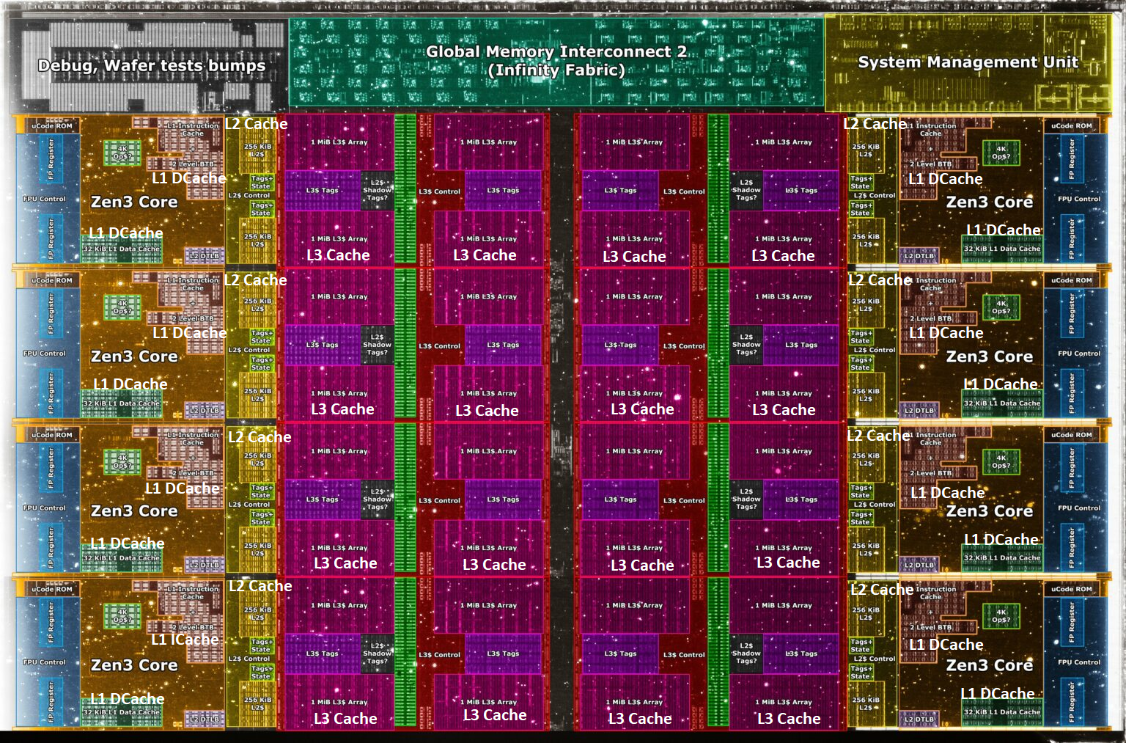
A Solution: Deeper and Larger Memory Hierarchies
Core Count:
8 cores/16 threads
L1 Caches:
32 KB per core
L2 Caches:
512 KB per core
L3 Cache:
32 MB shared
AMD Ryzen 5000, 2020
https://wccftech.com/amd-ryzen-5000-zen-3-vermeer-undressed-high-res-die-shots-close-ups-pictured-detailed/

Slide 18
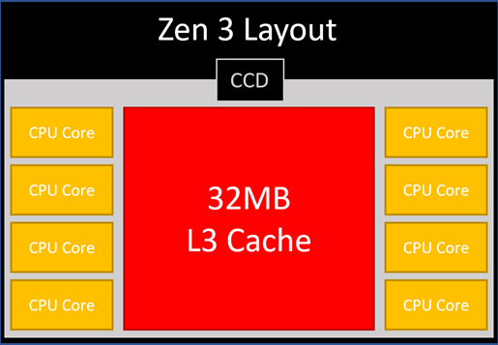
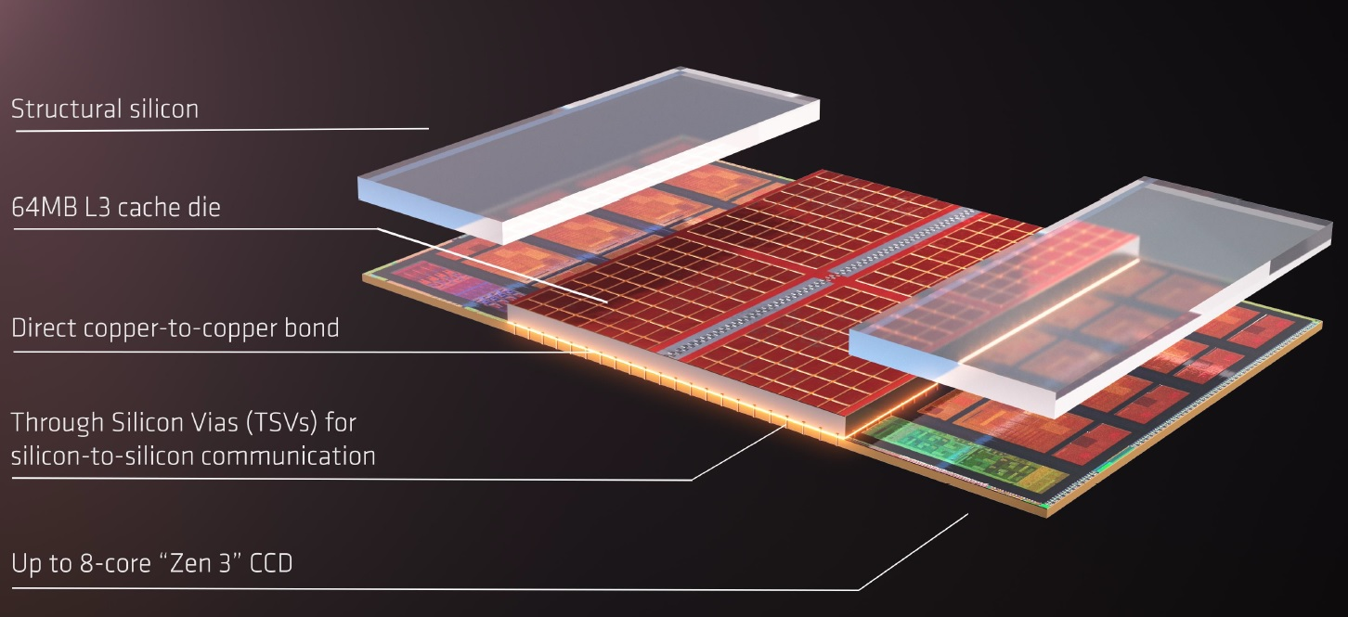
AMD’s 3D Last Level Cache (2021)
AMD increases the L3 size of their 8-core Zen 3 processors from 32 MB to 96 MB
Additional 64 MB L3 cache die stacked on top of the processor die
- Connected using Through Silicon Vias (TSVs)
- Total of 96 MB L3 cache
https://community.microcenter.com/discussion/5134/comparing-zen-3-to-zen-2
https://youtu.be/gqAYMx34euU
https://www.tech-critter.com/amd-keynote-computex-2021/
Notes:
CCD = Core Chiplet Die
Structural silicon is used to equalize the height and facilitate heat dissipation from the cores.

Slide 19
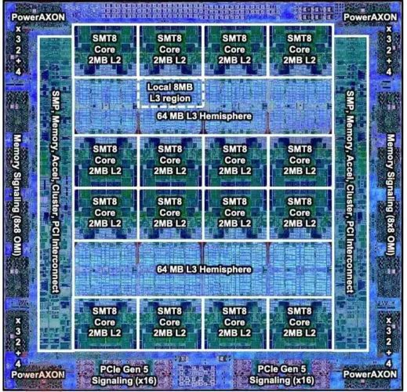
Deeper and Larger Memory Hierarchies
IBM POWER10,
2020
Cores:
15-16 cores,
8 threads/core
L2 Caches:
2 MB per core
L3 Cache:
120 MB shared
https://www.it-techblog.de/ibm-power10-prozessor-mehr-speicher-mehr-tempo-mehr-sicherheit/09/2020/

Slide 20
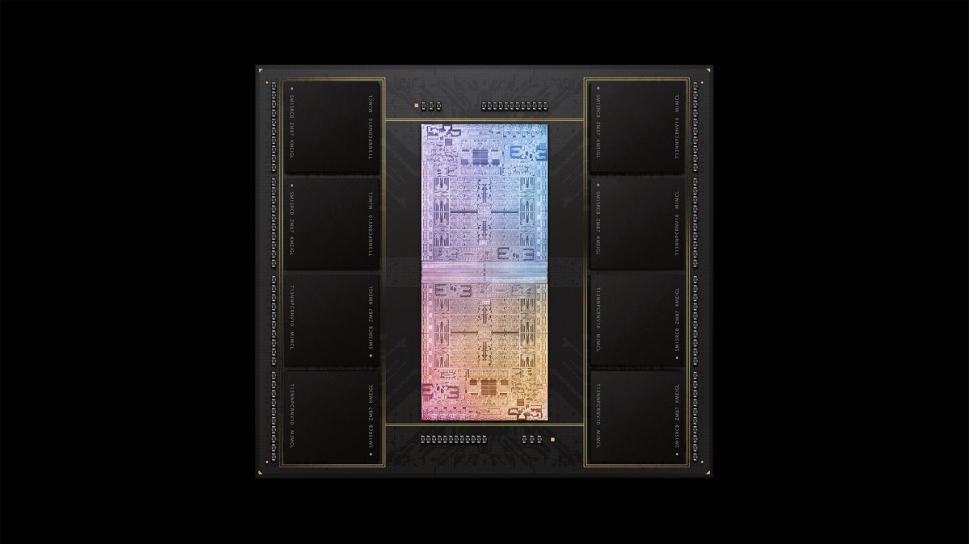
Deeper and Larger Memory Hierarchies
A lot of
SRAM
Storage
DRAM
DRAM
Storage
Apple M1 Ultra System (2022)
https://www.gsmarena.com/apple_announces_m1_ultra_with_20core_cpu_and_64core_gpu-news-53481.php

Slide 21
Data Movement Overwhelms Modern Machines
Amirali Boroumand, Saugata Ghose, Youngsok Kim, Rachata Ausavarungnirun, Eric Shiu, Rahul Thakur, Daehyun Kim, Aki Kuusela, Allan Knies, Parthasarathy Ranganathan, and Onur Mutlu, "Google Workloads for Consumer Devices: Mitigating Data Movement Bottlenecks" Proceedings of the 23rd International Conference on Architectural Support for Programming Languages and Operating Systems (ASPLOS), Williamsburg, VA, USA, March 2018.
62.7% of the total system energy
is spent on data movement

Slide 22
Data Movement Overwhelms Accelerators
Amirali Boroumand, Saugata Ghose, Berkin Akin, Ravi Narayanaswami, Geraldo F. Oliveira, Xiaoyu Ma, Eric Shiu, and Onur Mutlu, "Google Neural Network Models for Edge Devices: Analyzing and Mitigating Machine Learning Inference Bottlenecks" Proceedings of the 30th International Conference on Parallel Architectures and Compilation Techniques (PACT), Virtual, September 2021. [Slides (pptx) (pdf)] [Talk Video (14 minutes)]
> 90% of the total system energy
is spent on memory in large ML models

Slide 23
The Problem
Data access is the major performance and energy bottleneck
Our current
design principles
cause great energy waste
(and great performance loss)

Slide 24
The Problem
Processing of data
is performed
far away from the data

Slide 25
Today’s Computing Systems
Processor centric
All data processed in the processor → at great system cost

Slide 26
Yet …
“It’s the Memory, Stupid!” (Richard Sites, MPR, 1996)
Mutlu+, “Runahead Execution: An Alternative to Very Large Instruction Windows for Out-of-Order Processors,” HPCA 2003.

Slide 27
The Performance Perspective
Onur Mutlu, Jared Stark, Chris Wilkerson, and Yale N. Patt, "Runahead Execution: An Alternative to Very Large Instruction Windows for Out-of-order Processors" Proceedings of the 9th International Symposium on High-Performance Computer Architecture (HPCA), pages 129-140, Anaheim, CA, February 2003. Slides (pdf)
One of the 15 computer arch. papers of 2003 selected as Top Picks by IEEE Micro. HPCA Test of Time Award (awarded in 2021).

Slide 28
The Performance Perspective (Today)
All of Google’s Data Center Workloads (2015):
Kanev+, “Profiling a Warehouse-Scale Computer,” ISCA 2015.

Slide 29
The Performance Perspective (Today)
All of Google’s Data Center Workloads (2015):
Kanev+, “Profiling a Warehouse-Scale Computer,” ISCA 2015.

Slide 30
Perils of Processor-Centric Design
Grossly-imbalanced systems
Processing done only in one place
All else just stores and moves data: data moves a lot
→ Energy inefficient
→ Low performance
→ Complex
Overly complex and bloated processor (and accelerators)
To tolerate data access from memory
Complex hierarchies and mechanisms
→ Energy inefficient
→ Low performance
→ Complex

Slide 31
The Energy Perspective
Dally, HiPEAC 2015

Slide 32
Data Movement vs. Computation Energy
Dally, HiPEAC 2015
A memory access consumes ~100-1000X
the energy of a complex addition

Slide 33
Data Movement vs. Computation Energy
Han+, “EIE: Efficient Inference Engine on Compressed Deep Neural Network,” ISCA 2016.

Slide 34
Data Movement vs. Computation Energy
6400X
A memory access consumes 6400X
the energy of a simple integer addition
Han+, “EIE: Efficient Inference Engine on Compressed Deep Neural Network,” ISCA 2016.

Slide 35
We Do Not Want to Move Data!
Dally, HiPEAC 2015
A memory access consumes ~100-1000X
the energy of a complex addition

Slide 36
We Need A Paradigm Shift To …
Enable computation with minimal data movement
Compute where it makes sense (where data resides)
Make computing architectures more data-centric

Slide 37
Axiom
An Intelligent Architecture
Handles Data Well

Slide 38
How to Handle Data Well
Ensure data does not overwhelm the components
via intelligent algorithms
via intelligent architectures
via whole system designs: algorithm-architecture-devices
Take advantage of vast amounts of data and metadata
to improve architectural & system-level decisions
Understand and exploit properties of (different) data
to improve algorithms & architectures in various metrics

Slide 39
Corollaries: Computing Systems Today …
Are processor-centric vs. data-centric
Make designer-dictated decisions vs. data-driven
Make component-based myopic decisions vs. data-aware

Slide 40
Architectures for Intelligent Machines
Data-centric
Data-driven
Data-aware

Slide 41
A Blueprint for Fundamentally Better Architectures
Onur Mutlu, "Intelligent Architectures for Intelligent Computing Systems" Invited Paper in Proceedings of the Design, Automation, and Test in Europe Conference (DATE), Virtual, February 2021. [Slides (pptx) (pdf)] [IEDM Tutorial Slides (pptx) (pdf)] [Short DATE Talk Video (11 minutes)] [Longer IEDM Tutorial Video (1 hr 51 minutes)]

Slide 42
We Need to Revisit the Entire Stack
Problem
Algorithm
Program/Language
System Software
SW/HW Interface
Micro-architecture
Logic
Devices
Electrons
We can get there step by step

Slide 43
Data-Centric (Memory-Centric) Architectures

Slide 44
Data-Centric Architectures: Properties
Process data where it resides (where it makes sense)
Processing in and near memory structures
Low-latency and low-energy data access
Low latency memory
Low energy memory
Low-cost data storage and processing
High capacity memory at low cost: hybrid memory, compression
Intelligent data management
Intelligent controllers handling robustness, security, cost, perf.

Slide 45
Processing Data Where It Makes Sense

Slide 46
Process Data Where It Makes Sense
Sensors
A lot of
SRAM
Storage
DRAM
DRAM
Storage
Apple M1 Ultra System (2022)
https://www.gsmarena.com/apple_announces_m1_ultra_with_20core_cpu_and_64core_gpu-news-53481.php

Slide 47
We Need to Think Differently from the Past Approaches

Slide 48
Mindset: Memory as an Accelerator
CPU
core
CPU
core
mini-CPU
core
GPU
(throughput)
core
GPU
(throughput)
core
video
core
GPU
(throughput)
core
GPU
(throughput)
core
CPU
core
CPU
core
Memory
imaging
core
LLC
Specialized
compute-capability
in memory
Memory Controller
Memory Bus
Memory similar to a “conventional” accelerator
48

Slide 49
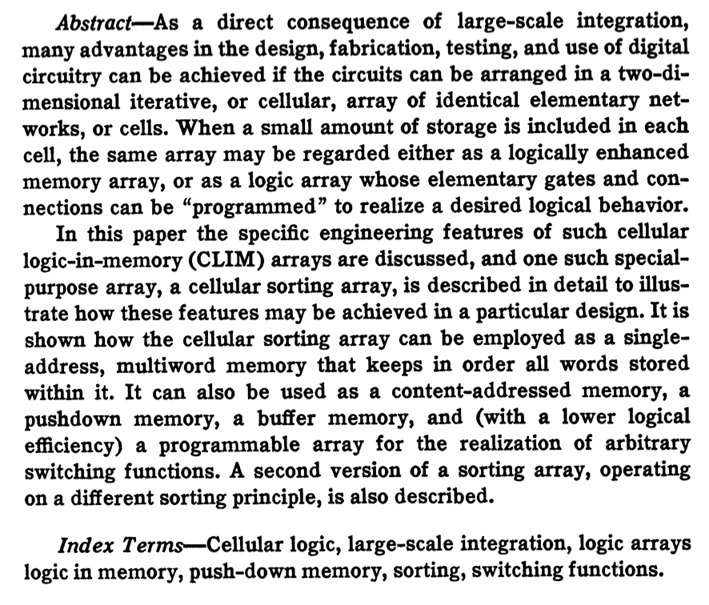
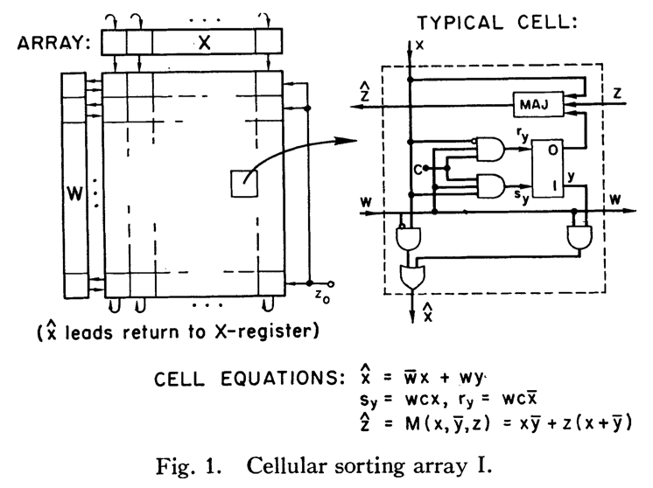
Processing in Memory: An Old Idea (I)
Kautz, “Cellular Logic-in-Memory Arrays”, IEEE TC 1969.
49
https://doi.org/10.1109/T-C.1969.222754

Slide 50
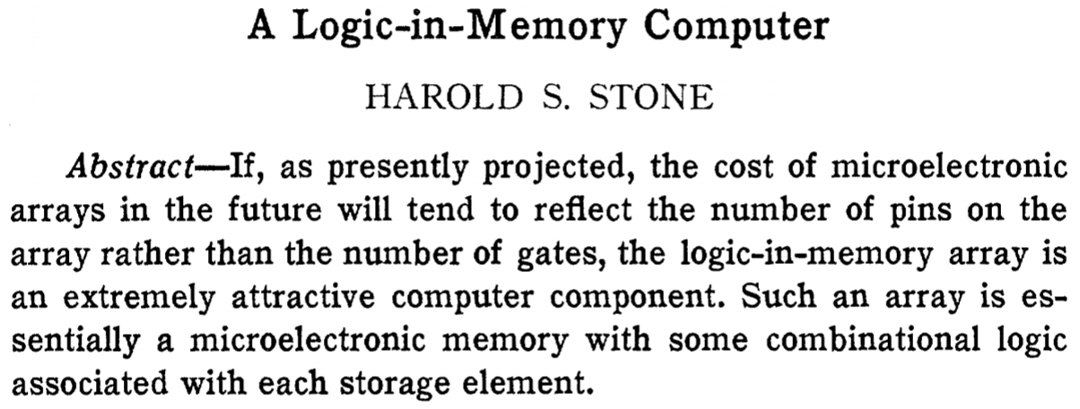
Processing in Memory: An Old Idea (II)
Stone, “A Logic-in-Memory Computer,” IEEE TC 1970.
https://safari.ethz.ch/architecture/fall2020/lib/exe/fetch.php?media=stone_logic_in_memory_1970.pdf

Slide 51
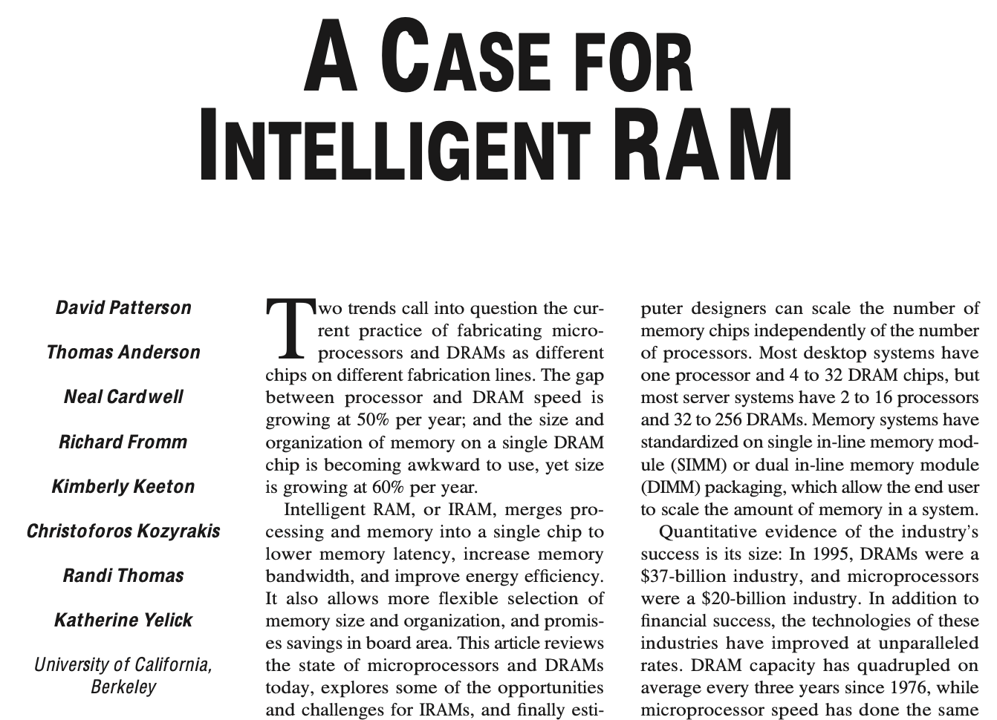
Processing in Memory: An Old Idea (III)
Patterson et al., “A Case for Intelligent RAM,” IEEE Micro 1997.
https://doi.org/10.1109/40.592312

Slide 52
Why In-Memory Computation Today?
Huge problems with Memory Technology
Memory technology scaling is not going well (e.g., RowHammer)
Many scaling issues demand intelligence in memory
Huge demand from Applications & Systems
Data access bottleneck
Energy & power bottlenecks
Data movement energy dominates computation energy
Need all at the same time: performance, energy, sustainability
We can improve all metrics by minimizing data movement
Designs are squeezed in the middle

Slide 53
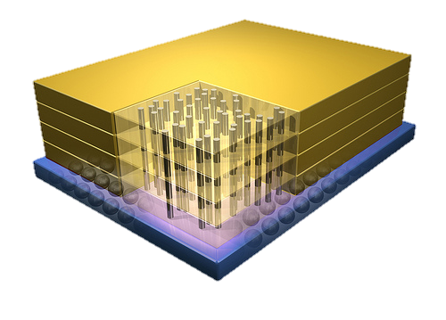
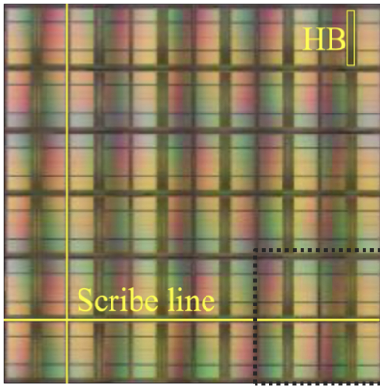
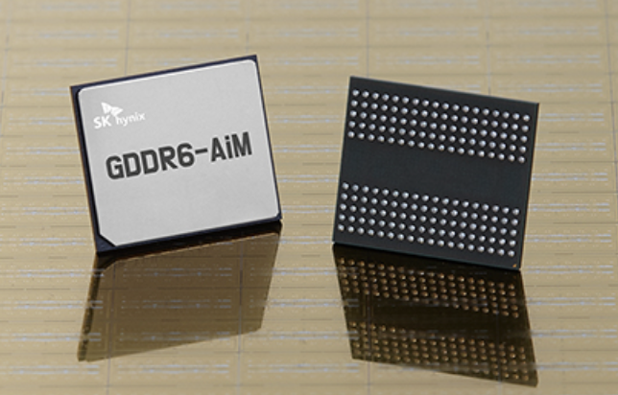
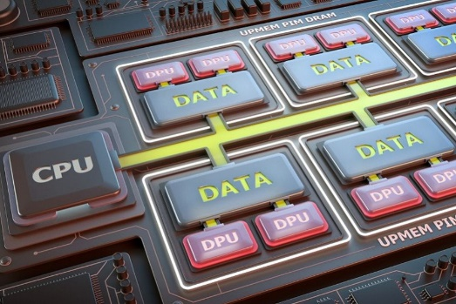
Processing-in-Memory Landscape Today
[Samsung 2021]
[Alibaba 2022]
[SK Hynix 2022]
[Samsung 2021]
[UPMEM 2019]
And, many other experimental chips and startups

Slide 54
Memory Scaling Issues Are Real
Onur Mutlu, "Memory Scaling: A Systems Architecture Perspective" Proceedings of the 5th International Memory Workshop (IMW), Monterey, CA, May 2013. Slides (pptx) (pdf) EETimes Reprint
54
https://people.inf.ethz.ch/omutlu/pub/memory-scaling_memcon13.pdf

Slide 55
A Curious Phenomenon [Kim et al., ISCA 2014]
One can
predictably induce errors
in most DRAM memory chips
Kim+, “Flipping Bits in Memory Without Accessing Them: An Experimental Study of DRAM Disturbance Errors,” ISCA 2014.

Slide 56
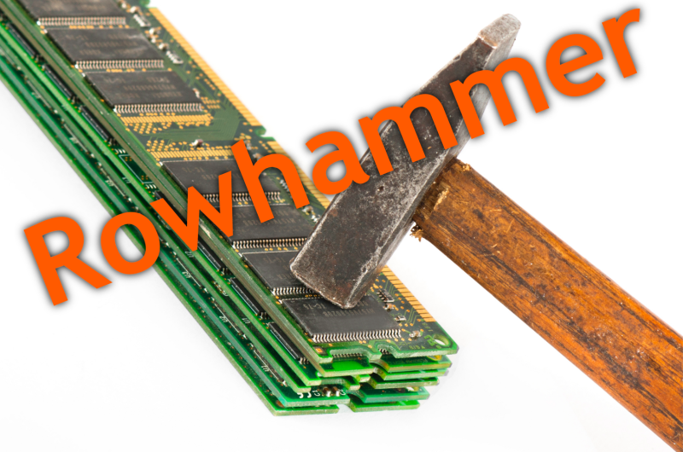
56
Notes:
Picture from the article:
http://thehackernews.com/2015/03/dram-rowhammer-vulnerability.html

Slide 57
Modern Memory is Prone to Disturbance Errors
Row of Cells
Wordline
Row
Victim Row
Row
Hammered Row
V_{LOW}
Opened
V_{HIGH}
Closed
Row
Victim Row
Row
Repeatedly reading a row enough times (before memory gets refreshed) induces disturbance errors in adjacent rows in most real DRAM chips you can buy today
Flipping Bits in Memory Without Accessing Them: An Experimental Study of DRAM Disturbance Errors, (Kim et al., ISCA 2014)

Slide 58
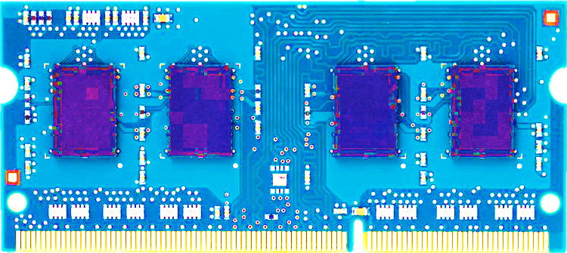
Most DRAM Modules Are Vulnerable
A company
B company
C company
86%
(37/43)
83%
(45/54)
88%
(28/32)
Up to
1.0×10⁷ errors
Up to
2.7×10⁶ errors
Up to
3.3×10⁵ errors
Flipping Bits in Memory Without Accessing Them: An Experimental Study of DRAM Disturbance Errors, (Kim et al., ISCA 2014)

Slide 59
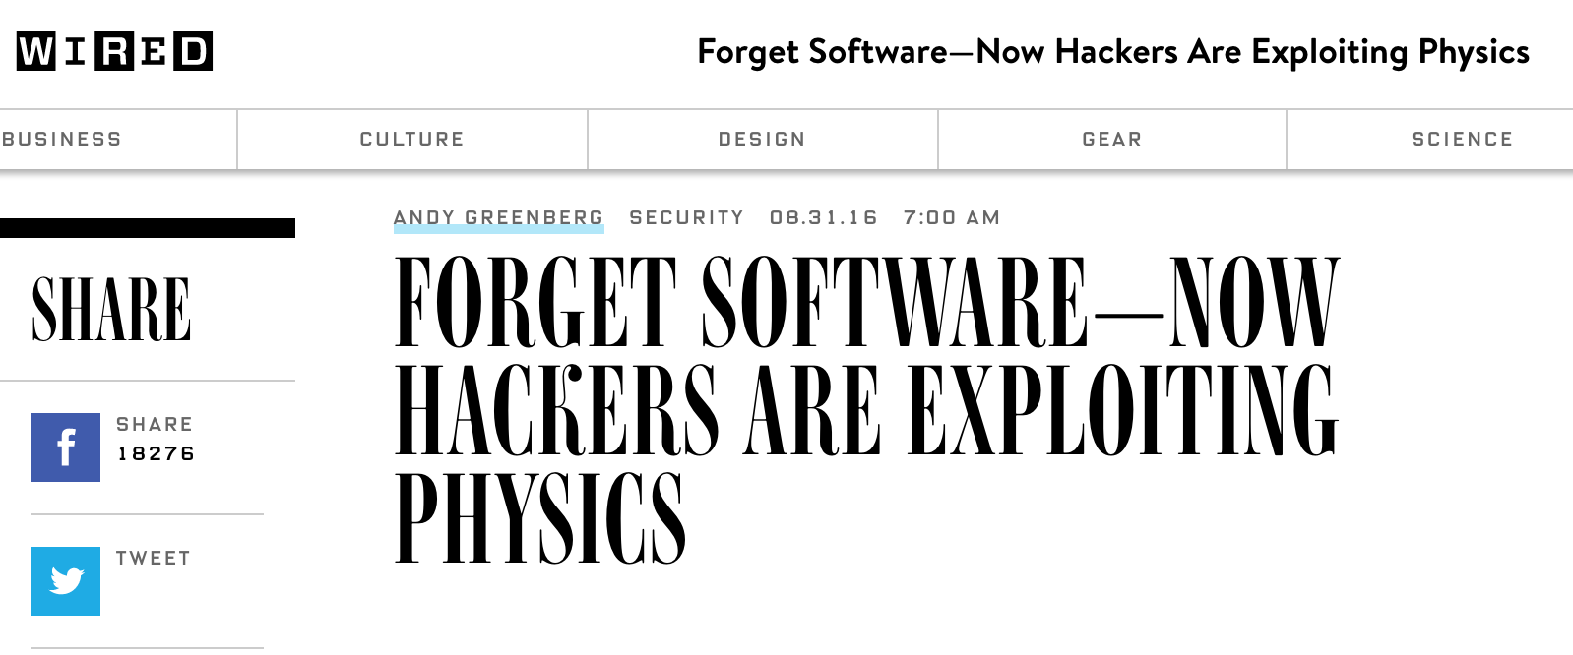
The RowHammer Vulnerability
A simple hardware failure mechanism
can create a widespread
system security vulnerability
59

Slide 60
RowHammer [ISCA 2014]
Yoongu Kim, Ross Daly, Jeremie Kim, Chris Fallin, Ji Hye Lee, Donghyuk Lee, Chris Wilkerson, Konrad Lai, and Onur Mutlu, "Flipping Bits in Memory Without Accessing Them: An Experimental Study of DRAM Disturbance Errors" Proceedings of the 41st International Symposium on Computer Architecture (ISCA), Minneapolis, MN, June 2014. [Slides (pptx) (pdf)] [Lightning Session Slides (pptx) (pdf)] [Source Code and Data] [Lecture Video (1 hr 49 mins), 25 September 2020] One of the 7 papers of 2012-2017 selected as Top Picks in Hardware and Embedded Security for IEEE TCAD (link). Selected to the ISCA-50 25-Year Retrospective Issue covering 1996-2020 in 2023 (Retrospective (pdf) Full Issue).

Slide 61
Memory Scaling Issues Are Real
Onur Mutlu and Jeremie Kim, "RowHammer: A Retrospective" IEEE Transactions on Computer-Aided Design of Integrated Circuits and Systems (TCAD) Special Issue on Top Picks in Hardware and Embedded Security, 2019. [Preliminary arXiv version] [Slides from COSADE 2019 (pptx)] [Slides from VLSI-SOC 2020 (pptx) (pdf)] [Talk Video (1 hr 15 minutes, with Q&A)]

Slide 62
Memory Scaling Issues Are Real
Onur Mutlu, Ataberk Olgun, and A. Giray Yaglikci, "Fundamentally Understanding and Solving RowHammer" Invited Special Session Paper at the 28th Asia and South Pacific Design Automation Conference (ASP-DAC), Tokyo, Japan, January 2023. [arXiv version] [Slides (pptx) (pdf)] [Talk Video (26 minutes)]
https://arxiv.org/pdf/2211.07613.pdf

Slide 63
The Story of RowHammer Tutorial …
Onur Mutlu, "Security Aspects of DRAM: The Story of RowHammer" Invited Tutorial at 14th IEEE Electron Devices Society International Memory Workshop (IMW), Dresden, Germany, May 2022. [Slides (pptx)(pdf)] [Tutorial Video (57 minutes)]
https://www.youtube.com/watch?v=37hWglkQRG0

Slide 64
10 Years of RowHammer in 20 Minutes
Onur Mutlu, "The Story of RowHammer" Invited Talk at the Workshop on Robust and Safe Software 2.0 (RSS2), held with the 27th International Conference on Architectural Support for Programming Languages and Operating Systems (ASPLOS), Virtual, 28 February 2022. [Slides (pptx) (pdf)]
https://www.youtube.com/watch?v=ctKTRyi96Bk

Slide 65
Latest RowHammer Lecture
https://www.youtube.com/watch?v=p1pjF8WvERQ

Slide 66
The Push from Circuits and Devices
Main Memory Needs
Intelligent Controllers

Slide 67
An Example Intelligent Controller
A. Giray Yaglikci, Minesh Patel, Jeremie S. Kim, Roknoddin Azizi, Ataberk Olgun, Lois Orosa, Hasan Hassan, Jisung Park, Konstantinos Kanellopoulos, Taha Shahroodi, Saugata Ghose, and Onur Mutlu, "BlockHammer: Preventing RowHammer at Low Cost by Blacklisting Rapidly-Accessed DRAM Rows" Proceedings of the 27th International Symposium on High-Performance Computer Architecture (HPCA), Virtual, February-March 2021. [Slides (pptx) (pdf)] [Short Talk Slides (pptx) (pdf)] [Intel Hardware Security Academic Awards Short Talk Slides (pptx) (pdf)] [Talk Video (22 minutes)] [Short Talk Video (7 minutes)] [Intel Hardware Security Academic Awards Short Talk Video (2 minutes)] [BlockHammer Source Code] Intel Hardware Security Academic Award Finalist (one of 4 finalists out of 34 nominations)

Slide 68
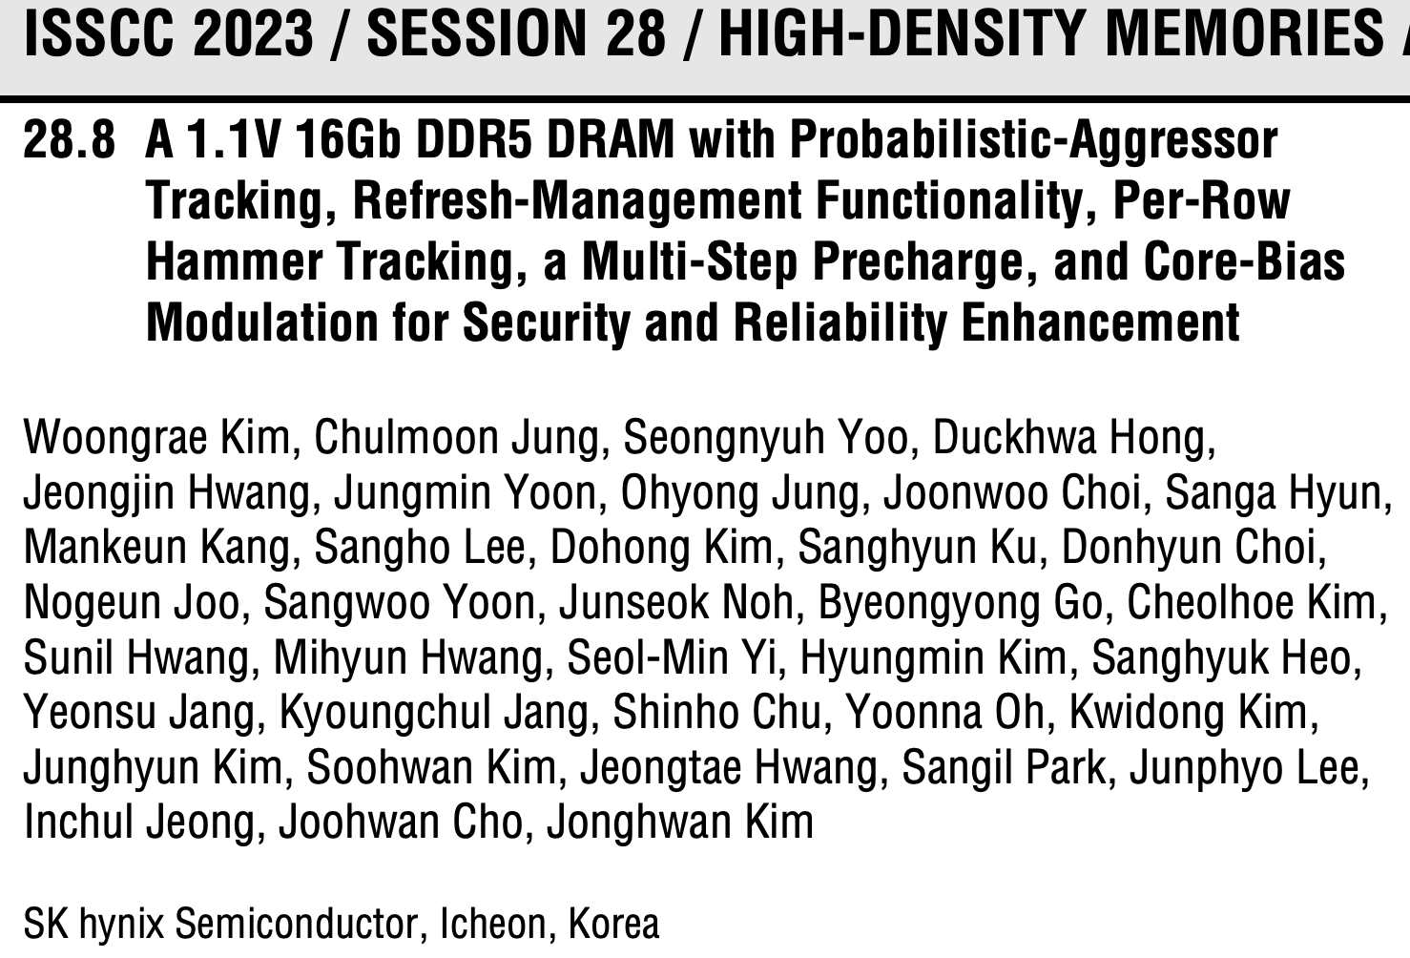
Industry’s Intelligent DRAM Controllers (I)

Slide 69
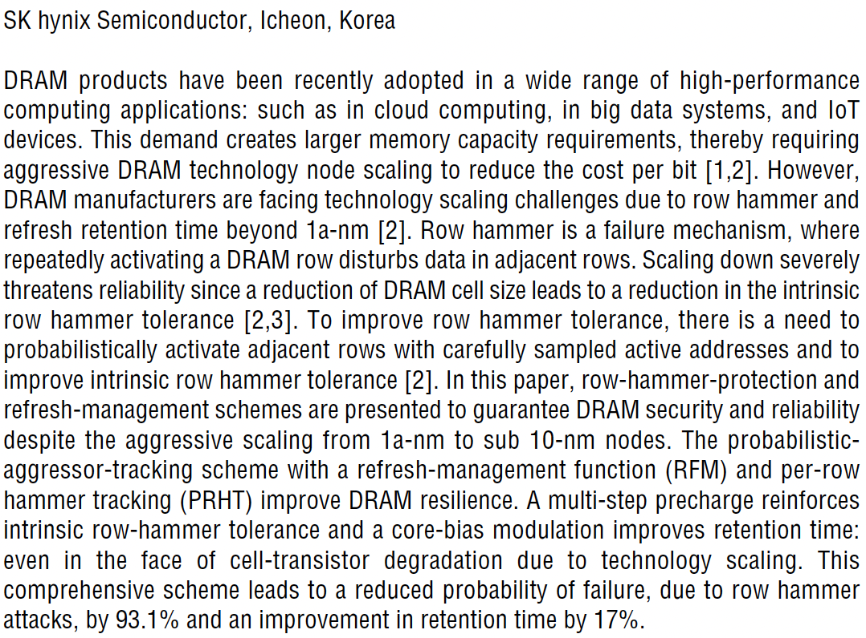
Industry’s Intelligent DRAM Controllers (II)

Slide 70
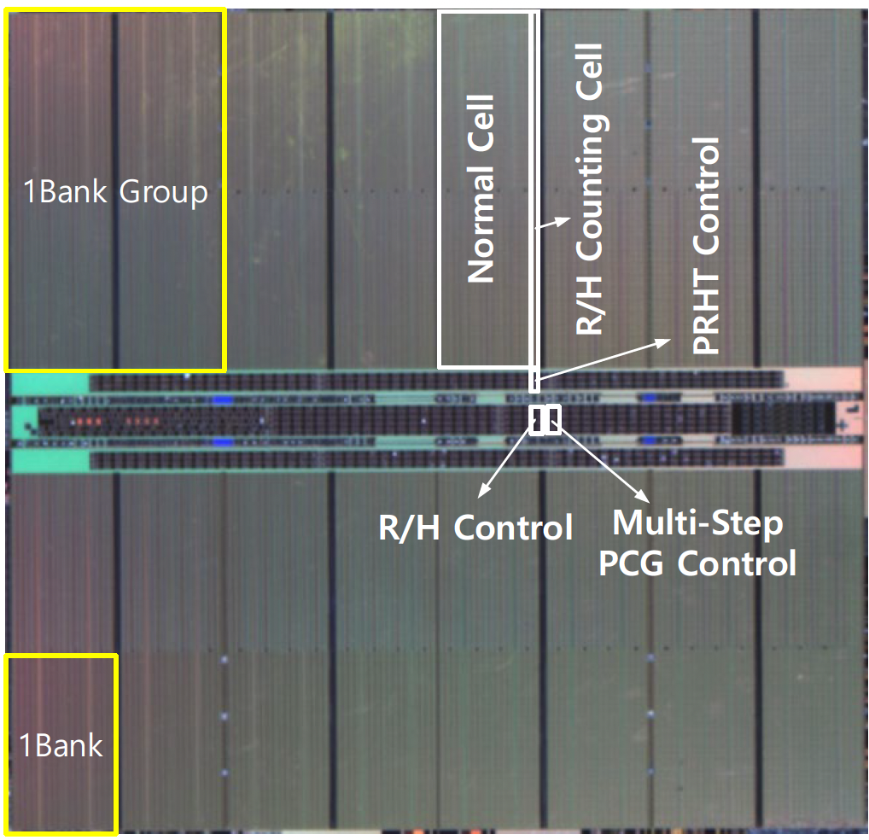
Industry’s Intelligent DRAM Controllers (III)

Slide 71
Industry’s Intelligent DRAM Controllers (IV)
https://arxiv.org/pdf/2302.03591v1.pdf

Slide 72
Are We Now BitFlip Free?
Appears at ISCA 2023

Slide 73
RowPress [ISCA 2023]
Haocong Luo, Ataberk Olgun, Giray Yaglikci, Yahya Can Tugrul, Steve Rhyner, M. Banu Cavlak, Joel Lindegger, Mohammad Sadrosadati, and Onur Mutlu, "RowPress: Amplifying Read Disturbance in Modern DRAM Chips" Proceedings of the 50th International Symposium on Computer Architecture (ISCA), Orlando, FL, USA, June 2023. [Slides (pptx) (pdf)] [Lightning Talk Slides (pptx) (pdf)] [Lightning Talk Video (3 minutes)] [RowPress Source Code and Datasets (Officially Artifact Evaluated with All Badges)] Officially artifact evaluated as available, reusable and reproducible. Best artifact award at ISCA 2023.
73

Slide 74
Emerging Memories Also Need Intelligent Controllers
Benjamin C. Lee, Engin Ipek, Onur Mutlu, and Doug Burger, "Architecting Phase Change Memory as a Scalable DRAM Alternative" Proceedings of the 36th International Symposium on Computer Architecture (ISCA), pages 2-13, Austin, TX, June 2009. Slides (pdf) One of the 13 computer architecture papers of 2009 selected as Top Picks by IEEE Micro. Selected as a CACM Research Highlight. 2022 Persistent Impact Prize.

Slide 75
Industry Is Writing Papers About It, Too

Slide 76
Call for Intelligent Memory Controllers

Slide 77
The Takeaway
Intelligent
Memory Controllers
Can Avoid Many Failures
& Enable Better Scaling

Slide 78
Three Key Systems & Application Trends
1. Data access is the major bottleneck
Applications are increasingly data hungry
2. Energy consumption is a key limiter
3. Data movement energy dominates compute
Especially true for off-chip to on-chip movement

Slide 79
Challenge and Opportunity for Future
High Performance,
Energy Efficient,
Sustainable
(All at the Same Time)

Slide 80
Goal: Processing Inside Memory
Many questions … How do we design the:
compute-capable memory & controllers?
processors & communication units?
software & hardware interfaces?
system software, compilers, languages?
algorithms & theoretical foundations?
Memory
Processor
Core
Database
Graphs
Media
Cache
Query
Interconnect
Problem
Results
Algorithm
Program/Language
System Software
SW/HW Interface
Micro-architecture
Logic
Devices
Electrons

Slide 81
PIM Review and Open Problems
Onur Mutlu, Saugata Ghose, Juan Gomez-Luna, and Rachata Ausavarungnirun, "A Modern Primer on Processing in Memory" Invited Book Chapter in Emerging Computing: From Devices to Systems - Looking Beyond Moore and Von Neumann, Springer, 2022.
https://arxiv.org/pdf/1903.03988.pdf

Slide 82
Processing in Memory: Two Approaches
1. Processing near Memory
2. Processing using Memory

Slide 83
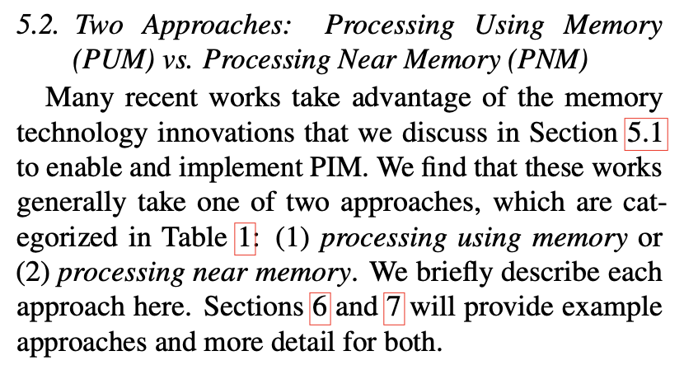
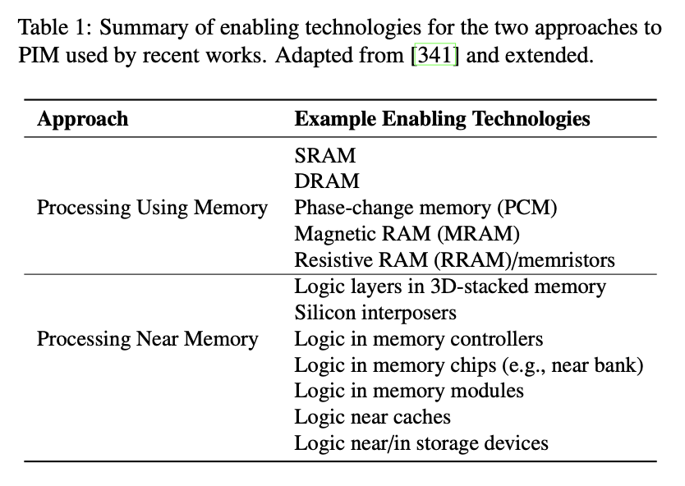
Two PIM Approaches
Onur Mutlu, Saugata Ghose, Juan Gomez-Luna, and Rachata Ausavarungnirun, "A Modern Primer on Processing in Memory" Invited Book Chapter in Emerging Computing: From Devices to Systems - Looking Beyond Moore and Von Neumann, Springer, to be published in 2021. [Tutorial Video on "Memory-Centric Computing Systems" (1 hour 51 minutes)]
https://people.inf.ethz.ch/omutlu/pub/ModernPrimerOnPIM_springer-emerging-computing-bookchapter21.pdf

Slide 84
Tutorial on Memory-Centric Computing: Introduction
Geraldo F. Oliveira
Prof. Onur Mutlu
ISCA 2024
29 June 2024

Slide 85
Agenda
Introduction to Memory-Centric Computing Systems
Invited Talk by Prof. Minsoo Rhu: “Memory-Centric Computing Systems – For AI and Beyond"
Coffee Break
Real-World Processing-Near-Memory Systems
Processing-Using-Memory Architectures for Bulk Bitwise Op.
Invited Talk by Prof. Saugata Ghose: “RACER and ReRAM PUM”
PIM Programming & Infrastructure for PIM Research
Closing Remarks

Slide 86
Agenda
Introduction to Memory-Centric Computing Systems
Invited Talk by Prof. Minsoo Rhu: “Memory-Centric Computing Systems – For AI and Beyond"
Coffee Break
Real-World Processing-Near-Memory Systems
Processing-Using-Memory Architectures for Bulk Bitwise Op.
Invited Talk by Prof. Saugata Ghose: “RACER and ReRAM PUM”
PIM Programming & Infrastructure for PIM Research
Closing Remarks

