Slide 1
Tutorial on Memory-Centric Computing: Conclusion Remarks
Geraldo F. Oliveira
Prof. Onur Mutlu
ISCA 2024
29 June 2024

Slide 2
Agenda
Introduction to Memory-Centric Computing Systems
Invited Talk by Prof. Minsoo Rhu: “Memory-Centric Computing Systems – For AI and Beyond”
Coffee Break
Real-World Processing-Near-Memory Systems
Processing-Using-Memory Architectures for Bulk Bitwise Op.
Invited Talk by Prof. Saugata Ghose: “RACER and ReRAM PUM”
PIM Programming & Infrastructure for PIM Research
Closing Remarks

Slide 3
Challenge and Opportunity for Future
Fundamentally
Energy-Efficient
(Data-Centric)
Computing Architectures

Slide 4
Challenge and Opportunity for Future
Fundamentally
High-Performance
(Data-Centric)
Computing Architectures

Slide 5
Challenge and Opportunity for Future
Computing Architectures
with
Minimal Data Movement

Slide 6
Concluding Remarks
We must design systems to be balanced, high-performance, energy-efficient (all at the same time) → intelligent systems
Data-centric, data-driven, data-aware
Enable computation capability inside and close to memory
This can
Lead to orders-of-magnitude improvements
Enable new applications & computing platforms
Enable better understanding of nature
…
Future of truly memory-centric computing is bright
We need to do research & design across the computing stack
Notes:
Perhaps we have taken processor-centric system design a bit too far

Slide 7
Fundamentally Better Architectures
Data-centric
Data-driven
Data-aware

Slide 8
We Need to Revisit the Entire Stack
Problem
Algorithm
Program/Language
System Software
SW/HW Interface
Micro-architecture
Logic
Devices
Electrons
We can get there step by step

Slide 9
We Need to Exploit Good Principles
Data-centric system design
All components intelligent
Better (cross-layer) communication, better interfaces
Better-than-worst-case design
Heterogeneity
Flexibility, adaptability
Open minds

Slide 10
PIM Review and Open Problems
Onur Mutlu, Saugata Ghose, Juan Gomez-Luna, and Rachata Ausavarungnirun, "A Modern Primer on Processing in Memory" Invited Book Chapter in Emerging Computing: From Devices to Systems - Looking Beyond Moore and Von Neumann, Springer, to be published in 2021.
https://arxiv.org/pdf/1903.03988.pdf

Slide 11
Special Research Sessions & Courses (I)
Special Session at ISVLSI 2022: 9 cutting-edge talks
https://www.youtube.com/watch?v=qeukNs5XI3g

Slide 12
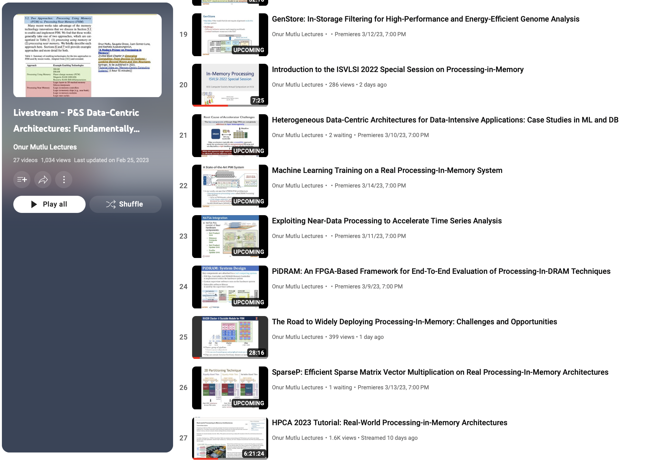
Special Research Sessions & Courses (II)
Special Session at ISVLSI 2022: 9 cutting-edge talks
https://www.youtube.com/playlist?list=PL5Q2soXY2Zi8KzG2CQYRNQOVD0GOBrnKy

Slide 13
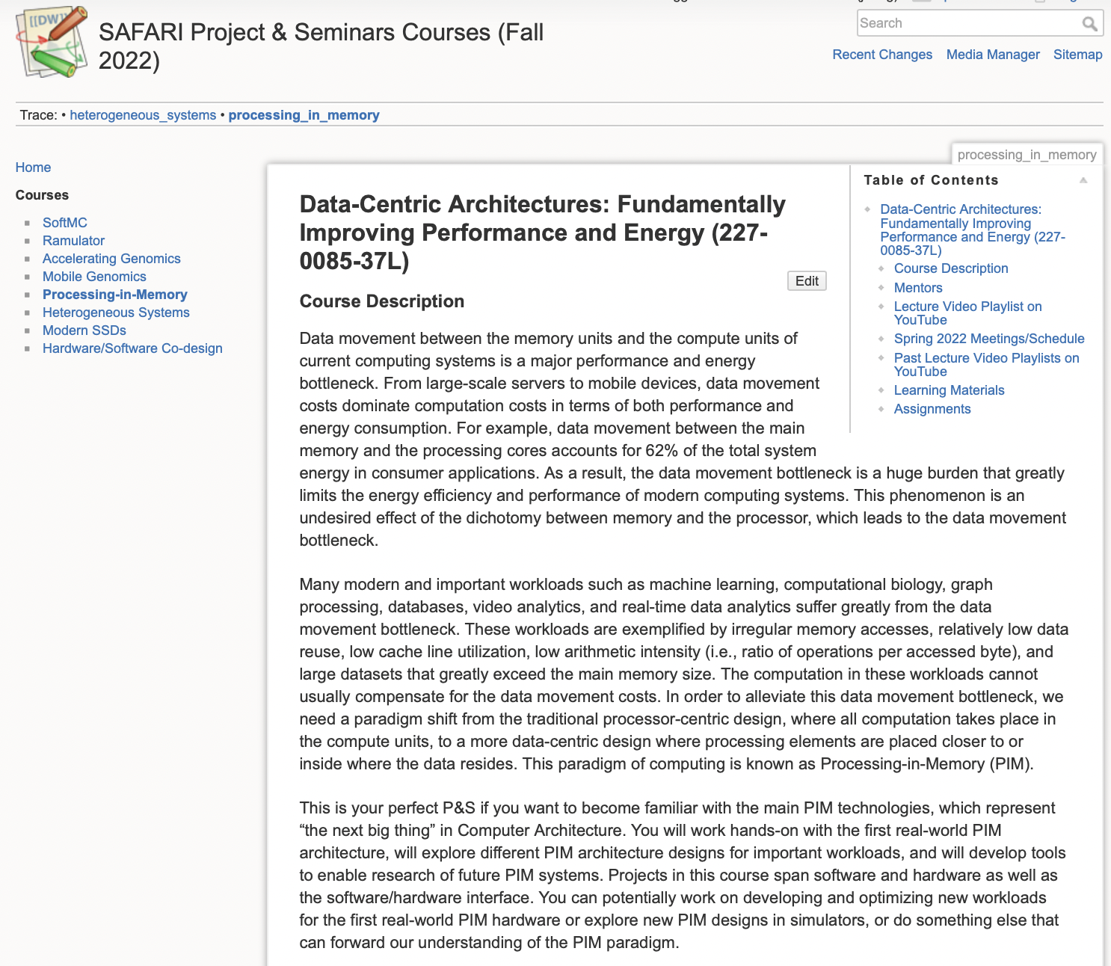
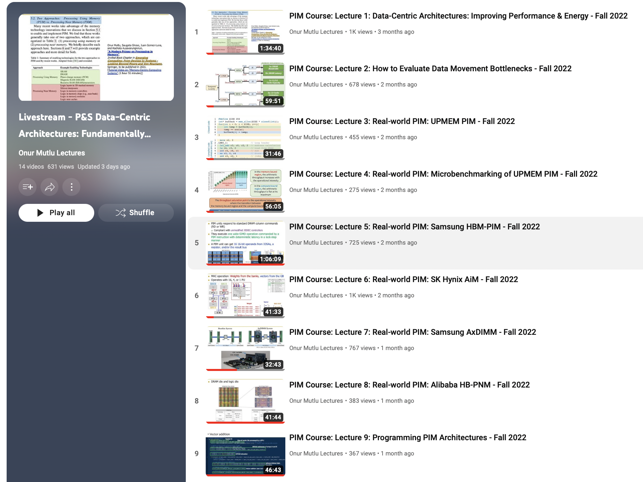
Processing-in-Memory Course (Fall 2022)
Short weekly lectures
Hands-on projects
https://safari.ethz.ch/projects_and_seminars/fall2022/doku.php?id=processing_in_memory
https://youtube.com/playlist?list=PL5Q2soXY2Zi8KzG2CQYRNQOVD0GOBrnKy

Slide 14
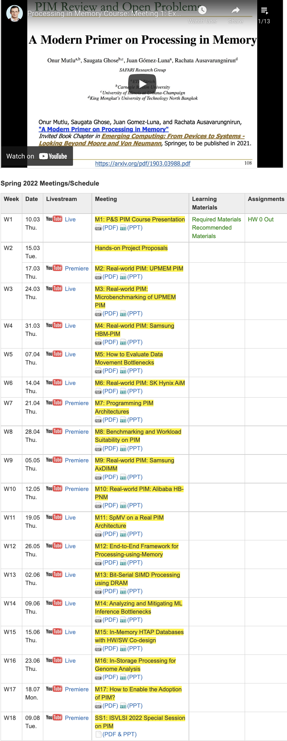
PIM Course (Fall 2022)
Fall 2022 Edition:
https://safari.ethz.ch/projects_and_seminars/fall2022/doku.php?id=processing_in_memory
Spring 2022 Edition:
https://safari.ethz.ch/projects_and_seminars/spring2022/doku.php?id=processing_in_memory
Youtube Livestream (Fall 2022):
https://www.youtube.com/watch?v=QLL0wQ9I4Dw&list=PL5Q2soXY2Zi8KzG2CQYRNQOVD0GOBrnKy
Youtube Livestream (Spring 2022):
https://www.youtube.com/watch?v=9e4Chnwdovo&list=PL5Q2soXY2Zi-841fUYYUK9EsXKhQKRPyX
Project course
Taken by Bachelor’s/Master’s students
Processing-in-Memory lectures
Hands-on research exploration
Many research readings
https://www.youtube.com/onurmutlulectures

Slide 15
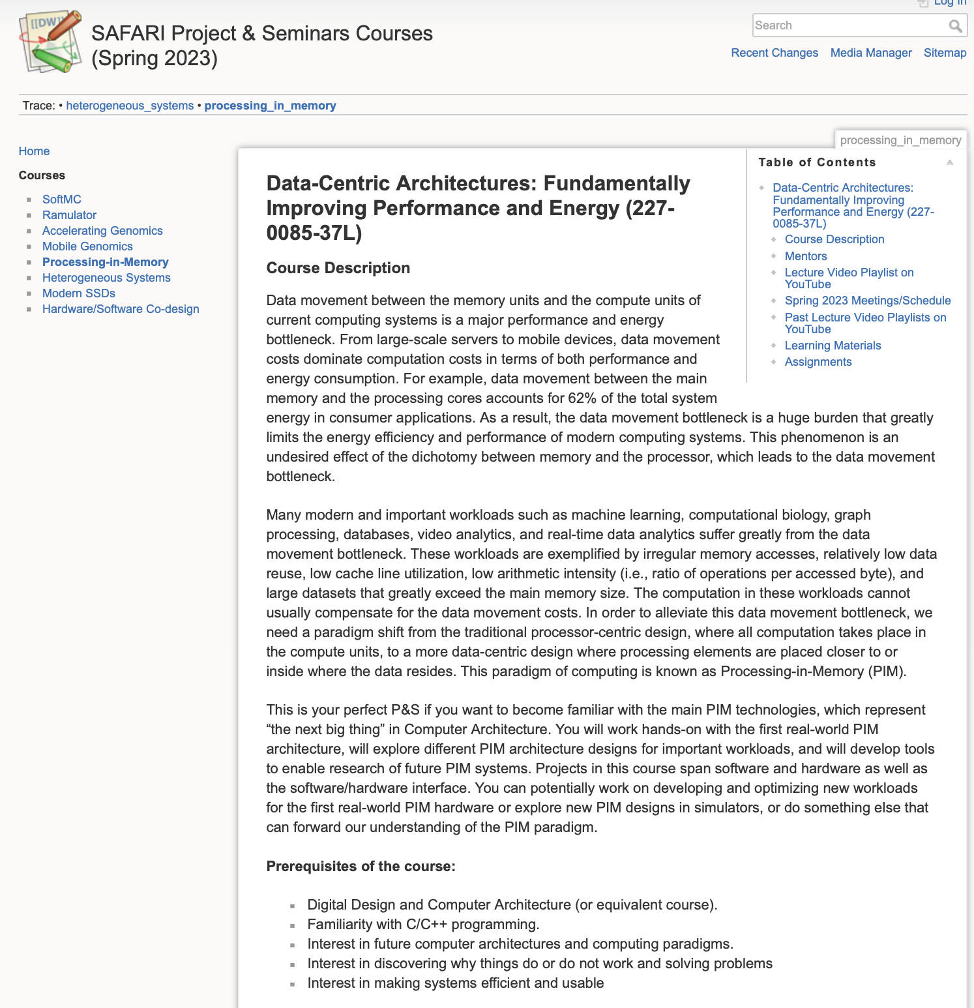
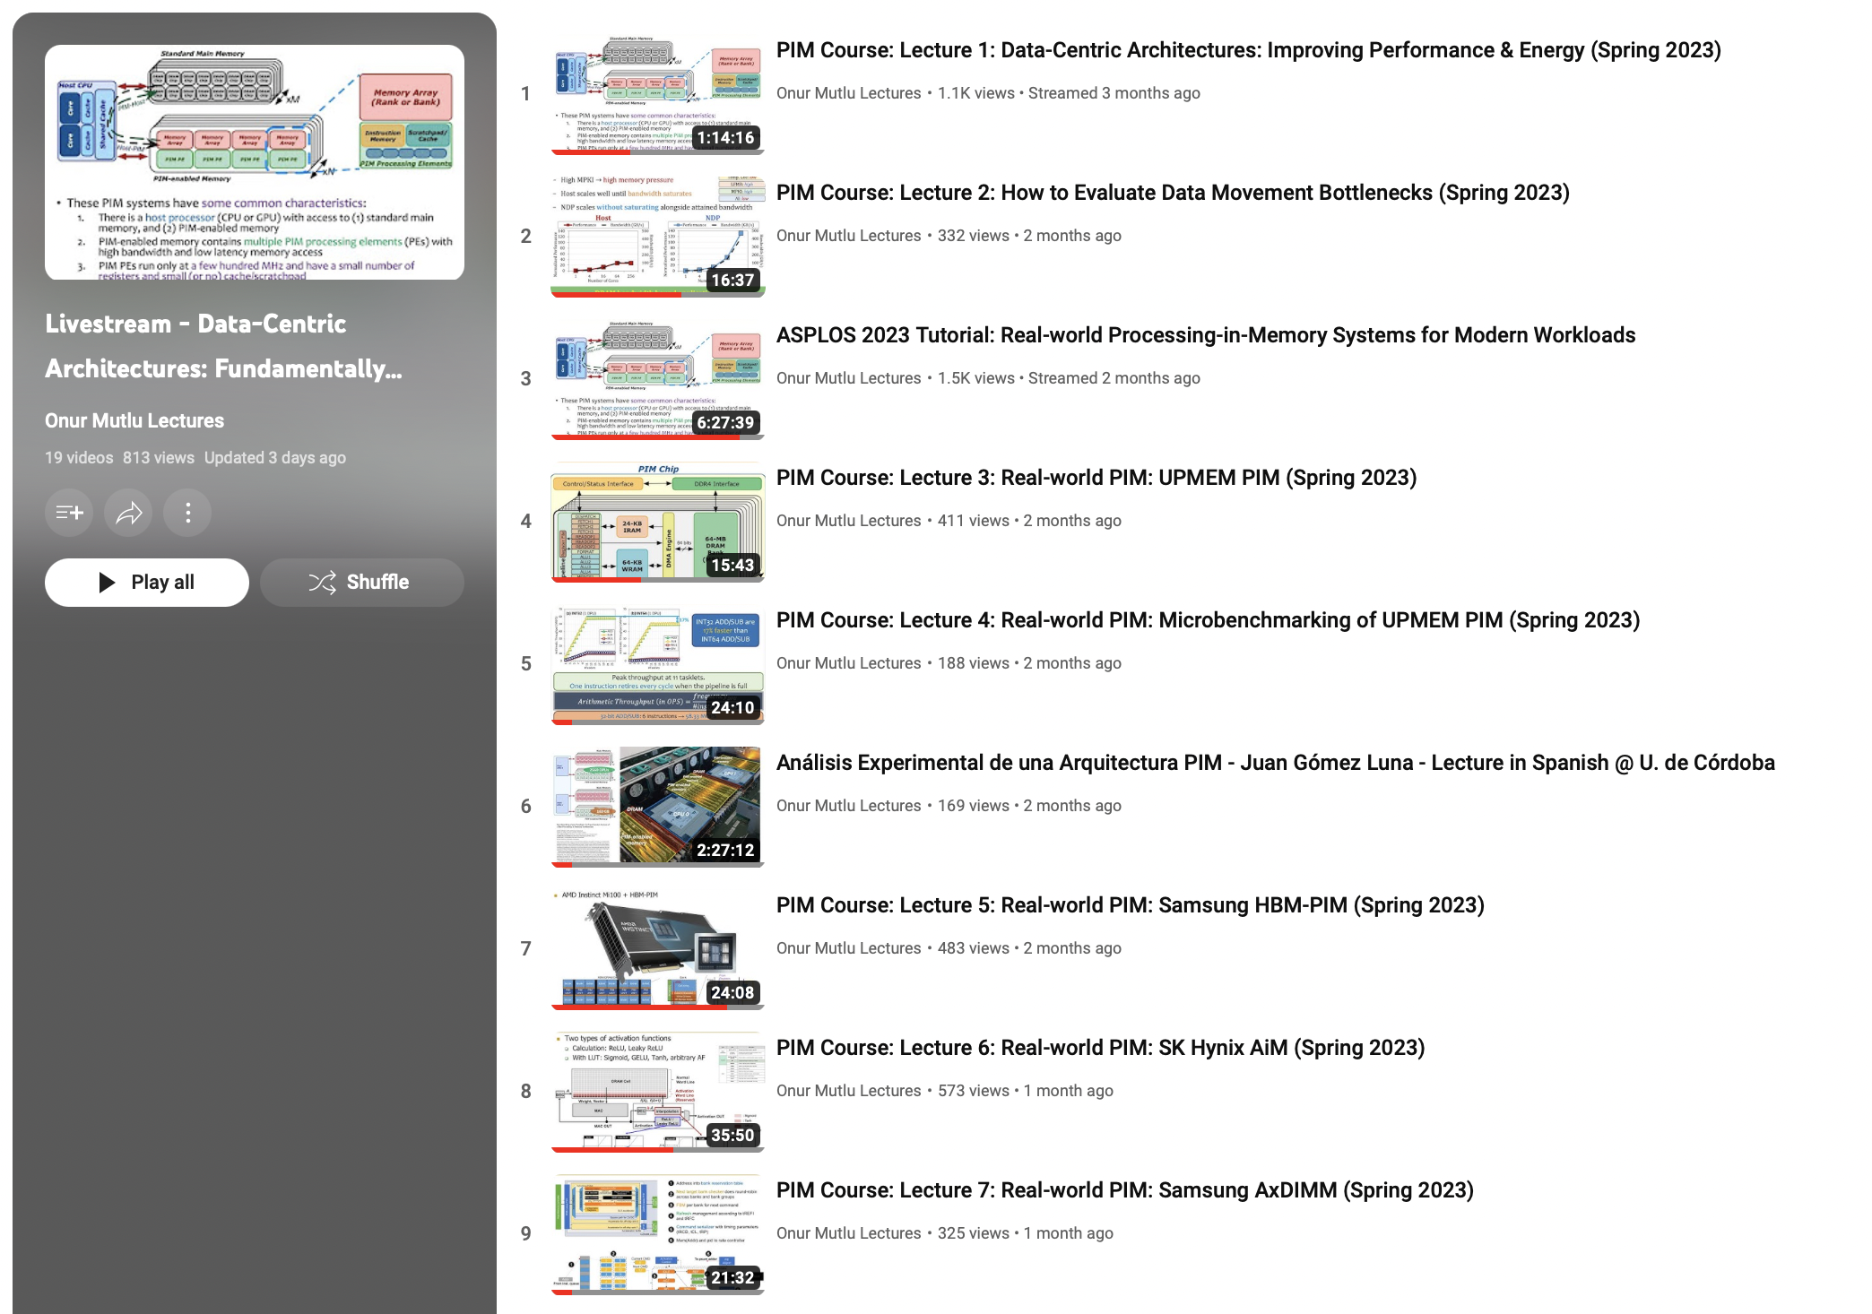
Processing-in-Memory Course (Spring 2023)
Short weekly lectures
Hands-on projects
https://www.youtube.com/playlist?list=PL5Q2soXY2Zi_EObuoAZVSq_o6UySWQHvZ
https://safari.ethz.ch/projects_and_seminars/spring2023/doku.php?id=processing_in_memory

Slide 16
Real PIM Tutorials [ISCA’23, ASPLOS’23, HPCA’23]
June, March, Feb : Lectures + Hands-on labs + Invited talks
https://events.safari.ethz.ch/isca-pim-tutorial/

Slide 17
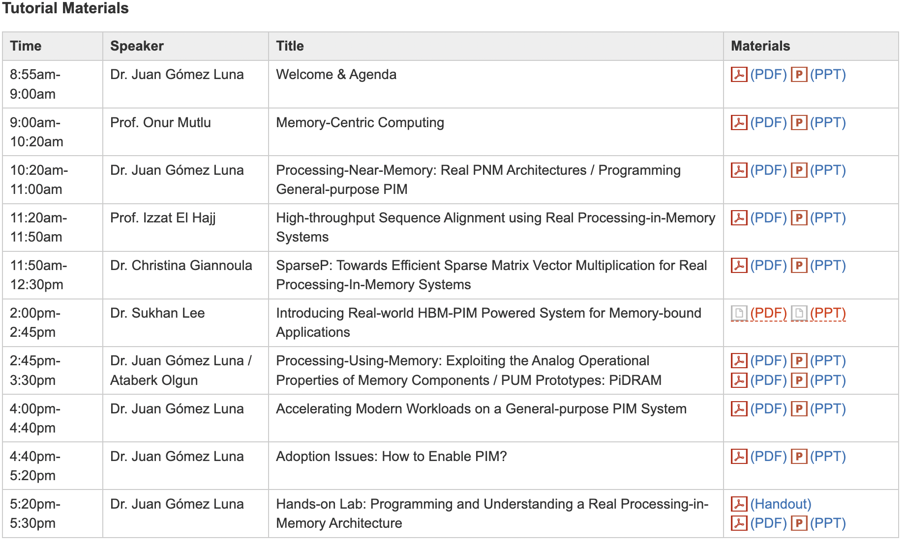
Real PIM Tutorial [ISCA 2023]
June 18: Lectures + Hands-on labs + Invited talks
https://www.youtube.com/live/GIb5EgSrWk0
https://events.safari.ethz.ch/isca-pim-tutorial/

Slide 18
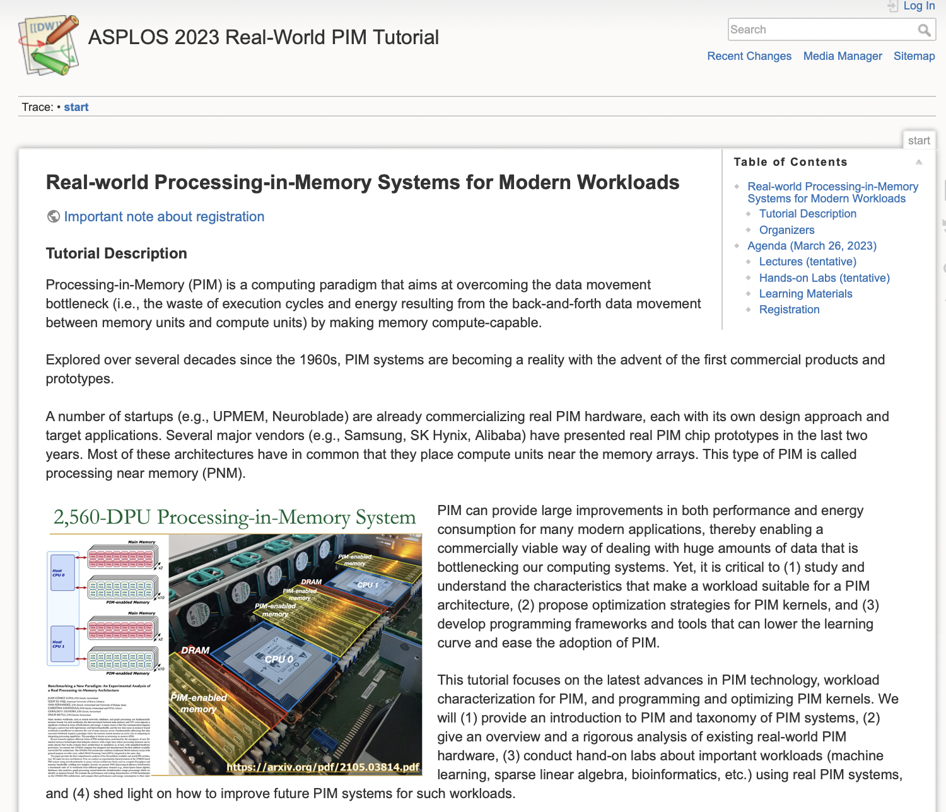
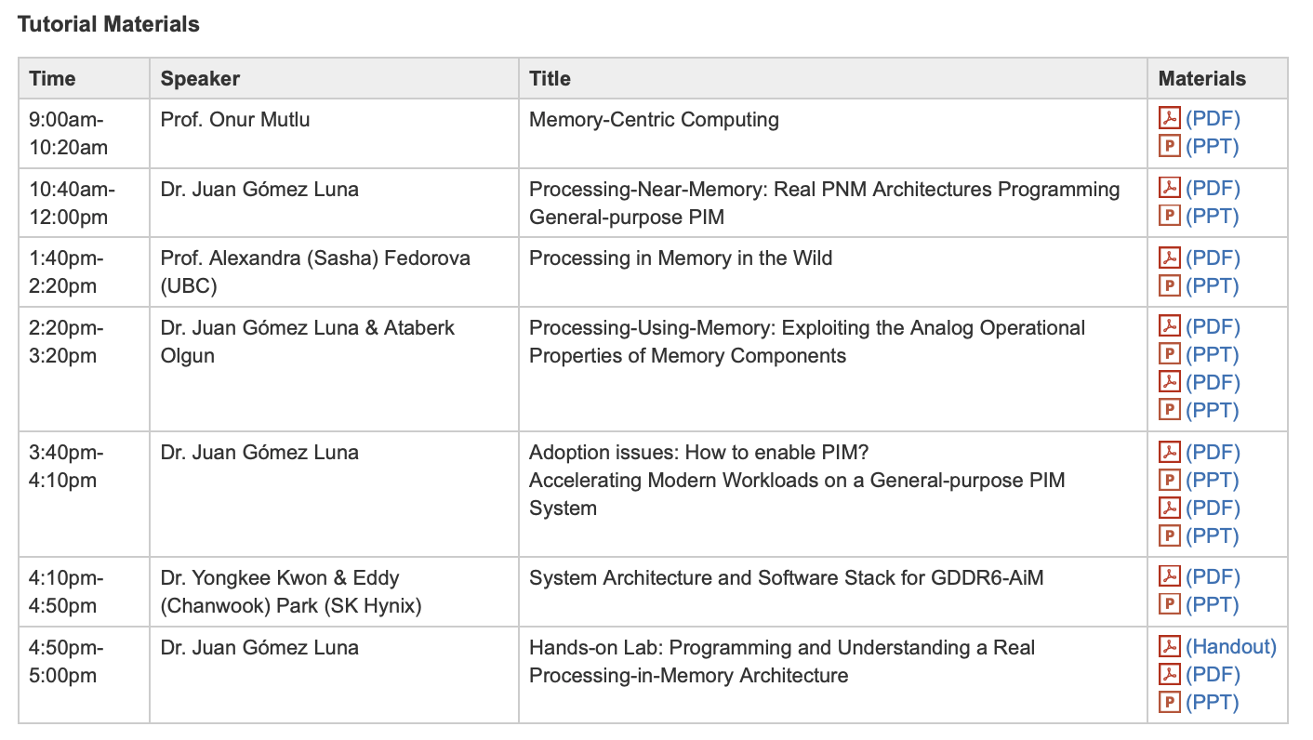
Real PIM Tutorial [ASPLOS 2023]
March 26: Lectures + Hands-on labs + Invited talks
https://www.youtube.com/watch?v=oYCaLcT0Kmo
https://events.safari.ethz.ch/asplos-pim-tutorial/

Slide 19
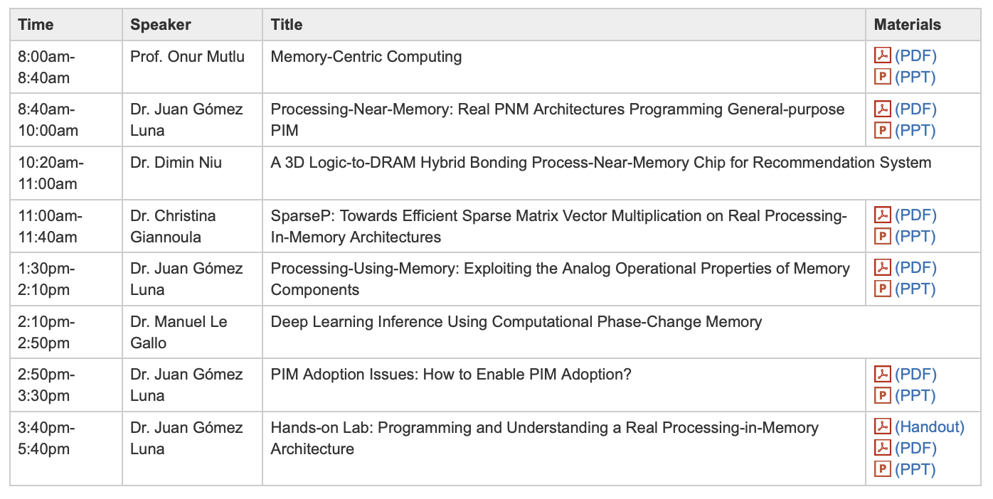
Real PIM Tutorial [HPCA 2023]
February 26: Lectures + Hands-on labs + Invited Talks
https://www.youtube.com/watch?v=f5-nT1tbz5w
https://events.safari.ethz.ch/real-pim-tutorial/

Slide 20
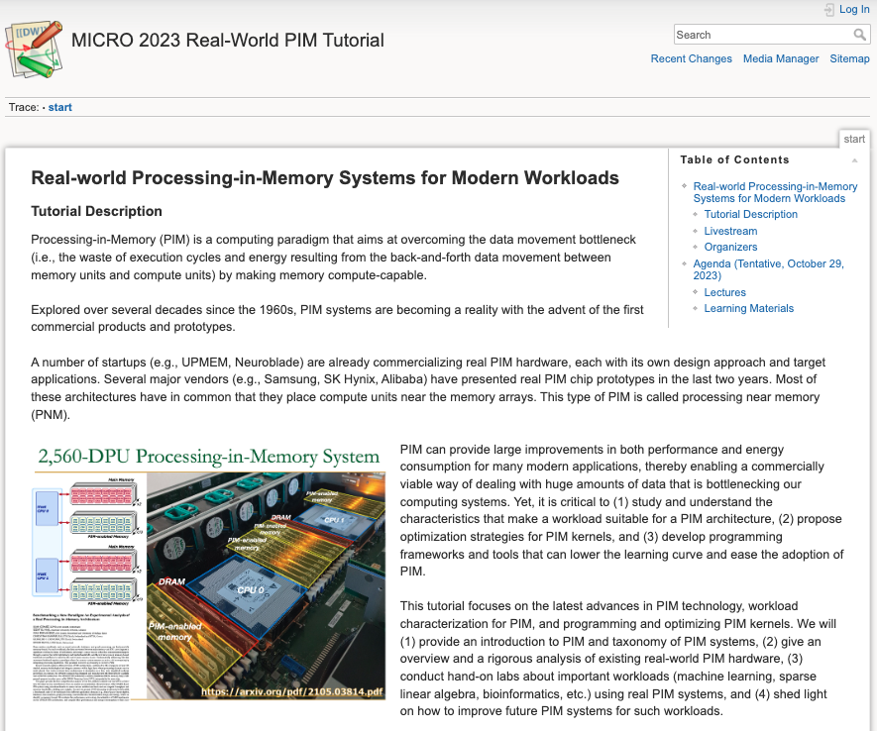
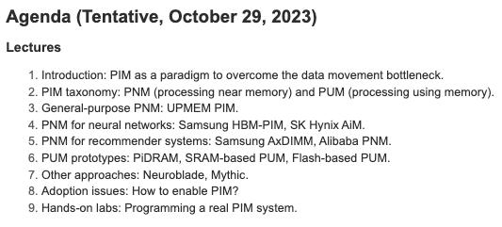
Real PIM Tutorial [MICRO 2023]
October 29: Lectures + Hands-on labs + Invited talks
https://www.youtube.com/ live/ohU00NSIxOI
https://events.safari.ethz.ch/micro-pim-tutorial

Slide 21
PIM Tutorial at HEART 2024
https://events.safari.ethz.ch/heart24-memorycentric-tutorial

Slide 22
This PIM Tutorial at ISCA 2024
https://events.safari.ethz.ch/isca24-memorycentric-tutorial

Slide 23
Referenced Papers, Talks, Artifacts
All are available at
https://people.inf.ethz.ch/omutlu/projects.htm
https://www.youtube.com/onurmutlulectures
https://github.com/CMU-SAFARI/

Slide 24
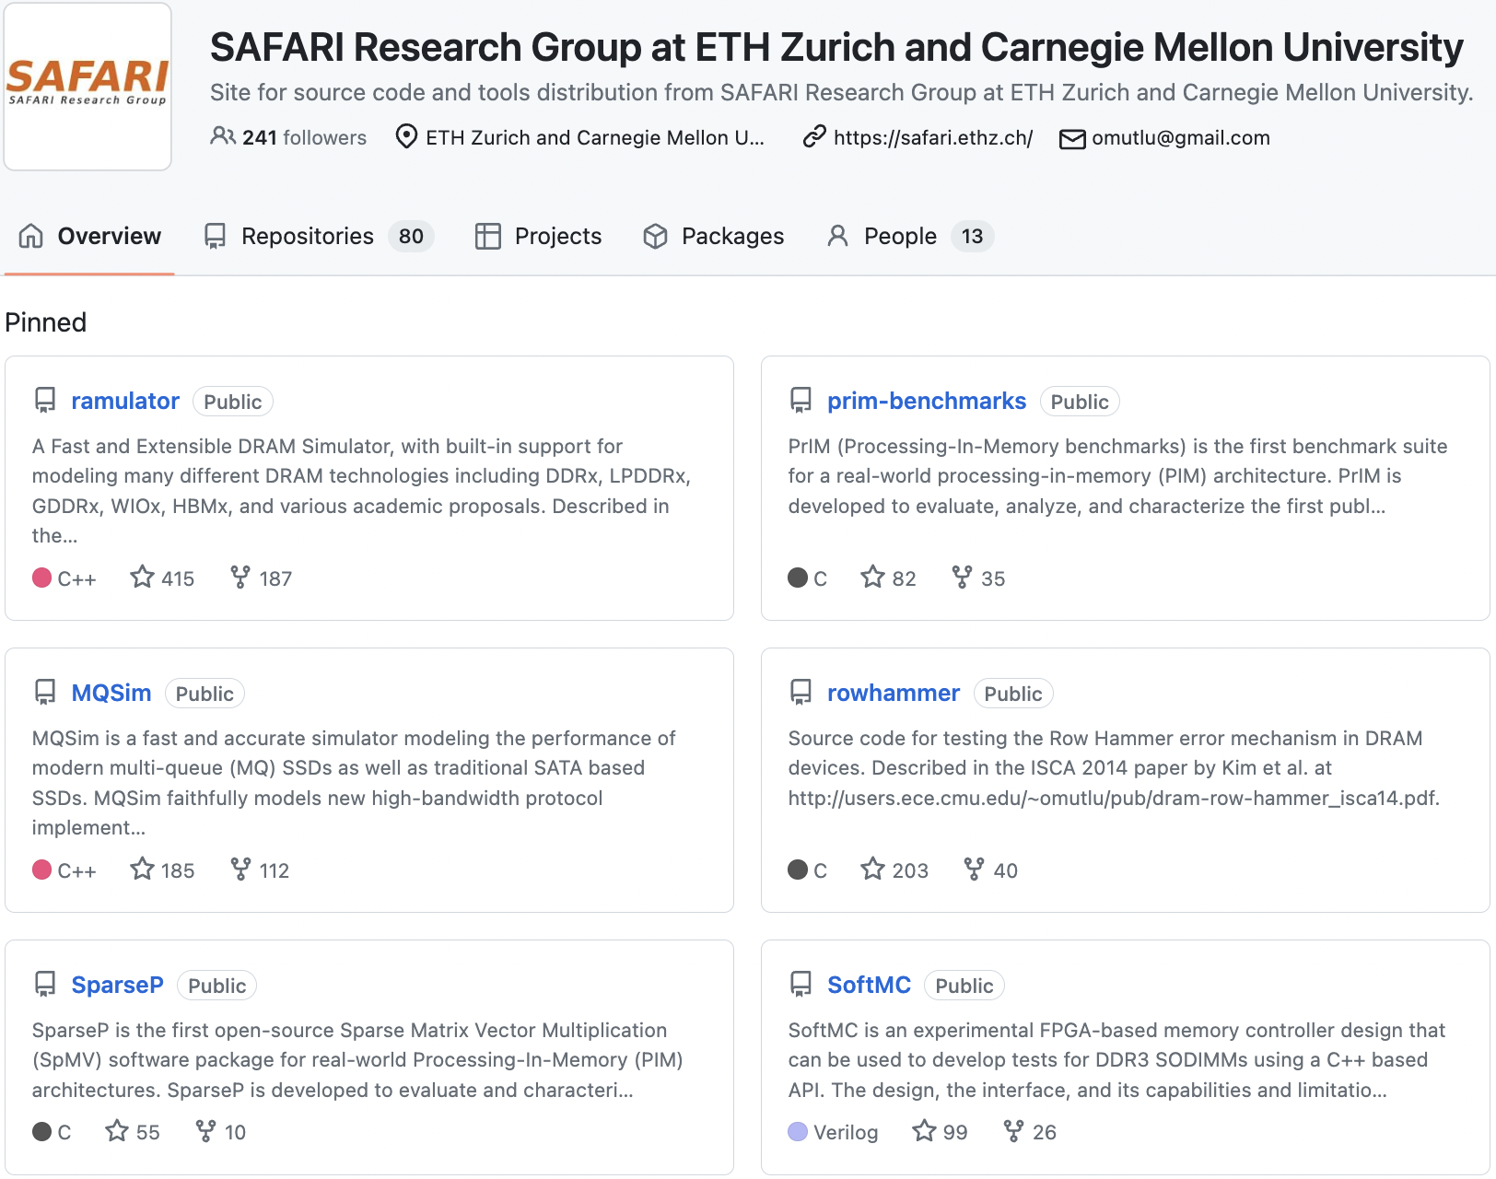
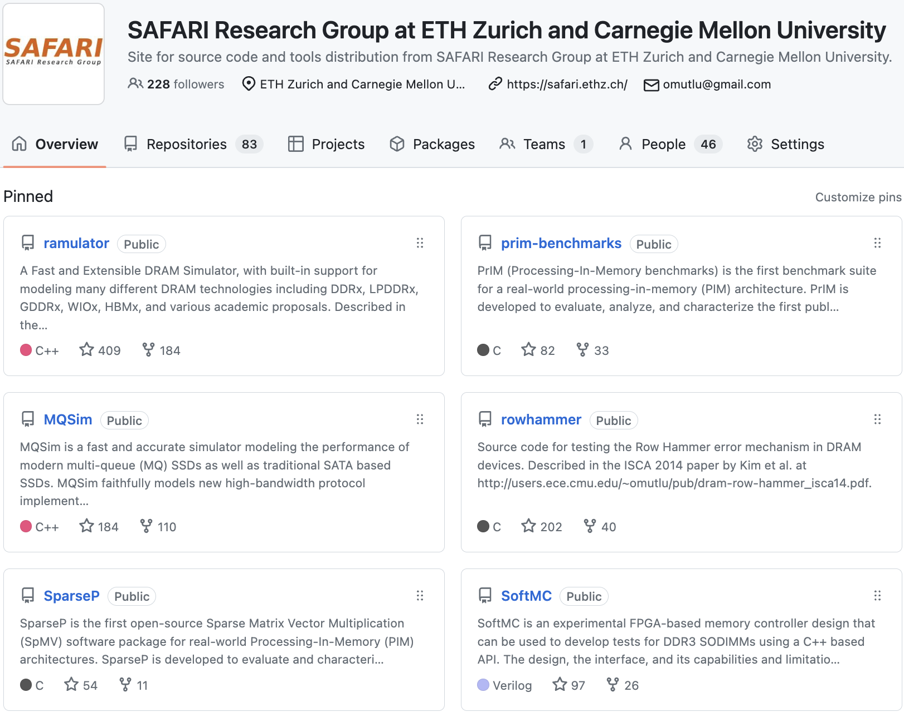
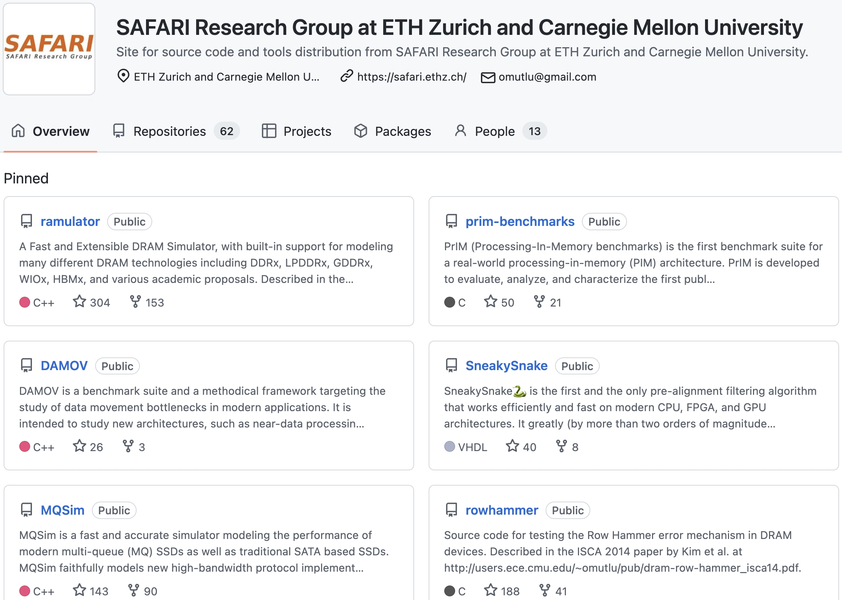
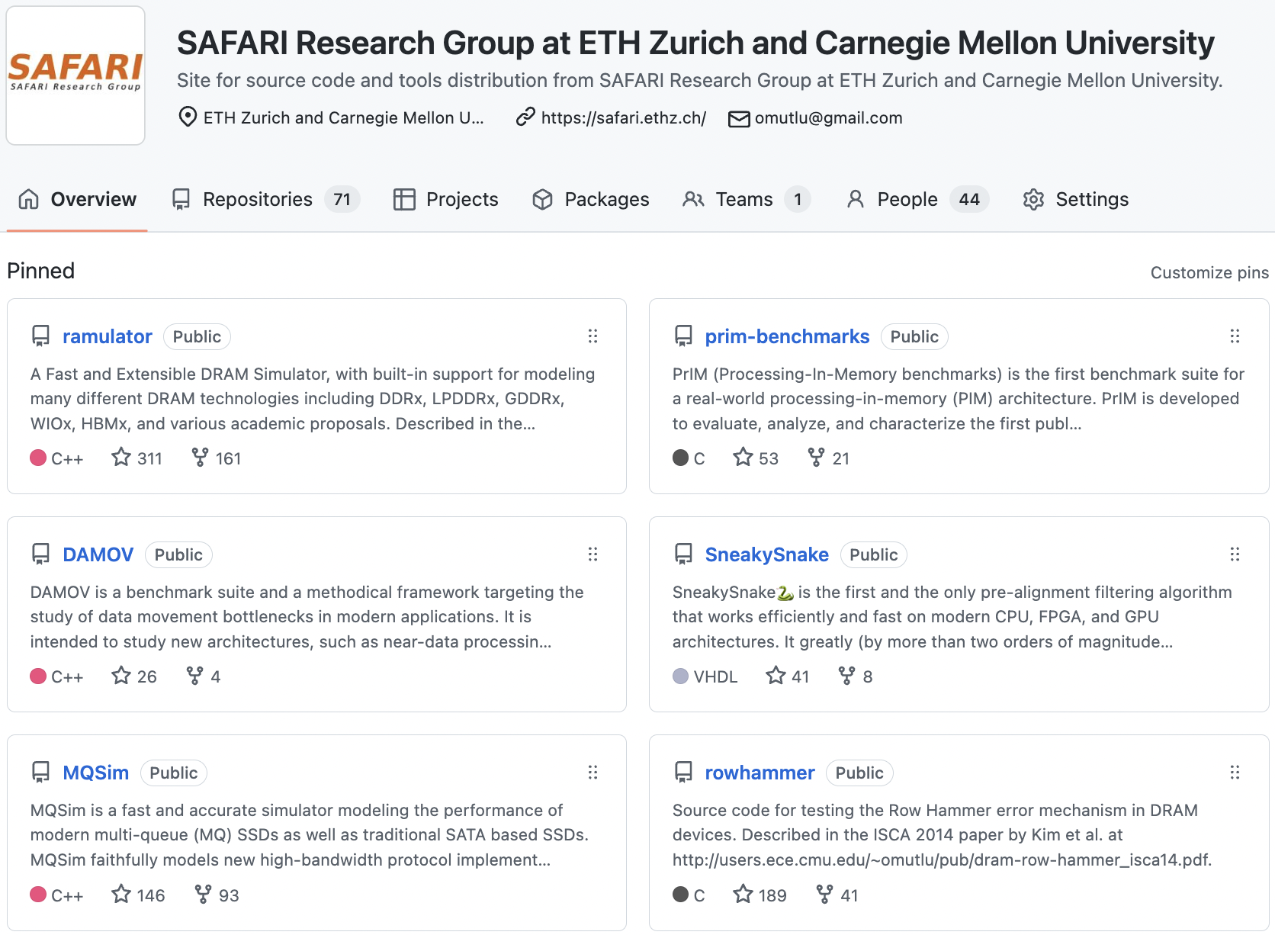
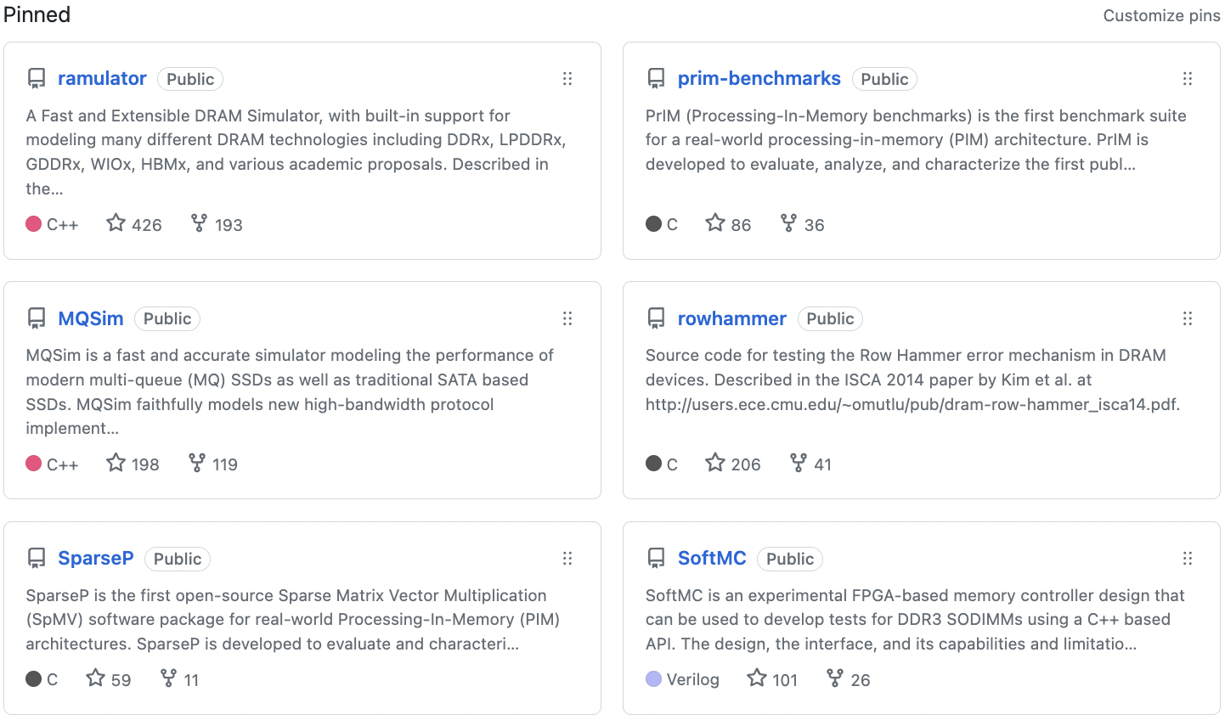
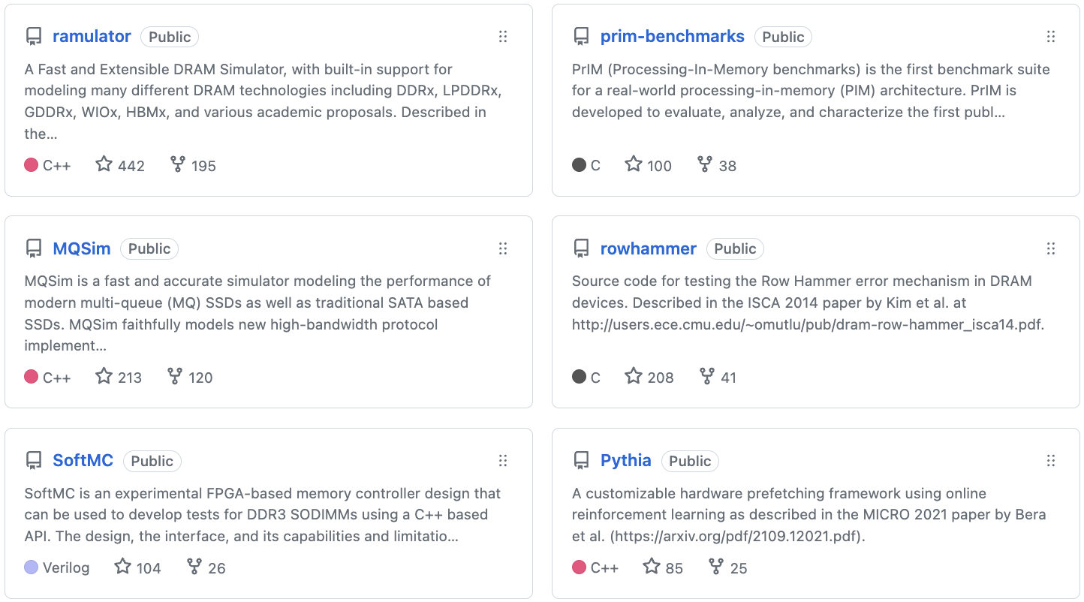
Open Source Tools: SAFARI GitHub
https://github.com/CMU-SAFARI/

Slide 25
Tutorial on Memory-Centric Computing: Conclusion Remarks
Geraldo F. Oliveira
Prof. Onur Mutlu
ISCA 2024
29 June 2024

