Slide 1


3rd Workshop on
Memory-Centric Computing:
Logistics
Dr. Geraldo F. Oliveira
https://geraldofojunior.github.io
ISCA 2025
21 June 2025

Slide 2
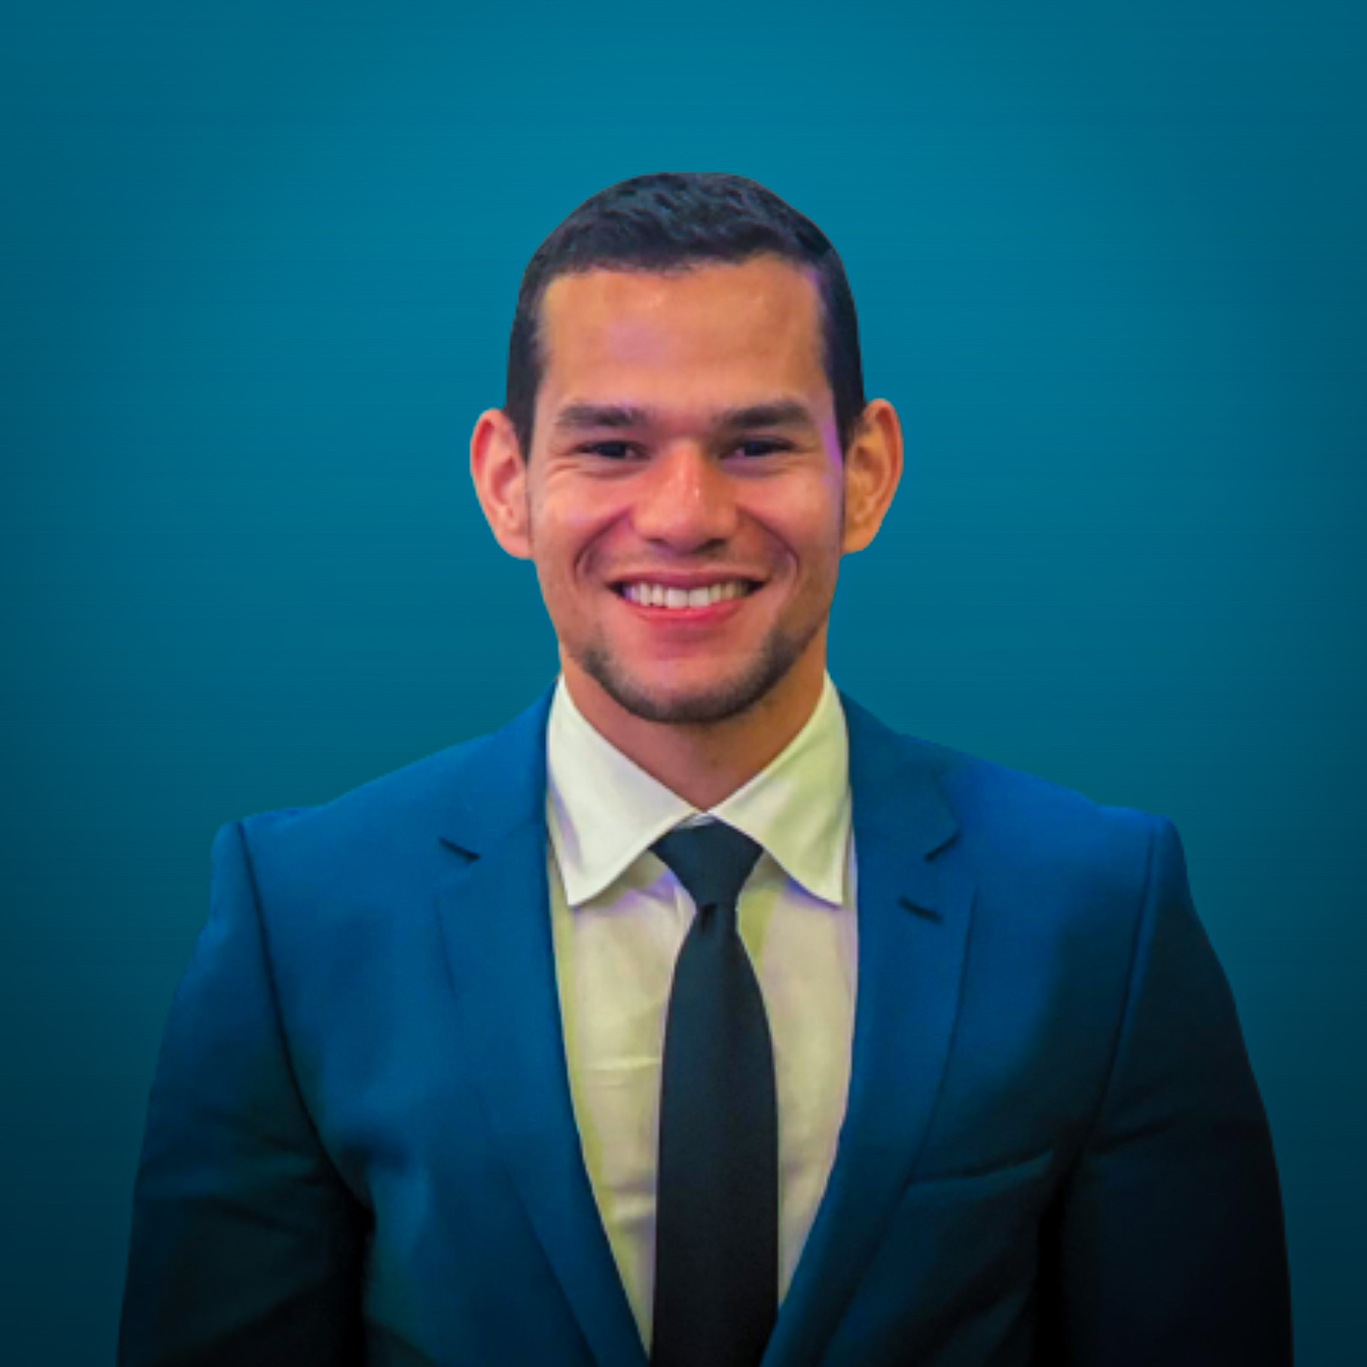
Brief Self Introduction
Dr. Geraldo F. Oliveira
  Researcher @ SAFARI Research Group since November 2017
  I am in the job market for industry positions
  https://geraldofojunior.github.io/
  geraldofojunior@gmail.com (Best way to reach me)
  https://safari.ethz.ch
Research in:
  Computer architecture, computer systems, hardware security
  Memory and storage systems
  Hardware security, safety, predictability
  Fault tolerance
  Hardware/software cooperation
  …

Slide 3

Get the Materials Online
https://events.safari.ethz.ch/isca25-MCCSys/doku.php

Slide 4
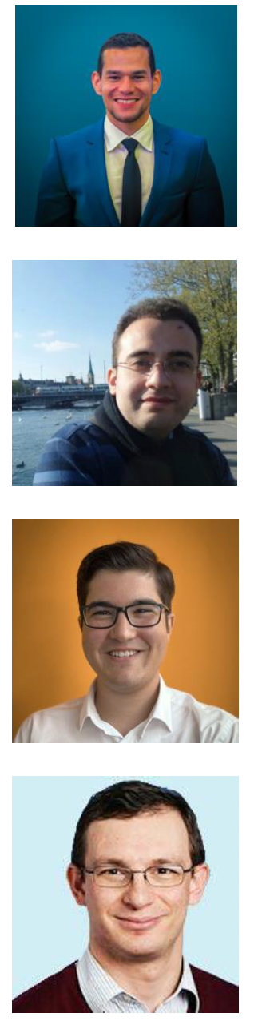
Organizers
Dr. Geraldo F. Oliveira
  Researcher @ SAFARI Research Group since November 2017
  I am in the job market for industry positions
  https://geraldofojunior.github.io/
Dr. Mohammad Sadrosadati
  Senior Researcher and Lecturer, SAFARI @ ETH Zürich
  https://scholar.google.com/citations?user=-mHpDvAAAAAJ
Ataberk Olgun
  PhD Candidate, SAFARI Research @ ETH Zürich
  https://ataberkolgun.com/
Prof. Onur Mutlu
  Professor of Computer Science at ETH Zurich
  https://people.inf.ethz.ch/omutlu/index.html

Slide 5
Agenda Workshop
Prof. Onur Mutlu:
Recent Advances in Processing-in-DRAM
Dr. Alper Buyuktosunoglu:
A Near-DRAM Accelerator for Compiler-Generated Fully Homomorphic Encryption Applications
Coffee Break
Processing-Using-Memory (PUM) Systems for Bulk Bitwise Operations
Ismail E. Yuksel
Functionally-Complete Boolean Logic in Real DRAM Chips
Processing-Near-Memory (PNM) Systems: Academia & Industry Developments
Manos Frouzakis:
PIMDAL: Mitigating the Memory Bottleneck in Data Analytics using a Real Processing-in-Memory System
Dr. Mohammad Sadr:
Processing-Near-Storage & Processing-Using-Storage

Slide 6
3rd Workshop on
Memory-Centric Computing:
Logistics
Dr. Geraldo F. Oliveira
https://geraldofojunior.github.io
ISCA 2025
21 June 2025

