Slide 1


3rd Workshop on
Memory-Centric Computing:
Processing-Near-Memory
Dr. Geraldo F. Oliveira
https://geraldofojunior.github.io
ISCA 2025
21 June 2025

Slide 2
Processing-in-Memory:
Overview
  Two main approaches for Processing-in-Memory:
1
Processing-Near-Memory: PIM logic is added to the same die as memory or to the logic layer of 3D-stacked memory
2
Processing-Using-Memory: uses the operational principles of
memory cells to perform computation
DRAM
(e.g., 3D-Stacked Memory)
DRAM Bank
Vault
Controller
Processing-
Using-DRAM
DRAM Vault
…
PHY
Processing-Near-Vault
…
Processing-Near-Bank
Notes:
Processing-in-Memory architectures alleviate data movement bottlenecks by moving computation to where the data resides. Such architectures can be implemented
[CLICK] by adding logic near the memory arrays, in what is called processing-near-memory or
[CLICK] by using the analog operating principles of the memory cells to perform computation, in what is called processing-using-memory
[NEXT]

Slide 3
When to Employ PNM
Mobile consumer workloads
(GoogleWL²)
Graph processing
(Tesseract¹)
Neural networks
(GoogleWL²)
Processing-near-Memory
Databases
(Polynesia⁵)
DNA
sequence mapping
(GenASM³; GRIM-Filter⁴)
Time series analysis
(NATSA⁶)
...
[1] Ahn+, “A Scalable Processing-in-Memory Accelerator for Parallel Graph Processing," ISCA, 2015
[2] Boroumand+, "Google Workloads for Consumer Devices: Mitigating Data Movement Bottlenecks,” ASPLOS, 2018
[3] Cali+, "GenASM: A High-Performance, Low-Power Approximate String Matching Acceleration Framework for Genome Sequence Analysis,” MICRO, 2020
[4] Kim+, "GRIM-Filter: Fast Seed Location Filtering in DNA Read Mapping Using Processing-in-Memory Technologies,” BMC Genomics, 2018
[5] Boroumand+, "Polynesia: Enabling High-Performance and Energy-Efficient Hybrid Transactional/Analytical Databases with Hardware/Software Co-Design,” ICDE, 2022
[6] Fernandez+, “NATSA: A Near-Data Processing Accelerator for Time Series Analysis,” ICCD, 2020

Slide 4
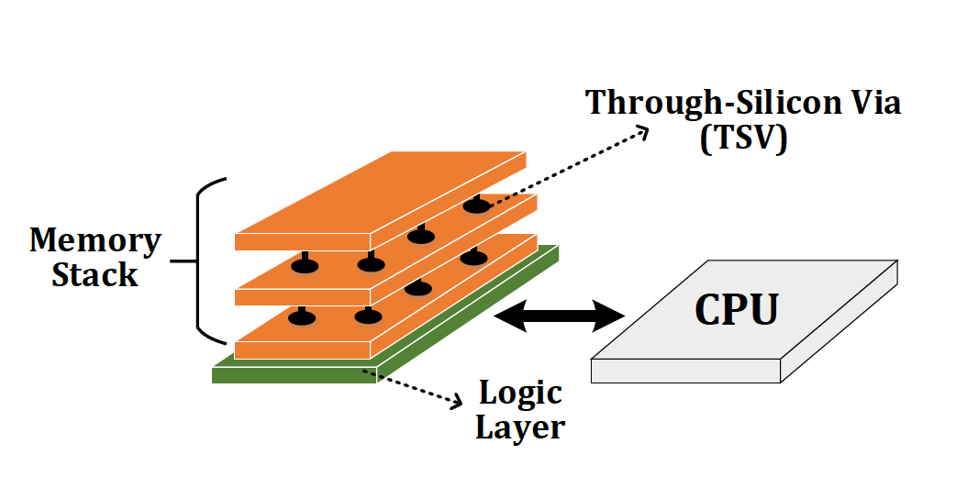
Processing Near-Memory (PNM)
Processing Near-Memory (PNM)
  Move computation closer to where the data resides
Logic layer
3D stacked DRAM
Memory controller
Memory module (DIMM)

Slide 5
PNM: Design Challenges (I)
Limited power & area budget with 3D-stacked memories
  e.g., area and power budget of the vault’s underlying logic layer is just 4.4mm² and 312mW (circa HMC 2.0)
Strict thermal constraints
  It requires cooling solutions to remove heat throughout a 3D stack (i.e., volume-wise) instead of a 2D surface
Challenging manufacturing of logic+DRAM
  Logic process has been developed for speed performance, DRAM process for density and memory reliability
  e.g., Logic gates implemented with memory process slowdowns by ~21.5% [Kim+, Integration'99]

Slide 6
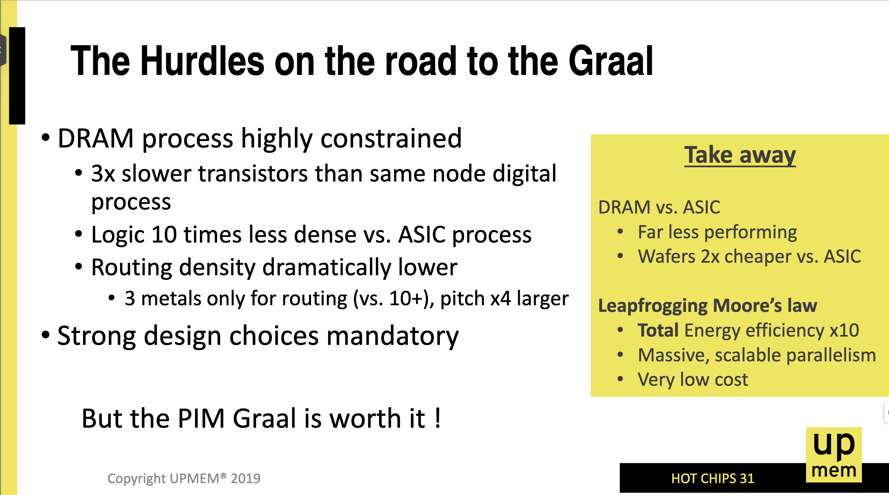
PNM: Design Challenges (II)
Devaux, Fabrice. "The True Processing in Memory Accelerator," in HCS, 2019.

Slide 7
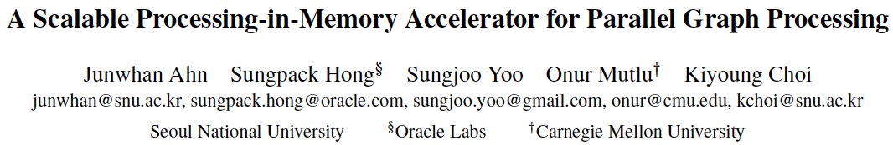
Tesseract System for Graph Processing
Junwhan Ahn, Sungpack Hong, Sungjoo Yoo, Onur Mutlu, and Kiyoung Choi,
"A Scalable Processing-in-Memory Accelerator for Parallel Graph Processing"
Proceedings of the 42nd International Symposium on Computer Architecture (ISCA), Portland, OR, June 2015.
[Slides (pptx) (pdf)] [Lightning Session Slides (pptx) (pdf)]
Top Picks Honorable Mention by IEEE Micro.
Selected to the ISCA-50 25-Year Retrospective Issue covering 1996-2020 in 2023 (Retrospective (pdf) Full Issue).

Slide 8
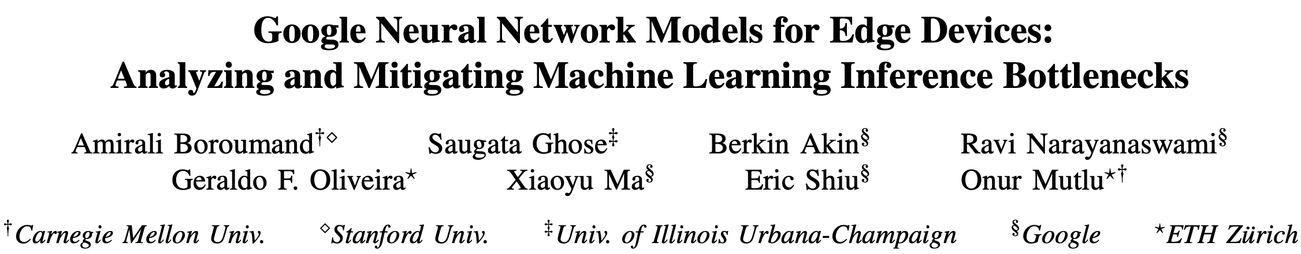
Accelerating Neural Network Inference
Amirali Boroumand, Saugata Ghose, Berkin Akin, Ravi Narayanaswami, Geraldo F. Oliveira, Xiaoyu Ma, Eric Shiu, and Onur Mutlu,
"Google Neural Network Models for Edge Devices: Analyzing and Mitigating Machine Learning Inference Bottlenecks"
Proceedings of the 30th International Conference on Parallel Architectures and Compilation Techniques (PACT), Virtual, September 2021.
[Slides (pptx) (pdf)]
[Talk Video (14 minutes)]

Slide 9
PIM for Mobile Devices
Amirali Boroumand, Saugata Ghose, Youngsok Kim, Rachata Ausavarungnirun, Eric Shiu, Rahul Thakur, Daehyun Kim, Aki Kuusela, Allan Knies, Parthasarathy Ranganathan, and Onur Mutlu,
"Google Workloads for Consumer Devices: Mitigating Data Movement Bottlenecks"
Proceedings of the 23rd International Conference on Architectural Support for Programming Languages and Operating Systems (ASPLOS), Williamsburg, VA, USA, March 2018.
[Slides (pptx) (pdf)] [Lightning Session Slides (pptx) (pdf)] [Poster (pptx) (pdf)]
[Lightning Talk Video (2 minutes)]
[Full Talk Video (21 minutes)]

Slide 10
Possible PNM Designs
General-purpose programmable cores
  Wimpy cores (possibility of running any workload)
  E.g. from academia: Tesseract PIM for Graph Processing
  E.g. from industry: UPMEM PIM
PIM Core
Cache
Fixed-function units
  Hardware/software co-designed PIM for efficiency
  E.g. from academia: Mensa for NN Edge Inference
  E.g. from industry: Samsung HBM-PIM, SK hynix AiM
PIM-Accelerator 1
…
PIM-Accelerator N
Reconfigurable architectures
  PNM cores coupled with FPGAs, CGRA
  E.g. from academia: NERO for Weather Prediction
  E.g. from industry: Samsung AxDIMM
Reconfigurable Accelerator

Slide 11
Possible PNM Designs
General-purpose programmable cores
  Wimpy cores (possibility of running any workload)
  E.g. from academia: Tesseract PIM for Graph Processing
  E.g. from industry: UPMEM PIM
PIM Core
Cache
Fixed-function units
  Hardware/software co-designed PIM for efficiency
  E.g. from academia: Mensa for NN Edge Inference
  E.g. from industry: Samsung HBM-PIM, SK hynix AiM
PIM-Accelerator 1
…
PIM-Accelerator N
Reconfigurable architectures
  PNM cores coupled with FPGAs, CGRA
  E.g. from academia: NERO for Weather Prediction
  E.g. from industry: Samsung AxDIMM
Reconfigurable Accelerator

Slide 12




Accelerating In-Memory Graph Processing
Large graphs are everywhere (circa 2015)
Scalable large-scale graph processing is challenging
36 Million
Wikipedia Pages
1.4 Billion
Facebook Users
300 Million
Twitter Users
30 Billion
Instagram Photos

Slide 13
Key Bottlenecks in Graph Processing
for (v: graph.vertices) {
for (w: v.successors) {
w.next_rank += weight * v.rank;
}
}
1. Frequent random memory accesses
v
&w
w.rank
w.next_rank
w.edges
weight * v.rank
w
…
2. Little amount of computation

Slide 14

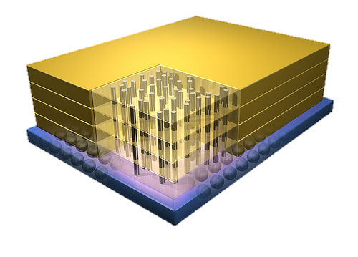
Opportunity: 3D-Stacked Logic+Memory
Memory
Logic
Other “True 3D” technologies
under development

Slide 15
Tesseract System for Graph Processing
Interconnected set of 3D-stacked memory+logic chips with simple cores
Host Processor
Memory
Memory-Mapped
Accelerator Interface
(Noncacheable, Physically Addressed)
Logic
In-Order Core
DRAM Controller
…
…
LP
PF Buffer
Crossbar Network
…
MTP
…
Message Queue
NI
15
Ahn+, “A Scalable Processing-in-Memory Accelerator for Parallel Graph Processing” ISCA 2015.

Slide 16
More on Tesseract
Junwhan Ahn, Sungpack Hong, Sungjoo Yoo, Onur Mutlu, and Kiyoung Choi,
"A Scalable Processing-in-Memory Accelerator for Parallel Graph Processing"
Proceedings of the 42nd International Symposium on Computer Architecture (ISCA), Portland, OR, June 2015.
[Slides (pptx) (pdf)] [Lightning Session Slides (pptx) (pdf)]
Top Picks Honorable Mention by IEEE Micro.
Selected to the ISCA-50 25-Year Retrospective Issue covering 1996-2020 in 2023
(Retrospective (pdf) Full Issue).

Slide 17
Possible PNM Designs
General-purpose programmable cores
  Wimpy cores (possibility of running any workload)
  E.g. from academia: Tesseract PIM for Graph Processing
  E.g. from industry: UPMEM PIM
PIM Core
Cache
Fixed-function units
  Hardware/software co-designed PIM for efficiency
  E.g. from academia: Mensa for NN Edge Inference
  E.g. from industry: Samsung HBM-PIM, SK hynix AiM
PIM-Accelerator 1
…
PIM-Accelerator N
Reconfigurable architectures
  PNM cores coupled with FPGAs, CGRA
  E.g. from academia: NERO for Weather Prediction
  E.g. from industry: Samsung AxDIMM
Reconfigurable Accelerator

Slide 18
UPMEM Processing-in-DRAM Engine (2019)
Processing in DRAM Engine
Includes standard DIMM modules, with a large number of DPU processors combined with DRAM chips.
Replaces standard DIMMs
  DDR4 R-DIMM modules
    8GB+128 DPUs (16 PIM chips)
    Standard 2x-nm DRAM process
  Large amounts of compute & memory bandwidth
CPU
(x86, ARM, RV…)
DDR
Data bus
https://www.anandtech.com/show/14750/hot-chips-31-analysis-inmemory-processing-by-upmem
https://www.upmem.com/video-upmem-presenting-its-true-processing-in-memory-solution-hot-chips-2019/

Slide 19
Accelerator Model (I)
UPMEM DIMMs coexist with conventional DIMMs
Integration of UPMEM DIMMs in a system follows an accelerator model
UPMEM DIMMs can be seen as a loosely coupled accelerator
  Explicit data movement between the main processor (host CPU) and the accelerator (UPMEM)
  Explicit kernel launch onto the UPMEM processors
This resembles GPU computing

Slide 20
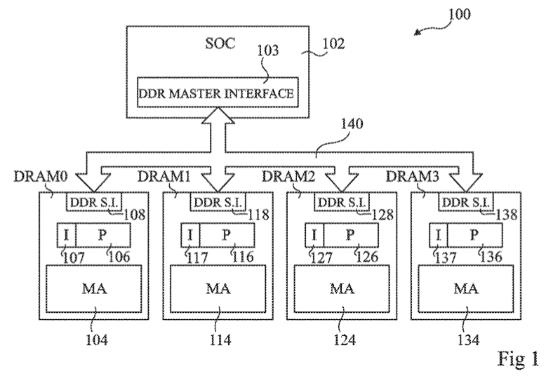
System Organization (I)
FIG. 1 schematically illustrates a computing system comprising DRAM circuits having integrated processors according to an example embodiment
Fabrice Devaux, Jean-François Roy. “Memory circuit with integrated processor.” US 10,324,870 B2.

Slide 21
System Organization (II)
In a UPMEM-based PIM system UPMEM DIMMs coexist with regular DDR4 DIMMs
Notes:
P21 DIMMs.
DPUs cannot be shared. There is a large number of DPUs.
No need for OS.
This simplifies security implications. No side channels.

Slide 22
System Organization (III)
A UPMEM DIMM contains 8 or 16 chips
  Thus, 1 or 2 ranks of 8 chips each
Inside each PIM chip there are:
  8 64MB banks per chip: Main RAM (MRAM) banks
  8 DRAM Processing Units (DPUs) in each chip, 64 DPUs per rank

Slide 23
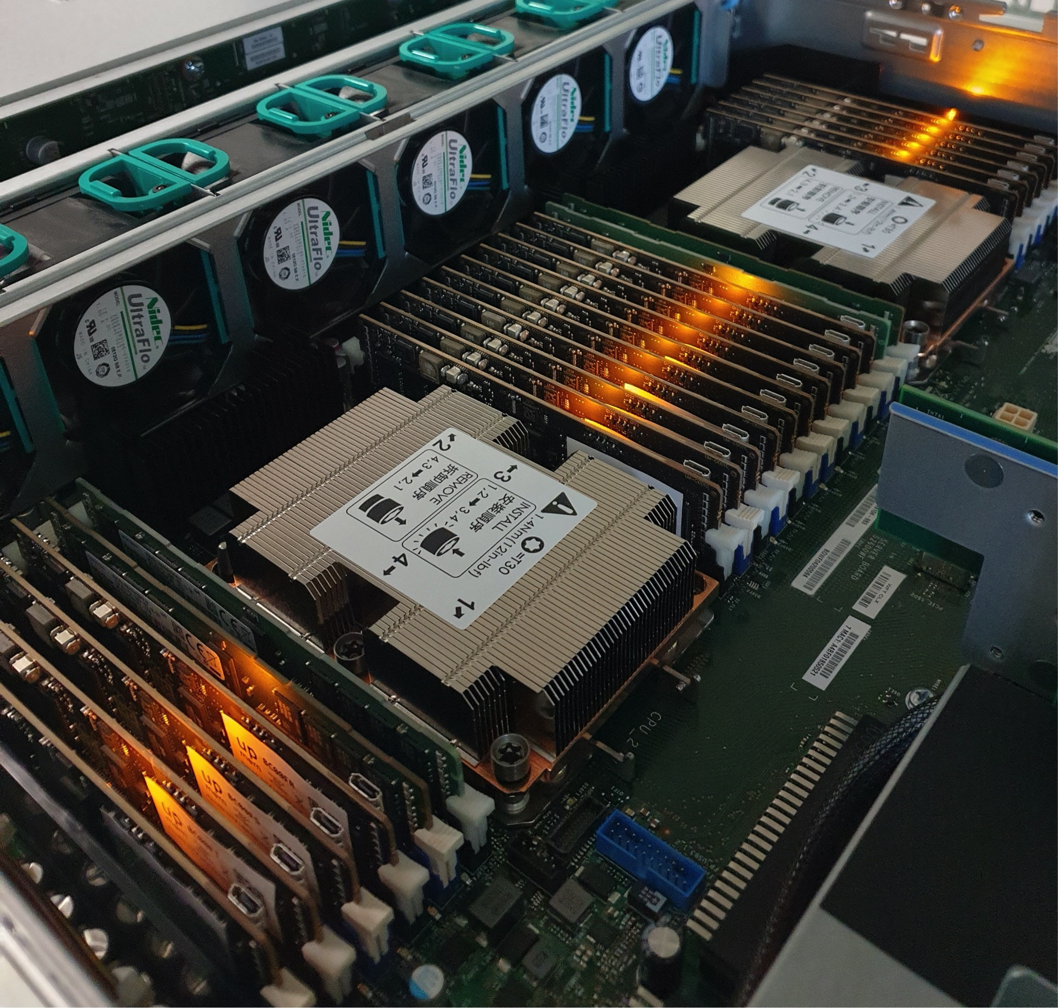
2,560-DPU System (II)

Slide 24
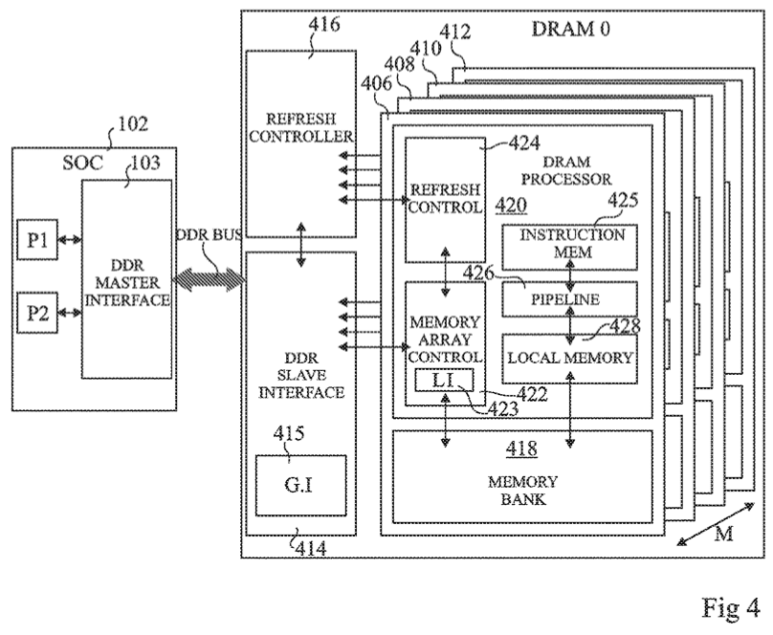
DRAM Processing Unit (I)
FIG. 4 schematically illustrates part of the computing system of FIG. 1 in more detail according to an example embodiment
Fabrice Devaux, Jean-François Roy. “Memory circuit with integrated processor.” US 10,324,870 B2.

Slide 25
DRAM Processing Unit (II)

Slide 26
DPU: Arithmetic Throughput vs. Operational Intensity

Slide 27
DPU Pipeline
In-order pipeline
  Up to 425 MHz
Fine-grain multithreaded
  24 hardware threads
14 pipeline stages
  DISPATCH: Thread selection
  FETCH: Instruction fetch
  READOP: Register file
  FORMAT: Operand formatting
  ALU: Operation and WRAM
  MERGE: Result formatting
To the DMA engine

Slide 28
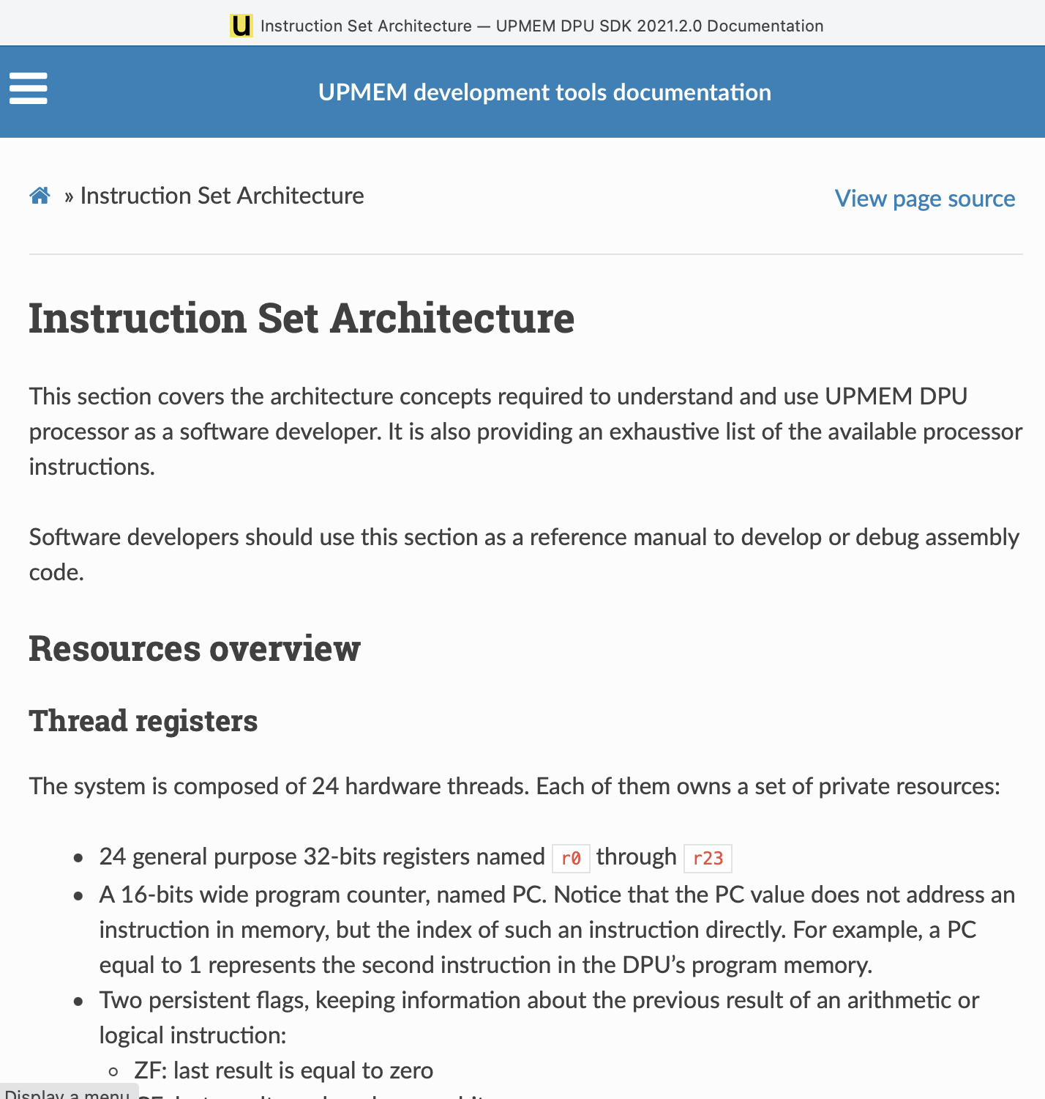
DPU Instruction Set Architecture
Specific 32-bit ISA
  Aiming at scalar, in-order, and multithreaded implementation
  Allowing compilation of 64-bit C code
  LLVM/Clang compiler
https://sdk.upmem.com/2021.2.0/201_IS.html#

Slide 29
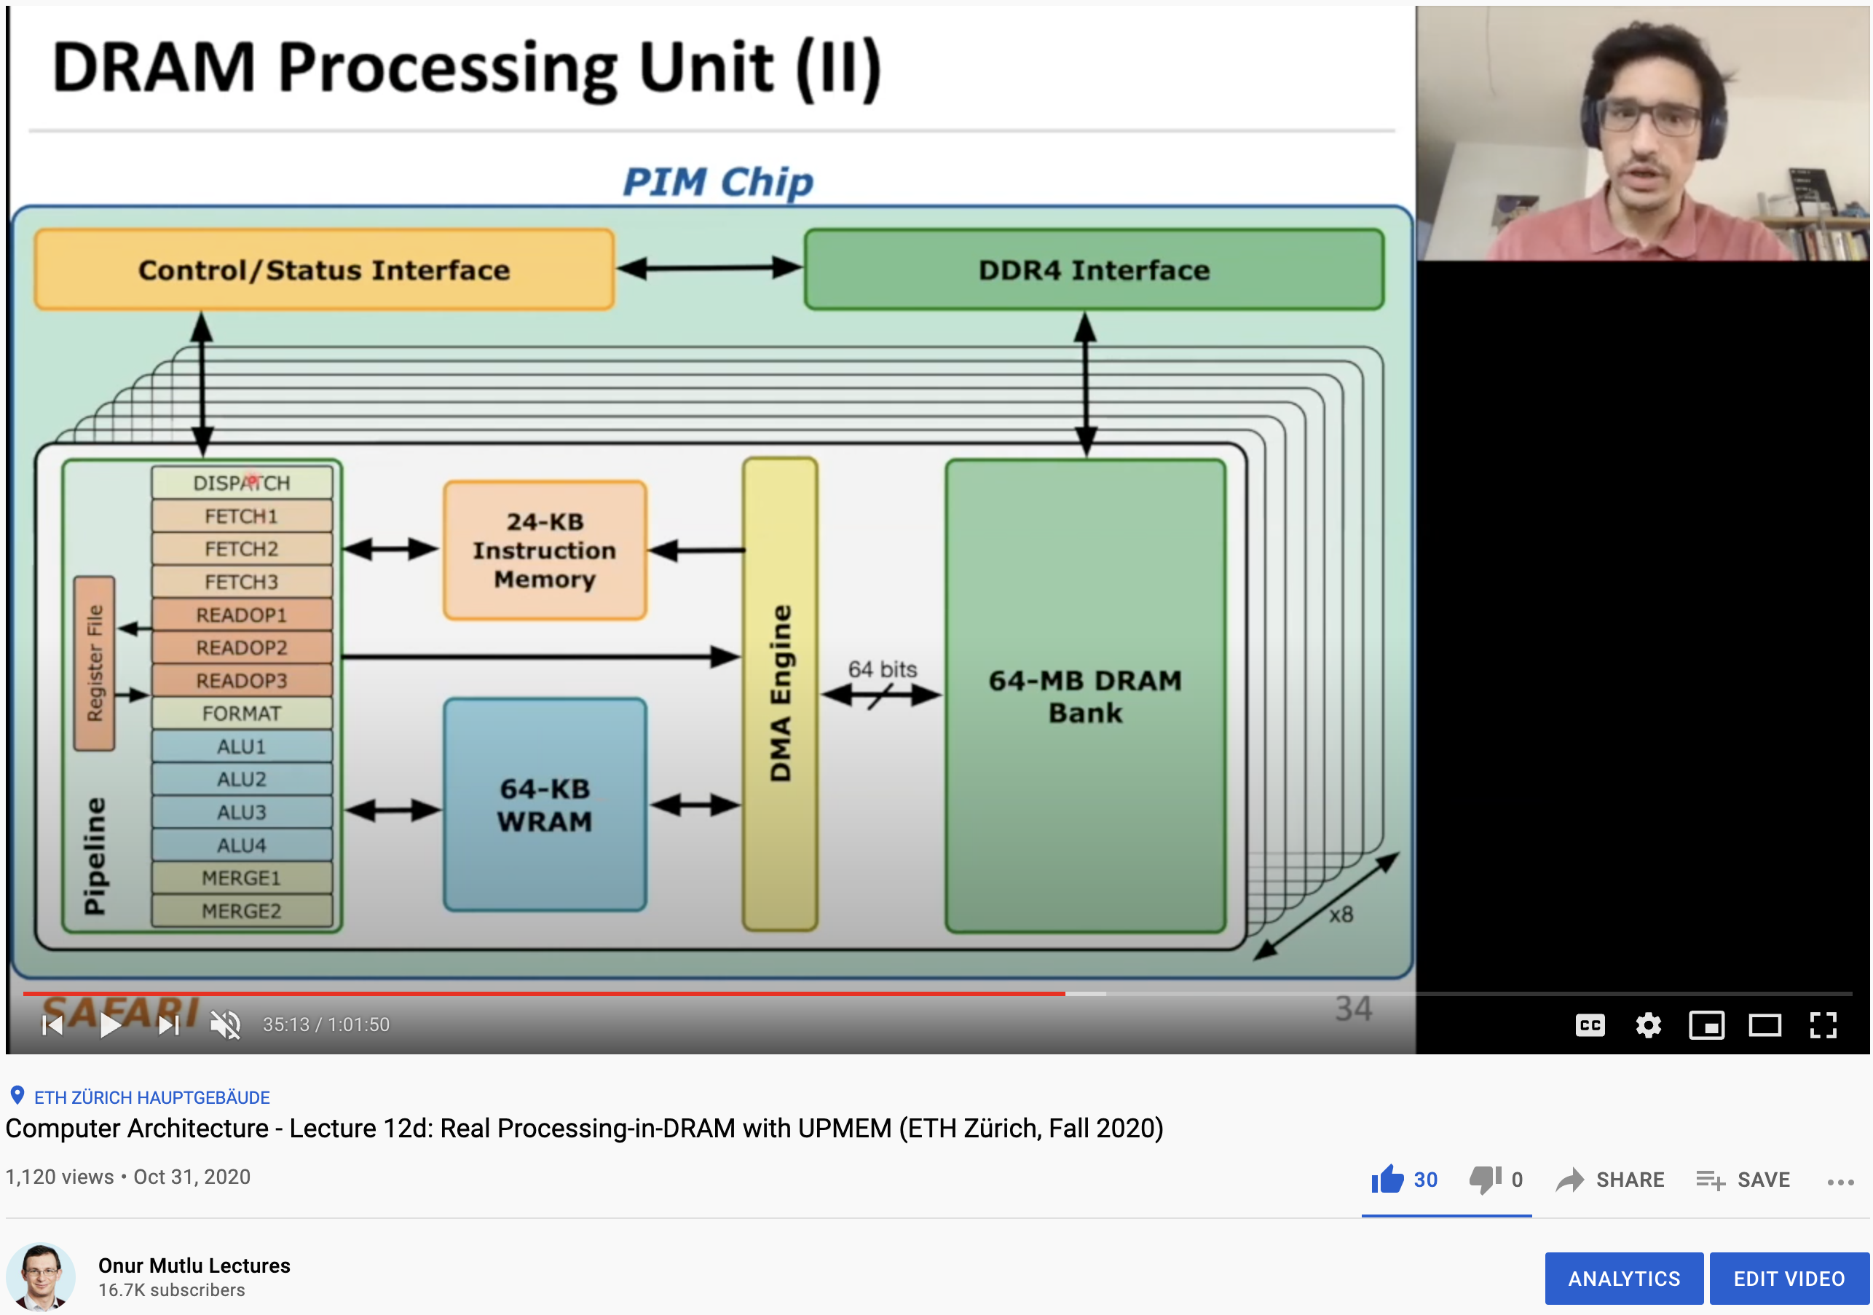
More on the UPMEM PIM System
https://www.youtube.com/watch?v=Sscy1Wrr22A&list=PL5Q2soXY2Zi9xidyIgBxUz7xRPS-wisBN&index=26

Slide 30
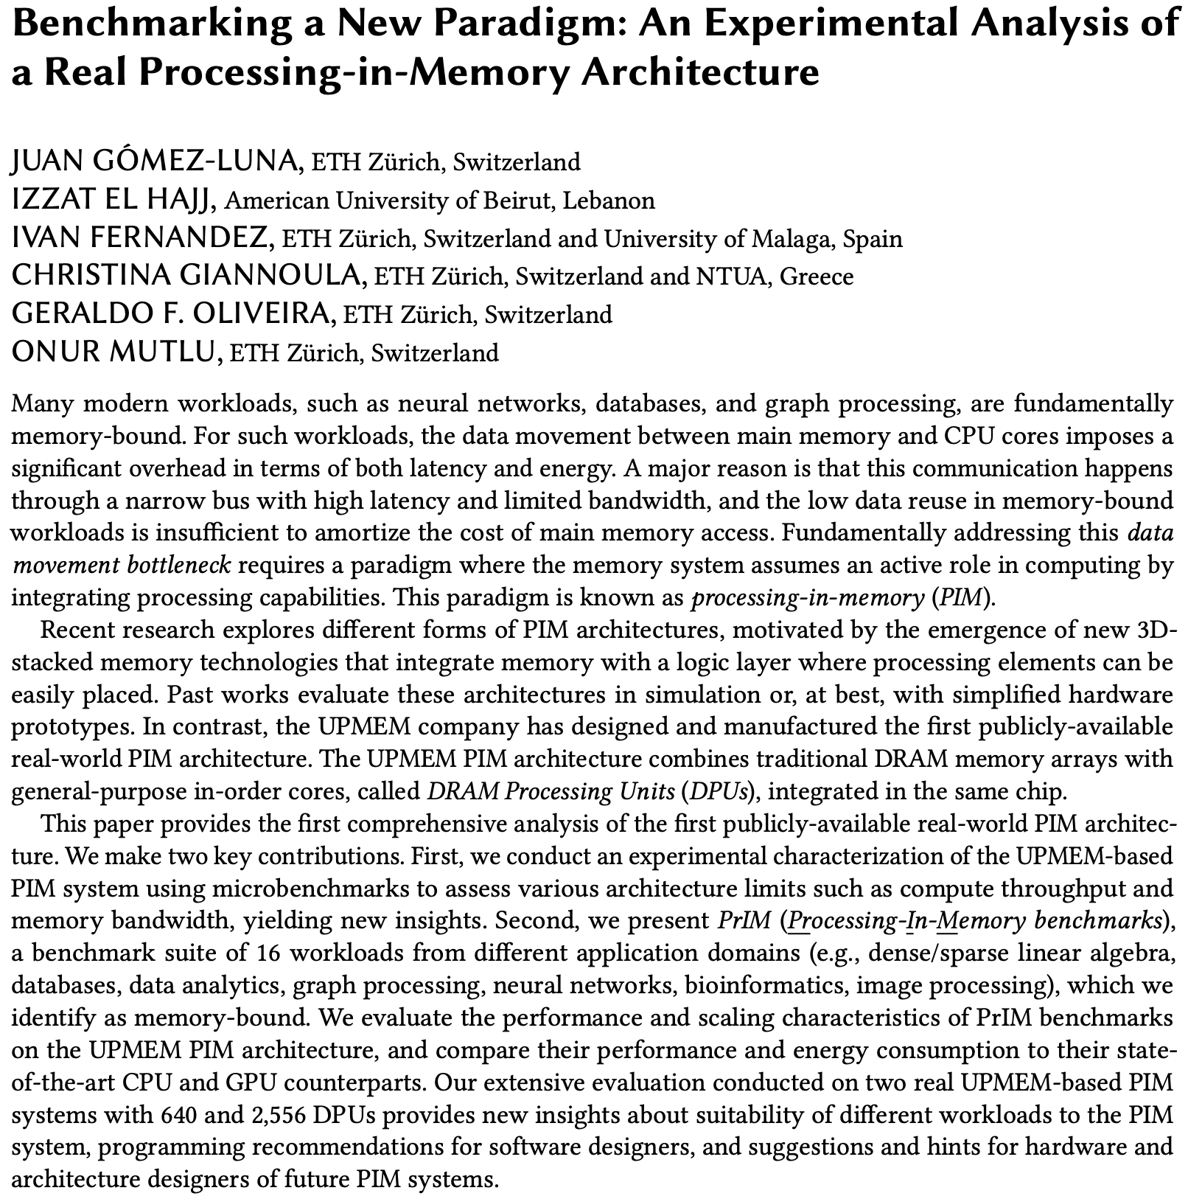
Experimental Analysis of the UPMEM PIM Engine
https://arxiv.org/pdf/2105.03814.pdf

Slide 31
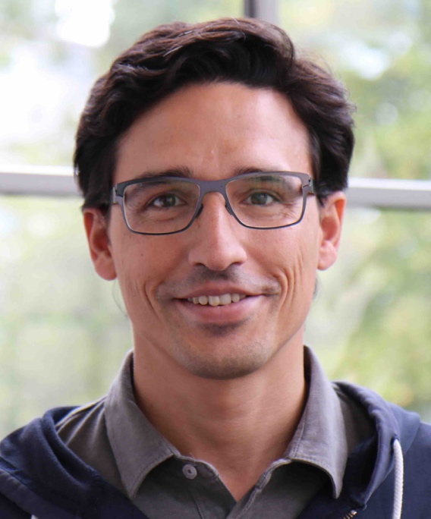
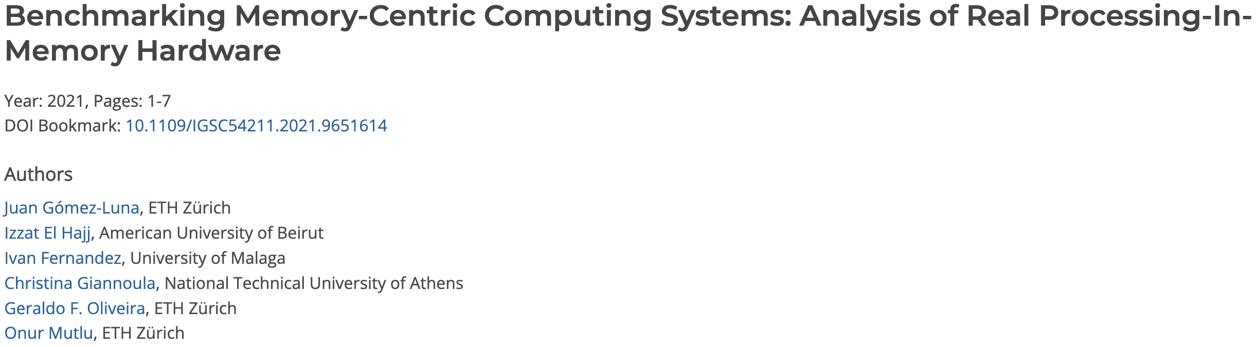
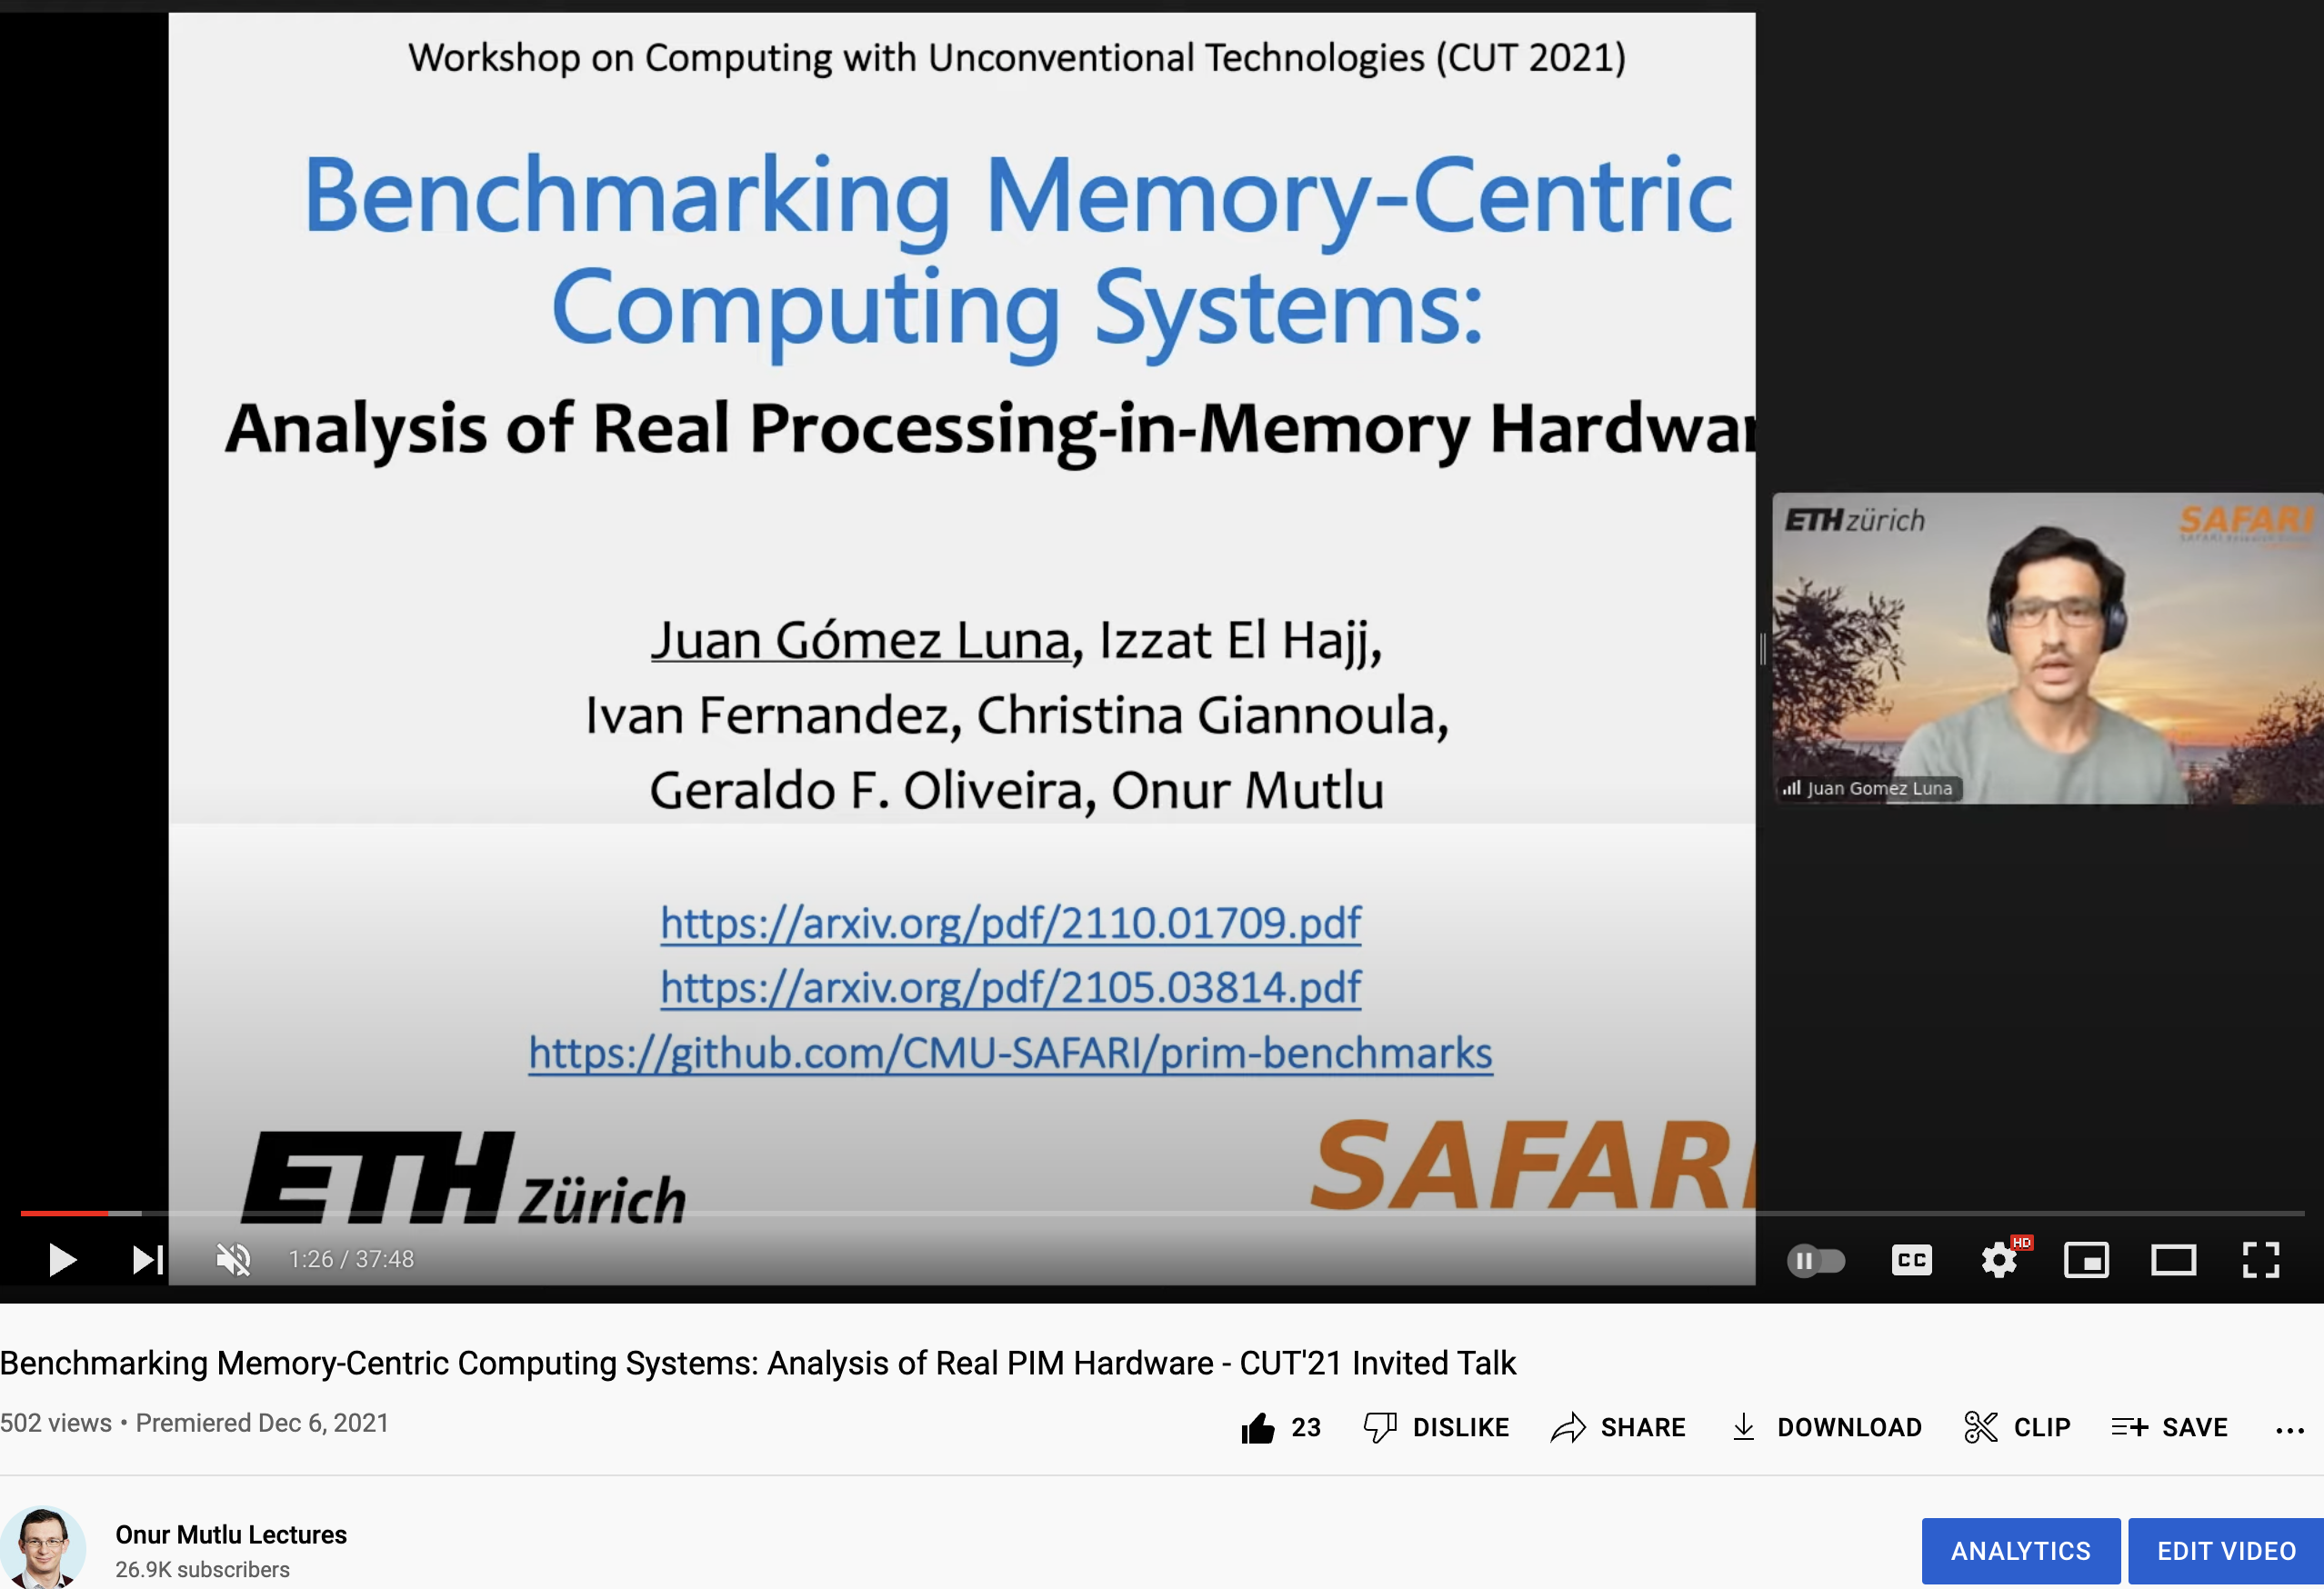
Recent SRC TECHCON Presentation
Dr. Juan Gomez-Luna
  Benchmarking Memory-Centric Computing Systems: Analysis of Real Processing-in-Memory Hardware
  Based on two major works
    https://arxiv.org/pdf/2105.03814.pdf
    https://arxiv.org/pdf/2207.07886.pdf
https://www.youtube.com/watch?v=nphV36SrysA

Slide 32
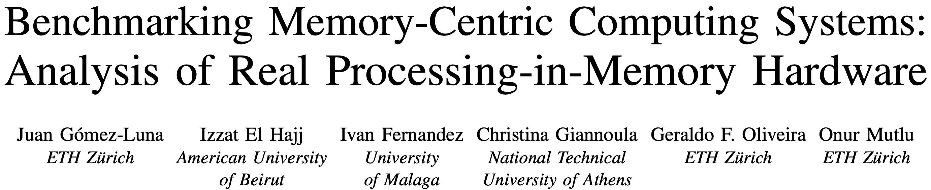
UPMEM PIM System Summary & Analysis
Juan Gomez-Luna, Izzat El Hajj, Ivan Fernandez, Christina Giannoula, Geraldo F. Oliveira, and Onur Mutlu,
"Benchmarking Memory-Centric Computing Systems: Analysis of Real Processing-in-Memory Hardware"
Invited Paper at Workshop on Computing with Unconventional Technologies (CUT), Virtual, October 2021.
[arXiv version]
[PrIM Benchmarks Source Code]
[Slides (pptx) (pdf)]
[Talk Video (37 minutes)]
[Lightning Talk Video (3 minutes)]

Slide 33
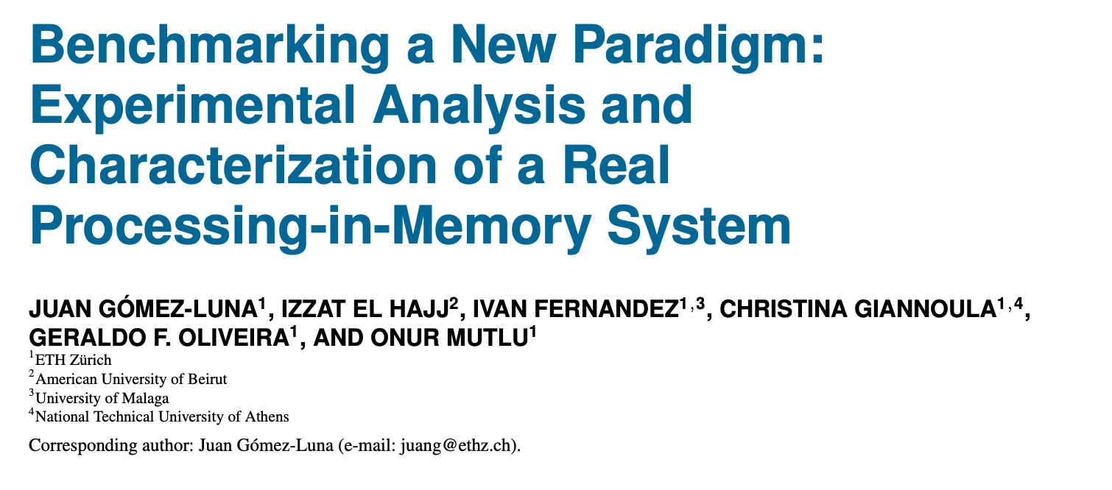
Understanding a Modern PIM Architecture
https://arxiv.org/pdf/2105.03814.pdf
https://github.com/CMU-SAFARI/prim-benchmarks

Slide 34
PrIM Benchmarks: Application Domains
Domain | Benchmark | Short name
Dense linear algebra | Vector Addition | VA
 | Matrix-Vector Multiply | GEMV
Sparse linear algebra | Sparse Matrix-Vector Multiply | SpMV
Databases | Select | SEL
 | Unique | UNI
Data analytics | Binary Search | BS
 | Time Series Analysis | TS
Graph processing | Breadth-First Search | BFS
Neural networks | Multilayer Perceptron | MLP
Bioinformatics | Needleman-Wunsch | NW
Image processing | Image histogram (short) | HST-S
 | Image histogram (large) | HST-L
Parallel primitives | Reduction | RED
 | Prefix sum (scan-scan-add) | SCAN-SSA
 | Prefix sum (reduce-scan-scan) | SCAN-RSS
 | Matrix transposition | TRNS

Slide 35
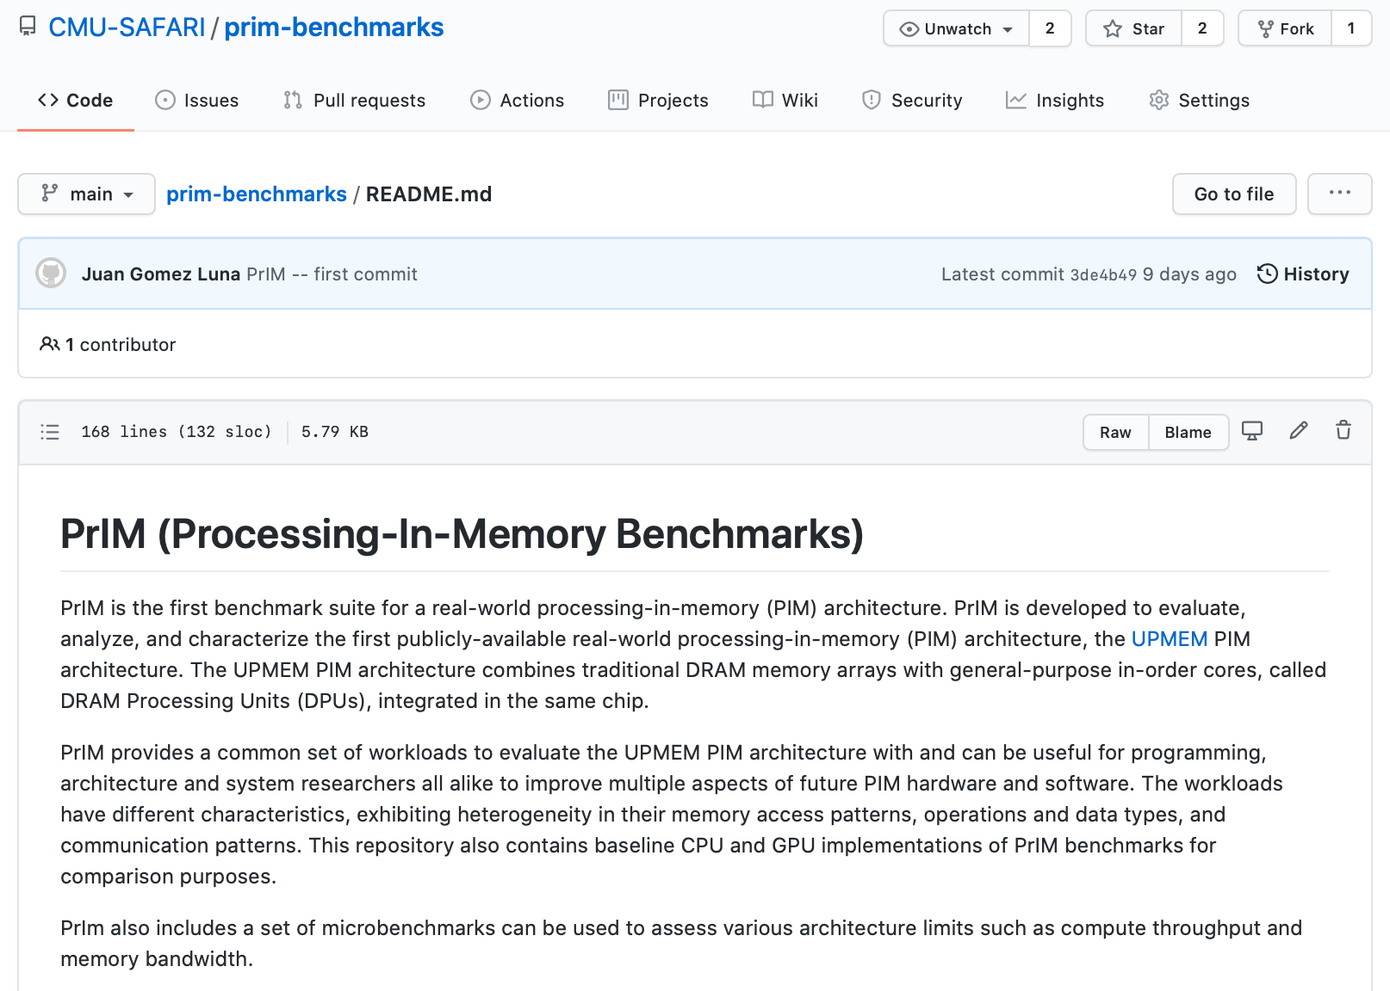
PrIM Benchmarks are Open Source
All microbenchmarks, benchmarks, and scripts
https://github.com/CMU-SAFARI/prim-benchmarks

Slide 36
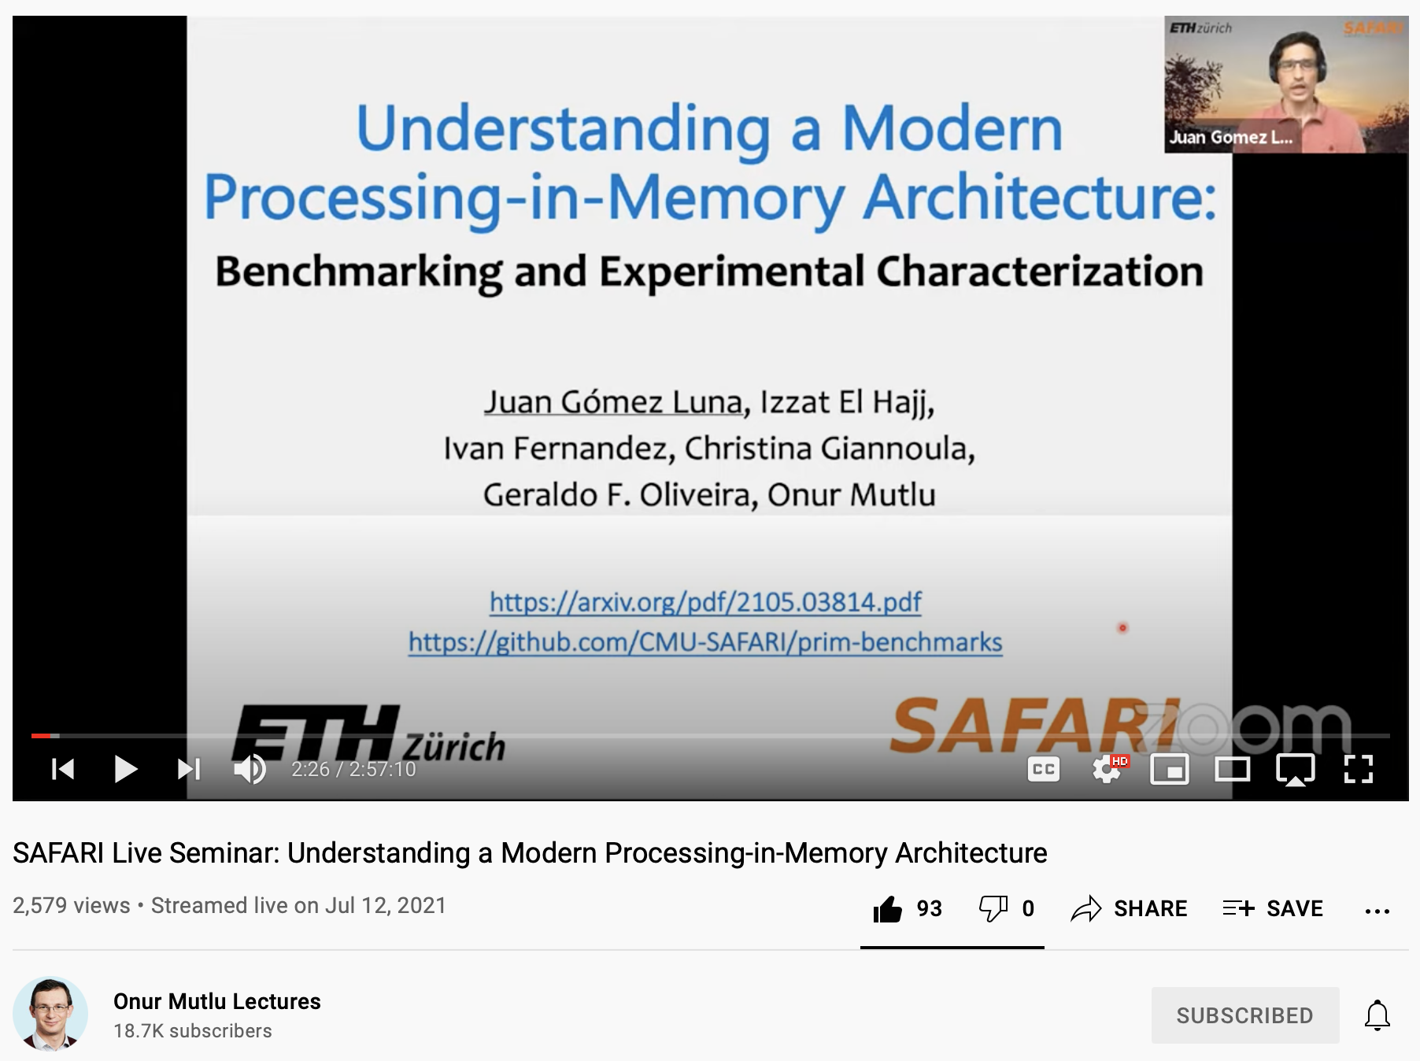
Understanding a Modern PIM Architecture
https://www.youtube.com/watch?v=D8Hjy2iU9l4&list=PL5Q2soXY2Zi_tOTAYm--dYByNPL7JhwR9

Slide 37
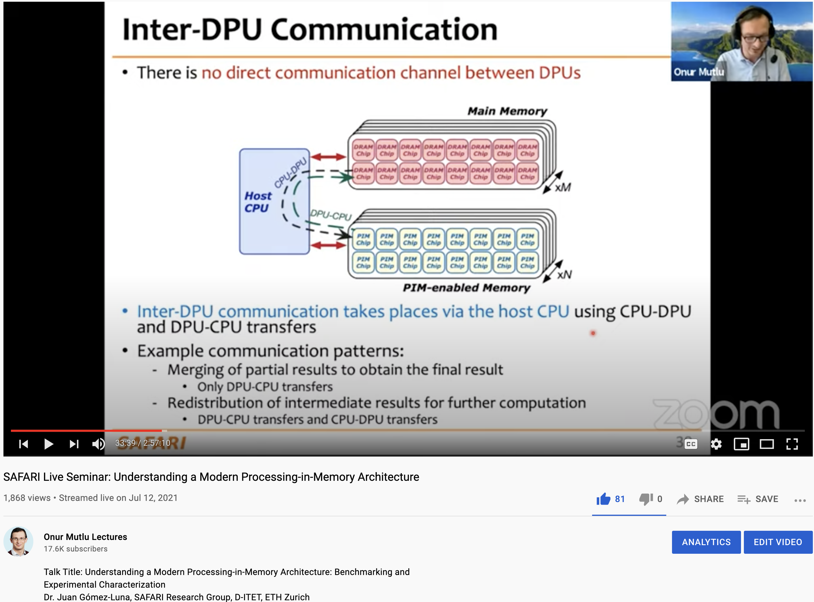
More on Analysis of the UPMEM PIM Engine
https://www.youtube.com/watch?v=D8Hjy2iU9l4&list=PL5Q2soXY2Zi_tOTAYm--dYByNPL7JhwR9

Slide 38
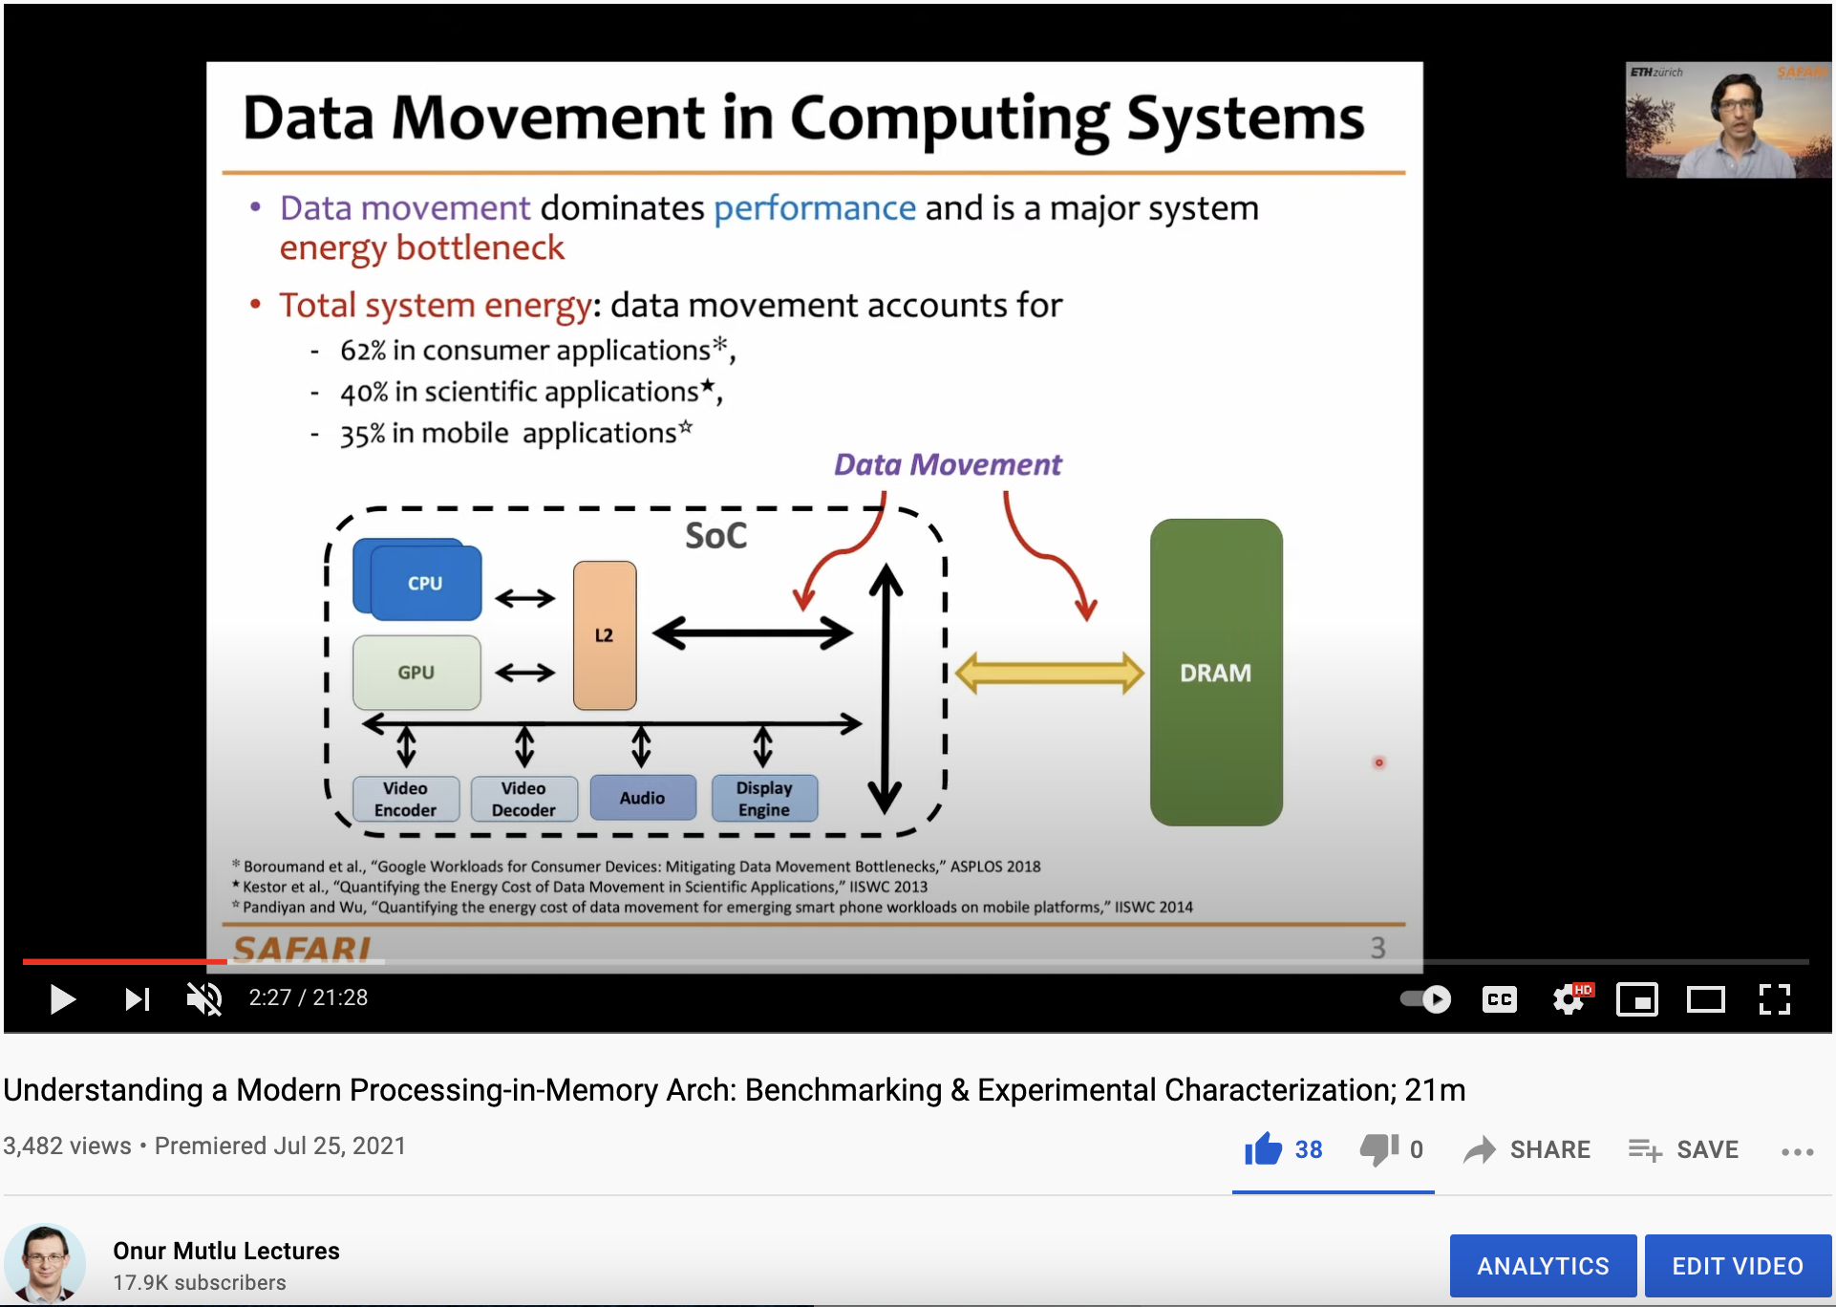
More on Analysis of the UPMEM PIM Engine
https://www.youtube.com/watch?v=Pp9jSU2b9oM&list=PL5Q2soXY2Zi8_VVChACnON4sfh2bJ5IrD&index=159

Slide 39
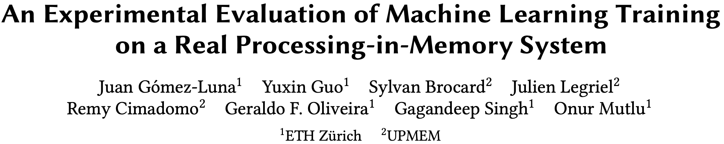
ML Training on Real PIM Systems
Juan Gómez Luna, Yuxin Guo, Sylvan Brocard, Julien Legriel, Remy Cimadomo, Geraldo F. Oliveira, Gagandeep Singh, and Onur Mutlu,
"Evaluating Machine Learning Workloads on Memory-Centric Computing Systems"
Proceedings of the 2023 IEEE International Symposium on Performance Analysis of Systems and Software (ISPASS), Raleigh, North Carolina, USA, April 2023.
[arXiv version, 16 July 2022.]
[PIM-ML Source Code]
Best paper session.
https://github.com/CMU-SAFARI/pim-ml
https://arxiv.org/pdf/2207.07886.pdf

Slide 40
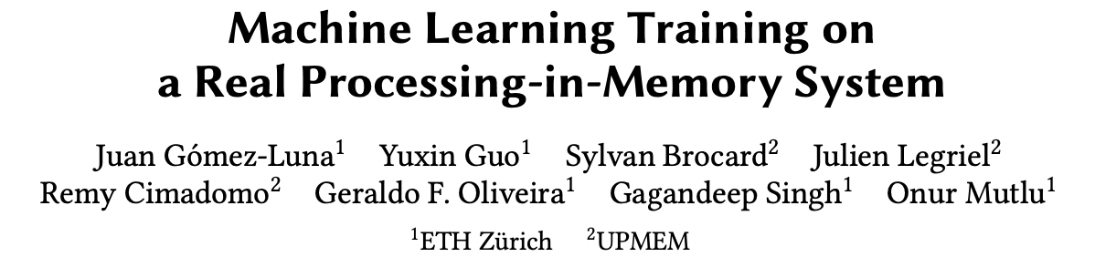
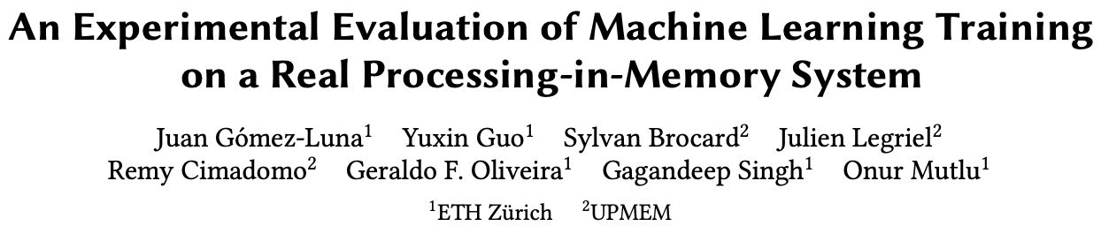
ML Training on a Real PIM System
Short version: https://arxiv.org/pdf/2206.06022.pdf
Long version: https://arxiv.org/pdf/2207.07886.pdf
https://www.youtube.com/watch?v=qeukNs5XI3g&t=11226s

Slide 41
ML Training on a Real PIM System
Need to optimize data representation
  (1) fixed-point
  (2) quantization
  (3) hybrid precision
Use lookup tables (LUTs) to implement complex functions (e.g., sigmoid)
Optimize data placement & layout for streaming
Large speedups: 2.8X/27X vs. CPU, 1.3x/3.2x vs. GPU

Slide 42
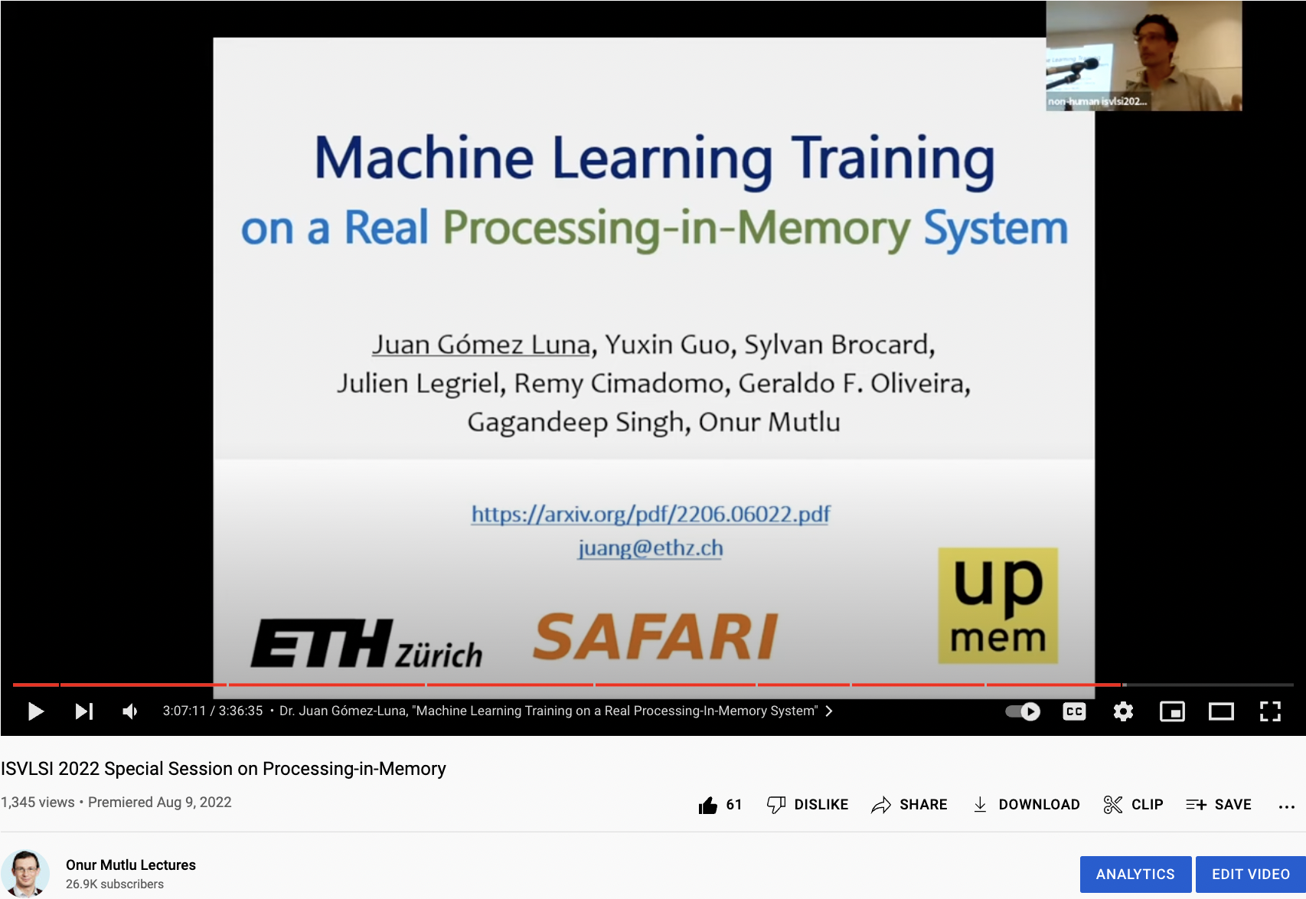
ML Training on Real PIM Talk Video
https://www.youtube.com/watch?v=qeukNs5XI3g&t=11226s

Slide 43
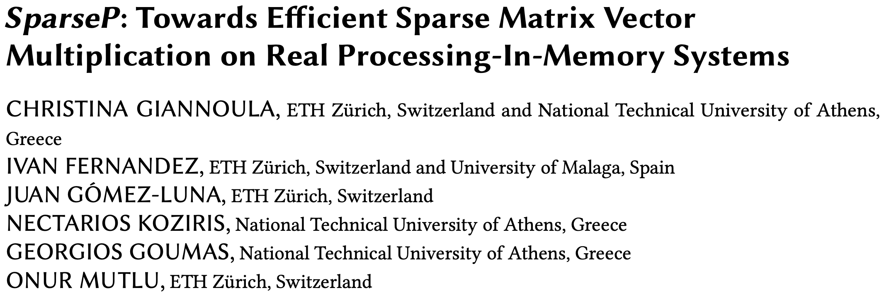
SpMV Multiplication on Real PIM Systems
Appears at SIGMETRICS 2022
https://arxiv.org/pdf/2201.05072.pdf
https://github.com/CMU-SAFARI/SparseP
https://www.youtube.com/watch?v=5kaOsJKlGrE

Slide 44
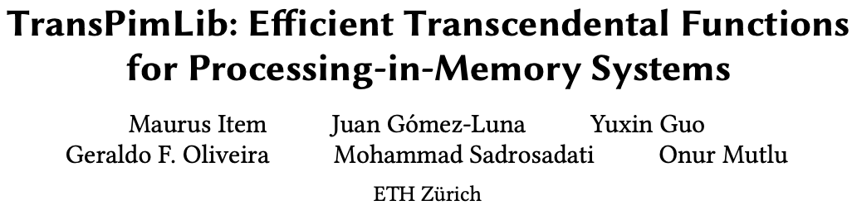
Transcendental Functions on Real PIM Systems
Maurus Item, Juan Gómez Luna, Yuxin Guo, Geraldo F. Oliveira, Mohammad Sadrosadati, and Onur Mutlu,
"TransPimLib: Efficient Transcendental Functions for Processing-in-Memory Systems"
Proceedings of the 2023 IEEE International Symposium on Performance Analysis of Systems and Software (ISPASS), Raleigh, North Carolina, USA, April 2023.
[arXiv version]
[Slides (pptx) (pdf)]
[TransPimLib Source Code]
[Talk Video (17 minutes)]
https://github.com/CMU-SAFARI/transpimlib
https://arxiv.org/pdf/2304.01951.pdf

Slide 45
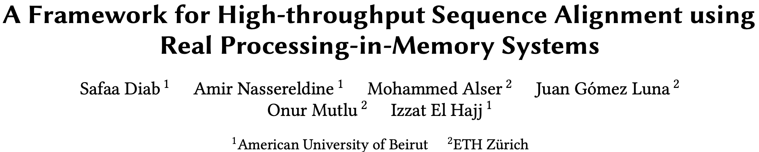
Sequence Alignment on Real PIM Systems
Safaa Diab, Amir Nassereldine, Mohammed Alser, Juan Gómez Luna, Onur Mutlu, and Izzat El Hajj,
"A Framework for High-throughput Sequence Alignment using Real Processing-in-Memory Systems"
Bioinformatics, [published online on] 27 March 2023.
[Online link at Bioinformatics Journal]
[arXiv preprint]
[AiM Source Code]
https://github.com/CMU-SAFARI/alignment-in-memory
https://arxiv.org/pdf/2208.01243.pdf

Slide 46
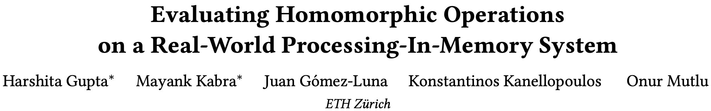
Homomorphic Operations on Real PIM Systems
Harshita Gupta, Mayank Kabra, Juan Gómez-Luna, Konstantinos Kanellopoulos, and Onur Mutlu,
"Evaluating Homomorphic Operations on a Real-World Processing-In-Memory System"
Proceedings of the 2023 IEEE International Symposium on Workload Characterization Poster Session (IISWC), Ghent, Belgium, October 2023.
[arXiv version]
[Lightning Talk Slides (pptx) (pdf)]
[Poster (pptx) (pdf)]
https://arxiv.org/pdf/2309.06545.pdf

Slide 47
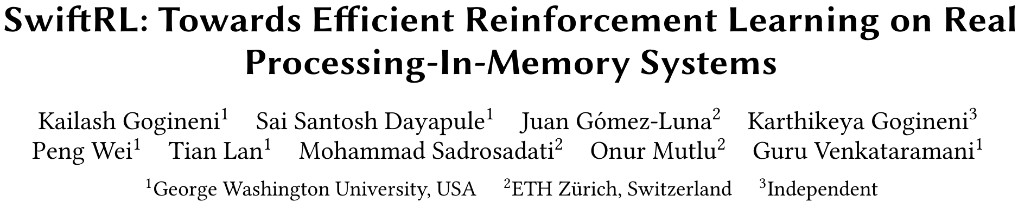
Accelerating Reinforcement Learning
Kailash Gogineni, Sai Santosh Dayapule, Juan Gomez-Luna, Karthikeya Gogineni, Peng Wei, Tian Lan, Mohammad Sadrosadati, Onur Mutlu, Guru Venkataramani,
"SwiftRL: Towards Efficient Reinforcement Learning on Real Processing-In-Memory Systems"
Proceedings of the 2024 IEEE International Symposium on Performance Analysis of Systems and Software (ISPASS), Indianapolis, Indiana, May 2024.
[Slides (pptx) (pdf)]
[arXiv version]
https://arxiv.org/pdf/2405.03967

Slide 48
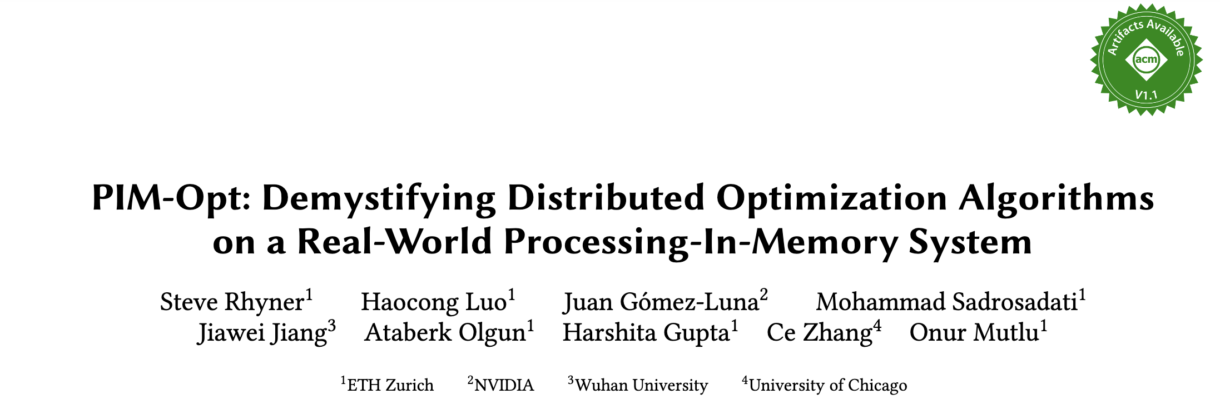
Accelerating ML Training on Real PIM Systems
Steve Rhyner, Haocong Luo, Juan Gómez-Luna, Mohammad Sadrosadati, Jiawei Jiang, Ataberk Olgun, Harshita Gupta, Ce Zhang, and Onur Mutlu,
"PIM-Opt: Demystifying Distributed Optimization Algorithms on a Real-World Processing-In-Memory System"
Proceedings of the 33rd International Conference on Parallel Architectures and Compilation Techniques (PACT), Long Beach, CA, USA, October 2024.
[Preliminary arXiv version]
https://arxiv.org/pdf/2404.07164

Slide 49
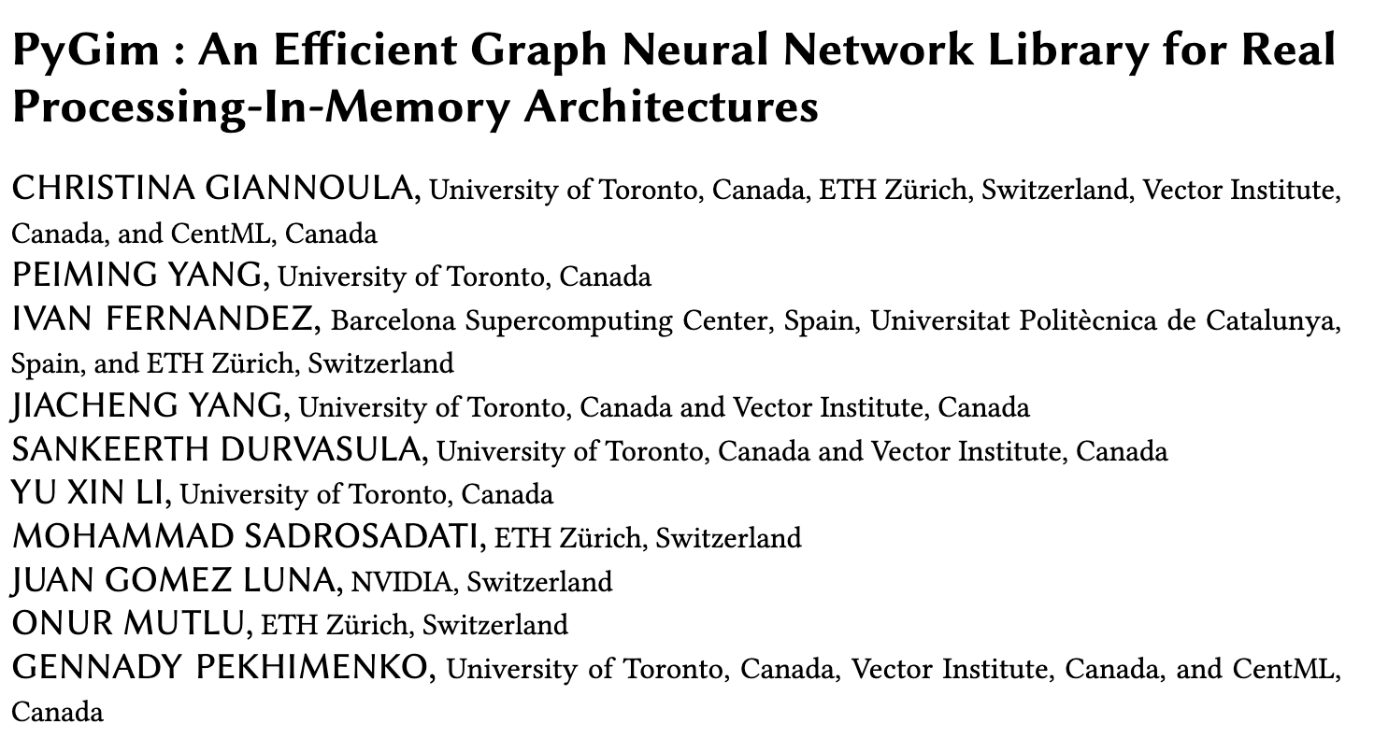
Accelerating GNNs on Real PIM Systems
https://arxiv.org/pdf/2402.16731

Slide 50
SpMV Multiplication on Real PIM Systems
Appears in SIGMETRICS 2022
https://arxiv.org/pdf/2201.05072.pdf
https://github.com/CMU-SAFARI/SparseP
https://www.youtube.com/watch?v=5kaOsJKlGrE

Slide 51
Sequence Alignment on Real PIM Systems
Safaa Diab, Amir Nassereldine, Mohammed Alser, Juan Gómez Luna, Onur Mutlu, and Izzat El Hajj,
"A Framework for High-throughput Sequence Alignment using Real Processing-in-Memory Systems"
Bioinformatics, [published online on] 27 March 2023.
[Online link at Bioinformatics Journal]
[arXiv preprint]
[AiM Source Code]
https://github.com/CMU-SAFARI/alignment-in-memory
https://arxiv.org/pdf/2208.01243.pdf

Slide 52
Summary
Sequence alignment on traditional systems is limited by the memory bandwidth bottleneck
Processing-in-memory (PIM) overcomes this bottleneck by placing cores near the memory
Our framework, Alignment-in-Memory (AIM), is a PIM framework that supports multiple alignment algorithms (NW, SWG, GenASM, WFA)
  Implemented on UPMEM, the first real PIM system
Results show substantial speedups over both CPUs (1.8X-28X) and GPUs (1.2X-2.7X)
AIM is available at:
  https://github.com/CMU-SAFARI/alignment-in-memory
52

Slide 53
Possible PNM Designs
General-purpose programmable cores
  Wimpy cores (possibility of running any workload)
  E.g. from academia: Tesseract PIM for Graph Processing
  E.g. from industry: UPMEM PIM
PIM Core
Cache
Fixed-function units
  Hardware/software co-designed PIM for efficiency
  E.g. from academia: Mensa for NN Edge Inference
  E.g. from industry: Samsung HBM-PIM, SK hynix AiM
PIM-Accelerator 1
…
PIM-Accelerator N
Reconfigurable architectures
  PNM cores coupled with FPGAs, CGRA
  E.g. from academia: NERO for Weather Prediction
  E.g. from industry: Samsung AxDIMM
Reconfigurable Accelerator

Slide 54
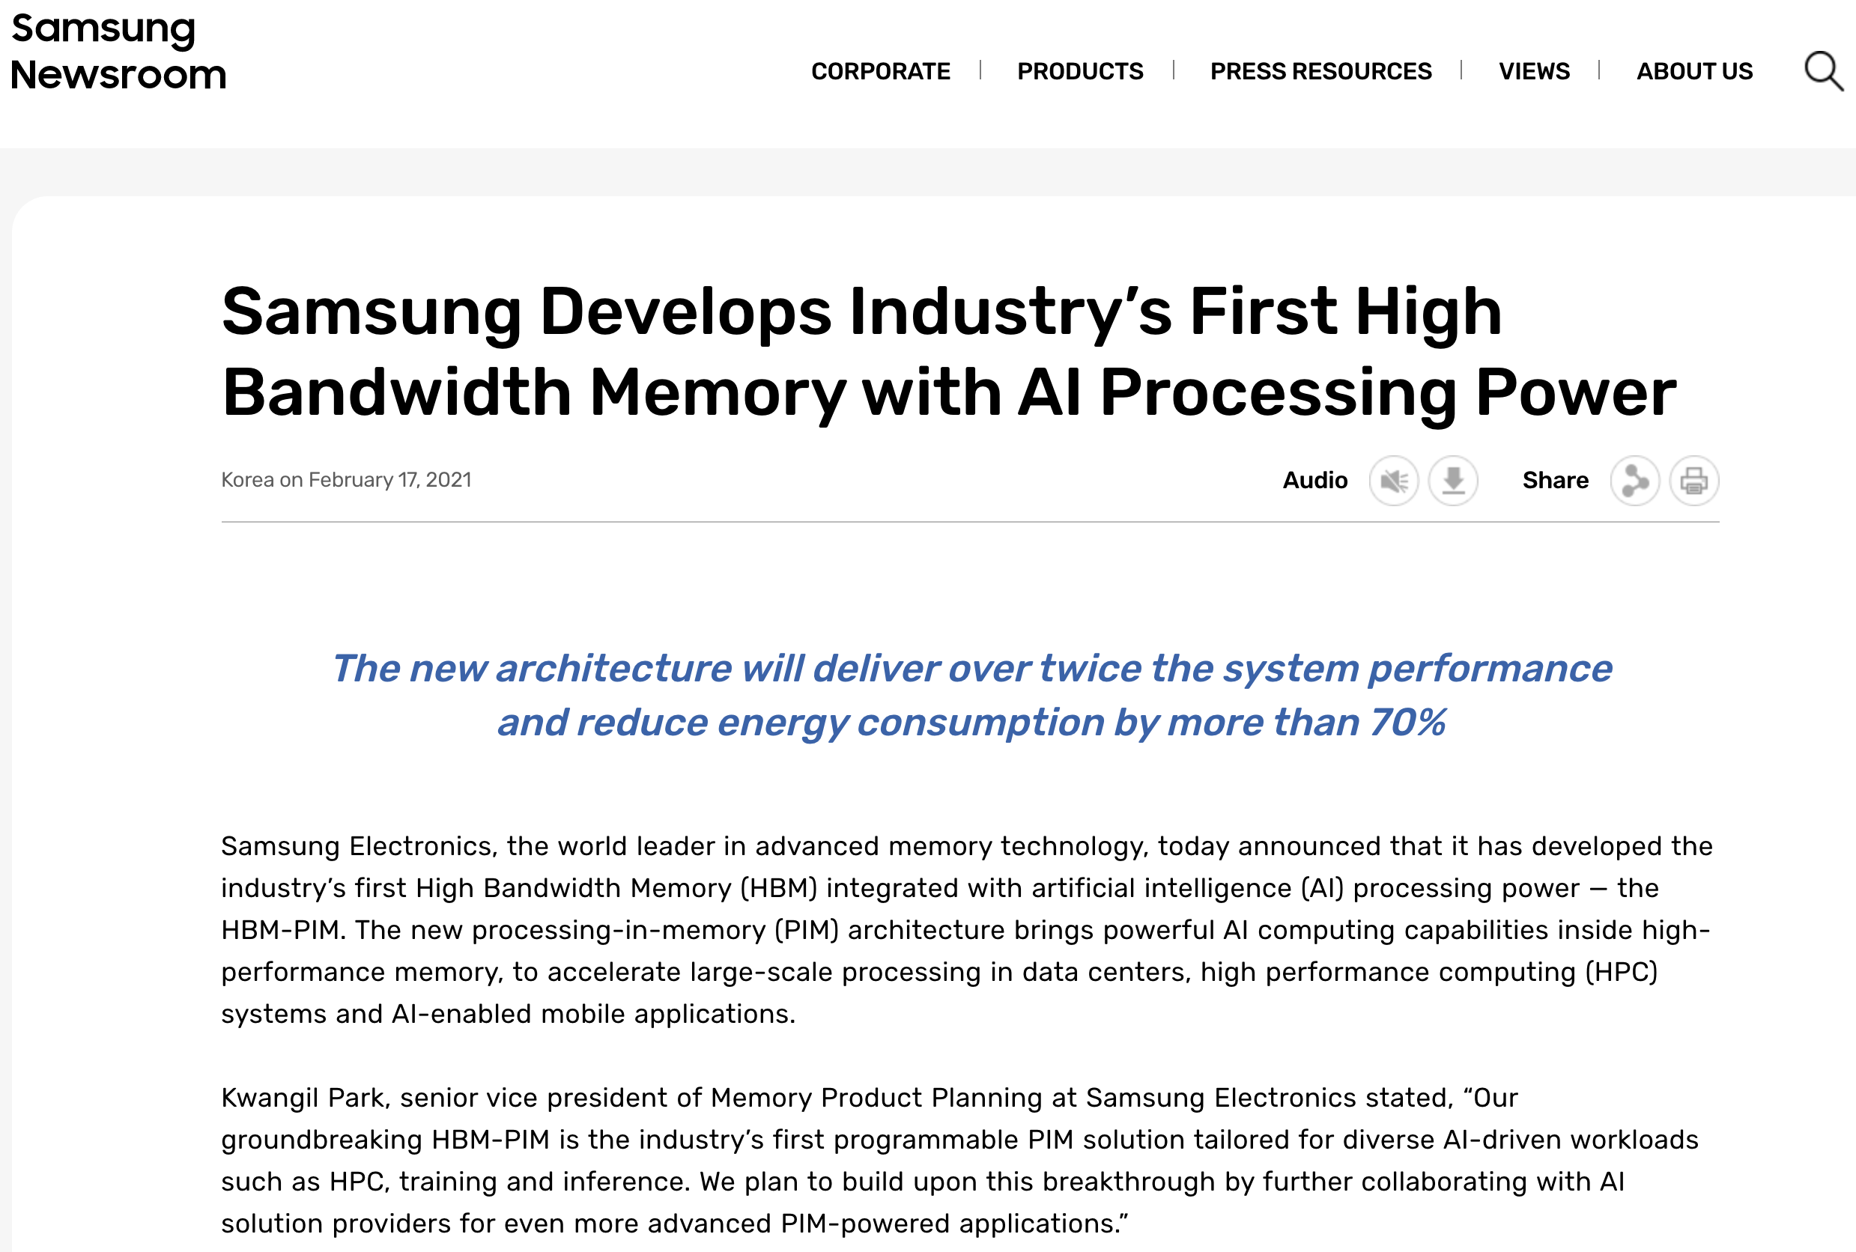
Samsung Function-in-Memory DRAM (2021)
https://news.samsung.com/global/samsung-develops-industrys-first-high-bandwidth-memory-with-ai-processing-power

Slide 55
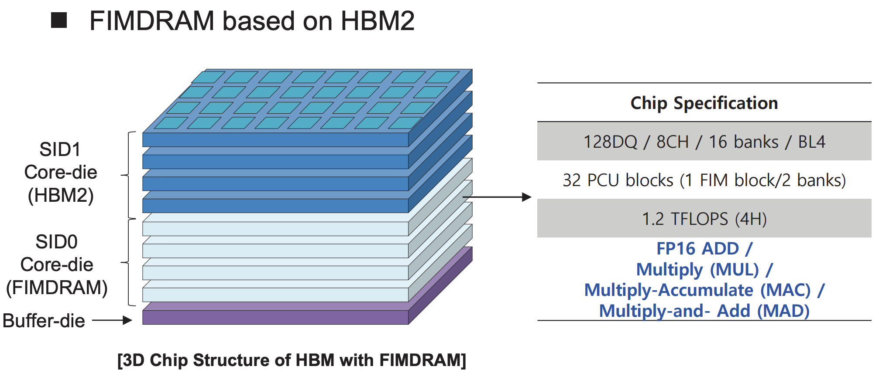
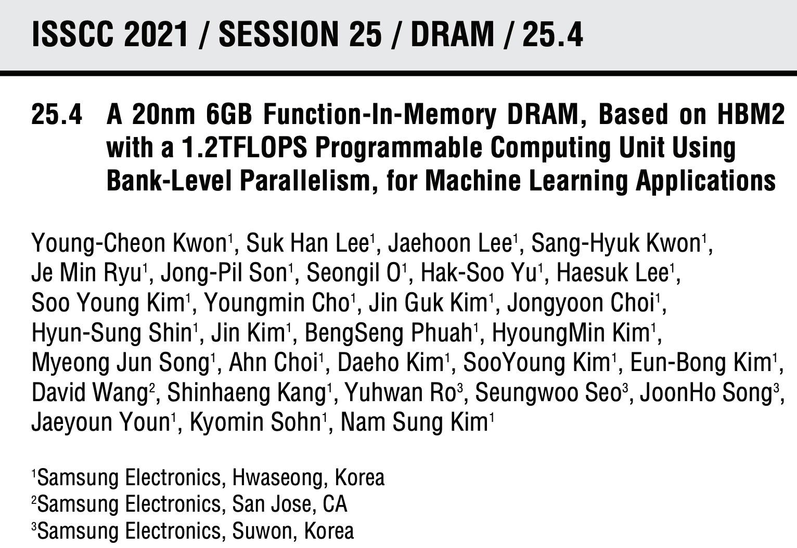
Samsung Function-in-Memory DRAM (2021)

Slide 56
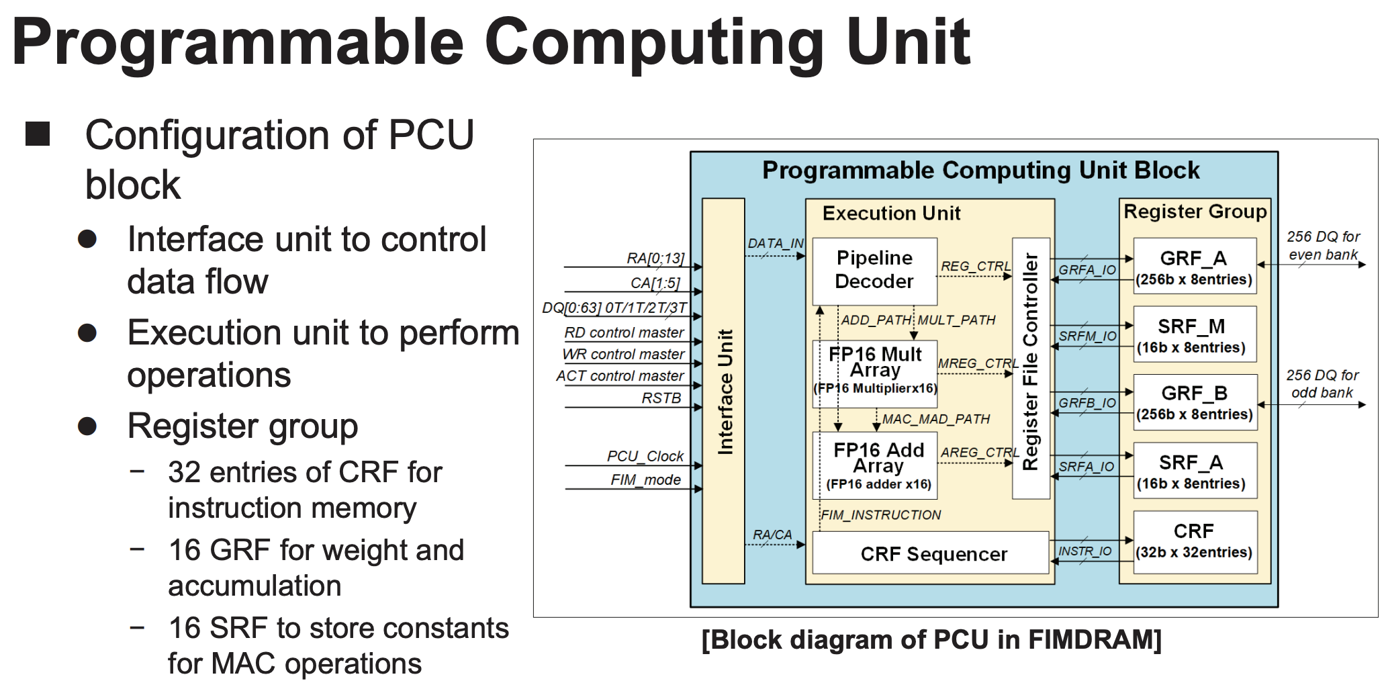
Samsung Function-in-Memory DRAM (2021)

Slide 57
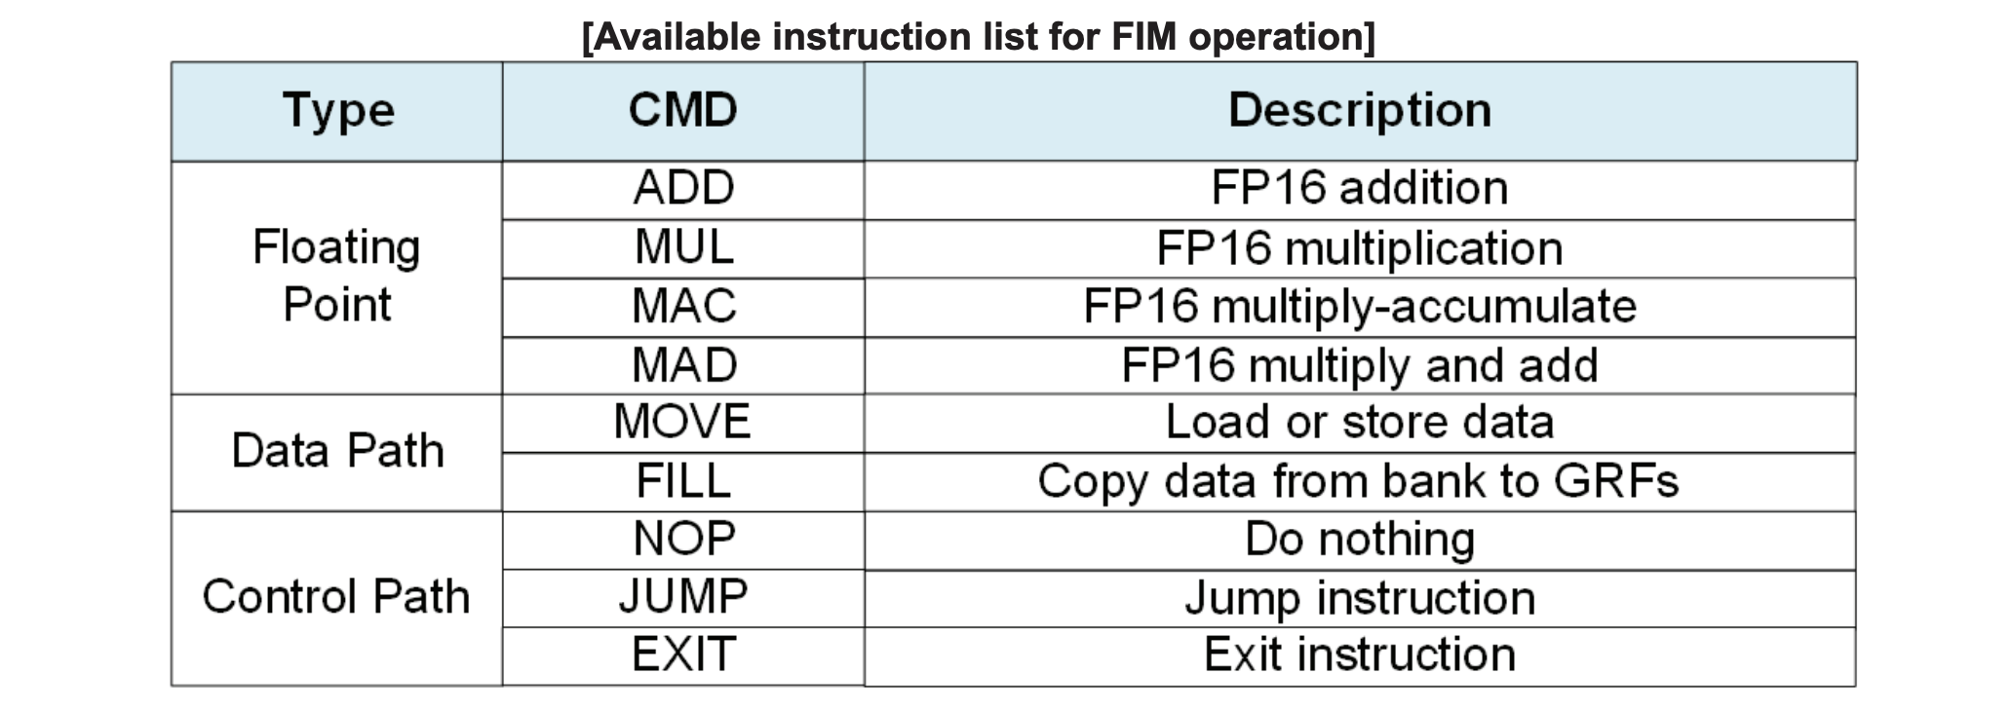
Samsung Function-in-Memory DRAM (2021)

Slide 58
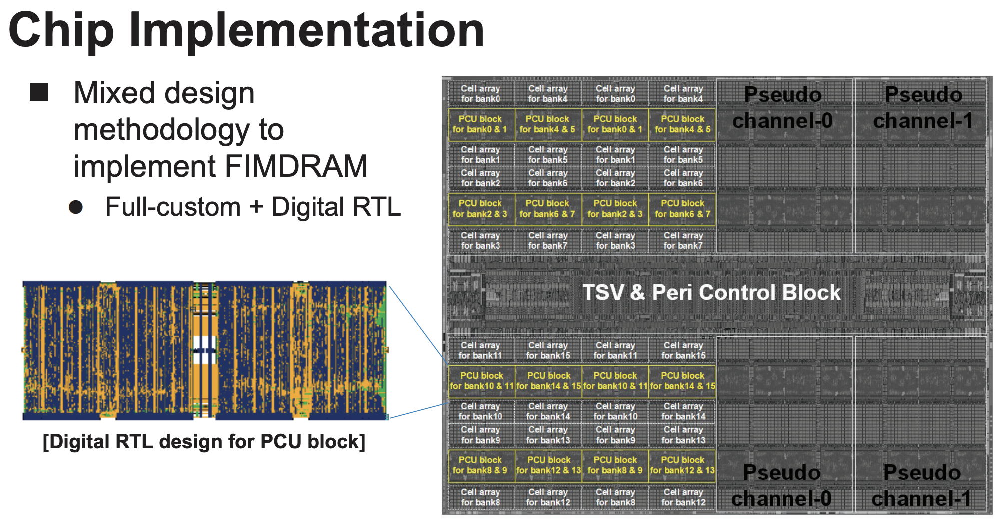
Samsung Function-in-Memory DRAM (2021)

Slide 59
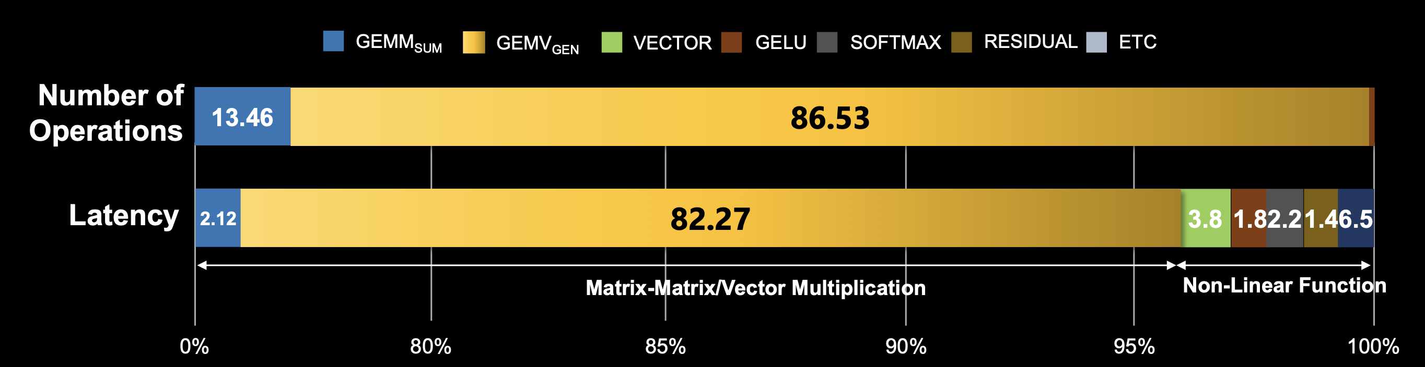
Samsung PNM Solutions for Generative AI (2023)
Main target: transformer decoders used in ChatGPT, GPT-3
  Compute-bound step: Summarization
  Memory-bound step: Generation
    Most of the execution time is spent on the memory copy from the host CPU memory to the CPU memory
GEMV portion can be 60%-80% of total generation latency, which is the target of PIM/PNM
[J. H. Kim+ HC, 2023]

Slide 60
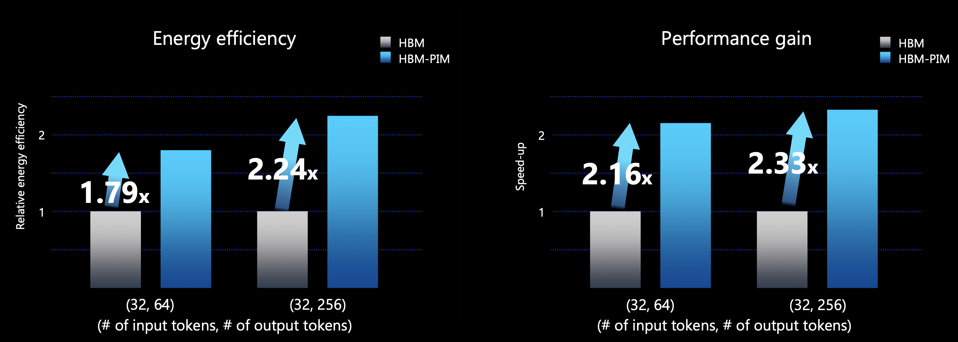
Solution I: Samsung’s HBM-PIM (2023)
AMD MI100 GPUs fabricated with HBM-PIM
Experimental setup: GPT-J (6B, 32 input tokes), single AMD MI100-PIM GPU
GPT can be accelerated by more than 2x over baseline
[J. H. Kim+ HC, 2023]

Slide 61
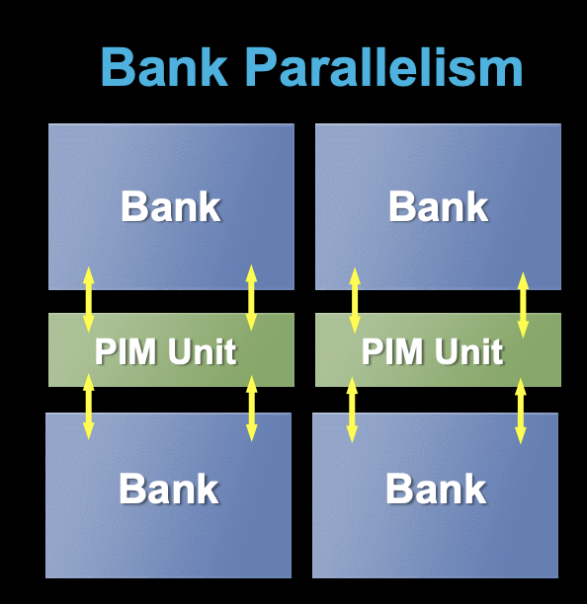
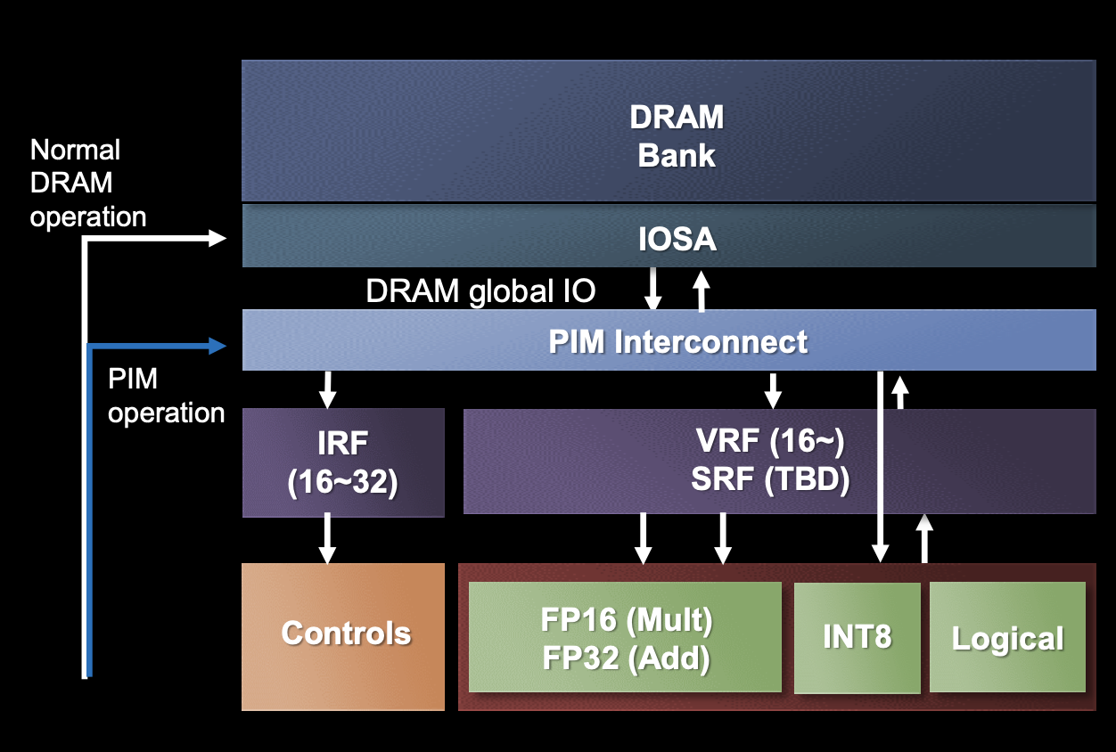
Solution II: Samsung’s LPDDR-PIM (2023)
PIM for on-device generative AI
  Datacenter costs and power consumption are increasing due to the growing demand for cloud AI
LPDDR-PIM improves battery life by preventing memory over-provisioning just for bandwidth
4.47x performance gains and 70.6% energy reduction in GPT-2
[J. H. Kim+ HC, 2023]

Slide 62
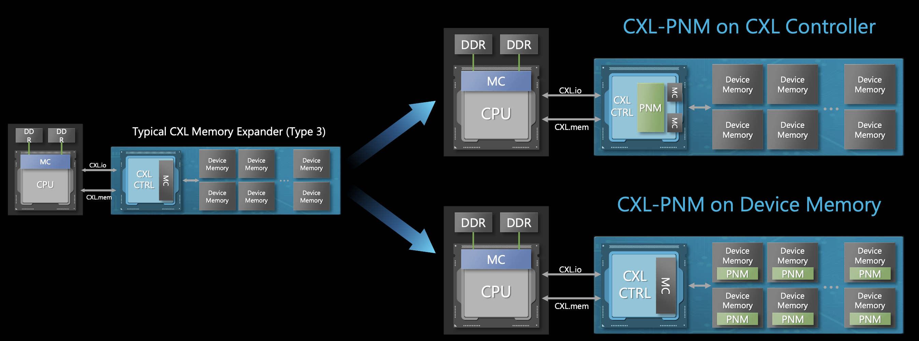
Solution III: Samsung’s CXL-PNM (2023)
A CXL-based processing-near-memory solution
  Improves capacity, bandwidth, and power
  Large-scale large-language models are often capacity-bound
Multiple CXL-PNM can offer 4.4x higher energy efficiency and
53% higher throughput than multiple GPUs
[J. H. Kim+ HC, 2023]

Slide 63
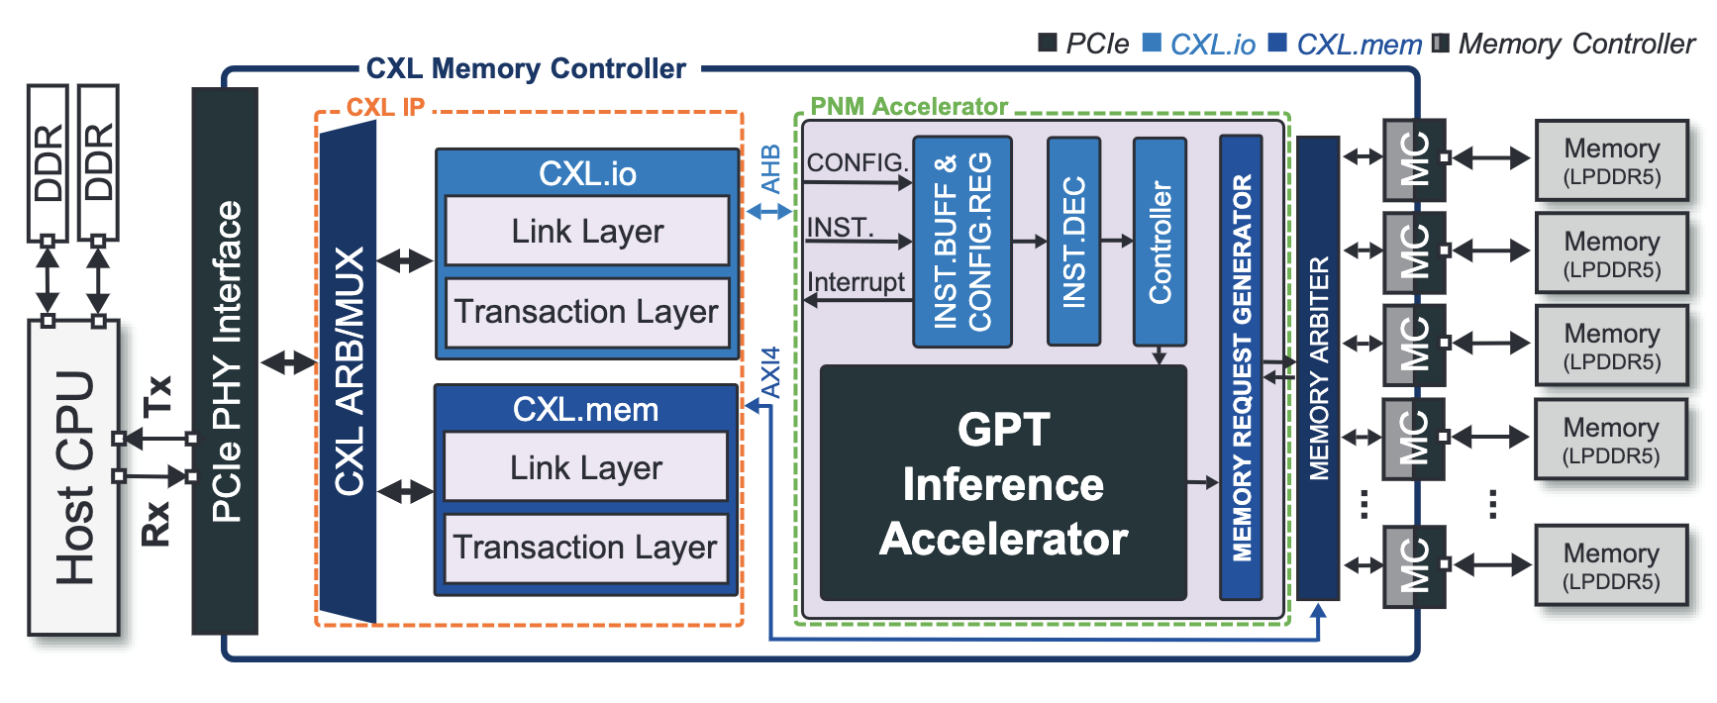
Solution IV: Samsung’s CXL-PNM + LPDDR5X (2024)
A CXL-based processing-near-memory solution
  Improves capacity, bandwidth, and power
  Large-scale large-language models are often capacity-bound
Multiple CXL-PNM can offer 23% lower latency, 31% higher throughput, and 2.8x higher energy efficiency at 30% lower hardware cost than multiple GPUs
[SS Park+ HPCA, 2024]

Slide 64
SK hynix AiM: Chip Implementation (2022)
4 Gb AiM die with 16 processing units (PUs)
Lee et al., A 1ynm 1.25V 8Gb, 16Gb/s/pin GDDR6-based Accelerator-in-Memory supporting 1TFLOPS MAC Operation and Various Activation Functions for Deep-Learning Applications, ISSCC 2022
Notes:
* The operating voltage is 1.25V:
- Lowered from 1.35V of the normal GDDR6, for bank parallel operation.
* 16Gb/s is reached at 1.25V in DL operation.
Flat-lid package for lower thermal resistance.
Tested in a prototype system with an FPGA (connected to host CPU via PCIe).

Slide 65
SK hynix AiM: System Organization (2022)
GDDR6-based AiM architecture
Lee et al., A 1ynm 1.25V 8Gb, 16Gb/s/pin GDDR6-based Accelerator-in-Memory supporting 1TFLOPS MAC Operation and Various Activation Functions for Deep-Learning Applications, ISSCC 2022

Slide 66
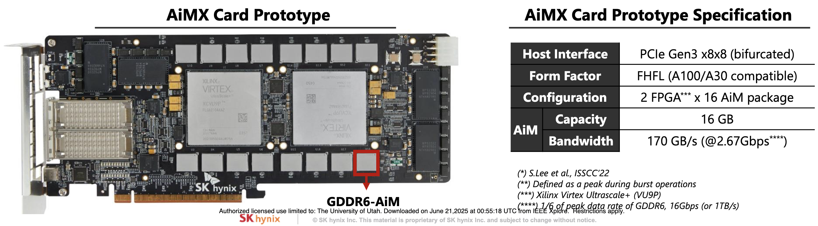
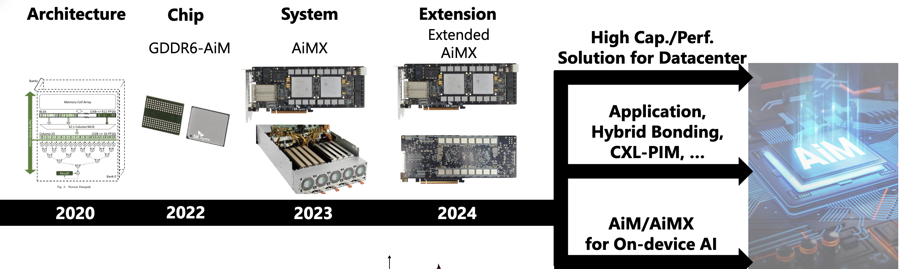
SK hynix AiMX & Beyond (2024)
FPGA-based AiMX Card Prototype
Kim et al., “SK hynix AI-Specific Computing Memory Solution: From AiM device to Heterogeneous AiMX-xPU System for Comprehensive LLM Inference,” in HCS, 2024.

Slide 67
Possible PNM Designs
General-purpose programmable cores
  Wimpy cores (possibility of running any workload)
  E.g. from academia: Tesseract PIM for Graph Processing
  E.g. from industry: UPMEM PIM
PIM Core
Cache
Fixed-function units
  Hardware/software co-designed PIM for efficiency
  E.g. from academia: Mensa for NN Edge Inference
  E.g. from industry: Samsung HBM-PIM, SK hynix AiM
PIM-Accelerator 1
…
PIM-Accelerator N
Reconfigurable architectures
  PNM cores coupled with FPGAs, CGRA
  E.g. from academia: NERO for Weather Prediction
  E.g. from industry: Samsung AxDIMM
Reconfigurable Accelerator

Slide 68
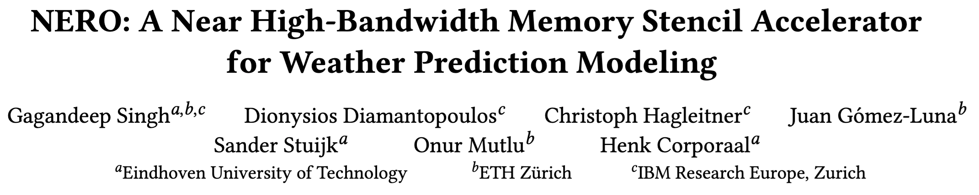
FPGA-based Processing Near Memory
Gagandeep Singh, Dionysios Diamantopoulos, Christoph Hagleitner, Juan Gómez-Luna, Sander Stuijk, Onur Mutlu, and Henk Corporaal,
"NERO: A Near High-Bandwidth Memory Stencil Accelerator for Weather Prediction Modeling"
Proceedings of the 30th International Conference on Field-Programmable Logic and Applications (FPL), Gothenburg, Sweden, September 2020.

Slide 69
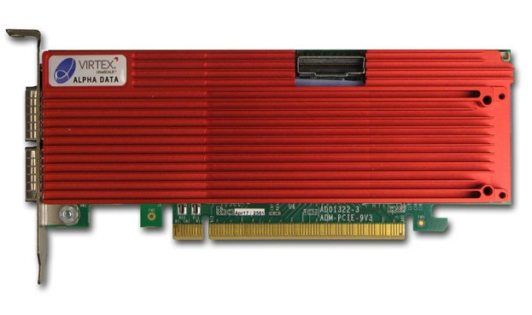
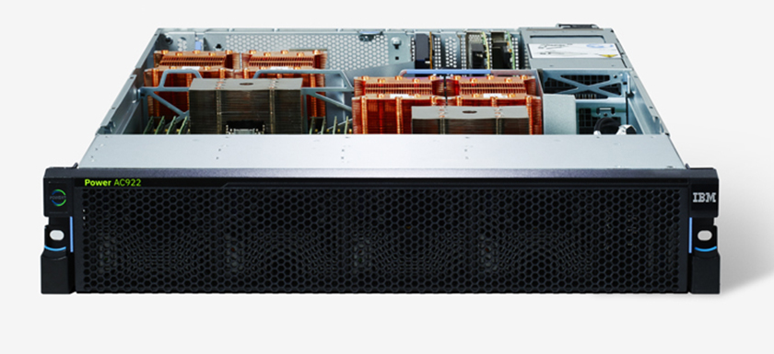
Heterogeneous System: CPU+FPGA
CAPI2
Source: IBM
Source: AlphaData
POWER9 AC922
DDR4-based AD9V3 board
We evaluate two POWER9+FPGA systems:
  1. HBM-based board AD9H7
  Xilinx Virtex Ultrascale+™ XCVU37P-2
  2. DDR4-based board AD9V3
  Xilinx Virtex Ultrascale+™ XCVU3P-2
Notes:
and the second is alphadata 9v3 with DDR4
Our CPU-FPGA heterogeneous platform offloads the rep-ri-zen-tuh-tiv weather kernels onto the FPGA
% with 98% of stencil execution time
%In the execution flow of our application:
Application data is stored in the HOST DRAM
Since our platform offers memory-coherent access of FPGA to the system memory, we build a pipelined execution, where communication time for transferring data from host to FPGA memory is masked with the actual FPGA processing
%Despite the low computational complexity, we were able to hide the memory access latency with the CAPI2 interface

Slide 70
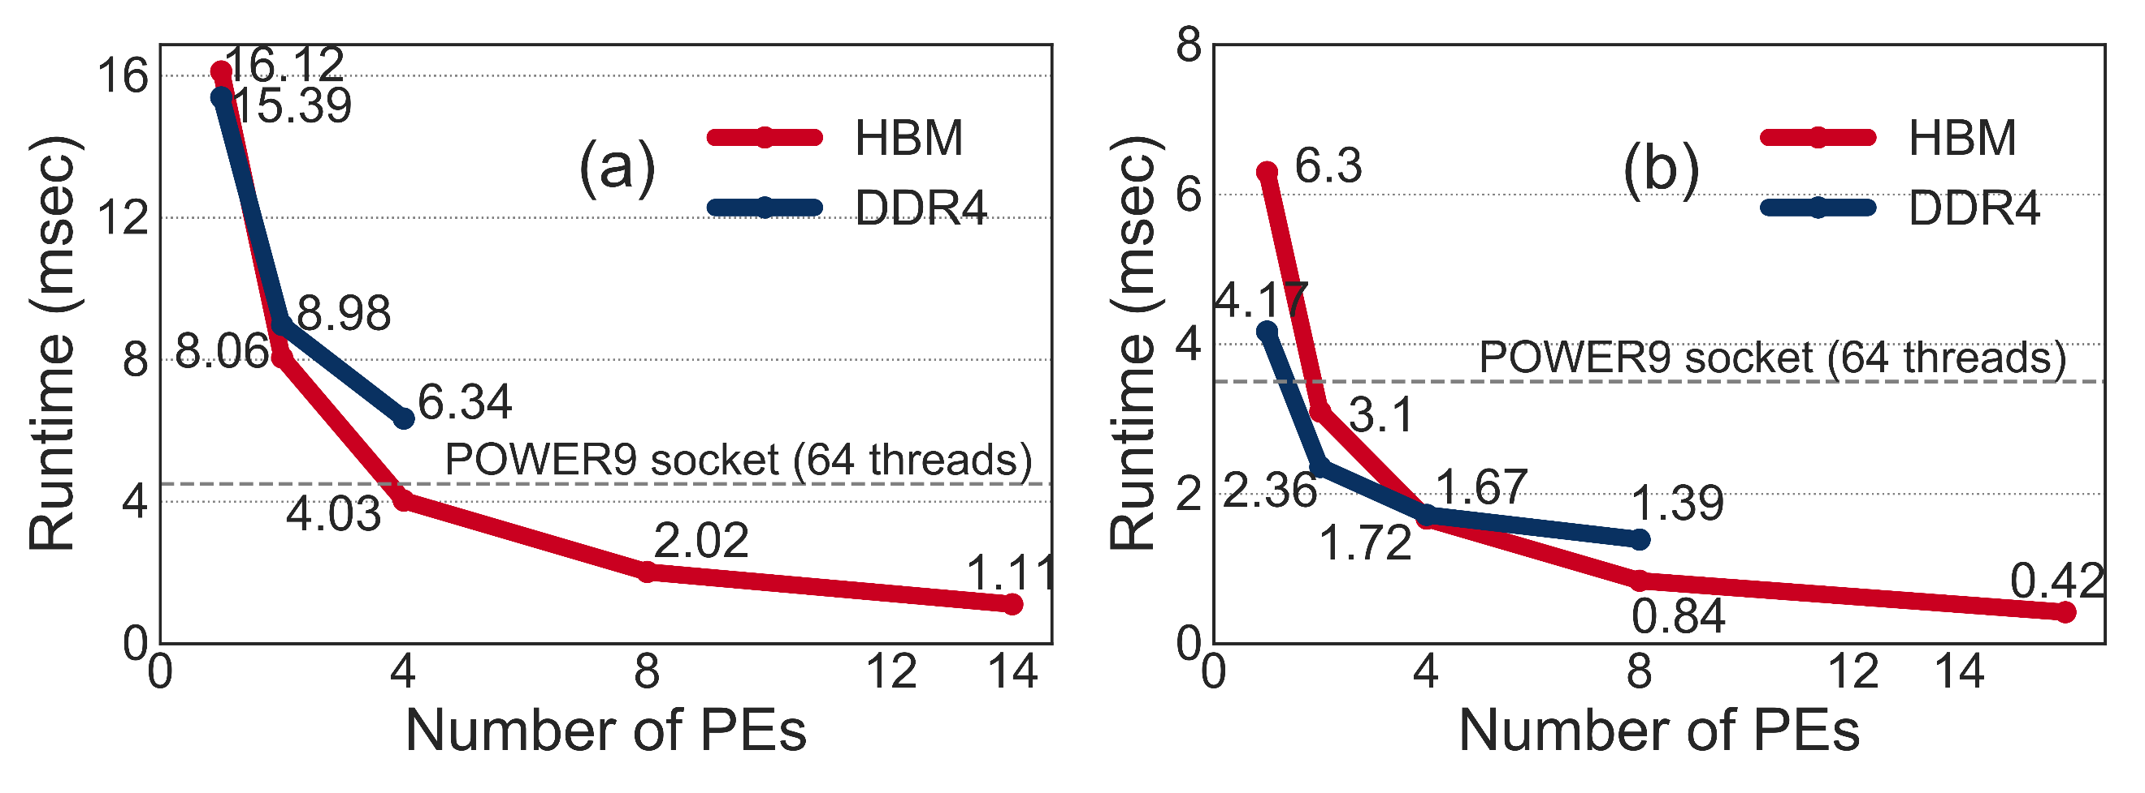
NERO Performance Analysis
Vertical Advection
Horizontal Diffusion
NERO is 4.2x and 8.3x faster than
a complete POWER9 socket
Notes:
By carefully designing the micro-archictecture architecture with application specific heterogeneous memory hierarchy, NERO is 4.2 times and 8.3 times faster for vertical advection and horizontal diffusion respectively than a complete~POWER9~socket.

Slide 71
Possible PNM Designs
General-purpose programmable cores
  Wimpy cores (possibility of running any workload)
  E.g. from academia: Tesseract PIM for Graph Processing
  E.g. from industry: UPMEM PIM
PIM Core
Cache
Fixed-function units
  Hardware/software co-designed PIM for efficiency
  E.g. from academia: Mensa for NN Edge Inference
  E.g. from industry: Samsung HBM-PIM, SK hynix AiM
PIM-Accelerator 1
…
PIM-Accelerator N
Reconfigurable architectures
  PNM cores coupled with FPGAs, CGRA
  E.g. from academia: NERO for Weather Prediction
  E.g. from industry: Samsung AxDIMM
Reconfigurable Accelerator

Slide 72
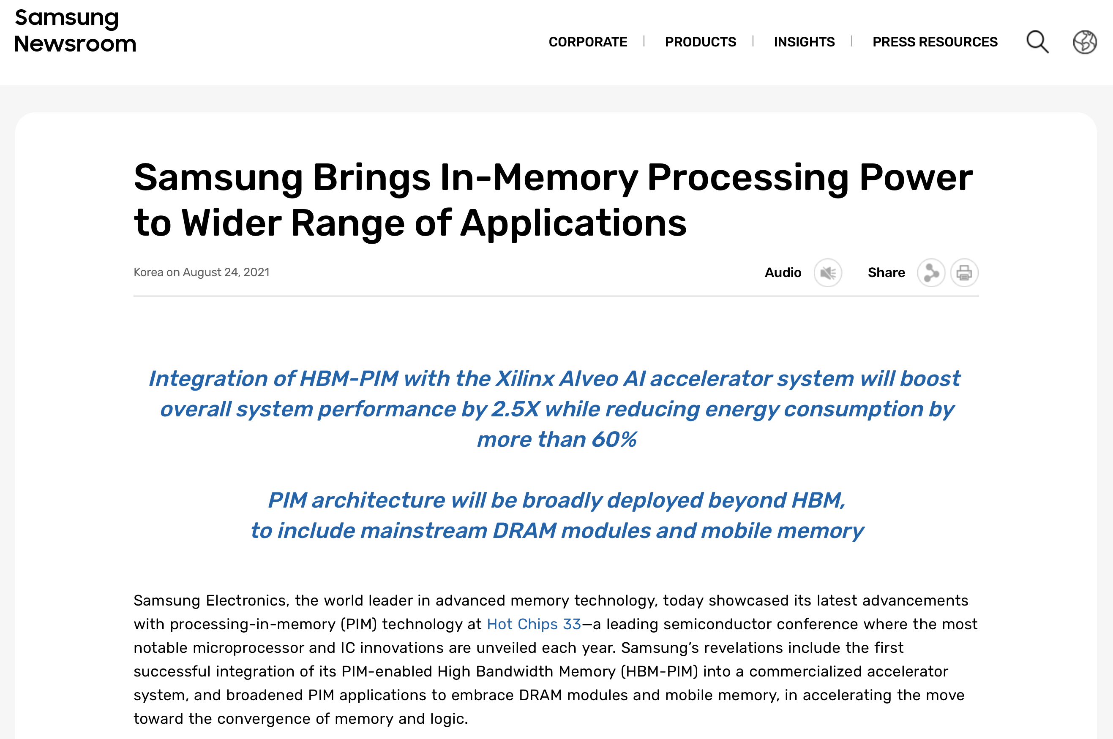

Samsung AxDIMM (2021)
https://news.samsung.com/global/samsung-brings-in-memory-processing-power-to-wider-range-of-applications

Slide 73



Samsung AxDIMM (2021)
DIMM-based PIM
  DLRM recommendation system
Baseline System
AxDIMM System
[Ke+, IEEE Micro’2021]

Slide 74
AxDIMM Design: Hardware Architecture
FPGA board with standard DIMM interface:
It serves as a real-system
near-memory processing implementation
[Ke+, IEEE Micro’2021]

Slide 75
AxDIMM Design: Hardware Architecture
Two execution modes:
non-acceleration mode
acceleration mode (blocking)
[Ke+, IEEE Micro’2021]
Notes:
Blocking = No concurrent access from host.

Slide 76

Sparse Length Sum with AxDIMM (IEEE Micro 2021)
https://doi.org/10.1109/MM.2021.3097700

Slide 77

Sparse Length Sum with AxDIMM (AICAS 2022)
https://doi.org/10.1109/AICAS54282.2022.9869896

Slide 78

Database Operations with AxDIMM (DaMoN 2022)
https://doi.org/10.1145/3533737.3535093

Slide 79

Longer Lecture on AxDIMM
https://youtu.be/SXdzQZAKG-Y

Slide 80

Another Longer Lecture on AxDIMM
https://youtu.be/2FMQg786GKs

Slide 81





Processing-in-Memory Landscape Today
[Samsung 2021]
[Alibaba 2022]
[SK Hynix 2022]
[Samsung 2021]
[UPMEM 2019]
This does not include many experimental chips and startups

Slide 82
Possible PNM Designs
General-purpose programmable cores
  Wimpy cores (possibility of running any workload)
  E.g. from academia: Tesseract PIM for Graph Processing
  E.g. from industry: UPMEM PIM
PIM Core
Cache
Fixed-function units
  Hardware/software co-designed PIM for efficiency
  E.g. from academia: Mensa for NN Edge Inference
  E.g. from industry: Samsung HBM-PIM, SK hynix AiM
PIM-Accelerator 1
…
PIM-Accelerator N
Reconfigurable architectures
  PNM cores coupled with FPGAs, CGRA
  E.g. from academia: NERO for Weather Prediction
  E.g. from industry: Samsung AxDIMM
Reconfigurable Accelerator

Slide 83

Research Tools PNM: DAMOV-SIM
Geraldo F. Oliveira, Juan Gomez-Luna, Lois Orosa, Saugata Ghose, Nandita Vijaykumar, Ivan fernandez, Mohammad Sadrosadati, and Onur Mutlu,
"DAMOV: A New Methodology and Benchmark Suite for Evaluating Data Movement Bottlenecks"
IEEE Access, 8 September 2021.
Preprint in arXiv, 8 May 2021.
[arXiv preprint]
[IEEE Access version]
[DAMOV Suite and Simulator Source Code]
[SAFARI Live Seminar Video (2 hrs 40 mins)]
[Short Talk Video (21 minutes)]

Slide 84
Step 3: Memory Bottleneck Classification (2/2)
Goal: identify the specific sources of data movement bottlenecks
Configuration 1: Host CPU System
DRAM
DRAM
DRAM
L3
DRAM
DAMOV-SIM Simulator
L1
L2
CPU
L1
L2
CPU
L1
L2
Off-chip link
CPU
L1
L2
CPU
Configuration 2: NDP System
DRAM
DRAM
DRAM
# Cores
DRAM
CPU
L1
…
Off-chip link
CPU
L1
Scalability Analysis
CPU
L1
CPU
L1
Integrated ZSim and Ramulator
Logic Layer
Scalability Analysis:
  1, 4, 16, 64, and 256 out-of-order/in-order host and NDP CPU cores
  3D-stacked memory as main memory
DAMOV-SIM: https://github.com/CMU-SAFARI/DAMOV
272
Notes:
[CLICK] The goal of the scalability analysis we perform is to nail down the specific sources of data movement bottlenecks in the application.
In this analysis, we evaluate the performance and energy scaling of an application in three different system configurations; and collect the key metrics for our bottleneck classification
[CLICK] During scalability analysis, we simulate three system configurations of a general-purpose multicore processor. To this end, we build a framework that integrates the ZSim CPU simulator with the Ramulator memory simulator to produce a fast, scalable, and cycle-accurate open-source simulator called DAMOV-SIM. We use ZSim to simulate the core microarchitecture, cache hierarchy, coherence protocol, and prefetchers. We use Ramulator to simulate the DRAM architecture, memory controllers, and memory accesses.
[CLICK] The first configuration we evaluate is of a host CPU with a deep cache hierarchy, with a 32 KB, private L1 cache, a 256 KB private L2 cache, and a shared 8MB L3 cache.
[CLICK] The second configuration is of an NDP CPU with only a private read-only L1 cache of 32 KB.
In our paper we evaluate an third configuration that includes hardware prefetcher on top of configuration 1. However, we omit such configuration in this talk.
The remaining components of the processor configuration are kept the same to isolate the impact of only the caches, prefetchers, and NDP.
This way, we expect that the performance and energy differences between the three configurations to come exclusively from the different data movement requirements.
[CLICK] For all configurations, we sweep the number of CPU cores in our analysis from 1 to 256, as previous works show that large core counts are necessary to saturate the bandwidth provided by modern high-bandwidth memories, and because modern CPUs and NDP proposals can have varying core counts.
[CLICK] We simulate a memory architecture similar to the Hybrid Memory Cube device where the host CPU accesses memory through a high-speed off-chip link,
[CLICK] and the NDP logic resides in the logic layer of the memory chip and has direct access to the DRAM banks, thus taking advantage of higher memory bandwidth and lower memory latency.
[NEXT]

Slide 85

DAMOV is Open Source
We open-source our benchmark suite and our toolchain
DAMOV-SIM
DAMOV
Benchmarks
Notes:
We open source DAMOV to facilitate further research in mitigating data movement bottlenecks, including in near data processing.
[CLICK] In our DAMOV repository, we provide
[CLICK] The complete set of 144 application functions that compose our benchmark suite
[CLICK] And our DAMOV-SIM simulator
[NEXT]

Slide 86
DAMOV is Open Source
We open-source our benchmark suite and our toolchain
Get DAMOV at:
https://github.com/CMU-SAFARI/DAMOV
DAMOV-SIM
DAMOV
Benchmarks
Notes:
We open source DAMOV to facilitate further research in mitigating data movement bottlenecks, including in near data processing.
[CLICK] In our DAMOV repository, we provide
[CLICK] The complete set of 144 application functions that compose our benchmark suite
[CLICK] And our DAMOV-SIM simulator
[NEXT]

Slide 87

More on DAMOV Analysis Methodology & Workloads
https://www.youtube.com/watch?v=GWideVyo0nM&list=PL5Q2soXY2Zi_tOTAYm--dYByNPL7JhwR9&index=3

Slide 88
More on DAMOV Methods & Benchmarks
Geraldo F. Oliveira, Juan Gomez-Luna, Lois Orosa, Saugata Ghose, Nandita Vijaykumar, Ivan fernandez, Mohammad Sadrosadati, and Onur Mutlu,
"DAMOV: A New Methodology and Benchmark Suite for Evaluating Data Movement Bottlenecks"
IEEE Access, 8 September 2021.
Preprint in arXiv, 8 May 2021.
[arXiv preprint]
[IEEE Access version]
[DAMOV Suite and Simulator Source Code]
[SAFARI Live Seminar Video (2 hrs 40 mins)]
[Short Talk Video (21 minutes)]

Slide 89

Research Tools PNM: Samsung HBM-PIM
https://github.com/SAITPublic/PIMSimulator

Slide 90

Research Tools PNM: UPMEM PIM (I)
https://github.com/VIA-Research/uPIMulator

Slide 91

Research Tools PNM: UPMEM PIM (II)
https://ieeexplore.ieee.org/document/10476411/

Slide 92
3rd Workshop on
Memory-Centric Computing:
Processing-Near-Memory
Dr. Geraldo F. Oliveira
https://geraldofojunior.github.io
ISCA 2025
21 June 2025

