Slide 1

PuDHammer
Experimental Analysis of Read Disturbance Effects of Processing-using-DRAM in Real DRAM Chips
İsmail Emir Yüksel
Akash Sood Ataberk Olgun Oğuzhan Canpolat Haocong Luo
Nisa Bostancı Mohammad Sadrosadati Giray Yağlıkçı Onur Mutlu
Notes:
Hello, I am Ismail Emir Yuksel.
I will be presenting our work, Simultaneous Many-Row Activation in Off-the-Shelf DRAM Chips

Slide 2
Executive Summary
Motivation: Processing-using-DRAM (PuD) alleviates data movement bottlenecks
DRAM can perform many PuD operations by activating multiple DRAM rows
in quick succession or simultaneously (i.e., multiple-row activation)
Modern DRAM is subject to read disturbance (e.g., RowHammer)
    Repeatedly activating even a single row induces bitflips in unaccessed rows
Problem: No prior work study the read disturbance effects of multiple-row activation
Goal: Understand and analyze read disturbance effects of multiple-row activation
Experimental Study: 316 COTS DDR4 chips from four major manufacturers to study
read disturbance effects of multiple-row activation, which we call PuDHammer
PuDHammer significantly exacerbates DRAM read disturbance,
causing up to 158.58x reduction in min. hammer count to induce first bitflip (HC_{first})
PuDHammer bypasses in-DRAM RowHammer mitigation in DDR4 and
induces 11340x more bitflips than RowHammer
Mitigation: We adapt Per Row Activation Counting (PRAC) for PuDHammer
Adapted PRAC solution incurs an average system performance overhead of 48.26%

Slide 3
Outline
Background
Problem & Goal
Testing Infrastructure
Read Disturbance Effect of CoMRA
Read Disturbance Effect of SiMRA
Mitigating PuDHammer
Conclusion
Notes:
Here is the outline of my talk

Slide 4
Outline
Background
Problem & Goal
Testing Infrastructure
Read Disturbance Effect of CoMRA
Read Disturbance Effect of SiMRA
Mitigating PuDHammer
Conclusion
Notes:
Here is the outline of my talk

Slide 5

Data Movement Bottleneck
Today’s computing systems are processor centric
All data is processed in the processor → at great system cost
Computing Unit
(CPU, GPU, FPGA, Accelerators)
Main Memory
(DRAM)
Memory
Channel
More than 60% of the total system energy is spent on data movement¹
¹ A. Boroumand et al., “Google Workloads for Consumer Devices: Mitigating Data Movement Bottlenecks,” ASPLOS, 2018

Slide 6

DRAM Organization
DRAM Module
DRAM
Chip
Subarray
DRAM Cell
Bank
…
Wordline
Chip I/O
Row Decoder
DRAM Row
Bitline
…
Sense Amps.
DRAM Chip
DRAM Bank
DRAM Subarray
Notes:
DRAM is used as the main memory in many computing systems.
[CLICK] a DRAM module consists of multiple DRAM chips
[CLICK]Each chip contains multiple banks
[CLICK] Each bank is composed of multiple subarrays and sense amplifiers
[CLICK] And within each subarray, there is a two dimensional array of DRAM cells.
[CLICK] These cells are organized into rows that are selected using wordlines
[CLICK] And the cells are connected to a row of sense amplifiers via bitlines

Slide 7
DRAM Operation
DRAM Subarray
1
ACTIVATE (ACT):
Fetch the row’s content
into the sense amplifiers
2
Column Access (RD/WR):
Read/Write the target
column and drive to I/O
Sense
Amplifiers
3
PRECHARGE (PRE):
Prepare the bank
for a new ACTIVATE
I/O Circuitry
Notes:
Data is internally accessed in a row granularity. To access data,
[CLICK] the memory controller first needs to activate the row that contains the data and fetch the row’s content into the sense amplifiers
[CLICK] Then, column accesses are serviced from the sense amplifiers
[CLICK] Finally, the subarray needs to be precharged to get ready for the next row activation

Slide 8
Processing-using-DRAM (PuD)
Processing-using-DRAM uses the analog operational principles of
DRAM cells to perform computation
Multiple-row activation is a key technique to realize many PuD operations
DRAM
(e.g., 3D-Stacked Memory)
DRAM Bank
Vault
Controller
Processing-
Using-DRAM
DRAM Vault
PHY
…
…
Notes:
Processing-in-Memory architectures alleviate data movement bottlenecks by moving computation to where the data resides. Such architectures can be implemented
[CLICK] by adding logic near the memory arrays, in what is called processing-near-memory or
[CLICK] by using the analog operating principles of the memory cells to perform computation, in what is called processing-using-memory

Slide 9
Processing-using-DRAM (PuD)
Multiple-row activation is a key technique to realize many PuD operations
1. Consecutive Multiple-Row Activation (CoMRA)
Multiple-row activation is a key technique to realize many PuD operations
2. Simultaneous Multiple-Row Activation (SiMRA)
DRAM
(e.g., 3D-Stacked Memory)
DRAM Bank
Vault
Controller
Processing-
Using-DRAM
Processing-
Using-DRAM
DRAM Vault
PHY
…
…
…
…
Notes:
Processing-in-Memory architectures alleviate data movement bottlenecks by moving computation to where the data resides. Such architectures can be implemented
[CLICK] by adding logic near the memory arrays, in what is called processing-near-memory or
[CLICK] by using the analog operating principles of the memory cells to perform computation, in what is called processing-using-memory

Slide 10
Consecutive Multiple-Row Activation
Violating timing of PRE command greatly
can activate two rows consecutively

Slide 11

Consecutive Multiple-Row Activation
Violating timing of PRE command greatly
can activate two rows consecutively
36ns
14ns
ACT src
PRE
ACT dst
<9ns
d
s
t
s
r
c
d
s
t
d
s
t
s
r
c

Slide 12
Consecutive Multiple-Row Activation
Violating timing of PRE command greatly
can activate two rows consecutively
36ns
14ns
ACT src
PRE
ACT dst
<9ns
d
s
t
s
r
c
src’s content
is copied to dst
s
r
c
d
s
t
s
r
c

Slide 13
Simultaneous Multiple-Row Activation
Activating two rows in quick succession
can simultaneously activate
multiple rows in a subarray
36ns
14ns
ACT Row A
PRE
ACT Row B
<3ns
<3ns
Subarray X
ACT
Row A
…
ACT
Row B
DRAM Bank
Notes:
Our key observation is activating two rows in quick succession can simultaneously activate many rows in a subarray
[CLICK] You may remember this pictorial example where Row A and Row B is in Subarray X.
[CLICK] When we respect to the timing parameters between ACT and PRE and PRE and ACT
[CLICK] we activate a single row at a time.
[CLICK] However, when we greatly violate these timing parameters, we observe that we can activate many rows at once in the same subarray

Slide 14
Example: In-DRAM Majority-of-Three (MAJ3)
<3ns
<3ns
ACT
PRE
ACT
a
a
a
Three rows perturb bitlines simultaneously
Assert three rows’ wordlines
b
b
b
b
b
b
d
s
t
b
b
b
Sense amplifiers sample the output of majority
[Seshadri+ MICRO’17, Gao+ MICRO’19]
Notes:
These works first
[CLICK] activate three rows simultaneously by either modifying the row decoder circuitry or violating standard DRAM timing parameters in off-the-shelf DRAM chips, we will see how this works in real DRAM chips later in this talk
[CLICK] By activating three rows simultaneously, DRAM will assert these rows’ wordlines
[CLICK] After that these activated rows perturb bitlines simultaneously
[CLICK] After some time, sense amplifier amplifies the perturbation on the bitline and sample the output of majority of the values stored in activated rows

Slide 15
Read Disturbance in DRAM
Unfortunately, even activating a single DRAM row
disturbs the data-integrity of other unaccessed DRAM rows
Prominent example: RowHammer
DRAM Subarray
Row 1
Row 1
Row 1
Victim Row
Row 2
Row 2
Row 2
Row 2
Row 2
Row 2
open
open
Aggressor Row
closed
open
closed
Row 3
Row 3
Row 3
Victim Row
Repeatedly opening (activating) and closing a DRAM row
many times causes RowHammer bitflips in adjacent rows

Slide 16
Outline
Background
Problem & Goal
Testing Infrastructure
Read Disturbance Effect of CoMRA
Read Disturbance Effect of SiMRA
Combined Effect of CoMRA, SiMRA, and RowHammer
Conclusion
Notes:
Here is the outline of my talk

Slide 17
Problem & Goal
Problem
No prior work investigates the read disturbance effects of multiple-row activation
Goal
Understand how multiple-row activation
affect read disturbance vulnerability in DRAM

Slide 18
Outline
Background
Problem & Goal
Real DRAM Chip Testing Infrastructure
Read Disturbance Effect of CoMRA
Read Disturbance Effect of SiMRA
Mitigating PuDHammer
Conclusion
Notes:
Here is the outline of my talk

Slide 19
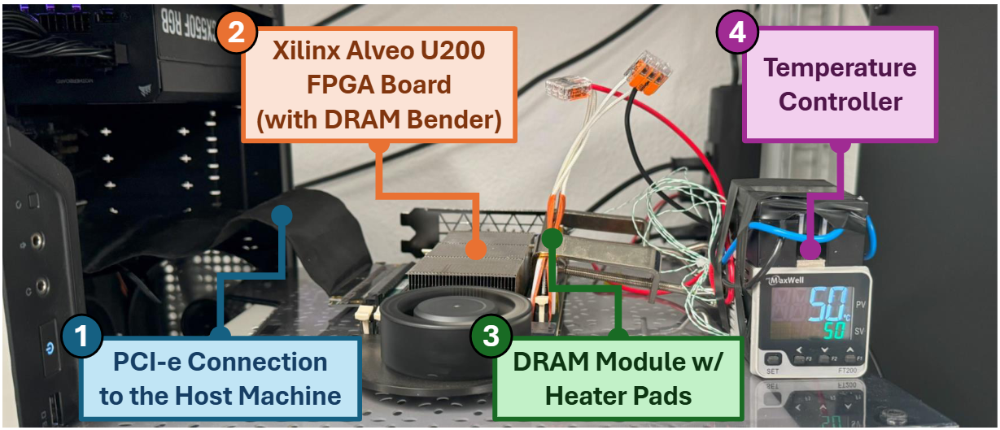
DRAM Bender: DRAM Testing Infrastructure
Fine-grained control over DRAM commands, timings,
temperature, and voltage
Olgun et al., "DRAM Bender: An Extensible and Versatile FPGA-based Infrastructure to Easily Test State-of-the-art DRAM Chips," TCAD, 2023.
Notes:
This infrastucture
[CLICK] enables fine-grained control over DRAM commands, timings, temperature and voltage

Slide 20
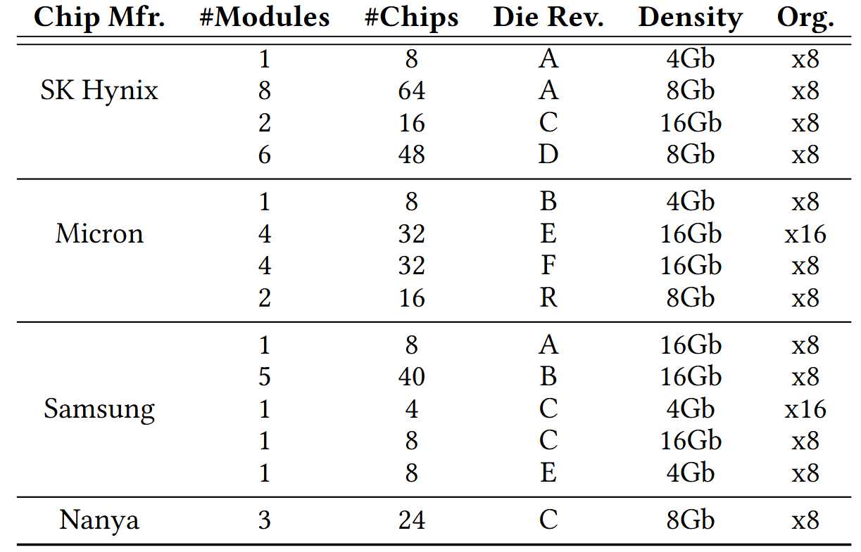
DRAM Chips Tested
316 DDR4 chips from four major DRAM manufacturers
Covers different die revisions and chip densities
Notes:
[CLICK] We test 120 DDR4 chips from two major DRAM manufacturers,
[CLICK] covering different die densities and revisions

Slide 21
Outline
Background
Problem & Goal
Testing Infrastructure
Read Disturbance Effect of CoMRA
Read Disturbance Effect of SiMRA
Mitigating PuDHammer
Conclusion
Notes:
Here is the outline of my talk

Slide 22
Recall: CoMRA
Violating timing of PRE command greatly
can activate two rows consecutively
36ns
14ns
ACT src
PRE
ACT dst
<9ns
d
s
t
s
r
c
src’s content
is copied to dst
s
r
c
d
s
t
s
r
c

Slide 23


Hammering with CoMRA
ACT src
PRE
ACT dst
36ns
7.5ns
Double-Sided
Single-Sided
victim
.
.
.
src
aggressor
src
aggressor
victim
victim
.
.
.
dst
aggressor
victim
.
.
.
dst
aggressor
victim
DRAM Subarray
DRAM Subarray

Slide 24

Characterization Methodology
Carefully sweep
    Row addresses: src and dst
    Timing parameters: Between ACT → PRE and PRE → ACT
    Data Pattern: 0x00, 0xFF, 0xAA, and 0x55
    Temperature (◦C): 50, 60, 70, and 80
ACT src
PRE
ACT dst
Temperature
DRAM Subarray
.
.
.
ACT
aggressor
src
victim
ACT
aggressor
dst
.
.
.
50 ◦C
80 ◦C
DRAM Bank
Notes:
[CLICK] In this study, we focus on individual subarrays, here denoted as Subarray X
[CLICK] We perform our experiment using the following command sequence: Activate Row A, Precharge, and Activate Row B, where Row A and Row B in the same subarray
[CLICK] We carefully sweep four parameters: Row addresses: Row A and Row B
[CLICK] Timing parameters between ACT Row A and Precharge and between Precharge and ACT Row B

Slide 25

Read Disturbance Vulnerability Metric: HC_{first}
The minimum hammer count
required to induce the first bitflip
Lower is worse
1 Hammer
Aggressor Row (src)
ACT src
Record bitflips
in victim
Victim Row
PRE
Aggressor Row (dst)
ACT dst
Notes:
To evaluate the robustness of in-DRAM operations, we define a metric called success rate
[CLICK] as the percentage of DRAM cells that produce correct output of a tested operation in all test trials. We test total of 10000 trials and record the success rate for each tested cell
[CLICK] Let’s see the success rate in a in-DRAM copy example where we try to copy src to dst.
[CLICK] Assume we have three trials and in the first trial, first cell produce incorrect result. Meaning we couldn’t copy s value to that cell.
[CLICK] As a result, two out of three cells for this source and destination row pair produce correct output in all test trials.
[CLICK]Hence the success rate for this experiment is 66.67%

Slide 26
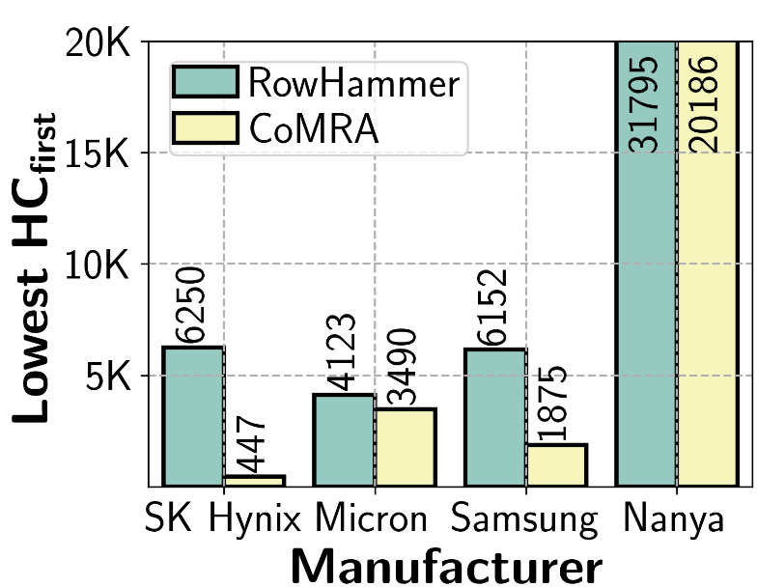
Double-Sided CoMRA vs. RowHammer (I)
1.58x
13.98x
3.28x
1.18x
Double-sided CoMRA decreases lowest HC_{first} by 13.98x
compared to double-sided RowHammer
Lowest HC_{first} reduction trend consistent across all four manufacturer

Slide 27
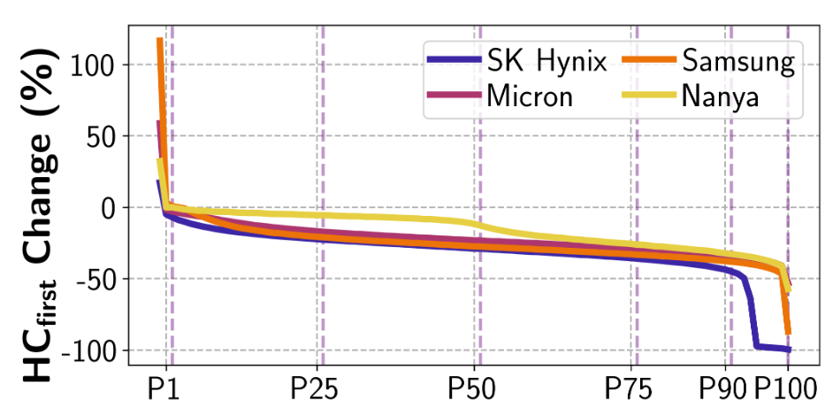
Double-Sided CoMRA vs. RowHammer (II)
Represents 99% of tested victim rows
Represents 50% of tested victim rows
HCfirst reduction of 50%
RowHammer HCfirst = 100
CoMRA HCfirst = 50

Slide 28
Double-Sided CoMRA vs. RowHammer (II)
>99% of tested victim rows
experience lower HCfirst
Double-sided CoMRA decreases HC_{first} for a large fraction of rows
compared to double-sided RowHammer

Slide 29
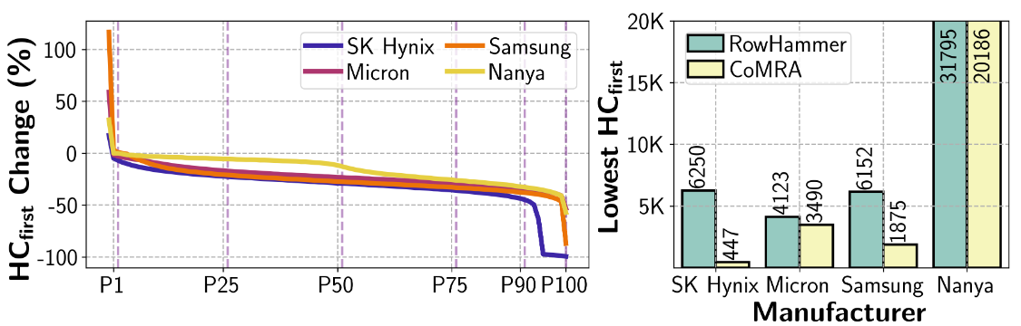
Double-Sided CoMRA vs. RowHammer
Key Takeaway
CoMRA exacerbates DRAM’s vulnerability
to read disturbance in all four major manufacturers

Slide 30
Outline
Background
Problem & Goal
Testing Infrastructure
Read Disturbance Effect of CoMRA
Read Disturbance Effect of SiMRA
Mitigating PuDHammer
Conclusion
Notes:
Here is the outline of my talk

Slide 31
Recall: SiMRA
Activating two rows in quick succession
can simultaneously activate
multiple rows in a subarray
36ns
14ns
ACT Row A
PRE
ACT Row B
<3ns
<3ns
Subarray X
ACT
Row A
…
ACT
Row B
DRAM Bank
Notes:
Our key observation is activating two rows in quick succession can simultaneously activate many rows in a subarray
[CLICK] You may remember this pictorial example where Row A and Row B is in Subarray X.
[CLICK] When we respect to the timing parameters between ACT and PRE and PRE and ACT
[CLICK] we activate a single row at a time.
[CLICK] However, when we greatly violate these timing parameters, we observe that we can activate many rows at once in the same subarray

Slide 32
Characterization Methodology
Carefully sweep
    Row addresses: Row A and Row B
    Timing parameters: Between ACT → PRE and PRE → ACT
    Data Pattern: 0x00, 0xFF, 0xAA, and 0x55
    Temperature (◦C): 50, 60, 70, and 80
Temperature
ACT Row A
PRE
ACT Row B
Subarray X
ACT
Row A
…
ACT
Row B
DRAM Bank
50 ◦C
80 ◦C
Notes:
[CLICK] In this study, we focus on individual subarrays, here denoted as Subarray X
[CLICK] We perform our experiment using the following command sequence: Activate Row A, Precharge, and Activate Row B, where Row A and Row B in the same subarray
[CLICK] We carefully sweep four parameters: Row addresses: Row A and Row B
[CLICK] Timing parameters between ACT Row A and Precharge and between Precharge and ACT Row B

Slide 33
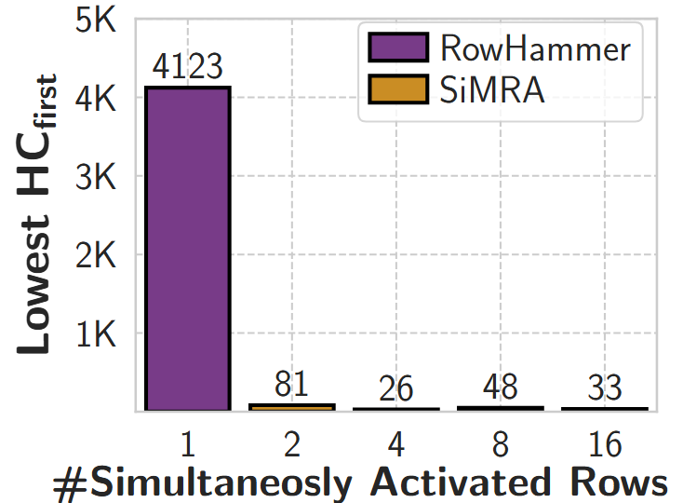
Double-Sided SiMRA vs. RowHammer (I)
51x
159x
86x
125x
Double-sided SiMRA decreases lowest HC_{first} by 159x
compared to double-sided RowHammer
Lowest HC_{first} reduction trend consistent
across all tested number of simultaneously activated rows

Slide 34
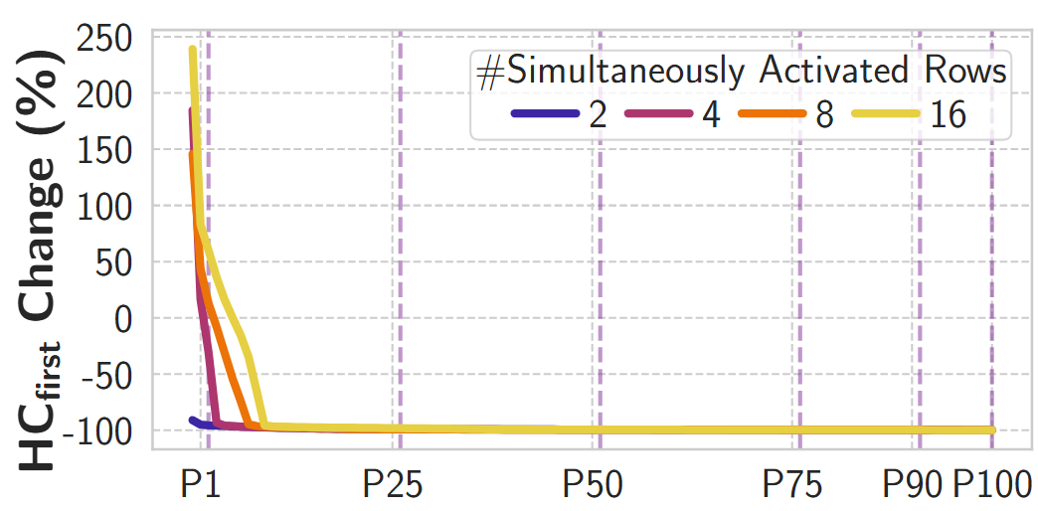
Double-Sided SiMRA vs. RowHammer (II)
>99% of tested victim rows
experience lower HCfirst
at least 25.19% of tested victim rows experience >99% HCfirst reduction

Slide 35
Double-Sided SiMRA vs. RowHammer (II)
Double-sided SiMRA
significantly decreases HC_{first} for a majority of rows
compared to double-sided RowHammer

Slide 36
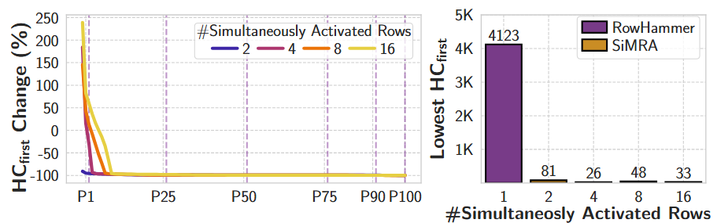
Double-sided SiMRA vs. RowHammer
Key Takeaway
SiMRA drastically exacerbates
DRAM’s vulnerability to read disturbance

Slide 37
Outline
Background
Problem & Goal
Testing Infrastructure
Read Disturbance Effect of CoMRA
Read Disturbance Effect of SiMRA
Mitigating PuDHammer
Conclusion
Notes:
Here is the outline of my talk

Slide 38
Mitigating PuDHammer
1
Analyze the effectiveness of existing in-DRAM RowHammer mitigation against PuDHammer
2
Adapt RowHammer mitigations
to account for against PuDHammer

Slide 39
Mitigating PuDHammer
1
Analyze the effectiveness of existing in-DRAM RowHammer mitigation against PuDHammer
2
Adapt RowHammer mitigations
to account for against PuDHammer

Slide 40


Target Row Refresh (TRR)
DRAM vendors equip their DRAM chips with a proprietary
mitigation mechanisms known as Target Row Refresh (TRR)
Key Idea: TRR refreshes nearby rows upon detecting an aggressor row
TRR-equipped DRAM Chip
Memory
Controller
REF
Row 0
TRR
Row 1
aggressor
Row 2
Row 3
Aggressor detected: Row 2
Row 4
Refresh neighbor rows
TRR-induced refreshes
Notes:
To protect their DRAM chips against RowHammer, DRAM vendors currently implement proprietary RowHammer mitigation mechanisms typically called Target Row Refresh or (TRR)
[CLICK] The key idea of TRR is to refresh nearby rows upon detecting an aggressor row
[CLICK] We demonstrate how TRR operates at a high-level.
[CLICK] The TRR mechanism detects [CLICK] an aggressor row as a result of [CLICK] repeatedly activating and precharging the same row. [CLICK]
[CLICK] To protect the neighbor victim rows from experiencing RowHammer bit flips, [CLICK] TRR refreshes the victim rows by performing TRR-induced refresh operations. TRR refreshes victim rows by piggybacking TRR-induced refreshes to the REFRESH commands that the memory controller periodically issues.

Slide 41
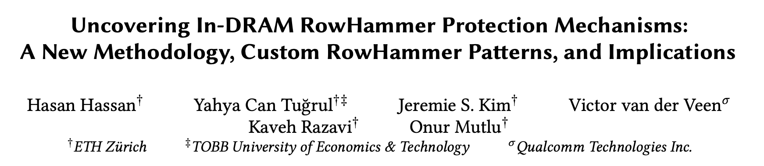
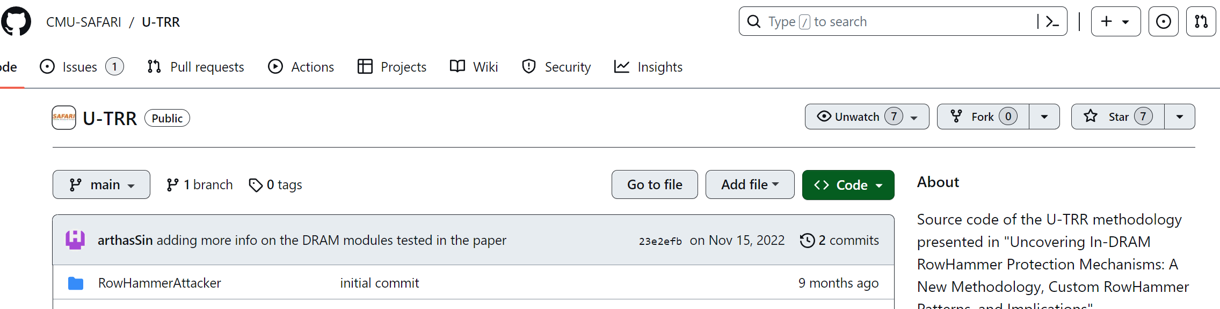
Reverse Engineering TRR
Hassan et al., "Uncovering In-DRAM RowHammer Protection Mechanisms:
A New Methodology, Custom RowHammer Patterns, and Implications,” in MICRO, 2021.
Key idea: Use data retention failures as a side channel
to detect when a row is refreshed by on-die mitigation
[Hassan+, MICRO’21, source code available at https://github.com/CMU-SAFARI/U-TRR]
Notes:
We use the methodology presented in this paper
[CLICK] Where the key idea is to use data retention failures as a side channel to detect when a row is refreshed by the on-die mitigation mechanism
[CLICK] We re-use the source code that is publicly available on this Github page.

Slide 42
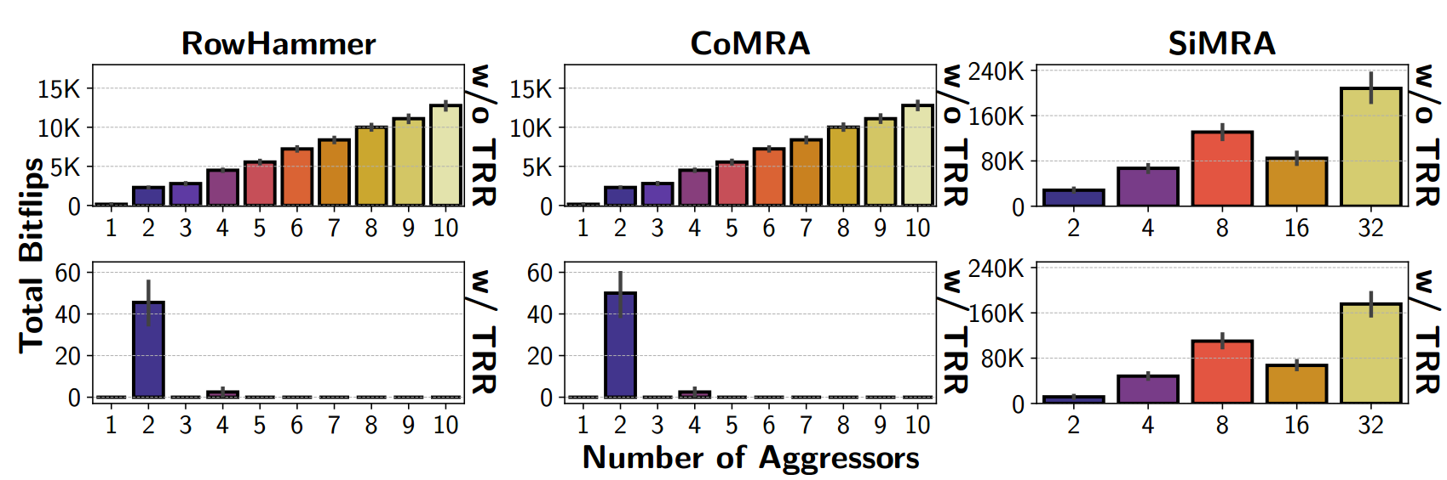
PuDHammer in the presence of TRR
>10K bitflips
<60
bitflips
>10K bitflips
~60
bitflips
CoMRA induces 1.10x more bitflips than RowHammer
on average in the presence of TRR

Slide 43
PuDHammer in the presence of TRR
>10K bitflips
<60
bitflips
~240K
bitflips
~180K
bitflips
SiMRA induces 11340x more bitflips than RowHammer
on average in the presence of TRR

Slide 44
Mitigating PuDHammer
1
Analyze the effectiveness of existing in-DRAM RowHammer mitigation against PuDHammer
2
Adapt RowHammer mitigations
to account for against PuDHammer

Slide 45
Mitigating PuDHammer
1
Analyze the effectiveness of existing in-DRAM RowHammer mitigation against PuDHammer
2
Adapt RowHammer mitigations
to account for against PuDHammer

Slide 46
Adapting RowHammer Mitigations for PuDHammer
A Naïve Approach (PRAC-Naïve)
Reducing RowHammer threshold
to SiMRA’s lowest observed HCfirst
Weighted Counting (PRAC-WC)
Count each operation differently
depending on their lowest observed HCfirst

Slide 47
Methodology
Environment: Cycle-level DRAM simulator Ramulator2 [Kim+ CAL'15, Luo+ CAL'23]
System Configuration:
  Processor 4-core, out-of-order, 4.2GHz clock frequency
  DRAM DDR5, 1 channel, 2 rank/channel, 8 bank groups,
  4 banks/bank group, 128K rows/bank
  Memory Ctrl. 64-entry read and write requests queues,
  Scheduling policy: FR-FCFS with a column cap of 4
  PRAC 4 RFMs per Back-off
  PIM Unit 1-core, issues CoMRA & SiMRA operations with a fixed invertal
Workloads:
    60 five-core five-core multiprogrammed workload mixes.
    Each mix is composed of
      four workloads from five major benchmark suites and
      one synthetic workload that periodically performs back-to-back one SiMRA with 32-row activation and one CoMRA operation

Slide 48
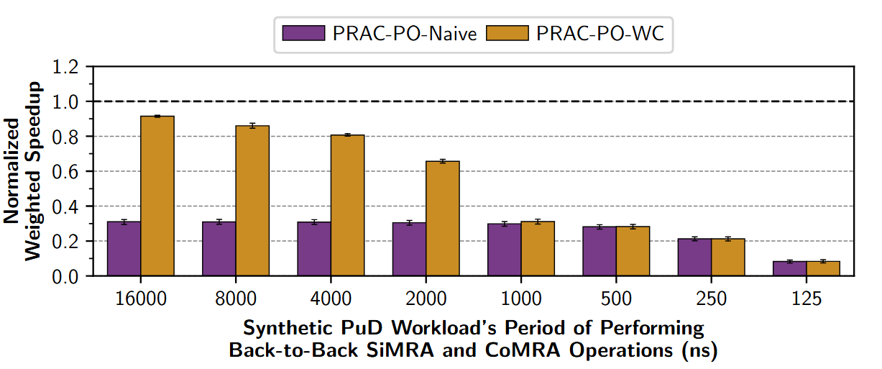
Weighted Speedup Results
PRAC-Naïve
PRAC-WC
PRAC-Naïve
PRAC-WC
Normalized
to no RH mitigation
DRAM performs PuD operations in every 125ns

Slide 49
Weighted Speedup Results
PRAC-Naïve
PRAC-WC
PRAC-WC greatly outperforms PRAC-Naïve until 2us.
PRAC-WC incurs an average (maximum)
performance overhead of 48.26% (98.83%).

Slide 50
More in the Paper
More characterization results
    Temperature, spatial variation, timing parameters, access pattern,
    data pattern, aggressor row on time analyses for CoMRA and SiMRA
    Combined Read Disturbance Effect of RowHammer with PuD
      Combined pattern is more effective than RowHammer alone
      (e.g., 1.66x reduction in HCfirst on average)
Details and analyses on mitigating PuDHammer
    Discussion on how modifying DRAM chips could help mitigating PuDHammer
    More details on PRAC adaptation
      Challenges on adapting for PuDHammer
      An area-efficient PRAC solution
      ..
Notes:
We have more content in the paper, including
…

Slide 51
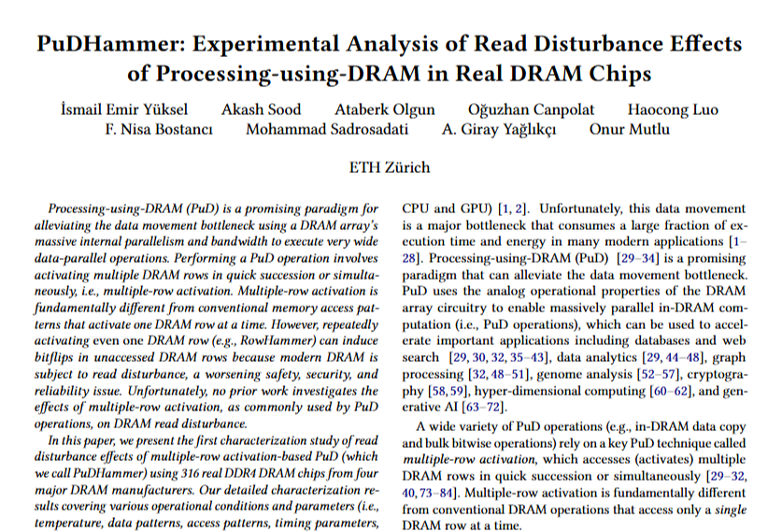
Available on arXiv
https://arxiv.org/pdf/2506.12947
Notes:
The extended version of our study is available on arxiv

Slide 52
Outline
Background
Problem & Goal
Testing Infrastructure
Read Disturbance Effect of CoMRA
Read Disturbance Effect of SiMRA
Mitigating PuDHammer
Conclusion
Notes:
Here is the outline of my talk

Slide 53
Conclusion
We extensively study the interaction between read disturbance and multiple-row activation-based Processing-using-DRAM operations
We characterize 316 DDR4 chips from four major manufacturers
PuDHammer significantly exacerbates the DRAM read vulnerability
(e.g., HCfirst reduces from 4K to 26)
PuDHammer bypasses in-DRAM RowHammer mitigation (TRR)
and induces 11340x more bitflips than RowHammer
We adapt Per Row Activation Counting (PRAC) for PuDHammer
Incurs 48.26% performance overhead on average
across 60 multiprogrammed workload mixes
We hope our findings guide system-level and architectural solutions
to enable read-disturbance-resilient future PuD systems.
Notes:
In this study,
[CLICK] We experimentally demonstrate that off-the-shelf DRAM chips can simultaneously activate up to 32 DRAM rows
[CLICK] perform MAJ3, MAJ5, MAJ7, and MAJ9 operations
[CLICK] and copy one row’s content into up to 31 different rows simultaneously
[CLICK] We characterize the success rate of in-DRAM operations on 120 DDR4 chips from two major manufacturers And we highlight three key results
[CLICK] By storing multiple copies of majority’s input operands, we can increase the success rate of majority operations
[CLICK] and operating conditions can significantly affect the robustness of in-DRAM operations
[CLICK] We conclude that these empirical results demonstrate the promising potential of using DRAM as a computation substrate

Slide 54
PuDHammer
Experimental Analysis of Read Disturbance Effects of Processing-using-DRAM in Real DRAM Chips
İsmail Emir Yüksel
Akash Sood Ataberk Olgun Oğuzhan Canpolat Haocong Luo
Nisa Bostancı Mohammad Sadrosadati Giray Yağlıkçı Onur Mutlu
Notes:
Hello, I am Ismail Emir Yuksel.
I will be presenting our work, Simultaneous Many-Row Activation in Off-the-Shelf DRAM Chips

Slide 55
PuDHammer
Experimental Analysis of Read Disturbance Effects of Processing-using-DRAM in Real DRAM Chips
Backup Slides
İsmail Emir Yüksel
Akash Sood Ataberk Olgun Oğuzhan Canpolat Haocong Luo
Nisa Bostancı Mohammad Sadrosadati Giray Yağlıkçı Onur Mutlu
Notes:
Hello, I am Ismail Emir Yuksel.
I will be presenting our work, Simultaneous Many-Row Activation in Off-the-Shelf DRAM Chips

Slide 56
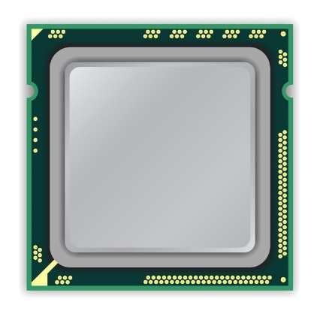
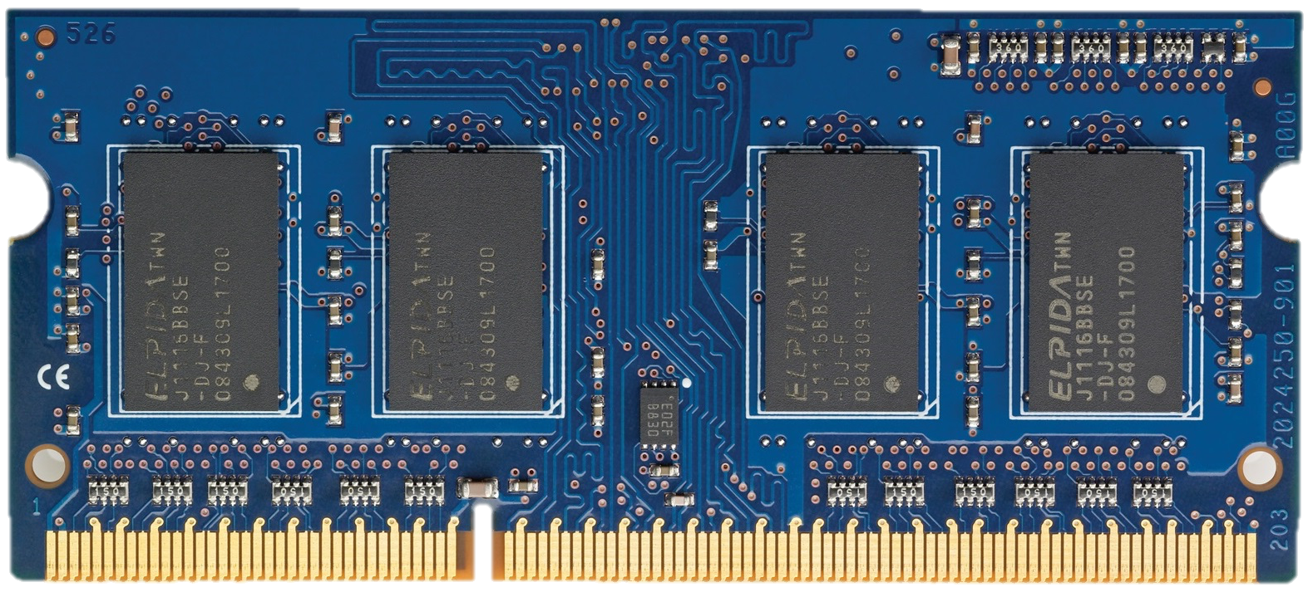

Per Row Activation Counting in DDR5 (April 2024)
RFM
ACT A
ACT A
ACT A
Back-off
PRAC Counters
DRAM Rows
0xA
back-off threshold
continue to
send commands
N_{BO}
1
accurately tracks
activation counts
of each row
2
requires
preventive
action
allocates a fixed time for preventive refresh
Back-off
...
ACT A
ACT A
ACT A
RFM
ACT
DRAM Command Timeline

Slide 57
Adapting PRAC for PuDHammer
A Naïve Approach
Reducing RowHammer threshold
to SiMRA’s lowest observed HCfirst
Weighted Counting
Count each operation differently
depending on their lowest observed HCfirst

Slide 58
A Naïve Approach (PRAC-Naïve)
Lowest HCfirst for tested DRAM chips
RH: ~4K
CoMRA: ~400
SiMRA: ~20
N_{BO}=20
...
ACT A
SiMRA
CoMRA
DRAM Command Timeline
PRAC Counters
DRAM Rows
0xA
N_{BO}
1
2

Slide 59
Weighted Counting (PRAC-WC)
Threshold is set to 4K (RH Threshold)
Each operation increases counters by
RH (ACT): 1
CoMRA: 10
SiMRA: 200
N_{BO}=4K
...
ACT A
SiMRA
CoMRA
DRAM Command Timeline
PRAC Counters
DRAM Rows
0xA
N_{BO}
201
1

Slide 60
Limitations of Tested COTS DRAM Chips (I)
Some COTS DRAM chips do not support all in-DRAM operations
    We do not observe simultaneous multiple-row activation
    in all tested Samsung chips
    Hypothesis
      Internal DRAM circuitry ignores the PRE command or
      the second ACT command when the timing parameters are greatly violated
    If such a limitation were not imposed, we believe these DRAM chips are also fundamentally capable of performing the operations
    we examine in this work

Slide 61
Limitations of Tested COTS DRAM Chips (II)
Tested COTS DRAM chips support only
consecutive two row activation and
simultaneous activation of 2, 4, 8, 16, and 32 rows
    Hypothesis
      This is due to our current infrastructure limitations,
      where we can issue DRAM commands at intervals of only 1.5ns.
      Having fine-grained control on timing would allow us to deassert/assert desired intermediate signals
      in the row decoder circuitry

Slide 62
In-DRAM Row-Copy (RowClone)
ACT src
36ns
Fetch src’s content
into the sense amplifiers
d
s
t
s
r
c
Assert the src’s wordline
d
s
t
s
r
c
Notes:
[CLICK] To perform RowClone, we first activate the source row by issuing ACT src command. This will assert the src’s wordline
[CLICK] and then fetch src’s content into the sense amplifiers

Slide 63
In-DRAM Row-Copy (RowClone)
ACT src
PRE
ACT dst
36ns
7.5ns
Activates dst row
Bitlines are still at src voltage
s
r
c
d
s
t
src’s content
is copied to dst
s
r
c
sense amplifier is still enabled
d
s
t
s
r
c
Notes:
After that, we activate
[CLICK] the destination row without performing precharge operation in between two activate commands
[CLICK] By doing that DRAM will keep the bitlines at src voltage
[CLICK] and keep the sense amplifier enabled
[CLICK] As a result, after some time, the source row’s content is copied to the destination row

Slide 64
Aggressor Row On Time & RowPress
RowHammer
Aggressor Row
Open
Close
Minimum allowed row on time
(t_{RASmin})
hammer count = 2
RowPress
Aggressor Row
Open
Close
Aggressor row on time
(t_{AggON})
Instead of using a high hammer count,
☞ increase the time that the aggressor row stays open
[Luo+, ISCA’23]
Notes:
In contrast, RowPress, instead of a high activation count, [CLICK] increases the time the that aggressor stays open.
Doing so disturbs adjacent rows enough to cause bitflips without having very high activation count.

Slide 65
CoMRA (w/ increased tAggOn)
Hammering with CoMRA
ACT src
PRE
ACT dst
36ns
7.5ns
PRE
36ns
Pressing with CoMRA
ACT src
PRE
ACT dst
36ns
7.5ns
PRE
tAggOn
(more than 36ns)

Slide 66
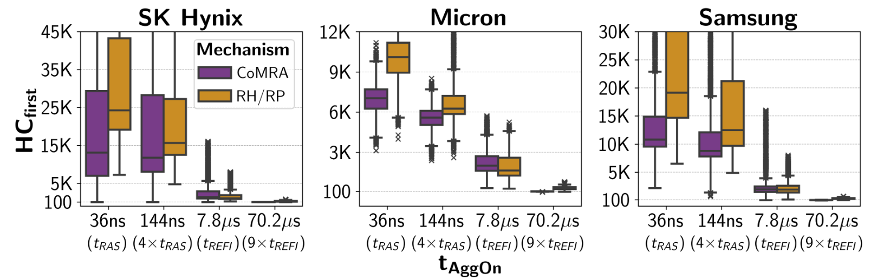
CoMRA (w/ Aggressor Row On Time) vs RowPress
For CoMRA
From 36ns to 70.2us
79x reduction
For RH/RP
From 36ns to 70.2us
31x reduction

Slide 67
CoMRA (w/ Aggressor Row On Time) vs RowPress
Trend consistent across all four manufacturer:
Increasing tAggOn significantly reduces HCfirst
for both CoMRA and RH/RP

Slide 68
CoMRA (w/ Aggressor Row On Time) vs RowPress
Key Takeaway 2
Pressing with CoMRA is more effective than hammering with CoMRA

Slide 69
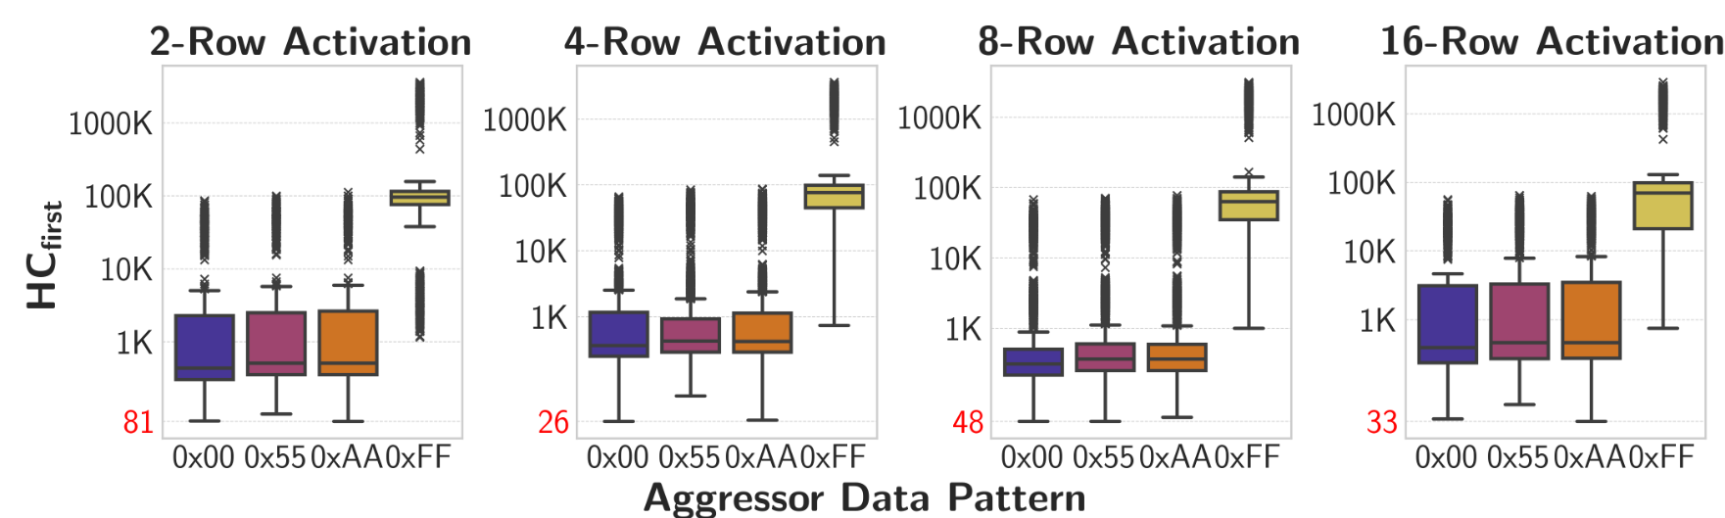
Impact of the Data Pattern
Aggressor Rows = 0xFF..FF
Victim Rows = 0x00..00
(Victim has negated data pattern)

Slide 70
Impact of the Data Pattern
58x
(Victim has negated data pattern)
Initializing victim rows with 0x00
increases avg. HCfirst by 58x
Dominant bitflip direction for SiMRA
1->0
Dominant bitflip direction for RH*
0->1
*not shown in the figure

Slide 71
Impact of the Data Pattern
Trend consistent across all tested number
of simultaneously activated rows
Key Takeaway 2
SiMRA is significantly affected by data pattern and
directionality of SiMRA and RowHammer bitflips
are opposite

Slide 72
PuDHammer in the presence of TRR

Slide 73
PuDHammer in the presence of TRR

