Slide 1


3rd Workshop on
Memory-Centric Computing:
Storage-Centric Computing
Mohammad Sadrosadati
m.sadr89@gmail.com
ISCA 2025
21 June 2025

Slide 2
Goal: Processing Inside Memory/Storage
Many questions … How do we design the:
  compute-capable memory & controllers?
  processors & communication units?
  software & hardware interfaces?
  system software, compilers, languages?
  algorithms & theoretical foundations?
Database
Graphs
Media
ML Model
Memory/Storage
Processor
Core
Cache
Query
Interconnect
Problem
Results
Algorithm
Program/Language
System Software
SW/HW Interface
Micro-architecture
Logic
Devices
Electrons

Slide 3
Processing in Memory:
Two Types
1. Processing near Memory
2. Processing using Memory

Slide 4
Storage-Centric Computing:
Two Types
1. Processing near Storage
2. Processing using Storage

Slide 5
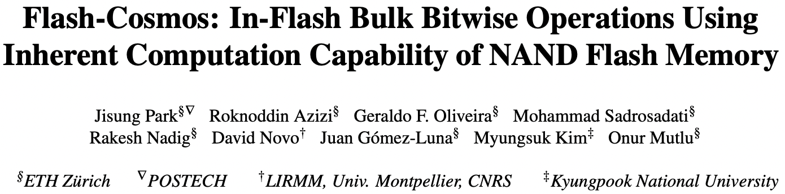
Flash-Cosmos: In-Flash Bulk Bitwise Execution
Jisung Park, Roknoddin Azizi, Geraldo F. Oliveira, Mohammad Sadrosadati, Rakesh Nadig, David Novo, Juan Gómez-Luna, Myungsuk Kim, and Onur Mutlu,
"Flash-Cosmos: In-Flash Bulk Bitwise Operations Using Inherent Computation Capability of NAND Flash Memory"
Proceedings of the 55th International Symposium on Microarchitecture (MICRO), Chicago, IL, USA, October 2022.
[Slides (pptx) (pdf)]
[Longer Lecture Slides (pptx) (pdf)]
[Lecture Video (44 minutes)]
[arXiv version]
https://arxiv.org/pdf/2209.05566.pdf

Slide 6
Talk Outline
Motivation
Background
Flash-Cosmos
Evaluation
Summary

Slide 7
Bulk Bitwise Operations
...
Hyper-dimensional
Computing
Databases
Web Search
Bulk Bitwise Operations
Cryptography
Genome Analysis
Set Operations
Graph Processing

Slide 8
Bulk Bitwise Operations
Databases
(database queries and indexing)
...
Hyper-dimensional
Computing
Web Search
Data movement between compute units
and the memory hierarchy significantly affects the performance of bulk bitwise operations
Bulk Bitwise Operations
Cryptography
Genome Analysis
Set Operations
Graph Processing

Slide 9
Data-Movement Bottleneck
Conventional systems perform outside-storage processing (OSP) after moving the data to host CPU through the memory hierarchy
Computation
Storage
Host Processor
(CPU, GPU)
Read
Read
Main
Memory
Write
Write
Memory Bandwidth
tens to hundreds of GB/s
Storage I/O Bandwidth
~ 8 GB/s
Data Movement Bottleneck
The external I/O bandwidth of storage is the
main bottleneck for data movement in OSP

Slide 10
NDP for Bulk Bitwise Operations
Cache
(e.g., Compute Cache¹)
Our focus
Large data sets
that do not fit
in main memory
...
DRAM-based
main memory
(e.g., Ambit²)
Near-Data
Processing
In-Flash
(e.g., ParaBit⁵)
NVM-based
main memory
(e.g., Pinatubo³)
In-Storage
(e.g., Biscuit⁴)
[1] Aga+, “Compute Caches," HPCA, 2017
[2] Seshadri+, “Ambit: In-Memory Accelerator for Bulk Bitwise Operations Using Commodity DRAM Technology,” MICRO, 2017
[3] Li+, “Pinatubo: A Processing-in-Memory Architecture for Bulk Bitwise Operations in Emerging Non-Volatile Memories,” DAC, 2016
[4] Gu+, “Biscuit: A Framework for Near-Data Processing of Big Data Workloads,” ISCA, 2016
[5] Gao+, “ParaBit: Processing Parallel Bitwise Operations in NAND Flash Memory Based SSDs,” MICRO, 2021

Slide 11
In-Storage Processing (ISP)
ISP performs computation using an in-storage computation unit
ISP reduces external data movement by transferring only the computation results to the host
Read
In-Storage Computation Unit
Host Processor
(CPU, GPU)
NAND
Chip #1
NAND
Chip #4
Read
Main
Memory
Read
⋯
⋯
Write
Write
Write
Computation
NAND
Chip #4
NAND
Chip #1
Storage
⋯
Memory Bandwidth
tens to hundreds of GB/s
Storage External
I/O Bandwidth
~ 8 GB/s
Storage Internal
I/O Bandwidth
~ 9.6 GB/s
Data Movement Bottleneck

Slide 12
In-Storage Processing (ISP)
ISP performs computation using the in-storage computation unit
ISP reduces external data movement by transferring only the computation results to the host
Read
Storage internal I/O bandwidth is the main bottleneck for data movement in ISP
In-Storage Computation Unit
Processor
(CPU, GPU)
NAND
Chip #1
NAND
Chip #4
Read
Main
Memory
Read
⋯
⋯
Write
Write
Write
NAND
Chip #1
NAND
Chip #4
Storage
⋯
Memory Bandwidth
tens to hundreds of GB/s
Storage External
I/O Bandwidth
~ 8 GB/s
Storage Internal
I/O Bandwidth
~ 9.6 GB/s
Data Movement Bottleneck

Slide 13
In-Flash Processing (IFP)
IFP performs computation within the flash chips as the data operands are being read serially
IFP reduces the internal data movement bottleneck in storage by transferring only the computation results to the in-storage computation unit
In-Storage Computation Unit
Read
Host Processor
(CPU, GPU)
NAND
Chip #1
NAND
Chip #4
Main
Memory
Computation
Read
Read
⋯
⋯
Write
Write
Write
NAND
Chip #1
NAND
Chip #4
Storage
⋯
Memory Bandwidth
tens to hundreds of GB/s
Storage External
I/O Bandwidth
~ 8 GB/s
Storage Internal
I/O Bandwidth
~ 9.6 GB/s
Data Sensing Bottleneck

Slide 14
In-Flash Processing (IFP)
IFP performs computation within the flash chips as the data operands are being read serially
IFP reduces the internal data movement bottleneck in storage by transferring only the computation results to the in-storage computation unit
Read
IFP fundamentally mitigates the data movement
In-Storage Computation Unit
Host Processor
(CPU, GPU)
NAND
Chip #1
NAND
Chip #4
Main
Memory
Computation
Read
Read
⋯
⋯
Write
Write
Write
NAND
Chip #1
NAND
Chip #4
Storage
⋯
Memory Bandwidth
tens to hundreds of GB/s
Storage External
I/O Bandwidth
~ 8 GB/s
Storage Internal
I/O Bandwidth
~ 9.6 GB/s
Data Sensing Bottleneck

Slide 15
Data Sensing Bottleneck in IFP
State-of-the-art IFP technique ^{[1]} performs bulk bitwise operations by controlling the latching circuit of the page buffer
NAND Flash Chip
Operand A
Operand B
Operand C
In-Storage Computation Unit
Operand D
NAND
Chip #1
⋯
NAND
Chip #4
…
⋯
NAND
Chip #1
NAND
Chip #4
A
⋯
Page Buffer
[1] Gao+, “ParaBit: Processing Parallel Bitwise Operations in NAND Flash Memory Based SSDs,” MICRO, 2021

Slide 16
Data Sensing Bottleneck in IFP
State-of-the-art IFP technique ^{[1]} performs bulk bitwise operations by controlling the latching circuit of the page buffer
NAND Flash Chip
A
A
B
C
Data Sensing
D
…
A
A
Page Buffer

Slide 17
Data Sensing Bottleneck in IFP
State-of-the-art IFP technique ^{[1]} performs bulk bitwise operations by controlling the latching circuit of the page buffer
NAND Flash Chip
A
B
B
C
D
Data Sensing
…
A AND B
A
A
Page Buffer

Slide 18
Data Sensing Bottleneck in IFP
State-of-the-art IFP technique ^{[1]} performs bulk bitwise operations by controlling the latching circuit of the page buffer
NAND Flash Chip
A
B
C
C
D
Data Sensing
…
A AND B AND C
A AND B
Page Buffer

Slide 19
Data Sensing Bottleneck in IFP
State-of-the-art IFP technique ^{[1]} performs bulk bitwise operations by controlling the latching circuit of the page buffer
NAND Flash Chip
Serial data sensing is the bottleneck in
prior in-flash processing techniques
A
B
C
C
D
…
Data Sensing
A AND B AND C
A AND B
Page Buffer

Slide 20
Reliability Issues in IFP
Prior IFP approaches cannot leverage ECC and
data-randomization techniques as computation is performed within the flash chips during data sensing
NAND Flash Chip
A
B
C
D
…
A
Page Buffer

Slide 21
Reliability Issues in IFP
Prior IFP approaches cannot leverage ECC and
data-randomization techniques as computation is performed within the flash chips during data sensing
NAND Flash Chip
A
A
B
B
C
D
Data
Sensing
…
Page Buffer

Slide 22
Reliability Issues in IFP
Prior IFP approaches cannot leverage ECC and
data-randomization techniques as computation is performed within the flash chips during data sensing
NAND Flash Chip
A
B
B
B
C
D
Data
Sensing
…
A
A AND B
Page Buffer

Slide 23
Reliability Issues in IFP
Prior IFP approaches cannot leverage ECC and
data-randomization techniques as computation is performed within the flash chips during data sensing
NAND Flash Chip
Prior IFP techniques requires the application to be highly error-tolerant
A
B
B
B
C
D
Data
Sensing
…
A
A AND B
Page Buffer

Slide 24
Our Goal
Address the bottleneck of state-of-the-art IFP techniques
(serial sensing of operands)
Make IFP reliable
(provide accurate computation results)

Slide 25
Our Proposal
Flash-Cosmos enables
  Computation on multiple operands using a
  single sensing operation
  Provide high reliability during in-flash computation
NAND Flash Chip
A
A
B
B
C
C
D
Data
Sensing
…
A AND B AND C
Page Buffer

Slide 26
Talk Outline
Motivation
Background
Flash-Cosmos
Evaluation
Summary

Slide 27
NAND Flash Basics: A Flash Cell
A flash cell stores data by adjusting the amount of charge in the cell
1
0
Erased Cell
(Low Charge Level)
Programmed Cell
(High Charge Level)
Activation
Operates as an open switch
Operates as a resistor

Slide 28
NAND Flash Basics: A NAND String
A set of flash cells are serially connected to form a NAND String
Bitline (BL)
1
0
0
1
…
0
NAND String

Slide 29
NAND Flash Basics: Read Mechanism
NAND flash memory reads data by checking the bitline current
Bitline (BL)
1
0
0
Non-Target Cells:
Operate as resistors
regardless of stored data
1
…
0
NAND String

Slide 30
NAND Flash Basics: Read Mechanism
NAND flash memory reads data by checking the bitline current
Bitline (BL)
Target Cells:
Operate as resistors (1)
or open switches (0)
1
0
0
Non-Target Cells:
Operate as resistors
regardless of stored data
1
…
0
NAND String

Slide 31
NAND Flash Basics: Read Mechanism
NAND flash memory reads data by checking the bitline current
BL_{i}
BL_{j}
Target Cells:
Operate as resistors (1)
or open switches (0)
1
0
0
1
0
Reads as ‘1’
if BL current
flows
1
Reads as ‘0’
if BL current
cannot flow
Non-Target Cells:
Operate as resistors
regardless of stored data
1
0
…
…
0
1
NAND String

Slide 32
NAND Flash Basics: A NAND Flash Block
NAND strings connected to different bitlines comprise a NAND block
BL₁
BL₂
BL₃
BL₄
BL₅
BL_{N}
Block
WL₁
1
1
1
1
1
…
1
A single wordline (WL) controls a large number of flash cells: High bit-level parallelism
WL₂
0
0
0
0
0
…
0
WL₃
0
0
0
0
0
…
0
WL₄
1
1
1
1
1
…
1
…
…
…
…
…
…
WL_{M}
0
0
0
0
0
…
0

Slide 33
NAND Flash Basics: Block Organization
A large number of blocks share the same bitlines
BL₁
BL₂
BL₃
BL₄
BL₅
BL_{N}
…
Block₁
…
…
…
…
…
…
…
…
…
Block₂
…
…
…
…
…
…
…
…
…
…
…
…
…
…
…
Block_{K}
…
…
…
…
…
…
…
…

Slide 34
Similarity to Digital Logic Gates
A large number of blocks share the same bitlines
BL₁
BL₂
BL₃
BL₄
BL₅
BL_{N}
…
Block₁
…
…
…
…
…
…
…
…
…
Cells in the same block
are connected serially:
Similar to digital NAND
…
Block₂
…
…
…
…
…
…
…
…
…
…
…
…
…
2-input NAND
(A•B)’
…
A
…
Block_{K}
B
…
…
…
…
…
…
…
Notes:
Our key observation is that NAND flash memory has similar organization to digital AND logic, as multiple cells are serially connected to the bitline, [Click] and

Slide 35
Similarity to Digital Logic Gates
A large number of blocks share the same bitlines.
BL₁
BL₂
BL₃
BL₄
BL₅
BL_{N}
…
Block₁
…
…
…
…
…
…
…
…
…
Cells in the same block
are connected serially:
Similar to digital NAND
…
Block₂
Cells in different blocks
are connected in parallel: Similar to digital NOR
…
…
…
…
…
…
…
…
…
…
…
…
…
2-input NAND
2-input NOR
(A+B)’
(A•B)’
A
…
A
…
Block_{K}
B
…
…
…
…
…
…
…
B
Notes:
It also similar to digital OR logic, in that multiple NAND strings are connected to the bitline in parallel. [Click]

Slide 36
Talk Outline
Motivation
Background
Flash-Cosmos
Evaluation
Summary

Slide 37

Flash-Cosmos: Overview
Enables in-flash bulk bitwise operations on multiple operands with a single sensing operation using
Multi-Wordline Sensing (MWS)

Slide 38
Multi-Wordline Sensing (MWS): Bitwise AND
Intra-Block MWS: Simultaneously activates multiple WLs in the same block
  Bitwise AND of the stored data in the WLs
BL₁
BL₂
BL₃
BL₄
WL₁
0
0
1
1
…
WL₂
0
1
0
1
…
WL₃
1
0
1
1
…
WL₄
0
0
1
0
…
…
…
…
…
Block_{i}

Slide 39
Multi-Wordline Sensing (MWS): Bitwise AND
Intra-Block MWS: Simultaneously activates multiple WLs in the same block
  Bitwise AND of the stored data in the WLs
BL₁
BL₂
BL₃
BL₄
WL₁
0
0
1
1
…
WL₂
0
1
0
1
…
WL₃
1
0
1
1
…
Non-Target Cells:
Operate
as resistors
0
0
1
0
…
WL₄
…
…
…
…
Block_{i}

Slide 40
Multi-Wordline Sensing (MWS): Bitwise AND
Intra-Block MWS: Simultaneously activates multiple WLs in the same block
  Bitwise AND of the stored data in the WLs
BL₁
BL₂
BL₃
BL₄
Target Cells:
Operate
as resistors (1)
or open switches (0)
WL₁
0
0
1
1
…
WL₂
0
1
0
1
…
WL₃
1
0
1
1
…
Non-Target Cells:
Operate
as resistors
0
0
1
0
…
WL₄
…
…
…
…
Result:
0
0
0
1

Slide 41
Multi-Wordline Sensing (MWS): Bitwise AND
Intra-Block MWS: Simultaneously activates multiple WLs in the same block
  Bitwise AND of the stored data in the WLs
BL₁
BL₂
BL₃
BL₄
Target Cell:
Operate
as a resistance (1)
or an open switch (0)
WL₁
0
0
1
1
…
A bitline reads as ‘1’ only when all the target cells store ‘1’
→ Equivalent to the bitwise AND of all the target cells
WL₂
0
1
0
1
…
WL₃
1
0
1
1
…
Non-Target Cell:
Operate
as a resistance
0
0
1
0
…
WL₄
…
…
…
…
Result:
0
0
0
1

Slide 42
Multi-Wordline Sensing (MWS): Bitwise AND
Intra-Block MWS: Simultaneously activates multiple WLs in the same block
  Bitwise AND of the stored data in the WLs
BL₁
BL₂
BL₃
BL₄
WL₁
0
0
1
1
…
Target Cell:
Operate
as a resistance (1)
or an open switch (0)
WL₂
0
1
0
1
…
WL₃
1
0
1
1
…
WL₄
0
0
1
0
…
…
…
…
…
Result:
0
0
0
0

Slide 43
Multi-Wordline Sensing (MWS): Bitwise AND
Intra-Block MWS: Simultaneously activates multiple WLs in the same block
  Bitwise AND of the stored data in the WLs
BL₁
BL₂
BL₃
BL₄
A bitline reads as ‘1’ only when all the target cells store ‘1’
→ Equivalent to the bitwise AND of all the target cells
WL₁
0
0
1
1
…
Target Cell:
Operate
as a resistance (1)
or an open switch (0)
WL₂
0
1
0
1
…
WL₃
1
0
1
1
…
WL₄
0
0
1
0
…
…
…
…
…
Result:
0
0
0
0

Slide 44
Multi-Wordline Sensing (MWS): Bitwise AND
Intra-Block MWS: Simultaneously activates multiple WLs in the same block
  Bitwise AND of the stored data in the WLs
BL₁
BL₂
BL₃
BL₄
Flash-Cosmos (Intra-Block MWS) enables
bitwise AND of multiple pages in the same block
via a single sensing operation
WL₁
0
0
1
1
…
A bitline reads as ‘1’ only when all the target cells store ‘1’
→ Equivalent to the bitwise AND of all the target cells
Target Cell:
Operate
as a resistance (1)
or an open switch (0)
WL₂
0
1
0
1
…
WL₃
1
0
1
1
…
WL₄
0
0
1
1
…
…
…
…
…
Result:
0
0
0
1

Slide 45
Multi-Wordline Sensing (MWS): Bitwise OR
Inter-Block MWS: Simultaneously activates multiple WLs in different blocks
  Bitwise OR of the stored data in the WLs
BL₁
BL₂
BL₃
BL₄
WL_{x} in Block₁
1
0
1
0
…
…
…
…
…
WL_{y} in Block_{i}
1
1
0
0
…
…
…
…
…

Slide 46
Multi-Wordline Sensing (MWS): Bitwise OR
Inter-Block MWS: Simultaneously activates multiple WLs in different blocks
  Bitwise OR of the stored data in the WLs
BL₁
BL₂
BL₃
BL₄
WL_{x} in Block₁
1
0
1
0
…
…
…
…
…
WL_{y} in Block_{i}
1
1
0
0
…
…
…
…
…
Result:
1
1
1
0

Slide 47
Multi-Wordline Sensing (MWS): Bitwise OR
Inter-Block MWS: Simultaneously activates multiple WLs in different blocks
  Bitwise OR of the stored data in the WLs
BL₁
BL₂
BL₃
BL₄
WL_{x} in Block₁
1
0
1
0
…
A bitline reads as ‘0’ only when all the target cells store ‘0’
→ Equivalent to the bitwise OR of all the target cells
…
…
…
…
WL_{y} in Block_{i}
1
1
0
0
…
…
…
…
…
Result:
1
1
1
0

Slide 48
Multi-Wordline Sensing (MWS): Bitwise OR
Inter-Block MWS: Simultaneously activates multiple WLs in different blocks
  Bitwise OR of the stored data in the WLs
BL₁
BL₂
BL₃
BL₄
WL_{x} in Block₁
1
0
1
0
…
…
…
…
…
WL_{y} in Block_{i}
1
1
0
0
…
…
…
…
…
WL_{y} in Block_{i}
1
0
0
1
…
Result:
1
1
1
1
Notes:
Like intra-block MWS, [Click] this property holds when we activate more than two wordlines in different blocks at the same time, [Click], as we can see …

Slide 49
Multi-Wordline Sensing (MWS): Bitwise OR
Inter-Block MWS: Simultaneously activates multiple WLs in different blocks
  Bitwise OR of the stored data in the WLs
BL₁
BL₂
BL₃
BL₄
A bitline reads as ‘0’ only when all the target cells store ‘0’
→ Equivalent to the bitwise OR of all the target cells
WL_{x} in Block₁
1
0
1
0
…
…
…
…
…
WL_{y} in Block_{i}
1
1
0
0
…
…
…
…
…
WL_{y} in Block_{i}
1
0
0
1
…
Result:
1
1
1
1

Slide 50
Multi-Wordline Sensing (MWS): Bitwise OR
Inter-Block MWS: Simultaneously activates multiple WLs in different blocks
  Bitwise OR of the stored data in the WLs
BL₁
BL₂
BL₃
BL₄
1
0
1
0
…
Flash-Cosmos (Inter-Block MWS) enables
bitwise OR of multiple pages in different blocks
via a single sensing operation
WL_{x} in Block₁
…
…
…
…
WL_{y} in Block_{i}
1
1
0
0
…
…
…
…
…
WL_{y} in Block_{i}
1
0
0
1
…
Result:
1
1
1
1

Slide 51
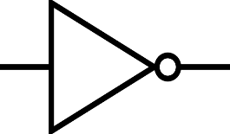




Supporting Other Bitwise Operations
Bitwise NOT
Exploit Inverse Read^{[1]} which is supported in modern NAND flash memory
Bitwise NAND/ NOR
Exploit MWS + Inverse Read
Bitwise XOR/XNOR
Use XOR between sensing and cache latches ^{[2]} which is also supported in NAND flash memory
[1] Lee+, “High-Performance 1-Gb-NAND Flash Memory with 0.12-µm Technology,” JSSC, 2002
[2] Kim+, “A 512-Gb 3-b/Cell 64-Stacked WL 3-D-NAND Flash Memory,” JSSC, 2018

Slide 52
Flash-Cosmos: Overview
Enables in-flash bulk bitwise operations on multiple operands with a
single sensing operation using
Multi-Wordline Sensing (MWS)
Increases the reliability of in-flash
bulk bitwise operations by using Enhanced SLC-mode Programming (ESP)

Slide 53
Enhanced SLC-Mode Programming (ESP)
SLC-mode programming provides a large voltage margin between the erased and programmed states
Based on our real device characterization, we observe that
SLC-mode programming is still highly error-prone without the use of ECC and data-randomization
1
0
# of cells
Erased
Prog.
Threshold voltage
Voltage margin in SLC-mode

Slide 54
Enhanced SLC-Mode Programming (ESP)
ESP further increases the voltage margin between the erased and programmed states
A wider voltage margin between the two states improves reliability by making the cells less vulnerable to errors
ESP
1
0
0
# of cells
Erased
Prog.
Prog.
Increased voltage margin in ESP
Threshold voltage

Slide 55
Enhanced SLC-Mode Programming (ESP)
ESP increases the voltage margin between the erased and programmed states
A wider voltage margin between the two states improves reliability during data sensing by making the cells less vulnerable to errors
ESP improves the reliability of in-flash computation without the use of ECC or
data-randomization techniques
ESP
1
0
0
# of cells
Erased
Prog.
Prog.
Increased voltage margin in ESP
Threshold voltage

Slide 56
Enhanced SLC-Mode Programming (ESP)
ESP increases the voltage margin between the erased and programmed states
A wider voltage margin between the two states improves reliability during data sensing by making the cells less vulnerable to errors
ESP can improve the reliability of prior
in-flash processing techniques as well
ESP
1
0
0
# of cells
Erased
Prog.
Prog.
Increased voltage margin in ESP
Threshold voltage

Slide 57
Talk Outline
Motivation
Background
Flash-Cosmos
Evaluation
Summary

Slide 58
Evaluation Methodology
We evaluate Flash-Cosmos using
160 real state-of-the-art 3D NAND flash chips

Slide 59
Real Device Characterization
We validate the feasibility, performance, and reliability of Flash-Cosmos
160 48-layer 3D TLC NAND flash chips
  3,686,400 tested wordlines
Under worst-case operating conditions
  1-year retention time at 10K P/E cycles
  Worst-case data patterns

Slide 60
Results: Real-Device Characterization
Both intra- and inter-block MWS operations
require no changes to the cell array
of commodity NAND flash chips
Both MWS operations can activate multiple WLs
(intra: up to 48, inter: up to 4) at the same time
with small increase in sensing latency (< 10%)
ESP significantly improves
the reliability of computation results
(no observed bit error in the tested flash cells)
Notes:
Through our real-device characterization, we demnostrated that both MWS operations are possible without requiring any change ot the cell array of commodity NAND flash chips, [Click] and they can reliably activate multiple wordlines at the same time without significant increase in sensing latency. [Click]
We also observed no errors in the tested cells when we program data using ESP, which shows that Flash-Cosmos enables reliable in-flash bulk bitwise operations. [Click]

Slide 61
Evaluation Methodology
We evaluate Flash-Cosmos using
160 real state-of-the-art 3D NAND flash chips
Three real-world applications that perform
bulk bitwise operations

Slide 62
Evaluation with real-world workloads
Simulation
  MQSim [Tavakkol+, FAST’18] to model the performance of
  Flash-Cosmos and the baselines
Workloads
  Three real-world applications that heavily rely on bulk bitwise operations
  Bitmap Indices (BMI): Bitwise AND of up to ~1,000 operands
  Image Segmentation (IMS): Bitwise AND of 3 operands
  k-clique star listing (KCS): Bitwise OR of up to 32 operands
Baselines
  Outside-Storage Processing (OSP): a multi-core CPU (Intel i7 11700K)
  In-Storage Processing (ISP): an in-storage hardware accelerator
  ParaBit [Gao+, MICRO’21]: the state-of-the-art in-flash processing (IFP) mechanism

Slide 63
Results: Performance & Energy
ISP
ParaBit
Flash-Cosmos
150×
70×
14×
Energy benefit over OSP
Speedup over OSP
2×
25×
3.5×
12×
13.4×
3.3×
2×
20×
1.6×
10×
2.5×
Flash-Cosmos provides significant performance & energy benefits over all the baselines
The larger the number of operands,
the higher the performance & energy benefits
Notes:
Add average

Slide 64
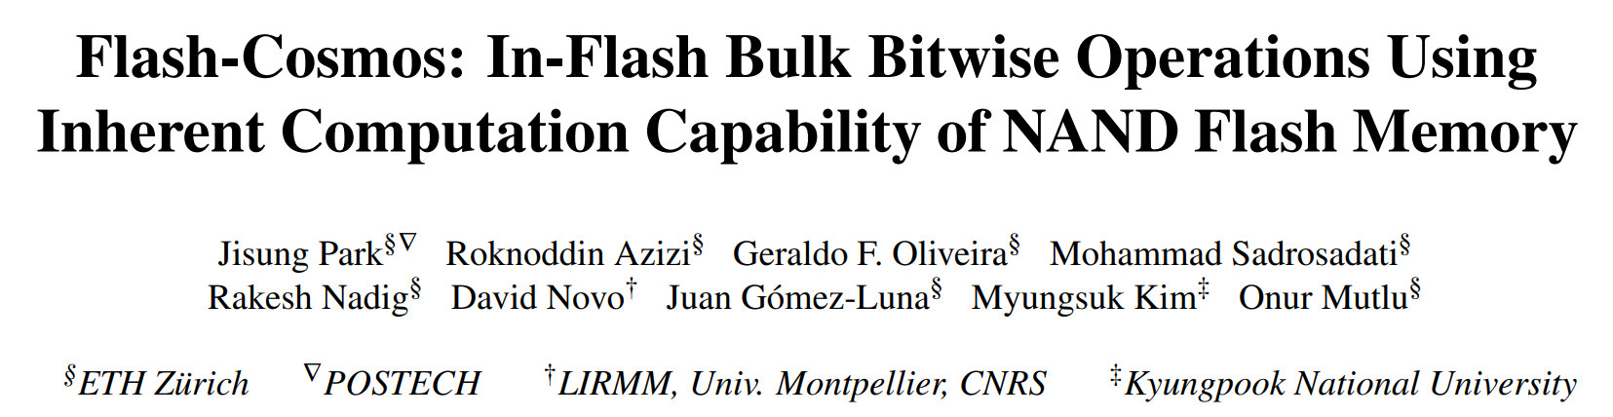

More in the Paper
https://arxiv.org/abs/2209.05566.pdf
Notes:
Direct to the PDF

Slide 65
Talk Outline
Motivation
Background
Flash-Cosmos
Evaluation of Flash-Cosmos and Key Results
Summary

Slide 66




Flash-Cosmos: Summary
First work to enable multi-operand
bulk bitwise operations with a single sensing operation and high reliability
Improves performance by 3.5x/25x/32x on average over ParaBit/ISP/OSP across the workloads
Improves energy efficiency by 3.3x/13.4x/95x on average over ParaBit/ISP/OSP across the workloads
Low-cost & requires no changes to flash cell arrays

Slide 67
More on Flash-Cosmos
Jisung Park, Roknoddin Azizi, Geraldo F. Oliveira, Mohammad Sadrosadati, Rakesh Nadig, David Novo, Juan Gómez-Luna, Myungsuk Kim, and Onur Mutlu,
"Flash-Cosmos: In-Flash Bulk Bitwise Operations Using Inherent Computation Capability of NAND Flash Memory"
Proceedings of the 55th International Symposium on Microarchitecture (MICRO), Chicago, IL, USA, October 2022.
[Slides (pptx) (pdf)]
[Longer Lecture Slides (pptx) (pdf)]
[Lecture Video (44 minutes)]
[arXiv version]
https://arxiv.org/pdf/2209.05566.pdf

Slide 68
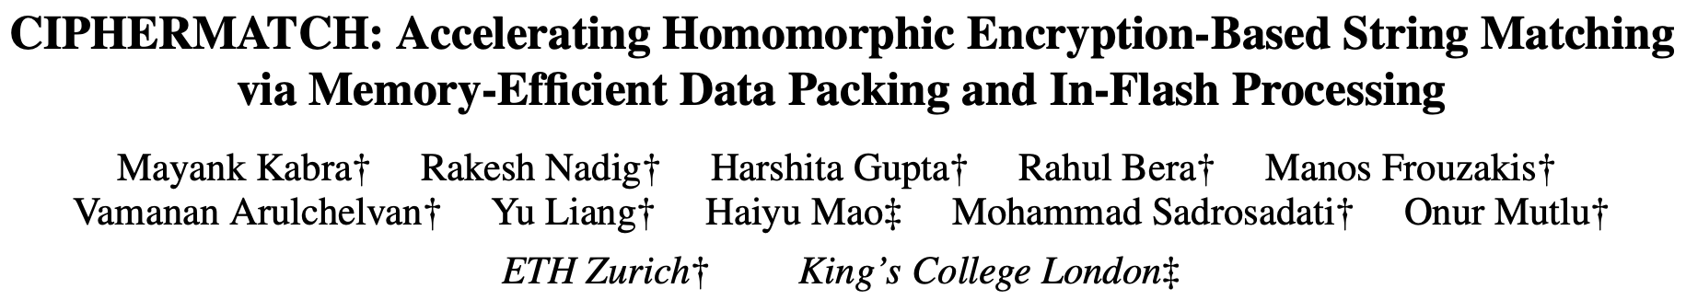
CIPHERMATCH: Accelerating Secure String Matching
Mayank Kabra, Rakesh Nadig, Harshita Gupta, Rahul Bera, Manos Frouzakis, Vamanan Arulchelvan, Yu Liang, Haiyu Mao, Mohammad Sadrosadati and Onur Mutlu,
”CIPHERMATCH: Accelerating Homomorphic Encryption-Based String Matching via Memory-Efficient Data Packing and In-Flash Processing"
Proceedings of the 30th International Conference on Architectural Support for Programming Languages and Operating System (ASPLOS), Rotterdam, Netherlands April 2025.
[arXiv version]
https://arxiv.org/pdf/2503.08968.pdf

Slide 69
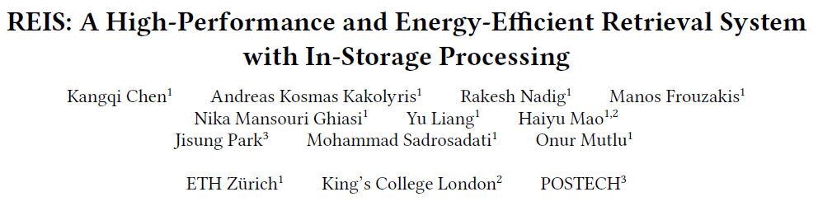
Upcoming Presentation at ISCA 2025
To be presented at ISCA 2025
Presenter – Andreas Kosmas Kakolyris
Visit us in Session 6C: Memory Acceleration
Location: Ono Auditorium

Slide 70
Storage-Centric Computing:
Two Types
1. Processing near Storage
2. Processing using Storage

Slide 71
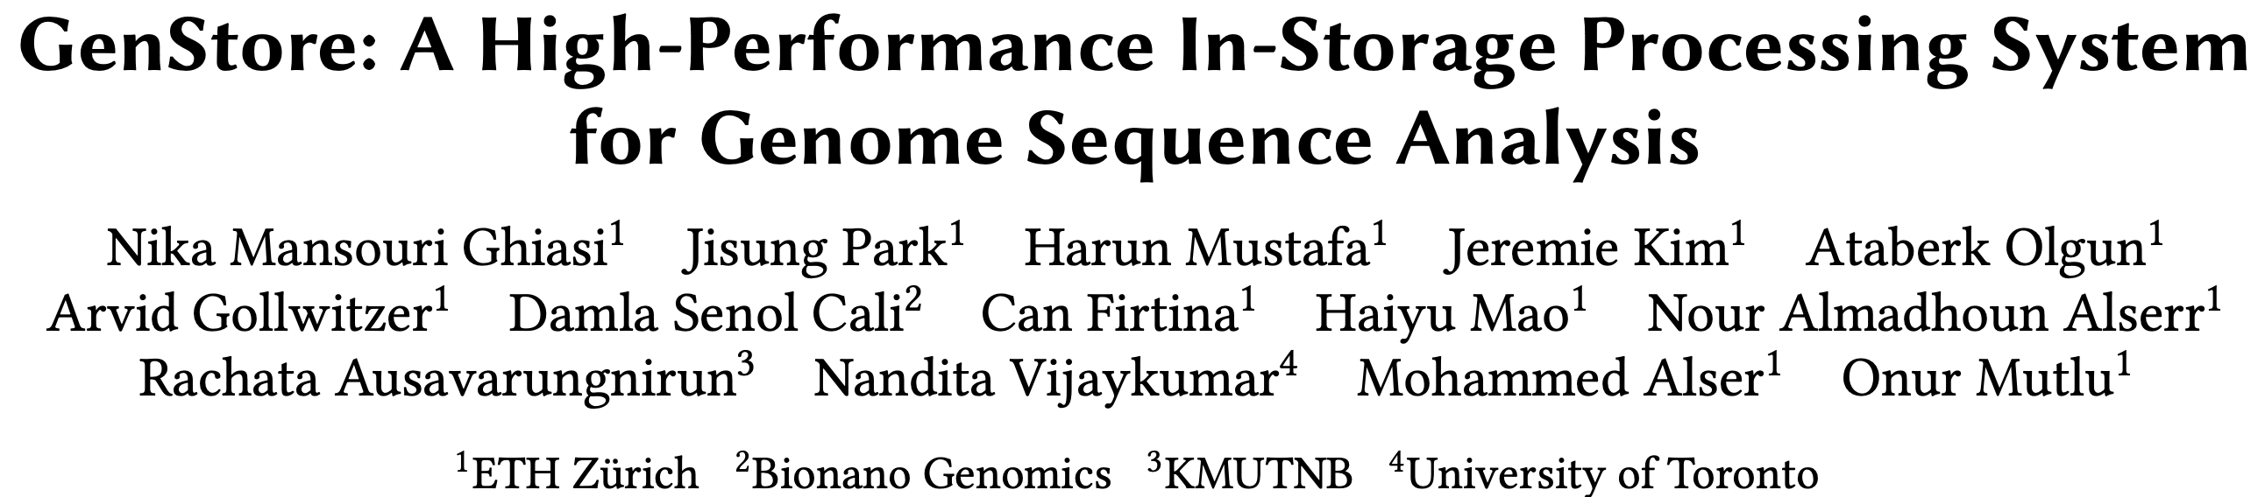
In-Storage Genomic Data Filtering [ASPLOS 2022]
Nika Mansouri Ghiasi, Jisung Park, Harun Mustafa, Jeremie Kim, Ataberk Olgun, Arvid Gollwitzer, Damla Senol Cali, Can Firtina, Haiyu Mao, Nour Almadhoun Alserr, Rachata Ausavarungnirun, Nandita Vijaykumar, Mohammed Alser, and Onur Mutlu,
"GenStore: A High-Performance and Energy-Efficient In-Storage Computing System for Genome Sequence Analysis"
Proceedings of the 27th International Conference on Architectural Support for Programming Languages and Operating Systems (ASPLOS), Virtual, February-March 2022.
[Lightning Talk Slides (pptx) (pdf)]
[Lightning Talk Video (90 seconds)]
https://github.com/CMU-SAFARI/GenStore
https://arxiv.org/pdf/2202.10400

Slide 72




GenStore:
A High-Performance In-Storage Processing System for Genome Sequence Analysis
Nika Mansouri Ghiasi, Jisung Park, Harun Mustafa, Jeremie Kim, Ataberk Olgun,
Arvid Gollwitzer, Damla Senol Cali, Can Firtina, Haiyu Mao, Nour Almadhoun Alserr,
Rachata Ausavarungnirun, Nandita Vijaykumar, Mohammed Alser, and Onur Mutlu
Notes:
Hi, I’m Nika, and today I will introduce GenStore: A High-Performance In-Storage Processing System
for Genome Sequence Analysis

Slide 73

Genome Sequence Analysis
Genome sequence analysis is critical for many applications
  Personalized medicine
  Outbreak tracing
  Evolutionary studies
Genome sequencing machines extract smaller fragments of the original DNA sequence, known as reads
AAGCTTCCATGG
AAATGGGCTTTC
GCTTCCAGAATG
GCCCAAATGGTT
Notes:
Genome sequence analysis (GSA) is critical for many applications [CLICK]
Genome sequencing machines extract smaller fragments of the original DNA sequence, known as reads. [CLICK]

Slide 74
Genome Sequence Analysis
Read mapping: first key step in genome sequence analysis
  Aligns reads to potential matching locations in the reference genome
  For each matching location, the alignment step finds the degree of similarity (alignment score)
Reference Genome
…GCCCATATGGTTAAGCTTCCATGGAAATGGGCTTTCGCTTCCACAATG…
Differences
Differences
GCTTCCAGAATG
Calculating the alignment score requires computationally-expensive approximate string matching (ASM) to account for differences between reads and the reference genome due to:
AAGCTTCCATGG
AAATGGGCTTTC
GCCCAAATGGTT
  Sequencing errors
  Genetic variation
Notes:
Read mapping is the first key step in genome sequence analysis [CLICK]
That Aligns reads to potential matching locations within the reference genome [CLICK]
For each matching location, the alignment step finds the degree of similarity between read and reference by calculating the alignment score
Calculating the alignment score requires computationally-expensive approximate string matching (ASM) to account for differences between reads and the reference genome. [CLICK]

Slide 75

Genome Sequence Analysis
Data Movement from Storage
Alignment
Storage
System
Main
Memory
Cache
Computation
Unit
(CPU or Accelerator)
AAGCTTCCATGG
CGTTCCTTGGCA
GGGCCAGAATG
CCTTTGGGTCCA
AAAATTCCATGG
GAATGGGGCCA
TTTTTTCCAAAA
TCCCCGGGGCCA
GCTTCCAGAATG
Computation overhead
Data movement overhead
Notes:
Read mapping performs alignment on large genomic datasets, containing millions of reads. [CLICK]
Therefore, read mapping is both computationally expensive [CLICK]
And incurs high data movement overhead [CLICK]

Slide 76



Accelerating Genome Sequence Analysis
Heuristics
Accelerators
Filters
Storage
System
Main
Memory
Cache
Computation
Unit
(CPU or Accelerator)
AAGCTTCCATGG
CGTTCCTTGGCA
GGGCCAGAATG
CCTTTGGGTCCA
AAAATTCCATGG
GAATGGGGCCA
TTTTTTCCAAAA
TCCCCGGGGCCA
GCTTCCAGAATG
✓
Computation overhead
Data movement overhead
Notes:
There has been significant effort into improving read mapping performance [CLICK]
Through efficient heuristics [CLICK]
hardware accelerators [CLICK]
and various filters that prune reads that do not require expensive computation [CLICK].
While these approaches address the computation overhead in read mapping [CLICK]
[While Reads Move] None of them alleviate the data movement overhead from storage, whose impact becomes even larger when the computation overhead gets alleviated [CLICK]

Slide 77

Key Idea
Filter reads that do not require alignment
inside the storage system
Storage
System
Main
Memory
Cache
Computation
Unit
(CPU or Accelerator)
AAGCTTCCATGG
CGTTCCTTGGCA
GGGCCAGAATG
CCTTTGGGTCCA
AAAATTCCATGG
GAATGGGGCCA
TTTTTTCCAAAA
TCCCCGGGGCCA
GCTTCCAGAATG
Filtered Reads
Exactly-matching reads
Do not need expensive approximate string matching during alignment
Non-matching reads
Do not have potential matching locations and can skip alignment
Notes:
Our key idea is to filter reads that do not require the expensive alignment computation in the storage system [CLICK] …
[While Reads Move] To fundamentally reduce the data movement overhead of read mapping
Examples of the reads that not require the costlt alignment step
Exactly-matching reads to the reference genome that do not need approximate string matching performed during alignment
Non-matching reads that have no potential matching locations in the reference genome hence skip the alignemt step

Slide 78
Challenges
Filter reads that do not require alignment
inside the storage system
Storage
System
Main
Memory
Cache
Computation
Unit
(CPU or Accelerator)
AAGCTTCCATGG
CGTTCCTTGGCA
GGGCCAGAATG
CCTTTGGGTCCA
AAAATTCCATGG
GAATGGGGCCA
TTTTTTCCAAAA
TCCCCGGGGCCA
GCTTCCAGAATG
Filtered Reads
Read mapping workloads can exhibit different behavior
There are limited hardware resources
in the storage system
Notes:
However, filtering reads in a modern SSD can be challenging [CLICK]
Due to different behavior across read mapping workloads. [CLICK]
And the limited hardware resources in the SSD. By addressing these challenges [CLICK]

Slide 79
GenStore
Filter reads that do not require alignment
inside the storage system
GenStore-Enabled
Storage
System
Main
Memory
Cache
Computation
Unit
(CPU or Accelerator)
✓
Computation overhead
✓
Data movement overhead
  GenStore provides significant speedup (1.4x - 33.6x) and
  energy reduction (3.9x – 29.2x) at low cost
Notes:
We propose GenStore, the first in-storage processing system designed for genome sequence analysis. [CLICK]
To reduce both the computation [CLICK]
And the data movement overhead [CLICK]
GenStore provides high-performance and energy benefits compared to state-of-the-art HW and SW baselines [CLICK]

Slide 80
More on GenStore
Nika Mansouri Ghiasi, Jisung Park, Harun Mustafa, Jeremie Kim, Ataberk Olgun, Arvid Gollwitzer, Damla Senol Cali, Can Firtina, Haiyu Mao, Nour Almadhoun Alserr, Rachata Ausavarungnirun, Nandita Vijaykumar, Mohammed Alser, and Onur Mutlu,
"GenStore: A High-Performance and Energy-Efficient In-Storage Computing System for Genome Sequence Analysis"
Proceedings of the 27th International Conference on Architectural Support for Programming Languages and Operating Systems (ASPLOS), Virtual, February-March 2022.
[Lightning Talk Slides (pptx) (pdf)]
[Lightning Talk Video (90 seconds)]
https://github.com/CMU-SAFARI/GenStore
https://arxiv.org/pdf/2202.10400

Slide 81
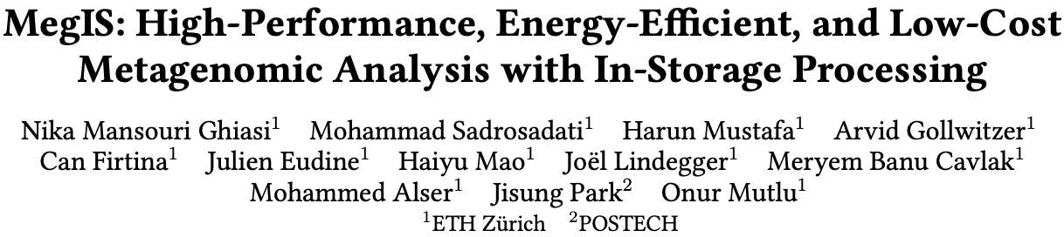
In-Storage Metagenomics [ISCA 2024]
Nika Mansouri Ghiasi, Mohammad Sadrosadati, Harun Mustafa, Arvid Gollwitzer, Can Firtina, Julien Eudine, Haiyu Mao, Joel Lindegger, Meryem Banu Cavlak, Mohammed Alser, Jisung Park, and Onur Mutlu,
"MegIS: High-Performance and Low-Cost Metagenomic Analysis with In-Storage Processing"
Proceedings of the 51st Annual International Symposium on Computer Architecture (ISCA), Buenos Aires, Argentina, July 2024.
[Slides (pptx) (pdf)]
[arXiv version]
https://github.com/CMU-SAFARI/MegIS
https://arxiv.org/pdf/2406.19113

Slide 82


MegIS: Metagenomics In-Storage
First in-storage system for end-to-end metagenomic analysis
Idea: Cooperative in-storage processing for metagenomic analysis
  Hardware/software co-design between the storage system and host system
FTL
SSD
Controller
SSD DRAM
Cores
Standard
Metadata
Host System
MegIS-Enabled SSD
Cntrl
Cntrl
⋯
Channel#1
⋯
Channel#N
Notes:
Which is the first in-storage processing system for end-to-end metagenomic analysis
The key idea of megis is Cooperative ISP for metagenomics
Which is enabled by a synergistic hardware/software co-design between the storage system and the host system

Slide 83






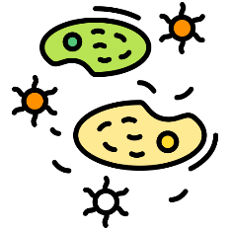




MegIS’s Steps
Step 1
GCTCA
Preparation
of Input Queries
Query
K-mers
CTCAT
TCATG
…
Step 2
Metagenomic sample
with species that
are not known in advance
V. cholerae
Presence/Absence Identification
SARS-CoV-2
E. coli
Step 3
Abundance
Estimation
A large database
containing information
on many species

Slide 84
MegIS Hardware-Software Co-Design
FTL
SSD
Controller
SSD DRAM
Cores
Standard
Metadata
Host System
MegIS-Enabled SSD
Cntrl
Cntrl
⋯
Channel#1
⋯
Channel#N
Notes:
To (i) leverage and (ii) orchestrate the capabilities of both systems, megis includes hw/sw co-design in 5 directions

Slide 85

MegIS Hardware-Software Co-Design
Task partitioning and mapping
Each step executes
in its most suitable system
Step 1
Step 2
Step 3
FTL
SSD
Controller
SSD DRAM
Cores
Standard
Metadata
Host System
MegIS-Enabled SSD
Cntrl
Cntrl
⋯
Channel#1
⋯
Channel#N

Slide 86
MegIS Hardware-Software Co-Design
Task partitioning and mapping
Each step executes
in its most suitable system
Data/computation flow coordination
Reduce communication overhead
Reduce #writes to flash chips
Step 1
Step 2
Step 3
FTL
SSD
Controller
SSD DRAM
Cores
Standard
Metadata
Host System
MegIS-Enabled SSD
Cntrl
Cntrl
⋯
Channel#1
⋯
Channel#N

Slide 87
MegIS Hardware-Software Co-Design
Task partitioning and mapping
Each step executes
in its most suitable system
Data/computation flow coordination
Reduce communication overhead
Reduce #writes to flash chips
Step 1
Step 2
Step 3
FTL
SSD
Controller
SSD DRAM
Cores
Standard
Metadata
Host System
MegIS-Enabled SSD
Cntrl
Cntrl
⋯
Channel#1
⋯
Channel#N
Storage-aware algorithms
Enable efficient
access patterns to the SSD

Slide 88
MegIS Hardware-Software Co-Design
Task partitioning and mapping
Each step executes
in its most suitable system
Data/computation flow coordination
Reduce communication overhead
Reduce #writes to flash chips
Step 1
Step 2
Step 3
FTL
SSD
Controller
SSD DRAM
Cores
Standard
Metadata
ACC
ACC
Host System
MegIS-Enabled SSD
Cntrl
Cntrl
⋯
Channel#1
⋯
Channel#N
Storage-aware algorithms
Enable efficient
access patterns to the SSD
Lightweight in-storage accelerators
Minimize SRAM/DRAM buffer spaces needed inside the SSD

Slide 89
MegIS Hardware-Software Co-Design
Task partitioning and mapping
Each step executes
in its most suitable system
Data/computation flow coordination
Reduce communication overhead
Reduce #writes to flash chips
Step 1
Step 2
Step 3
MegIS
FTL
SSD
Controller
SSD DRAM
FTL
Cores
Standard
Metadata
ACC
ACC
Host System
MegIS-Enabled SSD
Cntrl
Cntrl
MegIS
Metadata
⋯
Channel#1
⋯
Channel#N
Storage-aware algorithms
Enable efficient
access patterns to the SSD
Lightweight in-storage accelerators
Minimize SRAM/DRAM buffer spaces needed inside the SSD
Data mapping scheme and Flash Translation Layer (FTL)
Specialize to the characteristics of metagenomic analysis
Leverage the SSD’s full internal bandwidth
Notes:
6 mins until here

Slide 90
Evaluation: Methodology Overview
Performance, Energy, and Power Analysis
Hardware Components
Synthesized Verilog model for the in-storage accelerators
MQSim [Tavakkol+, FAST’18] for SSD’s internal operations
Ramulator [Kim+, CAL’15] for SSD’s internal DRAM
Software Components
Measure on a real system:
AMD® EPYC® CPU with 128 physical cores
1-TB DRAM
Baseline Comparison Points
Performance-optimized software, Kraken2 [Genome Biology’19]
Accuracy-optimized software, Metalign [Genome Biology’20]
PIM hardware-accelerated tool (using processing-in-memory), Sieve [ISCA’21]
SSD Configurations
SSD-C: with SATA3 interface (0.5 GB/s sequential read bandwidth)
SSD-P: with PCIe Gen4 interface (7 GB/s sequential read bandwidth)
Notes:
We model performance, energy, and power of the systems based on
the latency and throughput of each hardware-based and software-based component
We valuate the following baselines:
...
We evaluate these tools on systems with cost-optimized and performance-optimized SSD configurations

Slide 91
Evaluation: Speedup over the Software Baselines
Performance-Optimized
Accuracy-Optimized
MegIS
SSD-C
SSD-C
Speedup
5.8x
5.8x
14.9x
14.9x
Sample Genetic Diversity
Sample Genetic Diversity
MegIS provides significant speedup over both
Performance-Optimized and Accuracy-Optimized baselines
Notes:
We analyze the benefits of MegIS for samples with low, medium, and high genetic diversity,
And here I am showing for a cost optimized-SSD
We observe that compared to both P-Opt and A-Opt
MegIS provides significant speedups

Slide 92
Evaluation: Speedup over the Software Baselines
Performance-Optimized
Accuracy-Optimized
MegIS
SSD-P
Speedup
4.0x
12.1x
Sample Genetic Diversity
MegIS provides significant speedup over both
Performance-Optimized and Accuracy-Optimized baselines
MegIS improves performance on both
cost-optimized and performance-optimized SSDs

Slide 93
Evaluation: Speedup over the PIM Baseline
PIM
MegIS
PIM
MegIS
SSD-C
SSD-P
Speedup
4.9x
1.9x
Sample Genetic Diversity
Sample Genetic Diversity
MegIS provides significant speedup over the PIM baseline
Notes:
Similarly, we evaluate megis compared to the pim baseline
and show that on systems with cost-optimized
and performance-optimized ssds,
MegiS significantly outperforms the PIM baseline

Slide 94
Evaluation: Reduction in Energy Consumption
On average across different input sets and SSDs
5.4x
15.2x
1.9x
GeoMean Energy Reduction
(Higher is Better)
MegIS provides significant energy reduction over
the Performance-Optimized, Accuracy-Optimized, and PIM baselines
Notes:
Next, we show megis's energy reduction on average accross different input sets and SSDs and observe that megis provides...

Slide 95
Evaluation: Accuracy, Area, and Power
Accuracy
Same accuracy as the accuracy-optimized baseline
Significantly higher accuracy than the performance-optimized and PIM baselines
  4.6 – 5.2× higher F1 scores
  3 – 24% lower L1 norm error
Area and Power
Total for an 8-channel SSD:
Area: 0.04 mm² (Only 1.7% of the area of three ARM Cortex R4 cores in an SSD controller)
Power: 7.658 mW
Notes:
MegIS provides all these benefits while achieving high accuracy

Slide 96
Evaluation: System Cost-Efficiency
Cost-optimized system ($): With SSD-C and 64-GB DRAM
Performance-optimized system ($$$): With SSD-P and 1-TB DRAM
2.4x
7.2x
GMean Speedup
($)
($)
($$$)
($$$)
($)
MegIS outperforms the baselines
even when running on a much less costly system
Notes:
Self-note (copy from arxiv version): For the performance-optimized system, we calculate the cost of 1TB
DRAM to be roughly 7080 USD (8 x 128GB modules [230]) and the cost of
SSD-P to be roughly 875 USD. For the performance-optimized system, we calculate
the cost of 64GB DRAM to be roughly 312 USD (8 x 8GB modules [231],
assuming the same number of memory channels as the performance-optimized
system) and the cost of SSD-C to be roughly 346 USD. Note that the cost of
the total storage system depends not only on the price of each SSD but also on
the available interconnection slots in the systems, as systems typically have
fewer PCIe slots (needed for SSD-P) than SATA slots (needed for SSD-C).

Slide 97
Evaluation: System Cost-Efficiency
Cost-optimized system ($): With SSD-C and 64-GB DRAM
Performance-optimized system ($$$): With SSD-P and 1-TB DRAM
MegIS improves system cost-efficiency
and makes metagenomics more accessible
for wider adoption
2.4x
7.2x
GMean Speedup
($)
($)
($$$)
($$$)
($)
MegIS outperforms the baselines
even when running on a much less costly system
Notes:
Self-note (copy from arxiv version): For the performance-optimized system, we calculate the cost of 1TB
DRAM to be roughly 7080 USD (8 x 128GB modules [230]) and the cost of
SSD-P to be roughly 875 USD. For the performance-optimized system, we calculate
the cost of 64GB DRAM to be roughly 312 USD (8 x 8GB modules [231],
assuming the same number of memory channels as the performance-optimized
system) and the cost of SSD-C to be roughly 346 USD. Note that the cost of
the total storage system depends not only on the price of each SSD but also on
the available interconnection slots in the systems, as systems typically have
fewer PCIe slots (needed for SSD-P) than SATA slots (needed for SSD-C).

Slide 98
More in the Paper
MegIS’s performance when running in-storage processing operations on the cores existing in the SSD controller
MegIS’s performance when using the same accelerators outside SSD
Sensitivity analysis with varying
  Database sizes
  Memory capacities
  #SSDs
  #Channels
  #Samples
MegIS’s performance for abundance estimation
Notes:
Let me briefly talk about other results that are included in the paper before concluding this talk. These include the following:

Slide 99
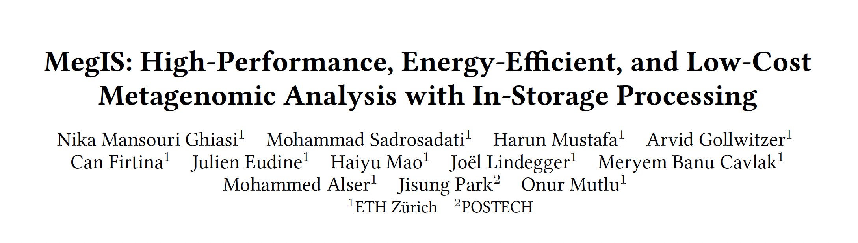

More in the Paper
MegIS’s performance with the cores in the SSD controller
MegIS’s performance outside SSD
Sensitivity analysis with varying
  Database sizes
  Memory capacities
  #SSDs
  #Channels
  #Samples
MegIS’s performance for abundance estimation
https://arxiv.org/abs/2406.19113

Slide 100




MegIS: Summary
Metagenomic analysis suffers from
significant storage I/O data movement overhead
MegIS
The first in-storage processing system for end-to-end metagenomic analysis
Leverages and orchestrates processing inside and outside the storage system
Improves performance
2.7×–37.2× over performance-optimized software
6.9×–100.2× over accuracy-optimized software
1.5×–5.1× over hardware-accelerated PIM baseline
High accuracy
Same as accuracy-optimized
4.8× higher F1 scores
over performance-optimized/PIM
Reduces energy consumption
5.4× over performance-optimized software
15.2× over accuracy-optimized software
1.9× over hardware-accelerated PIM baseline
Low area overhead
1.7% of the three cores
in an SSD controller

Slide 101
More on MegIS
Nika Mansouri Ghiasi, Mohammad Sadrosadati, Harun Mustafa, Arvid Gollwitzer, Can Firtina, Julien Eudine, Haiyu Mao, Joel Lindegger, Meryem Banu Cavlak, Mohammed Alser, Jisung Park, and Onur Mutlu,
"MegIS: High-Performance and Low-Cost Metagenomic Analysis with In-Storage Processing"
Proceedings of the 51st Annual International Symposium on Computer Architecture (ISCA), Buenos Aires, Argentina, July 2024.
[Slides (pptx) (pdf)]
[arXiv version]
https://github.com/CMU-SAFARI/MegIS
https://arxiv.org/pdf/2406.19113

Slide 102
Storage-Centric Computing:
Two Types
1. Processing near Storage
2. Processing using Storage

Slide 103
Summary and Future Outlook

Slide 104
Our Vision on Storage-Centric Computing
Entire storage system as a specialized-enough accelerator
  Special-purpose accelerators
  General-purpose computation
  Multiple different memory technologies
    Processing-using-Flash/DRAM
    Processing-near-Flash/DRAM
Storage system becomes a first-class citizen where computation takes place when it makes
  greatly improving performance, energy efficiency, system cost, sustainability, …

Slide 105
Storage-Centric Computing: Some Challenges
Reliability of computation
Limited endurance
Higher latencies of flash memories
Small internal DRAMs
Limited power and area budgets
Programming framework
Security guarantees
…
Problem
Algorithm
Program/Language
System Software
SW/HW Interface
Micro-architecture
Logic
Devices
Electrons
We can get there step by step

Slide 106
3rd Workshop on
Memory-Centric Computing:
Storage-Centric Computing
Mohammad Sadrosadati
m.sadr89@gmail.com
ISCA 2025
21 June 2025

