Slide 1

PIMDAL
Mitigating the Memory Bottleneck in Data Analytics using a Real Processing-in-Memory System
Manos Frouzakis, Juan Gómez-Luna, Geraldo F. Oliveira, Mohammad Sadrosadati, Onur Mutlu

Slide 2
Executive Summary
Problem:
Performance of database operators used for analytical query processing is limited by accesses to off-chip main memory
Motivation:
Processing-in-Memory systems move computation to where the data resides
Evaluate a real-world PIM system for analytical query processing
Challenge:
Current database implementations on conventional systems cannot straightforwardly be ported due to the limitations of current PIM systems
Goal:
Create implementation of TPC-H queries that achieves optimal performance on UPMEM PIM system, to evaluate potential of PIM for analytical query processing
Results:
PIM outperforms CPU in 4 out of 5 TPC-H queries, by 3.9× on average
Outperforms GPU on 2 of the queries that require little communication

Slide 3
Outline
Background and Goal
PIMDAL
Experiments and Methodology
Evaluation and Insights
Conclusion & Outlook

Slide 4
Outline
Background and Goal
PIMDAL
Experiments and Methodology
Evaluation and Insights
Conclusion & Outlook

Slide 5
Database Management Systems
Development of DBMSs started in the late 1950s
  Even before the invention of the microprocessor
DBMSs evolved together with computer architectures
Larger DRAM sizes enabled the development of in-memory databases, where data is kept in main memory
  Performance and energy improvements compared to moving data from storage
In-memory databases still suffer from data movement bottlenecks due to off-chip main memory accesses
1

Slide 6
Database Operators
Relational databases consist of tables where each data point is a row
  Row is a tuple where each entry belongs to a set
Database (DB) operators perform computation on rows and columns of one or multiple tables
DB Operator | Function
Selection | Filter tuples based on a predicate on columns
Aggregation | Grouping with aggregations groups columns with equal keys together and aggregates remaining columns
Ordering | Orders tuples based on some columns
Join | Concatenates rows of table to rows of another table based on key columns
2

Slide 7
Memory-Bound DB Operators
Roofline model of DB operators running on an Intel Xeon 6226R Gold CPU with 128 GB of DDR4 DRAM
10³
10²
10¹
10⁰
10⁻¹
10⁰
10¹
3

Slide 8
Memory-Bound DB Operators
Roofline model of DB operators running on an Intel Xeon 6226R Gold CPU with 128 GB of DDR4 DRAM
10³
The performance of the four DB operators is bottlenecked by main memory accesses
10²
10¹
10⁰
10⁻¹
10⁰
10¹
3

Slide 9
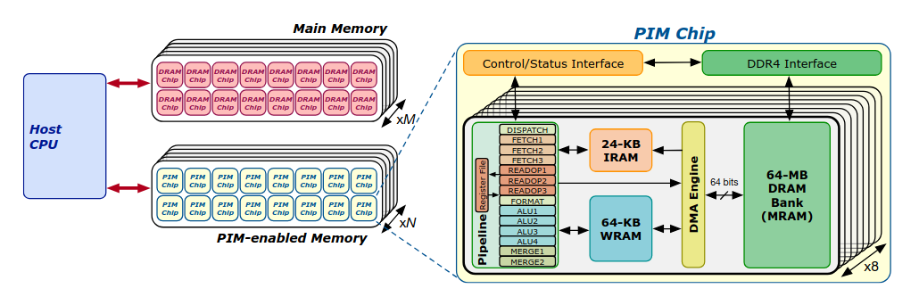
UPMEM System Characteristics
Complement standard DDR4 DIMMs with PIM DIMMs equipped with PIM-cores (DPUs) for processing
PIM-cores can access internal DRAM with high bandwidth
PIM-cores are multi-threaded, in-order, RISC-like cores
PIM-threads can independently execute their own code
Use scratchpad memory (SPM) instead of caches, which is managed by programmer
Inter PIM-core communication happens over host
4

Slide 10
Challenges and Limitations
Hardware unaware implementation of DB operators on UPMEM can lead to subpar performance due to three main reasons
Data movement in PIM code must be explicitly managed by programmer and can degrade performance if suboptimal
DB operators can require multiplication or division, which is costly on UPMEM due to the lack of hardware support
DB operators can require data redistribution and thus communication over the host
5

Slide 11
Goal
Create high performance implementation of TPC-H queries on UPMEM PIM system, to evaluate the potential of PIM for analytical query processing
Implement DB operators on a real-world PIM system, while addressing the limitations previously mentioned
Discover strengths and limitations of current memory-centric architectures for analytical query processing
To this end we propose PIMDAL, a library for analytical query processing on the UPMEM system
6

Slide 12
Outline
Background and Goal
PIMDAL
Experiments and Methodology
Evaluation and Insights
Conclusion & Outlook

Slide 13
Design Principles
From a previous UPMEM characterization¹ we deduce 2 design principles for PIMDAL
Transfer latency from DRAM to scratchpad memory (SPM) has the form α + β×size
  ⟶ Use as big, continuous memory transfers as possible
Full pipeline occupancy and throughput achieved at 11 threads
  ⟶ Use at least 11 PIM-thread​s
Challenge: SPM is shared by all the threads, design principles can interfere with each other
7

Slide 14
Structure
PIMDAL consists of a PIM and a host component
Host component feeds PIM system with data and provides communication capabilities
  Load data from disk and transfer data between host
  and PIM system
  Redistribute data between PIM-cores
PIM component implements the four DB operators: selection, aggregation, ordering and join
  Operates on data stored in column-store format in DRAM, where each column in a table is stored contiguously in memory
8

Slide 15
Two Algorithmic Building Blocks
Two common algorithms for implementing aggregation and join are sorting and hashing:
Aggregation
  Group equal elements together by sorting them
  Join elements by mapping them to the same hash table entry
Join
  Sort-merge: Order both tables in the same order, iterate efficiently, match the keys and join them
  Hash: Store inner relation in hash table, probe with outer relation and join them
Key Challenges: Parallelism and very irregular memory accesses
9

Slide 16
Outline
Background and Goal
PIMDAL
Experiments and Methodology
Evaluation and Insights
Conclusion & Outlook

Slide 17
Micro-Benchmarks
Measure performance of standalone operators and compare to CPU/GPU
  Kernel execution time
  IPC of in-order pipeline
  Weak and strong scaling analysis of end-to-end execution
​Main goal is to gain insights into performance of DB operators
Comparison to CPU and GPU reference implementations
  Comparison to CPU using custom implementation based on Apache Arrow
  Comparison to GPU using cudf
10

Slide 18
TPC-H Queries
TPC-H benchmark widely used for comparing different commercial DBMSs
Suite of business oriented ad-hoc queries
Use 5 queries from the TPC-H benchmark that do not rely on variable-length datatypes
  Includes combinations of all DB operators
  All require addition, 4 of them multiplication
Reference implementations:
  PyArrow on the CPU
  Cudf on the GPU
11

Slide 19
System Configurations
 | UPMEM PIM System | Intel Xeon Gold 6226R | Nvidia A6000 GPU
PEs | 2048 DPUs | 16 cores (32 threads) | 108 SM
Memory | 131 GB | 128 GB | 48 GB
Int32 Throughput | 760 GOps | 1606 GOps | 38 TOps
Bandwidth | 1.2 TB/s | 79 GB/s | 768 GB/s
12

Slide 20
Outline
Background and Goal
PIMDAL
PIMDAL: Data Movement Optimization
Experiments and Methodology
Evaluation and Insights
Conclusion
Towards Data-Centric Architectures

Slide 21
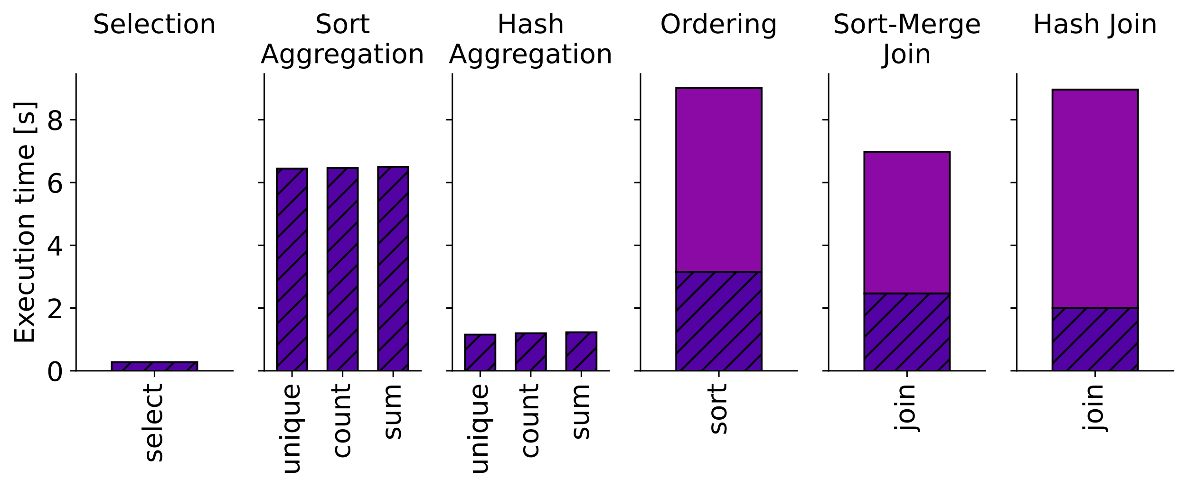
Kernel Execution Time Overview
13

Slide 22
Aggregation
Comparing hash to sort based aggregation for different number of unique elements/groups
Sorting is inefficient for small number of output elements but performance remains constant for a growing number
  Few elements cannot be partitioned efficiently
Hash aggregation faster for smaller number of output elements
Execution time increases for hash aggregation because steps are repeated if output does not fit in SPM
14

Slide 23
Aggregation
Key Takeaway 1: SPM or cache utilization still plays a role in the performance of PIM architectures, as the example of hash and sort based aggregation shows.
Comparing hash to sort based aggregation for different number of unique elements/groups
Sorting is inefficient for small number of output elements but performance remains constant for a growing number
  Few elements cannot be partitioned efficiently
Hash aggregation faster for smaller number of output elements
Execution time increases for hash aggregation because steps are repeated if output does not fit in SPM
14

Slide 24
Join
Hash and sort-merge join are two commonly used join algorithms
On conventional systems hash join achieves significantly better performance in the general use-case
A surprising result is that on PIM systems sort-merge join outperforms hash join
What we currently know about algorithm performance does not necessarily translate to PIM systems
For more insights we can look into sort compared to hash partitioning performance
15

Slide 25
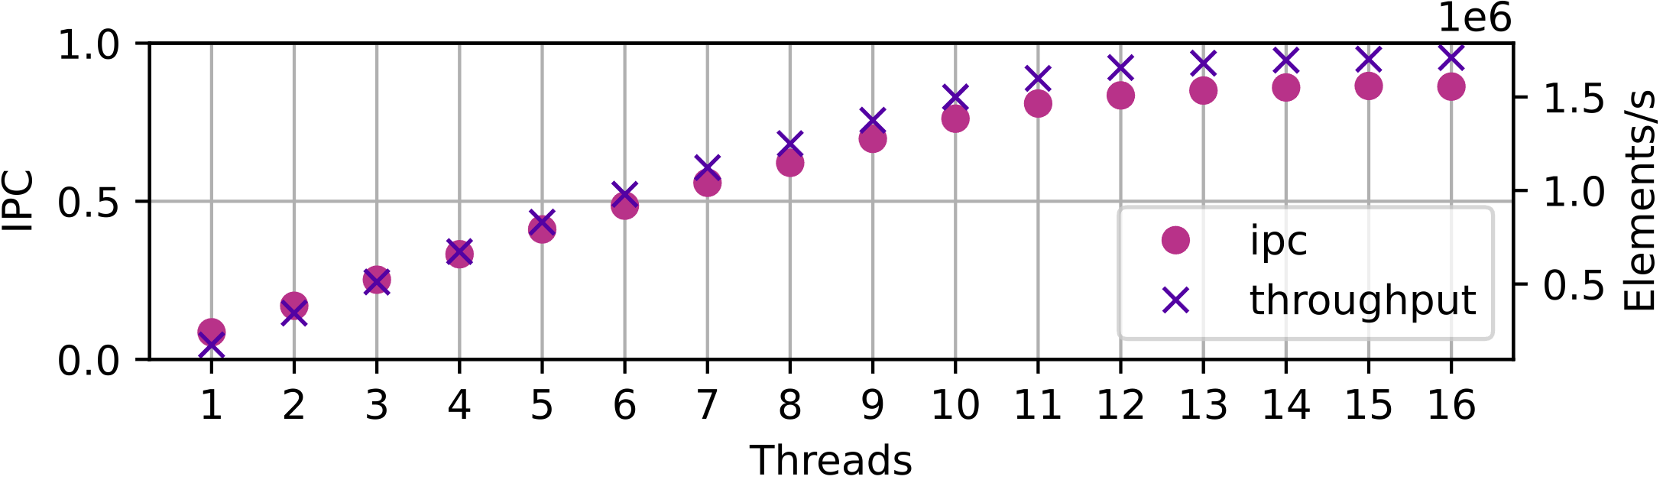
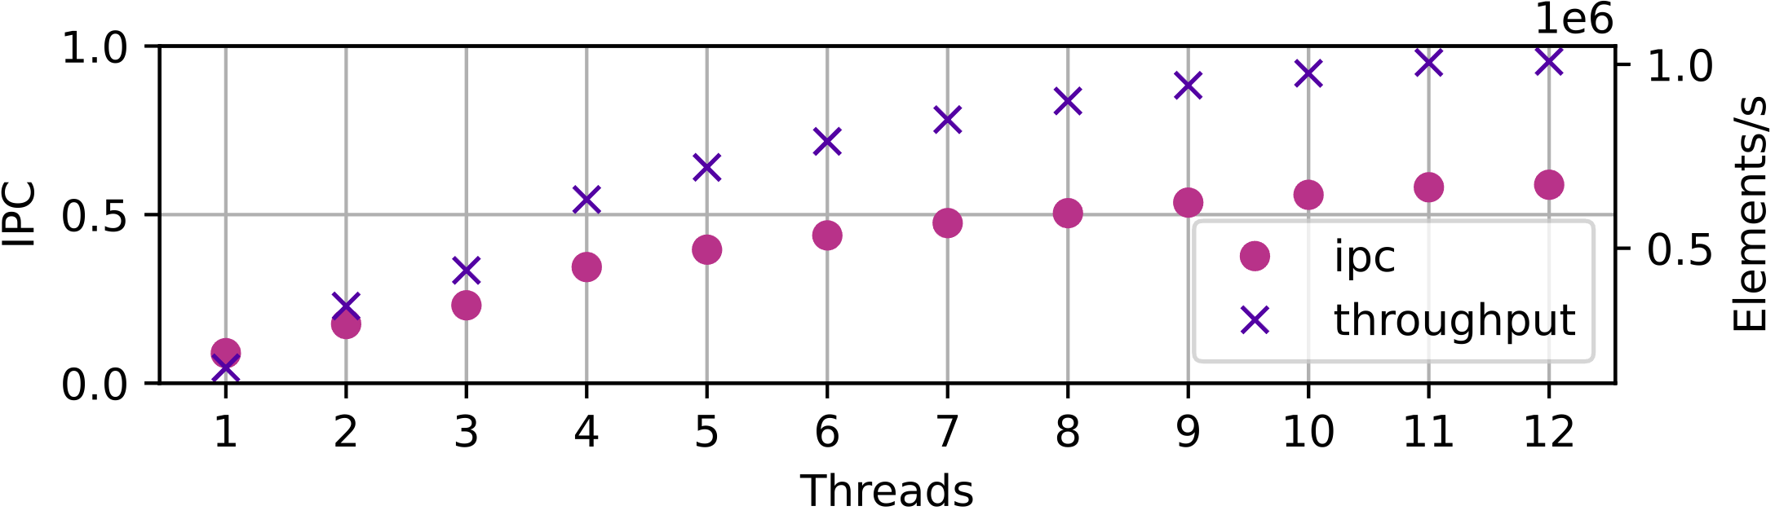
Sort vs Hash Partitioning
Sort Partitioning
Hash Partitioning
Sort outperforms hash partitioning
Sort partitioning has lower arithmetic intensity and simpler memory accesses
Hash partitioning has higher arithmetic intensity and more complex memory accesses
This is exactly where conventional and PIM systems differ
We try to mitigate this using the radix-cluster algorithm
  This leads to other issues such as synchronization
16

Slide 26
Sort vs Hash Partitioning
Sort Partitioning
Hash Partitioning
Key Takeaway 2: The most efficient algorithms for PIM can differ from the state-of-the-art on other architectures. One such example is sort-merge compared to hash join
Sort outperforms hash partitioning
Sort partitioning has lower arithmetic intensity and simpler memory accesses
Hash partitioning has higher arithmetic intensity and more complex memory accesses
This is exactly where conventional and PIM systems differ
We try to mitigate this using the radix-cluster algorithm
  This leads to other issues such as synchronization
16

Slide 27
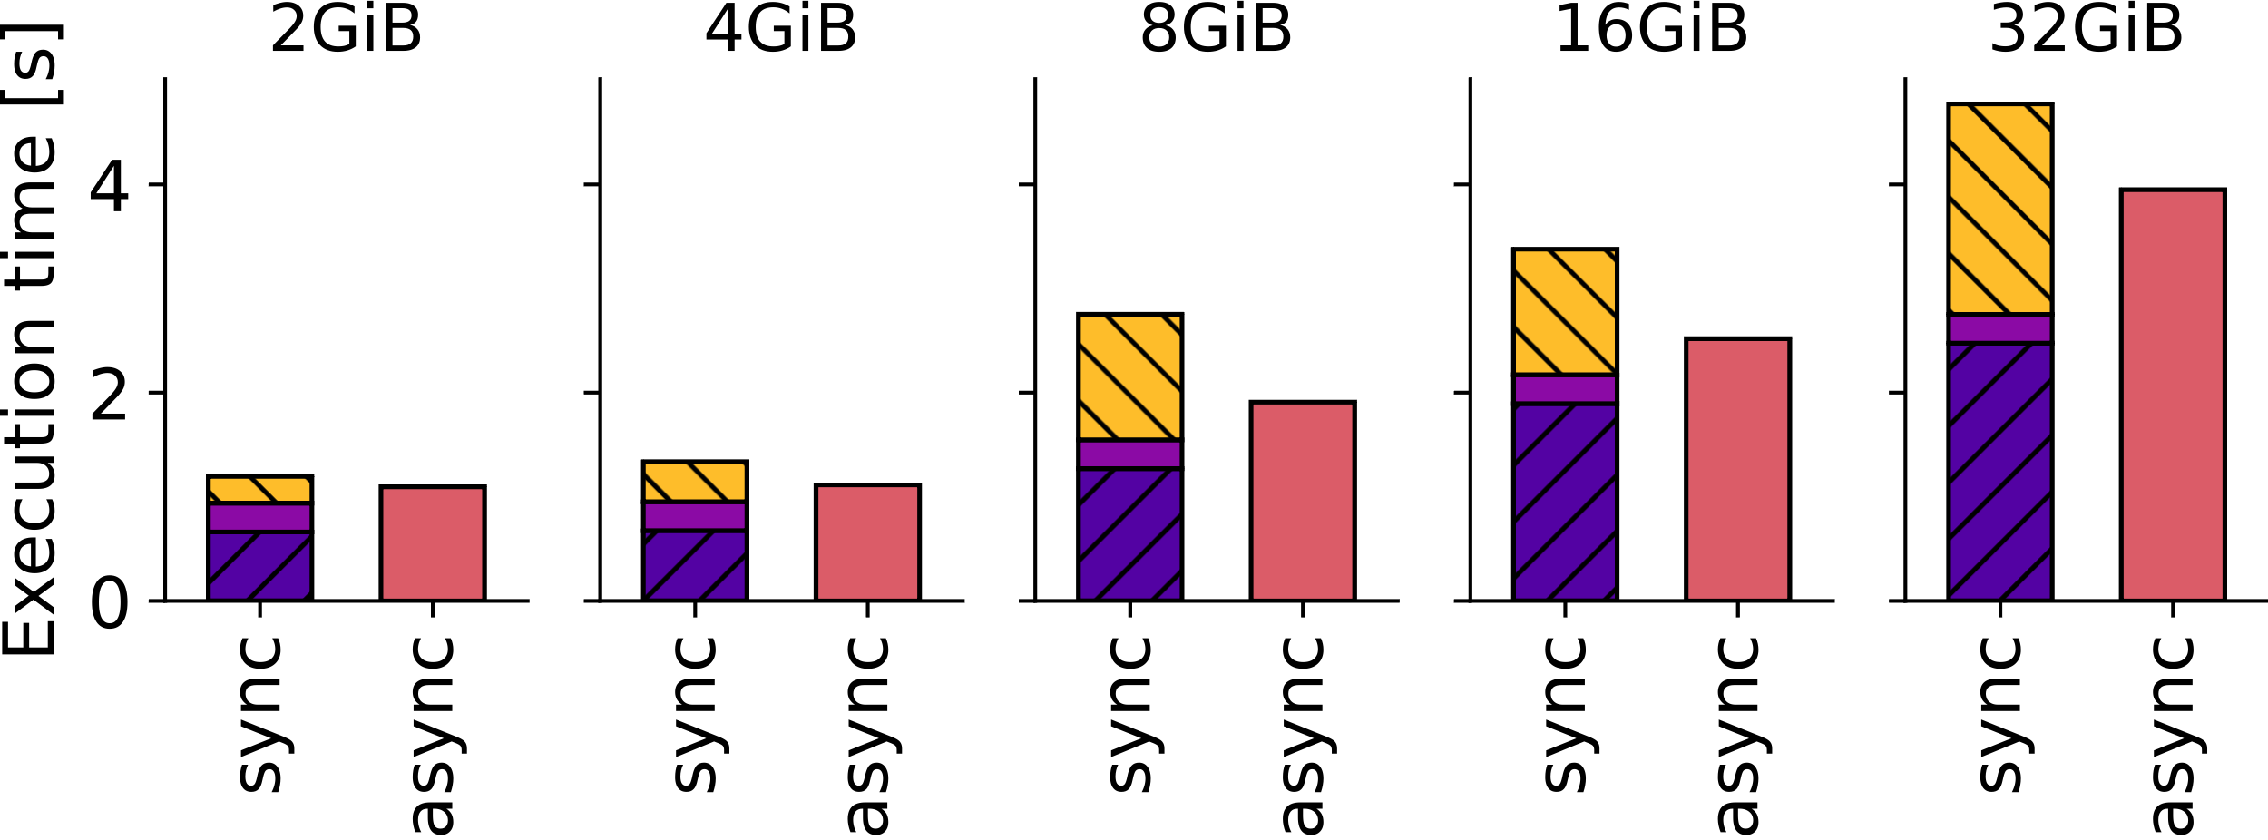
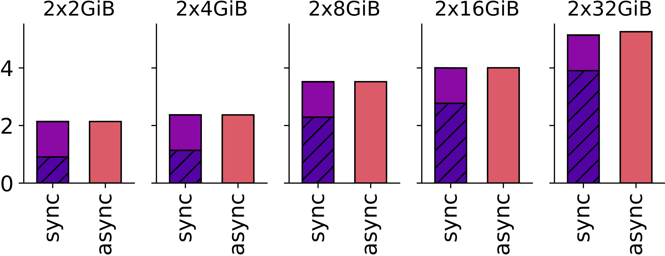
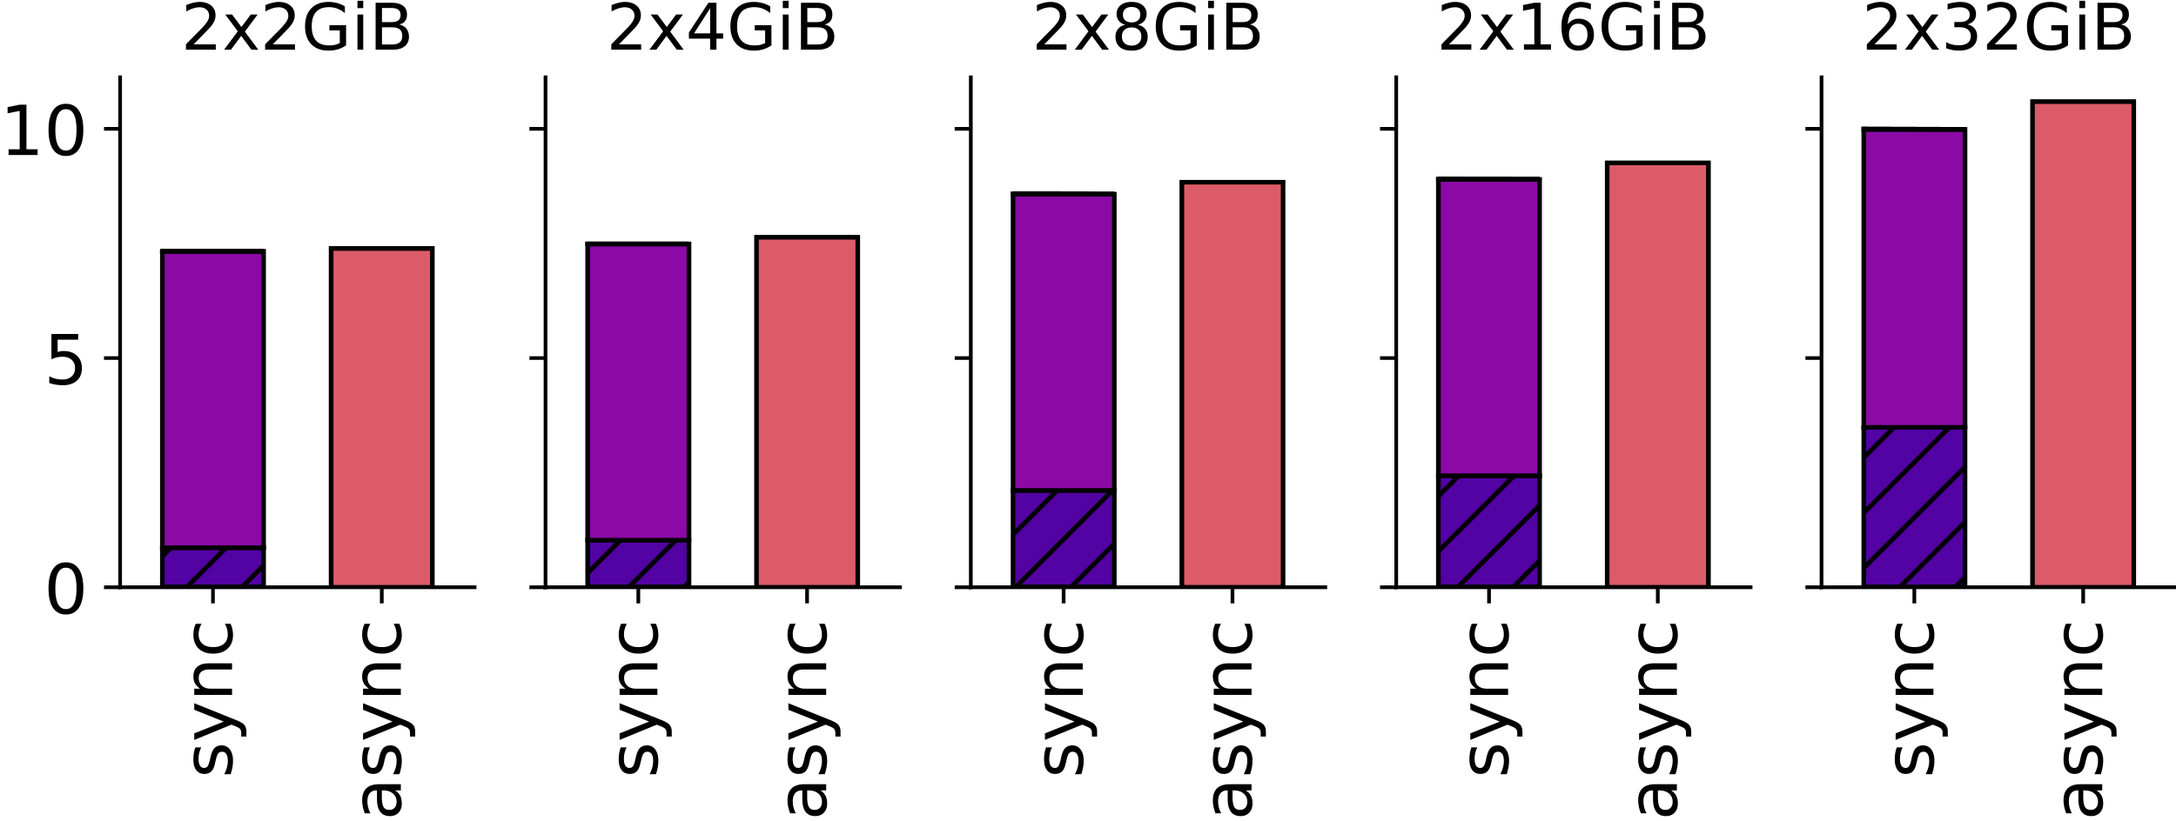
Weak Scaling Analysis I
Selection
Hash Aggregation
Sort Aggregation
The main bottleneck for hash aggregations is the initial, and for selection also the final data transfers
Sort aggregation is less limited by transfers due to longer execution time
Asynchronous execution only improves performance when there are significant transfers from and to the host
  Transfers can be performed successively, improving bandwidth utilization
17

Slide 28
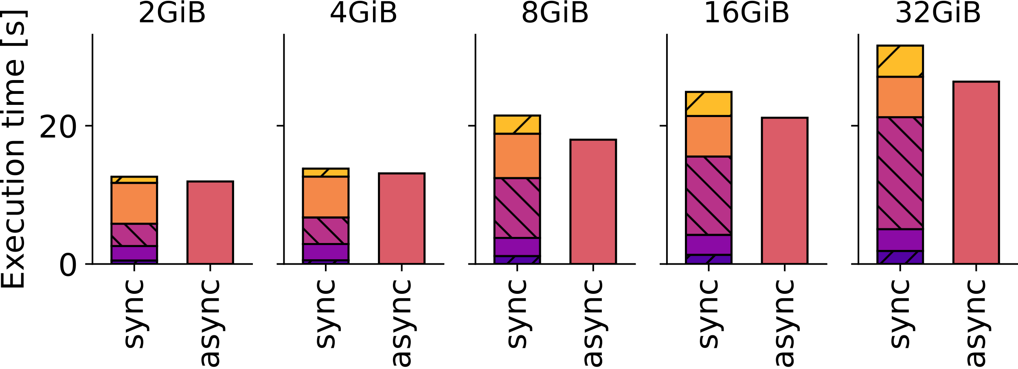
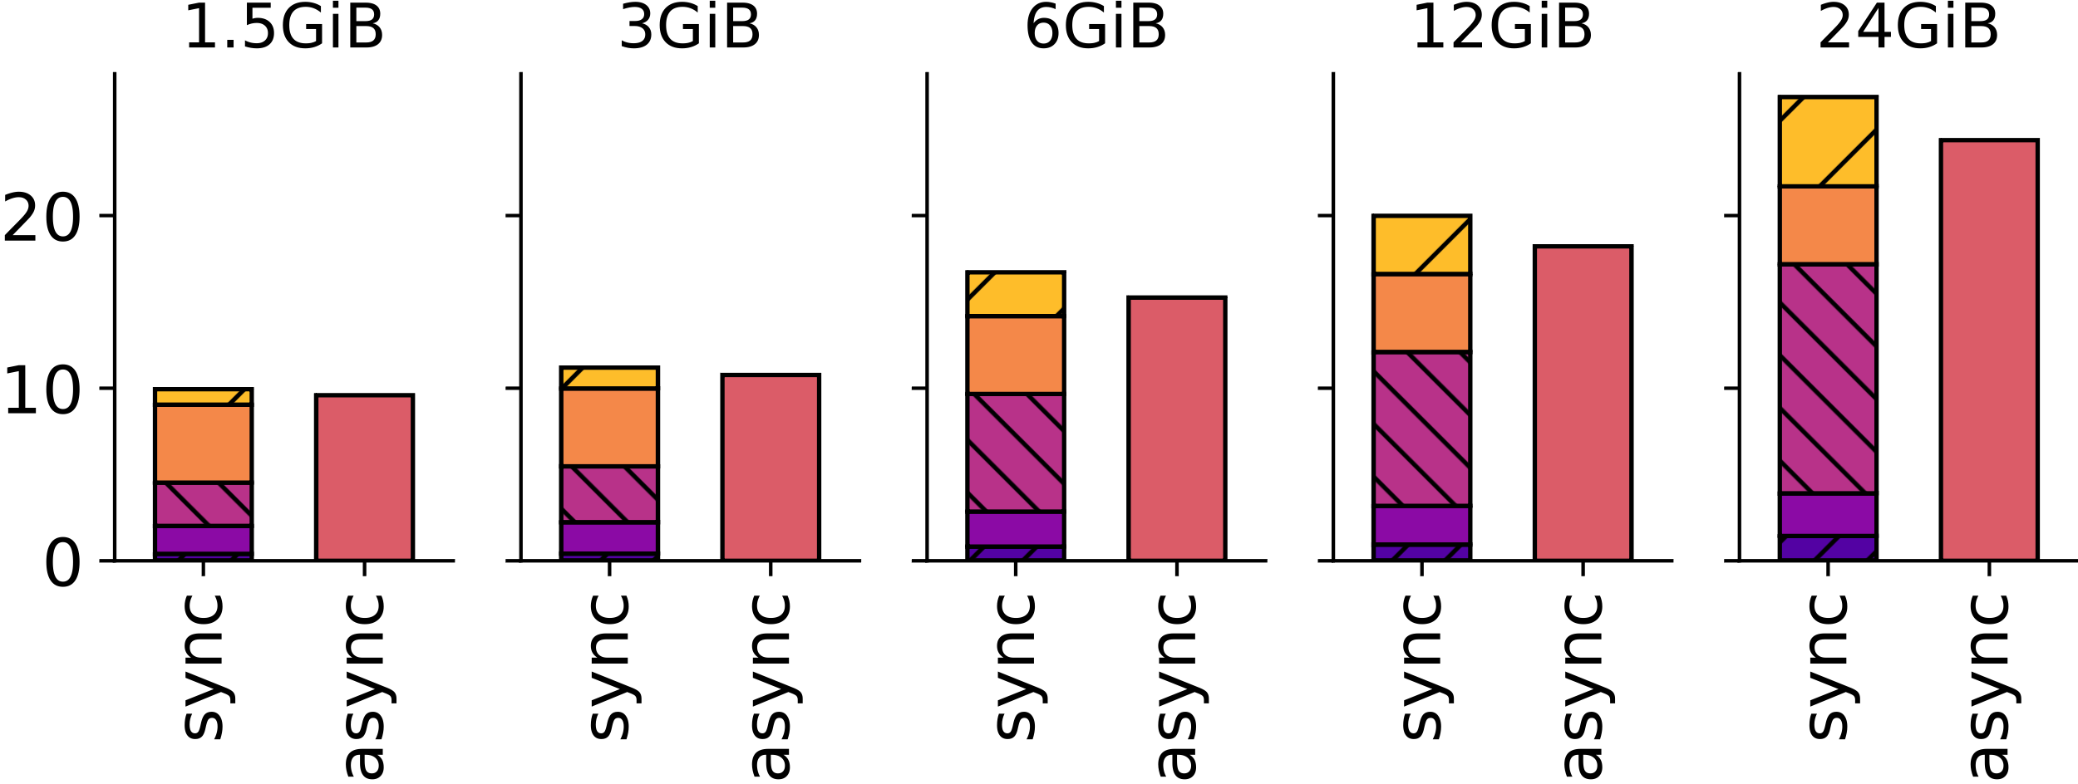
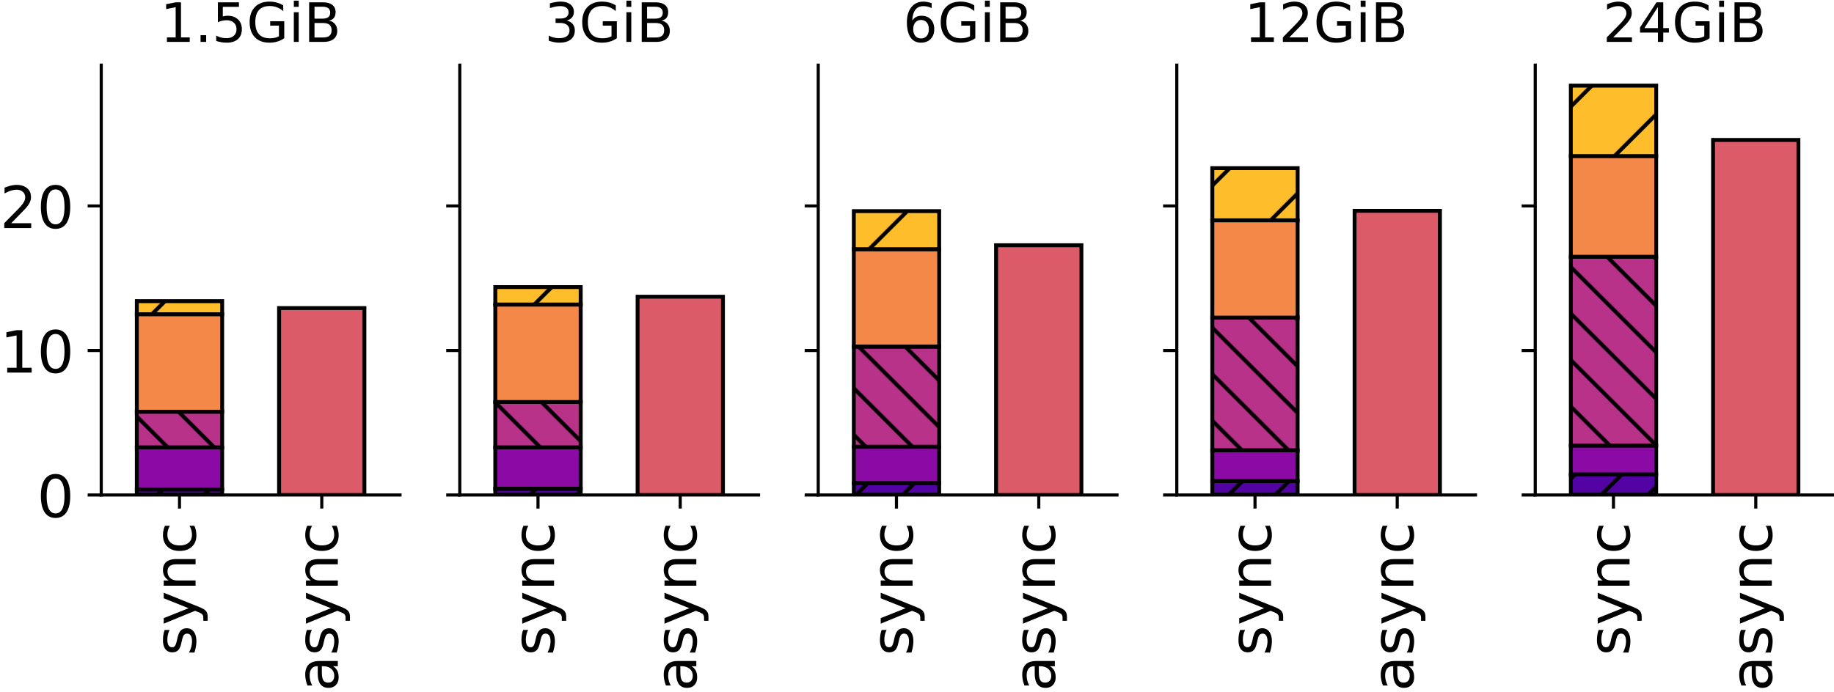
Weak Scaling Analysis II
Ordering
Sort-Merge Join
Hash Join
Performance is similar for all three operators
The biggest bottleneck in operator performance is data redistribution between PIM-cores
For all DB operators the weak scaling with the number of
PIM-cores or ranks is far from optimal
  PIM execution time remains constant
  Data transfer time increases due to contention
18

Slide 29
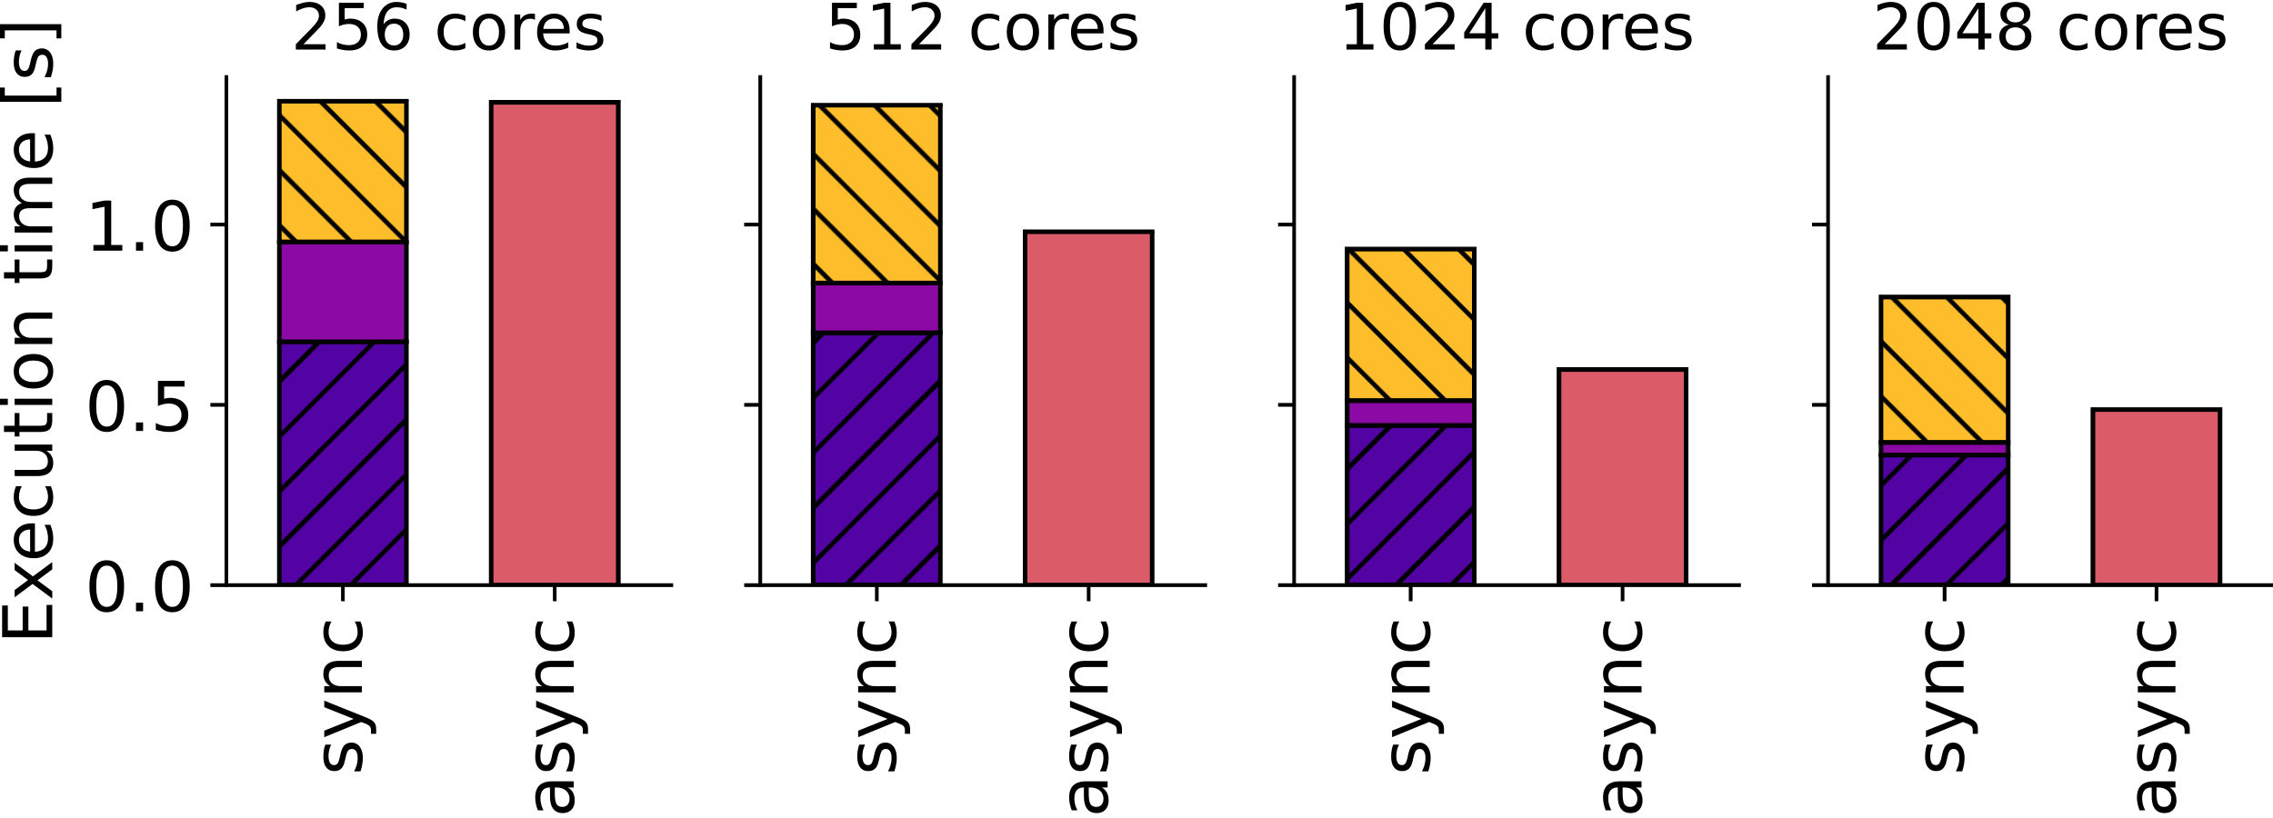
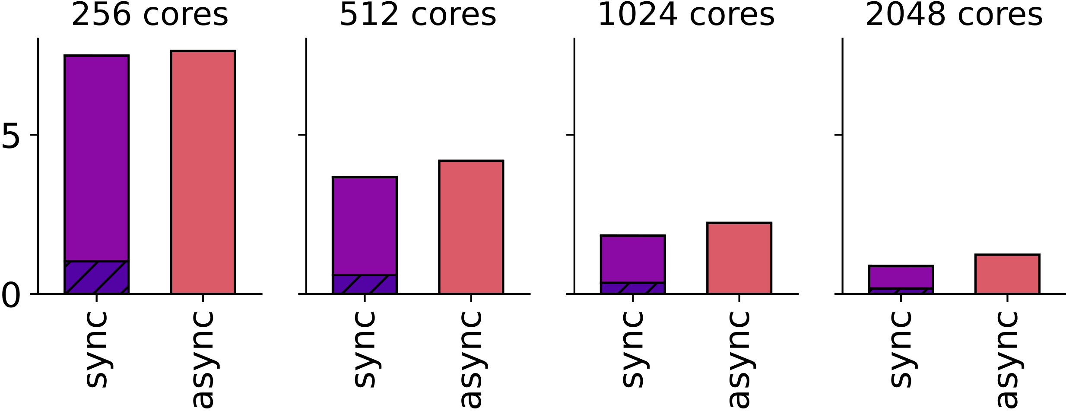
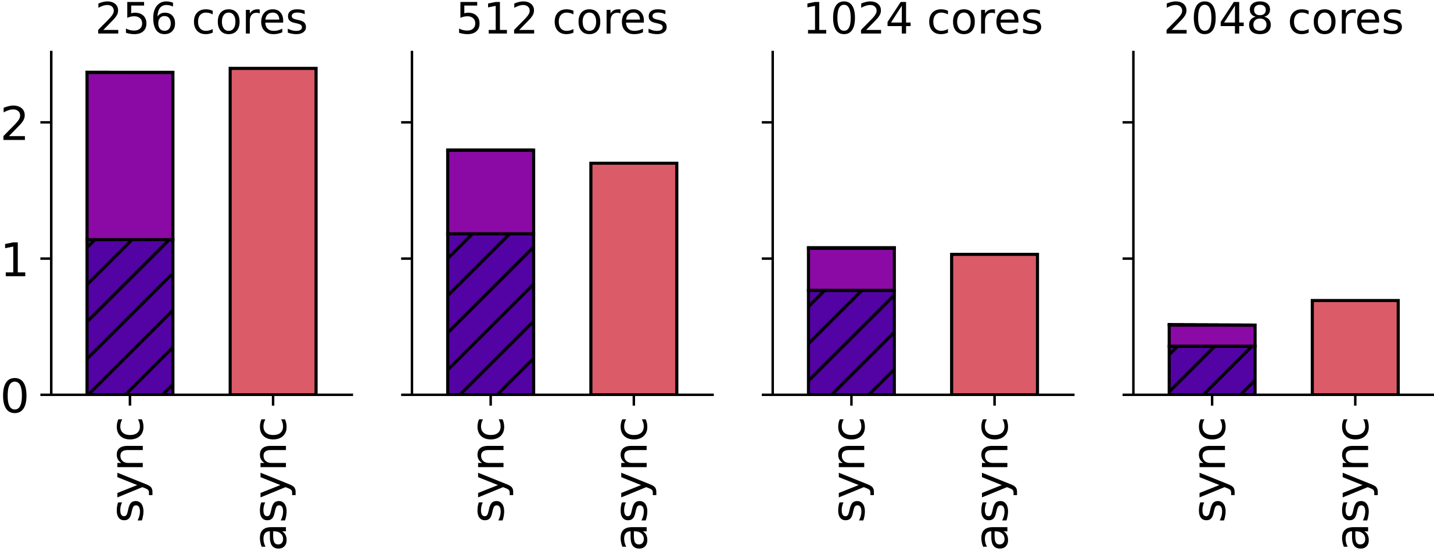
Strong Scaling Analysis I
Selection
Hash Aggregation
Sort Aggregation
Transfer and execution time improves with more PIM-cores, but not optimally
Bandwidth does not fully scale with PIM-cores, since memory channels are shared by PIM-ranks
19

Slide 30
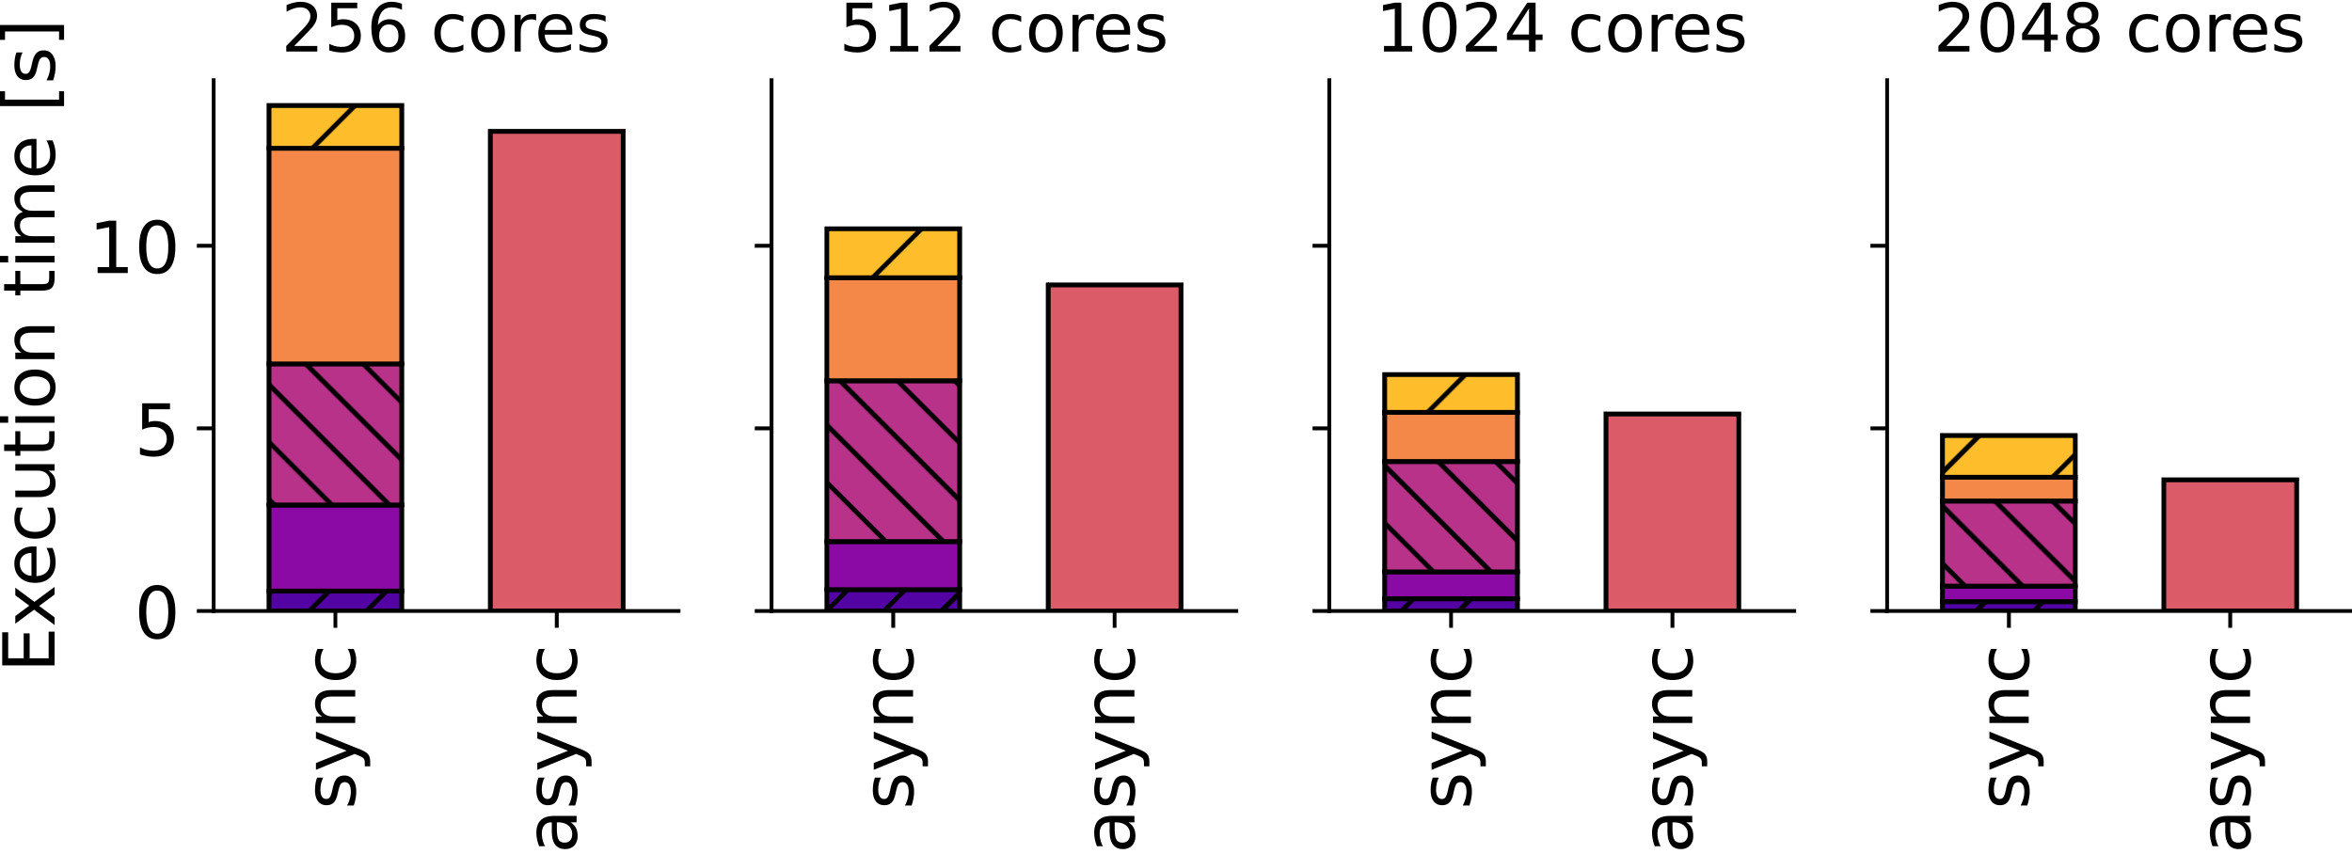
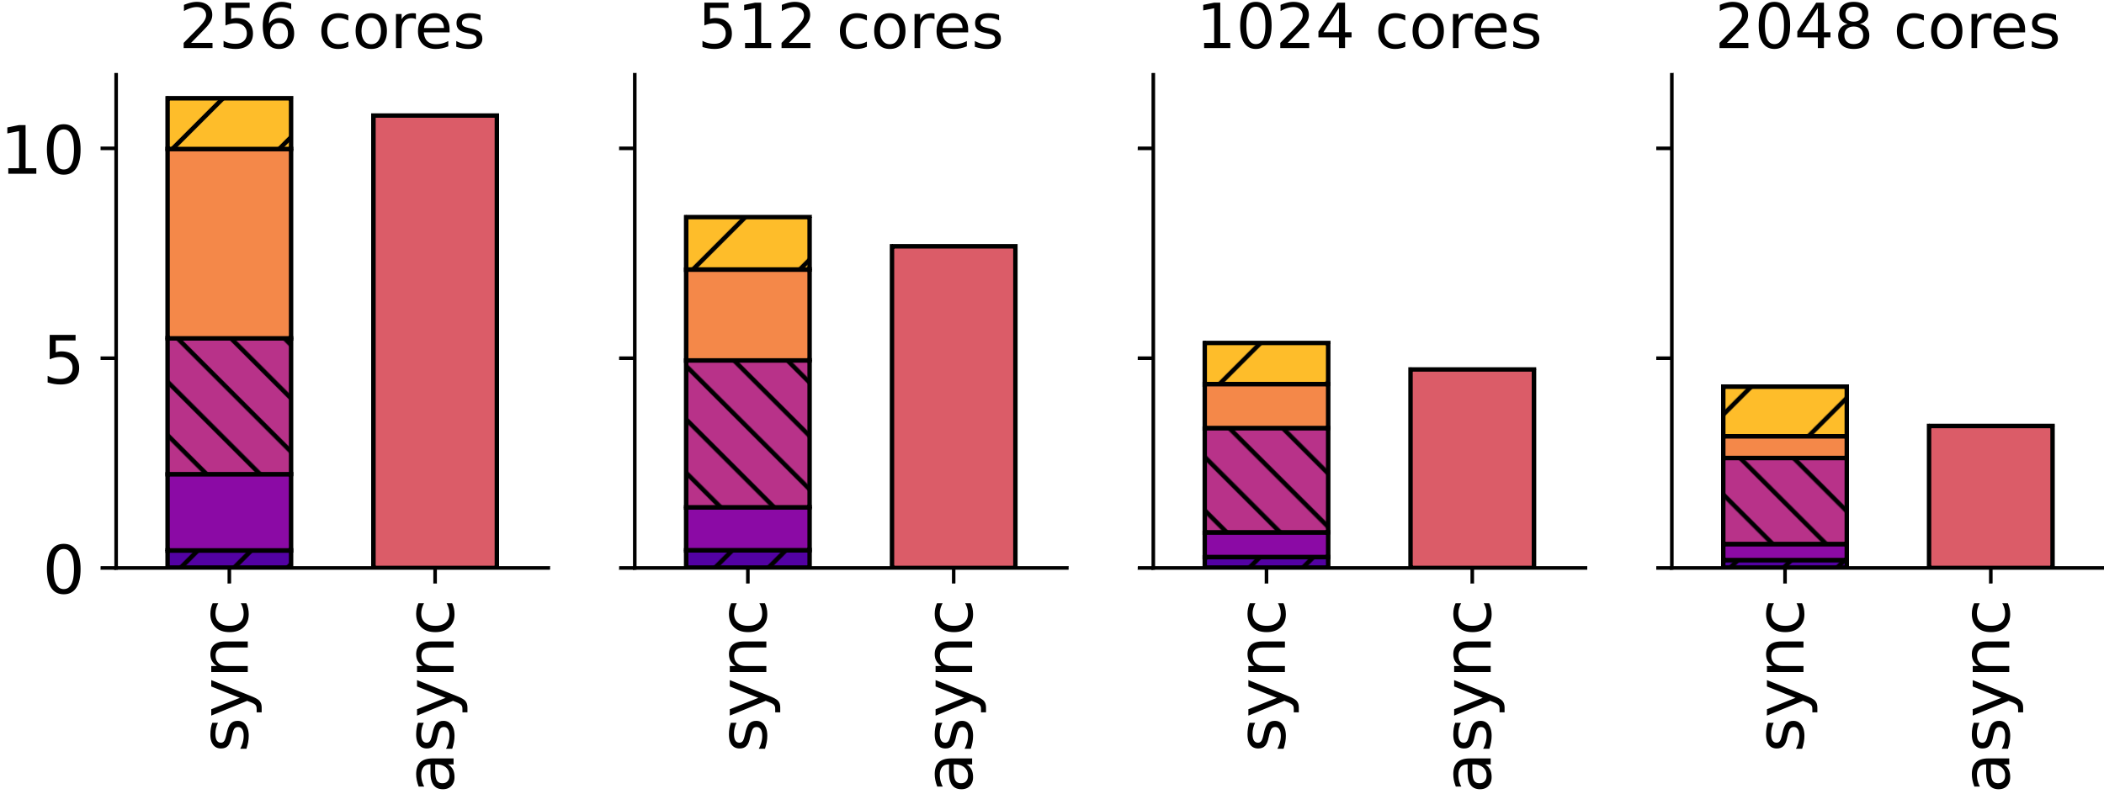
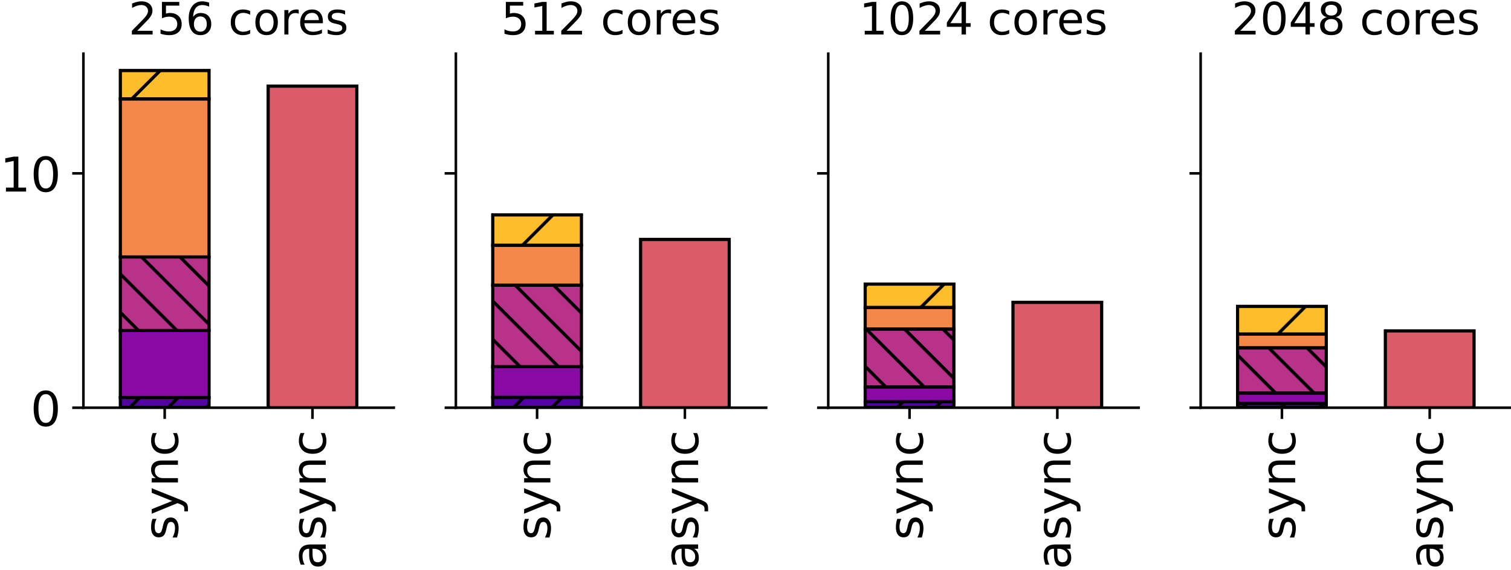
Strong Scaling Analysis II
Ordering
Sort-Merge Join
Hash Join
The behavior is similar for the more complex operators
Overall, using as many PIM-cores as possible is always beneficial for the performance of DB operators on the UPMEM system
The main bottleneck of complex DB operators remains data redistribution between PIM-cores
20

Slide 31
Strong Scaling Analysis II
Ordering
Sort-Merge Join
Hash Join
Key Takeaway 3: Current PIM systems are still limited by the weaknesses of processor-centric architectures. This is because processors have to be used for data transfers.
The behavior is similar for the more complex operators
Overall, using as many PIM-cores as possible is always beneficial for the performance of DB operators on the UPMEM system
The main bottleneck of complex DB operators remains data redistribution between PIM-cores
20

Slide 32
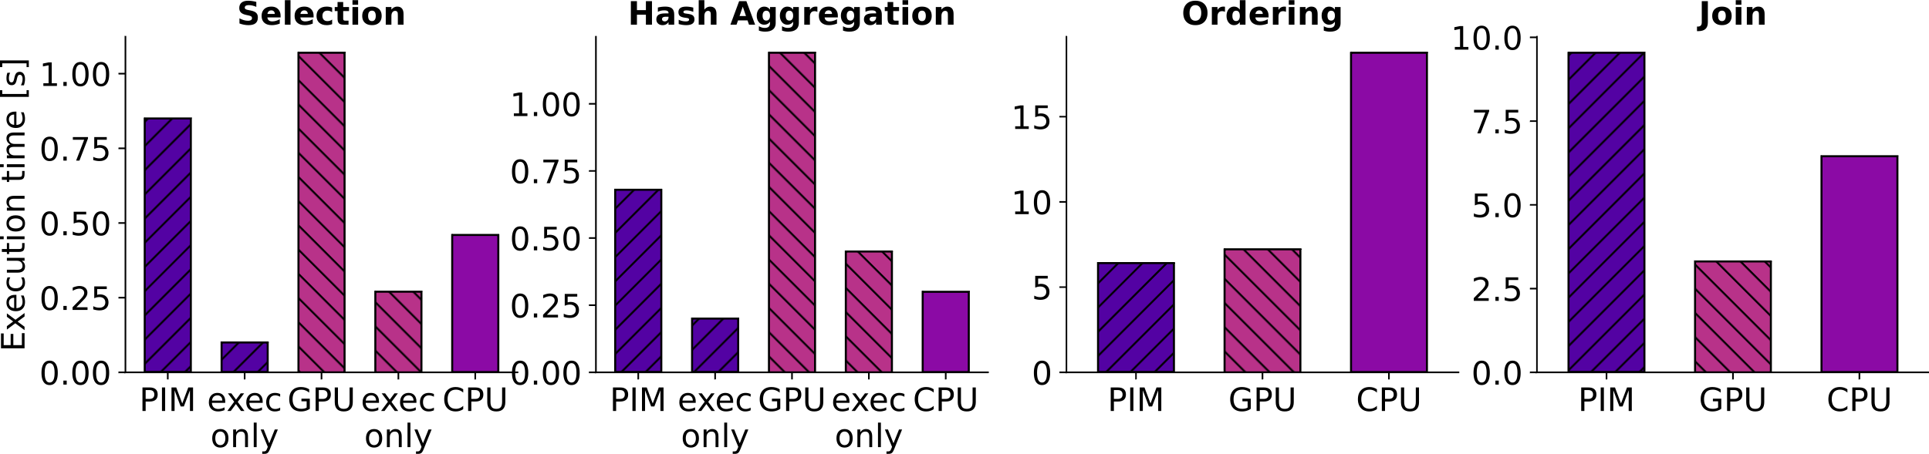
Comparison to CPU and GPU (8 GB)
Simpler operators selection and aggregation show no speedup on PIM and GPU when including transfer times
Ordering with more memory accesses outperforms the CPU on both PIM and GPU
Join is slower on PIM than on GPU due to data redistribution
On CPU it is slower due to small data size as we show next
21

Slide 33
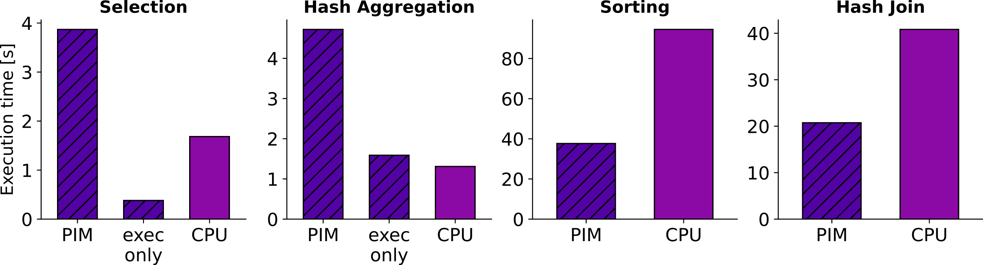
Comparison to CPU (32 GB)
Comparison of selection remains the same
For aggregation speedup gets worse, likely because the cache provides a higher performance uplift on the CPU
The two more memory-bound operators perform the best on PIM compared to the CPU
22

Slide 34
Comparison to CPU (32 GB)
Key Takeaway 4: Queries using ordering and join are better suited for acceleration using PIM systems compared to selection and aggregation.
Comparison of selection remains the same
For aggregation speedup gets worse, likely because the cache provides a higher performance uplift on the CPU
The two more memory-bound operators perform the best on PIM compared to the CPU
22

Slide 35
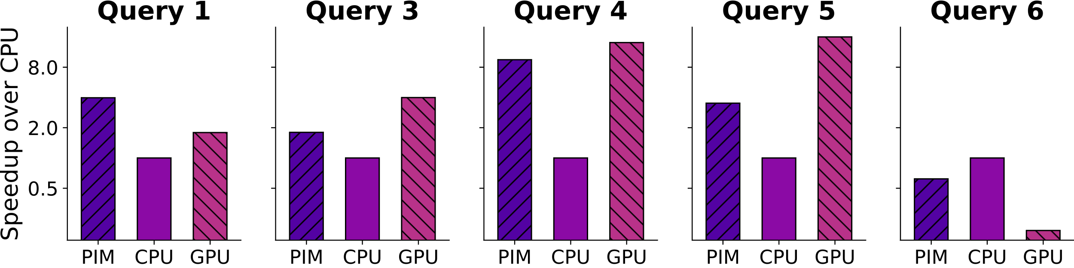
TPC-H Benchmark CPU
Outperform CPU on all queries but 6, by 3.9× on average
Speedup in queries 3 to 5 is mainly due to joins
In query 1 due to high number of columns aggregated
Outperform CPU even with complex arithmetic operations
  Can represent decimals as 64-bit integers, multiplication is simple due to magnitudes of numbers used
  Query 4 without multiplication performs best on PIM
23

Slide 36
TPC-H Benchmark GPU
Outperform GPU in queries 1 and 6 that do not rely on join
by 2.2× and 3.3× respectively
Join requires data redistribution over the host which is slow
  Single GPU has unified memory
Overall TPC-H performance is limited by main memory
Inter PIM-core communication is currently an issue, but scaling PIM memory should be easier than GPU memory
24

Slide 37
TPC-H Benchmark GPU
Key Takeaway 5: Data analytics is well suited for more data-centric architectures as the results from PIM and also the GPU show.
Outperform GPU in queries 1 and 6 that do not rely on join
by 2.2× and 3.3× respectively
Join requires data redistribution over the host which is slow
  Single GPU has unified memory
Overall TPC-H performance is limited by main memory
Inter PIM-core communication is currently an issue, but scaling PIM memory should be easier than GPU memory
24

Slide 38
Outline
Background and Goal
PIMDAL
Experiments and Methodology
Evaluation and Insights
Conclusion & Outlook

Slide 39
Conclusion & Outlook
Memory-centric architectures can significantly accelerate data analytics as PIMDAL shows on the UPMEM system
We find strengths and weaknesses of PIM for implemented DB operators using HW performance metrics
Communication between PIM-cores is a key limitation of current PIM systems
  Might require a fundamentally new memory architecture
Memory-centric systems can play a key role in data analytics in the future, especially if they can support even more complex operations as found in machine learning for example
Main memory is only one part of the equation, what happens if data needs to be loaded from storage?
25

Slide 40
Questions?
“PIMDAL: Mitigating the Memory Bottleneck in Data Analytics using a Real Processing-in-Memory System” with more insights can be found on arXiv:
https://arxiv.org/abs/2504.01948

