Slide 1



Memory-Centric
Computing
Geraldo F. Oliveira
Onur Mutlu
omutlu@gmail.com
https://people.inf.ethz.ch/omutlu
29 October 2023
Real-World PIM Tutorial Opening Talk @ MICRO-56

Slide 2
The Problem
Computing
is Bottlenecked by Data

Slide 3
Data is Key for AI, ML, Genomics, …
Important workloads are all data intensive
They require rapid and efficient processing of large amounts of data
Data is increasing
  We can generate more than we can process
  We need to perform more sophisticated analyses on more data

Slide 4
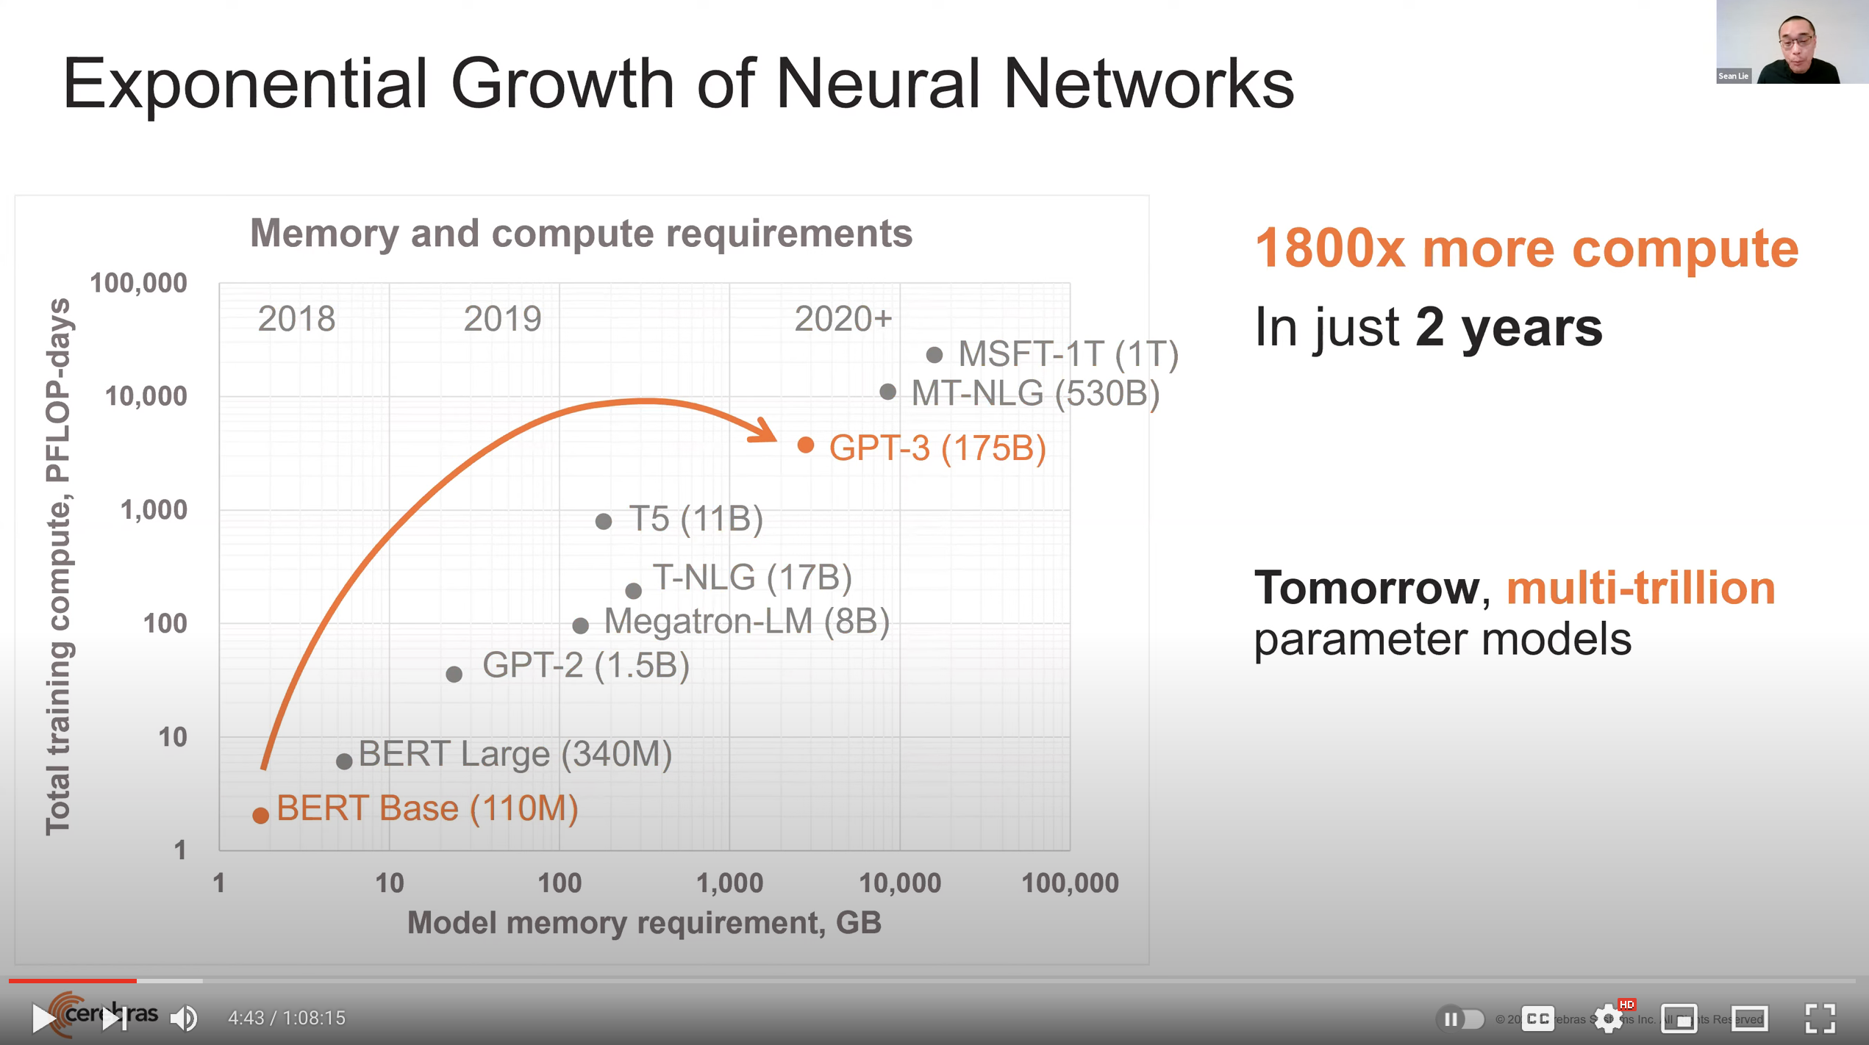
Huge Demand for Performance & Efficiency
~4 orders of magnitude increase in memory requirement in
just two years!
https://www.youtube.com/watch?v=x2-qB0J7KHw

Slide 5
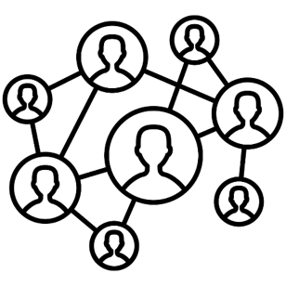



Data is Key for Future Workloads
In-memory Databases
[Mao+, EuroSys’12;
Clapp+ (Intel), IISWC’15]
Graph/Tree Processing
[Xu+, IISWC’12; Umuroglu+, FPL’15]
In-Memory Data Analytics
[Clapp+ (Intel), IISWC’15;
Awan+, BDCloud’15]
Datacenter Workloads
[Kanev+ (Google), ISCA’15]

Slide 6
Data Overwhelms Modern Machines
In-memory Databases
[Mao+, EuroSys’12;
Clapp+ (Intel), IISWC’15]
Graph/Tree Processing
[Xu+, IISWC’12; Umuroglu+, FPL’15]
Data → performance & energy bottleneck
In-Memory Data Analytics
[Clapp+ (Intel), IISWC’15;
Awan+, BDCloud’15]
Datacenter Workloads
[Kanev+ (Google), ISCA’15]

Slide 7








Data is Key for Future Workloads
  Chrome
TensorFlow Mobile
    Google’s web browser
Google’s machine learning framework
  Video Playback
  Video Capture
Google’s video codec
Google’s video codec
Notes:
In this work, we take a look at widely-used google consumer workloads, to figure out the major sources of energy consumption.
We look at Google Chrome web brower. We take a look at Tensorflow, Google’s machine learning framework, and we also take a look at two important video related workloads, video playback and video capture, both rely on Google’s vp9 codec technology.

Slide 8
Data Overwhelms Modern Machines
  Chrome
TensorFlow Mobile
    Google’s web browser
Google’s machine learning framework
Data → performance & energy bottleneck
  Video Playback
  Video Capture
Google’s video codec
Google’s video codec
Notes:
In this work, we take a look at widely-used google consumer workloads, to figure out the major sources of energy consumption.
We look at Google Chrome web brower. We take a look at Tensorflow, Google’s machine learning framework, and we also take a look at two important video related workloads, video playback and video capture, both rely on Google’s vp9 codec technology.

Slide 9
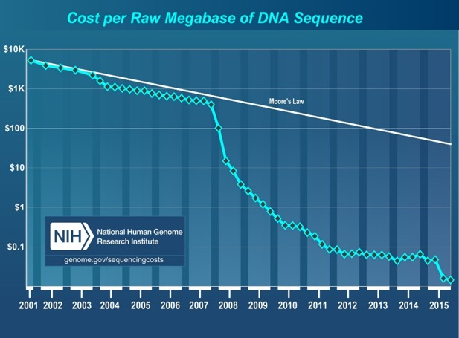
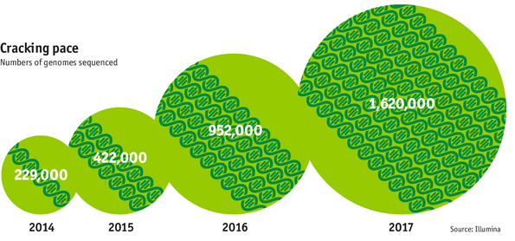

Data is Key for Future Workloads
development of high-throughput sequencing (HTS) technologies
Number of Genomes Sequenced
http://www.economist.com/news/21631808-so-much-genetic-data-so-many-uses-genes-unzipped
Notes:
However, since the development of high throughput sequencing (HTS) technologies, the cost of genome sequencing has fallen off a cliff (<< 1,000$) making it viable for almost everyone's use.

Slide 10

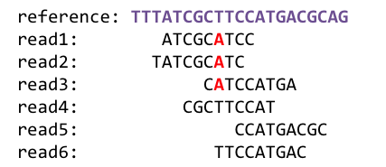
1
Sequencing
Genome Analysis
Read Mapping
2
Data → performance & energy bottleneck
Variant Calling
Scientific Discovery
3
4
Notes:
Genome analysis starts with sequencing random short DNA fragments of copies of the original molecule.
Unfortunately, these reads lack information about their order and which part of genome they are originated from.
Hence the second step is to map these reads to a long reference genome.

Slide 11
Data Overwhelms Modern Machines …
Storage/memory capability
Communication capability
Computation capability
Greatly impacts robustness, energy, performance, cost

Slide 12
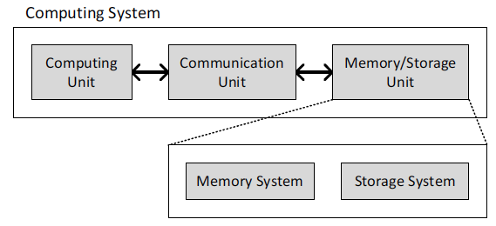
A Computing System
Three key components
Computation
Communication
Storage/memory
Burks, Goldstein, von Neumann, “Preliminary discussion of the
logical design of an electronic computing instrument,” 1946.
Image source: https://lbsitbytes2010.wordpress.com/2013/03/29/john-von-neumann-roll-no-15/

Slide 13
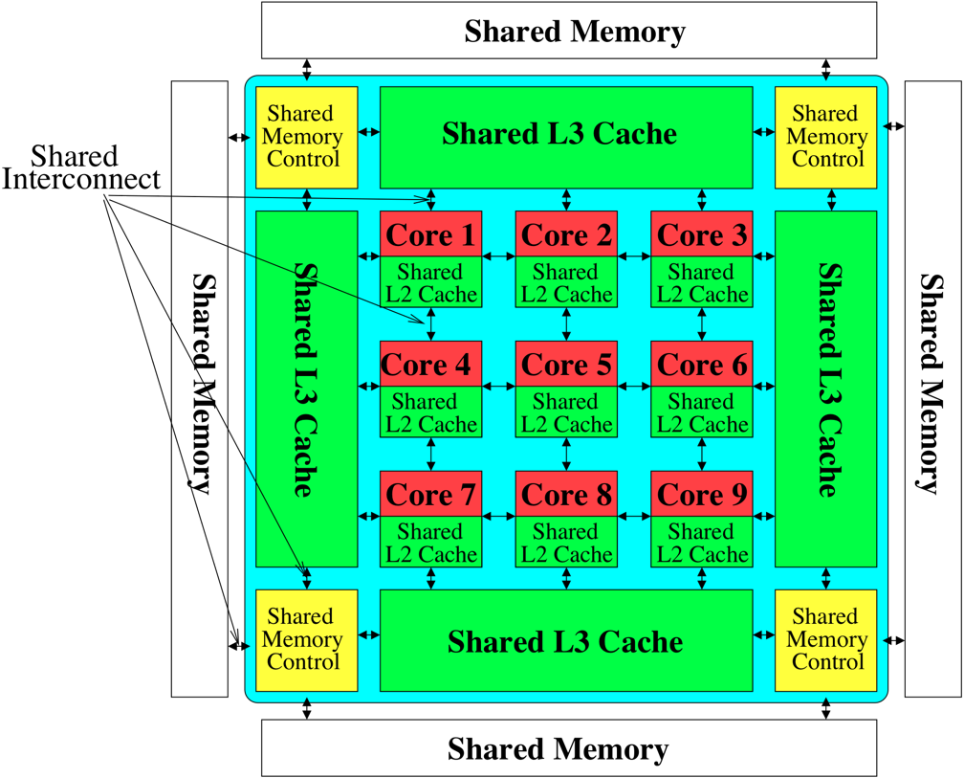
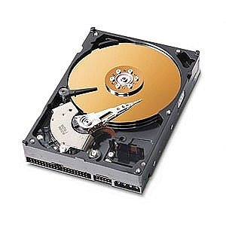
Perils of Processor-Centric Design
Most of the system is dedicated to storing and moving data
Yet, system is still bottlenecked by memory

Slide 14
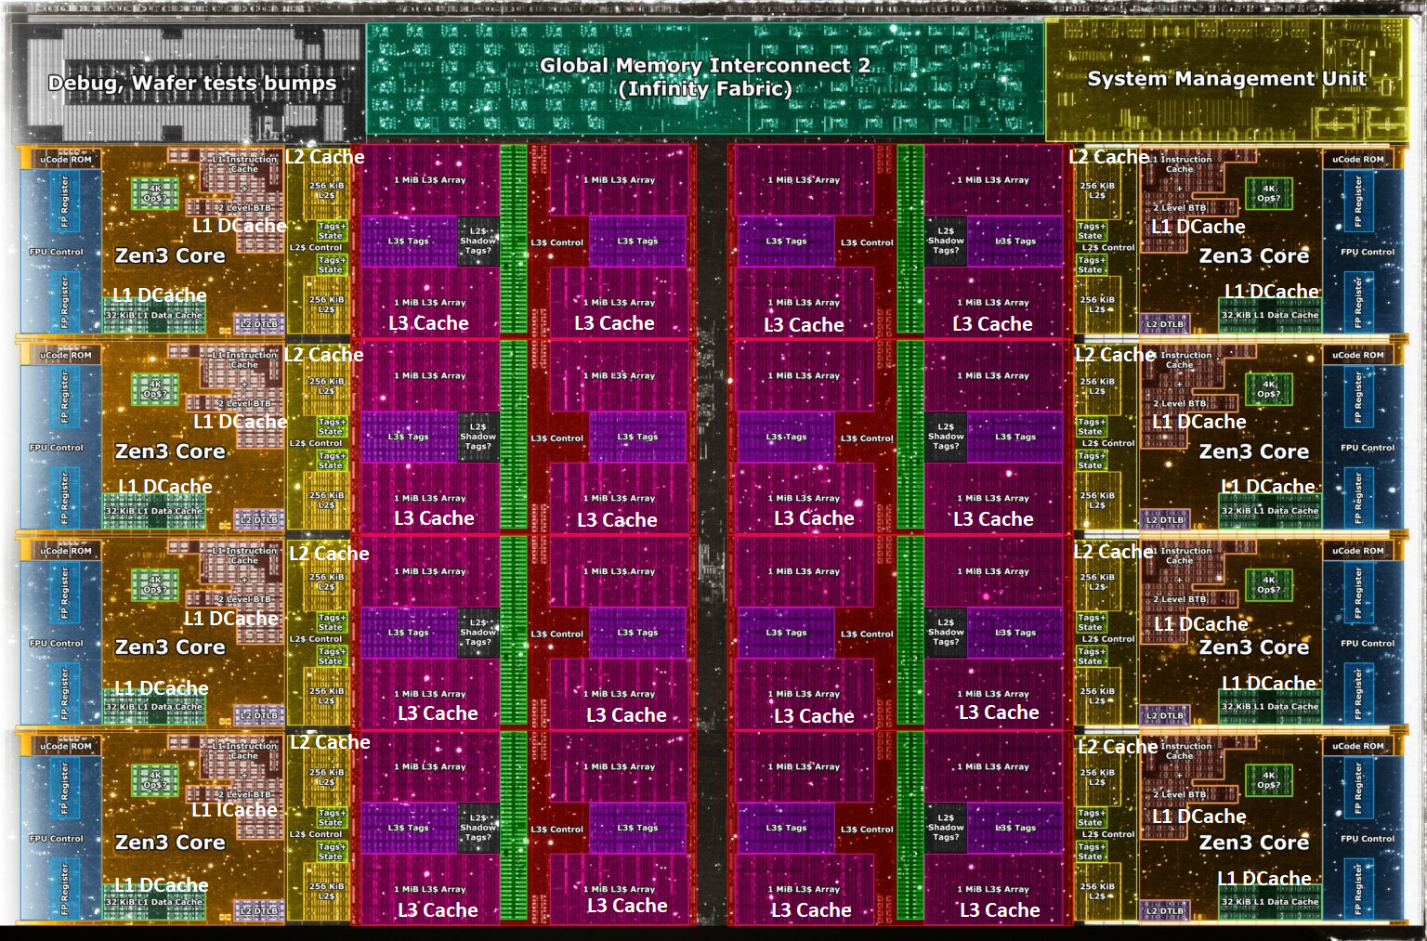
A Solution: Deeper and Larger Memory Hierarchies
Core Count:
8 cores/16 threads
L1 Caches:
32 KB per core
L2 Caches:
512 KB per core
L3 Cache:
32 MB shared
AMD Ryzen 5000, 2020
https://wccftech.com/amd-ryzen-5000-zen-3-vermeer-undressed-high-res-die-shots-close-ups-pictured-detailed/

Slide 15
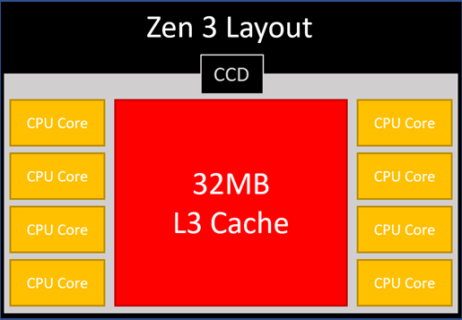
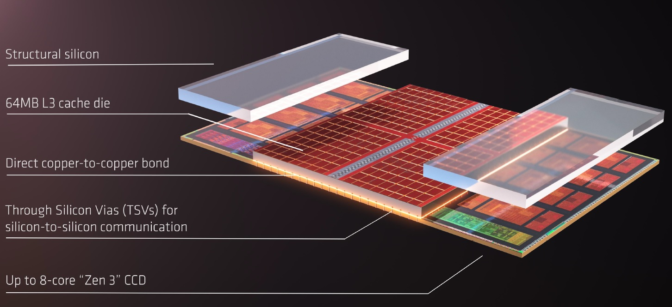
AMD’s 3D Last Level Cache (2021)
AMD increases the L3 size of their 8-core Zen 3 processors from 32 MB to 96 MB
Additional 64 MB L3 cache die stacked on top of the processor die
- Connected using Through Silicon Vias (TSVs)
- Total of 96 MB L3 cache
https://community.microcenter.com/discussion/5134/comparing-zen-3-to-zen-2
https://youtu.be/gqAYMx34euU
https://www.tech-critter.com/amd-keynote-computex-2021/
Notes:
CCD = Core Chiplet Die
Structural silicon is used to equalize the height and facilitate heat dissipation from the cores.

Slide 16
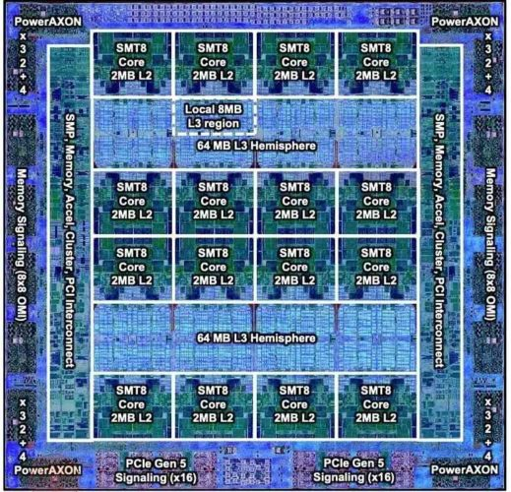
Deeper and Larger Memory Hierarchies
IBM POWER10,
2020
Cores:
15-16 cores,
8 threads/core
L2 Caches:
2 MB per core
L3 Cache:
120 MB shared
https://www.it-techblog.de/ibm-power10-prozessor-mehr-speicher-mehr-tempo-mehr-sicherheit/09/2020/

Slide 17
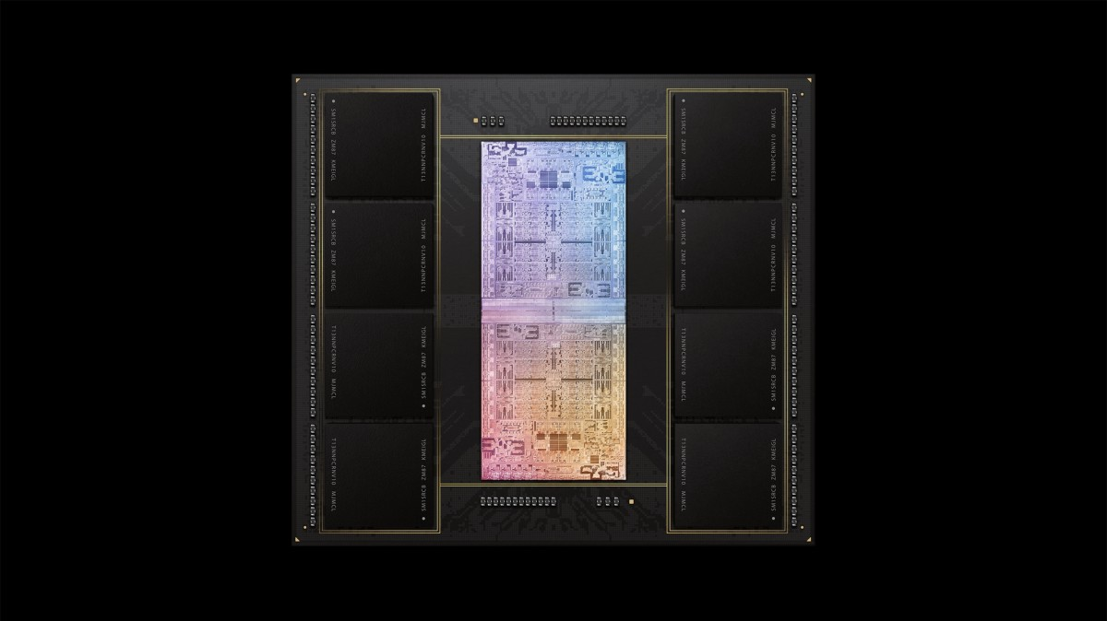
Deeper and Larger Memory Hierarchies
A lot of
SRAM
Storage
DRAM
DRAM
Storage
Apple M1 Ultra System (2022)
https://www.gsmarena.com/apple_announces_m1_ultra_with_20core_cpu_and_64core_gpu-news-53481.php

Slide 18
Data Movement Overwhelms Modern Machines
Amirali Boroumand, Saugata Ghose, Youngsok Kim, Rachata Ausavarungnirun, Eric Shiu, Rahul Thakur, Daehyun Kim, Aki Kuusela, Allan Knies, Parthasarathy Ranganathan, and Onur Mutlu,
"Google Workloads for Consumer Devices: Mitigating Data Movement Bottlenecks"
Proceedings of the 23rd International Conference on Architectural Support for Programming Languages and Operating Systems (ASPLOS), Williamsburg, VA, USA, March 2018.
62.7% of the total system energy
is spent on data movement

Slide 19
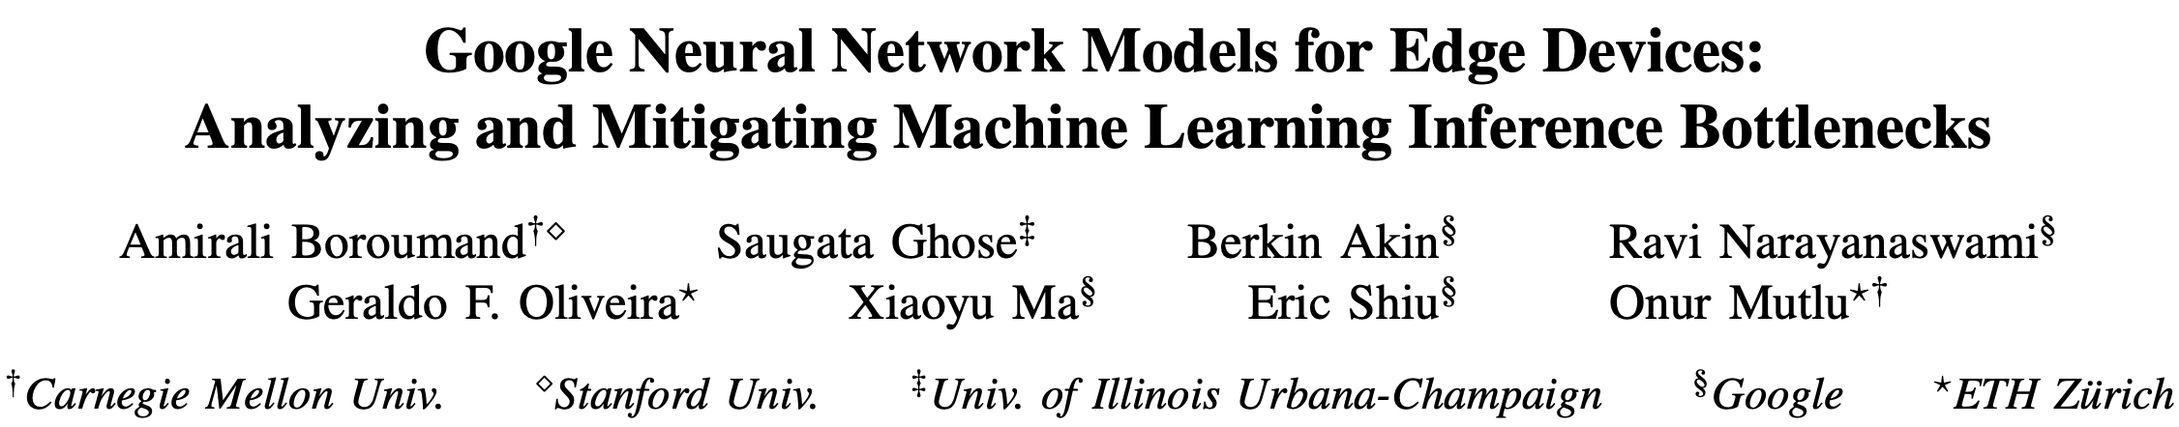
Data Movement Overwhelms Accelerators
Amirali Boroumand, Saugata Ghose, Berkin Akin, Ravi Narayanaswami, Geraldo F. Oliveira, Xiaoyu Ma, Eric Shiu, and Onur Mutlu,
"Google Neural Network Models for Edge Devices: Analyzing and Mitigating Machine Learning Inference Bottlenecks"
Proceedings of the 30th International Conference on Parallel Architectures and Compilation Techniques (PACT), Virtual, September 2021.
[Slides (pptx) (pdf)]
[Talk Video (14 minutes)]
> 90% of the total system energy
is spent on memory in large ML models

Slide 20
The Problem
Data access is the major performance and energy bottleneck
Our current
design principles
cause great energy waste
(and great performance loss)

Slide 21
The Problem
Processing of data
is performed
far away from the data

Slide 22
Today’s Computing Systems
Processor centric
All data processed in the processor → at great system cost

Slide 23
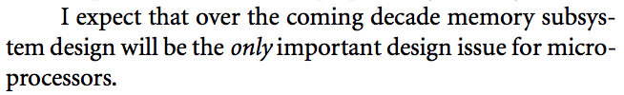
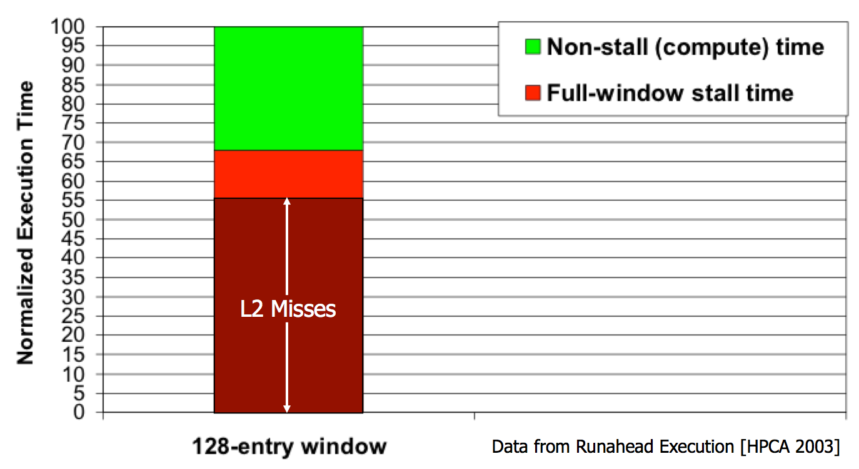
Yet …
“It’s the Memory, Stupid!” (Richard Sites, MPR, 1996)
Mutlu+, “Runahead Execution: An Alternative to Very Large Instruction Windows for Out-of-Order Processors,” HPCA 2003.

Slide 24
The Performance Perspective
Onur Mutlu, Jared Stark, Chris Wilkerson, and Yale N. Patt,
"Runahead Execution: An Alternative to Very Large Instruction Windows for Out-of-order Processors"
Proceedings of the 9th International Symposium on High-Performance Computer Architecture (HPCA), pages 129-140, Anaheim, CA, February 2003. Slides (pdf)
  One of the 15 computer arch. papers of 2003 selected as Top Picks by IEEE Micro.
  HPCA Test of Time Award (awarded in 2021).

Slide 25
The Performance Perspective (Today)
All of Google’s Data Center Workloads (2015):
Kanev+, “Profiling a Warehouse-Scale Computer,” ISCA 2015.

Slide 26
The Performance Perspective (Today)
All of Google’s Data Center Workloads (2015):
Kanev+, “Profiling a Warehouse-Scale Computer,” ISCA 2015.

Slide 27
Perils of Processor-Centric Design
Grossly-imbalanced systems
  Processing done only in one place
  All else just stores and moves data: data moves a lot
  → Energy inefficient
  → Low performance
  → Complex
Overly complex and bloated processor (and accelerators)
  To tolerate data access from memory
  Complex hierarchies and mechanisms
  → Energy inefficient
  → Low performance
  → Complex

Slide 28
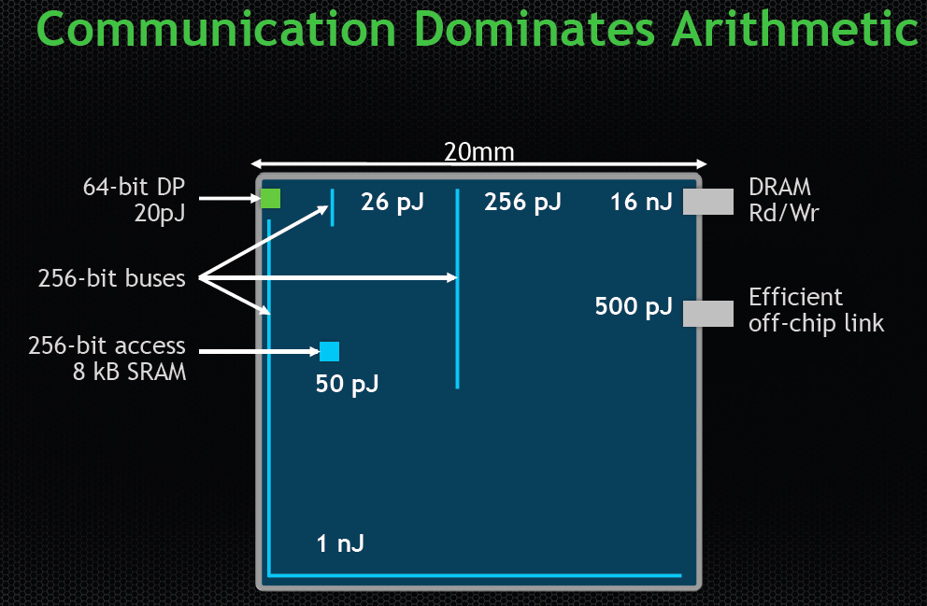
The Energy Perspective
Dally, HiPEAC 2015

Slide 29
Data Movement vs. Computation Energy
Dally, HiPEAC 2015
A memory access consumes ~100-1000X
the energy of a complex addition

Slide 30
Data Movement vs. Computation Energy
Han+, “EIE: Efficient Inference Engine on Compressed Deep Neural Network,” ISCA 2016.

Slide 31
Data Movement vs. Computation Energy
6400X
A memory access consumes 6400X
the energy of a simple integer addition
Han+, “EIE: Efficient Inference Engine on Compressed Deep Neural Network,” ISCA 2016.

Slide 32
We Do Not Want to Move Data!
Dally, HiPEAC 2015
A memory access consumes ~100-1000X
the energy of a complex addition

Slide 33
We Need A Paradigm Shift To …
Enable computation with minimal data movement
Compute where it makes sense (where data resides)
Make computing architectures more data-centric

Slide 34
Axiom
An Intelligent Architecture
Handles Data Well

Slide 35
How to Handle Data Well
Ensure data does not overwhelm the components
  via intelligent algorithms
  via intelligent architectures
  via whole system designs: algorithm-architecture-devices
Take advantage of vast amounts of data and metadata
  to improve architectural & system-level decisions
Understand and exploit properties of (different) data
  to improve algorithms & architectures in various metrics

Slide 36
Corollaries: Computing Systems Today …
Are processor-centric vs. data-centric
Make designer-dictated decisions vs. data-driven
Make component-based myopic decisions vs. data-aware

Slide 37
Architectures for Intelligent Machines
Data-centric
Data-driven
Data-aware

Slide 38
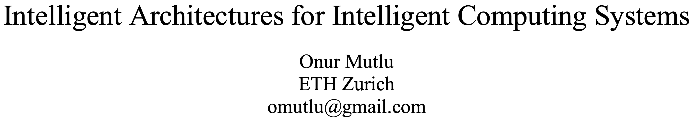
A Blueprint for Fundamentally Better Architectures
Onur Mutlu,
"Intelligent Architectures for Intelligent Computing Systems"
Invited Paper in Proceedings of the Design, Automation, and Test in Europe Conference (DATE), Virtual, February 2021.
[Slides (pptx) (pdf)]
[IEDM Tutorial Slides (pptx) (pdf)]
[Short DATE Talk Video (11 minutes)]
[Longer IEDM Tutorial Video (1 hr 51 minutes)]

Slide 39
We Need to Revisit the Entire Stack
Problem
Algorithm
Program/Language
System Software
SW/HW Interface
Micro-architecture
Logic
Devices
Electrons
We can get there step by step

Slide 40
Data-Centric (Memory-Centric) Architectures

Slide 41
Data-Centric Architectures: Properties
Process data where it resides (where it makes sense)
  Processing in and near memory structures
Low-latency and low-energy data access
  Low latency memory
  Low energy memory
Low-cost data storage and processing
  High capacity memory at low cost: hybrid memory, compression
Intelligent data management
  Intelligent controllers handling robustness, security, cost, perf.

Slide 42
Processing Data
Where It Makes Sense

Slide 43
Process Data Where It Makes Sense
Sensors
A lot of
SRAM
Storage
DRAM
DRAM
Storage
Apple M1 Ultra System (2022)
https://www.gsmarena.com/apple_announces_m1_ultra_with_20core_cpu_and_64core_gpu-news-53481.php

Slide 44
We Need to Think Differently from the Past Approaches

Slide 45
Mindset: Memory as an Accelerator
CPU
core
CPU
core
mini-CPU
core
GPU
(throughput)
core
GPU
(throughput)
core
video
core
GPU
(throughput)
core
GPU
(throughput)
core
CPU
core
CPU
core
Memory
imaging
core
LLC
Specialized
compute-capability
in memory
Memory Controller
Memory Bus
Memory similar to a “conventional” accelerator

Slide 46
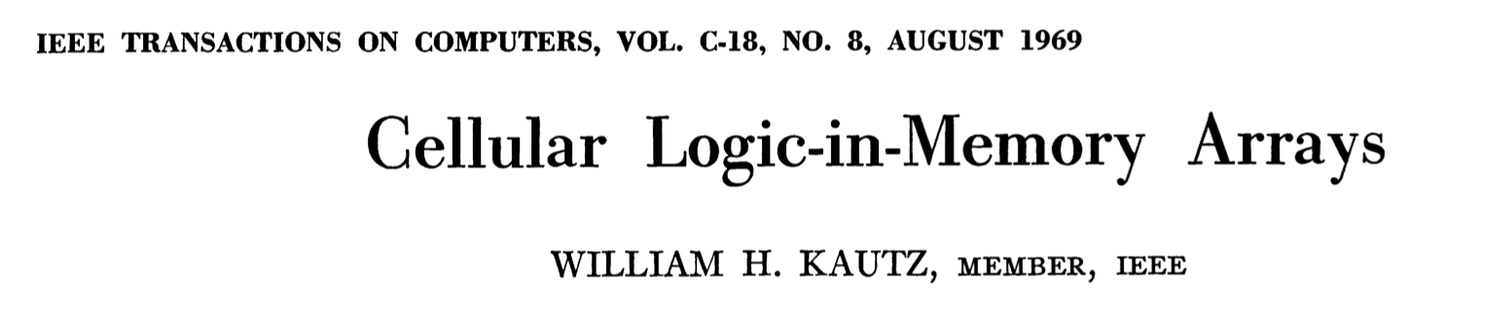
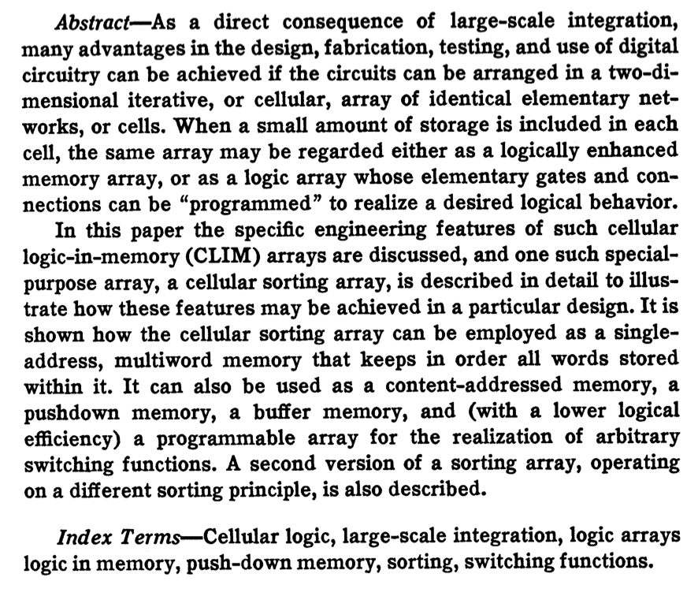
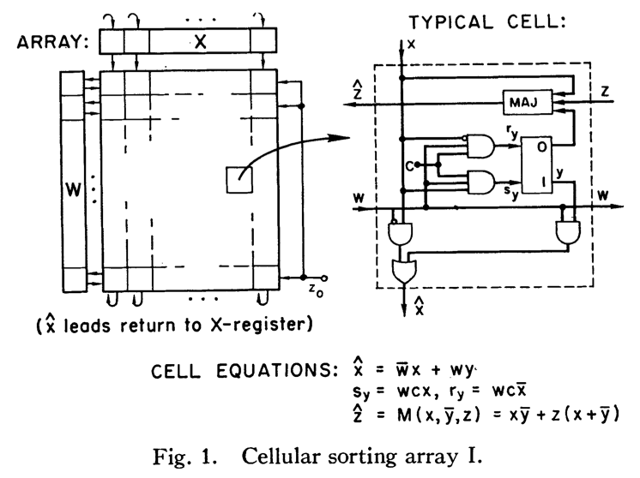
Processing in Memory: An Old Idea (I)
Kautz, “Cellular Logic-in-Memory Arrays”, IEEE TC 1969.
https://doi.org/10.1109/T-C.1969.222754

Slide 47
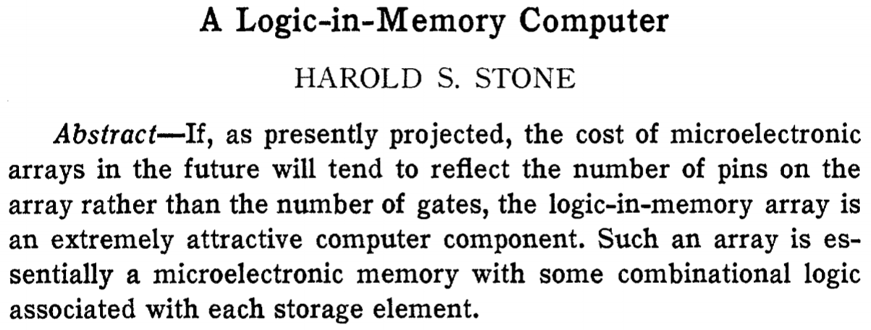
Processing in Memory: An Old Idea (II)
Stone, “A Logic-in-Memory Computer,” IEEE TC 1970.
https://safari.ethz.ch/architecture/fall2020/lib/exe/fetch.php?media=stone_logic_in_memory_1970.pdf

Slide 48
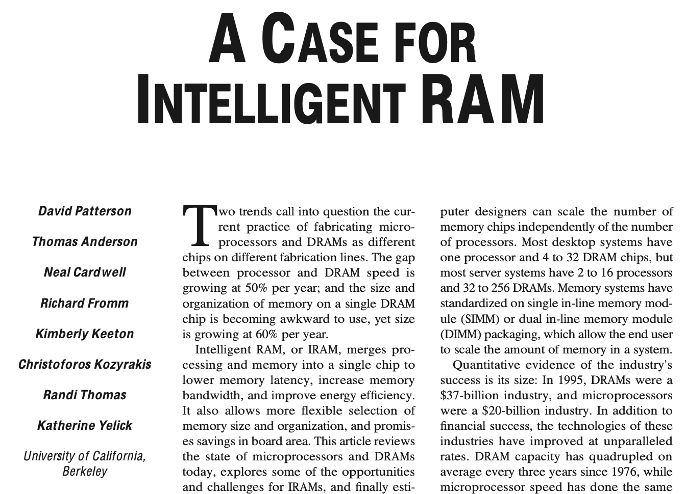
Processing in Memory: An Old Idea (III)
Patterson et al., “A Case for Intelligent RAM,” IEEE Micro 1997.
https://doi.org/10.1109/40.592312

Slide 49
Why In-Memory Computation Today?
Huge problems with Memory Technology
  Memory technology scaling is not going well (e.g., RowHammer)
  Many scaling issues demand intelligence in memory
Huge demand from Applications & Systems
  Data access bottleneck
  Energy & power bottlenecks
  Data movement energy dominates computation energy
  Need all at the same time: performance, energy, sustainability
  We can improve all metrics by minimizing data movement
Designs are squeezed in the middle

Slide 50
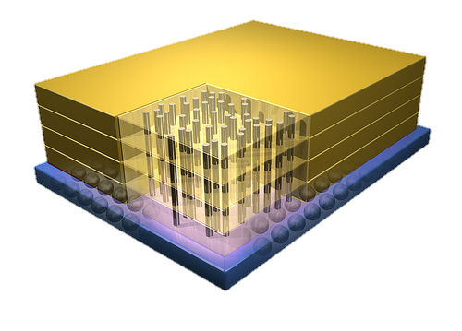


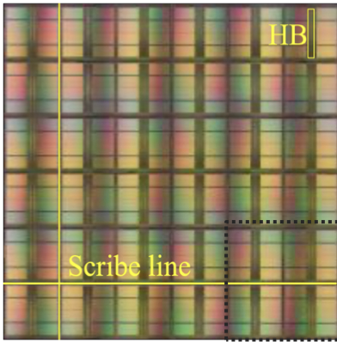
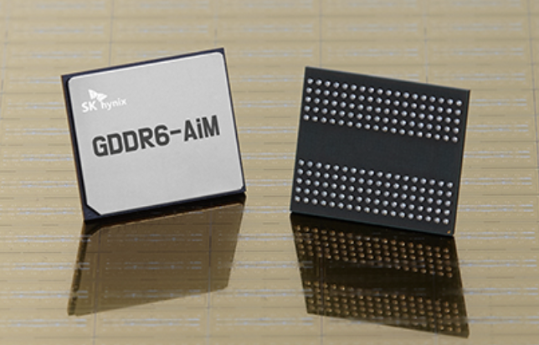
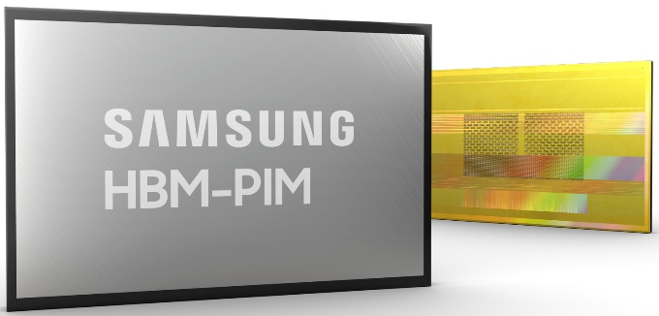
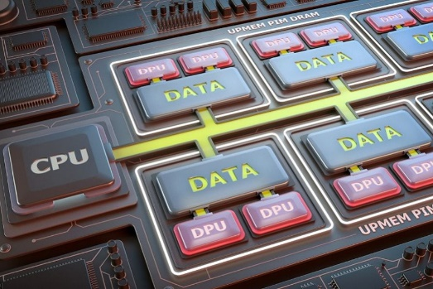
Processing-in-Memory Landscape Today
[Samsung 2021]
[Alibaba 2022]
[SK Hynix 2022]
[Samsung 2021]
[UPMEM 2019]
And, many other experimental chips and startups

Slide 51
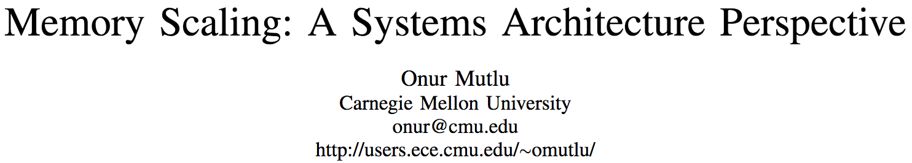
Memory Scaling Issues Are Real
Onur Mutlu,
"Memory Scaling: A Systems Architecture Perspective"
Proceedings of the 5th International Memory Workshop (IMW), Monterey, CA, May 2013. Slides (pptx) (pdf)
EETimes Reprint
https://people.inf.ethz.ch/omutlu/pub/memory-scaling_memcon13.pdf

Slide 52
A Curious Phenomenon [Kim et al., ISCA 2014]
One can
predictably induce errors
in most DRAM memory chips
Kim+, “Flipping Bits in Memory Without Accessing Them: An Experimental Study of DRAM Disturbance Errors,” ISCA 2014.

Slide 53
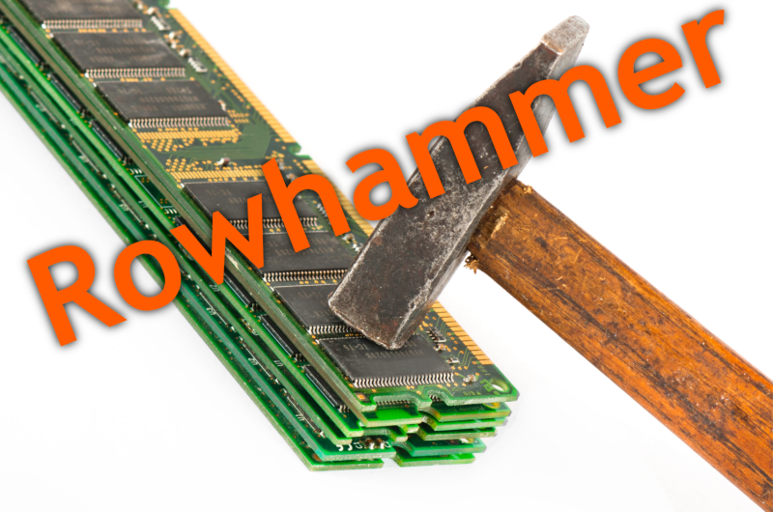
Notes:
Picture from the article:
http://thehackernews.com/2015/03/dram-rowhammer-vulnerability.html

Slide 54
Modern Memory is Prone to Disturbance Errors
Row of Cells
Wordline
Row
Victim Row
Row
Hammered Row
V_{LOW}
Opened
V_{HIGH}
Closed
Row
Victim Row
Row
Repeatedly reading a row enough times (before memory gets refreshed) induces disturbance errors in adjacent rows in most real DRAM chips you can buy today
Flipping Bits in Memory Without Accessing Them: An Experimental Study of DRAM Disturbance Errors, (Kim et al., ISCA 2014)

Slide 55
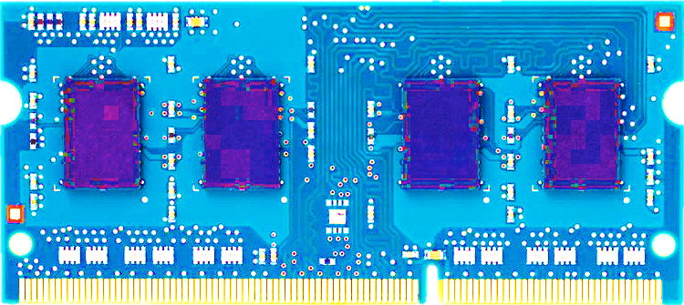
Most DRAM Modules Are Vulnerable
A company
B company
C company
86%
(37/43)
83%
(45/54)
88%
(28/32)
Up to
1.0×10⁷
errors
Up to
2.7×10⁶
errors
Up to
3.3×10⁵
errors
Flipping Bits in Memory Without Accessing Them: An Experimental Study of DRAM Disturbance Errors, (Kim et al., ISCA 2014)

Slide 56
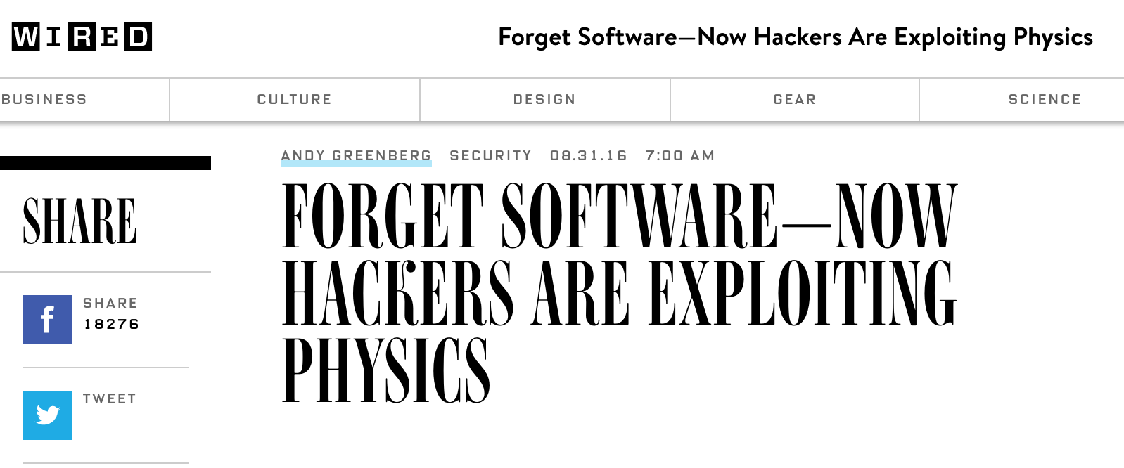
The RowHammer Vulnerability
A simple hardware failure mechanism
can create a widespread
system security vulnerability

Slide 57
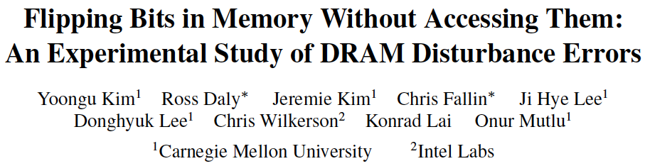
RowHammer [ISCA 2014]
Yoongu Kim, Ross Daly, Jeremie Kim, Chris Fallin, Ji Hye Lee, Donghyuk Lee, Chris Wilkerson, Konrad Lai, and Onur Mutlu,
"Flipping Bits in Memory Without Accessing Them: An Experimental Study of DRAM Disturbance Errors"
Proceedings of the 41st International Symposium on Computer Architecture (ISCA), Minneapolis, MN, June 2014.
[Slides (pptx) (pdf)] [Lightning Session Slides (pptx) (pdf)] [Source Code and Data] [Lecture Video (1 hr 49 mins), 25 September 2020]
One of the 7 papers of 2012-2017 selected as Top Picks in Hardware and Embedded Security for IEEE TCAD (link).
Selected to the ISCA-50 25-Year Retrospective Issue covering 1996-2020 in 2023 (Retrospective (pdf) Full Issue).

Slide 58
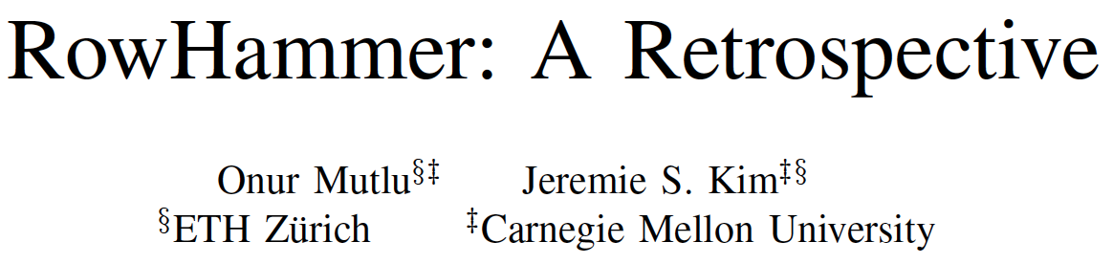
Memory Scaling Issues Are Real
Onur Mutlu and Jeremie Kim,
"RowHammer: A Retrospective"
IEEE Transactions on Computer-Aided Design of Integrated Circuits and Systems (TCAD) Special Issue on Top Picks in Hardware and Embedded Security, 2019.
[Preliminary arXiv version]
[Slides from COSADE 2019 (pptx)]
[Slides from VLSI-SOC 2020 (pptx) (pdf)]
[Talk Video (1 hr 15 minutes, with Q&A)]

Slide 59

Memory Scaling Issues Are Real
Onur Mutlu, Ataberk Olgun, and A. Giray Yaglikci,
"Fundamentally Understanding and Solving RowHammer"
Invited Special Session Paper at the 28th Asia and South Pacific Design Automation Conference (ASP-DAC), Tokyo, Japan, January 2023.
[arXiv version]
[Slides (pptx) (pdf)]
[Talk Video (26 minutes)]
https://arxiv.org/pdf/2211.07613.pdf

Slide 60
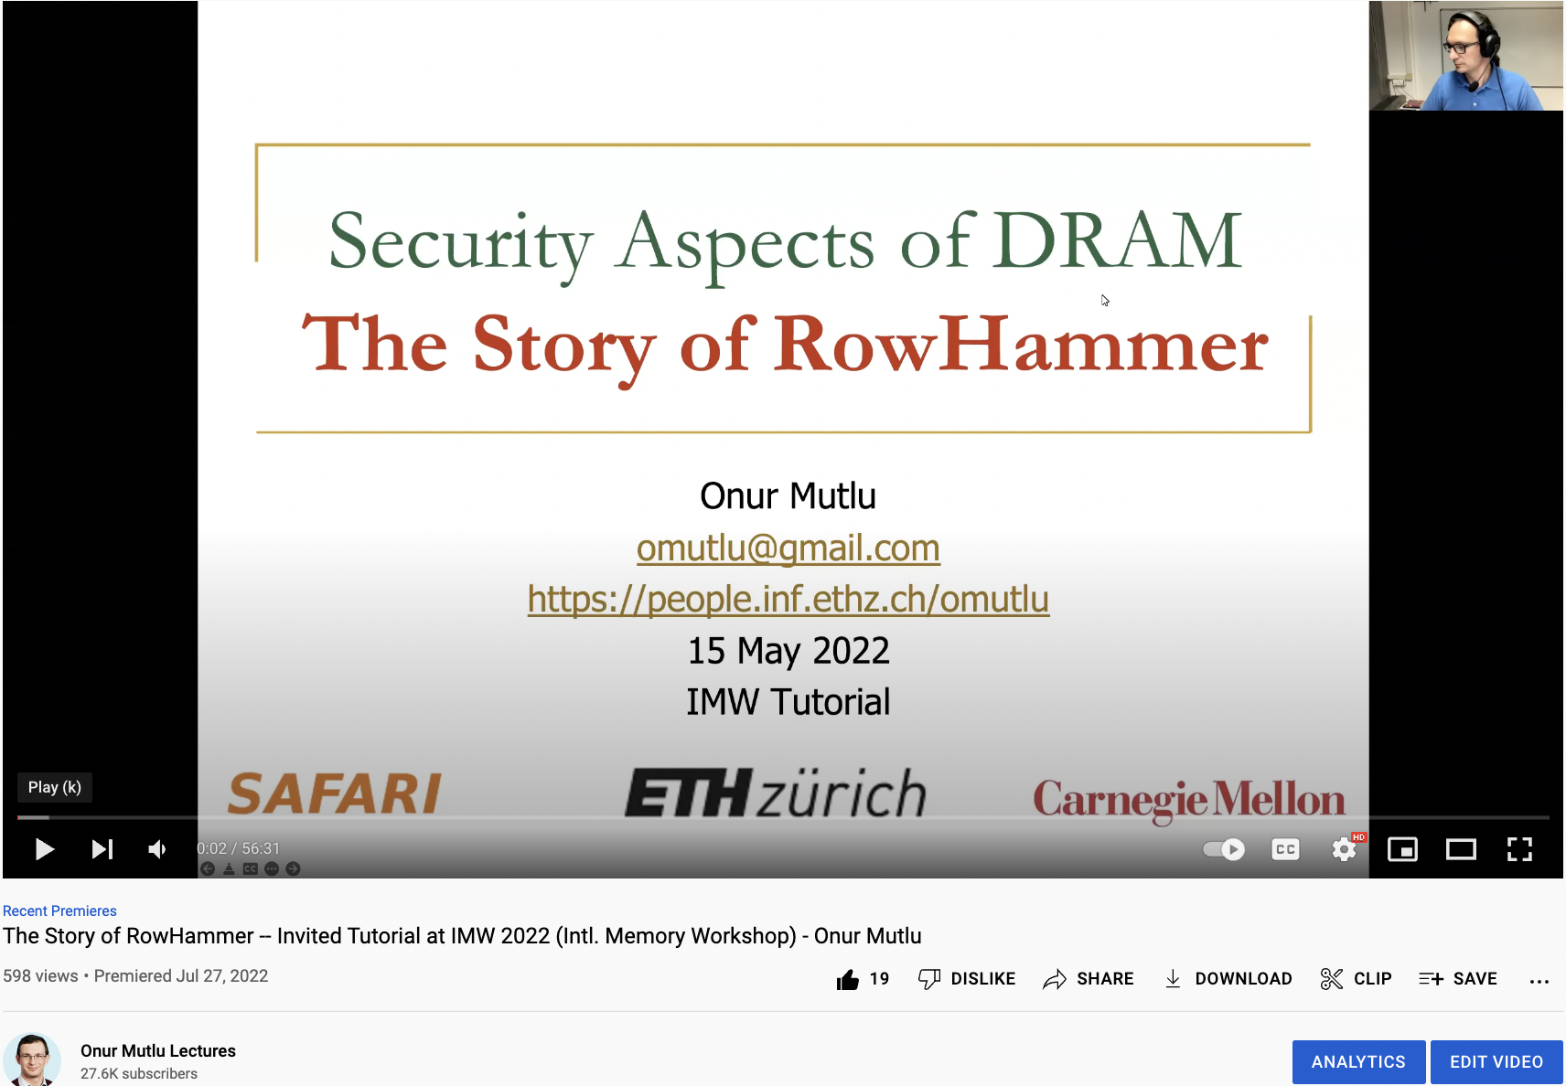
The Story of RowHammer Tutorial …
Onur Mutlu,
"Security Aspects of DRAM: The Story of RowHammer"
Invited Tutorial at 14th IEEE Electron Devices Society International Memory Workshop (IMW), Dresden, Germany, May 2022.
[Slides (pptx)(pdf)]
[Tutorial Video (57 minutes)]
https://www.youtube.com/watch?v=37hWglkQRG0

Slide 61
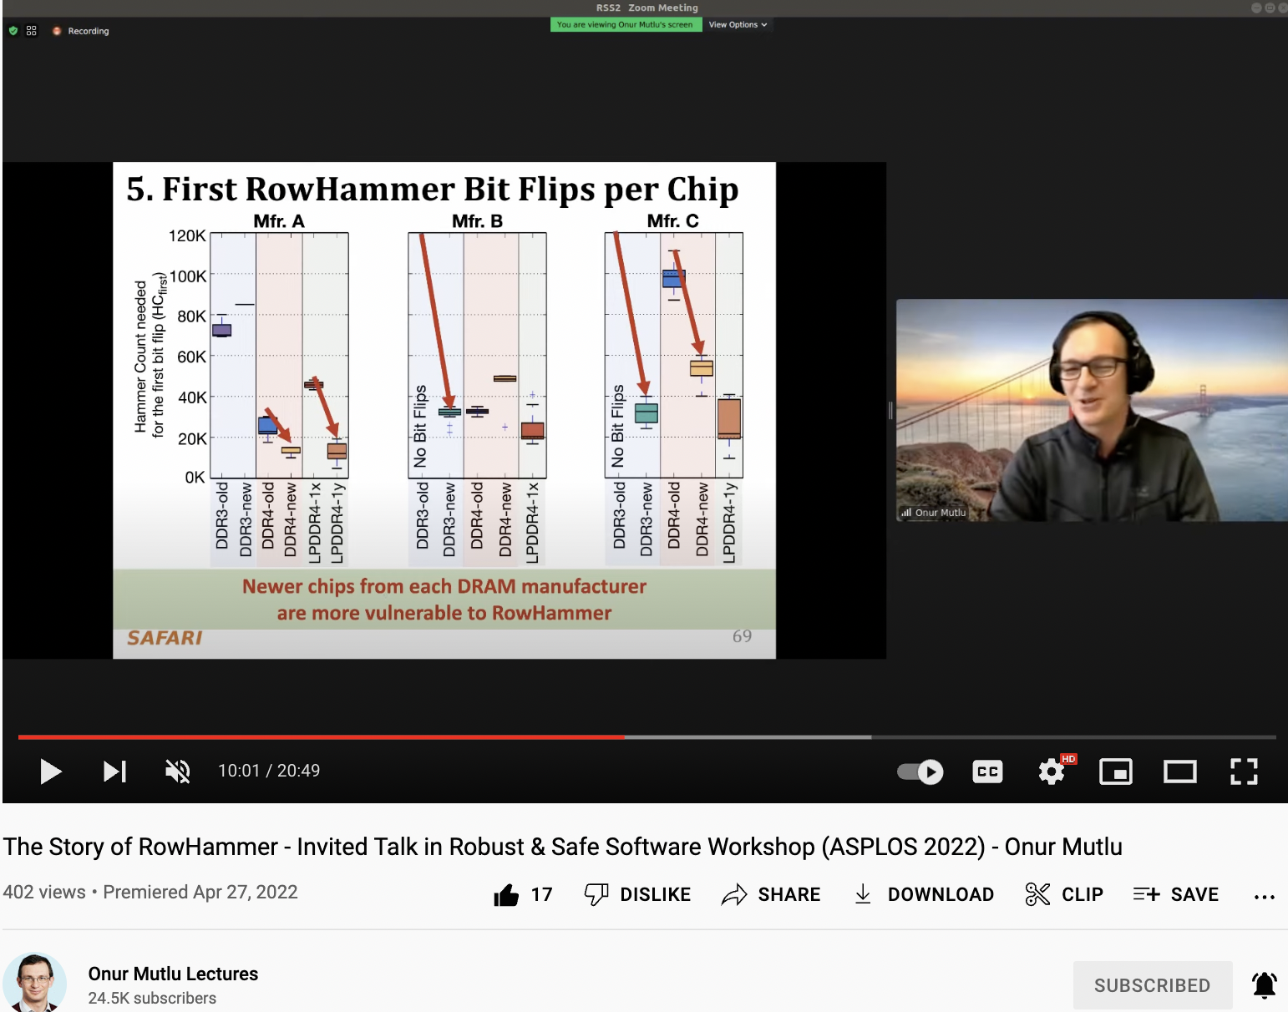
10 Years of RowHammer in 20 Minutes
Onur Mutlu,
"The Story of RowHammer"
Invited Talk at the Workshop on Robust and Safe Software 2.0 (RSS2), held with the 27th International Conference on Architectural Support for Programming Languages and Operating Systems (ASPLOS), Virtual, 28 February 2022.
[Slides (pptx) (pdf)]
https://www.youtube.com/watch?v=ctKTRyi96Bk

Slide 62
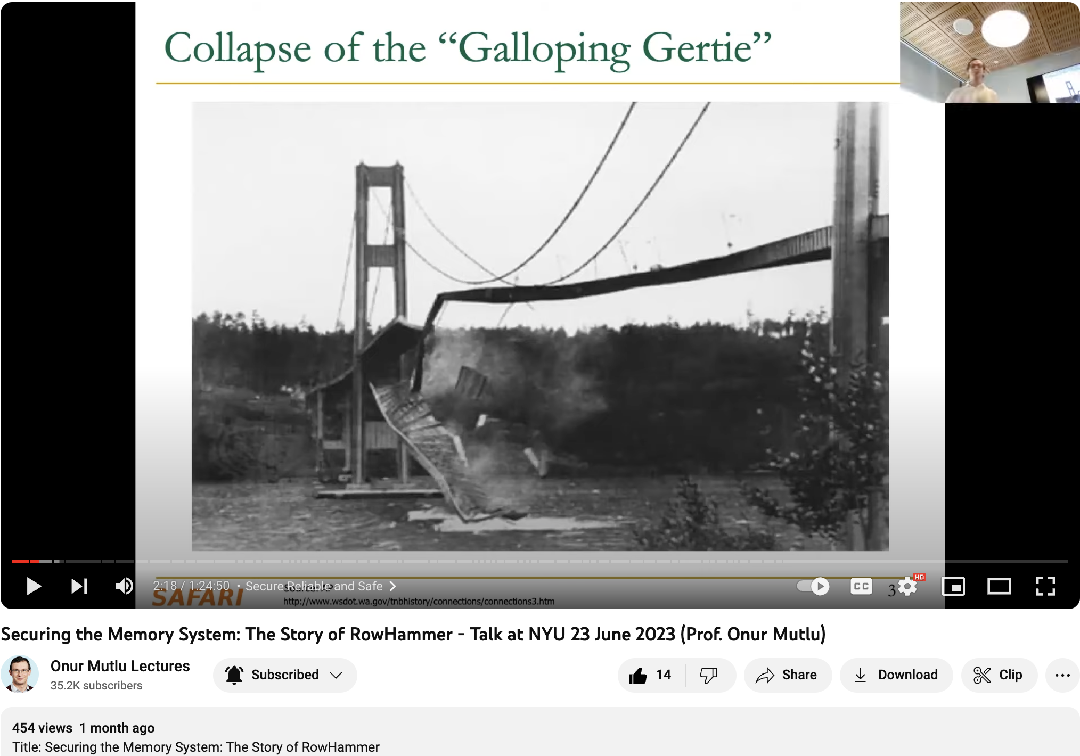
Latest RowHammer Lecture
https://www.youtube.com/watch?v=p1pjF8WvERQ

Slide 63
The Push from Circuits and Devices
Main Memory Needs
Intelligent Controllers

Slide 64
An Example Intelligent Controller
A. Giray Yaglikci, Minesh Patel, Jeremie S. Kim, Roknoddin Azizi, Ataberk Olgun, Lois Orosa, Hasan Hassan, Jisung Park, Konstantinos Kanellopoulos, Taha Shahroodi, Saugata Ghose, and Onur Mutlu,
"BlockHammer: Preventing RowHammer at Low Cost by Blacklisting Rapidly-Accessed DRAM Rows"
Proceedings of the 27th International Symposium on High-Performance Computer Architecture (HPCA), Virtual, February-March 2021.
[Slides (pptx) (pdf)]
[Short Talk Slides (pptx) (pdf)]
[Intel Hardware Security Academic Awards Short Talk Slides (pptx) (pdf)]
[Talk Video (22 minutes)]
[Short Talk Video (7 minutes)]
[Intel Hardware Security Academic Awards Short Talk Video (2 minutes)]
[BlockHammer Source Code]
Intel Hardware Security Academic Award Finalist (one of 4 finalists out of 34 nominations)

Slide 65
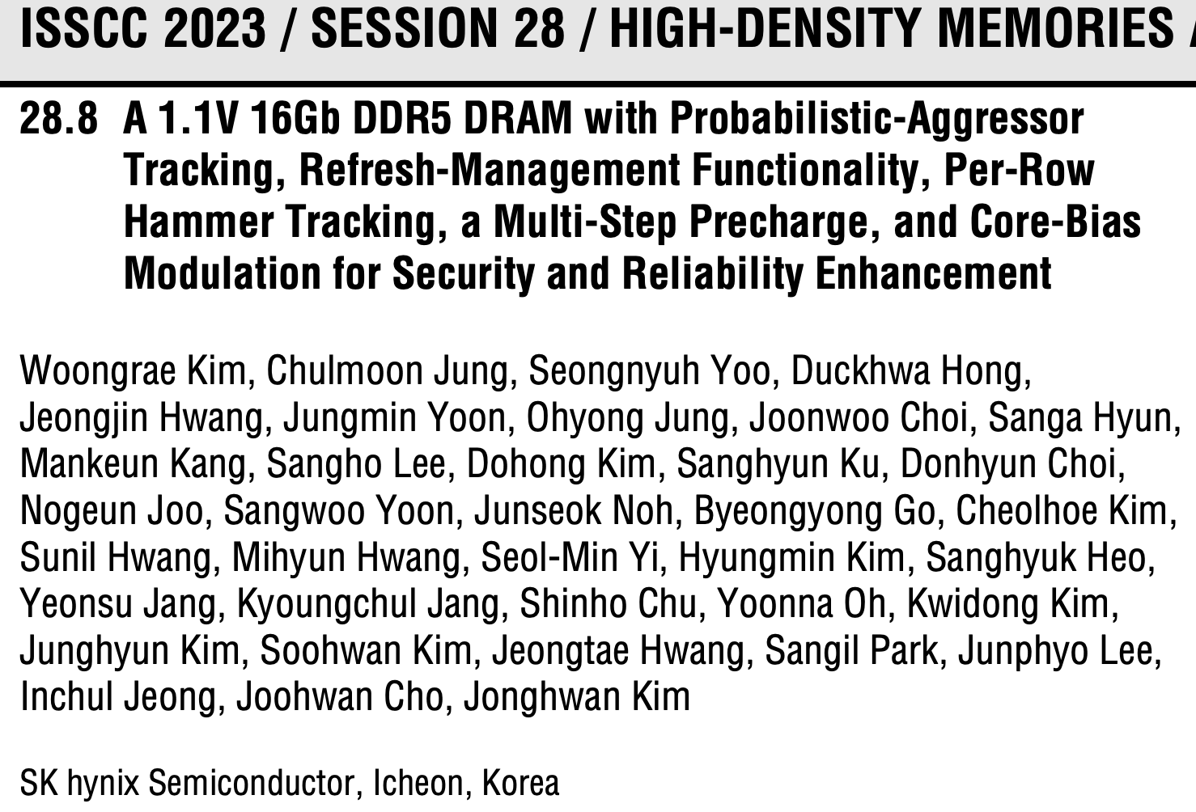
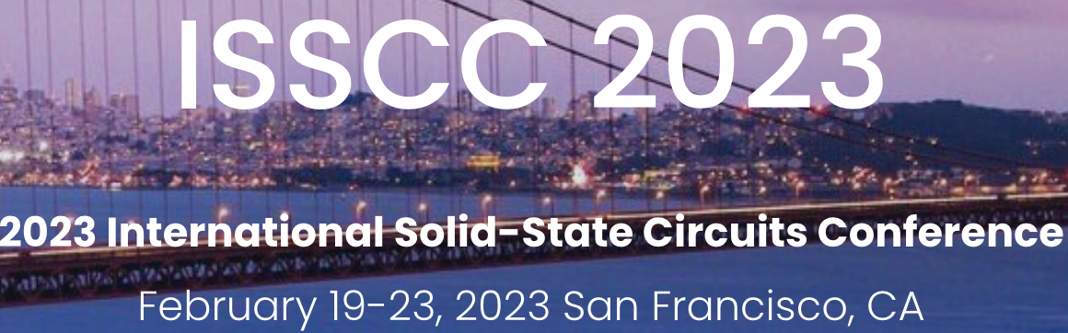
Industry’s Intelligent DRAM Controllers (I)

Slide 66
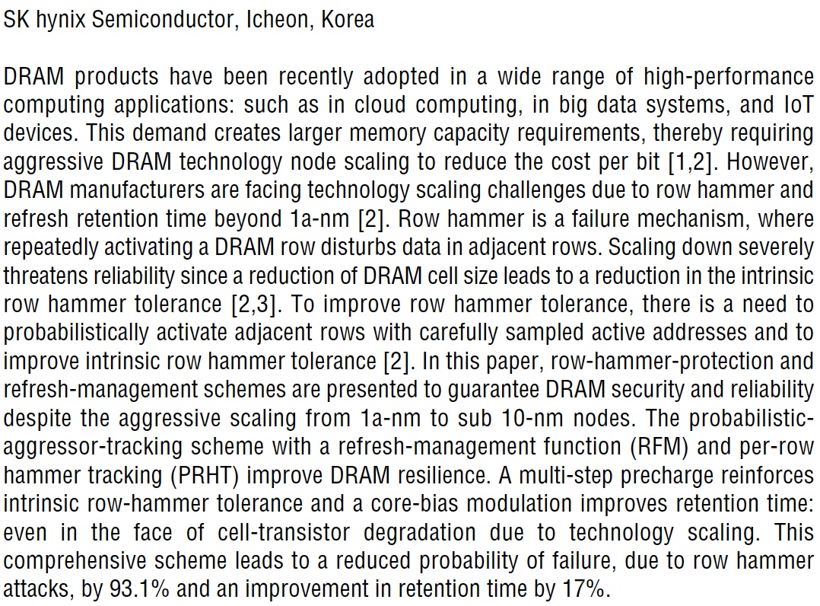
Industry’s Intelligent DRAM Controllers (II)

Slide 67
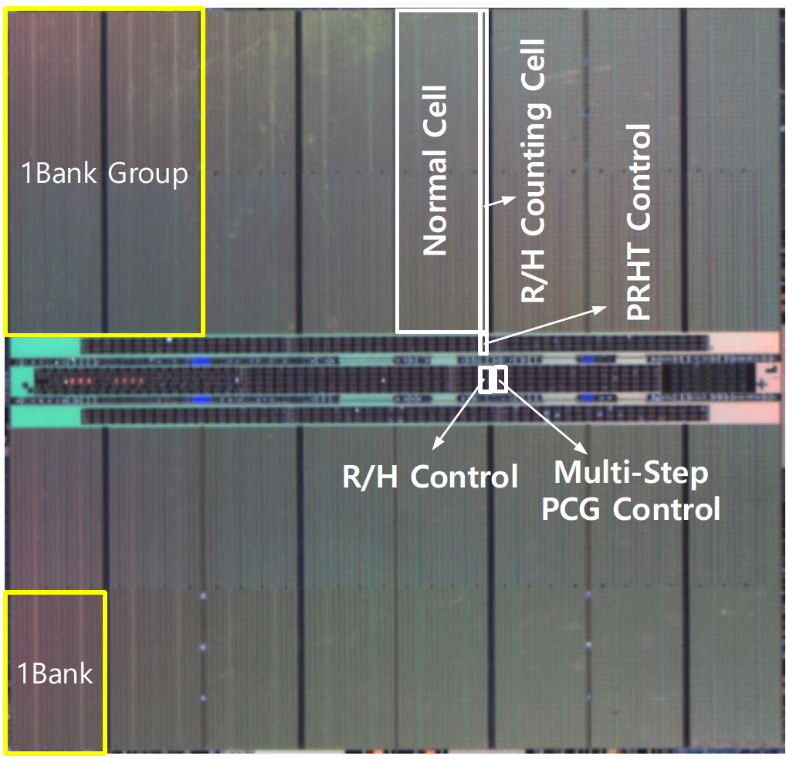
Industry’s Intelligent DRAM Controllers (III)

Slide 68
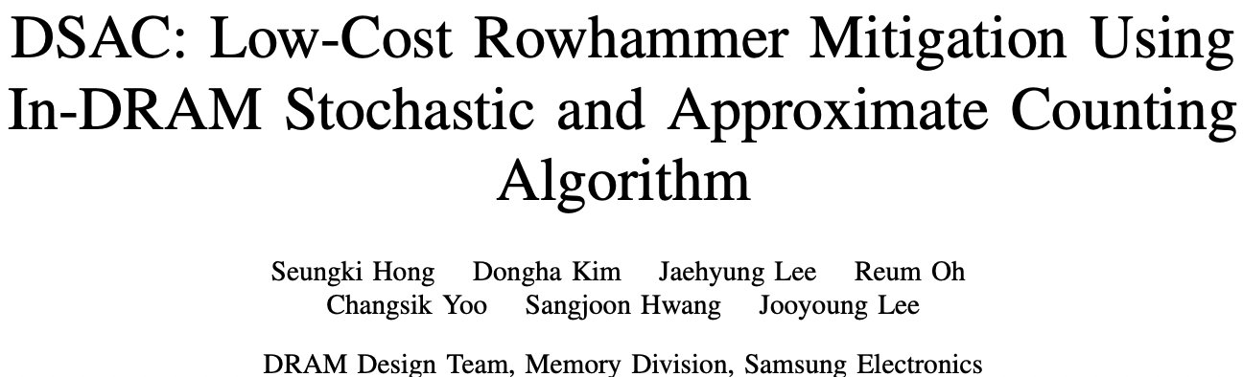
Industry’s Intelligent DRAM Controllers (IV)
https://arxiv.org/pdf/2302.03591v1.pdf

Slide 69
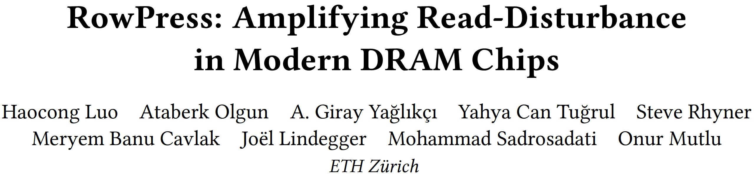
Are We Now BitFlip Free?
Appears at ISCA 2023

Slide 70

RowPress [ISCA 2023]
Haocong Luo, Ataberk Olgun, Giray Yaglikci, Yahya Can Tugrul, Steve Rhyner, M. Banu Cavlak, Joel Lindegger, Mohammad Sadrosadati, and Onur Mutlu,
"RowPress: Amplifying Read Disturbance in Modern DRAM Chips"
Proceedings of the 50th International Symposium on Computer Architecture (ISCA), Orlando, FL, USA, June 2023.
[Slides (pptx) (pdf)]
[Lightning Talk Slides (pptx) (pdf)]
[Lightning Talk Video (3 minutes)]
[RowPress Source Code and Datasets (Officially Artifact Evaluated with All Badges)]
Officially artifact evaluated as available, reusable and reproducible.
Best artifact award at ISCA 2023.

Slide 71
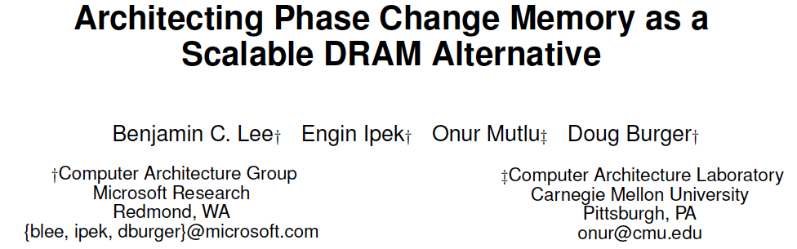
Emerging Memories Also Need Intelligent Controllers
Benjamin C. Lee, Engin Ipek, Onur Mutlu, and Doug Burger,
"Architecting Phase Change Memory as a Scalable DRAM Alternative"
Proceedings of the 36th International Symposium on Computer Architecture (ISCA), pages 2-13, Austin, TX, June 2009. Slides (pdf)
One of the 13 computer architecture papers of 2009 selected as Top Picks by IEEE Micro. Selected as a CACM Research Highlight. 2022 Persistent Impact Prize.

Slide 72
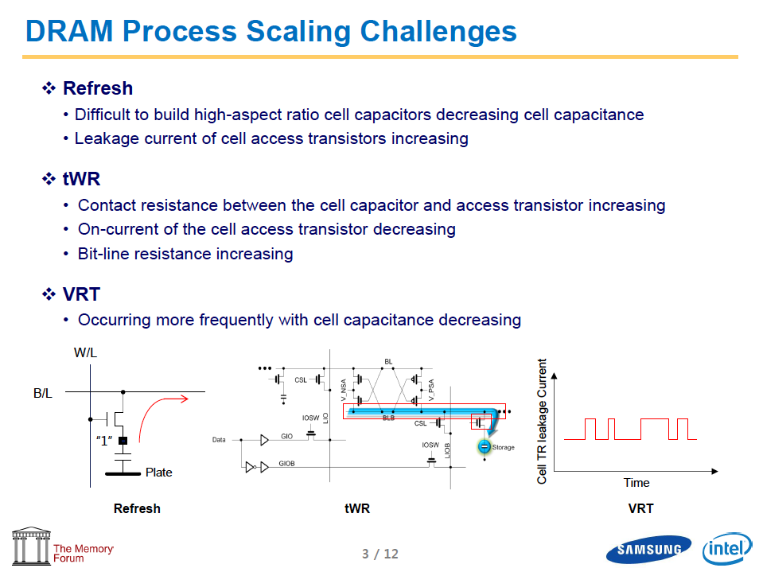
Industry Is Writing Papers About It, Too

Slide 73
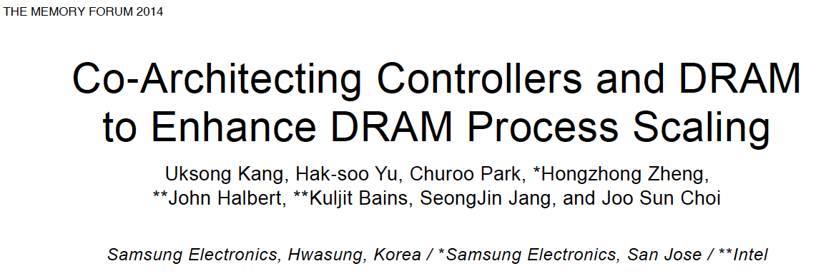
Call for Intelligent Memory Controllers

Slide 74
The Takeaway
Intelligent
Memory Controllers
Can Avoid Many Failures
& Enable Better Scaling

Slide 75
Three Key Systems & Application Trends
1. Data access is the major bottleneck
  Applications are increasingly data hungry
2. Energy consumption is a key limiter
3. Data movement energy dominates compute
  Especially true for off-chip to on-chip movement

Slide 76
Challenge and Opportunity for Future
High Performance,
Energy Efficient,
Sustainable
(All at the Same Time)

Slide 77
Goal: Processing Inside Memory
Many questions … How do we design the:
  compute-capable memory & controllers?
  processors & communication units?
  software & hardware interfaces?
  system software, compilers, languages?
  algorithms & theoretical foundations?
Memory
Processor
Core
Database
Graphs
Media
Cache
Query
Interconnect
Problem
Results
Algorithm
Program/Language
System Software
SW/HW Interface
Micro-architecture
Logic
Devices
Electrons

Slide 78
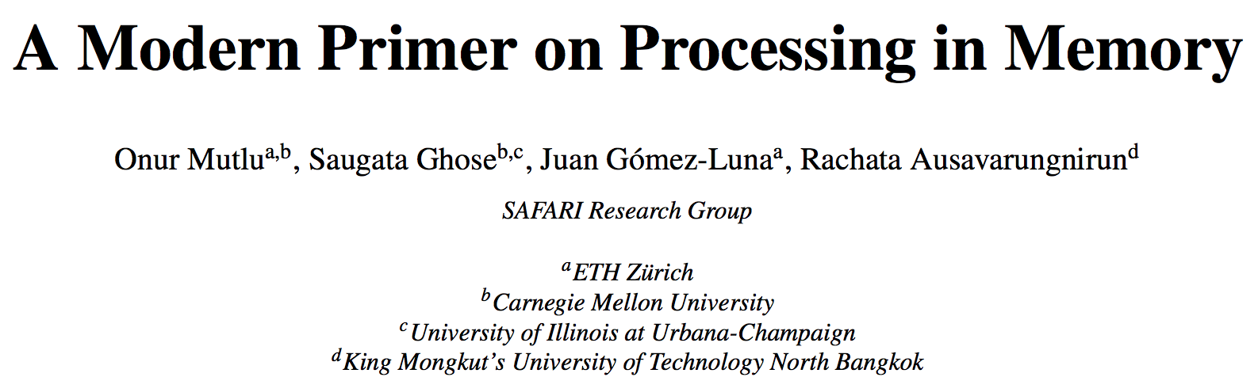
PIM Review and Open Problems
Onur Mutlu, Saugata Ghose, Juan Gomez-Luna, and Rachata Ausavarungnirun,
"A Modern Primer on Processing in Memory"
Invited Book Chapter in Emerging Computing: From Devices to Systems - Looking Beyond Moore and Von Neumann, Springer, 2022.
https://arxiv.org/pdf/1903.03988.pdf

Slide 79
Processing in Memory:
Two Approaches
1. Processing near Memory
2. Processing using Memory

Slide 80
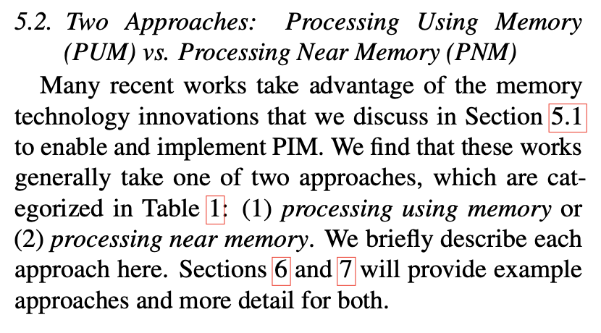
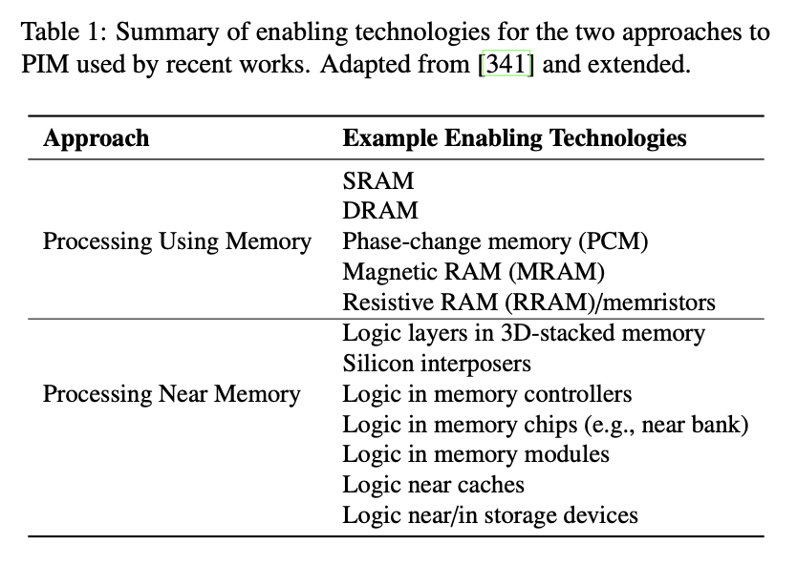
Two PIM Approaches
Onur Mutlu, Saugata Ghose, Juan Gomez-Luna, and Rachata Ausavarungnirun,
"A Modern Primer on Processing in Memory"
Invited Book Chapter in Emerging Computing: From Devices to Systems - Looking Beyond Moore and Von Neumann, Springer, to be published in 2021.
[Tutorial Video on "Memory-Centric Computing Systems" (1 hour 51 minutes)]
https://people.inf.ethz.ch/omutlu/pub/ModernPrimerOnPIM_springer-emerging-computing-bookchapter21.pdf

Slide 81
Processing in Memory:
Two Approaches
1. Processing near Memory
2. Processing using Memory

Slide 82
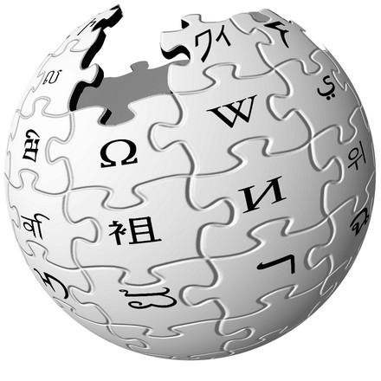



Accelerating In-Memory Graph Processing
Large graphs are everywhere (circa 2015)
Scalable large-scale graph processing is challenging
36 Million
Wikipedia Pages
1.4 Billion
Facebook Users
300 Million
Twitter Users
30 Billion
Instagram Photos

Slide 83
Key Bottlenecks in Graph Processing
for (v: graph.vertices) {
for (w: v.successors) {
w.next_rank += weight * v.rank;
}
}
1. Frequent random memory accesses
v
&w
w.rank
w.next_rank
w.edges
weight * v.rank
w
…
2. Little amount of computation

Slide 84
Opportunity: 3D-Stacked Logic+Memory
Memory
Logic
Other “True 3D” technologies
under development

Slide 85
Tesseract System for Graph Processing
Interconnected set of 3D-stacked memory+logic chips with simple cores
Host Processor
Memory
Memory-Mapped
Accelerator Interface
(Noncacheable, Physically Addressed)
Logic
In-Order Core
DRAM Controller
…
…
LP
PF Buffer
Crossbar Network
…
MTP
…
Message Queue
NI
Ahn+, “A Scalable Processing-in-Memory Accelerator for Parallel Graph Processing” ISCA 2015.

Slide 86
Tesseract System for Graph Processing
Host Processor
Memory
Memory-Mapped
Accelerator Interface
(Noncacheable, Physically Addressed)
Logic
In-Order Core
DRAM Controller
…
…
Communications via
Remote Function Calls
LP
PF Buffer
Crossbar Network
…
MTP
…
Message Queue
NI

Slide 87
Tesseract System for Graph Processing
Host Processor
Memory
Memory-Mapped
Accelerator Interface
(Noncacheable, Physically Addressed)
Logic
Prefetching
In-Order Core
DRAM Controller
…
…
LP
PF Buffer
Crossbar Network
…
MTP
…
Message Queue
NI

Slide 88
Evaluated Systems
DDR3-OoO
HMC-OoO
HMC-MC
Tesseract
32 Tesseract Cores
8 OoO
4GHz
8 OoO
4GHz
8 OoO
4GHz
8 OoO
4GHz
128
In-Order
2GHz
128
In-Order
2GHz
8 OoO
4GHz
8 OoO
4GHz
8 OoO
4GHz
8 OoO
4GHz
128
In-Order
2GHz
128
In-Order
2GHz
102.4GB/s
640GB/s
640GB/s
8TB/s
Ahn+, “A Scalable Processing-in-Memory Accelerator for Parallel Graph Processing” ISCA 2015.

Slide 89
Tesseract Graph Processing Performance
>13X Performance Improvement
On five graph processing algorithms
Ahn+, “A Scalable Processing-in-Memory Accelerator for Parallel Graph Processing” ISCA 2015.

Slide 90
Tesseract Graph Processing System Energy
> 8X Energy Reduction
Ahn+, “A Scalable Processing-in-Memory Accelerator for Parallel Graph Processing” ISCA 2015.

Slide 91

More on Tesseract
Junwhan Ahn, Sungpack Hong, Sungjoo Yoo, Onur Mutlu, and Kiyoung Choi,
"A Scalable Processing-in-Memory Accelerator for Parallel Graph Processing"
Proceedings of the 42nd International Symposium on Computer Architecture (ISCA), Portland, OR, June 2015.
[Slides (pptx) (pdf)] [Lightning Session Slides (pptx) (pdf)]
Top Picks Honorable Mention by IEEE Micro.
Selected to the ISCA-50 25-Year Retrospective Issue covering 1996-2020 in 2023
(Retrospective (pdf) Full Issue).

Slide 92

In-Storage Genomic Data Filtering [ASPLOS 2022]
Nika Mansouri Ghiasi, Jisung Park, Harun Mustafa, Jeremie Kim, Ataberk Olgun, Arvid Gollwitzer, Damla Senol Cali, Can Firtina, Haiyu Mao, Nour Almadhoun Alserr, Rachata Ausavarungnirun, Nandita Vijaykumar, Mohammed Alser, and Onur Mutlu,
"GenStore: A High-Performance and Energy-Efficient In-Storage Computing System for Genome Sequence Analysis"
Proceedings of the 27th International Conference on Architectural Support for Programming Languages and Operating Systems (ASPLOS), Virtual, February-March 2022.
[Lightning Talk Slides (pptx) (pdf)]
[Lightning Talk Video (90 seconds)] [Talk Video (17 minutes)]

Slide 93

Genome Sequence Analysis
Data Movement from Storage
Alignment
Storage
System
Main
Memory
Cache
Computation
Unit
(CPU or Accelerator)
AAGCTTCCATGG
CGTTCCTTGGCA
GGGCCAGAATG
CCTTTGGGTCCA
AAAATTCCATGG
GAATGGGGCCA
TTTTTTCCAAAA
TCCCCGGGGCCA
GCTTCCAGAATG
Computation overhead
Data movement overhead
Notes:
Read mapping performs alignment on large genomic datasets, containing millions of reads. [CLICK]
Therefore, read mapping is both computationally expensive [CLICK]
And incurs high data movement overhead [CLICK]

Slide 94



Compute-Centric Accelerators
Heuristics
Accelerators
Filters
Storage
System
Main
Memory
Cache
Computation
Unit
(CPU or Accelerator)
AAGCTTCCATGG
CGTTCCTTGGCA
GGGCCAGAATG
CCTTTGGGTCCA
AAAATTCCATGG
GAATGGGGCCA
TTTTTTCCAAAA
TCCCCGGGGCCA
GCTTCCAGAATG
✓
Computation overhead
Data movement overhead
Notes:
There has been significant effort into improving read mapping performance [CLICK]
Through efficient heuristics [CLICK]
hardware accelerators [CLICK]
and various filters that prune reads that do not require expensive computation [CLICK].
While these approaches address the computation overhead in read mapping [CLICK]
[While Reads Move] None of them alleviate the data movement overhead from storage, whose impact becomes even larger when the computation overhead gets alleviated [CLICK]

Slide 95

Key Idea: In-Storage Filtering
Filter reads that do not require alignment
inside the storage system
Storage
System
Main
Memory
Cache
Computation
Unit
(CPU or Accelerator)
AAGCTTCCATGG
CGTTCCTTGGCA
GGGCCAGAATG
CCTTTGGGTCCA
AAAATTCCATGG
GAATGGGGCCA
TTTTTTCCAAAA
TCCCCGGGGCCA
GCTTCCAGAATG
Filtered Reads
Exactly-matching reads
Do not need expensive approximate string matching during alignment
Non-matching reads
Do not have potential matching locations and can skip alignment
Notes:
Our key idea is to filter reads that do not require the expensive alignment computation in the storage system [CLICK] …
[While Reads Move] To fundamentally reduce the data movement overhead of read mapping
Examples of the reads that not require the costlt alignment step
Exactly-matching reads to the reference genome that do not need approximate string matching performed during alignment
Non-matching reads that have no potential matching locations in the reference genome hence skip the alignemt step

Slide 96
GenStore
Filter reads that do not require alignment
inside the storage system
GenStore-Enabled
Storage
System
Main
Memory
Cache
Computation
Unit
(CPU or Accelerator)
✓
Computation overhead
✓
Data movement overhead
  GenStore provides significant speedup (1.4x - 33.6x) and
  energy reduction (3.9x – 29.2x) at low cost
Notes:
We propose GenStore, the first in-storage processing system designed for genome sequence analysis. [CLICK]
To reduce both the computation [CLICK]
And the data movement overhead [CLICK]
GenStore provides high-performance and energy benefits compared to state-of-the-art HW and SW baselines [CLICK]

Slide 97
In-Storage Genomic Data Filtering [ASPLOS 2022]
Nika Mansouri Ghiasi, Jisung Park, Harun Mustafa, Jeremie Kim, Ataberk Olgun, Arvid Gollwitzer, Damla Senol Cali, Can Firtina, Haiyu Mao, Nour Almadhoun Alserr, Rachata Ausavarungnirun, Nandita Vijaykumar, Mohammed Alser, and Onur Mutlu,
"GenStore: A High-Performance and Energy-Efficient In-Storage Computing System for Genome Sequence Analysis"
Proceedings of the 27th International Conference on Architectural Support for Programming Languages and Operating Systems (ASPLOS), Virtual, February-March 2022.
[Lightning Talk Slides (pptx) (pdf)]
[Lightning Talk Video (90 seconds)]

Slide 98





Google Workloads for Consumer Devices:
Mitigating Data Movement Bottlenecks
Amirali Boroumand
Saugata Ghose, Youngsok Kim, Rachata Ausavarungnirun,
Eric Shiu, Rahul Thakur, Daehyun Kim, Aki Kuusela,
Allan Knies, Parthasarathy Ranganathan, Onur Mutlu

Slide 99




Consumer Devices
Consumer devices are everywhere!
Energy consumption is
a first-class concern in consumer devices
Notes:
Consumer devices like tablets smartphone and wearable are now everywhere and used by billions of people.
One of the major challenge in these devices is battery limitation which makes the energy consumption a critical concern …

Slide 100





Popular Consumer Workloads
  Chrome
TensorFlow Mobile
    Google’s web browser
Google’s machine learning framework
  Video Playback
  Video Capture
Google’s video codec
Google’s video codec
Notes:
In this work, we take a look at widely-used google consumer workloads, to figure out the major sources of energy consumption.
We look at Google Chrome web brower. We take a look at Tensorflow, Google’s machine learning framework, and we also take a look at two important video related workloads, video playback and video capture, both rely on Google’s vp9 codec technology.

Slide 101
Energy Cost of Data Movement
1st key observation: 62.7% of the total system energy is spent on data movement
Data Movement
SoC
DRAM
CPU
L2
CPU
L1
CPU
CPU
Compute Unit
Processing-In-Memory (PIM)
  Potential solution: move computation close to data
  Challenge: limited area and energy budget
Notes:
Throughout our analysis, we make a key observation that out of all sources of energy consumption, data movement is a major contributor to the total system energy. We find that across all of the workloads, on average around 62.7% of total system energy is spent on data movement.
One way to reduce data movement cost is to move computation close to data, or …
One potential solution to address this cost it do move computation close to data, or in other words, do procesing in memory. However, the challenge is that these devices.
One potential solution to mitigate data movement cost and reduce total system energy is to execute data-movement heavy portions of application close to data, or in other words, do processing in memory. However, consumer devices are extermely limited in terms of area and power budget. So the question is can we move part of the data movement heavy portion given the limited area and energy budget. Our

Slide 102
Using PIM to Reduce Data Movement
  2nd key observation: a significant fraction of the
  data movement often comes from simple functions
We can design lightweight logic to implement
these simple functions in memory
Small embedded
low-power core
Small fixed-function accelerators
PIM Core
PIM Accelerator
PIM Accelerator
PIM Accelerator
  Offloading to PIM logic reduces energy and improves performance, on average, by 2.3X and 2.2X
Notes:
To figure out if we can use processing in memory, we dig deeper into our analysis and we make another key observation that majority of data movement often comes form simple functions and pritmitives. We find that these simple function can be implemented in memory as either a small embedded core, or group of small fixed function accelerators. Our result shows that offloading these function to PIM logic can significantly reduce data movement for each function and reduce energy on average around 55% and improve perforamcne around 54%.
our PIM core can reduce significant portion of data movement, reduce enregy by 49.1% for each function and improve performance up to 2.2X. While using group of fixed function accelerator reduce energy by 55.4% and improve performance by up to 2.5X.
Or use Saugata’s approach : Reduces total system energy by an average of 55.4%
Reduces execution time by an average of 54.2%
Our result show that both of them can significantly reduce the data movement for each function.
Feedback: talk about result more
Don’t talk about specific detail like MemCopy, MemSet stuff like that
Main take away: data movement come from simple functions that are simple enough to implement in PIM
We find that these functions and primitves can be implemented as PIM logic using either (1) a small low-power general-purpose embedded core or (2) a group of small fixed-function accelerators (PIM accelerators). Our Analysis shows that both are cost-feasible to use in consumer devices. We find that they eliminate a significant fraction of dat amovement, and reduce energy consumption for each of these operation on average by 49 and 55%.

Slide 103
Workload Analysis
  Chrome
TensorFlow Mobile
    Google’s web browser
Google’s machine learning framework
  Video Playback
  Video Capture
Google’s video codec
Google’s video codec
Notes:
In this work, we take a look at widely-used google consumer workloads, to figure out the major sources of energy consumption.
We look at Google Chrome web brower. We take a look at Tensorflow, Google’s machine learning framework, and we also take a look at two important video related workloads, video playback and video capture, both rely on Google’s vp9 codec technology.

Slide 104


TensorFlow Mobile
Inference
Prediction
57.3% of the inference energy is spent on
data movement
54.4% of the data movement energy comes from
packing/unpacking and quantization

Slide 105
Normalized Energy
Chrome Browser
TensorFlow Mobile
Video Playback and Capture
PIM core and PIM accelerator reduce
energy consumption on average by 49.1% and 55.4%
Notes:
We make another obsrevation that using PIM accelerator provide limited energy reduction over PIM core, for some of these workloads, such as texture tiling. This is becase these kernels are data intensive and have low ocmputational compleity, and as a result, using fixed function accelerator does not provide significant energy reduction over the PIM core.

Slide 106
Normalized Runtime
Chrome Browser
Video Playback and Capture
TensorFlow Mobile
Offloading these kernels to PIM core and PIM accelerator reduces program runtime on average by 44.6% and 54.2%
Notes:
PIM-Core and PIM-Acc significantly outperform CPU-Only across all kernels, improving performance by … This perfomance benefit come from higher bandwidth and lower access latency of 3D-stacked memory, because all of these kernels are data intensive.
Performance improvement of PIM-acc over PIM-core differes across different workloads. In some cases such as Texture Tiling, the performance improvement of PIM-Acc over PIM-Core is limited by the low computational complexity of these two kernels. But there are other cases, such as compression that benefit significantly from using PIM-Acc over PIM-Core in terms of performance, because these kernels are more compute-intensive and less data-intensive compared to texture tiling and.

Slide 107
More on PIM for Mobile Devices
Amirali Boroumand, Saugata Ghose, Youngsok Kim, Rachata Ausavarungnirun, Eric Shiu, Rahul Thakur, Daehyun Kim, Aki Kuusela, Allan Knies, Parthasarathy Ranganathan, and Onur Mutlu,
"Google Workloads for Consumer Devices: Mitigating Data Movement Bottlenecks"
Proceedings of the 23rd International Conference on Architectural Support for Programming Languages and Operating Systems (ASPLOS), Williamsburg, VA, USA, March 2018.
[Slides (pptx) (pdf)] [Lightning Session Slides (pptx) (pdf)] [Poster (pptx) (pdf)]
[Lightning Talk Video (2 minutes)]
[Full Talk Video (21 minutes)]

Slide 108

Accelerating GPU Execution with PIM (I)
Kevin Hsieh, Eiman Ebrahimi, Gwangsun Kim, Niladrish Chatterjee, Mike O'Connor, Nandita Vijaykumar, Onur Mutlu, and Stephen W. Keckler,
"Transparent Offloading and Mapping (TOM): Enabling Programmer-Transparent Near-Data Processing in GPU Systems"
Proceedings of the 43rd International Symposium on Computer Architecture (ISCA), Seoul, South Korea, June 2016.
[Slides (pptx) (pdf)]
[Lightning Session Slides (pptx) (pdf)]

Slide 109

Accelerating GPU Execution with PIM (II)
Ashutosh Pattnaik, Xulong Tang, Adwait Jog, Onur Kayiran, Asit K. Mishra, Mahmut T. Kandemir, Onur Mutlu, and Chita R. Das,
"Scheduling Techniques for GPU Architectures with Processing-In-Memory Capabilities"
Proceedings of the 25th International Conference on Parallel Architectures and Compilation Techniques (PACT), Haifa, Israel, September 2016.

Slide 110

Accelerating Linked Data Structures
Kevin Hsieh, Samira Khan, Nandita Vijaykumar, Kevin K. Chang, Amirali Boroumand, Saugata Ghose, and Onur Mutlu,
"Accelerating Pointer Chasing in 3D-Stacked Memory: Challenges, Mechanisms, Evaluation"
Proceedings of the 34th IEEE International Conference on Computer Design (ICCD), Phoenix, AZ, USA, October 2016.

Slide 111

Accelerating Dependent Cache Misses
Milad Hashemi, Khubaib, Eiman Ebrahimi, Onur Mutlu, and Yale N. Patt,
"Accelerating Dependent Cache Misses with an Enhanced Memory Controller"
Proceedings of the 43rd International Symposium on Computer Architecture (ISCA), Seoul, South Korea, June 2016.
[Slides (pptx) (pdf)]
[Lightning Session Slides (pptx) (pdf)]

Slide 112

Accelerating Runahead Execution
Milad Hashemi, Onur Mutlu, and Yale N. Patt,
"Continuous Runahead: Transparent Hardware Acceleration for Memory Intensive Workloads"
Proceedings of the 49th International Symposium on Microarchitecture (MICRO), Taipei, Taiwan, October 2016.
[Slides (pptx) (pdf)] [Lightning Session Slides (pdf)] [Poster (pptx) (pdf)]
Best paper session.

Slide 113

Accelerating Climate Modeling
Gagandeep Singh, Dionysios Diamantopoulos, Christoph Hagleitner, Juan Gómez-Luna, Sander Stuijk, Onur Mutlu, and Henk Corporaal,
"NERO: A Near High-Bandwidth Memory Stencil Accelerator for Weather Prediction Modeling"
Proceedings of the 30th International Conference on Field-Programmable Logic and Applications (FPL), Gothenburg, Sweden, September 2020.
[Slides (pptx) (pdf)]
[Lightning Talk Slides (pptx) (pdf)]
[Talk Video (23 minutes)]
Nominated for the Stamatis Vassiliadis Memorial Award.

Slide 114

Accelerating Approximate String Matching
Damla Senol Cali, Gurpreet S. Kalsi, Zulal Bingol, Can Firtina, Lavanya Subramanian, Jeremie S. Kim, Rachata Ausavarungnirun, Mohammed Alser, Juan Gomez-Luna, Amirali Boroumand, Anant Nori, Allison Scibisz, Sreenivas Subramoney, Can Alkan, Saugata Ghose, and Onur Mutlu,
"GenASM: A High-Performance, Low-Power Approximate String Matching Acceleration Framework for Genome Sequence Analysis"
Proceedings of the 53rd International Symposium on Microarchitecture (MICRO), Virtual, October 2020.
[Lighting Talk Video (1.5 minutes)]
[Lightning Talk Slides (pptx) (pdf)]
[Talk Video (18 minutes)]
[Slides (pptx) (pdf)]

Slide 115

Accelerating Sequence-to-Graph Mapping
Damla Senol Cali, Konstantinos Kanellopoulos, Joel Lindegger, Zulal Bingol, Gurpreet S. Kalsi, Ziyi Zuo, Can Firtina, Meryem Banu Cavlak, Jeremie Kim, Nika MansouriGhiasi, Gagandeep Singh, Juan Gomez-Luna, Nour Almadhoun Alserr, Mohammed Alser, Sreenivas Subramoney, Can Alkan, Saugata Ghose, and Onur Mutlu,
"SeGraM: A Universal Hardware Accelerator for Genomic Sequence-to-Graph and Sequence-to-Sequence Mapping"
Proceedings of the 49th International Symposium on Computer Architecture (ISCA), New York, June 2022.
[arXiv version]
https://arxiv.org/pdf/2205.05883.pdf

Slide 116

Accelerating Basecalling + Read Mapping
Haiyu Mao, Mohammed Alser, Mohammad Sadrosadati, Can Firtina, Akanksha Baranwal, Damla Senol Cali, Aditya Manglik, Nour Almadhoun Alserr, and Onur Mutlu,
"GenPIP: In-Memory Acceleration of Genome Analysis via Tight Integration of Basecalling and Read Mapping"
Proceedings of the 55th International Symposium on Microarchitecture (MICRO), Chicago, IL, USA, October 2022.
[Slides (pptx) (pdf)]
[Longer Lecture Slides (pptx) (pdf)]
[Lecture Video (25 minutes)]
[arXiv version]
https://arxiv.org/pdf/2209.08600.pdf

Slide 117

Accelerating Time Series Analysis
Ivan Fernandez, Ricardo Quislant, Christina Giannoula, Mohammed Alser, Juan Gómez-Luna, Eladio Gutiérrez, Oscar Plata, and Onur Mutlu,
"NATSA: A Near-Data Processing Accelerator for Time Series Analysis"
Proceedings of the 38th IEEE International Conference on Computer Design (ICCD), Virtual, October 2020.
[Slides (pptx) (pdf)]
[Talk Video (10 minutes)]
[Source Code]

Slide 118

Accelerating Graph Pattern Mining
Maciej Besta, Raghavendra Kanakagiri, Grzegorz Kwasniewski, Rachata Ausavarungnirun, Jakub Beránek, Konstantinos Kanellopoulos, Kacper Janda, Zur Vonarburg-Shmaria, Lukas Gianinazzi, Ioana Stefan, Juan Gómez-Luna, Marcin Copik, Lukas Kapp-Schwoerer, Salvatore Di Girolamo, Nils Blach, Marek Konieczny, Onur Mutlu, and Torsten Hoefler,
"SISA: Set-Centric Instruction Set Architecture for Graph Mining on Processing-in-Memory Systems"
Proceedings of the 54th International Symposium on Microarchitecture (MICRO), Virtual, October 2021.
[Slides (pdf)]
[Talk Video (22 minutes)]
[Lightning Talk Video (1.5 minutes)]
[Full arXiv version]

Slide 119

Accelerating HTAP Database Systems
Amirali Boroumand, Saugata Ghose, Geraldo F. Oliveira, and Onur Mutlu,
"Polynesia: Enabling High-Performance and Energy-Efficient Hybrid Transactional/Analytical Databases with Hardware/Software Co-Design"
Proceedings of the 38th International Conference on Data Engineering (ICDE), Virtual, May 2022.
[arXiv version]
[Slides (pptx) (pdf)]
[Short Talk Slides (pptx) (pdf)]
https://arxiv.org/pdf/2204.11275.pdf

Slide 120
Accelerating Neural Network Inference
Amirali Boroumand, Saugata Ghose, Berkin Akin, Ravi Narayanaswami, Geraldo F. Oliveira, Xiaoyu Ma, Eric Shiu, and Onur Mutlu,
"Google Neural Network Models for Edge Devices: Analyzing and Mitigating Machine Learning Inference Bottlenecks"
Proceedings of the 30th International Conference on Parallel Architectures and Compilation Techniques (PACT), Virtual, September 2021.
[Slides (pptx) (pdf)]
[Talk Video (14 minutes)]

Slide 121




Google Neural Network Models for Edge Devices:
Analyzing and Mitigating
Machine Learning Inference Bottlenecks
Amirali Boroumand Saugata Ghose Berkin Akin
Ravi Narayanaswami Geraldo F. Oliveira Xiaoyu Ma
Eric Shiu Onur Mutlu
PACT 2021
Notes:
Hi, I’m Geraldo, a PhD Student at ETH Zurich.
Today I will present our work “Google Neural Network Models for Edge Devices: Analyzing and Mitigating Machine Learning Inference Bottlenecks”
This work was lead by Amirali Boroumand during his internship at Google.

Slide 122
Executive Summary
Context: We extensively analyze a state-of-the-art edge ML accelerator (Google Edge TPU) using 24 Google edge models
  Wide range of models (CNNs, LSTMs, Transducers, RCNNs)
Problem: The Edge TPU accelerator suffers from three challenges:
  It operates significantly below its peak throughput
  It operates significantly below its theoretical energy efficiency
  It inefficiently handles memory accesses
  Key Insight: These shortcomings arise from the monolithic design of the Edge TPU accelerator
  The Edge TPU accelerator design does not account for layer heterogeneity
  Key Mechanism: A new framework called Mensa
  Mensa consists of heterogeneous accelerators whose dataflow and hardware are specialized for specific families of layers
  Key Results: We design a version of Mensa for Google edge ML models
  Mensa improves performance and energy by 3.0X and 3.1X
  Mensa reduces cost and improves area efficiency
Notes:
First, I will give an overview of this work.
[CLICK] In this work, we extensively analyze 24 edge NN models from Google while running inference on the Google Edge TPU accelerator for various types of NN models
[CLICK] We identify that while running NN inference, the accelerator suffers from three main challenges
[CLICK] it operates significantly below its peak throughput
[CLICK] it operates significantly below its theorical peak energy efficiency
[CLICK] and its memory system is not efficient
[CLICK] Our analysis leads to the key insight that these challenges arrive due to the monolithic one-size-fit-all design of the accelerators, which does not account for heterogeneity across different NN layers
[CLICK] To solve this issue, we propose Mensa, a framework that maps the execution of a particular NN layer to its most appropriate hardware accelerator
[CLICK] We extensively evaluate Mensa for Google NN models and we observe that it improves performance and energy efficiency by 3.0x and 3.1x compared to the baseline Edge TPU accelerator while reducing area and cost across 24 edge ML models
[NEXT]

Slide 123





Google Edge Neural Network Models
  We analyze inference execution using 24 edge NN models
6 RNN
Transducers
2 LSTMs
Speech Recognition
Language Translation
13 CNN
3 RCNN
Google Edge TPU
Face Detection
Image Captioning
Notes:
[CLICK] We analyze inference execution on the accelerator using 24 edge NN models that serve as internal benchmarks for the Google Edge TPU, including
[CLICK] 6 RNN Transducers, used for applications such as automatic speech recognition.
[CLICK] 13 convolutional neural networks (CNNs), typically used for applications such as image classification and object detection
[CLICK] 2 long short-term memories (LSTMs), used for applications such as language translation and and handwriting recognition, and
[CLICK] 3 recurrent convolutional neural networks (RCNNs), used for applications such as image captioning
[NEXT]

Slide 124
Diversity Across the Models
Insight 1: there is significant variation in terms of
layer characteristics across the models
Layers from
CNNs and RCNNs
Layers from
LSTMs and Transducers
Notes:
We draw key two insights from our model analysis
[CLICK] First, we observe a large variation in terms of layer characteristics across different models.
[CLICK] To illustrate, the figure shows the total parameter footprint vs. the FLOP/B ratio (or reuse) across the layers of representative CNNs, LSTMs, and Transducers
[CLICK] We observe from the figure that that layers from LSTMs and Transducers have larger parameter footprints and lower reuse than layers from CNNs.
[NEXT]

Slide 125
Diversity Within the Models
Insight 2: even within each model, layers exhibit
significant variation in terms of layer characteristics
For example, our analysis of edge CNN models shows:
1
2
Variation in MAC intensity: up to 200x across layers
Variation in FLOP/Byte: up to 244x across layers
Notes:
[CLICK] Second, even within a single model, layers show variation in terms of layer characteristics
[CLICK] For example, we observe that layers in a single CNN models show
[CLICK] a varying MAC intensity of up to 200x across different layers
and
[CLICK] a varying flop/byte ratio of up to 244x across different layers
[NEXT]

Slide 126


Mensa High-Level Overview
Edge TPU Accelerator
Mensa
Model A
Model B
Model C
Model A
Model B
Model C
Runtime
Family 1
Family 2
Family 3
CPU
3D-Stacked DRAM
PE
PE
PE
PE
PE
PE
PE
PE
PE
PE
PE
PE
PE
PE
PE
PE
Buffer
PE
PE
PE
PE
PE
PE
PE
PE
NoC
PE
PE
PE
PE
PE
PE
PE
PE
PE
PE
PE
PE
PE
PE
PE
PE
NoC
PE
PE
PE
PE
PE
PE
PE
PE
NoC
NoC
PE
PE
PE
PE
PE
PE
PE
PE
PE
PE
PE
PE
PE
PE
PE
PE
Monolithic Accelerator
Buffer
Buffer
Buffer
Acc. 1
Acc. 2
Acc. 3
Heterogeneous Accelerators
Notes:
[CLICK ] In a baseline system, different machine learning models are execute in a single, monolithic edge accelerator, which leads to performance and energy issues.
[CLICK] On the other hand, Mensa distributes the layers from an NN model using a runtime scheduler across a collection of smaller hardware accelerators that are catered the properties of different layer types. By specializing each accelerator to a subset of layers, Mensa avoids the shortcomings of current monolithic edge ML accelerators, resulting in a highly-efficient and high-performance accelerator with a much smaller area.
Next I will give an brief overview of Mensa’s ruy
[NEXT]

Slide 127
Identifying Layer Families
  Key observation: the majority of layers group into
  a small number of layer families
Family 1
Family 1
Family 2
Family 5
Family 2
Family 4
Family 5
Family 3
Family 3
Family 4
  Families 1 & 2: low parameter footprint, high data reuse and MAC intensity
  → compute-centric layers
  Families 3, 4 & 5: high parameter footprint, low data reuse and MAC intensity
  → data-centric layers
Notes:
First, we need to decide how many accelerators we need based on the key characteristics of our NN models.
[CLICK] We make a key observation that the majority of the layers we target fall into five major families in terms key characteristics that impact hardware design
[CLICK] First, we find two Families of layers (families 1 and 2) that have low parameter footprint and high data reuse and MAC intensity. We call such layers compute-centric layers.
[CLICK] Second, we find three families of layers (families, 3, 4 and 5) that have high parameter footprint , low data reuse and MAC intensity. We call such layers data-centric layers.
[NEXT]

Slide 128
Mensa: Energy Reduction
Mensa-G reduces energy consumption by 3.0X
compared to the baseline Edge TPU
Notes:
[CLICK] Fist, Mensa-G placement of accelerators and careful dataflow design enables to reduce the energy consumed by on-chip and off-chip parameter traffic by 15.3x on average compared to the baseline.
[CLICK] Second, Mensa-G reduces the dynamic energy of on-chip buffers and Noc by almost 50x compared to the Baseline system with high bw memory.
[CLICK] We conclude that Mensa-G reduces energy by 66% and improves inference energy efficiency by 3.0x compared to the baseline edge TPU.
[NEXT]

Slide 129
Mensa: Throughput Improvement
Mensa-G improves inference throughput by 3.1X
compared to the baseline Edge TPU
Notes:
[CLICK] We also analyze Mensa-G’s throughput compared to the Baseline edge TPU and Baseline edge TPU with the high bandwidth off-chip memory
[CLICK] We observe that Mensa-G’s improve throughput compared to the baseline edge TPU by 3.1X on average
[NEXT]

Slide 130
Mensa: Highly-Efficient ML Inference
Amirali Boroumand, Saugata Ghose, Berkin Akin, Ravi Narayanaswami, Geraldo F. Oliveira, Xiaoyu Ma, Eric Shiu, and Onur Mutlu,
"Google Neural Network Models for Edge Devices: Analyzing and Mitigating Machine Learning Inference Bottlenecks"
Proceedings of the 30th International Conference on Parallel Architectures and Compilation Techniques (PACT), Virtual, September 2021.
[Slides (pptx) (pdf)]
[Talk Video (14 minutes)]

Slide 131

Accelerating Data-Intensive Workloads
Junwhan Ahn, Sungjoo Yoo, Onur Mutlu, and Kiyoung Choi,
"PIM-Enabled Instructions: A Low-Overhead, Locality-Aware Processing-in-Memory Architecture"
Proceedings of the 42nd International Symposium on Computer Architecture (ISCA), Portland, OR, June 2015.
[Slides (pdf)] [Lightning Session Slides (pdf)]

Slide 132

FPGA-based Processing Near Memory
Gagandeep Singh, Mohammed Alser, Damla Senol Cali, Dionysios Diamantopoulos, Juan Gómez-Luna, Henk Corporaal, and Onur Mutlu,
"FPGA-based Near-Memory Acceleration of Modern Data-Intensive Applications"
IEEE Micro (IEEE MICRO), 2021.

Slide 133
Eliminating the Adoption Barriers
Processing-in-Memory
in the Real World

Slide 134
Processing-in-Memory Landscape Today
[Samsung 2021]
[Alibaba 2022]
[SK Hynix 2022]
[Samsung 2021]
[UPMEM 2019]
This does not include many experimental chips and startups

Slide 135
UPMEM Processing-in-DRAM Engine (2019)
Processing in DRAM Engine
Includes standard DIMM modules, with a large number of DPU processors combined with DRAM chips.
Replaces standard DIMMs
  DDR4 R-DIMM modules
    8GB+128 DPUs (16 PIM chips)
    Standard 2x-nm DRAM process
  Large amounts of compute & memory bandwidth
https://www.anandtech.com/show/14750/hot-chips-31-analysis-inmemory-processing-by-upmem
https://www.upmem.com/video-upmem-presenting-its-true-processing-in-memory-solution-hot-chips-2019/

Slide 136

UPMEM Memory Modules
E19: 8 chips DIMM (1 rank). DPUs @ 267 MHz
P21: 16 chips DIMM (2 ranks). DPUs @ 350 MHz
www.upmem.com

Slide 137


2,560-DPU Processing-in-Memory System
https://arxiv.org/pdf/2105.03814.pdf

Slide 138

More on the UPMEM PIM System
https://www.youtube.com/watch?v=Sscy1Wrr22A&list=PL5Q2soXY2Zi9xidyIgBxUz7xRPS-wisBN&index=26

Slide 139

Understanding a Modern PIM Architecture
https://arxiv.org/pdf/2105.03814.pdf
https://github.com/CMU-SAFARI/prim-benchmarks

Slide 140
PrIM Benchmarks: Application Domains
Domain | Benchmark | Short name
Dense linear algebra | Vector Addition | VA
 | Matrix-Vector Multiply | GEMV
Sparse linear algebra | Sparse Matrix-Vector Multiply | SpMV
Databases | Select | SEL
 | Unique | UNI
Data analytics | Binary Search | BS
 | Time Series Analysis | TS
Graph processing | Breadth-First Search | BFS
Neural networks | Multilayer Perceptron | MLP
Bioinformatics | Needleman-Wunsch | NW
Image processing | Image histogram (short) | HST-S
 | Image histogram (large) | HST-L
Parallel primitives | Reduction | RED
 | Prefix sum (scan-scan-add) | SCAN-SSA
 | Prefix sum (reduce-scan-scan) | SCAN-RSS
 | Matrix transposition | TRNS

Slide 141

PrIM Benchmarks are Open Source
All microbenchmarks, benchmarks, and scripts
https://github.com/CMU-SAFARI/prim-benchmarks

Slide 142


ML Training on a Real PIM System
Short version: https://arxiv.org/pdf/2206.06022.pdf
Long version: https://arxiv.org/pdf/2207.07886.pdf
https://www.youtube.com/watch?v=qeukNs5XI3g&t=11226s

Slide 143
ML Training on a Real PIM System
Need to optimize data representation
  (1) fixed-point
  (2) quantization
  (3) hybrid precision
Use lookup tables (LUTs) to implement complex functions (e.g., sigmoid)
Optimize data placement & layout for streaming
Large speedups: 2.8X/27X vs. CPU, 1.3x/3.2x vs. GPU

Slide 144

ML Training on Real PIM Talk Video
https://www.youtube.com/watch?v=qeukNs5XI3g&t=11226s

Slide 145

SpMV Multiplication on Real PIM Systems
Appears in SIGMETRICS 2022
https://arxiv.org/pdf/2201.05072.pdf
https://github.com/CMU-SAFARI/SparseP
https://www.youtube.com/watch?v=5kaOsJKlGrE

Slide 146

Sequence Alignment on Real PIM Systems
Safaa Diab, Amir Nassereldine, Mohammed Alser, Juan Gómez Luna, Onur Mutlu, and Izzat El Hajj,
"A Framework for High-throughput Sequence Alignment using Real Processing-in-Memory Systems"
Bioinformatics, [published online on] 27 March 2023.
[Online link at Bioinformatics Journal]
[arXiv preprint]
[AiM Source Code]
https://github.com/CMU-SAFARI/alignment-in-memory
https://arxiv.org/pdf/2208.01243.pdf

Slide 147
Summary
Sequence alignment on traditional systems is limited by the memory bandwidth bottleneck
Processing-in-memory (PIM) overcomes this bottleneck by placing cores near the memory
Our framework, Alignment-in-Memory (AIM), is a PIM framework that supports multiple alignment algorithms (NW, SWG, GenASM, WFA)
  Implemented on UPMEM, the first real PIM system
Results show substantial speedups over both CPUs (1.8X-28X) and GPUs (1.2X-2.7X)
AIM is available at:
  https://github.com/CMU-SAFARI/alignment-in-memory

Slide 148

Samsung Function-in-Memory DRAM (2021)
https://news.samsung.com/global/samsung-develops-industrys-first-high-bandwidth-memory-with-ai-processing-power

Slide 149


Samsung Function-in-Memory DRAM (2021)

Slide 150

Samsung Function-in-Memory DRAM (2021)

Slide 151

Samsung Function-in-Memory DRAM (2021)

Slide 152

Samsung Function-in-Memory DRAM (2021)

Slide 153

Samsung PNM Solutions for Generative AI (2023)
Main target: transformer decoders used in ChatGPT, GPT-3
  Compute-bound step: Summarization
  Memory-bound step: Generation
    Most of the execution time is spent on the memory copy from the host CPU memory to the CPU memory
GEMV portion can be 60%-80% of total generation latency, which is the target of PIM/PNM
From: J. H. Kim, “Samsung AI-cluster system with HBM-PIM and CXL-based Processing-near-Memory for transformer-based LLMs,” HC, 2023.

Slide 154

Solution I: Samsung’s HBM-PIM (2023)
AMD MI100 GPUs fabricated with HBM-PIM
Experimental setup: GPT-J (6B, 32 input tokes), single AMD MI100-PIM GPU
GPT can be accelerated by more than 2x over baseline
From: J. H. Kim, “Samsung AI-cluster system with HBM-PIM and CXL-based Processing-near-Memory for transformer-based LLMs,” HC, 2023.

Slide 155


Solution II: Samsung’s LPDDR-PIM (2023)
PIM for on-device generative AI
  Datacenter costs and power consumption are increasing due to the growing demand for cloud AI
LPDDR-PIM improves battery life by preventing memory over-provisioning just for bandwidth
4.47x performance gains and 70.6% energy reduction in GPT-2
From: J. H. Kim, “Samsung AI-cluster system with HBM-PIM and CXL-based Processing-near-Memory for transformer-based LLMs,” HC, 2023.

Slide 156

Solution III: Samsung’s CXL-PNM (2023)
A CXL-based processing-near-memory solution
  Improves capacity, bandwidth, and power
  Large-scale large-language models are often capacity-bound
Multiple CXL-PNM can offer 4.4x higher energy efficiency and
53% higher throughput than multiple GPUs
From: J. H. Kim, “Samsung AI-cluster system with HBM-PIM and CXL-based Processing-near-Memory for transformer-based LLMs,” HC, 2023.

Slide 157



Samsung AxDIMM (2021)
DDRx-PIM
  Deep learning recommendation system
Baseline System
AxDIMM System
Ke et al. "Near-Memory Processing in Action: Accelerating Personalized Recommendation with AxDIMM", IEEE Micro (2021)

Slide 158
SK Hynix AiM: Chip Implementation (2022)
4 Gb AiM die with 16 processing units (PUs)
Lee et al., A 1ynm 1.25V 8Gb, 16Gb/s/pin GDDR6-based Accelerator-in-Memory supporting 1TFLOPS MAC Operation and Various Activation Functions for Deep-Learning Applications, ISSCC 2022
Notes:
* The operating voltage is 1.25V:
- Lowered from 1.35V of the normal GDDR6, for bank parallel operation.
* 16Gb/s is reached at 1.25V in DL operation.
Flat-lid package for lower thermal resistance.
Tested in a prototype system with an FPGA (connected to host CPU via PCIe).

Slide 159
SK Hynix AiM: System Organization (2022)
GDDR6-based AiM architecture
Lee et al., A 1ynm 1.25V 8Gb, 16Gb/s/pin GDDR6-based Accelerator-in-Memory supporting 1TFLOPS MAC Operation and Various Activation Functions for Deep-Learning Applications, ISSCC 2022

Slide 160



AliBaba PIM Recommendation System (2022)

Slide 161
Processing in Memory:
Two Approaches
1. Processing near Memory
2. Processing using Memory

Slide 162

Starting Simple: Data Copy and Initialization
  memmove & memcpy: 5% cycles in Google’s datacenter [Kanev+ ISCA’15]
000000000000000
Zero initialization
(e.g., security)
Forking
Checkpointing
Many more
VM Cloning
Deduplication
Page Migration

Slide 163
Today’s Systems: Bulk Data Copy
1) High latency
Memory
3) Cache pollution
L3
CPU
L2
L1
MC
2) High bandwidth utilization
4) Unwanted data movement
1046ns, 3.6uJ (for 4KB page copy via DMA)

Slide 164
Future Systems: In-Memory Copy
3) No cache pollution
1) Low latency
Memory
L3
CPU
L2
L1
MC
2) Low bandwidth utilization
4) No unwanted data movement
1046ns, 3.6uJ
→ 90ns, 0.04uJ

Slide 165
Brief Review:
Inside A DRAM Chip

Slide 166

Inside a DRAM Chip
Bitline
Wordline
Subarray
(2D Array
of DRAM Cells)
DRAM Cells
Wordline
Access
Transistor
Bitline
Sense Amplifiers
Row Buffer
Storage
Capacitor
DRAM Bank
DRAM Chips
DRAM Module
Notes:
A DRAM module
[CLICK] is composed of many DRAM chips
[CLICK] Each DRAM chip is composed of several banks.
[CLICK] Each bank has many subarrays, which are a 2D array of DRAM cells
[CLICK] The 2D array of DRAM cells are horizontally connected via a wordline
[CLICK] And vertically connected via a bitline
[CLICK] The bitlines are connected to an array of sense amplifiers
[CLICK] called row buffer .
[CLICK] A DRAM cell is composed of
[CLICK] A storage capacitor, which holds the data stored in DRAM as charge and
[CLICK] An access transistor, which enables and disables the charge flow from the storage capacitor to the bitline
[NEXT]

Slide 167
Inside a DRAM Chip: Another View
Subarray
Chip I/O
Bank
Bank I/O
Memory Channel
Row of DRAM Cells
Row Buffer

Slide 168
DRAM Cell Operation
wordline
½ V_{DD}
access
transistor
bitline
storage
capacitor
1. ACTIVATE (ACT)
2. READ/WRITE
3. PRECHARGE (PRE)
enable
sense
amplifier
Notes:
The DRAM cells operates using three main commands: ACTIVATE, READ/WRITE, and PRECHARGE.
[NEXT]

Slide 169
DRAM Cell Operation (1/3)
wordline
1. raise wordline
V_{DD}
½ V_{DD}
+ δ
access
transistor
bitline
storage
capacitor
1. ACTIVATE (ACT)
5. capacitor charge is restored
2. capacitor loses charge to bitline
2. READ/WRITE
4. amplify deviation
in the bitline
3. PRECHARGE (PRE)
3. enable
sense amplifier
enable
sense
amplifier
Notes:
To read the charge level stored in the storage capacitor, the memory controller issues an ACTIVATE command. Prior to receiving the ACTIVATE command, the bitline is held under a reference voltage, usually 1/2 VDD.
[CLICK] First, once the DRAM array receives the ACTIVE command, the wordline of the target row is asserted, which connects all cells along the row to their respective bitlines.
[CLICK] Second, the storage capacitor shares charge with its corresponding bitline
[CLICK] Third, the sense amplifier is enabled and
[CLICK] Fourth, the resulting bitline voltage shift is sensed and amplified by the bitline’s sense amplifier. Once the sense amplifiers finish amplification
[CLICK] the row buffer will contain the values originally stored within the cells along the asserted wordline. Also, the charge in the storage capacitor is fully restored. At the end of the ACTIVATE operation, the DRAM array is ready to receive read and write requests from the memory controller.
[NEXT]]

Slide 170
DRAM Cell Operation (2/3)
wordline
V_{DD}
access
transistor
bitline
storage
capacitor
1. ACTIVATE (ACT)
2. READ/WRITE
3. PRECHARGE (PRE)
enable
read/write charge
latched in sense amplifier
sense
amplifier
Notes:
The memory controller then issues read or write commands to columns within the activated row.
[NEXT]

Slide 171
DRAM Cell Operation (3/3)
1. lower
wordline
wordline
V_{DD}
2. precharge bitline for next access
½ V_{DD}
access
transistor
bitline
storage
capacitor
1. ACTIVATE (ACT)
2. READ/WRITE
3. PRECHARGE (PRE)
3. disable
sense amplifier
enable
sense
amplifier
Notes:
To prepare the DRAM array for future access to other DRAM rows, the memory controller issues a precharge command. It works as follows
[CLICK] First, the capacitor is disconnected from the bitline by disabling the wordline
[CLICK] Second, the bitline voltage is restored to its quiescent state. Now, the DRAM array is ready for next accesses.
[CLICK] Third, the sense amplifier is disabled.
[NEXT]

Slide 172
Future Systems: In-Memory Copy
3) No cache pollution
1) Low latency
Memory
L3
CPU
L2
L1
MC
2) Low bandwidth utilization
4) No unwanted data movement
1046ns, 3.6uJ
→ 90ns, 0.04uJ

Slide 173
RowClone: In-DRAM Row Copy
Idea: Two consecutive ACTivates
4 Kbytes
Negligible HW cost
Step 1: Activate row A
Step 2: Activate row B
Transfer row
DRAM subarray
Transfer
row
Row Buffer (4 Kbytes)
8 bits
Data Bus
Notes:
copy

Slide 174
RowClone: Intra-Subarray
V_{DD}
V_{DD}/2 + δ
V_{DD}
V_{DD}/2
V_{DD}/2 + δ
src
0
dst
0
Amplify the difference
Data gets copied
Sense Amplifier
(Row Buffer)
V_{DD}/2
0

Slide 175
RowClone: Latency and Energy Savings
11.6x
74x
Seshadri et al., “RowClone: Fast and Efficient In-DRAM Copy and Initialization of Bulk Data,” MICRO 2013.

Slide 176

More on RowClone
Vivek Seshadri, Yoongu Kim, Chris Fallin, Donghyuk Lee, Rachata Ausavarungnirun, Gennady Pekhimenko, Yixin Luo, Onur Mutlu, Michael A. Kozuch, Phillip B. Gibbons, and Todd C. Mowry,
"RowClone: Fast and Energy-Efficient In-DRAM Bulk Data Copy and Initialization"
Proceedings of the 46th International Symposium on Microarchitecture (MICRO), Davis, CA, December 2013. [Slides (pptx) (pdf)] [Lightning Session Slides (pptx) (pdf)] [Poster (pptx) (pdf)]

Slide 177

RowClone in Off-the-Shelf DRAM Chips
Idea: Violate DRAM timing parameters to mimic RowClone
https://parallel.princeton.edu/papers/micro19-gao.pdf

Slide 178

Real Processing Using Memory Prototype
End-to-end RowClone & TRNG using off-the-shelf DRAM chips
Idea: Violate DRAM timing parameters to mimic RowClone
https://arxiv.org/pdf/2111.00082.pdf
https://github.com/cmu-safari/pidram
https://www.youtube.com/watch?v=qeukNs5XI3g&t=4192s

Slide 179

Real Processing Using Memory Prototype
https://arxiv.org/pdf/2111.00082.pdf
https://github.com/cmu-safari/pidram
https://www.youtube.com/watch?v=qeukNs5XI3g&t=4192s
Host Machine
FPGA Board
RISC-V System
PiM-Enabled DIMM

Slide 180

Real Processing Using Memory Prototype
https://arxiv.org/pdf/2111.00082.pdf
https://github.com/cmu-safari/pidram
https://www.youtube.com/watch?v=qeukNs5XI3g&t=4192s

Slide 181

Microbenchmark Copy/Initialization Throughput
In-DRAM Copy and Initialization
improve throughput by 119x and 89x
Notes:
This plot shows the throughput improvement provided by in-DRAM copy operations for bulk data initialization and copy over CPU-based copy and initialization using LOAD and STORE instructions. We do not execute any CLFLUSH instructions and assume that the data is up to date in DRAM and there are no cached copies.
The x-axis shows the size of the arrays that we copy or initialize. The dark gray bar shows the improvement for initialization operations, and the bright gray bar shows the improvement for copy operations.
[CLICK] We observe that in-DRAM copy and initialization operations improve copy and initialization throughput by 119x and 89x including the overheads of system support required for RowClone operations

Slide 182

PiDRAM is Open Source
https://github.com/CMU-SAFARI/PiDRAM
Notes:
PiDRAM is openly and freely available on Github. If you are interested in PiDRAM, please use it and feel free to contribute to it.

Slide 183

Extended Version on ArXiv
https://arxiv.org/abs/2111.00082
Notes:
An extended version of our conference paper is available on arXiv on this link where we discuss our framework in more detail.

Slide 184

Long Talk + Tutorial on Youtube
https://youtu.be/s_z_S6FYpC8
Notes:
I also describe PiDRAM in more detail and give a tutorial on how to use our framework in this SAFARI live seminar talk.

Slide 185

Functionally-Complete Real PUM Prototype
Ismail Emir Yuksel, Yahya Can Tuğrul, Ataberk Olgun, Nisa Bostanci, A. Giray Yaglikci, Geraldo F. Oliveira, Haocong Luo, Juan Gómez-Luna,Mohammad Sadrosadati, and Onur Mutlu,
"Functionally-Complete Boolean Logic in DRAM: An Experimental Characterization and Analysis of Real DRAM Chips,"
Proceedings of the 30th International Symposium on High-Performance Computer Architecture (HPCA), Edinburgh, Scotland, March 2024.

Slide 186
Improvements on RowClone

Slide 187
RowClone Extensions and Follow-Up Work
Can we do faster inter-subarray copy?
  Yes, see LISA [Chang et al., HPCA 2016]
Can we enable data movement at smaller granularities within a bank?
  Yes, see FIGARO [Wang et al., MICRO 2020]
Can we do better inter-bank copy?
  Yes, see Network-on-Memory [CAL 2020]
Can similar ideas and DRAM properties be used to perform computation on data?
  Yes, see Ambit [Seshadri et al., CAL 2015, MICRO 2017]

Slide 188
LISA: Increasing Connectivity in DRAM
Kevin K. Chang, Prashant J. Nair, Saugata Ghose, Donghyuk Lee, Moinuddin K. Qureshi, and Onur Mutlu,
"Low-Cost Inter-Linked Subarrays (LISA): Enabling Fast Inter-Subarray Data Movement in DRAM"
Proceedings of the 22nd International Symposium on High-Performance Computer Architecture (HPCA), Barcelona, Spain, March 2016.
[Slides (pptx) (pdf)]
[Source Code]

Slide 189
Moving Data Inside DRAM?
8Kb
Bank
512
rows
Subarray 1
Bank
DRAM
cell
Subarray 2
Bank
Subarray 3
…
…
Bank
Subarray N
DRAM
Internal
Data Bus (64b)
Low connectivity in DRAM is the fundamental bottleneck for bulk data movement
Goal: Provide a new substrate to enable
wide connectivity between subarrays

Slide 190

Key Idea and Applications
Low-cost Inter-linked subarrays (LISA)
  Fast bulk data movement between subarrays
  Wide datapath via isolation transistors: 0.8% DRAM chip area
LISA is a versatile substrate → new applications
Subarray 1
…
Subarray 2
  Fast bulk data copy: Copy latency 1.363ms→0.148ms (9.2x)
  → 66% speedup, -55% DRAM energy
  In-DRAM caching: Hot data access latency 48.7ns→21.5ns (2.2x)
  → 5% speedup
  Fast precharge: Precharge latency 13.1ns→5.0ns (2.6x)
  → 8% speedup

Slide 191
More on LISA
Kevin K. Chang, Prashant J. Nair, Saugata Ghose, Donghyuk Lee, Moinuddin K. Qureshi, and Onur Mutlu,
"Low-Cost Inter-Linked Subarrays (LISA): Enabling Fast Inter-Subarray Data Movement in DRAM"
Proceedings of the 22nd International Symposium on High-Performance Computer Architecture (HPCA), Barcelona, Spain, March 2016.
[Slides (pptx) (pdf)]
[Source Code]

Slide 192

FIGARO: Fine-Grained In-DRAM Copy
Yaohua Wang, Lois Orosa, Xiangjun Peng, Yang Guo, Saugata Ghose, Minesh Patel, Jeremie S. Kim, Juan Gómez Luna, Mohammad Sadrosadati, Nika Mansouri Ghiasi, and Onur Mutlu,
"FIGARO: Improving System Performance via Fine-Grained In-DRAM Data Relocation and Caching"
Proceedings of the 53rd International Symposium on Microarchitecture (MICRO), Virtual, October 2020.

Slide 193

Network-On-Memory: Fast Inter-Bank Copy
Seyyed Hossein SeyyedAghaei Rezaei, Mehdi Modarressi, Rachata Ausavarungnirun, Mohammad Sadrosadati, Onur Mutlu, and Masoud Daneshtalab,
"NoM: Network-on-Memory for Inter-Bank Data Transfer in Highly-Banked Memories"
IEEE Computer Architecture Letters (CAL), to appear in 2020.

Slide 194
(Truly) In-Memory Computation
We can support in-DRAM AND, OR, NOT, MAJ
At low cost
Using analog computation capability of DRAM
  Idea: activating multiple rows performs computation
30-60X performance and energy improvement
  Seshadri+, “Ambit: In-Memory Accelerator for Bulk Bitwise Operations Using Commodity DRAM Technology,” MICRO 2017.
New memory technologies enable even more opportunities
  Memristors, resistive RAM, phase change mem, STT-MRAM, …
  Can operate on data with minimal movement

Slide 195
In-DRAM AND/OR: Triple Row Activation
½V_{DD}
½V_{DD}+δ
V_{DD}
A
Final State
AB + BC + AC
B
C
C(A + B) + ~C(AB)
dis
en
0
½V_{DD}
Seshadri+, “Fast Bulk Bitwise AND and OR in DRAM”, IEEE CAL 2015.

Slide 196

More on In-DRAM Bulk AND/OR
Vivek Seshadri, Kevin Hsieh, Amirali Boroumand, Donghyuk Lee, Michael A. Kozuch, Onur Mutlu, Phillip B. Gibbons, and Todd C. Mowry,
"Fast Bulk Bitwise AND and OR in DRAM"
IEEE Computer Architecture Letters (CAL), April 2015.

Slide 197

In-DRAM NOT: Dual Contact Cell
Idea:
Feed the
negated value
in the sense amplifier
into a special row
Seshadri+, “Ambit: In-Memory Accelerator for Bulk Bitwise Operations using Commodity DRAM Technology,” MICRO 2017.

Slide 198
Performance: In-DRAM Bitwise Operations

Slide 199
Energy of In-DRAM Bitwise Operations
Seshadri+, “Ambit: In-Memory Accelerator for Bulk Bitwise Operations using Commodity DRAM Technology,” MICRO 2017.

Slide 200
Bulk Bitwise Operations in Workloads
[1] Li and Patel, BitWeaving, SIGMOD 2013
[2] Goodwin+, BitFunnel, SIGIR 2017

Slide 201
In-DRAM Acceleration of Database Queries
>4-12X Performance Improvement
Seshadri+, “Ambit: In-Memory Accelerator for Bulk Bitwise Operations using Commodity DRAM Technology,” MICRO 2017.

Slide 202
More on Ambit
Vivek Seshadri, Donghyuk Lee, Thomas Mullins, Hasan Hassan, Amirali Boroumand, Jeremie Kim, Michael A. Kozuch, Onur Mutlu, Phillip B. Gibbons, and Todd C. Mowry,
"Ambit: In-Memory Accelerator for Bulk Bitwise Operations Using Commodity DRAM Technology"
Proceedings of the 50th International Symposium on Microarchitecture (MICRO), Boston, MA, USA, October 2017.
[Slides (pptx) (pdf)] [Lightning Session Slides (pptx) (pdf)] [Poster (pptx) (pdf)]

Slide 203

In-DRAM Bulk Bitwise Execution
Vivek Seshadri and Onur Mutlu,
"In-DRAM Bulk Bitwise Execution Engine"
Invited Book Chapter in Advances in Computers, to appear in 2020.
[Preliminary arXiv version]

Slide 204

SIMDRAM Framework
Nastaran Hajinazar, Geraldo F. Oliveira, Sven Gregorio, Joao Dinis Ferreira, Nika Mansouri Ghiasi, Minesh Patel, Mohammed Alser, Saugata Ghose, Juan Gomez-Luna, and Onur Mutlu,
"SIMDRAM: An End-to-End Framework for Bit-Serial SIMD Computing in DRAM"
Proceedings of the 26th International Conference on Architectural Support for Programming Languages and Operating Systems (ASPLOS), Virtual, March-April 2021.
[2-page Extended Abstract]
[Short Talk Slides (pptx) (pdf)]
[Talk Slides (pptx) (pdf)]
[Short Talk Video (5 mins)]
[Full Talk Video (27 mins)]

Slide 205





SIMDRAM Framework: Overview
User Input
Step 1: Generate
MAJ logic
Step 2: Generate
sequence of
DRAM commands
SIMDRAM Output
Desired operation
New SIMDRAM $μ$Program
ACT/PRE
ACT/PRE
ACT/PRE
ACT/ACT/PRE
done
$$μProgram$$
$$μProgram$$
MAJ
Main memory
AND/OR/NOT logic
MAJ/NOT logic
bbop_new
New SIMDRAM
instruction
ISA
$μ$Program
User Input
Step 3: Execution according to $μ$Program
SIMDRAM Output
SIMDRAM-enabled application
Instruction result
in memory
foo () {
bbop_new
}
ACT/PRE
ACT/PRE
ACT/PRE
ACT/PRE/PRE
done
ACT/PRE
Control Unit
$μ$Program
Memory Controller

Slide 206
More on SIMDRAM
Nastaran Hajinazar, Geraldo F. Oliveira, Sven Gregorio, Joao Dinis Ferreira, Nika Mansouri Ghiasi, Minesh Patel, Mohammed Alser, Saugata Ghose, Juan Gomez-Luna, and Onur Mutlu,
"SIMDRAM: An End-to-End Framework for Bit-Serial SIMD Computing in DRAM"
Proceedings of the 26th International Conference on Architectural Support for Programming Languages and Operating Systems (ASPLOS), Virtual, March-April 2021.
[2-page Extended Abstract]
[Short Talk Slides (pptx) (pdf)]
[Talk Slides (pptx) (pdf)]
[Short Talk Video (5 mins)]
[Full Talk Video (27 mins)]

Slide 207

In-DRAM Physical Unclonable Functions
Jeremie S. Kim, Minesh Patel, Hasan Hassan, and Onur Mutlu,
"The DRAM Latency PUF: Quickly Evaluating Physical Unclonable Functions by Exploiting the Latency-Reliability Tradeoff in Modern DRAM Devices"
Proceedings of the 24th International Symposium on High-Performance Computer Architecture (HPCA), Vienna, Austria, February 2018.
[Lightning Talk Video]
[Slides (pptx) (pdf)] [Lightning Session Slides (pptx) (pdf)]
[Full Talk Lecture Video (28 minutes)]

Slide 208

In-DRAM True Random Number Generation
Jeremie S. Kim, Minesh Patel, Hasan Hassan, Lois Orosa, and Onur Mutlu,
"D-RaNGe: Using Commodity DRAM Devices to Generate True Random Numbers with Low Latency and High Throughput"
Proceedings of the 25th International Symposium on High-Performance Computer Architecture (HPCA), Washington, DC, USA, February 2019.
[Slides (pptx) (pdf)]
[Full Talk Video (21 minutes)]
[Full Talk Lecture Video (27 minutes)]
Top Picks Honorable Mention by IEEE Micro.

Slide 209

In-DRAM True Random Number Generation
Ataberk Olgun, Minesh Patel, A. Giray Yaglikci, Haocong Luo, Jeremie S. Kim, F. Nisa Bostanci, Nandita Vijaykumar, Oguz Ergin, and Onur Mutlu,
"QUAC-TRNG: High-Throughput True Random Number Generation Using Quadruple Row Activation in Commodity DRAM Chips"
Proceedings of the 48th International Symposium on Computer Architecture (ISCA), Virtual, June 2021.
[Slides (pptx) (pdf)]
[Short Talk Slides (pptx) (pdf)]
[Talk Video (25 minutes)]
[SAFARI Live Seminar Video (1 hr 26 mins)]

Slide 210

In-DRAM True Random Number Generation
F. Nisa Bostanci, Ataberk Olgun, Lois Orosa, A. Giray Yaglikci, Jeremie S. Kim, Hasan Hassan, Oguz Ergin, and Onur Mutlu,
"DR-STRaNGe: End-to-End System Design for DRAM-based True Random Number Generators"
Proceedings of the 28th International Symposium on High-Performance Computer Architecture (HPCA), Virtual, April 2022.
[Slides (pptx) (pdf)]
[Short Talk Slides (pptx) (pdf)]
https://arxiv.org/pdf/2201.01385.pdf

Slide 211

In-DRAM Lookup-Table Based Execution
João Dinis Ferreira, Gabriel Falcao, Juan Gómez-Luna, Mohammed Alser, Lois Orosa, Mohammad Sadrosadati, Jeremie S. Kim, Geraldo F. Oliveira, Taha Shahroodi, Anant Nori, and Onur Mutlu,
"pLUTo: Enabling Massively Parallel Computation in DRAM via Lookup Tables"
Proceedings of the 55th International Symposium on Microarchitecture (MICRO), Chicago, IL, USA, October 2022.
[Slides (pptx) (pdf)]
[Longer Lecture Slides (pptx) (pdf)]
[Lecture Video (26 minutes)]
[arXiv version]
[Source Code (Officially Artifact Evaluated with All Badges)]
Officially artifact evaluated as available, reusable and reproducible.
https://arxiv.org/pdf/2104.07699.pdf

Slide 212

SRC TECHCON Presentation
Geraldo F. Oliveira
  pLUTo: Enabling Massively Parallel Computation in DRAM via Lookup Tables
  https://arxiv.org/pdf/2104.07699.pdf
https://youtu.be/9t1FJQ6nNw4?si=bhylWCLZde2DC7os

Slide 213

In-Flash Bulk Bitwise Execution
Jisung Park, Roknoddin Azizi, Geraldo F. Oliveira, Mohammad Sadrosadati, Rakesh Nadig, David Novo, Juan Gómez-Luna, Myungsuk Kim, and Onur Mutlu,
"Flash-Cosmos: In-Flash Bulk Bitwise Operations Using Inherent Computation Capability of NAND Flash Memory"
Proceedings of the 55th International Symposium on Microarchitecture (MICRO), Chicago, IL, USA, October 2022.
[Slides (pptx) (pdf)]
[Longer Lecture Slides (pptx) (pdf)]
[Lecture Video (44 minutes)]
[arXiv version]
https://arxiv.org/pdf/2209.05566.pdf

Slide 214



Summary: Flash-Cosmos
The first work that enables
in-flash multi-operand bulk bitwise operations
with a single sensing operation and high reliability
Improves performance
by 32x/25x/3.5x over OSP/ISP/ParaBit
Improves energy efficiency
by 95x/13.4x/3.3x over OSP/ISP/ParaBit
Low-cost & requires no changes to flash cell arrays
$

Slide 215
Flash-Cosmos: Basic Ideas
Flash-Cosmos enables
  Computation on multiple operands with a single sensing operation
  Accurate computation results by eliminating raw bit errors in stored data
NAND Flash Chip
Operand O₁
Operand O₁
Operand O₂
Operand O₂
Operand O₃
Operand O₃
…
…
Simultaneous sensing
Operand O₃₂
Operand O₃₂
Bitlines (BLs)
Page Buffer
O₁ & O₂ & O₃ & … & O₃₂
Notes:
At a very high level, Flash-Cosmos enables [Click] computation while sensing multiple operands at once and accurate computation results by zeroing raw bit errors in stored data. [Click]

Slide 216

Pinatubo: RowClone and Bitwise Ops in PCM
https://cseweb.ucsd.edu/~jzhao/files/Pinatubo-dac2016.pdf

Slide 217
Other Readings on Processing using NVM
Shafiee+, “ISAAC: A Convolutional Neural Network Accelerator with In-Situ Analog Arithmetic in Crossbars”, ISCA 2016.
Chi+, “PRIME: A Novel Processing-in-memory Architecture for Neural Network Computation in ReRAM-based Main Memory”, ISCA 2016.
Prezioso+, “Training and Operation of an Integrated Neuromorphic Network based on Metal-Oxide Memristors”, Nature 2015
Ambrogio+, “Equivalent-accuracy accelerated neural-network training using analogue memory”, Nature 2018.

Slide 218
Processing in Memory:
Adoption Challenges
1. Processing near Memory
2. Processing using Memory

Slide 219
Eliminating the Adoption Barriers
How to Enable Adoption of Processing in Memory

Slide 220
Potential Barriers to Adoption of PIM
1. Applications & software for PIM
2. Ease of programming (interfaces and compiler/HW support)
3. System and security support: coherence, synchronization, virtual memory, isolation, communication interfaces, …
4. Runtime and compilation systems for adaptive scheduling, data mapping, access/sharing control, …
5. Infrastructures to assess benefits and feasibility
All can be solved with change of mindset

Slide 221
We Need to Revisit the Entire Stack
Problem
Algorithm
Program/Language
System Software
SW/HW Interface
Micro-architecture
Logic
Devices
Electrons
We can get there step by step

Slide 222
Adoption: How to Keep It Simple?
Junwhan Ahn, Sungjoo Yoo, Onur Mutlu, and Kiyoung Choi,
"PIM-Enabled Instructions: A Low-Overhead, Locality-Aware Processing-in-Memory Architecture"
Proceedings of the 42nd International Symposium on Computer Architecture (ISCA), Portland, OR, June 2015.
[Slides (pdf)] [Lightning Session Slides (pdf)]

Slide 223

Adoption: How to Ease Programmability? (I)
Geraldo F. Oliveira, Alain Kohli, David Novo,
Juan Gómez-Luna, Onur Mutlu,
“DaPPA: A Data-Parallel Framework for Processing-in-Memory Architectures,”
in PACT SRC Student Competition, Vienna, Austria, October 2023.

Slide 224

Adoption: How to Ease Programmability? (II)
Jinfan Chen, Juan Gómez-Luna, Izzat El Hajj, YuXin Guo, and Onur Mutlu,
"SimplePIM: A Software Framework for Productive and Efficient Processing in Memory"
Proceedings of the 32nd International Conference on Parallel Architectures and Compilation Techniques (PACT), Vienna, Austria, October 2023.

Slide 225

Adoption: How to Ease Programmability? (III)
Geraldo F. Oliveira, Ataberk Olgun, A. Giray Yaglicki, Nisa Bostanci, Juan Gómez-Luna, Saugata Ghose, and Onur Mutlu,
"MIMDRAM: An End-to-End Processing-using-DRAM System for Energy-Efficient and Programmer-Transparent MIMD Computing,"
Proceedings of the 30th International Symposium on High-Performance Computer Architecture (HPCA), Edinburgh, Scotland, March 2024.

Slide 226

Adoption: How to Maintain Coherence? (I)
Amirali Boroumand, Saugata Ghose, Minesh Patel, Hasan Hassan, Brandon Lucia, Kevin Hsieh, Krishna T. Malladi, Hongzhong Zheng, and Onur Mutlu,
"LazyPIM: An Efficient Cache Coherence Mechanism for Processing-in-Memory"
IEEE Computer Architecture Letters (CAL), June 2016.

Slide 227

Challenge: Coherence for Hybrid CPU-PIM Apps
Traditional
coherence
No coherence
overhead

Slide 228

Adoption: How to Maintain Coherence? (II)
Amirali Boroumand, Saugata Ghose, Minesh Patel, Hasan Hassan, Brandon Lucia, Kevin Hsieh, Krishna T. Malladi, Hongzhong Zheng, and Onur Mutlu,
"CoNDA: Efficient Cache Coherence Support for Near-Data Accelerators"
Proceedings of the 46th International Symposium on Computer Architecture (ISCA), Phoenix, AZ, USA, June 2019.

Slide 229
Adoption: How to Support Synchronization?
Christina Giannoula, Nandita Vijaykumar, Nikela Papadopoulou, Vasileios Karakostas, Ivan Fernandez, Juan Gómez-Luna, Lois Orosa, Nectarios Koziris, Georgios Goumas, Onur Mutlu,
"SynCron: Efficient Synchronization Support for Near-Data-Processing Architectures"
Proceedings of the 27th International Symposium on High-Performance Computer Architecture (HPCA), Virtual, February-March 2021.
[Slides (pptx) (pdf)]
[Short Talk Slides (pptx) (pdf)]
[Talk Video (21 minutes)]
[Short Talk Video (7 minutes)]

Slide 230
Adoption: How to Support Virtual Memory?
Kevin Hsieh, Samira Khan, Nandita Vijaykumar, Kevin K. Chang, Amirali Boroumand, Saugata Ghose, and Onur Mutlu,
"Accelerating Pointer Chasing in 3D-Stacked Memory: Challenges, Mechanisms, Evaluation"
Proceedings of the 34th IEEE International Conference on Computer Design (ICCD), Phoenix, AZ, USA, October 2016.

Slide 231
Adoption: Code and Data Mapping
Kevin Hsieh, Eiman Ebrahimi, Gwangsun Kim, Niladrish Chatterjee, Mike O'Connor, Nandita Vijaykumar, Onur Mutlu, and Stephen W. Keckler,
"Transparent Offloading and Mapping (TOM): Enabling Programmer-Transparent Near-Data Processing in GPU Systems"
Proceedings of the 43rd International Symposium on Computer Architecture (ISCA), Seoul, South Korea, June 2016.
[Slides (pptx) (pdf)]
[Lightning Session Slides (pptx) (pdf)]

Slide 232

DAMOV Analysis Methodology & Workloads
https://arxiv.org/pdf/2105.03725.pdf

Slide 233

Methodology Overview
User Input
Step 1
Application Profiling
DAMOV-SIM Simulator
Target Application
roi_begin
ld 0xFF
st 0xAF
ld 0xFF
st 0xAF
ld 0xFF
Source Code
Memory Traces
# Cores
roi_end
Profiler
Scalability Analysis
DRAM Bandwidth
Methodology Output
Step 2
Locality-based Clustering
DRAM Latency
L1/L2 Cache Capacity
High
Temporal Locality
LFMR
L3 Cache Contention
High
Spatial Locality
Temp. Locality
L1 Cache Capacity
…
Step 3
Memory Bottleneck Class.
Memory Bottleneck Classes
LFMR
Compute-Bound
Low
Arithmetic Intensity
Low
LLC MPKI
Last-to-First
Miss Ratio (LFMR)
Notes:
Our methodology has three steps.
[CLICK] It takes as input an application’s source code and its input datasets.
[CLICK] In Step 1, we use a hardware profiling tool to identify memory-bound functions across many applications. This step allows for a quick first-level identification of many applications that suffer from memory bottlenecks and functions that cause these bottlenecks.
[CLICK] We utilize a new simulator, called DAMOV-SIM to collect key metrics and execute performance analysis of the functions identified in Step 1.
[CLICK] In Step 2, we use the architecture-independent profiling tool to collect metrics that provide insights about the memory access behavior of the memory-bottlenecked functions.
[CLICK] In Step 3, we collect architecture-dependent metrics and analyze the performance and energy of each function in an application when each of our three candidate data movement mitigation mechanisms is applied to the system.
[CLICK] By combining the data obtained from all three steps, we can systematically classify the leading causes of data movement bottlenecks in an application or function into different bottleneck classes
[NEXT]

Slide 234
Methodology Overview
User Input
Step 1
Application Profiling
DAMOV-SIM Simulator
Target Application
roi_begin
ld 0xFF
st 0xAF
ld 0xFF
st 0xAF
ld 0xFF
Source Code
Memory Traces
# Cores
roi_end
Profiler
Scalability Analysis
DRAM Bandwidth
Methodology Output
Step 2
Locality-based Clustering
DRAM Latency
L1/L2 Cache Capacity
High
Temporal Locality
LFMR
L3 Cache Contention
High
Spatial Locality
Temp. Locality
L1 Cache Capacity
…
Step 3
Memory Bottleneck Class.
Memory Bottleneck Classes
LFMR
Compute-Bound
Low
Arithmetic Intensity
Low
LLC MPKI
Last-to-First
Miss Ratio (LFMR)
Notes:
So let’s check the first step
[NEXT]

Slide 235
Step 1: Application Profiling
Goal: Identify application functions that suffer from data movement bottlenecks
Signal processing
Machine learning
Data mining
Hardware Profiling Tool:
Intel VTune
Data analytics
Genomics
Deep Neural Networks
Security
Linear algebra
Image processing
Data reorganization
Graph processing
Physics
Database
MemoryBound:
CPU is stalled due to load/store
Notes:
[CLICK] The goal of the first step is to identify functions in an application that suffers from memory bottlenecks
[CLICK] To profile the applications and identify functions that suffer from data movement bottlenecks
[CLICK] we use a hardware profiling tool. In this work, we decided to use Intel Vtune
[CLICK] Intel Vtune provides a metric called Memory bound, which is defined as the percentage of CPU pipeline slots that are not utilized because of memory stalls.
[NEXT]

Slide 236
Methodology Overview
User Input
Step 1
Application Profiling
DAMOV-SIM Simulator
Target Application
roi_begin
ld 0xFF
st 0xAF
ld 0xFF
st 0xAF
ld 0xFF
Source Code
Memory Traces
# Cores
roi_end
Profiler
Scalability Analysis
DRAM Bandwidth
Methodology Output
Step 2
Locality-based Clustering
DRAM Latency
L1/L2 Cache Capacity
High
Temporal Locality
LFMR
L3 Cache Contention
High
Spatial Locality
Temp. Locality
L1 Cache Capacity
…
Step 3
Memory Bottleneck Class.
Memory Bottleneck Classes
LFMR
Compute-Bound
Low
Arithmetic Intensity
Low
LLC MPKI
Last-to-First
Miss Ratio (LFMR)
Notes:
Let's give a look to the second step.
[NEXT]

Slide 237
Step 2: Locality-Based Clustering
Goal: analyze application’s memory characteristics
Spatial Locality⁷
Stride Profile Histogram
Stride Profile Histogram
Memory Trace
Frequency (count)
Frequency (count)
0
1
2
3
4
5
stride profile(1)+= 1
1
2
4
8
16
32
…
2^{N}
1
2
4
8
16
32
…
2^{N}
Stride Profile (bin)
Stride Profile (bin)
Low spatial locality
High spatial locality
[7] Weinberg+, “Quantifying Locality in the Memory Access Patterns of HPC Applications,” SC, 2005
Notes:
In Step 2, we aim to analyze application’s memory characteristics, as locality, thus we could understand how it affects the components of the memory system, as cache behavior or prefetching. To this end, we evaluate two key metrics.
[CLICK] We first evaluate spatial locality from an application.
[CLICK] For this, we collect the memory trace of an application
[CLICK] To build a histogram called the stride profile, where each bin stores how many times each stride appear in the memory trace.
[CLICK] In this example, the stride between the first accessed address and the next accessed address is equal to 1. We increment a stride profile histogram in bin 1 to indicate such stride has been observed.
[CLICK] We use the stride profile histogram to calculate the cumulative distribution of stride profiles, which represents the final spatial locality value.
[CLICK] A spatial locality value close to 0 is caused by large stride values or random accesses, as shown in this example. In such case, we say the application has low spatial locality
[CLICK] A spatial locality value close to 1 is caused by a completely sequential access pattern. . In such case, we say the application has high spatial locality
[NEXT]

Slide 238
Step 2: Locality-Based Clustering
Goal: analyze application’s memory characteristics
Spatial Locality⁷
Stride Profile Histogram
Stride Profile Histogram
Memory Trace
Frequency (count)
Frequency (count)
0
1
2
3
4
5
stride profile(1)+= 1
1
2
4
8
16
32
…
2^{N}
1
2
4
8
16
32
…
2^{N}
Stride Profile (bin)
Stride Profile (bin)
Low spatial locality
High spatial locality
Temporal Locality⁷
Reuse Profile Histogram
Reuse Profile Histogram
Memory Trace
Frequency (count)
Frequency (count)
A
A
A
A
reuse profile(4)+= 1
1
2
4
8
16
32
…
2^{N}
1
2
4
8
16
32
…
2^{N}
Reuse Profile (bin)
Reuse Profile (bin)
Low temporal locality
High temporal locality
[7] Weinberg+, “Quantifying Locality in the Memory Access Patterns of HPC Applications,” SC, 2005
Notes:
[CLICK] Similarly, we evaluate how much temporal locality an application has.
[CLICK] For this, we collect the memory trace of an application
[CLICK] to create a histogram called reuse profile, where each bin represents the number of times a memory address is reused. For each memory address, we increment the bin that represents the corresponding number of repetitions.
[CLICK] In this example, memory address A is reused 4 times. Thus, we increment the reuse profile histogram in bin 4 to indicate such reuse has been observed.
[CLICK] We use the reuse profile histogram to calculate the cumulative distribution of rese profiles, which represents the final temporal locality value.
[CLICK] A temporal locality value close to 0 is caused by low data reuse. In such case, we say the application has low temporal locality
[CLICK] A temporal locality value close to 1 is caused by high data reuse/ In such case, we say the application has high temporal locality
[NEXT]

Slide 239
Methodology Overview
User Input
Step 1
Application Profiling
DAMOV-SIM Simulator
Target Application
roi_begin
ld 0xFF
st 0xAF
ld 0xFF
st 0xAF
ld 0xFF
Source Code
Memory Traces
# Cores
roi_end
Profiler
Scalability Analysis
DRAM Bandwidth
Methodology Output
Step 2
Locality-based Clustering
DRAM Latency
L1/L2 Cache Capacity
High
Temporal Locality
LFMR
L3 Cache Contention
High
Spatial Locality
Temp. Locality
L1 Cache Capacity
…
Step 3
Memory Bottleneck Class.
Memory Bottleneck Classes
LFMR
Compute-Bound
Low
Arithmetic Intensity
Low
LLC MPKI
Last-to-First
Miss Ratio (LFMR)
Notes:
Finally, let's look deeper into Step 3 of our methodology
[NEXT]

Slide 240
Step 3: Memory Bottleneck Classification (1/2)
Arithmetic Intensity (AI)
- floating-point/arithmetic operations per L1 cache lines accessed
→ shows computational intensity per memory request
LLC Misses-per-Kilo-Instructions (MPKI)
- LLC misses per one thousand instructions
→ shows memory intensity
Last-to-First Miss Ratio (LFMR)
- LLC misses per L1 misses
→ shows if an application benefits from L2/L3 caches
Notes:
While Step 2 allows us to understand inherent application sources for memory boundedness, it is important to understand how hardware architectural features can also result in memory bottlenecks. As a result, in our third step we perform a scalability analysis of the functions selected in Step 1, where we evaluate performance and energy scaling for three different system configurations. The scalability analysis makes use of three architecture-dependent metrics:
[CLICK] First, Arithmetic Intensity (AI), defined as the number of arithmetic and logic operations performed per L1 cache line accessed.
[CLICK] This metric indicates how much computation there is per memory request. Intuitively, applications with high AI are likely to be computationally intensive, while applications with low AI tend to be memory intensive
[CLICK] Second, Misses per Kilo-Instruction (MPKI), defined as the number of LLC misses per one thousand instructions.
[CLICK] This metric is considered to be a good indicator of NDP suitability by several prior works since it indicates memory intensity of an application.
[CLICK] and third, a new metric called Last-to-First Miss-Ratio (LFMR) define as the ratio between the number of LLC misses and the total number of L1 cache misses.
[CLICK] We find that this metric accurately identifies how much an application benefits from the deep cache hierarchy. An LFMR value close to 0 means that the number of LLC misses is very small compared to the number of L1 misses. However, an LFMR value close to 1 means that very few L1 misses hit in L2 or L3 caches, and the application does not benefit much from the deep cache hierarchy, and most L1 misses need to be serviced by main memory
[NEXT]
[NEXT]

Slide 241
Step 3: Memory Bottleneck Classification (2/2)
Goal: identify the specific sources of data movement bottlenecks
Configuration 1: Host CPU System
DRAM
DRAM
DRAM
L3
DRAM
DAMOV-SIM Simulator
L1
L2
CPU
L1
L2
CPU
L1
L2
Off-chip link
CPU
L1
L2
CPU
Configuration 2: NDP System
DRAM
DRAM
DRAM
# Cores
DRAM
CPU
L1
…
Off-chip link
CPU
L1
Scalability Analysis
CPU
L1
CPU
L1
Integrated ZSim and Ramulator
Logic Layer
Scalability Analysis:
  1, 4, 16, 64, and 256 out-of-order/in-order host and NDP CPU cores
  3D-stacked memory as main memory
DAMOV-SIM: https://github.com/CMU-SAFARI/DAMOV
Notes:
[CLICK] The goal of the scalability analysis we perform is to nail down the specific sources of data movement bottlenecks in the application.
In this analysis, we evaluate the performance and energy scaling of an application in three different system configurations; and collect the key metrics for our bottleneck classification
[CLICK] During scalability analysis, we simulate three system configurations of a general-purpose multicore processor. To this end, we build a framework that integrates the ZSim CPU simulator with the Ramulator memory simulator to produce a fast, scalable, and cycle-accurate open-source simulator called DAMOV-SIM. We use ZSim to simulate the core microarchitecture, cache hierarchy, coherence protocol, and prefetchers. We use Ramulator to simulate the DRAM architecture, memory controllers, and memory accesses.
[CLICK] The first configuration we evaluate is of a host CPU with a deep cache hierarchy, with a 32 KB, private L1 cache, a 256 KB private L2 cache, and a shared 8MB L3 cache.
[CLICK] The second configuration is of an NDP CPU with only a private read-only L1 cache of 32 KB.
In our paper we evaluate an third configuration that includes hardware prefetcher on top of configuration 1. However, we omit such configuration in this talk.
The remaining components of the processor configuration are kept the same to isolate the impact of only the caches, prefetchers, and NDP.
This way, we expect that the performance and energy differences between the three configurations to come exclusively from the different data movement requirements.
[CLICK] For all configurations, we sweep the number of CPU cores in our analysis from 1 to 256, as previous works show that large core counts are necessary to saturate the bandwidth provided by modern high-bandwidth memories, and because modern CPUs and NDP proposals can have varying core counts.
[CLICK] We simulate a memory architecture similar to the Hybrid Memory Cube device where the host CPU accesses memory through a high-speed off-chip link,
[CLICK] and the NDP logic resides in the logic layer of the memory chip and has direct access to the DRAM banks, thus taking advantage of higher memory bandwidth and lower memory latency.
[NEXT]

Slide 242
Step 3: Memory Bottleneck Analysis
Memory Bottleneck Class
High
Low
1a: DRAM Bandwidth
High
AI
MPKI
Low
1b: DRAM Latency
AI
Low
Low
  Six classes of
  data movement bottlenecks:
  each class ↔ data movement
  mitigation mechanism
LFMR
Low
Low
1c: L1/L2
Cache Capacity
Decreasing
MPKI
AI
Temporal Locality
Increasing
Low
Low
2a: L3 Cache Contention
MPKI
AI
LFMR
Low
2b: L1 Cache Capacity
High
MPKI
AI
Low
Low
2c: Compute-Bound
High
Notes:
[CLICK] With such classification, we analyze how the functions in each class correlates with different data movement mitigation mechanisms in terms of performance and energy using our scalability analysis.
[NEXT]

Slide 243

DAMOV is Open Source
We open-source our benchmark suite and our toolchain
DAMOV-SIM
DAMOV
Benchmarks
Notes:
We open source DAMOV to facilitate further research in mitigating data movement bottlenecks, including in near data processing.
[CLICK] In our DAMOV repository, we provide
[CLICK] The complete set of 144 application functions that compose our benchmark suite
[CLICK] And our DAMOV-SIM simulator
[NEXT]

Slide 244
DAMOV is Open Source
We open-source our benchmark suite and our toolchain
Get DAMOV at:
https://github.com/CMU-SAFARI/DAMOV
DAMOV-SIM
DAMOV
Benchmarks
Notes:
We open source DAMOV to facilitate further research in mitigating data movement bottlenecks, including in near data processing.
[CLICK] In our DAMOV repository, we provide
[CLICK] The complete set of 144 application functions that compose our benchmark suite
[CLICK] And our DAMOV-SIM simulator
[NEXT]

Slide 245

More on DAMOV Analysis Methodology & Workloads
https://www.youtube.com/watch?v=GWideVyo0nM&list=PL5Q2soXY2Zi_tOTAYm--dYByNPL7JhwR9&index=3

Slide 246

More on DAMOV Methods & Benchmarks
Geraldo F. Oliveira, Juan Gomez-Luna, Lois Orosa, Saugata Ghose, Nandita Vijaykumar, Ivan fernandez, Mohammad Sadrosadati, and Onur Mutlu,
"DAMOV: A New Methodology and Benchmark Suite for Evaluating Data Movement Bottlenecks"
IEEE Access, 8 September 2021.
Preprint in arXiv, 8 May 2021.
[arXiv preprint]
[IEEE Access version]
[DAMOV Suite and Simulator Source Code]
[SAFARI Live Seminar Video (2 hrs 40 mins)]
[Short Talk Video (21 minutes)]

Slide 247
Challenge and Opportunity for Future
Fundamentally
Energy-Efficient
(Data-Centric)
Computing Architectures

Slide 248
Challenge and Opportunity for Future
Fundamentally
High-Performance
(Data-Centric)
Computing Architectures

Slide 249
Challenge and Opportunity for Future
Computing Architectures
with
Minimal Data Movement

Slide 250
Concluding Remarks
We must design systems to be balanced, high-performance, energy-efficient (all at the same time) → intelligent systems
  Data-centric, data-driven, data-aware
Enable computation capability inside and close to memory
This can
  Lead to orders-of-magnitude improvements
  Enable new applications & computing platforms
  Enable better understanding of nature
  …
Future of truly memory-centric computing is bright
  We need to do research & design across the computing stack
Notes:
Perhaps we have taken processor-centric system design a bit too far

Slide 251
Fundamentally Better Architectures
Data-centric
Data-driven
Data-aware

Slide 252
We Need to Revisit the Entire Stack
Problem
Algorithm
Program/Language
System Software
SW/HW Interface
Micro-architecture
Logic
Devices
Electrons
We can get there step by step

Slide 253
We Need to Exploit Good Principles
Data-centric system design
All components intelligent
Better (cross-layer) communication, better interfaces
Better-than-worst-case design
Heterogeneity
Flexibility, adaptability
Open minds

Slide 254
PIM Review and Open Problems
Onur Mutlu, Saugata Ghose, Juan Gomez-Luna, and Rachata Ausavarungnirun,
"A Modern Primer on Processing in Memory"
Invited Book Chapter in Emerging Computing: From Devices to Systems - Looking Beyond Moore and Von Neumann, Springer, to be published in 2021.
https://arxiv.org/pdf/1903.03988.pdf

Slide 255
A Blueprint for Fundamentally Better Architectures
Onur Mutlu,
"Intelligent Architectures for Intelligent Computing Systems"
Invited Paper in Proceedings of the Design, Automation, and Test in Europe Conference (DATE), Virtual, February 2021.
[Slides (pptx) (pdf)]
[IEDM Tutorial Slides (pptx) (pdf)]
[Short DATE Talk Video (11 minutes)]
[Longer IEDM Tutorial Video (1 hr 51 minutes)]

Slide 256
Funding Acknowledgments
Alibaba, AMD, ASML, Google, Facebook, Hi-Silicon, HP Labs, Huawei, IBM, Intel, Microsoft, Nvidia, Oracle, Qualcomm, Rambus, Samsung, Seagate, VMware, Xilinx
NSF
NIH
GSRC
SRC
CyLab
EFCL
SNSF
Thank you!

Slide 257

Acknowledgments
Think BIG, Aim HIGH!
https://safari.ethz.ch

Slide 258


Onur Mutlu’s SAFARI Research Group
Computer architecture, HW/SW, systems, bioinformatics, security, memory
https://safari.ethz.ch/safari-newsletter-january-2021/
40+ Researchers
Think BIG, Aim HIGH!
https://safari.ethz.ch

Slide 259

SAFARI Newsletter December 2021 Edition
https://safari.ethz.ch/safari-newsletter-december-2021/

Slide 260

SAFARI Introduction & Research
Computer architecture, HW/SW, systems, bioinformatics, security, memory
Think BIG, Aim HIGH!
https://www.youtube.com/watch?v=mV2OuB2djEs

Slide 261
Referenced Papers, Talks, Artifacts
All are available at
  https://people.inf.ethz.ch/omutlu/projects.htm
  https://www.youtube.com/onurmutlulectures
  https://github.com/CMU-SAFARI/

Slide 262







Open Source Tools: SAFARI GitHub
https://github.com/CMU-SAFARI/

Slide 263

Special Research Sessions & Courses
Special Session at ISVLSI 2022: 9 cutting-edge talks
https://www.youtube.com/watch?v=qeukNs5XI3g

Slide 264

Special Research Sessions & Courses (II)
Special Session at ISVLSI 2022: 9 cutting-edge talks
https://www.youtube.com/playlist?list=PL5Q2soXY2Zi8KzG2CQYRNQOVD0GOBrnKy

Slide 265

Comp Arch (Fall 2021)
Fall 2021 Edition:
  https://safari.ethz.ch/architecture/fall2021/doku.php?id=schedule
Fall 2020 Edition:
  https://safari.ethz.ch/architecture/fall2020/doku.php?id=schedule
Youtube Livestream (2021):
  https://www.youtube.com/watch?v=4yfkM_5EFgo&list=PL5Q2soXY2Zi-Mnk1PxjEIG32HAGILkTOF
Youtube Livestream (2020):
  https://www.youtube.com/watch?v=c3mPdZA-Fmc&list=PL5Q2soXY2Zi9xidyIgBxUz7xRPS-wisBN
Master’s level course
  Taken by Bachelor’s/Masters/PhD students
  Cutting-edge research topics + fundamentals in Computer Architecture
  5 Simulator-based Lab Assignments
  Potential research exploration
  Many research readings
https://www.youtube.com/onurmutlulectures

Slide 266

DDCA (Spring 2022)
Spring 2022 Edition:
  https://safari.ethz.ch/digitaltechnik/spring2022/doku.php?id=schedule
Spring 2021 Edition:
  https://safari.ethz.ch/digitaltechnik/spring2021/doku.php?id=schedule
Youtube Livestream (Spring 2022):
  https://www.youtube.com/watch?v=cpXdE3HwvK0&list=PL5Q2soXY2Zi97Ya5DEUpMpO2bbAoaG7c6
Youtube Livestream (Spring 2021):
  https://www.youtube.com/watch?v=LbC0EZY8yw4&list=PL5Q2soXY2Zi_uej3aY39YB5pfW4SJ7LlN
Bachelor’s course
  2nd semester at ETH Zurich
  Rigorous introduction into “How Computers Work”
  Digital Design/Logic
  Computer Architecture
  10 FPGA Lab Assignments
https://www.youtube.com/onurmutlulectures

Slide 267


Processing-in-Memory Course (Spring 2023)
Short weekly lectures
Hands-on projects
https://www.youtube.com/playlist?list=PL5Q2soXY2Zi_EObuoAZVSq_o6UySWQHvZ
https://safari.ethz.ch/projects_and_seminars/spring2023/doku.php?id=processing_in_memory

Slide 268


Processing-in-Memory Course (Fall 2022)
Short weekly lectures
Hands-on projects
https://safari.ethz.ch/projects_and_seminars/fall2022/doku.php?id=processing_in_memory
https://youtube.com/playlist?list=PL5Q2soXY2Zi8KzG2CQYRNQOVD0GOBrnKy

Slide 269



Real PIM Tutorial (HPCA 2023)
February 26: Lectures + Hands-on labs + Invited Talks
https://www.youtube.com/watch?v=f5-nT1tbz5w
https://events.safari.ethz.ch/real-pim-tutorial/

Slide 270



Real PIM Tutorial (ASPLOS 2023)
March 26: Lectures + Hands-on labs + Invited talks
https://www.youtube.com/watch?v=oYCaLcT0Kmo
https://events.safari.ethz.ch/asplos-pim-tutorial/

Slide 271



Real PIM Tutorial [ISCA 2023]
June 18: Lectures + Hands-on labs + Invited talks
https://www.youtube.com/live/GIb5EgSrWk0
https://events.safari.ethz.ch/isca-pim-tutorial/

Slide 272



Current Real PIM Tutorial [MICRO 2023]
October 29: Lectures + Hands-on labs + Invited talks
https://www.youtube.com/
live/ohU00NSIxOI
https://events.safari.ethz.ch/micro-pim-tutorial

Slide 273

SSD Course (Spring 2023)
Spring 2023 Edition:
  https://safari.ethz.ch/projects_and_seminars/spring2023/doku.php?id=modern_ssds
Fall 2022 Edition:
  https://safari.ethz.ch/projects_and_seminars/fall2022/doku.php?id=modern_ssds
Youtube Livestream (Spring 2023):
  https://www.youtube.com/watch?v=4VTwOMmsnJY&list=PL5Q2soXY2Zi_8qOM5Icpp8hB2SHtm4z57&pp=iAQB
Youtube Livestream (Fall 2022):
  https://www.youtube.com/watch?v=hqLrd-Uj0aU&list=PL5Q2soXY2Zi9BJhenUq4JI5bwhAMpAp13&pp=iAQB
Project course
  Taken by Bachelor’s/Master’s students
  SSD Basics and Advanced Topics
  Hands-on research exploration
  Many research readings
https://www.youtube.com/onurmutlulectures

Slide 274

Genomics Course (Fall 2022)
Fall 2022 Edition:
  https://safari.ethz.ch/projects_and_seminars/fall2022/doku.php?id=bioinformatics
Spring 2022 Edition:
  https://safari.ethz.ch/projects_and_seminars/spring2022/doku.php?id=bioinformatics
Youtube Livestream (Fall 2022):
  https://www.youtube.com/watch?v=nA41964-9r8&list=PL5Q2soXY2Zi8tFlQvdxOdizD_EhVAMVQV
Youtube Livestream (Spring 2022):
  https://www.youtube.com/watch?v=DEL_5A_Y3TI&list=PL5Q2soXY2Zi8NrPDgOR1yRU_Cxxjw-u18
Project course
  Taken by Bachelor’s/Master’s students
  Genomics lectures
  Hands-on research exploration
  Many research readings
https://www.youtube.com/onurmutlulectures

Slide 275

Hetero. Systems (Spring’22)
Spring 2022 Edition:
  https://safari.ethz.ch/projects_and_seminars/spring2022/doku.php?id=heterogeneous_systems
Youtube Livestream:
  https://www.youtube.com/watch?v=oFO5fTrgFIY&list=PL5Q2soXY2Zi9XrgXR38IM_FTjmY6h7Gzm
Project course
  Taken by Bachelor’s/Master’s students
  GPU and Parallelism lectures
  Hands-on research exploration
  Many research readings
https://www.youtube.com/onurmutlulectures

Slide 276


HW/SW Co-Design (Spring 2022)
Spring 2022 Edition:
  https://safari.ethz.ch/projects_and_seminars/spring2022/doku.php?id=hw_sw_codesign
Youtube Livestream:
  https://youtube.com/playlist?list=PL5Q2soXY2Zi8nH7un3ghD2nutKWWDk-NK
Project course
  Taken by Bachelor’s/Master’s students
  HW/SW co-design lectures
  Hands-on research exploration
  Many research readings
https://www.youtube.com/onurmutlulectures

Slide 277

RowHammer & DRAM Exploration (Fall 2022)
Fall 2022 Edition:
  https://safari.ethz.ch/projects_and_seminars/fall2022/doku.php?id=softmc
Spring 2022 Edition:
  https://safari.ethz.ch/projects_and_seminars/spring2022/doku.php?id=softmc
Youtube Livestream (Spring 2022):
  https://www.youtube.com/watch?v=r5QxuoJWttg&list=PL5Q2soXY2Zi_1trfCckr6PTN8WR72icUO
Bachelor’s course
  Elective at ETH Zurich
  Introduction to DRAM organization & operation
  Tutorial on using FPGA-based infrastructure
  Verilog & C++
  Potential research exploration
https://www.youtube.com/onurmutlulectures

Slide 278

Exploration of Emerging Memory Systems (Fall 2022)
Fall 2022 Edition:
  https://safari.ethz.ch/projects_and_seminars/fall2022/doku.php?id=ramulator
Spring 2022 Edition:
  https://safari.ethz.ch/projects_and_seminars/spring2022/doku.php?id=ramulator
Youtube Livestream (Spring 2022):
  https://www.youtube.com/watch?v=aM-llXRQd3s&list=PL5Q2soXY2Zi_TlmLGw_Z8hBo2925ZApqV
Bachelor’s course
  Elective at ETH Zurich
  Introduction to memory system simulation
  Tutorial on using Ramulator
  C++
  Potential research exploration
https://www.youtube.com/onurmutlulectures

Slide 279
Memory-Centric
Computing
Geraldo F. Oliveira
Onur Mutlu
omutlu@gmail.com
https://people.inf.ethz.ch/omutlu
29 October 2023
Real-World PIM Tutorial Opening Talk @ MICRO-56

