Slide 1
MICRO 2023 Tutorial
Real-world Processing-in-Memory Systems for Modern Workloads
Processing-Using-Memory
Exploiting the Analog Operational
Properties of Memory Components
Geraldo F. Oliveira
Professor Onur Mutlu
Sunday, October 29, 2023

Slide 2
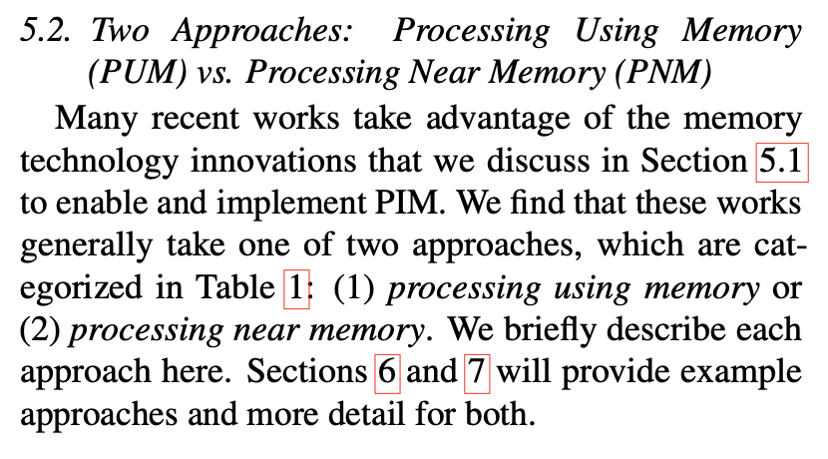
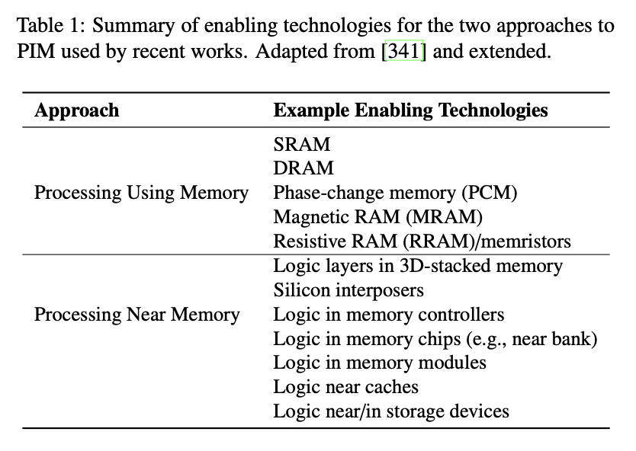
Two PIM Approaches
Onur Mutlu, Saugata Ghose, Juan Gomez-Luna, and Rachata Ausavarungnirun,
"A Modern Primer on Processing in Memory"
Invited Book Chapter in Emerging Computing: From Devices to Systems - Looking Beyond Moore and Von Neumann, Springer, 2022.
[Tutorial Video on "Memory-Centric Computing Systems" (1 hour 51 minutes)]
https://people.inf.ethz.ch/omutlu/pub/ModernPrimerOnPIM_springer-emerging-computing-bookchapter21.pdf

Slide 3
Processing-Using-Memory (PUM)
PUM: Exploits analog operational principles of the memory circuitry to perform computation
  Exploits internal connectivity to move data
  Leverages the large internal bandwidth and parallelism available inside the memory arrays
A common approach for PUM architectures is to perform bulk bitwise operations
  Simple logical operations (e.g., AND, OR, XOR)
  More complex operations (e.g., addition, multiplication)

Slide 4
DRAM Operation

Slide 5

Inside a DRAM Chip
Bitline
Wordline
Subarray
(2D Array
of DRAM Cells)
DRAM Cells
Wordline
Access
Transistor
Bitline
Sense Amplifiers
Row Buffer
Storage
Capacitor
DRAM Bank
DRAM Chips
DRAM Module
Notes:
A DRAM module
[CLICK] is composed of many DRAM chips
[CLICK] Each DRAM chip is composed of several banks.
[CLICK] Each bank has many subarrays, which are a 2D array of DRAM cells
[CLICK] The 2D array of DRAM cells are horizontally connected via a wordline
[CLICK] And vertically connected via a bitline
[CLICK] The bitlines are connected to an array of sense amplifiers
[CLICK] called row buffer .
[CLICK] A DRAM cell is composed of
[CLICK] A storage capacitor, which holds the data stored in DRAM as charge and
[CLICK] An access transistor, which enables and disables the charge flow from the storage capacitor to the bitline
[NEXT]

Slide 6
DRAM Cell Operation
wordline
½ V_{DD}
access
transistor
bitline
storage
capacitor
1. ACTIVATE (ACT)
2. READ/WRITE
3. PRECHARGE (PRE)
enable
sense
amplifier
Notes:
The DRAM cells operates using three main commands: ACTIVATE, READ/WRITE, and PRECHARGE.
[NEXT]

Slide 7
DRAM Cell Operation (I)
wordline
1. raise wordline
V_{DD}
½ V_{DD}
+ δ
access
transistor
bitline
storage
capacitor
1. ACTIVATE (ACT)
5. capacitor charge is restored
2. capacitor loses charge to bitline
2. READ/WRITE
4. amplify deviation
in the bitline
3. PRECHARGE (PRE)
3. enable
sense amplifier
enable
sense
amplifier
Notes:
To read the charge level stored in the storage capacitor, the memory controller issues an ACTIVATE command. Prior to receiving the ACTIVATE command, the bitline is held under a reference voltage, usually 1/2 VDD.
[CLICK] First, once the DRAM array receives the ACTIVE command, the wordline of the target row is asserted, which connects all cells along the row to their respective bitlines.
[CLICK] Second, the storage capacitor shares charge with its corresponding bitline
[CLICK] Third, the sense amplifier is enabled and
[CLICK] Fourth, the resulting bitline voltage shift is sensed and amplified by the bitline’s sense amplifier. Once the sense amplifiers finish amplification
[CLICK] the row buffer will contain the values originally stored within the cells along the asserted wordline. Also, the charge in the storage capacitor is fully restored. At the end of the ACTIVATE operation, the DRAM array is ready to receive read and write requests from the memory controller.
[NEXT]]

Slide 8
DRAM Cell Operation (II)
wordline
V_{DD}
access
transistor
bitline
storage
capacitor
1. ACTIVATE (ACT)
2. READ/WRITE
3. PRECHARGE (PRE)
enable
read/write charge
latched in sense amplifier
sense
amplifier
Notes:
The memory controller then issues read or write commands to columns within the activated row.
[NEXT]

Slide 9
DRAM Cell Operation (III)
1. lower
wordline
wordline
V_{DD}
2. precharge bitline for next access
½ V_{DD}
access
transistor
bitline
storage
capacitor
1. ACTIVATE (ACT)
2. READ/WRITE
3. PRECHARGE (PRE)
3. disable
sense amplifier
enable
sense
amplifier
Notes:
To prepare the DRAM array for future access to other DRAM rows, the memory controller issues a precharge command. It works as follows
[CLICK] First, the capacitor is disconnected from the bitline by disabling the wordline
[CLICK] Second, the bitline voltage is restored to its quiescent state. Now, the DRAM array is ready for next accesses.
[CLICK] Third, the sense amplifier is disabled.
[NEXT]

Slide 10
Starting Simple:
Data Copy and Initialization

Slide 11
Starting Simple: Data Copy and Initialization
Bulk Data Copy
src
dst
Bulk Data Initialization
dst
val

Slide 12
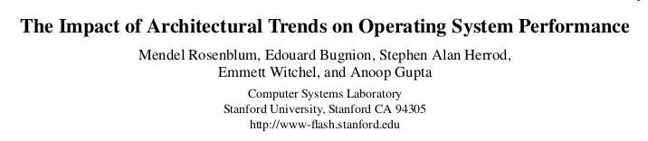
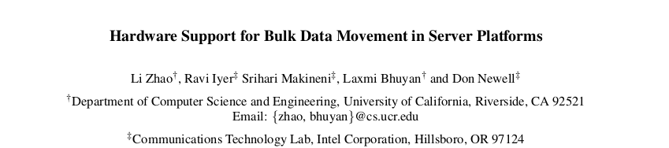
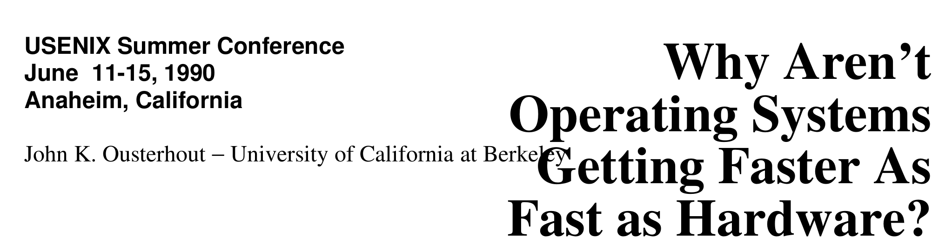
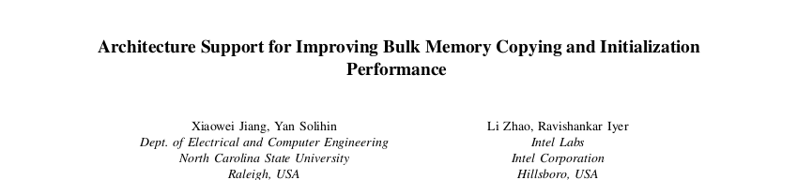
Bulk Data Copy and Initialization
Bulk Data Copy
src
dst
Bulk Data Initialization
dst
val

Slide 13

Starting Simple: Data Copy and Initialization
memmove & memcpy: 5% cycles in Google’s datacenter [Kanev+ ISCA’15]
000000000000000
Zero initialization
(e.g., security)
Forking
Checkpointing
Many more
VM Cloning
Deduplication
Page Migration

Slide 14
Today’s Systems: Bulk Data Copy
1) High latency
Memory
3) Cache pollution
L3
CPU
L2
L1
MC
2) High bandwidth utilization
4) Unwanted data movement
1046ns, 3.6uJ (for 4KB page copy via DMA)

Slide 15
Future Systems: In-Memory Copy
3) No cache pollution
1) Low latency
Memory
L3
CPU
L2
L1
MC
2) Low bandwidth utilization
4) No unwanted data movement
1046ns, 3.6uJ
→ 90ns, 0.04uJ

Slide 16
RowClone: In-DRAM Row Copy
4 Kbytes
Idea: Two consecutive ACT
Negligible HW cost
Step 1: Activate row A
Step 2: Activate row B
Transfer row
DRAM subarray
Transfer
row
Row Buffer (4 Kbytes)
8 bits
11.6X latency reduction, 74X energy reduction
Data Bus
Notes:
copy

Slide 17
RowClone: In-DRAM Row Copy (I)
source A
½ V_{DD}
Row copy
command sequence²:
1. ACTIVATE (ACT)
destination B
2. ACTIVATE (ACT)
3. PRECHARGE (PRE)
sense
amplifier
enable
Notes:
Now, let's see how we can use the internal DRAM cell operation to perform in-DRAM computation. First, we will see how we can perform in-DRAM row copy.
[CLICK] Let's assume we want to copy the value stored in source row A
[CLICK] to destination row B
[CLICK] The two rows share the same bitline
[CLICK] RowClone enables copying a source row 𝐴 to a destination row 𝐵 in the same subarray by issuing two consecutive ACTIVATE commands to these two rows, followed by a PRECHARGE command. This command sequence is called ACT/ACT/PRE. It works as follows.
[NEXT]

Slide 18
RowClone: In-DRAM Row Copy (II)
source A
½ V_{DD}
V_{DD}
½ V_{DD}
1. ACTIVATE source row A
bitline
Row copy
command sequence²:
2. bitline will be pulled
to charge level of row A
5. PRECHARGE bitline
for next access
1. ACTIVATE (ACT)
destination B
3. ACTIVATE destination row B
2. ACTIVATE (ACT)
3. PRECHARGE (PRE)
4. charge level of source row A will be copied to destination row B
sense
amplifier
enable
² V. Seshadri et al., “RowClone: Fast and Energy-Efficient In-DRAM Bulk Data Copy and Initialization", MICRO, 2013
Notes:
First, we issue an ACTIVATE command to source row A.
[CLICK] which will copy the contents of the source row 𝐴 into the row buffer.
[CLICK] We then issue an ACTIVATE command to destination row B, which connects the cells in the destination row 𝐵 to the bitlines.
[CLICK] Because the sense amplifiers have already sensed and amplified the source data by the time row 𝐵 is activated, the data in each cell of row 𝐵 is overwritten by the data stored in the row buffer, thus copying the data in source row A to destination row B
[CLICK] Finally, we issue an activate command to prepare the DRAM array fora next access.
[NEXT]

Slide 19
RowClone: Intra-Subarray (II)
s
r
c
r
o
w
s
d
s
r
c
t
r
r
o
o
w
w
s
r
c
r
o
w
Row Buffer
1. Activate src row (copy data from src to row buffer)
2. Activate dst row (disconnect src from row buffer, connect dst – copy data from row buffer to dst)

Slide 20
RowClone: Inter-Bank
Chip I/O
Bank
Shared internal bus
Memory Channel
Overlap the latency of the read and the write
1.9X latency reduction, 3.2X energy reduction

Slide 21
Generalized RowClone
0.01% area cost
Inter Subarray Copy
(Use Inter-Bank Copy Twice)
Subarray
Chip I/O
Bank
Bank I/O
Memory Channel
Inter Bank Copy
(Pipelined
Internal RD/WR)
Intra Subarray
Copy (2 ACTs)

Slide 22
RowClone: Latency and Energy Savings
11.6x
74x
Seshadri et al., “RowClone: Fast and Efficient In-DRAM Copy and Initialization of Bulk Data,” MICRO 2013

Slide 23
RowClone: Fast Row Initialization
0
0
0
0
0
0
0
0
0
0
0
0
Fix a row at Zero
(0.5% loss in capacity)

Slide 24
Copy and Initialization in Workloads

Slide 25
RowClone: Application Performance

Slide 26
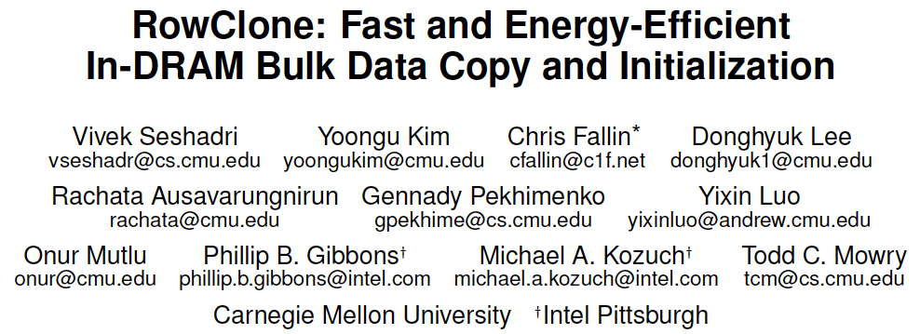
More on RowClone
Vivek Seshadri, Yoongu Kim, Chris Fallin, Donghyuk Lee, Rachata Ausavarungnirun, Gennady Pekhimenko, Yixin Luo, Onur Mutlu, Michael A. Kozuch, Phillip B. Gibbons, and Todd C. Mowry,
"RowClone: Fast and Energy-Efficient In-DRAM Bulk Data Copy and Initialization"
Proceedings of the 46th International Symposium on Microarchitecture (MICRO), Davis, CA, December 2013. [Slides (pptx) (pdf)] [Lightning Session Slides (pptx) (pdf)] [Poster (pptx) (pdf)]

Slide 27
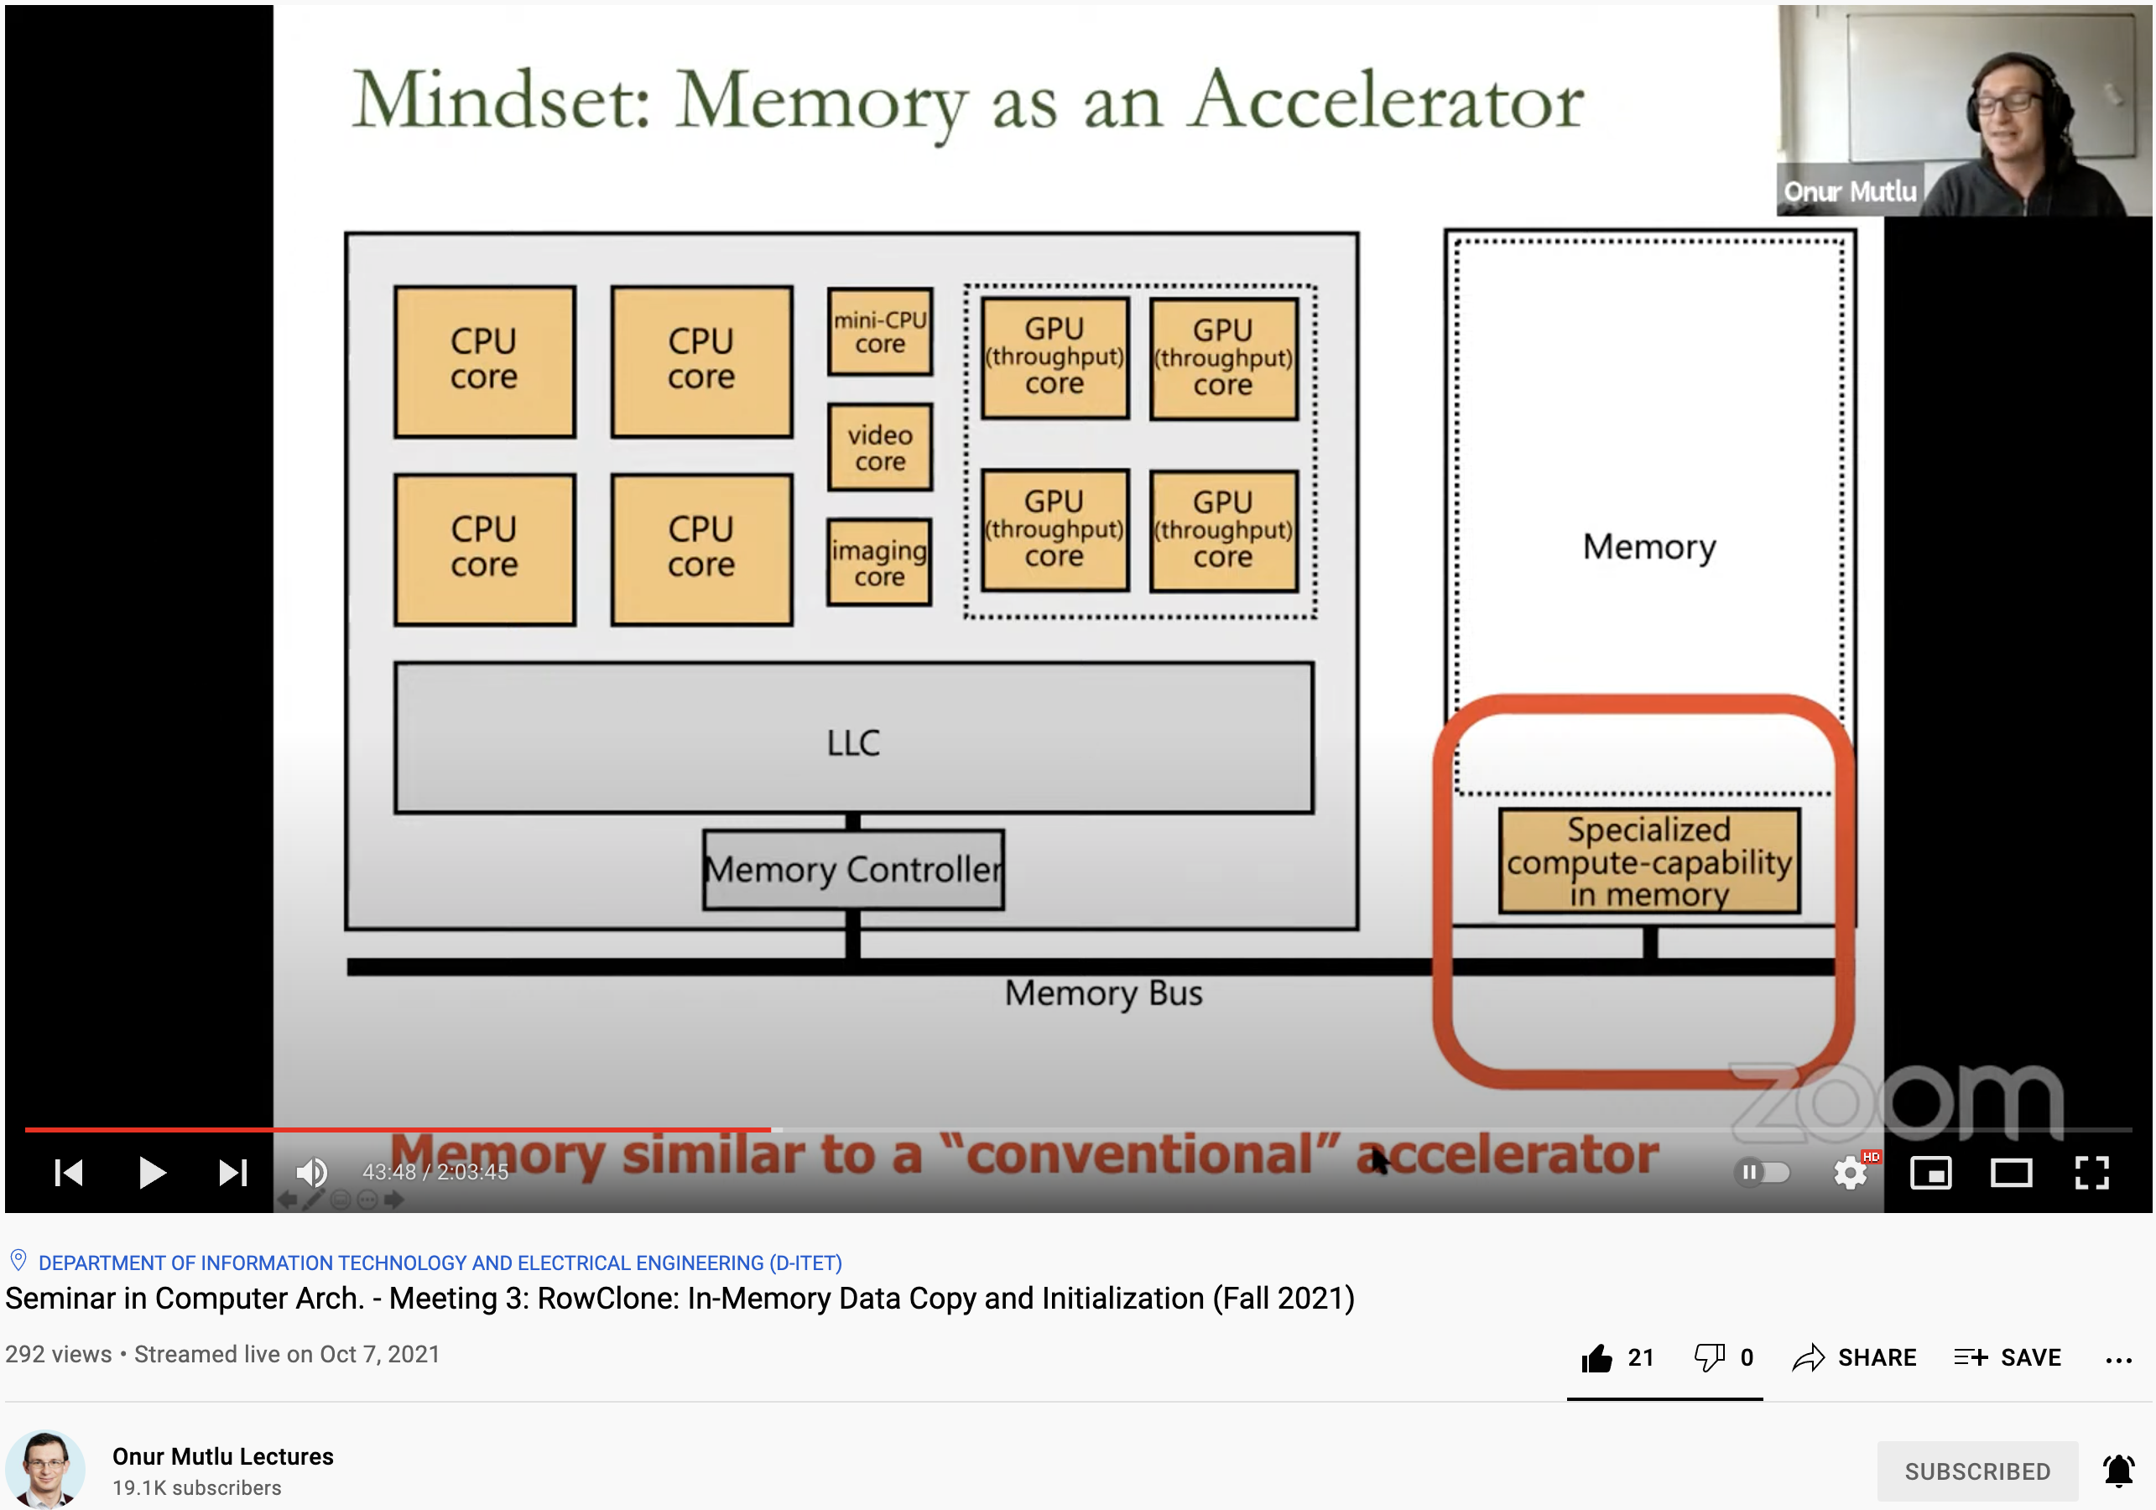
Lecture on RowClone & Processing using DRAM
https://www.youtube.com/watch?v=n6Pwg1qax_E&list=PL5Q2soXY2Zi_7UBNmC9B8Yr5JSwTG9yH4&index=4

Slide 28
Generalized RowClone
0.01% area cost
Inter Subarray Copy
(Use Inter-Bank Copy Twice)
Subarray
Chip I/O
Bank
Bank I/O
Memory Channel
Inter Bank Copy
(Pipelined
Internal RD/WR)
Intra Subarray
Copy (2 ACTs)

Slide 29
Moving Data Inside DRAM?
8Kb
Bank
512
rows
Subarray 1
Bank
DRAM
cell
Subarray 2
Bank
Subarray 3
…
…
Bank
Subarray N
DRAM
Internal
Data Bus (64b)
Low connectivity in DRAM is the fundamental bottleneck for bulk data movement
Goal: Provide a new substrate to enable
wide connectivity between subarrays

Slide 30

Key Idea and Applications
Low-cost Inter-linked subarrays (LISA)
  Fast bulk data movement between subarrays
  Wide datapath via isolation transistors: 0.8% DRAM chip area
LISA is a versatile substrate → new applications
Subarray 1
…
Subarray 2
  Fast bulk data copy: Copy latency 1.363ms→0.148ms (9.2x)
  → 66% speedup, -55% DRAM energy
  In-DRAM caching: Hot data access latency 48.7ns→21.5ns (2.2x)
  → 5% speedup
  Fast precharge: Precharge latency 13.1ns→5.0ns (2.6x)
  → 8% speedup

Slide 31
More on LISA
Kevin K. Chang, Prashant J. Nair, Saugata Ghose, Donghyuk Lee, Moinuddin K. Qureshi, and Onur Mutlu,
"Low-Cost Inter-Linked Subarrays (LISA): Enabling Fast Inter-Subarray Data Movement in DRAM"
Proceedings of the 22nd International Symposium on High-Performance Computer Architecture (HPCA), Barcelona, Spain, March 2016.
[Slides (pptx) (pdf)]
[Source Code]

Slide 32
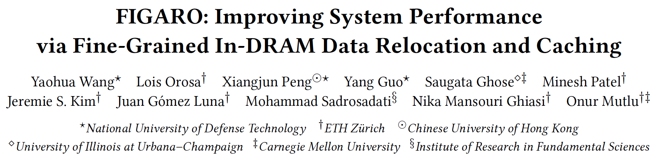
FIGARO: Fine-Grained In-DRAM Copy
Yaohua Wang, Lois Orosa, Xiangjun Peng, Yang Guo, Saugata Ghose, Minesh Patel, Jeremie S. Kim, Juan Gómez Luna, Mohammad Sadrosadati, Nika Mansouri Ghiasi, and Onur Mutlu,
"FIGARO: Improving System Performance via Fine-Grained In-DRAM Data Relocation and Caching"
Proceedings of the 53rd International Symposium on Microarchitecture (MICRO), Virtual, October 2020.

Slide 33
In-Memory
Bulk Bitwise Operations

Slide 34
In-Memory Bulk Bitwise Operations
We can support in-DRAM COPY, ZERO, AND, OR, NOT, MAJ
At low cost
Using inherent analog computation capability of DRAM
  Idea: activating multiple rows performs computation
30-60X performance and energy improvement
  Seshadri+, “Ambit: In-Memory Accelerator for Bulk Bitwise Operations Using Commodity DRAM Technology,” MICRO 2017.
New memory technologies enable even more opportunities
  Memristors, resistive RAM, phase change memory, STT-MRAM, …
  Can operate on data with minimal movement

Slide 35
Triple-Row Activation: Majority Function (I)
A
½ V_{DD}
bitline
Majority function
command sequence³:
B
1. ACTIVATE (ACT)
2. PRECHARGE (PRE)
C
sense
amplifier
enable
³ V. Seshadri et al., “Ambit: In-Memory Accelerator for Bulk Bitwise Operations Using Commodity DRAM Technology", MICRO, 2017
Notes:
We can also follow similar principles to execute majority functions in-DRAM. A 3-input majority outputs 1 if at least two of the inputs are also 1.
Let's assume we want to compute the majority function between three rows
[CLICK] A
[CLICK] B
[CLICK] C
[CLICK] All there rows share the same bitline.
[CLICK] The authors of Ambit shows that simultaneously activating three DRAM rows via a DRAM operation called Triple Row Activation can be used to perform bitwise Boolean Majority operations on the values contained within the cells of the three rows. Let's see how it works.
[NEXT]

Slide 36
Triple-Row Activation: Majority Function (II)
A
V_{DD}
½ V_{DD}
½ V_{DD}
ACTIVATE three rows simultaneously
→ triple-row activation
bitline
Majority function
command sequence³:
B
MAJ(A, B, C ) =
MAJ(V_{dd}, V_{dd}, 0) = V_{dd}
1. ACTIVATE (ACT)
2. bitline will be pulled
to the majority of
cells A, B, and C
2. PRECHARGE (PRE)
C
3. values in cells A, B, C
will be overwritten
with the majority output
4. PRECHARGE bitline
for next access
sense
amplifier
enable
³ V. Seshadri et al., “Ambit: In-Memory Accelerator for Bulk Bitwise Operations Using Commodity DRAM Technology", MICRO, 2017
Notes:
First, when activating three rows, three cells connected to each bitline share charge simultaneously and contribute to the perturbation of the bitline.
[CLICK] Upon sensing the perturbation, the sense amplifier amplifies the bitline voltage to 𝑉𝐷𝐷 or 0 if at least two of the capacitors of the three DRAM cells are charged or discharged, respectively. As such, a triple row activation results in a Boolean majority operation among the three DRAM cells on each bitline.
[CLICK] In this example, the majority of rows A, B, and C will be equal to Vdd.
[CLICK] The result of the majority operation is then overwritten to all three DRAM cells
[CLICK] To end of the operation, the memory controller needs to issue a PRECHARGE command to prepare the DRAM array to future accesses
[NEXT]

Slide 37
Ambit: In-DRAM Bulk Bitwise AND/OR
A
½ V_{DD}
bitline
B
MAJ (A, B, 0) = AND (A, B)
MAJ (A, B, 1) = OR (A, B)
C
sense
amplifier
enable
V. Seshadri et al., “Ambit: In-Memory Accelerator for Bulk Bitwise Operations Using Commodity DRAM Technology", MICRO, 2017
Notes:
Ambit uses the triple row activation command sequence to implement Boolean AND and OR operations by simply setting one of the inputs (for example, 𝐶) to 1 or 0.
[CLICK] The AND operation is computed by setting 𝐶 to 0 since the majority of A, B, and 0 is equivalent to A AND B
[CLICK] The OR operation is computed by setting 𝐶 to 1 since the majority of A, B, and 1 is equivalent to A OR B
[NEXT]

Slide 38
Ambit: Subarray Organization
regular
row decoder
1006 regular
data rows
1
1
1
1
1
1
1
1
1
1
1
1
1
1
2 pre-initialized rows
0
0
0
0
0
0
0
0
0
0
0
0
0
0
Less than 1% of overhead
in existing DRAM chips
bitwise decoder
16 designated rows
for triple activation
address A
sense amplifiers
V. Seshadri et al., “Ambit: In-Memory Accelerator for Bulk Bitwise Operations Using Commodity DRAM Technology", MICRO, 2017
Notes:
In order to perform processing-using-DRAM,
[CLICK] Ambit makes use of a subarray organization that incorporates additional functionality to perform logic primitives. Ambit splits the DRAM rows into three groups.
[CLICK] First, Ambit designates 16 row address as compute rows, which can execute triple row activation. We call this group the Bitwise group.
[CLICK] Second, Ambit pre-initialize two rows with all 1s and all 0s values. These rows are used as control rows for AND and OR logic operations. We call this group the control group.
[CLICK] Third, Ambit uses the remaining DRAM rows as regular data rows, which stores users data. We call this group the data group
[CLICK] Ambit requires only minimal modifications to the DRAM subarray, namely,
[CLICK] a regular row decoder that can activate rows in the data and control groups and
[CLICK] a small row decoder that can address the bitwise group.
[CLICK] This special row decoder can simultaneously activate three rows using a single address, which perform a majority operation between the three activated rows
[CLICK] Ambit imposes less the 1\% of overhead in existing DRAM chips.

Slide 39
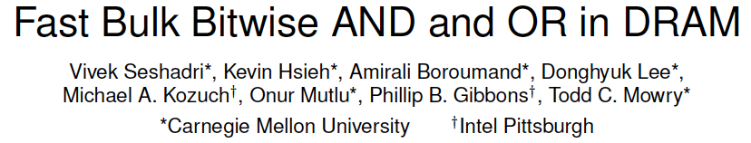
More on In-DRAM Bulk AND/OR
Vivek Seshadri, Kevin Hsieh, Amirali Boroumand, Donghyuk Lee, Michael A. Kozuch, Onur Mutlu, Phillip B. Gibbons, and Todd C. Mowry,
"Fast Bulk Bitwise AND and OR in DRAM"
IEEE Computer Architecture Letters (CAL), April 2015.

Slide 40
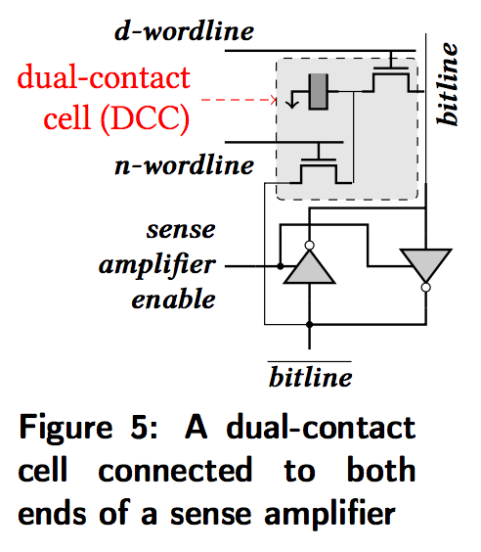
In-DRAM NOT: Dual Contact Cell
Idea:
Feed the
negated value
in the sense amplifier
into a special row
Seshadri+, “Ambit: In-Memory Accelerator for Bulk Bitwise Operations using Commodity DRAM Technology,” MICRO 2017

Slide 41
In-DRAM NOT Operation
Seshadri+, “Ambit: In-Memory Accelerator for Bulk Bitwise Operations using Commodity DRAM Technology,” MICRO 2017

Slide 42
Performance: In-DRAM Bitwise Operations

Slide 43
Energy of In-DRAM Bitwise Operations
Seshadri+, “Ambit: In-Memory Accelerator for Bulk Bitwise Operations using Commodity DRAM Technology,” MICRO 2017

Slide 44
Bulk Bitwise Operations in Workloads
[1] Li and Patel, BitWeaving, SIGMOD 2013
[2] Goodwin+, BitFunnel, SIGIR 2017

Slide 45
Example Data Structure: Bitmap Index
Alternative to B-tree and its variants
Efficient for performing range queries and joins
Many bitwise operations to perform a query
age < 18
18 < age < 25
25 < age < 60
age > 60
Bitmap 1
Bitmap 2
Bitmap 3
Bitmap 4

Slide 46
Performance: Bitmap Index on Ambit
>5.4-6.6X Performance Improvement
Seshadri+, “Ambit: In-Memory Accelerator for Bulk Bitwise Operations using Commodity DRAM Technology,” MICRO 2017

Slide 47
Performance: BitWeaving on Ambit
>4-12X Performance Improvement
Seshadri+, “Ambit: In-Memory Accelerator for Bulk Bitwise Operations using Commodity DRAM Technology,” MICRO 2017

Slide 48
More on In-DRAM Bitwise Operations
Vivek Seshadri et al., “Ambit: In-Memory Accelerator for Bulk Bitwise Operations Using Commodity DRAM Technology,” MICRO 2017.

Slide 49
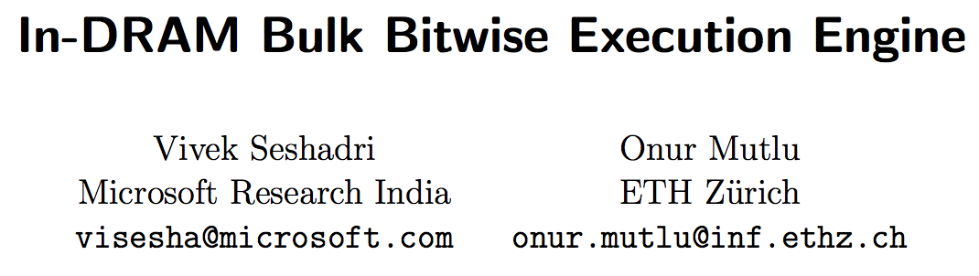
More on In-DRAM Bulk Bitwise Execution
Vivek Seshadri and Onur Mutlu,
"In-DRAM Bulk Bitwise Execution Engine"
Invited Book Chapter in Advances in Computers, 2020.
[Preliminary arXiv version]

Slide 50
A Framework for PUM in DRAM

Slide 51
PUM: Prior Works
DRAM and other memory technologies that are capable of performing computation using memory
Shortcomings:
Support only basic operations (e.g., Boolean operations, addition)
  Not widely applicable
Support a limited set of operations
  Lack the flexibility to support new operations
Require significant changes to the DRAM
  Costly (e.g., area, power)
Notes:
Many prior works followed up by Ambit have explored DRAM designs (as well as other memory technologies), that are capable of performing computation using memory. However, three major shortcoming prevents these proposals from becoming widely applicable:
[CLICK] First, they support only basic operations (e.g., Boolean operations, addition) and fall short on efficiently supporting more complex operations.
[CLICK] which limits their applicability
[CLICK] Second, they support only a limited and specific set of operations,
[CLICK] lacking the flexibility to support new operations and cater to the wide variety of applications that can potentially benefit from processing using DRAM.
[CLICK] And some prior works propose processing-using-DRAM designs that support more complex operations [CLICK] However, such designs require significant changes to the DRAM subarray, which makes them costly.
[NEXT]

Slide 52
PuM: Prior Works
DRAM and other memory technologies that are capable of performing computation using memory
Shortcomings:
Support only basic operations (e.g., Boolean operations, addition)
  Not widely applicable
Support a limited set of operations
  Lack the flexibility to support new operations
Require significant changes to the DRAM
  Costly (e.g., area, power)
Need a framework that aids general adoption of PuM, by:
- Efficiently implementing complex operations
- Providing flexibility to support new operations
Notes:
This highlights the need for a framework that aids the general adoption of processing-using-DRAM by efficiently implementing complex operations, while providing the flexibility to support new desired operations
[NEXT]

Slide 53
Our Goal
Goal: Design a PuM framework that
  Efficiently implements complex operations
  Provides the flexibility to support new desired operations
  Minimally changes the DRAM architecture
Notes:
Accordingly, [CLICK] our goal is to design a processing using memory framework that,
[CLICK] Efficiently implements complex operations
[CLICK] Provides the flexibility to support new desired operations
[CLICK] Minimally changes the DRAM architecture

Slide 54
Key Idea
SIMDRAM: An end-to-end processing-using-DRAM framework that provides the programming interface, the ISA, and the hardware support for:
  Efficiently computing complex operations in DRAM
  Providing the ability to implement arbitrary operations as required
  Using an in-DRAM massively-parallel SIMD substrate that requires minimal changes to DRAM architecture
Notes:
[CLICK] we introduce SIMDRAM, An end-to-end processing-using-DRAM framework that provides the programming interface, the ISA, and the hardware support for:
[CLICK] Efficiently computing complex operations in DRAM, and [CLICK] Providing the ability to implement arbitrary operations as required
[CLICK] SIMDRAM achieves this using an in-DRAM massively-parallel SIMD substrate that requires minimal changes to DRAM architecture

Slide 55
SIMDRAM: PUM Substrate
SIMDRAM framework is built around a DRAM substrate that enables two techniques:
(1) Vertical data layout
(2) Majority-based computation
most significant bit (MSB)
C_{out}= AB + AC_{in} + BC_{in}
A
MAJ
Row Decoder
4-bit element size
B
C_{out}
C_{in}
least significant bit (LSB)
Pros compared to the conventional horizontal layout:
Implicit shift operation
Massive parallelism
Pros compared to AND/OR/NOT-based computation:
Higher performance
Higher throughput
Lower energy consumption
Notes:
We build the SIMDRAM
framework around a DRAM substrate that enables two
key techniques: first, [CLICK] vertical data layout in DRAM
[CLICK] Prior works show that employing a vertical layout for the data in DRAM, eliminates the need for adding extra logic in DRAM to implement bit-shift operation which is essential for many complex operations.
[CLICK] Employing vertical data layout provides SIMDRAM with two key benefits:
[CLICK] implicit shift operation
[CLICK] and massive parallelism, wherein each DRAM column operates as a SIMD lane
[CLICK] The second key technique used in SIMDRAM’s substrate is majority based computation. As opposed to using basic logic operations such as AND/OR/NOT to implement in-DRAM computation, SIMDRAM uses [CLICK] logically complete set of majority (MAJ) and NOT operations to implement in-DRAM computation.
Doing so [CLICK] enables SIMDRAM to achieve [CLICK] higher performance, [CLICK] higher throughput, and [CLICK] lower energy consumption compared to using basic logical operations for in-DRAM computation.

Slide 56





SIMDRAM Framework
User Input
Step 1: Generate
MAJ logic
Step 2: Generate
sequence of
DRAM commands
SIMDRAM Output
Desired operation
New SIMDRAM $μ$Program
ACT/PRE
ACT/PRE
ACT/PRE
ACT/ACT/PRE
done
$$μProgram$$
$$μProgram$$
MAJ
Main memory
AND/OR/NOT logic
MAJ/NOT logic
bbop_new
New SIMDRAM
instruction
ISA
$μ$Program
User Input
Step 3: Execution according to $μ$Program
SIMDRAM Output
SIMDRAM-enabled application
Instruction result
in memory
foo () {
bbop_new
}
ACT/PRE
ACT/PRE
ACT/PRE
ACT/PRE/PRE
done
ACT/PRE
Control Unit
$μ$Program
Memory Controller
Notes:
SIMDRAM is an end-to-end framework that provides the user with
the ability to implement an arbitrary operation in DRAM
The framework is composed of three main steps which are illustrated in this picture.
[CLICK] It takes as user input input the AND/OR/NOT representation of a desired operation.
[CLICK] Step 1 builds an efficient MAJ/NOT representation of a given desired operation from its AND/OR/NOT-based implementation. Specifically, this step takes as input a desired
operation and uses logic optimization to minimize the number of logic primitives (and, therefore, the computation latency) required to perform the operation.
[CLICK] The second step allocates DRAM rows to the operation’s inputs and outputs and generates the required sequence of DRAM commands to execute the desired operation.
[CLICK] This step’s output is a μProgram, i.e., the optimized sequence of DRAM commands that is stored in main memory and will be used to execute the operation at runtime. The uProgram
[CLICK] is stored in main memory and will be used to execute the operation at runtime
[CLICK] and a new SIMDRAM instruction called bbop is created as an interface to the uProgram, and then added to the CPU ISA
[CLICK] The third step executes the μProgram to perform the operation. SIMDRAM uses a control unit in the memory controller that transparently issues the sequence of commands to DRAM, as dictated by the μProgram. Once the μProgram is complete, the result of the operation is held in DRAM.
[NEXT]

Slide 57

SIMDRAM Framework: Step 1
User Input
Step 1: Generate
MAJ logic
Step 2: Generate
sequence of
DRAM commands
SIMDRAM Output
Desired operation
New SIMDRAM $μ$Program
ACT/PRE
ACT/PRE
ACT/PRE
ACT/ACT/PRE
done
$$μProgram$$
$$μProgram$$
MAJ
Main memory
AND/OR/NOT logic
MAJ/NOT logic
bbop_new
New SIMDRAM
instruction
ISA
$μ$Program
User Input
Step 3: Execution according to $μ$Program
SIMDRAM Output
SIMDRAM-enabled application
Instruction result
in memory
foo () {
bbop_new
}
ACT/PRE
ACT/PRE
ACT/PRE
ACT/PRE/PRE
done
ACT/PRE
Control Unit
$μ$Program
Memory Controller
Notes:
Now let’s look into the first step of the SIMDRAM framework in more detail

Slide 58

Step 1: Naïve MAJ/NOT Implementation
A
A
MAJ
C
B
C
output is “1” only when A = B = “1”
B
0
A
A
MAJ
C
B
C
  output is “0” only when A = B = “0”
B
1
A
0
MAJ
B
A
Part 1
B
C_{out}
MAJ
C_{out}
MAJ
MAJ
1
C_{in}
1
0
C_{in}
Naïvely converting AND/OR/NOT-implementation to MAJ/NOT-implementation leads to an unoptimized circuit
Notes:
As AMBIT showed, it is quite trivial to convert a Boolean equation to the equivalent Majority equation
[CLICK] As Each two-input AND is in implemented using a three-input MAJ primitive, where one of the inputs is tied to logic 0
[CLICK] And an OR primitive is implemented using a three-input MAJ primitive, where one of the inputs is tied to logic 1
[CLICK] Accordingly, The first part of the transformation process in step 1 of the SIMDRAM framework simply replaces the AND and OR primitives, with MAJ primitives.
[CLICK] However, naively converting AND/OR primitives with MAJ primitives yields a implementation of the operation that correctly replicates the functionality of the initial AND/OR/NOT implementation, but is likely inefficient.

Slide 59
Step 1: Efficient MAJ/NOT Implementation
Greedy
optimization
algorithm⁴
0
MAJ
A
MAJ
A
B
Part 2
B
C_{out}
MAJ
1
MAJ
C_{out}
1
MAJ
C_{in}
0
C_{in}
Step 1 generates an optimized
MAJ/NOT-implementation of the desired operation
⁴ L. Amarù et al, “Majority-Inverter Graph: A Novel Data-Structure and Algorithms for Efficient Logic Optimization”, DAC, 2014.
Notes:
To address this issue, the second part of the transformation process
[CLICK] takes the inefficient MAJ/NOT-based implementation, and uses
[CLICK] a greedy algorithm to apply a series of transformations that consolidate multiple MAJ primitives into a smaller number of MAJ primitives with identical functionality.
[CLICK] This yields an optimized MAJ/NOT-based implementation that requires fewer logic primitives to perform the same operation that the unoptimized implementation performs.
For example, This picture shows the generated MAJ/NOT-based for the carry propagation logic in a full addition which requires only one majority logic primitive instead of four.
[CLICK] Therefore, Step 1 generates an optimized MAJ/NOT implementation of the desired operations.
[NEXT]

Slide 60

SIMDRAM Framework: Step 2
User Input
Step 1: Generate
MAJ logic
Step 2: Generate
sequence of
DRAM commands
SIMDRAM Output
Desired operation
New SIMDRAM $μ$Program
ACT/PRE
ACT/PRE
ACT/PRE
ACT/ACT/PRE
done
$$μProgram$$
$$μProgram$$
MAJ
Main memory
AND/OR/NOT logic
MAJ/NOT logic
bbop_new
New SIMDRAM
instruction
ISA
$μ$Program
User Input
Step 3: Execution according to $μ$Program
SIMDRAM Output
SIMDRAM-enabled application
Instruction result
in memory
foo () {
bbop_new
}
ACT/PRE
ACT/PRE
ACT/PRE
ACT/PRE/PRE
done
ACT/PRE
Control Unit
$μ$Program
Memory Controller
Notes:
Let’s now take a more detailed look at Step 2 of the SIMDRAM framework

Slide 61
Step 2: µProgram Generation
µProgram: A series of microarchitectural operations (e.g., ACT/PRE) that SIMDRAM uses to execute SIMDRAM operation in DRAM
Goal of Step 2: To generate the µProgram that executes the desired SIMDRAM operation in DRAM
Task 1: Allocate DRAM rows to the operands
Task 2: Generate µProgram
Notes:
[CLICK] Each SIMDRAM operation is stored as a μProgram which is a series of microarchitectural operations, such as activation and precharge, that SIMDRAM uses to execute SIMDRAM operations in DRAM
[CLICK] Accordingly, the goal of the second step is to take the optimized MAJ/not-based implementation in Step 1
and generate a μProgram that executes the desired SIMDRAM operation in DRAM.
To this end, the second step of the framework performs two key tasks on the optimized
MAJ-based implementation of the operation:
[CLICK] first, allocating DRAM rows to the operands, which assigns each input operand of each MAJ operation to a DRAM row, and
[CLICK] And, second, generating the μProgram.
[NEXT]

Slide 62
Step 2: µProgram Generation
µProgram: A series of microarchitectural operations (e.g., ACT/PRE) that SIMDRAM uses to execute SIMDRAM operation in DRAM
Goal of Step 2: To generate the µProgram that executes the desired SIMDRAM operation in DRAM
Task 1: Allocate DRAM rows to the operands
Task 2: Generate µProgram
Notes:
Now let’s take a look at the first task of step 2
[NEXT]

Slide 63
Task 1: Allocating DRAM Rows to Operands
Allocation algorithm considers two constraints specific to processing-using-DRAM
regular
row decoder
Constraint 1:
Limited number of rows reserved for computation
1
1
1
1
1
1
1
1
1
1
1
1
1
1
0
0
0
0
0
0
0
0
0
0
0
0
0
0
bitwise decoder
Compute
rows
subarray organization
Notes:
The goal of task 1 is to allocate DRAM rows to the input operands of each MAJ primitive in the MAJ/NOT-based implementation of the operation.
when allocating DRAM rows to operands, SIMDRAM takes into account two extra constraints that are specific to processing-using-DRAM.
[CLICK] First, the number of compute rows which are rows in the subarray that are designated to perform bitwise operations is limited
[NEXT]

Slide 64
Task 1: Allocating DRAM Rows to Operands
Allocation algorithm considers two constraints specific to processing-using-DRAM
regular
row decoder
Constraint 2:
Destructive behavior
of triple-row activation
1
1
1
1
1
1
1
1
1
1
1
1
1
1
0
0
0
0
0
0
0
0
0
0
0
0
0
0
bitwise decoder
Overwritten with MAJ output
subarray organization
Notes:
Second, [CLICK] performing MAJ in DRAM has destructive behavior,
[CLICK] in other words, the triple-row activation operation overwrites the original values of the three input rows with the output of the MAJ function;
[NEXT]

Slide 65
Task 1: Allocating DRAM Rows to Operands
Allocation algorithm:
Assigns as many inputs as the number of free compute rows
All three input rows contain the MAJ output and can be reused
Allocation
algorithm
A
MAJ
B
C_{out}
C_{in}
1
1
1
1
1
1
1
1
1
1
1
1
1
0
0
0
0
0
0
0
0
0
0
0
0
0
C_{out}
Triple-row activation
C_{out}
C_{out}
Notes:
Based on these two issues, we present a new allocation algorithm inspired by the linear scan register allocation algorithm .:
[CLICK] Our allocation algorithm takes as input the MAJ/NOT implementation of the operation generated in step 1, and starts by [CLICK] assigning the inputs of each majority logic primitive to the available compute rows, one at a time. [CLICK] Since the number of compute rows are limited, three in this example, this step of the algorithm assigns only as many inputs to the compute rows as the number of compute rows that are not allocated to any operand yet.
Next, [CLICK] performing triple row activation in the compute rows, computes the majority of A, B and Carry in, which in fact [CLICK] computes the Carry out value. As a result of the destructive behavior of the triple row activation in DRAM, the carry out is stored in all three input rows at the end of the triple row activation. [CLICK] our allocation algorithm takes advantage of this behavior and reuses these rows for row to operand allocation in the next round of triple row activation in case the value stored in these rows is an input for the next MAJ function.
[NEXT]
----------------
[CLICK] When assigning a DRAM row to the output of the majority logic primitive, the algorithm
[CLICK] reuses any of the previously allocated DRAM rows for the same majority primitive
[CLICK] this is possible because our algorithm takes advantage of the destructive behavior of the triple-row activation operation, since the value produced by the majority of A, B, and carry in will be store in all three row allocated for them at the end of the triple-row activation

Slide 66
Step 2: µProgram Generation
µProgram: A series of microarchitectural operations (e.g., ACT/PRE) that SIMDRAM uses to execute SIMDRAM operation in DRAM
Goal of Step 2: To generate the µProgram that executes the desired SIMDRAM operation in DRAM
Task 1: Allocate DRAM rows to the operands
Task 2: Generate µProgram
Notes:
Now let’s take a look at the second task of the step 2
[NEXT]

Slide 67
Task 2: Generate an initial µProgram
Initial µProgram
1. Copy A to reserved row (ACT/ACT/PRE)
2. Copy B to reserved row (ACT/ACT/PRE)
3. Copy C_{in} to reserved row
(ACT/ACT/PRE)
4. Execute MAJ
(ACT/PRE)
5. Copy C_{out} to destination row
(ACT/PRE)
MAJ
A
MAJ
A
C_{out}
B
C_{out}
B
C_{in}
C_{in}
1. Generate
µProgram
Notes:
Task 2 works in three key parts: The first part generates an initial micro-program.
[CLICK] This part first copies the three operands from the data rows to the DRAM rows allocated to them in task 1, using row-copy operation witch consists of two activations followed by a precharge.
Once all inputs of the MAJ are copied to the allocated rows, [CLICK] a triple-row activation operation is issued to execute the majority logic
Finally, [CLICK] another row copy is issued to copy the output of the MAJ stored in the compute rows back to the destination data rows
[CLICK] The resulting sequence of DRAM commands represents the initial uProgram
[NEXT]

Slide 68
Task 2: Optimize the µProgram
Initial µProgram
1. Copy A to reserved row (ACT/ACT/PRE)
2. Copy B to reserved row (ACT/ACT/PRE)
3. Copy C_{in} to reserved row
(ACT/ACT/PRE)
4. Execute MAJ
(ACT/PRE)
5. Copy C_{out} to destination row
(ACT/PRE)
MAJ
A
MAJ
A
C_{out}
B
C_{out}
B
C_{in}
C_{in}
1. Generate
µProgram
2. Optimize
Notes:
[CLICK] In the second step we optimize the initial uProgram by leveraging the structure of our processing-using-DRAM substrate.
[NEXT]

Slide 69
Task 2: Optimize the µProgram
Initial µProgram
1. Copy A to reserved row (ACT/ACT/PRE)
2. Copy B to reserved row (ACT/ACT/PRE)
3. Copy C_{in} to reserved row
(ACT/ACT/PRE)
4. Execute MAJ
(ACT/PRE)
5. Copy C_{out} to destination row
(ACT/PRE)
MAJ
^{Coalesce}
^{row copies}
A
MAJ
A
C_{out}
B
C_{out}
B
C_{in}
C_{in}
1. Generate
µProgram
2. Optimize
Notes:
Including the ability to coalesce multiple row copy operation into a single one, and
[NEXT]

Slide 70
Task 2: Optimize the µProgram
Initial µProgram
1. Copy A to reserved row (ACT/ACT/PRE)
2. Copy B to reserved row (ACT/ACT/PRE)
3. Copy C_{in} to reserved row
(ACT/ACT/PRE)
4. Execute MAJ
(ACT/PRE)
5. Copy C_{out} to destination row
(ACT/PRE)
MAJ
A
MAJ
A
C_{out}
B
C_{out}
B
C_{in}
C_{in}
1. Generate
µProgram
^{Merge}
^{MAJ + row copy}
2. Optimize
Notes:
merging a majority and row copy operation into a single operation.
[NEXT]

Slide 71
Task 2: Optimize the µProgram
Optimized µProgram
Initial µProgram
1. Copy A to reserved row (ACT/ACT/PRE)
2. Copy B to reserved row (ACT/ACT/PRE)
3. Copy C_{in} to reserved row
(ACT/ACT/PRE)
4. Execute MAJ
(ACT/PRE)
5. Copy C_{out} to destination row
(ACT/PRE)
Copy A, B, C_{in}
to reserved rows
(ACT/ACT/PRE)
2. Execute MAJ and
copy C_{out} to destination row
(ACT/ACT/PRE)
MAJ
^{Coalesce}
^{row copies}
A
MAJ
A
C_{out}
B
C_{out}
B
C_{in}
C_{in}
1. Generate
µProgram
^{Merge}
^{MAJ + row copy}
2. Optimize
Notes:
[CLICK] with these two optimizations, Task 2 of step 2 generates an optimized uProgram that requires fewer DRAM operations to execute the same desired operation
We invite you to read our paper for more details about the two optimizations discussed here.
[NEXT]

Slide 72
Task 2: Generate N-bit Computation
Final µProgram is optimized and computes the desired operation for operands of N-bit size in a bit-serial fashion
Final µProgram
Optimized µProgram
Repeat N times:
Copy A, B, C_{in}
to reserved rows
(ACT/ACT/PRE)
2. Execute MAJ and
copy C_{out} to destination row
(ACT/ACT/PRE)
Repeat N times:
Copy A, B, C_{in}
to reserved rows
(ACT/ACT/PRE)
2. Execute MAJ and
copy C_{out} to destination row
(ACT/ACT/PRE)
MAJ
A
MAJ
A
C_{out}
B
C_{out}
B
C_{in}
C_{in}
1. Generate
µProgram
2. Optimize
3. Generate N-bit
computation
Notes:
Once all potential operations are coalesced, the framework now has an optimized micro program that compute the desired opertatoin for operands of size 1-bit.
[CLICK] The final part of task 2 generalizes this 1-bit version of the operation into an N-bit version by repeating the DRAM commands in the optimized micro program for N times.
[CLICK] The final outcome is an optimized uProgram that can execute bit-serial computation over a flexible precision in DRAM.
[NEXT]

Slide 73
Task 2: Generate µProgram
Final µProgram is optimized and computes the desired operation for operands of N-bit size in a bit-serial fashion
Final µProgram
Repeat N times:
Copy A, B, C_{in}
to reserved rows
(ACT/ACT/PRE)
2. Execute MAJ and
copy C_{out} to destination row
(ACT/ACT/PRE)
Stored in a reserved DRAM region
for future use
A new SIMDRAM instruction (called bbop)
added to CPU ISA
Notes:
[CLICK] The final uProgram is then stored in a reserved region of DRAM for future use.
[CLICK] Also, a new SIMDRAM instruction, called bbop, is created and added to the CPU ISA. The SIMDRAM instructions is used later by the programmer to perform the added SIMDRAM operation
[NEXT]

Slide 74

SIMDRAM Framework: Step 3
User Input
Step 1: Generate
MAJ logic
Step 2: Generate
sequence of
DRAM commands
SIMDRAM Output
Desired operation
New SIMDRAM $μ$Program
ACT/PRE
ACT/PRE
ACT/PRE
ACT/ACT/PRE
done
$$μProgram$$
$$μProgram$$
MAJ
Main memory
AND/OR/NOT logic
MAJ/NOT logic
bbop_new
New SIMDRAM
instruction
ISA
$μ$Program
User Input
Step 3: Execution according to $μ$Program
SIMDRAM Output
SIMDRAM-enabled application
Instruction result
in memory
foo () {
bbop_new
}
ACT/PRE
ACT/PRE
ACT/PRE
ACT/PRE/PRE
done
ACT/PRE
Control Unit
$μ$Program
Memory Controller
Notes:
Now let’s take a more detailed look at Step 3, the final step of the SIMDRAM framework

Slide 75


Step 3: µProgram Execution
SIMDRAM control unit: handles the execution of the µProgram at runtime
Upon receiving a bbop instruction, the control unit:
  Loads the µProgram corresponding to SIMDRAM operation
  Issues the sequence of DRAM commands (ACT/PRE) stored in the µProgram to SIMDRAM subarrays to perform the in-DRAM operation
User Input
Step 3: Execution according to $μ$Program
SIMDRAM Output
SIMDRAM-enabled application
Instruction result
in memory
foo () {
bbop_new
}
ACT/PRE
ACT/PRE
ACT/PRE
ACT/ACT/PRE
done
ACT/PRE
Control Unit
$μ$Program
Memory Controller
18
Notes:
[CLICK] SIMDRAM uses a control unit in the memory controller that handles the execution of the
μProgram at runtime, transparently to the programmer.
[CLICK] To perform a SIMDRAM operation, program a bbop instruction. Upon receiving this instruction, the control unit
[CLICK] loads the μProgram corresponding to the bbop from the main memory
[CLICK] and performs the requested SIMDRAM operation by issuing the sequence of DRAM commands stores in the μProgram of that SIMDRAM operation.
[CLICK] at the end of the uProgram's execution, the outcome of the SIMDRAM operation is stored in memory.
[NEXT]

Slide 76
System Integration
Efficiently transposing data
Programming interface
Handling page faults, address translation, coherence, and interrupts
Handling limited subarray size
Security implications
Limitations of our framework
Notes:
we employ several techniques to efficiently integrate SIMDRAM in the system
[NEXT]

Slide 77
System Integration
Efficiently transposing data
Programming interface
Handling page faults, address translation, coherence, and interrupts
Handling limited subarray size
Security implications
Limitations of our framework
Notes:
The first technique is regarding efficient transposing of the data layout in DRAM that enables SIMDRAM to store the data required for in-DRAM computation in a vertical layout.
[NEXT]

Slide 78
Transposing Data
SIMDRAM operates on vertically-laid-out data
Other system components expect data to be laid out horizontally
Challenging to share data between SIMDRAM and CPU
Notes:
while SIMDRAM operates on vertically-laid-out data, [CLICK] the other system components including the CPU expect the data to be laid out in the traditional horizontal format, [CLICK] making it challenging to share data between SIMDRAM and CPU
instructions.
To address this issue …
[NEXT]

Slide 79
Transposition Unit
Last–Level Cache
Object Tracker (OT)
Horizontal → Vertical
Transpose
Vertical → Horizontal
Transpose
Transposition Unit
Transpose Buffer
Transpose Buffer
Store Unit
Fetch Unit
Memory Controller
Notes:
SIMDRAM uses a specialized hardware unit placed
[CLICK] between the last-level cache (LLC)
[CLICK] and the memory controller,
[[CLICK] called data transposition unit, to transform the data layout from horizontal to vertical, and vice versa.
[CLICK] The transposition unit tracks SIMDRAM objects,
[CLICK] and ensures that its corresponding data is in a vertical layout and ready for SIMDRAM compution, whenever the data is in DRAM.
[CLIC] and in a horizontal layout whenever the data is in the cache and is ready for computation in the processor
[NEXT]

Slide 80
Efficiently Transposing Data
Last–Level Cache
Object Tracker (OT)
Horizontal → Vertical
Transpose
Vertical → Horizontal
Transpose
Transposition Unit
Transpose Buffer
Low impact on the throughput of
SIMDRAM operations
Transpose Buffer
Store Unit
Fetch Unit
Low area cost (0.06 mm²)
Memory Controller
Notes:
[CLICK] Our ecaluations show that the transposition unit imposes very low overhead on the throughput of SIMDRAM operations
[CLICK] while imposing very low area overhead
[NEXT]

Slide 81
Programming Interface
Four new SIMDRAM ISA extensions
Type | ISA Format
Initialization | bbop_trsp_init address, size, n
1-Input Operation | bbop_op dst, src, size, n
2-Input Operation | bbop_op dst, src_1, src_2, size, n
Predication | bbop_if_else dst, src_1, src_2, select, size, n

Slide 82
Programming Interface
Four new SIMDRAM ISA extensions
Type | ISA Format
Initialization | bbop_trsp_init address, size, n
1-Input Operation | bbop_op dst, src, size, n
2-Input Operation | bbop_op dst, src_1, src_2, size, n
Predication | bbop_if_else dst, src_1, src_2, select, size, n

Slide 83
Programming Interface
Four new SIMDRAM ISA extensions
Type | ISA Format
Initialization | bbop_trsp_init address, size, n
1-Input Operation | bbop_op dst, src, size, n
2-Input Operation | bbop_op dst, src_1, src_2, size, n
Predication | bbop_if_else dst, src_1, src_2, select, size, n

Slide 84
Programming Interface
Four new SIMDRAM ISA extensions
Type | ISA Format
Initialization | bbop_trsp_init address, size, n
1-Input Operation | bbop_op dst, src, size, n
2-Input Operation | bbop_op dst, src_1, src_2, size, n
Predication | bbop_if_else dst, src_1, src_2, select, size, n

Slide 85
Programming Interface
Four new SIMDRAM ISA extensions
Type | ISA Format
Initialization | bbop_trsp_init address, size, n
1-Input Operation | bbop_op dst, src, size, n
2-Input Operation | bbop_op dst, src_1, src_2, size, n
Predication | bbop_if_else dst, src_1, src_2, select, size, n

Slide 86
Code Using SIMDRAM Instructions
← C code for vector add/sub
with predicated execution
1 | int size = 65536;
2 | int elm_size = sizeof (uint8_t);
3 | uint8_t *A , *B , *C = (uint8_t *) malloc(size * elm_size);
4 | uint8_t *pred = (uint8_t *) malloc(size * elm_size);
5 | …
6 | for (int i = 0; i < size ; ++ i){
7 | bool cond = A[i] > pred[i];
8 | if (cond)
9 | C [i] = A[i] + B[i];
10 | else
11 | C [i] = A[i] - B [i];
12 | }
1 | int size = 65536;
2 | int elm_size = sizeof(uint8_t);
3 | uint8_t *A , *B , *C = (uint8_t *) malloc(size * elm_size);
4
5 | bbop_trsp_init(A , size , elm_size);
6 | bbop_trsp_init(B , size , elm_size);
7 | bbop_trsp_init(C , size , elm_size);
8 | uint8_t *pred = (uint8_t *) malloc(size * elm_size);
9 | // D, E, F store intermediate data
10 | uint8_t *D , *E = (uint8_t *) malloc (size * elm_size);
11 | bool *F = (bool *) malloc (size * sizeof(bool));
12 | …
13 | bbop_add(D , A , B , size , elm_size);
14 | bbop_sub(E , A , B , size , elm_size);
15 | bbop_greater(F , A , pred , size , elm_size);
16 | bbop_if_else(C , D , E , F , size , elm_size);
Equivalent code using SIMDRAM operations →

Slide 87
Code Using SIMDRAM Instructions
← C code for vector add/sub
with predicated execution
1 | int size = 65536;
2 | int elm_size = sizeof (uint8_t);
3 | uint8_t *A , *B , *C = (uint8_t *) malloc(size * elm_size);
4 | uint8_t *pred = (uint8_t *) malloc(size * elm_size);
5 | …
6 | for (int i = 0; i < size ; ++ i){
7 | bool cond = A[i] > pred[i];
8 | if (cond)
9 | C [i] = A[i] + B[i];
10 | else
11 | C [i] = A[i] - B [i];
12 | }
1 | int size = 65536;
2 | int elm_size = sizeof(uint8_t);
3 | uint8_t *A , *B , *C = (uint8_t *) malloc(size * elm_size);
4
5 | bbop_trsp_init(A , size , elm_size);
6 | bbop_trsp_init(B , size , elm_size);
7 | bbop_trsp_init(C , size , elm_size);
8 | uint8_t *pred = (uint8_t *) malloc(size * elm_size);
9 | // D, E, F store intermediate data
10 | uint8_t *D , *E = (uint8_t *) malloc (size * elm_size);
11 | bool *F = (bool *) malloc (size * sizeof(bool));
12 | …
13 | bbop_add(D , A , B , size , elm_size);
14 | bbop_sub(E , A , B , size , elm_size);
15 | bbop_greater(F , A , pred , size , elm_size);
16 | bbop_if_else(C , D , E , F , size , elm_size);
Equivalent code using SIMDRAM operations →

Slide 88
Code Using SIMDRAM Instructions
← C code for vector add/sub
with predicated execution
1 | int size = 65536;
2 | int elm_size = sizeof (uint8_t);
3 | uint8_t *A , *B , *C = (uint8_t *) malloc(size * elm_size);
4 | uint8_t *pred = (uint8_t *) malloc(size * elm_size);
5 | …
6 | for (int i = 0; i < size ; ++ i){
7 | bool cond = A[i] > pred[i];
8 | if (cond)
9 | C [i] = A[i] + B[i];
10 | else
11 | C [i] = A[i] - B [i];
12 | }
1 | int size = 65536;
2 | int elm_size = sizeof(uint8_t);
3 | uint8_t *A , *B , *C = (uint8_t *) malloc(size * elm_size);
4
5 | bbop_trsp_init(A , size , elm_size);
6 | bbop_trsp_init(B , size , elm_size);
7 | bbop_trsp_init(C , size , elm_size);
8 | uint8_t *pred = (uint8_t *) malloc(size * elm_size);
9 | // D, E, F store intermediate data
10 | uint8_t *D , *E = (uint8_t *) malloc (size * elm_size);
11 | bool *F = (bool *) malloc (size * sizeof(bool));
12 | …
13 | bbop_add(D , A , B , size , elm_size);
14 | bbop_sub(E , A , B , size , elm_size);
15 | bbop_greater(F , A , pred , size , elm_size);
16 | bbop_if_else(C , D , E , F , size , elm_size);
Equivalent code using SIMDRAM operations →

Slide 89
Code Using SIMDRAM Instructions
← C code for vector add/sub
with predicated execution
1 | int size = 65536;
2 | int elm_size = sizeof (uint8_t);
3 | uint8_t *A , *B , *C = (uint8_t *) malloc(size * elm_size);
4 | uint8_t *pred = (uint8_t *) malloc(size * elm_size);
5 | …
6 | for (int i = 0; i < size ; ++ i){
7 | bool cond = A[i] > pred[i];
8 | if (cond)
9 | C [i] = A[i] + B[i];
10 | else
11 | C [i] = A[i] - B [i];
12 | }
1 | int size = 65536;
2 | int elm_size = sizeof(uint8_t);
3 | uint8_t *A , *B , *C = (uint8_t *) malloc(size * elm_size);
4
5 | bbop_trsp_init(A , size , elm_size);
6 | bbop_trsp_init(B , size , elm_size);
7 | bbop_trsp_init(C , size , elm_size);
8 | uint8_t *pred = (uint8_t *) malloc(size * elm_size);
9 | // D, E, F store intermediate data
10 | uint8_t *D , *E = (uint8_t *) malloc (size * elm_size);
11 | bool *F = (bool *) malloc (size * sizeof(bool));
12 | …
13 | bbop_add(D , A , B , size , elm_size);
14 | bbop_sub(E , A , B , size , elm_size);
15 | bbop_greater(F , A , pred , size , elm_size);
16 | bbop_if_else(C , D , E , F , size , elm_size);
Equivalent code using SIMDRAM operations →

Slide 90
Code Using SIMDRAM Instructions
← C code for vector add/sub
with predicated execution
1 | int size = 65536;
2 | int elm_size = sizeof (uint8_t);
3 | uint8_t *A , *B , *C = (uint8_t *) malloc(size * elm_size);
4 | uint8_t *pred = (uint8_t *) malloc(size * elm_size);
5 | …
6 | for (int i = 0; i < size ; ++ i){
7 | bool cond = A[i] > pred[i];
8 | if (cond)
9 | C [i] = A[i] + B[i];
10 | else
11 | C [i] = A[i] - B [i];
12 | }
1 | int size = 65536;
2 | int elm_size = sizeof(uint8_t);
3 | uint8_t *A , *B , *C = (uint8_t *) malloc(size * elm_size);
4
5 | bbop_trsp_init(A , size , elm_size);
6 | bbop_trsp_init(B , size , elm_size);
7 | bbop_trsp_init(C , size , elm_size);
8 | uint8_t *pred = (uint8_t *) malloc(size * elm_size);
9 | // D, E, F store intermediate data
10 | uint8_t *D , *E = (uint8_t *) malloc (size * elm_size);
11 | bool *F = (bool *) malloc (size * sizeof(bool));
12 | …
13 | bbop_add(D , A , B , size , elm_size);
14 | bbop_sub(E , A , B , size , elm_size);
15 | bbop_greater(F , A , pred , size , elm_size);
16 | bbop_if_else(C , D , E , F , size , elm_size);
Equivalent code using SIMDRAM operations →

Slide 91
Code Using SIMDRAM Instructions
← C code for vector add/sub
with predicated execution
1 | int size = 65536;
2 | int elm_size = sizeof (uint8_t);
3 | uint8_t *A , *B , *C = (uint8_t *) malloc(size * elm_size);
4 | uint8_t *pred = (uint8_t *) malloc(size * elm_size);
5 | …
6 | for (int i = 0; i < size ; ++ i){
7 | bool cond = A[i] > pred[i];
8 | if (cond)
9 | C [i] = A[i] + B[i];
10 | else
11 | C [i] = A[i] - B [i];
12 | }
1 | int size = 65536;
2 | int elm_size = sizeof(uint8_t);
3 | uint8_t *A , *B , *C = (uint8_t *) malloc(size * elm_size);
4
5 | bbop_trsp_init(A , size , elm_size);
6 | bbop_trsp_init(B , size , elm_size);
7 | bbop_trsp_init(C , size , elm_size);
8 | uint8_t *pred = (uint8_t *) malloc(size * elm_size);
9 | // D, E, F store intermediate data
10 | uint8_t *D , *E = (uint8_t *) malloc (size * elm_size);
11 | bool *F = (bool *) malloc (size * sizeof(bool));
12 | …
13 | bbop_add(D , A , B , size , elm_size);
14 | bbop_sub(E , A , B , size , elm_size);
15 | bbop_greater(F , A , pred , size , elm_size);
16 | bbop_if_else(C , D , E , F , size , elm_size);
Equivalent code using SIMDRAM operations →

Slide 92
Code Using SIMDRAM Instructions
← C code for vector add/sub
with predicated execution
1 | int size = 65536;
2 | int elm_size = sizeof (uint8_t);
3 | uint8_t *A , *B , *C = (uint8_t *) malloc(size * elm_size);
4 | uint8_t *pred = (uint8_t *) malloc(size * elm_size);
5 | …
6 | for (int i = 0; i < size ; ++ i){
7 | bool cond = A[i] > pred[i];
8 | if (cond)
9 | C [i] = A[i] + B[i];
10 | else
11 | C [i] = A[i] - B [i];
12 | }
1 | int size = 65536;
2 | int elm_size = sizeof(uint8_t);
3 | uint8_t *A , *B , *C = (uint8_t *) malloc(size * elm_size);
4
5 | bbop_trsp_init(A , size , elm_size);
6 | bbop_trsp_init(B , size , elm_size);
7 | bbop_trsp_init(C , size , elm_size);
8 | uint8_t *pred = (uint8_t *) malloc(size * elm_size);
9 | // D, E, F store intermediate data
10 | uint8_t *D , *E = (uint8_t *) malloc (size * elm_size);
11 | bool *F = (bool *) malloc (size * sizeof(bool));
12 | …
13 | bbop_add(D , A , B , size , elm_size);
14 | bbop_sub(E , A , B , size , elm_size);
15 | bbop_greater(F , A , pred , size , elm_size);
16 | bbop_if_else(C , D , E , F , size , elm_size);
Equivalent code using SIMDRAM operations →
Notes:
Discuss manual vs automatic programming

Slide 93

More in the Paper
Nastaran Hajinazar, Geraldo F. Oliveira, Sven Gregorio, Joao Dinis Ferreira, Nika Mansouri Ghiasi, Minesh Patel, Mohammed Alser, Saugata Ghose, Juan Gomez-Luna, and Onur Mutlu,
"SIMDRAM: An End-to-End Framework for Bit-Serial SIMD Computing in DRAM"
Proceedings of the 26th International Conference on Architectural Support for Programming Languages and Operating Systems (ASPLOS), Virtual, 2021
[2-page Extended Abstract]
[Short Talk Slides (pptx) (pdf)]
[Talk Slides (pptx) (pdf)]
[Short Talk Video (5 mins)]
[Full Talk Video (27 mins)]

Slide 94
Methodology: Experimental Setup
Simulator: gem5
Baselines:
  A multi-core CPU (Intel Skylake)
  A high-end GPU (NVidia Titan V)
  Ambit: a state-of-the-art in-memory computing mechanism
Evaluated SIMDRAM configurations (all using a DDR4 device):
  1-bank: SIMDRAM exploits 65’536 SIMD lanes (an 8 kB row buffer)
  4-banks: SIMDRAM exploits 262’144 SIMD lanes
  16-banks: SIMDRAM exploits 1’048’576 SIMD lanes
Notes:
[CLICK] We implement SIMDRAM using gem5 simulator
[CLICK] We compare SIMDRAM against three baselines
[CLICK] a multi-core CPU
[CLICK] a high-end GPU
[CLICK] and, Ambit, an state-of-the-art in-DRAM computing mechanism
[CLICK] We evaluate three different configurations of SIMDRAM
[CLICK] 1-bank configuration, where a single DRAM bank is extended to enable SIMDRAM computation. This enables SIMDRAM to execute operations over 64K SIMD lanes
[CLICK] We also evaluate SIMDRAM with four in-DRAM computation enabled banks
[CLICK] And 16 in-DRAM computation enabled banks.
[NEXT]

Slide 95
Methodology: Workloads
Evaluated:
16 complex in-DRAM operations:
  Absolute - Predication
  Addition/Subtraction - ReLU
  BitCount - AND-/OR-/XOR-Reduction
  Equality/ Greater/Greater Equal - Division/Multiplication
7 real-world applications
  BitWeaving (databases) - LeNET (neural networks)
  TPH-H (databases) - VGG-13/VGG-16 (neural networks)
  kNN (machine learning) - Brightness (graphics)
Notes:
[CLICK] To demonstrate its generality, we evaluate SIMDRAM using
[CLICK] 16 complex in-DRAM operations
And [CLICK] 7 commonly-used real-world applications from various domains
[NEXT]

Slide 96
Throughput Analysis
Average normalized throughput across all 16 SIMDRAM operations
SIMDRAM significantly outperforms
all state-of-the-art baselines for a wide range of operations
Notes:
First, we compare the throughput across all 16 SIMDRAM operations, normalized to the three baselines.
[CLICK] Here, the X axis shows each one of the three baselines we evaluated, and the Y axis shows the average normalized throughput in GigaOPerations per second. We make the following observations.
[CLICK] First, SIMDRAM with a single bank provides 5.5x the throughput of the baseline CPU
[CLICK] This value increases to 22x the throughput of the baseline CPU using four DRAM banks
[CLICK] and to 88x the throughput of the CPU using 16 DRAM banks.
[CLICK] Second, SIMDRAM with a single bank is not enough to outperform the throughput of the GPU.
[CLICK] However, with four DRAM banks, SIMDRAM provides 1.5x the throughput of the GPU
[CLICK] which scales to 5.8x when using 16 DRAM banks.
[CLICK] Third, compared to Ambit, SIMDRAM 1 bank provides 2x Ambit's throughput of Ambit.
[CLICK] While SIMDRAM 4 banks provides 7.9x
[CLICK] And SIMDRAM 16 banks provides 31.6x the throughput of Ambit.
[CLICK] We conclude that SIMDRAM can largely outperform all three state-of-the-art baselines for a wide range of operations
[NEXT]

Slide 97
Energy Analysis
Average normalized energy efficiency across all 16 SIMDRAM operations
SIMDRAM is more energy-efficient than
all state-of-the-art baselines for a wide range of operations
Notes:
Second, we compare the energy efficiency across all 16 SIMDRAM operations, normalized to the three baselines.
[CLICK] Here, the X axis shows each one of the three baselines we evaluated, and the Y axis shows the average normalized energy efficiency in Throughput per Watt. We make the following observations.
[CLICK] SIMDRAM provides 257x the energy efficiency of the CPU baseline,
[CLICK] 31x the energy efficiency of the high-end GPU
[CLICK] And 2.6x the energy efficiency of Ambit
[CLICK] We conclude that SIMDRAM is more energy efficient than all state-of-the-art baselines
[NEXT]

Slide 98
Real-World Application
Average speedup across 7 real-world applications
SIMDRAM effectively and efficiently accelerates
many commonly-used real-world applications
Notes:
Third, we compare the speedup across all 7 real-world applications,
[CLICK] First, SIMDRAM with a single bank provides 3x speedup compared to the baseline CPU
[CLICK] which scales to 8.7x using four DRAM banks and
[CLICK] 21x using all 16 SIMDRAM-capable banks
[CLICK] Second, SIMDRAM with a single bank and
[CLICK] with four banks is not enough to outperform the GPU.
[CLICK] However, by using all 16 SIMDRAM-capable banks, SIMDRAM provides an average speedup of 2.1x compared to the GPU
CLICK] Third, SIMDRAM with a single bank provides 2.5x speedup compared to Ambit
[CLICK] which scales to 7.3x using four DRAM banks and
[CLICK] 17.5x using all 16 SIMDRAM-capable banks
[CLICK] We conclude that SIMDRAM can effectively and efficiently accelerate many commonly used real-world applications.

Slide 99
More in the Paper
Evaluation:
  Reliability
  Data movement overhead
  Data transposition overhead
  Area overhead
  Comparison to in-cache computing
Notes:
Please read out paper for more evaluations.

Slide 100
SIMDRAM: Conclusion
SIMDRAM: An end-to-end processing-using-DRAM framework that provides the programming interface, the ISA, and the hardware support for:
  Efficiently computing complex operations
  Providing the ability to implement arbitrary operations as required
  Using a massively-parallel in-DRAM SIMD substrate
Key Results: SIMDRAM provides:
  88x and 5.8x the throughput and 257x and 31x the energy efficiency of a baseline CPU and a high-end GPU, respectively, for 16 in-DRAM operations
  21x and 2.1x the performance of the CPU and GPU over seven real-world applications
Conclusion: SIMDRAM is a promising PuM framework
  Can ease the adoption of processing-using-DRAM architectures
  Improve the performance and efficiency of processing-using-DRAM architectures
Notes:
[CLICK] we introduce SIMDRAM, an end-to-end processing-using-DRAM framework that provides the programming interface, the ISA, and the hardware support for efficiently computing complex operations, while providing the user with the ability to implement arbitrary operations as required, using a massively-parallel in-DRAM SIMD substrate.
[CLICK] Our evaluations show that
[CLICK] SIMDRAM provides 88x and 5.8x the throughput and 257x and 31x the energy efficiency of a baseline CPU and a high-end GPU, respectively, for 16 in-DRAM operations
[CLICK] and 21x and 2.1x the performance of the CPU and the GPU over seven real-world applications.
[CLICK] We conclude, that SIMDRAM is a promising processing using memory framework
Can ease the adoption of processing-using-DRAM architectures, and
Improve the performance and efficiency of processing-using-DRAM architectures
[NEXT]

Slide 101
Extending PUM Operations

Slide 102
Limitations of Processing-using-DRAM
Data Movement | RowClone, Seshadri+ 2013 LISA, Chang+ 2013
Bitwise Operations | Ambit, Seshadri+ 2017
Bit Shifting | DRISA, Li+ 2017
Arithmetic Operations | SIMDRAM, Hajinazar & Oliveira+ 2021
Existing Processing-using-DRAM architectures
only support a limited range of operations
Notes:
THE RANGE OF OPERATIONS SUPPORTED BY PRIOR PROCESSING-USING-MEMORY PROPOSALS IS LIMITED TO DATA MOVEMENT, BITWISE OPERATIONS, BUT SHIFTING, AND ARITHMETIC OPERATIONS.
THIS LIMITS THE POTENTIAL OF PROCESSING-USING-MEMORY TO TARGET MANY REAL-WORLD APPLICATIONS THAT REQUIRE MORE COMPLEX OPERATIONS.

Slide 103
The Goal of pLUTo
Extend Processing-using-DRAM to support
the execution of arbitrarily complex operations
Notes:
STATED PLAINLY, THE GOAL OF PLUTO IS THUS, PRECISELY, TO **EXTEND**…

Slide 104

pLUTo: Key Idea
x
?
ALU
f(x)
x
x
input
output
Notes:
TO DO SO, LET’S BEGIN BY CONSIDERING THE KEY IDEA BEHIND PLUTO’S OPERATION.
CONVENTIONAL ARCHITECTURES EMPLOY DEDICATED ARITHMETIC LOGIC UNITS, ALUS <POINT>, TO
HIGH-LEVEL KEY IDEA: INTRODUCE THE CONCEPT OF LUT QUERY
WHAT DOES IT PROVIDE AND HOW IT FIXES THE PROBLEM WE STATED BEFORE?

Slide 105

pLUTo: Key Idea
x
ALU
f(x)
x
x
input
output
x
x
LUT[x]
?
input
output
Notes:
TO DO SO, LET’S BEGIN BY CONSIDERING THE KEY IDEA BEHIND PLUTO’S OPERATION.
CONVENTIONAL ARCHITECTURES EMPLOY DEDICATED ARITHMETIC LOGIC UNITS, ALUS <POINT>, TO
HIGH-LEVEL KEY IDEA: INTRODUCE THE CONCEPT OF LUT QUERY
WHAT DOES IT PROVIDE AND HOW IT FIXES THE PROBLEM WE STATED BEFORE?

Slide 106
pLUTo: Key Idea
x
ALU
f(x)
x
x
input
output
Replace computation with memory accesses
→ pLUTo LUT Query operation
x
LUT[x]
input
output
Notes:
TO DO SO, LET’S BEGIN BY CONSIDERING THE KEY IDEA BEHIND PLUTO’S OPERATION.
CONVENTIONAL ARCHITECTURES EMPLOY DEDICATED ARITHMETIC LOGIC UNITS, ALUS <POINT>, TO
HIGH-LEVEL KEY IDEA: INTRODUCE THE CONCEPT OF LUT QUERY
WHAT DOES IT PROVIDE AND HOW IT FIXES THE PROBLEM WE STATED BEFORE?

Slide 107
In-DRAM pLUTo LUT Query: Setup
LUT Query:
Return {2nd, 1st, 2nd, 4th}
prime numbers
input
vector
1 | 0 | 1 | 3
match logic
?
?
?
?
 | Prime numbers | A
LUT index | i | f(i)
0 | 1st | 2
1 | 2nd | 3
2 | 3rd | 5
3 | 4th | 7
0
row decoder
1
2
3
lookup table
row buffer
- | - | - | -
1 | 0 | 1 | 3
input vector
3 | 2 | 3 | 7
output
vector
- | - | - | -
output vector
Notes:
TO ILLUSTRATE PLUTO’S OPERATION, I WILL NOW GO OVER THE EXECUTION OF A SIMPLE OPERATION IN PLUTO.
WE BEGIN BY CLEARLY DEFINING THE OPERATION WE WANT TO REPLACE.

Slide 108
In-DRAM pLUTo LUT Query: Setup
LUT Query:
Return {2nd, 1st, 2nd, 4th}
prime numbers
input
vector
1 | 0 | 1 | 3
match logic
?
?
?
?
 | Prime numbers | A
LUT index | i | f(i)
0 | 1st | 2
1 | 2nd | 3
2 | 3rd | 5
3 | 4th | 7
0
2
3
5
7
2
3
5
7
2
3
5
7
2
3
5
7
row decoder
1
2
3
5
7
2
DRAM array
3
lookup table
row buffer
- | - | - | -
1 | 0 | 1 | 3
input vector
3 | 2 | 3 | 7
output
vector
- | - | - | -
output vector
Notes:
TO ILLUSTRATE PLUTO’S OPERATION, I WILL NOW GO OVER THE EXECUTION OF A SIMPLE OPERATION IN PLUTO.
WE BEGIN BY CLEARLY DEFINING THE OPERATION WE WANT TO REPLACE.

Slide 109
In-DRAM pLUTo LUT Query: Setup
LUT Query:
Return {2nd, 1st, 2nd, 4th}
prime numbers
input
vector
1 | 0 | 1 | 3
match logic
?
?
?
?
 | Prime numbers | A
LUT index | i | f(i)
0 | 1st | 2
1 | 2nd | 3
2 | 3rd | 5
3 | 4th | 7
0
2
3
5
7
2
3
5
7
2
3
5
7
2 | 2 | 2 | 2
3 | 3 | 3 | 3
5 | 5 | 5 | 5
7 | 7 | 7 | 7
2
3
5
7
row decoder
1
2
3
5
7
2
DRAM array
3
lookup table
Multiple copies of the lookup table
→ exploit DRAM parallelism
row buffer
- | - | - | -
1 | 0 | 1 | 3
input vector
3 | 2 | 3 | 7
output
vector
- | - | - | -
output vector
Notes:
TO ILLUSTRATE PLUTO’S OPERATION, I WILL NOW GO OVER THE EXECUTION OF A SIMPLE OPERATION IN PLUTO.
WE BEGIN BY CLEARLY DEFINING THE OPERATION WE WANT TO REPLACE.

Slide 110
In-DRAM pLUTo LUT Query: Setup
LUT Query:
Return {2nd, 1st, 2nd, 4th}
prime numbers
input
vector
1 | 0 | 1 | 3
match logic
?
?
?
?
 | Prime numbers | A
LUT index | i | f(i)
0 | 1st | 2
1 | 2nd | 3
2 | 3rd | 5
3 | 4th | 7
pLUTo
row sweep
0
2
3
5
7
2
3
5
7
2
3
5
7
2 | 2 | 2 | 2
3 | 3 | 3 | 3
5 | 5 | 5 | 5
7 | 7 | 7 | 7
2
3
5
7
1
2
DRAM array
3
lookup table
row buffer
- | - | - | -
1 | 0 | 1 | 3
input vector
3 | 2 | 3 | 7
output
vector
- | - | - | -
output vector
Notes:
TO ILLUSTRATE PLUTO’S OPERATION, I WILL NOW GO OVER THE EXECUTION OF A SIMPLE OPERATION IN PLUTO.
WE BEGIN BY CLEARLY DEFINING THE OPERATION WE WANT TO REPLACE.

Slide 111
In-DRAM pLUTo LUT Query: Step 1
LUT Query:
Return {2nd, 1st, 2nd, 4th}
prime numbers
input
vector
1 | 0 | 1 | 3
match logic
?
?
?
?
 | Prime numbers | A
LUT index | i | f(i)
0 | 1st | 2
1 | 2nd | 3
2 | 3rd | 5
3 | 4th | 7
0
pLUTo
row sweep
0
2 | 2 | 2 | 2
2 | 2 | 2 | 2
2 | 2 | 2 | 2
3 | 3 | 3 | 3
5 | 5 | 5 | 5
7 | 7 | 7 | 7
1
2
DRAM array
3
lookup table
row buffer
- | - | - | -
1 | 0 | 1 | 3
input vector
3 | 2 | 3 | 7
output
vector
- | - | - | -
output vector
Notes:
TO ILLUSTRATE PLUTO’S OPERATION, I WILL NOW GO OVER THE EXECUTION OF A SIMPLE OPERATION IN PLUTO.
WE BEGIN BY CLEARLY DEFINING THE OPERATION WE WANT TO REPLACE.

Slide 112
In-DRAM pLUTo LUT Query: Step 1
Accessing
the 2nd (1)
prime number?
LUT Query:
Return {2nd, 1st, 2nd, 4th}
prime numbers
input
vector
1 | 0 | 1 | 3
match logic
match logic
?
?
?
?
 | Prime numbers | A
LUT index | i | f(i)
0 | 1st | 2
1 | 2nd | 3
2 | 3rd | 5
3 | 4th | 7
pLUTo
row sweep
0
2 | 2 | 2 | 2
2 | 2 | 2 | 2
3 | 3 | 3 | 3
5 | 5 | 5 | 5
7 | 7 | 7 | 7
1
2
DRAM array
3
lookup table
2 | 2 | 2 | 2
row buffer
- | - | - | -
1 | 0 | 1 | 3
input vector
3 | 2 | 3 | 7
output
vector
- | - | - | -
output vector
Notes:
TO ILLUSTRATE PLUTO’S OPERATION, I WILL NOW GO OVER THE EXECUTION OF A SIMPLE OPERATION IN PLUTO.
WE BEGIN BY CLEARLY DEFINING THE OPERATION WE WANT TO REPLACE.

Slide 113
In-DRAM pLUTo LUT Query: Step 1
Accessing
the 2nd (1)
prime number?
LUT Query:
Return {2nd, 1st, 2nd, 4th}
prime numbers
input
vector
input
vector
1 | 0 | 1 | 3
1
match logic
match logic
0 = 1 ?
?
?
?
?
 | Prime numbers | A
LUT index | i | f(i)
0 | 1st | 2
1 | 2nd | 3
2 | 3rd | 5
3 | 4th | 7
pLUTo
row sweep
0
2 | 2 | 2 | 2
2 | 2 | 2 | 2
3 | 3 | 3 | 3
5 | 5 | 5 | 5
7 | 7 | 7 | 7
1
2
DRAM array
3
lookup table
2 | 2 | 2 | 2
row buffer
- | - | - | -
1 | 0 | 1 | 3
input vector
3 | 2 | 3 | 7
output
vector
- | - | - | -
output vector
Notes:
TO ILLUSTRATE PLUTO’S OPERATION, I WILL NOW GO OVER THE EXECUTION OF A SIMPLE OPERATION IN PLUTO.
WE BEGIN BY CLEARLY DEFINING THE OPERATION WE WANT TO REPLACE.

Slide 114
In-DRAM pLUTo LUT Query: Step 1
Accessing
the 2nd (1)
prime number?
LUT Query:
Return {2nd, 1st, 2nd, 4th}
prime numbers
input
vector
input
vector
1 | 0 | 1 | 3
match logic
?
?
?
?
𝘅
 | Prime numbers | A
LUT index | i | f(i)
0 | 1st | 2
1 | 2nd | 3
2 | 3rd | 5
3 | 4th | 7
pLUTo
row sweep
0
2 | 2 | 2 | 2
2 | 2 | 2 | 2
3 | 3 | 3 | 3
5 | 5 | 5 | 5
7 | 7 | 7 | 7
1
2
DRAM array
3
lookup table
2 | 2 | 2 | 2
row buffer
- | - | - | -
1 | 0 | 1 | 3
input vector
3 | 2 | 3 | 7
output
vector
- | - | - | -
output vector
Notes:
TO ILLUSTRATE PLUTO’S OPERATION, I WILL NOW GO OVER THE EXECUTION OF A SIMPLE OPERATION IN PLUTO.
WE BEGIN BY CLEARLY DEFINING THE OPERATION WE WANT TO REPLACE.

Slide 115
In-DRAM pLUTo LUT Query: Step 1
Accessing
the 1st (0)
prime number?
LUT Query:
Return {2nd, 1st, 2nd, 4th}
prime numbers
input
vector
input
vector
1 | 0 | 1 | 3
match logic
?
?
?
?
𝘅
 | Prime numbers | A
LUT index | i | f(i)
0 | 1st | 2
1 | 2nd | 3
2 | 3rd | 5
3 | 4th | 7
pLUTo
row sweep
0
2 | 2 | 2 | 2
2 | 2 | 2 | 2
3 | 3 | 3 | 3
5 | 5 | 5 | 5
7 | 7 | 7 | 7
1
2
DRAM array
3
lookup table
2 | 2 | 2 | 2
row buffer
- | - | - | -
1 | 0 | 1 | 3
input vector
3 | 2 | 3 | 7
output
vector
- | - | - | -
output vector
Notes:
TO ILLUSTRATE PLUTO’S OPERATION, I WILL NOW GO OVER THE EXECUTION OF A SIMPLE OPERATION IN PLUTO.
WE BEGIN BY CLEARLY DEFINING THE OPERATION WE WANT TO REPLACE.

Slide 116
In-DRAM pLUTo LUT Query: Step 1
Accessing
the 1st (0)
prime number?
LUT Query:
Return {2nd, 1st, 2nd, 4th}
prime numbers
input
vector
input
vector
1 | 0 | 1 | 3
0
match logic
𝘅
0 = 0 ?
 | Prime numbers | A
LUT index | i | f(i)
0 | 1st | 2
1 | 2nd | 3
2 | 3rd | 5
3 | 4th | 7
pLUTo
row sweep
0
2 | 2 | 2 | 2
2 | 2 | 2 | 2
3 | 3 | 3 | 3
5 | 5 | 5 | 5
7 | 7 | 7 | 7
1
2
DRAM array
3
lookup table
2 | 2 | 2 | 2
row buffer
- | - | - | -
1 | 0 | 1 | 3
input vector
3 | 2 | 3 | 7
output
vector
- | - | - | -
output vector
Notes:
TO ILLUSTRATE PLUTO’S OPERATION, I WILL NOW GO OVER THE EXECUTION OF A SIMPLE OPERATION IN PLUTO.
WE BEGIN BY CLEARLY DEFINING THE OPERATION WE WANT TO REPLACE.

Slide 117
In-DRAM pLUTo LUT Query: Step 1
Accessing
the 1st (0)
prime number?
LUT Query:
Return {2nd, 1st, 2nd, 4th}
prime numbers
input
vector
input
vector
input
vector
1 | 0 | 1 | 3
match logic
𝘅
✓
?
?
?
 | Prime numbers | A
LUT index | i | f(i)
0 | 1st | 2
1 | 2nd | 3
2 | 3rd | 5
3 | 4th | 7
pLUTo
row sweep
0
2 | 2 | 2 | 2
2 | 2 | 2 | 2
3 | 3 | 3 | 3
5 | 5 | 5 | 5
7 | 7 | 7 | 7
1
2
DRAM array
3
lookup table
2 | 2 | 2 | 2
- | - | - | -
row buffer
2
1 | 0 | 1 | 3
input vector
3 | 2 | 3 | 7
output
vector
- | - | - | -
output vector
Notes:
TO ILLUSTRATE PLUTO’S OPERATION, I WILL NOW GO OVER THE EXECUTION OF A SIMPLE OPERATION IN PLUTO.
WE BEGIN BY CLEARLY DEFINING THE OPERATION WE WANT TO REPLACE.

Slide 118
In-DRAM pLUTo LUT Query: Step 1
Accessing
the 1st (0)
prime number?
LUT Query:
Return {2nd, 1st, 2nd, 4th}
prime numbers
input
vector
input
vector
input
vector
1 | 0 | 1 | 3
match logic
𝘅
✓
?
?
?
 | Prime numbers | A
LUT index | i | f(i)
0 | 1st | 2
1 | 2nd | 3
2 | 3rd | 5
3 | 4th | 7
pLUTo
row sweep
0
2 | 2 | 2 | 2
2 | 2 | 2 | 2
3 | 3 | 3 | 3
5 | 5 | 5 | 5
7 | 7 | 7 | 7
1
2
DRAM array
3
lookup table
2 | 2 | 2 | 2
row buffer
- | - | - | -
1 | 0 | 1 | 3
input vector
3 | 2 | 3 | 7
output
vector
- | - | - | -
2
output vector
Notes:
TO ILLUSTRATE PLUTO’S OPERATION, I WILL NOW GO OVER THE EXECUTION OF A SIMPLE OPERATION IN PLUTO.
WE BEGIN BY CLEARLY DEFINING THE OPERATION WE WANT TO REPLACE.

Slide 119
In-DRAM pLUTo LUT Query: Step 1
Accessing
the 2nd (1)
prime number?
LUT Query:
Return {2nd, 1st, 2nd, 4th}
prime numbers
input
vector
input
vector
input
vector
1 | 0 | 1 | 3
match logic
𝘅
✓
?
?
?
𝘅
 | Prime numbers | A
LUT index | i | f(i)
0 | 1st | 2
1 | 2nd | 3
2 | 3rd | 5
3 | 4th | 7
pLUTo
row sweep
0
2 | 2 | 2 | 2
2 | 2 | 2 | 2
3 | 3 | 3 | 3
5 | 5 | 5 | 5
7 | 7 | 7 | 7
1
2
DRAM array
3
lookup table
2 | 2 | 2 | 2
row buffer
- | - | - | -
1 | 0 | 1 | 3
input vector
3 | 2 | 3 | 7
output
vector
- | 2 | - | -
output vector
Notes:
TO ILLUSTRATE PLUTO’S OPERATION, I WILL NOW GO OVER THE EXECUTION OF A SIMPLE OPERATION IN PLUTO.
WE BEGIN BY CLEARLY DEFINING THE OPERATION WE WANT TO REPLACE.

Slide 120
In-DRAM pLUTo LUT Query: Step 1
Accessing
the 4th (3)
prime number?
LUT Query:
Return {2nd, 1st, 2nd, 4th}
prime numbers
input
vector
input
vector
input
vector
1 | 0 | 1 | 3
match logic
𝘅
✓
?
?
?
𝘅
𝘅
 | Prime numbers | A
LUT index | i | f(i)
0 | 1st | 2
1 | 2nd | 3
2 | 3rd | 5
3 | 4th | 7
pLUTo
row sweep
0
2 | 2 | 2 | 2
2 | 2 | 2 | 2
3 | 3 | 3 | 3
5 | 5 | 5 | 5
7 | 7 | 7 | 7
1
2
DRAM array
3
lookup table
2 | 2 | 2 | 2
row buffer
- | - | - | -
1 | 0 | 1 | 3
input vector
3 | 2 | 3 | 7
output
vector
- | 2 | - | -
output vector
Notes:
TO ILLUSTRATE PLUTO’S OPERATION, I WILL NOW GO OVER THE EXECUTION OF A SIMPLE OPERATION IN PLUTO.
WE BEGIN BY CLEARLY DEFINING THE OPERATION WE WANT TO REPLACE.

Slide 121
In-DRAM pLUTo LUT Query: Step 2
LUT Query:
Return {2nd, 1st, 2nd, 4th}
prime numbers
input
vector
1 | 0 | 1 | 3
match logic
?
?
?
?
 | Prime numbers | A
LUT index | i | f(i)
0 | 1st | 2
1 | 2nd | 3
2 | 3rd | 5
3 | 4th | 7
pLUTo
row sweep
0
2 | 2 | 2 | 2
3 | 3 | 3 | 3
5 | 5 | 5 | 5
7 | 7 | 7 | 7
1
3 | 3 | 3 | 3
2
DRAM array
3
lookup table
row buffer
- | - | - | -
1 | 0 | 1 | 3
input vector
3 | 2 | 3 | 7
output
vector
- | 2 | - | -
output vector
Notes:
TO ILLUSTRATE PLUTO’S OPERATION, I WILL NOW GO OVER THE EXECUTION OF A SIMPLE OPERATION IN PLUTO.
WE BEGIN BY CLEARLY DEFINING THE OPERATION WE WANT TO REPLACE.

Slide 122
In-DRAM pLUTo LUT Query: Step 2
LUT Query:
Return {2nd, 1st, 2nd, 4th}
prime numbers
input
vector
1 | 0 | 1 | 3
match logic
?
𝘅
✓
?
✓
𝘅
?
?
 | Prime numbers | A
LUT index | i | f(i)
0 | 1st | 2
1 | 2nd | 3
2 | 3rd | 5
3 | 4th | 7
pLUTo
row sweep
0
2 | 2 | 2 | 2
3 | 3 | 3 | 3
5 | 5 | 5 | 5
7 | 7 | 7 | 7
1
2
DRAM array
3
lookup table
- | - | - | -
3 | 3 | 3 | 3
row buffer
3
3
1 | 0 | 1 | 3
input vector
3 | 2 | 3 | 7
output
vector
- | 2 | - | -
output vector
Notes:
TO ILLUSTRATE PLUTO’S OPERATION, I WILL NOW GO OVER THE EXECUTION OF A SIMPLE OPERATION IN PLUTO.
WE BEGIN BY CLEARLY DEFINING THE OPERATION WE WANT TO REPLACE.

Slide 123
In-DRAM pLUTo LUT Query: Step 2
LUT Query:
Return {2nd, 1st, 2nd, 4th}
prime numbers
input
vector
1 | 0 | 1 | 3
match logic
?
𝘅
✓
?
✓
𝘅
?
?
 | Prime numbers | A
LUT index | i | f(i)
0 | 1st | 2
1 | 2nd | 3
2 | 3rd | 5
3 | 4th | 7
pLUTo
row sweep
0
2 | 2 | 2 | 2
3 | 3 | 3 | 3
5 | 5 | 5 | 5
7 | 7 | 7 | 7
1
2
DRAM array
3
lookup table
- | - | - | -
row buffer
3 | 3 | 3 | 3
1 | 0 | 1 | 3
input vector
3 | 2 | 3 | 7
output
vector
- | 2 | - | -
3
3
output vector
Notes:
TO ILLUSTRATE PLUTO’S OPERATION, I WILL NOW GO OVER THE EXECUTION OF A SIMPLE OPERATION IN PLUTO.
WE BEGIN BY CLEARLY DEFINING THE OPERATION WE WANT TO REPLACE.

Slide 124
In-DRAM pLUTo LUT Query: Step 3
LUT Query:
Return {2nd, 1st, 2nd, 4th}
prime numbers
input
vector
1 | 0 | 1 | 3
match logic
?
?
?
?
 | Prime numbers | A
LUT index | i | f(i)
0 | 1st | 2
1 | 2nd | 3
2 | 3rd | 5
3 | 4th | 7
pLUTo
row sweep
0
2 | 2 | 2 | 2
3 | 3 | 3 | 3
5 | 5 | 5 | 5
7 | 7 | 7 | 7
1
2
DRAM array
5 | 5 | 5 | 5
3
lookup table
row buffer
- | - | - | -
1 | 0 | 1 | 3
input vector
3 | 2 | 3 | 7
output
vector
3 | 2 | 3 | -
output vector
Notes:
TO ILLUSTRATE PLUTO’S OPERATION, I WILL NOW GO OVER THE EXECUTION OF A SIMPLE OPERATION IN PLUTO.
WE BEGIN BY CLEARLY DEFINING THE OPERATION WE WANT TO REPLACE.

Slide 125
In-DRAM pLUTo LUT Query: Step 3
LUT Query:
Return {2nd, 1st, 2nd, 4th}
prime numbers
input
vector
1 | 0 | 1 | 3
match logic
?
?
?
?
 | Prime numbers | A
LUT index | i | f(i)
0 | 1st | 2
1 | 2nd | 3
2 | 3rd | 5
3 | 4th | 7
pLUTo
row sweep
0
2 | 2 | 2 | 2
3 | 3 | 3 | 3
5 | 5 | 5 | 5
7 | 7 | 7 | 7
1
2
DRAM array
3
lookup table
row buffer
- | - | - | -
5 | 5 | 5 | 5
1 | 0 | 1 | 3
input vector
3 | 2 | 3 | 7
output
vector
3 | 2 | 3 | -
output vector
Notes:
TO ILLUSTRATE PLUTO’S OPERATION, I WILL NOW GO OVER THE EXECUTION OF A SIMPLE OPERATION IN PLUTO.
WE BEGIN BY CLEARLY DEFINING THE OPERATION WE WANT TO REPLACE.

Slide 126
In-DRAM pLUTo LUT Query: Step 3
LUT Query:
Return {2nd, 1st, 2nd, 4th}
prime numbers
input
vector
1 | 0 | 1 | 3
match logic
?
?
𝘅
𝘅
𝘅
𝘅
?
?
 | Prime numbers | A
LUT index | i | f(i)
0 | 1st | 2
1 | 2nd | 3
2 | 3rd | 5
3 | 4th | 7
pLUTo
row sweep
0
2 | 2 | 2 | 2
3 | 3 | 3 | 3
5 | 5 | 5 | 5
7 | 7 | 7 | 7
1
2
DRAM array
3
lookup table
row buffer
5 | 5 | 5 | 5
1 | 0 | 1 | 3
input vector
3 | 2 | 3 | 7
output
vector
3 | 2 | 3 | -
output vector
Notes:
TO ILLUSTRATE PLUTO’S OPERATION, I WILL NOW GO OVER THE EXECUTION OF A SIMPLE OPERATION IN PLUTO.
WE BEGIN BY CLEARLY DEFINING THE OPERATION WE WANT TO REPLACE.

Slide 127
In-DRAM pLUTo LUT Query: Step 4
LUT Query:
Return {2nd, 1st, 2nd, 4th}
prime numbers
input
vector
1 | 0 | 1 | 3
match logic
?
?
?
?
 | Prime numbers | A
LUT index | i | f(i)
0 | 1st | 2
1 | 2nd | 3
2 | 3rd | 5
3 | 4th | 7
pLUTo
row sweep
0
2 | 2 | 2 | 2
3 | 3 | 3 | 3
5 | 5 | 5 | 5
7 | 7 | 7 | 7
1
2
DRAM array
3
7 | 7 | 7 | 7
lookup table
row buffer
- | - | - | -
1 | 0 | 1 | 3
input vector
3 | 2 | 3 | 7
output
vector
3 | 2 | 3 | -
output vector
Notes:
TO ILLUSTRATE PLUTO’S OPERATION, I WILL NOW GO OVER THE EXECUTION OF A SIMPLE OPERATION IN PLUTO.
WE BEGIN BY CLEARLY DEFINING THE OPERATION WE WANT TO REPLACE.

Slide 128
In-DRAM pLUTo LUT Query: Step 4
LUT Query:
Return {2nd, 1st, 2nd, 4th}
prime numbers
input
vector
1 | 0 | 1 | 3
match logic
?
?
?
✓
𝘅
𝘅
𝘅
?
 | Prime numbers | A
LUT index | i | f(i)
0 | 1st | 2
1 | 2nd | 3
2 | 3rd | 5
3 | 4th | 7
pLUTo
row sweep
0
2 | 2 | 2 | 2
3 | 3 | 3 | 3
5 | 5 | 5 | 5
7 | 7 | 7 | 7
1
2
DRAM array
3
lookup table
7 | 7 | 7 | 7
7
row buffer
- | - | - | -
1 | 0 | 1 | 3
input vector
3 | 2 | 3 | 7
output
vector
3 | 2 | 3 | -
output vector
Notes:
TO ILLUSTRATE PLUTO’S OPERATION, I WILL NOW GO OVER THE EXECUTION OF A SIMPLE OPERATION IN PLUTO.
WE BEGIN BY CLEARLY DEFINING THE OPERATION WE WANT TO REPLACE.

Slide 129
In-DRAM pLUTo LUT Query: Step 4
LUT Query:
Return {2nd, 1st, 2nd, 4th}
prime numbers
input
vector
1 | 0 | 1 | 3
match logic
?
?
?
✓
𝘅
𝘅
𝘅
?
 | Prime numbers | A
LUT index | i | f(i)
0 | 1st | 2
1 | 2nd | 3
2 | 3rd | 5
3 | 4th | 7
pLUTo
row sweep
0
2 | 2 | 2 | 2
3 | 3 | 3 | 3
5 | 5 | 5 | 5
7 | 7 | 7 | 7
1
2
DRAM array
3
lookup table
7 | 7 | 7 | 7
row buffer
- | - | - | -
1 | 0 | 1 | 3
input vector
3 | 2 | 3 | 7
output
vector
7
3 | 2 | 3 | -
output vector
Notes:
TO ILLUSTRATE PLUTO’S OPERATION, I WILL NOW GO OVER THE EXECUTION OF A SIMPLE OPERATION IN PLUTO.
WE BEGIN BY CLEARLY DEFINING THE OPERATION WE WANT TO REPLACE.

Slide 130
pLUTo Designs
Match Logic: shared by the three pLUTo designs
BSA
Buffered Sense Amplifier
GSA
Gated Sense Amplifier
GMC
Gated Memory Cell
Notes:
WHILE I UNFORTUNATELY DO NOT HAVE TIME TO EXPLAIN THE OPERATION OF EACH OF THE THREE DESIGNS IN DETAIL, I DO WANT TO LEAVE YOU WITH SOME INTUITION AS TO HOW THEY WORK: THE MAIN DIFFERENCE BETWEEN

Slide 131
pLUTo Designs
Match Logic: shared by the three pLUTo designs
BSA
Buffered Sense Amplifier
GSA
Gated Sense Amplifier
GMC
Gated Memory Cell
Notes:
WHILE I UNFORTUNATELY DO NOT HAVE TIME TO EXPLAIN THE OPERATION OF EACH OF THE THREE DESIGNS IN DETAIL, I DO WANT TO LEAVE YOU WITH SOME INTUITION AS TO HOW THEY WORK: THE MAIN DIFFERENCE BETWEEN

Slide 132
pLUTo Designs
Match Logic: shared by the three pLUTo designs
BSA
Buffered Sense Amplifier
GSA
Gated Sense Amplifier
GMC
Gated Memory Cell
Notes:
NOTE THAT THIS PROCESS, WHICH I HAVE SO FAR PRESENTED IN AN IMPLEMENTATION-AGNOSTIC MANNER, REQUIRES TWO IMPORTANT COMPONENTS THAT ARE NOT PRESENT IN COMMODITY DRAM.
FIRST, THE **MATCH LOGIC** THAT IS INDENTIFIES MATCHES BETWEEN THE INDEX OF THE CURRENTLY ACTIVATED ROW AND EACH OF THE ELEMENTS IN THE SOURCE ROW BUFFER.
THIS HARDWARE COMPONENT IS SHARED BY ALL PLUTO DESIGNS AND IS ALWAYS IMPLEMENTED IN THE SAME WAY.
AND WE KNOW THAT THE MATCH LOGIC GIVES US THE ABILITY TO… <EXPLAIN M-C SWITCH>
THERE IS HOWEVER, A LESS TRIVIAL TASK TO ACCOMPLISH: THAT OF STORING INTERMEDIATE RESULTS AS THE RESULT OF THE PLUTO LUT QUERY IS PROGRESSIVELY CONSTRUCTED.
SOLVING THIS CHALLENGE ESSENTIALLY AMOUNTS TO FINDING A WAY OF BUFFERING THESE INTERMEDIATE RESULTS.
WE EXPLORE THREE DIFFERENT WAYS TO DO THIS, WITH DIFFERENT PERFORMANCE, ENERGY EFFICIENCY AND AREA OVERHEAD TRADE-OFFS.

Slide 133
pLUTo Designs
Match Logic: shared by the three pLUTo designs
BSA
Buffered Sense Amplifier
GSA
Gated Sense Amplifier
GMC
Gated Memory Cell
Notes:
NOTE THAT THIS PROCESS, WHICH I HAVE SO FAR PRESENTED IN AN IMPLEMENTATION-AGNOSTIC MANNER, REQUIRES TWO IMPORTANT COMPONENTS THAT ARE NOT PRESENT IN COMMODITY DRAM.
FIRST, THE **MATCH LOGIC** THAT IS INDENTIFIES MATCHES BETWEEN THE INDEX OF THE CURRENTLY ACTIVATED ROW AND EACH OF THE ELEMENTS IN THE SOURCE ROW BUFFER.
THIS HARDWARE COMPONENT IS SHARED BY ALL PLUTO DESIGNS AND IS ALWAYS IMPLEMENTED IN THE SAME WAY.
AND WE KNOW THAT THE MATCH LOGIC GIVES US THE ABILITY TO… <EXPLAIN M-C SWITCH>
THERE IS HOWEVER, A LESS TRIVIAL TASK TO ACCOMPLISH: THAT OF STORING INTERMEDIATE RESULTS AS THE RESULT OF THE PLUTO LUT QUERY IS PROGRESSIVELY CONSTRUCTED.
SOLVING THIS CHALLENGE ESSENTIALLY AMOUNTS TO FINDING A WAY OF BUFFERING THESE INTERMEDIATE RESULTS.
WE EXPLORE THREE DIFFERENT WAYS TO DO THIS, WITH DIFFERENT PERFORMANCE, ENERGY EFFICIENCY AND AREA OVERHEAD TRADE-OFFS.

Slide 134
pLUTo Designs
Match Logic: shared by the three pLUTo designs
BSA
Buffered Sense Amplifier
GSA
Gated Sense Amplifier
GMC
Gated Memory Cell
Notes:
NOTE THAT THIS PROCESS, WHICH I HAVE SO FAR PRESENTED IN AN IMPLEMENTATION-AGNOSTIC MANNER, REQUIRES TWO IMPORTANT COMPONENTS THAT ARE NOT PRESENT IN COMMODITY DRAM.
FIRST, THE **MATCH LOGIC** THAT IS INDENTIFIES MATCHES BETWEEN THE INDEX OF THE CURRENTLY ACTIVATED ROW AND EACH OF THE ELEMENTS IN THE SOURCE ROW BUFFER.
THIS HARDWARE COMPONENT IS SHARED BY ALL PLUTO DESIGNS AND IS ALWAYS IMPLEMENTED IN THE SAME WAY.
AND WE KNOW THAT THE MATCH LOGIC GIVES US THE ABILITY TO… <EXPLAIN M-C SWITCH>
THERE IS HOWEVER, A LESS TRIVIAL TASK TO ACCOMPLISH: THAT OF STORING INTERMEDIATE RESULTS AS THE RESULT OF THE PLUTO LUT QUERY IS PROGRESSIVELY CONSTRUCTED.
SOLVING THIS CHALLENGE ESSENTIALLY AMOUNTS TO FINDING A WAY OF BUFFERING THESE INTERMEDIATE RESULTS.
WE EXPLORE THREE DIFFERENT WAYS TO DO THIS, WITH DIFFERENT PERFORMANCE, ENERGY EFFICIENCY AND AREA OVERHEAD TRADE-OFFS.

Slide 135
pLUTo Designs
Match Logic: shared by the three pLUTo designs
BSA
Buffered Sense Amplifier
GSA
Gated Sense Amplifier
GMC
Gated Memory Cell
Notes:
NOTE THAT THIS PROCESS, WHICH I HAVE SO FAR PRESENTED IN AN IMPLEMENTATION-AGNOSTIC MANNER, REQUIRES TWO IMPORTANT COMPONENTS THAT ARE NOT PRESENT IN COMMODITY DRAM.
FIRST, THE **MATCH LOGIC** THAT IS INDENTIFIES MATCHES BETWEEN THE INDEX OF THE CURRENTLY ACTIVATED ROW AND EACH OF THE ELEMENTS IN THE SOURCE ROW BUFFER.
THIS HARDWARE COMPONENT IS SHARED BY ALL PLUTO DESIGNS AND IS ALWAYS IMPLEMENTED IN THE SAME WAY.
AND WE KNOW THAT THE MATCH LOGIC GIVES US THE ABILITY TO… <EXPLAIN M-C SWITCH>
THERE IS HOWEVER, A LESS TRIVIAL TASK TO ACCOMPLISH: THAT OF STORING INTERMEDIATE RESULTS AS THE RESULT OF THE PLUTO LUT QUERY IS PROGRESSIVELY CONSTRUCTED.
SOLVING THIS CHALLENGE ESSENTIALLY AMOUNTS TO FINDING A WAY OF BUFFERING THESE INTERMEDIATE RESULTS.
WE EXPLORE THREE DIFFERENT WAYS TO DO THIS, WITH DIFFERENT PERFORMANCE, ENERGY EFFICIENCY AND AREA OVERHEAD TRADE-OFFS.

Slide 136
pLUTo Designs: Tradeoff Space
Performance
Gated
Memory Cell
Gated
Sense Amplifier
v
Buffered
Sense Amplifier
Area Efficiency
Energy Efficiency
pLUTo designs cover a broad design space and provide
different performance, energy, and area efficiency

Slide 137
System Integration
pLUTo Compiler
pLUTo Controller
C-Like Code with
pLUTo API calls
Assembly Code with
pLUTo ISA Extensions
Execution in the DRAM Substrate
ACT
PRE
ACT
ACT
PRE
...
pluto_subarray_alloc
pluto_bit_shift_l
pluto_or
pluto_op
api_pluto_mul

Slide 138
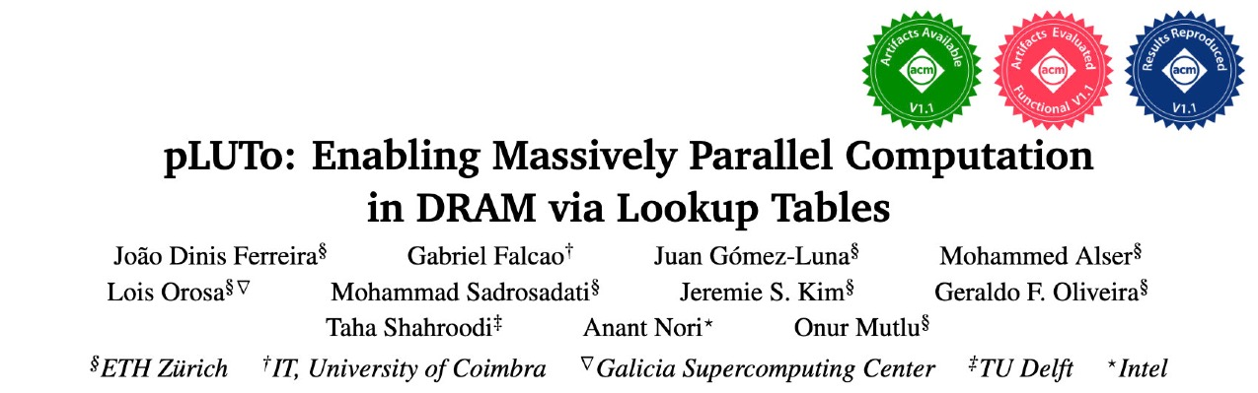

More in the Paper
https://arxiv.org/pdf/2104.07699.pdf
Notes:
YOU CAN FIND MORE DETAILS ABOUT OUR PROPOSED SYSTEM INTEGRATION STACK IN OUR PAPER,
INCLUDING A STEP-BY-STEP EXAMPLE OF HOW AN APPLICATION CHANGES FROM HIGH-LEVEL C CODE TO THE LOW-LEVEL PLUTO INSTRUCTIONS THAT MAP TO DRAM COMMANDS.

Slide 139
Performance
Average speedup across 7 real-world workloads
pLUTo significantly outperforms CPU, GPU and PnM baselines

Slide 140
Performance (normalized to area)
Average speedup normalized to area across 7 real-world workloads
pLUTo provides substantially higher performance per unit area than both the CPU and the GPU

Slide 141
Energy Consumption
Average energy consumption across 7 real-world workloads
pLUTo significantly reduces energy consumption compared to processor-centric architectures for various workloads

Slide 142
More Results in the Paper
Comparison with FPGA
Area Overhead Analysis
Circuit-Level Reliability & Correctness
Subarray-Level Parallelism
LUT Loading Overhead
Range of Supported Operations
https://arxiv.org/pdf/2104.07699.pdf

Slide 143
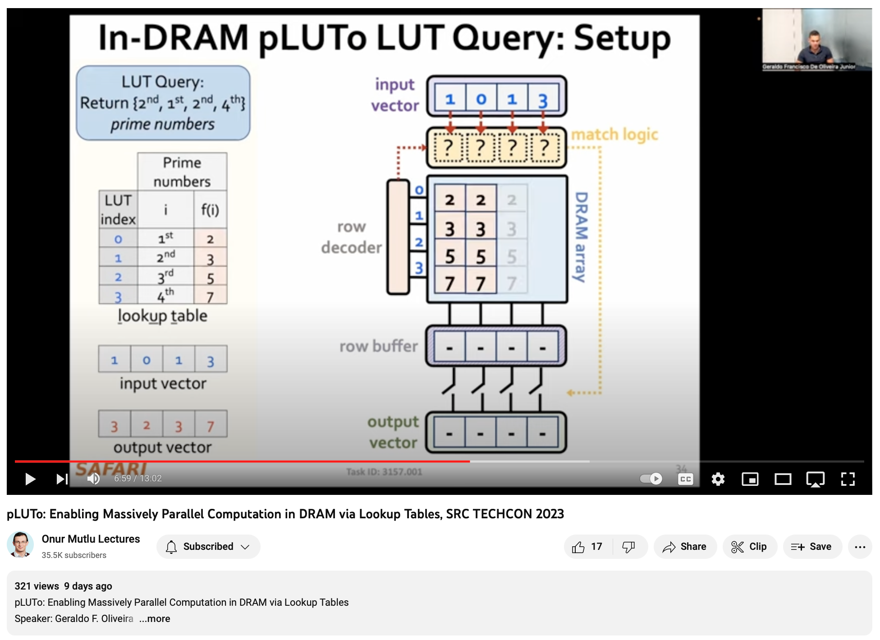
SRC TECHCON Presentation
Geraldo F. Oliveira
  pLUTo: Enabling Massively Parallel Computation in DRAM via Lookup Tables
  https://arxiv.org/pdf/2104.07699.pdf
https://youtu.be/9t1FJQ6nNw4?si=bhylWCLZde2DC7os

Slide 144
Is PUM in DRAM
Really Feasible?

Slide 145

RowClone in Off-the-Shelf DRAM Chips
Idea: Violate DRAM timing parameters to mimic RowClone
https://parallel.princeton.edu/papers/micro19-gao.pdf

Slide 146
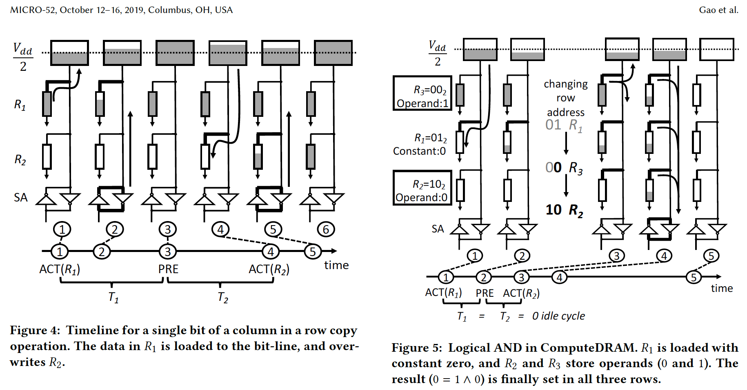
RowClone & Bitwise Ops in Real DRAM Chips
https://parallel.princeton.edu/papers/micro19-gao.pdf

Slide 147
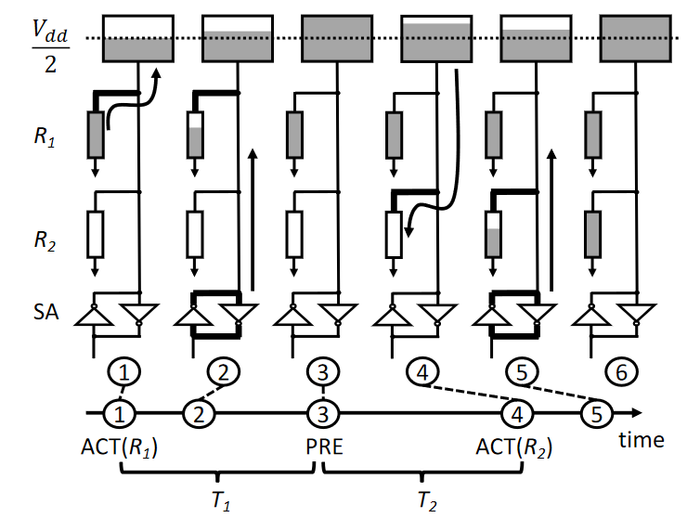
Row Copy in ComputeDRAM
Bitline is above V_{DD}/2 when R2 is activated.

Slide 148
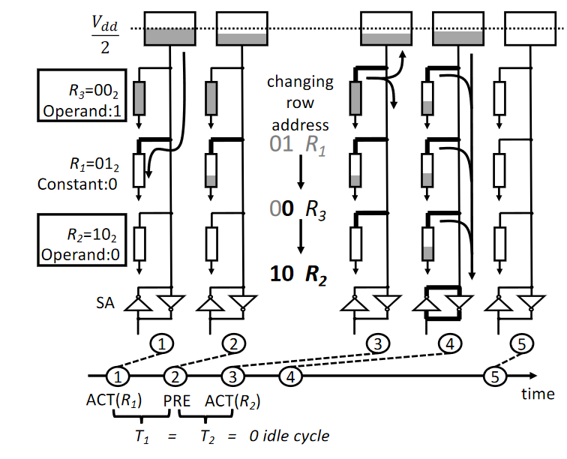
Bitwise AND in ComputeDRAM
T2 very short
PRE cannot close R1
R3 will appear on the address bus
ACT(R2) will activate R3 and R2
T1 very short
Sense amps are not activated

Slide 149
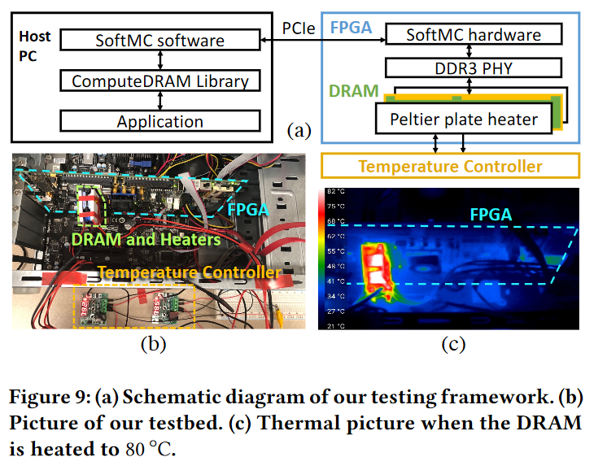
Experimental Methodology

Slide 150
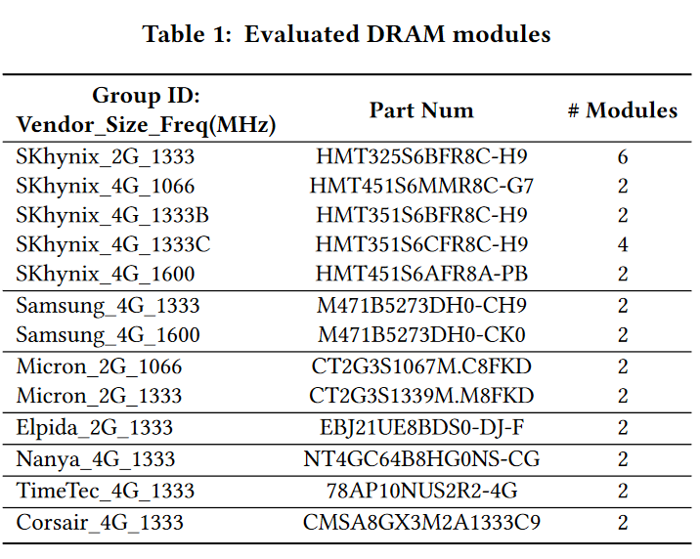
Experimental Methodology
32 DDR3 Modules
~256 DRAM Chips

Slide 151
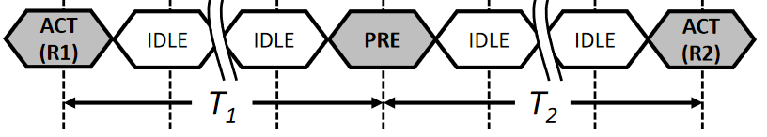
Proof of Concept
How they test these memory modules:
  Vary T₁ and T₂, observe what happens.
  SoftMC Experiment
Select a random subarray
Fill subarray with random data
Issue ACT-PRE-ACTs with given T₁ & T₂
Read out subarray
Find out how many columns in a row support either operation
  Row-wise success ratio

Slide 152
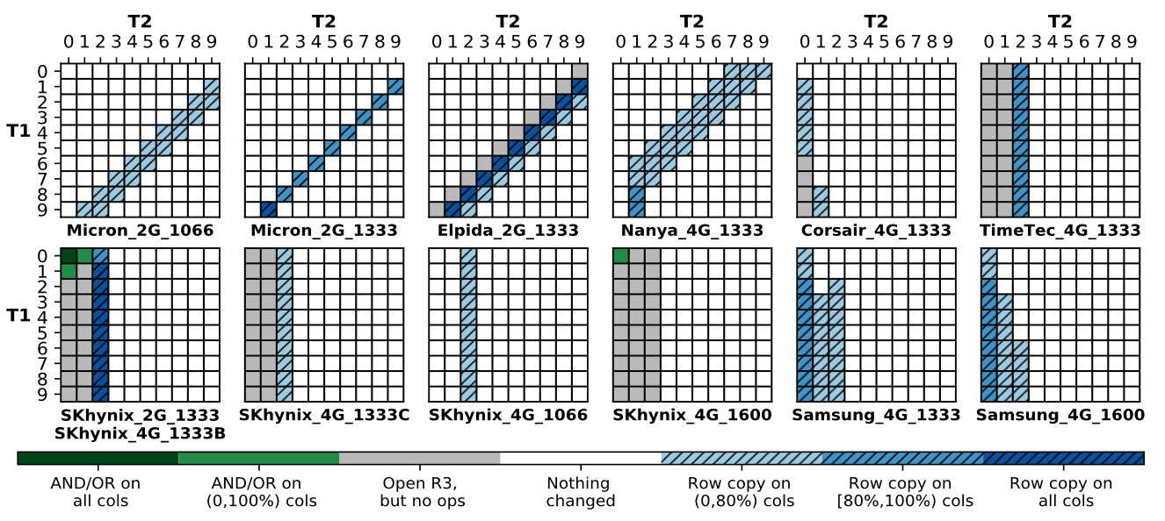
Proof of Concept
Each grid represents the success ratio of operations for a specific DDR3 module.

Slide 153
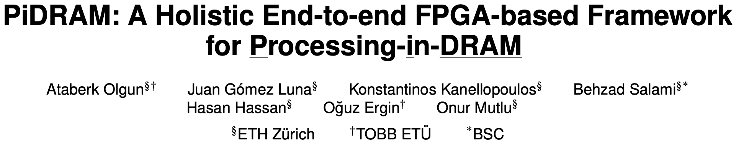
Real Processing-Using-Memory Prototype
End-to-end RowClone & TRNG using off-the-shelf DRAM chips
Idea: Violate DRAM timing parameters to mimic RowClone
https://arxiv.org/pdf/2111.00082.pdf
https://github.com/cmu-safari/pidram
https://www.youtube.com/watch?v=qeukNs5XI3g&t=4192s

Slide 154


PiDRAM
Goal: Develop a flexible platform to explore
end-to-end implementations of PuM techniques
Enable rapid integration via key components
Hardware
Software
Easy-to-extend
Memory Controller
Extensible
Software Library
1
1
ISA-transparent
PuM Controller
Custom
Supervisor Software
2
2

Slide 155
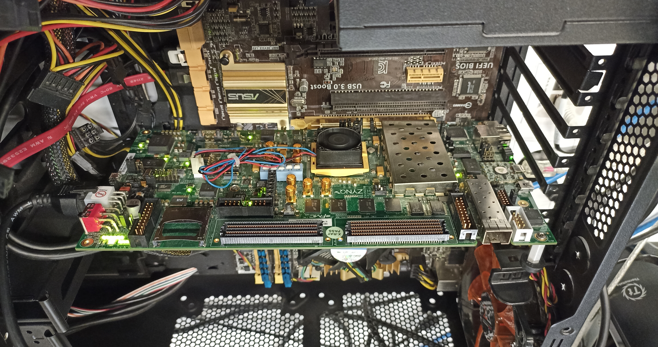
Real Processing-Using-Memory Prototype
Host Machine
https://arxiv.org/pdf/2111.00082.pdf
https://github.com/cmu-safari/pidram
https://www.youtube.com/watch?v=qeukNs5XI3g&t=4192s
FPGA Board
RISC-V System
PiM-Enabled DIMM

Slide 156
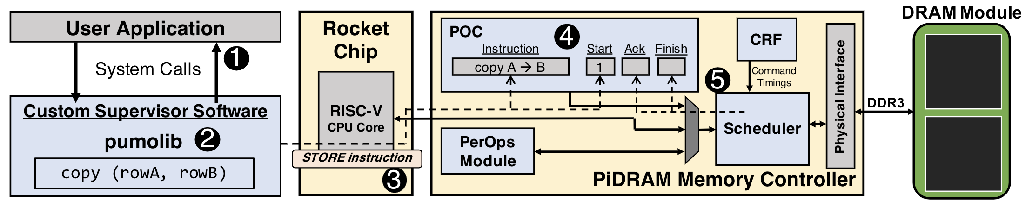
PiDRAM Workflow
1- User application interfaces with the OS via system calls
2- OS uses PUM Operations Library (pumolib) to convey operation related information to the hardware using
3- STORE instructions that target the memory mapped registers of the PUM Operations Controller (POC)
4- POC oversees the execution of a PUM operation (e.g., RowClone, bulk bitwise operations)
5- Scheduler arbitrates between regular (load, store) and PUM operations and issues DRAM commands with custom timings

Slide 157
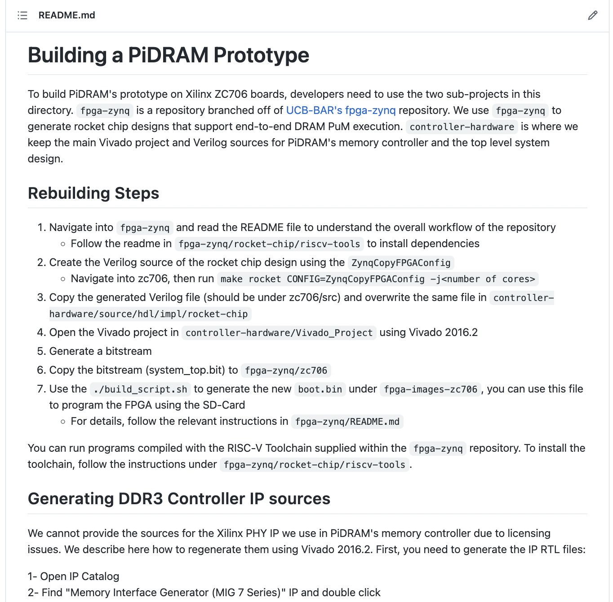
Real Processing-Using-Memory Prototype
https://arxiv.org/pdf/2111.00082.pdf
https://github.com/cmu-safari/pidram
https://www.youtube.com/watch?v=qeukNs5XI3g&t=4192s

Slide 158
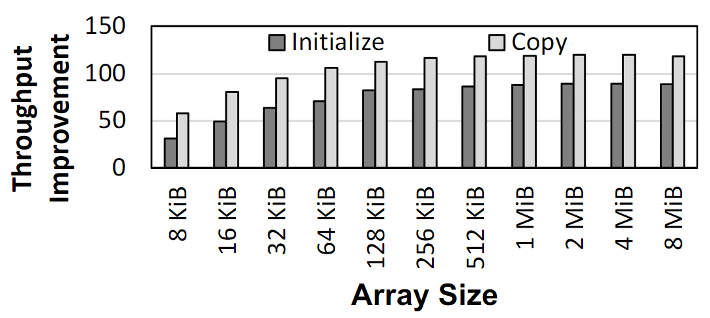
Microbenchmark Copy/Initialization Throughput
In-DRAM Copy and Initialization
improve throughput by 119x and 89x
Notes:
This plot shows the throughput improvement provided by in-DRAM copy operations for bulk data initialization and copy over CPU-based copy and initialization using LOAD and STORE instructions. We do not execute any CLFLUSH instructions and assume that the data is up to date in DRAM and there are no cached copies.
The x-axis shows the size of the arrays that we copy or initialize. The dark gray bar shows the improvement for initialization operations, and the bright gray bar shows the improvement for copy operations.
[CLICK] We observe that in-DRAM copy and initialization operations improve copy and initialization throughput by 119x and 89x including the overheads of system support required for RowClone operations

Slide 159
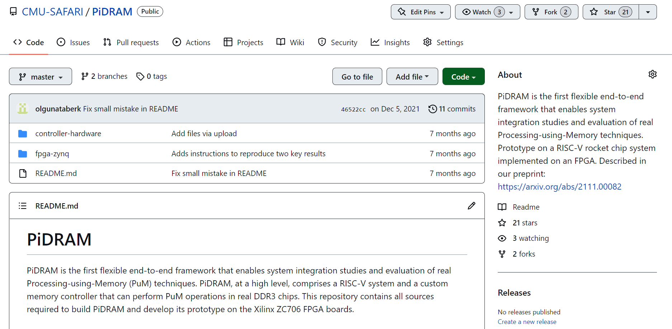
PiDRAM is Open Source
https://github.com/CMU-SAFARI/PiDRAM
Notes:
PiDRAM is openly and freely available on Github. If you are interested in PiDRAM, please use it and feel free to contribute to it.

Slide 160
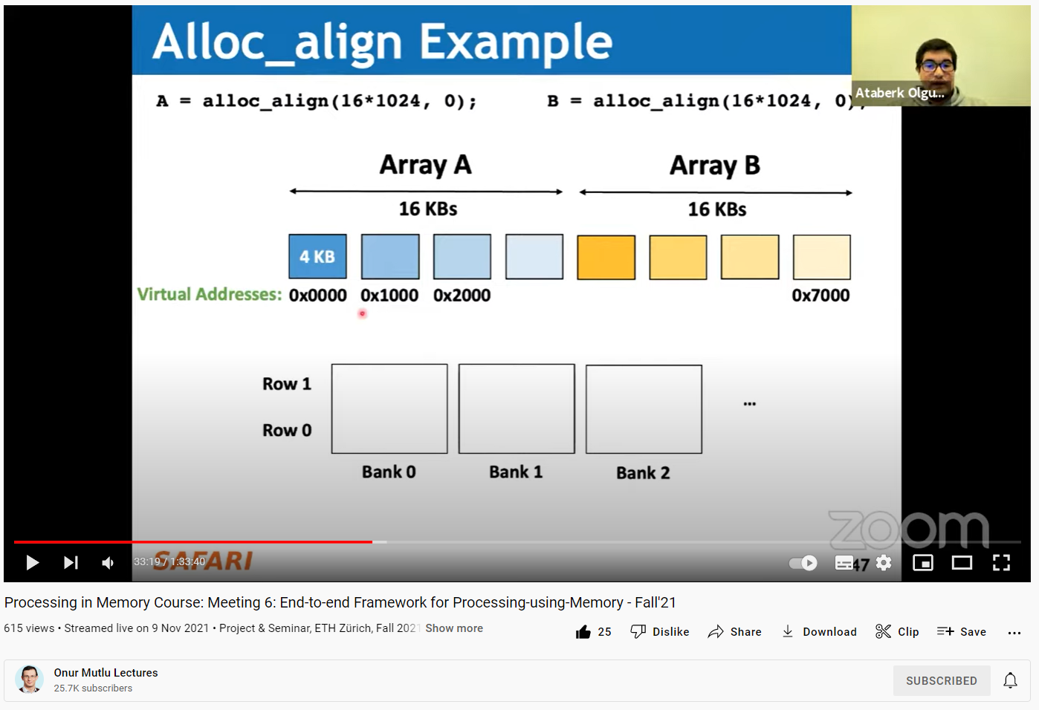
PiDRAM: Long Talk and Tutorial
https://youtu.be/s_z_S6FYpC8
Notes:
I also describe PiDRAM in more detail and give a tutorial on how to use our framework in this SAFARI live seminar talk.

Slide 161
PUM in Non-Volatile Memories

Slide 162
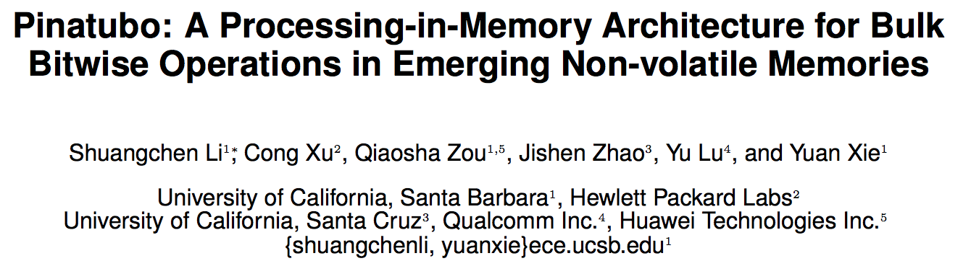
Pinatubo: Row Copy and Bitwise Ops in PCM
https://cseweb.ucsd.edu/~jzhao/files/Pinatubo-dac2016.pdf

Slide 163
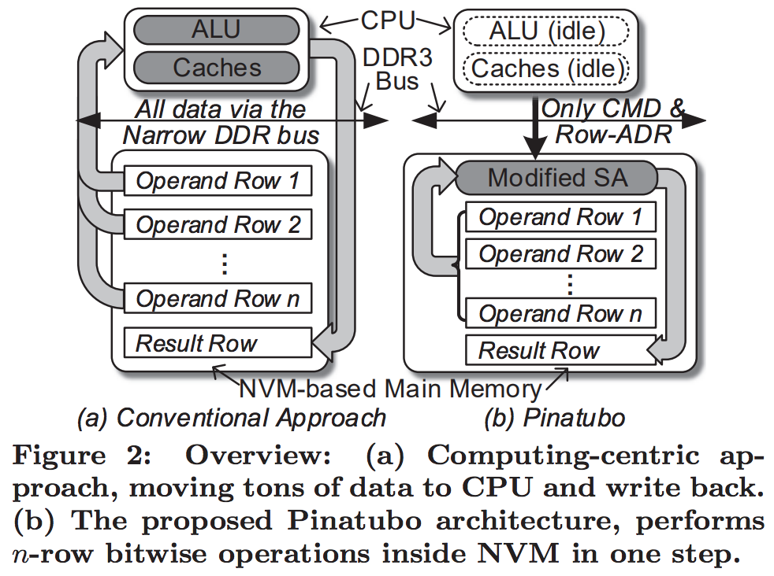
Pinatubo: Row Copy and Bitwise Ops in PCM
https://cseweb.ucsd.edu/~jzhao/files/Pinatubo-dac2016.pdf

Slide 164
In-Memory Crossbar Array Operations
Some emerging NVM technologies have crossbar array structure
  Memristors, resistive RAM, phase change mem, STT-MRAM, …
Crossbar arrays can be used to perform dot product operations using “analog computation capability”
  Can operate on multiple pieces of data using Kirchoff’s laws
    Bitline current is a sum of products of wordline V x (1 / cell R)
  Computation is in analog domain inside the crossbar array
Need peripheral circuitry for D→A and A→D conversion of inputs and outputs

Slide 165
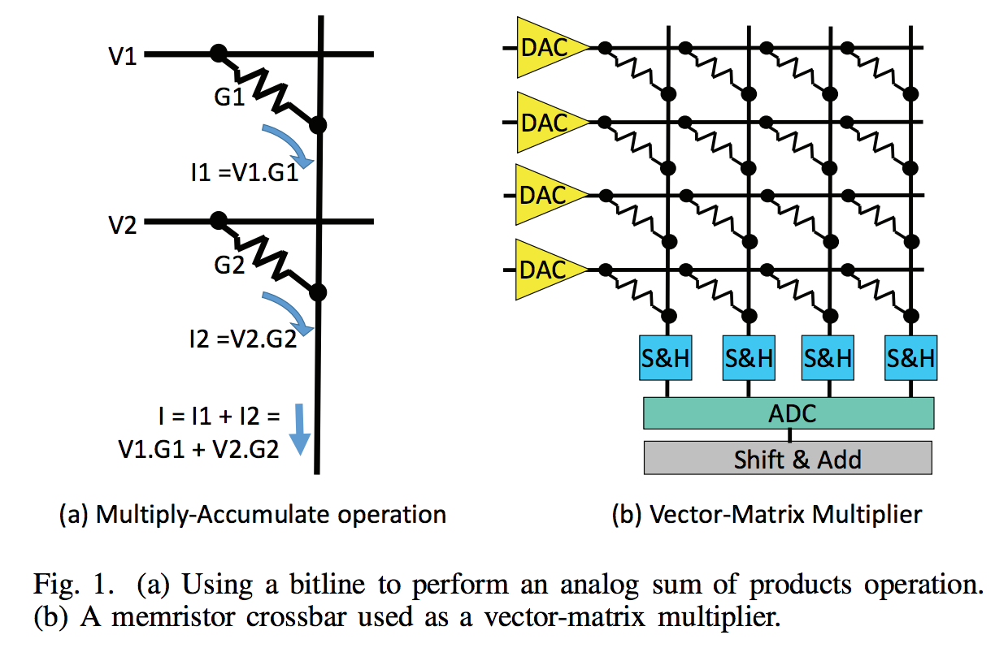
In-Memory Crossbar Computation
Shafiee+, “ISAAC: A Convolutional Neural Network Accelerator with In-Situ Analog Arithmetic in Crossbars”, ISCA 2016

Slide 166
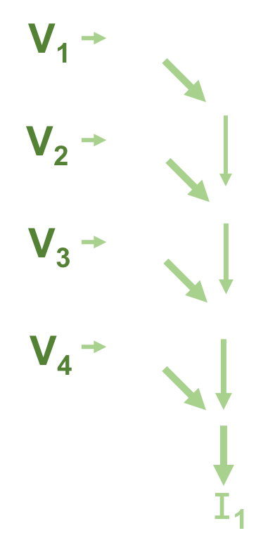
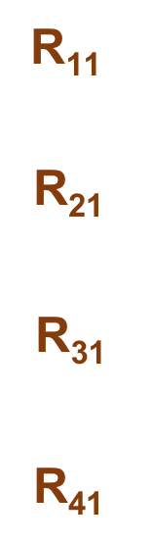
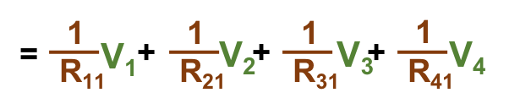
In-Memory Crossbar Computation
Notes:
This is a core part of ReRAM-based PIM. We use resistance of each cell to represent the value of weight, and add voltages representing values of inputs on each row.
According to the Kirchhoff‘s law, we finally obtain a current, representing the value of output. Thus, by modifying the peripheral circuit of ReRAM array, it can support a Matrix-Multiply-Vector operation in almost one read cycle. Let’s see how to do it.
We have an input vector, multiply it with a matrix, and get an output vector.
First, we write the matrix into a ReRAM array.
Then we feed inputs into the ReRAM array, through performing an analog sum, finally we obtain outputs.

Slide 167
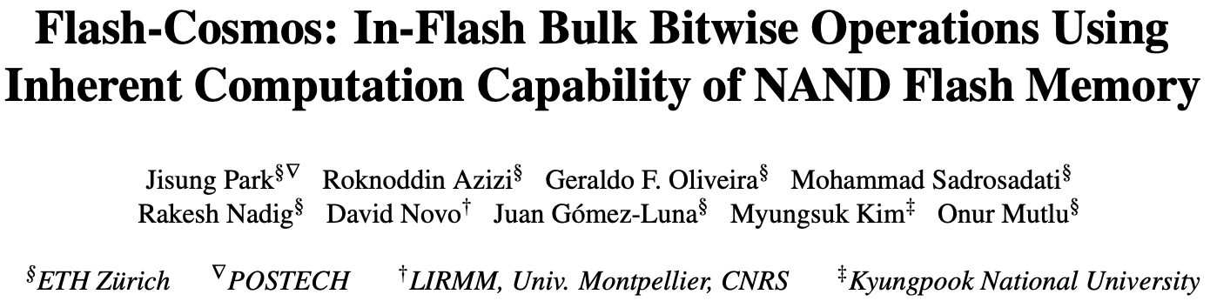
In-Flash Bulk Bitwise Execution
Jisung Park, Roknoddin Azizi, Geraldo F. Oliveira, Mohammad Sadrosadati, Rakesh Nadig, David Novo, Juan Gómez-Luna, Myungsuk Kim, and Onur Mutlu,
"Flash-Cosmos: In-Flash Bulk Bitwise Operations Using Inherent Computation Capability of NAND Flash Memory"
Proceedings of the 55th International Symposium on Microarchitecture (MICRO), Chicago, IL, USA, October 2022.
[Slides (pptx) (pdf)]
[Longer Lecture Slides (pptx) (pdf)]
[Lecture Video (44 minutes)]
[arXiv version]
https://arxiv.org/pdf/2209.05566.pdf

Slide 168
NAND Flash Basics: A Flash Cell
A flash cell stores data by adjusting the amount of charge in the cell
1
0
Erased Cell
(Low Charge Level)
Programmed Cell
(High Charge Level)
Activation
Operates as an open switch
Operates as a resistor

Slide 169
NAND Flash Basics: A NAND String
A set of flash cells are serially connected to form a NAND String
Bitline (BL)
1
0
0
1
…
0
NAND String

Slide 170
NAND Flash Basics: A NAND Flash Block
NAND strings connected to different bitlines comprise a NAND block
BL₁
BL₂
BL₃
BL₄
BL₅
BL_{N}
Block
WL₁
1
1
1
1
1
…
1
A single wordline (WL) controls a large number of flash cells: High bit-level parallelism
WL₂
0
0
0
0
0
…
0
WL₃
0
0
0
0
0
…
0
WL₄
1
1
1
1
1
…
1
…
…
…
…
…
…
WL_{M}
0
0
0
0
0
…
0

Slide 171
Multi-Wordline Sensing (MWS): Bitwise AND
Intra-Block MWS: Simultaneously activates multiple WLs in the same block
  Bitwise AND of the stored data in the WLs
BL₁
BL₂
BL₃
BL₄
Target Cells:
Operate
as resistors (1)
or open switches (0)
WL₁
0
0
1
1
…
WL₂
0
1
0
1
…
WL₃
1
0
1
1
…
Non-Target Cells:
Operate
as resistors
0
0
1
0
…
WL₄
…
…
…
…
Result:
0
0
0
1

Slide 172
Multi-Wordline Sensing (MWS): Bitwise AND
Intra-Block MWS: Simultaneously activates multiple WLs in the same block
  Bitwise AND of the stored data in the WLs
BL₁
BL₂
BL₃
BL₄
Target Cell:
Operate
as a resistance (1)
or an open switch (0)
WL₁
0
0
1
1
…
A bitline reads as ‘1’ only when all the target cells store ‘1’
→ Equivalent to the bitwise AND of all the target cells
WL₂
0
1
0
1
…
WL₃
1
0
1
1
…
Non-Target Cell:
Operate
as a resistance
0
0
1
0
…
WL₄
…
…
…
…
Result:
0
0
0
1

Slide 173
Multi-Wordline Sensing (MWS): Bitwise AND
Intra-Block MWS: Simultaneously activates multiple WLs in the same block
  Bitwise AND of the stored data in the WLs
BL₁
BL₂
BL₃
BL₄
Flash-Cosmos (Intra-Block MWS) enables
bitwise AND of multiple pages in the same block
via a single sensing operation
WL₁
0
0
1
1
…
A bitline reads as ‘1’ only when all the target cells store ‘1’
→ Equivalent to the bitwise AND of all the target cells
Target Cell:
Operate
as a resistance (1)
or an open switch (0)
WL₂
0
1
0
1
…
WL₃
1
0
1
1
…
WL₄
0
0
1
1
…
…
…
…
…
Result:
0
0
0
1

Slide 174
Multi-Wordline Sensing (MWS): Bitwise OR
Inter-Block MWS: Simultaneously activates multiple WLs in different blocks
  Bitwise OR of the stored data in the WLs
BL₁
BL₂
BL₃
BL₄
WL_{x} in Block₁
1
0
1
0
…
…
…
…
…
WL_{y} in Block_{i}
1
1
0
0
…
…
…
…
…
Result:
1
1
1
0

Slide 175
Multi-Wordline Sensing (MWS): Bitwise OR
Inter-Block MWS: Simultaneously activates multiple WLs in different blocks
  Bitwise OR of the stored data in the WLs
BL₁
BL₂
BL₃
BL₄
WL_{x} in Block₁
1
0
1
0
…
A bitline reads as ‘0’ only when all the target cells store ‘0’
→ Equivalent to the bitwise OR of all the target cells
…
…
…
…
WL_{y} in Block_{i}
1
1
0
0
…
…
…
…
…
Result:
1
1
1
0

Slide 176
Multi-Wordline Sensing (MWS): Bitwise OR
Inter-Block MWS: Simultaneously activates multiple WLs in different blocks
  Bitwise OR of the stored data in the WLs
BL₁
BL₂
BL₃
BL₄
1
0
1
0
…
Flash-Cosmos (Inter-Block MWS) enables
bitwise OR of multiple pages in different blocks
via a single sensing operation
WL_{x} in Block₁
…
…
…
…
WL_{y} in Block_{i}
1
1
0
0
…
…
…
…
…
WL_{y} in Block_{i}
1
0
0
1
…
Result:
1
1
1
1

Slide 177
Processing-Using-Memory (PUM)
PUM: Exploits analog operational principles of the memory circuitry to perform computation
  Exploits internal connectivity to move data
  Leverages the large internal bandwidth and parallelism available inside the memory arrays
A common approach for PUM architectures is to perform bulk bitwise operations
  Simple logical operations (e.g., AND, OR, XOR)
  More complex operations (e.g., addition, multiplication)

Slide 178
MICRO 2023 Tutorial
Real-world Processing-in-Memory Systems for Modern Workloads
Processing-Using-Memory
Exploiting the Analog Operational
Properties of Memory Components
Geraldo F. Oliveira
Professor Onur Mutlu
Sunday, October 29, 2023

