Slide 1
International Symposium on Microarchitecture (MICRO)
Real-world
Processing-in-Memory
Systems
for Modern Workloads
https://ethz.zoom.us/j/68459763236?pwd=NEIzK1JGV0pHTjRaUzV5NmRna3JkZz09
https://www.youtube.com/live/ohU00NSIxOI?si=h1I9eUx7KCScMHrg
October 29th, 2023

Slide 2
Data Movement in Computing Systems
Data movement dominates performance and is a major system energy bottleneck
Total system energy: data movement accounts for
  62% in consumer applications✻,
  40% in scientific applications★,
  35% in mobile applications☆
Data Movement
SoC
DRAM
CPU
CPU
L2
GPU
Video Encoder
Video Decoder
Audio
Display Engine
✻ Boroumand et al., “Google Workloads for Consumer Devices: Mitigating Data Movement Bottlenecks,” ASPLOS 2018
★ Kestor et al., “Quantifying the Energy Cost of Data Movement in Scientific Applications,” IISWC 2013
☆ Pandiyan and Wu, “Quantifying the energy cost of data movement for emerging smart phone workloads on mobile platforms,” IISWC 2014

Slide 3
Data Movement in Computing Systems
Data movement dominates performance and is a major system energy bottleneck
Total system energy: data movement accounts for
  62% in consumer applications✻,
  40% in scientific applications★,
  35% in mobile applications☆
Compute systems should be more data-centric
Data Movement
SoC
CPU
Processing-In-Memory proposes
computing where it makes sense
(where data resides)
CPU
L2
DRAM
GPU
Video Encoder
Video Decoder
Audio
Display Engine
✻ Boroumand et al., “Google Workloads for Consumer Devices: Mitigating Data Movement Bottlenecks,” ASPLOS 2018
★ Kestor et al., “Quantifying the Energy Cost of Data Movement in Scientific Applications,” IISWC 2013
☆ Pandiyan and Wu, “Quantifying the energy cost of data movement for emerging smart phone workloads on mobile platforms,” IISWC 2014

Slide 4
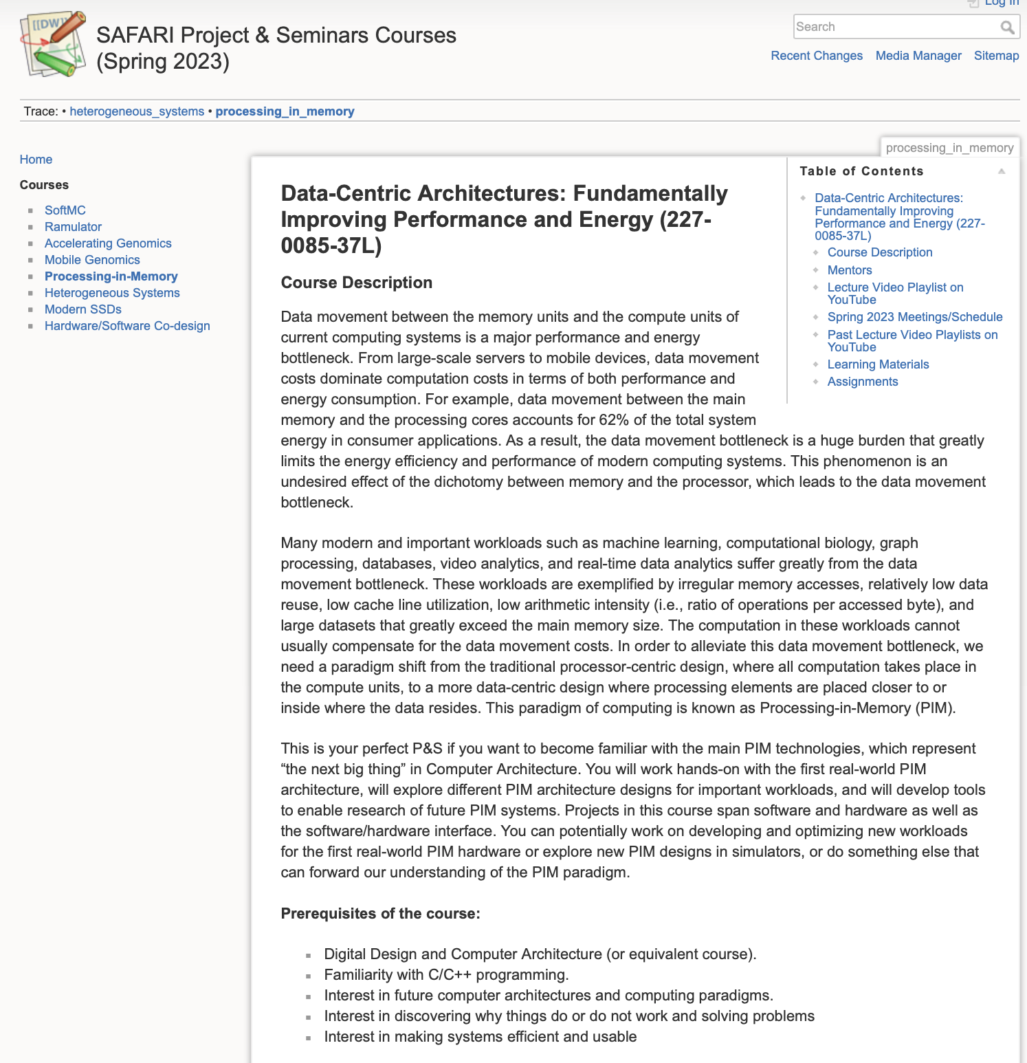
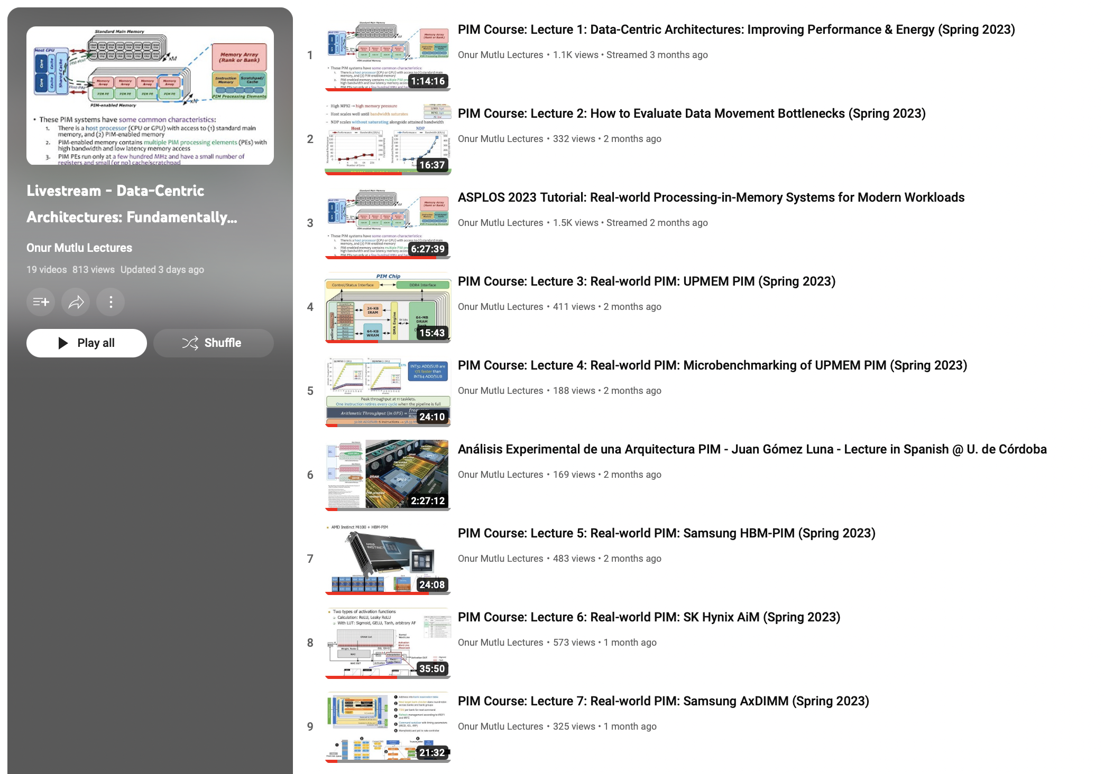
Processing-in-Memory Course (Spring 2023)
Short weekly lectures
Hands-on projects
https://www.youtube.com/playlist?list=PL5Q2soXY2Zi_EObuoAZVSq_o6UySWQHvZ
https://safari.ethz.ch/projects_and_seminars/spring2023/doku.php?id=processing_in_memory

Slide 5
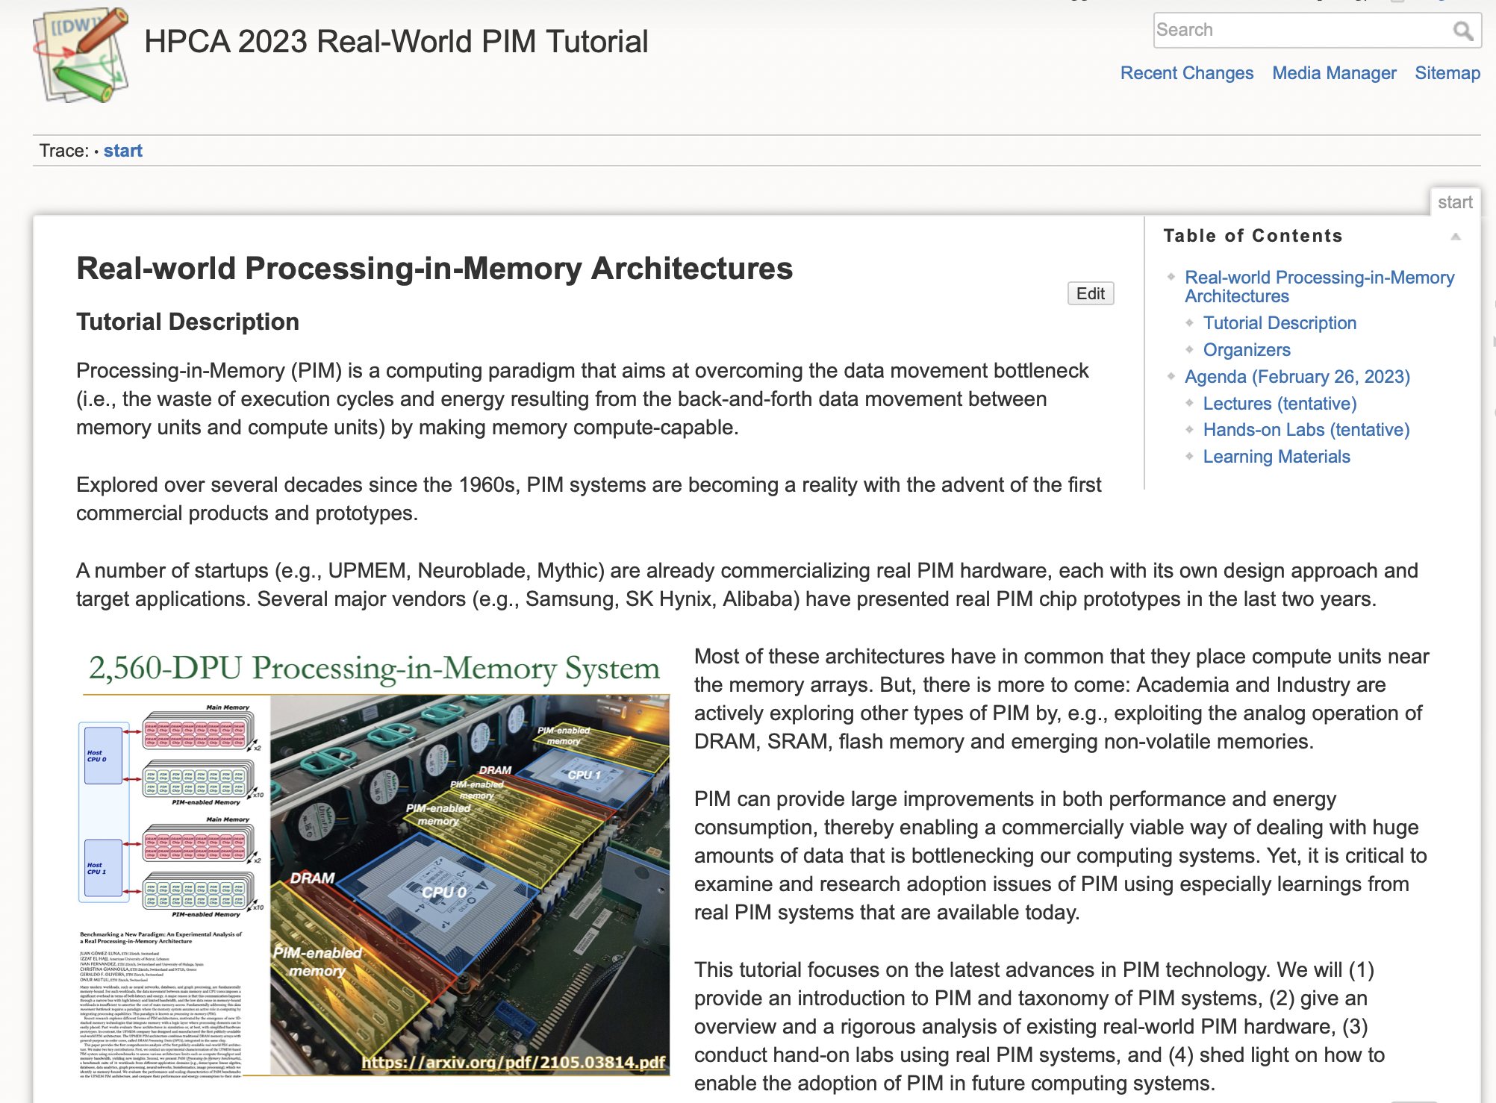
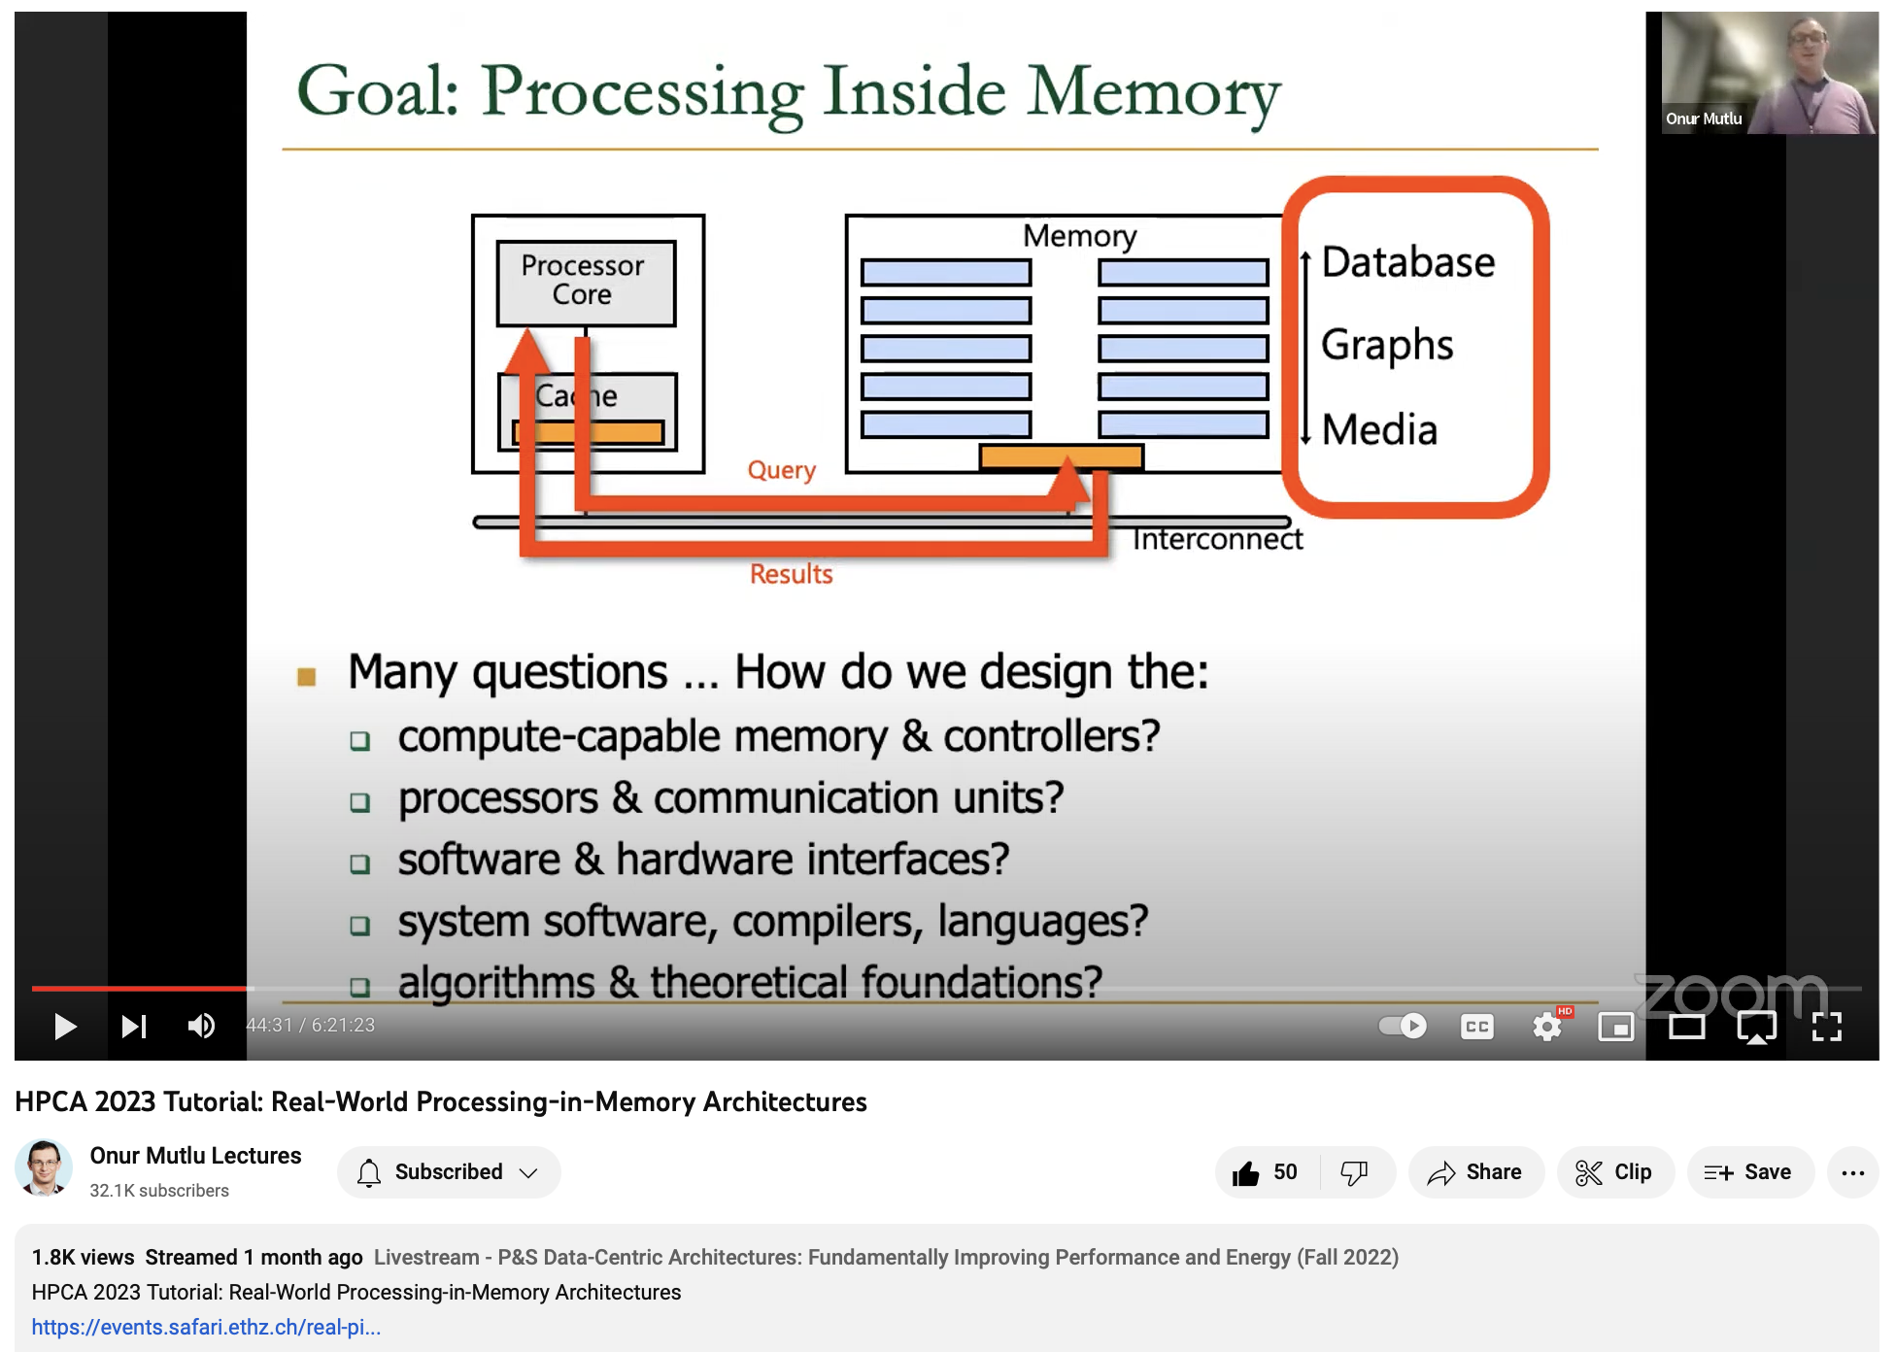
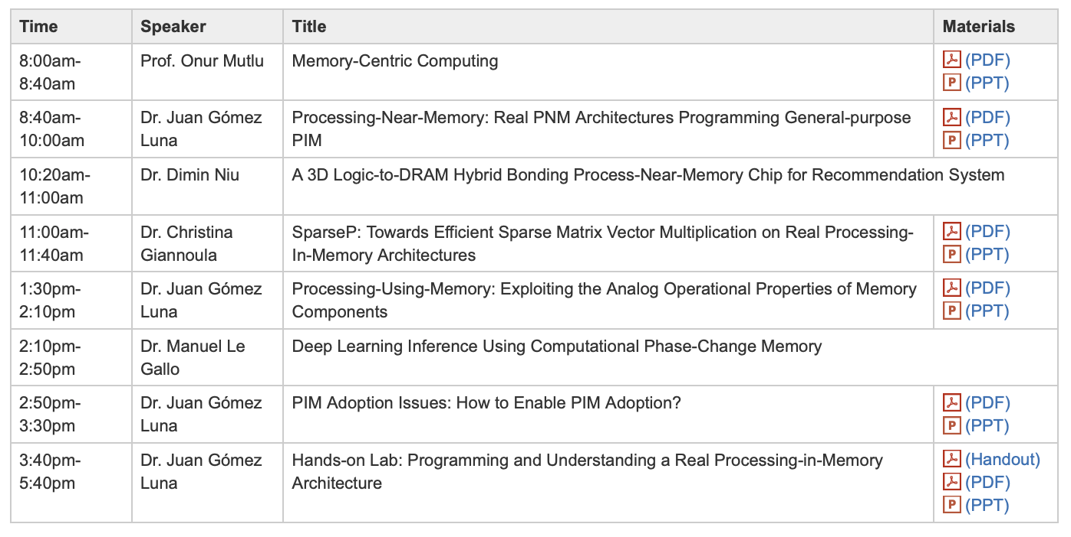
Real PIM Tutorial (HPCA 2023)
February 26th: Lectures + Hands-on labs + Invited lectures
https://www.youtube.com/live/f5-nT1tbz5w?feature=share
https://events.safari.ethz.ch/real-pim-tutorial/doku.php?id=start

Slide 6
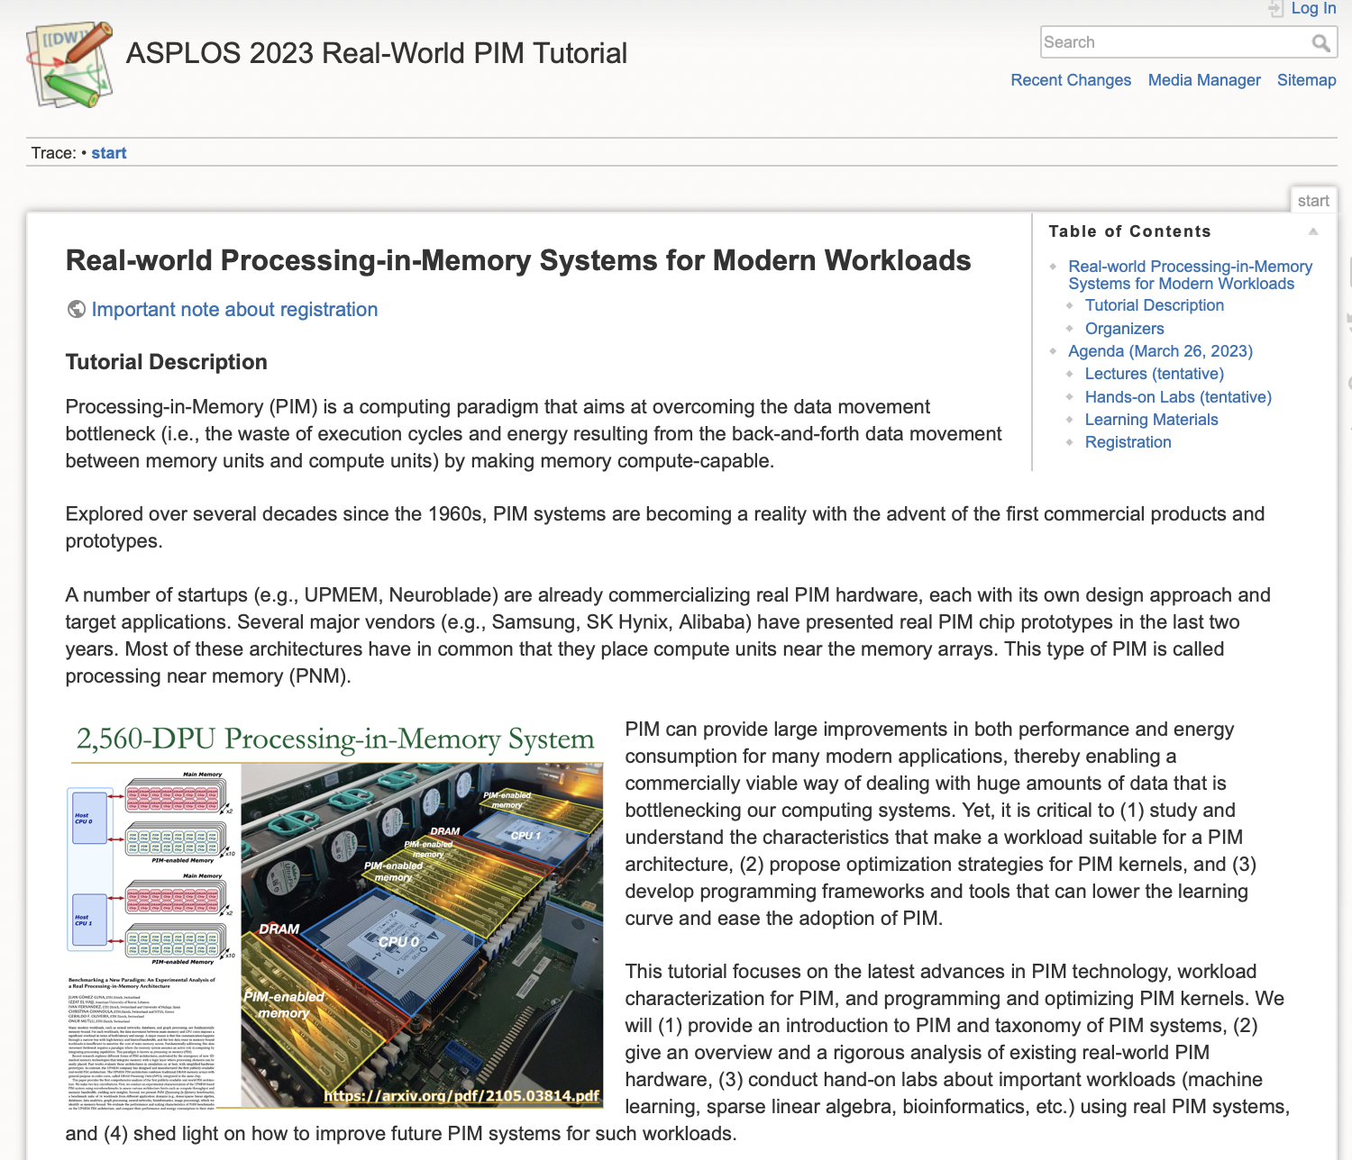
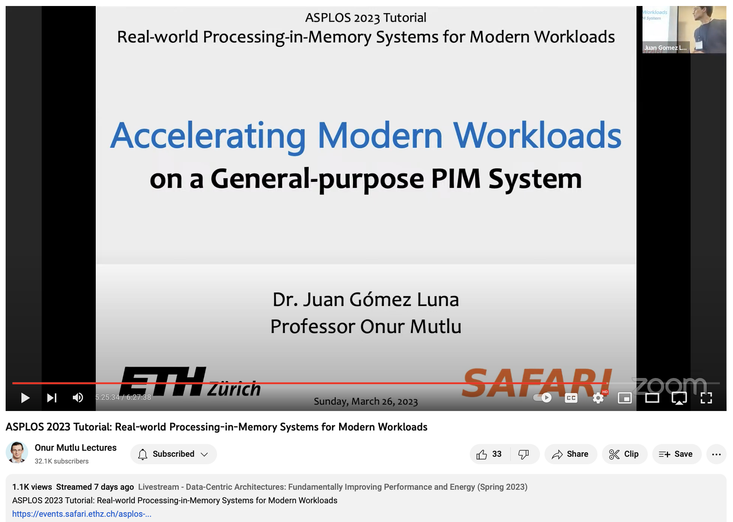
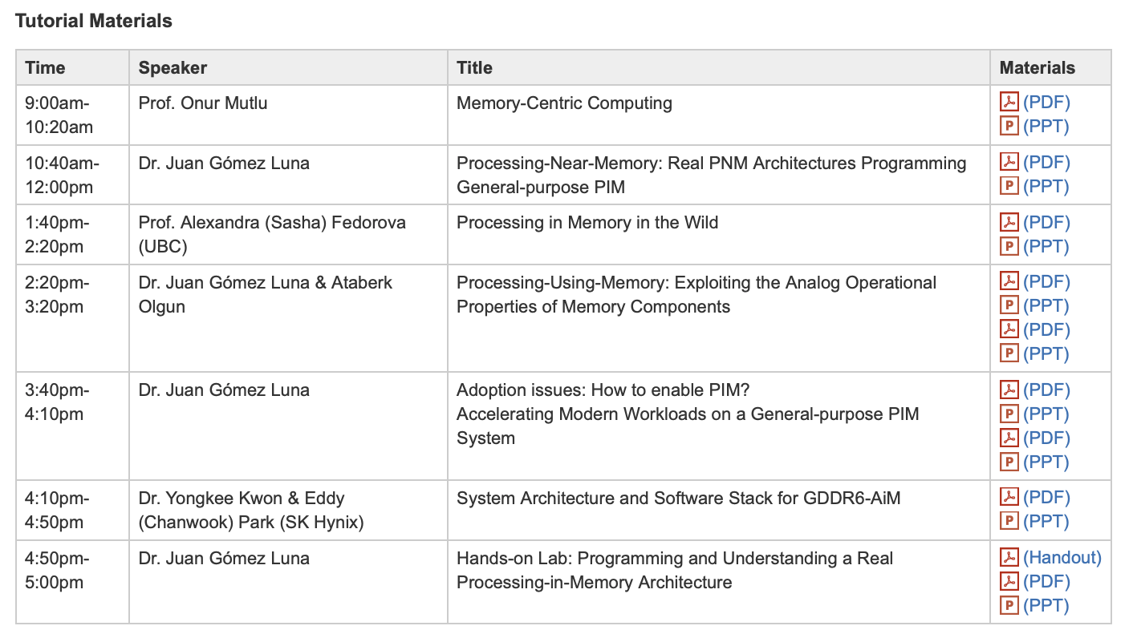
Real PIM Tutorial (ASPLOS 2023)
March 26th: Lectures + Hands-on labs + Invited lectures
https://www.youtube.com/live/oYCaLcT0Kmo?feature=share
https://events.safari.ethz.ch/asplos-pim-tutorial/doku.php?id=start

Slide 7
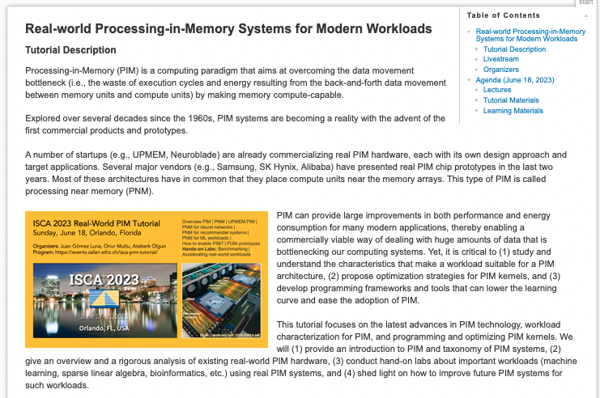
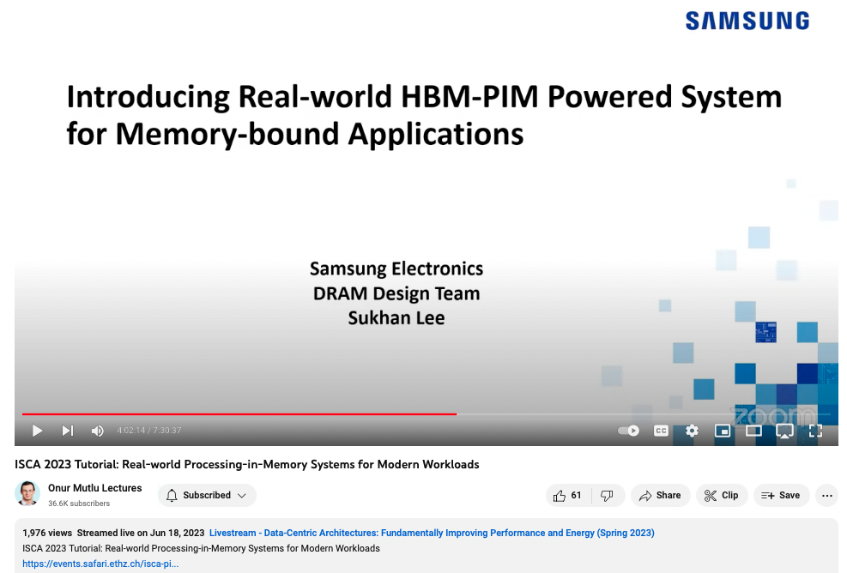
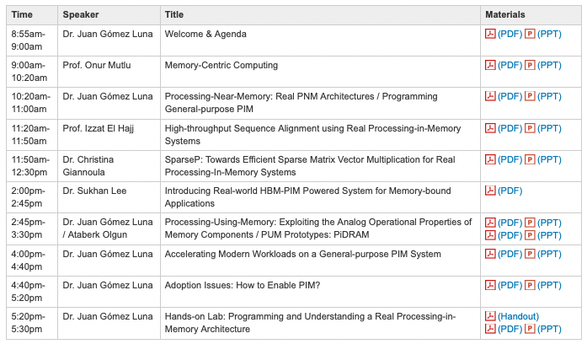
Real PIM Tutorial (ISCA 2023)
June 18th: Lectures + Hands-on labs + Invited lectures
https://www.youtube.com/live/GIb5EgSrWk0?si=Ws5bzE4UhHsj-mII
https://events.safari.ethz.ch/isca-pim-tutorial/doku.php?id=start

Slide 8
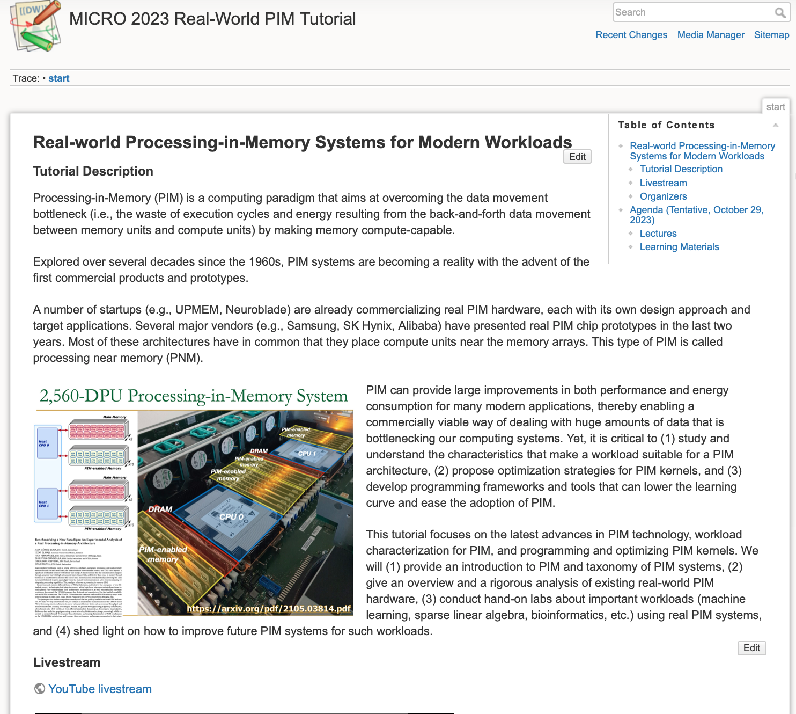
Real PIM Tutorial (MICRO 2023)
October 29th: Lectures + Hands-on labs + Invited lectures
https://youtube.com/live/ohU00NSIxOI?feature=share
https://events.safari.ethz.ch/micro-pim-tutorial/doku.php?id=start

Slide 9
Agenda (EDT GMT-4)
7:55am-8:00am, Dr Juan Gómez Luna, “Welcome & Agenda.”
8:00am-9:20am, Prof. Onur Mutlu / Geraldo F. Oliveira, "Memory-centric Computing: Introduction to PIM as a Paradigm to Overcome the Data Movement Bottleneck."
  PIM taxonomy: PNM (processing near memory) and PUM (processing using memory).
  DAMOV Workload Characterization Methodology.
9:20am-10:20am, Dr. Juan Gómez Luna, “Processing-Near-Memory: Real PNM.”
  PNM prototypes: Samsung HBM-PIM, SK Hynix AiM, Samsung AxDIMM, Alibaba HB-PNM.
  UPMEM PIM: Architecture Characterization, Programming.
Coffee break (10:20am-10:40am)
10:40am-11:20am, Prof. Youngsok Kim (Yonsei University), "PID-Join: A Fast In-Memory Join Algorithm for Commodity PIM-Enabled DIMMs."
11:20am-12:00pm, Dr. Abu Sebastian (IBM Research - Zürich), "PUM Based on Memristive Devices: The IBM HERMES Project Chip."
Lunch break (12:00pm-1:00pm)
1:00pm-2:00pm, Geraldo F. Oliveira, "Processing-Using-DRAM: Ambit, SIMDRAM, pLUTo."
2:00pm-3:15pm, Dr. Juan Gómez Luna, “Accelerating Modern Workloads on a General-purpose PIM System: Machine leaning, Genomics...”
3:15pm-3:45pm, Dr. Juan Gómez Luna, “Adoption Issues: How to Enable PIM?”
3:45pm-4:15pm, Dr. Juan Gómez Luna, "SimplePIM: A Software Framework for High-level PIM Programming."
4:15pm-5:00pm, Ataberk Olgun, "Processing-Using-Memory Prototypes: PiDRAM."
5:00pm-5:10pm, Dr. Juan Gómez Luna, “Introduction/Preparation for Hands-on Labs.”
  Optional - Hands-on Lab: Programming and Understanding a Real PIM Architecture.

Slide 10
Join Algorithm for Commodity PIM DIMMs
PID-Join: A Fast In-Memory Join Algorithm for Commodity PIM-Enabled DIMMs
  Prof. Youngsok Kim
Abstract: Modern dual in-line memory modules (DIMMs) now allow applications to offload their memory-intensive operations onto the in-DIMM processors (IDPs) located near the memory banks of a DIMM. The IDPs can greatly accelerate in-memory joins whose performance is frequently bottlenecked by main-memory accesses. In this talk, I will present PID-Join, a fast in-memory join algorithm which exploits the IDPs to further improve the performance of in-memory joins. PID-Join is optimized for UPMEM DIMMs, currently the only publicly-available DIMMs equipped with the IDPs. PID-Join achieves significant speedups over the existing CPU-based join implementations by prototyping and evaluating hash, sort-merge, and nested-loop algorithms optimized for the IDPs, enabling fast inter-IDP communication using host CPU cache streaming and vector instructions, and facilitating fast rank-wise data transfers between the IDPs and the main memory.
Bio: Youngsok Kim is currently an assistant professor with the Department of Computer Science at Yonsei University. His research interests span computer architecture and system software with an emphasis on architecture-conscious database management systems, performance modeling, and architectural support for deep learning. He received his BSc and PhD in Computer Science and Engineering from POSTECH. He was a post-doc researcher at Seoul National University before joining Yonsei University, and was an intern at Consumer Hardware, Google Inc. and S.LSI Business, Samsung Electronics Co., Ltd. during his PhD studies.

Slide 11
PUM based on Memristive Devices
PUM based on Memristive Devices: The IBM HERMES Project Chip
  Dr. Abu Sebastian
Abstract: I will introduce analog in-memory computing (or processing using memory) based on memristive technology. A multi-tile, mixed-signal AIMC prototype chip (The IBM HERMES Project Chip) aimed at deep learning inference application will be presented. This chip fabricated in 14nm CMOS technology comprises 64 AIMC cores/tiles based on phase-change memory technology. I will delve deeper into the device, circuits, architectural and algorithmic aspects of AIMC based on this prototype chip. Finally, I will conclude with a brief overview of on-going research activities.
Bio: Dr. Abu Sebastian is one of the technical leaders of IBM’s research efforts towards next generation AI Hardware and manages the in-memory computing group at IBM Research - Zurich. He is the author of over 200 publications in peer-reviewed journals/conference proceedings and holds over 90 US patents. In 2015 he was awarded the European Research Council (ERC) consolidator grant and in 2020, he was awarded an ERC Proof-of-concept grant. He was an IBM Master Inventor and was named Principal and Distinguished Research Staff Member in 2018 and 2020, respectively. In 2019, he received the Ovshinsky Lectureship Award for his contributions to "Phase-change materials for cognitive computing". In 2023, he was conferred the title of Visiting Professor in Materials by University of Oxford. He is a distinguished lecturer and fellow of the IEEE. Homepage: https://research.ibm.com/people/abu-sebastian

Slide 12
International Symposium on Microarchitecture (MICRO)
Real-world
Processing-in-Memory
Systems
for Modern Workloads
https://ethz.zoom.us/j/68459763236?pwd=NEIzK1JGV0pHTjRaUzV5NmRna3JkZz09
https://www.youtube.com/live/ohU00NSIxOI?si=h1I9eUx7KCScMHrg
October 29th, 2023

