Slide 1
MICRO 2023 Tutorial
Real-world Processing-in-Memory Systems for Modern Workloads
PIM Adoption Issues
How to Enable PIM Adoption?
Dr. Juan Gómez Luna
Professor Onur Mutlu
Sunday, October 29, 2023

Slide 2
Potential Barriers to Adoption of PIM
1. Applications & software for PIM
2. Ease of programming (interfaces and compiler/HW support)
3. System and security support: coherence, synchronization, virtual memory, isolation, communication interfaces, …
4. Runtime and compilation systems for adaptive scheduling, data mapping, access/sharing control, …
5. Infrastructures to assess benefits and feasibility
All can be solved with change of mindset

Slide 3
We Need to Revisit the Entire Stack
Problem
Algorithm
Program/Language
System Software
SW/HW Interface
Micro-architecture
Logic
Devices
Electrons
We can get there step by step

Slide 4
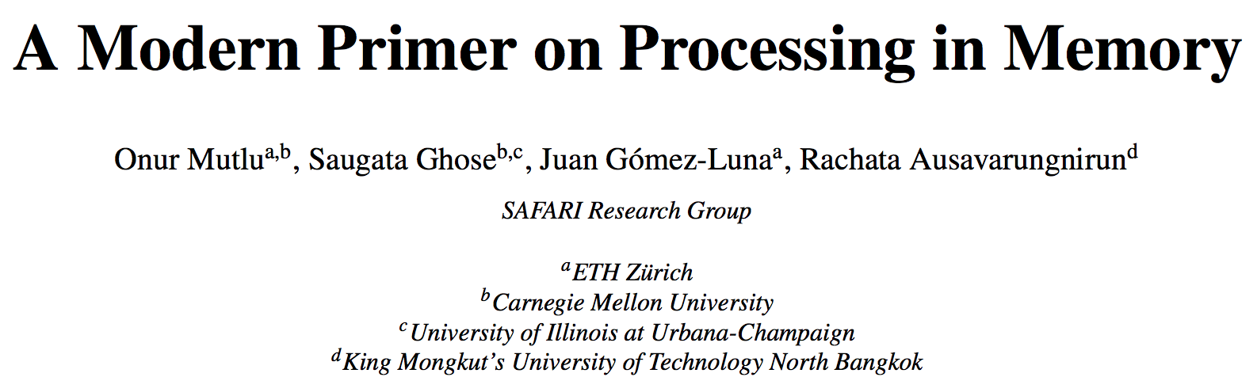
PIM Review and Open Problems
Onur Mutlu, Saugata Ghose, Juan Gomez-Luna, and Rachata Ausavarungnirun,
"A Modern Primer on Processing in Memory"
Invited Book Chapter in Emerging Computing: From Devices to Systems - Looking Beyond Moore and Von Neumann, Springer, 2022.
https://arxiv.org/pdf/1903.03988.pdf

Slide 5
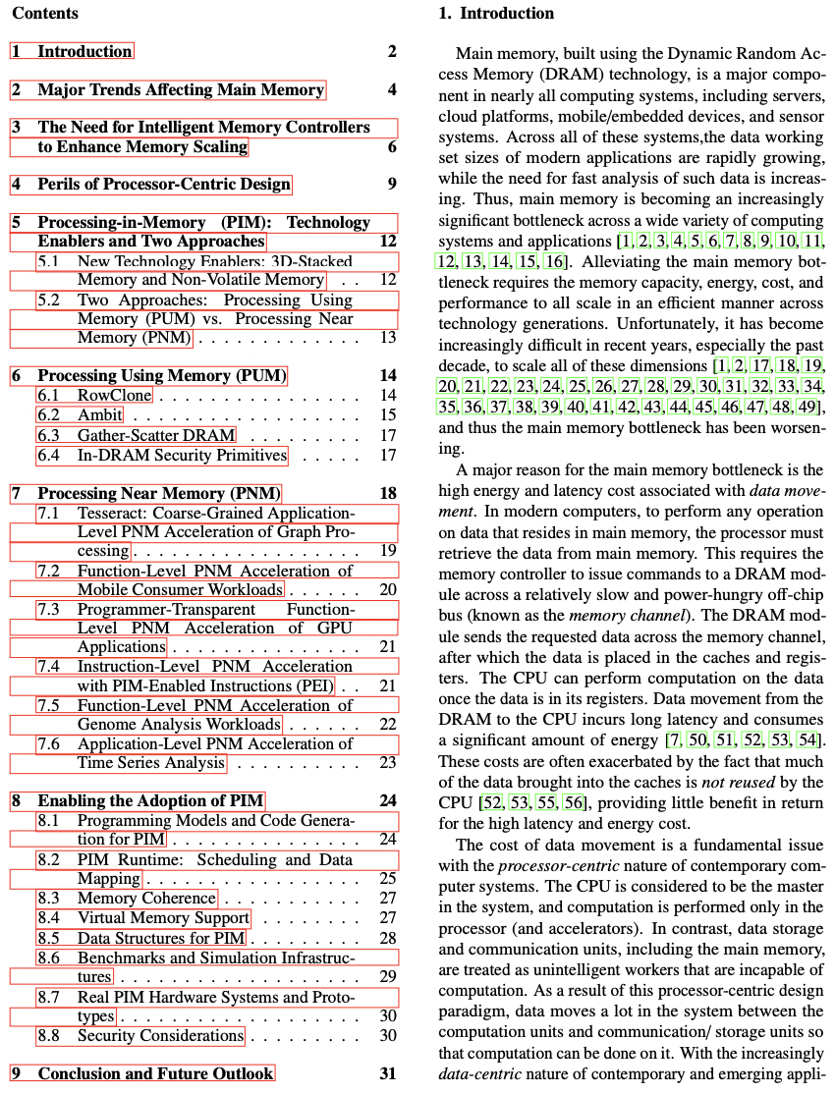

Slide 6
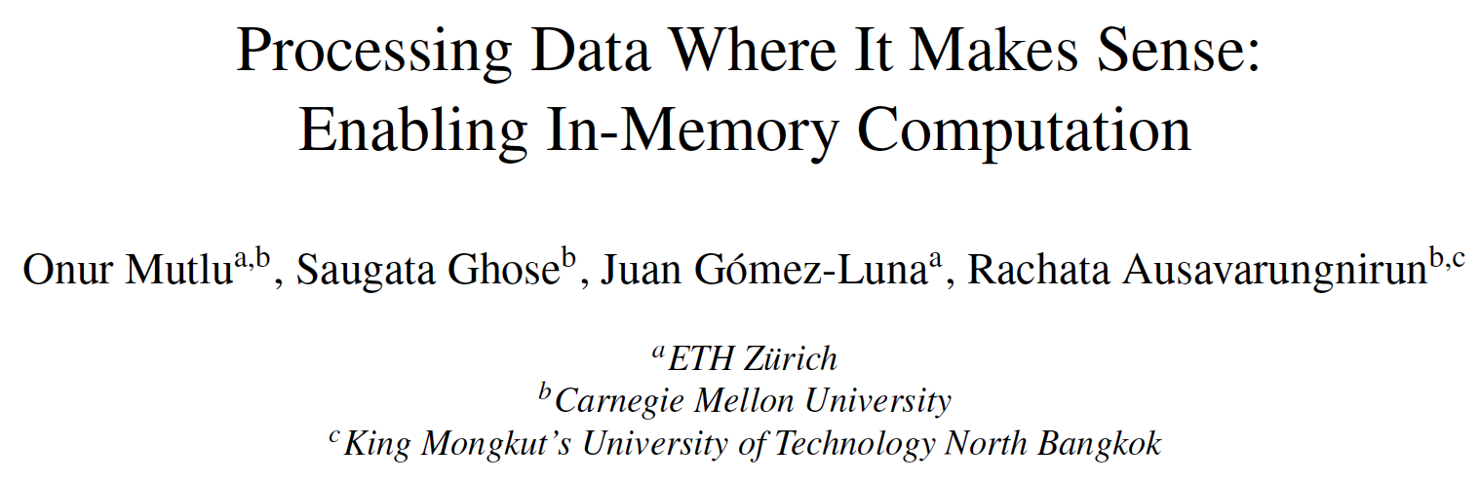
PIM Review and Open Problems (II)
Onur Mutlu, Saugata Ghose, Juan Gomez-Luna, and Rachata Ausavarungnirun,
"Processing Data Where It Makes Sense: Enabling In-Memory Computation"
Invited paper in Microprocessors and Microsystems (MICPRO), June 2019.
[arXiv version]
https://arxiv.org/pdf/1903.03988.pdf

Slide 7
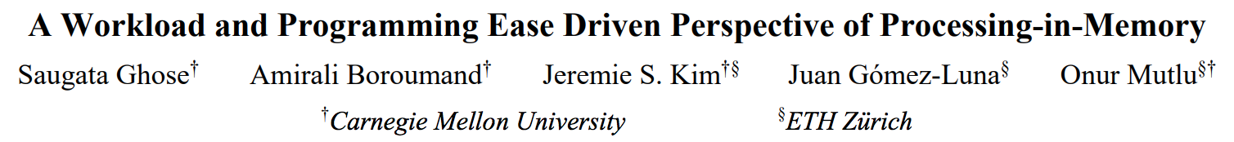
PIM Review and Open Problems (III)
Saugata Ghose, Amirali Boroumand, Jeremie S. Kim, Juan Gomez-Luna, and Onur Mutlu,
"Processing-in-Memory: A Workload-Driven Perspective"
Invited Article in IBM Journal of Research & Development, Special Issue on Hardware for Artificial Intelligence, to appear in November 2019.
[Preliminary arXiv version]
https://arxiv.org/pdf/1907.12947.pdf

Slide 8
Real PIM Hardware Systems and Prototypes

Slide 9
UPMEM Processing-in-DRAM Engine (2019)
Processing in DRAM Engine
Includes standard DIMM modules, with a large number of DPU processors combined with DRAM chips.
Replaces standard DIMMs
  DDR4 R-DIMM modules
    8GB+128 DPUs (16 PIM chips)
    Standard 2x-nm DRAM process
  Large amounts of compute & memory bandwidth
CPU
(x86, ARM, RV…)
DDR
Data bus
https://www.anandtech.com/show/14750/hot-chips-31-analysis-inmemory-processing-by-upmem
https://www.upmem.com/video-upmem-presenting-its-true-processing-in-memory-solution-hot-chips-2019/

Slide 10
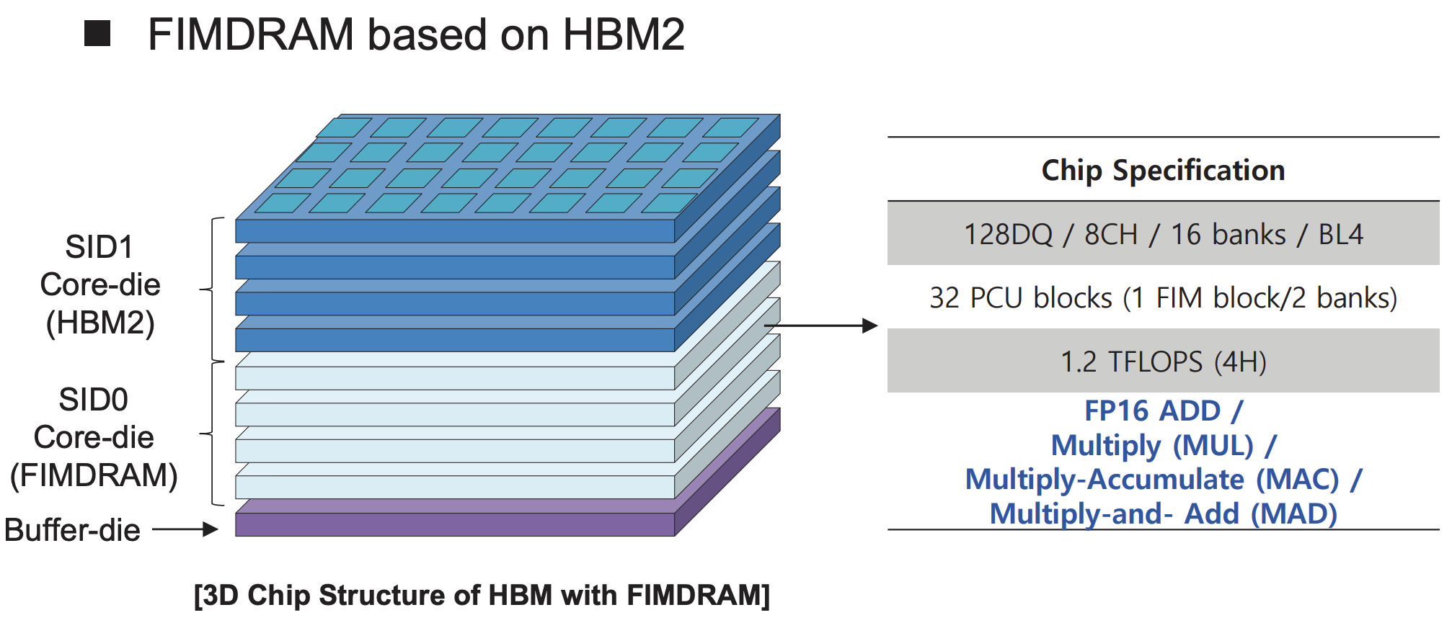
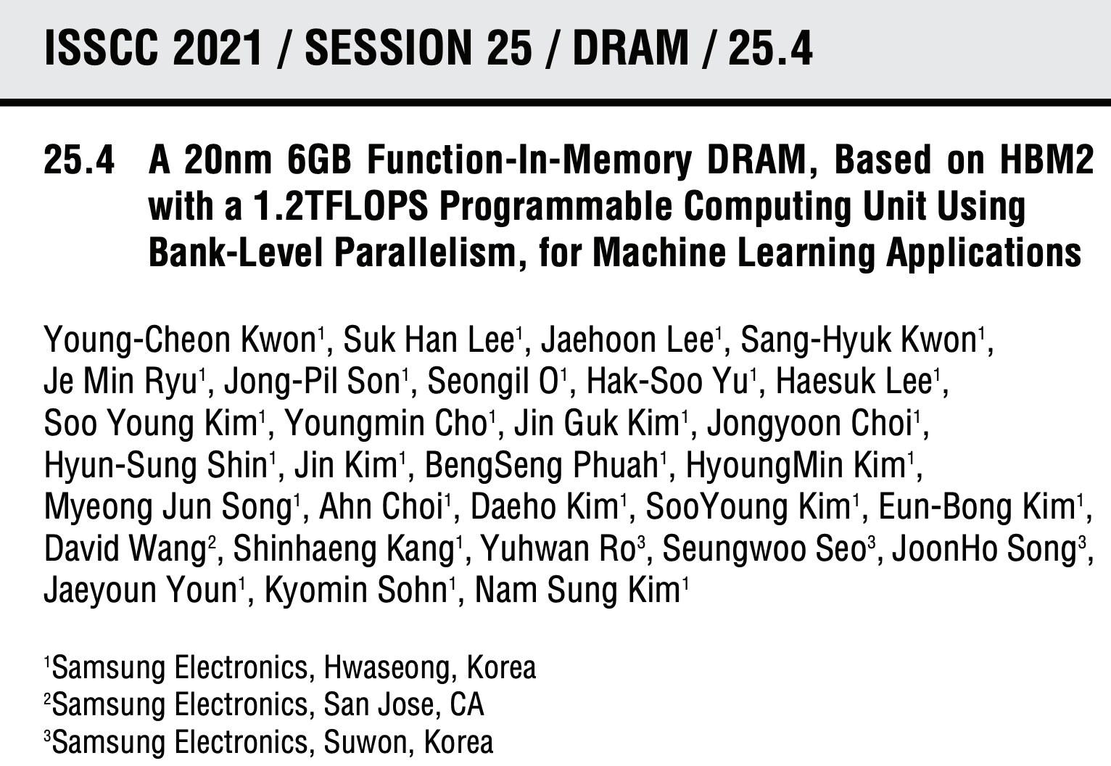
Samsung Function-in-Memory DRAM (2021)

Slide 11
AiM: Chip Implementation
4 Gb AiM die with 16 processing units (PUs)
Lee et al., A 1ynm 1.25V 8Gb, 16Gb/s/pin GDDR6-based Accelerator-in-Memory supporting 1TFLOPS MAC Operation and Various Activation Functions for Deep-Learning Applications, ISSCC 2022
Notes:
* The operating voltage is 1.25V:
- Lowered from 1.35V of the normal GDDR6, for bank parallel operation.
* 16Gb/s is reached at 1.25V in DL operation.
Flat-lid package for lower thermal resistance.
Tested in a prototype system with an FPGA (connected to host CPU via PCIe).

Slide 12
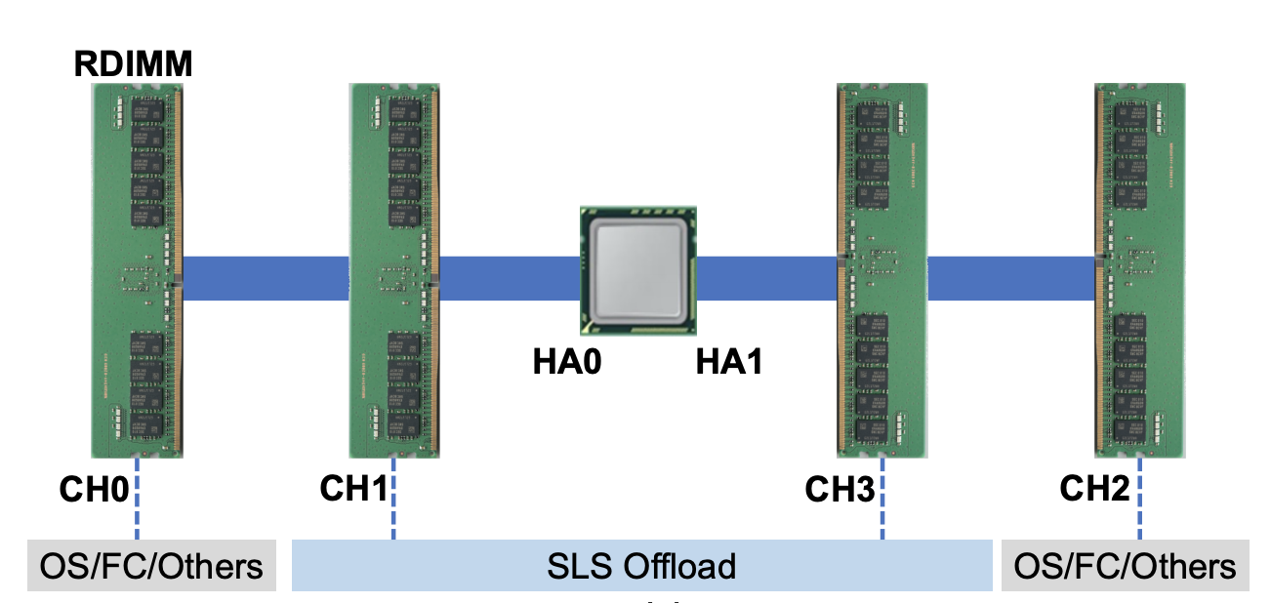
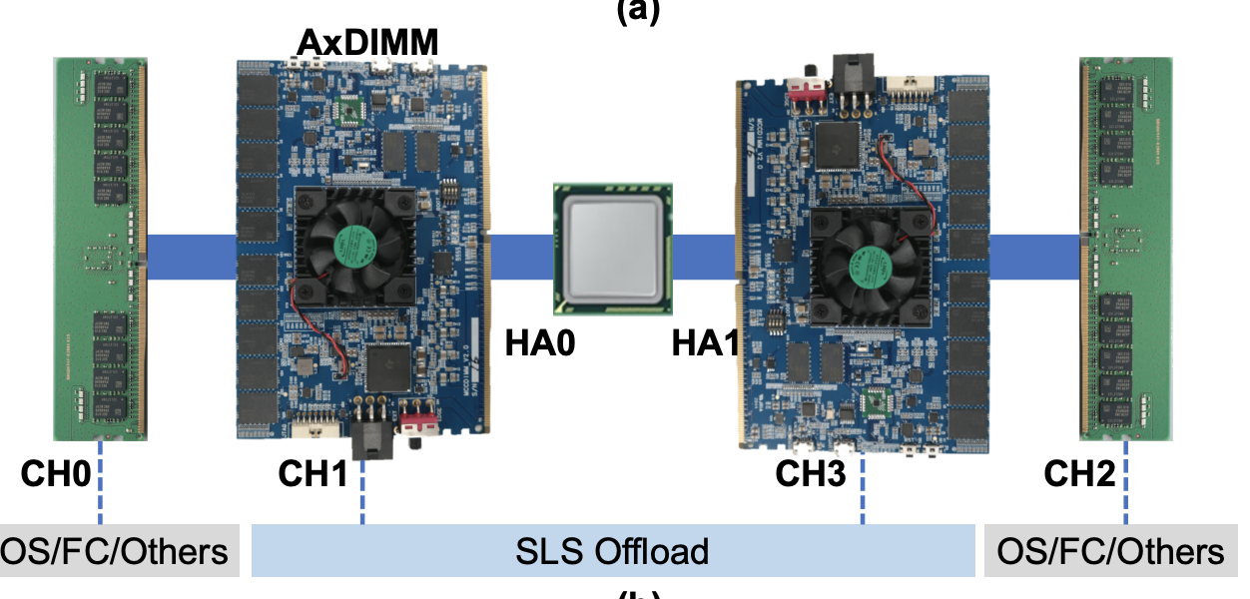
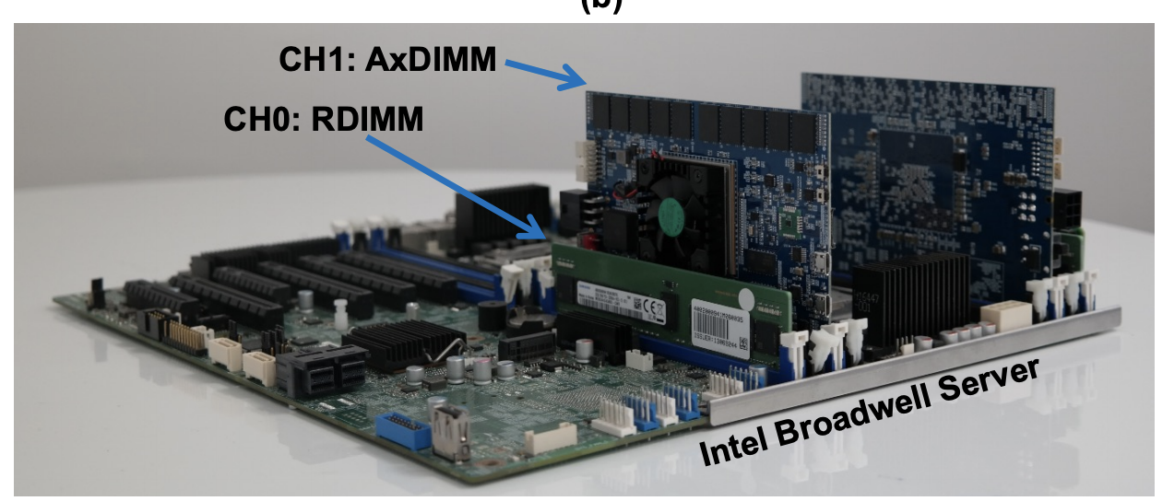
Samsung AxDIMM (2021)
DIMM-based PIM
  DLRM recommendation system
Baseline System
AxDIMM System
Ke et al. "Near-Memory Processing in Action: Accelerating Personalized Recommendation with AxDIMM", IEEE Micro (2021)

Slide 13
HB-PNM: Overall Architecture
3D-stacked logic die and DRAM die vertically bonded by hybrid bonding (HB)
Niu et al., 184QPS/W 64Mb/mm2 3D Logic-to-DRAM Hybrid Bonding with Process-Near-Memory Engine for Recommendation System, ISSCC 2022

Slide 14
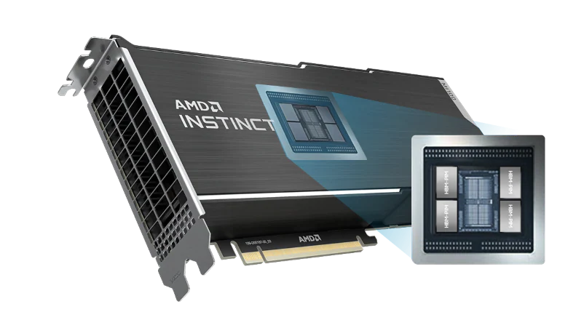
AMD GPU with HBM-PIM
AMD Instinct Mi100 + HBM-PIM
https://semiconductor.samsung.com/newsroom/tech-blog/samsung-electronics-semiconductor-unveils-cutting-edge-memory-technology-to-accelerate-next-generation-ai/

Slide 15
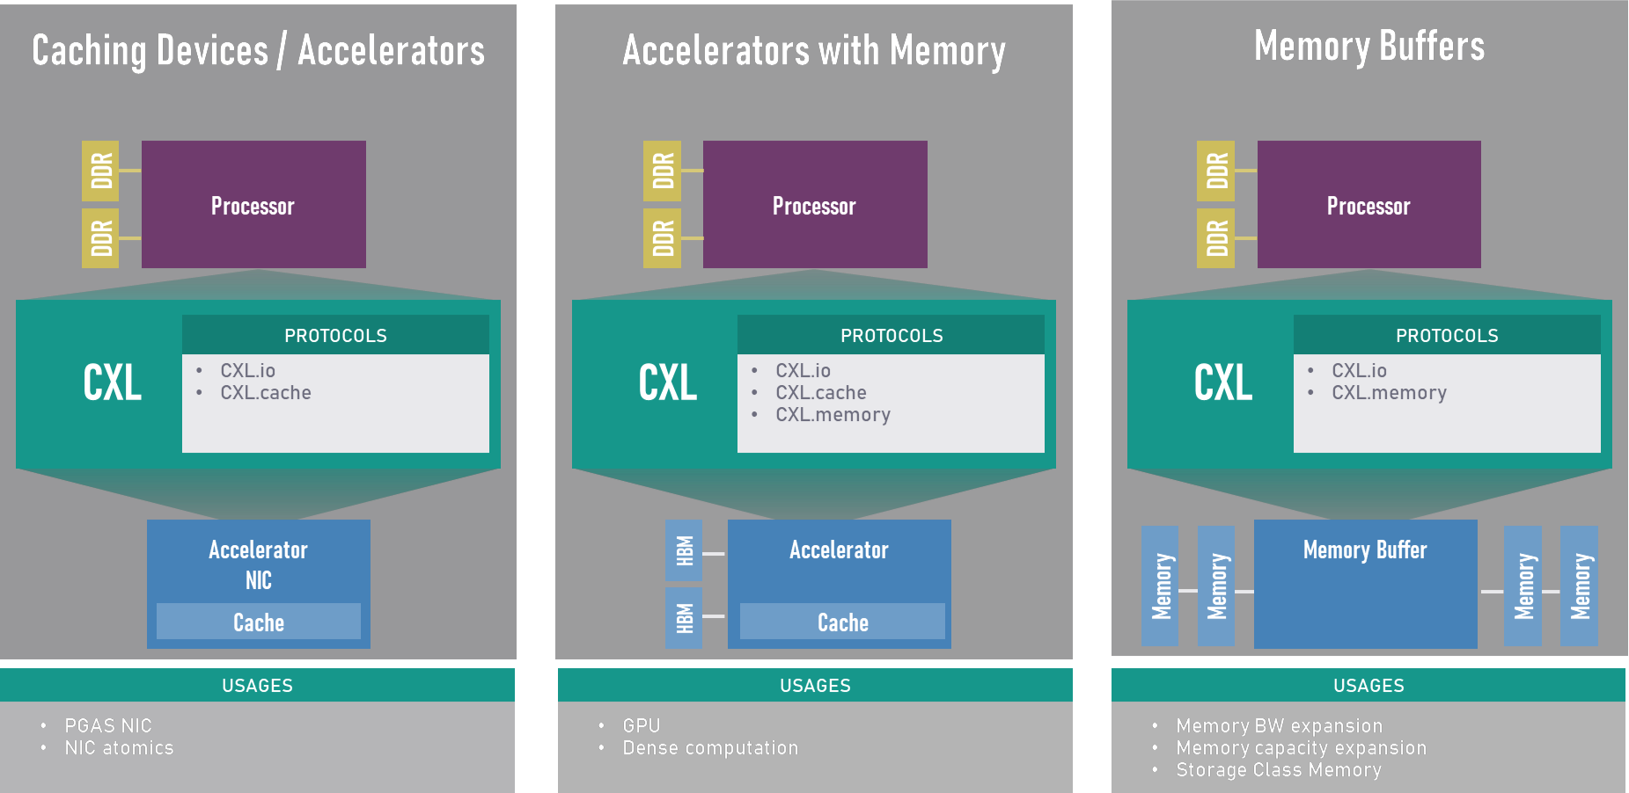
Compute Express Link (CXL)
Compute Express Link (CXL) is an open industry standard interconnect offering high-bandwidth, low-latency connectivity between host processor and devices such as accelerators, memory buffers, and smart I/O devices
https://www.computeexpresslink.org/_files/ugd/0c1418_14c5283e7f3e40f9b2955c7d0f60bebe.pdf

Slide 16
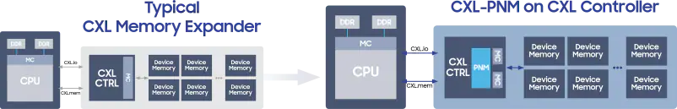
CXL and PIM
CXL, as a high-bandwidth and low-latency interconnect, is a perfect complement for near-data processing
https://semiconductor.samsung.com/newsroom/tech-blog/samsung-electronics-semiconductor-unveils-cutting-edge-memory-technology-to-accelerate-next-generation-ai/

Slide 17
Programming Models and
Code Generation for PIM

Slide 18
UPMEM System Organization
A UPMEM DIMM contains 8 or 16 chips
  Thus, 1 or 2 ranks of 8 chips each
Inside each PIM chip there are:
  8 64MB banks per chip: Main RAM (MRAM) banks
  8 DRAM Processing Units (DPUs) in each chip, 64 DPUs per rank

Slide 19
Accelerator Model (I)
UPMEM DIMMs coexist with conventional DIMMs
Integration of UPMEM DIMMs in a system follows an accelerator model
UPMEM DIMMs can be seen as a loosely coupled accelerator
  Explicit data movement between the main processor (host CPU) and the accelerator (UPMEM)
  Explicit kernel launch onto the UPMEM processors
This resembles GPU computing

Slide 20
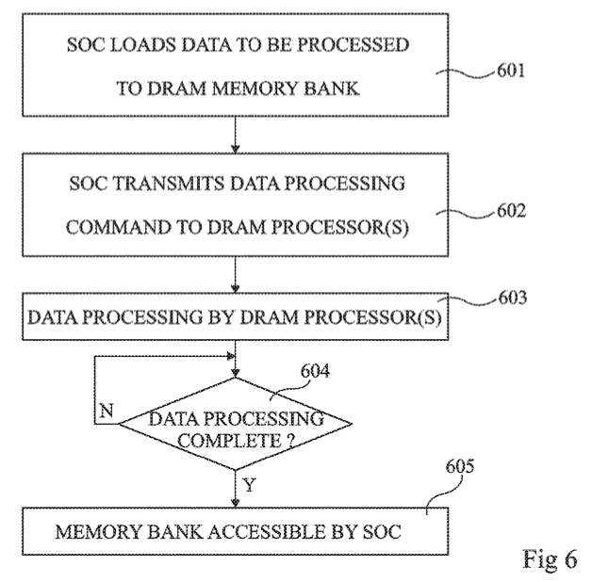
Accelerator Model (II)
FIG. 6 is a flow diagram representing operations in a method of delegating a processing task to a DRAM processor according to an example embodiment
Fabrice Devaux, Jean-François Roy. “Memory circuit with integrated processor.” US 10,324,870 B2.

Slide 21
Inter-DPU Communication
There is no direct communication channel between DPUs
Inter-DPU communication takes places via the host CPU using CPU-DPU and DPU-CPU transfers
Example communication patterns:
  Merging of partial results to obtain the final result
    Only DPU-CPU transfers
  Redistribution of intermediate results for further computation
    DPU-CPU transfers and CPU-DPU transfers

Slide 22
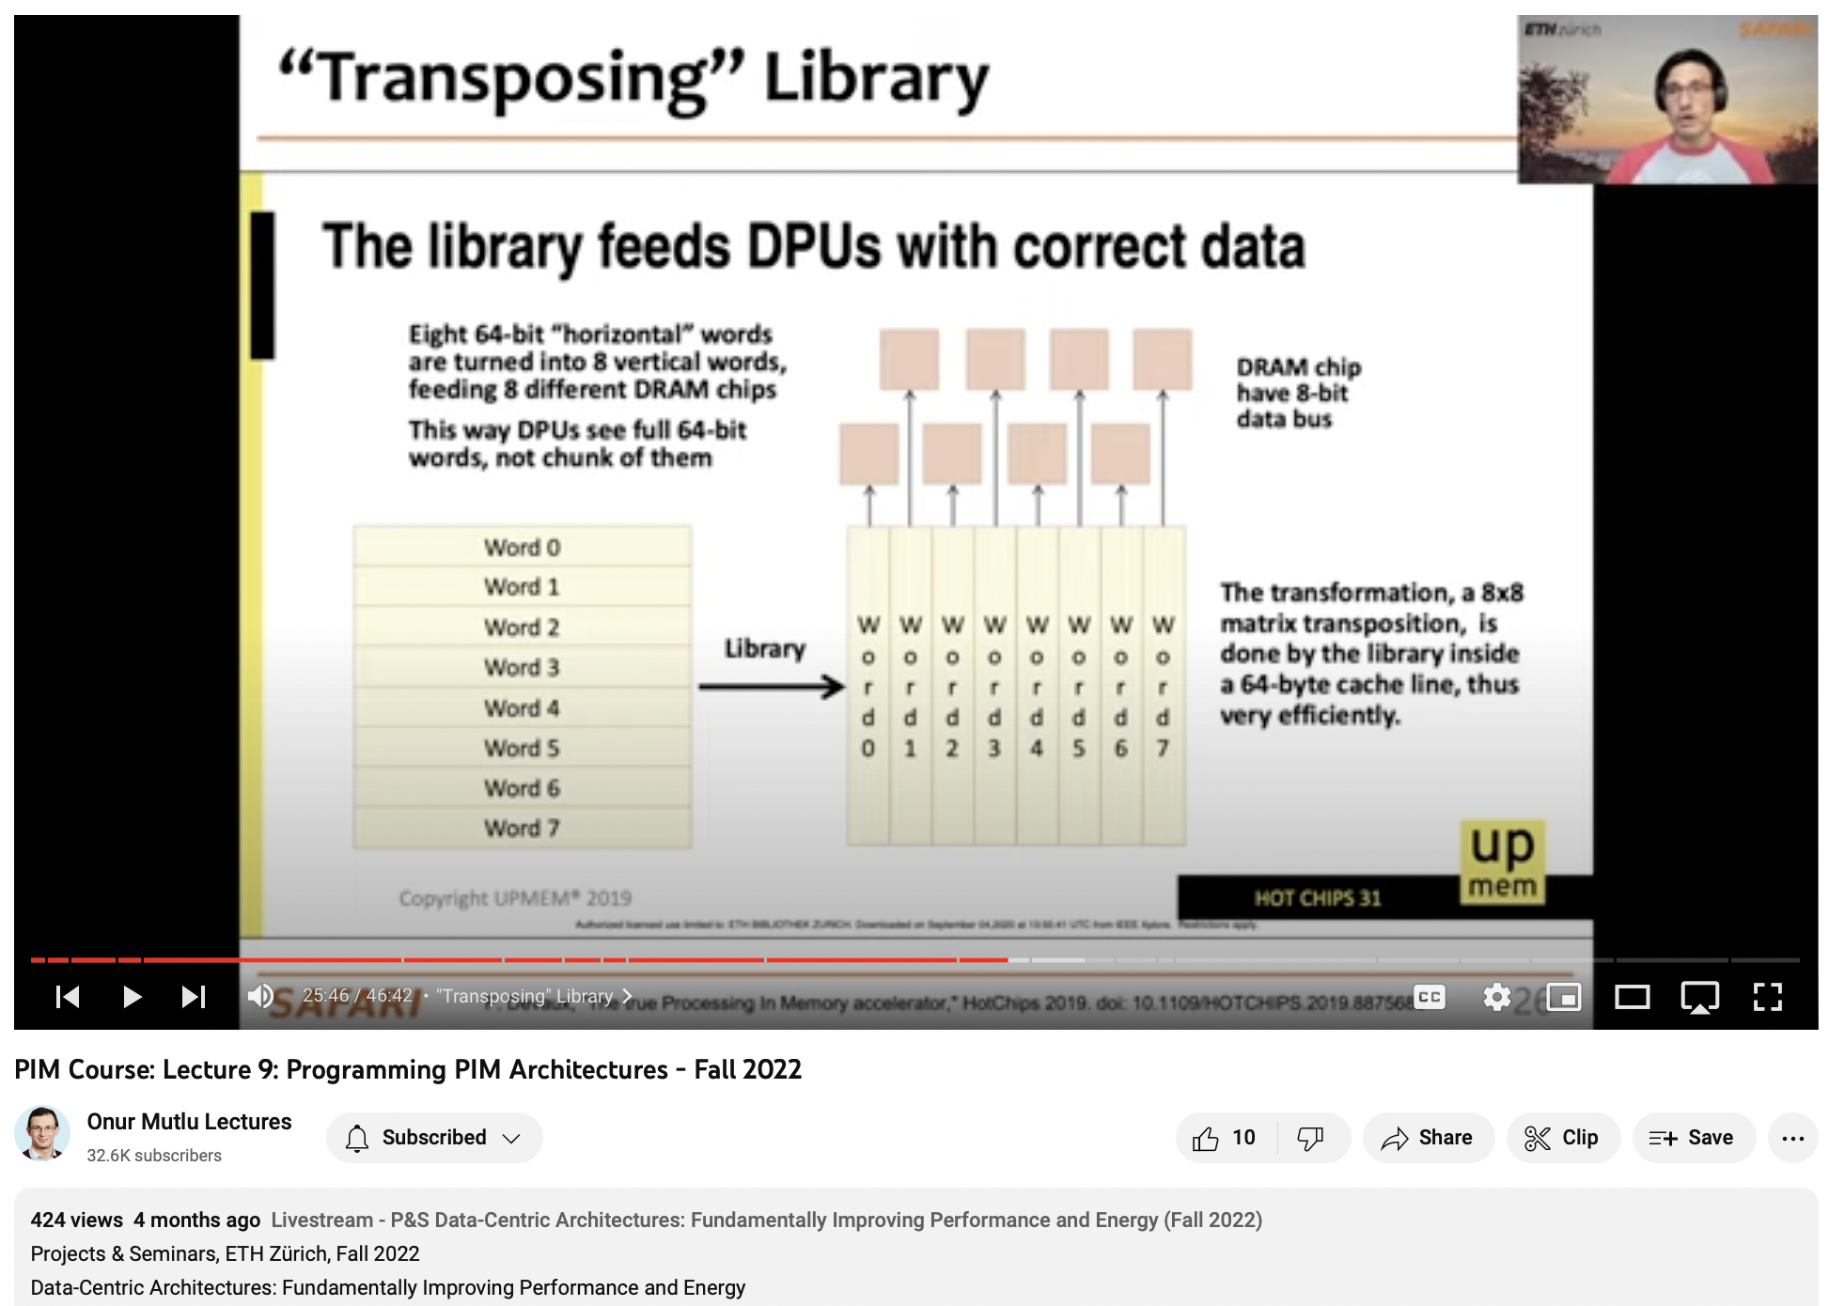
Lecture on Programming UPMEM PIM
https://youtu.be/zF70xuhesME

Slide 23
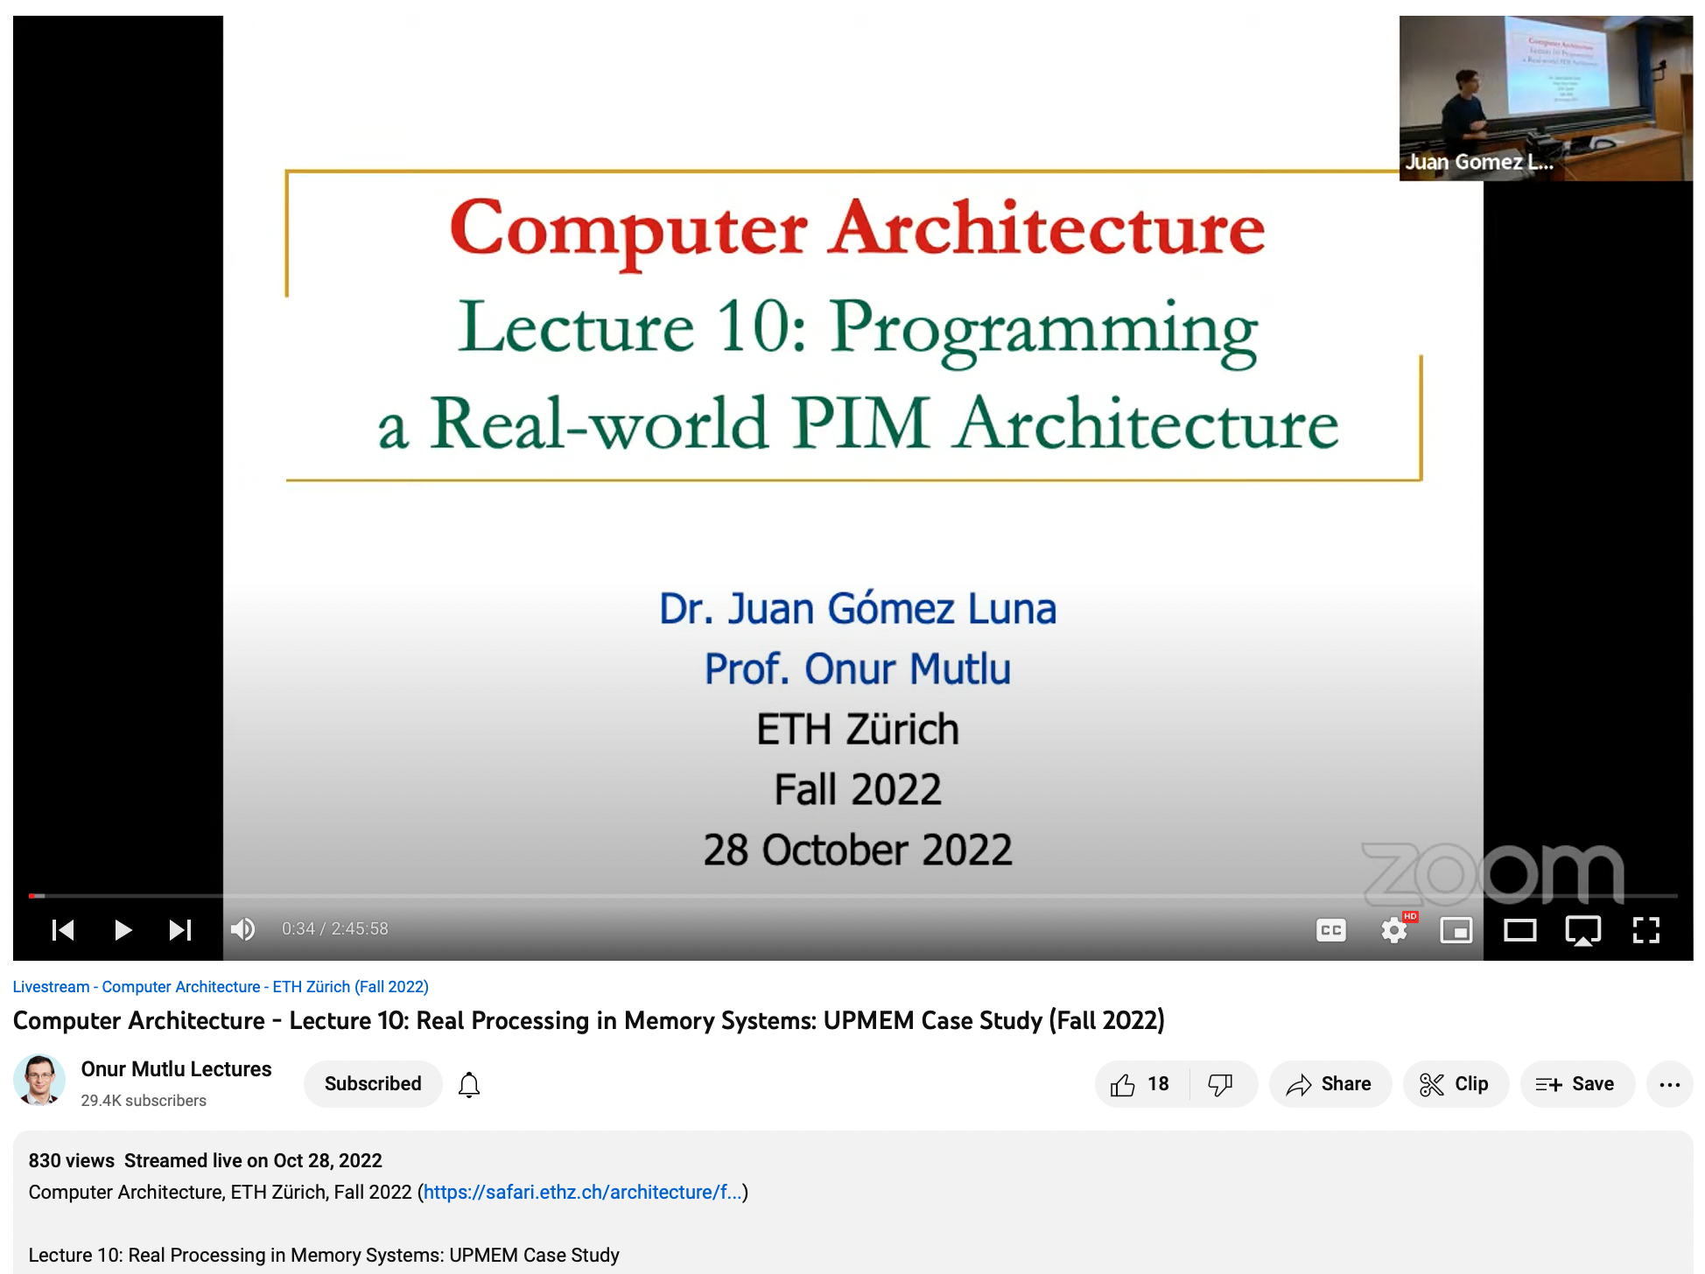
Another Lecture on PIM Programming
https://youtu.be/pHEHdLsnNdk

Slide 24
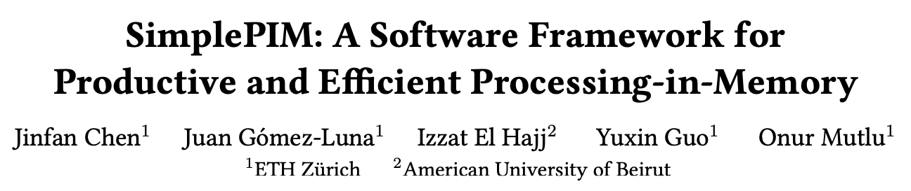
High-level Programming for PIM
Jinfan Chen, Juan Gómez-Luna, Izzat El Hajj, YuXin Guo, and Onur Mutlu,
"SimplePIM: A Software Framework for Productive and Efficient Processing in Memory"
Proceedings of the 32nd International Conference on Parallel Architectures and Compilation Techniques (PACT), Vienna, Austria, October 2023.
[Slides (pptx) (pdf)]
[SimplePIM Source Code]

Slide 25





SIMDRAM Framework
User Input
Step 1: Generate
MAJ logic
Step 2: Generate
sequence of
DRAM commands
SIMDRAM Output
Desired operation
New SIMDRAM $μ$Program
ACT/PRE
ACT/PRE
ACT/PRE
ACT/ACT/PRE
done
$$μProgram$$
$$μProgram$$
MAJ
Main memory
AND/OR/NOT logic
MAJ/NOT logic
bbop_new
New SIMDRAM
instruction
ISA
$μ$Program
User Input
Step 3: Execution according to $μ$Program
SIMDRAM Output
SIMDRAM-enabled application
Instruction result
in memory
foo () {
bbop_new
}
ACT/PRE
ACT/PRE
ACT/PRE
ACT/PRE/PRE
done
ACT/PRE
Control Unit
$μ$Program
Memory Controller
Notes:
SIMDRAM is an end-to-end framework that provides the user with
the ability to implement an arbitrary operation in DRAM
The framework is composed of three main steps which are illustrated in this picture.
[CLICK] It takes as user input input the AND/OR/NOT representation of a desired operation.
[CLICK] Step 1 builds an efficient MAJ/NOT representation of a given desired operation from its AND/OR/NOT-based implementation. Specifically, this step takes as input a desired
operation and uses logic optimization to minimize the number of logic primitives (and, therefore, the computation latency) required to perform the operation.
[CLICK] The second step allocates DRAM rows to the operation’s inputs and outputs and generates the required sequence of DRAM commands to execute the desired operation.
[CLICK] This step’s output is a μProgram, i.e., the optimized sequence of DRAM commands that is stored in main memory and will be used to execute the operation at runtime. The uProgram
[CLICK] is stored in main memory and will be used to execute the operation at runtime
[CLICK] and a new SIMDRAM instruction called bbop is created as an interface to the uProgram, and then added to the CPU ISA
[CLICK] The third step executes the μProgram to perform the operation. SIMDRAM uses a control unit in the memory controller that transparently issues the sequence of commands to DRAM, as dictated by the μProgram. Once the μProgram is complete, the result of the operation is held in DRAM.
[NEXT]

Slide 26
Programming Interface
Four new SIMDRAM ISA extensions
Type | ISA Format
Initialization | bbop_trsp_init address, size, n
1-Input Operation | bbop_op dst, src, size, n
2-Input Operation | bbop_op dst, src_1, src_2, size, n
Predication | bbop_if_else dst, src_1, src_2, select, size, n

Slide 27
Code Using SIMDRAM Instructions
← C code for vector add/sub
with predicated execution
1 | int size = 65536;
2 | int elm_size = sizeof (uint8_t);
3 | uint8_t *A , *B , *C = (uint8_t *) malloc(size * elm_size);
4 | uint8_t *pred = (uint8_t *) malloc(size * elm_size);
5 | …
6 | for (int i = 0; i < size ; ++ i){
7 | bool cond = A[i] > pred[i];
8 | if (cond)
9 | C [i] = A[i] + B[i];
10 | else
11 | C [i] = A[i] - B [i];
12 | }
1 | int size = 65536;
2 | int elm_size = sizeof(uint8_t);
3 | uint8_t *A , *B , *C = (uint8_t *) malloc(size * elm_size);
4
5 | bbop_trsp_init(A , size , elm_size);
6 | bbop_trsp_init(B , size , elm_size);
7 | bbop_trsp_init(C , size , elm_size);
8 | uint8_t *pred = (uint8_t *) malloc(size * elm_size);
9 | // D, E, F store intermediate data
10 | uint8_t *D , *E = (uint8_t *) malloc (size * elm_size);
11 | bool *F = (bool *) malloc (size * sizeof(bool));
12 | …
13 | bbop_add(D , A , B , size , elm_size);
14 | bbop_sub(E , A , B , size , elm_size);
15 | bbop_greater(F , A , pred , size , elm_size);
16 | bbop_if_else(C , D , E , F , size , elm_size);
Equivalent code using SIMDRAM operations →
Notes:
Discuss manual vs automatic programming

Slide 28
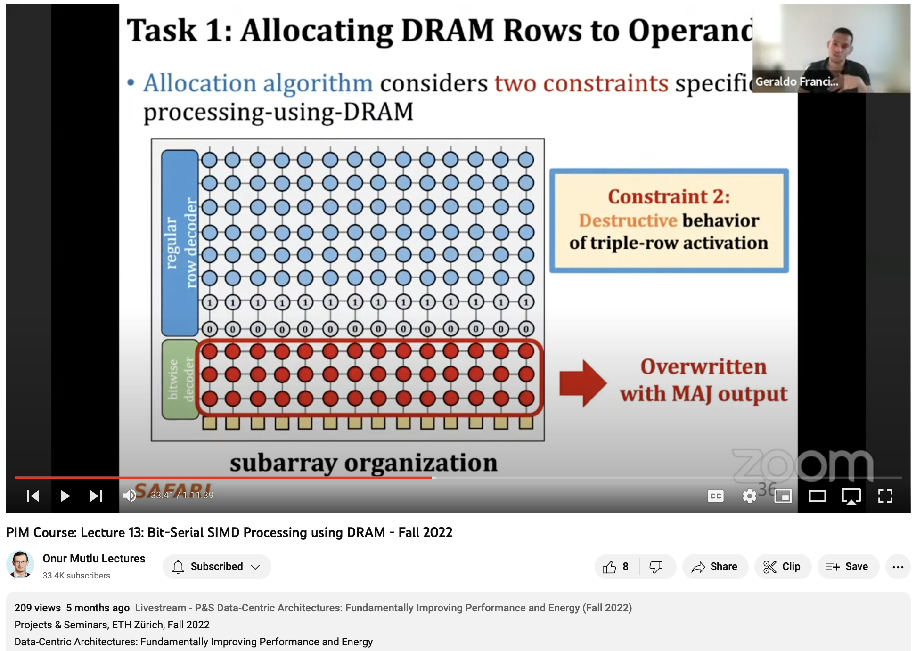
Lecture on SIMDRAM
https://youtu.be/cMWTuuQ5Dug

Slide 29
PIM Runtime:
Scheduling and Data Mapping

Slide 30
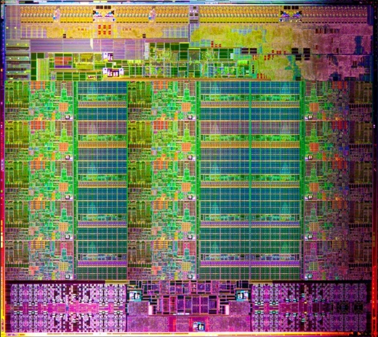
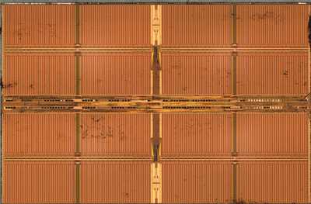
Simple PIM Operations as ISA Extensions (I)
PageRank algorithm (Page et al. 1999)
for (v: graph.vertices) {
value = weight * v.rank;
for (w: v.successors) {
w.next_rank += value;
}
}
Host Processor
Main Memory
w.next_rank
w.next_rank
w.next_rank
w.next_rank
64 bytes in
64 bytes out
Conventional Architecture

Slide 31
Simple PIM Operations as ISA Extensions (II)
PageRank algorithm (Page et al. 1999)
for (v: graph.vertices) {
value = weight * v.rank;
for (w: v.successors) {
__pim_add(&w.next_rank, value);
}
}
pim.add r1, (r2)
Host Processor
Main Memory
value
w.next_rank
w.next_rank
8 bytes in
0 bytes out
In-Memory Addition

Slide 32
Example PEI Microarchitecture
Host Processor
3D-stacked Memory
Out-Of-Order Core
Last-Level Cache
DRAM Controller
L1 Cache
PCU
L2 Cache
PCU (PEI Computation Unit)
DRAM Controller
PCU
Network
HMC Controller
PMU (PEI
Mgmt Unit)
…
PIM Directory
Locality Monitor
DRAM Controller
PCU
Example PEI uArchitecture

Slide 33
PEI Performance Delta: Large Data Sets
(Large Inputs, Baseline: CPU-Only)
Percentage of Performance Improvement
wrt Baseline (CPU-only)
GeoMean
Locality-Aware = PIM or CPU depending on data location

Slide 34
PEI Energy Consumption
Host-Only (CPU)
PIM-Only
Locality-Aware
Total Energy Consumption
Breakdown of Energy Consumption on Different System Components

Slide 35
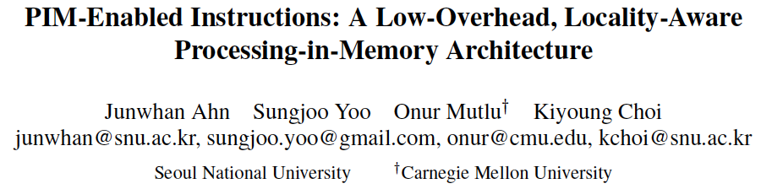
More on PIM-Enabled Instructions
Junwhan Ahn, Sungjoo Yoo, Onur Mutlu, and Kiyoung Choi,
"PIM-Enabled Instructions: A Low-Overhead, Locality-Aware Processing-in-Memory Architecture"
Proceedings of the 42nd International Symposium on Computer Architecture (ISCA), Portland, OR, June 2015.
[Slides (pdf)] [Lightning Session Slides (pdf)]

Slide 36
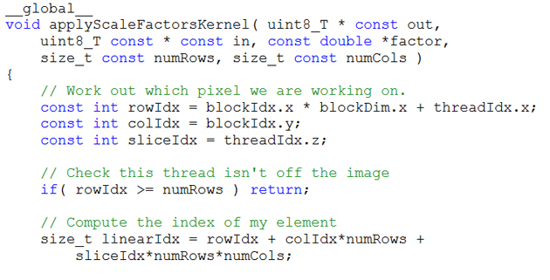
Key Challenge 1: Code Mapping
Challenge 1: Which operations should be executed in memory vs. in CPU?
?
3D-stacked memory
(memory stack)
SM (Streaming Multiprocessor)
?
Logic layer
Logic layer SM
Main GPU
Crossbar switch
Vault Ctrl
….
Vault Ctrl

Slide 37
Key Challenge 2: Data Mapping
Challenge 2: How should data be mapped to different 3D memory stacks?
3D-stacked memory
(memory stack)
SM (Streaming Multiprocessor)
Logic layer
Logic layer SM
Main GPU
Crossbar switch
Vault Ctrl
….
Vault Ctrl

Slide 38
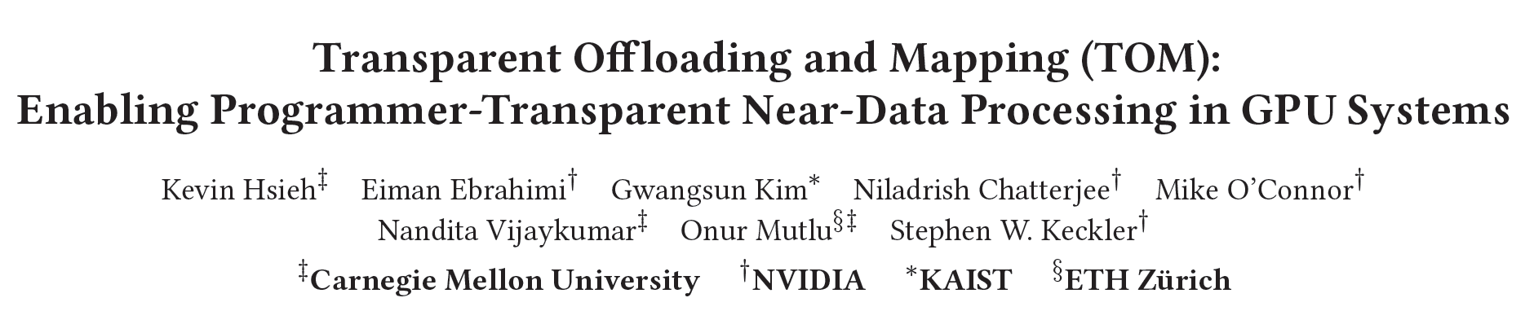
How to Do the Code and Data Mapping?
Kevin Hsieh, Eiman Ebrahimi, Gwangsun Kim, Niladrish Chatterjee, Mike O'Connor, Nandita Vijaykumar, Onur Mutlu, and Stephen W. Keckler,
"Transparent Offloading and Mapping (TOM): Enabling Programmer-Transparent Near-Data Processing in GPU Systems"
Proceedings of the 43rd International Symposium on Computer Architecture (ISCA), Seoul, South Korea, June 2016.
[Slides (pptx) (pdf)]
[Lightning Session Slides (pptx) (pdf)]

Slide 39
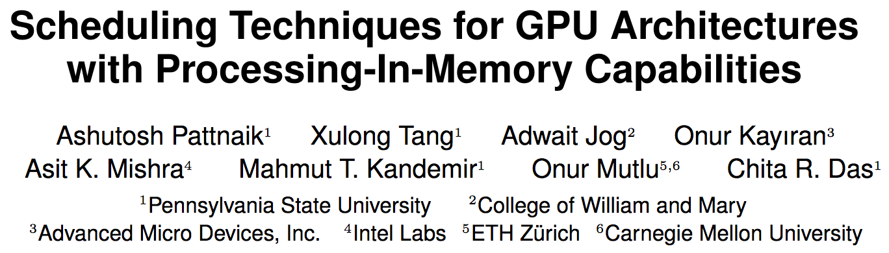
How to Schedule Code? (I)
Ashutosh Pattnaik, Xulong Tang, Adwait Jog, Onur Kayiran, Asit K. Mishra, Mahmut T. Kandemir, Onur Mutlu, and Chita R. Das,
"Scheduling Techniques for GPU Architectures with Processing-In-Memory Capabilities"
Proceedings of the 25th International Conference on Parallel Architectures and Compilation Techniques (PACT), Haifa, Israel, September 2016.

Slide 40
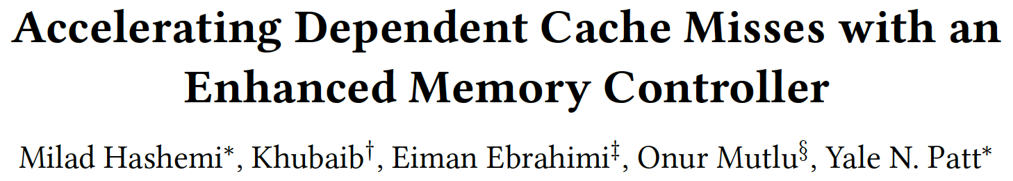
How to Schedule Code? (II)
Milad Hashemi, Khubaib, Eiman Ebrahimi, Onur Mutlu, and Yale N. Patt,
"Accelerating Dependent Cache Misses with an Enhanced Memory Controller"
Proceedings of the 43rd International Symposium on Computer Architecture (ISCA), Seoul, South Korea, June 2016.
[Slides (pptx) (pdf)]
[Lightning Session Slides (pptx) (pdf)]

Slide 41
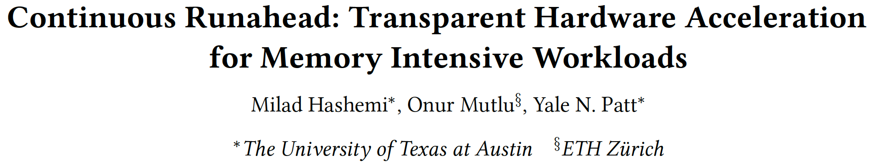
How to Schedule Code? (III)
Milad Hashemi, Onur Mutlu, and Yale N. Patt,
"Continuous Runahead: Transparent Hardware Acceleration for Memory Intensive Workloads"
Proceedings of the 49th International Symposium on Microarchitecture (MICRO), Taipei, Taiwan, October 2016.
[Slides (pptx) (pdf)] [Lightning Session Slides (pdf)] [Poster (pptx) (pdf)]

Slide 42
Research Questions
What are simple mechanisms to enable and disable PIM execution? How can PIM execution be throttled for highest performance gains? How should data locations and access patterns affect where/whether PIM execution should occur?
Which parts of a given application’s code should be executed on PIM? What are simple mechanisms to identify when those parts of the application code can benefit from PIM?
What are scheduling mechanisms to share PIM engines between multiple requesting cores to maximize benefits obtained from PIM?
What are simple mechanisms to manage access to a memory that serves both CPU requests and PIM requests?

Slide 43
Memory Coherence

Slide 44
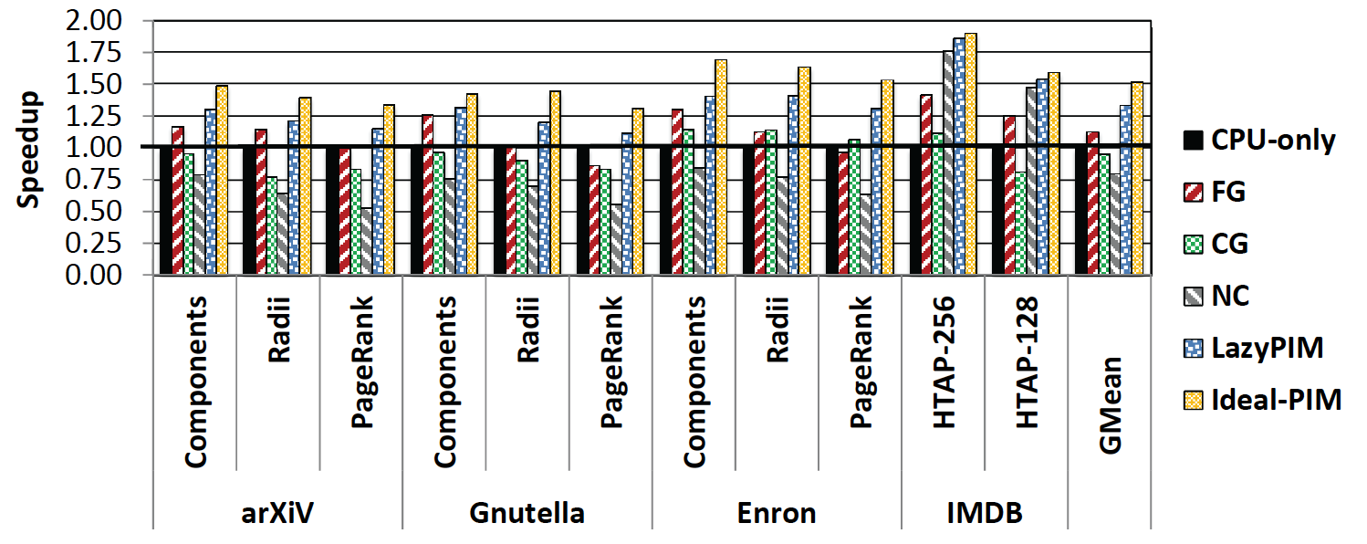
Challenge: Coherence for Hybrid CPU-PIM Apps
Traditional
coherence
No coherence
overhead

Slide 45
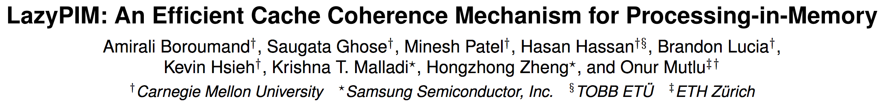
How to Maintain Coherence? (I)
Amirali Boroumand, Saugata Ghose, Minesh Patel, Hasan Hassan, Brandon Lucia, Kevin Hsieh, Krishna T. Malladi, Hongzhong Zheng, and Onur Mutlu,
"LazyPIM: An Efficient Cache Coherence Mechanism for Processing-in-Memory"
IEEE Computer Architecture Letters (CAL), June 2016.

Slide 46
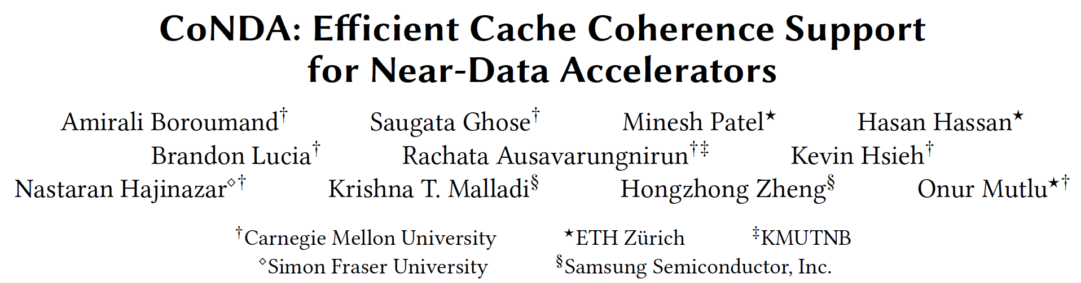
How to Maintain Coherence? (II)
Amirali Boroumand, Saugata Ghose, Minesh Patel, Hasan Hassan, Brandon Lucia, Kevin Hsieh, Krishna T. Malladi, Hongzhong Zheng, and Onur Mutlu,
"CoNDA: Efficient Cache Coherence Support for Near-Data Accelerators"
Proceedings of the 46th International Symposium on Computer Architecture (ISCA), Phoenix, AZ, USA, June 2019.

Slide 47






CoNDA:
Efficient Cache Coherence Support for Near-Data Accelerators
Amirali Boroumand
Saugata Ghose, Minesh Patel, Hasan Hassan,
Brandon Lucia, Rachata Ausavarungnirun, Kevin Hsieh,
Nastaran Hajinazar, Krishna Malladi, Hongzhong Zheng, Onur Mutlu

Slide 48

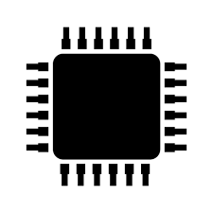

Specialized Accelerators
  Specialized accelerators are now everywhere!
ASIC
NDA
GPU
FPGA
ASIC
Recent advancement in 3D-stacked technology enabled Near-Data Accelerators (NDA)
DRAM
CPU
NDA
ASIC
Notes:
Specialized accelerators are now every where, and they are widely used to improve the performance and energy efficiency of computing systems.
At the same time, recent advancement in 3D-stacked technology enabled near data acceleartors. These accelerators can further boost the benefits of specialized accelerator by moving computation close to data and getting rid of data movement.

Slide 49
Coherence For NDAs
  Challenge: Coherence between NDAs and CPUs
(1) Large cost of
off-chip communication
DRAM
CPU
L2
CPU
L1
CPU
CPU
Compute Unit
(2) NDA applications generate
a large amount of off-chip data movement
NDA
ASIC
It is impractical to use traditional coherence protocols
Notes:
However, one of the major system challenges for adopting near data accelartors into computing system is coherence. Maintainig coherence between NDAs and CPUs is very challenging because of two reasons: First, the cost of off-chip communication between NDAs and CPUs is very high. Second, NDA applications typically have poor locality, and generate a large amount of off-chip data movement which leads to a large number of coherence misses. Because of these challenges, it is
Impractical use traditional coherence protocols for coherence, because that leads to a large amount of off-chip coherence messages, which can eliminate a significant portion of NDA benefits

Slide 50
Existing Coherence Mechanisms
  We extensively study existing NDA coherence mechanisms and make three key observations:
These mechanisms eliminate
a significant portion of NDA’s benefits
1
The majority of off-chip coherence traffic
generated by these mechanisms is unnecessary
2
Much of the off-chip traffic can be eliminated
if the coherence mechanism has insight
into the memory accesses
3
ASIC
Notes:
In this work, We extensively study existing NDA coherence mechanisms and make three key observations:
First, these mechanisms eliminate a significant portion of NDA’s benefits as they generate a large amount of off-chip coherence traffic,
Second, …
Finally, we find that a significant portion of off-chip traffic can be eliminated if the coherence mechanism has insight into
which memory accesses actually require a coherence operation (what part of the shared data is actually accessed)

Slide 51
An Optimistic Approach
  We find that an optimistic approach to coherence can address the challenges related to NDA coherence
1
Gain insights before any coherence checks happens
2
Perform only the necessary coherence requests
ASIC
Notes:
Based on these observations, we find that an optimistic approach to coherence can address the challenges of NDA coherence.
We find that an optimistic execution model for NDA enables us to gain insight into the memory accesses before any coherence permissions are
checked, and as a result, enforce coherence with only the necessary data movement/coherence requests.
We propose CoNDA, a new coherence mechanism that optimistically executes code on an NDA to gather information on memory
accesses. Optimistic execution enables CoNDA to identify and avoid performing unnecessary coherence requests
Our evaluation shows that CoNDA consistency retain the benefit of NDA across all of the workloads and …

Slide 52
CoNDA
  We propose CoNDA, a mechanism that uses optimistic NDA execution to avoid unnecessary coherence traffic
CPU
NDA
Time
CPU Thread Execution
Offload NDA kernel
Concurrent CPU + NDA
Execution
No
Coherence Request
Optimistic
execution
Signature
Send signatures
Signature
  Coherence Resolution
Commit or Re-execute
Notes:
So, based on the execution model I just explained, we propose a coherence mechanism, which uses that execution model to avoid unnecessary coherence traffic.
Basically, in Conda, CPU offload the kernel to NDA. NDA starts executing in optimistic mode. During optimistic execution
CoNDA efficiently tracks the addresses of all NDA reads, NDA writes, and CPU write using compressed signatures. When optimistic mode is done, NDA send these signaturs to CPU and CoNDA use these signatures to resolve coherence violations.
If CoNDA detects any coherence violation (1) the NDA invalidates all
Of updates; (2) the CPU resolves the coherence
requests, performing only the necessary coherence operations (including
any cache line updates); and (3) the NDA re-executes the
uncommitted portion of the kernel.
Otherwise, CoNDA performs the necessary coherence operations, clears the uncommitted flag
for all data updates in the NDA L1 cache, and resumes optimistic execution if
the NDA kernel is not finished.

Slide 53
CoNDA
  We propose CoNDA, a mechanism that uses optimistic NDA execution to avoid unnecessary coherence traffic
CPU
NDA
Time
CPU Thread Execution
Offload NDA kernel
Concurrent CPU + NDA
Execution
No
Coherence Request
Optimistic
execution
Signature
Send signatures
Signature
  Coherence Resolution
  CoNDA comes within 10.4% and 4.4% of performance
  and energy of an ideal NDA coherence mechanism
Commit or Re-execute
Notes:
So, based on the execution model I just explained, we propose a coherence mechanism, which uses that execution model to avoid unnecessary coherence traffic.
Basically, in Conda, CPU offload the kernel to NDA. NDA starts executing in optimistic mode. During optimistic execution
CoNDA efficiently tracks the addresses of all NDA reads, NDA writes, and CPU write using compressed signatures. When optimistic mode is done, NDA send these signaturs to CPU and CoNDA use these signatures to resolve coherence violations.
If CoNDA detects any coherence violation (1) the NDA invalidates all
Of updates; (2) the CPU resolves the coherence
requests, performing only the necessary coherence operations (including
any cache line updates); and (3) the NDA re-executes the
uncommitted portion of the kernel.
Otherwise, CoNDA performs the necessary coherence operations, clears the uncommitted flag
for all data updates in the NDA L1 cache, and resumes optimistic execution if
the NDA kernel is not finished.

Slide 54
CoNDA:
Efficient Cache Coherence Support for Near-Data Accelerators
Amirali Boroumand
Saugata Ghose, Minesh Patel, Hasan Hassan,
Brandon Lucia, Rachata Ausavarungnirun, Kevin Hsieh,
Nastaran Hajinazar, Krishna Malladi, Hongzhong Zheng, Onur Mutlu

Slide 55
How to Maintain Coherence? (II)
Amirali Boroumand, Saugata Ghose, Minesh Patel, Hasan Hassan, Brandon Lucia, Kevin Hsieh, Krishna T. Malladi, Hongzhong Zheng, and Onur Mutlu,
"CoNDA: Efficient Cache Coherence Support for Near-Data Accelerators"
Proceedings of the 46th International Symposium on Computer Architecture (ISCA), Phoenix, AZ, USA, June 2019.

Slide 56
Synchronization Support

Slide 57
How to Support Synchronization?
Christina Giannoula, Nandita Vijaykumar, Nikela Papadopoulou, Vasileios Karakostas, Ivan Fernandez, Juan Gómez-Luna, Lois Orosa, Nectarios Koziris, Georgios Goumas, Onur Mutlu,
"SynCron: Efficient Synchronization Support for Near-Data-Processing Architectures"
Proceedings of the 27th International Symposium on High-Performance Computer Architecture (HPCA), Virtual, February-March 2021.
[Slides (pptx) (pdf)]
[Short Talk Slides (pptx) (pdf)]
[Talk Video (21 minutes)]
[Short Talk Video (7 minutes)]

Slide 58






SynCron
Efficient Synchronization Support
for Near-Data-Processing Architectures
Christina Giannoula
Nandita Vijaykumar, Nikela Papadopoulou, Vasileios Karakostas
Ivan Fernandez, Juan Gómez Luna, Lois Orosa
Nectarios Koziris, Georgios Goumas, Onur Mutlu

Slide 59
Executive Summary
Problem:
Synchronization support is challenging for NDP systems
Prior schemes are not suitable or efficient for NDP systems
Contribution:
SynCron: the first end-to-end synchronization solution for NDP architectures
Key Results:
SynCron comes within 9.5% and 6.2% of performance and energy of an Ideal zero-overhead synchronization scheme

Slide 60







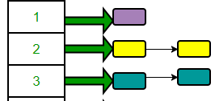
Synchronization is Necessary
Image Processing
Bioinformatics
Graph Analytics
Databases
Single Source Shortest Path (SSSP)
for v in Graph:
for u in neighbors[v]:
if distance[v] + edge_weight[v, u] < distance[u]
if distance[v] + edge_weight[v, u] < distance[u]
distance[u] = distance[v] + edge_weight[v, u]
Locks
Barriers
Concurrent
Data Structures
lock_acquire(u)
lock_release(u)

Slide 61
Baseline NDP Architecture
Synchronization challenges in NDP systems:
NDP System
NDP Unit
NDP Core
Main Memory
Programmable Core / Accelerator
NDP Core
Private Cache
NDP Core
(1) Lack of hardware cache coherence support
(2) Expensive communication across NDP units
(3) Lack of a shared level of cache memory

Slide 62

NDP Synchronization Solution Space
(1) Shared Memory
(2) Message-passing
Hardware Cache
Coherence
Remote
Atomics
Specialized Hardware Support
Software-based Schemes
Specialized Hardware Support
SynCron’s Key Techniques:
1. Hardware support for synchronization acceleration
2. Direct buffering of synchronization variables
3. Hierarchical message-passing communication
4. Integrated hardware-only overflow management
NDPs:
SynCron [HPCA’21]

Slide 63

1. Hardware Synchronization Support
NDP Unit 0
NDP Unit 1
NDP Core 0
Main Memory
NDP Core 0
Main Memory
`````
ISA
NDP Core 1
NDP Core 1
Synchronization
Engine 0
Synchronization
Engine 1
Local
lock acquire
  No Complex Cache Coherence Protocols
  No Expensive Atomic Operations
  Low Hardware Cost

Slide 64
2. Direct Buffering of Variables
NDP Unit 0
NDP Unit 1
NDP Core 0
Main Memory
NDP Core 0
Main Memory
NDP Core 1
NDP Core 1
Synchronization
Engine 0
Synchronization
Engine 1
Synchronization
Processing Unit
Synchronization
Table
Address
…
--
…
Local
lock acquire
Indexing Counters
--
…
--
…
--
…

Slide 65
2. Direct Buffering of Variables
NDP Unit 0
NDP Unit 1
NDP Core 0
Main Memory
NDP Core 0
Main Memory
NDP Core 1
NDP Core 1
Synchronization
Engine 0
Synchronization
Engine 1
Synchronization
Processing Unit
Synchronization
Table
Address
…
0x33A9
…
Local
lock acquire
      No Costly Memory Accesses
      Low Latency
Indexing Counters
--
…
--
…
--
…

Slide 66
3. Hierarchical Communication
NDP Unit 0
NDP Unit 1
NDP Core 0
Main Memory
NDP Core 0
Main Memory
NDP Core 1
NDP Core 1
Synchronization
Engine 0
Synchronization
Engine 1
syncronVar
NDP Unit 2
NDP Unit 3
NDP Core 0
Main Memory
NDP Core 0
Main Memory
NDP Core 1
NDP Core 1
Synchronization
Engine 2
Synchronization
Engine 3

Slide 67
3. Hierarchical Communication
Local
lock acquire
NDP Unit 0
NDP Unit 1
NDP Core 0
Main Memory
NDP Core 0
Main Memory
NDP Core 1
NDP Core 1
Synchronization
Engine 0
Synchronization
Engine 1
syncronVar
NDP Unit 2
NDP Unit 3
Master
NDP Core 0
Main Memory
NDP Core 0
Main Memory
NDP Core 1
NDP Core 1
Synchronization
Engine 2
Synchronization
Engine 3

Slide 68

3. Hierarchical Communication
Global
lock acquire
NDP Unit 0
NDP Unit 1
NDP Core 0
Main Memory
NDP Core 0
Main Memory
NDP Core 1
NDP Core 1
Synchronization
Engine 0
Synchronization
Engine 1
syncronVar
NDP Unit 2
NDP Unit 3
Master
NDP Core 0
Main Memory
NDP Core 0
Main Memory
Minimize Expensive Traffic
NDP Core 1
NDP Core 1
Synchronization
Engine 2
Synchronization
Engine 3

Slide 69
SynCron
SynCron’s Benefits:
High System Performance
Low Hardware Cost
Programming Ease
General Synchronization Support
The first end-to-end synchronization solution for NDP architectures
SynCron comes within 9.5% and 6.2% of performance and energy of Ideal zero-overhead synchronization

Slide 70
SynCron
Efficient Synchronization Support
for Near-Data-Processing Architectures
Christina Giannoula
Nandita Vijaykumar, Nikela Papadopoulou, Vasileios Karakostas
Ivan Fernandez, Juan Gómez Luna, Lois Orosa
Nectarios Koziris, Georgios Goumas, Onur Mutlu

Slide 71
How to Support Synchronization?
Christina Giannoula, Nandita Vijaykumar, Nikela Papadopoulou, Vasileios Karakostas, Ivan Fernandez, Juan Gómez-Luna, Lois Orosa, Nectarios Koziris, Georgios Goumas, Onur Mutlu,
"SynCron: Efficient Synchronization Support for Near-Data-Processing Architectures"
Proceedings of the 27th International Symposium on High-Performance Computer Architecture (HPCA), Virtual, February-March 2021.
[Slides (pptx) (pdf)]
[Short Talk Slides (pptx) (pdf)]
[Talk Video (21 minutes)]
[Short Talk Video (7 minutes)]

Slide 72
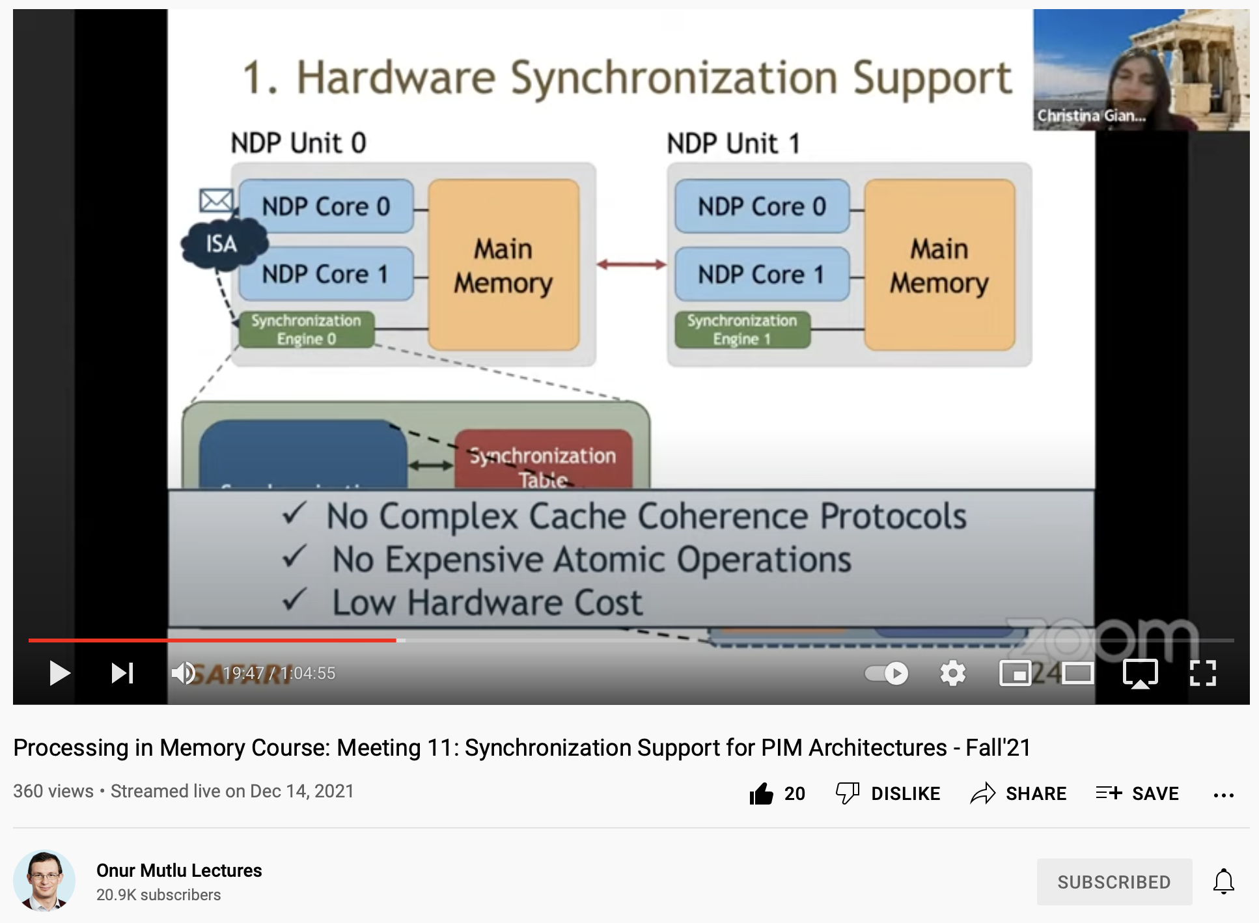
Lecture on Synchronization Support for PIM
https://youtu.be/GHZkRHp_AG0

Slide 73
How to Design Data Structures for PIM?
Zhiyu Liu, Irina Calciu, Maurice Herlihy, and Onur Mutlu,
"Concurrent Data Structures for Near-Memory Computing"
Proceedings of the 29th ACM Symposium on Parallelism in Algorithms and Architectures (SPAA), Washington, DC, USA, July 2017.
[Slides (pptx) (pdf)]

Slide 74
Virtual Memory Support

Slide 75
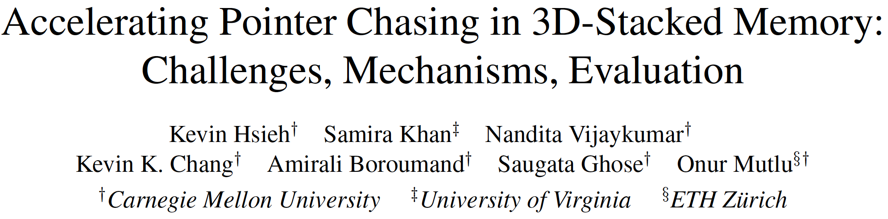
Accelerating Linked Data Structures
Kevin Hsieh, Samira Khan, Nandita Vijaykumar, Kevin K. Chang, Amirali Boroumand, Saugata Ghose, and Onur Mutlu,
"Accelerating Pointer Chasing in 3D-Stacked Memory: Challenges, Mechanisms, Evaluation"
Proceedings of the 34th IEEE International Conference on Computer Design (ICCD), Phoenix, AZ, USA, October 2016.

Slide 76
Executive Summary
Our Goal: Accelerating pointer chasing inside main memory
Challenges: Parallelism challenge and Address translation challenge
Our Solution: In-Memory PoInter Chasing Accelerator (IMPICA)
  Address-access decoupling: enabling parallelism in the accelerator with low cost
  IMPICA page table: low cost page table in logic layer
Key Results:
  1.2X – 1.9X speedup for pointer chasing operations, +16% database throughput
  6% - 41% reduction in energy consumption

Slide 77


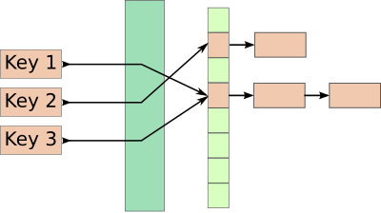
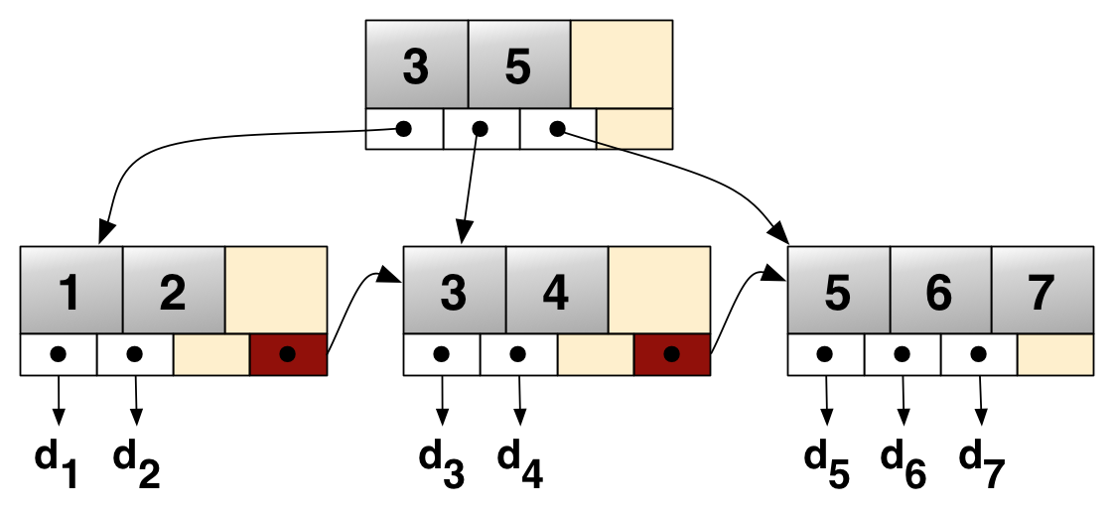
Linked Data Structures
Linked data structures are widely used in many important applications
Linked data structures are
connected by pointers
Database
Key-value stores
B-Tree
Hash Table

Slide 78
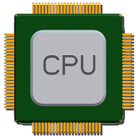
The Problem: Pointer Chasing
Traversing linked data structures requires chasing pointers
Find(A)
H
Addr (A)
Addr (E)
Addr (H)
E
Q
Data (H)
Data (E)
A
F
M
Data (A)
MEM
Serialized and irregular access pattern
6X cycles per instruction in real workloads

Slide 79
Our Goal
Accelerating pointer chasing inside main memory
Find(A)
H
Find
(A)
E
Q
Data (A)
DRAM layers
A
F
M
MEM
Logic layer

Slide 80
Parallelism Challenge
Time
CPU core
Comp
Memory
access
Comp
CPU core
Comp
Memory
access
Comp
In-Memory Accelerator
Comp
Memory access
Comp
Comp
Memory access
Comp
Slower for two operations
Faster for one operation

Slide 81
Parallelism Challenge and Opportunity
A simple in-memory accelerator can still be slower than multiple CPU cores
Opportunity: a pointer-chasing accelerator spends a long time waiting for memory
CPU core
CPU core
CPU core
Accelerator
Comp
Memory access (10-15X of Comp)
Comp

Slide 82
Our Solution: Address-Access Decoupling
Time
CPU core
Comp
Memory
access
Comp
CPU core
Comp
Memory
access
Comp
Address-access decoupling enables parallelism in both engines with low cost
Address Engine
Comp
Comp
Comp
Comp
Memory access
Access Engine
Memory access

Slide 83
IMPICA Core Architecture
DRAM
DRAM Dies
DRAM Layers
Logic Layer
Memory Controller
IMPICA Cache
Access Queue
Request Queue
Address
Engine
Access
Engine
Traversal 1
Response Queue
Traversal 2
To/From CPU

Slide 84
Address Translation Challenge
The page table walk requires multiple memory accesses
Pointer (VA)
TLB/MMU
Pointer (PA)
PTW
No TLB/MMU on the memory side
Duplicating it is costly and creates compatibility issue
PTW
PTW
PTW
PTW
Page table walk

Slide 85
Our Solution: IMPICA Page Table
Completely decouple the page table of IMPICA from the page table of the CPUs
IMPICA Page Table
CPU Page Table
Map linked data structure into IMPICA regions
IMPICA page table is a partial-to-any mapping
Virtual Page
Physical Page
IMPICA Region
Virtual Page
Physical Page
Virtual Address Space
Physical Address Space

Slide 86
IMPICA Page Table: Mechanism
Virtual Address
Bit [47:41]
Flat page table
saves one memory access
Bit [40:21]
Bit [20:12]
Bit [11:0]
Region Table
+
Tiny region table is almost always in the cache
+
Flat Page Table (2MB)
Small Page Table (4KB)
+
Physical Address
86

Slide 87
Evaluation Methodology
Simulator: gem5
System Configuration
  CPU
    4 OoO cores, 2GHz
    Cache: 32KB L1, 1MB L2
  IMPICA
    1 core, 500MHz, 32KB Cache
  Memory Bandwidth
    12.8 GB/s for CPU, 51.2 GB/s for IMPICA
Our simulator code is open source
  https://github.com/CMU-SAFARI/IMPICA

Slide 88
Result – Microbenchmark Performance
1.9X
1.3X
1.2X

Slide 89
Result – Database Performance
+16%
+5%
+2%
-0%
-4%
-13%

Slide 90
System Energy Consumption
-6%
-10%
-24%
-41%

Slide 91
Area and Power Overhead
CPU (Cortex-A57) | 5.85 mm² per core
L2 Cache | 5 mm² per MB
Memory Controller | 10 mm²
IMPICA (+32KB cache) | 0.45 mm²
Power overhead: average power increases by 5.6%

Slide 92
How to Support Virtual Memory?
Kevin Hsieh, Samira Khan, Nandita Vijaykumar, Kevin K. Chang, Amirali Boroumand, Saugata Ghose, and Onur Mutlu,
"Accelerating Pointer Chasing in 3D-Stacked Memory: Challenges, Mechanisms, Evaluation"
Proceedings of the 34th IEEE International Conference on Computer Design (ICCD), Phoenix, AZ, USA, October 2016.

Slide 93
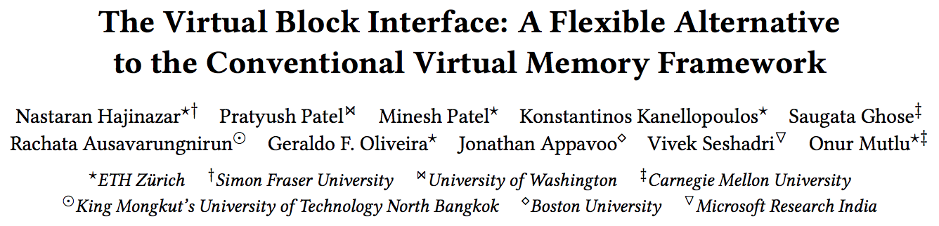
Rethinking Virtual Memory
Nastaran Hajinazar, Pratyush Patel, Minesh Patel, Konstantinos Kanellopoulos, Saugata Ghose, Rachata Ausavarungnirun, Geraldo Francisco de Oliveira Jr., Jonathan Appavoo, Vivek Seshadri, and Onur Mutlu,
"The Virtual Block Interface: A Flexible Alternative to the Conventional Virtual Memory Framework"
Proceedings of the 47th International Symposium on Computer Architecture (ISCA), Virtual, June 2020.
[Slides (pptx) (pdf)]
[Lightning Talk Slides (pptx) (pdf)]
[ARM Research Summit Poster (pptx) (pdf)]
[Talk Video (26 minutes)]
[Lightning Talk Video (3 minutes)]
[Lecture Video (43 minutes)]

Slide 94
VBI: Overview
P₁
P₂
Processes
Processes
. . .
P_{n}
P₁
P₂
. . .
P_{n}
Virtual Address Space (VAS)
VBI Address Space
VAS 1
VAS 2
VAS n
VB 1
VB 2
VB 3
VB 4
Page Tables
managed by the OS
Memory Translation Layer
in the memory controller
Physical Memory
Physical Memory
Conventional Virtual Memory
VBI
94

Slide 95
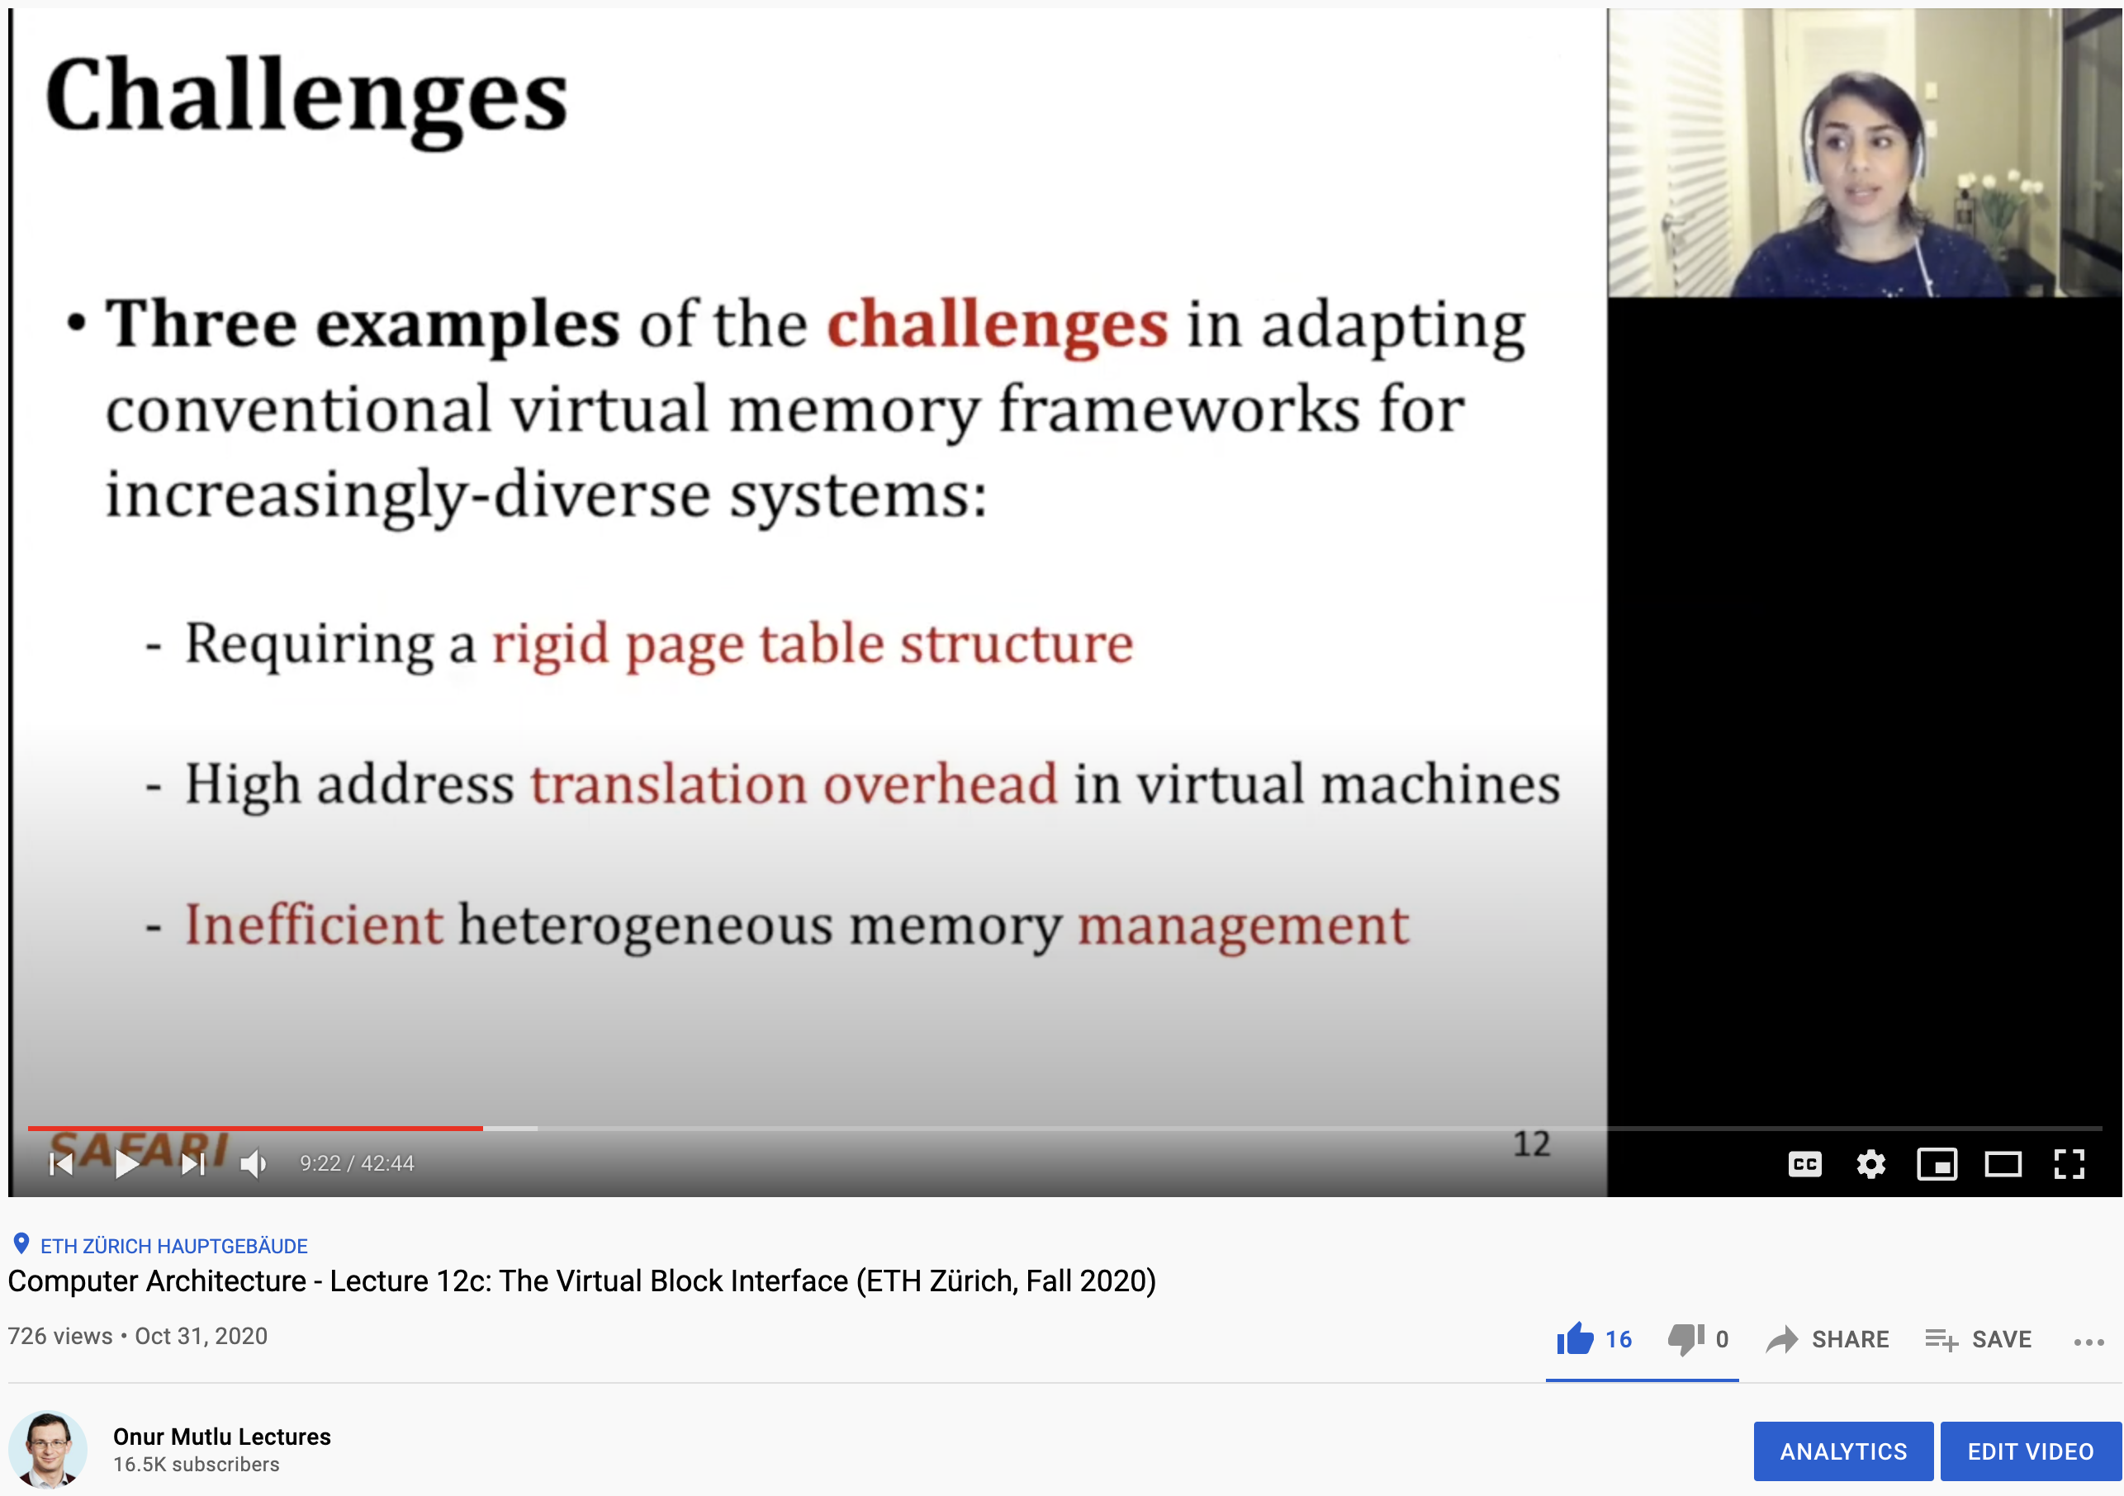
Lecture on Virtual Block Interface
https://www.youtube.com/watch?v=2RhGMpY18zw&list=PL5PHm2jkkXmi5CxxI7b3JCL1TWybTDtKq&index=22

Slide 96
Security Considerations

Slide 97
DRAM Latency PUF Key Idea
A cell’s latency failure probability is inherently related to random process variation from manufacturing
We can provide repeatable and unique device signatures using latency error patterns
High % chance to fail with reduced t_{RCD}
Low % chance to fail with reduced t_{RCD}
Row Decoder
SA
SA
SA
SA
SA
SA
SA
Notes:
Our key idea is to reduce DRAM read access latency below the reliable datasheet specifications using software-only system calls in order to exploit the resulting error patterns as unique identifiers.
[CLICK] We find that the probability that a cell will result in a latency failure due to a reduced-tRCD access, is inherently related to random process variation from manufacturing [CLICK] This knowledge enables us to provide a repeatable and unique device signature with these patterns of latency failures.
[CLICK] Here is a cartoon showing the manufacturing variation across a region of DRAM. When accessed with a reduced timing parameter, [CLICK] some cells have a high percentage chance of failing, while others [CLICK] have a low percentage chance of failing.
The Key Idea is to generate a PUF response using the locations of cells that have a high percentage chance of failing with a tRCD value reduced below manufacturer-recommended values.

Slide 98
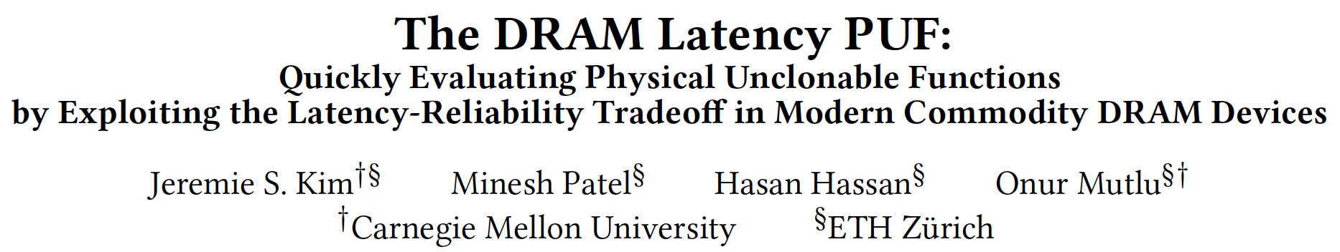
DRAM Latency Physical Unclonable Functions
Jeremie S. Kim, Minesh Patel, Hasan Hassan, and Onur Mutlu,
"The DRAM Latency PUF: Quickly Evaluating Physical Unclonable Functions by Exploiting the Latency-Reliability Tradeoff in Modern DRAM Devices"
Proceedings of the 24th International Symposium on High-Performance Computer Architecture (HPCA), Vienna, Austria, February 2018.
[Lightning Talk Video]
[Slides (pptx) (pdf)] [Lightning Session Slides (pptx) (pdf)]
[Full Talk Lecture Video (28 minutes)]

Slide 99
D-RaNGe Key Idea
A cell’s latency failure probability is inherently related to random process variation from manufacturing
We can extract random values by observing DRAM cells’ latency failure probabilities
High % chance to fail with reduced t_{RCD}
Low % chance to fail with reduced t_{RCD}
Row Decoder
SA
SA
SA
SA
SA
SA
SA
Notes:
Our key idea is to reduce DRAM read access latency below the reliable datasheet specification values using software-only system calls in order to exploit the resulting error patterns as true random numbers
[CLICK] We find that the probability that a cell will result in a latency failure due to a reduced-tRCD access, is inherently related to random process variation from manufacturing [CLICK] This knowledge enables us to provide random values by observing DRAM cells’ latency failure probabilities.
[CLICK] Here is a cartoon showing the manufacturing variation across a region of DRAM. When accessed with a reduced timing parameter, [CLICK] some cells have a high percentage chance of failing, while others [CLICK] have a low percentage chance of failing.

Slide 100
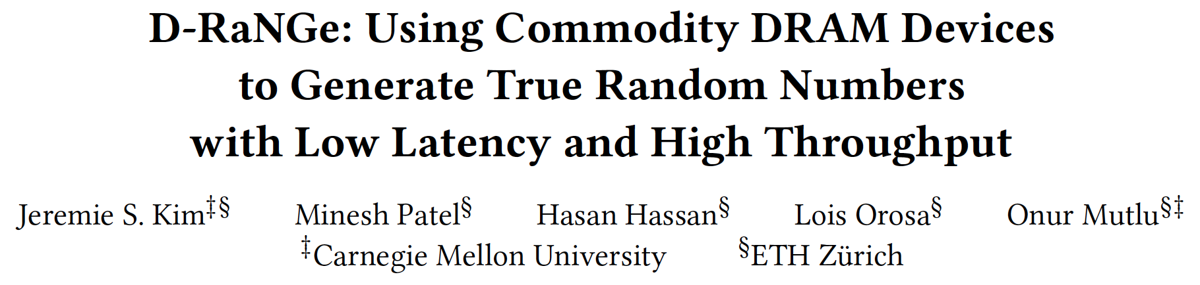
DRAM Latency True Random Number Generator
Jeremie S. Kim, Minesh Patel, Hasan Hassan, Lois Orosa, and Onur Mutlu,
"D-RaNGe: Using Commodity DRAM Devices to Generate True Random Numbers with Low Latency and High Throughput"
Proceedings of the 25th International Symposium on High-Performance Computer Architecture (HPCA), Washington, DC, USA, February 2019.
[Slides (pptx) (pdf)]
[Full Talk Video (21 minutes)]
[Full Talk Lecture Video (27 minutes)]
Top Picks Honorable Mention by IEEE Micro.

Slide 101
Quadruple Activation (QUAC)
New Observation
Carefully-engineered DRAM commands
can activate four rows in real DRAM chips
Activate four rows with two ACT commands
Violated
ACT
<3ns
PRE
<3ns
ACT
35ns
14ns
Default

Slide 102
Generating Random Values via QUAC
V_{DD}/2
R3
V_{dd}
R2
V_{TH}
R1
0
Voltage Difference
Logic-1
R0
-V_{TH}
Ready to Sense
Voltage Level
Sense Amplifier
-V_{dd}
Enable
Time
V_{DD}/2

Slide 103
Generating Random Values via QUAC
V_{DD}/2
+ $ε$
R3
V_{dd}
R2
V_{TH}
R1
0
Voltage Difference
R0
-V_{TH}
Sense Amplifier
-V_{dd}
Enable
ACT
R0
PRE
ACT R3
Time
V_{DD}/2

Slide 104
Generating Random Values via QUAC
V_{DD}/2
+ $ε$
R3
V_{dd}
Random perturbation
R2
V_{TH}
R1
0
Voltage Difference
R0
-V_{TH}
Sense Amplifier
-V_{dd}
Enable
ACT
R0
PRE
ACT R3
Time
Enable Sense Amplifiers
V_{DD}/2

Slide 105
QUAC-TRNG
Key Idea: Leverage random values on sense amplifiers generated by QUAC operations as source of entropy
R3
R2
DRAM Segment
R1
R0
Sense Amplifiers
Step 1
Initialize
Step 2
QUAC
Random Values
Logic-1
Logic-0

Slide 106
QUAC-TRNG
Key Idea: Leverage random values on sense amplifiers generated by QUAC operations as source of entropy
256-bit Shannon Entropy Blocks
Sense Amplifiers
Memory Controller
SHA-256
256-bit TRN
Step 1
Initialize
Step 2
QUAC
Step 3
Read
Step 4
Post-process

Slide 107
QUAC-TRNG
Key Idea: Leverage random values on sense amplifiers generated by QUAC operations as source of entropy
Sense Amplifiers
Memory Controller
SHA-256
256-bit TRN
Generates a 256-bit random number
for every 256-bit Shannon Entropy block
Step 1
Initialize
Step 2
QUAC
Step 3
Read
Step 4
Post-process

Slide 108
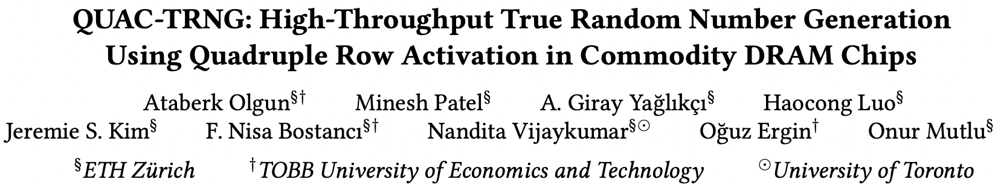
In-DRAM True Random Number Generation
Ataberk Olgun, Minesh Patel, A. Giray Yaglikci, Haocong Luo, Jeremie S. Kim, F. Nisa Bostanci, Nandita Vijaykumar, Oguz Ergin, and Onur Mutlu,
"QUAC-TRNG: High-Throughput True Random Number Generation Using Quadruple Row Activation in Commodity DRAM Chips"
Proceedings of the 48th International Symposium on Computer Architecture (ISCA), Virtual, June 2021.
[Slides (pptx) (pdf)]
[Short Talk Slides (pptx) (pdf)]
[Talk Video (25 minutes)]
[SAFARI Live Seminar Video (1 hr 26 mins)]

Slide 109
Benchmarks and
Simulation Infrastructures

Slide 110
PrIM Benchmarks: Application Domains
Domain | Benchmark | Short name
Dense linear algebra | Vector Addition | VA
 | Matrix-Vector Multiply | GEMV
Sparse linear algebra | Sparse Matrix-Vector Multiply | SpMV
Databases | Select | SEL
 | Unique | UNI
Data analytics | Binary Search | BS
 | Time Series Analysis | TS
Graph processing | Breadth-First Search | BFS
Neural networks | Multilayer Perceptron | MLP
Bioinformatics | Needleman-Wunsch | NW
Image processing | Image histogram (short) | HST-S
 | Image histogram (large) | HST-L
Parallel primitives | Reduction | RED
 | Prefix sum (scan-scan-add) | SCAN-SSA
 | Prefix sum (reduce-scan-scan) | SCAN-RSS
 | Matrix transposition | TRNS

Slide 111
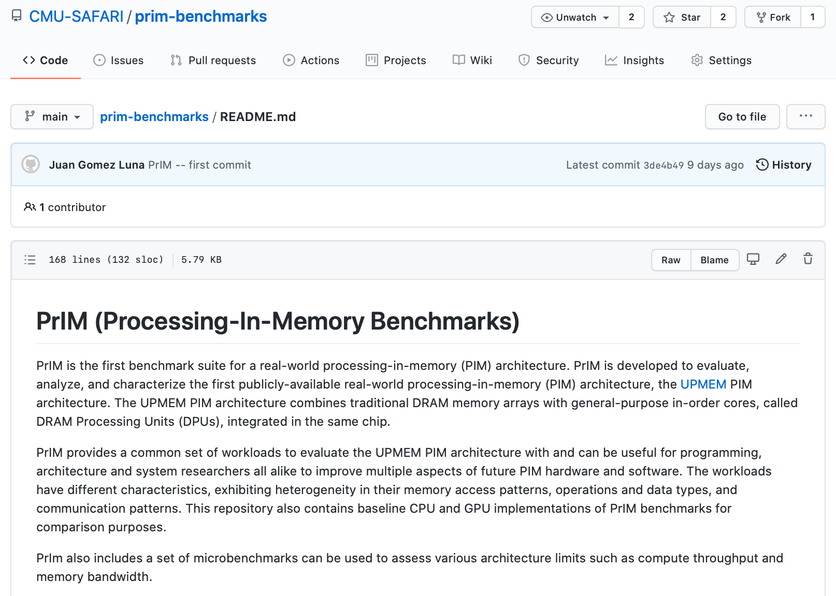
PrIM Benchmarks are Open Source
All microbenchmarks, benchmarks, and scripts
https://github.com/CMU-SAFARI/prim-benchmarks

Slide 112
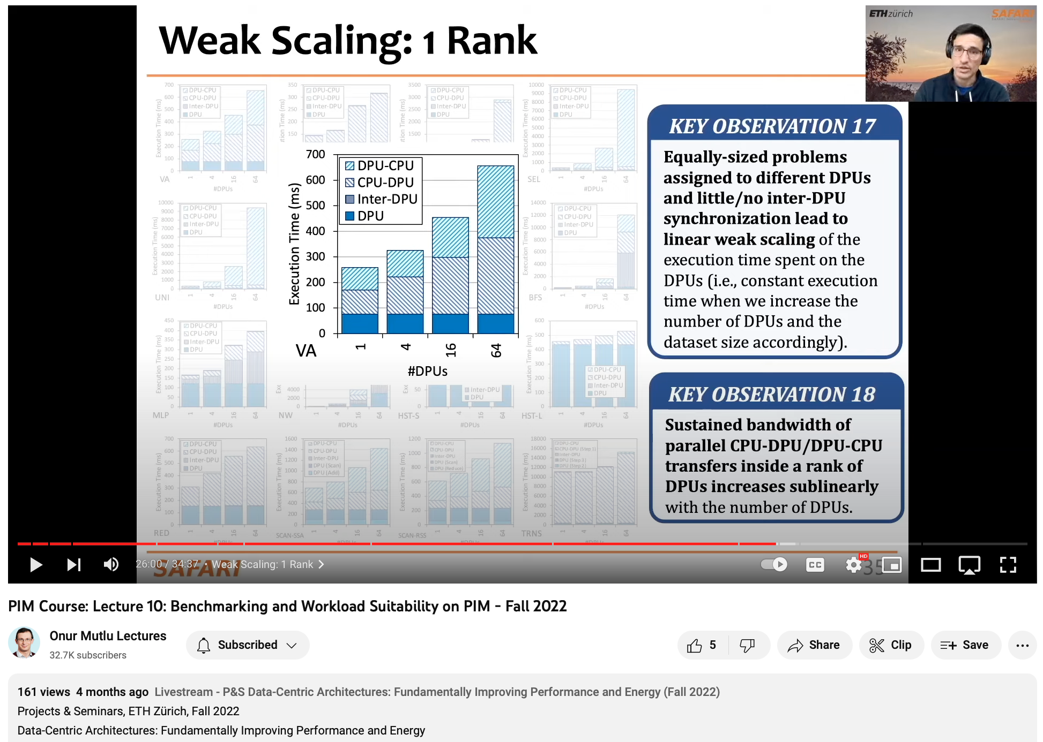
Lecture on PrIM Benchmarks
https://youtu.be/H_xvB_O-bWM

Slide 113
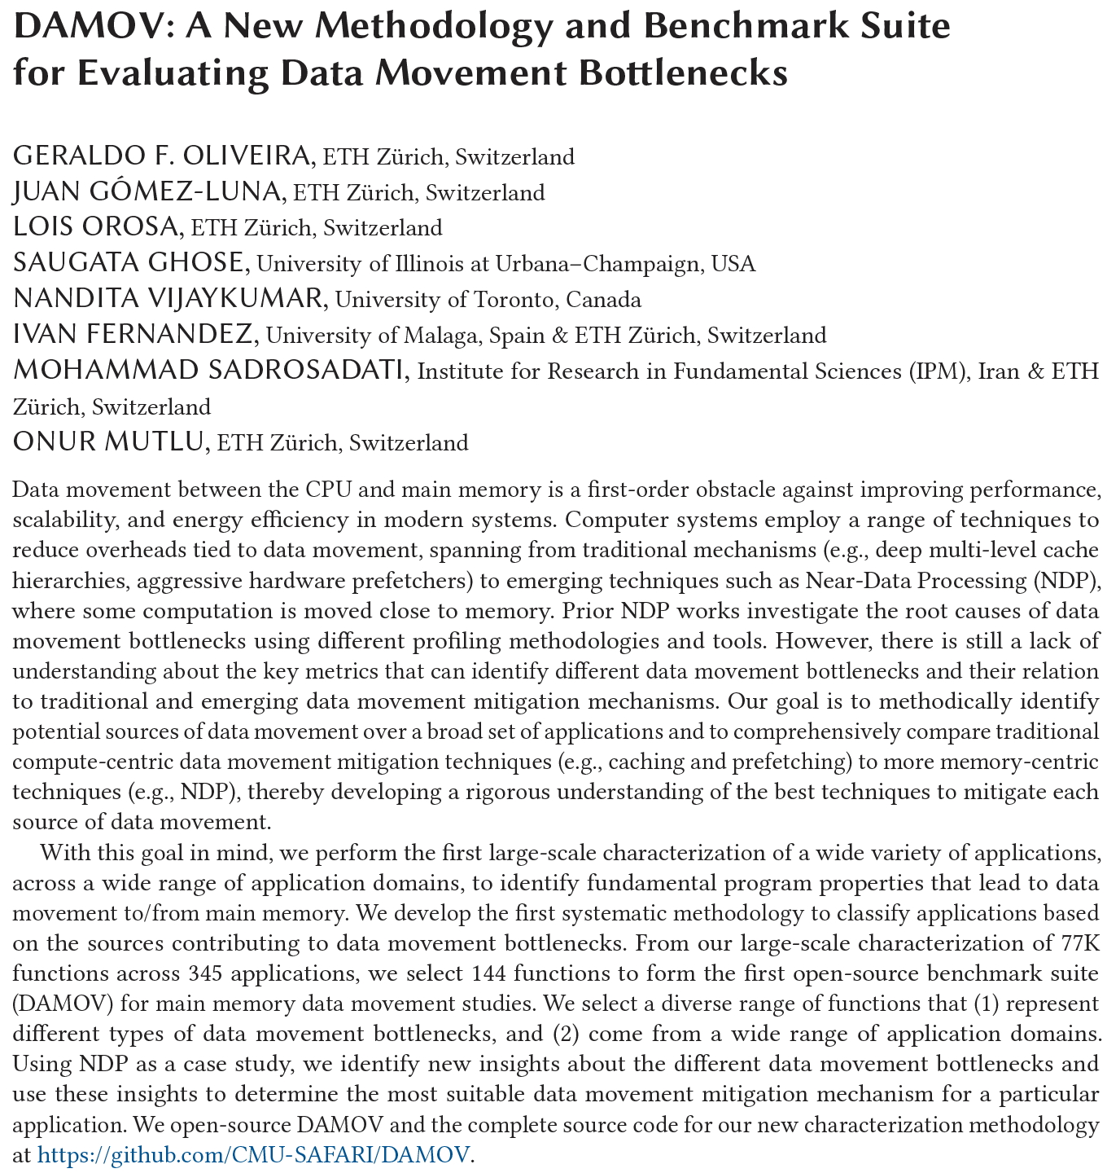
DAMOV Analysis Methodology & Workloads
https://arxiv.org/pdf/2105.03725.pdf

Slide 114

Methodology Overview
User Input
Step 1
Application Profiling
DAMOV-SIM Simulator
Target Application
roi_begin
ld 0xFF
st 0xAF
ld 0xFF
st 0xAF
ld 0xFF
Source Code
Memory Traces
# Cores
roi_end
Profiler
Scalability Analysis
DRAM Bandwidth
Methodology Output
Step 2
Locality-based Clustering
DRAM Latency
L1/L2 Cache Capacity
High
Temporal Locality
LFMR
L3 Cache Contention
High
Spatial Locality
Temp. Locality
L1 Cache Capacity
…
Step 3
Memory Bottleneck Class.
Memory Bottleneck Classes
LFMR
Compute-Bound
Low
Arithmetic Intensity
Low
LLC MPKI
Last-to-First
Miss Ratio (LFMR)
16
Notes:
Our methodology has three steps.
[CLICK] It takes as input an application’s source code and its input datasets.
[CLICK] In Step 1, we use a hardware profiling tool to identify memory-bound functions across many applications. This step allows for a quick first-level identification of many applications that suffer from memory bottlenecks and functions that cause these bottlenecks.
[CLICK] We utilize a new simulator, called DAMOV-SIM to collect key metrics and execute performance analysis of the functions identified in Step 1.
[CLICK] In Step 2, we use the architecture-independent profiling tool to collect metrics that provide insights about the memory access behavior of the memory-bottlenecked functions.
[CLICK] In Step 3, we collect architecture-dependent metrics and analyze the performance and energy of each function in an application when each of our three candidate data movement mitigation mechanisms is applied to the system.
[CLICK] By combining the data obtained from all three steps, we can systematically classify the leading causes of data movement bottlenecks in an application or function into different bottleneck classes
[NEXT]

Slide 115
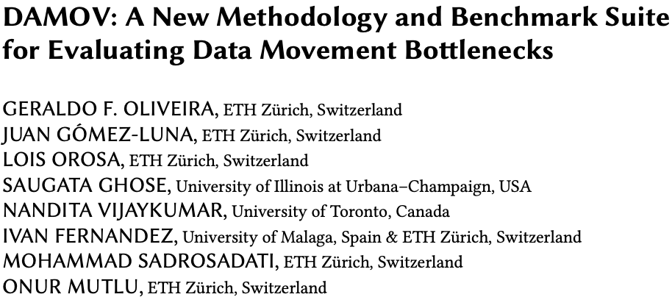
More on DAMOV
Geraldo F. Oliveira, Juan Gomez-Luna, Lois Orosa, Saugata Ghose, Nandita Vijaykumar, Ivan Fernandez, Mohammad Sadrosadati, and Onur Mutlu,
"DAMOV: A New Methodology and Benchmark Suite for Evaluating Data Movement Bottlenecks"
Preprint in arXiv, 8 May 2021.
[arXiv preprint]
[DAMOV Suite and Simulator Source Code]
[SAFARI Live Seminar Video (2 hrs 40 mins)]
[Short Talk Video (21 minutes)]

Slide 116
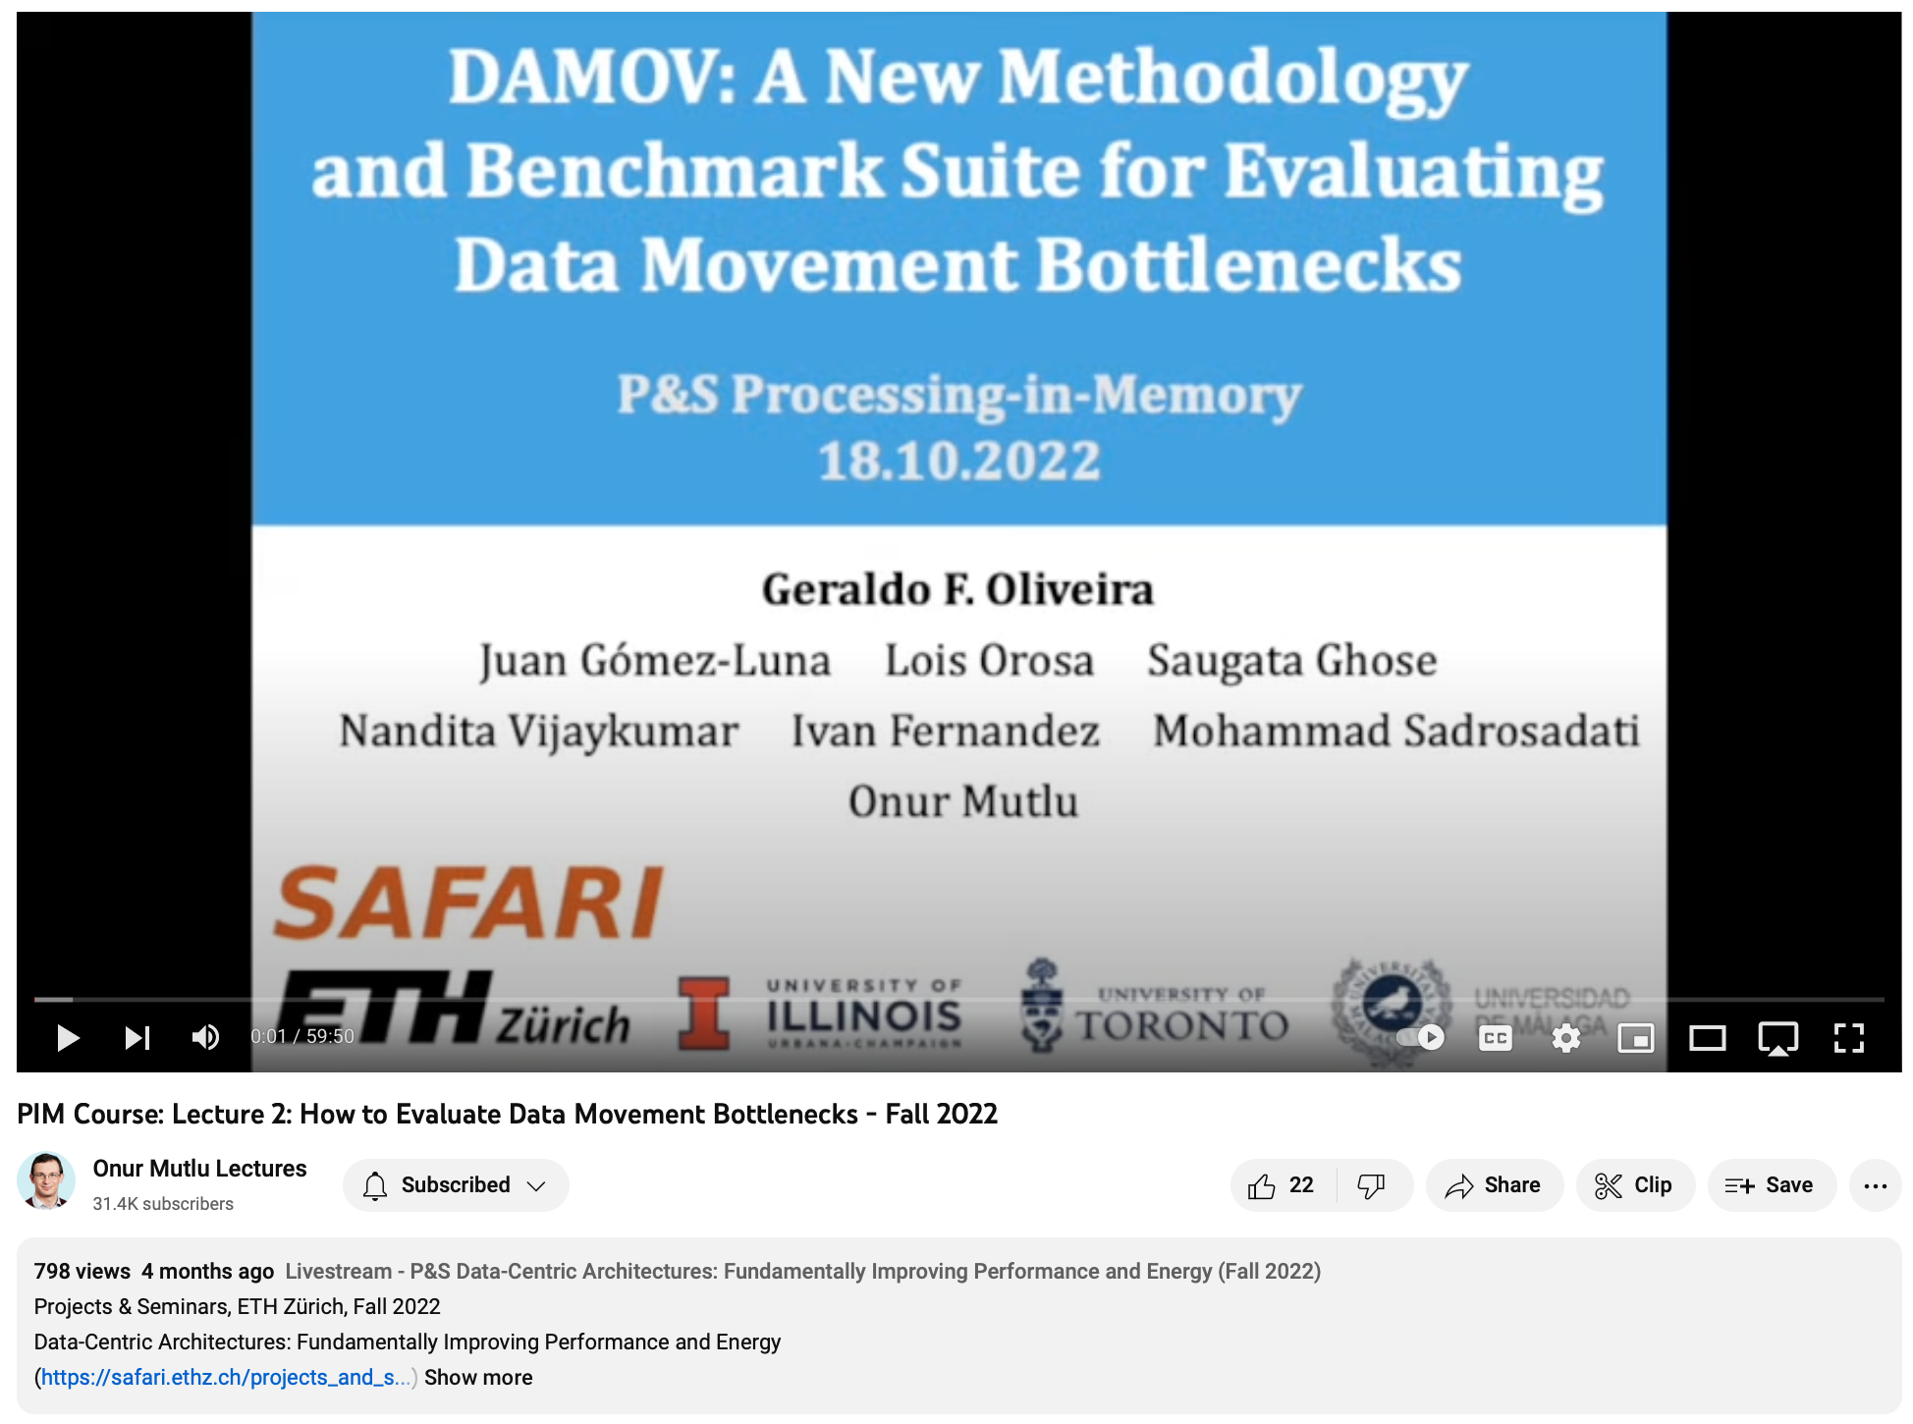
Lecture on DAMOV
https://youtu.be/An2lACOASdo
74

Slide 117
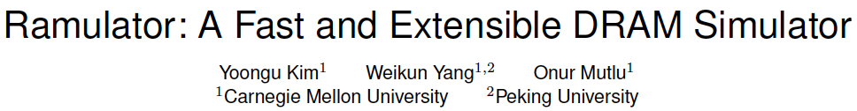
Simulation Infrastructures for PIM
Ramulator extended for PIM
  Flexible and extensible DRAM simulator
  Can model many different memory standards and proposals
  Kim+, “Ramulator: A Flexible and Extensible DRAM Simulator”, IEEE CAL 2015.
  https://github.com/CMU-SAFARI/ramulator-pim
  https://github.com/CMU-SAFARI/ramulator
  [Source Code for Ramulator-PIM]

Slide 118
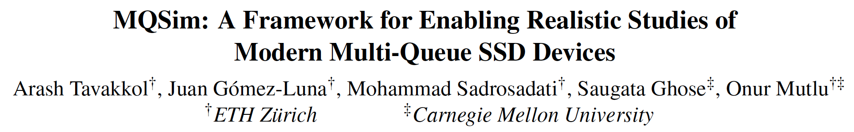
Simulation Infrastructures for PIM (in SSDs)
Arash Tavakkol, Juan Gomez-Luna, Mohammad Sadrosadati, Saugata Ghose, and Onur Mutlu,
"MQSim: A Framework for Enabling Realistic Studies of Modern Multi-Queue SSD Devices"
Proceedings of the 16th USENIX Conference on File and Storage Technologies (FAST), Oakland, CA, USA, February 2018.
[Slides (pptx) (pdf)]
[Source Code]

Slide 119


NAPEL: Near-Memory Computing Application Performance Prediction via Ensemble Learning
Funded by the Horizon 2020 Framework Programme of the European Union
MSCA-ITN-EID
Gagandeep Singh, Juan Gomez-Luna, Giovanni Mariani, Geraldo F. Oliveira,
Stefano Corda, Sander Stuijk, Onur Mutlu, Henk Corporaal
56th Design Automation Conference (DAC), Las Vegas
4th-June-2019

Slide 120
Executive Summary
Motivation: A promising paradigm to alleviate data movement bottleneck is near-memory computing (NMC), which consists of placing compute units close to the memory subsystem
Problem: Simulation times are extremely slow, imposing long run-time especially in the early-stage design space exploration
Goal: A quick high-level performance and energy estimation framework for NMC architectures
Our contribution: NAPEL
  Fast and accurate performance and energy prediction for previously-unseen applications using ensemble learning
  Use intelligent statistical techniques and micro-architecture-independent application features to minimize experimental runs
Evaluation
  NAPEL is, on average, 220x faster than state-of-the-art NMC simulator
  Error rates (average) of 8.5% and 11.5% for performance and energy estimation
We open source Ramulator-PIM: https://github.com/CMU-SAFARI/ramulator-pim/

Slide 121
NMC Simulators
Simulation for:
  Design space exploration (DSE)
  Workload suitability analysis
NMC Simulators:
  Sinuca, 2015
  HMC-SIM, 2016
  CasHMC, 2016
  Smart Memory Cube (SMC), 2016
  CLAPPS, 2017
  Gem5+HMC, 2017
  Ramulator-PIM¹, 2019
¹Ramulator-PIM: https://github.com/CMU-SAFARI/ramulator-pim/

Slide 122
NMC Simulators
Simulation for:
  Design space exploration (DSE)
  Workload suitability analysis
NMC Simulators:
  Sinuca, 2015
  HMC-SIM, 2016
  CasHMC, 2016
  Smart Memory Cube (SMC), 2016
  CLAPPS, 2017
  Gem5+HMC, 2017
  Ramulator-PIM¹, 2019
Simulation of real workloads can be 10000x slower than native-execution!!!
¹Ramulator-PIM: https://github.com/CMU-SAFARI/ramulator-pim/

Slide 123
NMC Simulators
Simulation for:
  Design space exploration (DSE)
  Workload suitability analysis
NMC Simulators:
  Sinuca, 2015
  HMC-SIM, 2016
  CasHMC, 2016
  Smart Memory Cube (SMC), 2016
  CLAPPS, 2017
  Gem5+HMC, 2017
  Ramulator-PIM¹, 2019
Idea: Leverage ML with statistical techniques for quick NMC performance/energy prediction
¹Ramulator-PIM: https://github.com/CMU-SAFARI/ramulator-pim/

Slide 124
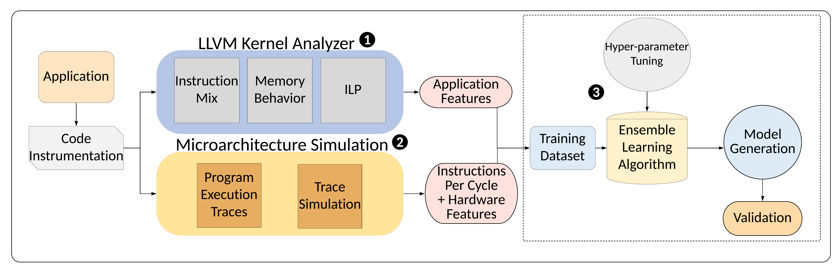
NAPEL: Near-Memory Computing Application Performance Prediction via Ensemble Learning
NAPEL Model Training

Slide 125
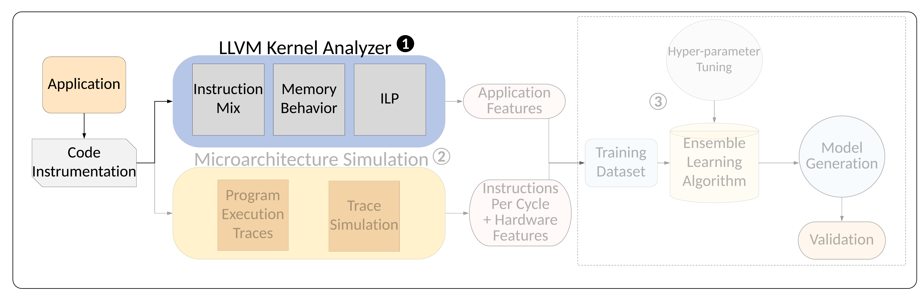
Phase 1: LLVM Analyzer

Slide 126
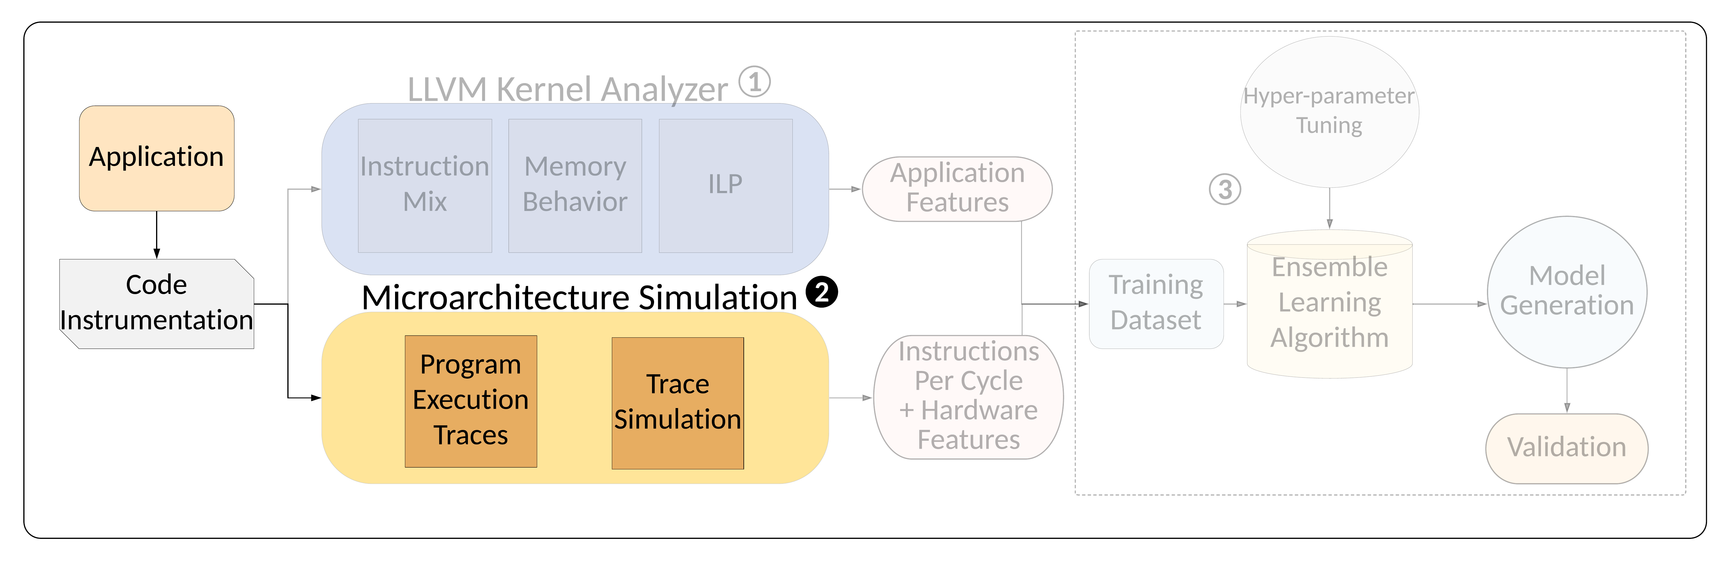

Phase 2: Microarchitecture Simulation
Central composite design of experiments technique to minimize the number of experiments while data collection

Slide 127

Phase 3: Ensemble ML Training
Application Features
Instruction Mix
ILP
Reuse distance
Memory traffic
Register traffic
Memory footprint
Architecture Features
Core type
#PEs
Core frequency
Cache line size
DRAM layers
Cache access fraction
DRAM access fraction

Slide 128

NAPEL Framework

Slide 129

NAPEL Prediction

Slide 130

Experimental Setup
Host System
  IBM POWER9
  Power: AMESTER
NMC Subsystem
  Ramulator-PIM¹
Workloads
  PolyBench and Rodinia
  Heterogeneous workloads such as image processing, machine learning, graph processing etc.
Accuracy in terms of mean relative error (MRE)
¹https://github.com/CMU-SAFARI/ramulator-pim/

Slide 131
NAPEL Accuracy: Performance and
Energy Estimates
(a) Performance prediction
(b) Energy prediction

Slide 132
NAPEL Accuracy: Performance and
Energy Estimates
(a) Performance prediction
MRE of 8.5% and 11.6% for performance and energy
(b) Energy prediction

Slide 133

Speed of Evaluation
256 DoE configurations for 12 evaluated applications
1
256

Slide 134
Speed of Evaluation
256 DoE configurations for 12 evaluated applications
220x (up to 1039x) faster than NMC simulator
1
256

Slide 135
Use Case: NMC Suitability Analysis
Assess the potential of offloading a workload to NMC
NAPEL provides accurate prediction of NMC suitability
MRE between 1.3% to 26.3% (average 14.1%)

Slide 136

Performance & Energy Models for PIM
Gagandeep Singh, Juan Gomez-Luna, Giovanni Mariani, Geraldo F. Oliveira, Stefano Corda, Sander Stujik, Onur Mutlu, and Henk Corporaal,
"NAPEL: Near-Memory Computing Application Performance Prediction via Ensemble Learning"
Proceedings of the 56th Design Automation Conference (DAC), Las Vegas, NV, USA, June 2019.
[Slides (pptx) (pdf)]
[Poster (pptx) (pdf)]
[Source Code for Ramulator-PIM]

Slide 137
Applications that
Benefit from PIM

Slide 138

Lectures about Applications on Real PIM Systems
https://www.youtube.com/playlist?list=PL5Q2soXY2Zi_EObuoAZVSq_o6UySWQHvZ

Slide 139

New Applications and Use Cases for PIM
Jeremie S. Kim, Damla Senol Cali, Hongyi Xin, Donghyuk Lee, Saugata Ghose, Mohammed Alser, Hasan Hassan, Oguz Ergin, Can Alkan, and Onur Mutlu,
"GRIM-Filter: Fast Seed Location Filtering in DNA Read Mapping Using Processing-in-Memory Technologies"
BMC Genomics, 2018.
Proceedings of the 16th Asia Pacific Bioinformatics Conference (APBC), Yokohama, Japan, January 2018.
arxiv.org Version (pdf)

Slide 140


Genome Read In-Memory (GRIM) Filter:
Fast Seed Location Filtering in DNA Read Mapping using Processing-in-Memory Technologies
Jeremie Kim,
Damla Senol, Hongyi Xin, Donghyuk Lee,
Saugata Ghose, Mohammed Alser, Hasan Hassan,
Oguz Ergin, Can Alkan, and Onur Mutlu
Notes:
Hello, my name is Jeremie Kim and I will be presenting Genome Read In-Memory Filter which will also be referred to as GRIM-Filter for short.
[CLICK]

Slide 141
Executive Summary
Genome Read Mapping is a very important problem and is the first step in many types of genomic analysis
  Could lead to improved health care, medicine, quality of life
Read mapping is an approximate string matching problem
  Find the best fit of 100 character strings into a 3 billion character dictionary
  Alignment is currently the best method for determining the similarity between two strings, but is very expensive
We propose an in-memory processing algorithm GRIM-Filter for accelerating read mapping, by reducing the number of required alignments
We implement GRIM-Filter using in-memory processing within 3D-stacked memory and show up to 3.7x speedup.

Slide 142

Accelerating Approximate String Matching
Damla Senol Cali, Gurpreet S. Kalsi, Zulal Bingol, Can Firtina, Lavanya Subramanian, Jeremie S. Kim, Rachata Ausavarungnirun, Mohammed Alser, Juan Gomez-Luna, Amirali Boroumand, Anant Nori, Allison Scibisz, Sreenivas Subramoney, Can Alkan, Saugata Ghose, and Onur Mutlu,
"GenASM: A High-Performance, Low-Power Approximate String Matching Acceleration Framework for Genome Sequence Analysis"
Proceedings of the 53rd International Symposium on Microarchitecture (MICRO), Virtual, October 2020.
[Lighting Talk Video (1.5 minutes)]
[Lightning Talk Slides (pptx) (pdf)]
[Talk Video (18 minutes)]
[Slides (pptx) (pdf)]

Slide 143


Google Workloads for Consumer Devices:
Mitigating Data Movement Bottlenecks
Amirali Boroumand
Saugata Ghose, Youngsok Kim, Rachata Ausavarungnirun,
Eric Shiu, Rahul Thakur, Daehyun Kim, Aki Kuusela,
Allan Knies, Parthasarathy Ranganathan, Onur Mutlu

Slide 144

Accelerating Climate Modeling
Gagandeep Singh, Dionysios Diamantopoulos, Christoph Hagleitner, Juan Gómez-Luna, Sander Stuijk, Onur Mutlu, and Henk Corporaal,
"NERO: A Near High-Bandwidth Memory Stencil Accelerator for Weather Prediction Modeling"
Proceedings of the 30th International Conference on Field-Programmable Logic and Applications (FPL), Gothenburg, Sweden, September 2020.
[Slides (pptx) (pdf)]
[Lightning Talk Slides (pptx) (pdf)]
[Talk Video (23 minutes)]
Nominated for the Stamatis Vassiliadis Memorial Award.

Slide 145

Accelerating Time Series Analysis
Ivan Fernandez, Ricardo Quislant, Christina Giannoula, Mohammed Alser, Juan Gómez-Luna, Eladio Gutiérrez, Oscar Plata, and Onur Mutlu,
"NATSA: A Near-Data Processing Accelerator for Time Series Analysis"
Proceedings of the 38th IEEE International Conference on Computer Design (ICCD), Virtual, October 2020.

Slide 146
Epilogue

Slide 147
PIM Review and Open Problems
Onur Mutlu, Saugata Ghose, Juan Gomez-Luna, and Rachata Ausavarungnirun,
"A Modern Primer on Processing in Memory"
Invited Book Chapter in Emerging Computing: From Devices to Systems - Looking Beyond Moore and Von Neumann, Springer, 2022.
https://arxiv.org/pdf/1903.03988.pdf

Slide 149
PIM Review and Open Problems (II)
Onur Mutlu, Saugata Ghose, Juan Gomez-Luna, and Rachata Ausavarungnirun,
"Processing Data Where It Makes Sense: Enabling In-Memory Computation"
Invited paper in Microprocessors and Microsystems (MICPRO), June 2019.
[arXiv version]
https://arxiv.org/pdf/1903.03988.pdf

Slide 150
PIM Review and Open Problems (III)
Saugata Ghose, Amirali Boroumand, Jeremie S. Kim, Juan Gomez-Luna, and Onur Mutlu,
"Processing-in-Memory: A Workload-Driven Perspective"
Invited Article in IBM Journal of Research & Development, Special Issue on Hardware for Artificial Intelligence, to appear in November 2019.
[Preliminary arXiv version]
https://arxiv.org/pdf/1907.12947.pdf

Slide 151

Longer Lecture on Enabling PIM Adoption
https://youtu.be/fIWsDpyHy94

Slide 152
Challenge and Opportunity for Future
Fundamentally
Energy-Efficient
(Data-Centric)
Computing Architectures

Slide 153
Challenge and Opportunity for Future
Fundamentally
High-Performance
(Data-Centric)
Computing Architectures

Slide 154
Challenge and Opportunity for Future
Computing Architectures
with
Minimal Data Movement

Slide 155
A Tutorial on Memory-Centric Systems
Onur Mutlu,
"Memory-Centric Computing Systems"
Invited Tutorial at 66th International Electron Devices Meeting (IEDM), Virtual, 12 December 2020.
[Slides (pptx) (pdf)]
[Executive Summary Slides (pptx) (pdf)]
[Tutorial Video (1 hour 51 minutes)]
[Executive Summary Video (2 minutes)]
[Abstract and Bio]
[Related Keynote Paper from VLSI-DAT 2020]
[Related Review Paper on Processing in Memory]
https://www.youtube.com/watch?v=H3sEaINPBOE
https://www.youtube.com/onurmutlulectures

Slide 156


Slide 157
A Tutorial on Memory-Centric Computing
Onur Mutlu,
"Memory-Centric Computing"
Education Class at Embedded Systems Week (ESWEEK), Virtual, 9 October 2021.
[Slides (pptx) (pdf)]
[Abstract (pdf)]
[Talk Video (2 hours, including Q&A)]
[Invited Paper at DATE 2021]
["A Modern Primer on Processing in Memory" paper]
https://www.youtube.com/watch?v=N1Ac1ov1JOM
https://www.youtube.com/onurmutlulectures

Slide 158

Latest Longer & Detailed Tutorial on PIM
Onur Mutlu,
"Memory-Centric Computing"
Education Class at Embedded Systems Week (ESWEEK), Virtual, 9 October 2021.
[Slides (pptx) (pdf)]
[Abstract (pdf)]
[Talk Video (2 hours, including Q&A)]
[Invited Paper at DATE 2021]
["A Modern Primer on Processing in Memory" paper]
https://www.youtube.com/watch?v=N1Ac1ov1JOM&list=PL5Q2soXY2Zi8D_5MGV6EnXEJHnV2YFBJl&index=65
https://www.youtube.com/watch?v=N1Ac1ov1JOM
https://www.youtube.com/onurmutlulectures

Slide 159


Processing-in-Memory Course (Fall 2022)
Short weekly lectures
Hands-on projects
https://safari.ethz.ch/projects_and_seminars/fall2022/doku.php?id=processing_in_memory
https://youtube.com/playlist?list=PL5Q2soXY2Zi8KzG2CQYRNQOVD0GOBrnKy

Slide 160


Processing-in-Memory Course (Spring 2023)
Short weekly lectures
Hands-on projects
https://www.youtube.com/playlist?list=PL5Q2soXY2Zi_EObuoAZVSq_o6UySWQHvZ
https://safari.ethz.ch/projects_and_seminars/spring2023/doku.php?id=processing_in_memory

Slide 161

Introducción al Procesamiento en Memoria
(en Español)
https://youtu.be/QixM8UUwGi8

Slide 162

Análisis de una Arquitectura Real de Procesamiento en Memoria (en Español)
https://youtu.be/F7HWu336an0

Slide 163
MICRO 2023 Tutorial
Real-world Processing-in-Memory Systems for Modern Workloads
PIM Adoption Issues
How to Enable PIM Adoption?
Dr. Juan Gómez Luna
Professor Onur Mutlu
Sunday, October 29, 2023

