Slide 1
MICRO 2023 Tutorial
Real-world Processing-in-Memory Systems for Modern Workloads
Hands-on Lab
Programming and Understanding a
Real Processing-in-Memory Architecture
Dr. Juan Gómez Luna
Professor Onur Mutlu
Sunday, October 29, 2023

Slide 2
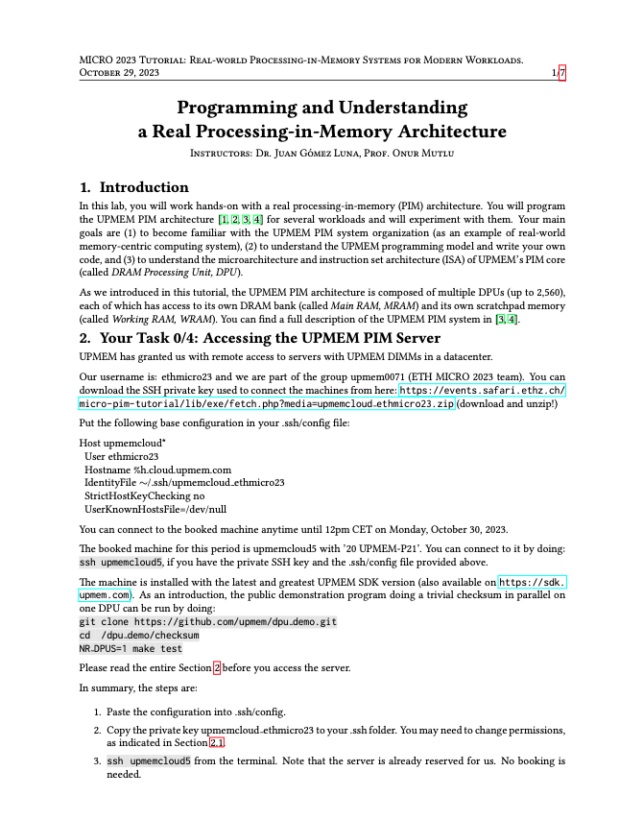
Real PIM Tutorial: Hands-on Lab

Slide 3
How to Access the UPMEM PIM Server?
1. Paste the configuration into .ssh/config
Host upmemcloud*
User ethmicro23
Hostname %h.cloud.upmem.com
IdentityFile ~/.ssh/upmemcloud_ethmicro23
StrictHostKeyChecking no
UserKnownHostsFile=/dev/null
2. Copy the private key upmemcloud_ethmicro23 to your .ssh folder. You may need to change permissions
3. ssh upmemcloud5 from the terminal
Access until 12pm CET on Monday, October 30, 2023

Slide 4
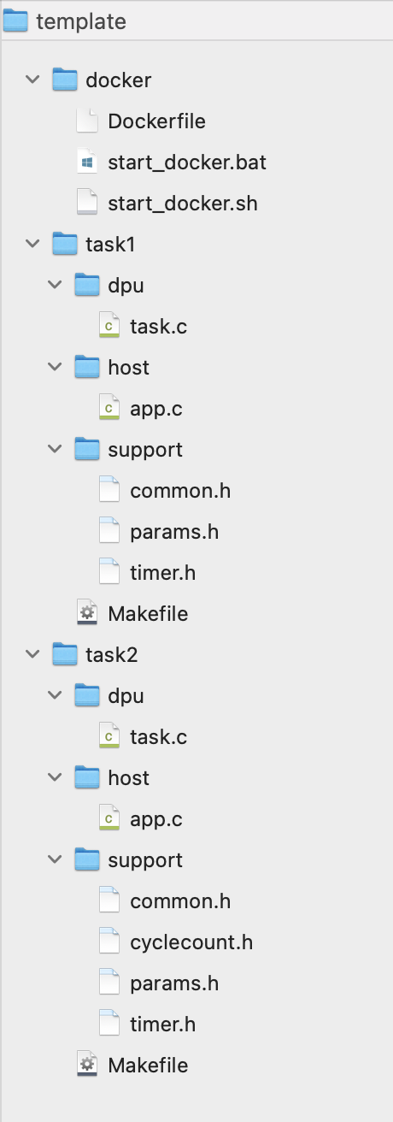
Template Files
Contain templates for task 1 and task 2
Task 2’s template can be used for the remaining tasks

Slide 5
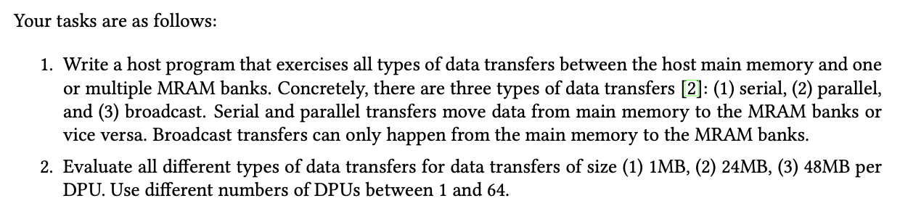
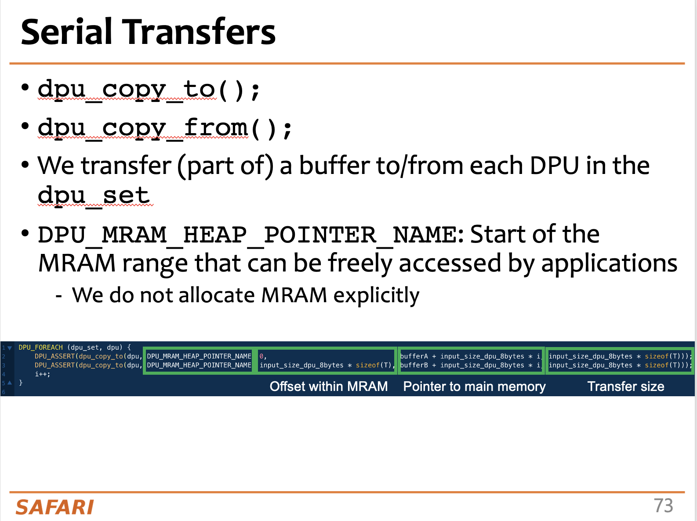
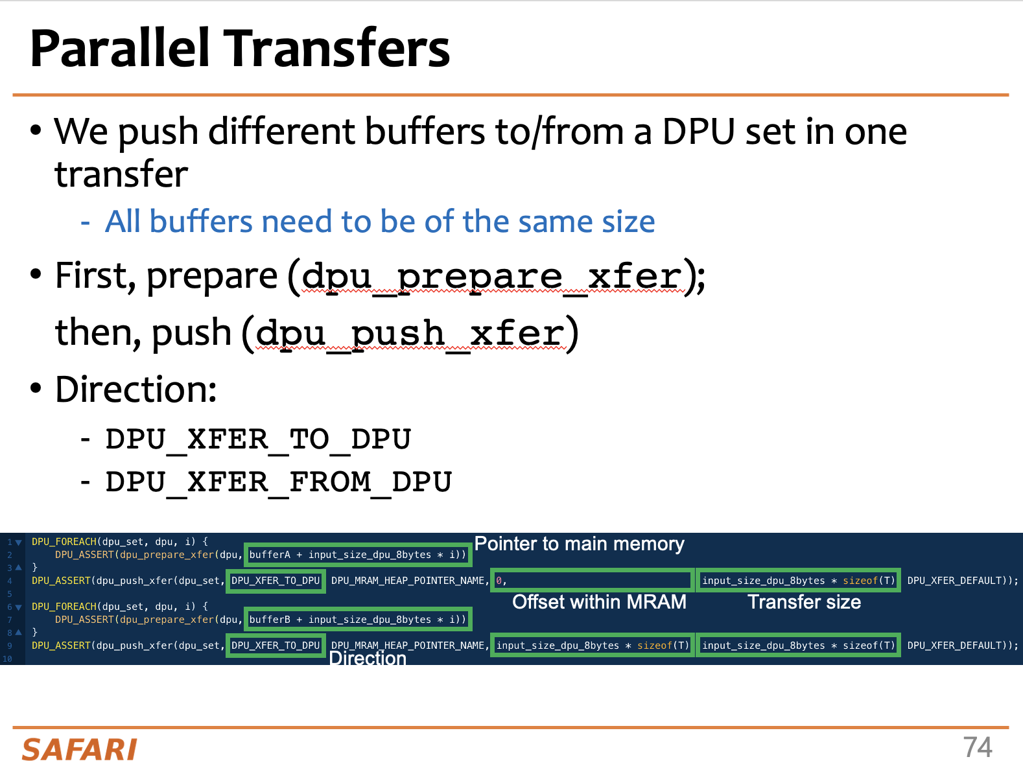
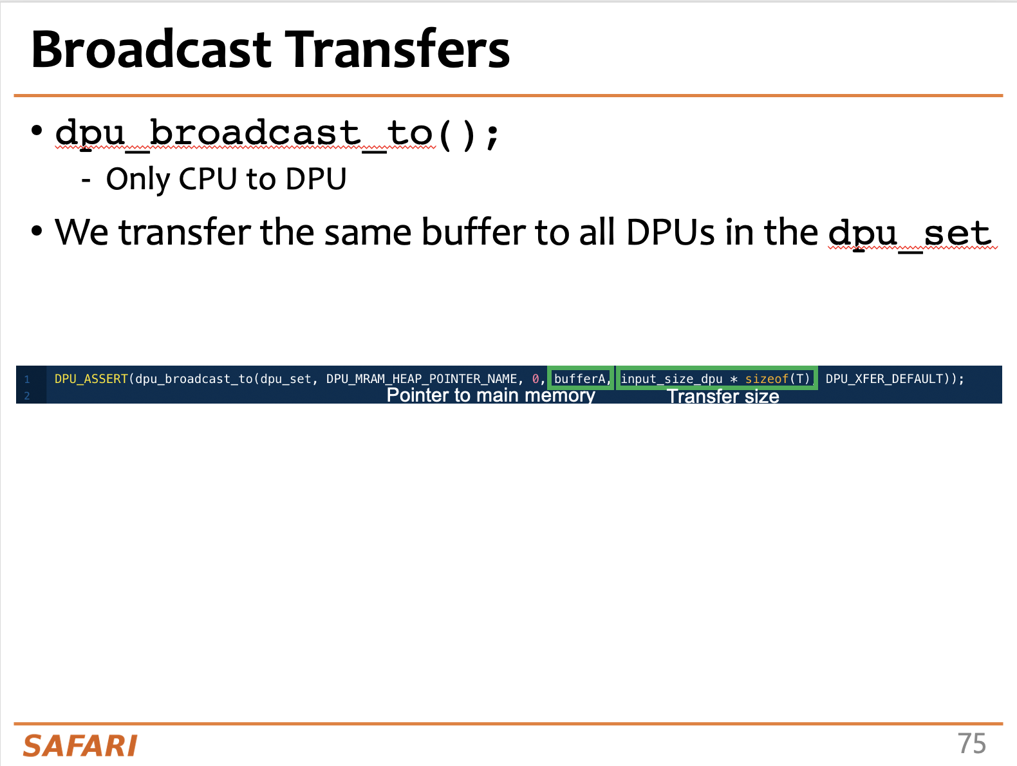
Task 1: CPU-DPU and DPU-CPU Transfers
Use serial, parallel, and broadcast transfers

Slide 6
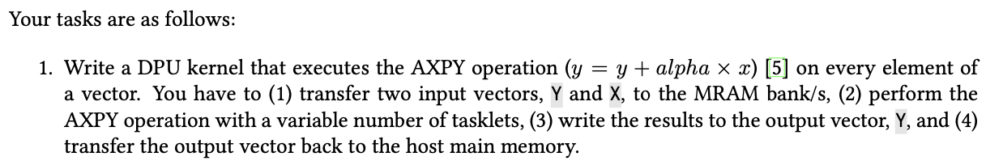
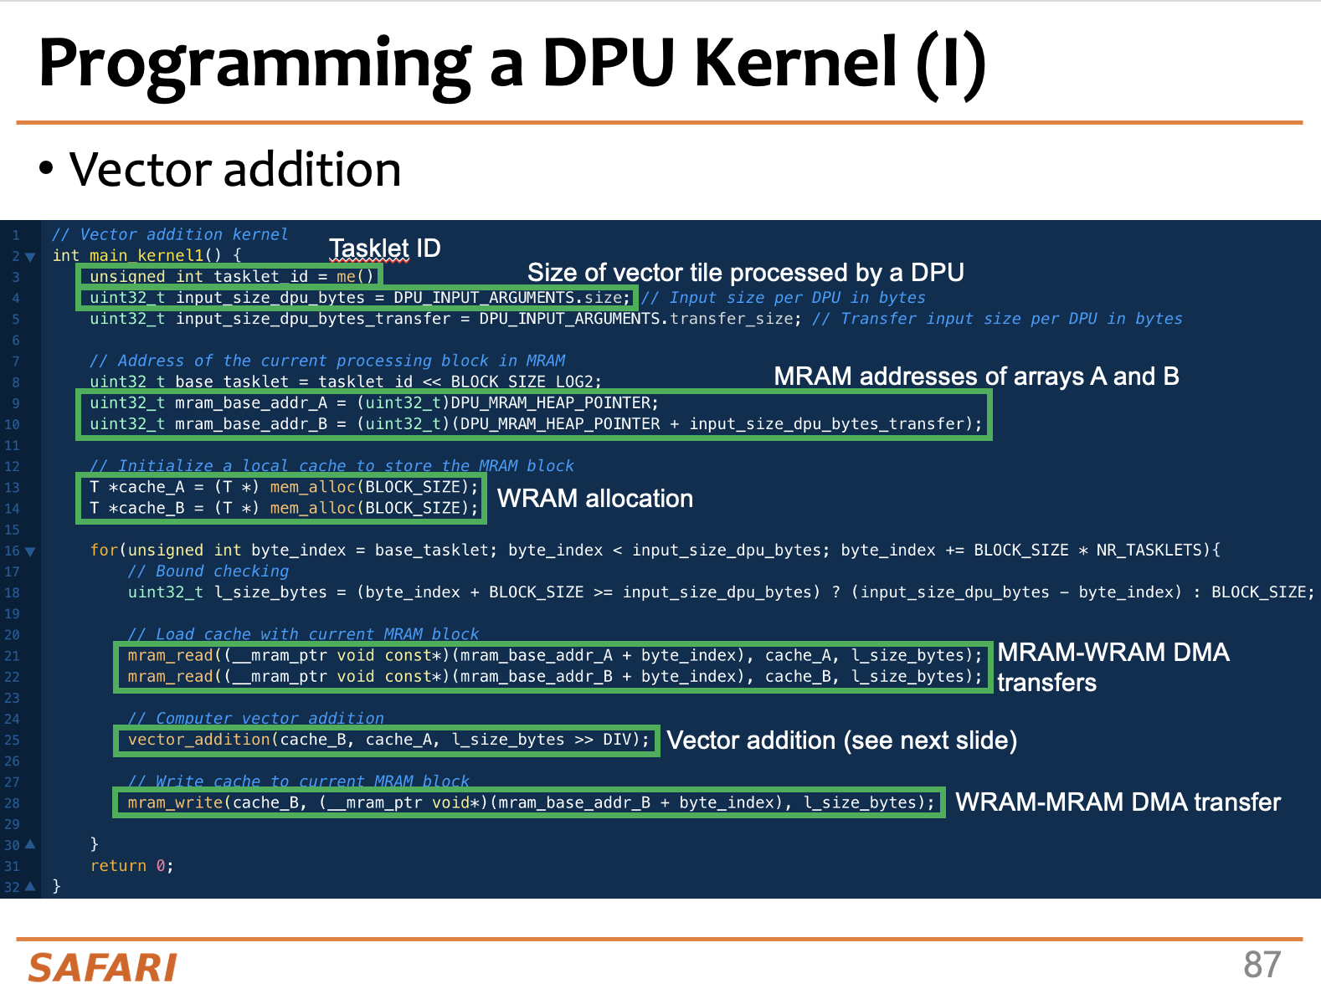
Task 2: AXPY
VA is a good reference code for this task

Slide 7
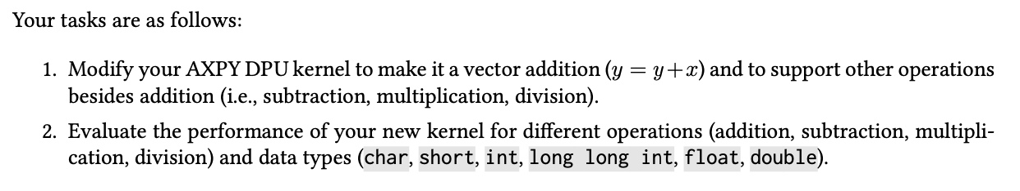
Task 3: Operations and Datatypes
You will observe significant variations in arithmetic throughput for different operations and datatypes

Slide 8
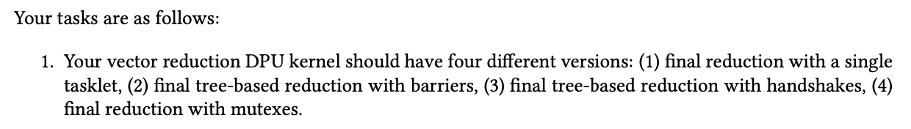
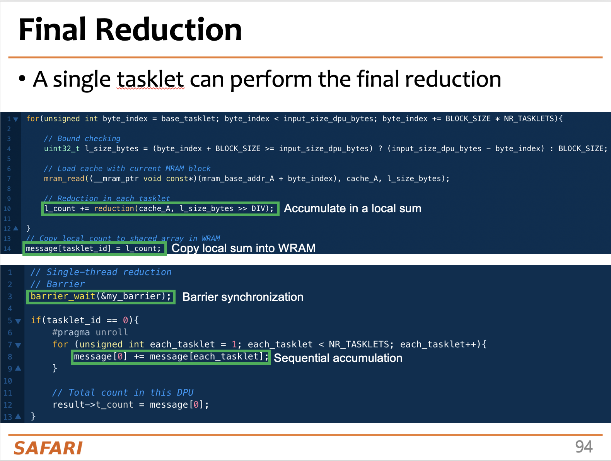
Task 4: Vector Reduction
Performance differences due to the final reduction step

Slide 9
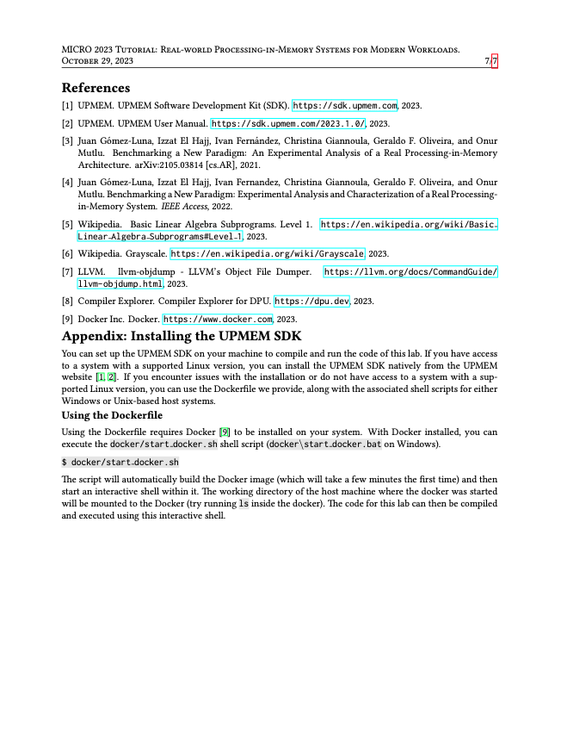
Real PIM Tutorial: Hands-on Lab

Slide 10
MICRO 2023 Tutorial
Real-world Processing-in-Memory Systems for Modern Workloads
Hands-on Lab
Programming and Understanding a
Real Processing-in-Memory Architecture
Dr. Juan Gómez Luna
Professor Onur Mutlu
Sunday, October 29, 2023

