Slide 1
MICRO 2023 Tutorial
Real-world Processing-in-Memory Systems for Modern Workloads
Accelerating Modern Workloads
on a General-purpose PIM System
Dr. Juan Gómez Luna
Professor Onur Mutlu
Sunday, October 29, 2023

Slide 2
Potential Barriers to Adoption of PIM
1. Applications & software for PIM
2. Ease of programming (interfaces and compiler/HW support)
3. System and security support: coherence, synchronization, virtual memory, isolation, communication interfaces, …
4. Runtime and compilation systems for adaptive scheduling, data mapping, access/sharing control, …
5. Infrastructures to assess benefits and feasibility
All can be solved with change of mindset

Slide 3
Benchmarking and
Workload Suitability

Slide 4
PrIM Benchmarks
Goal
  A common set of workloads that can be used to
    evaluate the UPMEM PIM architecture,
    compare software improvements and compilers,
    compare future PIM architectures and hardware
Two key selection criteria:
  Selected workloads from different application domains
  Memory-bound workloads on processor-centric architectures
14 different workloads, 16 different benchmarks*
*There are two versions for two of the workloads (HST, SCAN).

Slide 5
PrIM Benchmarks: Application Domains
Domain | Benchmark | Short name
Dense linear algebra | Vector Addition | VA
 | Matrix-Vector Multiply | GEMV
Sparse linear algebra | Sparse Matrix-Vector Multiply | SpMV
Databases | Select | SEL
 | Unique | UNI
Data analytics | Binary Search | BS
 | Time Series Analysis | TS
Graph processing | Breadth-First Search | BFS
Neural networks | Multilayer Perceptron | MLP
Bioinformatics | Needleman-Wunsch | NW
Image processing | Image histogram (short) | HST-S
 | Image histogram (large) | HST-L
Parallel primitives | Reduction | RED
 | Prefix sum (scan-scan-add) | SCAN-SSA
 | Prefix sum (reduce-scan-scan) | SCAN-RSS
 | Matrix transposition | TRNS

Slide 6
Roofline Model
Intel Advisor on an Intel Xeon E3-1225 v6 CPU
Peak compute performance
L3
DRAM
All workloads fall in the memory-bound area of the Roofline

Slide 7
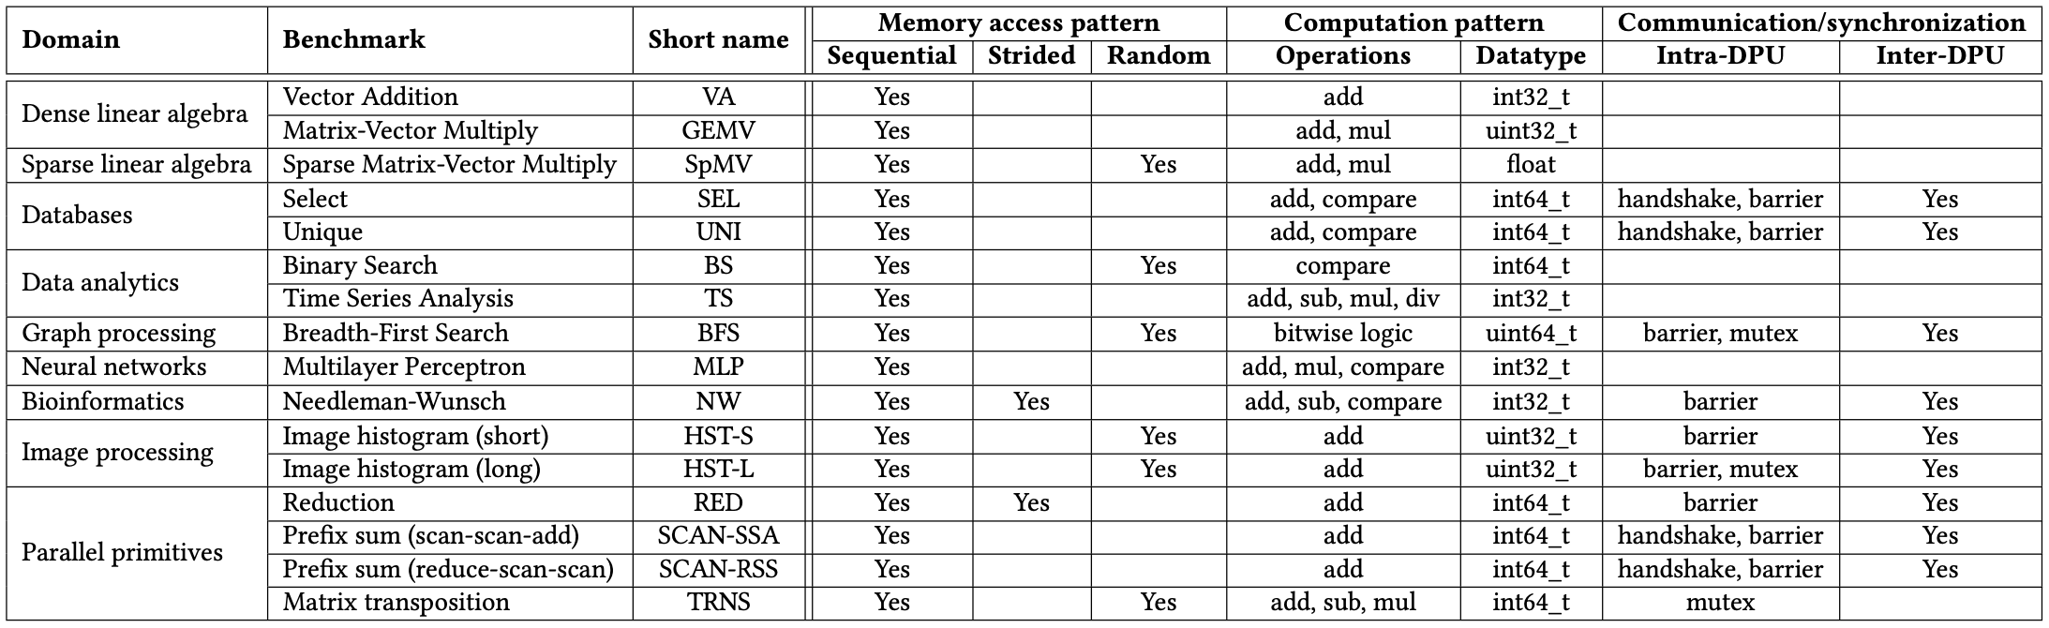
PrIM Benchmarks: Diversity
PrIM benchmarks are diverse:
  Memory access patterns
  Operations and datatypes
  Communication/synchronization

Slide 8
PrIM Benchmarks: Inter-DPU Communication
Inter-DPU communication
  Result merging:
    SEL, UNI, HST-S, HST-L, RED
    Only DPU-CPU transfers
  Redistribution of intermediate results:
    BFS, MLP, NW, SCAN-SSA, SCAN-RSS
    DPU-CPU and CPU-DPU transfers

Slide 9
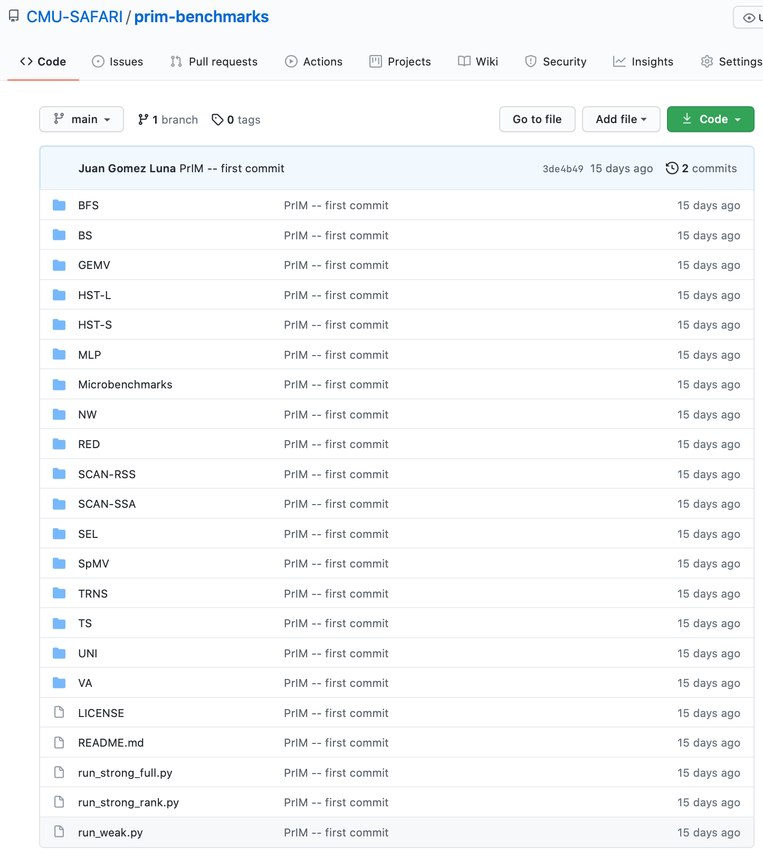
PrIM Benchmarks
16 benchmarks and scripts for evaluation
https://github.com/CMU-SAFARI/prim-benchmarks

Slide 10
Outline
Introduction
  Accelerator Model
  UPMEM-based PIM System Overview
UPMEM PIM Programming
  Vector Addition
  CPU-DPU Data Transfers
  Inter-DPU Communication
  CPU-DPU/DPU-CPU Transfer Bandwidth
DRAM Processing Unit
  Arithmetic Throughput
  WRAM and MRAM Bandwidth
PrIM Benchmarks
  Roofline Model
  Benchmark Diversity
Evaluation
  Strong and Weak Scaling
  Comparison to CPU and GPU
Key Takeaways

Slide 11
Evaluation Methodology
We evaluate the 16 PrIM benchmarks on two UPMEM-based systems:
  2,556-DPU system
  640-DPU system
Strong and weak scaling experiments on the 2,556-DPU system
  1 DPU with different numbers of tasklets
  1 rank (strong and weak)
  Up to 32 ranks
Strong scaling refers to how the execution time of a program solving a particular problem varies with the number of processors for a fixed problem size
Weak scaling refers to how the execution time of a program solving a particular problem varies
with the number of processors for a fixed problem size per processor

Slide 12
Evaluation Methodology
We evaluate the 16 PrIM benchmarks on two UPMEM-based systems:
  2,556-DPU system
  640-DPU system
Strong and weak scaling experiments on the 2,556-DPU system
  1 DPU with different numbers of tasklets
  1 rank (strong and weak)
  Up to 32 ranks
Comparison of both UPMEM-based PIM systems to state-of-the-art CPU and GPU
  Intel Xeon E3-1240 CPU
  NVIDIA Titan V GPU

Slide 13
2,560-DPU System
UPMEM-based PIM system with 20 UPMEM DIMMs of 16 chips each (40 ranks)
  P21 DIMMs
  Dual x86 socket
    UPMEM DIMMs coexist with regular DDR4 DIMMs
    2 memory controllers/socket (3 channels each)
    2 conventional DDR4 DIMMs on one channel of one controller
2560 DPUs*
160 GB
* There are 4 faulty DPUs in the system that we use in our experiments. Thus, the maximum number of DPUs we can use is 2,556.

Slide 14
640-DPU System
UPMEM-based PIM system with 10 UPMEM DIMMs of 8 chips each (10 ranks)
  E19 DIMMs
  x86 socket
    2 memory controllers (3 channels each)
    2 conventional DDR4 DIMMs on one channel of one controller
640 DPUs
40 GB

Slide 15
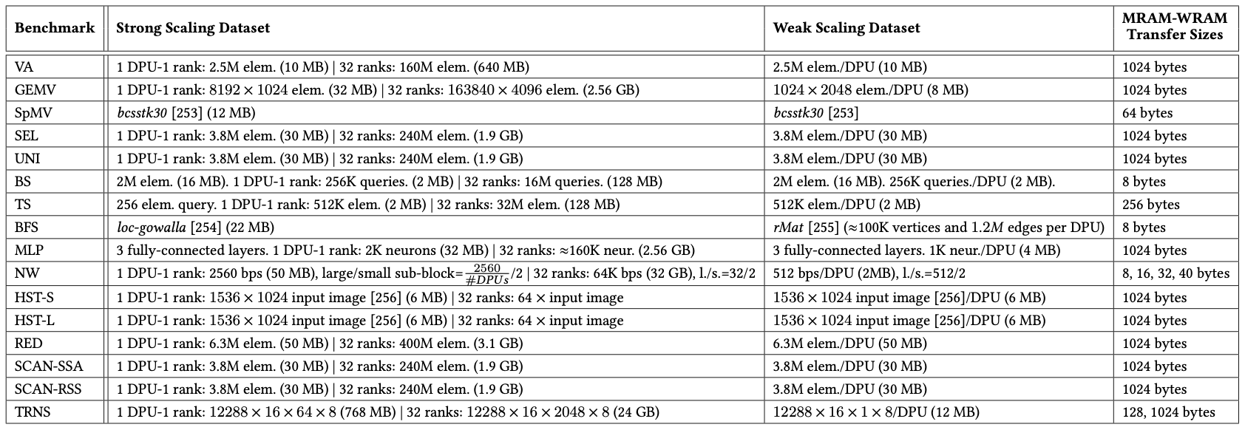
Datasets
Strong and weak scaling experiments
The PrIM benchmarks repository includes
all datasets and scripts used in our evaluation
https://github.com/CMU-SAFARI/prim-benchmarks

Slide 16
Strong Scaling: 1 DPU (I)
Strong scaling experiments on 1 DPU
  We set the number of tasklets to 1, 2, 4, 8, and 16
  We show the breakdown of execution time:
    DPU: Execution time on the DPU
    Inter-DPU: Time for inter-DPU communication via the host CPU
    CPU-DPU: Time for CPU to DPU transfer of input data
    DPU-CPU: Time for DPU to CPU transfer of final results
  Speedup over 1 tasklet

Slide 17
Strong Scaling: 1 DPU (II)
VA, GEMV, SpMV, SEL, UNI, TS, MLP, NW, HST-S, RED, SCAN-SSA (Scan kernel), SCAN-RSS (both kernels), and TRNS (Step 2 kernel), the best performing number of tasklets is 16
Speedups 1.5-2.0x as we double the number of tasklets from 1 to 8.
Speedups 1.2-1.5x from 8 to 16, since the pipeline throughput saturates at 11 tasklets
KEY OBSERVATION 10
A number of tasklets greater than 11 is a good choice for most real-world workloads we tested (16 kernels out of 19 kernels from 16 benchmarks), as it fully utilizes the DPU’s pipeline.

Slide 18
Strong Scaling: 1 DPU (III)
VA, GEMV, SpMV, BS, TS, MLP, HST-S do not use intra-DPU synchronization primitives
In SEL, UNI, NW, RED, SCAN-SSA (Scan kernel), SCAN-RSS (both kernels), synchronization is lightweight
BFS, HST-L, TRNS (Step 3) use mutexes, which cause contention when accessing shared data structures

Slide 19
Strong Scaling: 1 DPU (IV)
VA, GEMV, SpMV, BS, TS, MLP, HST-S do not use intra-DPU synchronization primitives
In SEL, UNI, NW, RED, SCAN-SSA (Scan kernel), SCAN-RSS (both kernels), synchronization is lightweight
BFS, HST-L, TRNS (Step 3) use mutexes, which cause contention when accessing shared data structures
KEY OBSERVATION 11
Intensive use of intra-DPU synchronization across tasklets (e.g., mutexes, barriers, handshakes) may limit scalability, sometimes causing the best performing number of tasklets to be lower than 11.

Slide 20
Strong Scaling: 1 DPU (V)
SCAN-SSA (Add kernel) is not compute-intensive. Thus, performance saturates with less that 11 tasklets (recall STREAM ADD).
BS shows similar behavior
KEY OBSERVATION 12
Most real-world workloads are in the compute-bound region of the DPU (all kernels except SCAN-SSA (Add kernel) and BS), i.e., the pipeline latency dominates the MRAM access latency.

Slide 21
Strong Scaling: 1 DPU (VI)
The amount of time spent on CPU-DPU and DPU-CPU transfers is low compared to the time spent on DPU execution
TRNS performs step 1 of the matrix transposition via the CPU-DPU transfer.
Using small transfers (8 elements) does not exploit full CPU-DPU bandwidth
KEY OBSERVATION 13
Transferring large data chunks from/to the host CPU is preferred for input data and output results due to higher sustained CPU-DPU/DPU-CPU bandwidths.
Notes:
Fifth
TRNS

Slide 22
Strong Scaling: 1 Rank (I)
Strong scaling experiments on 1 rank
  We set the number of tasklets to the best performing one
  The number of DPUs is 1, 4, 16, 64
  We show the breakdown of execution time:
    DPU: Execution time on the DPU
    Inter-DPU: Time for inter-DPU communication via the host CPU
    CPU-DPU: Time for CPU to DPU transfer of input data
    DPU-CPU: Time for DPU to CPU transfer of final results
  Speedup over 1 DPU

Slide 23
Strong Scaling: 1 Rank (II)
VA, GEMV, SpMV, SEL, UNI, BS, TS, MLP, HST-S, HSTS-L, RED, SCAN-SSA (both kernel), SCAN-RSS (both kernels), and TRNS (both kernels) scale linearly with the number of DPUs
Scaling is sublinear for BFS and NW
BFS suffers load imbalance due to irregular graph topology
NW computes a diagonal of a 2D matrix in each iteration.
More DPUs does not mean more parallelization in shorter diagonals.

Slide 24
Strong Scaling: 1 Rank (III)
VA, GEMV, SpMV, BS, TS, TRNS do not need inter-DPU synchronization
SEL, UNI, HST-S, HST-L, RED, SCAN-SSA, SCAN-RSS need inter-DPU synchronization but 64 DPUs still obtain the best performance
BFS, MLP, NW require heavy inter-DPU synchronization, involving DPU-CPU and CPU-DPU transfers

Slide 25
Strong Scaling: 1 Rank (IV)
VA, GEMV, TS, MLP, HST-S, HST-L, RED, SCAN-SSA, SCAN-RSS, TRNS use parallel transfers.
CPU-DPU and DPU-CPU transfer times decrease as we increase the number of DPUs
BS, NW use parallel transfers but do not reduce transfer times:
BS transfers a complete array to all DPUs.
NW does not use all DPUs in all iterations
SpMV, SEL, UNI, BFS cannot use parallel transfers, as the transfer size per DPU is not fixed
PROGRAMMING RECOMMENDATION 5
Parallel CPU-DPU/DPU-CPU transfers inside a rank of DPUs are recommended for real-world workloads when all transferred buffers are of the same size.

Slide 26
Strong Scaling: 32 Ranks (I)
Strong scaling experiments on 32 rank
  We set the number of tasklets to the best performing one
  The number of DPUs is 256, 512, 1024, 2048
  We show the breakdown of execution time:
    DPU: Execution time on the DPU
    Inter-DPU: Time for inter-DPU communication via the host CPU
    We do not show CPU-DPU/DPU-CPU transfer times
  Speedup over 256 DPUs

Slide 27
Strong Scaling: 32 Ranks (II)
VA, GEMV, SEL, UNI, BS, TS, MLP, HST-S, HSTS-L, RED, SCAN-SSA (both kernel), SCAN-RSS (both kernels), and TRNS (both kernels) scale linearly with the number of DPUs
SpMV, BFS, NW do not scale linearly due to load imbalance
KEY OBSERVATION 14
Load balancing across DPUs ensures linear reduction of the execution time spent on the DPUs for a given problem size, when all available DPUs are used (as observed in strong scaling experiments).

Slide 28
Strong Scaling: 32 Ranks (III)
SEL, UNI, HST-S, HST-L, RED only need to merge final results
KEY OBSERVATION 15
The overhead of merging partial results from DPUs in the host CPU is tolerable across all PrIM benchmarks that need it.
BFS, MLP, NW, SCAN-SSA, SCAN-RSS have more complex communication
KEY OBSERVATION 16
Complex synchronization across DPUs (i.e., inter-DPU synchronization involving two-way communication with the host CPU) imposes significant overhead, which limits scalability to more DPUs.

Slide 29
Weak Scaling: 1 Rank
KEY OBSERVATION 17
Equally-sized problems assigned to different DPUs and little/no inter-DPU synchronization lead to linear weak scaling of the execution time spent on the DPUs (i.e., constant execution time when we increase the number of DPUs and the dataset size accordingly).
KEY OBSERVATION 18
Sustained bandwidth of parallel CPU-DPU/DPU-CPU transfers inside a rank of DPUs increases sublinearly with the number of DPUs.

Slide 30
CPU/GPU: Evaluation Methodology
Comparison of both UPMEM-based PIM systems to state-of-the-art CPU and GPU
  Intel Xeon E3-1240 CPU
  NVIDIA Titan V GPU
We use state-of-the-art CPU and GPU counterparts of PrIM benchmarks
  https://github.com/CMU-SAFARI/prim-benchmarks
We use the largest dataset that we can fit in the GPU memory
We show overall execution time, including DPU kernel time and inter DPU communication

Slide 31
CPU/GPU: Performance Comparison (I)
The 2,556-DPU and the 640-DPU systems outperform the CPU for all benchmarks except SpMV, BFS, and NW
The 2,556-DPU and the 640-DPU are, respectively, 93.0x and 27.9x faster than the CPU for 13 of the PrIM benchmarks

Slide 32
CPU/GPU: Performance Comparison (II)
The 2,556-DPU outperforms the GPU
for 10 PrIM benchmarks with an average of 2.54x
The performance of the 640-DPU is within 65%
the performance of the GPU for the same 10 PrIM benchmarks

Slide 33
CPU/GPU: Performance Comparison (III)
KEY OBSERVATION 19
The UPMEM-based PIM system can outperform a state-of-the-art GPU on workloads with three key characteristics:
Streaming memory accesses
No or little inter-DPU synchronization
No or little use of integer multiplication, integer division, or floating point operations
These three key characteristics make a workload potentially suitable to the UPMEM PIM architecture.

Slide 34
CPU/GPU: Energy Comparison (I)
The 640-DPU system consumes on average 1.64x less energy than the CPU for all 16 PrIM benchmarks
For 12 benchmarks, the 640-DPU system provides energy savings
of 5.23x over the CPU

Slide 35
CPU/GPU: Energy Comparison (II)
KEY OBSERVATION 20
The UPMEM-based PIM system provides large energy savings over a state-of-the-art CPU due to higher performance (thus, lower static energy) and less data movement between memory and processors.
The UPMEM-based PIM system provides energy savings over a state-of-the-art CPU/GPU on workloads where it outperforms the CPU/GPU.
This is because the source of both performance improvement and energy savings is the same: the significant reduction in data movement between the memory and the processor cores, which the UPMEM-based PIM system can provide for PIM-suitable workloads.

Slide 36
Outline
Introduction
  Accelerator Model
  UPMEM-based PIM System Overview
UPMEM PIM Programming
  Vector Addition
  CPU-DPU Data Transfers
  Inter-DPU Communication
  CPU-DPU/DPU-CPU Transfer Bandwidth
DRAM Processing Unit
  Arithmetic Throughput
  WRAM and MRAM Bandwidth
PrIM Benchmarks
  Roofline Model
  Benchmark Diversity
Evaluation
  Strong and Weak Scaling
  Comparison to CPU and GPU
Key Takeaways

Slide 37
Key Takeaway 1
The throughput saturation point is as low as ¼ OP/B,
i.e., 1 integer addition per every 32-bit element fetched
Memory-bound region
Compute-bound region
KEY TAKEAWAY 1
The UPMEM PIM architecture is fundamentally compute bound.
As a result, the most suitable workloads are memory-bound.

Slide 38
Key Takeaway 2
KEY TAKEAWAY 2
The most well-suited workloads for the UPMEM PIM architecture use no arithmetic operations or use only simple operations (e.g., bitwise operations and integer addition/subtraction).

Slide 39
Key Takeaway 3
KEY TAKEAWAY 3
The most well-suited workloads for the UPMEM PIM architecture require little or no communication across DPUs (inter-DPU communication).

Slide 40
Key Takeaway 4
KEY TAKEAWAY 4
• UPMEM-based PIM systems outperform state-of-the-art CPUs in terms of performance (by 23.2× on 2,556 DPUs for 16 PrIM benchmarks) and energy efficiency on most of PrIM benchmarks.
• UPMEM-based PIM systems outperform state-of-the-art GPUs on a majority of PrIM benchmarks (by 2.54× on 2,556 DPUs for 10 PrIM benchmarks), and the outlook is even more positive for future PIM systems.
• UPMEM-based PIM systems are more energy-efficient than state-of-the-art CPUs and GPUs on workloads that they provide performance improvements over the CPUs and the GPUs.

Slide 41
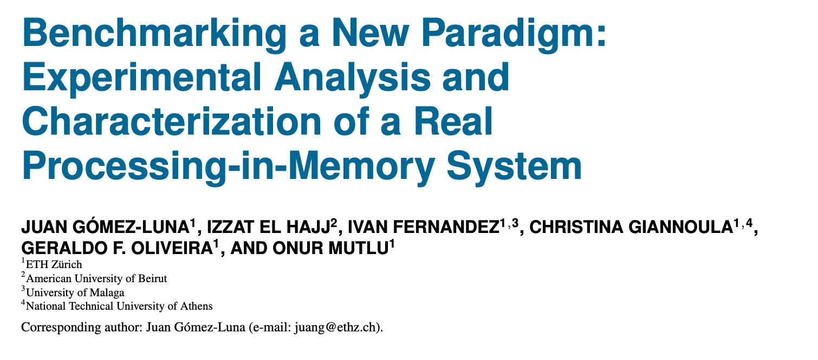
Understanding a Modern PIM Architecture
https://arxiv.org/pdf/2105.03814.pdf
https://github.com/CMU-SAFARI/prim-benchmarks

Slide 42
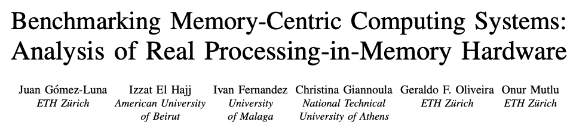
Short arXiv Version
https://arxiv.org/pdf/2110.01709.pdf
https://github.com/CMU-SAFARI/prim-benchmarks

Slide 43
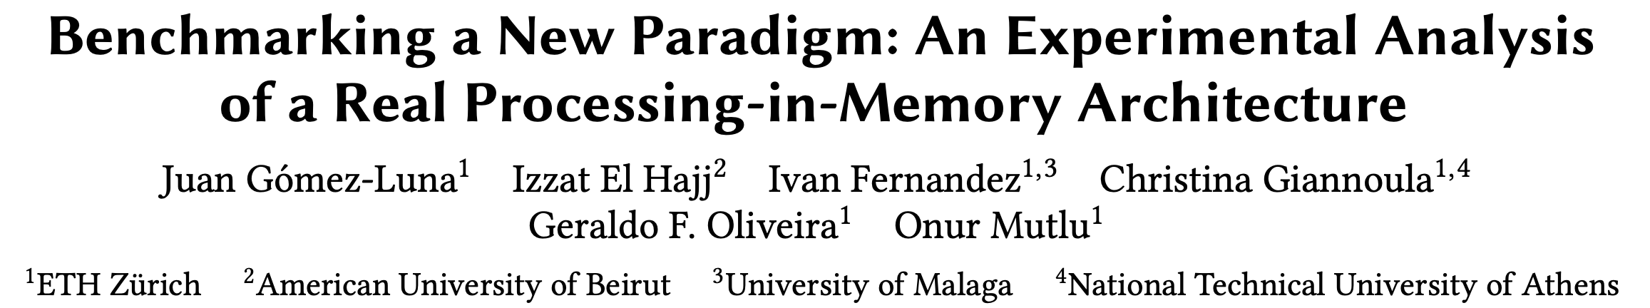
Long arXiv Version
https://arxiv.org/pdf/2105.03814.pdf
https://github.com/CMU-SAFARI/prim-benchmarks

Slide 44
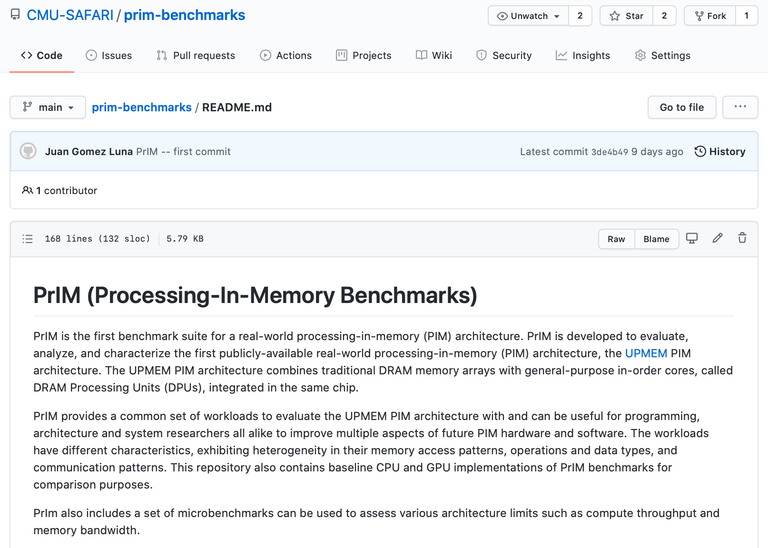
PrIM Repository
All microbenchmarks, benchmarks, and scripts
https://github.com/CMU-SAFARI/prim-benchmarks

Slide 45
Sparse Matrix Vector Multiplication

Slide 46





SparseP
Towards Efficient Sparse Matrix Vector Multiplication
on Real Processing-In-Memory Architectures
Christina Giannoula, Ivan Fernandez, Juan Gomez-Luna,
Nectarios Koziris, Georgios Goumas, Onur Mutlu

Slide 47
Our Work
Efficient Algorithmic Designs
The first open-source Sparse Matrix Vector Multiplication (SpMV) software package, SparseP, for real Processing-In-Memory (PIM) systems
Extensive Characterization
The first comprehensive analysis of SpMV on the first real commercial PIM architecture
SparseP is Open-Source
SparseP: https://github.com/CMU-SAFARI/SparseP
Recommendations for Architects and Programmers
Full Paper: https://arxiv.org/pdf/2201.05072.pdf

Slide 48
Sparse Matrix Vector Multiplication
Sparse Matrix Vector Multiplication (SpMV):
Widely-used kernel in graph processing, machine learning, scientific computing …
A highly memory-bound kernel
Roofline Model
Peak Compute Performance
Performance
Peak Memory Bandwidth
SpMV
Operational Intensity

Slide 49
Real Processing-In-Memory Systems
Real Near-Bank Processing-In-Memory (PIM) Systems:
High levels of parallelism
Low memory access latency
Large aggregate memory bandwidth
Host CPU
Main Memory
PIM-Enabled Memory
PIM-Enabled Memory
PIM-Enabled Memory
Bus
DRAM Bank
DRAM Bank
DRAM Bank
DRAM Bank
PIM-Enabled Memory
PIM-Enabled Memory
PIM-Enabled Memory
PIM Core
PIM Core
PIM Core
PIM Core
PIM-Enabled Memory
Bus
DRAM Bank
DRAM Bank
DRAM Bank
DRAM Bank

Slide 50
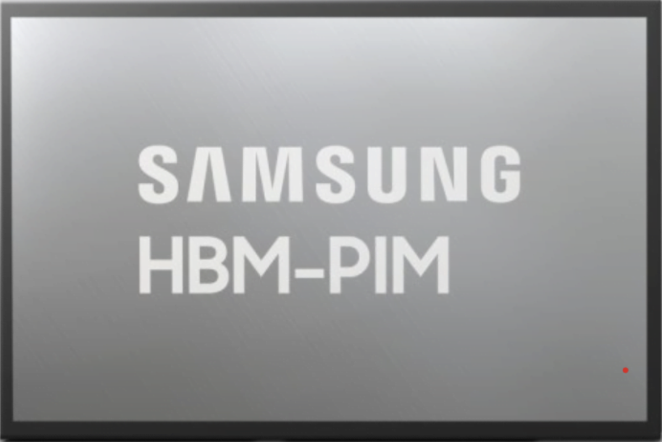
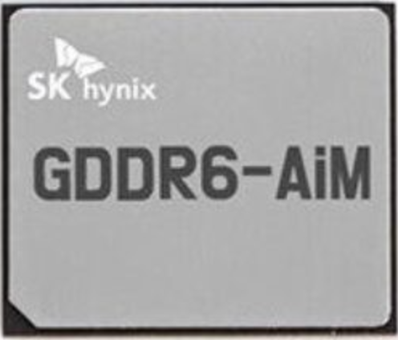
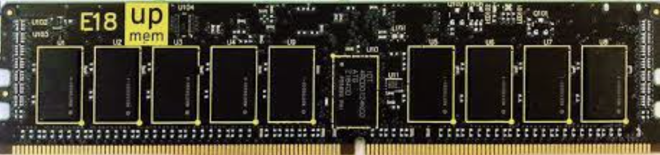
Real Processing-In-Memory Systems
Real Near-Bank Processing-In-Memory (PIM) Systems:
High levels of parallelism
Low memory access latency
Large aggregate memory bandwidth
Host CPU
Main Memory
PIM-Enabled Memory
Lee+, [ISSCC 2022]
Kwon+, [ISSCC 2021]
PIM-Enabled Memory
PIM-Enabled Memory
Bus
DRAM Bank
DRAM Bank
DRAM Bank
DRAM Bank
https://www.upmem.com
PIM-Enabled Memory
PIM-Enabled Memory
PIM-Enabled Memory
PIM Core
PIM Core
PIM Core
PIM Core
PIM-Enabled Memory
Bus
DRAM Bank
DRAM Bank
DRAM Bank
DRAM Bank

Slide 51

SparseP: SpMV Library for Real PIMs
Our Contributions:
Design efficient SpMV kernels for current and future PIM systems
  25 SpMV kernels
    4 compressed matrix formats (CSR, COO, BCSR, BCOO)
    6 data types
    4 data partitioning techniques
    Various load balancing schemes among PIM cores/threads
    3 synchronization approaches
Provide a comprehensive analysis of SpMV on the first commercially-available real PIM system
  26 sparse matrices
  Comparisons to state-of-the-art CPU and GPU systems
  Recommendations for software, system and hardware designers

Slide 52
Outline
SpMV Kernels for Real PIM Systems
Key Takeaways from Our Study
Conclusion

Slide 53
SpMV Execution on a PIM System
1
2
3
4
Load the
input vector
Execute the kernel
Retrieve the
partial results
Merge the
partial results
PIM-Enabled Memory
Host CPU
Main Memory
PIM Core
PIM Core
PIM Core
DRAM Bank
DRAM Bank
bus
DRAM Bank
DRAM Bank
DRAM Bank
bus
+

Slide 54
Data Partitioning Techniques
SparseP supports two types of data partitioning techniques:
1D Partitioning
2D Partitioning
Core 1
Core 1
Core 2
Core 2
=
*
=
4x input vector
1x output vector
*
2x output vector
Core 3
2x input vector
Core 4
Core 3
Core 4
perform the complete
SpMV computation
only on PIM cores
trade-off
computation vs
data transfer costs

Slide 55
1D Partitioning Technique
Load-Balancing Approaches:
CSR, COO:
  Balance Rows
  Balance NNZs *
BCSR, BCOO:
  Balance Blocks ^
  Balance NNZs ^
* row-granularity for CSR
^ block-row-granularity for BCSR

Slide 56
1D Partitioning Technique
Load-Balancing of #NNZs:
CSR (row-granularity), COO
CSR
COO
row-
granularity
nnz-
granularity
Core 1
Core 1
Core 2
Core 2
Core 3
Core 3
row-order
nnz-order
rowptr
0
1
3
5
7
7
8
8
9
rowind
0
1
1
2
2
3
3
5
7
colind
0
2
5
3
5
3
6
4
4
colind
0
2
5
3
5
3
6
4
4
values
2
1
8
3
6
9
3
4
7
values
2
1
8
3
6
9
3
4
7

Slide 57
1D Partitioning Technique
Load-Balancing of #NNZs:
CSR (row-granularity), COO
BCSR (block-row-granularity), BCOO
ΒCSR
ΒCOO
block-row-
granularity
block-
granularity
Core 1
Core 1
Core 2
Core 2
Core 3
Core 3
block-row-order
block-order
rowptr
0
1
3
5
7
7
8
8
9
rowind
0
1
1
2
2
3
3
5
7
colind
0
2
5
3
5
3
6
4
4
colind
0
2
5
3
5
3
6
4
4
values
2
1
8
3
6
9
3
4
7
values
2
1
8
3
6
9
3
4
7

Slide 58
2D Partitioning Technique
Equally-Sized Tiles
Equally-Wide Tiles
Variable-Sized Tiles
input vector
input vector
input vector
2x
2x
2x
4x
4x
4x
4x
3x
5x
Core 1
Core 3
Core 3
Core 1
Core 1
Core 3
+
+
+
Core 4
Core 2
Core 2
Core 4
Core 2
Core 4
output vector
output vector
output vector
High NNZ imbalance
across PIM cores
High NNZ balance across PIM cores of the same vertical partition
High NNZ balance
across all PIM cores

Slide 59
Load-Balance across Threads
Multithreaded PIM Cores:
1D Partitioning
2D Partitioning
Core 1
Multithreaded
PIM Core
Core 1
Core 2
Core 2
Core 3
DRAM
Bank
Core 3
Core 4
Core 4
Balance #Rows
Balance #Rows
Thread 1
Thread 1
Thread 2
Thread 2
Various load-balance schemes across threads

Slide 60
Load-Balance across Threads
Multithreaded PIM Cores:
1D Partitioning
2D Partitioning
Core 1
Multithreaded
PIM Core
Core 1
Core 2
Core 2
Core 3
DRAM
Bank
Core 3
Core 4
Core 4
Balance #NNZs
Balance #NNZs
(e.g., COO format)
Thread 1
Thread 1
Thread 2
Thread 2
Various load-balance schemes across threads

Slide 61

Load-Balance across Threads
Multithreaded PIM Cores:
1D Partitioning
2D Partitioning
Core 1
Multithreaded
PIM Core
Core 1
Core 2
Core 2
Core 3
DRAM
Bank
Core 3
Core 4
Core 4
Balance #NNZs
Balance #NNZs
(e.g., COO format)
Thread 1
Thread 1
Thread 2
Thread 2
Various load-balance schemes across threads
Various synchronization approaches among threads

Slide 62
Synchronization Approaches
Multithreaded
PIM Core
Multithreaded PIM Core:
DRAM Bank
Coarse-Grained (lb-cg)
Fine-Grained (lb-fg)
Thread 1
Thread 1
Thread 2
=
Thread 2
=
output vector
output vector
Thread 3
Thread 3
Lock-Free (lf)
partial results
Thread 1
+
=
+
=
Thread 2
Thread 1
output vector
Thread 3

Slide 63
SparseP Software Package
25 SpMV kernels for PIM Systems →
https://github.com/CMU-SAFARI/SparseP
Partitioning | Matrix Format | Load-Balancing
9x 1D Kernels | CSR | rows, nnzs *
 | COO▵ | rows, nnzs *, nnzs
 | BCSR | blocks ^, nnzs ^
 | BCOO▵ | blocks, nnzs
4x 2D Equally-Sized Tiles | CSR | --
 | COO▵ | --
 | BCSR | --
 | BCOO▵ | --
6x 2D Equally-Wide Tiles | CSR | nnzs *
 | COO▵ | nnzs
 | BCSR | blocks ^, nnzs ^
 | BCOO▵ | blocks, nnzs
6x 2D Variable-Sized Tiles | CSR | nnzs *
 | COO▵ | nnzs
 | BCSR | blocks ^, nnzs ^
 | BCOO▵ | blocks, nnz
Load-balance
across PIM cores/threads:
* row-granularity (CSR)
^ block-row-granularity (BCSR)
Synchronization
among threads of a PIM core:
▵ lb-cg, lb-fb, lf (COO, BCOO)
Data Types:
8-bit integer
16-bit integer
32-bit integer
64-bit integer
32-bit float
64-bit float

Slide 64
Outline
SpMV Kernels for Real PIM Systems
Key Takeaways from Our Study
Conclusion

Slide 65
UPMEM-based PIM System
20 UPMEM PIM DIMMs with 2560 PIM cores in total
Each multithreaded PIM core supports 24 threads
Host CPU
(2-socket,
Intel Xeon)
128 GB Main Memory
PIM-Enabled Memory
PIM-Enabled Memory
PIM-Enabled Memory
Bus
DRAM Bank
DRAM Bank
DRAM Bank
DRAM Bank
160 GB PIM-Enabled Memory
PIM-Enabled Memory
PIM-Enabled Memory
PIM Core
PIM Core
PIM Core
PIM Core
PIM-Enabled Memory
Bus
DRAM Bank
DRAM Bank
DRAM Bank
DRAM Bank
DISPATCH
24 KB
Instr. Mem.
64
bits
64 MB
DRAM
Bank
24x
threads
14-stage
Pipeline
FETCH
DMA Engine
ALU
64 KB
Data Mem.
MERGE

Slide 66
Sparse Matrix Data Set
26 sparse matrices*:
Diverse sparsity patterns
Variability on irregular patterns
Variability on block patterns
Regular Matrix
Scale-Free Matrix
* Suite Sparse Matrix Collection: https://sparse.tamu.edu/

Slide 67
Kernel Execution on One PIM Core
1
2
3
4
Load the
input vector
Execute the kernel
Retrieve the
partial results
Merge the
partial results
PIM-Enabled Memory
Host CPU
Main Memory
PIM Core
PIM Core
PIM Core
DRAM Bank
DRAM Bank
bus
DRAM Bank
DRAM Bank
DRAM Bank
bus
+

Slide 68
Lock-Based Synchronization
16 threads, COO, 32-bit integer
UPMEM DRAM bank
Multithreaded
PIM Core
64
bits
DRAM
Bank
DMA Engine
Fine-grained locking (lb-fg)
does not improve performance over coarse-grained locking (lb-cg)
Fine-Grained Locking: memory accesses to the local DRAM bank are serialized in the DMA engine of the UPMEM PIM hardware.

Slide 69
Lock-Based Synchronization
16 threads, COO, 32-bit integer
UPMEM DRAM bank
Fine-grained locking approaches cannot improve performance over coarse-grained locking, when the PIM hardware does not support concurrent accesses to the local DRAM bank.
Key Takeaway 1
Multithreaded
PIM Core
64
bits
DRAM
Bank
DMA Engine
Provide low-cost synchronization support and hardware support to enable concurrent memory accesses to the local DRAM bank, and integrate multiple DRAM banks per PIM core to increase execution parallelism.
Recommendation 1

Slide 70
Load-Balance within a PIM Core
16 threads, 32-bit integer
Load-balancing #NNZs
performs best in most matrices
Load-balancing #NNZ typically provides high computation balance across threads of a compute-limited PIM core

Slide 71
Load-Balance within a PIM Core
16 threads, 32-bit integer
Load-balancing #NNZs
causes high row imbalance
Load-balancing #NNZs: one single thread performs a much higher #memory accesses and #synchronization operations than the rest

Slide 72
Load-Balance within a PIM Core
16 threads, 32-bit integer
High operation imbalance in computation, synchronization, or memory instructions executed by multiple threads of a PIM core can cause high performance overhead.
Key Takeaway 2
Design algorithms that provide high load balance across threads of PIM core in terms of computations, synchronization points and memory accesses.
Recommendation 2

Slide 73
Scalability within a PIM Core
32-bit integer
Scalability increases up to 16 threads

Slide 74
Kernel Execution on Multiple PIM Cores
1
2
3
4
Load the
input vector
Execute the kernel
Retrieve the
partial results
Merge the
partial results
PIM-Enabled Memory
Host CPU
Main Memory
PIM Core
PIM Core
PIM Core
DRAM Bank
DRAM Bank
bus
DRAM Bank
DRAM Bank
DRAM Bank
bus
+

Slide 75
Comparison of Compressed Formats
2048 PIM Cores, 32-bit integer
1D
6.86x
Scale-free: COO, BCOO →
10.26x CSR, BCSR
13.66x
CSR
(row-granularity)
COO
Core 1
Core 1
Core 2
Core 2
In scale-free matrices, COO + BCOO provide higher non-zero element balance across PIM cores than CSR + BCSR, respectively.

Slide 76
Comparison of Compressed Formats
2048 PIM Cores, 32-bit integer
2D Equally-Sized Tiles
Core 1
Core 3
Scale-free:
COO, BCOO →
1.39x CSR, BCSR
1.23x
Core 2
Core 4
1.55x
Thread 1
Thread 1
Thread 2
Thread 2
CSR
(row-granularity)
COO
In scale-free matrices, COO + BCOO provide higher non-zero element balance across threads than CSR + BCSR, respectively.

Slide 77
Comparison of Compressed Formats
2048 PIM Cores, 32-bit integer
COO, BCOO → 32.38x CSR, BCSR
44x
46x
42x
40x
22x
24x
20x
21x
COO + BCOO formats provide higher non-zero element balance across PIM cores + threads than CSR + BCSR, respectively.

Slide 78
Comparison of Compressed Formats
2048 PIM Cores, 32-bit integer
The compressed matrix format used to store the input matrix determines the data partitioning across DRAM banks of PIM-enabled memory. As a result, it affects the load-balance across PIM cores (and threads of a PIM core) with corresponding performance implications.
Key Takeaway 3
Design compressed data structures that can be effectively partitioned across DRAM banks, with the goal of providing high computation balance across PIM cores (and threads of a PIM core).
Recommendation 3

Slide 79
End-to-End Performance
1
2
3
4
Load the
input vector
Execute the kernel
Retrieve the
partial results
Merge the
partial results
PIM-Enabled Memory
Host CPU
Main Memory
PIM Core
PIM Core
PIM Core
DRAM Bank
DRAM Bank
bus
DRAM Bank
DRAM Bank
DRAM Bank
bus
+

Slide 80
Scalability
The scalability is limited by the load time
COO format, 32-bit integer
1D
2D
Equally-Sized
2D
Equally-Wide
2D
Variable-Sized
#PIM Cores
#PIM Cores
#PIM Cores
#PIM Cores
1D: #bytes to load the input vector grows linearly to #PIM cores

Slide 81
Scalability
COO format, 32-bit integer
2D
Equally-Sized
2D
Equally-Wide
2D
Variable-Sized
The 1D-partitioned kernels are severely bottlenecked by the high data transfer costs to broadcast the whole input vector into DRAM banks of all PIM cores, through the narrow off-chip memory bus.
Key Takeaway 4
1D
Optimize the broadcast collective collective in data transfers to PIM-enabled memory to efficiently copy the input data into DRAM banks in the PIM system.
Recommendation 4
#PIM Cores
#PIM Cores
#PIM Cores
#PIM Cores

Slide 82
Scalability
The scalability is limited by the kernel time
COO format, 32-bit integer
1D
2D
Equally-Sized
2D
Equally-Wide
2D
Variable-Sized
#PIM Cores
#PIM Cores
#PIM Cores
#PIM Cores
2D Equally-Sized: kernel time is limited by only
a few PIM cores assigned to the 2D tiles with the largest #NNZs

Slide 83
Scalability
The scalability is limited by the retrieve time
COO format, 32-bit integer
1D
2D
Equally-Sized
2D
Equally-Wide
2D
Variable-Sized
> 88% of data is zeros
#PIM Cores
#PIM Cores
#PIM Cores
#PIM Cores
2D Equally-Wide + 2D Variable-Sized:
high amount of zero padding to gather the output vector →
parallel transfers supported at rank granularity = 64 PIM cores

Slide 84
Scalability
COO format, 32-bit integer
2D
Equally-Sized
2D
Equally-Wide
2D
Variable-Sized
The 2D equally-wide and variable-sized kernels need fine-grained parallel data transfers at DRAM bank granularity (zero padding) to be supported by the PIM system to achieve high performance.
Key Takeaway 5
1D
88.6%
88.0%
Optimize the gather collective operation at DRAM bank granularity in data transfers from PIM-enabled memory to efficiently retrieve the output results to the host CPU.
Recommendation 5
#PIM Cores
#PIM Cores
#PIM Cores
#PIM Cores

Slide 85
Comparison of Sparse Matrices
COO format, 32-bit integer
hugetric-00202
ldoor
Best-performing = 64 PIM cores
Best-performing = 128 PIM cores
1D: #PIM cores that provides the best performance
depends on the sparsity pattern of the input matrix

Slide 86
Comparison of Sparse Matrices
2048 PIM cores, COO format, 32-bit integer
Best-performing = 16 vertical part.
Best-performing = 8 vertical part.
2D: #vertical partitions that provides the best performance
depends on the sparsity pattern of the input matrix

Slide 87
Comparison of PIM Systems
COO format, 32-bit integer
PIM System A
hugetric-00202
PIM System B
hugetric-00202
Best-performing = 8 vertical part.
Best-performing = 16 vertical part.
System | PIM Cores | PIM Band. | Host CPU | Bus Band.
PIM A | 2048 @350 MHz | 1.43 TB/s | Intel Xeon Silver 4110 @2.1 GHz | 23.1 GB/s
PIM B | 2048 @425 MHz | 1.78 TB/s | Intel Xeon Silver 4215 @2.5 GHz | 21.8 GB/s

Slide 88
Comparison of PIM Systems
COO format, 32-bit integer
PIM System A
hugetric-00202
PIM System B
hugetric-00202
Best-performing = 8 vertical part.
Best-performing = 16 vertical part.
2D: #vertical partitions that provides the best performance
depends on the underlying hardware characteristics

Slide 89
Various Matrices and PIM Systems
COO format, 32-bit integer
There is no one-size-fits-all parallelization approach for SpMV, since the performance of each scheme depends on the characteristics of the input matrix and the underlying PIM hardware.
Key Takeaway 6
hugetric-00202
ldoor
`PIM System A
`PIM System B
Design adaptive algorithm that tune their configuration to the particular patterns of each input given and the characteristics of the PIM hardware.
Recommendation 6
#Vertical Partitions
#Vertical Partitions

Slide 90
1D vs 2D
Up to 2528 PIM Cores, 32-bit float
>1100 Idle Cores
>2200 Idle Cores
1.31x
1.45x
regular
scale-free
Best-performing SpMV execution:
trades off computation with lower data transfer costs

Slide 91
1D vs 2D
2528 PIM Cores, 32-bit float
Expensive data transfers to/from PIM-enabled memory performed via the narrow memory bus impose significant performance overhead to end-to-end SpMV execution. Thus, it is hard to fully exploit all available PIM cores of the system.
Key Takeaway 7
1329 Cores
253 Cores
1.31x
1.45x
Design high-speed communication channels and optimized libraries in data transfers to/from PIM-enabled memory, provide hardware support to effectively overlap computation with data transfers in the PIM system, and/or integrate PIM-enabled memory as the main memory of the system.
Recommendation 7
regular
scale-free

Slide 92
SpMV Execution on Various Systems
GPU System
CPU System
2
Execute the kernel
1
Execute the kernel
Load the
input vector
GPU Cores
Retrieve
the final vector
1
3
Host CPU
Main Memory
bus
DRAM Bank
DRAM Bank
Main Memory
GPU Global Memory
Host CPU
bus
DRAM Bank
DRAM Bank
DRAM Bank
DRAM Bank
SMX2
SMX2
Real PIM
System
1
2
3
4
Load the
input vector
Execute
the kernel
Retrieve the
partial results
Merge the
partial results
PIM-Enabled Memory
Main Memory
PIM Core
PIM Core
PIM Core
Host CPU
DRAM Bank
DRAM Bank
DRAM Bank
DRAM Bank
DRAM Bank
+
bus
bus

Slide 93
CPU/GPU Comparisons
System | Cores | Peak Performance | Bandwidth | TDP
CPU | Intel Xeon Silver 4110 | 660 GFlops | 23.1 GB/s | 2x85 W
GPU | NVIDIA Tesla V100 | 14.13 TFlops | 897 GB/s | 300 W
PIM | UPMEM 1st Gen. | 4.66 GFlops | 1.77 TB/s | 379 W
Processor-
Centric
Memory-Centric

Slide 94
CPU/GPU Comparisons
Kernel-Only (COO, 32-bit float):
  CPU = 0.51% of Peak Perf.
  GPU = 0.21% of Peak Perf.
  PIM (1D) = 50.7% of Peak Perf.
System | Cores | Peak Performance | Bandwidth | TDP
CPU | Intel Xeon Silver 4110 | 660 GFlops | 23.1 GB/s | 2x85 W
GPU | NVIDIA Tesla V100 | 14.13 TFlops | 897 GB/s | 300 W
PIM | UPMEM 1st Gen. | 4.66 GFlops | 1.77 TB/s | 379 W
Processor-
Centric
Memory-Centric

Slide 95
CPU/GPU Comparisons
Kernel-Only (COO, 32-bit float):
  CPU = 0.51% of Peak Perf.
  GPU = 0.21% of Peak Perf.
  PIM (1D) = 50.7% of Peak Perf.
End-to-End (COO, 32-bit float):
  CPU = 4.08 GFlop/s
  GPU = 1.92 GFlop/s
  PIM (1D) = 0.11 GFlop/s
System | Cores | Peak Performance | Bandwidth | TDP
CPU | Intel Xeon Silver 4110 | 660 GFlops | 23.1 GB/s | 2x85 W
GPU | NVIDIA Tesla V100 | 14.13 TFlops | 897 GB/s | 300 W
PIM | UPMEM 1st Gen. | 4.66 GFlops | 1.77 TB/s | 379 W
Processor-
Centric
Memory-Centric

Slide 96
CPU/GPU Comparisons
Kernel-Energy (COO, 32-bit float):
  CPU = 0.247 J
  GPU = 0.051 J
  PIM (1D) = 0.179 J
PIM: 1.38x higher energy efficiency over CPU
System | Cores | Peak Performance | Bandwidth | TDP
CPU | Intel Xeon Silver 4110 | 660 GFlops | 23.1 GB/s | 2x85 W
GPU | NVIDIA Tesla V100 | 14.13 TFlops | 897 GB/s | 300 W
PIM | UPMEM 1st Gen. | 4.66 GFlops | 1.77 TB/s | 379 W
Processor-
Centric
Memory-Centric

Slide 97
CPU/GPU Comparisons
Kernel-Energy (COO, 32-bit float):
  CPU = 0.247 J
  GPU = 0.051 J
  PIM (1D) = 0.179 J
System | Cores | Peak Performance | Bandwidth | TDP
CPU | Intel Xeon Silver 4110 | 660 GFlops | 23.1 GB/s | 2x85 W
GPU | NVIDIA Tesla V100 | 14.13 TFlops | 897 GB/s | 300 W
PIM | UPMEM 1st Gen. | 4.66 GFlops | 1.77 TB/s | 379 W
Many more results in the full paper: https://arxiv.org/pdf/2201.05072.pdf
Processor-
Centric
Memory-Centric

Slide 98
Outline
SpMV Kernels for Real PIM Systems
Key Takeaways from Our Study
Conclusion

Slide 99
Conclusion
SpMV is a fundamental linear algebra kernel for important applications (HPC, machine learning, graph analytics… )
SpMV is a highly memory-bound kernel in processor-centric systems (e.g., CPU and GPU systems)
Real near-bank PIM systems can tackle the data movement bottleneck (high parallelism, large aggregate memory bandwidth)
Key Contributions:
  SparseP : first open-source SpMV library for real PIM systems
  Comprehensive characterization and analysis of SPMV on the first real PIM system
  Recommendations to improve multiple aspects of future PIM hardware and software
SparseP: https://github.com/CMU-SAFARI/SparseP
Full Paper: https://arxiv.org/pdf/2201.05072.pdf
Our Work

Slide 100
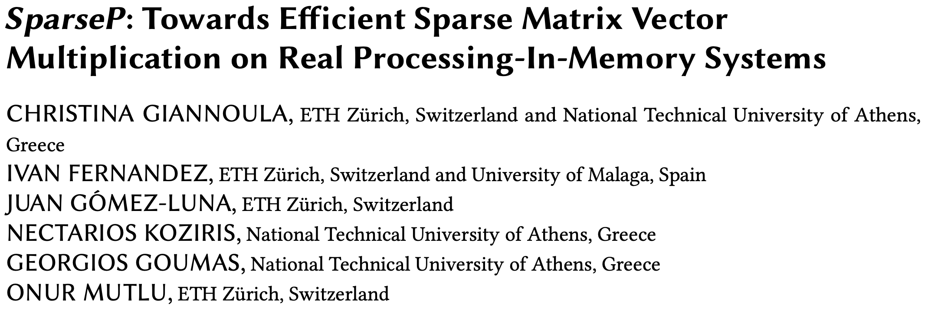
SparseP Paper and Repo
Appears at SIGMETRICS 2022
https://arxiv.org/pdf/2201.05072.pdf
https://github.com/CMU-SAFARI/SparseP
https://www.youtube.com/watch?v=5kaOsJKlGrE

Slide 101
SparseP
Towards Efficient Sparse Matrix Vector Multiplication
on Real Processing-In-Memory Architectures
Christina Giannoula, Ivan Fernandez, Juan Gomez-Luna,
Nectarios Koziris, Georgios Goumas, Onur Mutlu

Slide 102
Machine Learning Training

Slide 103
An Experimental Evaluation of
Machine Learning Training
on a Real Processing-in-Memory System
Juan Gómez Luna, Yuxin Guo, Sylvan Brocard,
Julien Legriel, Remy Cimadomo, Geraldo F. Oliveira,
Gagandeep Singh, Onur Mutlu
https://arxiv.org/pdf/2207.07886.pdf
https://github.com/CMU-SAFARI/pim-ml
juang@ethz.ch
Thursday, May 25, 2023

Slide 104
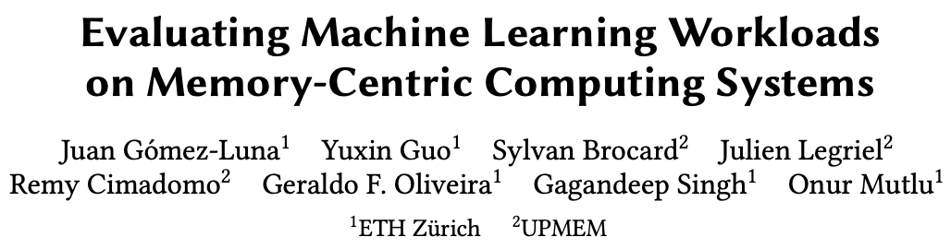
ISPASS 2023 Version
Presented at ISPASS 2023
https://people.inf.ethz.ch/omutlu/pub/MLonUPMEM-PIM_ispass23.pdf
Source code: https://github.com/CMU-SAFARI/pim-ml
https://youtu.be/60pkaI5AeM4

Slide 105
Executive Summary
Training machine learning (ML) algorithms is a computationally expensive process, frequently memory-bound due to repeatedly accessing large training datasets
Memory-centric computing systems, i.e., with Processing-in-Memory (PIM) capabilities, can alleviate this data movement bottleneck
Real-world PIM systems have only recently been manufactured and commercialized
  UPMEM has designed and fabricated the first publicly-available real-world PIM architecture
Our goal is to understand the potential of modern general-purpose PIM architectures to accelerate machine learning training
Our main contributions:
  PIM implementation of several classic machine learning algorithms: linear regression, logistic regression, decision tree, K-means clustering
  Workload characterization in terms of quality, performance, and scaling
  Comparison to their counterpart implementations on processor-centric systems (CPU and GPU)
    PIM version of DTR is 27x / 1.34x faster than the CPU / GPU version, respectively
    PIM version of KME is 2.8x / 3.2x faster than the CPU / GPU version, respectively
  Source code: https://github.com/CMU-SAFARI/pim-ml
Experimental evaluation on a real-world PIM system with 2,524 PIM cores @ 425 MHz and 158 GB of DRAM memory
Key observations, takeaways, and recommendations for ML workloads on general-purpose PIM systems

Slide 106
Outline
Machine learning workloads
Processing-in-memory
PIM implementation of ML workloads
Evaluation
Quality Metrics
Analysis of PIM Kernels
Performance Scaling
Comparison to CPU and GPU

Slide 107
Machine Learning Workloads
Machine learning training with large amounts of data is a computationally expensive process, which requires many iterations to update an ML model’s parameters
Frequent data movement between memory and processing elements to access training data
The amount of computation is not enough to amortize the cost of moving training data to the processing elements
  Low arithmetic intensity
  Low temporal locality
  Irregular memory accesses

Slide 108
Machine Learning Workloads: Our Goal
Our goal is to study and analyze how real-world general-purpose PIM can accelerate ML training
Four representative ML algorithms: linear regression, logistic regression, decision tree, K-means
Roofline model to quantify the memory boundedness of CPU versions of the four workloads
All workloads fall in the memory-bound area of the Roofline

Slide 109
Outline
Machine learning workloads
Processing-in-memory
PIM implementation of ML workloads
Evaluation
Quality Metrics
Analysis of PIM Kernels
Performance Scaling
Comparison to CPU and GPU

Slide 110
Processing-in-Memory (PIM)
PIM is a computing paradigm that advocates for memory-centric computing systems, where processing elements are placed near or inside the memory arrays
Real-world PIM architectures are becoming a reality
  UPMEM PIM, Samsung HBM-PIM, Samsung AxDIMM, SK Hynix AiM, Alibaba HB-PNM
These PIM systems have some common characteristics:
  There is a host processor (CPU or GPU) with access to (1) standard main memory, and (2) PIM-enabled memory
  PIM-enabled memory contains multiple PIM processing elements (PEs) with high bandwidth and low latency memory access
  PIM PEs run only at a few hundred MHz and have a small number of registers and small (or no) cache/scratchpad
  PIM PEs may need to communicate via the host processor

Slide 111
A State-of-the-Art PIM System
In our work, we use the UPMEM PIM architecture
  General-purpose processing cores called DRAM Processing Units (DPUs)
    Up to 24 PIM threads, called tasklets
    32-bit integer arithmetic, but multiplication/division are emulated*, as well as floating-point operations
  64-MB DRAM bank (MRAM), 64-KB scratchpad (WRAM)
* 8-bit integer multiplication is natively supported

Slide 112
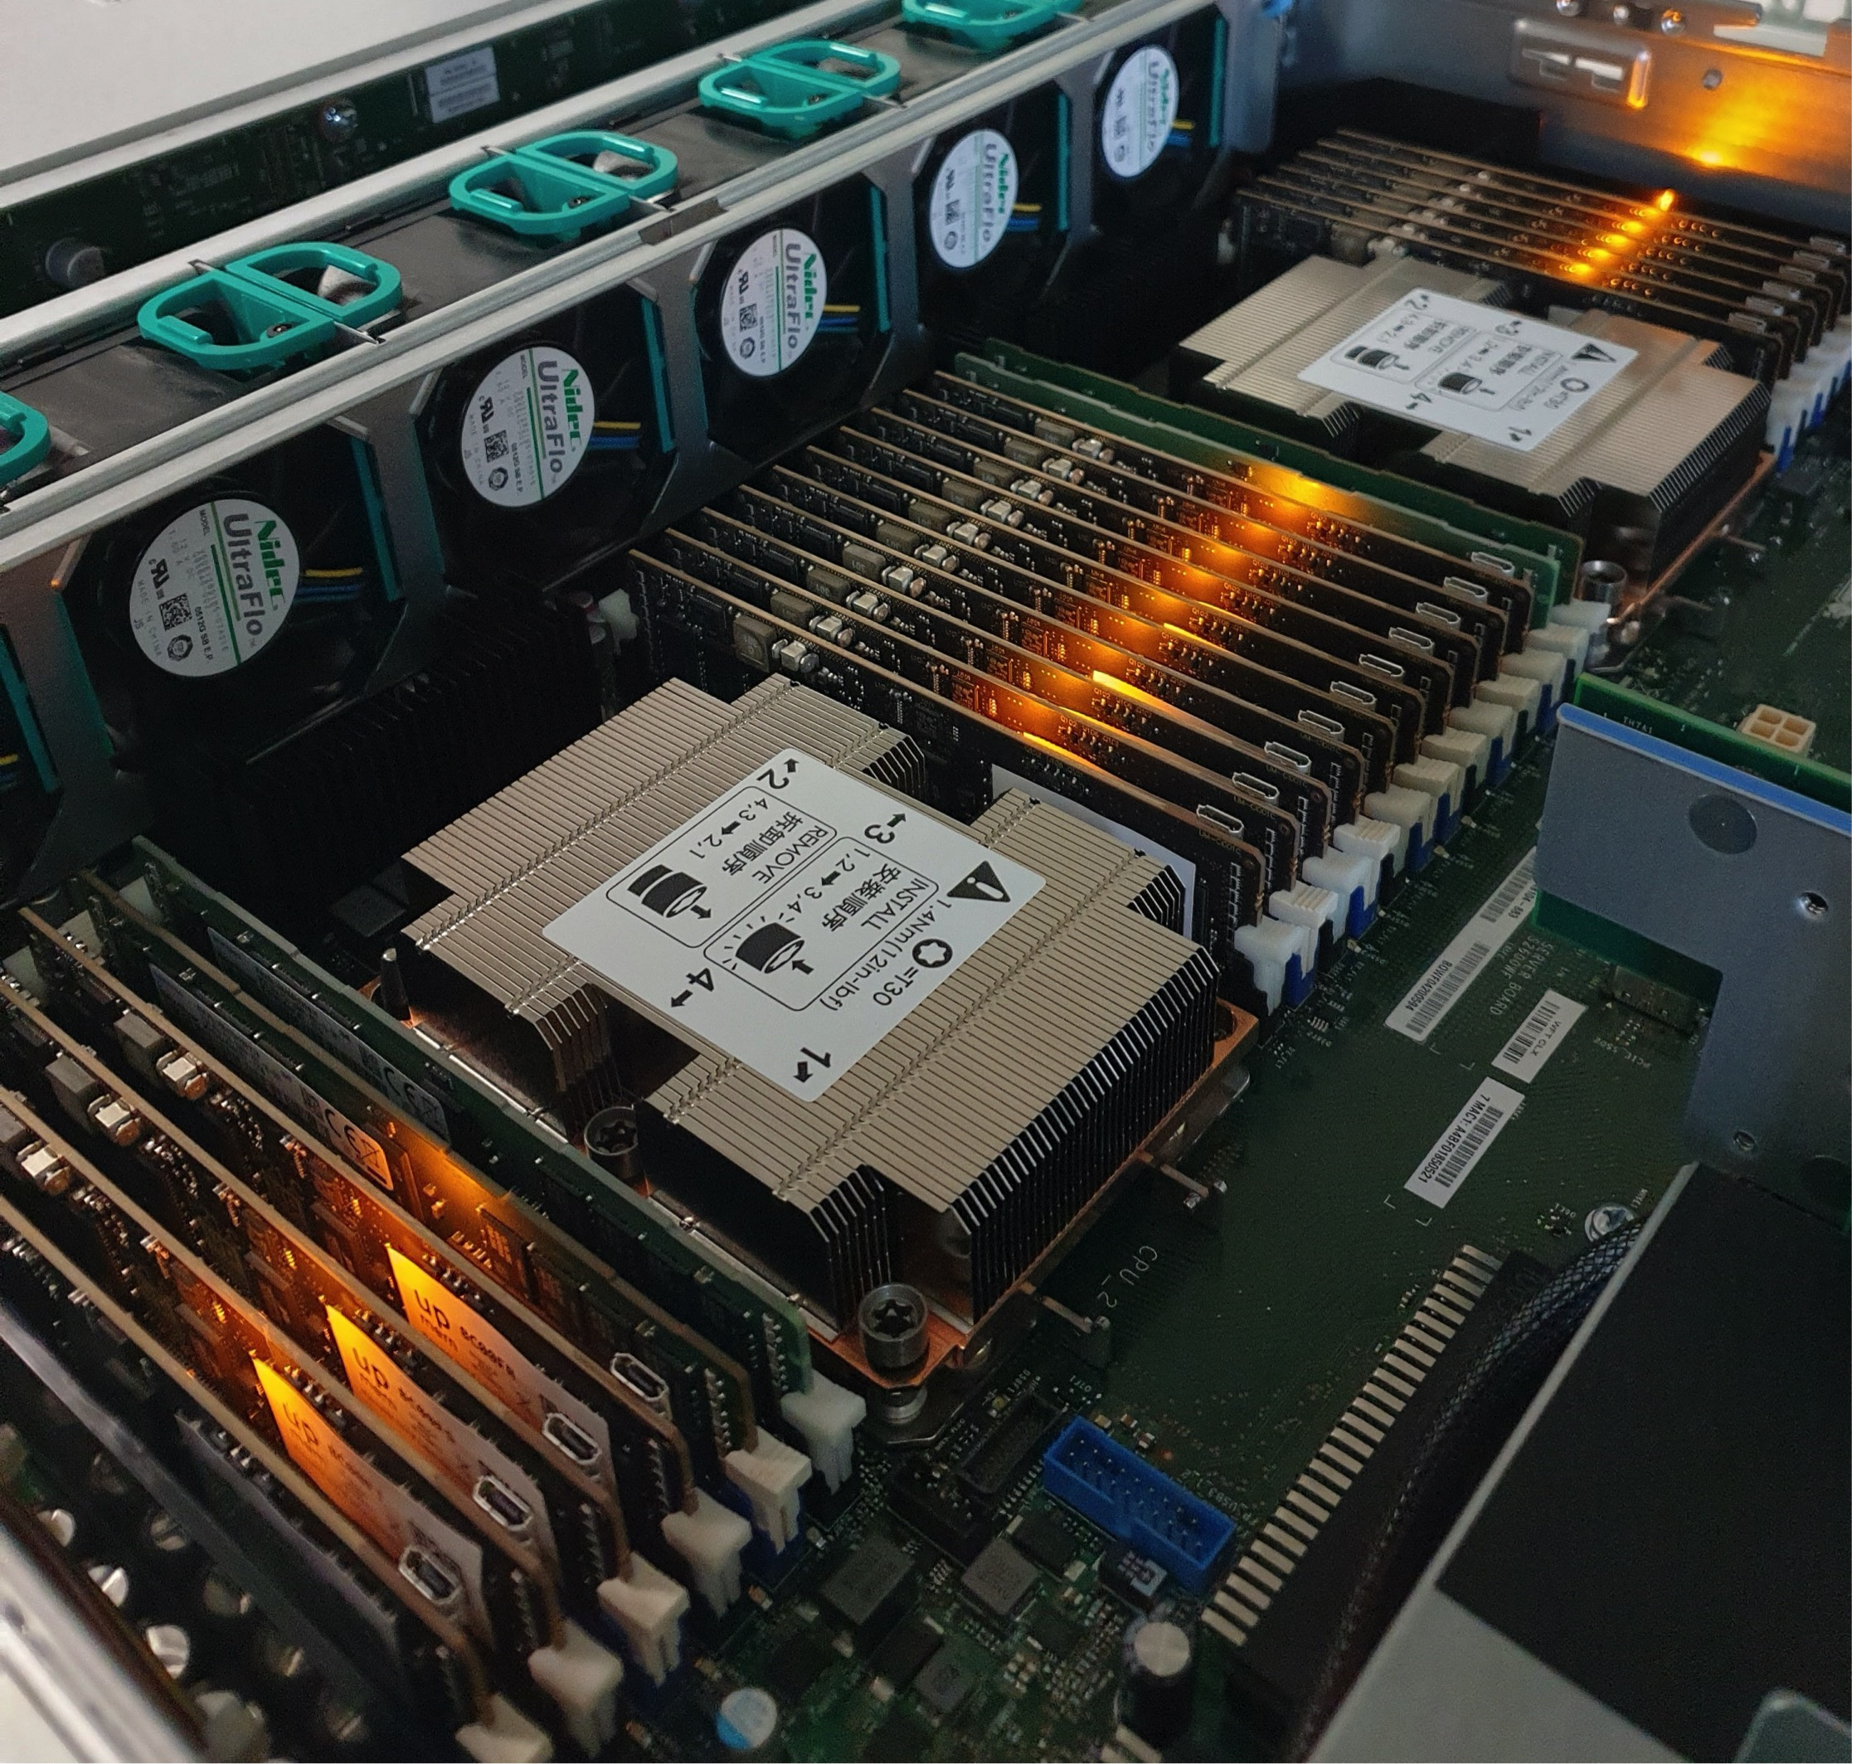
2,560-DPU UPMEM PIM System
20 UPMEM DIMMs of 16 chips each (40 ranks)
Dual x86 socket
UPMEM DIMMs coexist with regular DDR4 DIMMs
  2 memory controllers/socket (3 channels each)
  2 conventional DDR4 DIMMs on one channel of one controller
* There are some faulty DPUs in the system that we use in our experiments. Thus, the maximum number of DPUs we can use is 2,524

Slide 113
Outline
Machine learning workloads
Processing-in-memory
PIM implementation of ML workloads
Evaluation
Quality Metrics
Analysis of PIM Kernels
Performance Scaling
Comparison to CPU and GPU

Slide 114
ML Training Workloads
Four widely-used machine learning workloads:
  Linear regression (LIN)
  Logistic regression (LOG)
  Decision tree (DTR)
  K-means clustering (KME)
Diversity of our ML training workloads:
  Memory access patterns
  Operations and datatypes
  Communication/synchronization

Slide 115
Linear Regression
Linear regression (LIN) is a supervised learning algorithm where the predicted output variable has a linear relation with the input variable
  We use gradient descent as the optimization algorithm to find the minimum of the loss function
Our PIM implementation divides the training dataset (X) equally among PIM cores
  PIM threads compute dot products of row vectors and weights
  Each dot product is compared to the observed value y to compute a partial gradient value
  Partial gradient values are reduced and sent to the host
Four versions of LIN:
  LIN-FP32: training datasets of 32-bit real values
  LIN-INT32: 32-bit fixed-point representation
  LIN-HYB: hybrid precision (8-bit, 16-bit, 32-bit)
  LIN-BUI: custom multiplication based on 8-bit built-in multiplication

Slide 116
Custom Integer Multiplication
C code
1 result = X[i] * W[i]; // X and W are in WRAM (scratchpad)
1 lbs r3, r2, 0 // Load 1 byte from X[i]
2 lsl_add r2, r20, r1, 1 // Address of W[i]: r2=r20+(r1<<1)
3 lhs r4, r2, 0 // Load 2 bytes from W[i]
4 mul_ul_ul r2, r4, r3, small, 0x80000378 // r2=r4(l)*r3(l)
5 mul_sh_ul r5, r4, r3 // r5=r4(h)*r3(l)
6 lsl_add r2, r2, r5, 8 // r2=r2+(r5<<8)
7 mul_sh_ul r5, r3, r4 // r5=r3(h)*r4(l)
8 lsl_add r2, r2, r5, 8 // r2=r2+(r5<<8)
9 mul_sh_sh r3, r4, r3 // r3=r4(h)*r3(h)
10 lsl_add r2, r2, r3, 16, true, 0x80000378 //r2=r2+(r3<<16)
Default integer
multiplication
UPMEM ISA
1 __builtin_mul_sl_ul_rrr(templ, X[i], W[i]);
2 __builtin_mul_sl_sh_rrr(temph, X[i], W[i]);
3 result = (temph << 8) + templ;
1 lbs r4, r4, 0 // Load 1 byte from X[i]
2 lsl_add r5, r20, r3, 1 // Address of W[i]: r5=r20+(r1<<1)
3 lhs r5, r5, 0 // Load 2 bytes from W[i]
4 mul_sl_ul r6, r4, r5 // r6=r4(l)*r5(l)
5 mul_sl_sh r4, r4, r5 // r4=r4(l)*r5(h)
6 add r2, r6, r2 // r2=r2+r6
7 lsl_add r2, r2, r4, 8 // r2=r2+(r4 << 8)
C code
Custom integer
multiplication
UPMEM ISA

Slide 117
Logistic Regression
Logistic regression (LOG) is a supervised learning algorithm used for classification, which outputs probability values for each input observation variable or vector
  Sigmoid function to map predicted values to probabilities
Our PIM implementation follows the same workload distribution pattern as our linear regression implementation
Six versions of LOG:
  LOG-FP32: training datasets of 32-bit real values, Sigmoid approximated with Taylor series
  LOG-INT32: 32-bit fixed-point representation, Taylor series
  LOG-INT32-LUT: Sigmoid calculation with a lookup table (LUT)
    LOG-INT32-LUT(MRAM): LUT in MRAM
    LOG-INT32-LUT(WRAM): LUT in WRAM
  LOG-HYB-LUT: hybrid precision (8-bit, 16-bit, 32-bit), LUT in WRAM
  LOG-BUI-LUT: custom multiplication based on 8-bit built-in multiplication, LUT in WRAM

Slide 118
LUT-based Sigmoid Calculation
We take advantage of the fact that Sigmoid is symmetric
The LUT size depends on the boundary (e.g., 20) and the number of bits for the decimal part of the fixed-point representation (e.g., 10)
  20 x 1024 entries (with 16-bit entries) = 40 KB

Slide 119
Decision Tree
Decision trees (DTR) are tree-based methods used for classification and regression, which partition the feature space into leaves, with a simple prediction model in each leaf
Our PIM implementation partitions the training set among PIM cores, which compute partial Gini scores to evaluate the host’s split decisions
The host sends commands to the PIM cores:
  Split commit to split a tree leaf
  Split evaluate to evaluate a split
  Min-max to query minimum/maximum values of a feature in a tree leaf
Data layout in split commit to maximize memory bandwidth with streaming accesses
This data layout also ensures memory accesses in streaming in split evaluate

Slide 120
K-Means Clustering
K-means (KME) is an iterative clustering method used to find groups in a dataset which have not been explicitly labeled
Our PIM implementation distributes the dataset evenly over the PIM cores
PIM threads evaluate which centroid is the closest one to each point of the training set
  Counter and accumulator per coordinate (per centroid)
Then, the host recalculates the centroids
Convergence to a local optimum when the updated centroid’s coordinates are within a threshold (Frobenius norm)

Slide 121
Outline
Machine learning workloads
Processing-in-memory
PIM implementation of ML workloads
Evaluation
Quality Metrics
Analysis of PIM Kernels
Performance Scaling
Comparison to CPU and GPU

Slide 122
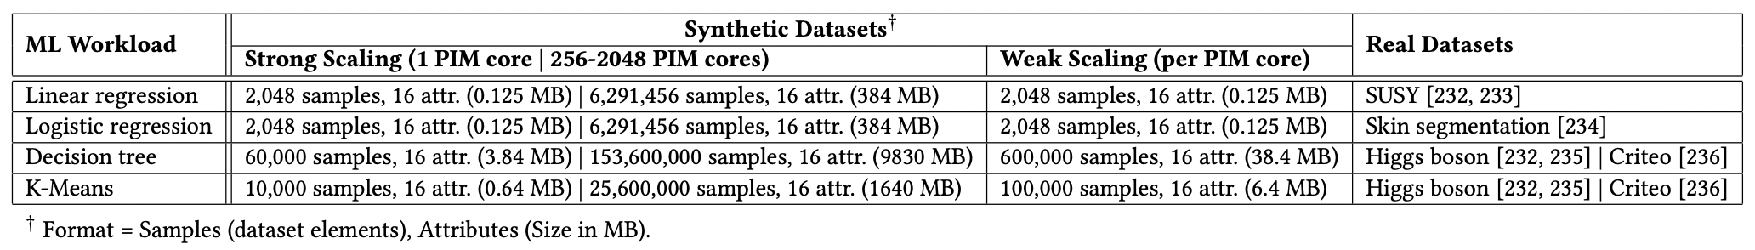
Evaluation Methodology
Synthetic and real datasets
Evaluated systems
  UPMEM PIM system with 2,524 PIM cores @ 425 MHz and 158 GB of DRAM
  Intel Xeon Silver 4215 CPU
  NVIDIA A100 GPU
We evaluate:
  Quality metrics
  Performance of PIM kernels
  Performance scaling
  Comparison to CPU and GPU

Slide 123
2,560-DPU UPMEM PIM System
20 UPMEM DIMMs of 16 chips each (40 ranks)
Dual x86 socket
UPMEM DIMMs coexist with regular DDR4 DIMMs
  2 memory controllers/socket (3 channels each)
  2 conventional DDR4 DIMMs on one channel of one controller
* There are some faulty DPUs in the system that we use in our experiments. Thus, the maximum number of DPUs we can use is 2,524

Slide 124
Outline
Machine learning workloads
Processing-in-memory
PIM implementation of ML workloads
Evaluation
Quality Metrics
Analysis of PIM Kernels
Performance Scaling
Comparison to CPU and GPU

Slide 125
Evaluation: Quality Metrics: LIN
Linear regression
The training error rate flattens after 500 iterations
Training error rate of LIN-FP32 is the same as the CPU version
For the integer versions, the training error rate remains
low and close to that of LIN-FP32

Slide 126
Evaluation: Quality Metrics: LOG
Logistic regression
Training error rate of LOG-FP32 is the same as the CPU version
LUT-based versions obtain lower training error rates than
LOG-INT32, since they use exact values, not approximations
Reduced-precision datatypes increase the training error rate, which heavily depends on the number of
decimal numbers of the samples (e.g., 4 in (a), 2 in (b))

Slide 127
Evaluation: Quality Metrics
Linear regression
  Training error rate of LIN-FP32 is the same as the CPU version
  For integer versions, it remains low and close to that of LIN-FP32
Logistic regression
  LUT-based versions obtain lower training error rates that LOG-INT32, since they use exact values, not approximations
Decision tree
  Training accuracy only slightly lower than that of the CPU version
K-means clustering
  Same Calinski-Harabasz score and adjusted Rand index of PIM and CPU versions
We maintain the accuracy of all workloads
(or keep it close to the CPU baseline)

Slide 128
Outline
Machine learning workloads
Processing-in-memory
PIM implementation of ML workloads
Evaluation
Quality Metrics
Analysis of PIM Kernels
Performance Scaling
Comparison to CPU and GPU

Slide 129
Evaluation: Analysis of PIM Kernels (I)
Linear regression
All versions saturate at 11 or more PIM threads
Fixed-point representation accelerates the kernel by an order of magnitude over FP32
Key Takeaway 1. Workloads with arithmetic operations or datatypes not natively supported by PIM cores run at low performance due to instruction emulation (e.g., FP in UPMEM PIM).
Recommendation 1. Use fixed-point representation, without much accuracy loss, if PIM cores do not support FP.

Slide 130
Evaluation: Analysis of PIM Kernels (II)
Linear regression
LIN-HYB is 41% faster than LIN-INT32
LIN-BUI provides an additional 25% speedup
Recommendation 2. Quantization can take advantage of native hardware support. Hybrid precision can significantly improve performance.
Recommendation 3. Programmers/better compilers can optimize code by leveraging native instructions (e.g., 8-bit integer multiplication in UPMEM) .

Slide 131
Evaluation: Analysis of PIM Kernels (III)
Logistic regression
Very high kernel time of LOG-FP32 and LOG-INT32 due to Sigmoid approximation
LOG-INT32-LUT(MRAM) is 53x faster
than LOG-INT32
Recommendation 4. Convert computation to memory accesses by keeping pre-calculated operation results (e.g., LUTs, memoization) in memory.
LOG-HYB-LUT is 28% faster than LOG-INT32-LUT
LOG-BUI-LUT provides an additional 43% speedup

Slide 132
Evaluation: Analysis of PIM Kernels (IV)
Linear regression, logistic regression, decision tree, K-means clustering
The performance of all kernels saturates at 11 or more PIM threads. In the UPMEM PIM architecture, this means that the pipeline latency hides the memory latency
As a result, these kernels are compute-bound
on the UPMEM PIM architecture
LIN
LOG
DTR
KME

Slide 133
Evaluation: Analysis of PIM Kernels (V)
Linear regression, logistic regression, decision tree, K-means clustering
Key Takeaway 2. ML workloads that are memory-bound due to low arithmetic intensity in CPU/GPU become compute-bound when running on PIM.
The performance of all kernels saturates at 11 or more PIM threads. In the UPMEM PIM architecture, this means that the pipeline latency hides the memory latency
As a result, these kernels are compute-bound
on the UPMEM PIM architecture
Recommendation 6. Maximize the utilization of PIM cores by keeping their pipeline fully busy.
LIN
LOG
DTR
KME

Slide 134
Outline
Machine learning workloads
Processing-in-memory
PIM implementation of ML workloads
Evaluation
Quality Metrics
Analysis of PIM Kernels
Performance Scaling
Comparison to CPU and GPU

Slide 135
Evaluation: Performance Scaling (I)
Weak scaling: 1 to 64 PIM cores
PIM kernel time of LIN, LOG, and DTR scales linearly with the number of PIM cores
KME converges with fewer iterations on a larger dataset
The sum of CPU-PIM, Inter PIM core, and PIM-CPU takes less than 7% of the total execution time in all cases

Slide 136
Evaluation: Performance Scaling (II)
Strong scaling: 256 to 2,048 PIM cores
PIM kernel time scales linearly with the number of PIM cores
Little overhead from inter PIM core communication and communication between host and PIM cores

Slide 137
Evaluation: Performance Scaling (II)
Strong scaling: 256 to 2,048 PIM cores
PIM kernel time scales linearly with the number of PIM cores
Key Takeaway 3. ML training workloads, which need large training datasets, benefit from large PIM-enabled memory with many PIM cores.
Even if PIM cores need to communicate via the host processor, the amount of data movement needed for intermediate results is tolerable.
Little overhead from inter PIM core communication and communication between host and PIM cores

Slide 138
Outline
Machine learning workloads
Processing-in-memory
PIM implementation of ML workloads
Evaluation
Quality Metrics
Analysis of PIM Kernels
Performance Scaling
Comparison to CPU and GPU

Slide 139
Comparison to CPU and GPU (I)
Linear regression and logistic regression
LIN
PIM versions are heavily burdened when they use operations that are not natively supported by the hardware
LOG
Several optimizations reduce the execution time considerably
(LIN/LOG up to 10x/3.9x faster than CPU)
and close the gap with GPU performance
(LIN/LOG still 4x/16x slower than GPU)

Slide 140
Comparison to CPU and GPU (II)
Decision tree and K-means with Higgs boson dataset
DTR
KME
PIM version of DTR is 27x faster than the CPU version and 1.34x faster than the GPU version
PIM version of KME is 2.8x faster than the CPU version and 3.2x faster than the GPU version

Slide 141
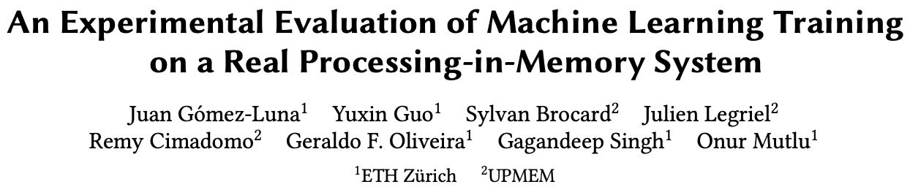
Long arXiv Version
Additional implementation details
More evaluation results
Extended observations, takeaways, and recommendations
https://arxiv.org/pdf/2207.07886.pdf
Source code: https://github.com/CMU-SAFARI/pim-ml

Slide 142
Comparison to CPU and GPU (III)
Decision tree and K-means with Criteo 1TB dataset
DTR
KME
PIM version of DTR is 62x faster than the CPU version and 4.5x faster than the GPU version
PIM version of KME is 2.7x faster than the CPU version and 3.2x faster than the GPU version

Slide 143
Comparison to CPU and GPU (IV)
Decision tree and K-means with Criteo 1TB dataset
Key Takeaway 4. ML workloads that require mainly operations natively supported by the PIM architecture,
such as decision tree and K-means clustering,
outperform their CPU and GPU counterparts.
DTR
KME
PIM version of DTR is 62x faster than the CPU version and 4.5x faster than the GPU version
PIM version of KME is 2.7x faster than the CPU version and 3.2x faster than the GPU version

Slide 144
Long arXiv Version
Additional implementation details
More evaluation results
Extended observations, takeaways, and recommendations
https://arxiv.org/pdf/2207.07886.pdf
Source code: https://github.com/CMU-SAFARI/pim-ml

Slide 145
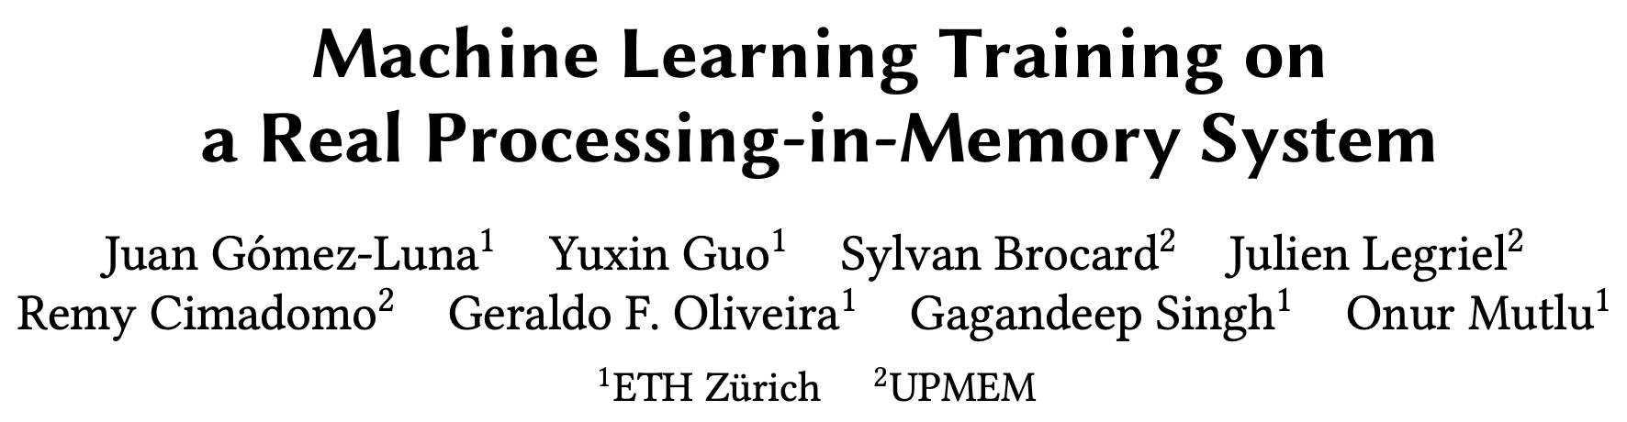
Short arXiv Version
Presented at ISVLSI 2022
https://arxiv.org/pdf/2206.06022.pdf
Source code: https://github.com/CMU-SAFARI/pim-ml
https://youtu.be/CVX8n-X-5wI

Slide 146
ISPASS 2023 Version
Presented at ISPASS 2023
https://people.inf.ethz.ch/omutlu/pub/MLonUPMEM-PIM_ispass23.pdf
Source code: https://github.com/CMU-SAFARI/pim-ml
https://youtu.be/60pkaI5AeM4

Slide 147
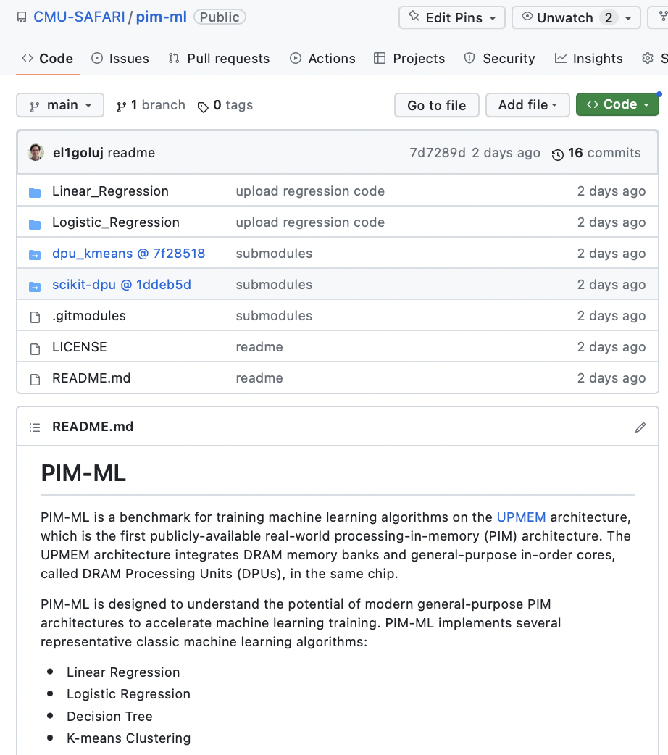
Source Code
https://github.com/CMU-SAFARI/pim-ml

Slide 148
Executive Summary
Training machine learning (ML) algorithms is a computationally expensive process, frequently memory-bound due to repeatedly accessing large training datasets
Memory-centric computing systems, i.e., with Processing-in-Memory (PIM) capabilities, can alleviate this data movement bottleneck
Real-world PIM systems have only recently been manufactured and commercialized
  UPMEM has designed and fabricated the first publicly-available real-world PIM architecture
Our goal is to understand the potential of modern general-purpose PIM architectures to accelerate machine learning training
Our main contributions:
  PIM implementation of several classic machine learning algorithms: linear regression, logistic regression, decision tree, K-means clustering
  Workload characterization in terms of quality, performance, and scaling
  Comparison to their counterpart implementations on processor-centric systems (CPU and GPU)
    PIM version of DTR is 27x / 1.34x faster than the CPU / GPU version, respectively
    PIM version of KME is 2.8x / 3.2x faster than the CPU / GPU version, respectively
  Source code: https://github.com/CMU-SAFARI/pim-ml
Experimental evaluation on a real-world PIM system with 2,524 PIM cores @ 425 MHz and 158 GB of DRAM memory
Key observations, takeaways, and recommendations for ML workloads on general-purpose PIM systems

Slide 149
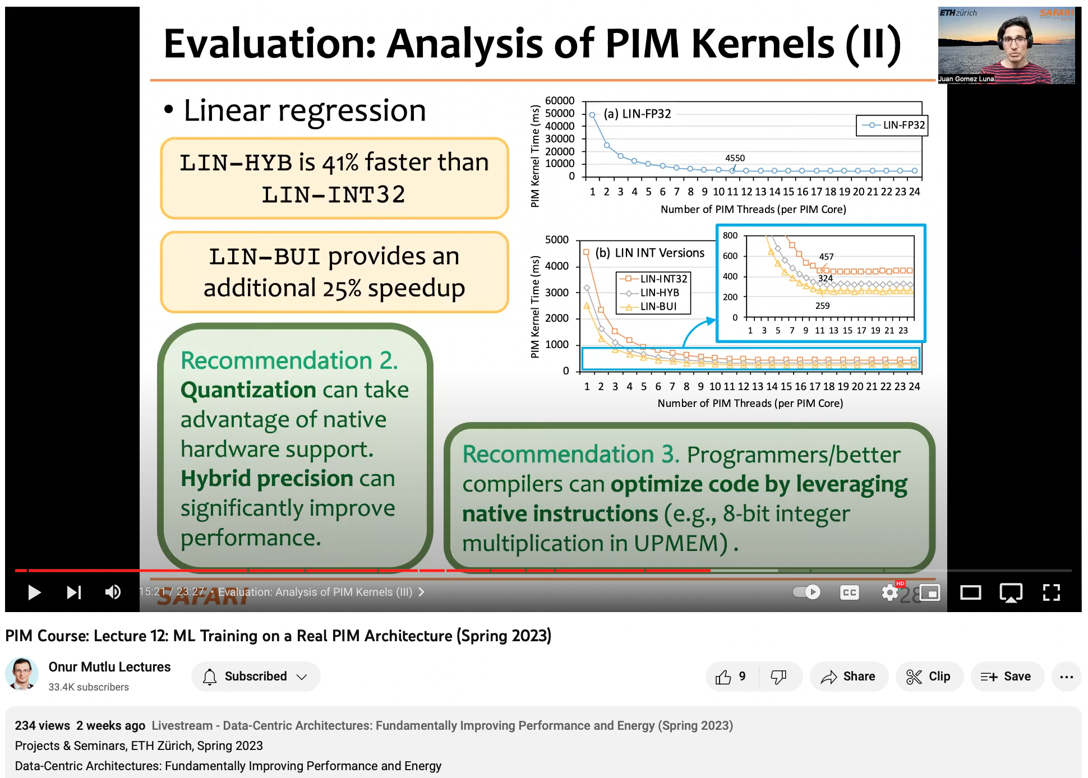
Lecture on PIM-ML
https://youtu.be/elWNYlSE10c

Slide 150
An Experimental Evaluation of
Machine Learning Training
on a Real Processing-in-Memory System
Juan Gómez Luna, Yuxin Guo, Sylvan Brocard,
Julien Legriel, Remy Cimadomo, Geraldo F. Oliveira,
Gagandeep Singh, Onur Mutlu
https://arxiv.org/pdf/2207.07886.pdf
https://github.com/CMU-SAFARI/pim-ml
juang@ethz.ch
Thursday, May 25, 2023

Slide 151
Genomics Sequence Alignment

Slide 152
High Throughput
Sequence Alignment
Using Real Processing-in-Memory Systems
Safaa Diab, Amir Nassereldine, Mohammed Alser,
Juan Gómez Luna, Onur Mutlu, Izzat El Hajj
https://arxiv.org/pdf/2208.01243.pdf
https://github.com/CMU-SAFARI/alignment-in-memory
juang@ethz.ch
Thursday, June 8, 2023

Slide 153
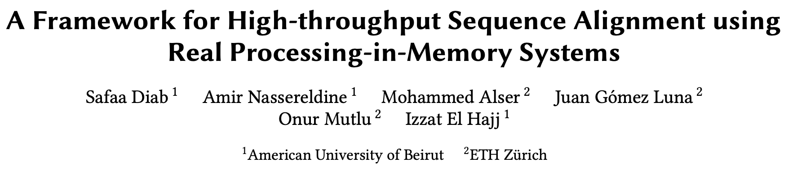
Sequence Alignment on Processing-in-Memory
Published in Bioinformatics (2023)
https://arxiv.org/pdf/2204.02085.pdf
https://arxiv.org/pdf/2208.01243.pdf
Source code: https://github.com/safaad/aim

Slide 154
Executive Summary
Genome sequence alignment is typically memory-bound on conventional processor-centric systems (CPU, GPU)
Processing-in-memory (PIM) has the potential to overcome this data movement bottleneck by placing compute capabilities near/inside memory arrays
We present Alignment-in-Memory (AiM), a PIM framework for genome sequence alignment on general-purpose PIM systems
  AiM supports multiple alignment algorithms: NW, SWG, GenASM, WFA
  Implemented for the UPMEM PIM architecture
Our evaluation shows that sequence alignment on PIM can be significantly faster than on CPUs and GPUs

Slide 155
Outline
Background & Motivation:
Sequence Alignment on CPU
Processing-in-memory to Alleviate the Data Movement Bottleneck
Alignment-in-memory: A Framework for Sequence Alignment on PIM Systems
Evaluation

Slide 156
Genome Analysis
A genome is the complete set of an organism’s genetic instructions
DNA is a string of base pairs (characters): A, C, G, T
  The human genome contains 3.2 billion base pairs
  Genome analysis helps to understand genetic variations, predict the presence and abundance of microbes, monitor disease outbreaks, develop personalized medicine, etc.
Sequencing machines provide only randomized fragments (reads), which need to be mapped to the reference genome
  Depending on the sequencing technology, there are short (50-300 bp) and long reads (10K-100K bp)
A key step in the read mapping process is sequence alignment
  Quadratic-time dynamic programming algorithms, e.g., Smith-Waterman, Needleman-Wunsch
  State-of-the-art algorithms: GenASM, WFA, WFA-adaptive

Slide 157

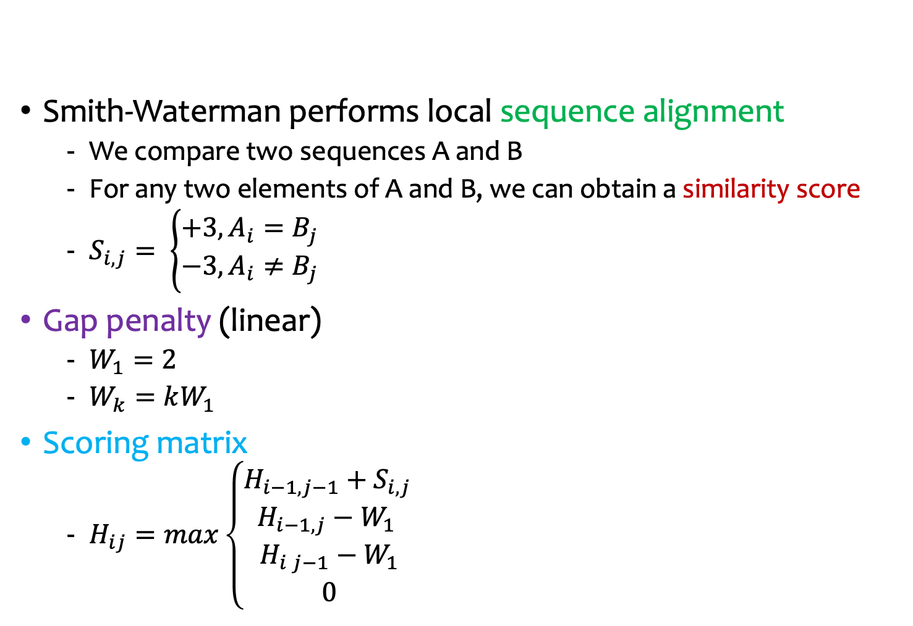







Sequence Alignment: Smith-Waterman (I)
Smith-Waterman performs local sequence alignment
  We compare two sequences A and B
  For any two elements of A and B, we can obtain a similarity score
  $S_{i, j}= \left\{\begin{matrix}+3, A_{i}=B_{j} \\ −3, A_{i}≠B_{j}\end{matrix}\right.$
Gap penalty (linear)
  $W_{1}=2$
  $W_{k}=kW_{1}$
Scoring matrix
  $H_{ij}=max\left\{\begin{aligned}\begin{matrix}H_{i−1, j−1}+S_{i, j } \\ H_{i−1, j}−W_{1} \\ H_{i j−1}−W_{1}\end{matrix} \\ 0\end{aligned}\right.$
$$H_{i−1, j−1}$$
$$H_{i−1, j}$$
$$+S_{i, j}$$
$$−W_{1}$$
$$H_{i, j−1}$$
$$H_{i, j}$$
$$−W_{1}$$
$$0$$

Slide 158


Sequence Alignment: Smith-Waterman (II)
Let’s align two sequences: AACC and AATC
First, we compute the scoring matrix
A
A
T
C
$$H_{1, 1}=\max\left(H_{0, 0}+S_{1, 1}, H_{0, 1}−W_{1},H_{1, 0}−W_{1}, 0\right)$$
$=\max\left(0+3, 0−2, 0−2, 0\right)=3$
0
0
0
0
0
A
0
3
3
1
0
$$H_{2, 1}=\max\left(H_{1, 0}+S_{2, 1}, H_{1, 1}−W_{1},H_{2, 0}−W_{1}, 0\right)$$
1
0
$=\max\left(0+3, 3−2, 0−2, 0\right)=3$
A
0
3
6
4
2
3
1
0
C
0
1
4
3
7
$$H_{1, 2}=\max\left(H_{0, 1}+S_{1, 2}, H_{0, 2}−W_{1},H_{1, 1}−W_{1}, 0\right)$$
3
1
6
4
$=\max\left(0+3, 0−2, 3−2, 0\right)=3$
C
0
0
2
1
6
3
1
4
9
To calculate one antidiagonal, we need the two previous antidiagonals

Slide 159
Sequence Alignment: Smith-Waterman (III)
Let’s align two sequences: AACC and AATC
Second, traceback and alignment
A
A
T
C
0
0
0
0
0
A
0
3
3
1
0
1
0
A
A
T
C
A
0
3
6
4
2
3
1
0
A
A
-
C
C
0
1
4
3
7
3
1
6
4
C
0
0
2
1
6
3
1
4
9
For the traceback process, we need the direction of the score calculation

Slide 160
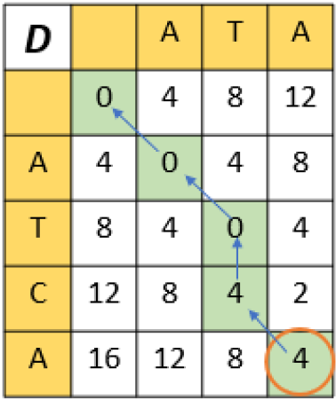
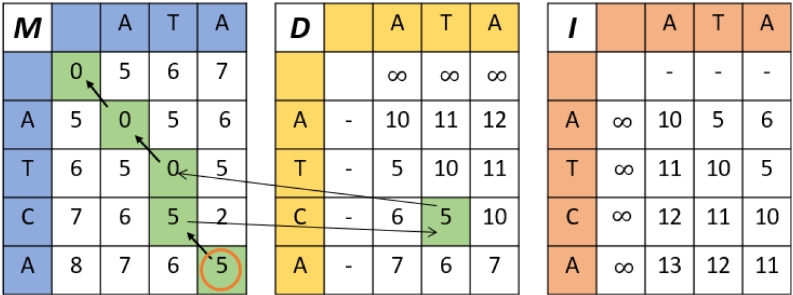
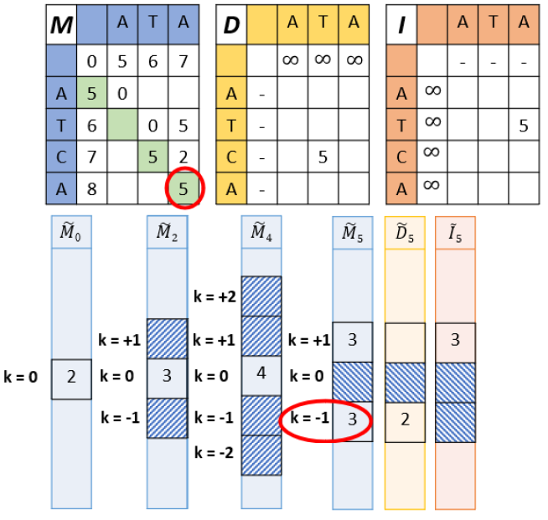
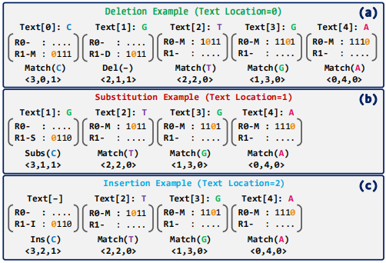
Sequence Alignment Algorithms
Smith-Waterman-Gotoh (SWG)
Needleman-Wunsch (NW)
Wavefront Algorithm (WFA)
GenASM
Senol Cali et al. "GenASM: A high-performance, low-power approximate string matching acceleration framework for genome sequence analysis." MICRO 2020
Marco-Sola et al. "Fast gap-affine pairwise alignment using the wavefront algorithm." Bioinformatics (2021)

Slide 161
Motivation: Alignment on CPU (I)
Scaling of sequence alignment on CPU
  Execution time
Performance tends to saturate
as the number of CPU threads grows

Slide 162
Motivation: Alignment on CPU (II)
Scaling of sequence alignment on CPU
  Instructions per cycle
As the number of CPU threads grows, IPC decreases.
This means that threads spend more time idle

Slide 163
Motivation: Alignment on CPU (III)
Scaling of sequence alignment on CPU
  Memory stalls
As the number of CPU threads grows,
threads spend more time waiting for memory

Slide 164
Outline
Background & Motivation:
Sequence Alignment on CPU
Processing-in-memory to Alleviate the Data Movement Bottleneck
Alignment-in-memory: A Framework for Sequence Alignment on PIM Systems
Evaluation

Slide 165
PIM to Minimize Data Movement
Processing-in-memory can alleviate the data movement bottleneck

Slide 166
Processing-in-Memory (PIM)
PIM is a computing paradigm that advocates for memory-centric computing systems, where processing elements are placed near or inside the memory arrays
Real-world PIM architectures are becoming a reality
  UPMEM PIM, Samsung HBM-PIM, Samsung AxDIMM, SK Hynix AiM, Alibaba HB-PNM
These PIM systems have some common characteristics:
  There is a host processor (CPU or GPU) with access to (1) standard main memory, and (2) PIM-enabled memory
  PIM-enabled memory contains multiple PIM processing elements (PEs) with high bandwidth and low latency memory access
  PIM PEs run only at a few hundred MHz and have a small number of registers and small (or no) cache/scratchpad
  PIM PEs may need to communicate via the host processor

Slide 167
A State-of-the-Art PIM System
In our work, we use the UPMEM PIM architecture
  General-purpose processing cores called DRAM Processing Units (DPUs)
    Up to 24 PIM threads, called tasklets
    32-bit integer arithmetic, but multiplication/division are emulated*, as well as floating-point operations
  64-MB DRAM bank (MRAM), 64-KB scratchpad (WRAM)
* 8-bit integer multiplication is natively supported

Slide 168
Outline
Background & Motivation:
Sequence Alignment on CPU
Processing-in-memory to Alleviate the Data Movement Bottleneck
Alignment-in-memory: A Framework for Sequence Alignment on PIM Systems
Evaluation

Slide 169
Alignment-in-Memory (AiM)
Supported algorithms
Smith-Waterman-Gotoh (SWG)
Needleman-Wunsch (NW)
Wavefront Algorithm (WFA)
GenASM
Senol Cali et al. "GenASM: A high-performance, low-power approximate string matching acceleration framework for genome sequence analysis." MICRO 2020
Marco-Sola et al. "Fast gap-affine pairwise alignment using the wavefront algorithm." Bioinformatics (2021)

Slide 170
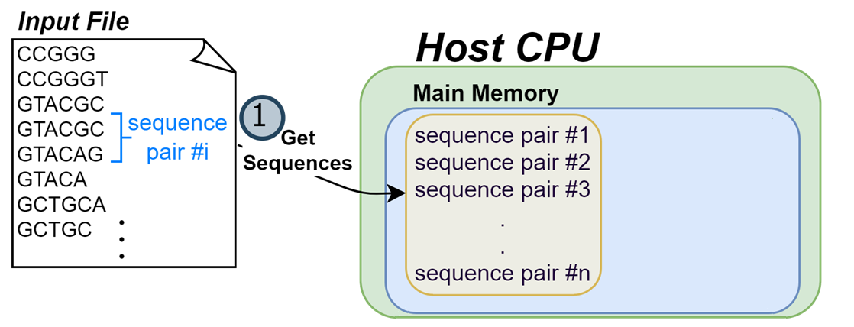
Alignment-in-Memory (AiM)
A framework for sequence alignment on PIM systems
(1) The host CPU reads sequence pairs from an input file
and stores them in main memory

Slide 171
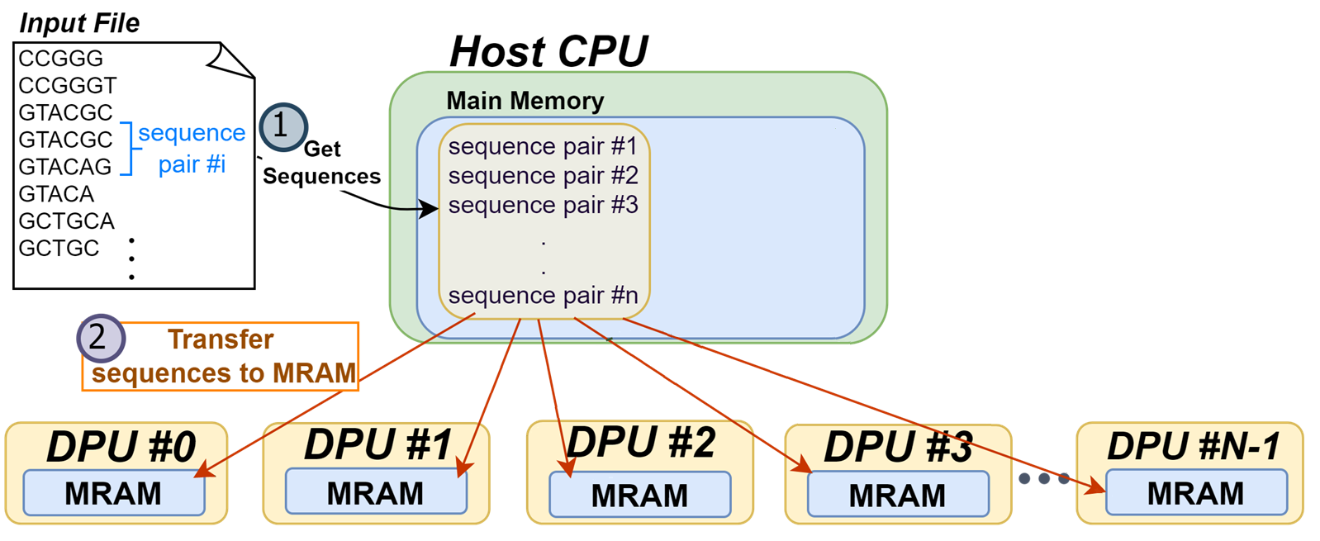
Alignment-in-Memory (AiM)
A framework for sequence alignment on PIM systems
(2) The sequence pairs are evenly partitioned across PIM cores (DPUs)
and transferred to the DRAM banks (MRAM) in the PIM DIMMs

Slide 172
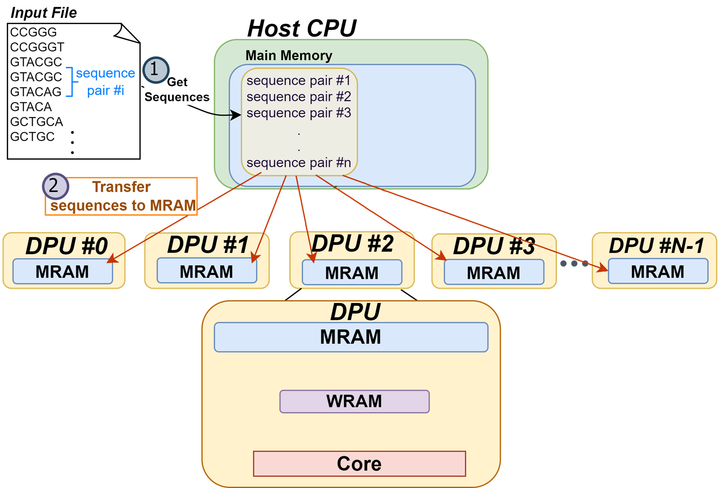
Alignment-in-Memory (AiM)
A framework for sequence alignment on PIM systems
In each PIM core (DPU) different threads will align different sequence pairs.
This approach avoids any inter-thread or inter PIM core synchronization

Slide 173
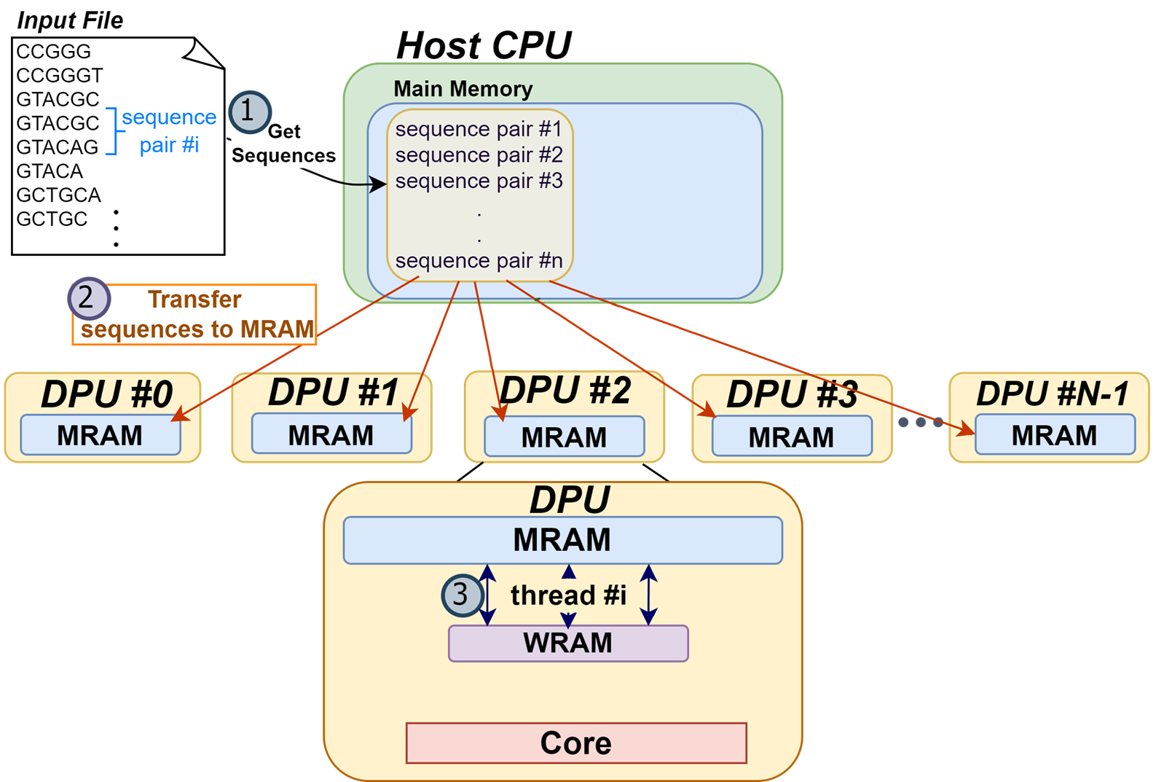
Alignment-in-Memory (AiM)
A framework for sequence alignment on PIM systems
(3) Each thread copies a sequence pair from the DRAM bank (MRAM) to the scratchpad (WRAM) using a DMA transfer

Slide 174
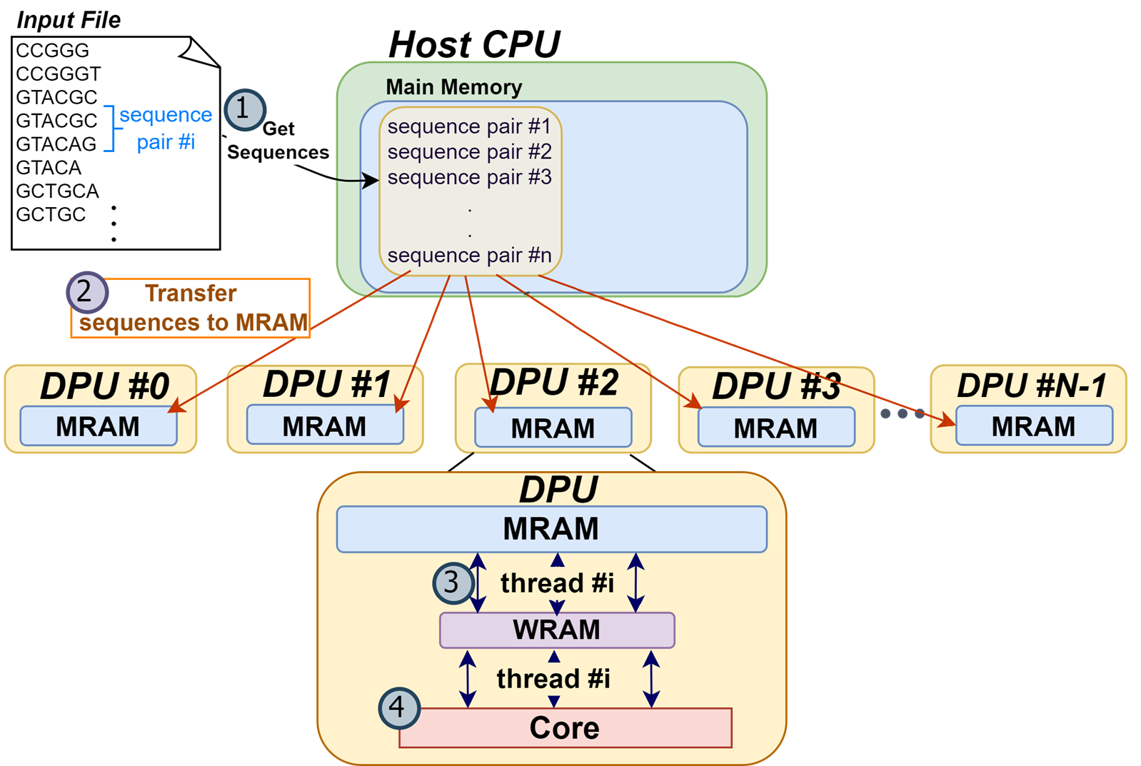
Alignment-in-Memory (AiM)
A framework for sequence alignment on PIM systems
(4) Threads align the sequence pairs and extract the alignment operations using traceback

Slide 175
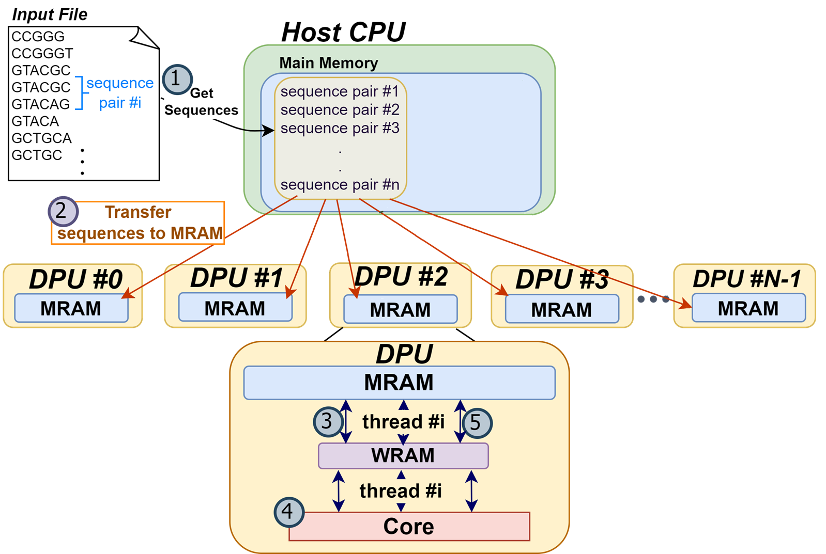
Alignment-in-Memory (AiM)
A framework for sequence alignment on PIM systems
(5) Threads write the alignment score and operations to the DRAM bank via a DMA write transfer

Slide 176
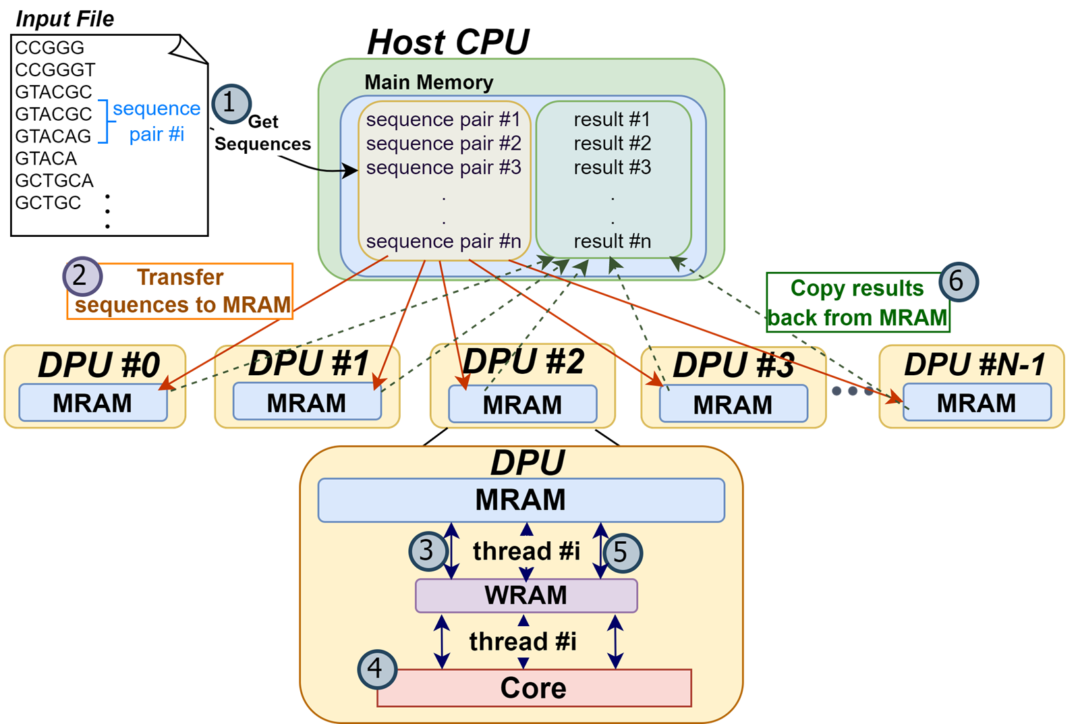
Alignment-in-Memory (AiM)
A framework for sequence alignment on PIM systems
(6) Once the execution on the PIM core has finished, the host CPU reads the alignment score and operations of each sequence pair

Slide 177
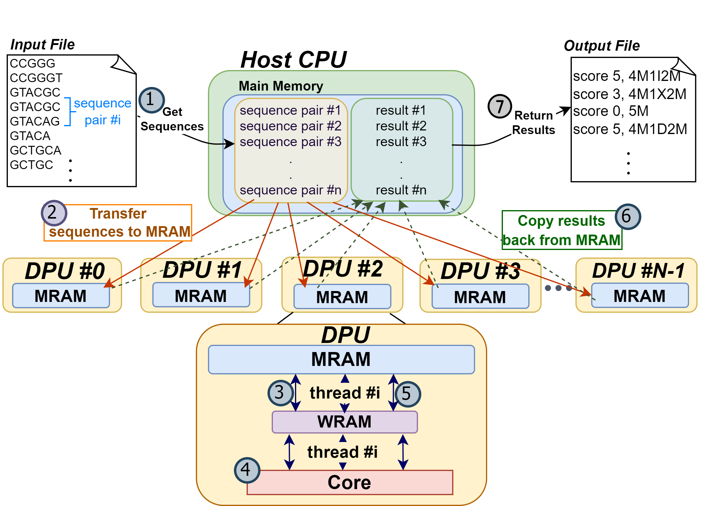
Alignment-in-Memory (AiM)
A framework for sequence alignment on PIM systems
(7) The host CPU writes the alignment results to an output file

Slide 178
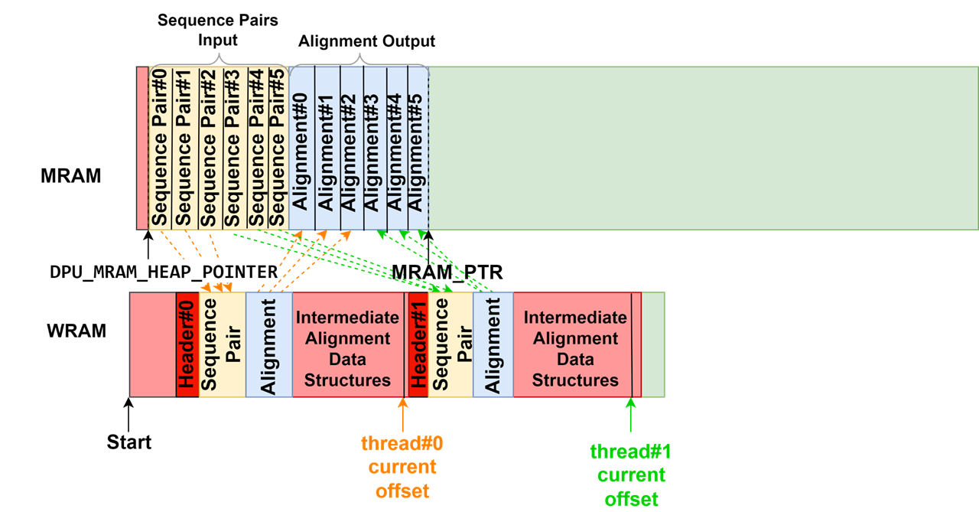
Data Management (I)
Using WRAM only for intermediate data structures
The scratchpad (WRAM) is fast but has limited capacity.
As a result, larger sequences need larger intermediate data structures, which may limit the number of concurrent PIM threads

Slide 179
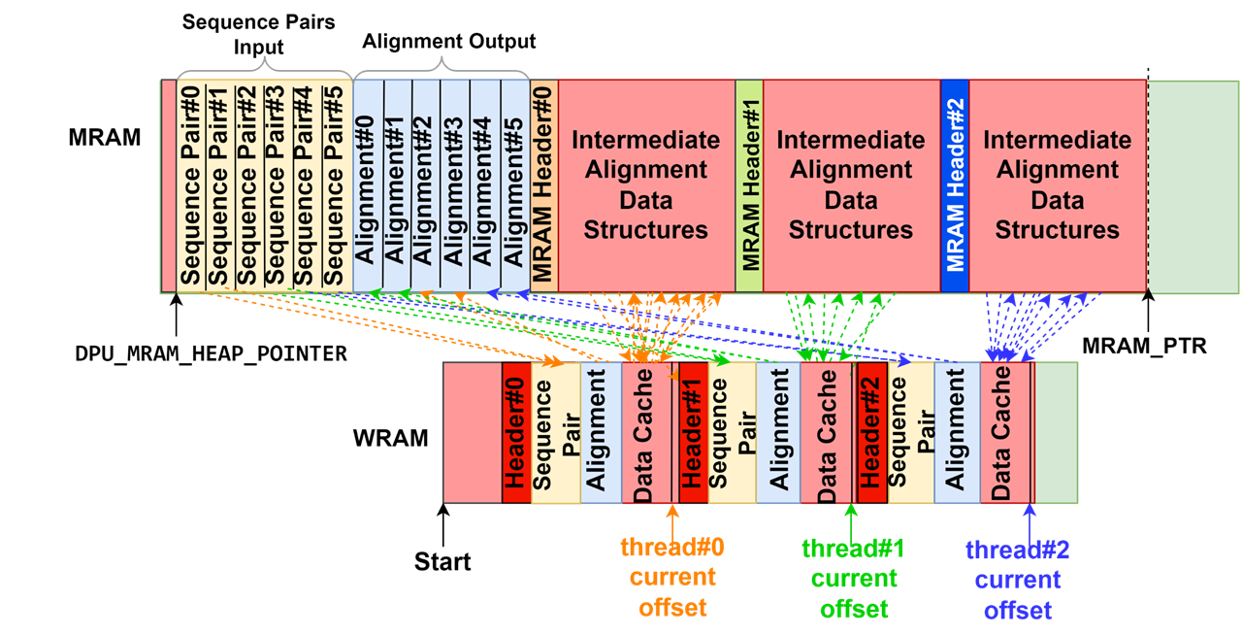
Data Management (II)
Using WRAM+MRAM for intermediate data structures
Data cache in the scratchpad (WRAM) is loaded on demand.
On average, longer access latency than WRAM only, but it is possible to run more concurrent PIM threads

Slide 180
Data Management (III)
WFA and WFA-adaptive use intermediate data structures of varying size
  Wavefront components
Thus, they require dynamic memory allocation
UPMEM SDK provides an incremental dynamic memory allocator
  However, this memory allocator is shared by all PIM threads, which requires synchronization
We design a custom per-thread memory allocator for low-overhead dynamic memory allocation

Slide 181
Outline
Background & Motivation:
Sequence Alignment on CPU
Processing-in-memory to Alleviate the Data Movement Bottleneck
Alignment-in-memory: A Framework for Sequence Alignment on PIM Systems
Evaluation

Slide 182
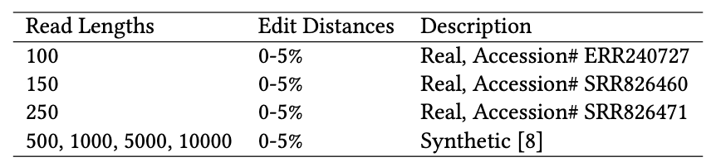
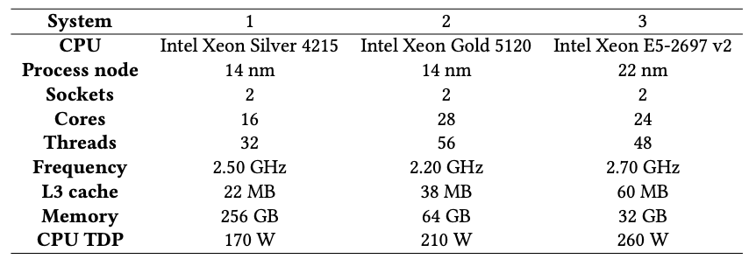
Evaluation Methodology
Real and synthetic datasets
Evaluated systems
  UPMEM PIM system with 2,560 PIM cores @ 425 MHz and 160 GB of DRAM
  Three CPU systems
*
*
*
^
*https://www.ebi.ac.uk/ena/browser/view
^https://github.com/smarco/WFA2-lib

Slide 183
Evaluation: PIM vs. CPU (I)
Evaluation on three CPU systems
The CPU system with the largest L3 cache is the best performing one, which aligns with the memory boundedness of sequence alignment

Slide 184
Evaluation: PIM vs. CPU (II)
PIM execution time including CPU-PIM/PIM-CPU transfers
PIM outperforms CPU systems in a majority of experiments
(up to 4.06× for SWG, up to 1.83× for WFA, up to 2.56× for WFA-adaptive)

Slide 185
Evaluation: PIM vs. CPU (III)
PIM execution time excluding CPU-PIM/PIM-CPU transfers
PIM speedups over CPU increase significantly when data transfer times are not included (up to 25.93× for WFA, up to 28.14× for WFA-adaptive)

Slide 186
Evaluation: PIM vs. CPU (III)
PIM execution time excluding CPU-PIM/PIM-CPU transfers
The overhead of CPU-PIM/PIM-CPU transfers could be avoided/hidden in future PIM systems that:
Use PIM DIMMs as main memory, or
Overlap data transfers and computation
PIM speedups over CPU increase significantly when data transfer times are not included (up to 25.93× for WFA, up to 28.14× for WFA-adaptive)

Slide 187
Evaluation: PIM vs. CPU (IV)
Algorithms with regular access patterns
PIM does not outperform CPU for algorithms with regular access patterns at small read lengths

Slide 188
WFA-Adaptive with Large Sequences
WFA and WFA-adaptive have linear space complexity
  Unlikely to exceed MRAM capacity
Large read lengths: 5,000 and 10,000 base pairs
PIM continues to outperform the CPU systems for large read lengths
Scalability is currently limited by WRAM capacity

Slide 189
WFA-Adaptive with Large Sequences
WFA and WFA-adaptive have linear space complexity
  Unlikely to exceed MRAM capacity
Large read lengths: 5,000 and 10,000 base pairs
Possible software solutions for (even) larger sequences:
Reduce WRAM footprint by streaming partial wavefront components from MRAM, or
Multiple PIM threads per alignment
Future UPMEM PIM cores may have larger WRAM capacity
PIM continues to outperform the CPU systems for large read lengths
Scalability is currently limited by WRAM capacity

Slide 190
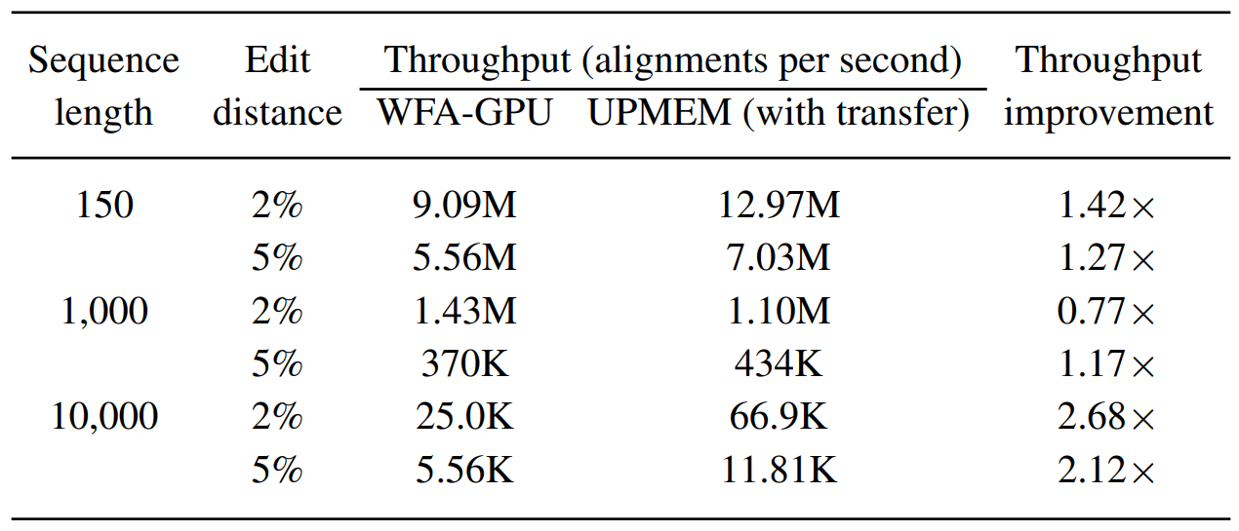
Evaluation: PIM vs. GPU
WFA on PIM vs. WFA on GPU
PIM outperforms GPU in a majority of experiments
Aguado-Puig et al. "WFA-GPU: Gap-affine pairwise alignment using GPUs." bioRxiv (2022)

Slide 191
Intermediate Data Structures
WRAM only vs. WRAM+MRAM for intermediate data structures
For large data structures (NW, SWG), WRAM only does not scale
For algorithms that use small data structures (GenASM), WRAM only is better
For algorithms that use medium-sized data structures (WFA, WFA-adaptive), WRAM only is better for short reads while WRAM+MRAM is better for long reads

Slide 192
Sequence Alignment on Processing-in-Memory
Published in Bioinformatics (2023)
https://arxiv.org/pdf/2204.02085.pdf
https://arxiv.org/pdf/2208.01243.pdf
Source code: https://github.com/safaad/aim

Slide 193
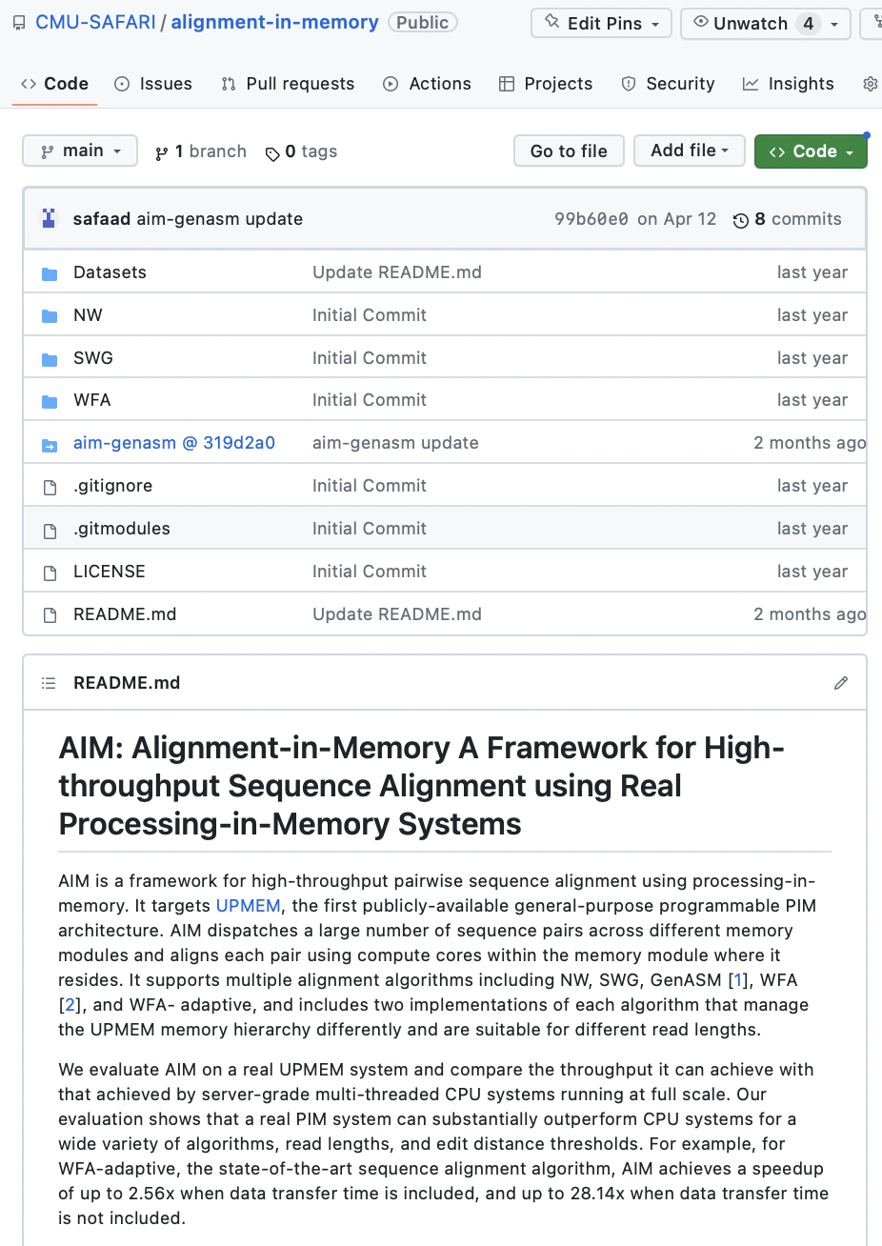
Source Code
https://github.com/CMU-SAFARI/alignment-in-memory
https://github.com/safaad/aim

Slide 194
Executive Summary
Genome sequence alignment is typically memory-bound on conventional processor-centric systems (CPU, GPU)
Processing-in-memory (PIM) has the potential to overcome this data movement bottleneck by placing compute capabilities near/inside memory arrays
We present Alignment-in-Memory (AiM), a PIM framework for genome sequence alignment on general-purpose PIM systems
  AiM supports multiple alignment algorithms: NW, SWG, GenASM, WFA
  Implemented for the UPMEM PIM architecture
Our evaluation shows that sequence alignment on PIM can be significantly faster than on CPUs and GPUs

Slide 195
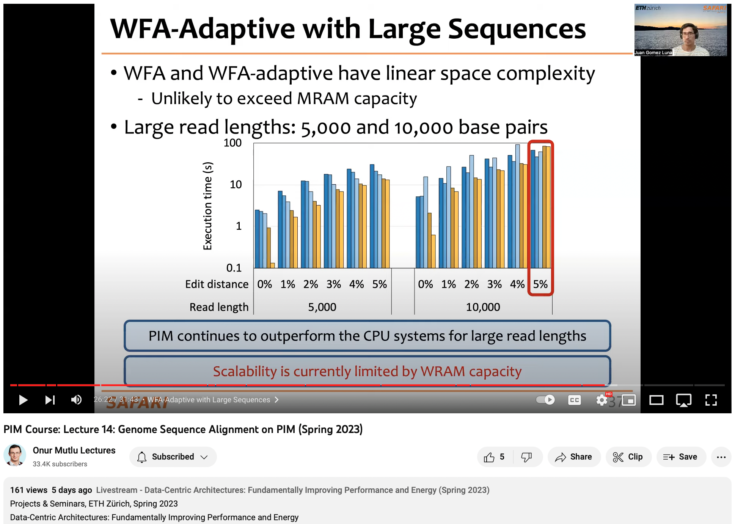
Lecture on Alignment-in-Memory
https://youtu.be/d_yGZVEFom8

Slide 196
High Throughput
Sequence Alignment
Using Real Processing-in-Memory Systems
Safaa Diab, Amir Nassereldine, Mohammed Alser,
Juan Gómez Luna, Onur Mutlu, Izzat El Hajj
https://arxiv.org/pdf/2208.01243.pdf
https://github.com/CMU-SAFARI/alignment-in-memory
juang@ethz.ch
Thursday, June 8, 2023

Slide 197
Transcendental Functions

Slide 198
TransPimLib:
Efficient Transcendental Functions for Processing-in-Memory Systems
Maurus Item, Juan Gómez Luna, Yuxin Guo,
Geraldo F. Oliveira, Mohammad Sadrosadati, Onur Mutlu
https://arxiv.org/pdf/2304.01951.pdf
https://github.com/CMU-SAFARI/transpimlib
juang@ethz.ch
Thursday, June 1, 2023

Slide 199
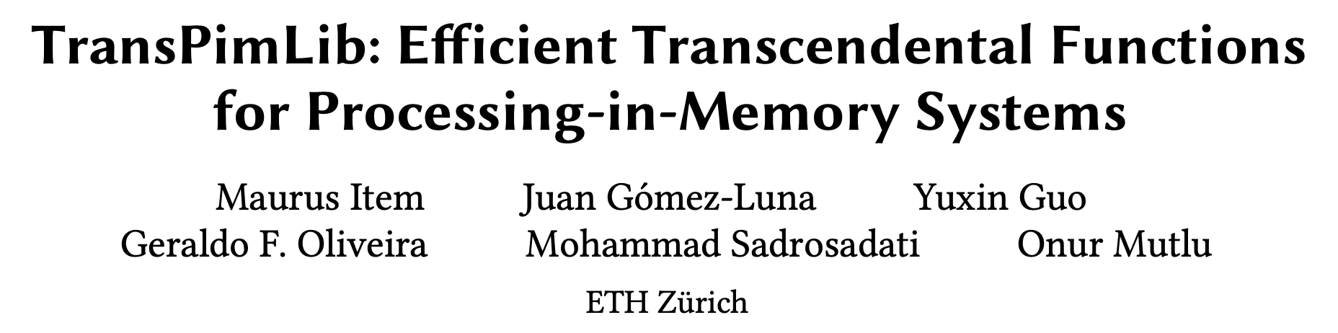
ISPASS 2023 Version
Presented at ISPASS 2023
https://people.inf.ethz.ch/omutlu/pub/TransPIMLib_ispass23.pdf
Source code: https://github.com/CMU-SAFARI/transpimlib
https://youtu.be/lqqf4eaaEE4

Slide 200
Executive Summary
Processing-in-Memory (PIM) promises to alleviate the data movement bottleneck
However, current real-world PIM systems have very constrained hardware, which results in limited instruction sets
  Difficulty/impossibility of computing complex operations, such as transcendental functions (e.g., trigonometric, exp, log) and other hard-to-calculate functions (e.g., square root)
  These functions are important for modern workloads, e.g., activation functions in machine learning applications
TransPimLib is the first library for transcendental and other hard-to-calculate functions on general-purpose PIM systems
  CORDIC-based and LUT-based methods for trigonometric functions, hyperbolic functions, exponentiation, logarithm, square root, etc.
  Source code: https://github.com/CMU-SAFARI/transpimlib
We implement TransPimLib for the UPMEM PIM architecture and evaluate its methods in terms of performance, accuracy, memory requirements, and setup time
  Three real workloads (Blackscholes, Sigmoid, Softmax)
Notes:
Transcendental functions are functions that do not satisfy a polynomial equation.

Slide 201
Outline
Processing-in-memory
and transcendental functions
TransPimLib:
A library for transcendental
and other hard-to-calculate functions
Evaluation

Slide 202
Processing-in-Memory (PIM)
PIM is a computing paradigm that advocates for memory-centric computing systems, where processing elements are placed near or inside the memory arrays
Real-world PIM architectures are becoming a reality
  UPMEM PIM, Samsung HBM-PIM, Samsung AxDIMM, SK Hynix AiM, Alibaba HB-PNM
These PIM systems have some common characteristics:
  There is a host processor (CPU or GPU) with access to (1) standard main memory, and (2) PIM-enabled memory
  PIM-enabled memory contains multiple PIM processing elements (PEs) with high bandwidth and low latency memory access
  PIM PEs run only at a few hundred MHz and have a small number of registers and small (or no) cache/scratchpad
  PIM PEs may need to communicate via the host processor

Slide 203
A State-of-the-Art PIM System
In our work, we use the UPMEM PIM architecture
  General-purpose processing cores called DRAM Processing Units (DPUs)
    Up to 24 PIM threads, called tasklets
    32-bit integer arithmetic, but multiplication/division are emulated*, as well as floating-point operations
  64-MB DRAM bank (MRAM), 64-KB scratchpad (WRAM)
* 8-bit integer multiplication is natively supported

Slide 204
How to Calculate Transcendental Functions in a PIM System?
Three possible alternatives

Slide 205
How to Calculate Transcendental Functions in a PIM System?
Three possible alternatives
TransPimLib
An open-source library with CORDIC- and LUT-based methods for trigonometric functions, hyperbolic functions, exponentiation, logarithm…
https://github.com/CMU-SAFARI/transpimlib

Slide 206
Outline
Processing-in-memory
and transcendental functions
TransPimLib:
A library for transcendental
and other hard-to-calculate functions
Evaluation

Slide 207
TransPimLib: Implementation
Various methods to calculate transcendental functions:
  Taylor approximation, minimax polynomials, CORDIC, LUTs
CORDIC is an iterative method that uses bit-shifts, additions, and table lookups
  In rotation mode, CORDIC computes the function value for an input θ by rotating a vector [1, 0] iteratively
  The rotation is done by multiplying the vector and a matrix
  The matrix represents the rotation angle, which decreases in each iteration
Fuzzy Lookup Tables (LUTs) return an (approximate) output f(x) for each input x
  A function a(x) returns an address to access the LUT
  The table returns LUT(a(x)) ≃ f(x)
  To generate the LUT, we need a helper function a⁻¹(), such that x = a(a⁻¹(x))
  LUTs’ accuracy improves with interpolation:
  f(x) ≃ LUT(a(x)) + LUT(a(x)+1) - LUT(a(x))·Δ
Notes:
We avoid methods that require multiplication, which is costly in the target architecture.
Interpolation: Δ represents where the input resides between two lookup table entries.

Slide 208
TransPimLib: CORDIC-based Methods
TransPimLib contains CORDIC implementations of trigonometric (sin, cos, tan) and hyperbolic (sinh, cosh, tanh) functions, exponentiation, logarithm, and square root
Example: Sine function

Slide 209
TransPimLib: LUT-based Methods
Multiplication-based LUT (M-LUT)
  Regular spacing between table entries
  a(x) = round((x - p) · k), where k represents the LUT density
LDEXP-based LUT (L-LUT)
  Multiplication is cheaper if we multiply by 2^{n}
  ldexp(arg, exp) to perform arg · 2^{exp}
  a(x) = round((x - p) · 2^{n})
    k is a power-of-two, which results in less precision but avoids multiplication
Direct Float Conversion-based LUT (D-LUT)
  a(x) uses the last n bits of the exponent and p bits of the mantissa
  Piece-wise linear density: 2^{n} steps of 2^{p} addresses
Map interval [0, 5] to a 12-entry LUT
Notes:
p defines what input value x corresponds to address 0 of the LUT.

Slide 210
TransPimLib: Combined Methods
Direct Float Conversion + LDEXP-based LUT (DL-LUT)
  Uses an L-LUT between 0 and the smallest exponent and a D-LUT for larger inputs
M-LUT
L-LUT
D-LUT
CORDIC+L-LUT (CORDIC+LUT)
  Replaces the first few iterations of CORDIC with a LUT
  Flexible tradeoff between computing cost, table size, and precision

Slide 211
TransPimLib: Supported Functions
 | Supported Functions
Implementation Method | sin | cos | tan | sinh | cosh | tanh | exp | log | sqrt | GELU
CORDIC | ✔️ | ✔️ | ✔️ | ✔️ | ✔️ | ✔️ | ✔️ | ✔️ | ✔️
M-LUT | ✔️ | ✔️ | ✔️ |  |  |  | ✔️ | ✔️ | ✔️
M-LUT+Interp. | ✔️ | ✔️ | ✔️ |  |  |  | ✔️ | ✔️ | ✔️
L-LUT | ✔️ | ✔️ | ✔️ |  |  |  | ✔️ | ✔️ | ✔️
L-LUT+Interp. | ✔️ | ✔️ | ✔️ |  |  |  | ✔️ | ✔️ | ✔️
D-LUT+Interp. | ✔️ |  |  |  |  | ✔️ |  |  |  | ✔️
DL-LUT+Interp. | ✔️ |  |  |  |  | ✔️ |  |  |  | ✔️
CORDIC+LUT | ✔️ | ✔️ | ✔️ | ✔️ | ✔️ | ✔️ | ✔️
Based on our preliminary analysis, we provide the most suitable methods for each of the supported functions (other than sine).

Slide 212
Outline
Processing-in-memory
and transcendental functions
TransPimLib:
A library for transcendental
and other hard-to-calculate functions
Evaluation

Slide 213
Evaluation Methodology
Evaluated systems
  UPMEM PIM system with 2,545 PIM cores @ 350 MHz and 159 GB of DRAM
  2-socket Intel Xeon CPU (32 cores)
Microbenchmarks
  Performance evaluation
    We measure execution cycles
  Accuracy evaluation
    Root-mean-square absolute error (RMSE) with respect to the CPU with the standard math library
  Setup time
    Generation on the host CPU and transfers to the PIM side
  Memory consumption
    All tables and variables allocated in the DRAM bank of a PIM core
  We use sine, as a representative function
Real-world Benchmarks
  Blackscholes: exp, log, sqrt, cumulative normal distribution (CNDF)
  Sigmoid
  Softmax

Slide 214
Microbenchmark Results: Performance (I)
We measure the execution cycles for an accuracy range between 10⁻⁴ and 10⁻⁹
LUT-based versions place the LUT in either the PIM core’s DRAM bank (MRAM) or the scratchpad (WRAM)
Performance of LUT-based methods is independent of the accuracy
Execution cycles depend on the number of multiplications:
Interp. M-LUT: 2 FP multiplications
Non-interp. M-LUT and inter. L-LUT: 1 FP multiplication
Non-interp. L-LUT: No FP multiplication
Fixed-point version of the L-LUT
Interp. Fix. L-LUT doubles the performance of inter. L-LUT due to faster fixed-point multiplication

Slide 215
Microbenchmark Results: Performance (II)
We measure the execution cycles for an accuracy range between 10⁻⁴ and 10⁻⁹
CORDIC-based methods take more execution cycles to provide higher accuracy
CORDIC accuracy increases with each iteration of the CORDIC algorithm
CORDIC+LUT runs faster than CORDIC, as it replaces the initial iterations with an
L-LUT query
At some point (~10⁻⁹), further increasing the LUT size or CORDIC iterations does not improve accuracy
Little benefit from placing LUTs in the scratchpad (WRAM) instead of the DRAM bank (MRAM)
Notes:
We also measure the maximum absolute error to be around 1e-7. Intuitively, this is due to the precision of floating-point values being limited.

Slide 216
Microbenchmark Results: Performance (III)
We measure the execution cycles for an accuracy range between 10⁻⁴ and 10⁻⁹
CORDIC-based methods take more execution cycles to provide higher accuracy
Key Takeaway 1
Interpolated L-LUT methods (lookup table with LDEXP operation)
offer the best tradeoff in terms of performance and accuracy
CORDIC accuracy increases with each iteration of the CORDIC algorithm
CORDIC+LUT runs faster than CORDIC, as it replaces the initial iterations with an
L-LUT query
At some point (~10⁻⁹), further increasing the LUT size or CORDIC iterations does not improve accuracy
Little benefit from placing LUTs in the scratchpad (WRAM) instead of the DRAM bank (MRAM)

Slide 217
Microbenchmark Results: Setup Time (I)
The setup time can also impact the decision of what method to use
For LUT-based methods, setup times increase with LUT size
CORDIC methods have flat setup times
CORDIC methods can provide higher overall performance
(i.e., setup time + PIM kernel time) than LUT-based methods
when the total number of transcendental functions in a workload is low.
For example, we estimate ~40 sine operations (see paper)

Slide 218
Microbenchmark Results: Setup Time (II)
The setup time can also impact the decision of what method to use
Key Takeaway 2
CORDIC-based methods are preferable when a PIM kernel needs to execute just a few transcendental functions due to their low setup time in the host CPU
For LUT-based methods, setup times increase with LUT size
CORDIC methods have flat setup times
CORDIC methods can provide higher overall performance
(i.e., setup time + PIM kernel time) than LUT-based methods
when the total number of transcendental functions in a workload is low.
For example, we estimate ~40 sine operations (see paper)

Slide 219
Microbenchmark Results: Memory (I)
We also obtain the memory consumption (in bytes) in the DRAM bank of a PIM core
Accuracy of non-interp. LUT methods is limited by the available memory
Memory consumption of CORDIC methods does not increase exponentially
Interpolation is an effective way of increasing accuracy without increasing LUT size
Notes:
CORDIC methods are recommended for applications where not much memory is available for the LUTs.

Slide 220
Microbenchmark Results: Memory (II)
We also obtain the memory consumption (in bytes) in the DRAM bank of a PIM core
Key Takeaway 3
Interpolated L-LUT methods offer a good tradeoff in terms of accuracy, execution cycles, and memory consumption.
However, CORDIC and CORDIC+LUT methods are recommended for applications that require high accuracy, where the available memory is limited (e.g., needed for large datasets)
Accuracy of non-interp. LUT methods is limited by the available memory
Memory consumption of CORDIC methods does not increase exponentially
Interpolation is an effective way of increasing accuracy without increasing LUT size

Slide 221
Other Supported Functions (I)
The general trends for other functions supported by TransPimLib are similar to those of the sine function
Some major differences:
  Tangent calculation takes around 2-3 times more cycles than sine calculation, as it requires
    Calculation of sine and cosine
    A floating-point division
  Some supported functions require range reduction and/or range extension
The cost differs between functions, as it depends on specific mathematical identity needed for the conversion
But range reduction/extension is only necessary depending on the actual range of input values

Slide 222
Other Supported Functions (II)
Some major differences:
  Activation functions tanh and GELU do not require range reduction/extension and are approximately linear in most parts
Key Takeaway 4
D-LUT and DL-LUT methods are well-suited for activation functions, such as tanh and GELU, which (1) do not require range extension, and (2) are approximately linear in most parts.
D-LUT and DL-LUT are faster than
interpolated L-LUT, while providing similar accuracy

Slide 223
Real-world Benchmark Results (I)
1 & 32 CPU cores
PIM baseline: Polynomial
Blackscholes
For Blackscholes, TransPimLib is 5-12x faster than the PIM baseline
Fixed-point L-LUT is 92% faster than the 32-thread CPU baseline
Sigmoid
For Sigmoid and Softmax, TransPimLib outperforms the PIM baseline and shows that it can save data movement from executing activation functions in the host CPU
Softmax

Slide 224
Real-world Benchmark Results (II)
1 & 32 CPU cores
PIM baseline: Polynomial
Key Takeaway 5
TransPimLib can reduce data movement from PIM cores to the CPU (Fig. (b)) for applications running on the PIM cores.
As a result, the execution of transcendental functions in the PIM cores (Fig. (c)) could be 6−8× faster than the execution in the host CPU
Blackscholes
For Blackscholes, TransPimLib is 5-12x faster than the PIM baseline
Fixed-point L-LUT is 92% faster than the 32-thread CPU baseline
Sigmoid
For Sigmoid and Softmax, TransPimLib outperforms the PIM baseline and shows that it can save data movement from executing activation functions in the host CPU
Softmax

Slide 225
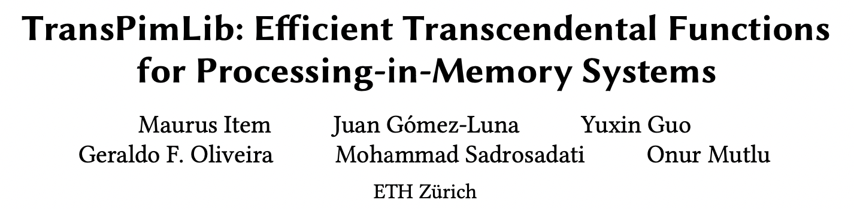
More in the Paper
Background on CORDIC and Fuzzy Lookup Tables
How to use TransPimLib (APIs)
Additional observations and takeaways
https://people.inf.ethz.ch/omutlu/pub/TransPIMLib_ispass23.pdf
https://arxiv.org/pdf/2304.01951.pdf

Slide 226
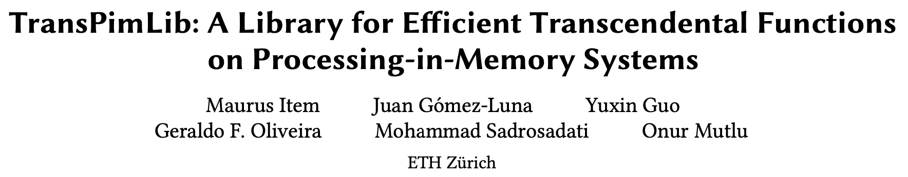
TransPimLib: arXiv Version
https://arxiv.org/pdf/2304.01951.pdf
Source code: https://github.com/CMU-SAFARI/transpimlib
https://youtu.be/lqqf4eaaEE4

Slide 227
ISPASS 2023 Version
Presented at ISPASS 2023
https://people.inf.ethz.ch/omutlu/pub/TransPIMLib_ispass23.pdf
Source code: https://github.com/CMU-SAFARI/transpimlib
https://youtu.be/lqqf4eaaEE4

Slide 228
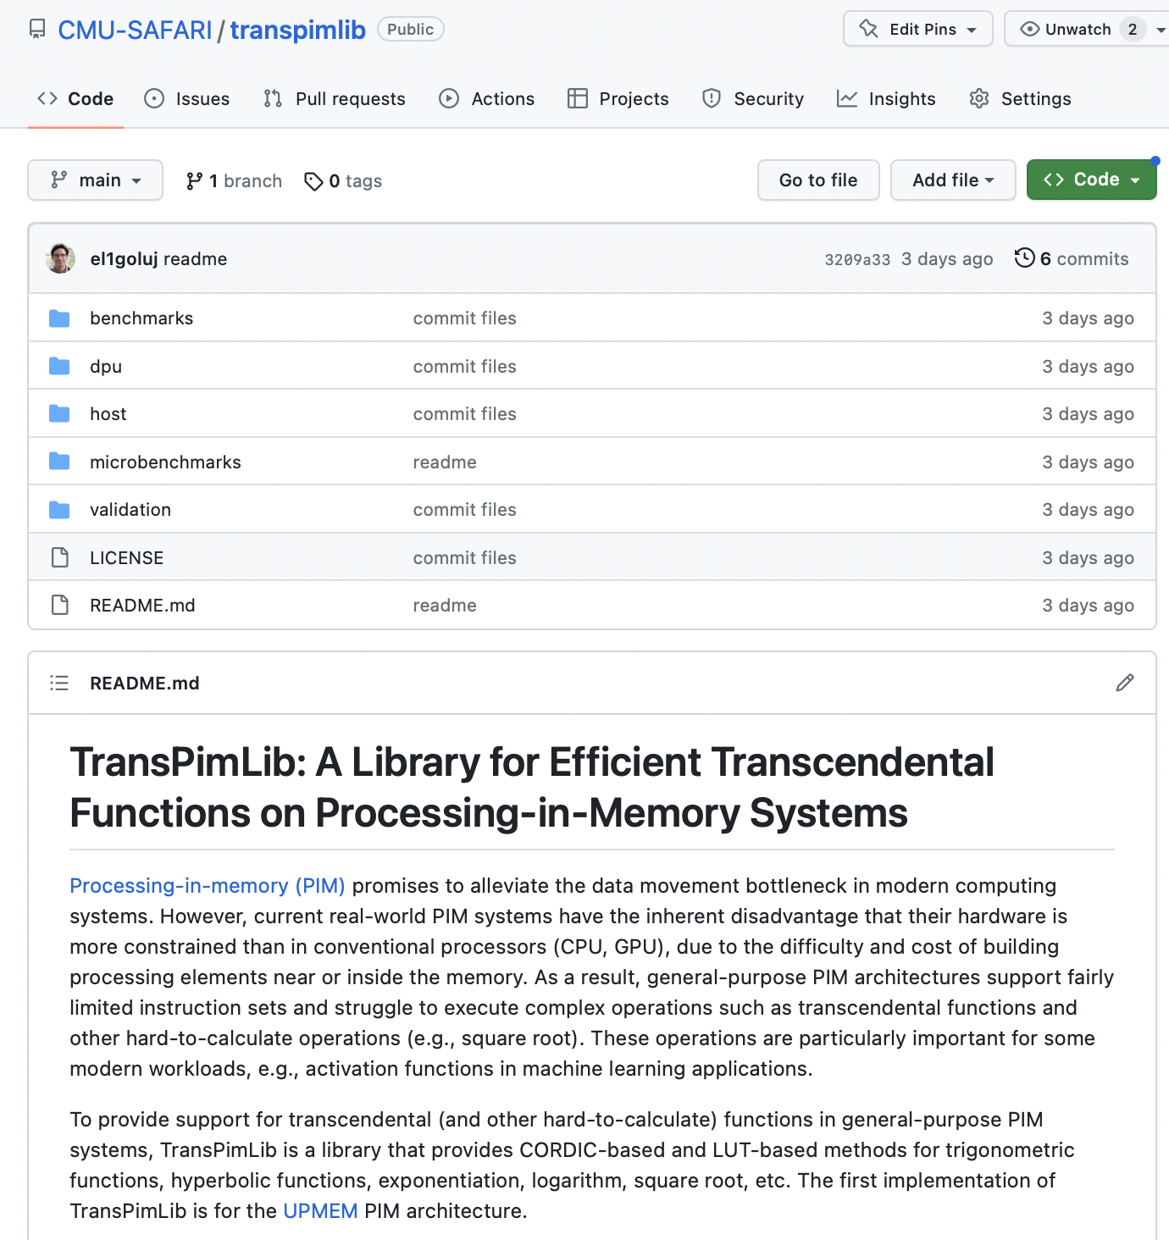
Source Code
https://github.com/CMU-SAFARI/transpimlib

Slide 229
Executive Summary
Processing-in-Memory (PIM) promises to alleviate the data movement bottleneck
However, current real-world PIM systems have very constrained hardware, which results in limited instruction sets
  Difficulty/impossibility of computing complex operations, such as transcendental functions (e.g., trigonometric, exp, log) and other hard-to-calculate functions (e.g., square root)
  These functions are important for modern workloads, e.g., activation functions in machine learning applications
TransPimLib is the first library for transcendental and other hard-to-calculate functions on general-purpose PIM systems
  CORDIC-based and LUT-based methods for trigonometric functions, hyperbolic functions, exponentiation, logarithm, square root, etc.
  Source code: https://github.com/CMU-SAFARI/transpimlib
We implement TransPimLib for the UPMEM PIM architecture and evaluate its methods in terms of performance, accuracy, memory requirements, and setup time
  Three real workloads (Blackscholes, Sigmoid, Softmax)
Notes:
Transcendental functions are functions that do not satisfy a polynomial equation.

Slide 230
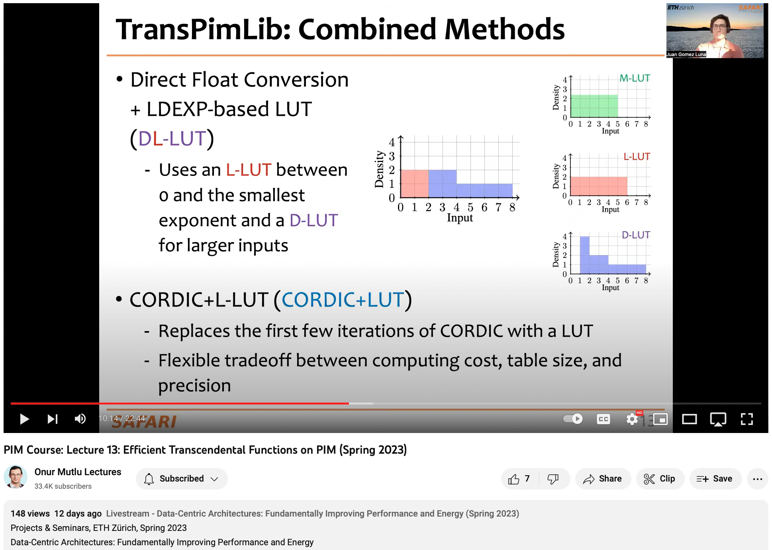
Lecture on TransPimLib
https://youtu.be/QSshvWOtJKQ

Slide 231
TransPimLib:
Efficient Transcendental Functions for Processing-in-Memory Systems
Maurus Item, Juan Gómez Luna, Yuxin Guo,
Geraldo F. Oliveira, Mohammad Sadrosadati, Onur Mutlu
https://arxiv.org/pdf/2304.01951.pdf
https://github.com/CMU-SAFARI/transpimlib
juang@ethz.ch
Thursday, June 1, 2023

Slide 232
Homomorphic Operations

Slide 233


Evaluating Homomorphic Operations on a Real-World
Processing-In-Memory System
Harshita Gupta* Mayank Kabra*
Juan Gómez-Luna Konstantinos Kanellopoulos
Onur Mutlu

Slide 234
Homomorphic Encryption
234

Slide 235




Homomorphic Encryption
Encrypts data
Data
User
Host System
Encrypted data
235

Slide 236




Homomorphic Encryption
Encrypts data
Data
Encrypted data
User
Host System
Encrypted data
Performs operations on the encrypted data without decrypting it
Central/Cloud Server
236

Slide 237


Homomorphic Encryption
Encrypts data
Data
Encrypted data
User
Host System
Encrypted data
Performs operations on the encrypted data without decrypting it.
Central/Cloud Server
Result
Encrypted result
Decrypts result
237

Slide 238
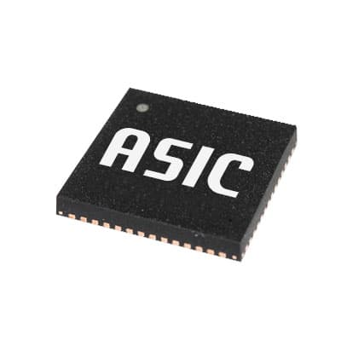
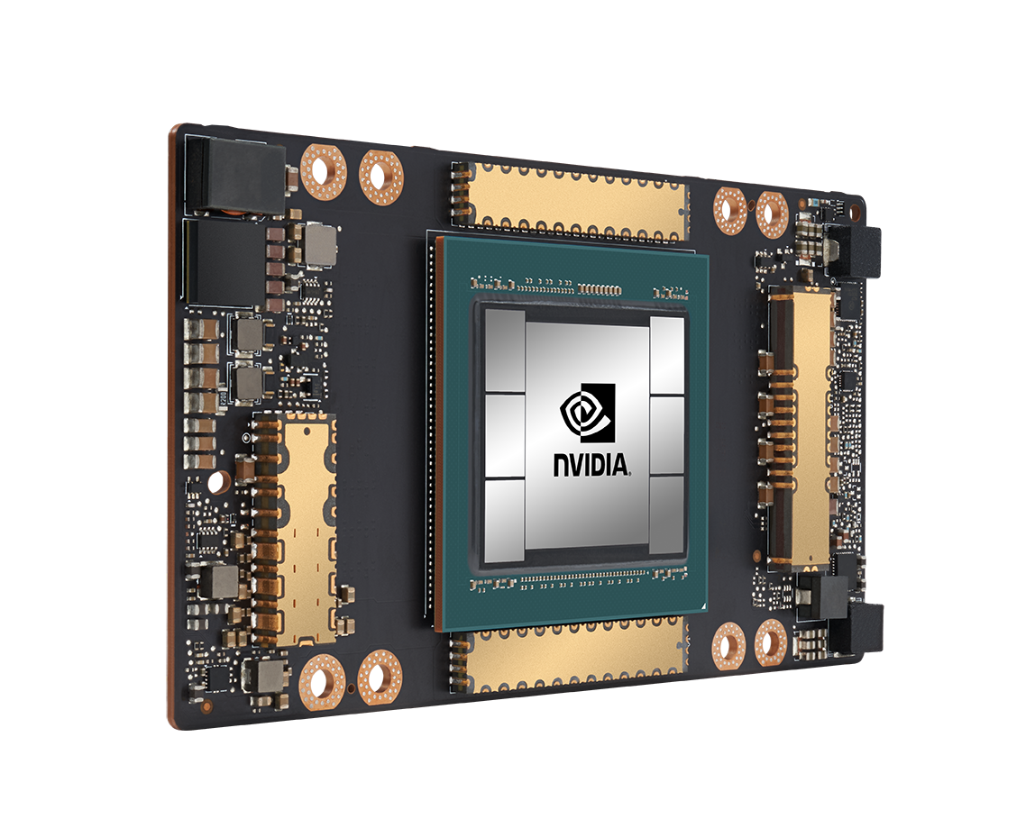
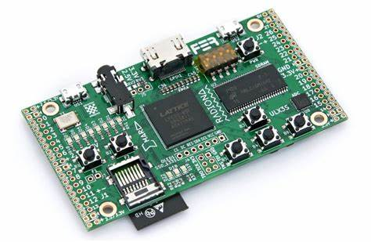
Motivation
Homomorphic operations suffer from
large memory capacity and data movement bottlenecks
Acceleration Techniques

Slide 239
Motivation
These approaches face challenges in resource limitations, data movement, and practical implementation
Acceleration Techniques

Slide 240
Our Goal
Evaluate the suitability of real-world general-purpose processing-in-memory (PIM) architectures to perform homomorphic operations.

Slide 241

Our Goal
Evaluate the suitability of real-world general-purpose processing-in-memory (PIM) architectures to perform homomorphic operations.
UPMEM: First Real World PIM Architecture

Slide 242
Evaluation Methodology​
1
Evaluation of homomorphic addition and multiplication on UPMEM PIM system
242

Slide 243
Evaluation Methodology​
1
Evaluation of homomorphic addition and multiplication on UPMEM PIM system
2
Evaluation with statistical workloads
(mean, variance, linear regression)

Slide 244
Evaluation Methodology​
1
Evaluation of homomorphic addition and multiplication on UPMEM PIM system
2
Evaluation with statistical workloads
(mean, variance, linear regression)
3
Comparison with custom CPU and GPU libraries
and an optimized CPU library (SEAL)

Slide 245
Evaluation: Homomorphic Addition

Slide 246
Evaluation: Homomorphic Addition
50 − 100× speedup provided by PIM over CPU
2 − 15× speedup over GPU

Slide 247
Evaluation: Homomorphic Multiplication

Slide 248
Evaluation: Homomorphic Multiplication
PIM lags 10 − 15× behind the GPU
due to the lack of native multiplication support

Slide 249
Evaluation: Linear Regression

Slide 250
Evaluation: Linear Regression
PIM is 6.4-7.5x faster than the custom CPU implementation
CPU-SEAL and GPU are faster than PIM

Slide 251
Key Takeaways
With native hardware support for 32-bit integer addition and
large number of PIM cores, the UPMEM PIM system outperforms
CPU and GPU for homomorphic addition.
1

Slide 252
Key Takeaways
With native hardware support for 32-bit integer addition and
large number of PIM cores, the UPMEM PIM system outperforms
CPU and GPU for homomorphic addition.
1
2
The lack of native support for 32-bit integer multiplication hampers the performance of PIM for homomorphic multiplication.

Slide 253
Key Takeaways
With native hardware support for 32-bit integer addition and
large number of PIM cores, the UPMEM PIM system outperforms
CPU and GPU for homomorphic addition.
1
2
The lack of native support for 32-bit integer multiplication hampers the performance of PIM for homomorphic multiplication.
3
The computational power of PIM scales with memory capacity via the addition of more memory banks and PIM cores.

Slide 254
Executive Summary
PROBLEM
Homomorphic encryption (HE) enables computation on encrypted data, however it suffers from memory usage and data movement bottlenecks.

Slide 255
Executive Summary
PROBLEM
Homomorphic encryption (HE) enables computation on encrypted data, however it suffers from memory usage and data movement bottlenecks.
GOAL
Our goal is to extensively evaluate homomorphic operations on real-world general-purpose processing-in-memory architectures.

Slide 256
Executive Summary
PROBLEM
Homomorphic encryption (HE) enables computation on encrypted data, however it suffers from memory usage and data movement bottlenecks.
GOAL
Our goal is to extensively evaluate homomorphic operations on real-world general-purpose processing-in-memory architectures.
CONTRIBUTIONS
Novel Implementation: First to implement homomorphic addition and multiplication on a real PIM system.
Performance Evaluation: Evaluated the performance of PIM across different HE security levels with real-world workloads: (i) mean, (ii) variance, (iii) linear regression.
Key Insights: Revealed PIM system capabilities and trade-offs for cryptography.

Slide 257
Executive Summary
PROBLEM
Homomorphic encryption (HE) enables computation on encrypted data, however it suffers from memory usage and data movement bottlenecks.
GOAL
Our goal is to extensively evaluate homomorphic operations on real-world general-purpose processing-in-memory architectures.
CONTRIBUTIONS
Novel Implementation: First to implement homomorphic addition and multiplication on a real PIM system.
Performance Evaluation: Evaluated the performance of PIM across different HE security levels with real-world workloads: (i) mean, (ii) variance, (iii) linear regression.
Key Insights: Revealed PIM system capabilities and trade-offs for cryptography.
EVALUATIONS
PIM is 50-100× faster than CPU and 2-15× faster than GPU in vector addition.
PIM outperforms CPU by 40-50× in vector multiplication but lags 10-15× behind GPU.
For statistical operations, PIM achieves 30× to 300× improvement over CPU and 10× to 30× over GPU.

Slide 258
Evaluating Homomorphic Operations on a Real-World
Processing-In-Memory System
Harshita Gupta* Mayank Kabra*
Juan Gómez-Luna Konstantinos Kanellopoulos
Onur Mutlu

Slide 259
MICRO 2023 Tutorial
Real-world Processing-in-Memory Systems for Modern Workloads
Accelerating Modern Workloads
on a General-purpose PIM System
Dr. Juan Gómez Luna
Professor Onur Mutlu
Sunday, October 29, 2023

