Slide 1




PiDRAM
An FPGA-based Framework for End-to-end Evaluation of Processing-in-DRAM Techniques
Ataberk Olgun
Juan Gomez Luna
Konstantinos Kanellopoulos
Behzad Salami
Hasan Hassan
Oğuz Ergin
Onur Mutlu
Notes:
Hi, I am Ataberk and I will present PiDRAM: An FPGA-based Framework for End-to-end Evaluation of Processing-in-DRAM Techniques. This work was done in a collaboration of SAFARI and Kasirga Research groups in ETH Zurich and TOBB University of Economics and technology.

Slide 2
Executive Summary
Motivation: Commodity DRAM based PiM techniques improve the performance
and energy efficiency of computing systems at no additional DRAM hardware cost
Problem: Challenges of integrating these PiM techniques into real systems are not solved
General-purpose computing systems, special-purpose testing platforms, and
system simulators cannot be used to efficiently study system integration challenges
Goal: Design and implement a flexible framework that can be used to:
solve system integration challenges
analyze trade-offs of end-to-end implementations
of commodity DRAM-based-PiM techniques
Key idea: PiDRAM, an FPGA-based framework that enables:
system integration studies
end-to-end evaluations of PIM techniques using real unmodified DRAM chips
Evaluation: End-to-end integration of two PiM techniques on PiDRAM’s FPGA prototype
Case Study #1 – RowClone: In-DRAM bulk data copy operations
119x speedup for copy operations compared to CPU-copy with system support
198 lines of Verilog and 565 lines of C++ code over PiDRAM’s flexible codebase
Case Study #2 – D-RaNGe: DRAM-based random number generation technique
8.30 Mb/s true random number generator (TRNG) throughput, 220 ns TRNG latency
190 lines of Verilog and 78 lines of C++ code over PiDRAM’s flexible codebase
PiDRAM: https://github.com/CMU-SAFARI/PiDRAM
Notes:
I will start with an executive summary
[CLICK] Commodity DRAM-based PIM techniques improve the performance and energy efficiency of computing systems without incurring any DRAM hardware cost
[CLICK] However, challenges of integrating these techniques into real systems are not yet solved.
[CLICK] Moreover, these challenges cannot be efficiently studied using existing computing systems, special-purpose DRAM testing platforms or system simulators
[CLICK] Our goal is to design and implement a flexible framework that can be used to [CLICK] solve the important system integration challenges and [CLICK] analyze the trade-offs of end-to-end implementations of commodity DRAM based PiM techniques
[CLICK] Our key idea is to develop PiDRAM, an FPGA-based framework that enables such studies using real unmodified DRAM chips
[CLICK] Using our framework, we conduct two case studies on two recent commodity DRAM based PiM techniques on a real FPGA prototype of a full system
[CLICK] In our first case study about in-DRAM bulk data copy operations, we show that in-DRAM data copy operations provide 119 times speedup over CPU-copy operations including system support. To conduct this case study over PiDRAM’s extensible code base, we add only 198 lines of Verilog and only 565 lines of C++ code.
[CLICK] In our second case study about an in-DRAM true random number generation technique, we show that an end-to-end implementation of a DRAM-based true random number generator can provide high throughput true random numbers at low latency. Implementing the true random number generator takes us only 190 additional lines of Verilog and 78 additional lines of C++ code over PiDRAM’s code base.

Slide 3
Outline
Background
  Commodity DRAM Based PiM Techniques
PiDRAM
  Overview
  Hardware & Software Components
  FPGA Prototype
Case Studies
  Case Study #1 – RowClone
  Case Study #2 – D-RaNGe
Conclusion
Notes:
Here is the outline of my talk. I will start by quickly introducing commodity DRAM based PuM techniques

Slide 4
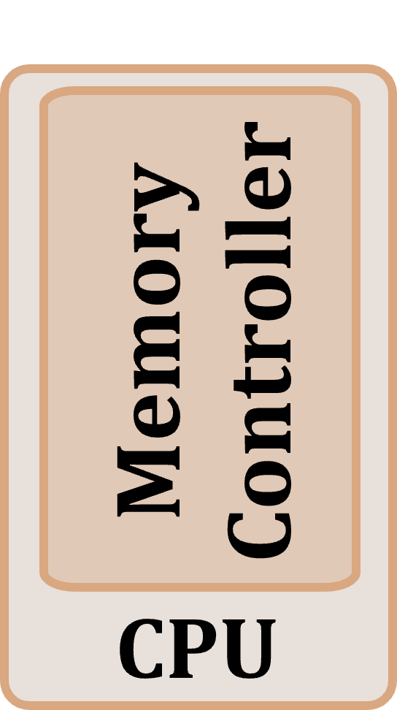
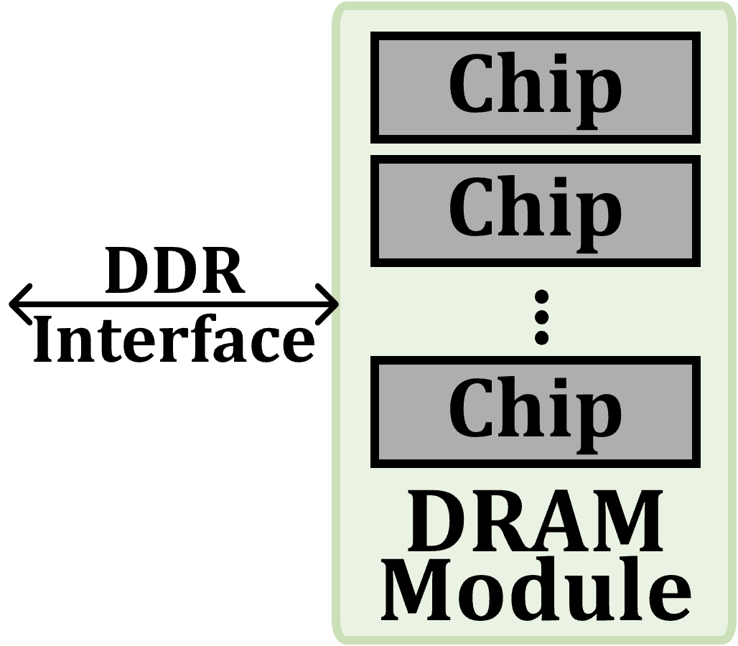
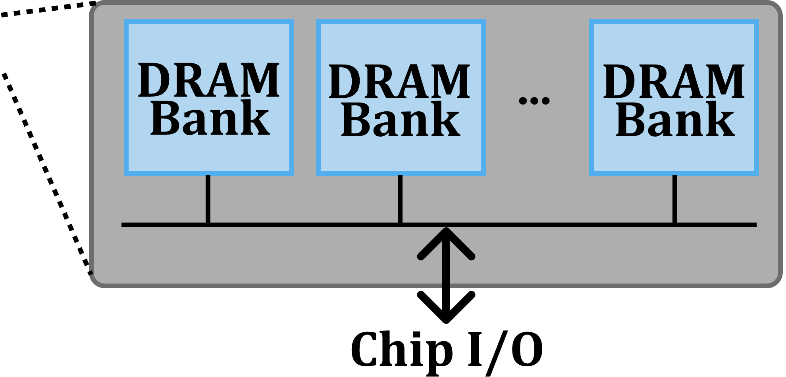
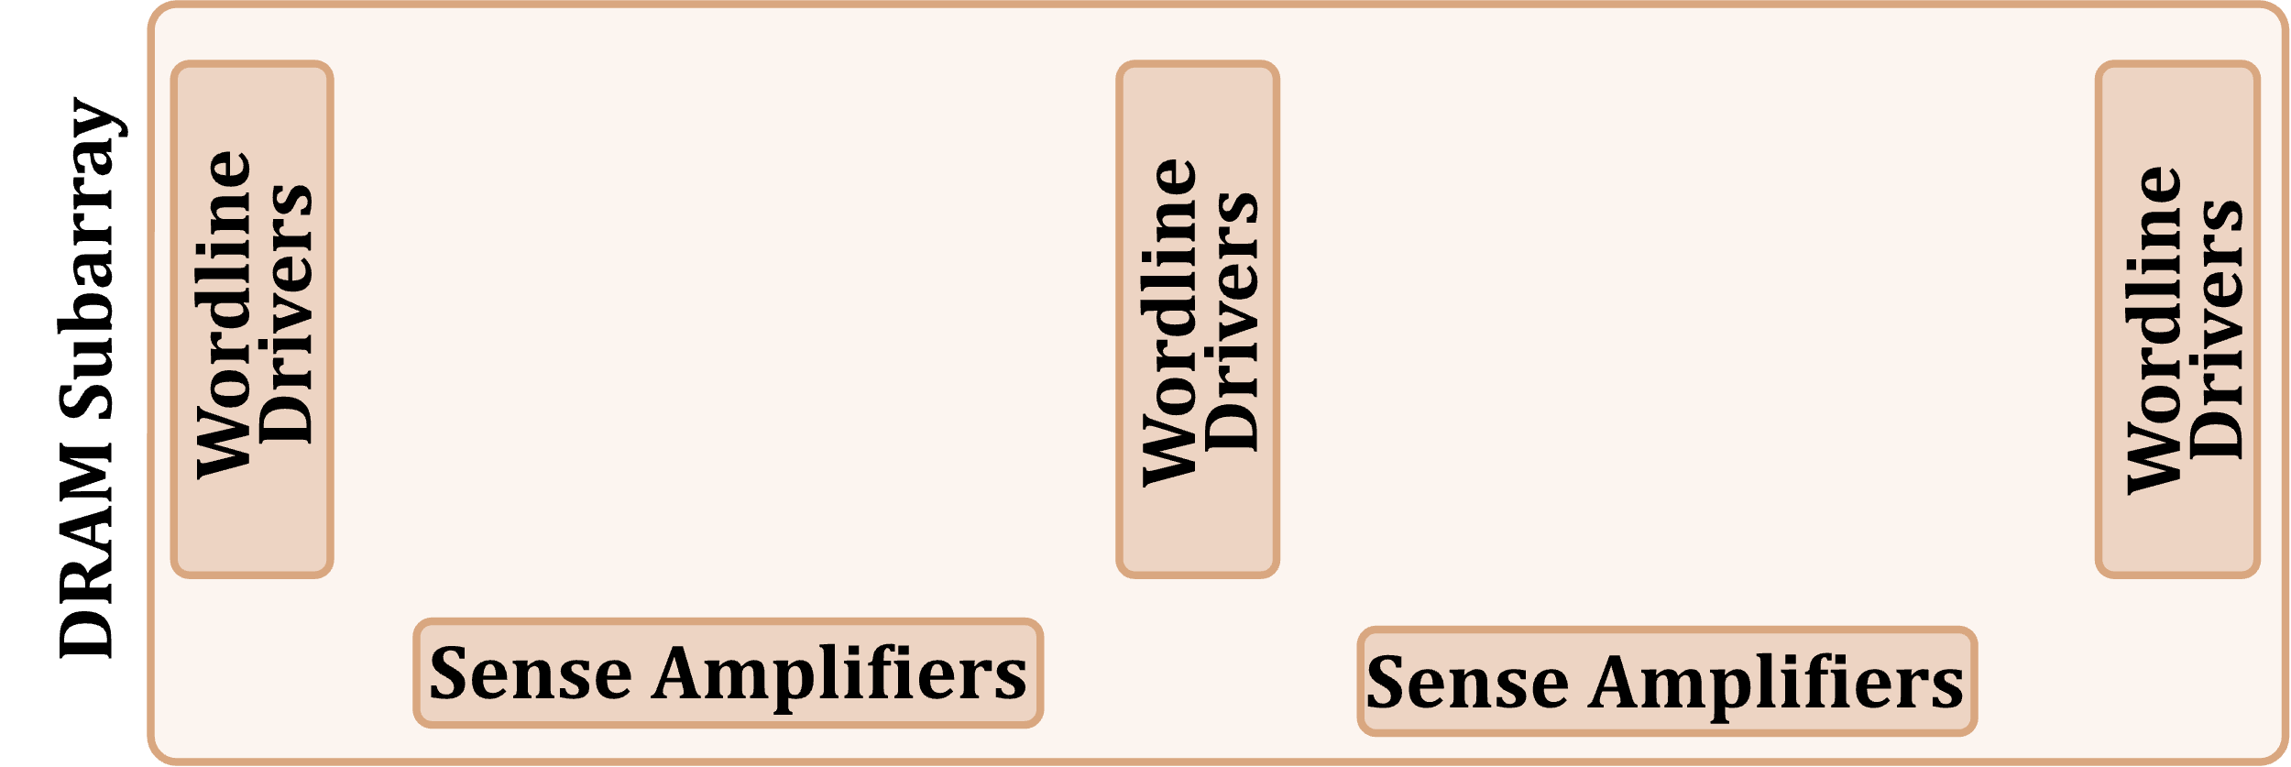
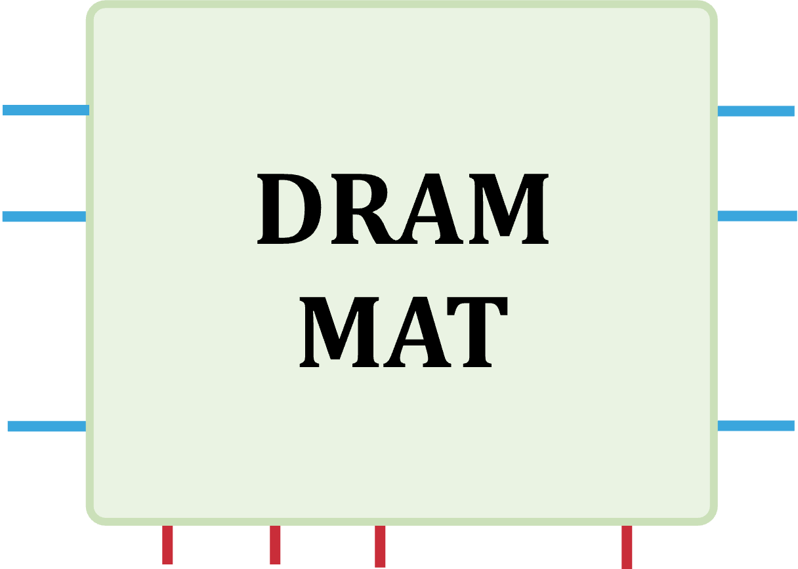
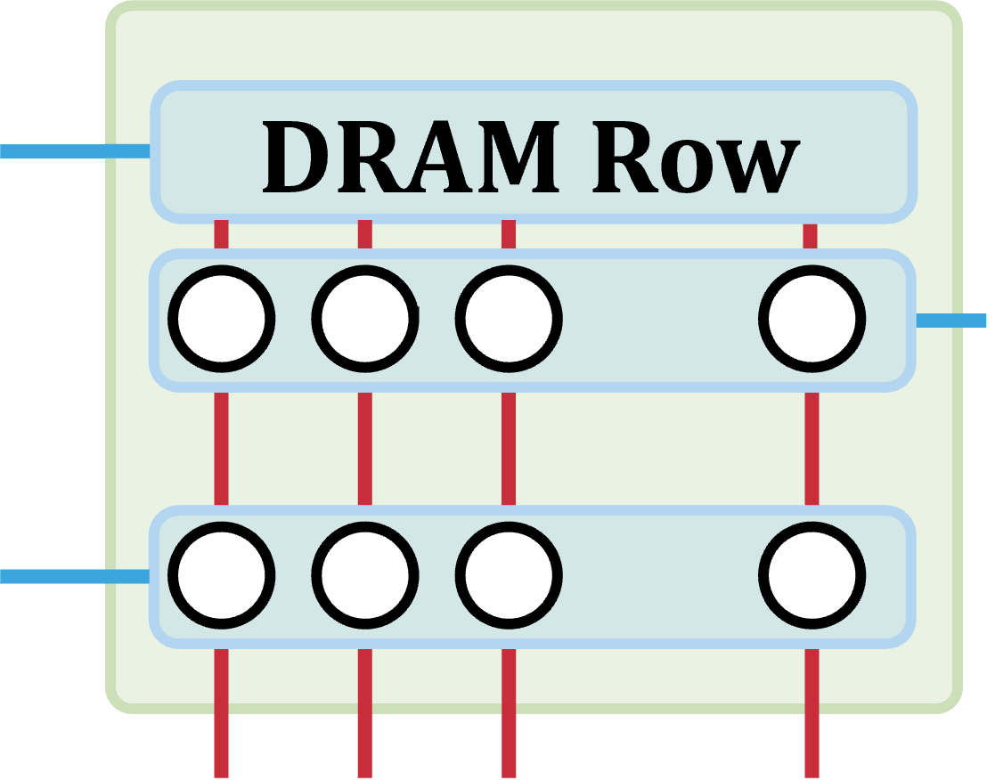
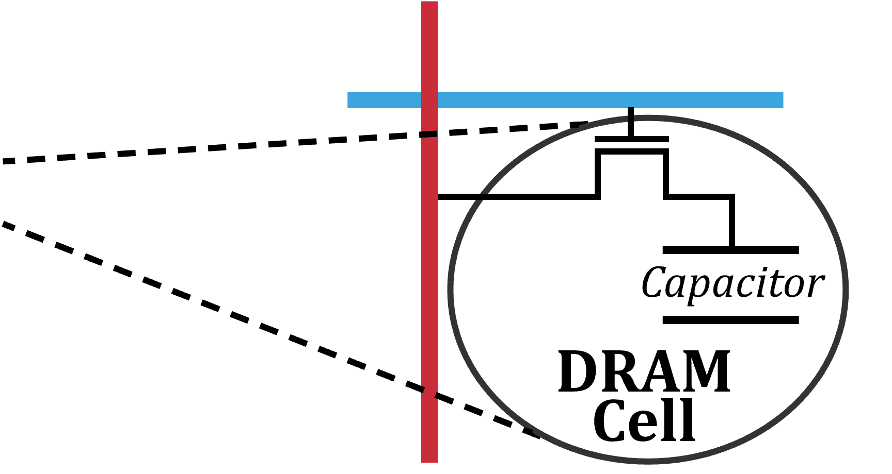
DRAM Organization
…
…
…
[Olgun+ ISCA’21]
Notes:
A processor’s memory controller
[CLICK] communicates with a set of DRAM chips within a DRAM module through a memory channel.
[CLICK] Each DRAM chip contains multiple banks that share a common chip I/O interface.
[CLICK] DRAM banks are organized into subarrays that consists of a set of wordline drivers and sense amplifiers
[CLICK] Subarrays are partitioned into DRAM MATs which are collections of DRAM cells that are separated from each other by wordline drivers.
[CLICK] DRAM cells are laid out onto a two-dimensional array of wordlines and bitlines within
a DRAM MAT. A row of DRAM cells is a DRAM row.
[CLICK] Here is a simplified diagram of a DRAM cell.

Slide 5
DRAM Operation
Cache line
…
Wordline Drivers
…
…
…
…
…
Sense Amplifiers
Sense Amplifiers
Sense Amplifiers
READ
READ
READ
READ
READ
READ
(Activation Latency)
(Access Latency)
(Precharge Latency)
DRAM Command Sequence
ACT R0
RD
RD
RD
PRE R0
ACT R1
RD
RD
RD
time
[Kim+ HPCA’19]
Notes:
Now we will look at how DRAM operates at the scope of a single subarray.
[CLICK] Because memory controllers typically access DRAM cells in the granularity of a cache line or a cache block we combine consecutive DRAM cells to form cache lines in this diagram.
[CLICK] On the bottom we have a timeline of DRAM commands.
[CLICK] First, we activate the first row to [CLICK] copy its cache lines to the sense amplifiers
[CLICK] At this point we can read data [CLICK] in cache line granularity from the sense [CLICK] amplifiers by sending READ commands
[CLICK] To access another row, we must first precharge the DRAM bank which closes the open DRAM row and sets the bitline voltage to half Vdd.
[CLICK] We can now activate the [CLICK] second row before [CLICK] [CLICK] [CLICK] reading data from it.
[CLICK] To ensure correct operation, we must obey certain timing parameters that define intervals between DRAM command pairs.
Three important timing parameters are tRAS, tRP, and tRCD
[CLICK] tRAS is the time required for the charge to become restored in the capacitors on the open row. tRAS dictates the amount of time we need to wait between successive activate and precharge commands
[CLICK] tRP is the time it takes for a bitline to become precharged to half Vdd such that a new activate command can be issued to open a DRAM row. Successive precharge and activate commands must be separated on the command bus by at least a tRP amount of time.
[CLICK] tRCD is the time it takes for sense amplifiers to amplify the bitline voltage to an I/O readable value. Successive activate and read commands must be separated by a tRCD amount of time.

Slide 6
Processing-in-Memory Techniques
Use operational principles of memory
to perform bulk data movement and computation
Commodity DRAM chips can already perform:
Row-copy: In-DRAM bulk data copy
(or initialization) at DRAM row granularity
True random number generation
Physical uncloneable functions
Majority operation
[Gao+, MICRO’19]-[Gao+, MICRO’22]
(e.g., [Kim+, HPCA’19]-[Olgun+, ISCA’21])
(e.g., [Kim+, HPCA’18])
[Gao+, MICRO’19]-[Gao+, MICRO’22]
Notes:
Commodity DRAM based PiM techniques use operational principles of commodity DRAM chips to move data and perform computation inside the DRAM chip.
[CLICK] Two examples of such techniques relevant to our work are in-DRAM data copy or initialization and [CLICK] in-DRAM true random number generation.

Slide 7
Row-Copy: Key Idea (RowClone)
s
r
c
r
o
w
s
d
s
r
c
t
r
r
o
o
w
w
s
r
c
r
o
w
Sense Amplifiers

1. Source row to sense amplifiers
?
2. Sense amplifiers to destination row
[Seshadri+ MICRO’13]
Notes:
I will describe the key idea of in-DRAM copy operations over this diagram. The diagram shows a simplified view of a DRAM subarray with a set of DRAM rows and sense amplifiers. To copy the orange source row to the gray destination row:
[CLICK] First, we copy the source row to row buffer
[CLICK] Second, we move the data from the sense amplifiers to the destination row
[CLICK] Current DRAM chips already support the first step of this operation. We can use activate commands to copy the source row to the destination row
[CLICK] I will describe how we can move data back from the sense amplifiers to the destination row later in my presentation

Slide 8
RowClone in Real DRAM Chips
Key Idea: Use carefully created DRAM command sequences
ACT → PRE → ACT command sequence
with greatly reduced DRAM timing parameters
ComputeDRAM [Gao+, MICRO’19] demonstrates
in-DRAM copy operations in real DDR3 chips
ACT S
PRE
ACT D
Standard
DRAM Timings
“activate row S, precharge, then activate row D”
ACT S
PRE
ACT D
Violated
DRAM Timings
“activate row S, then activate row D”
Notes:
The key idea in our RowClone implementation is to perform in-DRAM copy operations by using carefully crafted DRAM command sequences.

Slide 9
In-DRAM TRNG: Key Idea (D-RaNGe)
High % chance to fail
with reduced
access latency
50% chance to fail
Low % chance to fail with reduced
access latency
Row Decoder
SA
SA
SA
SA
SA
SA
SA
Commodity DRAM chips can already perform D-RaNGe
[Kim+ HPCA’19]
Notes:
The key idea of D-RaNGe, or the in-DRAM true random number generation technique that we are interested in is to reduce DRAM read access latency below manufacturer-recommended values and exploit the resulting error patterns as true random numbers. I will describe this over a diagram:
[CLICK] This diagram depicts a DRAM bank. We color and size the cells according to their failure probabilities when they are accessed with reduced access latency values.
[CLICK] Red cells fail with a high probability
[CLICK] and green cells fail with a low probability when accessed with reduced latency
[CLICK] D-RaNGe identifies cells that fail with a probability close to 50% and repeatedly accesses these cells with reduced access latency to generate true random numbers in DRAM

Slide 10

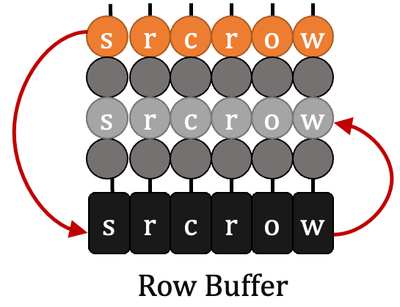
System Support for PiM
bulk data initialization
Application
Program/Language
supervisor for basic system support
System Software
software interface to execute PiM ops.
SW/HW Interface
control logic for PiM operations
Micro-architecture
support for custom timing parameters
Logic
Devices
Electrons
DRAM Chip

Slide 11
PiDRAM
bulk data initialization
Bridge the “system gap”
with customizable
HW/SW components
supervisor for basic system support
software interface to execute PiM ops.
control logic for PiM operations
in doing so,
allow users to
support for custom timing parameters
rapidly implement PiM techniques,
solve system integration challenges,
analyze end-to-end implementations
DRAM Chip

Slide 12
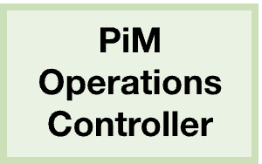
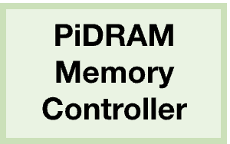


PiDRAM: Key Components
Control PiM operation
Memory controller for
custom timing parameters
Hardware
Software
Interface for
Applications
Supervisor software
for basic system support
Notes:
PiDRAM’s goal is to provide a flexible framework that is useful for studies on commodity DRAM based PiM techniques, such as the ones I described in the previous slides.
[CLICK] To guide our design, we look at the system requirements shared by the PiM techniques that we are interested in.
[CLICK] Then, we develop these key components as customizable modules to provide modularity and enhance the extensibility of PiDRAM
[CLICK] Overall, these components provide a common basis for developers of the framework to implement and enable system support for PiM techniques

Slide 13
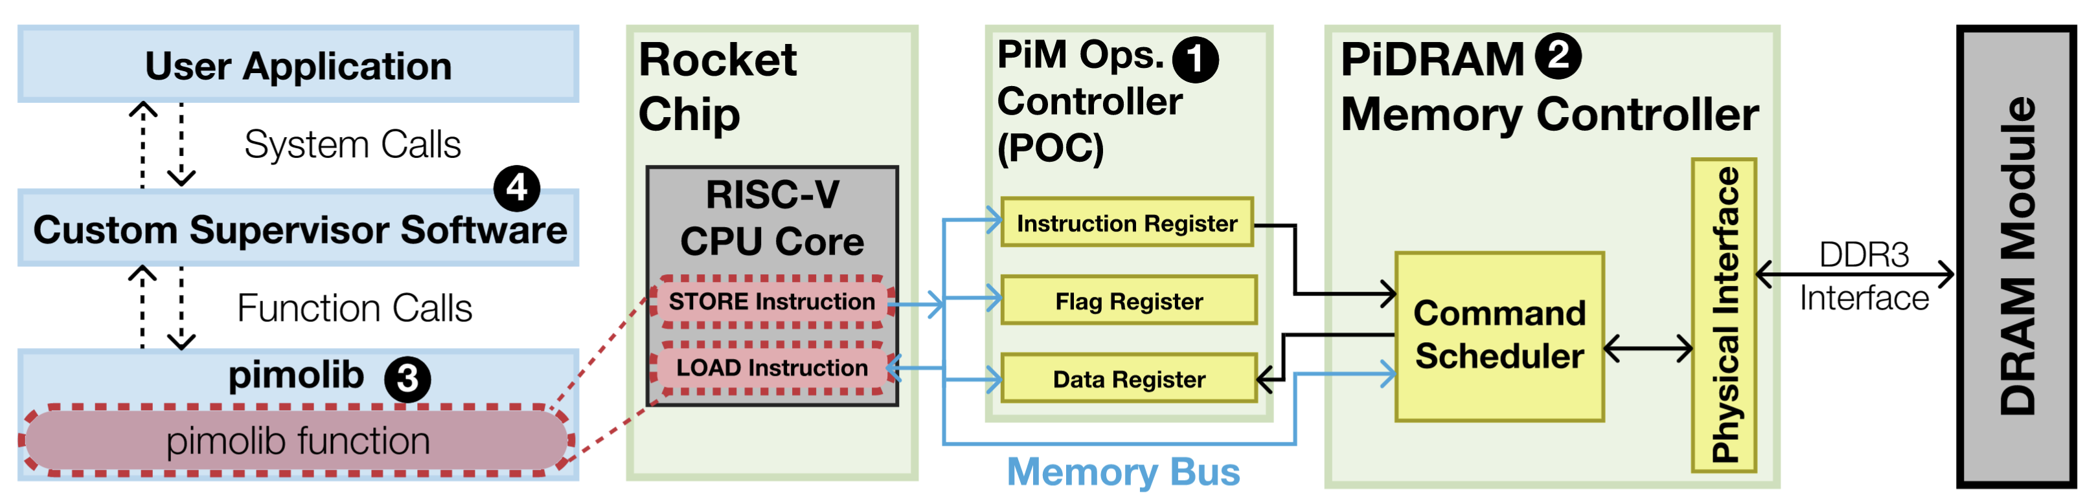
PiDRAM: System Design
Key components attached to a real computing system
Notes:
We attach the key components to a real RISC-V based computing system to develop PiDRAM’s system design.
[CLICK] In the system, we implement PiM Operations Controller and PiDRAM memory controller as hardware modules in the hardware system
[CLICK] the custom supervisor software runs on the hardware system
[CLICK] and the extensible software library is used by the supervisor software and runs on the hardware system
[CLICK] I will describe each component using this diagram

Slide 14
PiM Operations Controller (POC)
Decode & execute PiDRAM instructions (e.g., in-DRAM copy)
Receive instructions over memory-mapped interface
Simple interface to the PiDRAM memory controller
(i) send request, (ii) wait until completion, (iii) read results
Notes:
The PiM Operations Controller
[CLICK] decodes and executes PiDRAM instructions to perform PiM operations
[CLICK] It is connected to the hardware system as a memory mapped module, meaning that it receives the PiDRAM instructions over the memory bus from the RISC-V CPU core. The three registers, depicted as instruction, flag, and data registers in the figure are accessible over the memory bus. This makes it easy to port PiM operations controller to another system that uses a different CPU ISA.
[CLICK] PiM operations controller communicates with the PiDRAM memory controller over a simple interface where it sends a request for a PiM operation to the memory controller, waits until the operation is complete, and reads the results from the memory controller to perform a PiM operation.

Slide 15
PiDRAM Memory Controller
Perform PiM operations by violating DRAM timing parameters
Support conventional memory operations (e.g., LOAD/STORE)
One state machine per operation (e.g., LOAD/STORE, in-DRAM copy)
Easily replicate a state machine to implement a new operation
Controls the physical DDR3 interface
Receives commands from command scheduler & operates DDR3 pins
Notes:
The PiDRAM memory controller performs PiM operations by using timing parameters smaller than manufacturer-recommended values.
[CLICK] The command scheduler supports conventional memory operations like stores and loads. We implement one state machine in its command scheduler to control the execution per each memory operation. [CLICK] This makes PiDRAM memory controller easy to extend to support new PiM operations or new DRAM commands by replicating the state machines.
[CLICK] The physical interface controls the physical signals on the DDR3 interface. It receives DRAM commands from the command scheduler and drives the DDR3 interface signals.

Slide 16
PiM Operations Library (pimolib)
Contains customizable functions that interface with the POC
Software interface for performing PiM operations
Executes LOAD & STORE requests to communicate with the POC
Notes:
The PiM operations library or pimolib encapsulates customizable functions that interface with the pim operations controller to perform pim operations. We expose the PIM functionality to software using pimolib.
[CLICK] To perform a PiM operation, a typical function in pimolib executes LOAD&STORE requests to access the memory mapped registers of the Pim operations controller
I will later describe the communication protocol that pimolib obeys while communicating with the pim operations controller

Slide 17
Custom Supervisor Software
Exposes PiM operations to the user application via system calls
Contains the necessary OS primitives to develop end-to-end PiM techniques
(e.g., memory management and allocation for RowClone)
Notes:
The last component, custom supervisor software, exposes PiM oeprations to user applications via system calls
[CLICK] We implement the necessary OS primitivies to develop end-to-end PiM techniques in the custom supervisor software such as memory management and allocation for in-DRAM copy or RowClone operations)

Slide 18
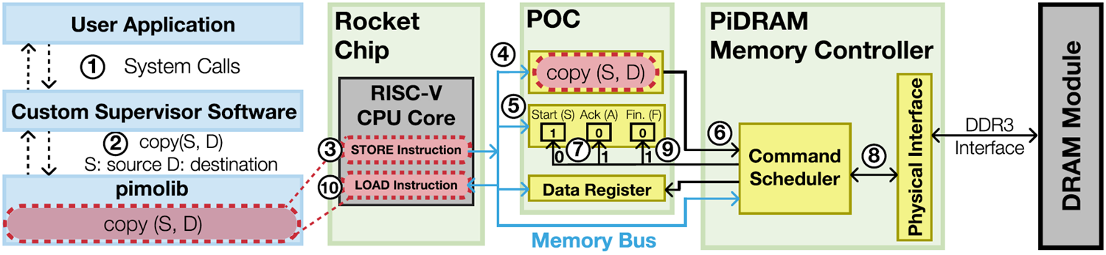
PiM Operation Execution Flow
Copy() function called by the user to perform a RowClone-Copy operation in DRAM
1
Application makes a system call: Copy(A, B, N bytes)
2
Custom Supervisor Software calls the Copy() pimolib function
Copy (S, D)
S: source DRAM row
D: destination DRAM row
Notes:
I will describe the execution flow for a PiM operation in our PiDRAM framework
As an example, we will look at what happens when the user calls the copy() function to perform an in-DRAM copy operation
[CLICK] The user first makes a system call to the copy function to copy N bytes from array A to array B
[CLICK] The custom supervisor software find the physical addresses corresponding to arrays A and B, and then calls the copy() function in the pimolib with the semantics that I show here
[CLICK] It takes two arguments, S is the address of the source DRAM row, and D is the address of the destination DRAM row

Slide 19
PiM Operation Execution Flow
3
Copy(S, D) executes two store instructions in the CPU
4
The first store updates the instruction register with Copy(S, D)
5
The second store sets the “Start” flag in the flag register
Start (S)
Start the execution of PiM operation
1
Notes:
The Copy function executes two store instrutions in the CPU
[CLICK] The first store instruction updates the instruction register with a PiDRAM instruction that instructs the Pim operations controller to perform in-DRAM copy from row S to row D
[CLICK] The second store instruction sets the start flag in the flag register [CLICK] to initiate the PiM operation

Slide 20
PiM Operation Execution Flow
6
POC instructs the memory controller to perform RowClone
7
POC resets the “Start” flag, and sets the “Ack” flag
8
PiDRAM memory controller issues commands
with violated timing parameters to the DDR3 module
Notes:
When the start flag is set, the Pim operations controller instructs the memory controller to perform an in-DRAM copy operation from row S to row D
[CLICK] When the memory controller acknowledges the Pim operations controller’s request, the Pim operations controller resets the start flag and sets the ack. flag. This indicates that the PiDRAM memory controller has started executing the last valid PiM operation.
[CLICK] To execute the PiM operation, the PiDRAM memory controller issues DRAM commands with violated timing parameters to the DDR3 module

Slide 21
PiM Operation Execution Flow
9
The memory controller sets the “Fin.” flag
10
Copy(S, D) periodically checks either “Ack” or “Fin.” flags
using LOAD instructions
Copy(S, D)returns when the periodically checked flag is set
Notes:
When the memory controller issues the last DRAM command to perform the operation, it sets the Fin. Flag. This indicates that the memory controller has finished executing the last valid PiM operation
[CLICK] The pimolib copy function periodically checks either the ACK or the FIN flags, based on a user-specified argument, to block until either the start or the end of the PiM operation. [CLICK] In other words, the pimolib function returns when either the ACK or the FIN flag is set.

Slide 22
PiM Operation Execution Flow
Data Register is not used in RowClone operations
because the result is stored in memory
It is used to read true random numbers generated by D-RaNGe
Notes:
In this example, we did not make use of the data register in the pim operations controller. This register was not useful because the in-DRAM copy operation’s result is already stored in memory.
[CLICK] However, we use this register in our in-DRAM true random number generator implementation in which case the random number generation function in the pimolib accesses the data register using LOAD instructions

Slide 23
PiDRAM Components Summary
Four key components orchestrate PiM operation execution
Notes:
[CLICK] In short, we implement four key components that together orchestrate the execution of PiM operations.

Slide 24
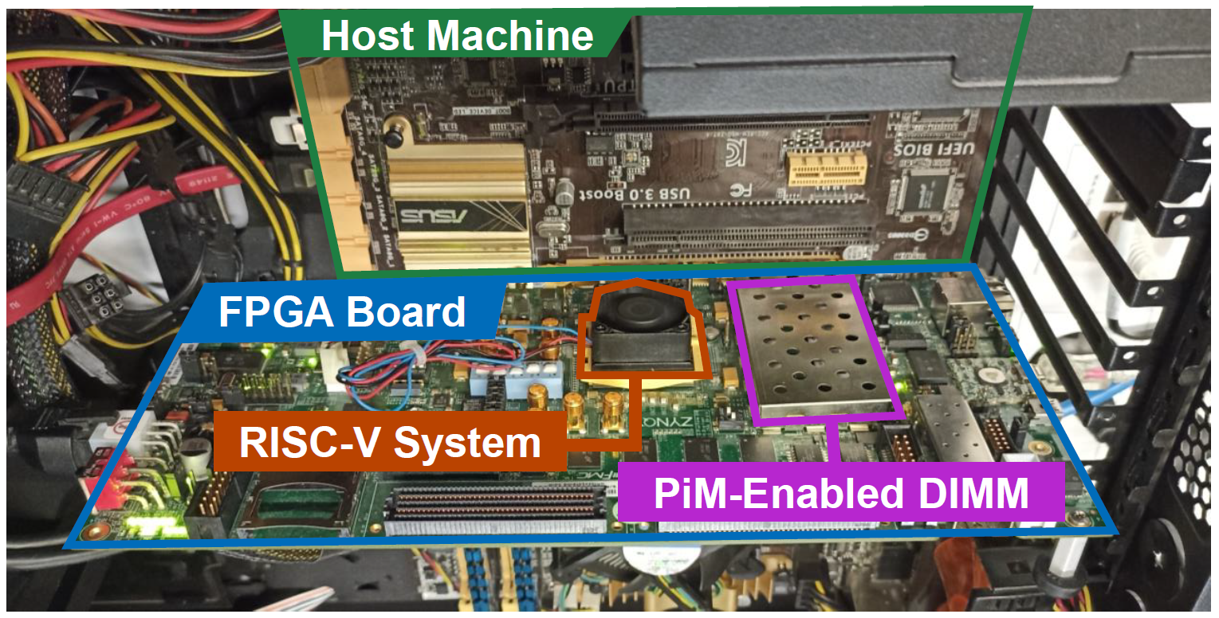
PiDRAM’s FPGA Prototype
Full system prototype on Xilinx ZC706 FPGA board
RISC-V System: In-order, pipelined RISC-V Rocket CPU core, L1D/I$, TLB
PiM-Enabled DIMM (Commodity): Micron MT8JTF12864, 1 GiB, 8 banks
Notes:
We develop a prototype of PiDRAM’s full system on a Xilinx ZC706 FPGA board
[CLICK] The RISC-V system comprises an in-order pipelined RISC-V core and level 1 data and instruction caches as well as a translation lookaside buffer
[CLICK] and we enable PIM operations in the DRAM module under the metal cage in the photograph

Slide 25
Outline
Background
  Commodity DRAM Based PiM Techniques
PiDRAM
  Overview
  Hardware & Software Components
  FPGA Prototype
Case Studies
  Case Study #1 – RowClone
  Case Study #2 – D-RaNGe
Conclusion
Notes:
I will continue with the case studies we performed on our full system prototype

Slide 26
RowClone Implementation
ACT S
PRE
ACT D
Standard
DRAM Timings
“activate row S, precharge, then activate row D”
ACT S
PRE
ACT D
Violated
DRAM Timings
“activate row S, then activate row D”
Extend the PiDRAM memory controller
to support the DRAM command sequence
Expose the operation to pimolib
by implementing the copy() PiDRAM instruction
1
2
Only 198 lines of Verilog code
Notes:
[CLICK] We extend the PiDRAM memory controller with a new state machine that controls the activate precharge activate command sequence
[CLICK] and expose the operation to pimolib by implementing the copy() PiDRAM instruction in the pim operations controller
[CLICK] These modifications take us only 198 lines of Verilog code over PiDRAM’s flexible code base

Slide 27
RowClone System Integration
Identify two challenges in end-to-end RowClone
1
Memory allocation (intra-subarray operation)
2
Memory coherency (computation in DRAM)
Implement CLFLUSH instruction in the RISC-V CPU
Evict a cache block from the CPU caches to the DRAM module
Notes:
We then study the challenges in integrating RowClone end-to-end in a real system
[CLICK] The first challenge we identify is proper memory allocation for RowClone operations. Because RowClone operations can only copy data inside a subarray, the data structures must be allocated properly to benefit from fast bulk-data copy operations in DRAM.
[CLICK] The second challenge is maintaining memory coherency. Because data movement, or computation is done inside memory, any cached copies of the data we operate on needs to be evicted and the data must be up to date in DRAM.
[CLICK] To address the second challenge, we implement the CLFLUSH instruction in the RISC-V CPU. This instruction allows us to evict a cache block, given its address as an argument, from CPU caches to the DRAM module. We use CLFLUSH instructions to evict data to DRAM prior to ROwClone operations.
[CLICK] I will now explain the first challenge in more detail

Slide 28
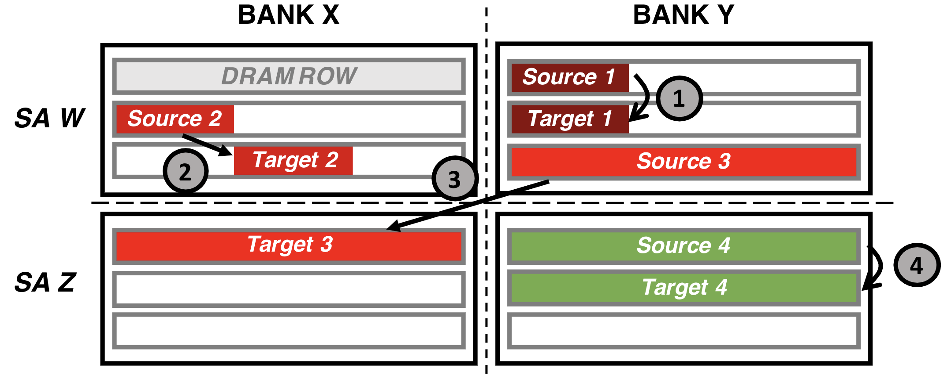
RowClone Memory Allocation (I)
Memory allocation requirements
Granularity: Operands must occupy DRAM rows fully
1
Notes:
We identify three memory allocation requirements for operands of RowClone operations
[CLICK] This is a simplified diagram of a DRAM chip with two banks on two columns and two subarrays (depicted as SA W and SA Z) on two rows.
[CLICK] The first requirement is the granularity requirement. Operands must occupy their DRAM rows fully. Otherwise, RowClone operations may overwrite data on the destination row.

Slide 29
RowClone Memory Allocation (I)
Memory allocation requirements
Alignment: Operands must be placed at the same offset
2
Notes:
The second requirement is called alignment. Operands must be placed at the same offsets in their respective DRAM rows. This is because in-DRAM the operand can be copied to the other operand only if their bits share the same set of sense amplifiers.

Slide 30
RowClone Memory Allocation (I)
Memory allocation requirements
Mapping: Operands must be placed in the same subarray
3
Notes:
The third requirement is called mapping. Because ROwClone operations can only be performed within a DRAM subarray, the operands must be placed or allocated in the same DRAM subarray in the same DRAM bank.

Slide 31
RowClone Memory Allocation (I)
Memory allocation requirements
Satisfies all three requirements
4
Notes:
In contrast to previous operand allocations, the allocation for source four and target four satisfy all three requirements and can be used in RowClone operations.

Slide 32
RowClone Memory Allocation (II)
Implement a new memory allocation function
to overcome the memory allocation challenges
Goal: Allocate virtual memory pages that are
mapped to the same DRAM subarray and aligned with each other
virtual_address = alloc_align(int size, int id)
size: # of bytes allocated
id: allocations with the same id go to the same subarray
1
Subarray
Mapping
Table
2
Page
Table
alloc_align(
4 KiB, “Subarray 0”)
1
Get physical address pointing to a DRAM row in subarray 0
2
Update the page table to map virtual address to subarray 0
Notes:
We implement a new memory allocation function in the custom supervisor software to overcome the memory allocation challenges of RowClone
[CLICK] The goal of this function is to allow programmers to allocate virtual memory pages that are mapped to the same DRAM subarray in an aligned way
[CLICK] The key mechanism of our function is to distribute the allocated virtual pages to different banks, but also map the virtual pages to different rows in the same DRAM subarray in those banks.
[CLICK] We implement alloc_align with the semantics I show here. It takes two arguments. The size arguments tells it the amount of data it needs to allocate in bytes, and the id argument is supplied by the programmer to collect data structures that are allocated with different alloc_align calls under the same subarray, such that they can be copied to and from each other.

Slide 33
RowClone Memory Allocation (II)
Implement a new memory allocation function
to overcome the memory allocation challenges
Goal: Allocate virtual memory pages that are
mapped to the same DRAM subarray and aligned with each other
https://arxiv.org/abs/2111.00082
virtual_address = alloc_align(int size, int id)
size: # of bytes allocated
id: allocations with the same id go to the same subarray
1
Subarray
Mapping
Table
2
Page
Table
alloc_align(
4 KiB, “Subarray 0”)
1
Get physical address pointing to a DRAM row in subarray 0
2
Update the page table to map virtual address to subarray 0

Slide 34
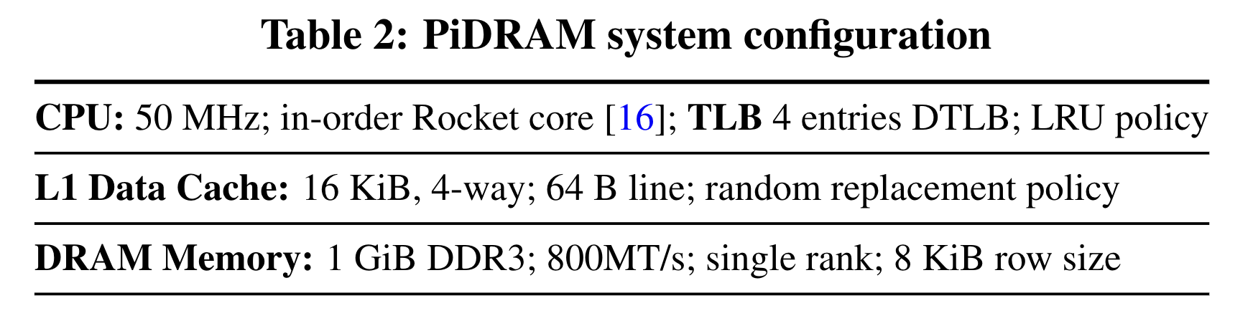
Evaluation: Methodology
in-DRAM copy/initialization granularity
Microbenchmarks
CPU-Copy (using LOAD/STORE instructions)
RowClone-Copy (using in-DRAM copy operations) with and without CLFLUSH
Copy/Initialization Heavy Workloads
forkbench (copy)
compile (initialization)
SPEC2006 libquantum: replace “calloc()” with in-DRAM initialization
Notes:
We evaluate the performance of RowClone operations with system support in our PiDRAM prototype.
[CLICK] This table shows the configuration of our prototyped system
[CLICK] We run two sets of microbenchmarks called CPU-Copy and RowClone-Copy. To perform bulk data copy, in the CPU-Copy microbenchmark we execute load and store instructions in the RISC-V core, and in the RowCLone-Copy microbenchmark we execute in-DRAM copy instructions
[CLICK] We estimate the performance improvements provided by RowClone-Copy and Initialization operations using two copy/initialization heavy workloads
[CLICK] and we run the libquantum workload from SPEC2006 end-to-end on our prototype

Slide 35
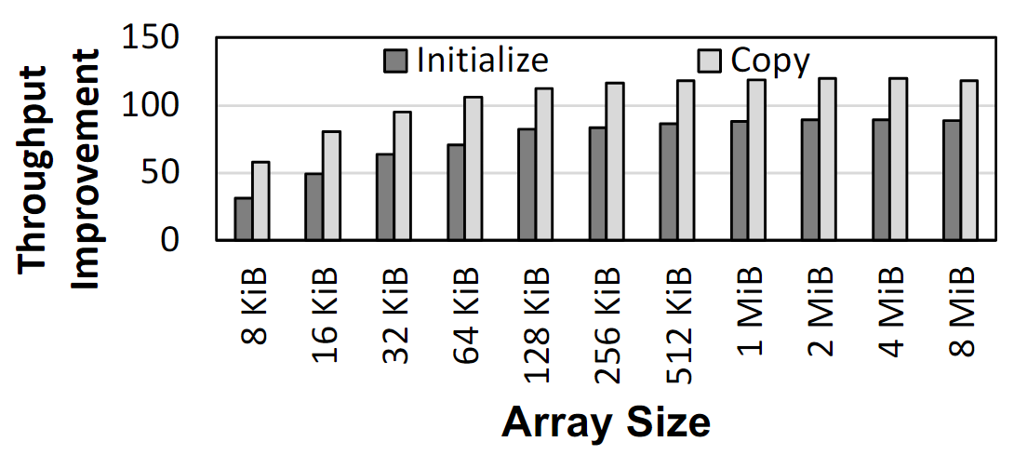
Microbenchmark Copy/Initialization
Throughput Improvement
In-DRAM Copy and Initialization
improve throughput by 119x and 89x, respectively
Notes:
This plot shows the throughput improvement provided by in-DRAM copy operations for bulk data initialization and copy over CPU-based copy and initialization using LOAD and STORE instructions. We do not execute any CLFLUSH instructions and assume that the data is up to date in DRAM and there are no cached copies.
The x-axis shows the size of the arrays that we copy or initialize. The dark gray bar shows the improvement for initialization operations, and the bright gray bar shows the improvement for copy operations.
[CLICK] We observe that in-DRAM copy and initialization operations improve copy and initialization throughput by 119x and 89x including the overheads of system support required for RowClone operations

Slide 36
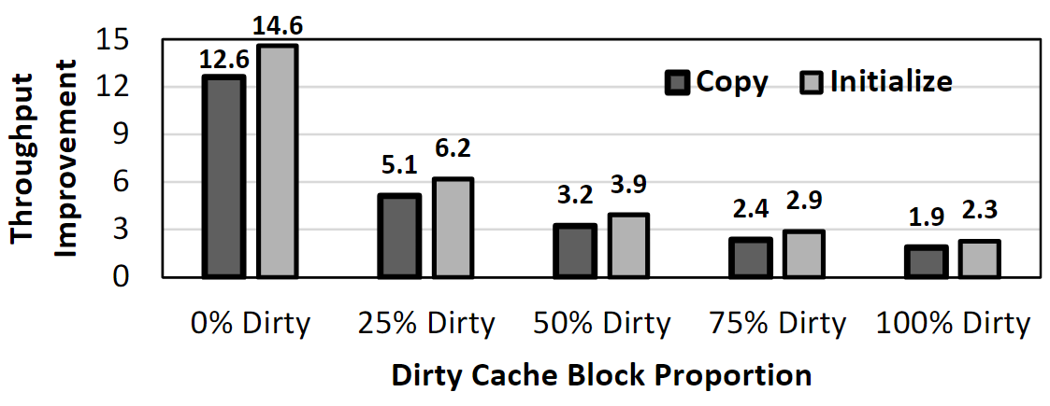
CLFLUSH Overhead
CLFLUSH dramatically reduces
the potential throughput improvement
Notes:
Now I will discuss the overheads of CLFLUSH operations. The plot shows the throughput improvement provided by in-DRAM copy and initialization over CPU-based copy and initialization when we copy 8 megabytes of data and all data is cached. The x-axis shows the proportion of the modified cache blocks among all cache blocks of the data being copied.
[CLICK] We observe that CLFLUSH operations dramatically reduce the potential copy throughput improvement provided by in-DRAM copy operations.

Slide 37
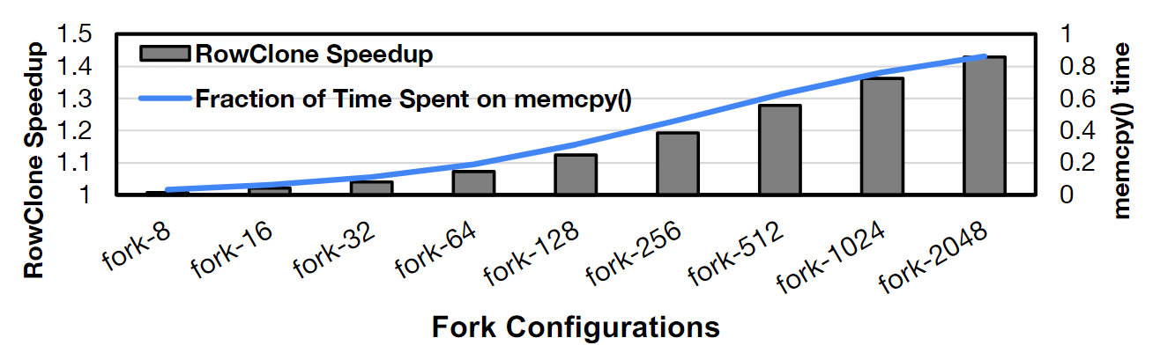
Other Workloads
forkbench (copy-heavy workload)
compile (initialization-heavy workload)
9% execution time reduction by in-DRAM initialization
  17% of compile’s execution time is spent on initialization
SPEC2006 libquantum
1.3% end-to-end execution time reduction
  2.3% of libquantum’s time is spent on initialization
Performance
improvement
increases
Notes:
I will summarize our results for other workloads in this slide
[CLICK] This plot shows the Speedup provided by rowclone-copy operations for the forkbench workload when the rowclone copy operations are used instead of CPU-based copy operations. The x-axis shows different configurations of the forkbench workload where the number after the hyphen indicates the amount of 4 KiB pages copied after each fork call.
We observe that as the fraction of time spent on copy operations increase, indicated by the blue curve, the speedup provided by RowClone increases, up to 42.9% for the fork-2K configuration
[CLICK] We observe 9% reduction in execution time for the initialization-heavy compile workload, which is expected as compile spends 17% of its execution time on initialization.
[CLICK] Finally, we observe 1.3% end-to-end execution time reduction for libquantum. Similarly this is because in our experiments libquantum spends only 2.3% of its time on bulk data initialization.

Slide 38
Outline
Background
  Commodity DRAM Based PiM Techniques
PiDRAM
  Overview
  Hardware & Software Components
  FPGA Prototype
Case Studies
  Case Study #1 – RowClone
  Case Study #2 – D-RaNGe
Conclusion
Notes:
Now I will describe our second key study

Slide 39
Recall: D-RaNGe Key Idea
High % chance to fail
with reduced
access latency
50% chance to fail
Low % chance to fail with reduced
access latency
Row Decoder
SA
SA
SA
SA
SA
SA
SA
Commodity DRAM chips can already perform D-RaNGe
[Kim+ HPCA’19]
Notes:
The key idea of D-RaNGe, or the in-DRAM true random number generation technique that we are interested in is to reduce DRAM read access latency below manufacturer-recommended values and exploit the resulting error patterns as true random numbers. I will describe this over a diagram:
[CLICK] This diagram depicts a DRAM bank. We color and size the cells according to their failure probabilities when they are accessed with reduced access latency values.
[CLICK] Red cells fail with a high probability
[CLICK] and green cells fail with a low probability when accessed with reduced latency
[CLICK] D-RaNGe identifies cells that fail with a probability close to 50% and repeatedly accesses these cells with reduced access latency to generate true random numbers in DRAM

Slide 40
D-RaNGe Implementation
Identify four DRAM cells that fail
randomly in a cache block
RNG Cell
1
1 0010110100110011101000110101
SA
[Kim+ HPCA’19]
1 0 1 0 1 0 0 1 0 0
Notes:
To implement the D-RaNGe true random number generation technique
[CLICK] We first identify a DRAM cache block that contains four cells with a failure probability of 50% when accessed with a reduced access latency value.
[CLICK] Then, we use these cells to produce true random numbers as accessing them with a reduced access latency will output random values.

Slide 41
D-RaNGe Implementation
Periodically generate true random numbers
by accessing the identified cache block
Reduce access latency
1 KiB random number buffer in POC
Programmers read random numbers from the
data register using the rand_dram() function call
190 lines of Verilog code
74 lines of C++ code
Notes:
We periodically generate true random numbers by accessing these four cells.
[CLICK] To store the periodically generated random numbers, we implement a one kilobyte random number buffer in the pim operations controller
[CLICK] The programmer reads a random number from the data register using the rand_dram() function call
[CLICK] Modifying PiDRAM to implement D-RaNGe takes us only 190 lines of Verilog and 74 lines of C++ code

Slide 42
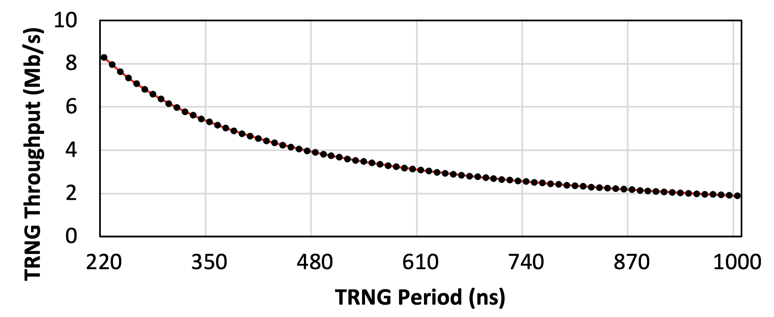
Evaluation
Methodology: Microbenchmark
that reads true random numbers
PiDRAM’s D-RaNGe generates true random numbers at 8.30 Mb/s throughput
Notes:
To evaluate our implementation of D-RaNGe, we run a microbenchmark that continuously reads true random numbers using the rand_dram() function.
[CLICK] This plot shows the true random number generation throughput we observe. On the x-axis, we show the true random number generation period which we can dynamically configure for PiDRAM’s D-RaNGe implementation.
[CLICK] We observe that our D-RaNGE implementation can generate true random numbers at high throughput.

Slide 43
Outline
Background
  Commodity DRAM Based PiM Techniques
PiDRAM
  Overview
  Hardware & Software Components
  FPGA Prototype
Case Studies
  Case Study #1 – RowClone
  Case Study #2 – D-RaNGe
Conclusion
Notes:
I will conclude with a summary

Slide 44
Executive Summary
Motivation: Commodity DRAM based PiM techniques improve the performance
and energy efficiency of computing systems at no additional DRAM hardware cost
Problem: Challenges of integrating these PiM techniques into real systems are not solved
General-purpose computing systems, special-purpose testing platforms, and
system simulators cannot be used to efficiently study system integration challenges
Goal: Design and implement a flexible framework that can be used to:
solve system integration challenges
analyze trade-offs of end-to-end implementations
of commodity DRAM-based-PiM techniques
Key idea: PiDRAM, an FPGA-based framework that enables:
system integration studies
end-to-end evaluations of PIM techniques using real unmodified DRAM chips
Evaluation: End-to-end integration of two PiM techniques on PiDRAM’s FPGA prototype
Case Study #1 – RowClone: In-DRAM bulk data copy operations
119x speedup for copy operations compared to CPU-copy with system support
198 lines of Verilog and 565 lines of C++ code over PiDRAM’s flexible codebase
Case Study #2 – D-RaNGe: DRAM-based random number generation technique
8.30 Mb/s true random number generator (TRNG) throughput, 220 ns TRNG latency
190 lines of Verilog and 74 lines of C++ code over PiDRAM’s flexible codebase
PiDRAM: https://github.com/CMU-SAFARI/PiDRAM
Notes:
I will start with an executive summary
[CLICK] Commodity DRAM-based PIM techniques improve the performance and energy efficiency of computing systems without incurring any DRAM hardware cost
[CLICK] However, challenges of integrating these techniques into real systems are not yet solved.
[CLICK] Moreover, these challenges cannot be efficiently studied using existing computing systems, special-purpose DRAM testing platforms or system simulators
[CLICK] Our goal is to design and implement a flexible framework that can be used to [CLICK] solve the important system integration challenges and [CLICK] analyze the trade-offs of end-to-end implementations of commodity DRAM based PiM techniques
[CLICK] Our key idea is to develop PiDRAM, an FPGA-based framework that enables such studies using real unmodified DRAM chips
[CLICK] Using our framework, we conduct two case studies on two recent commodity DRAM based PiM techniques on a real FPGA prototype of a full system
[CLICK] In our first case study about in-DRAM bulk data copy operations, we show that in-DRAM data copy operations provide 119 times speedup over CPU-copy operations including system support. To conduct this case study over PiDRAM’s extensible code base, we add only 198 lines of Verilog and only 565 lines of C++ code.
[CLICK] In our second case study about an in-DRAM true random number generation technique, we show that an end-to-end implementation of a DRAM-based true random number generator can provide high throughput true random numbers at low latency. Implementing the true random number generator takes us only 190 additional lines of Verilog and 78 additional lines of C++ code over PiDRAM’s code base.

Slide 45
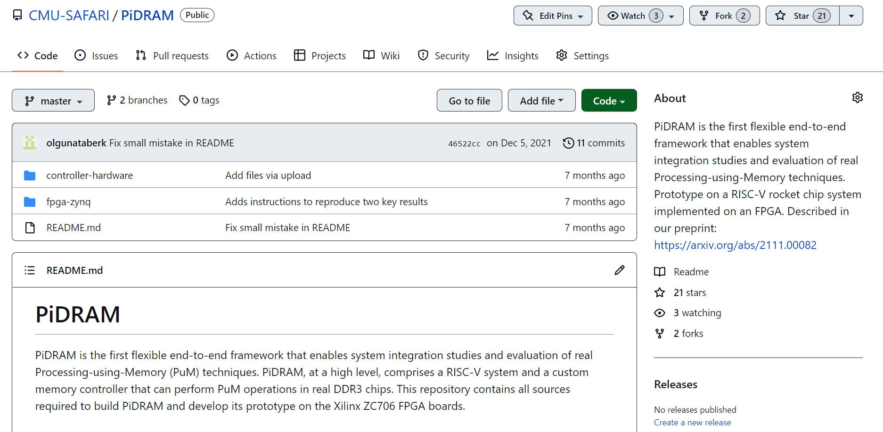
PiDRAM is Open Source
https://github.com/CMU-SAFARI/PiDRAM
Notes:
PiDRAM is openly and freely available on Github. If you are interested in PiDRAM, please use it and feel free to contribute to it.

Slide 46
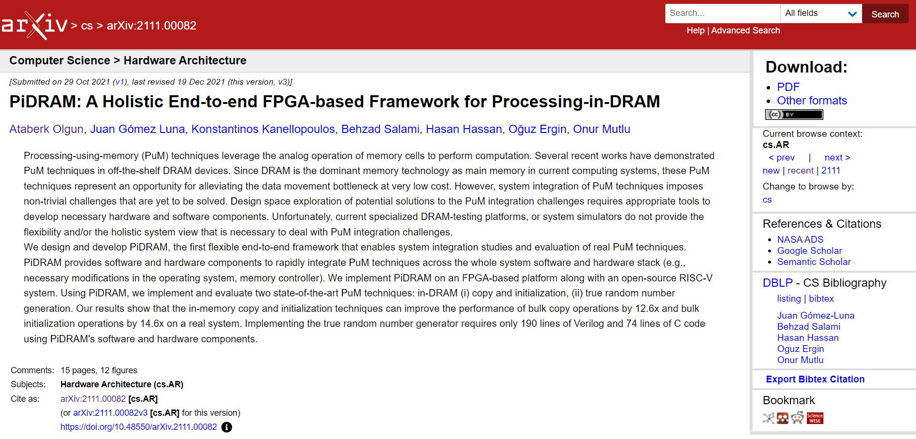
Extended Version on ArXiv
https://arxiv.org/abs/2111.00082
Notes:
An extended version of our conference paper is available on arXiv on this link where we discuss our framework in more detail.

Slide 47
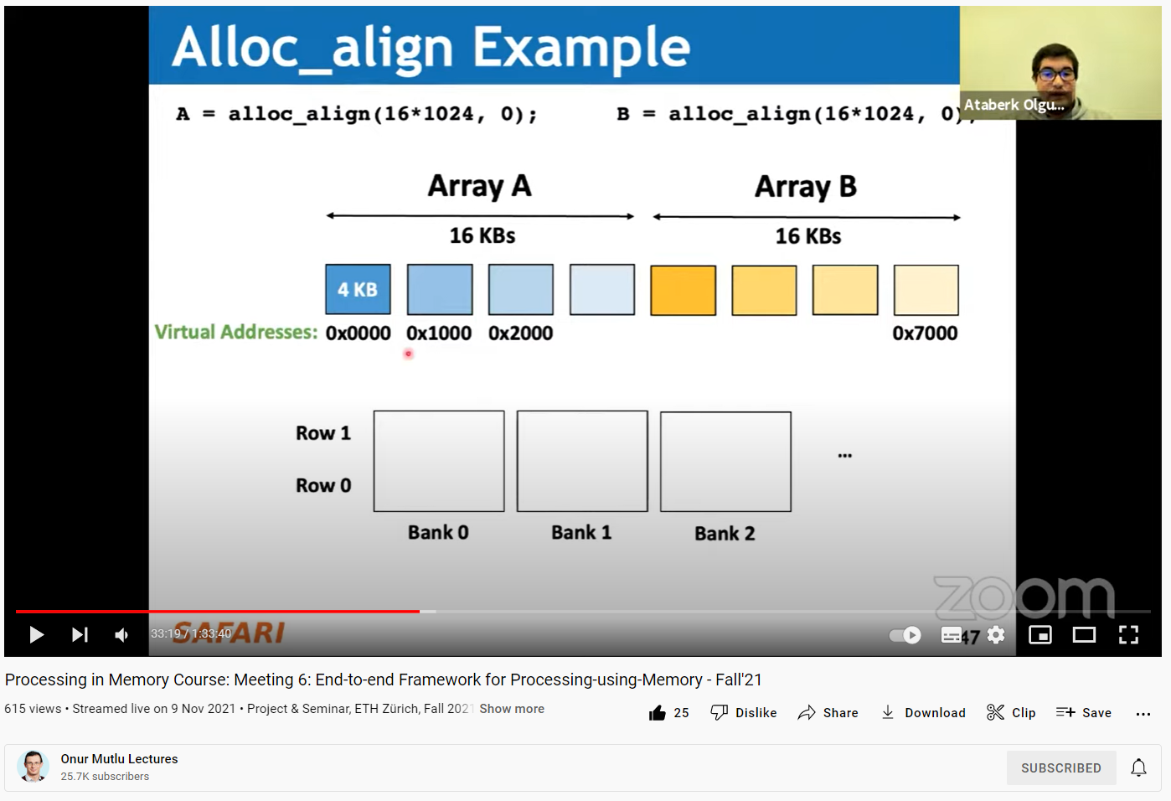
Long Talk + Tutorial on Youtube
https://youtu.be/s_z_S6FYpC8
Notes:
I also describe PiDRAM in more detail and give a tutorial on how to use our framework in this SAFARI live seminar talk.

Slide 48
PiDRAM
An FPGA-based Framework for End-to-end Evaluation of Processing-in-DRAM Techniques
Ataberk Olgun
Juan Gomez Luna
Konstantinos Kanellopoulos
Behzad Salami
Hasan Hassan
Oğuz Ergin
Onur Mutlu
Notes:
Thank you very much for listening to my presentation. I am happy to take your questions.

Slide 49
DRAM Bender
An Extensible and Versatile
FPGA-based Infrastructure to
Easily Test State-of-the-art DRAM Chips
Ataberk Olgun
Yahya Can Tugrul
Minesh Patel
Hasan Hassan
Lois Orosa
Oguz Ergin
A. Giray Yaglikci
Haocong Luo
Onur Mutlu

Slide 50






Factors Affecting DRAM Reliability and Latency
DRAM timing violation
Inter-cell interference
Manufacturing process
Temperature
Voltage
Factors affecting DRAM reliability and latency
cannot be properly modeled in simulation or analytically
We need to perform experimental studies
of real DRAM chips

Slide 51
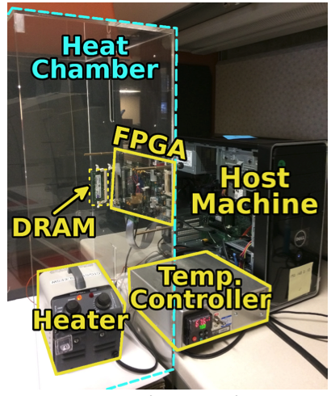
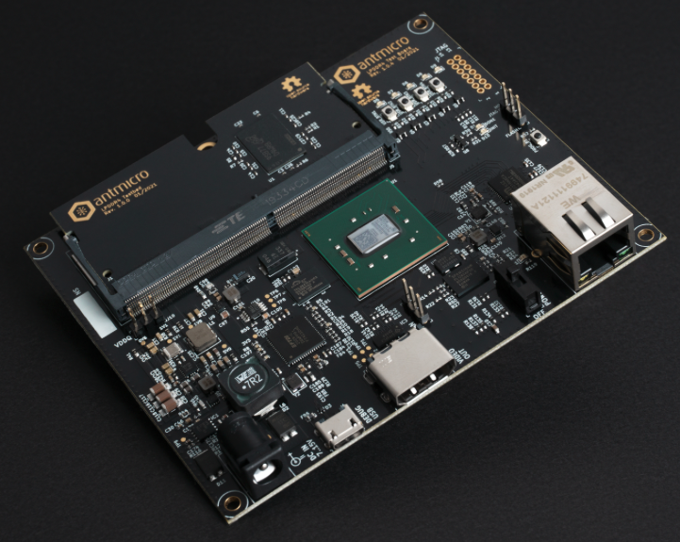
DRAM Testing Infrastructure
Allow experimental studies of real DRAM chips
Open-source FPGA-based testing infrastructure
Publicly-available: Start using today
Relatively low cost: An FPGA board + DRAM modules
SoftMC
Litex Tester

Slide 52
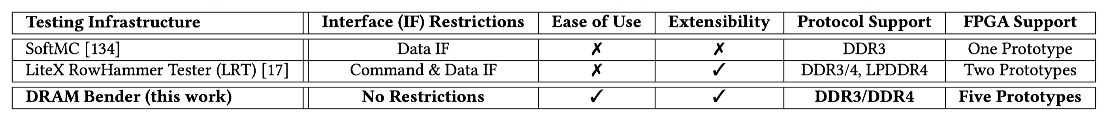
Limitations of Existing Infrastructure
Impose restrictions on the DDR4 interface.
Restrictions limit various characterization experiments.
Difficult to set up (based on discontinued HW/SW)
and use (require developing HW)
Monolithic hardware design
makes extensions (new standards, prototypes) relatively difficult

Slide 53
DRAM Bender: Design Goals
Flexibility
  Ability to test any DRAM operation
  Ability to test any combination of DRAM operations
  and custom timing parameters
Ease of use
  Simple programming interface (C++)
  Minimal programming effort and time
  Accessible to a wide range of users
    who may lack experience in hardware design
Extensibility
  Modular design
  Well-defined interfaces between hardware modules

Slide 54
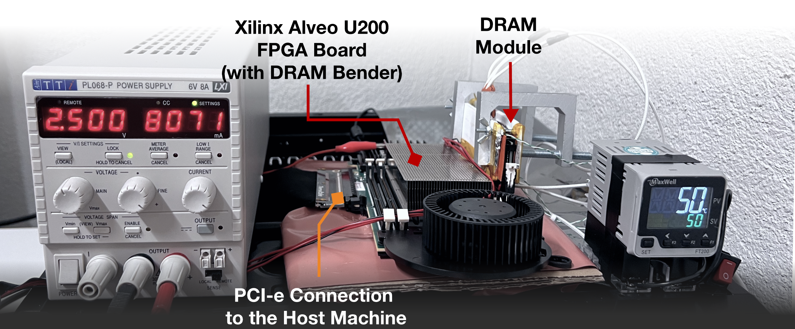
DRAM Bender: Overview
Publicly-available FPGA-based
DDR4/3 (and HBM2) characterization infrastructure
Easily programmable using the DRAM Bender C++ API
[Yaglikci+, DSN’22]

Slide 55
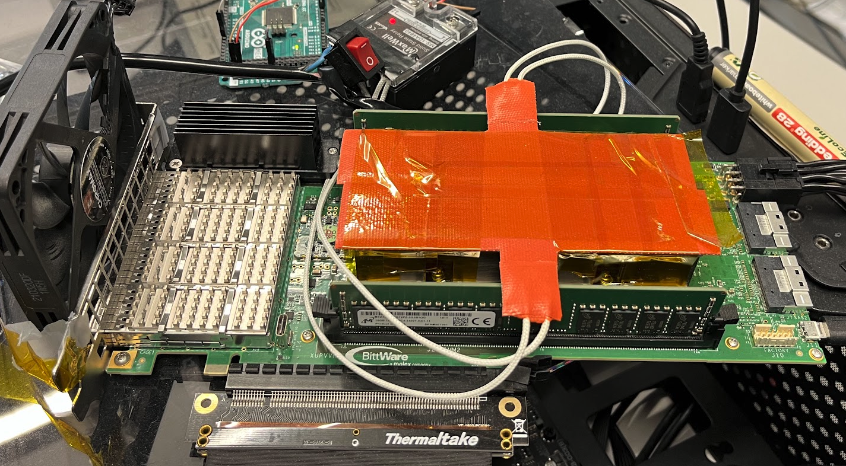
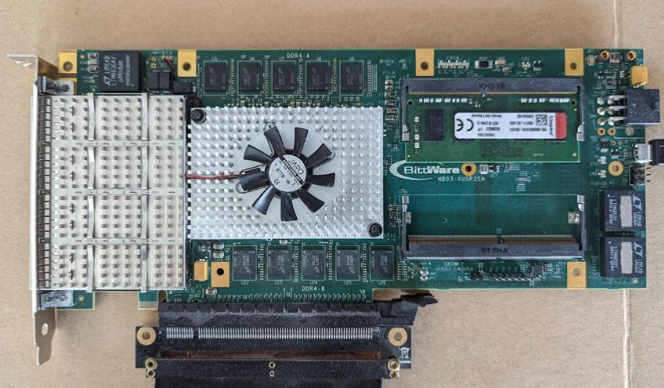
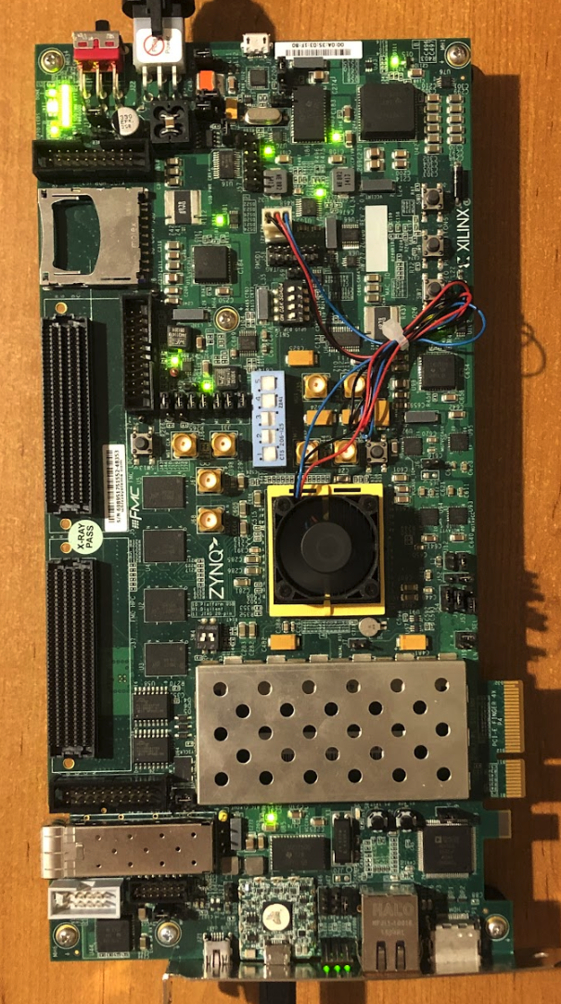
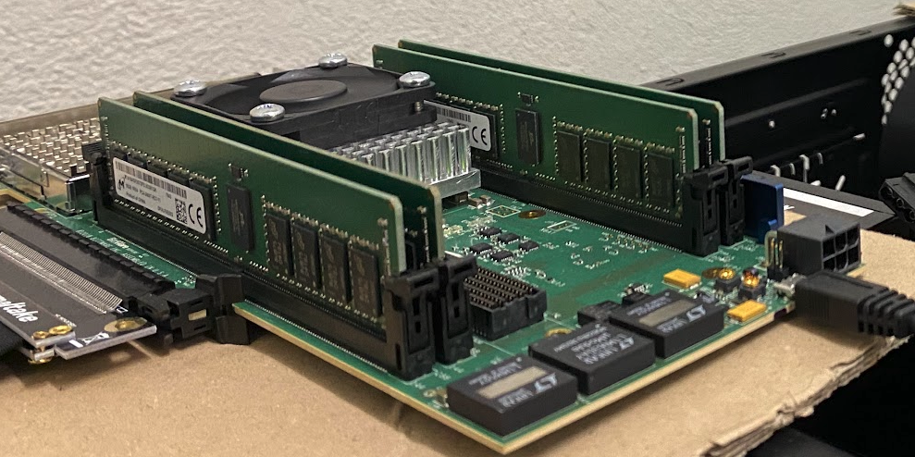
DRAM Bender: Prototypes
Five out of the box FPGA-based prototypes

Slide 56
DRAM Bender is Flexible
RowHammer: Interleaving Pattern of Activations
  Interleaving pattern significantly affects
  the number of RowHammer bitflips
RowHammer: Random Data Patterns
  Use 512-bit random data patterns
  Uncover more bitflips than 8-bit SoftMC random patterns
In-DRAM Bitwise Operations
  Demonstrate in-DRAM bitwise AND/OR capability
  in real DDR4 chips
DRAM Bender is flexible:
supports many different types of experiments

Slide 57
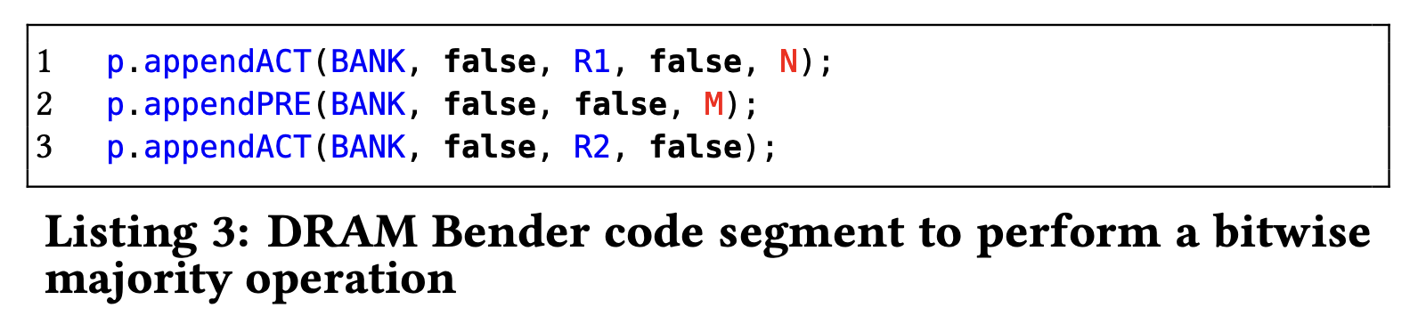
DRAM Bender is Easy to Use
Easily programmable using the DRAM Bender C++ API
In-DRAM Bitwise Operations
Easy to devise new experiments to uncover new insights

Slide 58
More in the paper (II)
DRAM Bender design details
  DRAM Bender instruction set architecture
  Hardware & software modules
  Prototype design
  Temperature controller setup
DRAM Bender application programming interface
Detailed results for three case studies
Future work & improvements

Slide 59
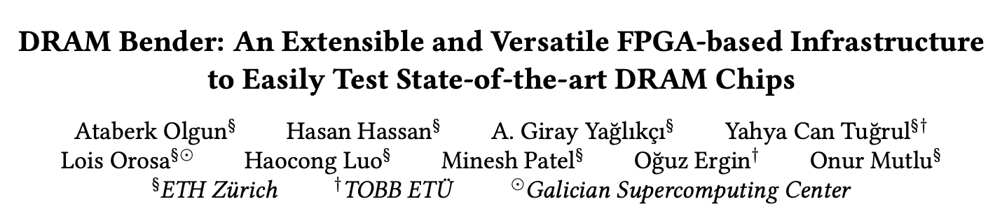

More in the paper (II)
https://arxiv.org/abs/2211.05838

Slide 60
Research DRAM Bender Enabled
[ISCA’23] Luo+, “RowPress: Amplifying Read Disturbance in Modern DRAM Chips”
[DSN’23 Disrupt] Olgun+, ”An Experimental Analysis of RowHammer on HBM2 DRAM Chips”
[arXiv Preprint, 2023] Orosa+, ”SpyHammer: Using RowHammer to Remotely Spy on Temperature”
[MICRO’22] Yaglikci+, “HIRA: Hidden Row Activation for Reducing Refresh Latency of Off-the-Shelf DRAM Chips”
[DSN’22] Yaglikci+, “Understanding RowHammer Under Reduced Wordline Voltage: An Experimental Study Using Real DRAM Devices”
[MICRO’21] Orosa+, “A Deeper Look into RowHammer’s Sensitivities: Experimental Analysis of
Real DRAM Chips and Implications on Future Attacks and Defenses”
[MICRO’21] Hassan+, “Uncovering In-DRAM RowHammer Protection Mechanisms:
A New Methodology, Custom RowHammer Patterns, and Implications”
[ISCA’21] Olgun+, “QUAC-TRNG: High-Throughput True Random Number Generation
Using Quadruple Row Activation in Commodity DRAM Chips”
[ISCA’21] Orosa+, “CODIC: A Low-Cost Substrate for Enabling Custom In-DRAM Functionalities and Optimizations”
[ISCA’20] Kim+, “Revisiting RowHammer: An Experimental Analysis of Modern Devices and Mitigation Techniques”
[S&P’20] Frigo+, “TRRespass: Exploiting the Many Sides of Target Row Refresh”
[HPCA’19] Kim+, “D-RaNGe: Using Commodity DRAM Devices to Generate True Random Numbers with Low Latency and High Throughput”
[MICRO’19] Koppula+, “EDEN: Enabling Energy-Efficient, High-Performance Deep Neural Network Inference Using Approximate DRAM”
[SIGMETRICS’18] Ghose+, “What Your DRAM Power Models Are Not Telling You: Lessons from a Detailed Experimental Study”
[SIGMETRICS’17] Chang+, “Understanding Reduced-Voltage Operation in Modern DRAM Devices:
Experimental Characterization, Analysis, and Mechanisms”
[MICRO’17] Khan+, “Detecting and Mitigating Data-Dependent DRAM Failures by Exploiting Current Memory Content”
[SIGMETRICS’16] Chang+, “Understanding Latency Variation in Modern DRAM Chips:
Experimental Characterization, Analysis, and Optimization”

Slide 61
A Highlight: RowPress
Keeping a DRAM row open for a long time
causes bitflips in adjacent rows
These bitflips do NOT require many row activations
Only one activation is enough in some cases!
RowHammer
Aggressor Row
Open
Close
36ns, 47K activations to induce bitflips
RowPress
Aggressor Row
Open
Close
7.8µs, only 5K activations to induce bitflips

Slide 62





RowPress Results & Source Code
Fully open source and artifact evaluated
https://github.com/CMU-SAFARI/RowPress
Notes:
We have more results in the paper, [CLICK] and our work is fully open-source and artifact evaluated.

Slide 63

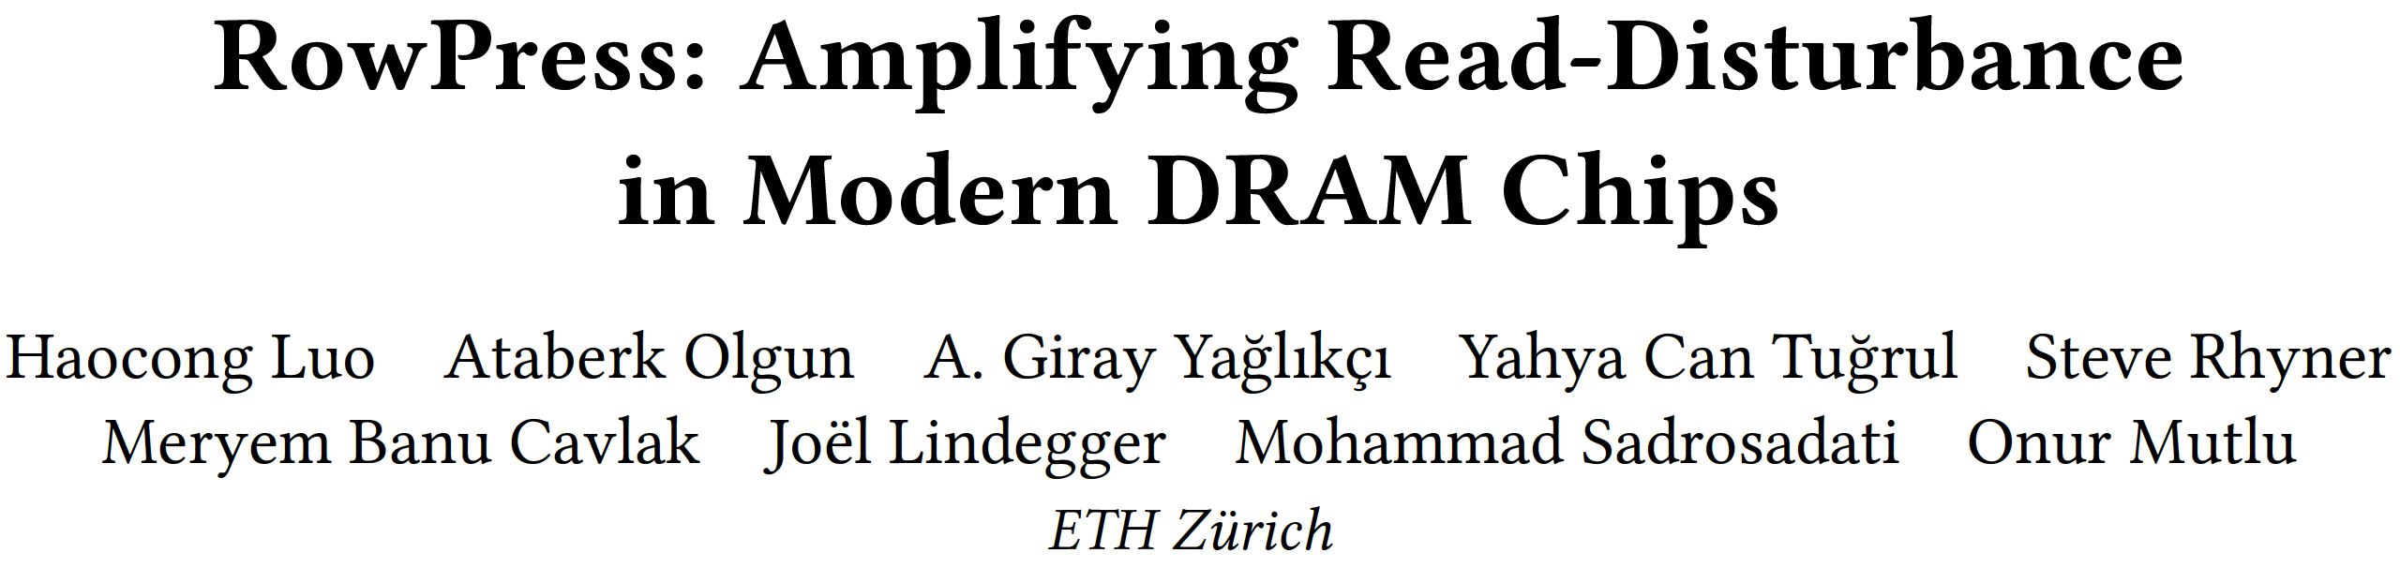
RowPress [ISCA 2023]
Haocong Luo, Ataberk Olgun, Giray Yaglikci, Yahya Can Tugrul, Steve Rhyner, M. Banu Cavlak, Joel Lindegger, Mohammad Sadrosadati, and Onur Mutlu,
"RowPress: Amplifying Read Disturbance in Modern DRAM Chips"
Proceedings of the 50th International Symposium on Computer Architecture (ISCA), Orlando, FL, USA, June 2023.
[Slides (pptx) (pdf)]
[Lightning Talk Slides (pptx) (pdf)]
[Lightning Talk Video (3 minutes)]
[RowPress Source Code and Datasets (Officially Artifact Evaluated with All Badges)]
Officially artifact evaluated as available, reusable and reproducible.
Best artifact award at ISCA 2023.

Slide 64
More Research DRAM Bender Enabled
[DRAMSec’23] Lang+, “BLASTER: Characterizing the Blast Radius of Rowhammer”
[Applied Sciences’22] Bepary+, “DRAM Retention Behavior with Accelerated Aging in Commercial Chips”
[ETS’21] Farmani+, “RHAT: Efficient RowHammer-Aware Test for Modern DRAM Modules”
[HOST’20] Talukder+, “Towards the Avoidance of Counterfeit Memory: Identifying the DRAM Origin”
[MICRO’19] Gao+, “ComputeDRAM: In-Memory Compute Using Off-the-Shelf DRAMs”
[IEEE Access’19] Talukder+, “PreLatPUF: Exploiting DRAM Latency Variations for Generating Robust Device Signatures”
[ICCE’18] Talukder+, “Exploiting DRAM Latency Variations for Generating True Random Numbers”

Slide 65
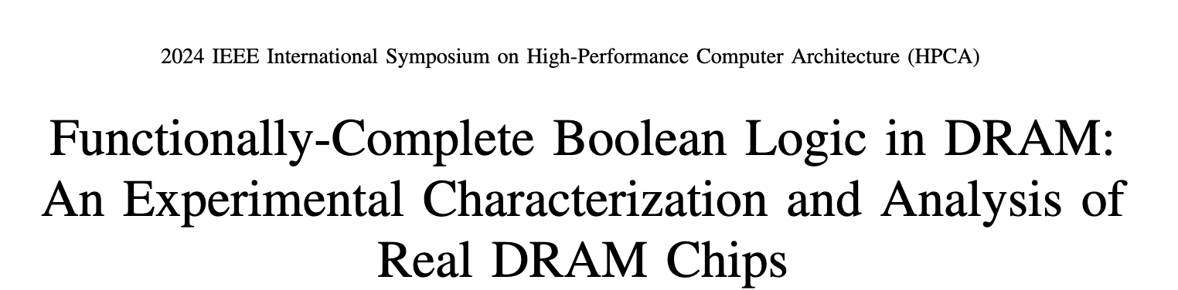
Functionally-Complete Real PUM Prototype
Ismail Emir Yuksel, Yahya Can Tuğrul, Ataberk Olgun,
Nisa Bostanci, A. Giray Yaglikci, Geraldo F. Oliveira, Haocong Luo, Juan Gómez-Luna, Mohammad Sadrosadati, and Onur Mutlu,
"Functionally-Complete Boolean Logic in DRAM: An Experimental Characterization and Analysis of
Real DRAM Chips,"
Proceedings of the 30th International Symposium on
High-Performance Computer Architecture (HPCA),
Edinburgh, Scotland, March 2024.

Slide 66


Summary
DRAM Bender
The first publicly-available DDR4 characterization infrastructure
Flexible and Easy to Use
Source code available:
github.com/CMU-SAFARI/DRAMBender
[Yaglikci+, DSN’22]
DRAM Bender enables many studies, ideas,
and methodologies in the design of future memory systems
Notes:
[CLICK] In summary, DRAM Bender is the first publicly-available DRAM characterization infrastructure
[CLICK] It is flexible and easy to use
[CLICK] The source code of DRAM Bender is available on GitHub
[CLICK] DRAM Bender enables many new studies, ideas, and methodologies in the design of future memory systems

Slide 67
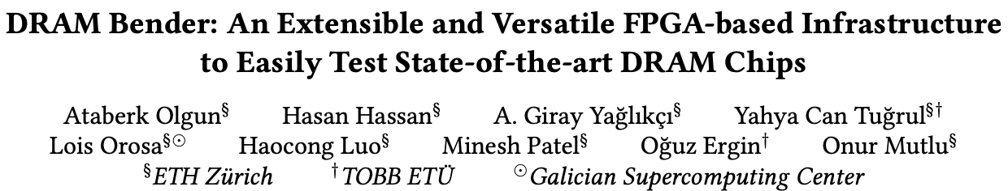
DRAM Bender
Ataberk Olgun, Hasan Hassan, A Giray Yağlıkçı, Yahya Can Tuğrul, Lois Orosa, Haocong Luo, Minesh Patel, Oğuz Ergin, and Onur Mutlu,
"DRAM Bender: An Extensible and Versatile FPGA-based Infrastructure to Easily Test State-of-the-art DRAM Chips"
IEEE Transactions on Computer-Aided Design of Integrated Circuits and Systems (TCAD), 2023.
[Extended arXiv version]
[DRAM Bender Source Code]
[DRAM Bender Tutorial Video (43 minutes)]
https://github.com/CMU-SAFARI/DRAM-Bender

Slide 68
DRAM Bender
An Extensible and Versatile
FPGA-based Infrastructure to
Easily Test State-of-the-art DRAM Chips
Ataberk Olgun
Yahya Can Tugrul
Minesh Patel
Hasan Hassan
Lois Orosa
Oguz Ergin
A. Giray Yaglikci
Haocong Luo
Onur Mutlu

Slide 69
BACKUP SLIDES

Slide 70
Accessing a DRAM Cell
wordline
capacitor
bitline
access transistor
Sense Amp
enable
[Seshadri+ MICRO’17]
Notes:
Here is how we access this DRAM cell. This is a diagram showing how a DRAM cell is connected to a sense amplifier.
[CLICK] A DRAM cell contains two components, the capacitor stores data and the access transistor determines if the cell is being accessed.
[CLICK] The access transistor is controlled by the wordline, which is enabled to
[CLICK] connect the DRAM cell to its bitline
[CLICK] The bitline bar is esentially the inverse of the bitline
[CLICK] The DRAM sense amplifier has an enable signal which determines if the sense amplifier is currently active.

Slide 71
Accessing a DRAM Cell
4
deviation in bitline voltage
enable wordline
wordline
1
½ V_{DD} + δ
V_{DD}
½ V_{DD}
capacitor
bitline
access transistor
2
connects cell to bitline
3
cell charge restored
cell loses charge to bitline
6
Sense Amp
enable sense amp
enable
5
[Seshadri+ MICRO’17]
Notes:
Initially, both the access transistor and the sense amplifier are disabled and both ends of the sense amplifier are maintained at half vdd. In this example, the capacitor is fully charged. To access the cell
[CLICK] we first enable the wordline, [CLICK] this connects the capacitor to its bitline.
[CLICK] Since the capacitor has a voltage level higher than the bitline, the charge starts flowing from the capacitor to the bitline, [CLICK] resulting in the bitline voltage to deviate slightly towards Vdd.
[CLICK] When we enable the sense amplifier, it will compare the voltage levels of bitline and bitline bar, and [CLICK] amplify the deviation until bitline voltage reaches Vdd.
[CLICK] Since the capacitor is still connected to the bitline, the amplification process also restores the charge in the capacitor.

Slide 72
alloc_align() function
SubArray Mapping Table (SAMT) enables alloc_align()
SAMT
SAMT
Entry
Physical addresses
of DRAM rows
Subarray 0
Subarray 1
…
Subarray N
alloc_align(
4 KiB, “Subarray 0”)
1
2
Page
Table
SAMT
1
Retrieve a physical address pointing to a DRAM row in subarray 0
2
Update the page table to map programmer-allocated address to subarray 0
Notes:
We implement a key structure in the supervisor software called subarray mapping table, to enable alloc_align().
[CLICK] SAMT is organized as a table of entries per DRAM subarray
[CLICK] Each SAMT entry contains a list of physical addresses that point to the DRAM rows in that subarray
[CLICK] An example alloc align call to allocate four kibs of data in subarray 0 [CLICK] accesses SAMT to retrieve a physical address pointing to a DRAM row in subarray 0, and then [CLICK] updates the page table to map the virtual address allocated for the programmer to subarray 0
This way, we allocate different virtual pages to the same DRAM subarray, such that we can use in-DRAM copy operations to copy data from and to these pages

Slide 73
Initializing SAMT
SAMT
SAMT
Entry
Physical addresses
of DRAM rows
Subarray 0
?
Subarray 1
…
Subarray N
Perform in-DRAM copy using every DRAM row address
as source and destination rows
If the in-DRAM copy operation succeeds
source and destination rows are in the same subarray
Notes:
[CLICK] To find physical addresses of the DRAM rows that map to a subarray,
[CLICK] We perform an experiment in our prototype where we try to copy data in-DRAM from every row address to every other row address.
[CLICK] We conclude that if the operation succeeds, the source and the destination row addresses we used must belong in the same subarray.
[CLICK] Please read our full paper in arXiv for more details on how our allocation mechanism works

Slide 74
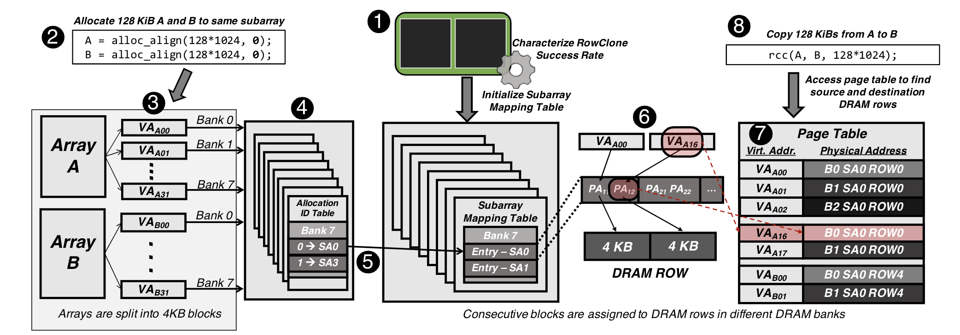

Slide 75
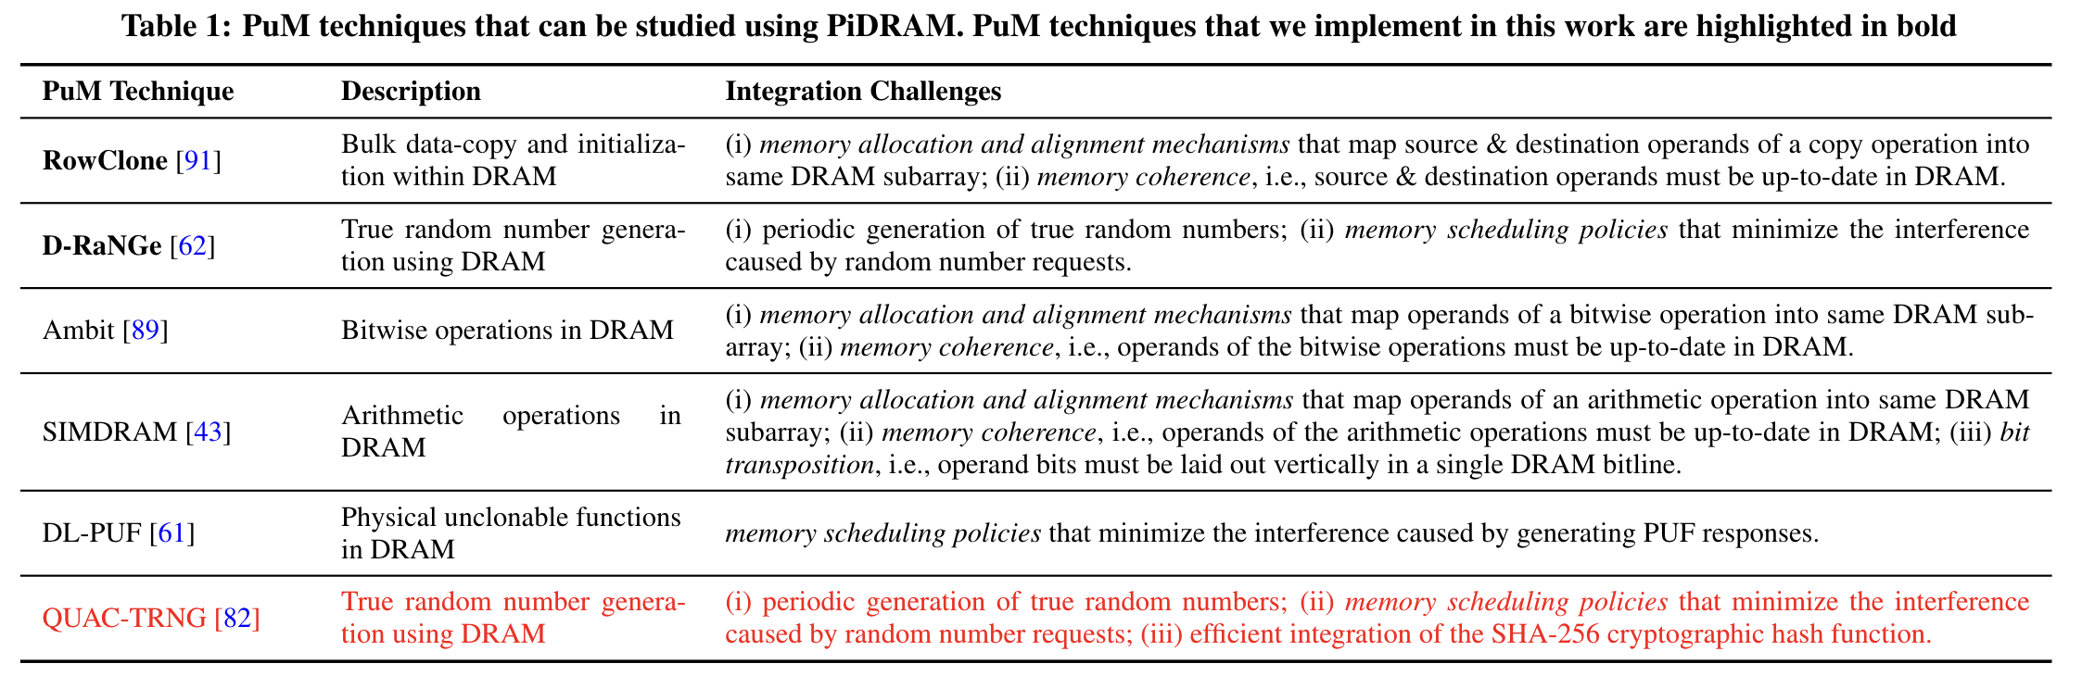

Slide 76
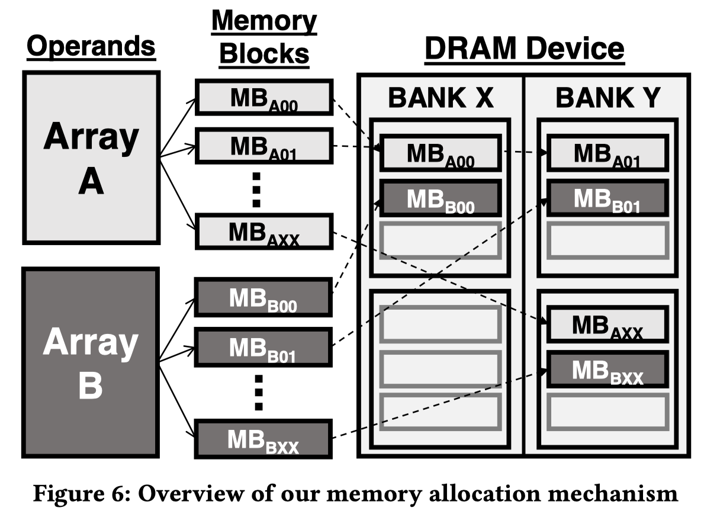

Slide 77
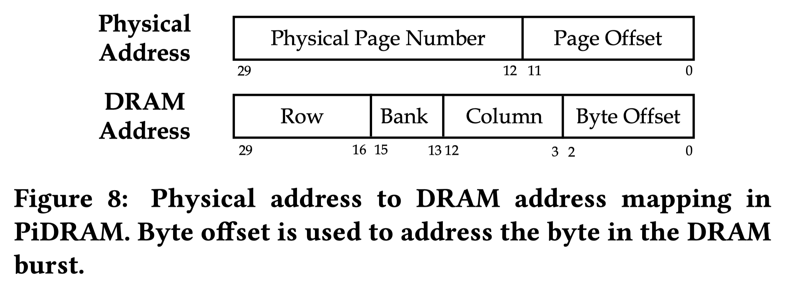

Slide 78
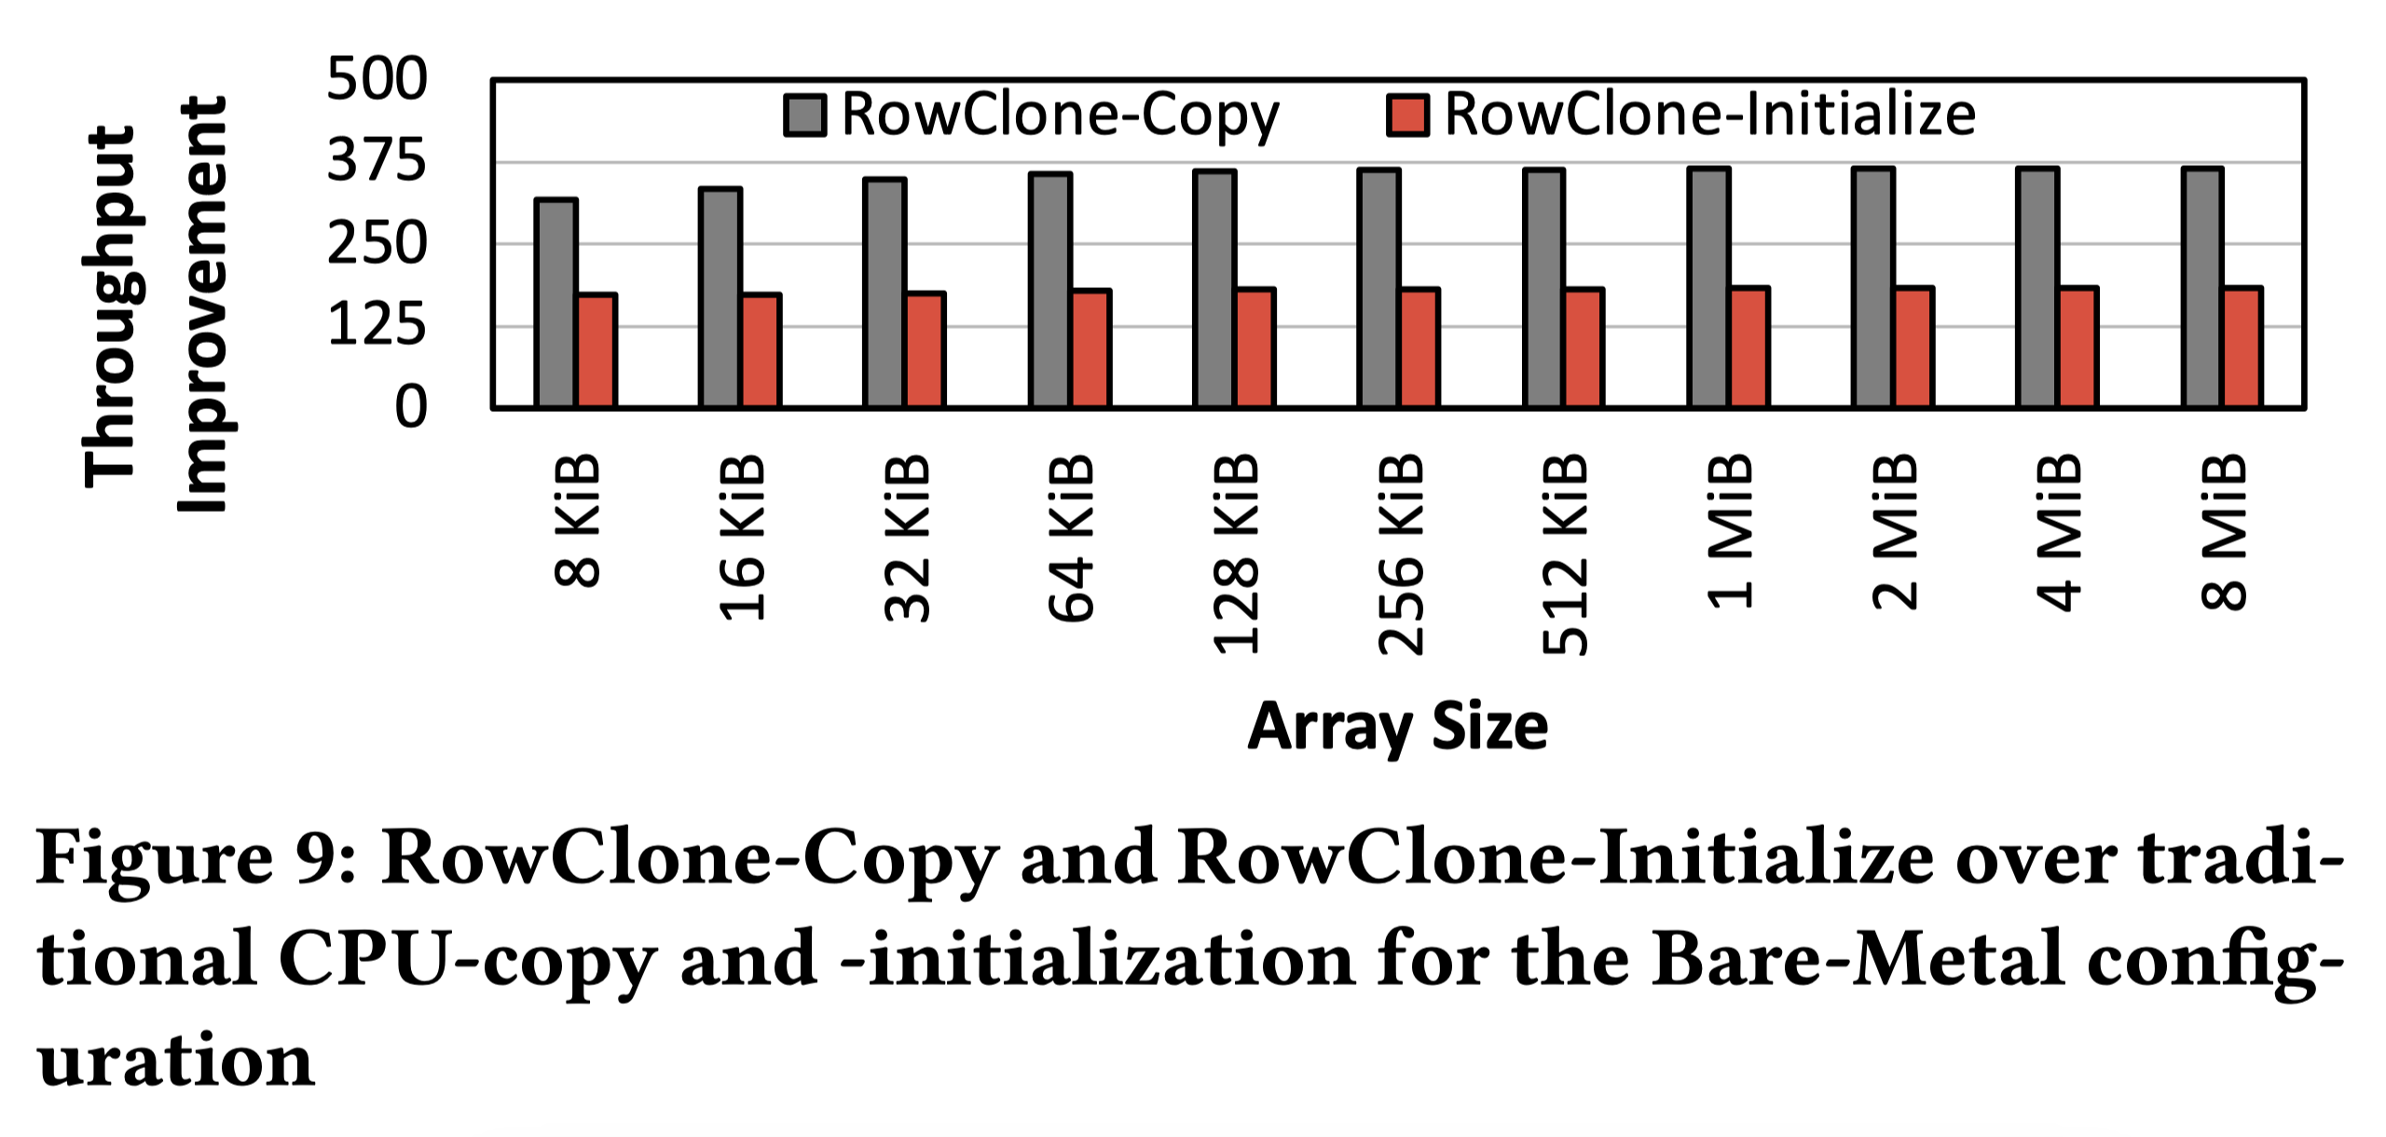

Slide 79
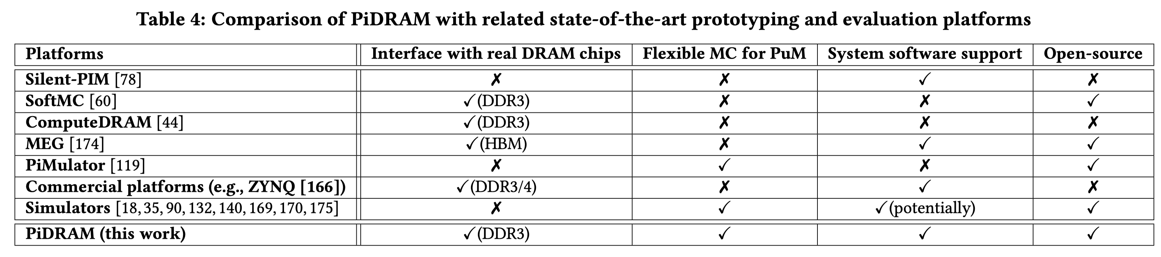

Slide 80
DRAM Organization
…
…
…
[Olgun+ ISCA’21]
Notes:
A processor’s memory controller
[CLICK] communicates with a set of DRAM chips within a DRAM module through a memory channel.
[CLICK] Each DRAM chip contains multiple banks that share a common chip I/O interface.
[CLICK] DRAM banks are organized into subarrays that consists of a set of wordline drivers and sense amplifiers
[CLICK] Subarrays are partitioned into DRAM MATs which are collections of DRAM cells that are separated from each other by wordline drivers.
[CLICK] DRAM cells are laid out onto a two-dimensional array of wordlines and bitlines within
a DRAM MAT. A row of DRAM cells is a DRAM row.
[CLICK] Here is a simplified diagram of a DRAM cell.

Slide 81
DRAM Operation
Cache line
…
Wordline Drivers
…
…
…
…
…
Sense Amplifiers
Sense Amplifiers
Sense Amplifiers
READ
READ
READ
READ
READ
READ
(Activation Latency)
(Access Latency)
(Precharge Latency)
DRAM Command Sequence
ACT R0
RD
RD
RD
PRE R0
ACT R1
RD
RD
RD
time
[Kim+ HPCA’19]
Notes:
Now we will look at how DRAM operates at the scope of a single subarray.
[CLICK] Because memory controllers typically access DRAM cells in the granularity of a cache line or a cache block we combine consecutive DRAM cells to form cache lines in this diagram.
[CLICK] On the bottom we have a timeline of DRAM commands.
[CLICK] First, we activate the first row to [CLICK] copy its cache lines to the sense amplifiers
[CLICK] At this point we can read data [CLICK] in cache line granularity from the sense [CLICK] amplifiers by sending READ commands
[CLICK] To access another row, we must first precharge the DRAM bank which closes the open DRAM row and sets the bitline voltage to half Vdd.
[CLICK] We can now activate the [CLICK] second row before [CLICK] [CLICK] [CLICK] reading data from it.
[CLICK] To ensure correct operation, we must obey certain timing parameters that define intervals between DRAM command pairs.
Three important timing parameters are tRAS, tRP, and tRCD
[CLICK] tRAS is the time required for the charge to become restored in the capacitors on the open row. tRAS dictates the amount of time we need to wait between successive activate and precharge commands
[CLICK] tRP is the time it takes for a bitline to become precharged to half Vdd such that a new activate command can be issued to open a DRAM row. Successive precharge and activate commands must be separated on the command bus by at least a tRP amount of time.
[CLICK] tRCD is the time it takes for sense amplifiers to amplify the bitline voltage to an I/O readable value. Successive activate and read commands must be separated by a tRCD amount of time.

Slide 82
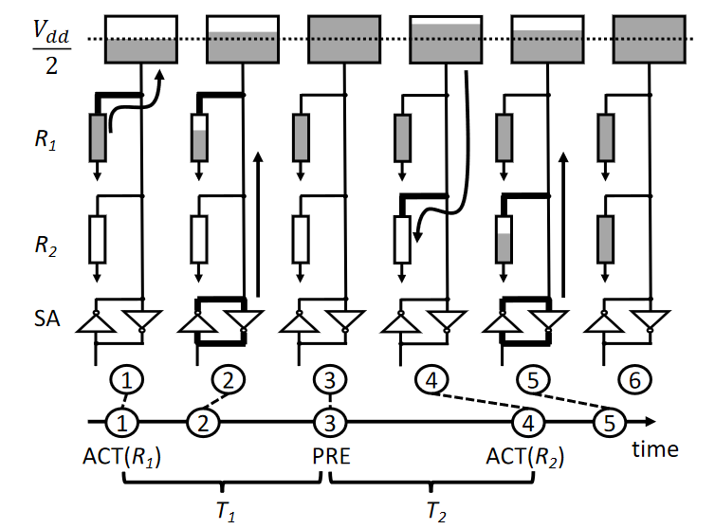
Row-copy in ComputeDRAM
[Gao+, MICRO’19]
Notes:
Simplified diagram of two cells on the same bitline
Top box: bitline voltage
R1 and R2 are two cells from two rows. Color of cells indicate their voltage level. We want to copy R1 to R2.
T1 and T2 around 10 nanoseconds (which is below standard timings) work

Slide 83

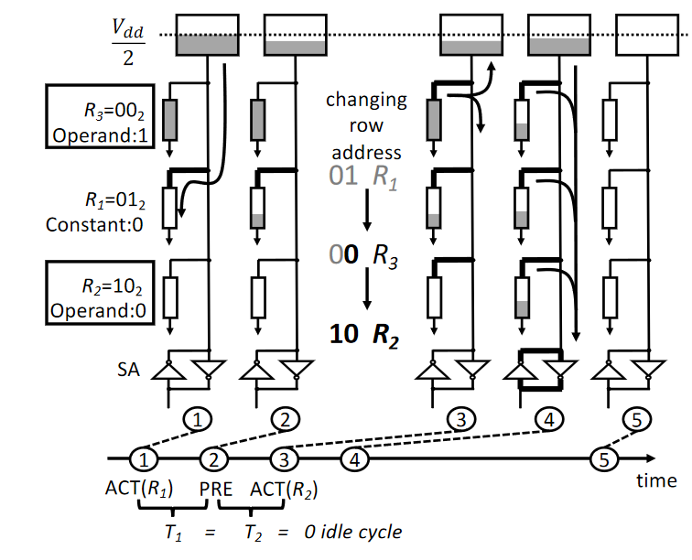
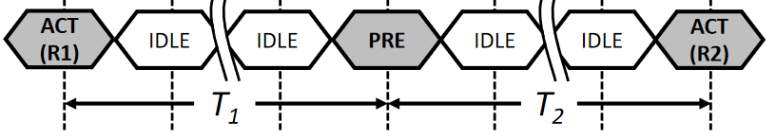
More in ComputeDRAM
Majority Function
Row-copy/Majority
Characterization
32 DDR3 Modules
~256 DRAM Chips

