Slide 1
MICRO 2023 Tutorial
Real-world Processing-in-Memory Systems for Modern Workloads
Processing-Near-Memory
Real PNM Architectures
Programming General-purpose PIM
Dr. Juan Gómez Luna
Professor Onur Mutlu
Sunday, October 29, 2023

Slide 2
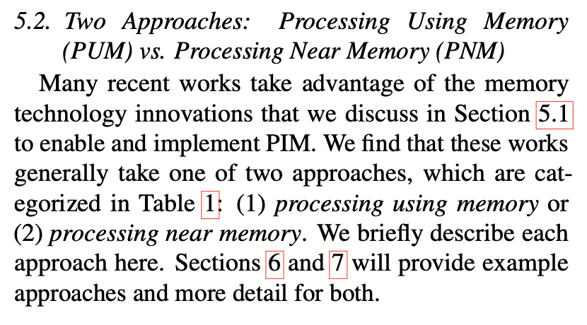
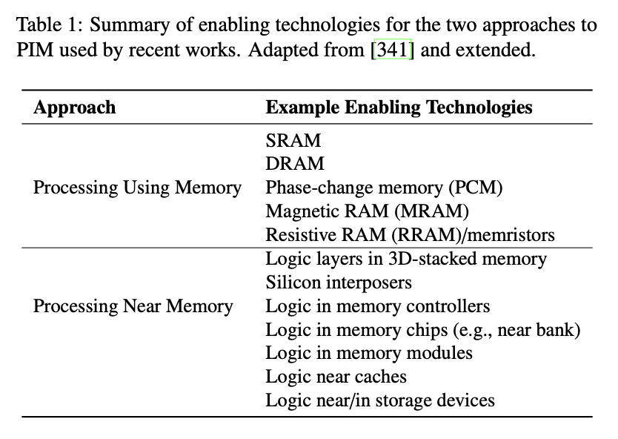
Two PIM Approaches
Onur Mutlu, Saugata Ghose, Juan Gomez-Luna, and Rachata Ausavarungnirun,
"A Modern Primer on Processing in Memory"
Invited Book Chapter in Emerging Computing: From Devices to Systems - Looking Beyond Moore and Von Neumann, Springer, 2022.
[Tutorial Video on "Memory-Centric Computing Systems" (1 hour 51 minutes)]
https://people.inf.ethz.ch/omutlu/pub/ModernPrimerOnPIM_springer-emerging-computing-bookchapter21.pdf

Slide 3
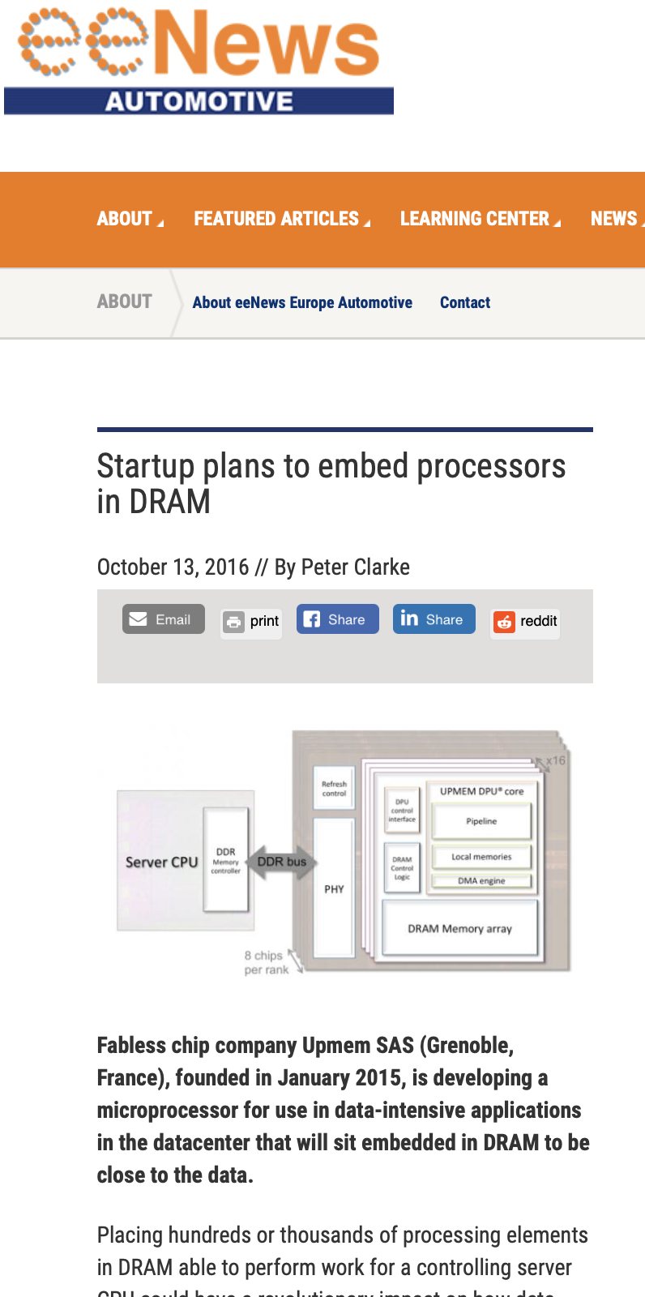
PIM Becomes Real
UPMEM, founded in January 2015, announces the first real-world PIM architecture in 2016
UPMEM’s PIM-enabled DIMMs start getting commercialized in 2019
In early 2021, Samsung announces FIMDRAM at ISSCC conference
Samsung’s LP-DDR5 and DIMM-based PIM announced a few months later
In early 2022, SK Hynix announces AiM and Alibaba announces HB-PNM at ISSCC conference
https://www.eenewsautomotive.com/news/startup-plans-embed-processors-dram-0#

Slide 4
UPMEM PIM

Slide 5
UPMEM Processing-in-DRAM Engine (2019)
Processing in DRAM Engine
Includes standard DIMM modules, with a large number of DPU processors combined with DRAM chips.
Replaces standard DIMMs
  DDR4 R-DIMM modules
    8GB+128 DPUs (16 PIM chips)
    Standard 2x-nm DRAM process
  Large amounts of compute & memory bandwidth
CPU
(x86, ARM, RV…)
DDR
Data bus
https://www.anandtech.com/show/14750/hot-chips-31-analysis-inmemory-processing-by-upmem
https://www.upmem.com/video-upmem-presenting-its-true-processing-in-memory-solution-hot-chips-2019/

Slide 6
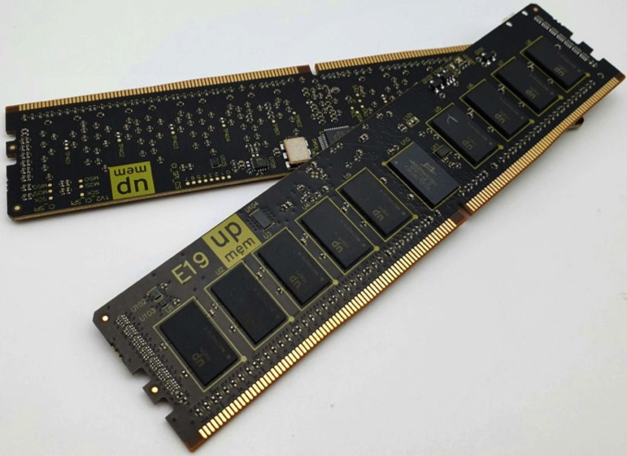
UPMEM DIMMs
E19: 8 chips/DIMM (1 rank). DPUs @ 267 MHz
P21: 16 chips/DIMM (2 ranks). DPUs @ 350 MHz
www.upmem.com

Slide 7
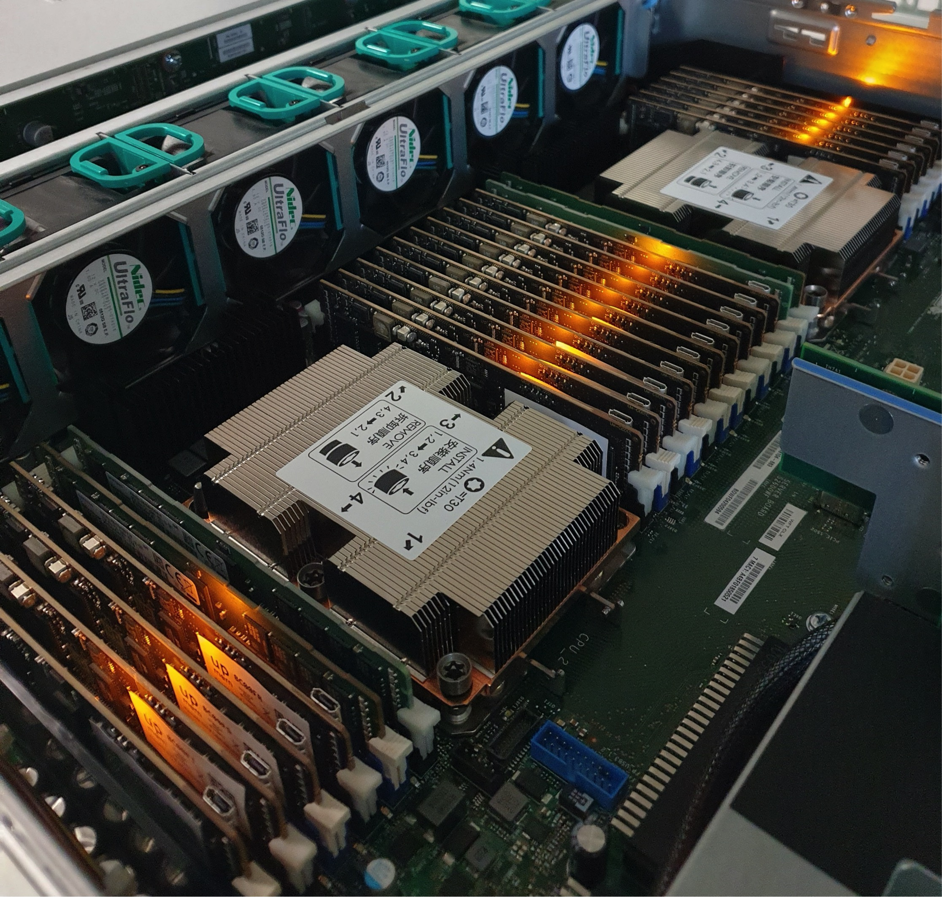
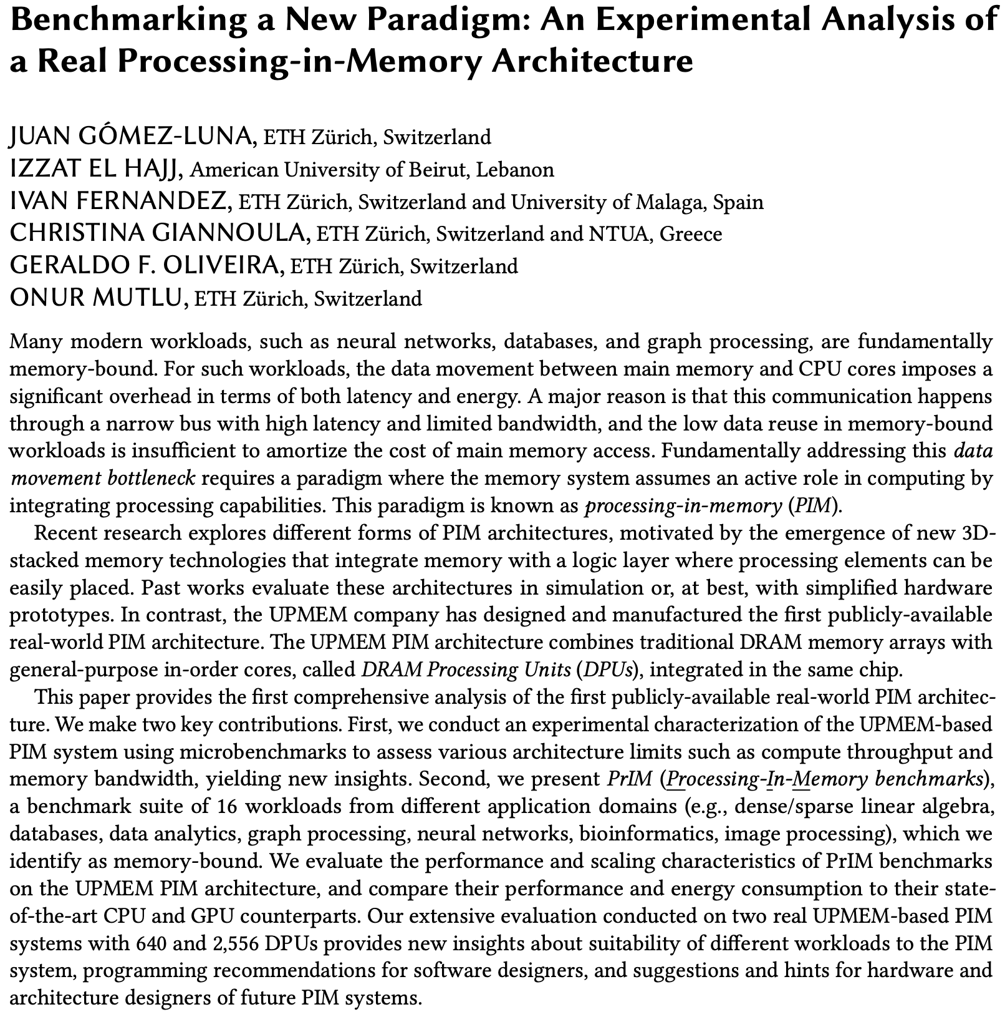
2,560-DPU Processing-in-Memory System
https://arxiv.org/pdf/2105.03814.pdf

Slide 8
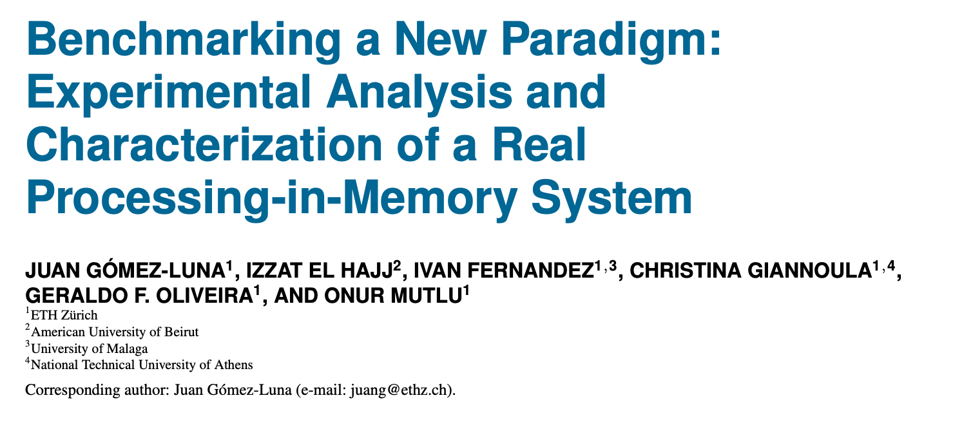
Understanding a Modern PIM Architecture
https://arxiv.org/pdf/2105.03814.pdf
https://github.com/CMU-SAFARI/prim-benchmarks

Slide 9
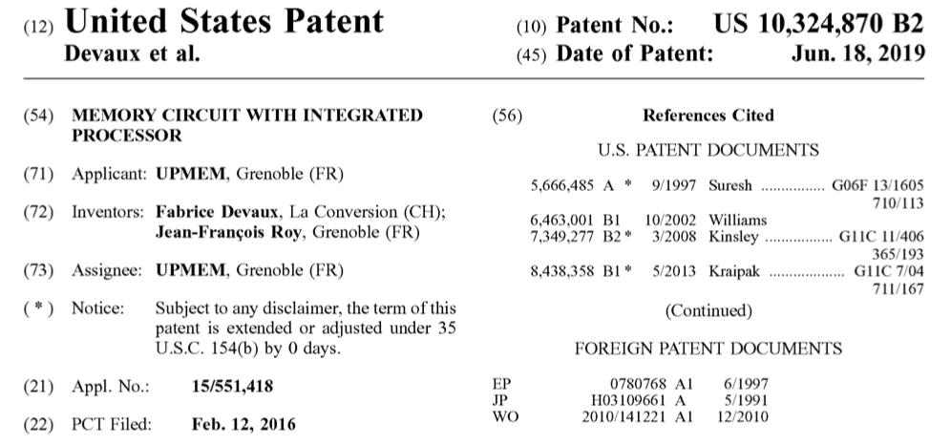
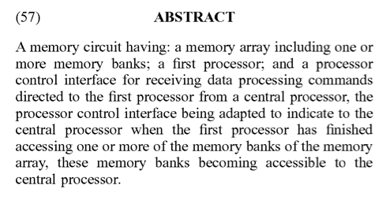
UPMEM Patent
Fabrice Devaux, Jean-François Roy. “Memory circuit with integrated processor.” US 10,324,870 B2.

Slide 10
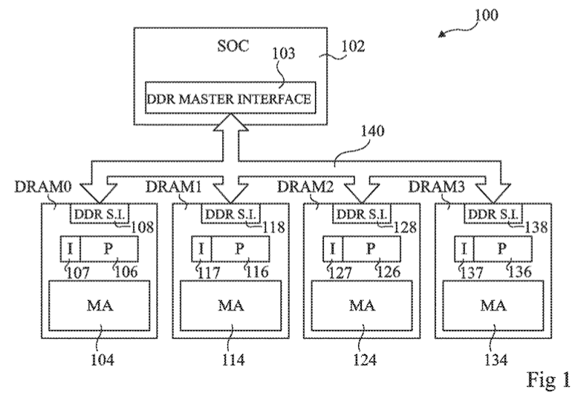
UPMEM PIM System Organization (I)
FIG. 1 schematically illustrates a computing system comprising DRAM circuits having integrated processors according to an example embodiment
Fabrice Devaux, Jean-François Roy. “Memory circuit with integrated processor.” US 10,324,870 B2.

Slide 11
UPMEM PIM System Organization (II)
In a UPMEM-based PIM system UPMEM DIMMs coexist with regular DDR4 DIMMs
Notes:
P21 DIMMs.
DPUs cannot be shared. There is a large number of DPUs.
No need for OS.
This simplifies security implications. No side channels.

Slide 12
UPMEM PIM System Organization (III)
A UPMEM DIMM contains 8 or 16 chips
  Thus, 1 or 2 ranks of 8 chips each
Inside each PIM chip there are:
  8 64MB banks per chip: Main RAM (MRAM) banks
  8 DRAM Processing Units (DPUs) in each chip, 64 DPUs per rank

Slide 13
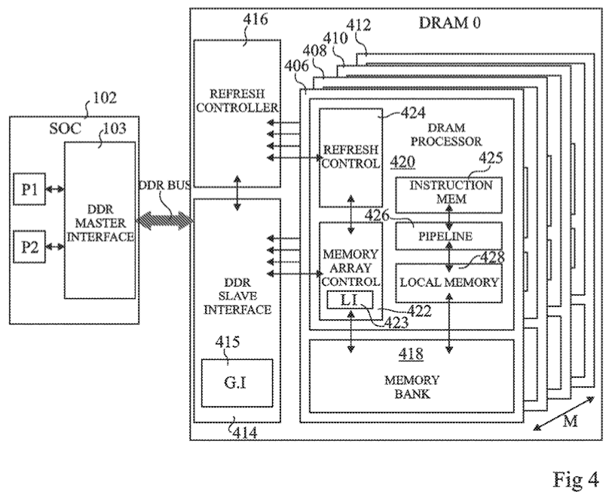
DRAM Processing Unit (I)
FIG. 4 schematically illustrates part of the computing system of FIG. 1 in more detail according to an example embodiment
Fabrice Devaux, Jean-François Roy. “Memory circuit with integrated processor.” US 10,324,870 B2.

Slide 14
DRAM Processing Unit (II)

Slide 15
DPU Pipeline
In-order pipeline
  Up to 425 MHz
Fine-grain multithreaded
  24 hardware threads
14 pipeline stages
  DISPATCH: Thread selection
  FETCH: Instruction fetch
  READOP: Register file
  FORMAT: Operand formatting
  ALU: Operation and WRAM
  MERGE: Result formatting
To the DMA engine

Slide 16
Fine-grained Multithreading

Slide 17
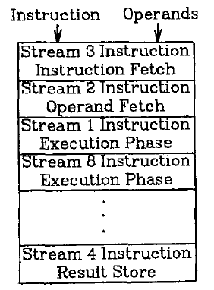
Fine-Grained Multithreading (I)
Idea: Hardware has multiple thread contexts (PC+registers). Each cycle, fetch engine fetches from a different thread
  By the time the fetched branch/instruction resolves, no instruction is fetched from the same thread
  Branch/instruction resolution latency overlapped with execution of other threads’ instructions
+ No logic needed for handling control and
data dependences within a thread
-- Single thread performance suffers
-- Extra logic for keeping thread contexts
-- Does not overlap latency if not enough
threads to cover the whole pipeline
Notes:
Latency overlap/hiding

Slide 18
Fine-Grained Multithreading (II)
Idea: Switch to another thread every cycle such that no two instructions from a thread are in the pipeline concurrently
Tolerates the control and data dependence latencies by overlapping the latency with useful work from other threads
Improves pipeline utilization by taking advantage of multiple threads
Thornton, “Parallel Operation in the Control Data 6600,” AFIPS 1964
Smith, “A pipelined, shared resource MIMD computer,” ICPP 1978

Slide 19
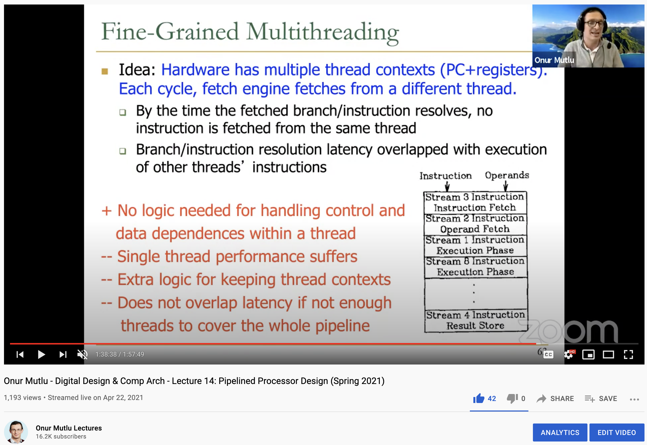
Lecture on Fine-Grained Multithreading
https://www.youtube.com/watch?v=6e5KZcCGBYw&list=PL5Q2soXY2Zi_uej3aY39YB5pfW4SJ7LlN&index=16

Slide 20
DPU Pipeline
In-order pipeline
  Up to 425 MHz
Fine-grain multithreaded
  24 hardware threads
14 pipeline stages
  DISPATCH: Thread selection
  FETCH: Instruction fetch
  READOP: Register file
  FORMAT: Operand formatting
  ALU: Operation and WRAM
  MERGE: Result formatting
To the DMA engine

Slide 21
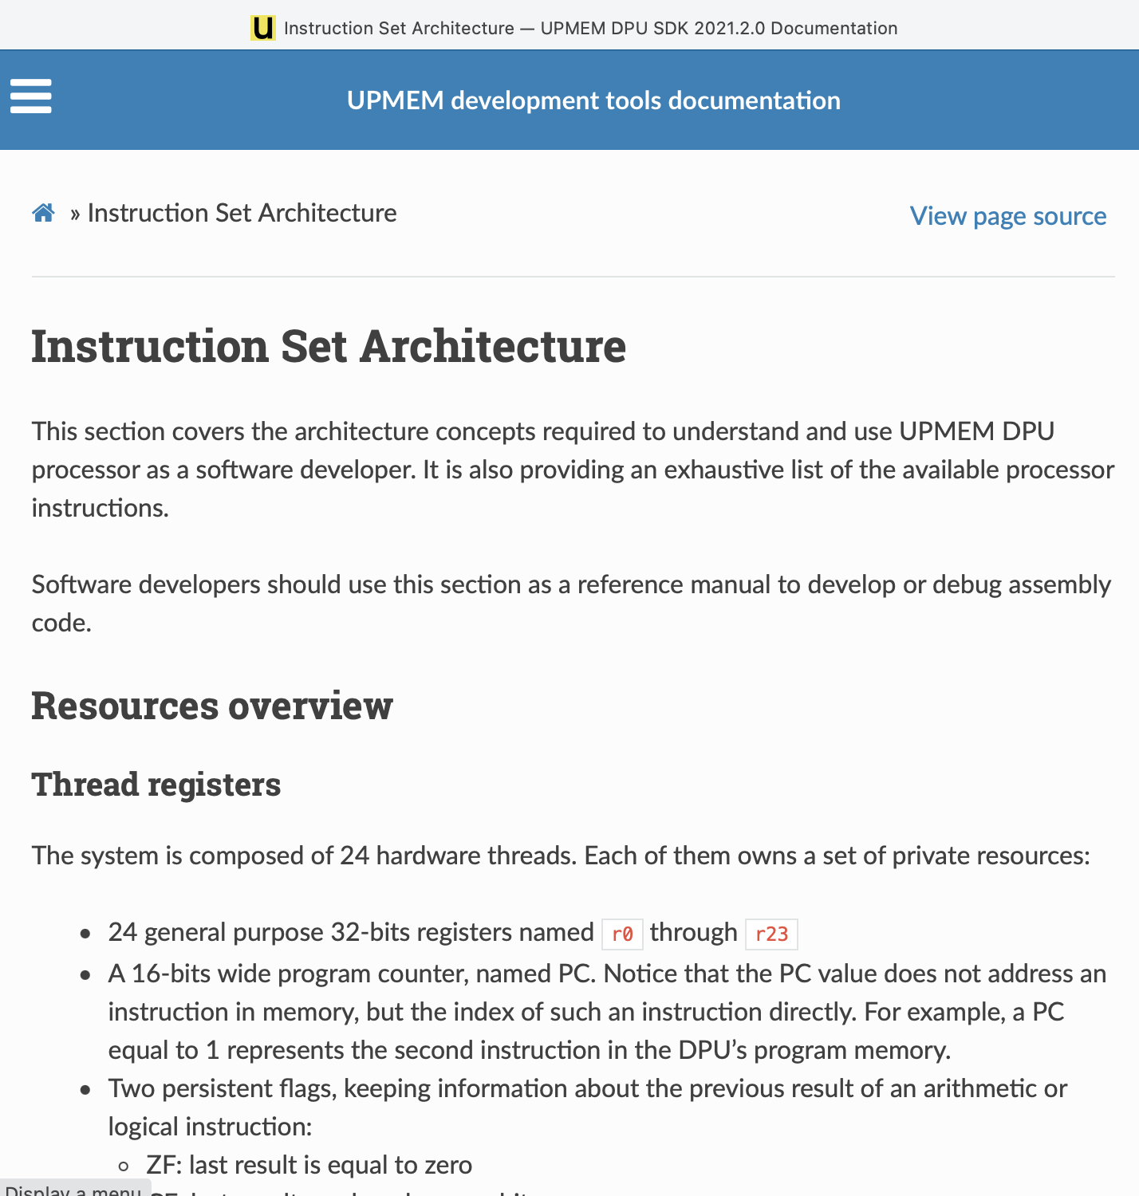
DPU Instruction Set Architecture
Specific 32-bit ISA
  Aiming at scalar, in-order, and multithreaded implementation
  Allowing compilation of 64-bit C code
  LLVM/Clang compiler
https://sdk.upmem.com/2021.2.0/201_IS.html#

Slide 22
Microbenchmark for INT32 ADD Throughput
1 #define SIZE 256
2 int* bufferA = mem_alloc(SIZE * sizeof(int));
3 for(int i = 0; i < SIZE; i++){
4 int temp = bufferA[i];
5 temp += scalar;
6 bufferA[i] = temp;
7 }
1 move r2, 0
2 .LBB0_1: // Loop header
3 lsl_add r3, r0, r2, 2 // Address calculation
4 lw r4, r3, 0 // Load from WRAM
5 add r4, r4, r1 // Add
6 sw r3, 0, r4 // Store to WRAM
7 add r2, r2, 1 // Index update
8 jneq r2, 256, .LBB0_1 // Conditional jump
C-based code
Compiled code (UPMEM DPU ISA)

Slide 23
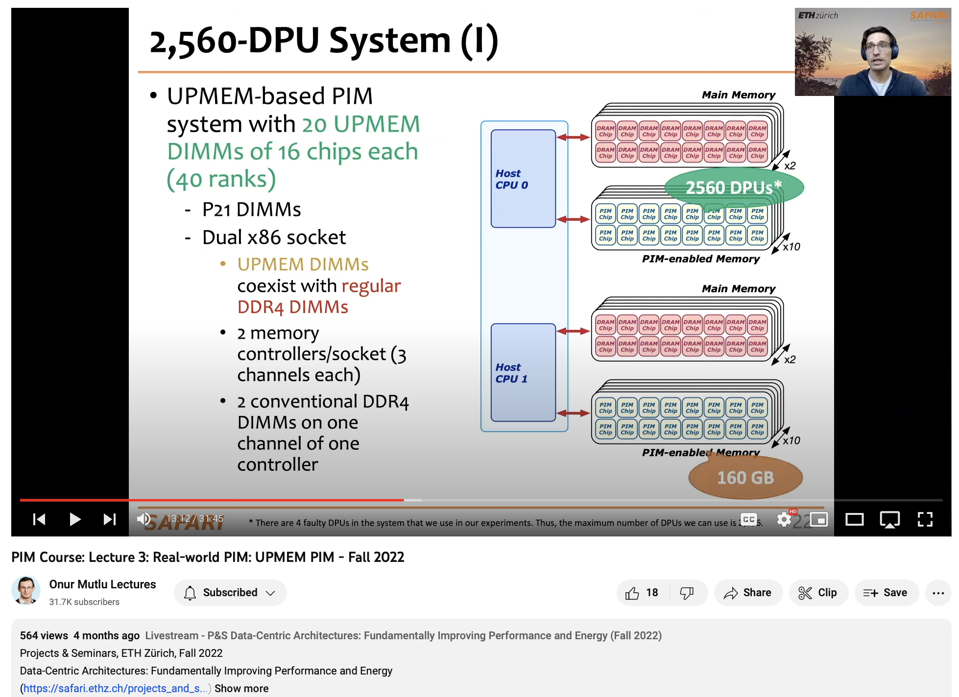
More on the UPMEM PIM Architecture
https://youtu.be/p_sLhKeo6ys
https://youtu.be/7c6x5GJG6dw

Slide 24
Understanding a Modern PIM Architecture
https://arxiv.org/pdf/2105.03814.pdf
https://github.com/CMU-SAFARI/prim-benchmarks

Slide 25
Key Takeaway 1
The throughput saturation point is as low as ¼ OP/B,
i.e., 1 integer addition per every 32-bit element fetched
Memory-bound region
Compute-bound region
KEY TAKEAWAY 1
The UPMEM PIM architecture is fundamentally compute bound.
As a result, the most suitable workloads are memory-bound.

Slide 26
CPU/GPU: Performance Comparison
KEY OBSERVATION
The UPMEM-based PIM system can outperform a state-of-the-art GPU on workloads with three key characteristics:
Streaming memory accesses
No or little inter-DPU synchronization
No or little use of integer multiplication, integer division, or floating point operations
These three key characteristics make a workload potentially suitable to the UPMEM PIM architecture.

Slide 27
Key Takeaway 2
KEY TAKEAWAY 2
The most well-suited workloads for the UPMEM PIM architecture use no arithmetic operations or use only simple operations (e.g., bitwise operations and integer addition/subtraction).

Slide 28
Key Takeaway 3
KEY TAKEAWAY 3
The most well-suited workloads for the UPMEM PIM architecture require little or no communication across DPUs (inter-DPU communication).

Slide 29
Key Takeaway 4
KEY TAKEAWAY 4
• UPMEM-based PIM systems outperform state-of-the-art CPUs in terms of performance (by 23.2× on 2,556 DPUs for 16 PrIM benchmarks) and energy efficiency on most of PrIM benchmarks.
• UPMEM-based PIM systems outperform state-of-the-art GPUs on a majority of PrIM benchmarks (by 2.54× on 2,556 DPUs for 10 PrIM benchmarks), and the outlook is even more positive for future PIM systems.
• UPMEM-based PIM systems are more energy-efficient than state-of-the-art CPUs and GPUs on workloads that they provide performance improvements over the CPUs and the GPUs.

Slide 30
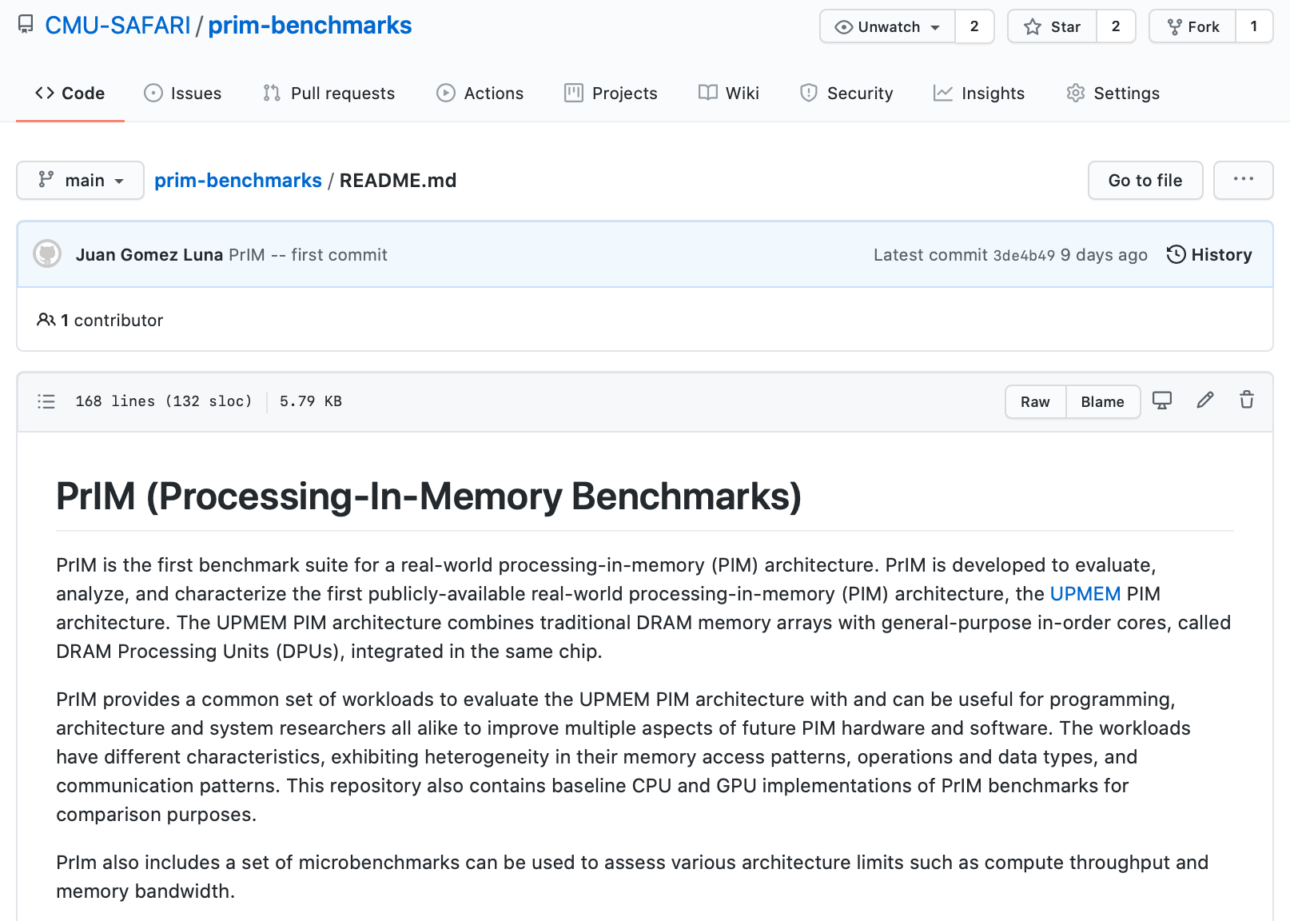
PrIM Repository
All microbenchmarks, benchmarks, and scripts
https://github.com/CMU-SAFARI/prim-benchmarks

Slide 31
Samsung FIMDRAM
(aka HBM-PIM)

Slide 32
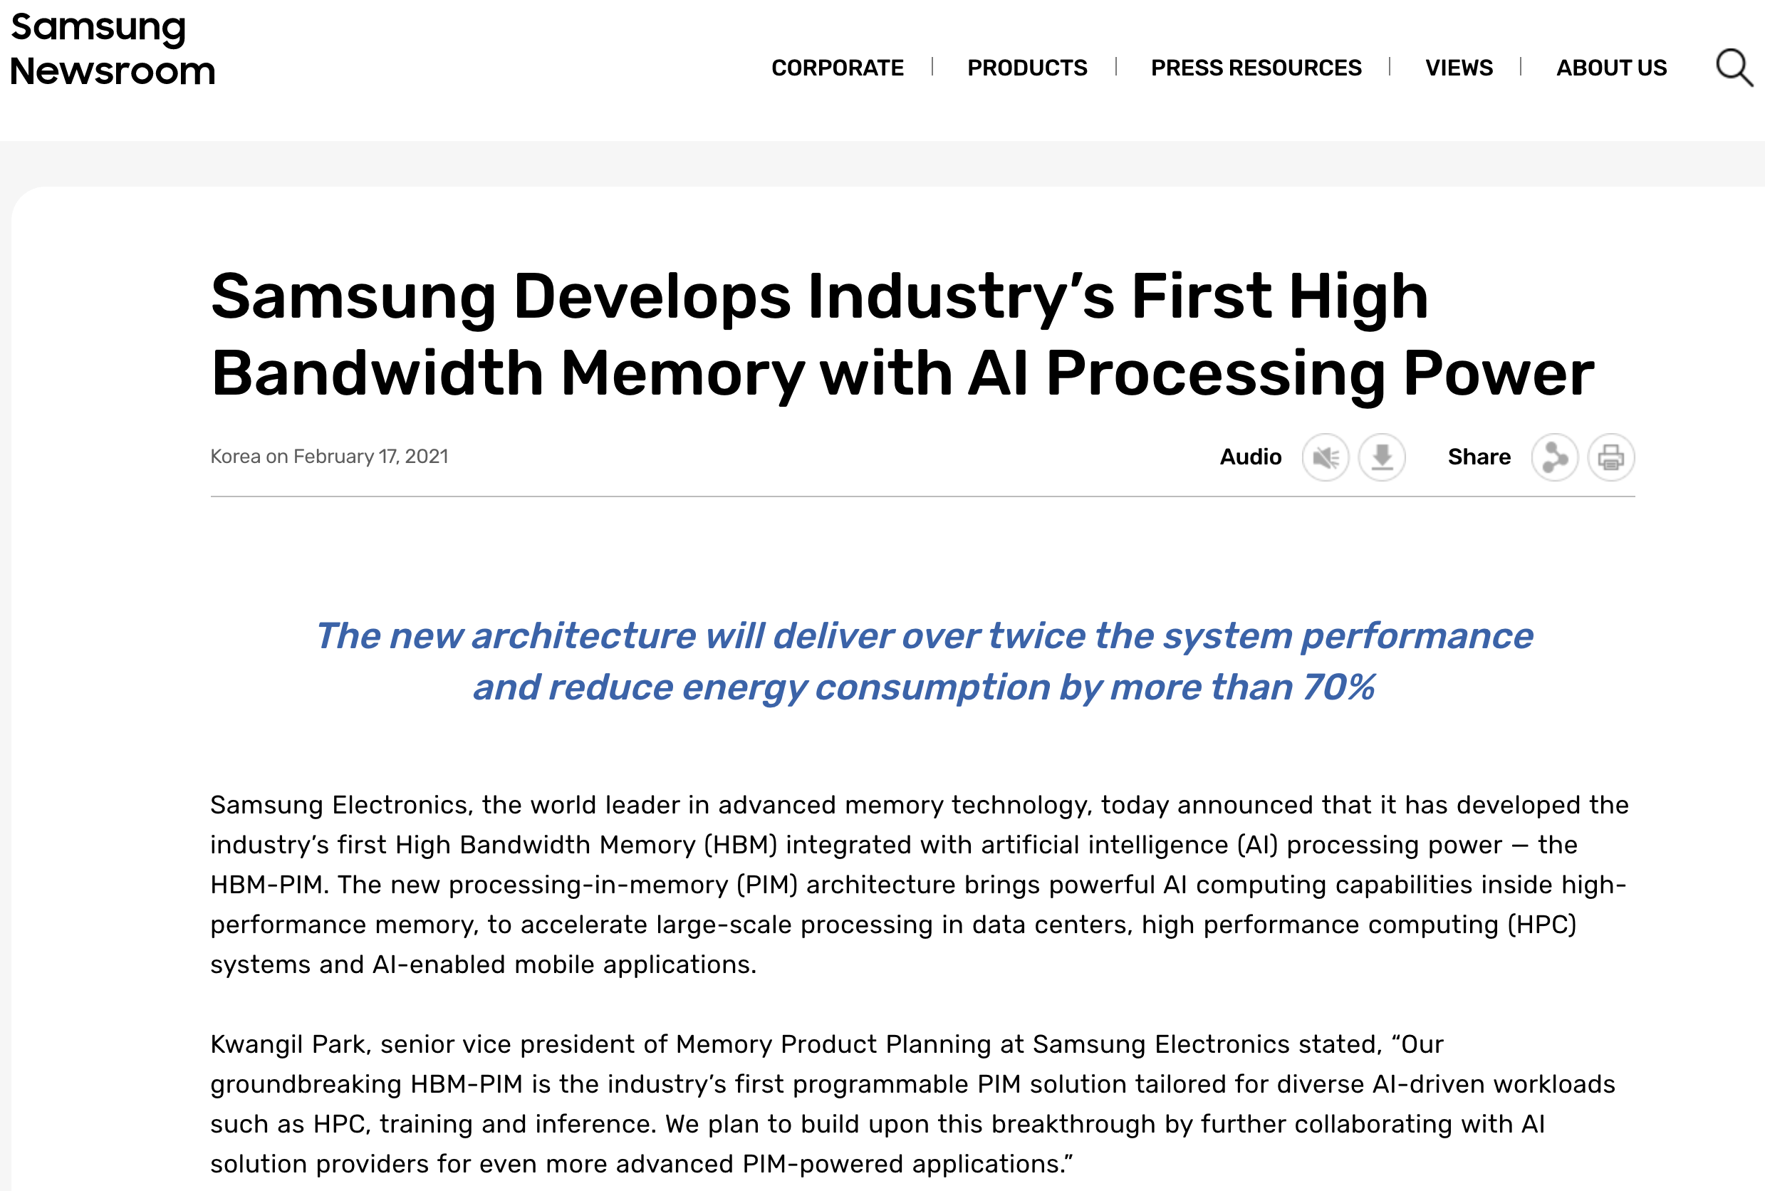
Samsung Function-in-Memory DRAM (2021)
https://news.samsung.com/global/samsung-develops-industrys-first-high-bandwidth-memory-with-ai-processing-power

Slide 33
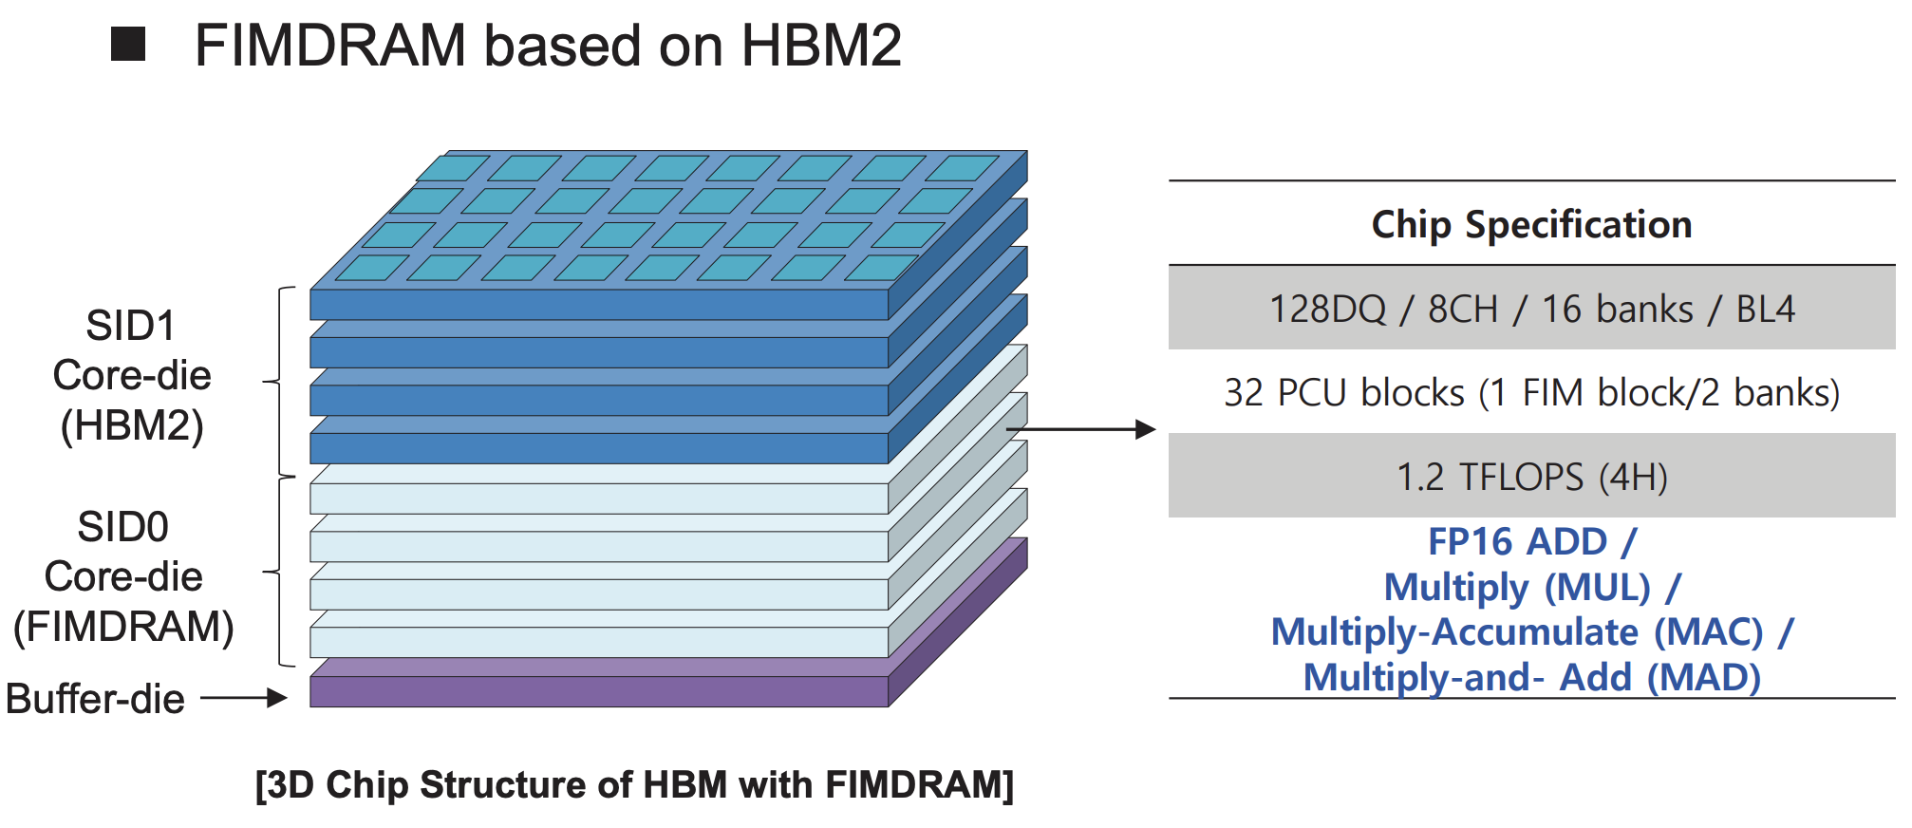
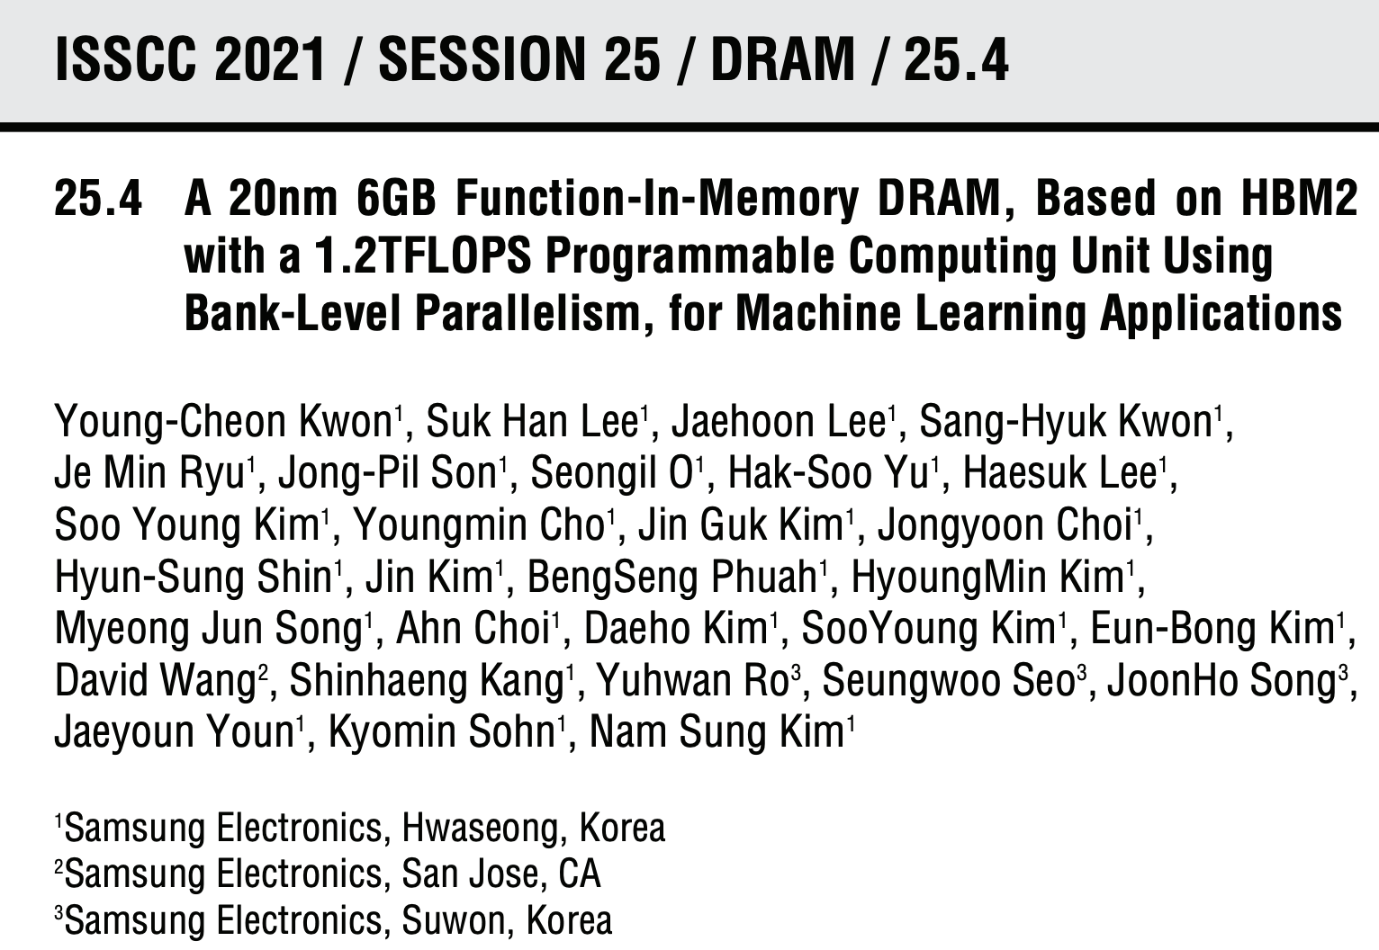
Samsung Function-in-Memory DRAM (2021)

Slide 34
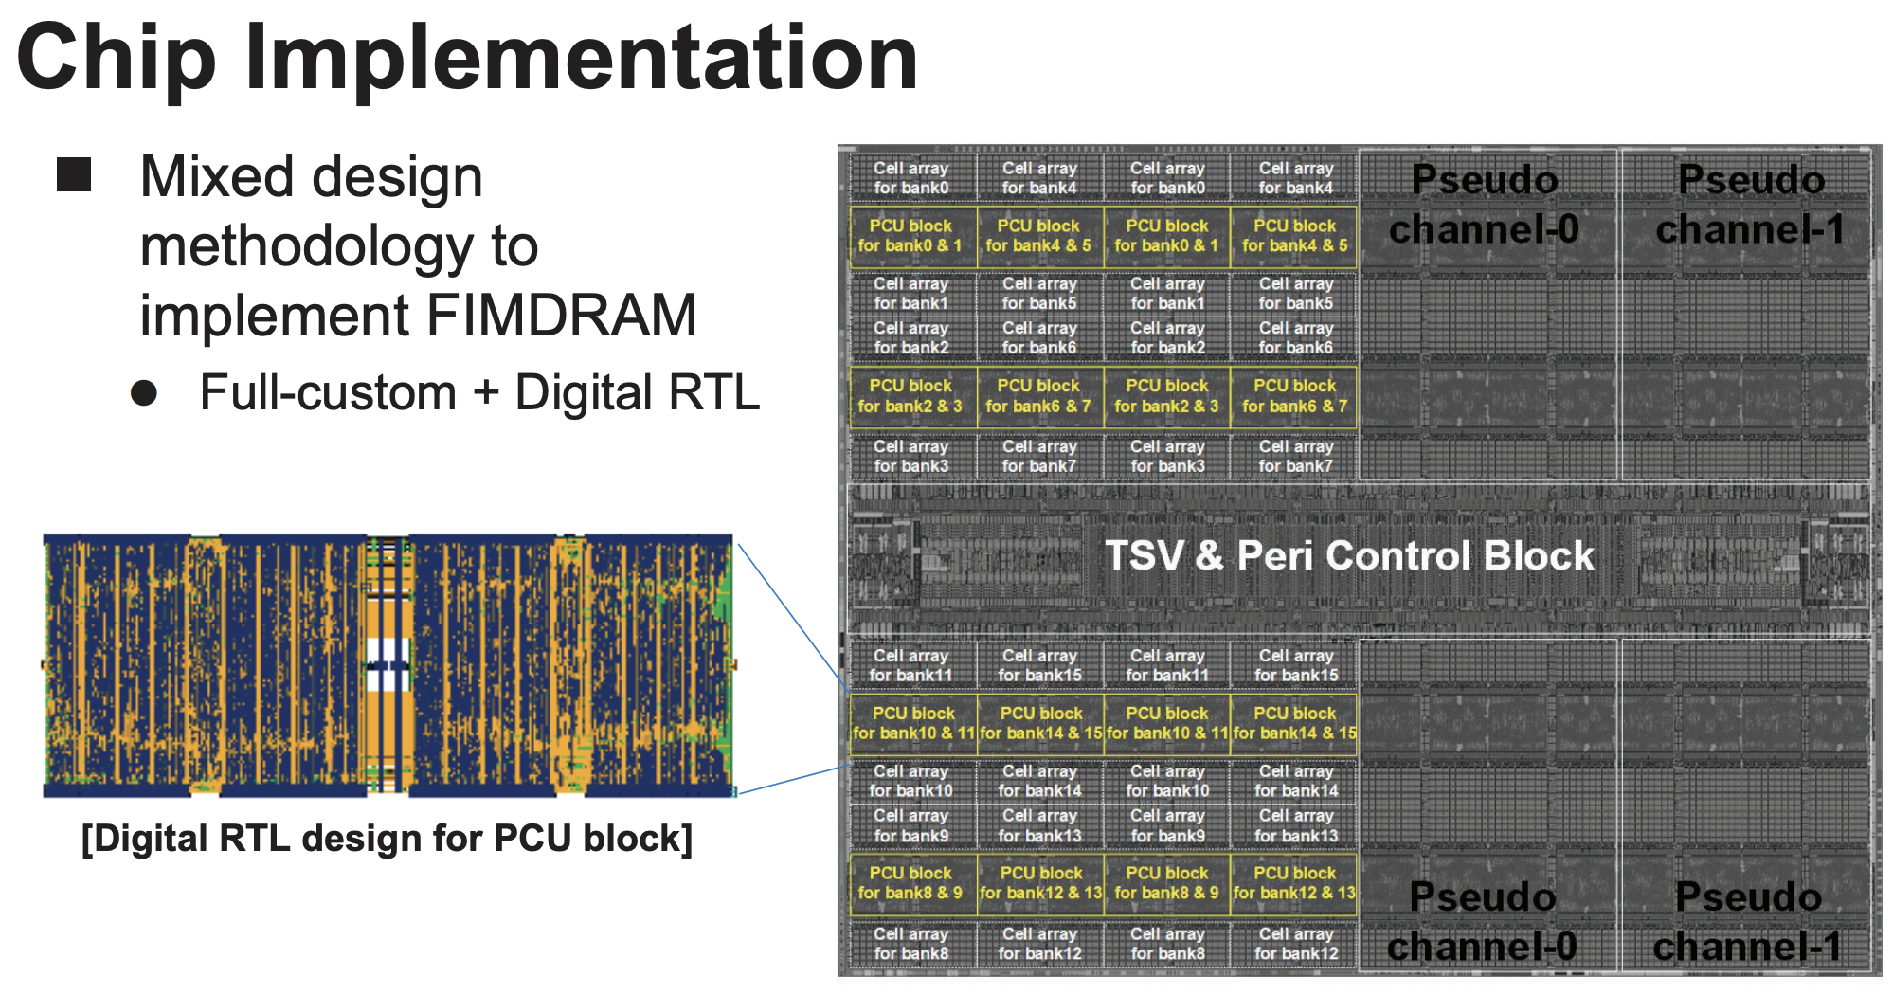
Samsung Function-in-Memory DRAM (2021)

Slide 35
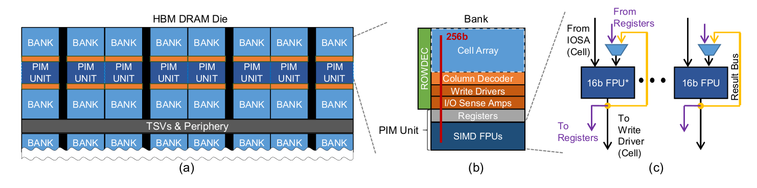
FIMDRAM: System Organization
PIM units respond to standard DRAM column commands (RD or WR)
  Compliant with unmodified JEDEC controllers
They execute one wide-SIMD operation commanded by a PIM instruction with deterministic latency in a lock-step manner
A PIM unit can get 16 16-bit operands from IOSAs, a register, and/or the result bus
Lee et al., Hardware Architecture and Software Stack for PIM Based on Commercial DRAM Technology, ISCA 2021

Slide 36
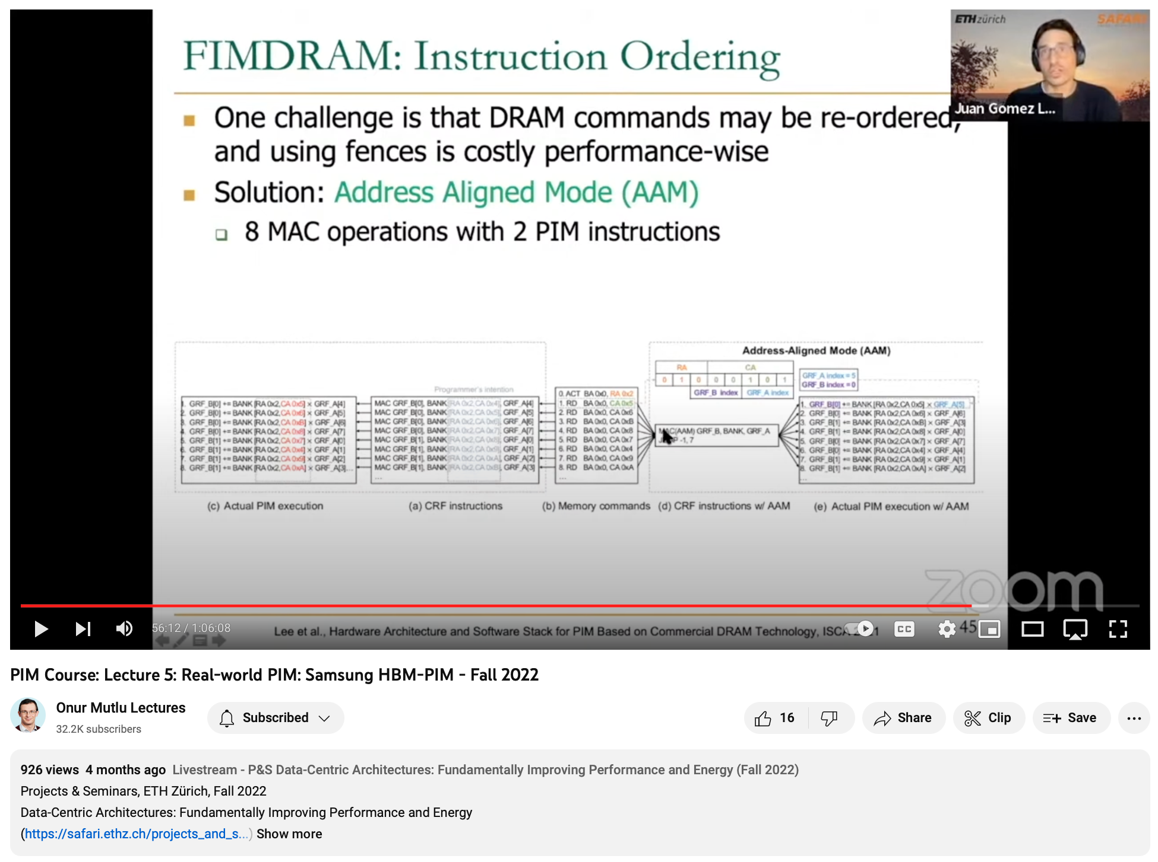
Lecture on FIMDRAM/HBM-PIM
https://youtu.be/67oMjDmeUvo

Slide 37
Samsung AxDIMM

Slide 38
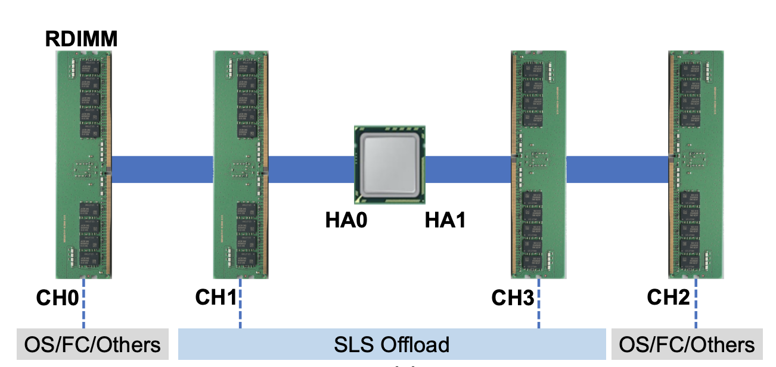
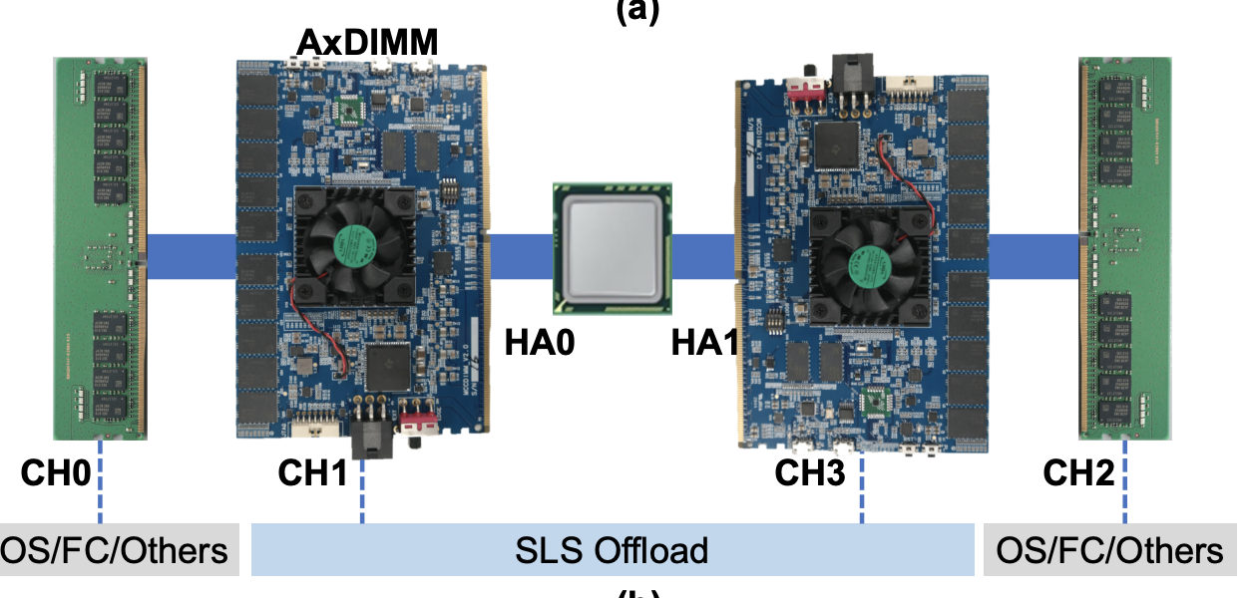
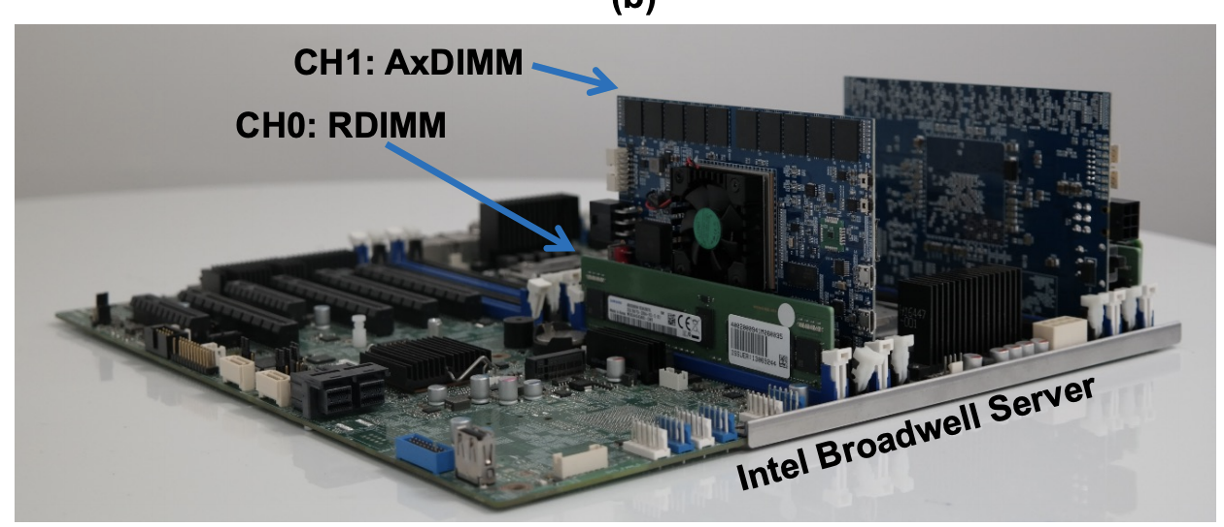
Samsung AxDIMM (2021)
DIMM-based PIM
  DLRM recommendation system
Baseline System
AxDIMM System
Ke et al. "Near-Memory Processing in Action: Accelerating Personalized Recommendation with AxDIMM", IEEE Micro (2021)

Slide 39
AxDIMM Design: Hardware Architecture
DDR4 slave PHY receives DRAM commands and NMP instructions
(via DQ pins) from the host side

Slide 40
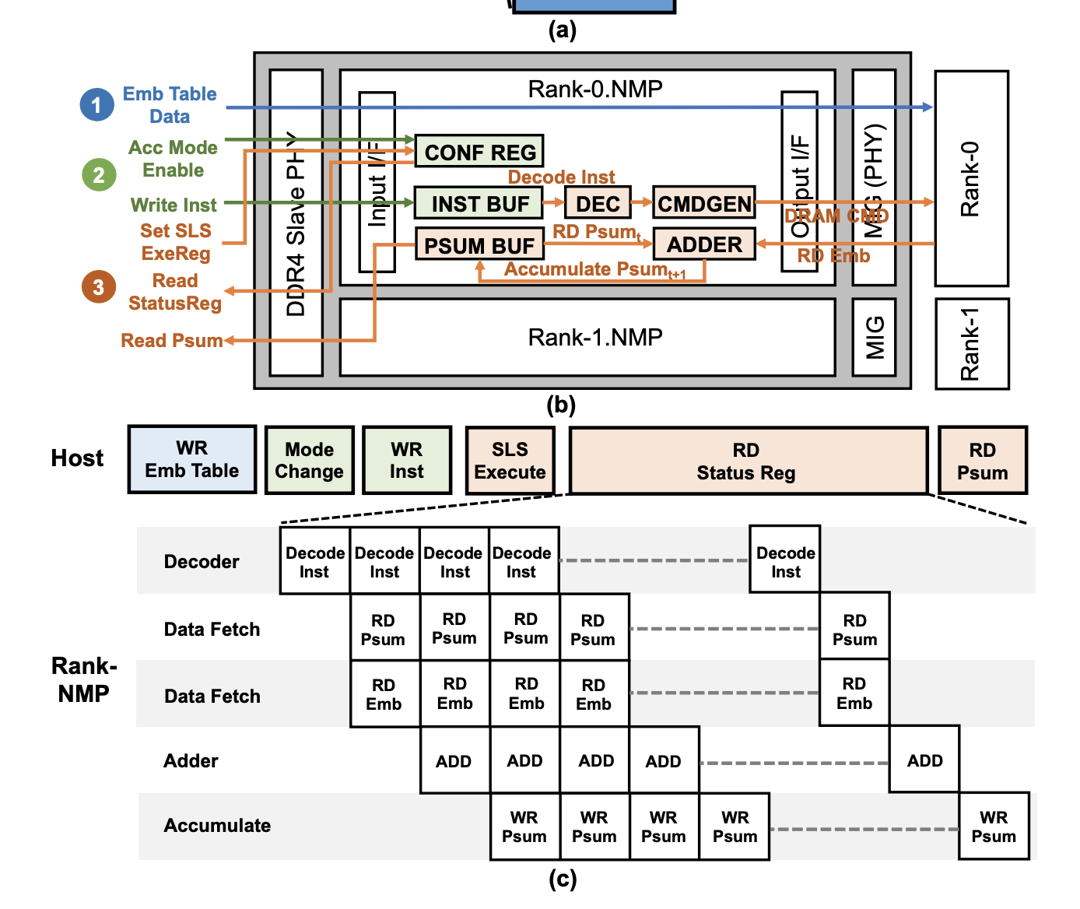
AxDIMM Design: Execution Flow

Slide 41
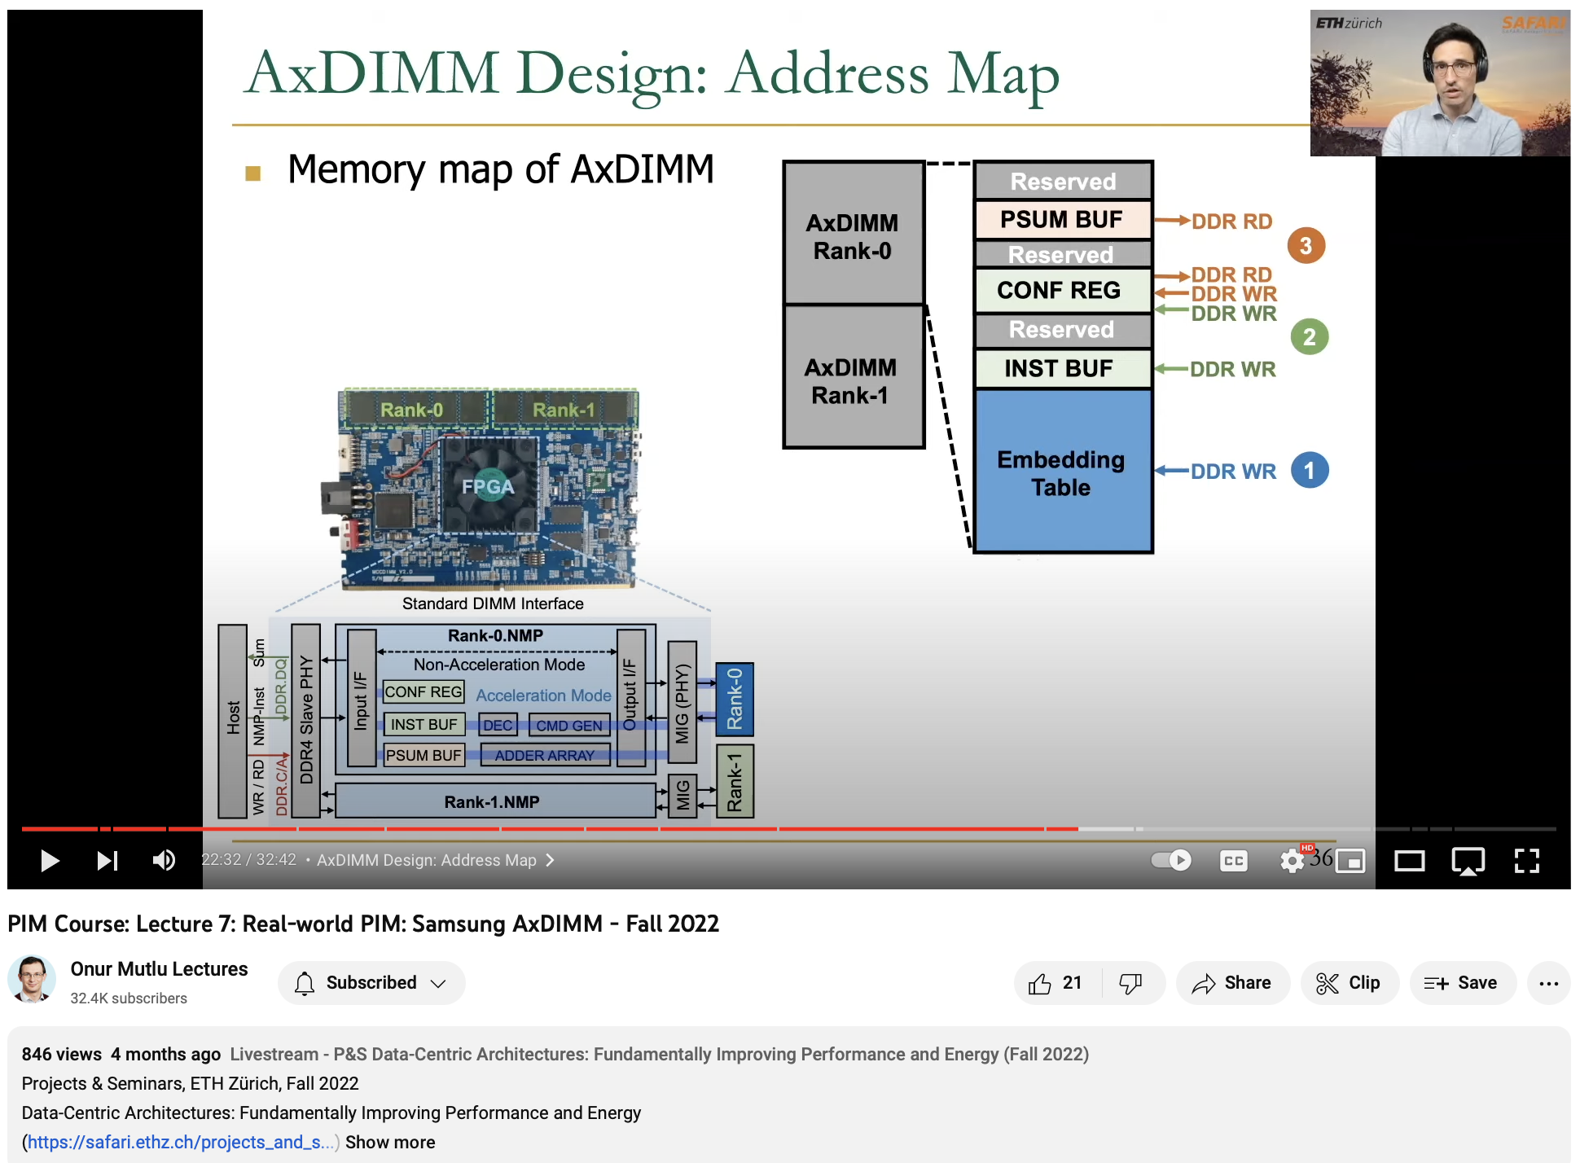
Lecture on AxDIMM
https://youtu.be/SXdzQZAKG-Y

Slide 42
SK Hynix AiM

Slide 43
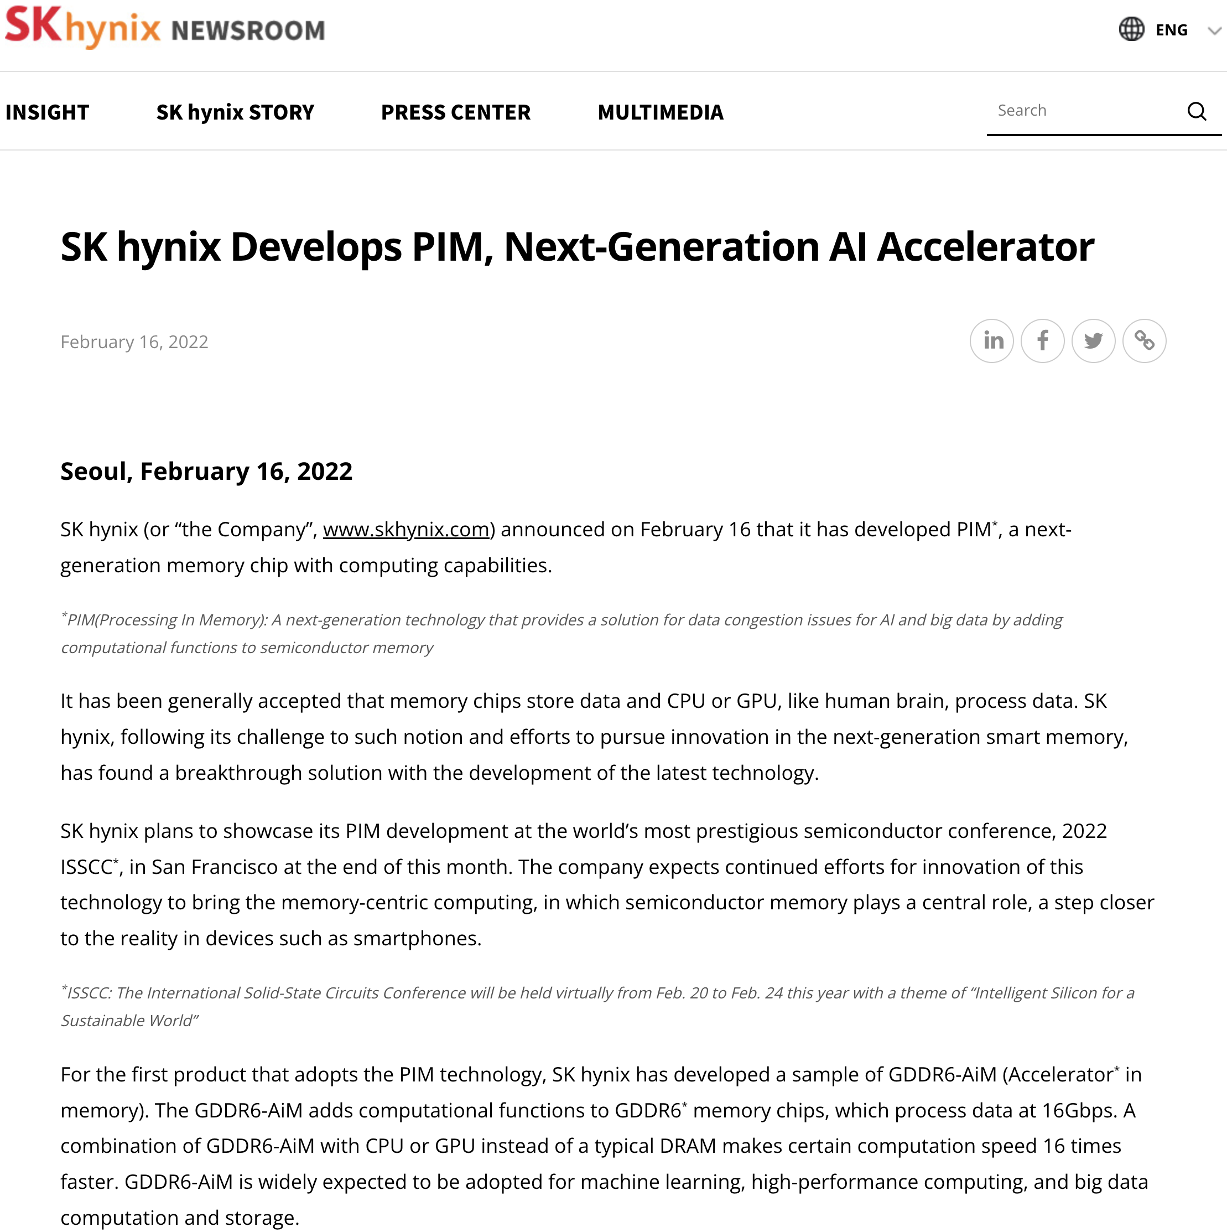
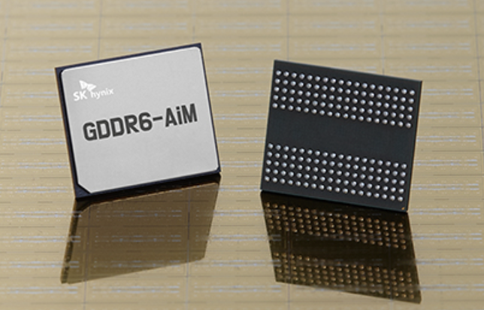
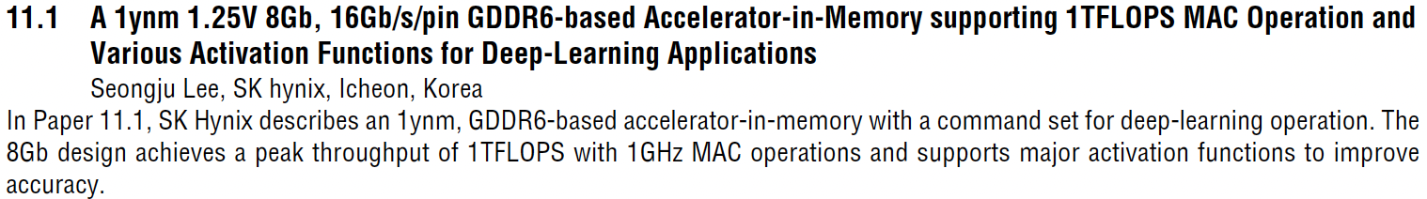
SK Hynix Accelerator-in-Memory (2022)
https://news.skhynix.com/sk-hynix-develops-pim-next-generation-ai-accelerator/

Slide 44
SK Hynix Accelerator-in-Memory (2022)
4 Gb AiM die with 16 processing units (PUs)
Lee et al., A 1ynm 1.25V 8Gb, 16Gb/s/pin GDDR6-based Accelerator-in-Memory supporting 1TFLOPS MAC Operation and Various Activation Functions for Deep-Learning Applications, ISSCC 2022
Notes:
* The operating voltage is 1.25V:
- Lowered from 1.35V of the normal GDDR6, for bank parallel operation.
* 16Gb/s is reached at 1.25V in DL operation.
Flat-lid package for lower thermal resistance.
Tested in a prototype system with an FPGA (connected to host CPU via PCIe).

Slide 45
SK Hynix AiM: System Organization (2022)
GDDR6-based AiM architecture
Lee et al., A 1ynm 1.25V 8Gb, 16Gb/s/pin GDDR6-based Accelerator-in-Memory supporting 1TFLOPS MAC Operation and Various Activation Functions for Deep-Learning Applications, ISSCC 2022

Slide 46
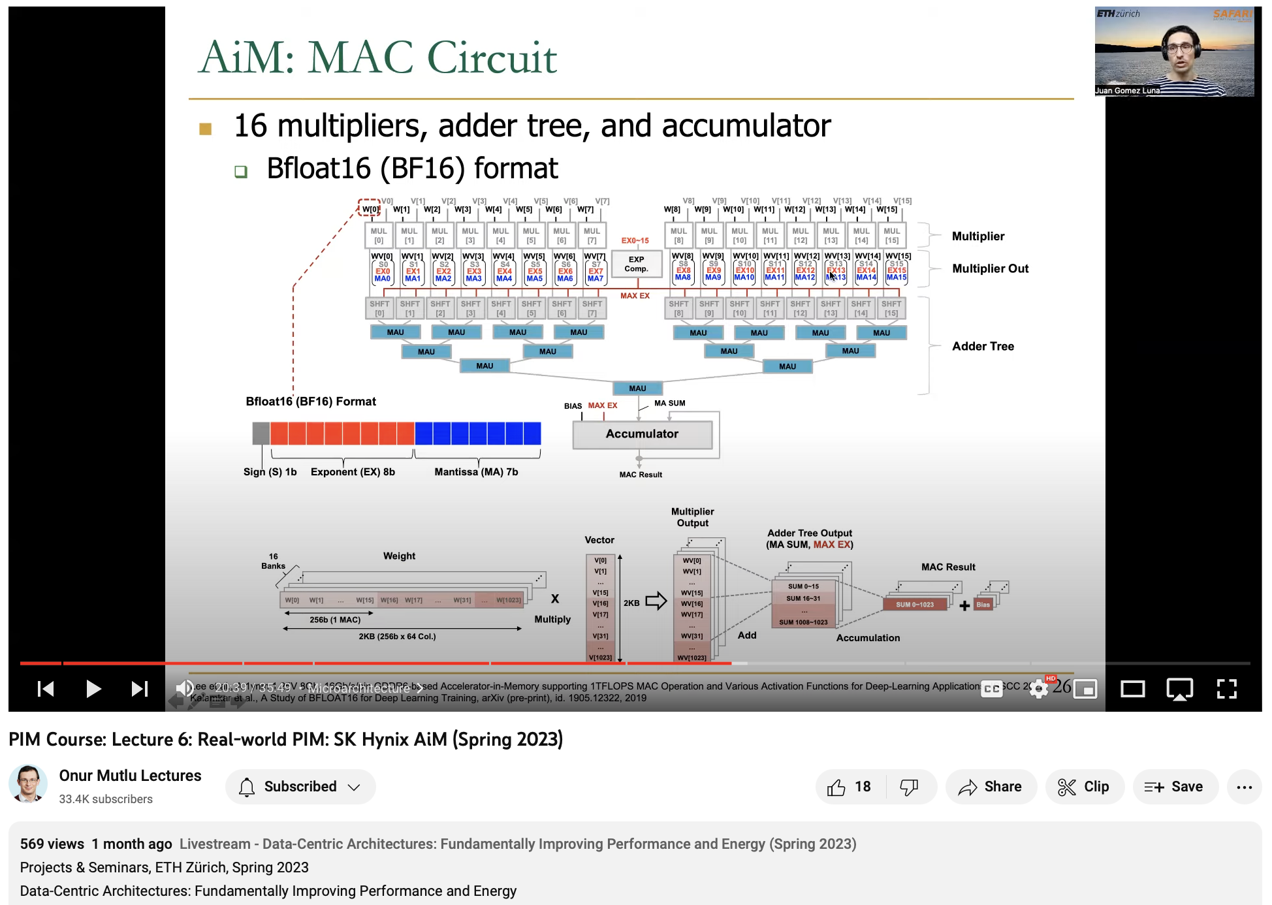
Lecture on Accelerator-in-Memory
https://youtu.be/HUSrlKgR1cM

Slide 47
Alibaba HB-PNM

Slide 48
Alibaba HB-PNM: Overall Architecture (2022)
3D-stacked logic die and DRAM die vertically bonded by hybrid bonding (HB)
Niu et al., 184QPS/W 64Mb/mm2 3D Logic-to-DRAM Hybrid Bonding with Process-Near-Memory Engine for Recommendation System, ISSCC 2022

Slide 49
Alibaba HB-PNM: Compute Engines
Match engine and neural engine for matching and ranking in a recommendation system
Niu et al., 184QPS/W 64Mb/mm2 3D Logic-to-DRAM Hybrid Bonding with Process-Near-Memory Engine for Recommendation System, ISSCC 2022

Slide 50
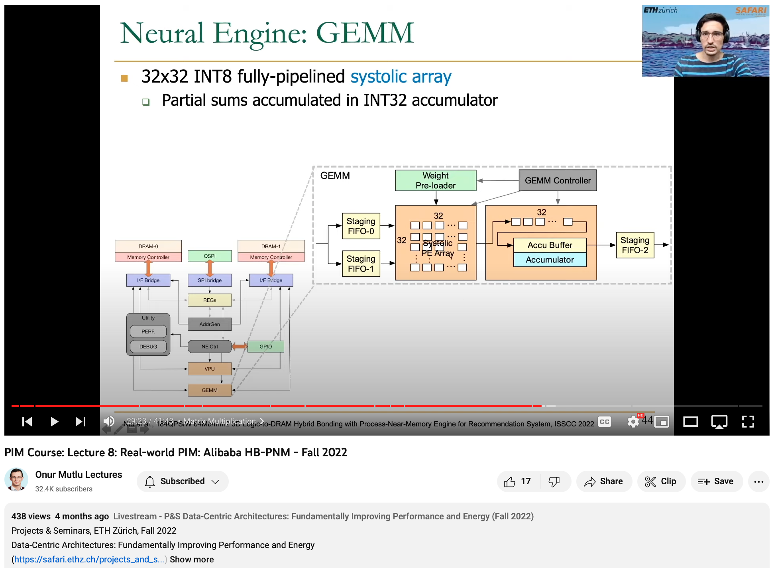
Lecture on HB-PNM
https://youtu.be/8MM6_36LmWQ

Slide 51
More Real PIM

Slide 52
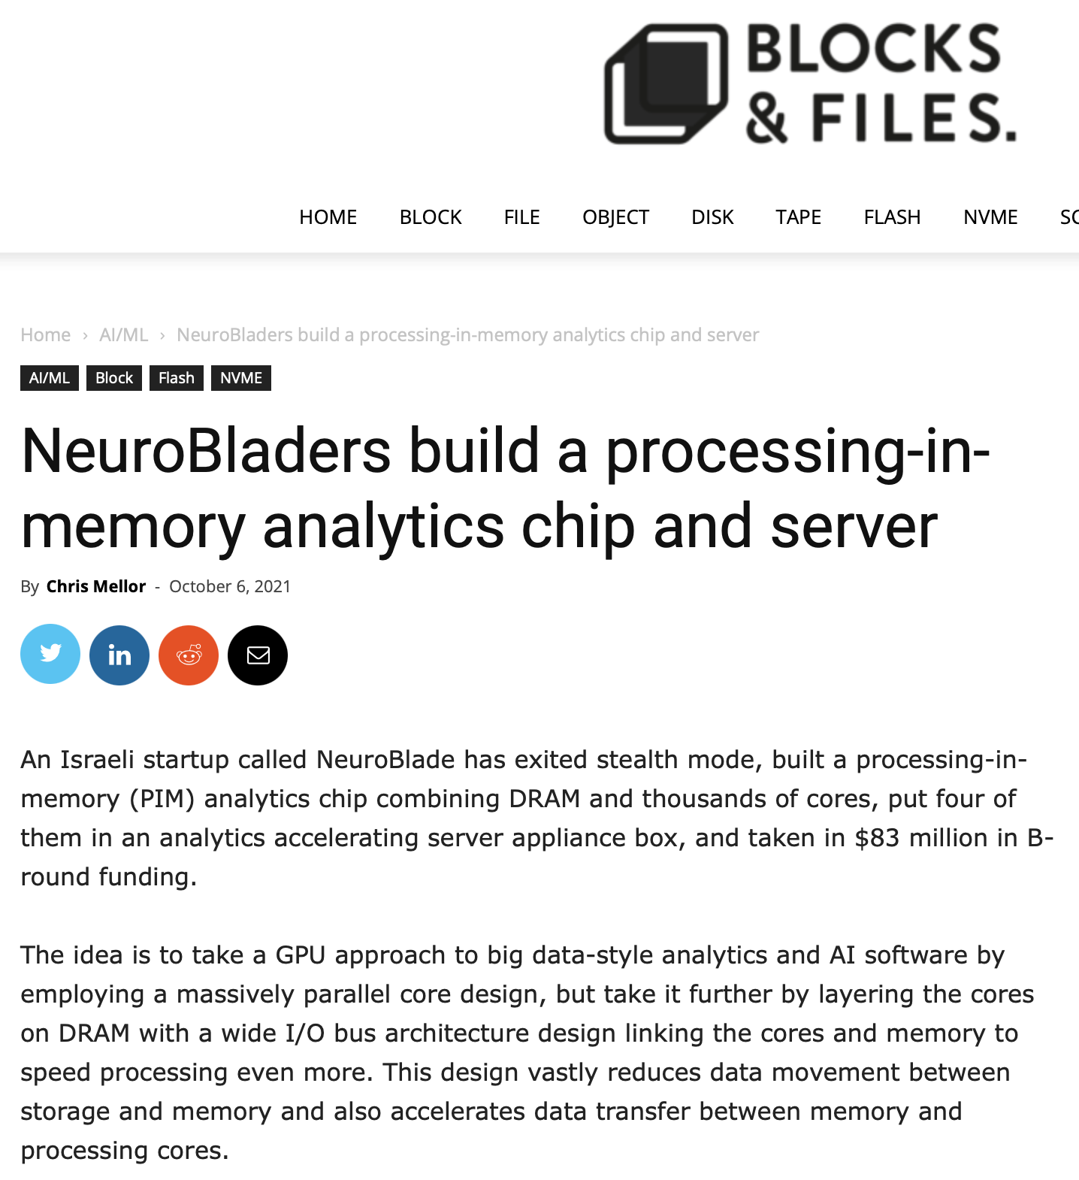
NeuroBlade
https://blocksandfiles.com/2021/10/06/neurobladers-build-a-processing-in-memory-analytics-chip-and-server/

Slide 53
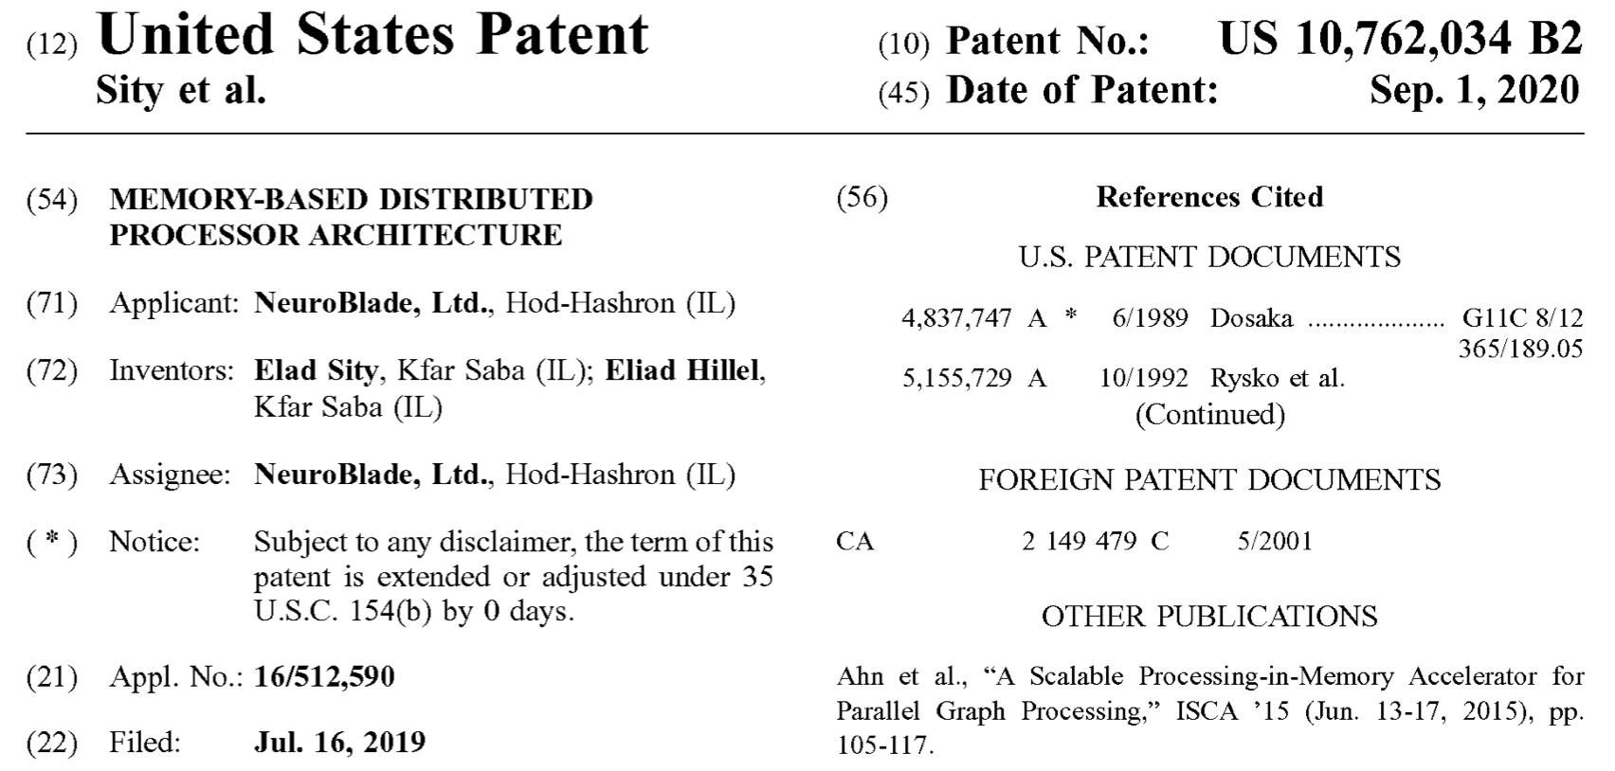
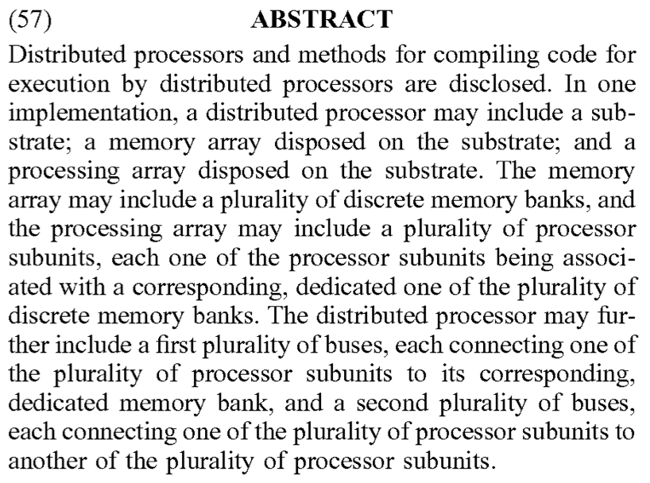
NeuroBlade Patent (I)
Sity et al., “Memory-based Distributed Processor Architecture,” US 10,762,034 B2

Slide 54
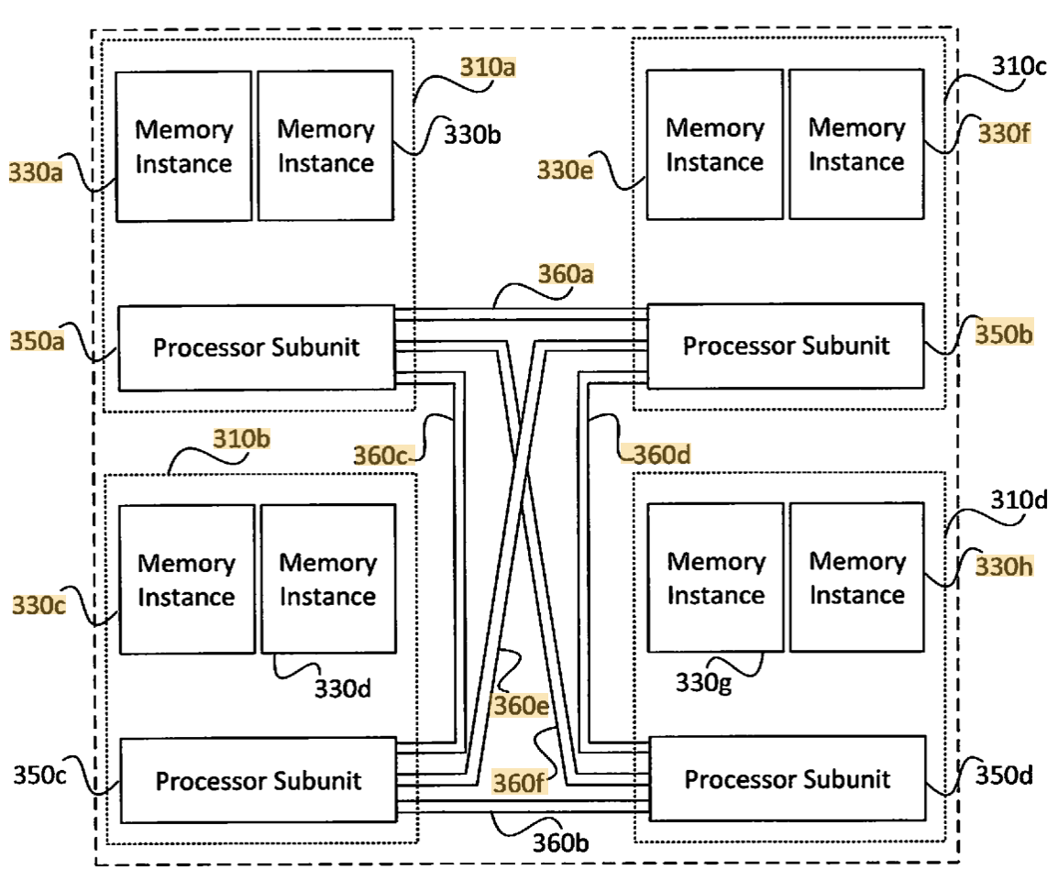
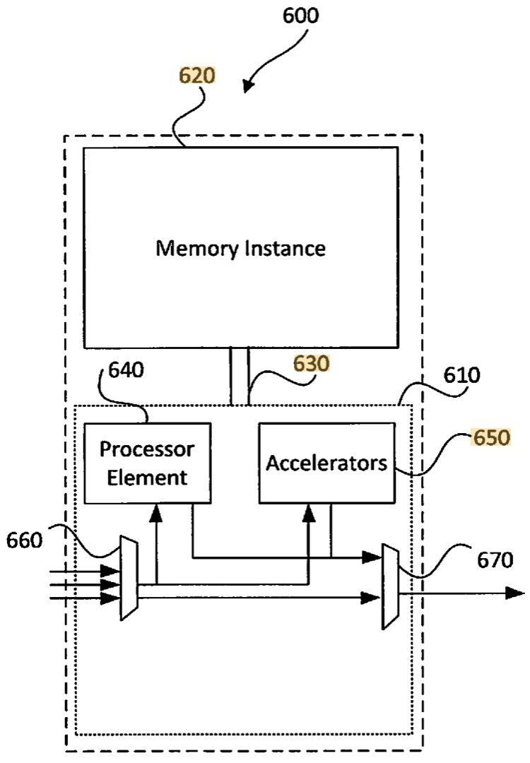
NeuroBlade Patent (II)
Sity et al., “Memory-based Distributed Processor Architecture,” US 10,762,034 B2

Slide 55
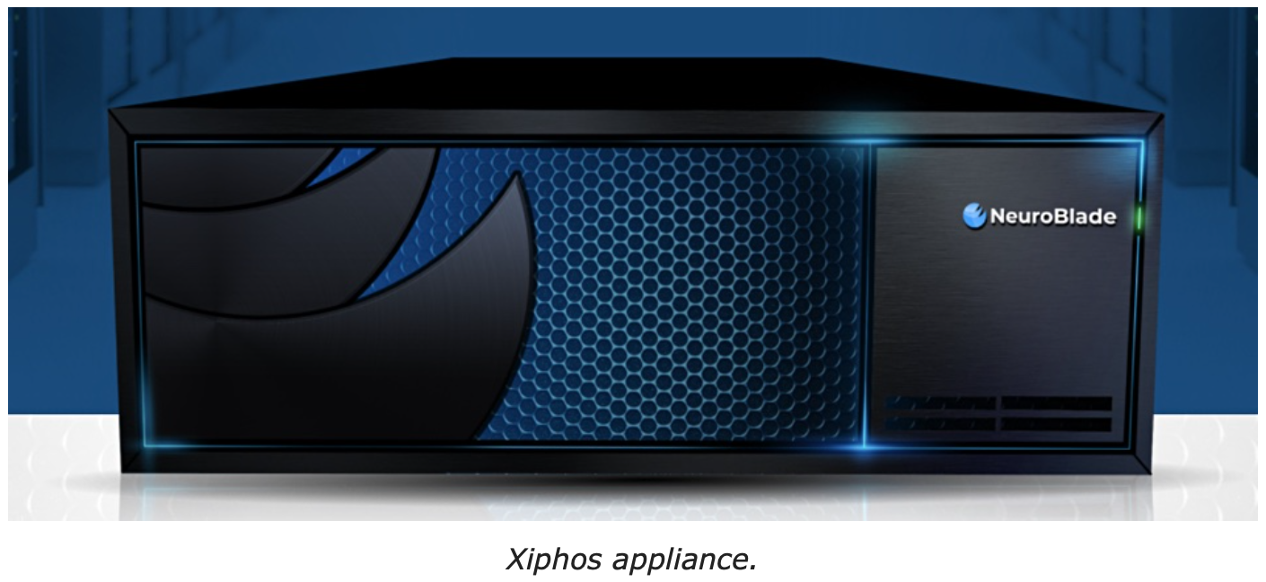
NeuroBlade: Xiphos
PIM XRAM chip
  IMPU (Intensive Memory Processing Unit)
x86 CPU, 32 NVMe SSDs
PCIe fabric: “Everything is connected on top of PCIe fabric.”
Wide I/O bus: multiple x16 PCIe buses
https://www.neuroblade.com

Slide 56
Variety of Current Real PIM Architectures
Differences
  Near-bank (UPMEM, FIMDRAM, AiM, HB-PNM) vs. near-chip (AxDIMM)
  General-purpose (UPMEM) vs. special-function (FIMDRAM, AiM, HB-PNM)
  FGMT (UPMEM) vs. SIMD (FIMDRAM, AiM, AxDIMM) vs. systolic array (HB-PNM)
  Natively integer (UPMEM, HB-PNM) vs. floating point (FIMDRAM)
    FP16 (FIMDRAM) vs. BF16 (AiM) vs. FP32 (AxDIMM)
  DDR4 (UPMEM, AxDIMM) vs. LPDDR4 (HB-PNM) vs. HBM2 (FIMDRAM) vs. GDDR6 (AiM)

Slide 57
Common Characteristics
These PIM systems have some common characteristics:
  There is a host processor (CPU or GPU) with access to (1) standard main memory, and (2) PIM-enabled memory
  PIM-enabled memory contains multiple PIM processing elements (PEs) with high bandwidth and low latency memory access
  PIM PEs run only at a few hundred MHz and have a small number of registers and small (or no) cache/scratchpad
  PIM PEs may need to communicate via the host processor

Slide 58
A State-of-the-Art PIM (PNM) System
These PIM systems have some common characteristics:
  There is a host processor (CPU or GPU) with access to (1) standard main memory, and (2) PIM-enabled memory
  PIM-enabled memory contains multiple PIM processing elements (PEs) with high bandwidth and low latency memory access
  PIM PEs run only at a few hundred MHz and have a small number of registers and small (or no) cache/scratchpad
  PEs may need to communicate via the host processor

Slide 59
Programming a
General-purpose PIM System

Slide 60
Accelerator Model (I)
Integration of UPMEM DIMMs in a system follows an accelerator model
UPMEM DIMMs coexist with conventional DIMMs
UPMEM DIMMs can be seen as a loosely coupled accelerator
  Explicit data movement between the main processor (host CPU) and the accelerator (UPMEM)
  Explicit kernel launch onto the UPMEM processors
This resembles GPU computing

Slide 61
GPU Computing
Computation is offloaded to the GPU
Three steps
  CPU-GPU data transfer (1)
  GPU kernel execution (2)
  GPU-CPU data transfer (3)
https://www.youtube.com/watch?v=y40-tY5WJ8A
https://safari.ethz.ch/digitaltechnik/spring2018/lib/exe/fetch.php?media=digitaldesign-2018-lecture22-gpuprogramming-afterlecture.pdf

Slide 62
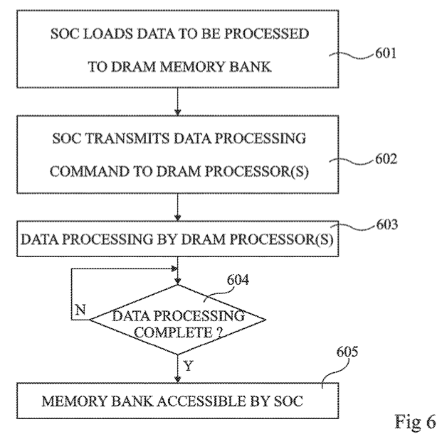
Accelerator Model (II)
FIG. 6 is a flow diagram representing operations in a method of delegating a processing task to a DRAM processor according to an example embodiment
Fabrice Devaux, Jean-François Roy. “Memory circuit with integrated processor.” US 10,324,870 B2.

Slide 63
System Organization
FIG. 1 schematically illustrates a computing system comprising DRAM circuits having integrated processors according to an example embodiment
Fabrice Devaux, Jean-François Roy. “Memory circuit with integrated processor.” US 10,324,870 B2.

Slide 64
First Programming Example: Vector Addition

Slide 65
Observations, Recommendations, Takeaways
GENERAL PROGRAMMING RECOMMENDATIONS
Execute on the DRAM Processing Units (DPUs) portions of parallel code that are as long as possible.
Split the workload into independent data blocks, which the DPUs operate on independently.
Use as many working DPUs in the system as possible.
Launch at least 11 tasklets (i.e., software threads) per DPU.
PROGRAMMING RECOMMENDATION 1
For data movement between the DPU’s MRAM bank and the WRAM, use large DMA transfer sizes when all the accessed data is going to be used.
KEY OBSERVATION 7
Larger CPU-DPU and DPU-CPU transfers between the host main memory and the DRAM Processing Unit’s Main memory (MRAM) banks result in higher sustained bandwidth.
KEY TAKEAWAY 1
The UPMEM PIM architecture is fundamentally compute bound. As a result, the most suitable work- loads are memory-bound.

Slide 66
Vector Addition (VA)
Our first programming example
We partition the input arrays across:
  DPUs
  Tasklets, i.e., software threads running on a DPU
Tasklet 0
Tasklet 1
Tasklet 0
Tasklet 1
Tasklet 0
Tasklet 1
Tasklet 0
Tasklet 1
DPU 0
DPU 1
DPU 2
DPU 3

Slide 67

UPMEM SDK Documentation
https://sdk.upmem.com/2023.1.0/

Slide 68
General Programming Recommendations
From UPMEM programming guide✻, presentations★, and white papers☆
GENERAL PROGRAMMING RECOMMENDATIONS
Execute on the DRAM Processing Units (DPUs) portions of parallel code that are as long as possible.
Split the workload into independent data blocks, which the DPUs operate on independently.
Use as many working DPUs in the system as possible.
Launch at least 11 tasklets (i.e., software threads) per DPU.
✻ https://sdk.upmem.com/2021.1.1/index.html
★ F. Devaux, "The true Processing In Memory accelerator," HotChips 2019. doi: 10.1109/HOTCHIPS.2019.8875680
☆ UPMEM, “Introduction to UPMEM PIM. Processing-in-memory (PIM) on DRAM Accelerator,” White paper

Slide 69
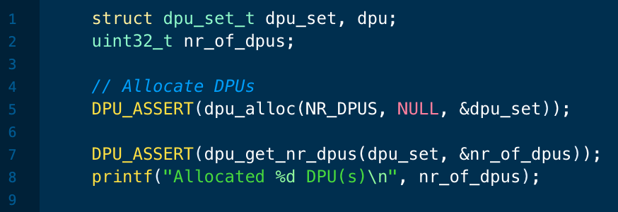
DPU Allocation
dpu_alloc() allocates a number of DPUs
  Creates a dpu_set
Can we allocate different DPU sets
over the course of a program?
Yes, we can. We show an example next
We deallocate a DPU set with dpu_free()

Slide 70
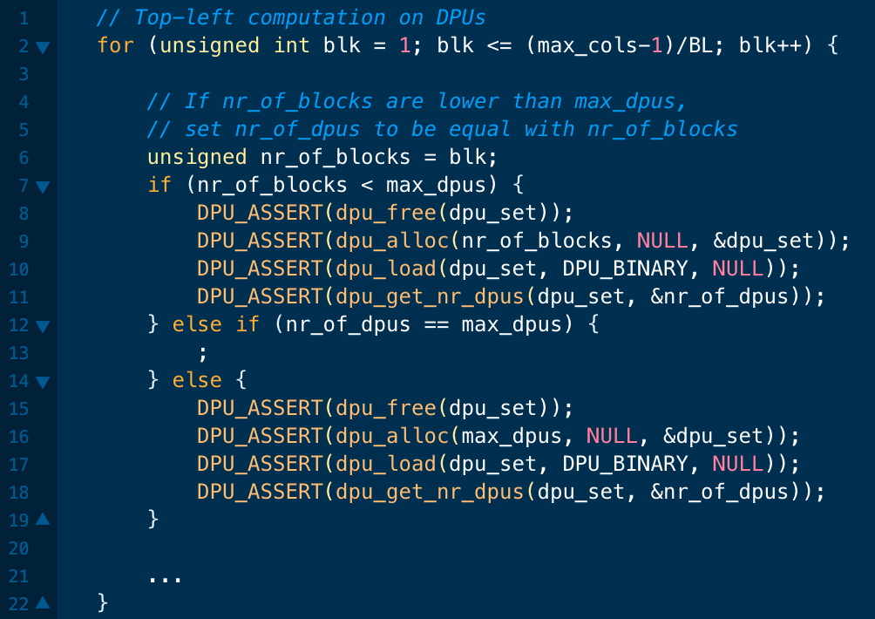
DPU Allocation: Needleman-Wunsch (NW)
In NW we change the number of DPUs in the DPU set as computation progresses

Slide 71
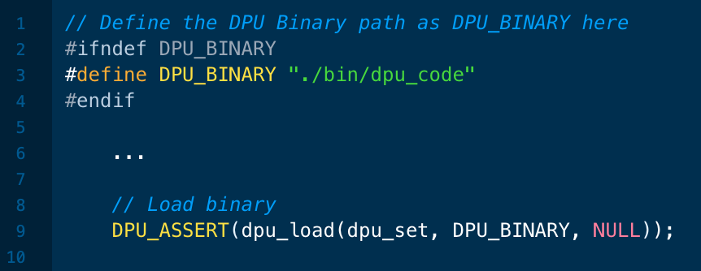
Load DPU Binary
dpu_load() loads a program in all DPUs of a dpu_set
Is it possible to launch different kernels onto different DPUs?
Yes, it is possible. This enables:
Workloads with task-level parallelism
Different programs using different DPU sets

Slide 72
CPU-DPU/DPU-CPU Data Transfers
CPU-DPU and DPU-CPU transfers
  Between host CPU’s main memory and DPUs’ MRAM banks
Serial CPU-DPU/DPU-CPU transfers:
  A single DPU (i.e., 1 MRAM bank)
Parallel CPU-DPU/DPU-CPU transfers:
  Multiple DPUs (i.e., many MRAM banks)
Broadcast CPU-DPU transfers:
  Multiple DPUs with a single buffer

Slide 73
Serial Transfers
dpu_copy_to();
dpu_copy_from();
We transfer (part of) a buffer to/from each DPU in the dpu_set
DPU_MRAM_HEAP_POINTER_NAME: Start of the MRAM range that can be freely accessed by applications
  We do not allocate MRAM explicitly
Offset within MRAM
Pointer to main memory
Transfer size

Slide 74
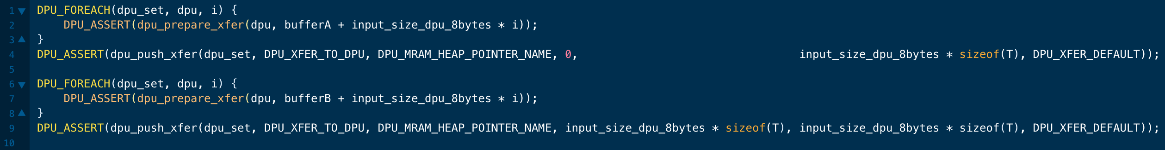
Parallel Transfers
We push different buffers to/from a DPU set in one transfer
  All buffers need to be of the same size
First, prepare (dpu_prepare_xfer);
then, push (dpu_push_xfer)
Direction:
  DPU_XFER_TO_DPU
  DPU_XFER_FROM_DPU
Pointer to main memory
Offset within MRAM
Transfer size
Direction

Slide 75
Broadcast Transfers
dpu_broadcast_to();
  Only CPU to DPU
We transfer the same buffer to all DPUs in the dpu_set
Pointer to main memory
Transfer size

Slide 76
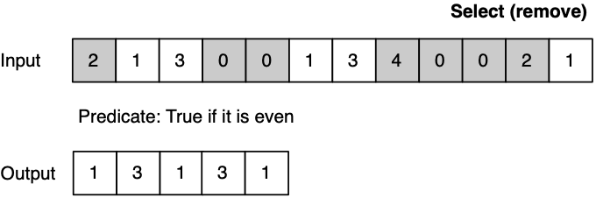
Different Types of Transfers in a Program
An example benchmark that uses both parallel and serial transfers
Select (SEL)
  Remove even values
Parallel transfers
DPU 0
DPU 1
DPU 2
Serial transfers
DPU 0
DPU 1
DPU 2

Slide 77
Inter-DPU Communication
There is no direct communication channel between DPUs
Inter-DPU communication takes place via the host CPU using CPU-DPU and DPU-CPU transfers
Example communication patterns:
  Merging of partial results to obtain the final result
    Only DPU-CPU transfers
  Redistribution of intermediate results for further computation
    DPU-CPU transfers and CPU-DPU transfers

Slide 78
How Fast are these Data Transfers?
With a microbenchmark, we obtain the sustained bandwidth of all types of CPU-DPU and DPU-CPU transfers
Two experiments:
  1 DPU: variable CPU-DPU and DPU-CPU transfer size (8 bytes to 32 MB)
  1 rank: 32 MB CPU-DPU and DPU-CPU transfers to/from a set of 1 to 64 MRAM banks within the same rank
Preliminary experiments with more than one rank
  Channel-level parallelism
DDR4 bandwidth bounds the maximum transfer bandwidth
The cost of the transfers can be amortized,
if enough computation is run on the DPUs

Slide 79
CPU-DPU/DPU-CPU Transfers: 1 DPU
Data transfer size varies between 8 bytes and 32 MB
KEY OBSERVATION 7
Larger CPU-DPU and DPU-CPU transfers between the host main memory and the DRAM Processing Unit’s Main memory (MRAM) banks result in higher sustained bandwidth.

Slide 80
CPU-DPU/DPU-CPU Transfers: 1 Rank (I)
CPU-DPU (serial/parallel/broadcast) and DPU-CPU (serial/parallel)
The number of DPUs varies between 1 and 64
KEY OBSERVATION 8
The sustained bandwidth of parallel CPU-DPU and DPU-CPU transfers between the host main memory and the DRAM Processing Unit’s Main memory (MRAM) banks increases with the number of DRAM Processing Units inside a rank.

Slide 81
CPU-DPU/DPU-CPU Transfers: 1 Rank (II)
CPU-DPU (serial/parallel/broadcast) and DPU-CPU (serial/parallel)
The number of DPUs varies between 1 and 64
KEY OBSERVATION 9
The sustained bandwidth of parallel CPU-DPU transfers is higher than the sustained bandwidth of parallel DPU-CPU transfers due to different implementations of CPU-DPU and DPU-CPU transfers in the UPMEM runtime library.
The sustained bandwidth of broadcast CPU-DPU transfers (i.e., the same buffer is copied to multiple MRAM banks) is higher than that of parallel CPU-DPU transfers (i.e., different buffers are copied to different MRAM banks) due to higher temporal locality in the CPU cache hierarchy.
Notes:
Load uses AVX write instructions, which are asynchronous.
However, AVX read instructions are synchronous

Slide 82
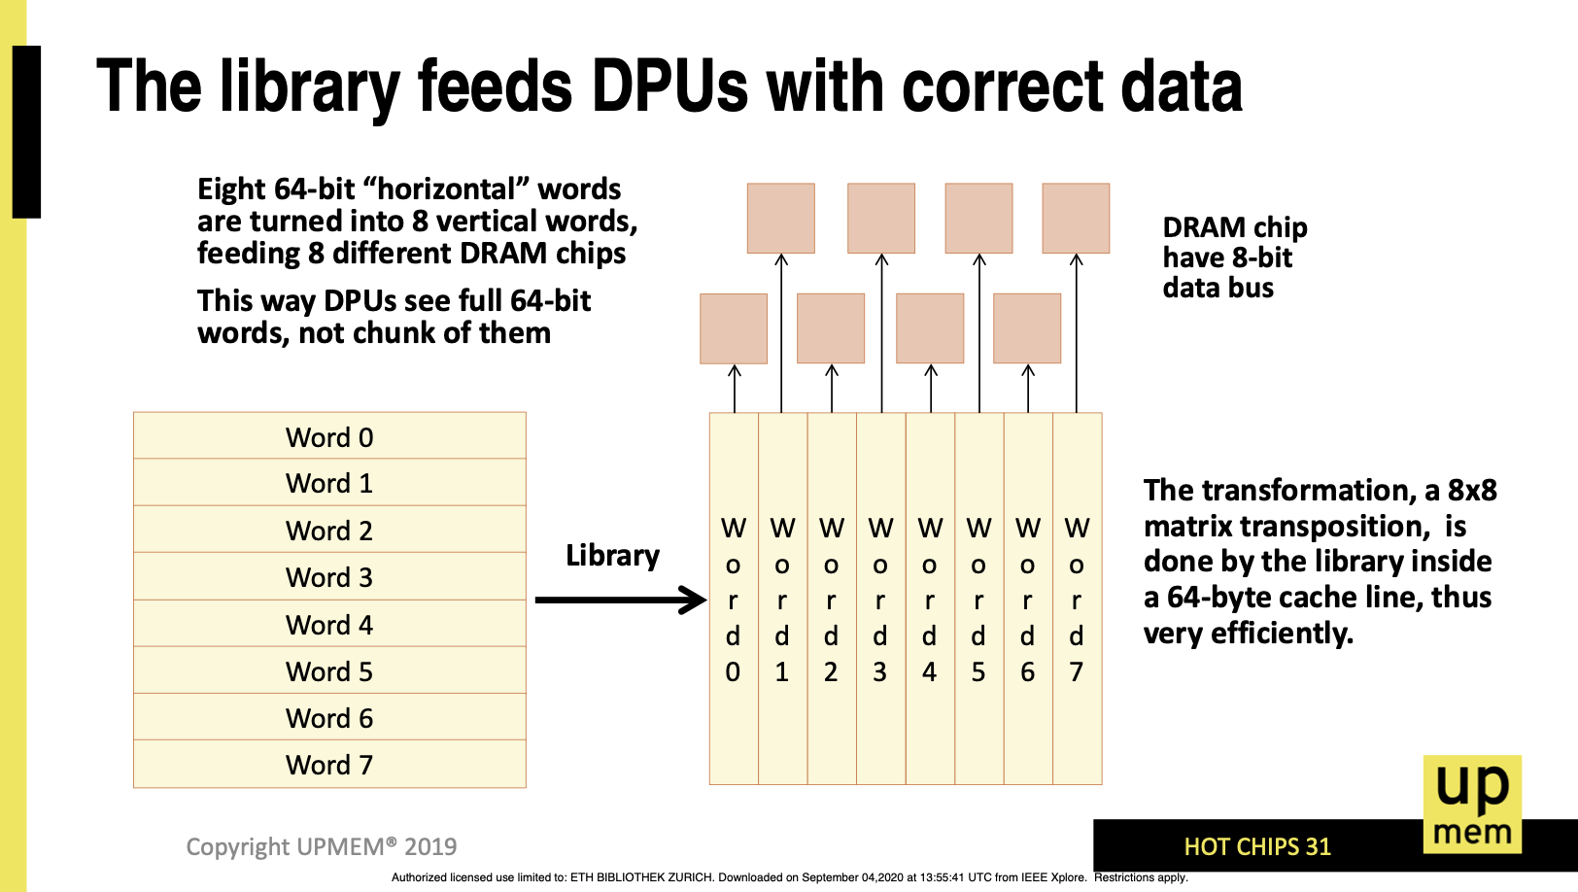
“Transposing” Library
F. Devaux, "The true Processing In Memory accelerator," HotChips 2019. doi: 10.1109/HOTCHIPS.2019.8875680

Slide 83
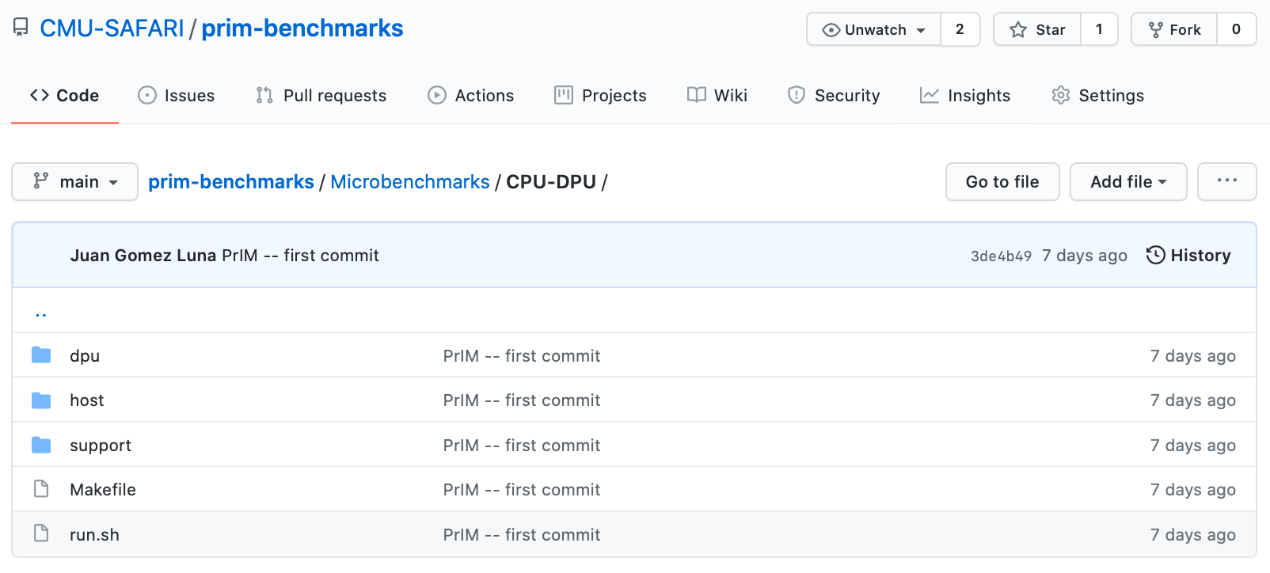
Microbenchmark: CPU-DPU
CPU-DPU (serial/parallel/broadcast) and DPU-CPU (serial/parallel)

Slide 84

DPU Kernel Launch
dpu_launch() launches a kernel on a dpu_set
  DPU_SYNCHRONOUS suspends the application until the kernel finishes
  DPU_ASYNCHRONOUS returns the control to the application
    dpu_sync or dpu_status to check kernel completion
What does the asynchronous execution enable?
Some ideas:
Task-level parallelism: concurrent execution of different kernels on different DPU sets
Concurrent heterogeneous computation on CPU and DPUs

Slide 85
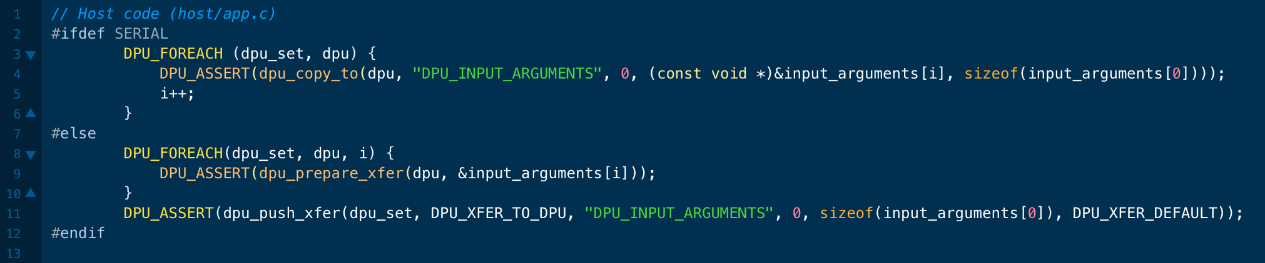
How to Pass Parameters to the Kernel?
We can use serial and parallel transfers
We pass them directly to the scratchpad memory of the DPU
  Working RAM (WRAM): 64KB per DPU
This is useful for input parameters and some results

Slide 86
Recall: Vector Addition (VA)
Our first programming example
We partition the input arrays across:
  DPUs
  Tasklets, i.e., software threads running on a DPU
Tasklet 0
Tasklet 1
Tasklet 0
Tasklet 1
Tasklet 0
Tasklet 1
Tasklet 0
Tasklet 1
DPU 0
DPU 1
DPU 2
DPU 3

Slide 87
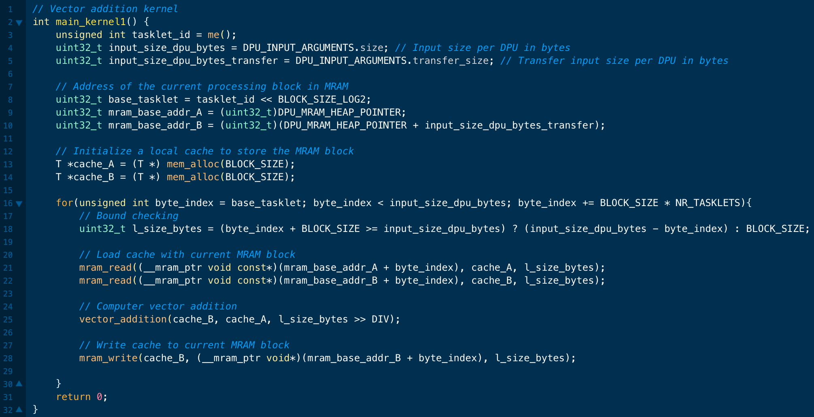
Programming a DPU Kernel (I)
Vector addition
Tasklet ID
Size of vector tile processed by a DPU
MRAM addresses of arrays A and B
WRAM allocation
MRAM-WRAM DMA transfers
Vector addition (see next slide)
WRAM-MRAM DMA transfer

Slide 88
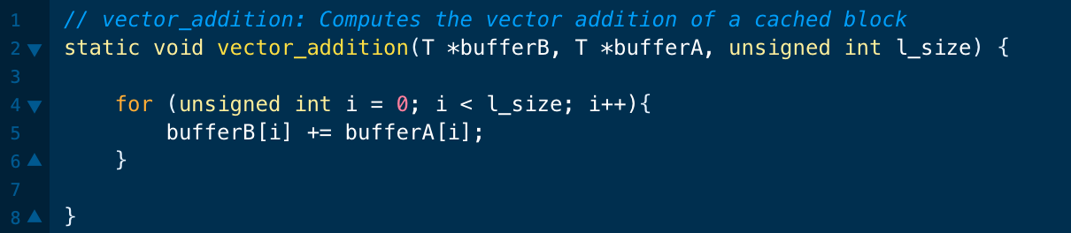
Programming a DPU Kernel (II)
Vector addition

Slide 89
Intra-DPU Synchronization

Slide 90
Synchronization Primitives
A tasklet is the software abstraction of a hardware thread
Each tasklet can have its own memory space in WRAM
  Tasklets can also share data in WRAM by sharing pointers
Tasklets within the same DPU can synchronize
  Mutual exclusion
    mutex_lock(); mutex_unlock();
  Handshakes
    handshake_wait_for(); handshake_notify();
  Barriers
    barrier_wait();
  Semaphores
    sem_give(); sem_take();

Slide 91
Parallel Reduction (I)
Tasklets in a DPU can work together on a parallel reduction
Tasklet 0
Tasklet 1
Tasklet 2
Tasklet 3

Slide 92
Parallel Reduction (II)
Each tasklet computes a local sum
Tasklet 0
Tasklet 1
Tasklet 2
Tasklet 3

Slide 93
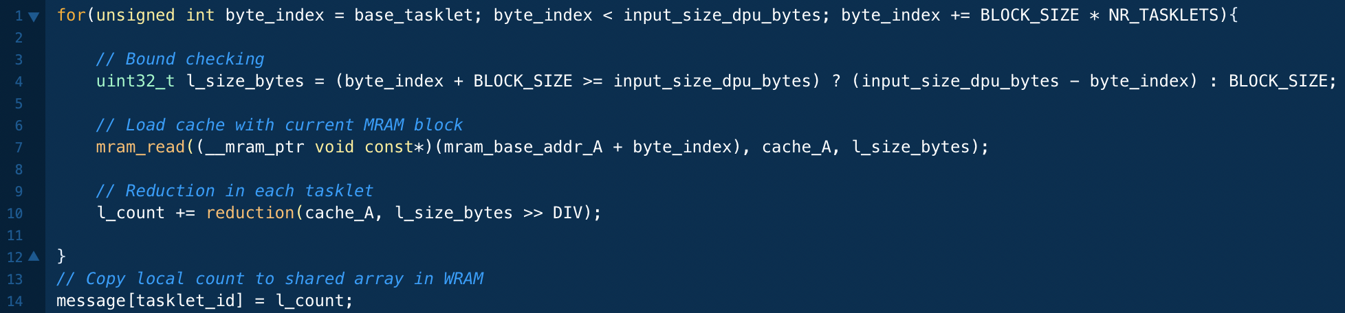
Parallel Reduction (III)
Each tasklet computes a local sum
Accumulate in a local sum
Copy local sum into WRAM

Slide 94

Final Reduction
A single tasklet can perform the final reduction
Accumulate in a local sum
Copy local sum into WRAM
Barrier synchronization
Sequential accumulation

Slide 95
Vector Reduction: Naïve Mapping
Thread 0
Thread 2
Thread 4
Thread 6
Thread 8
Thread 10
0
1
2
3
4
5
6
7
8
9
10
11
…
1
0+1
2+3
4+5
6+7
8+9
10+11
2
0...3
4..7
8..11
iterations
3
0..7
8..15
Slide credit: Hwu & Kirk

Slide 96

Using Barriers: Tree-Based Reduction
Multiple tasklets can perform a tree-based reduction
  After every iteration tasklets synchronize with a barrier
  Half of the tasklets retire at the end of an iteration
“offset” tasklets working
Barrier synchronization
A handshake-based tree-based reduction is also possible.
We can compare single-tasklet, barrier-based,
and handshake-based versions*
*Gómez-Luna et al., “Benchmarking a New Paradigm: An Experimental Analysis of a Real Processing-in-Memory Architecture,”
https://arxiv.org/pdf/2105.03814.pdf

Slide 97
Tree-Based Reduction on UPMEM PIM (I)
Single-thread vs. Barrier-based vs. Handshake-based on 1 DPU
High cost of intra-DPU synchronization
(especially, barrier synchronization)
when there is small amount of computation
Gómez-Luna et al. "Benchmarking a New Paradigm: An Experimental Analysis of a Real Processing-in-Memory Architecture." arXiv preprint arXiv:2105.03814 (2021). https://arxiv.org/pdf/2105.03814.pdf

Slide 98
Tree-Based Reduction on UPMEM PIM (II)
Single-thread vs. Barrier-based vs. Handshake-based on 1 DPU
2K elements
2M elements
Cost of intra-DPU synchronization
gets amortized when there is large amount of computation
Gómez-Luna et al. "Benchmarking a New Paradigm: An Experimental Analysis of a Real Processing-in-Memory Architecture." arXiv preprint arXiv:2105.03814 (2021). https://arxiv.org/pdf/2105.03814.pdf

Slide 99

Parallel Reduction on GPU
https://youtu.be/tJmcV9AMfp4

Slide 100
Prefix-Sum (Scan)
Input
1
2
3
4
1
1
1
1
0
1
2
3
2
2
2
2
Output (Exclusive Scan)
out[0] = 0; // Identity value
for(int i=1; i<n; i++)
out[i] = out[i-1] + in[i-1];
0
1
3
6
10
11
12
13
14
14
15
17
20
22
24
26
Output (Inclusive Scan)
out[0] = in[0];
for(int i=1; i<n; i++)
out[i] = out[i-1] + in[i];
1
3
6
10
11
12
13
14
14
15
17
20
22
24
26
28

Slide 101
Hierarchical (Inclusive) Scan: 1 DPU
Input
Tasklet 0
Tasklet 1
Tasklet 2
Tasklet 3
1
2
3
4
1
1
1
1
0
1
2
3
2
2
2
2
Per-tasklet (Inclusive) Scan
1
3
6
10
1
2
3
4
0
1
3
6
2
4
6
8
Output (Inclusive Scan)
1
3
6
10
11
12
13
14
14
14
15
17
20
20
22
24
26
28

Slide 102


Per-DPU (Inclusive) Scan (I)
Each tasklet computes scan locally
Per-tasklet scan

Slide 103

Per-DPU (Inclusive) Scan (II)
Each tasklet communicates with adjacent tasklets
Per-tasklet scan
Handshake-based synchronization

Slide 104

Per-DPU (Inclusive) Scan (III)
Each tasklet adds an offset to each own element
Per-tasklet scan
Handshake-based synchronization
Per-tasklet add

Slide 105
Scan-Scan-Add (SSA)
Input
DPU 0
DPU 1
DPU 2
DPU 3
1
2
3
4
1
1
1
1
0
1
2
3
2
2
2
2
Per-DPU (Inclusive) Scan
1
3
6
10
10
1
2
3
4
4
0
1
3
6
6
2
4
6
8
8
10
4
6
8
DPU kernel termination
Scan Partial Sums
10
14
20
28
Add
1
3
6
10
1
2
3
4
0
1
3
6
2
4
6
8
Output (Inclusive Scan)
+10
+14
+20
1
3
6
10
11
11
12
12
13
13
14
14
14
14
15
15
17
17
20
20
22
22
24
24
26
26
28
28

Slide 106
SSA: Memory Accesses
Scan
  First kernel reads input array (N elements) and writes array with per-DPU prefix sums (N elements)
Scan
  Second kernel reads and writes N / PER_DPU_SIZE elements
Add
  Third kernel reads array with per-DPU prefix sums (N elements) and writes output (N elements)
4N elements are read/written

Slide 107
Reduce-Scan-Scan (RSS)
Input
DPU 0
DPU 1
DPU 2
DPU 3
1
2
3
4
1
1
1
1
0
1
2
3
2
2
2
2
Per-DPU Reduction
10
10
4
4
6
6
8
8
10
4
6
8
DPU kernel termination
Scan Partial Sums
10
14
20
28
Per-DPU Scan
1
1
2
3
3
6
4
10
1
1
1
2
1
3
1
4
0
0
1
1
2
3
3
6
2
2
2
4
2
6
2
8
Output (Inclusive Scan)
+10
+14
+20
Add
1
3
6
10
11
11
12
12
13
13
14
14
14
14
15
15
17
17
20
20
22
22
24
24
26
26
28
28

Slide 108
RSS: Memory Accesses
Reduce
  First kernel reads input array (N elements) and writes per-DPU reduction (N / PER_DPU_SIZE elements)
Scan
  Second kernel reads and writes N / PER_DPU_SIZE elements
Scan
  Third kernel reads input array (N elements) and scan partial sums (N / PER_DPU_SIZE elements), and writes output (N elements)
3N elements are read/written

Slide 109
SCAN-SSA vs. SCAN-RSS on UPMEM PIM
SCAN-SSA vs. SCAN-RSS on 1 DPU
The cost of intra-DPU synchronization in RSS (in Reduce step)
may be noticeable for small arrays.
For large arrays, RSS is faster than SSA,
since it saves memory accesses
Gómez-Luna et al. "Benchmarking a New Paradigm: An Experimental Analysis of a Real Processing-in-Memory Architecture." arXiv preprint arXiv:2105.03814 (2021). https://arxiv.org/pdf/2105.03814.pdf

Slide 110

Parallel Prefix-Sum (Scan) on GPU
https://youtu.be/SG0gvcbf2eo

Slide 111
UPMEM SDK Documentation
https://sdk.upmem.com/2023.1.0/

Slide 112

Programming UPMEM PIM (I)
https://youtu.be/zF70xuhesME

Slide 113

Programming UPMEM PIM (II)
https://youtu.be/pHEHdLsnNdk

Slide 114
Microbenchmarking of UPMEM PIM

Slide 115
DPU Pipeline
In-order pipeline
  Up to 425 MHz
Fine-grain multithreaded
  24 hardware threads
14 pipeline stages
  DISPATCH: Thread selection
  FETCH: Instruction fetch
  READOP: Register file
  FORMAT: Operand formatting
  ALU: Operation and WRAM
  MERGE: Result formatting
To the DMA engine

Slide 116
Arithmetic Throughput: Microbenchmark
Goal
  Measure the maximum arithmetic throughput for different datatypes and operations
Microbenchmark
  We stream over an array in WRAM and perform read-modify-write operations
  Experiments on one DPU
  We vary the number of tasklets from 1 to 24
  Arithmetic operations: add, subtract, multiply, divide
  Datatypes: int32, int64, float, double
We measure cycles with an accurate cycle counter that the SDK provides
  We include WRAM accesses (including address calculation) and arithmetic operation

Slide 117
Microbenchmark for INT32 ADD Throughput
1 #define SIZE 256
2 int* bufferA = mem_alloc(SIZE * sizeof(int));
3 for(int i = 0; i < SIZE; i++){
4 int temp = bufferA[i];
5 temp += scalar;
6 bufferA[i] = temp;
7 }
1 move r2, 0
2 .LBB0_1: // Loop header
3 lsl_add r3, r0, r2, 2 // Address calculation
4 lw r4, r3, 0 // Load from WRAM
5 add r4, r4, r1 // Add
6 sw r3, 0, r4 // Store to WRAM
7 add r2, r2, 1 // Index update
8 jneq r2, 256, .LBB0_1 // Conditional jump
C-based code
Compiled code (UPMEM DPU ISA)

Slide 118
Arithmetic Throughput: 11 Tasklets
KEY OBSERVATION 1
The arithmetic throughput of a DRAM Processing Unit saturates at 11 or more tasklets.
This observation is consistent for different datatypes (INT32, INT64, UINT32, UINT64, FLOAT, DOUBLE) and operations (ADD, SUB, MUL, DIV).

Slide 119
Arithmetic Throughput: ADD/SUB
17%
INT32 ADD/SUB are 17% faster than INT64 ADD/SUB
Can we explain the peak throughput?
Peak throughput at 11 tasklets.
One instruction retires every cycle when the pipeline is full
$$Arithmetic Throughput \left(in OPS\right)=\frac{frequencyDPU}{\#instructions}$$

Slide 120

Arithmetic Throughput: #Instructions
Compiler explorer: https://dpu.dev
6 instructions in the 32-bit ADD/SUB microbenchmark
7 instructions in the 64-bit ADD/SUB microbenchmark

Slide 121
Arithmetic Throughput: ADD/SUB
17%
INT32 ADD/SUB are 17% faster than INT64 ADD/SUB
Can we explain the peak throughput?
Peak throughput at 11 tasklets.
One instruction retires every cycle when the pipeline is full
$$Arithmetic Throughput \left(in OPS\right)=\frac{frequencyDPU}{\#instructions}$$
32-bit ADD/SUB: 6 instructions → 58.33 MOPS
64-bit ADD/SUB: 7 instructions → 50.00 MOPS
at frequency_{DPU} = 350 MHz

Slide 122
Arithmetic Throughput: MUL/DIV
Huge throughput difference between ADD/SUB and MUL/DIV
DPUs do not have
a 32-bit multiplier
MUL/DIV implementation is based on an instruction that performs bit shifting and addition in 1 cycle
(MUL/DIV take a maximum of 32 instructions)

Slide 123
Arithmetic Throughput: Native Support
KEY OBSERVATION 2
DPUs provide native hardware support for 32- and 64-bit integer addition and subtraction, leading to high throughput for these operations.
DPUs do not natively support 32- and 64-bit multiplication and division, and floating point operations. These operations are emulated by the UPMEM runtime library, leading to much lower throughput.

Slide 124

Microbenchmark: Arithmetic Throughput
Arithmetic throughput for different operations and datatypes

Slide 125
DPU: WRAM Bandwidth

Slide 126
WRAM Bandwidth: Microbenchmark
Goal
  Measure the WRAM bandwidth for the STREAM benchmark
Microbenchmark
  We implement the four versions of STREAM: COPY, ADD, SCALE, and TRIAD
  The operations performed in ADD, SCALE, and TRIAD are addition, multiplication, and addition+multiplication, respectively
  We vary the number of tasklets from 1 to 16
  We show results for 1 DPU
We do not include accesses to MRAM

Slide 127
STREAM Benchmark in WRAM
// COPY
for(int i = 0; i < SIZE; i++){
bufferB[i] = bufferA[i];
}
// ADD
for(int i = 0; i < SIZE; i++){
bufferC[i] = bufferA[i] + bufferB[i];
}
// SCALE
for(int i = 0; i < SIZE; i++){
bufferB[i] = scalar * bufferA[i];
}
// TRIAD
for(int i = 0; i < SIZE; i++){
bufferC[i] = bufferA[i] + scalar * bufferB[i];
}
8 bytes read, 8 bytes written,
no arithmetic operations
16 bytes read, 8 bytes written,
ADD
8 bytes read, 8 bytes written,
MUL
16 bytes read, 8 bytes written,
MUL, ADD

Slide 128

WRAM Bandwidth: STREAM
How can we estimate the bandwidth?
Assuming that the pipeline is full, and Bytes is the number of bytes read and written:
$$WRAM Bandwidth \left(in\frac{B}{S}\right)= \frac{Bytes × frequencyDPU}{\#instructions}$$

Slide 129

WRAM Bandwidth: COPY
COPY executes 2 instructions (WRAM load and store).
With 11 tasklets, 11 × 16 bytes in 22 cycles:
$$WRAM Bandwidth \left(in\frac{B}{S}\right)= \frac{Bytes × frequencyDPU}{\#instructions}$$
$$WRAM Bandwidth \left(in\frac{B}{S}\right)=2,800\frac{MB}{s}at 350 MHz$$

Slide 130


WRAM Bandwidth: ADD
$$WRAM Bandwidth \left(in\frac{B}{S}\right)= \frac{Bytes × frequencyDPU}{\#instructions}$$
ADD executes 5 instructions (2 ld, add, addc, sd).
With 11 tasklets, 11 × 24 bytes in 55 cycles:
$$WRAM Bandwidth \left(in\frac{B}{S}\right)=1,680\frac{MB}{s}at 350 MHz$$

Slide 131
WRAM Bandwidth: Access Patterns
All 8-byte WRAM loads and stores take one cycle when the DPU pipeline is full
Microbenchmark: c[a[i]]=b[a[i]];
  Unit-stride: a[i]=a[i-1]+1;
  Strided: a[i]=a[i-1]+stride;
  Random: a[i]=rand();
KEY OBSERVATION 3
The sustained bandwidth provided by the DPU’s internal Working memory (WRAM) is independent of the memory access pattern (either streaming, strided, or random access pattern).
All 8-byte WRAM loads and stores take one cycle, when the DPU’s pipeline is full (i.e., with 11 or more tasklets).

Slide 132


Microbenchmark: STREAM and WRAM
STREAM benchmark and WRAM access patterns

Slide 133
DPU: MRAM Latency and Bandwidth

Slide 134
MRAM Bandwidth
Goal
  Measure MRAM bandwidth for different access patterns
Microbenchmarks
  Latency of a single DMA transfer for different transfer sizes
    mram_read(); // MRAM-WRAM DMA transfer
    mram_write(); // WRAM-MRAM DMA transfer
  STREAM benchmark
    COPY, COPY-DMA
    ADD, SCALE, TRIAD
  Strided access pattern
    Coarse-grain strided access
    Fine-grain strided access
  Random access pattern (GUPS)
We do include accesses to MRAM

Slide 135


MRAM Read and Write Latency (I)
$$MRAM Bandwidth \left(in\frac{B}{S}\right)=\frac{size × frequencyDPU}{MRAM Latency}$$
We can model the MRAM latency with a linear expression
$$MRAM Latency \left(in cycles\right)=α+β×size$$
In our measurements, $β$ equals 0.5 cycles/byte.
Theoretical maximum MRAM bandwidth = 700 MB/s at 350 MHz

Slide 136
MRAM Read and Write Latency (II)
KEY OBSERVATION 4
The DPU’s Main memory (MRAM) bank access latency increases linearly with the transfer size.
The maximum theoretical MRAM bandwidth is 2 bytes per cycle.
$$MRAM Latency \left(in cycles\right)=α+β×size$$

Slide 137
MRAM Read and Write Latency (III)
Read and write accesses to MRAM are symmetric
The sustained MRAM bandwidth increases
with data transfer size
PROGRAMMING RECOMMENDATION 1
For data movement between the DPU’s MRAM bank and the WRAM, use large DMA transfer sizes when all the accessed data is going to be used.

Slide 138
MRAM Read and Write Latency (IV)
MRAM latency changes slowly between 8 and 128 bytes
For small transfers, the fixed cost ($α$) dominates the variable cost ($β×size$)
PROGRAMMING RECOMMENDATION 2
For small transfers between the MRAM bank and the WRAM, fetch more bytes than necessary within a 128-byte limit. Doing so increases the likelihood of finding data in WRAM for later accesses (i.e., the program can check whether the desired data is in WRAM before issuing a new MRAM access).

Slide 139
MRAM Read and Write Latency (V)
2,048-byte transfers are only 4% faster than 1,024-byte transfers
Larger transfers require more WRAM, which may limit the number of tasklets
PROGRAMMING RECOMMENDATION 3
Choose the data transfer size between the MRAM bank and the WRAM based on the program’s WRAM usage, as it imposes a tradeoff between the sustained MRAM bandwidth and the number of tasklets that can run in the DPU (which is dictated by the limited WRAM capacity).

Slide 140
MRAM Bandwidth
Goal
  Measure MRAM bandwidth for different access patterns
Microbenchmarks
  Latency of a single DMA transfer for different transfer sizes
    mram_read(); // MRAM-WRAM DMA transfer
    mram_write(); // WRAM-MRAM DMA transfer
  STREAM benchmark
    COPY, COPY-DMA
    ADD, SCALE, TRIAD
  Strided access pattern
    Coarse-grain strided access
    Fine-grain strided access
  Random access pattern (GUPS)
We do include accesses to MRAM

Slide 141
STREAM Benchmark in MRAM
// COPY
// Load current MRAM block to WRAM
mram_read((__mram_ptr void const*)mram_address_A, bufferA,
SIZE * sizeof(uint64_t));
for(int i = 0; i < SIZE; i++){
bufferB[i] = bufferA[i];
}
// Write WRAM block to MRAM
mram_write(bufferB, (__mram_ptr void*)mram_address_B,
SIZE * sizeof(uint64_t));
// COPY-DMA
// Load current MRAM block to WRAM
mram_read((__mram_ptr void const*)mram_address_A, bufferA,
SIZE * sizeof(uint64_t));
// Write WRAM block to MRAM
mram_write(bufferA, (__mram_ptr void*)mram_address_B,
SIZE * sizeof(uint64_t));

Slide 142
STREAM Benchmark: COPY-DMA
The sustained bandwidth of COPY-DMA is close to
the theoretical maximum (700 MB/s): ~1.6 TB/s for 2,556 DPUs
COPY-DMA saturates with two tasklets, even though
the DMA engine can perform only one transfer at a time
Using two or more tasklets guarantees that there is always
a DMA request enqueued to keep the DMA engine busy

Slide 143
STREAM Benchmark: Bandwidth Saturation (I)
COPY and ADD saturate at 4 and 6 tasklets, respectively
SCALE and TRIAD saturate at 11 tasklets
The latency of MRAM accesses becomes longer than the pipeline latency after 4 and 6 tasklets for COPY and ADD, respectively
The pipeline latency of SCALE and TRIAD is longer than the MRAM latency for any number of tasklets (both use costly MUL)

Slide 144
STREAM Benchmark: Bandwidth Saturation (II)
KEY OBSERVATION 5
When the access latency to an MRAM bank for a streaming benchmark (COPY-DMA, COPY, ADD) is larger than the pipeline latency (i.e., execution latency of arithmetic operations and WRAM accesses), the performance of the DPU saturates at a number of tasklets smaller than 11. This is a memory-bound workload.
When the pipeline latency for a streaming benchmark (SCALE, TRIAD) is larger than the MRAM access latency, the performance of a DPU saturates at 11 tasklets. This is a compute-bound workload.

Slide 145
MRAM Bandwidth
Goal
  Measure MRAM bandwidth for different access patterns
Microbenchmarks
  Latency of a single DMA transfer for different transfer sizes
    mram_read(); // MRAM-WRAM DMA transfer
    mram_write(); // WRAM-MRAM DMA transfer
  STREAM benchmark
    COPY, COPY-DMA
    ADD, SCALE, TRIAD
  Strided access pattern
    Coarse-grain strided access
    Fine-grain strided access
  Random access pattern (GUPS)
We do include accesses to MRAM

Slide 146
Strided and Random Access to MRAM
// COARSE-GRAINED STRIDED ACCESS
// Load current MRAM block to WRAM
mram_read((__mram_ptr void const*)mram_address_A, bufferA,
SIZE * sizeof(uint64_t));
mram_read((__mram_ptr void const*)mram_address_B, bufferB,
SIZE * sizeof(uint64_t));
for(int i = 0; i < SIZE; i += stride){
bufferB[i] = bufferA[i];
}
// Write WRAM block to MRAM
mram_write(bufferB, (__mram_ptr void*)mram_address_B,
SIZE * sizeof(uint64_t));
// FINE-GRAINED STRIDED & RANDOM ACCESS
for(int i = 0; i < SIZE; i += stride){
int index = i * sizeof(uint64_t);
// Load current MRAM element to WRAM
mram_read((__mram_ptr void const*)(mram_address_A + index), bufferA, sizeof(uint64_t));
// Write WRAM element to MRAM
mram_write(bufferA, (__mram_ptr void*)(mram_address_B + index), sizeof(uint64_t));
}
Notes:
For random accesses we implement the GUPS benchmark.

Slide 147
Strided and Random Accesses (I)
Large difference in maximum sustained bandwidth between coarse-grained and fine-grained DMA
Coarse-grained DMA uses 1,024-byte transfers,
while fine-grained DMA uses 8-byte transfers
Random access achieves very similar maximum sustained bandwidth to fine-grained strided approach

Slide 148
Strided and Random Accesses (II)
The sustained MRAM bandwidth of coarse-grained DMA decreases as the stride increases
The effective utilization of the transferred data decreases
as the stride becomes larger (e.g., a stride 4 means that only one fourth of the transferred data is used)

Slide 149
Strided and Random Accesses (III)
For a stride of 16 or larger, the fine-grained DMA approach achieves higher bandwidth
With stride 16, only one sixteenth of the maximum sustained bandwidth (622.36 MB/s) of coarse-grained DMA
is effectively used, which is lower than
the bandwidth of fine-grained DMA (72.58 MB/s)

Slide 150
Strided and Random Accesses (IV)
PROGRAMMING RECOMMENDATION 4
For strided access patterns with a stride smaller than 16 8-byte elements, fetch a large contiguous chunk (e.g., 1,024 bytes) from a DPU’s MRAM bank.
For strided access patterns with larger strides and random access patterns, fetch only the data elements that are needed from an MRAM bank.

Slide 151


Microbenchmark: Strided and Random
Strided and random accesses to MRAM

Slide 152
DPU: Arithmetic Throughput vs. Operational Intensity

Slide 153
Arithmetic Throughput vs. Operational Intensity (I)
Goal
  Characterize memory-bound regions and compute-bound regions for different datatypes and operations
Microbenchmark
  We load one chunk of an MRAM array into WRAM
  Perform a variable number of operations on the data
  Write back to MRAM
The experiment is inspired by the Roofline model*
We define operational intensity (OI) as the number of arithmetic operations performed per byte accessed from MRAM (OP/B)
The pipeline latency changes with the operational intensity, but the MRAM access latency is fixed
*S. Williams et al., “Roofline: An Insightful Visual Performance Model for Multi-core Architectures,” CACM, 2009

Slide 154
Arithmetic Throughput vs. Operational Intensity (II)
int repetitions = input_repeat >= 1.0 ? (int)input_repeat : 1;
int stride = input_repeat >= 1.0 ? 1 : (int)(1 / input_repeat);
// Load current MRAM block to WRAM
mram_read((__mram_ptr void const*)mram_address_A, bufferA, SIZE * sizeof(T));
// Update
for(int r = 0; r < repetitions; r++){
for(int i = 0; i < SIZE; i+=stride){
#ifdef ADD
bufferA[i] += scalar; // ADD
#elif SUB
bufferA[i] -= scalar; // SUB
#elif MUL
bufferA[i] *= scalar; // MUL
#elif DIV
bufferA[i] /= scalar; // DIV
#endif
}
}
// Write WRAM block to MRAM
mram_write(bufferA, (__mram_ptr void*)mram_address_B, SIZE * sizeof(T));
input_repeat greater or equal to 1 indicates the (integer) number of repetitions per input element
input_repeat smaller than 1 indicates the fraction of elements that are updated

Slide 155
Arithmetic Throughput vs. Operational Intensity (III)
We show results of arithmetic throughput vs. operational intensity for
(a) 32-bit integer ADD, (b) 32-bit integer MUL,
(c) 32-bit floating-point ADD, and (d) 32-bit floating-point MUL
(results for other datatypes and operations show similar trends)

Slide 156
Arithmetic Throughput vs. Operational Intensity (IV)
In the memory-bound region, the arithmetic throughput increases with the operational intensity
Memory-bound region
Compute-bound region
In the compute-bound region, the arithmetic throughput is flat at its maximum
The throughput saturation point is the operational intensity
where the transition between
the memory-bound region and the compute-bound region happens
The throughput saturation point is as low as ¼ OP/B,
i.e., 1 integer addition per every 32-bit element fetched

Slide 157
Arithmetic Throughput vs. Operational Intensity (V)
KEY OBSERVATION 6
The arithmetic throughput of a DRAM Processing Unit (DPU) saturates at low or very low operational intensity (e.g., 1 integer addition per 32-bit element). Thus, the DPU is fundamentally a compute-bound processor.
We expect most real-world workloads be compute-bound in the UPMEM PIM architecture.

Slide 158

Microbenchmark: Arithmetic Throughput vs. Operational Intensity
Arithmetic Throughput versus Operational Intensity

Slide 159
Benchmarking and
Workload Suitability

Slide 160
PrIM Benchmarks
Goal
  A common set of workloads that can be used to
    evaluate the UPMEM PIM architecture,
    compare software improvements and compilers,
    compare future PIM architectures and hardware
Two key selection criteria:
  Selected workloads from different application domains
  Memory-bound workloads on processor-centric architectures
14 different workloads, 16 different benchmarks*
*There are two versions for two of the workloads (HST, SCAN).

Slide 161
PrIM Benchmarks: Application Domains
Domain | Benchmark | Short name
Dense linear algebra | Vector Addition | VA
 | Matrix-Vector Multiply | GEMV
Sparse linear algebra | Sparse Matrix-Vector Multiply | SpMV
Databases | Select | SEL
 | Unique | UNI
Data analytics | Binary Search | BS
 | Time Series Analysis | TS
Graph processing | Breadth-First Search | BFS
Neural networks | Multilayer Perceptron | MLP
Bioinformatics | Needleman-Wunsch | NW
Image processing | Image histogram (short) | HST-S
 | Image histogram (large) | HST-L
Parallel primitives | Reduction | RED
 | Prefix sum (scan-scan-add) | SCAN-SSA
 | Prefix sum (reduce-scan-scan) | SCAN-RSS
 | Matrix transposition | TRNS

Slide 162
Roofline Model
Intel Advisor on an Intel Xeon E3-1225 v6 CPU
Peak compute performance
L3
DRAM
All workloads fall in the memory-bound area of the Roofline

Slide 163

PrIM Benchmarks: Diversity
PrIM benchmarks are diverse:
  Memory access patterns
  Operations and datatypes
  Communication/synchronization

Slide 164
PrIM Benchmarks: Inter-DPU Communication
Inter-DPU communication
  Result merging:
    SEL, UNI, HST-S, HST-L, RED
    Only DPU-CPU transfers
  Redistribution of intermediate results:
    BFS, MLP, NW, SCAN-SSA, SCAN-RSS
    DPU-CPU and CPU-DPU transfers

Slide 165

PrIM Benchmarks
16 benchmarks and scripts for evaluation
https://github.com/CMU-SAFARI/prim-benchmarks

Slide 166
Outline
Introduction
  Accelerator Model
  UPMEM-based PIM System Overview
UPMEM PIM Programming
  Vector Addition
  CPU-DPU Data Transfers
  Inter-DPU Communication
  CPU-DPU/DPU-CPU Transfer Bandwidth
DRAM Processing Unit
  Arithmetic Throughput
  WRAM and MRAM Bandwidth
PrIM Benchmarks
  Roofline Model
  Benchmark Diversity
Evaluation
  Strong and Weak Scaling
  Comparison to CPU and GPU
Key Takeaways

Slide 167
Evaluation Methodology
We evaluate the 16 PrIM benchmarks on two UPMEM-based systems:
  2,556-DPU system
  640-DPU system
Strong and weak scaling experiments on the 2,556-DPU system
  1 DPU with different numbers of tasklets
  1 rank (strong and weak)
  Up to 32 ranks
Strong scaling refers to how the execution time of a program solving a particular problem varies with the number of processors for a fixed problem size
Weak scaling refers to how the execution time of a program solving a particular problem varies
with the number of processors for a fixed problem size per processor

Slide 168
Evaluation Methodology
We evaluate the 16 PrIM benchmarks on two UPMEM-based systems:
  2,556-DPU system
  640-DPU system
Strong and weak scaling experiments on the 2,556-DPU system
  1 DPU with different numbers of tasklets
  1 rank (strong and weak)
  Up to 32 ranks
Comparison of both UPMEM-based PIM systems to state-of-the-art CPU and GPU
  Intel Xeon E3-1240 CPU
  NVIDIA Titan V GPU

Slide 169
2,560-DPU System
UPMEM-based PIM system with 20 UPMEM DIMMs of 16 chips each (40 ranks)
  P21 DIMMs
  Dual x86 socket
    UPMEM DIMMs coexist with regular DDR4 DIMMs
    2 memory controllers/socket (3 channels each)
    2 conventional DDR4 DIMMs on one channel of one controller
2560 DPUs*
160 GB
* There are 4 faulty DPUs in the system that we use in our experiments. Thus, the maximum number of DPUs we can use is 2,556.

Slide 170
640-DPU System
UPMEM-based PIM system with 10 UPMEM DIMMs of 8 chips each (10 ranks)
  E19 DIMMs
  x86 socket
    2 memory controllers (3 channels each)
    2 conventional DDR4 DIMMs on one channel of one controller
640 DPUs
40 GB

Slide 171

Datasets
Strong and weak scaling experiments
The PrIM benchmarks repository includes
all datasets and scripts used in our evaluation
https://github.com/CMU-SAFARI/prim-benchmarks

Slide 172
Strong Scaling: 1 DPU (I)
Strong scaling experiments on 1 DPU
  We set the number of tasklets to 1, 2, 4, 8, and 16
  We show the breakdown of execution time:
    DPU: Execution time on the DPU
    Inter-DPU: Time for inter-DPU communication via the host CPU
    CPU-DPU: Time for CPU to DPU transfer of input data
    DPU-CPU: Time for DPU to CPU transfer of final results
  Speedup over 1 tasklet

Slide 173
Strong Scaling: 1 DPU (II)
VA, GEMV, SpMV, SEL, UNI, TS, MLP, NW, HST-S, RED, SCAN-SSA (Scan kernel), SCAN-RSS (both kernels), and TRNS (Step 2 kernel), the best performing number of tasklets is 16
Speedups 1.5-2.0x as we double the number of tasklets from 1 to 8.
Speedups 1.2-1.5x from 8 to 16, since the pipeline throughput saturates at 11 tasklets
KEY OBSERVATION 10
A number of tasklets greater than 11 is a good choice for most real-world workloads we tested (16 kernels out of 19 kernels from 16 benchmarks), as it fully utilizes the DPU’s pipeline.

Slide 174
Strong Scaling: 1 DPU (III)
VA, GEMV, SpMV, BS, TS, MLP, HST-S do not use intra-DPU synchronization primitives
In SEL, UNI, NW, RED, SCAN-SSA (Scan kernel), SCAN-RSS (both kernels), synchronization is lightweight
BFS, HST-L, TRNS (Step 3) use mutexes, which cause contention when accessing shared data structures

Slide 175
Strong Scaling: 1 DPU (IV)
VA, GEMV, SpMV, BS, TS, MLP, HST-S do not use intra-DPU synchronization primitives
In SEL, UNI, NW, RED, SCAN-SSA (Scan kernel), SCAN-RSS (both kernels), synchronization is lightweight
BFS, HST-L, TRNS (Step 3) use mutexes, which cause contention when accessing shared data structures
KEY OBSERVATION 11
Intensive use of intra-DPU synchronization across tasklets (e.g., mutexes, barriers, handshakes) may limit scalability, sometimes causing the best performing number of tasklets to be lower than 11.

Slide 176
Strong Scaling: 1 DPU (V)
SCAN-SSA (Add kernel) is not compute-intensive. Thus, performance saturates with less that 11 tasklets (recall STREAM ADD).
BS shows similar behavior
KEY OBSERVATION 12
Most real-world workloads are in the compute-bound region of the DPU (all kernels except SCAN-SSA (Add kernel) and BS), i.e., the pipeline latency dominates the MRAM access latency.

Slide 177
Strong Scaling: 1 DPU (VI)
The amount of time spent on CPU-DPU and DPU-CPU transfers is low compared to the time spent on DPU execution
TRNS performs step 1 of the matrix transposition via the CPU-DPU transfer.
Using small transfers (8 elements) does not exploit full CPU-DPU bandwidth
KEY OBSERVATION 13
Transferring large data chunks from/to the host CPU is preferred for input data and output results due to higher sustained CPU-DPU/DPU-CPU bandwidths.
Notes:
Fifth
TRNS

Slide 178
Strong Scaling: 1 Rank (I)
Strong scaling experiments on 1 rank
  We set the number of tasklets to the best performing one
  The number of DPUs is 1, 4, 16, 64
  We show the breakdown of execution time:
    DPU: Execution time on the DPU
    Inter-DPU: Time for inter-DPU communication via the host CPU
    CPU-DPU: Time for CPU to DPU transfer of input data
    DPU-CPU: Time for DPU to CPU transfer of final results
  Speedup over 1 DPU

Slide 179
Strong Scaling: 1 Rank (II)
VA, GEMV, SpMV, SEL, UNI, BS, TS, MLP, HST-S, HSTS-L, RED, SCAN-SSA (both kernel), SCAN-RSS (both kernels), and TRNS (both kernels) scale linearly with the number of DPUs
Scaling is sublinear for BFS and NW
BFS suffers load imbalance due to irregular graph topology
NW computes a diagonal of a 2D matrix in each iteration.
More DPUs does not mean more parallelization in shorter diagonals.

Slide 180
Strong Scaling: 1 Rank (III)
VA, GEMV, SpMV, BS, TS, TRNS do not need inter-DPU synchronization
SEL, UNI, HST-S, HST-L, RED, SCAN-SSA, SCAN-RSS need inter-DPU synchronization but 64 DPUs still obtain the best performance
BFS, MLP, NW require heavy inter-DPU synchronization, involving DPU-CPU and CPU-DPU transfers

Slide 181
Strong Scaling: 1 Rank (IV)
VA, GEMV, TS, MLP, HST-S, HST-L, RED, SCAN-SSA, SCAN-RSS, TRNS use parallel transfers.
CPU-DPU and DPU-CPU transfer times decrease as we increase the number of DPUs
BS, NW use parallel transfers but do not reduce transfer times:
BS transfers a complete array to all DPUs.
NW does not use all DPUs in all iterations
SpMV, SEL, UNI, BFS cannot use parallel transfers, as the transfer size per DPU is not fixed
PROGRAMMING RECOMMENDATION 5
Parallel CPU-DPU/DPU-CPU transfers inside a rank of DPUs are recommended for real-world workloads when all transferred buffers are of the same size.

Slide 182
Strong Scaling: 32 Ranks (I)
Strong scaling experiments on 32 rank
  We set the number of tasklets to the best performing one
  The number of DPUs is 256, 512, 1024, 2048
  We show the breakdown of execution time:
    DPU: Execution time on the DPU
    Inter-DPU: Time for inter-DPU communication via the host CPU
    We do not show CPU-DPU/DPU-CPU transfer times
  Speedup over 256 DPUs

Slide 183
Strong Scaling: 32 Ranks (II)
VA, GEMV, SEL, UNI, BS, TS, MLP, HST-S, HSTS-L, RED, SCAN-SSA (both kernel), SCAN-RSS (both kernels), and TRNS (both kernels) scale linearly with the number of DPUs
SpMV, BFS, NW do not scale linearly due to load imbalance
KEY OBSERVATION 14
Load balancing across DPUs ensures linear reduction of the execution time spent on the DPUs for a given problem size, when all available DPUs are used (as observed in strong scaling experiments).

Slide 184
Strong Scaling: 32 Ranks (III)
SEL, UNI, HST-S, HST-L, RED only need to merge final results
KEY OBSERVATION 15
The overhead of merging partial results from DPUs in the host CPU is tolerable across all PrIM benchmarks that need it.
BFS, MLP, NW, SCAN-SSA, SCAN-RSS have more complex communication
KEY OBSERVATION 16
Complex synchronization across DPUs (i.e., inter-DPU synchronization involving two-way communication with the host CPU) imposes significant overhead, which limits scalability to more DPUs.

Slide 185
Weak Scaling: 1 Rank
KEY OBSERVATION 17
Equally-sized problems assigned to different DPUs and little/no inter-DPU synchronization lead to linear weak scaling of the execution time spent on the DPUs (i.e., constant execution time when we increase the number of DPUs and the dataset size accordingly).
KEY OBSERVATION 18
Sustained bandwidth of parallel CPU-DPU/DPU-CPU transfers inside a rank of DPUs increases sublinearly with the number of DPUs.

Slide 186
CPU/GPU: Evaluation Methodology
Comparison of both UPMEM-based PIM systems to state-of-the-art CPU and GPU
  Intel Xeon E3-1240 CPU
  NVIDIA Titan V GPU
We use state-of-the-art CPU and GPU counterparts of PrIM benchmarks
  https://github.com/CMU-SAFARI/prim-benchmarks
We use the largest dataset that we can fit in the GPU memory
We show overall execution time, including DPU kernel time and inter DPU communication

Slide 187
CPU/GPU: Performance Comparison (I)
The 2,556-DPU and the 640-DPU systems outperform the CPU for all benchmarks except SpMV, BFS, and NW
The 2,556-DPU and the 640-DPU are, respectively, 93.0x and 27.9x faster than the CPU for 13 of the PrIM benchmarks

Slide 188
CPU/GPU: Performance Comparison (II)
The 2,556-DPU outperforms the GPU
for 10 PrIM benchmarks with an average of 2.54x
The performance of the 640-DPU is within 65%
the performance of the GPU for the same 10 PrIM benchmarks

Slide 189
CPU/GPU: Performance Comparison (III)
KEY OBSERVATION 19
The UPMEM-based PIM system can outperform a state-of-the-art GPU on workloads with three key characteristics:
Streaming memory accesses
No or little inter-DPU synchronization
No or little use of integer multiplication, integer division, or floating point operations
These three key characteristics make a workload potentially suitable to the UPMEM PIM architecture.

Slide 190
CPU/GPU: Energy Comparison (I)
The 640-DPU system consumes on average 1.64x less energy than the CPU for all 16 PrIM benchmarks
For 12 benchmarks, the 640-DPU system provides energy savings
of 5.23x over the CPU

Slide 191
CPU/GPU: Energy Comparison (II)
KEY OBSERVATION 20
The UPMEM-based PIM system provides large energy savings over a state-of-the-art CPU due to higher performance (thus, lower static energy) and less data movement between memory and processors.
The UPMEM-based PIM system provides energy savings over a state-of-the-art CPU/GPU on workloads where it outperforms the CPU/GPU.
This is because the source of both performance improvement and energy savings is the same: the significant reduction in data movement between the memory and the processor cores, which the UPMEM-based PIM system can provide for PIM-suitable workloads.

Slide 192
Outline
Introduction
  Accelerator Model
  UPMEM-based PIM System Overview
UPMEM PIM Programming
  Vector Addition
  CPU-DPU Data Transfers
  Inter-DPU Communication
  CPU-DPU/DPU-CPU Transfer Bandwidth
DRAM Processing Unit
  Arithmetic Throughput
  WRAM and MRAM Bandwidth
PrIM Benchmarks
  Roofline Model
  Benchmark Diversity
Evaluation
  Strong and Weak Scaling
  Comparison to CPU and GPU
Key Takeaways

Slide 193
Key Takeaway 1
The throughput saturation point is as low as ¼ OP/B,
i.e., 1 integer addition per every 32-bit element fetched
Memory-bound region
Compute-bound region
KEY TAKEAWAY 1
The UPMEM PIM architecture is fundamentally compute bound.
As a result, the most suitable workloads are memory-bound.

Slide 194
Key Takeaway 2
KEY TAKEAWAY 2
The most well-suited workloads for the UPMEM PIM architecture use no arithmetic operations or use only simple operations (e.g., bitwise operations and integer addition/subtraction).

Slide 195
Key Takeaway 3
KEY TAKEAWAY 3
The most well-suited workloads for the UPMEM PIM architecture require little or no communication across DPUs (inter-DPU communication).

Slide 196
Key Takeaway 4
KEY TAKEAWAY 4
• UPMEM-based PIM systems outperform state-of-the-art CPUs in terms of performance (by 23.2× on 2,556 DPUs for 16 PrIM benchmarks) and energy efficiency on most of PrIM benchmarks.
• UPMEM-based PIM systems outperform state-of-the-art GPUs on a majority of PrIM benchmarks (by 2.54× on 2,556 DPUs for 10 PrIM benchmarks), and the outlook is even more positive for future PIM systems.
• UPMEM-based PIM systems are more energy-efficient than state-of-the-art CPUs and GPUs on workloads that they provide performance improvements over the CPUs and the GPUs.

Slide 197
Understanding a Modern PIM Architecture
https://arxiv.org/pdf/2105.03814.pdf
https://github.com/CMU-SAFARI/prim-benchmarks

Slide 198

Short arXiv Version
https://arxiv.org/pdf/2110.01709.pdf
https://github.com/CMU-SAFARI/prim-benchmarks

Slide 199

Long arXiv Version
https://arxiv.org/pdf/2105.03814.pdf
https://github.com/CMU-SAFARI/prim-benchmarks

Slide 200
PrIM Repository
All microbenchmarks, benchmarks, and scripts
https://github.com/CMU-SAFARI/prim-benchmarks

Slide 201
MICRO 2023 Tutorial
Real-world Processing-in-Memory Systems for Modern Workloads
Processing-Near-Memory
Real PNM Architectures
Programming General-purpose PIM
Dr. Juan Gómez Luna
Professor Onur Mutlu
Sunday, October 29, 2023

