Slide 1
Tutorial on Memory-Centric Computing: Introduction
Geraldo F. Oliveira
https://geraldofojunior.github.io
MICRO 2024
02 November 2024

Slide 2
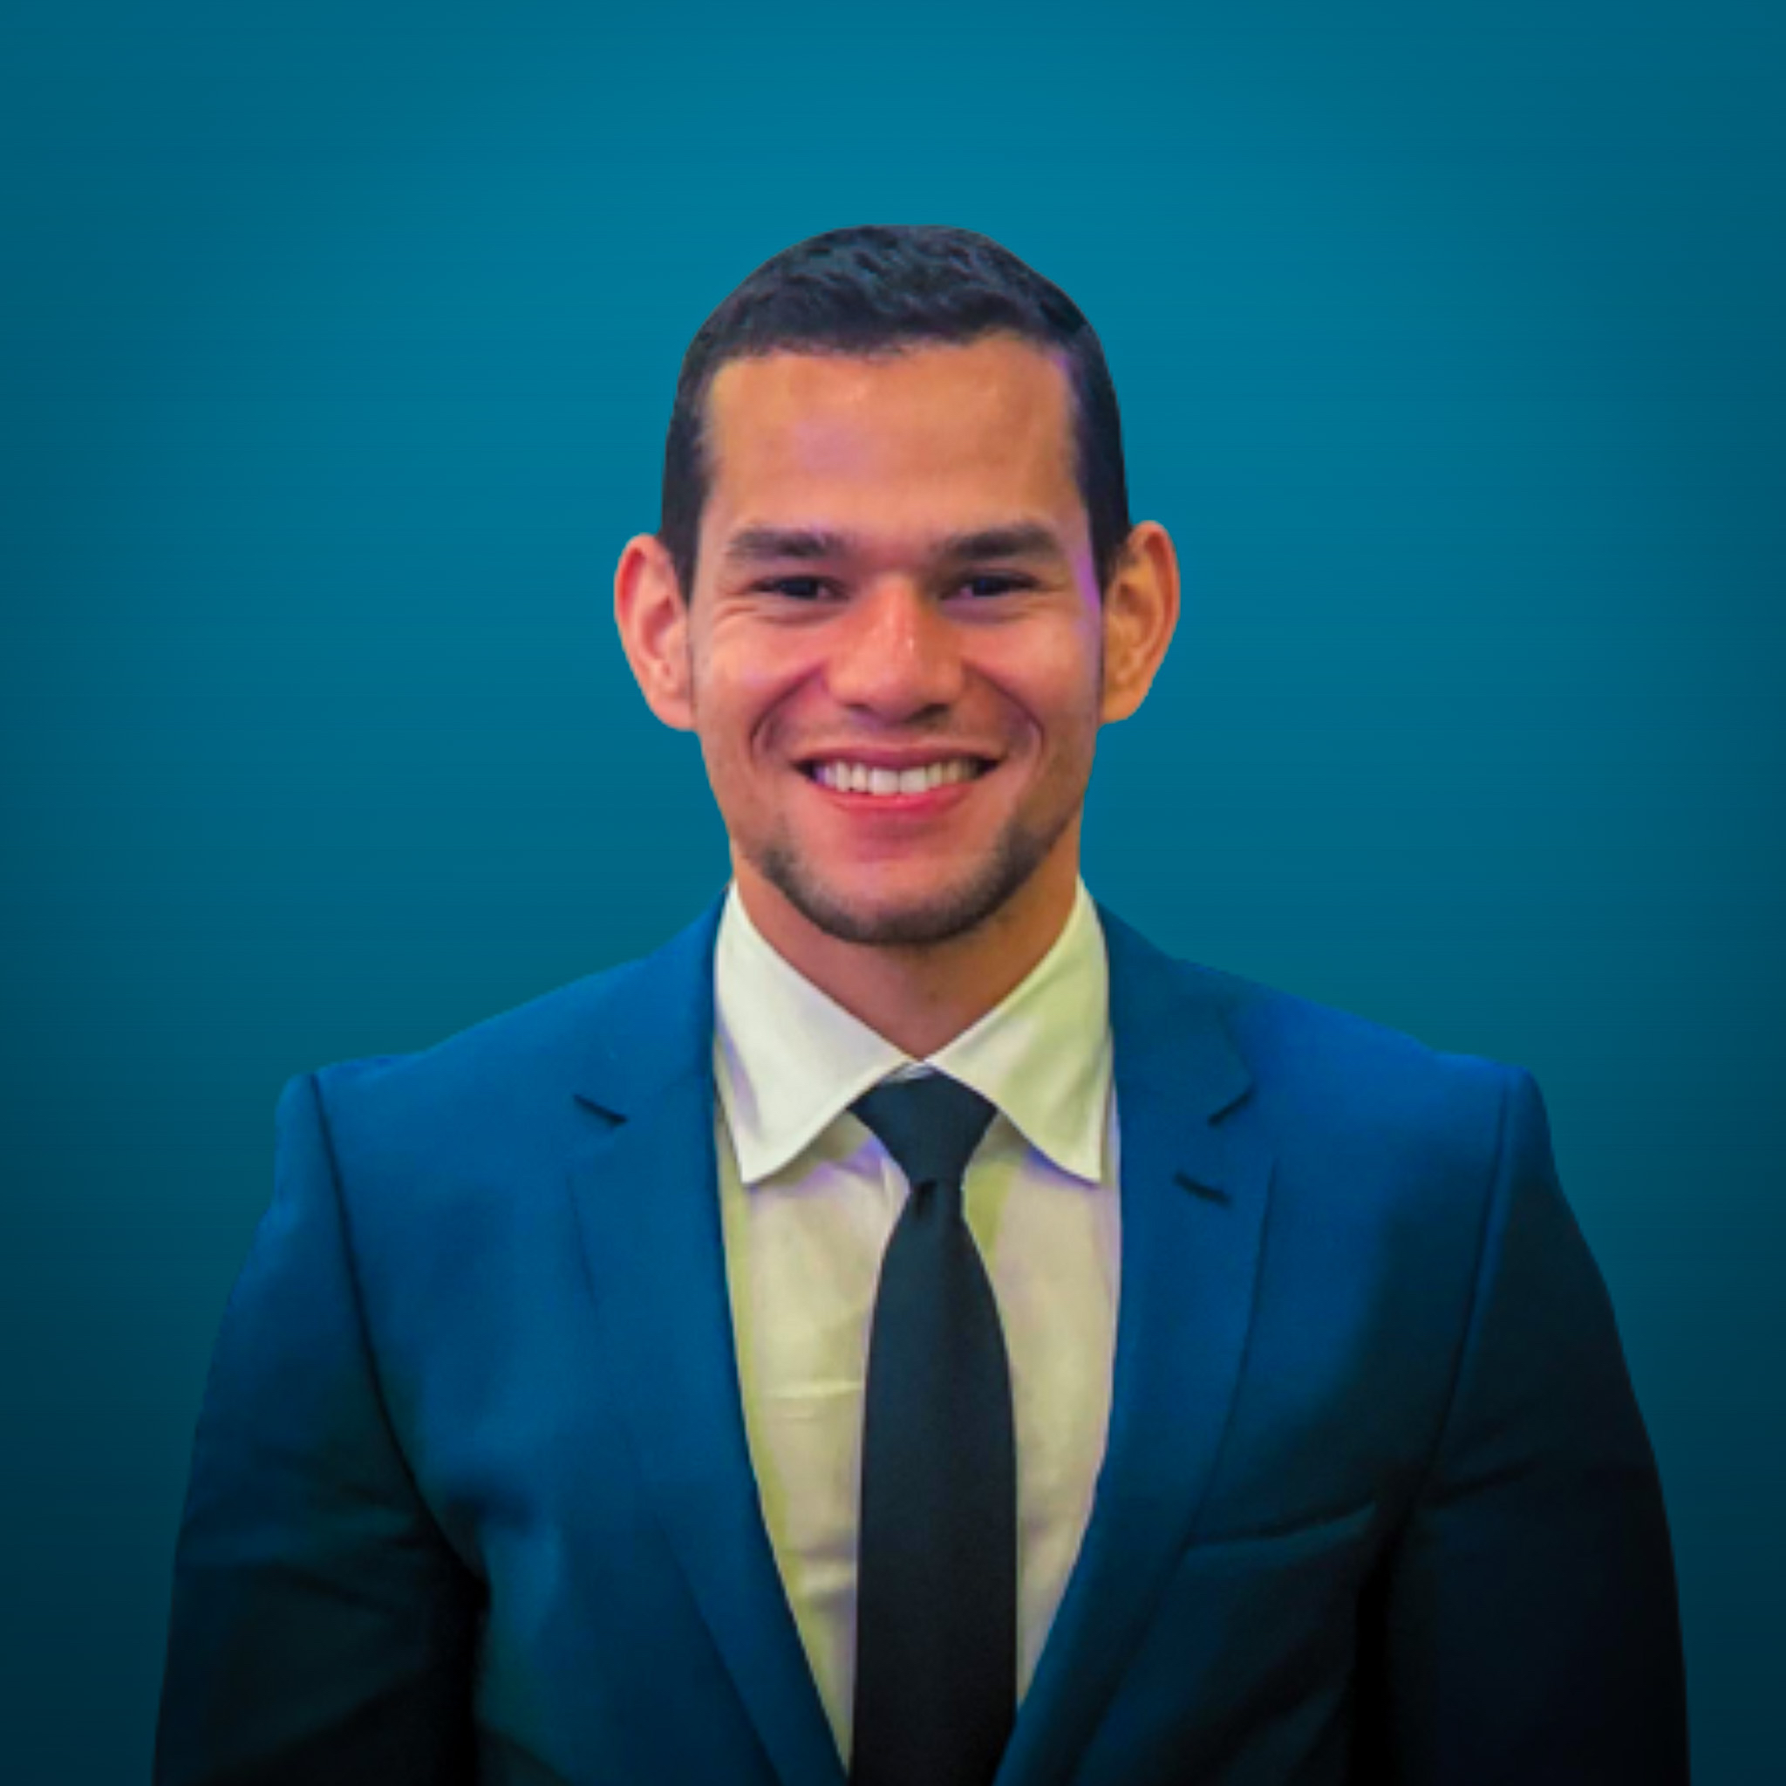
Brief Self Introduction
Geraldo F. Oliveira
Researcher @ SAFARI Research Group since November 2017
Soon, I will defend my PhD thesis, advised by Onur Mutlu
I am in the job market for industry positions
https://geraldofojunior.github.io/
geraldofojunior@gmail.com (Best way to reach me)
https://safari.ethz.ch
Research in:
Computer architecture, computer systems, hardware security
Memory and storage systems
Hardware security, safety, predictability
Fault tolerance
Hardware/software cooperation
…

Slide 3
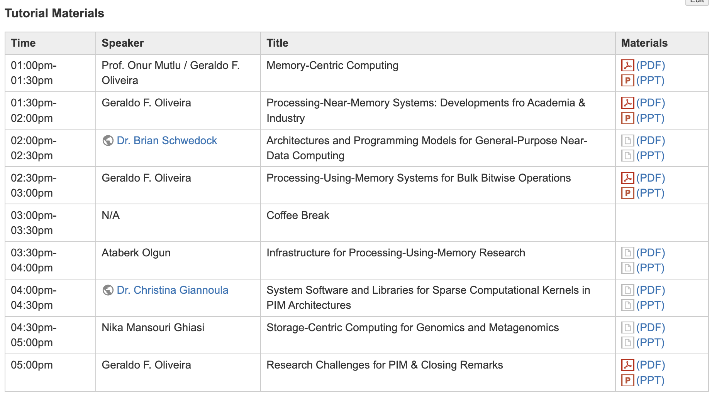
Get the Materials Online
https://events.safari.ethz.ch/micro24-memorycentric-tutorial/doku.php?id=start

Slide 4
Get the Materials Online
https://events.safari.ethz.ch/micro24-memorycentric-tutorial/doku.php?id=start

Slide 5
The Problem
Computing
is Bottlenecked by Data

Slide 6
Data is Key for AI, ML, Genomics, …
Important workloads are all data intensive
They require rapid and efficient processing of large amounts of data
Data is increasing
We can generate more than we can process
We need to perform more sophisticated analyses on more data

Slide 7
Huge Demand for Performance & Efficiency
Source: https://youtu.be/Bh13Idwcb0Q?t=283

Slide 8
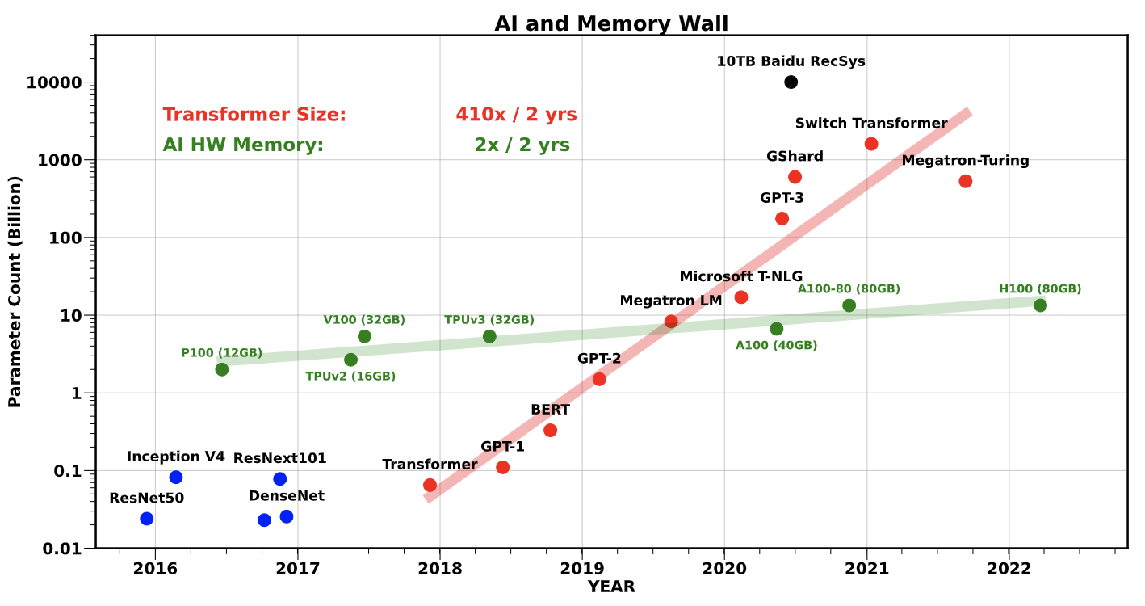
Huge Demand for Performance & Efficiency
Gholami, Amir, et al. "AI and Memory Wall." IEEE Micro, 2024.

Slide 9
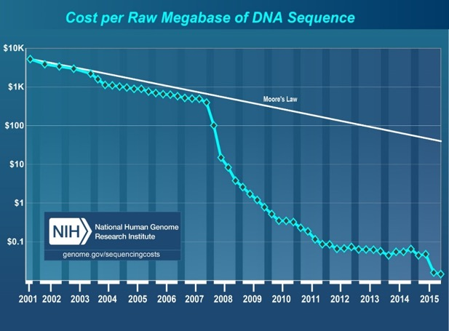
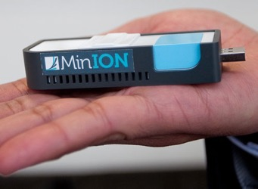
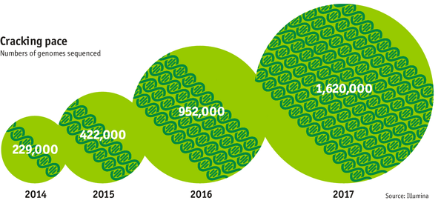
Huge Demand for Performance & Efficiency
development of new
sequencing technologies
Oxford Nanopore MinION
Number of Genomes Sequenced
http://www.economist.com/news/21631808-so-much-genetic-data-so-many-uses-genes-unzipped
Notes:
However, since the development of high throughput sequencing (HTS) technologies, the cost of genome sequencing has fallen off a cliff (<< 1,000$) making it viable for almost everyone's use.

Slide 10
Challenge and Opportunity for Future
High Performance,
Energy Efficient,
Sustainable
(All at the Same Time)

Slide 11
The Problem
Data access is the major performance and energy bottleneck
Our current
design principles
cause great energy waste
(and great performance loss)

Slide 12
The Problem
Processing of data
is performed
far away from the data

Slide 13
Today’s Computing Systems
Processor centric
All data processed in the processor → at great system cost

Slide 14
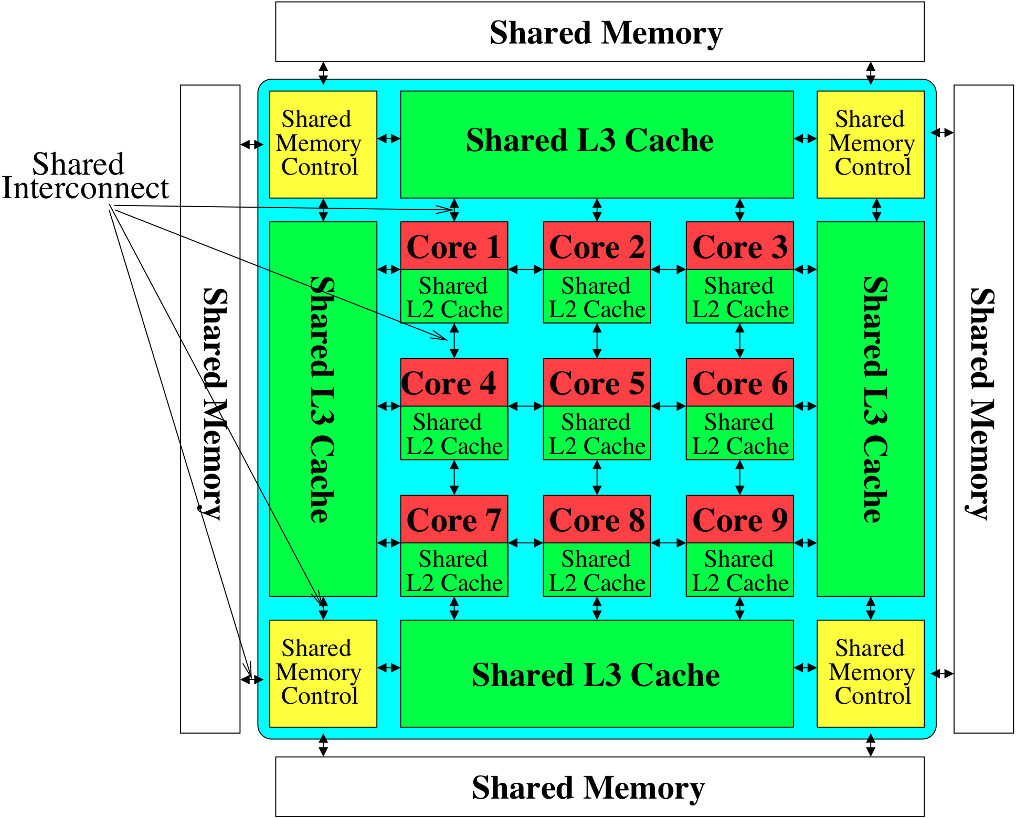
Perils of Processor-Centric Design
Most of the system is dedicated to storing and moving data
Yet, system is still bottlenecked by memory

Slide 15
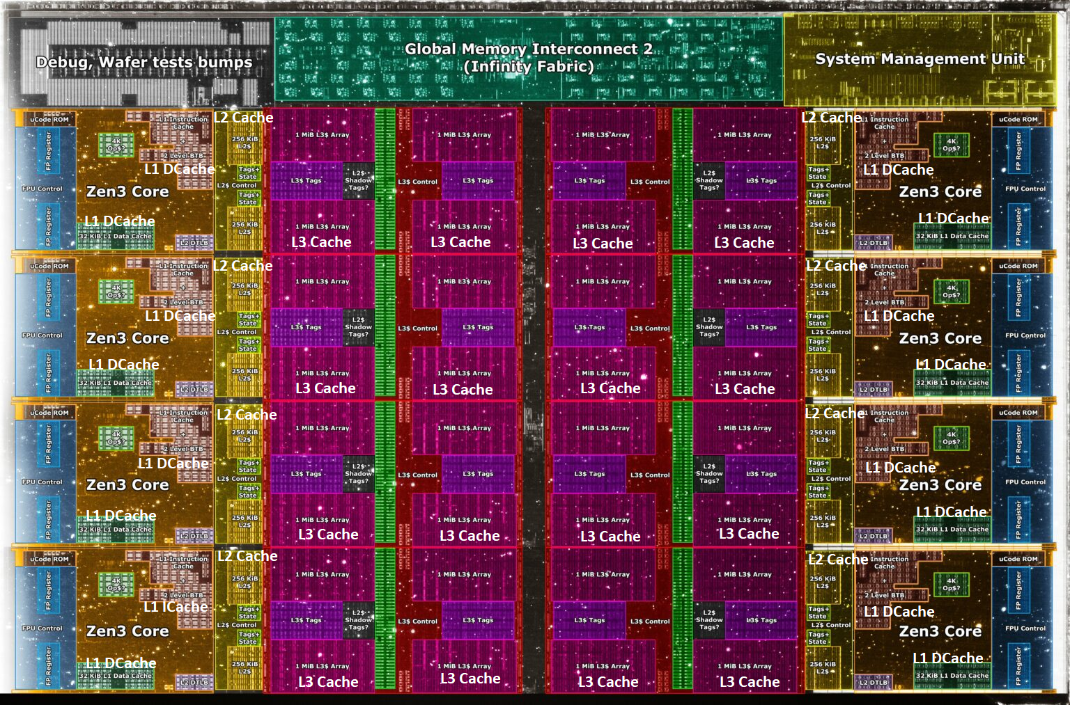
Deeper and Larger Memory Hierarchies
Core Count:
8 cores/16 threads
L1 Caches:
32 KB per core
L2 Caches:
512 KB per core
L3 Cache:
32 MB shared
AMD Ryzen 5000, 2020
https://wccftech.com/amd-ryzen-5000-zen-3-vermeer-undressed-high-res-die-shots-close-ups-pictured-detailed/

Slide 16
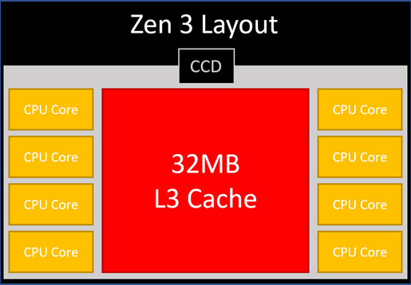
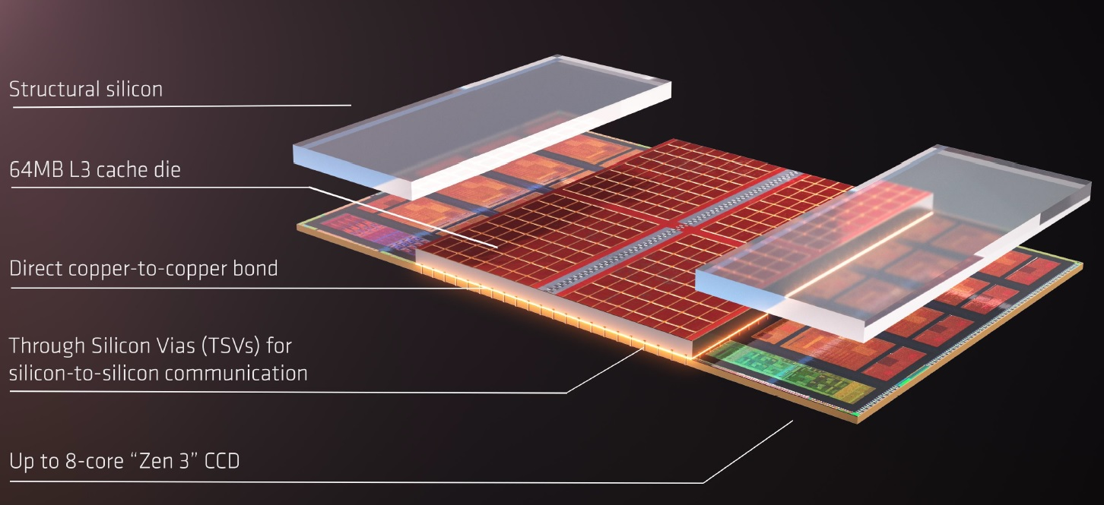
AMD’s 3D Last Level Cache (2021)
AMD increases the L3 size of their 8-core Zen 3 processors from 32 MB to 96 MB
Additional 64 MB L3 cache die stacked on top of the processor die
- Connected using Through Silicon Vias (TSVs)
- Total of 96 MB L3 cache
https://community.microcenter.com/discussion/5134/comparing-zen-3-to-zen-2
https://youtu.be/gqAYMx34euU
https://www.tech-critter.com/amd-keynote-computex-2021/
Notes:
CCD = Core Chiplet Die
Structural silicon is used to equalize the height and facilitate heat dissipation from the cores.

Slide 17
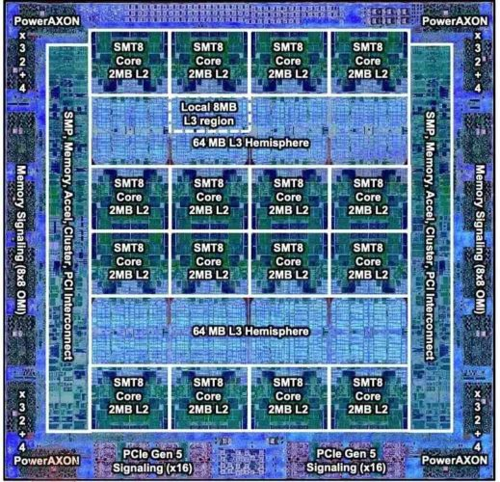
Deeper and Larger Memory Hierarchies
IBM POWER10,
2020
Cores:
15-16 cores,
8 threads/core
L2 Caches:
2 MB per core
L3 Cache:
120 MB shared
https://www.it-techblog.de/ibm-power10-prozessor-mehr-speicher-mehr-tempo-mehr-sicherheit/09/2020/

Slide 18
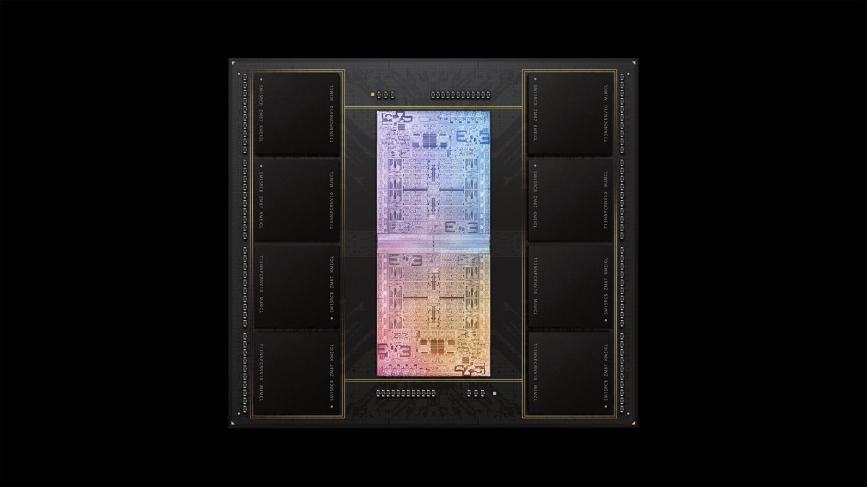
Deeper and Larger Memory Hierarchies
A lot of
SRAM
Storage
DRAM
DRAM
Storage
Apple M1 Ultra System (2022)
https://www.gsmarena.com/apple_announces_m1_ultra_with_20core_cpu_and_64core_gpu-news-53481.php

Slide 19
Data Overwhelms Modern Machines …
Storage/memory capability
Communication capability
Computation capability
Greatly impacts robustness, energy, performance, cost

Slide 20
It’s the Memory, Stupid!
“It’s the Memory, Stupid!” (Richard Sites, MPR, 1996)
http://cva.stanford.edu/classes/cs99s/papers/architects_look_to_future.pdf

Slide 21
The Performance Perspective
Mutlu+, “Runahead Execution: An Alternative to Very Large Instruction Windows for Out-of-Order Processors,” HPCA 2003.

Slide 22
The Performance Perspective
Onur Mutlu, Jared Stark, Chris Wilkerson, and Yale N. Patt, "Runahead Execution: An Alternative to Very Large Instruction Windows for Out-of-order Processors" Proceedings of the 9th International Symposium on High-Performance Computer Architecture (HPCA), pages 129-140, Anaheim, CA, February 2003. Slides (pdf)
One of the 15 computer arch. papers of 2003 selected as Top Picks by IEEE Micro. HPCA Test of Time Award (awarded in 2021).

Slide 23
The Performance Perspective (Today)
All of Google’s Data Center Workloads (2015):
Kanev+, “Profiling a Warehouse-Scale Computer,” ISCA 2015.

Slide 24
Three Key Systems Trends
1. Data access is a major bottleneck
Applications are increasingly data hungry
2. Energy consumption is a key limiter
3. Data movement energy dominates compute
Especially true for off-chip to on-chip movement

Slide 25
Data Movement vs. Computation Energy
Dally, HiPEAC 2015
A memory access consumes ~100-1000X
the energy of a complex addition

Slide 26
Data Movement vs. Computation Energy
Han+, “EIE: Efficient Inference Engine on Compressed Deep Neural Network,” ISCA 2016.

Slide 27
Data Movement vs. Computation Energy
6400X
A memory access consumes 6400X
the energy of a simple integer addition
Han+, “EIE: Efficient Inference Engine on Compressed Deep Neural Network,” ISCA 2016.

Slide 28
Energy Waste in Mobile Devices
Amirali Boroumand, Saugata Ghose, Youngsok Kim, Rachata Ausavarungnirun, Eric Shiu, Rahul Thakur, Daehyun Kim, Aki Kuusela, Allan Knies, Parthasarathy Ranganathan, and Onur Mutlu, "Google Workloads for Consumer Devices: Mitigating Data Movement Bottlenecks" Proceedings of the 23rd International Conference on Architectural Support for Programming Languages and Operating Systems (ASPLOS), Williamsburg, VA, USA, March 2018.
62.7% of the total system energy
is spent on data movement

Slide 29
Energy Waste in Accelerators
Amirali Boroumand, Saugata Ghose, Berkin Akin, Ravi Narayanaswami, Geraldo F. Oliveira, Xiaoyu Ma, Eric Shiu, and Onur Mutlu, "Google Neural Network Models for Edge Devices: Analyzing and Mitigating Machine Learning Inference Bottlenecks" Proceedings of the 30th International Conference on Parallel Architectures and Compilation Techniques (PACT), Virtual, September 2021. [Slides (pptx) (pdf)] [Talk Video (14 minutes)]
> 90% of the total system energy
is spent on memory in large ML models

Slide 30
Example Energy Breakdowns
In LSTMs and Transducers used by Google,
>90% energy spent on off-chip interconnect and DRAM
https://arxiv.org/pdf/2109.14320
Notes:
[CLICK] Fist, Mensa-G placement of accelerators and careful dataflow design enables to reduce the energy consumed by on-chip and off-chip parameter traffic by 15.3x on average compared to the baseline.
[CLICK] Second, Mensa-G reduces the dynamic energy of on-chip buffers and Noc by almost 50x compared to the Baseline system with high bw memory.
[CLICK] We conclude that Mensa-G reduces energy by 66% and improves inference energy efficiency by 3.0x compared to the baseline edge TPU.
[NEXT]

Slide 31
We Do Not Want to Move Data!
Dally, HiPEAC 2015
A memory access consumes ~100-1000X
the energy of a complex addition

Slide 32
Axiom
An Intelligent Architecture
Handles Data Well

Slide 33
How to Handle Data Well
Ensure data does not overwhelm the components
via intelligent algorithms
via intelligent architectures
via whole system designs: algorithm-architecture-devices
Take advantage of vast amounts of data and metadata
to improve architectural & system-level decisions
Understand and exploit properties of (different) data
to improve algorithms & architectures in various metrics

Slide 34
Corollaries: Computing Systems Today …
Are processor-centric vs. data-centric
Make designer-dictated decisions vs. data-driven
Make component-based myopic decisions vs. data-aware

Slide 35
Architectures for Intelligent Machines
Data-centric
Data-driven
Data-aware

Slide 36
A Blueprint for Fundamentally Better Architectures
Onur Mutlu, "Intelligent Architectures for Intelligent Computing Systems" Invited Paper in Proceedings of the Design, Automation, and Test in Europe Conference (DATE), Virtual, February 2021. [Slides (pptx) (pdf)] [IEDM Tutorial Slides (pptx) (pdf)] [Short DATE Talk Video (11 minutes)] [Longer IEDM Tutorial Video (1 hr 51 minutes)]

Slide 37
Data-Centric (Memory-Centric) Architectures

Slide 38
Data-Centric Architectures: Properties
Process data where it resides (where it makes sense)
Processing in and near memory structures
Low-latency and low-energy data access
Low latency memory
Low energy memory
Low-cost data storage and processing
High capacity memory at low cost: hybrid memory, compression
Intelligent data management
Intelligent controllers handling robustness, security, cost, perf.

Slide 39
Process Data Where It Makes Sense
Sensors
A lot of
SRAM
Storage
DRAM
DRAM
Storage
Apple M1 Ultra System (2022)
https://www.gsmarena.com/apple_announces_m1_ultra_with_20core_cpu_and_64core_gpu-news-53481.php

Slide 40
We Need to Think Differently from the Past Approaches

Slide 41
We Need A Paradigm Shift To …
Enable computation with minimal data movement
Compute where it makes sense (where data resides)
Make computing architectures more data-centric

Slide 42
Mindset: Memory as an Accelerator
CPU
core
CPU
core
mini-CPU
core
GPU
(throughput)
core
GPU
(throughput)
core
video
core
GPU
(throughput)
core
GPU
(throughput)
core
CPU
core
CPU
core
Memory
imaging
core
LLC
Specialized
compute-capability
in memory
Memory Controller
Memory Bus
Memory similar to a “conventional” accelerator
42

Slide 43
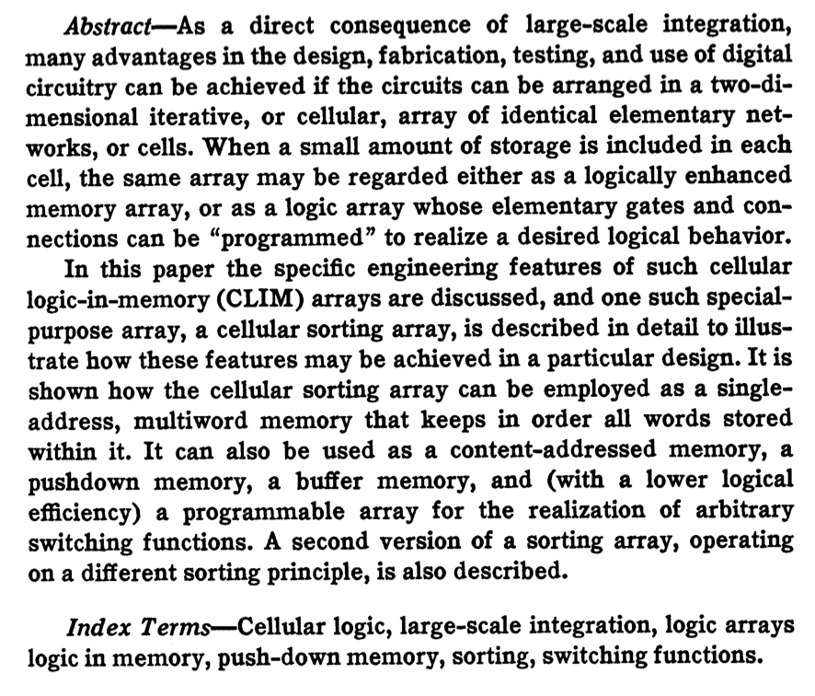
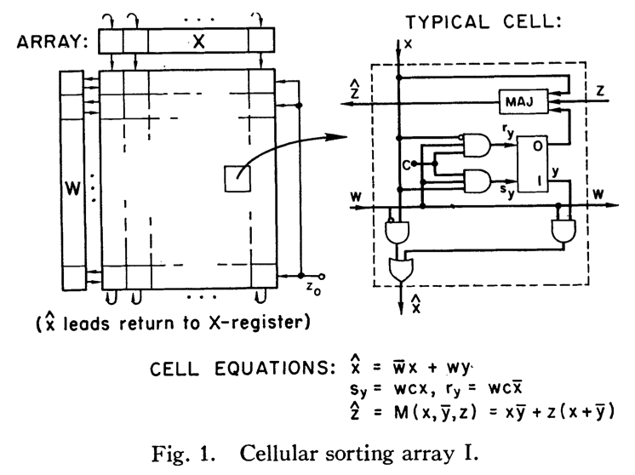
Processing in/near Memory: An Old Idea (I)
Kautz, “Cellular Logic-in-Memory Arrays”, IEEE TC 1969.
https://doi.org/10.1109/T-C.1969.222754

Slide 44
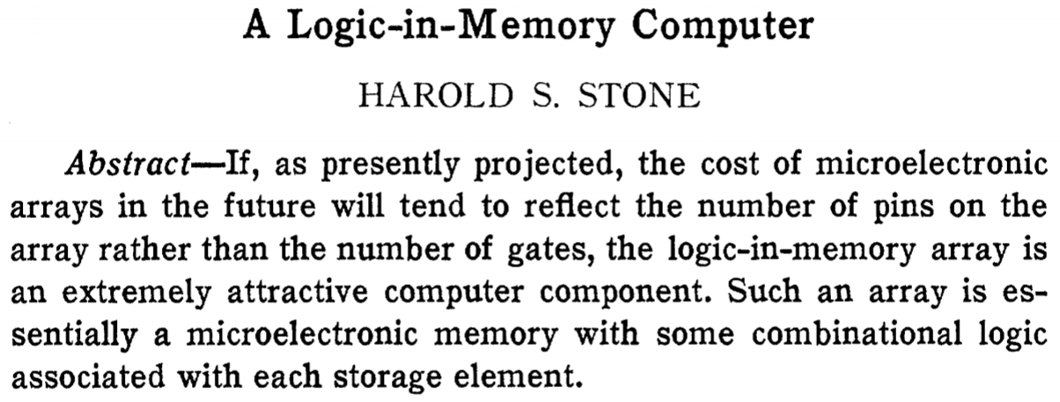
Processing in/near Memory: An Old Idea (II)
Stone, “A Logic-in-Memory Computer,” IEEE TC 1970.
https://safari.ethz.ch/architecture/fall2020/lib/exe/fetch.php?media=stone_logic_in_memory_1970.pdf

Slide 45
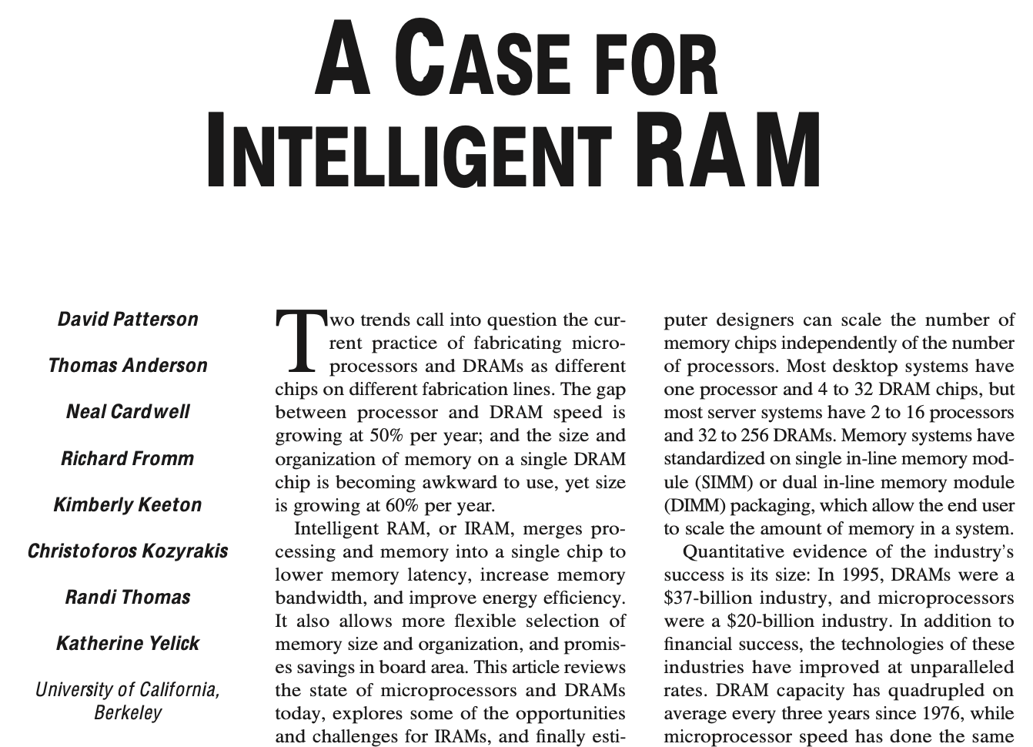
Processing in/near Memory: An Old Idea (III)
Patterson et al., “A Case for Intelligent RAM,” IEEE Micro 1997.
https://doi.org/10.1109/40.592312

Slide 46
Why In-Memory Computation Today?
Huge demand from Applications & Systems
Data access bottleneck
Energy & power bottlenecks
Data movement energy dominates computation energy
Need all at the same time: performance, energy, sustainability
We can improve all metrics by minimizing data movement
Huge problems with Memory Technology
Memory technology scaling is not going well (e.g., RowHammer)
Many scaling issues demand intelligence in memory
Designs are squeezed in the middle

Slide 47
Why In-Memory Computation Today?
Huge demand from Applications & Systems
Data access bottleneck
Energy & power bottlenecks
Data movement energy dominates computation energy
Need all at the same time: performance, energy, sustainability
We can improve all metrics by minimizing data movement
Huge problems with Memory Technology
Memory technology scaling is not going well (e.g., RowHammer)
Many scaling issues demand intelligence in memory
Designs are squeezed in the middle

Slide 48
Why In-Memory Computation Today?
Huge demand from Applications & Systems
Data access bottleneck
Energy & power bottlenecks
Data movement energy dominates computation energy
Need all at the same time: performance, energy, sustainability
We can improve all metrics by minimizing data movement
Huge problems with Memory Technology
Memory technology scaling is not going well (e.g., RowHammer)
Many scaling issues demand intelligence in memory
Designs are squeezed in the middle

Slide 49
Memory Scaling Issues Are Real
Onur Mutlu, "Memory Scaling: A Systems Architecture Perspective" Proceedings of the 5th International Memory Workshop (IMW), Monterey, CA, May 2013. Slides (pptx) (pdf) EETimes Reprint
49
https://people.inf.ethz.ch/omutlu/pub/memory-scaling_memcon13.pdf

Slide 50
A Curious Phenomenon [Kim et al., ISCA 2014]
One can
predictably induce errors
in most DRAM memory chips
Kim+, “Flipping Bits in Memory Without Accessing Them: An Experimental Study of DRAM Disturbance Errors,” ISCA 2014.

Slide 51
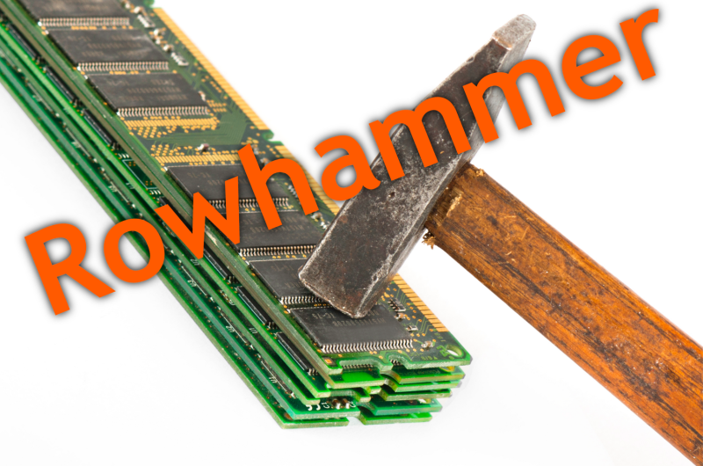
51
Notes:
Picture from the article:
http://thehackernews.com/2015/03/dram-rowhammer-vulnerability.html

Slide 52
Modern Memory is Prone to Disturbance Errors
Row of Cells
Wordline
Row
Victim Row
Row
Hammered Row
V_{LOW}
Opened
V_{HIGH}
Closed
Row
Victim Row
Row
Repeatedly reading a row enough times (before memory gets refreshed) induces disturbance errors in adjacent rows in most real DRAM chips you can buy today
Flipping Bits in Memory Without Accessing Them: An Experimental Study of DRAM Disturbance Errors, (Kim et al., ISCA 2014)

Slide 53
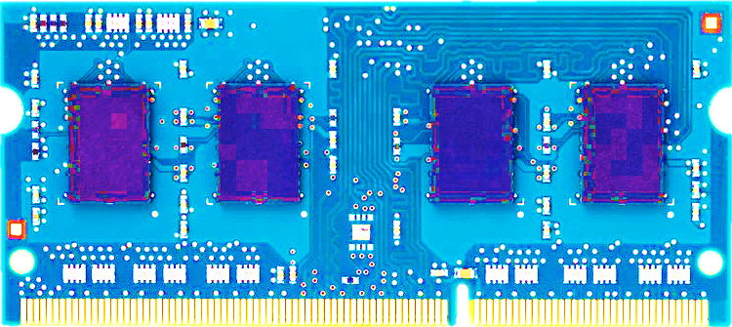
Most DRAM Modules Are Vulnerable
A company
B company
C company
86%
(37/43)
83%
(45/54)
88%
(28/32)
Up to
1.0×10⁷ errors
Up to
2.7×10⁶ errors
Up to
3.3×10⁵ errors
Flipping Bits in Memory Without Accessing Them: An Experimental Study of DRAM Disturbance Errors, (Kim et al., ISCA 2014)

Slide 54
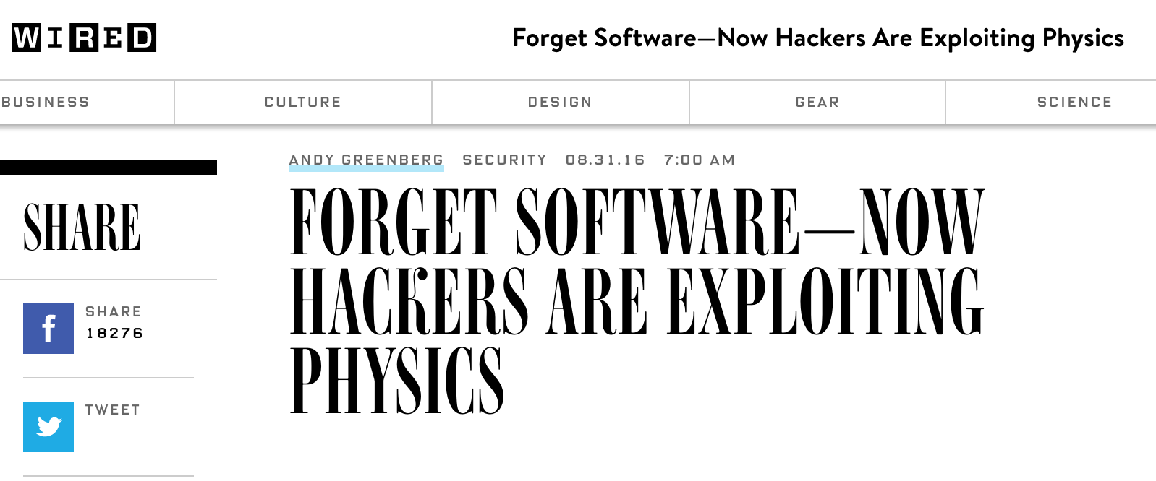
The RowHammer Vulnerability
A simple hardware failure mechanism
can create a widespread
system security vulnerability
54

Slide 55
RowHammer [ISCA 2014]
Yoongu Kim, Ross Daly, Jeremie Kim, Chris Fallin, Ji Hye Lee, Donghyuk Lee, Chris Wilkerson, Konrad Lai, and Onur Mutlu, "Flipping Bits in Memory Without Accessing Them: An Experimental Study of DRAM Disturbance Errors" Proceedings of the 41st International Symposium on Computer Architecture (ISCA), Minneapolis, MN, June 2014. [Slides (pptx) (pdf)] [Lightning Session Slides (pptx) (pdf)] [Source Code and Data] [Lecture Video (1 hr 49 mins), 25 September 2020] One of the 7 papers of 2012-2017 selected as Top Picks in Hardware and Embedded Security for IEEE TCAD (link). Selected to the ISCA-50 25-Year Retrospective Issue covering 1996-2020 in 2023 (Retrospective (pdf) Full Issue).

Slide 56
Memory Scaling Issues Are Real
Onur Mutlu and Jeremie Kim, "RowHammer: A Retrospective" IEEE Transactions on Computer-Aided Design of Integrated Circuits and Systems (TCAD) Special Issue on Top Picks in Hardware and Embedded Security, 2019. [Preliminary arXiv version] [Slides from COSADE 2019 (pptx)] [Slides from VLSI-SOC 2020 (pptx) (pdf)] [Talk Video (1 hr 15 minutes, with Q&A)]

Slide 57
Memory Scaling Issues Are Real
Onur Mutlu, Ataberk Olgun, and A. Giray Yaglikci, "Fundamentally Understanding and Solving RowHammer" Invited Special Session Paper at the 28th Asia and South Pacific Design Automation Conference (ASP-DAC), Tokyo, Japan, January 2023. [arXiv version] [Slides (pptx) (pdf)] [Talk Video (26 minutes)]
https://arxiv.org/pdf/2211.07613.pdf

Slide 58
The Story of RowHammer Tutorial …
Onur Mutlu, "Security Aspects of DRAM: The Story of RowHammer" Invited Tutorial at 14th IEEE Electron Devices Society International Memory Workshop (IMW), Dresden, Germany, May 2022. [Slides (pptx)(pdf)] [Tutorial Video (57 minutes)]
https://www.youtube.com/watch?v=37hWglkQRG0

Slide 59
10 Years of RowHammer in 20 Minutes
Onur Mutlu, "The Story of RowHammer" Invited Talk at the Workshop on Robust and Safe Software 2.0 (RSS2), held with the 27th International Conference on Architectural Support for Programming Languages and Operating Systems (ASPLOS), Virtual, 28 February 2022. [Slides (pptx) (pdf)]
https://www.youtube.com/watch?v=ctKTRyi96Bk

Slide 60
Latest RowHammer Lecture
https://www.youtube.com/watch?v=p1pjF8WvERQ

Slide 61
The Push from Circuits and Devices
Main Memory Needs
Intelligent Controllers

Slide 62
An Example Intelligent Controller
A. Giray Yaglikci, Minesh Patel, Jeremie S. Kim, Roknoddin Azizi, Ataberk Olgun, Lois Orosa, Hasan Hassan, Jisung Park, Konstantinos Kanellopoulos, Taha Shahroodi, Saugata Ghose, and Onur Mutlu, "BlockHammer: Preventing RowHammer at Low Cost by Blacklisting Rapidly-Accessed DRAM Rows" Proceedings of the 27th International Symposium on High-Performance Computer Architecture (HPCA), Virtual, February-March 2021. [Slides (pptx) (pdf)] [Short Talk Slides (pptx) (pdf)] [Intel Hardware Security Academic Awards Short Talk Slides (pptx) (pdf)] [Talk Video (22 minutes)] [Short Talk Video (7 minutes)] [Intel Hardware Security Academic Awards Short Talk Video (2 minutes)] [BlockHammer Source Code] Intel Hardware Security Academic Award Finalist (one of 4 finalists out of 34 nominations)

Slide 63
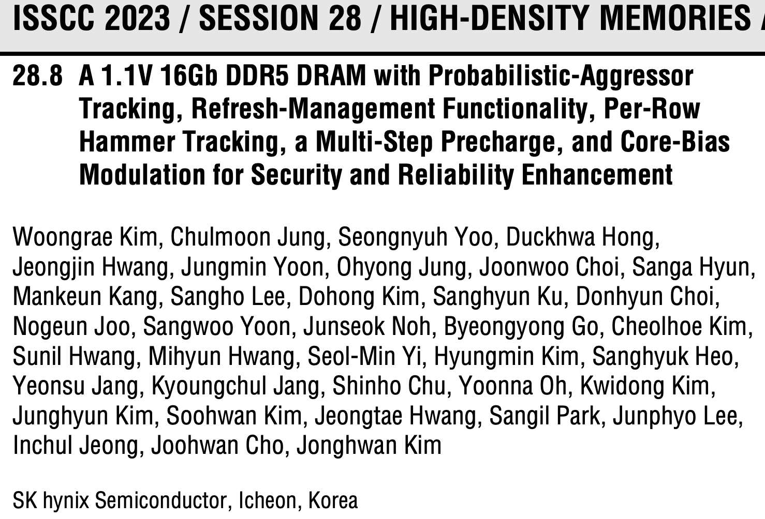
Industry’s Intelligent DRAM Controllers (I)

Slide 64
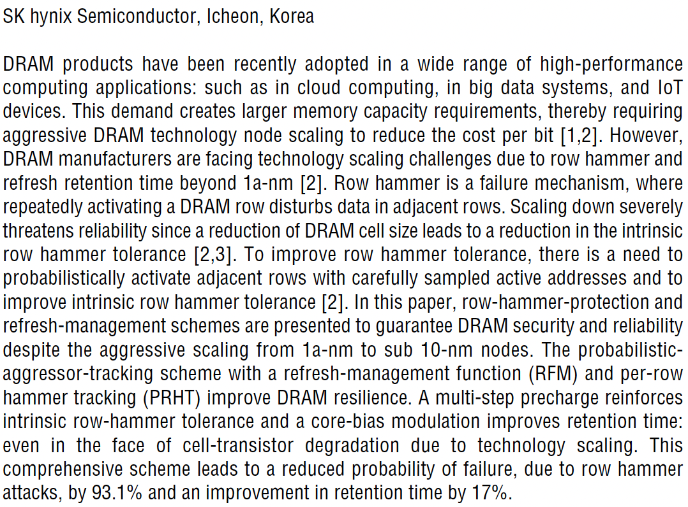
Industry’s Intelligent DRAM Controllers (II)

Slide 65
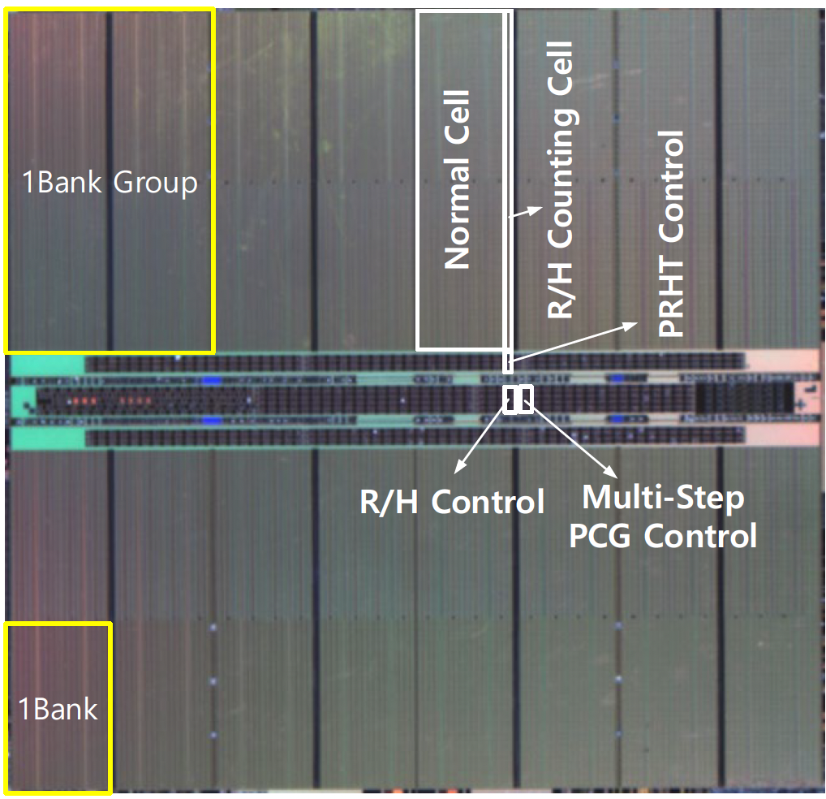
Industry’s Intelligent DRAM Controllers (III)

Slide 66
Industry’s Intelligent DRAM Controllers (IV)
https://arxiv.org/pdf/2302.03591v1.pdf

Slide 67
Are We Now BitFlip Free?
Haocong Luo, Ataberk Olgun, Giray Yaglikci, Yahya Can Tugrul, Steve Rhyner, M. Banu Cavlak, Joel Lindegger, Mohammad Sadrosadati, and Onur Mutlu, "RowPress: Amplifying Read Disturbance in Modern DRAM Chips" Proceedings of the 50th International Symposium on Computer Architecture (ISCA), Orlando, FL, USA, June 2023. [Slides (pptx) (pdf)] [Lightning Talk Slides (pptx) (pdf)] Officially artifact evaluated as available, reusable and reproducible. Best artifact award at ISCA 2023.

Slide 68
DRAM Read Disturbance: A Critical Challenge
Technology node scaling
[Kim+, ISCA’14]
[Kim+, ISCA’20]
[Luo+, ISCA’23]
DRAM cells become increasingly more vulnerable to read disturbance
Notes:
With technology node scaling, DRAM cells get smaller in size and closer to each other[CLICK]
Such that we observe significant reductions in the minimum hammer count to induce the first bitflip in the last decade [CLICK]
Thus DRAM cells become increasingly more vulnerable to read disturbance [CLICK]

Slide 69
Emerging Memories Also Need Intelligent Controllers
Benjamin C. Lee, Engin Ipek, Onur Mutlu, and Doug Burger, "Architecting Phase Change Memory as a Scalable DRAM Alternative" Proceedings of the 36th International Symposium on Computer Architecture (ISCA), pages 2-13, Austin, TX, June 2009. Slides (pdf) One of the 13 computer architecture papers of 2009 selected as Top Picks by IEEE Micro. Selected as a CACM Research Highlight. 2022 Persistent Impact Prize.

Slide 70
Industry Is Writing Papers About It, Too

Slide 71
Call for Intelligent Memory Controllers

Slide 72
The Takeaway
Intelligent
Memory Controllers
Can Avoid Many Failures
& Enable Better Scaling

Slide 73
Why In-Memory Computation Today?
Huge demand from Applications & Systems
Data access bottleneck
Energy & power bottlenecks
Data movement energy dominates computation energy
Need all at the same time: performance, energy, sustainability
We can improve all metrics by minimizing data movement
Huge problems with Memory Technology
Memory technology scaling is not going well (e.g., RowHammer)
Many scaling issues demand intelligence in memory
Designs are squeezed in the middle

Slide 74
Goal: Processing Inside Memory
Many questions … How do we design the:
compute-capable memory & controllers?
processors & communication units?
software & hardware interfaces?
system software, compilers, languages?
algorithms & theoretical foundations?
Memory
Processor
Core
Database
Graphs
Media
Cache
Query
Interconnect
Problem
Results
Algorithm
Program/Language
System Software
SW/HW Interface
Micro-architecture
Logic
Devices
Electrons

Slide 75
PIM Review and Open Problems
Onur Mutlu, Saugata Ghose, Juan Gomez-Luna, and Rachata Ausavarungnirun, "A Modern Primer on Processing in Memory" Invited Book Chapter in Emerging Computing: From Devices to Systems - Looking Beyond Moore and Von Neumann, Springer, 2022.
https://arxiv.org/pdf/1903.03988.pdf

Slide 76
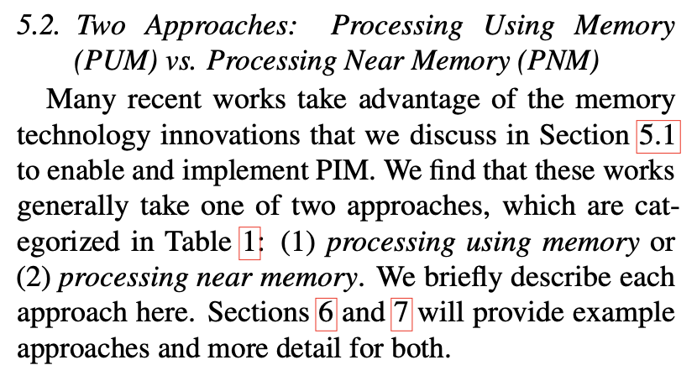
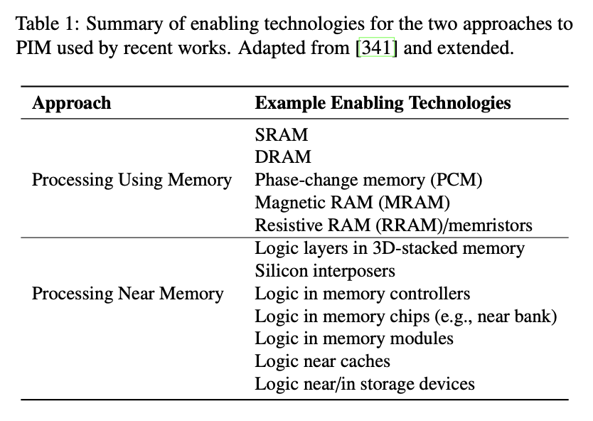
Two PIM Approaches
Onur Mutlu, Saugata Ghose, Juan Gomez-Luna, and Rachata Ausavarungnirun, "A Modern Primer on Processing in Memory" Invited Book Chapter in Emerging Computing: From Devices to Systems - Looking Beyond Moore and Von Neumann, Springer, to be published in 2021. [Tutorial Video on "Memory-Centric Computing Systems" (1 hour 51 minutes)]
https://people.inf.ethz.ch/omutlu/pub/ModernPrimerOnPIM_springer-emerging-computing-bookchapter21.pdf

Slide 77
Processing in Memory: Two Approaches
1. Processing using Memory
2. Processing near Memory

Slide 78
Processing-in-Memory: Nature of Computation
Two main approaches for Processing-in-Memory:
1
Processing-Near-Memory: Design compute logic and memory separately (as today) and integrate logic closer to memory
2
Processing-Using-Memory: Use analog operational principles of memory circuitry to perform computation (no compute logic)
DRAM (e.g., 3D-Stacked Memory)
DRAM Bank
Vault
Controller
Processing-
Using-DRAM
DRAM Vault
…
PHY
Processing-Near-Vault
…
Processing-Near-Bank
Notes:
Processing-in-Memory architectures alleviate data movement bottlenecks by moving computation to where the data resides. Such architectures can be implemented
[CLICK] by adding logic near the memory arrays, in what is called processing-near-memory or
[CLICK] by using the analog operating principles of the memory cells to perform computation, in what is called processing-using-memory
[NEXT]

Slide 79
A PIM Taxonomy
Nature (of computation)
Using: Use operational properties of memory structures
Near: Add logic close to memory structures
Technology
Flash, DRAM, SRAM, RRAM, MRAM, FeRAM, PCM, 3D, …
Location
Sensor, Cold Storage, Hard Disk, SSD, Main Memory, Cache, Register File, Memory Controller, Interconnect, …
A tuple of the three determines “PIM type”
One can combine multiple “PIM types” in a system

Slide 80
Agenda
Processing-Near-Memory Systems: Developments from Academia & Industry
Invited Talk by Dr. Brian Schwedock: Architectures and Programming Models for General-Purpose Near-Data Computing
Processing-Using-Memory Systems for Bulk Bitwise Operations
Coffee Break
Ataberk Olgun: Infrastructure for Processing-Using-Memory Research
Invited Talk by Dr. Christina Giannoula: System Software and Libraries for Sparse Computational Kernels in PIM Architectures
Nika Mansouri Ghiasi: Storage-Centric Computing for Genomics and Metagenomics
Research Challenges for PIM & Closing Remarks

Slide 81
Tutorial on Memory-Centric Computing: Introduction
Geraldo F. Oliveira
https://geraldofojunior.github.io
MICRO 2024
02 November 2024

Slide 82
Agenda
Processing-Near-Memory Systems: Developments from Academia & Industry
Invited Talk by Dr. Brian Schwedock: Architectures and Programming Models for General-Purpose Near-Data Computing
Processing-Using-Memory Systems for Bulk Bitwise Operations
Coffee Break
Ataberk Olgun: Infrastructure for Processing-Using-Memory Research
Invited Talk by Dr. Christina Giannoula: System Software and Libraries for Sparse Computational Kernels in PIM Architectures
Nika Mansouri Ghiasi: Storage-Centric Computing for Genomics and Metagenomics
Research Challenges for PIM & Closing Remarks

