Slide 1
Architectures and Programming Models for General-Purpose Near-Data Computing
Brian C. Schwedock
Memory-Centric Computing Systems @ MICRO’24
November 2, 2024

Slide 2
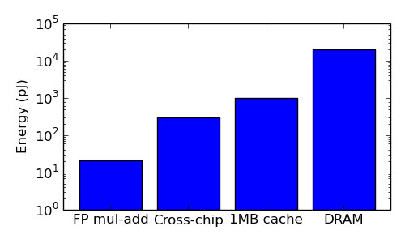
Data movement costs keep getting worse
Performance
Energy
1000x
[Efnusheva, IJCSIT’17]
[Dally, SC’10]

Slide 3
Memory hierarchy has evolved, but the interface has not
Core & L1
Core
L2
LLC bank
Loads & stores
50 years
Memory
Memory
Memory
… but software still sees this

Slide 4
Data movement optimizations are forced to be conservative
Software-controlled
Core
Core
Core
Core
Hardware-controlled
Private Cache
Private Cache
Private Cache
Private Cache
Replacement policies
Shared Cache
Shared Cache
Shared Cache
Shared Cache
Prefetchers
These mechanisms are not very effective
Memory
Memory

Slide 5
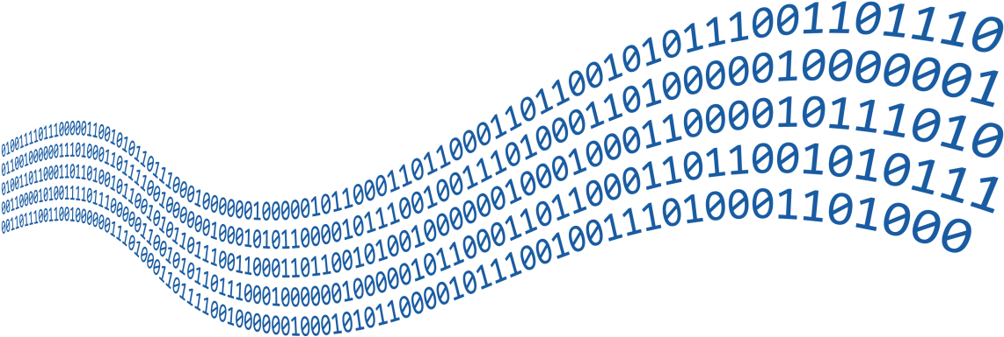
Hardware doesn’t know what applications want
Graph locality
Streaming throughput
Tail latency
Security
Memory interface doesn’t allow software to customize datapath
Software-controlled
Core
Core
Core
Core
Hardware-controlled
Private
Private
Private
Private
Shared
Shared
Shared
Shared
Memory
Memory

Slide 6
Specialized memory hierarchies (e.g., NDC, PIM) give big gains!
Graph optimizations
Security
Data placement
Remote memory operations
Sparse linear algebra / machine learning
Approximation / compression
Data marshalling / layout
Pointer chasing
Memoization
Prefetching
Relaxed coherence / consistency
Memory management
…
- Big opportunity -
Often >2x end-to-end speedup!
Core & L1
L2
LLC slice
Specialized hardware ➔ Not scalable!!!
Memory
Memory

Slide 7
How can we specialize the memory hierarchy without specialized hardware?

Slide 8
The interface is the problem!
Core
Core
Core
Core
Software-controlled
Loads & stores
Hardware-controlled
Private Cache
Private Cache
Private Cache
Shared Cache
Shared Cache
Shared Cache
ASICs
Programmable logic
Memory
Memory
Memory
Memory
Software’s view
Current systems
Specialized hierarchies
Programmable hierarchies

Slide 9
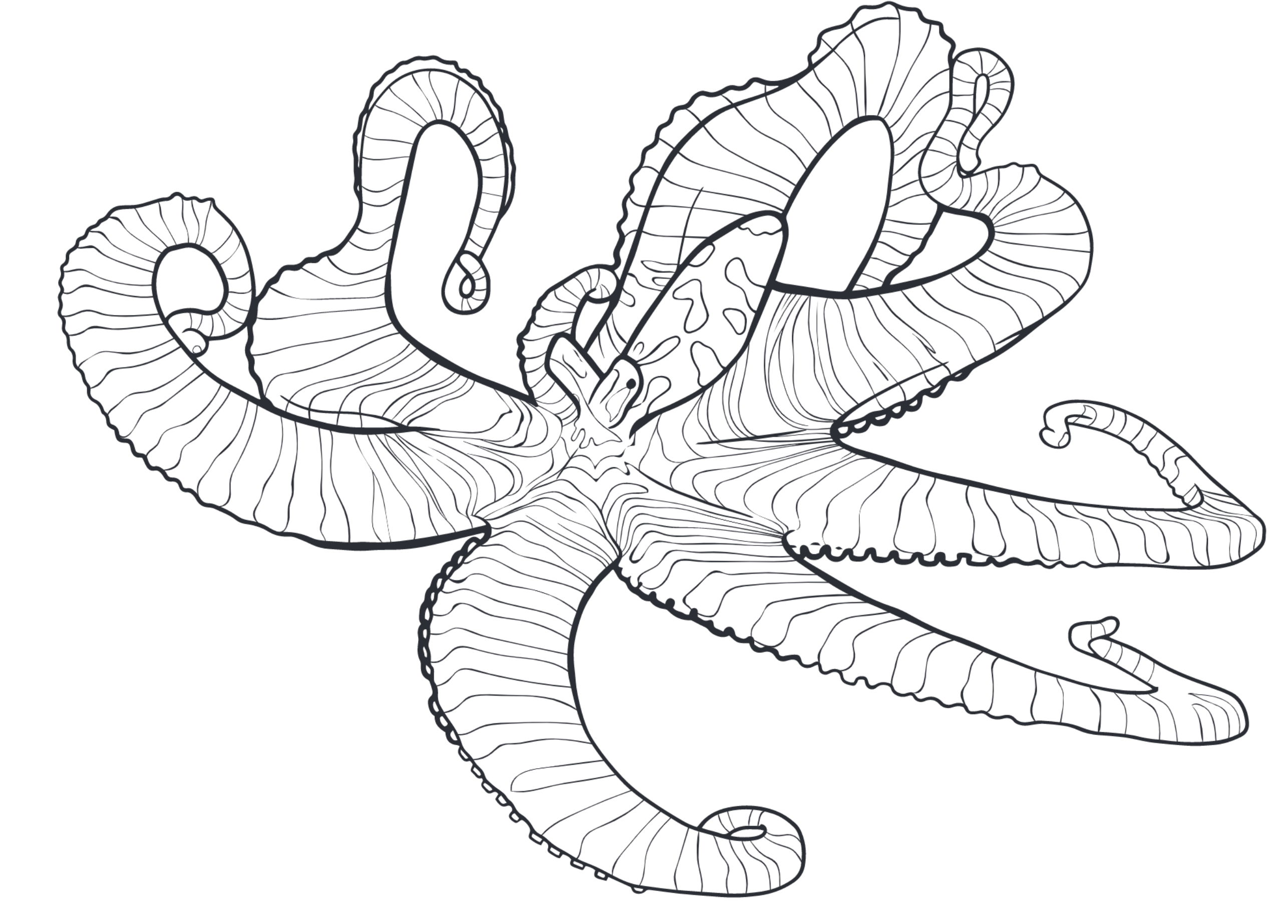
Overview
täkō
ISCA 2022
Leviathan
MICRO 2024
Long-lived workload
Task offload
Streaming
Data-triggered
* täkō is Japanese for “octopus”

Slide 10
Programmability replaces the need for custom hardware
Memory
Memory

Slide 11
Programmability replaces the need for custom hardware
Engine
Memory
Memory

Slide 12
täkō exposes data movement to software
Solution: Tell software when data moves! (& let it do something)
Baseline loads &
stores work normally
“Phantom” data lives
only in caches! [Carter, HPCA’99]
Software serves
misses to phantom
data (& evictions)
Core
Cache
Memory
Load
Normal Data
Miss
Data
App Code
Load
Phantom Data
täkō Engine
onMiss()
onEviction()
onWriteback()
App Code

Slide 13
täkō: Roadmap
Introduction
Example use case
täkō design
Evaluation

Slide 14
Base+delta (B+Δ) lossy compression
…
Compressed
Base
Δ
Δ
Δ
Δ
Base
Δ
Δ
+
+
+
+
≈
≈
≈
≈
…
Decompressed

Slide 15
B+Δ decompression: in the core
Core
B
Δ
+
≈
Load
Pros: Reduced memory and cache usage
Cons: Decompress on every access
Private Cache
B
Δ
Shared Cache
B
Δ
Memory
Δ
B
Δ
B

Slide 16
B+Δ decompression: compressed caches?
Core
Load
Pros:
Reduced memory and cache usage
Reuse decomp. data in private cache
Cons:
Compression scheme fixed in hardware
Cannot support lossy compression
Private Cache
B
Δ
+
≈
Shared Cache
Memory
Δ
[Miguel, MICRO’15]
Δ
B
Δ
B
B

Slide 17
B+Δ decompression: täkō
Core
Pros:
Reduced memory and cache usage
Reuse decomp. data in private cache
SW can implement any compression scheme!
… without needing new hardware for each!
Load
phantom
Private Cache
täkō Engine
B
Δ
+
≈
✅
Shared Cache
onMiss()
Memory
Δ
B
Δ
B

Slide 18
Evaluation: täkō leverages cache to capture reuse
16K objects, 32K accesses, Zipfian distribution (full experimental methodology shown later)
Data-movement triggers decompression on cache miss!
täkō with an ideal engine
Decompress on each access
Offload each decompression to L2

Slide 19
The interface is the problem
täkō is the solution
Core
Core
Software-controlled
Loads & stores
Hardware-controlled
Private Cache
Shared Cache
Engine
Memory
Memory
Software’s view
täkō

Slide 20
täkō: Roadmap
Introduction
Example use case
täkō design
Programming interface
Architecture
Evaluation

Slide 21
täkō programming interface
Callback
Description
onMiss(void* addr)
Generate & fill in cache line at addr.
onEviction(void* addr)
Handle eviction of clean data.
onWriteback(void* addr)
Handle eviction of dirty data.

Slide 22
Registering callbacks
Address range
0xFFFF
register(Morph, L2, 4 MB)
Morph
onMiss()
onEviction()
onWriteback()
Normal data
register(Morph, LLC, 8 MB)
0x0000

Slide 23
täkō: Roadmap
Introduction
Example use case
täkō design
Programming interface
Architecture
Evaluation

Slide 24
täkō architecture
Tile
Core
Hardware Scheduler
Callback Buffer
L1d
L1i
L2
Engine
L1d
TLB
rTLB
L3 Cache Bank
Dataflow Fabric
Data Array
Tag Array

Slide 25
onMiss callback
3
Scheduled
1
GET A
Core
Hardware Scheduler
∞
L1 hit
Callback Buffer
L1d
L1i
L2
Engine
L1d
TLB
rTLB
6
Response
L3 Cache Bank
5
Fill A
Data Array
2
L3 miss
4
Tags
onMiss(A)

Slide 26
onWriteback callback
3
Scheduled
Core
Hardware Scheduler
2
Callback Buffer
Invalidate A
L1d
L1i
L2
Engine
L1d
TLB
rTLB
L3 Cache Bank
Data Array
1
A evicted
(✔ = registered)
A ✔
4
onWriteback(A)
Tags

Slide 27
Additional cache and engine state
Core
2 bits per TLB entry
1 bit per tag
Callback buffer
Engine L1d
Engine TLB
Engine reverse TLB
< 3% overhead vs. L3 cache
Callback Buffer
Hardware Scheduler
L1d
L1i
TLB
L2
L1d
TLB
rTLB
Engine
L3 Cache Bank
Dataflow Fabric
Data Array
Tag Array

Slide 28
Engine microarchitecture
Engine Dataflow Fabric
Callbacks need memory-level parallelism
Callbacks are typically short
Callbacks are executed repeatedly
Multiple callbacks execute in parallel
Engine L1d

Slide 29
täkō: Roadmap
Introduction
Example use case
täkō design
Evaluation

Slide 30
Evaluation methodology
Cycle-level simulation of 16-tile CMP
Tile contains: OoO main core and täkō engine
täkō dataflow fabric: 5x5 array, 1-cycle PE latency
Ideal fabric: infinite PEs, 0-cycle PE latency
Core
Callback Buffer
Hardware Scheduler
L1d
L1i
TLB
L2
Engine
L1d
TLB
rTLB
L3 Cache Bank
Dataflow Fabric
Data Array
Tag Array

Slide 31
Commutative scatter-updates in graphs
Scatter-updates are common in graph algorithms:
But current cache hierarchies are bad at scatter-updates
Conflict between pull vs. push semantics
➔ Excess bandwidth & synchronization
2
for src in vertices:
for dst in outNeighbors(src):
vertex(dst) += vertex(src)
0
3
1
4
[Mukkara, MICRO’19]

Slide 32
Commutative scatter-updates in graphs
PHI changes the memory hierarchy to have push-based semantics
1. Updates are buffered in-cache without accessing memory
2. Updates applied on eviction:
2a) Immediately in-place, or
2b) Logged & deferred [Beamer, IPDPS’17]
Updates moved off critical path
Bandwidth optimized by 2a) vs 2b)
Core
UPDATE 0xFOO, +4
UPDATE 0xFOO, +2
Cache
0xFOO
4
6
2a) +6 in-place
2b) Log & defer
Memory
0xFOO
16
0xFOO: +6
10
[Mukkara, MICRO’19]

Slide 33
Example: PHI on täkō
Morph registered at L3 cache
Vertex updates buffered in phantom data
onWriteback selectively applies updates in-place or logs updates
Core
Memory
1
Update Vertex
A
F
B
E
L2
Engine
C
D
2
onMiss zeroes lines
L3
Bins
{B,0}
3a
{B,1} {E,2}
{B,1}
{F,1}
Impossible in software without täkō’s callbacks!
{C,3} {D,1}
3b
{F,1}
onWriteback can a) update in-place b) log update
{E,2}

Slide 34
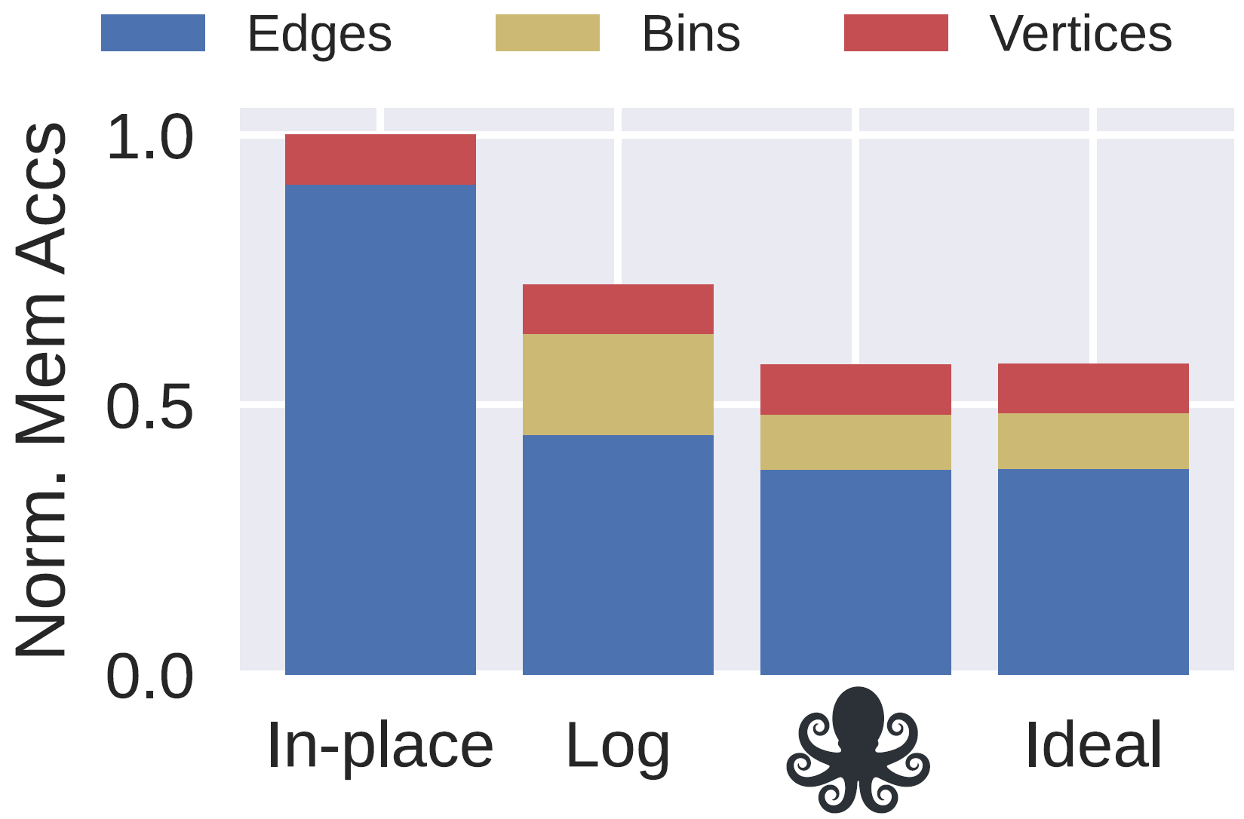
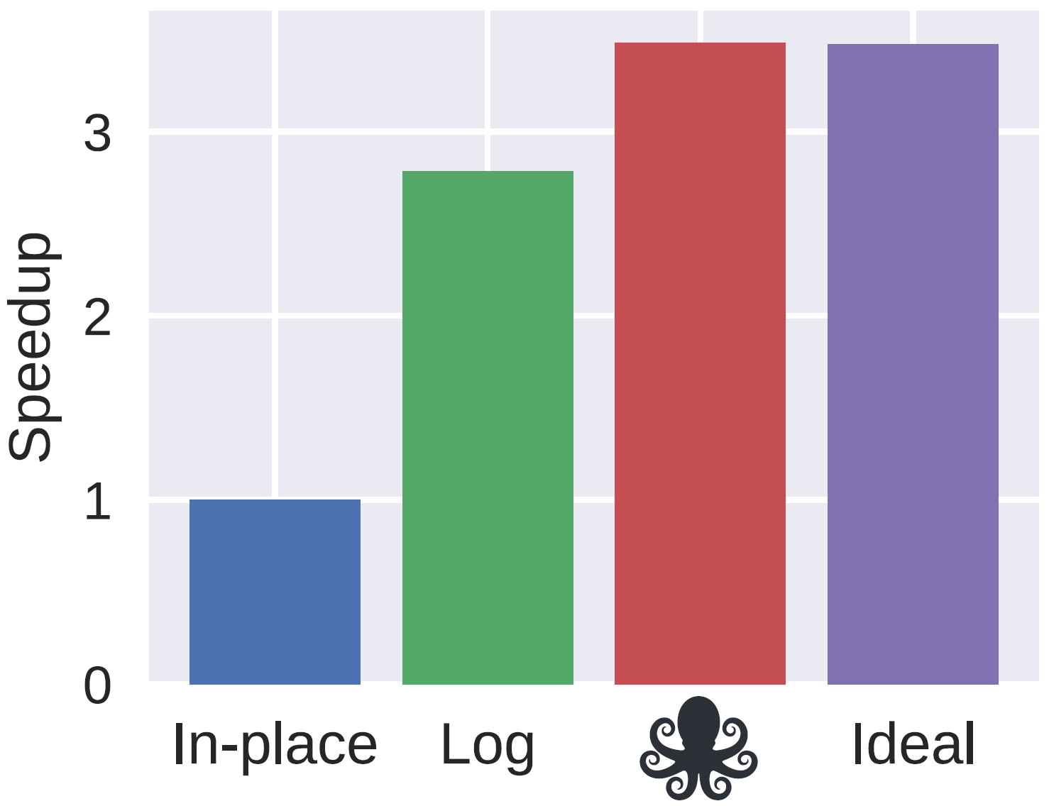
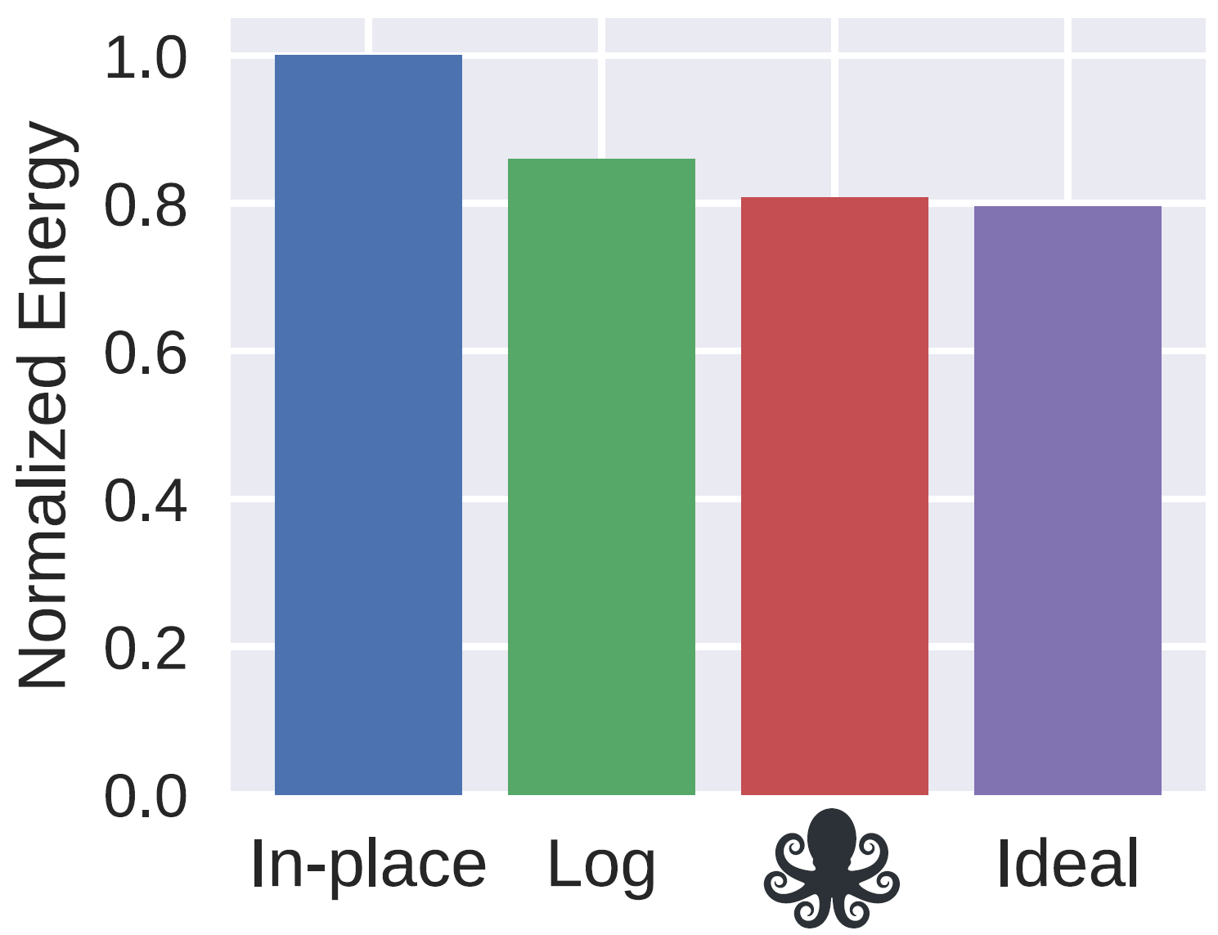
täkō’s benefits implementing PHI
PageRank, 16 threads, graph: 8M vertices & 80M edges
In-place
Log
In-place
Log
In-place
Log
täkō with an ideal engine
täkō implementation of PHI
Push-based PageRank
Software update-batching (always log)
[Beamer, IPDPS’17]

Slide 35
täkō: programmable specialized hierarchy
The memory interface limits software capabilities
Specialized hierarchies are beneficial but impractical
täkō provides a general-purpose architecture to enable software optimization of the cache hierarchy
Core
Callback Buffer
Hardware Scheduler
L1d
L1i
TLB
L2
Engine
L1d
TLB
rTLB
L3 Cache Bank
Dataflow Fabric
Data Array
Tag Array

Slide 36
Overview
täkō
ISCA 2022
Leviathan
MICRO 2024
Long-lived workload
Task offload
Streaming
Data-triggered

Slide 37
Near-data computing (NDC) paradigms
Task offload
Long-lived
Core
Cache
Memory
Core
Cache
Memory
Data
Data
Data
Data
App Code
Core
Cache
Memory
App Code
NDC HW
NDC HW
Task
Task
Data
Data
Data-triggered (e.g., täkō)
Streaming
NDC HW
Core
Cache
Memory
Core
Cache
Memory
Data
Data
Data
Data
App Code
App Code
NDC HW
NDC HW
Task
Task

Slide 38
Prior NDC designs mostly target a single paradigm
Task offload
Remote memory ops [ASPLOS’96]
Pointer chasing [PACT’16, ICCD’16]
Hash tables [MICRO’19]
Memoization [IEEE CAL’18]
…
Long-lived
Garbage collection [ISCA’18]
SerDes [MICRO’21, ASPLOS’20]
Memory deduplication [MICRO’17]
COREx [ISCA’18]
…
Livia [ASPLOS’20]
Dist-DA [MICRO’22]
No prior NDC design supports all NDC paradigms
Data-triggered
Compression [ASPLOS’19, MICRO’13, …]
Prefetching [HPCA’21, ASPLOS’18, …]
HTM [MICRO’16]
Coherence [MICRO’15, ISCA’94, …]
…
Streaming
Stream Dataflow [ISCA’17]
Stream ISA [ISCA’19]
SpZip [ISCA’21]
Graph traversals [MICRO’18]
…
täkō

Slide 39
Prior NDC suffers from poor hardware abstraction
Task loses locality
24-byte objects
Objects split over LLC lines
Core
Task
Core
NDC
Cache
Cache
0
64
128
Programmers shouldn’t have to worry about cache-line size
Cache line
Task loses locality
96-byte objects
Objects always span cache lines
Core
Task
Core
NDC
Cache
Cache
0
64
128

Slide 40
Leviathan: a unified NDC system with data management
L2
Engine
Task Offload
Long-lived workload
Task offload
Code
L1i
L1d
Scope:
NoC
Supports multiple NDC paradigms
Objects
HW abstraction:
Streaming
Data-triggered
Core
LLC Bank
Performs data management to ensure data locality

Slide 41
Leviathan: Roadmap
Motivation
Example NDC application
Design
Evaluation

Slide 42
Example application: linked-list traversal
1
2
3
Core
LLC bank
NDC HW
1
1
Reduced latency and network traffic!
3
2
3
2
Traditional: Each lookup pulls data to the core
Task offload NDC: Each lookup executes near the data

Slide 43
Leviathan: Roadmap
Motivation
Example NDC application
Design
Programming interface
Architecture
Evaluation

Slide 44
Programming interface: futures
Mechanism to asynchronously return data from NDC actions to the core
Future<T> fut = invoke (…)
T result = fut.wait()
3
invoke()
4
send()
1
invoke()
2
wait()

Slide 45
Programming interface: actors
class Node:
int key, value
Node* next
Node* Lookup(key):
if (this->key == key):
return value
if (next == nullptr):
return -1
return invoke next->Lookup(key)
Future<int> result = invoke node->Lookup(key)
Actor = data + action(s)
Data
Near-data action
“return” sends the value to the future
Actions can trigger further actions
Example action triggered by core

Slide 46
Programming interface: memory allocator
class Allocator<T>:
T* allocate()
void deallocate(T* object)
Normal array
Objects split over LLC banks
24-byte objects
0
64
128
w/ Leviathan allocator
Objects padded automatically
Leviathan only pads in cache! Data is compacted in DRAM
24-byte objects
0
64
128

Slide 47
Programming interface: paradigms
Task offload & long-lived
Data-triggered
Streaming
Core
Cache
Core
Cache
Core
Cache
Data
Data
Data
App Code
App Code
App Code
NDC HW
NDC HW
NDC HW
Task
Task
Task
Task
class Actor: # actor
int action1(…) # action
void action2(…) # action
Actor* a =
Allocator<Actor>::allocate()
Future<int> result =
invoke a->action1(…)
class Actor: # actor
# actions
Actor(State* s)
~Actor(State* s,
bool isDirty)
class Stream<T>: # actor
# Producer interface
void genStream() # action
void push(T entry)
# Consumer interface
Future<T> next()

Slide 48
Leviathan: Roadmap
Motivation
Example NDC application
Design
Programming interface
Architecture
Evaluation

Slide 49
Architecture: system
L2
Engine
L1i
L1d
Core
LLC Bank

Slide 50
Architecture: engines
Task offload & long-lived:
Check whether data is locally cached to execute action
If data not cached, forward action to next level
Data-triggered:
Maintain a buffer of currently-active actors
Map actors to their actions
Stream:
Track buffer size and head/tail pointers
Stall producer when buffer is full
Engine
Task-offload scheduler
Data-triggered scheduler
Stream scheduler
Execute action
Task-context buffer
Programmable compute logic
L1d
TLB
rTLB

Slide 51
Architecture: large object mapping
Padded 96B objects
0
64
128
192
256
Address
Address
Lines per object: 2
Per-object address
Bank id
TLB
Zero out LSBs
LLC hash function

Slide 52
Architecture: additional support
Compress padded data in main memory
Task offload & long-lived
Invoke instruction
Invoke backpressure buffer
Data-triggered
2 TLB registration bits
1 bit per cache tag
Streaming
Push and pop instructions
Total HW overhead including engines: 6.4% vs LLC

Slide 53
Leviathan: Roadmap
Motivation
Example NDC application
Design
Evaluation

Slide 54
Evaluation methodology
Cycle-level simulation of 16-tile CMP
Tile contents: OoO main core, LLC bank, and Leviathan engine
Engine compute: dataflow fabric, 5x5 array, 1-cycle PE latency
Ideal engine: dataflow fabric, infinite PEs, 0-cycle PE latency
L2
Engine
Task-offload scheduler
Data-triggered scheduler
Stream scheduler
L1i
L1d
Task-context buffer
L1d
Dataflow fabric
Core
LLC Bank
TLB
rTLB

Slide 55
Case Study:
Hash-table Lookups

Slide 56
Hash-table lookups w/ task offload NDC
lookup
hash function
1
2
3
bucket
1
2
3
1
2
3
1
2
3
class Node:
Node* next
int key
int values[N]
Data size doesn’t matter

Slide 57
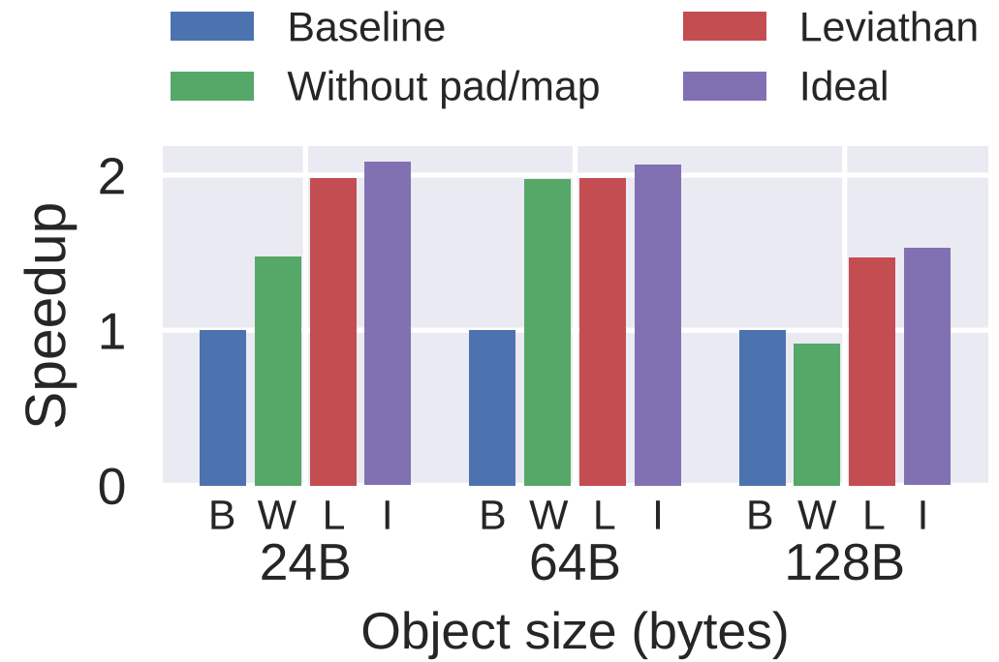
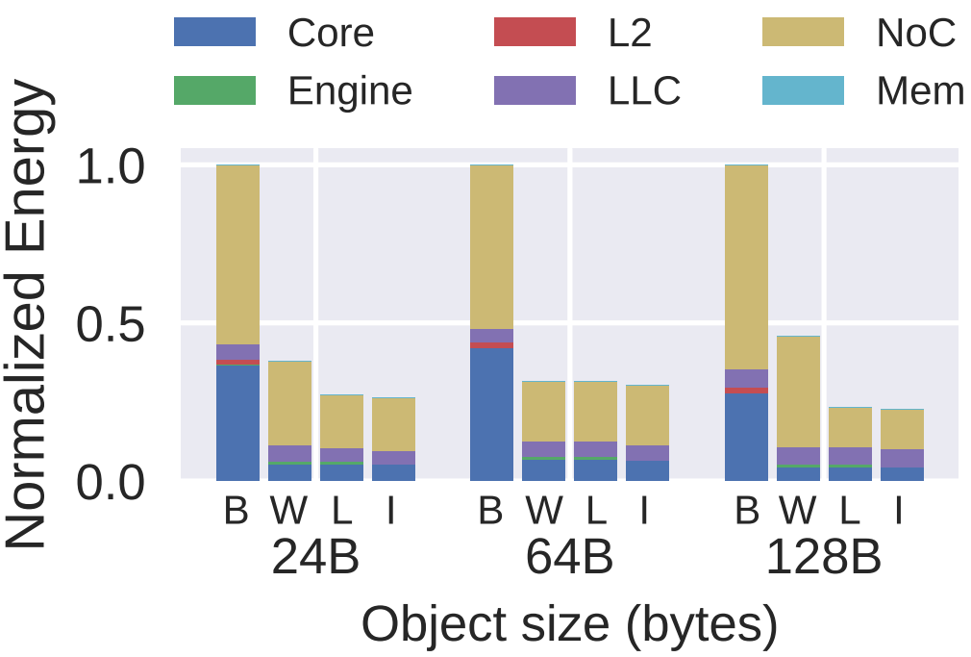
Leviathan’s benefits with transparent data management
16 threads, 32-node buckets, 4 MB total, lists accessed with uniform distribution

Slide 58
Case Study:
Multi-paradigm Accelerator

Slide 59
PHI requires support for multiple NDC paradigms
Core
Core
Task offload:
Offload remote memory operation (RMO) to cache
NOT supported by täkō
UPDATE 0xFOO, +6
UPDATE 0xFOO, +2
Cache
0xFOO
8
6
Data-triggered:
Conditionally update or log on evictions
Update in-place
Log & defer
Supported by täkō
Memory
0xFOO
10
0xFOO: +8
18
Leviathan is the only programmable system that supports both paradigms!
✅
[Mukkara, MICRO’19]

Slide 60
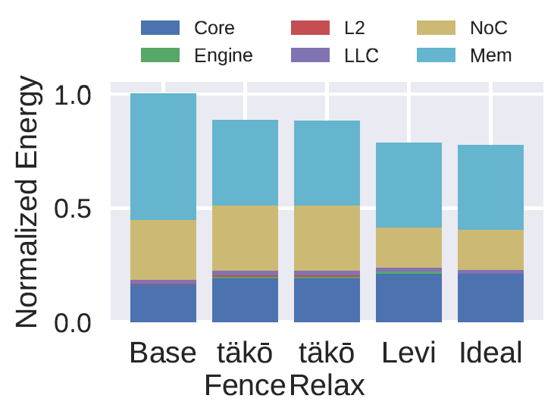
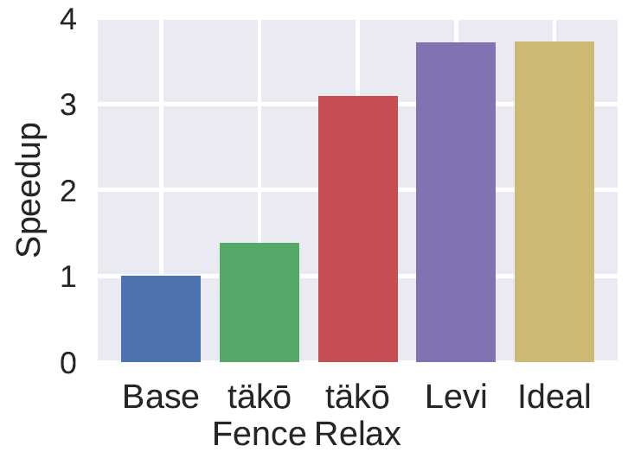
Leviathan’s benefits supporting multiple paradigms w/ PHI
PageRank, 16 threads, graph: 4M vertices & 40M edges
täkō with relaxed, fenceless atomics
täkō with normal, fenced atomics
Push-based PageRank
Leviathan implementation of PHI
Leviathan with an ideal engine

Slide 61
Leviathan: unified system for NDC
Practical NDC systems need to support many types of NDC
Data management is vital to provide locality to near-data actions
Leviathan provides a single architecture and programming interface for near-data computing
Long-lived workload
Task offload
Streaming
Data-triggered

Slide 62
Takeaways
Near-data computing tackles the data-movement bottleneck
Custom hardware and programming interfaces for each optimization is not scalable
General-purpose architectures enable software to implement a wide range of NDC designs
Long-lived workload
Task offload
Streaming
Data-triggered

