Slide 1
Tutorial on Memory-Centric Computing: Logistics
Geraldo F. Oliveira
https://geraldofojunior.github.io
PPoPP 2025
1st March 2025

Slide 2
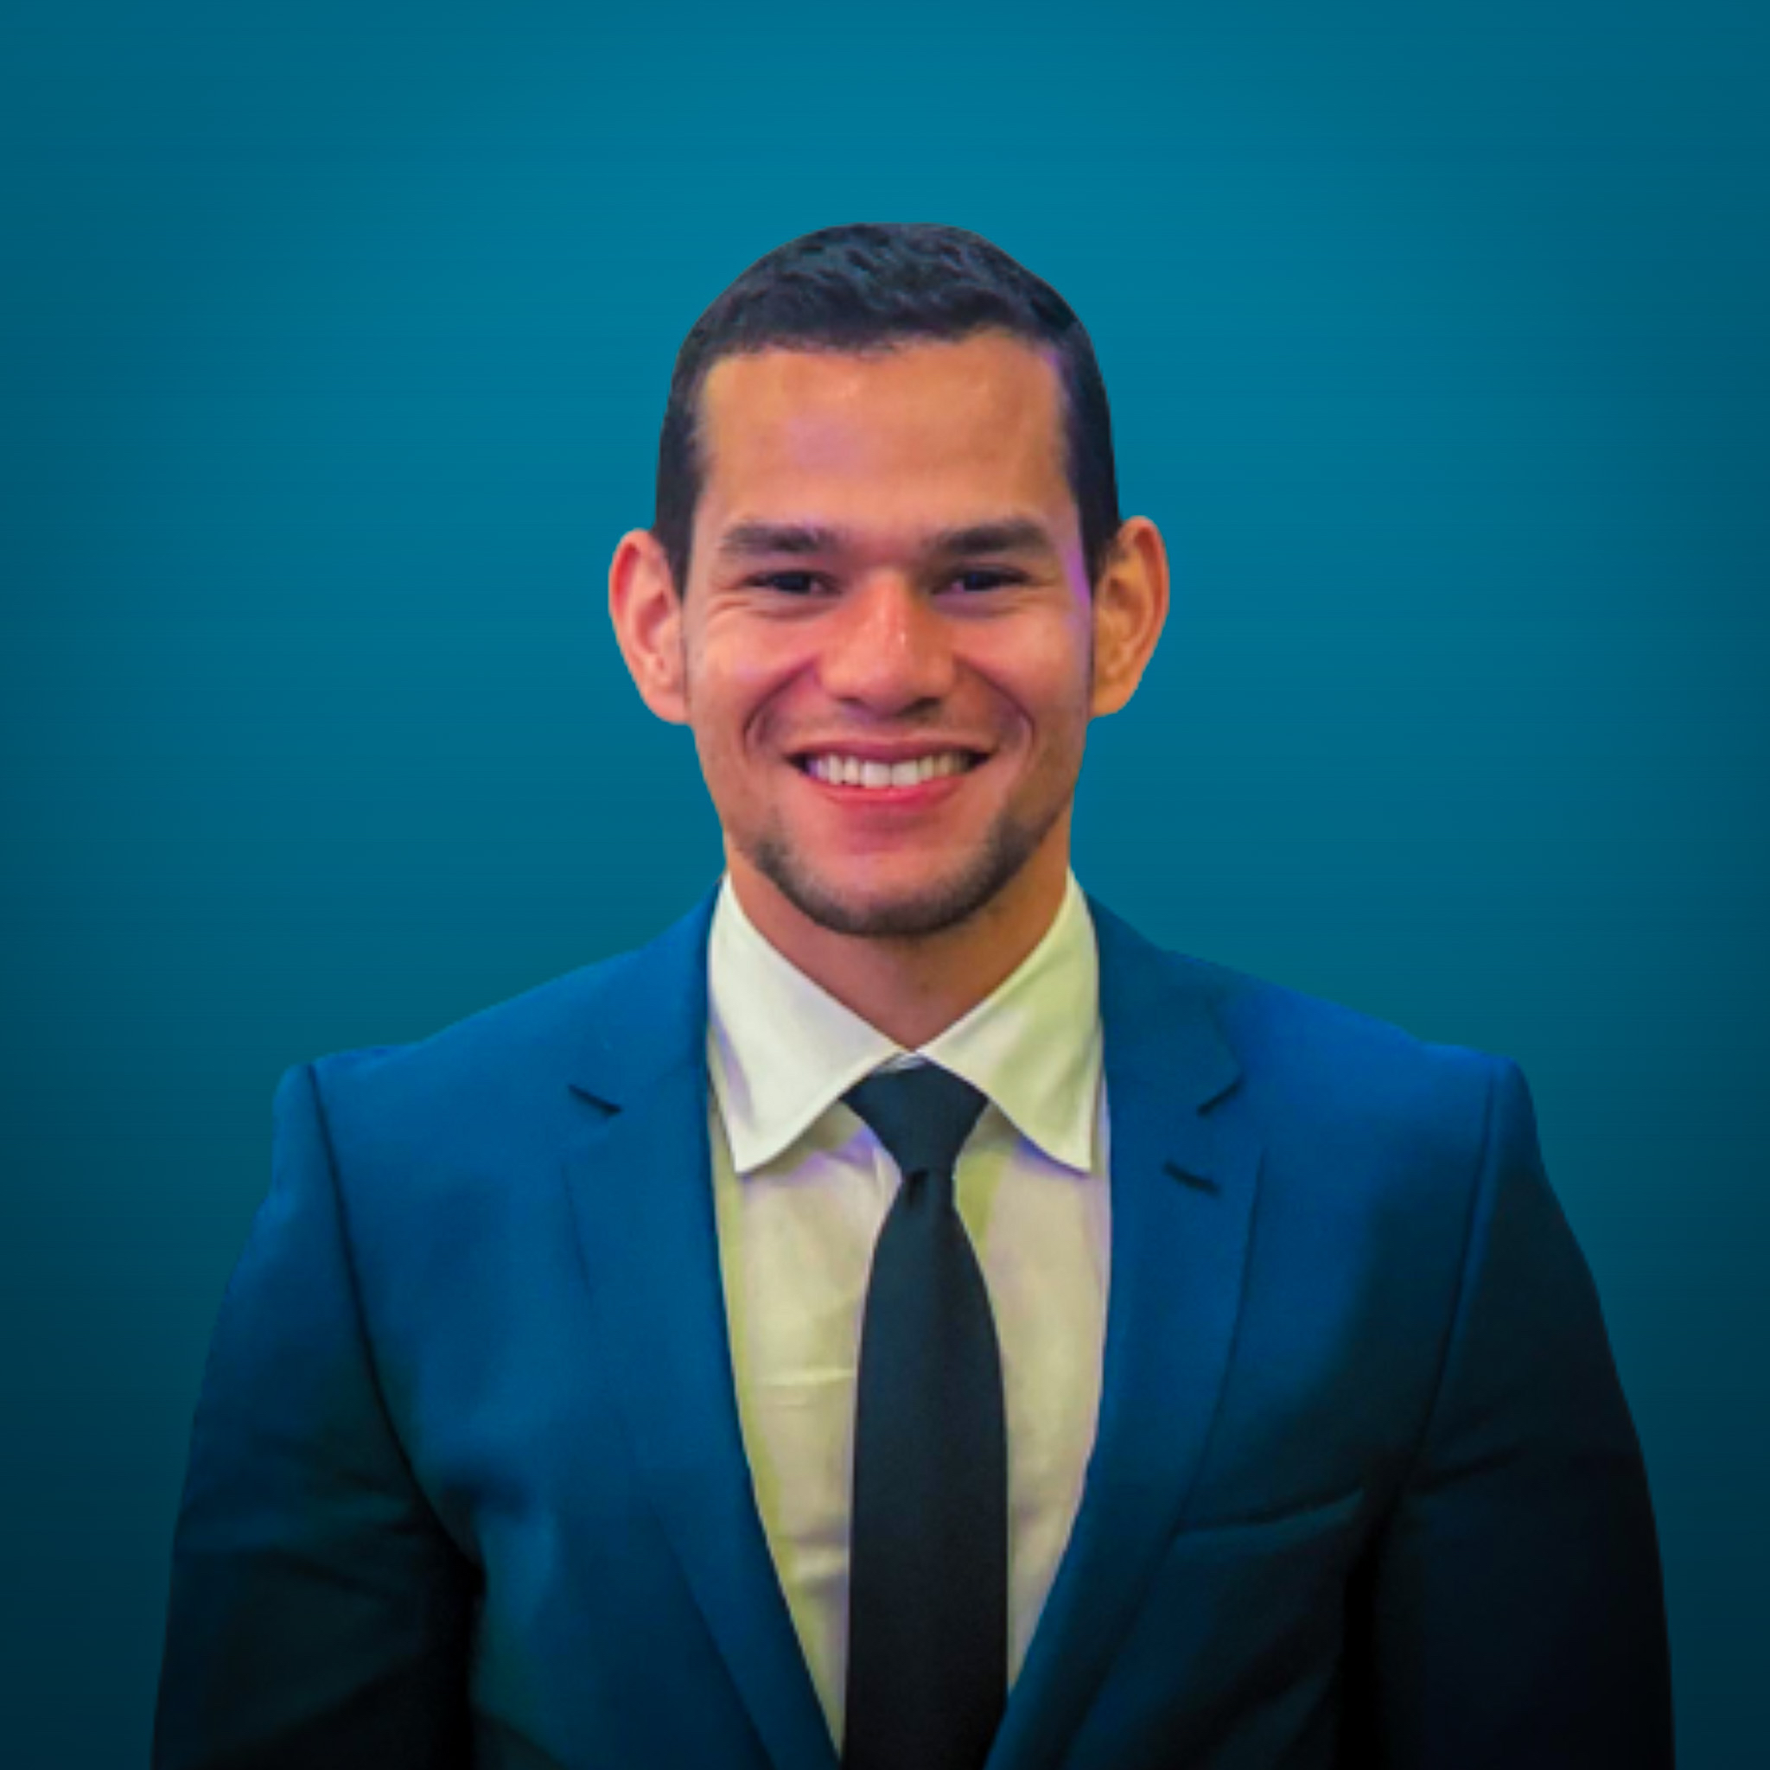
Brief Self Introduction
Geraldo F. Oliveira
Researcher @ SAFARI Research Group since November 2017
Very soon, I will defend my PhD thesis, advised by Onur Mutlu
I am in the job market for industry positions
https://geraldofojunior.github.io/
geraldofojunior@gmail.com (Best way to reach me)
https://safari.ethz.ch
Research in:
Computer architecture, computer systems, hardware security
Memory and storage systems
Hardware security, safety, predictability
Fault tolerance
Hardware/software cooperation
…

Slide 3
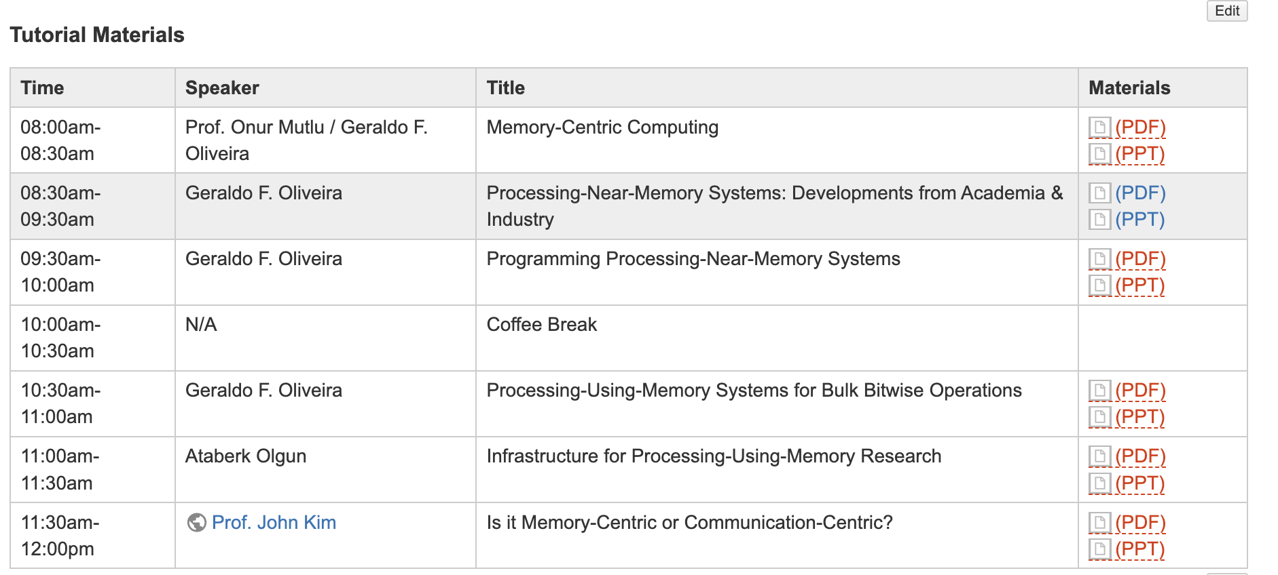
Get the Materials Online
https://events.safari.ethz.ch/ppopp25-memorycentric-tutorial/doku.php?id=start

Slide 4
Get the Materials Online
https://events.safari.ethz.ch/ppopp25-memorycentric-tutorial/doku.php?id=start
https://events.safari.ethz.ch/ppopp25-memorycentric tutorial/doku.php?id=start

Slide 5
Organizers
Geraldo F. Oliveira
Researcher @ SAFARI Research Group since November 2017
I am in the job market for industry positions
https://geraldofojunior.github.io/
Dr. Mohammad Sadrosadati
Senior Researcher and Lecturer, SAFARI @ ETH Zürich
https://scholar.google.com/citations?user=-mHpDvAAAAAJ
Ataberk Olgun
PhD Candidate, SAFARI Research @ ETH Zürich
https://ataberkolgun.com/
Prof. Onur Mutlu
Professor of Computer Science at ETH Zurich
https://people.inf.ethz.ch/omutlu/index.html

Slide 6
Agenda
Prof. Onur Mutlu: Memory-Centric Computing
Processing-Near-Memory Systems: Developments from Academia & Industry
Programming Processing-Near-Memory Systems
Coffee Break
Processing-Using-Memory Systems for Bulk Bitwise Operations
Ataberk Olgun: Infrastructure for Processing-Using-Memory Research
Invited Talk by Prof. John Kim: Is it Memory-Centric or Communication-Centric?

Slide 7
Next PIM Tutorials/Workshops (I)
https://events.safari.ethz.ch/asplos25-MCCSys/doku.php

Slide 8
Next PIM Tutorials/Workshops (II)
https://events.safari.ethz.ch/ics25-MCCSys/doku.php

Slide 9
Next PIM Tutorials/Workshops (III)
https://events.safari.ethz.ch/isca25-MCCSys/doku.php

Slide 10
Tutorial on Memory-Centric Computing: Logistics
Geraldo F. Oliveira
https://geraldofojunior.github.io
PPoPP 2025
1st March 2025

Slide 11
Agenda
Prof. Onur Mutlu: Memory-Centric Computing
Processing-Near-Memory Systems: Developments from Academia & Industry
Programming Processing-Near-Memory Systems
Coffee Break
Processing-Using-Memory Systems for Bulk Bitwise Operations
Ataberk Olgun: Infrastructure for Processing-Using-Memory Research
Invited Talk by Prof. John Kim: Is it Memory-Centric or Communication-Centric?

